Slide 1
Predicting Current and Short-Term
Intensity Change in Tropical Cyclones Using a Convolutional Neural Network
Sarah M. Griffin sarah.griffin@ssec.wisc.edu
Tony Wimmers, Derrick Herndon, Chris Velden
University of Wisconsin-Madison
Cooperative Institute for Meteorological Satellite Studies
AMS Hurricane Conference 2024 Long Beach, CA

Slide 2
Motivation
Accurate estimates of TC current intensity and forecasts of short-term intensity change are crucial to the warning process.
Machine learning models based heavily on satellite data have been shown to be very skillful at estimating current TC intensity.
Can we extend that skill to short-term TC intensity forecasts?
Spoiler: yes we can! 2 Deep Learning models have been developed for both estimating current TC intensity and predicting short-term intensity changes:
D-PRINT (DeeP IR INtensity of TCs)
D-MINT (Deep Multispectral INtensity of TCs)
Notes:
Some wording changes suggested but content mostly intact

Slide 3
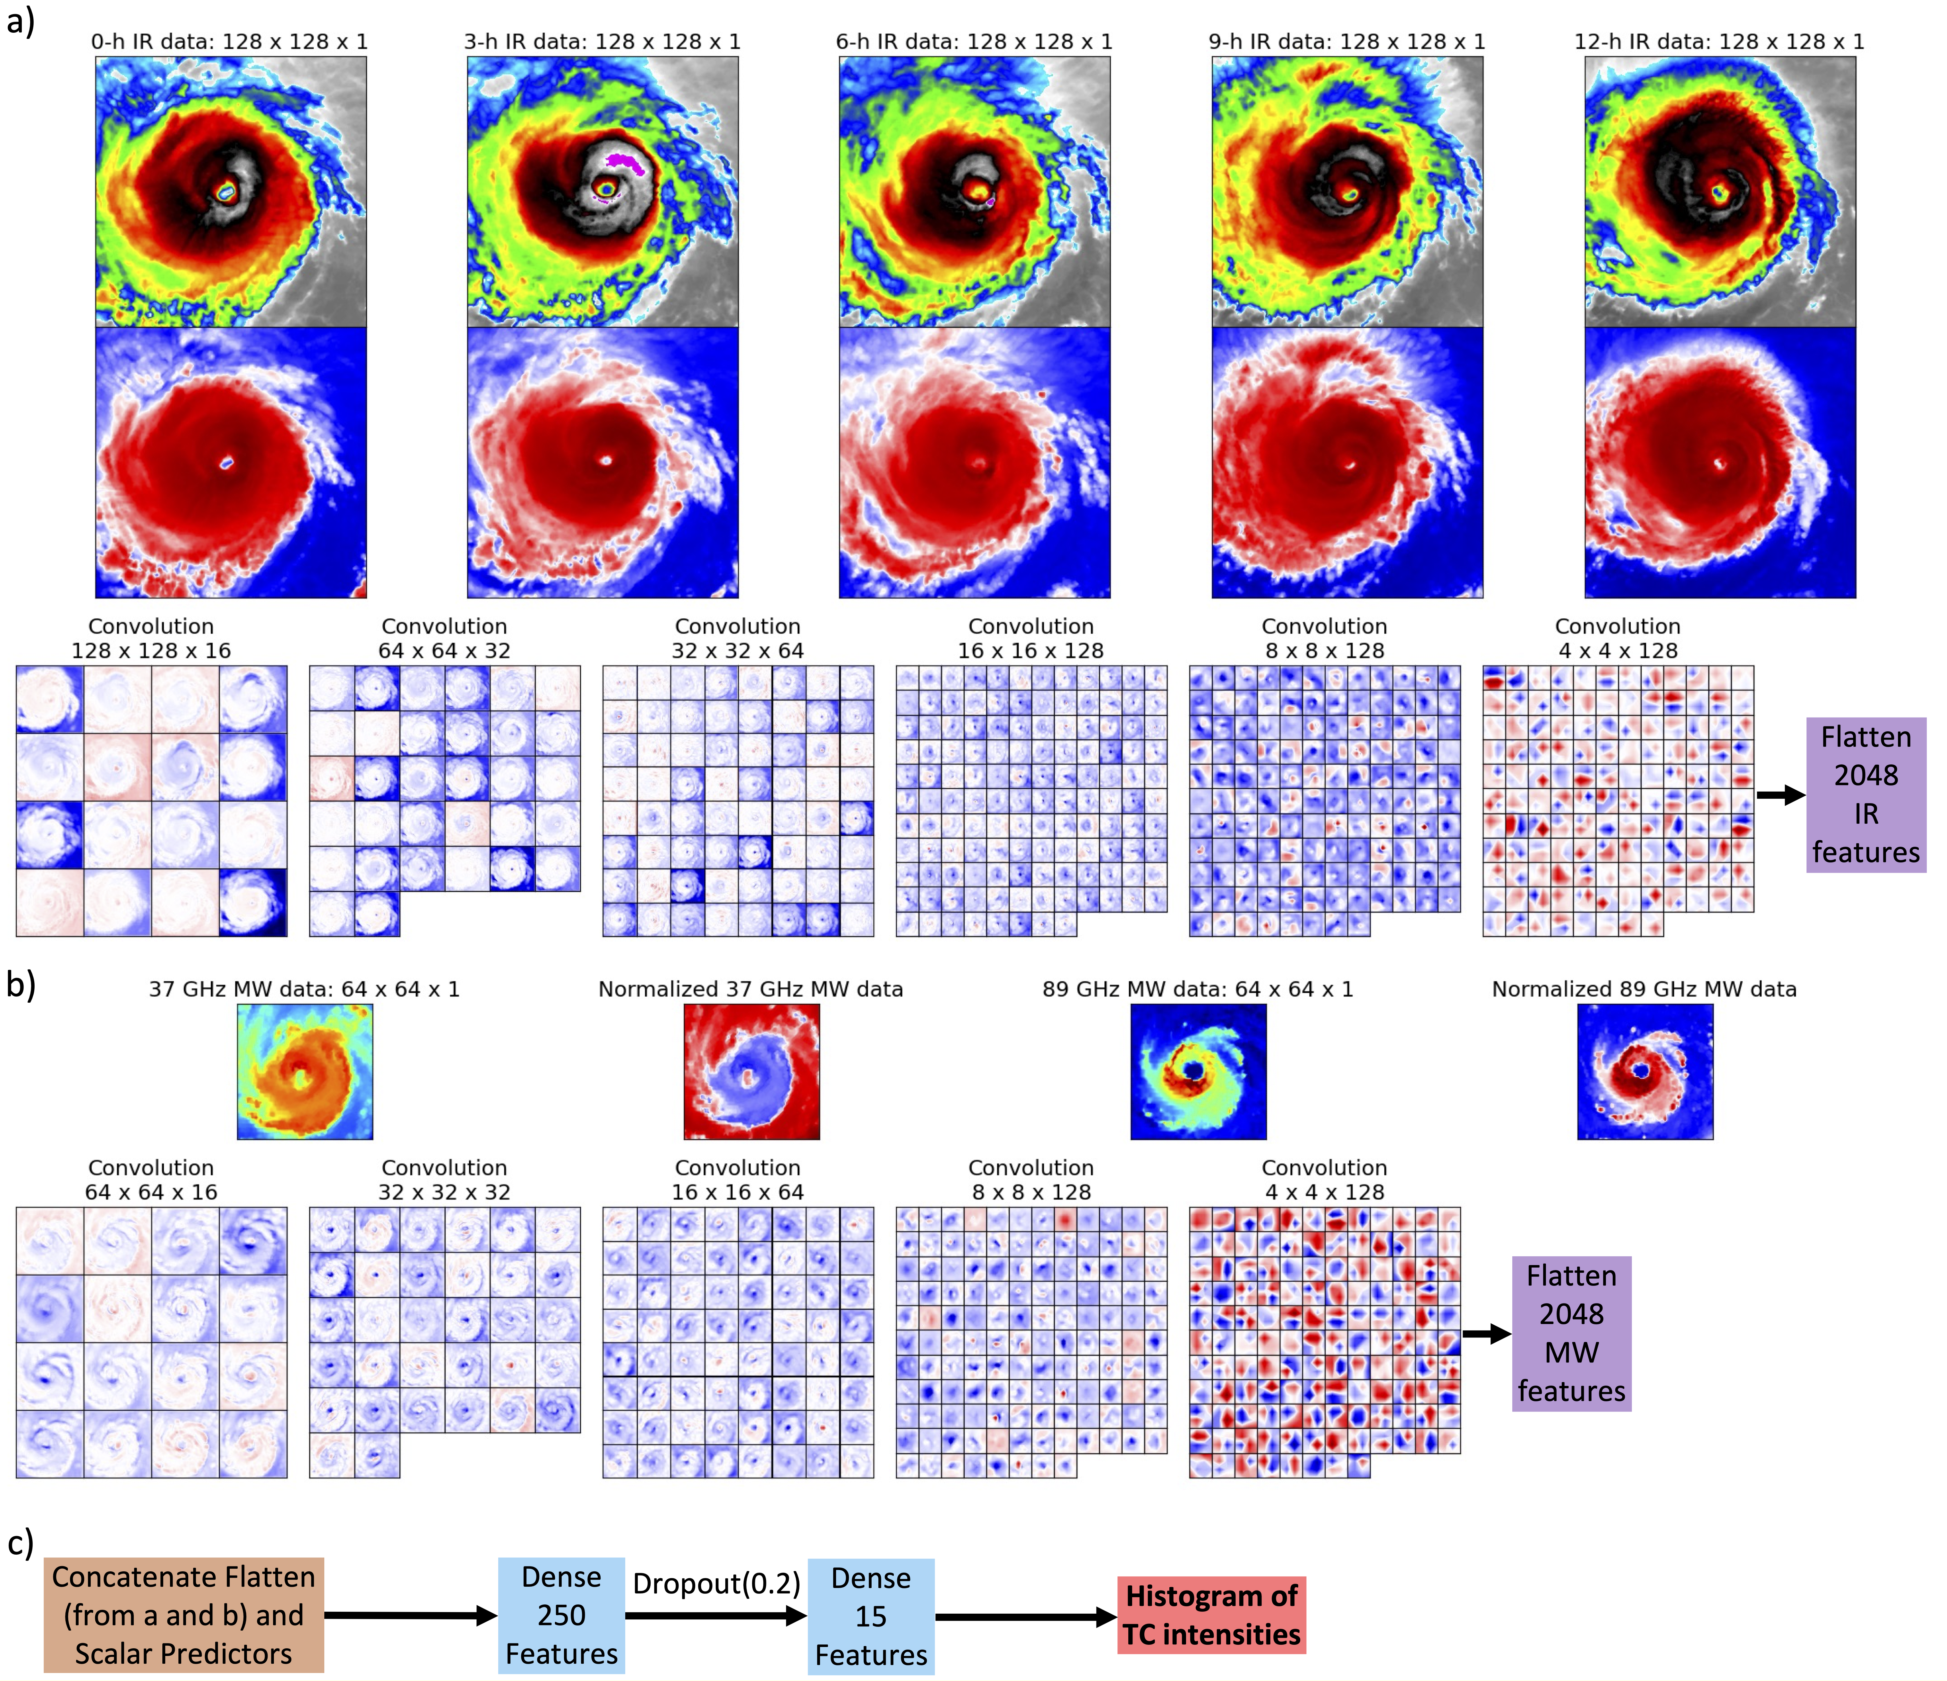
D-MINT and D-PRINT
Model Diagram
D-MINT
Steps a), b) and c)
D-PRINT
Steps a) and c) only

Slide 4
D-MINT and D-PRINT
Model Diagram
Input Features:
IR data: 128x128 grid over ~6 X 6° area centered on TC, normalized.
6 convolution layers where the scale gradually increases and more feature maps are added.
D-MINT
Steps a), b) and c)
D-PRINT
Steps a) and c) only

Slide 5
D-MINT and D-PRINT
Model Diagram
Input Features:
IR data: 128x128 grid over ~6 X 6° area centered on TC, normalized.
6 convolution layers where the scale gradually increases and more feature maps are added.
6-h intensity forecast
D-MINT
Steps a), b) and c)
D-PRINT
Steps a) and c) only

Slide 6
D-MINT and D-PRINT
Model Diagram
Input Features:
IR data: 128x128 grid over ~6 X 6° area centered on TC, normalized.
6 convolution layers where the scale gradually increases and more feature maps are added.
12 to 24 hour intensity forecast
D-MINT
Steps a), b) and c)
D-PRINT
Steps a) and c) only

Slide 7
D-MINT and D-PRINT
Model Diagram
Input Features:
IR data: 128x128 grid over ~6 X 6° area centered on TC, normalized.
6 convolution layers where the scale gradually increases and more feature maps are added.
D-MINT
Steps a), b) and c)
D-PRINT
Steps a) and c) only
Input Features
MW data: 64 x 64 grid over ~3.2 X 3.2° area centered on TC, normalized.
5 convolution layers
(not included in D-PRINT)

Slide 8
D-MINT and D-PRINT
Model Diagram
Input Features:
IR data: 128x128 grid over ~6 X 6° area centered on TC, normalized.
6 convolution layers where the scale gradually increases and more feature maps are added.
D-MINT
Steps a), b) and c)
D-PRINT
Steps a) and c) only
Input Features
MW data: 64 x 64 grid over ~3.2 X 3.2° area centered on TC, normalized.
5 convolution layers
(not included in D-PRINT)
Input Features:
Add normalized scalar location and time features.

Slide 9
D-MINT and D-PRINT
Model Diagram
Input Features:
IR data: 128x128 grid over ~6 X 6° area centered on TC, normalized.
6 convolution layers where the scale gradually increases and more feature maps are added.
D-MINT
Steps a), b) and c)
D-PRINT
Steps a) and c) only
Input Features
MW data: 64 x 64 grid over ~3.2 X 3.2° area centered on TC, normalized.
5 convolution layers
(not included in D-PRINT)
Input Features:
Add normalized scalar location and time features.
Output:
15 quantiles of TC intensity probabilities

Slide 10
Datasets
Microwave satellite data: 37-GHz and 89-GHz imagery from DMSP SSM/I and SSMIS,
TRMM TMI, Aqua AMSR-E, GPM GMI, and GCOM-WI AMSR-2
At least 65% of the TC in the image box must be covered by the overpass to be included
IR satellite data: IR-Window imagery from operational GEO satellites
Scalar data: Obtained from lsdiag files (developmental from CIRA, real-time from NHC/JTWC)
Model Training dataset: Images taken from Global TCs 1994 to 2015.
IR/MW images in the training dataset are randomly rotated/flipped to aid in generalized training
Validation dataset: Images taken from Global TCs 2016 and 2017.
# coincident IR+MW TC images from each TC basin | North Atlantic | Eastern North Pacific | Western North Pacific | Indian Ocean | Southern Hemisphere | Global
Training | 8578 | 9253 | 14,296 | 1190 | 7814 | 41,131
Validation | 1173 | 1238 | 1601 | 212 | 858 | 5082
Notes:
Restructured this a bit and added some clarifying info

Slide 11
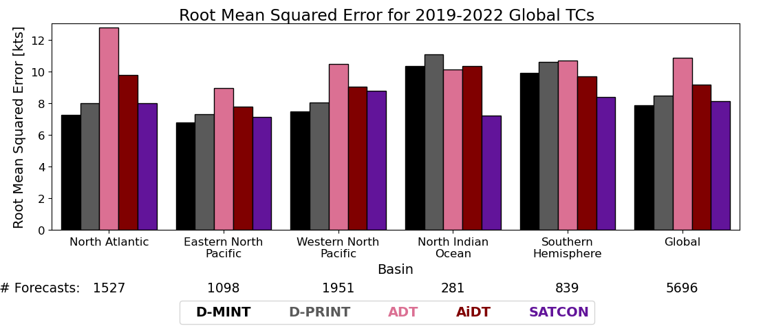
D-MINT and D-PRINT
TC Current Intensity Estimate (MSW) Performance Results
Compared with other Automated Satellite-Based Methods
better
# Estimates:
D-MINT and D-PRINT are generally quite competitive with other established automated methods, and in many cases outperform them.
D-MINT is slightly more skillful than D-PRINT but has a lower temporal resolution.
Note: D-MINT is now included in the SATCON consensus as of 2024, D-PRINT is not included yet (work in progress).
Notes:
Since each slide will only be dwelt on for 30-60 secs, best to distill the major takeaways into more simple overall points rather than lay out all the basin wins/losses. Added the comment about SATCON here

Slide 12
D-MINT and D-PRINT
Current Intensity Estimate Results
better
D-MINT and D-PRINT intensity is still overestimated for the weakest TCs, but less so than the other methods.
D-MINT and D-PRINT intensity is underestimated for strongest TCs, more than SATCON.
D-MINT and D-PRINT are the most skillful for the weakest TCs ( < 40 kts) and the strongest TCs (> 125 kts; though there are much fewer of these TCs).

Slide 13
D-MINT and D-PRINT
Future Intensity Prediction Results
Given the skill shown by the DL models in estimating current intensity, we focus on the prospects of short-term intensity prediction
We will show that the forecasting skill is competitive, but steadily declines with forecast lead time relative to other methods/models. It shows that satellite image structure can play an important part in the ~0-18 hr forecasts of intensity; beyond that, the future environment is the dominant factor.
Note: With regards to D-MINT forecasts and verification, MW images are not conveniently captured on the synoptic times, so forecasts are interpolated to valid times from the MW image. For example, a 12h forecast from a 02Z image is valid at 14Z, so the operational and model forecasts being compared with on the following slide are interpolated to be valid at 14Z.
Notes:
I think an intro slide like this is needed to transition to the main/forecast part

Slide 14
D-MINT and D-PRINT
Future Intensity Prediction Results
MW images are not conveniently on the synoptic times, so forecasts are interpolated to the valid time from the MW image.
better
better
better
better
Overall, D-MINT and D-PRINT are not as skillful at short-term intensity prediction as the official forecasts and ICON, but are comparable in skill to LGEM and HWRF.
better

Slide 15
D-MINT and D-PRINT
Future Intensity Prediction Results
D-PRINT can run on the synoptic times.

Slide 16
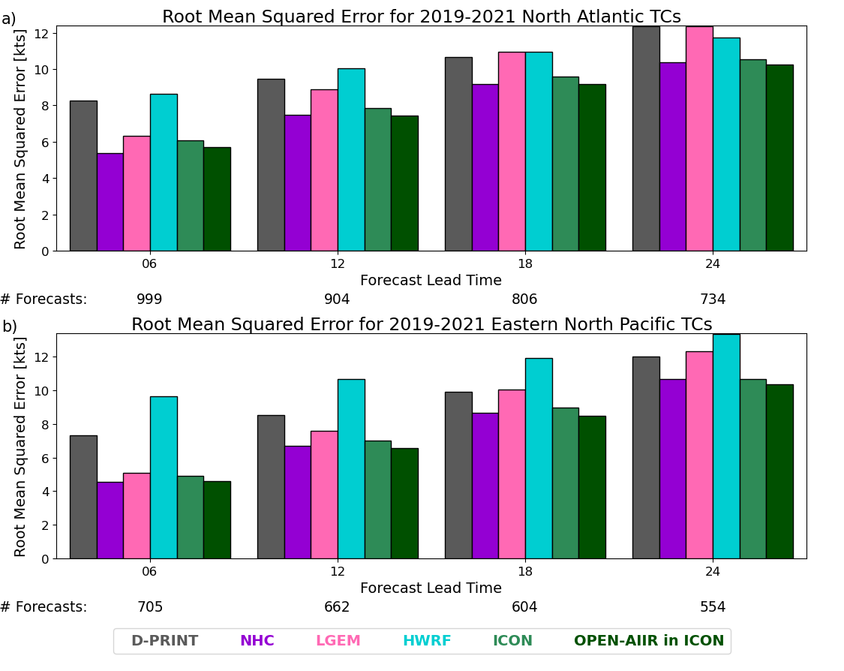
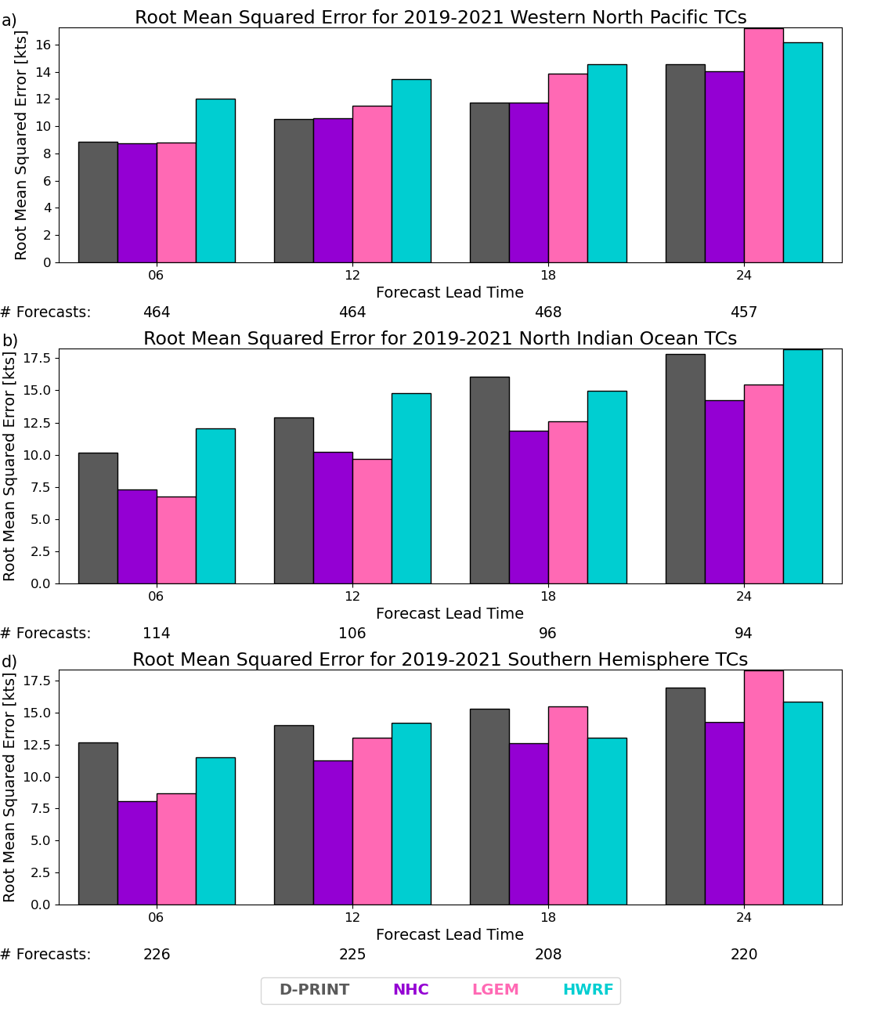
D-MINT and D-PRINT
Future Intensity Prediction Results
D-PRINT can run on the synoptic times.
D-PRINT intensity predictions are not as skillful as the official forecasts and ICON but are comparable in skill to LGEM and HWRF.
Adding D-PRINT into the ICON consensus
slightly increases its skill (ATL and EPAC).

Slide 17
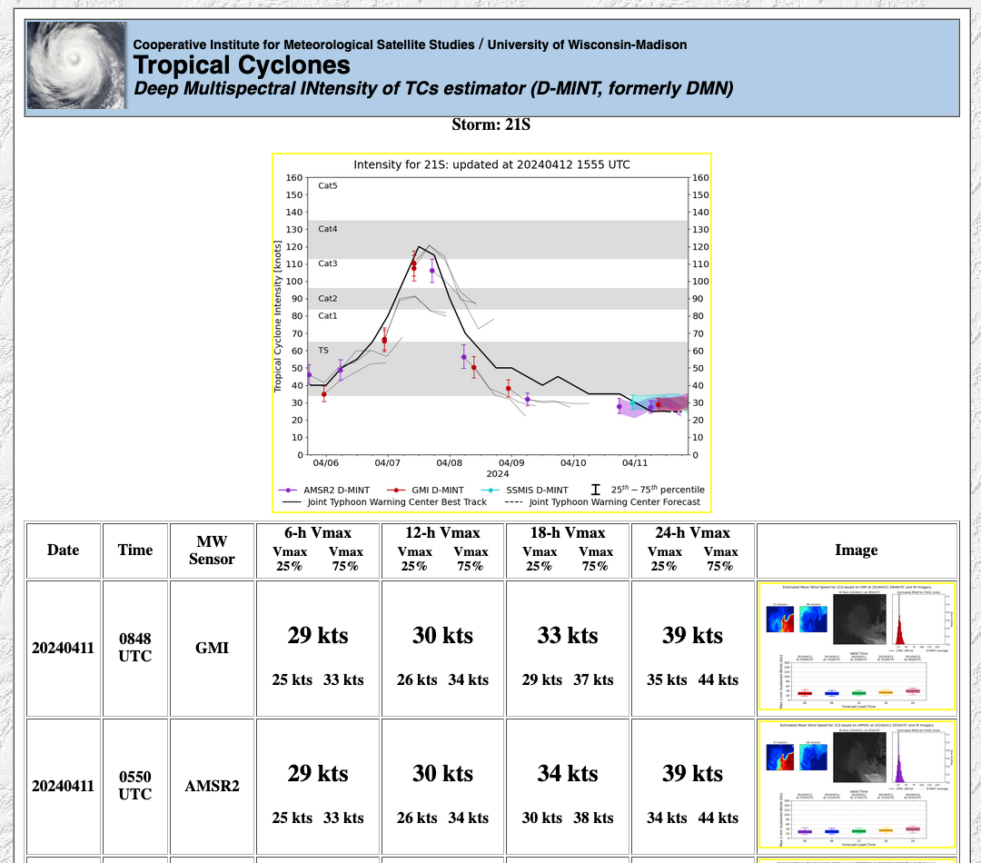
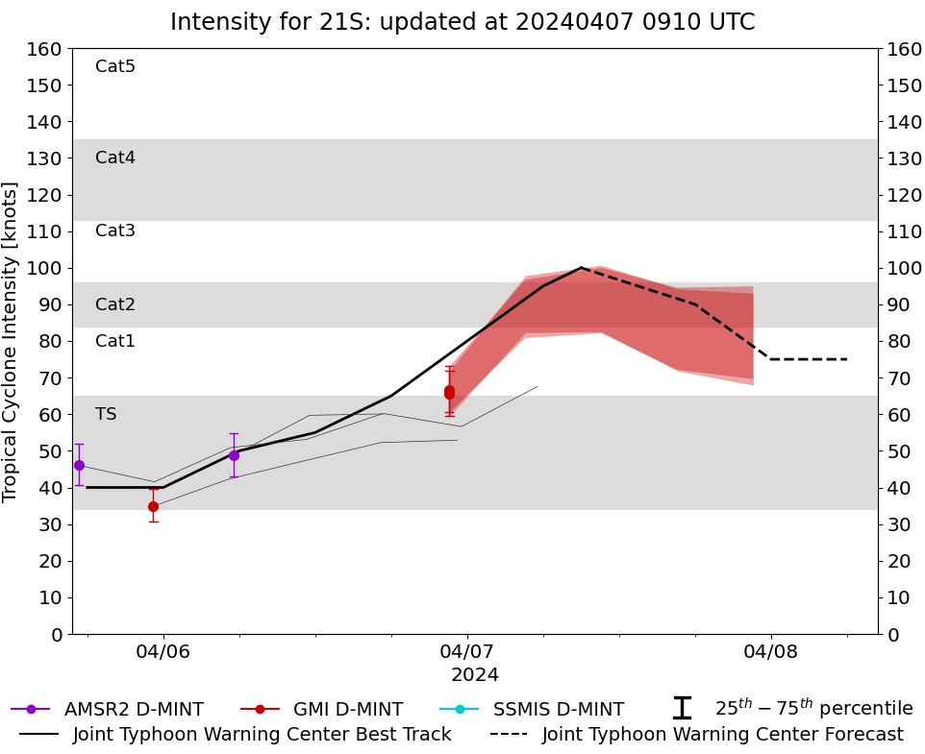
D-MINT and D-PRINT
Real-time Future Intensity Prediction
D-MINT and D-PRINT forecasts are currently running in real-time but not yet linked from the main CIMSS page (still in experimental/evaluation mode).
Past
forecasts
(thin black line)
Active
forecasts
(shaded regions)
Forecast intensities and range.

Slide 18
D-MINT and D-PRINT
Future Intensity Prediction Results
D-MINT and D-PRINT do not have any information about the official current TC intensity when they are initialized (i.e. like provided to other models/methods by NHC or JTWC through ATCF or TCVITALS).
As an experiment, D-MINT and D-PRINT forecasts were started with official initial intensities.
Notes:
This is a major finding as the results on the next slide show significant improvement, so I thought it deserved its own intro slide

Slide 19
D-MINT and D-PRINT
Future Intensity Prediction Results
better
better
better
better
Without the official current TC intensity.
better

Slide 20
D-MINT and D-PRINT
Future Intensity Prediction Results
better
better
better
better
Initialization with the official current TC intensity does significantly improve D-MINT and D-PRINT forecast skill, especially at the shorter lead times.
better

Slide 21
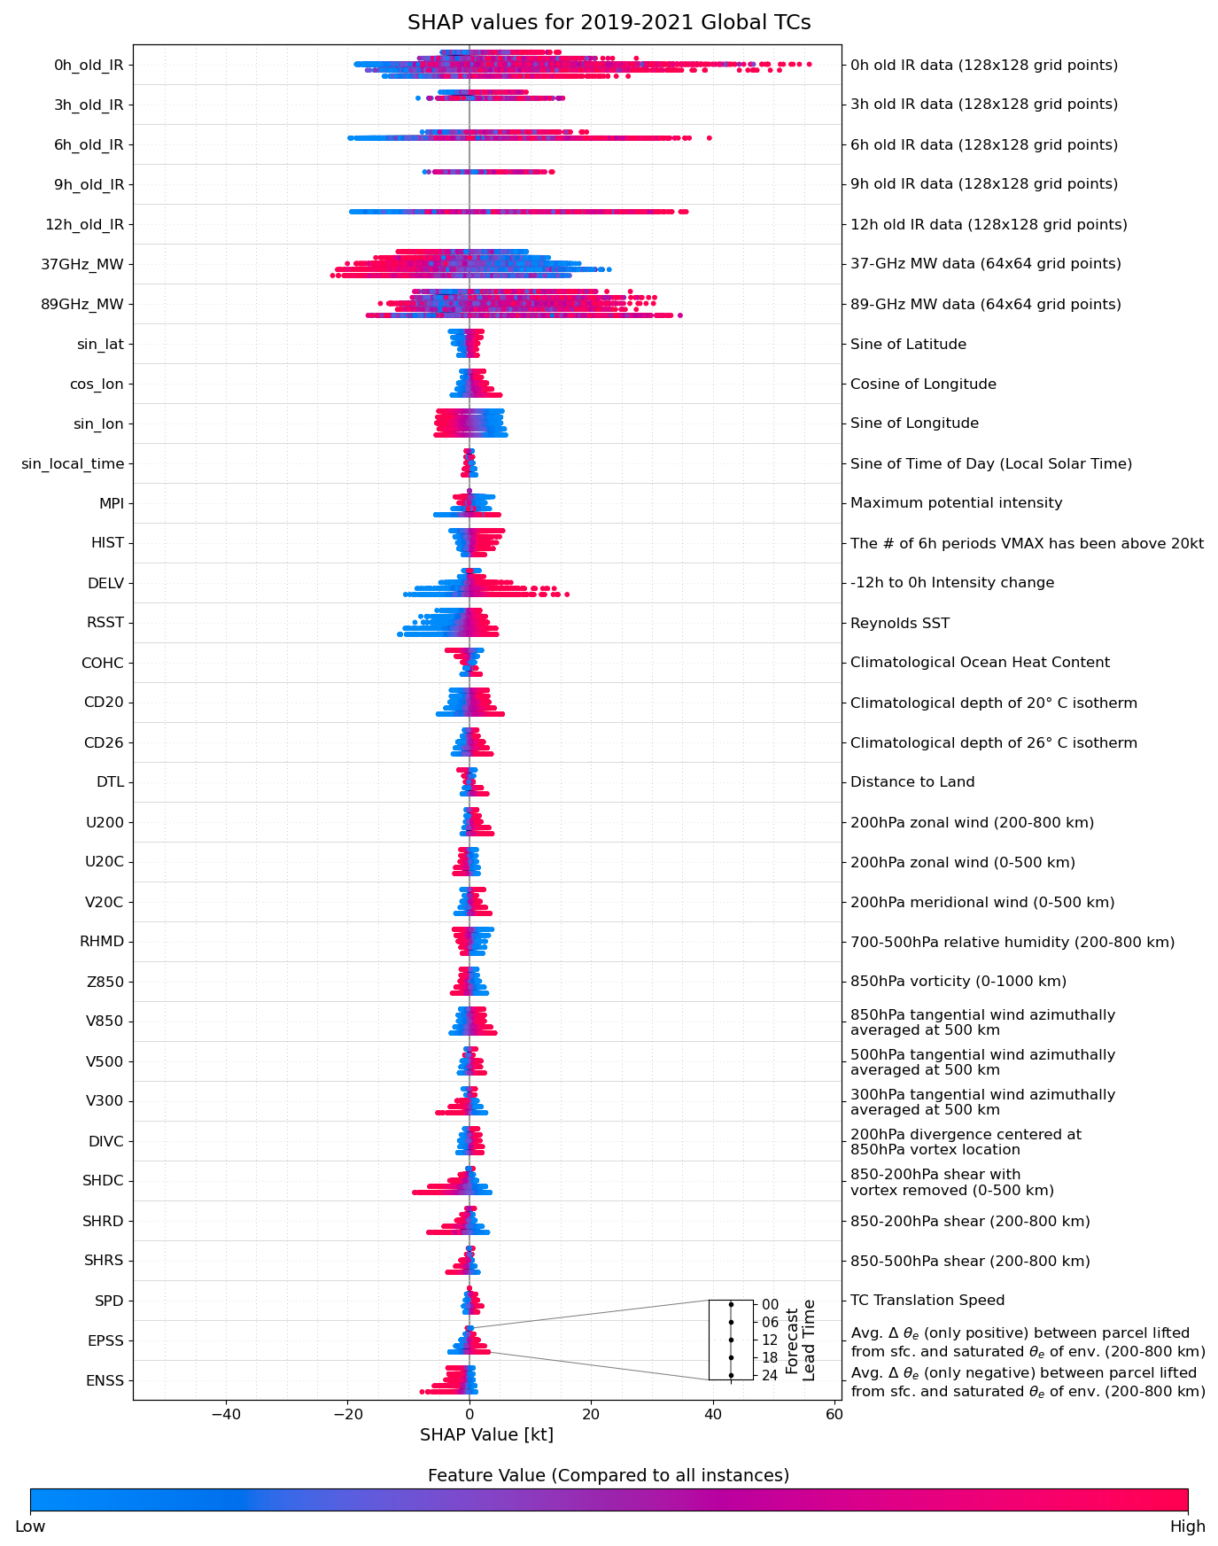
What parameters are contributing to the D-MINT/D-PRINT intensity estimates?
SHAP values represent the change in TC intensity from a 60 kt baseline
Higher latitude matters more for current intensity than future.
COHC is lower and land is closer at higher latitudes.
Shear has a lower impact on current intensity than future. Higher shear associated with higher current intensity.
An intensifying TC will continue to intensify, but a weakening TC may be either weak or strong.
Satellite predictors have the highest impact on intensity.
The 12h IR image has more impact than 0h on current intensity.

Slide 22
Summary
D-MINT and D-PRINT are Deep Learning models based on CNNs developed for estimating current TC intensity, and extended to predicting short-term future TC intensity.
They are both competitive with and in some cases more skillful than other more established automated satellite-based methods (ADT, AiDT, SATCON ) at estimating current TC intensity (estimates available on the CIMSS TC site).
For short-term intensity prediction:
Both models are less skillful than NHC and ICON in the North Atlantic and eastern North Pacific, but are competitive with other guidances and better for at least half of the lead times.
.D-MINT performs better than JTWC and other guidances for over half of the lead times in the western North Pacific, North Indian Ocean, and Southern Hemisphere TC basins.
Both models show notable skill increases if initialized with official current intensity.
Notes:
Changed some of the wording and stressor points a bit. Again, keep the conclusions general and don’t oversell (I heard from a couple folks that the results presented at the TCC were presented in a way that oversold them)

Slide 23
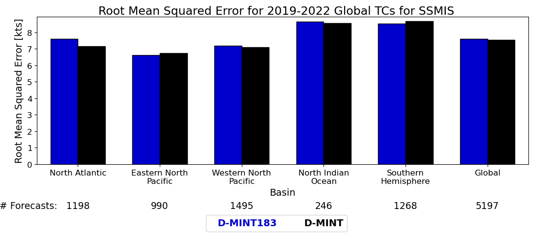
Work in Progress
Development of D-MINT183
Employs the 183GHz MW band channels rather than the 37/89GHz bands
Allows for additional current intensity estimates from ATMS, MHS, and TROPICS
better
Estimates:
First look: D-MINT183 and D-MINT have similar current intensity estimation skill using SSMIS.
Near-Future application: Include D-PRINT estimates in SATCON (D-MINT included as of 2024).
Questions?
Notes:
Few changes, and added the SATCON point

Slide 24
Extra Slides

Slide 25
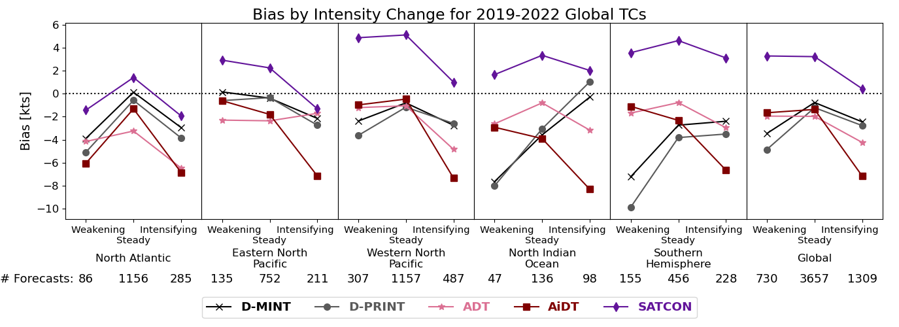
D-MINT and D-PRINT
Current Intensity Estimate Results
Does using 12h of IR imagery impact the Bias?
better
We do not see an overestimation of weakening TCs. If the number of IR images were causing a lag in TC intensity, we would expect a positive bias for weakening TCs due to the older IR images being from a stronger TC.

Slide 26
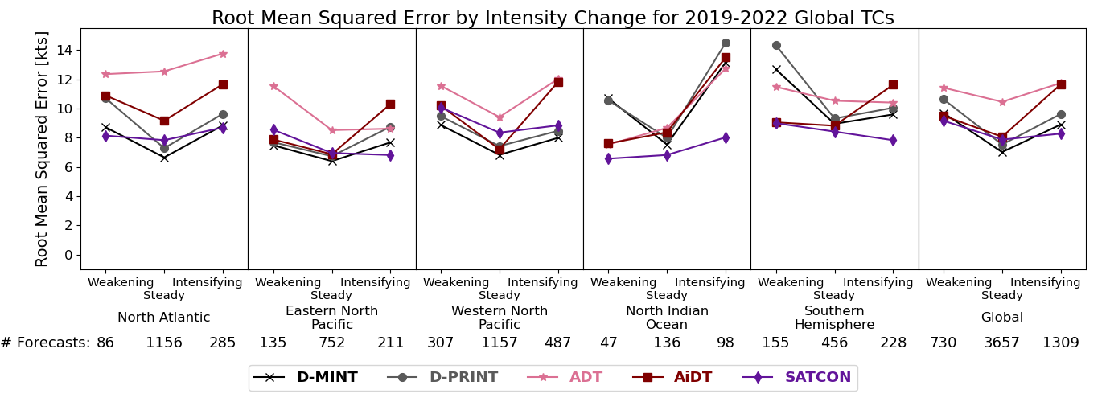
D-MINT and D-PRINT
Current Intensity Estimate Results
Does using 12h of IR imagery impact the RMSE?
better
D-MINT and D-PRINT do have more skill when the TC has steady intensity over the previous 12 h.
The range in RMSE by intensity change is larger than ADT and SATCON but lower than AiDT for Global TCs.

