Slide 1
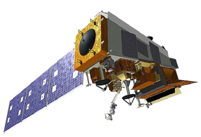
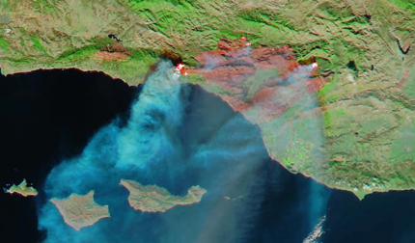
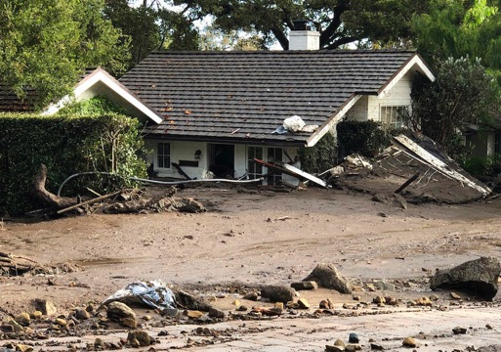
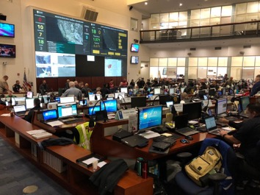
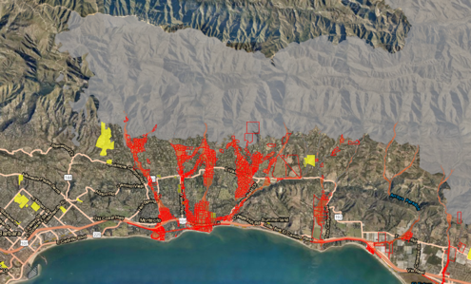
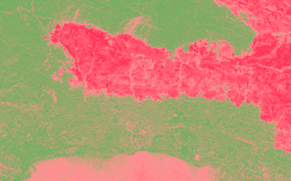
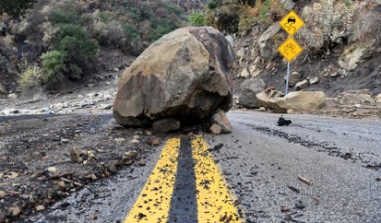
Goal: Reduce Delays in Debris Flow Hazard Warnings with VIIRS Inputs to Save Lives
Summary: IN034-03: Sam Batzli: “Measuring Fire Scars with JPSS Satellites”
Jan. 9, 2018. Mike Eliason/Santa Barbara County Fire Dept.
Aqua-MODIS False Color, Dec. 16, 2017
California EOC, K. Rowden
Preliminary dNBR Data Dec. 28, 2017
Evacuation Orders: Santa Barbara Co., EOC and Santa Barbara Co. Sheriff
Jan. 10, 2018. AP Photo/Michael Owen Baker. 21 Fatalities.

Slide 2
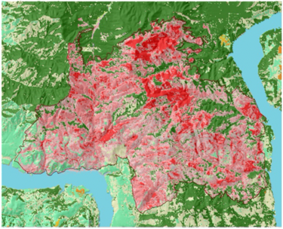
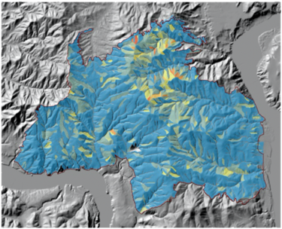
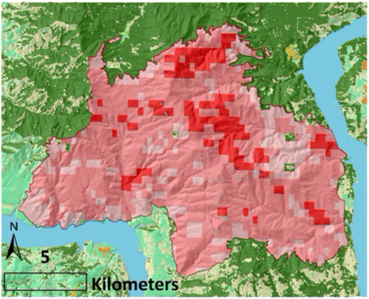
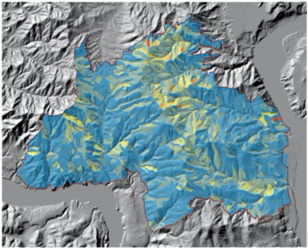
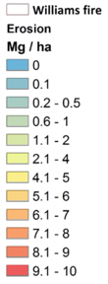
Examples show that timeliness is more important than resolution
Williams Flats Fire
Washington Aug. 2019
Landsat - BARC
30m
First post-fire clear image: Oct 10
VIIRS - BRIDGE
500m
First post-fire clear image: Aug 27
44-Days Earlier

Slide 3
This study has shown that an automated VIIRS-based dNDVI (BRIDGE) product can be an effective input for early debris-flow warnings.
Future work:
Generate examples from 2020 fire season
Streamline workflow towards automation (web dashboard)
Explore automated VIIRS-based dNBR
Inquires welcome: sabatzli@wisc.edu

