Slide 1
Assimilation of Aerosol Observations
R. Bradley Pierce
National Ocean and Atmospheric Administration
National Environmental Satellite, Data, and Information Service
Center for Satellite Applications and Research (STAR)
With contributions from:
Arlindo da Silva (NASA/GMAO)
Mariusz Pagowski and Georg Grell (NOAA/ESRL)
Pablo Saide and Greg Carmichael (U-Iowa/CGRER)
Sarah Lu (NWS/EMC)
WMO 5th DAOS Working Group University of Wisconsin Madison, 19-20 Sep 12

Slide 2
Outline
Motivation
  Anthropogenic changes in atmospheric composition
  Aerosol Global Observing System
Operational (and Pre-Operational) Aerosol assimilation
  MACC-II (EU)
  NAAPS (Navy)
  GEOS-5 (NASA)
  NEMS (NCEP)
  WRF-CHEM (ESRL)
RAQMS Global Aerosol Forecast Skill Assessment
  CalNex (http://www.esrl.noaa.gov/csd/projects/calnex/)
  ARCPAC (http://www.esrl.noaa.gov/csd/arcpac/)
Current research directions
  Links between aerosols and severe weather (preliminary results)

Slide 3
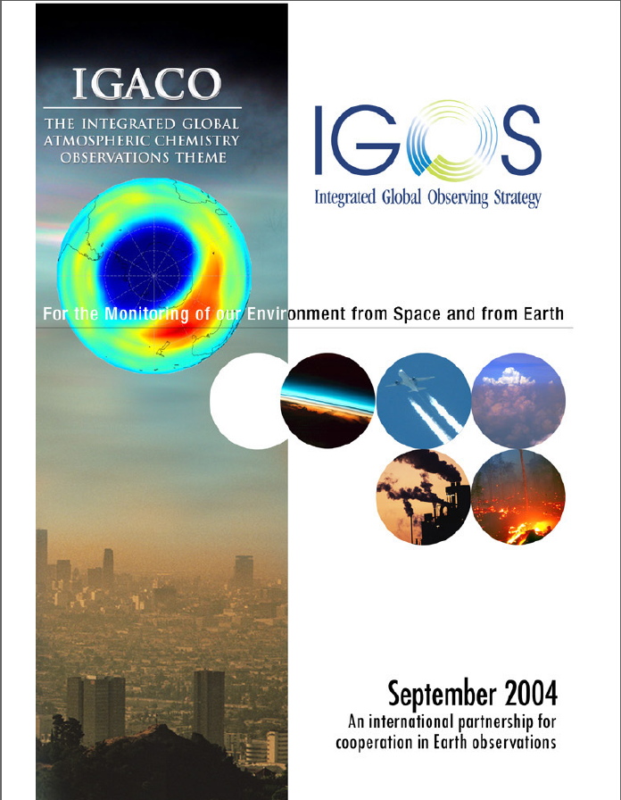
Motivation
Changes in atmospheric composition
since the industrial revolution
• Decreases in stratospheric ozone and increases in surface ultraviolet radiation
• Occurrence of urban smog and increased ozone background in the northern troposphere
• Increases in greenhouse gases and aerosols and associated climate change
• Acid rain and eutrophication of surface waters
• Enhanced aerosol and photo-oxidant levels due to biomass burning
• Increases in fine particles, reduction in visibility and human health effects
• Long-range transport of air pollution
“Many of these changes in atmospheric composition have socio-economic consequences through adverse effects on human and ecosystem health, on water supply and quality, and on crop growth.”
From IGOS Atmospheric Chemistry Theme Report 2004

Slide 4
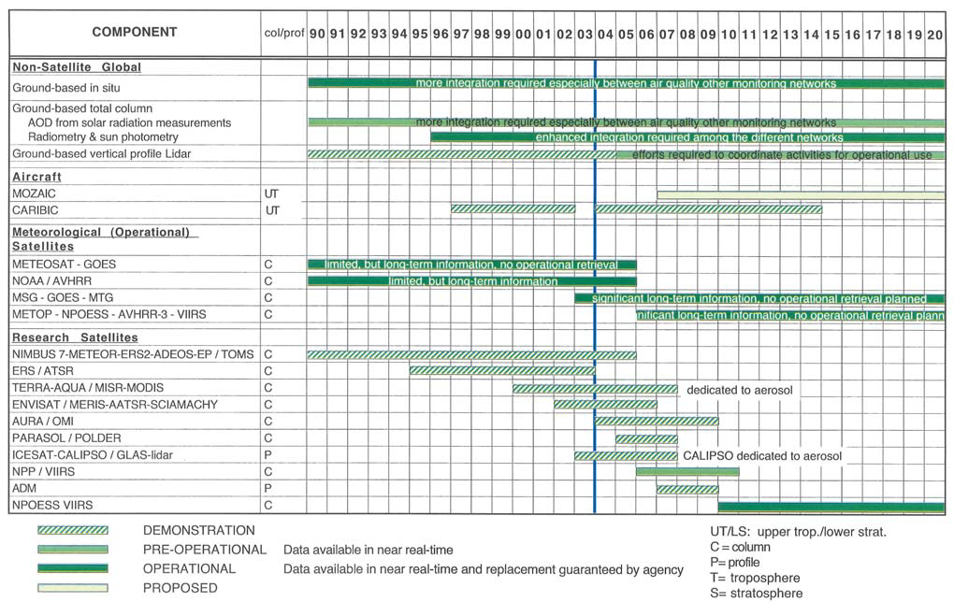
Satellite, ground-based and aircraft measurements for tropospheric aerosol optical properties
(From IGOS Atmospheric Chemistry Theme Report 2004)

Slide 5
Satellite, ground-based and aircraft measurements for tropospheric aerosol optical properties
(Updated)
GOES-R ABI
http://www.goes-r.gov/products/ATBDs/baseline/AAA_AODASP_v2.0_no_color.pdf

Slide 6
Outline
Motivation
  Anthropogenic changes in atmospheric composition
  Aerosol Global Observing System
Operational (and Pre-Operational) Aerosol assimilation
  MACC-II (EU)
  NAAPS (Navy)
  GEOS-5 (NASA)
  NEMS (NCEP)
  WRF-CHEM (ESRL)
RAQMS Global Aerosol Forecast Skill Assessment
  CalNex (http://www.esrl.noaa.gov/csd/projects/calnex/)
  ARCPAC (http://www.esrl.noaa.gov/csd/arcpac/)
Current research directions
  Links between aerosols and severe weather (preliminary results)

Slide 7


Development of GMES atmospheric services
ESA-funded PROMOTE (2004-2009) and EU FP6 GEMS (2005-2009) projects provided initial development of GMES atmospheric services
EU FP7 project MACC (2009-2011) continued activities initiated in GEMS and incorporated core elements of PROMOTE
EU FP7 project MACC-II offering essentially operational core services began on 1 Nov 2011
Development of constituent and aerosol assimilation/ forecasting within ECMWF Integrated Forecast System (IFS) Framework
Global Monitoring for Environment and Security(GMES) http://www.gmes-atmosphere.eu/

Slide 8
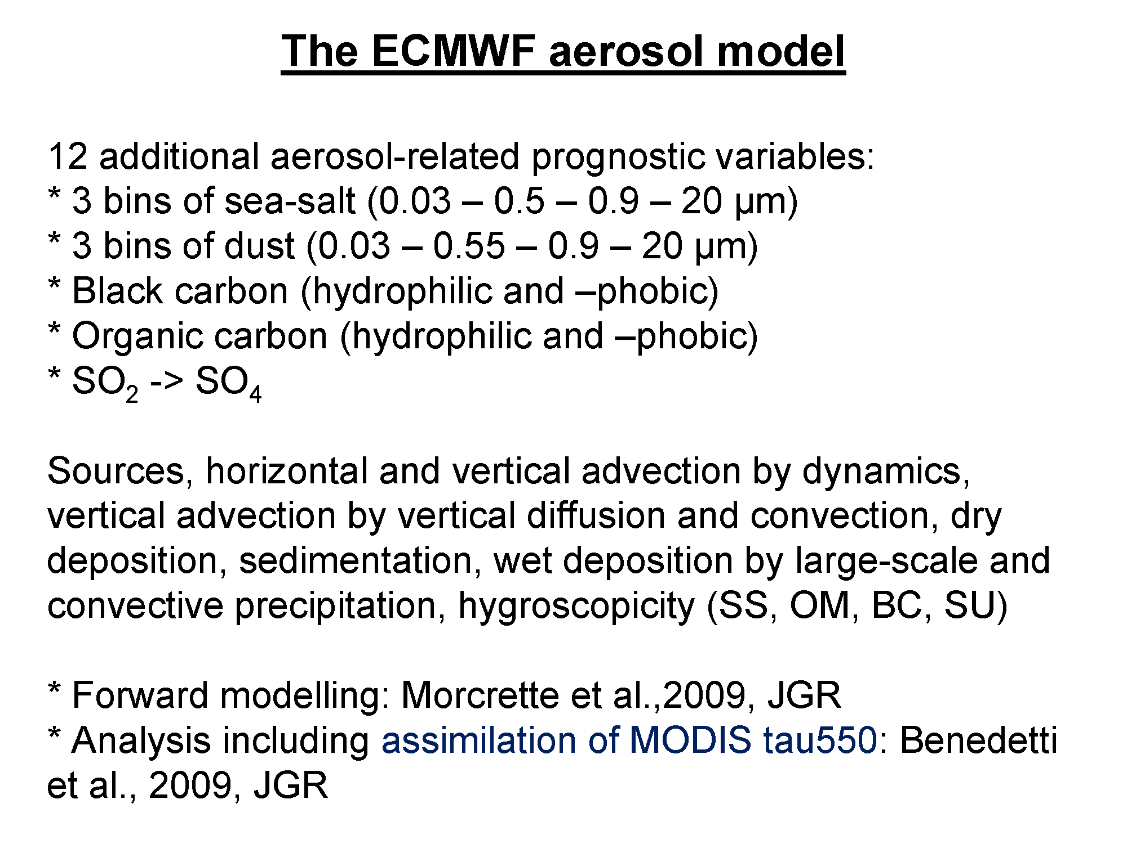
Angela Benedetti, ECMWF: International Cooperative for Aerosol Prediction (ICAP)/AEROCAST:
3rd Workshop: Ensemble Forecasts and Assimilation (http://bobcat.aero.und.edu/jzhang/ICAP/)

Slide 9
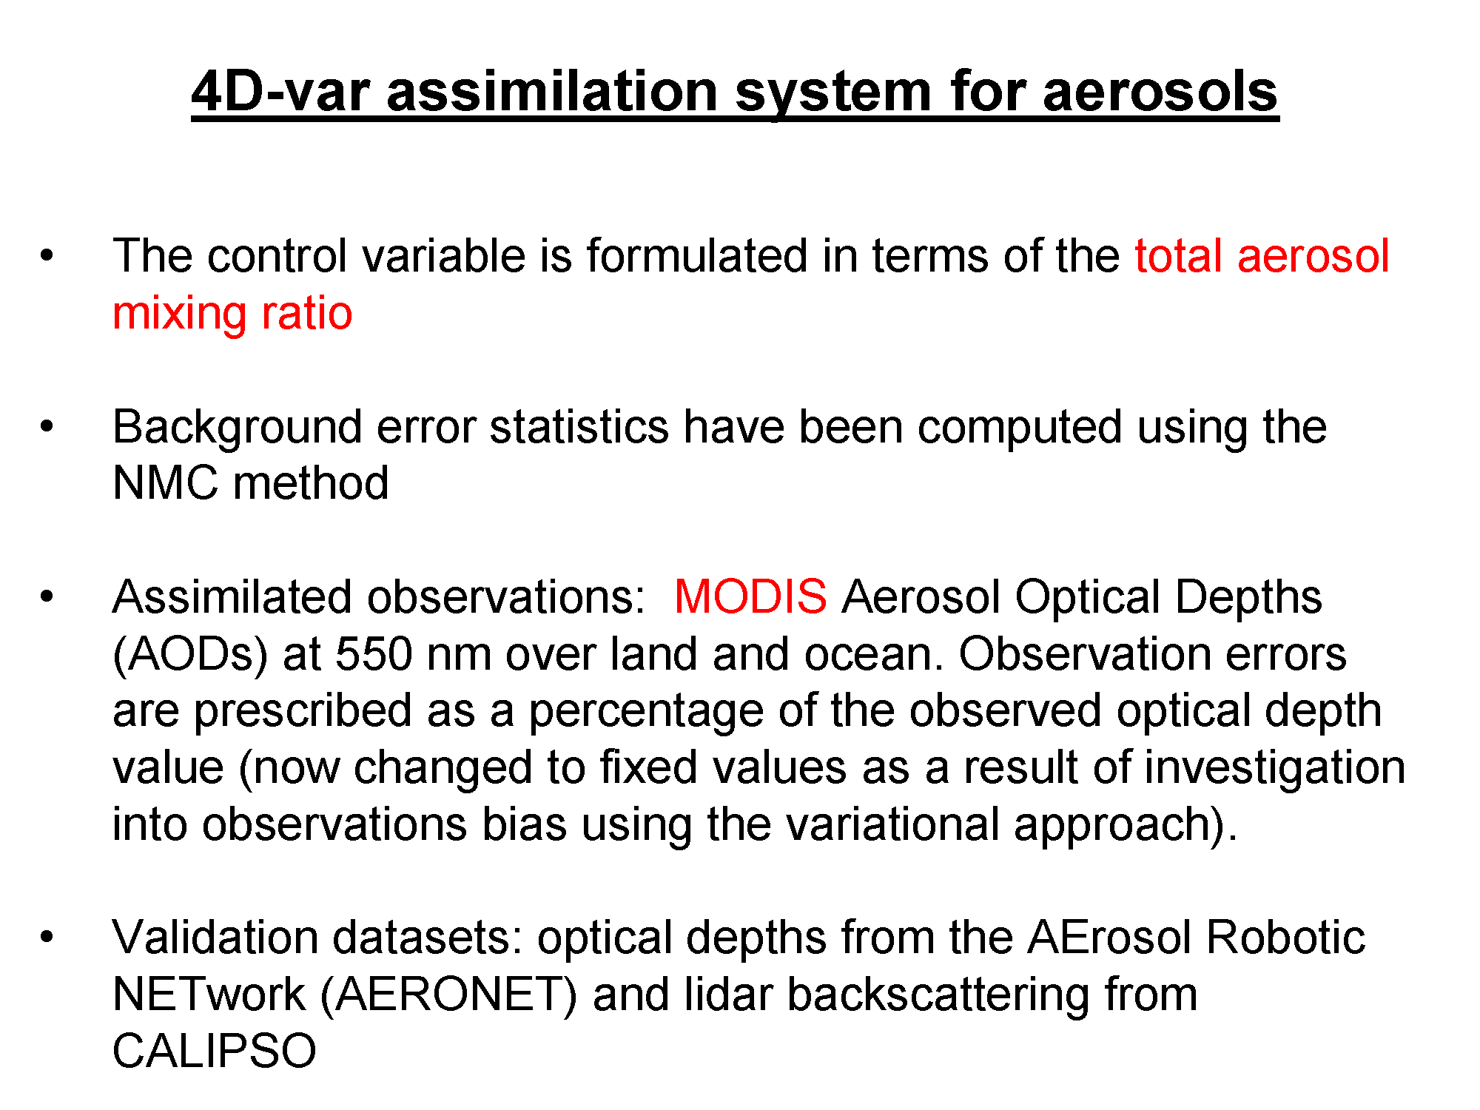
Angela Benedetti, ECMWF: International Cooperative for Aerosol Prediction (ICAP)/AEROCAST:
3rd Workshop: Ensemble Forecasts and Assimilation (http://bobcat.aero.und.edu/jzhang/ICAP/)

Slide 10
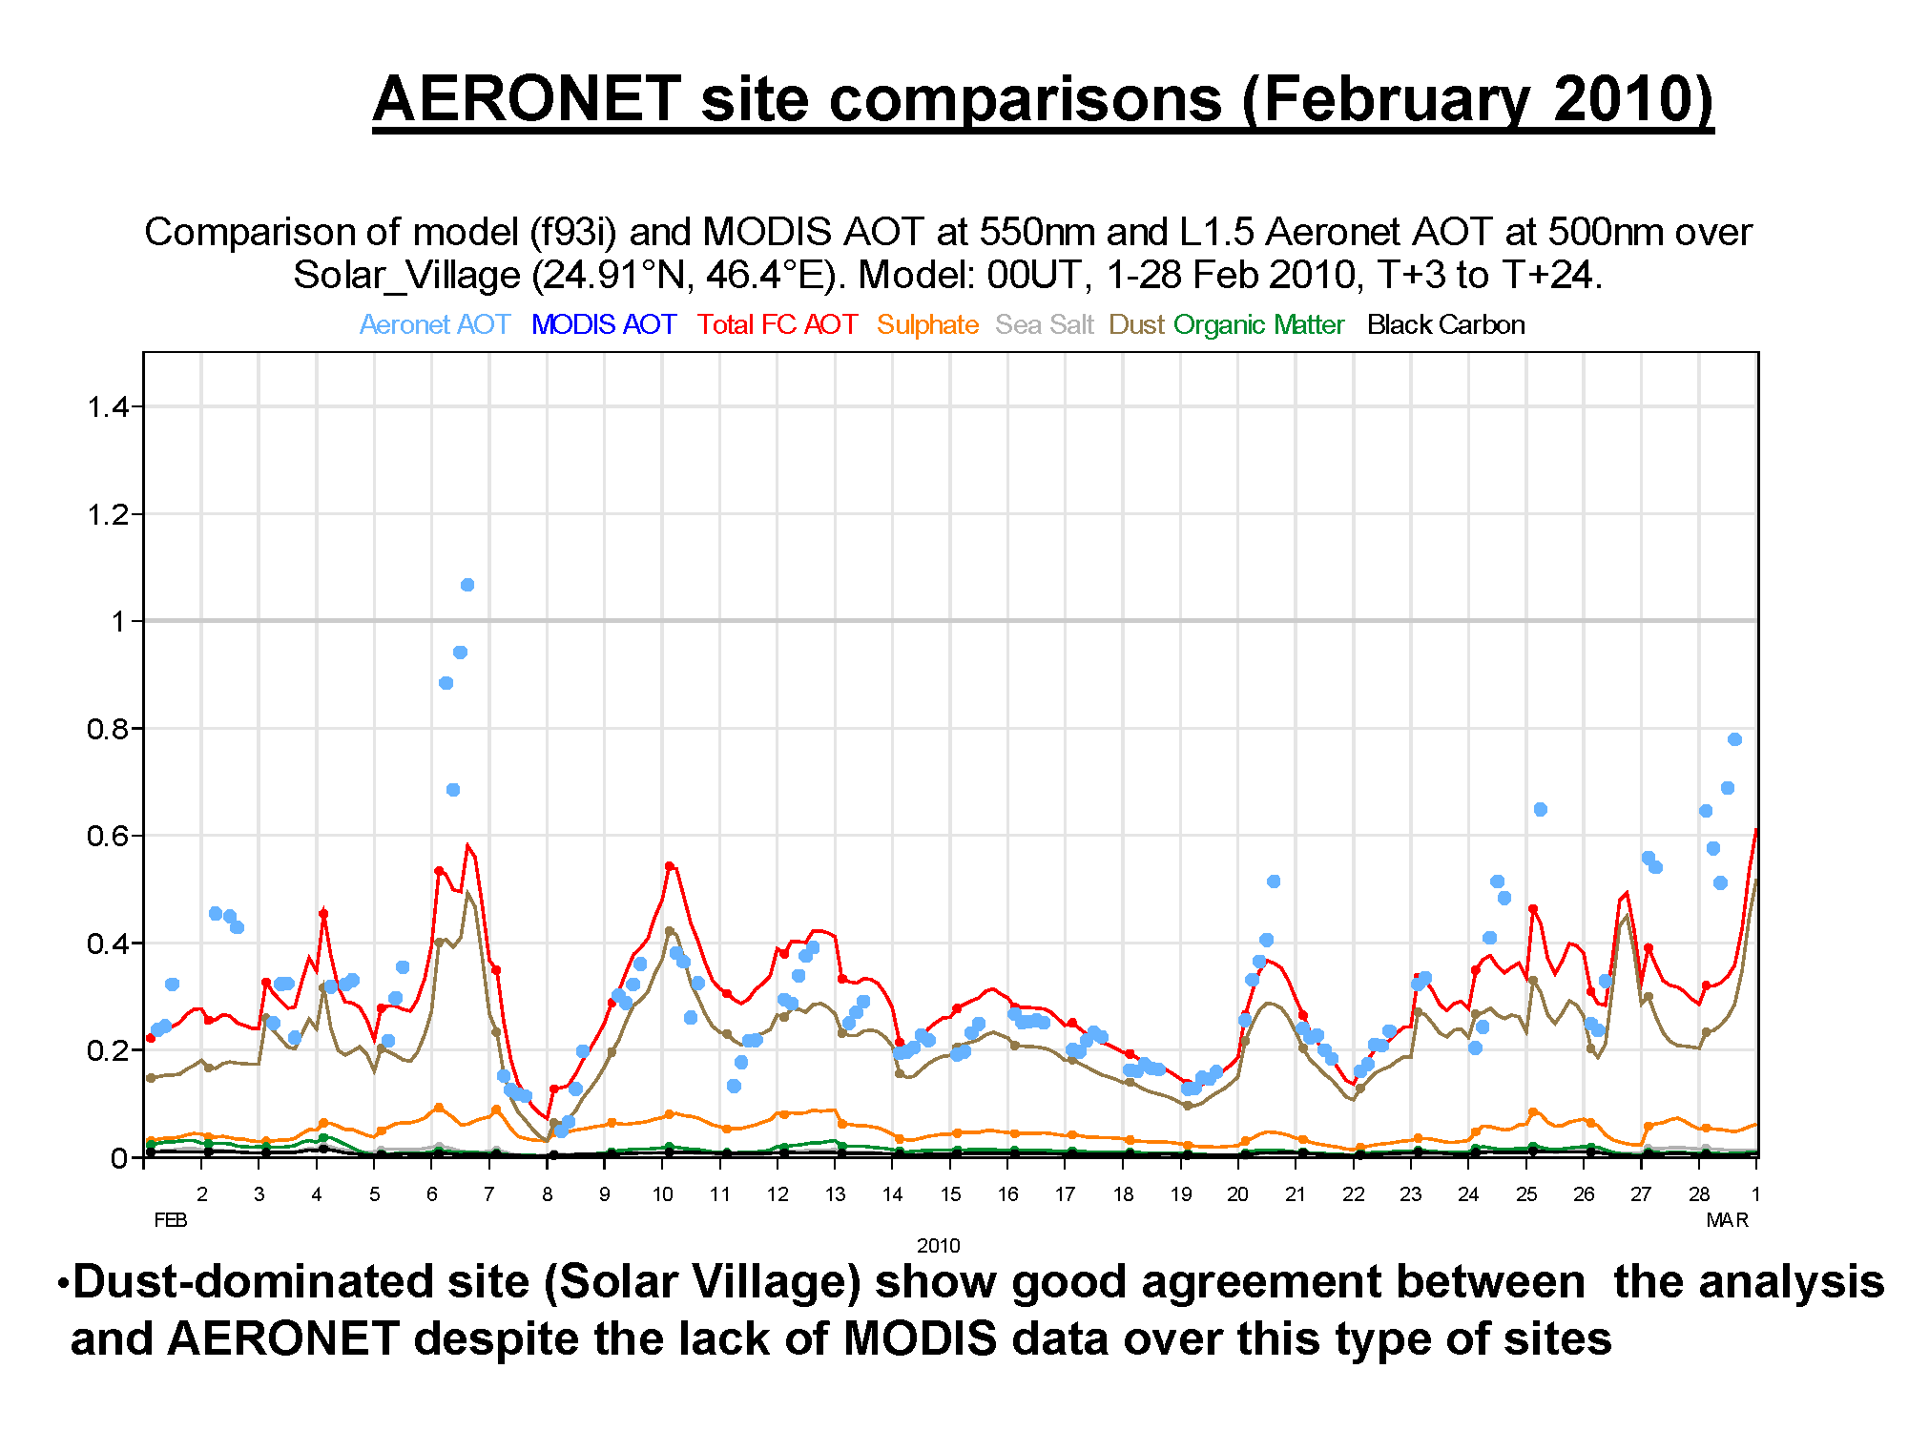
Angela Benedetti, ECMWF: International Cooperative for Aerosol Prediction (ICAP)/AEROCAST:
3rd Workshop: Ensemble Forecasts and Assimilation (http://bobcat.aero.und.edu/jzhang/ICAP/)

Slide 11

Operational AOD assimilation
Naval Research Laboratory (NRL)
Aerosol physics uses a version of the NRL operational Atmospheric Variational Data Assimilation System (NAVDAS) called NAVDAS-Aerosol Optical Depth (NAVDAS-AOD)
    2D variational approach
    constant aerosol mass adjustment for all species
    no adjustment for hydroscopic growth
Used to improve the NRL Aerosol Analysis and Prediction System (NAAPS)’s aerosol forecasting capability
Meteorological analysis and forecast fields from the Navy
Operational Global Analysis and Prediction System (NOGAPS)
NAVDAS-AOD assimilates over-water MODIS AOD from the NOAA NESDIS Near Real Time Processing Effort (NRTPE) (latency of 3 h or less in most cases)
Strict QA procedure is necessary to remove outliers associated with cloud artifacts [Zhang and Reid, 2006]
Zhang, J., J. S. Reid, D. L. Westphal, N. L. Baker, and E. J. Hyer (2008), A system for operational aerosol optical depth data assimilation over global oceans, J. Geophys. Res., 113, D10208, doi:10.1029/2007JD009065

Slide 12
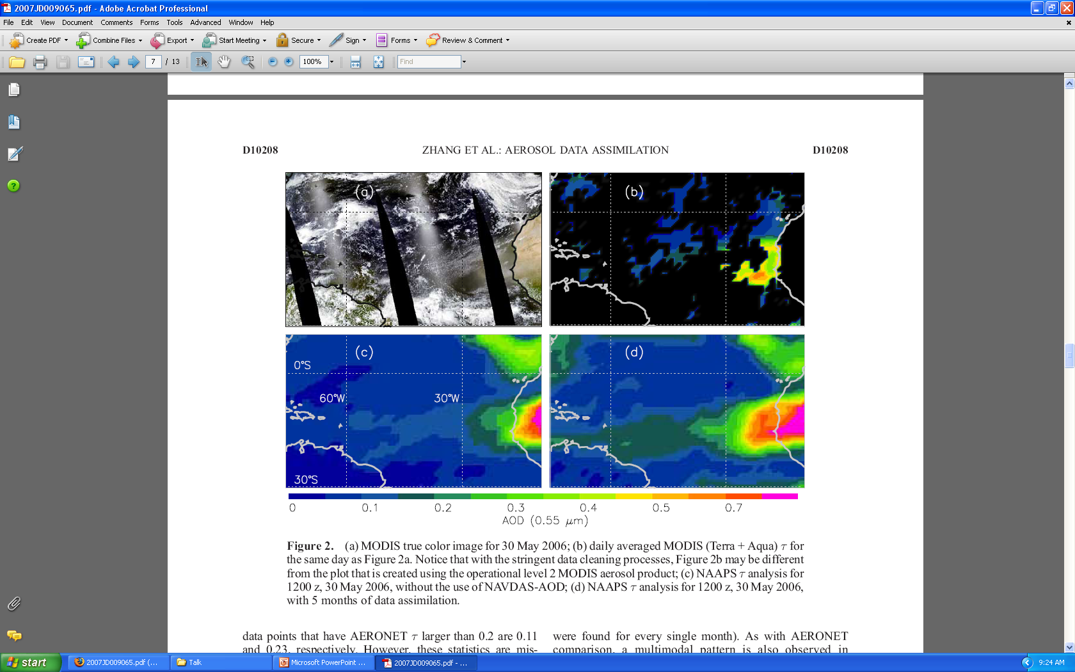
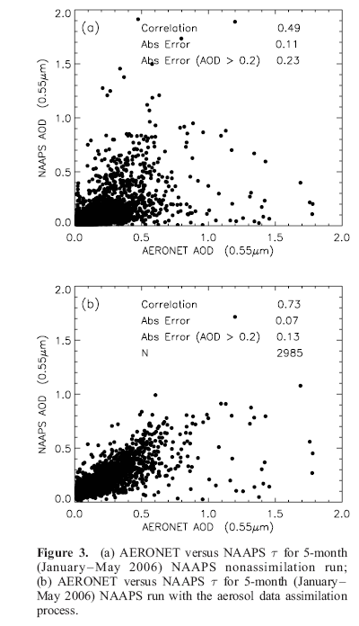
Aeronet Sun photometer validation
January-May 2006
No Assimilation
Aeronet comparisons limited to the coastal and
island AERONET sites
January-May 2006
MODIS Assimilation

Slide 13


Goddard Chemistry, Aerosol, Radiation, and Transport Model [Chin et al. 2002]
Sources and sinks for 5 non-interactive species
Convective and large scale wet removal
Dry deposition (and sedimentation for dust and sea salt)
Optics based primarily on OPAC
Dust
radius
dust | wind and topographic source, 5 mass bins
sea salt | wind driven source, 5 mass bins
black carbon | anthropogenic and wildfire source, mass hydrophic and hydrophilic
organic carbon | anthropogenic, biogenic, and wildfire source, mass hydrophic and hydrophilic
sulfate | anthropogenic and wildfire source of SO2, oxidation to SO4 mass
Seasalt
radius
Black
Carbon
hydrophobic
hydrophilic
Organic
Carbon
hydrophobic
hydrophilic
Sulfate
Mass
Slides provided by Arlindo da Silva Global Modeling and Assimilation Office, NASA/GSFC

Slide 14
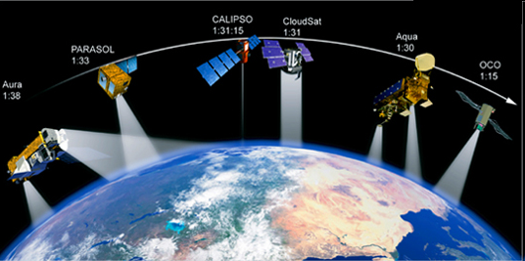
GEOS-5 Aerosol Data Assimilation
Focus on NASA EOS instruments, MODIS for now
Global, high resolution 2D AOD analysis
3D increments by means of Local Displacement Ensembles (LDE)
Simultaneous estimates of background bias (Dee and da Silva 1998)
Adaptive Statistical Quality Control (Dee et al. 1999):
  State dependent (adapts to the error of the day)
  Background and Buddy checks based on log-transformed AOD innovation
Error covariance models (Dee and da Silva 1999):
  Innovation based
  Maximum likelihood

Slide 15
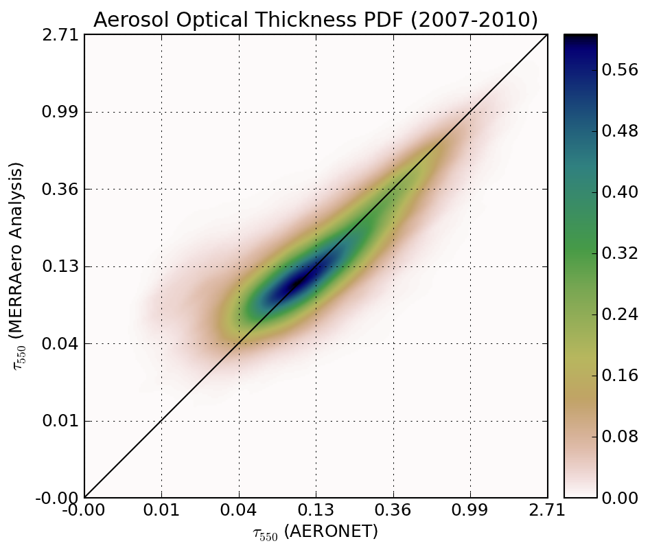
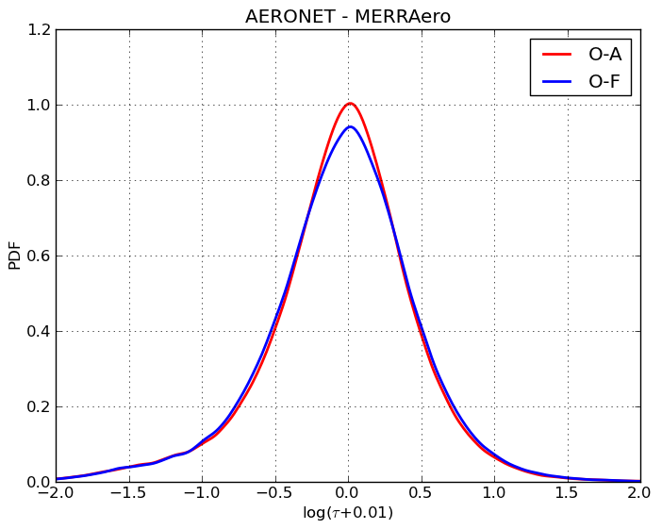
AERONET Validation of
Aerosol Assimilation
Based on 2007-10 data, aerosol assimilated fields.

Slide 16




GOCART module from GSFC’s GEOS5 has been implemented into NEMS GFS (with funding support from NASA Applied Sciences Program, JCSDA, and NWS). NEMS-GFS now has the capability to simulate dust, sulfate, sea salt and carbonaceous aerosols
Overview of the NOAA Environmental Modeling System
(NEMS) GFS Aerosol Component
Configuration:
  Forecast model: Global Forecast System (GFS) based on NOAA Environmental Modeling System (NEMS), NEMS-GFS
  Aerosol model: NASA Goddard Chemistry Aerosol Radiation and Transport Model, GOCART
  A common modeling framework using Earth System Modeling Framework (ESMF)
  In-line modeling approach:
    Consistent: no spatial-temporal interpolation, same physics parameterization
    Efficient: lower overall CPU costs and easier data management
    Allows for feedback to meteorology (aerosol-radiation feedback has been developed in GFS physics)
Phased Implementation:
  Dust-only guidance established in Q4FY12
  Full-package aerosol forecast after real-time global smoke emissions are available and tested (NCEP-NESDIS-GSFC collaborative activities funded by JCSDA)
Slides provided by Sarah Lu, NOAA/NCEP

Slide 17
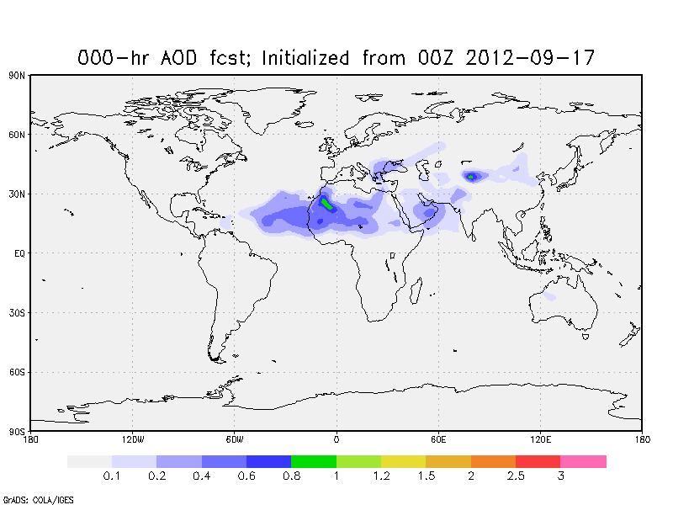
Near-Real-Time NEMS GFS Aerosol Component
Current Status:
5-day dust forecast once per day (at 00Z), output every 3 hour
Resolution: T126 L64
ICs: Aerosols from previous day forecast and meteorology from operational GDAS
GRIB2 products in 1x1 degree: 3-d distribution of dust aerosols (5 bins from 0.1 – 10 µm) and 2-d aerosol diagnosis fields (e.g., aerosol optical depth, surface mass concentration)
NCEP operational implementation on Sept 2012
Future Operational Benefits Associated with the NEMS GFS Aerosol Component
Enables future operational global short-range (e.g., 5-day) aerosol prediction
Allows aerosol impacts on medium range weather forecasts (GFS/GSI) to be considered
Provides global aerosol information required for various applications (e.g., satellite radiance data assimilation, satellite retrievals, SST analysis, UV-index forecasts)
Provides a first step toward an operational aerosol data assimilation capability at NCEP
Allows NCEP to explore aerosol-chemistry-climate interaction in the operational Climate Forecast System (CFS)--- Note that GFS is a candidate for the AGCM component of the next version of the CFS.
Provides lateral aerosol boundary conditions for regional aerosol forecast system
http://www.emc.ncep.noaa.gov/gmb/sarah/NGAC/html/realtime.ngac.html

Slide 18
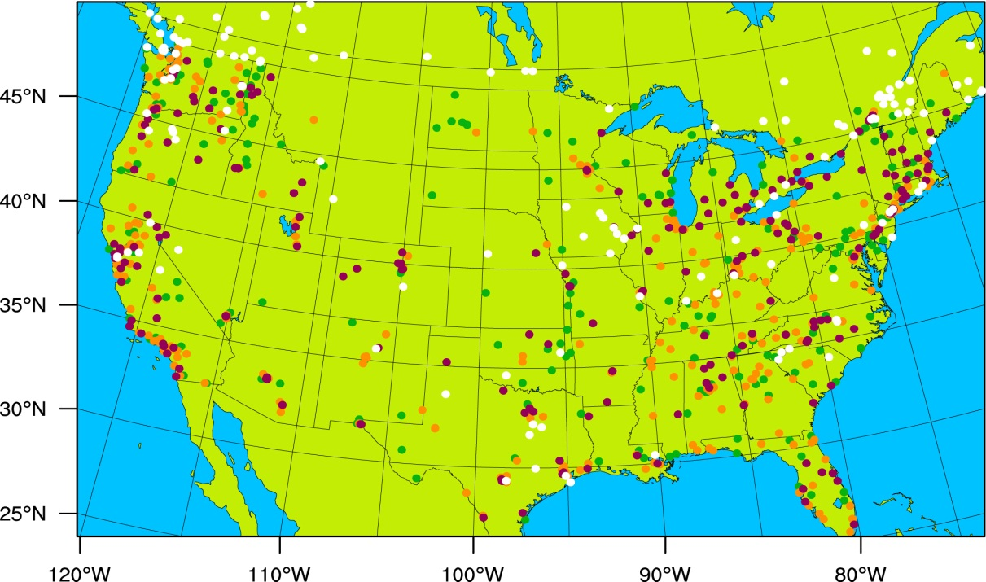
Assimilation of United States Environmental Protection Agency (EPA) AIRNow surface PM2.5 (fine particle) measurements
WRF-CHEM Experiments
AIRNow network dark brown – urban, light brown – suburban, green – rural, white – unknown.
Name | Description
NoDA | No aerosol assimilation
GSI | 3D-VAR assimilation of PM_{2.5}, PM_{2.5} as a state variable
EnKF_TOT | EnKF assimilation of PM_{2.5,} PM_{2.5} as a state variable
EnKF_SPEC | EnKF assimilation of PM_{2..5}, aerosol species as state variables
Pagowski & Grell, “Experiments with the assimilation of fine aerosols using an ensemble Kalman filter and GSI”, JGR, 2012, (pending minor revisions)
Slides provided by Mariusz Pagowski, NOAA/ESRL

Slide 19
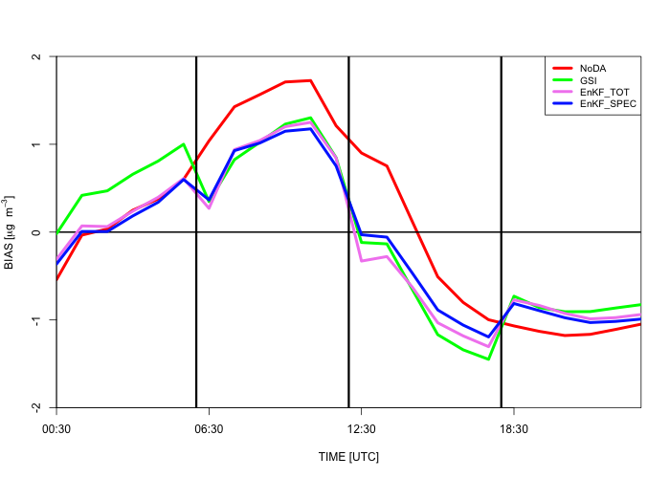
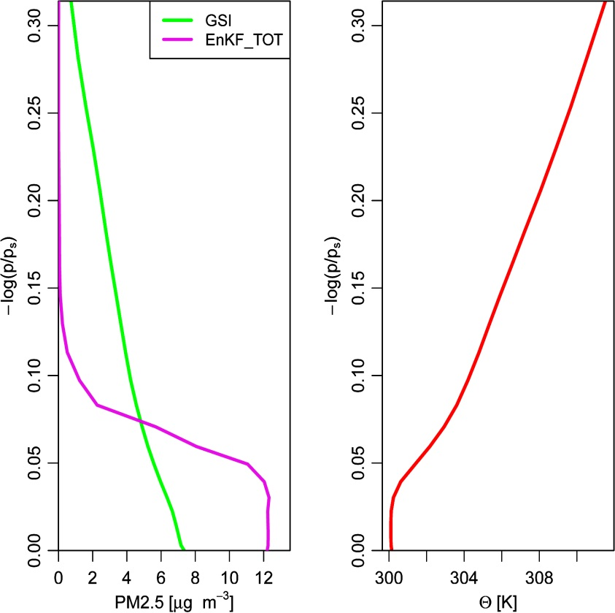
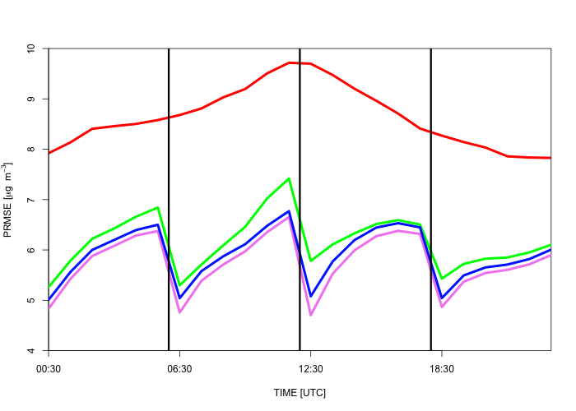
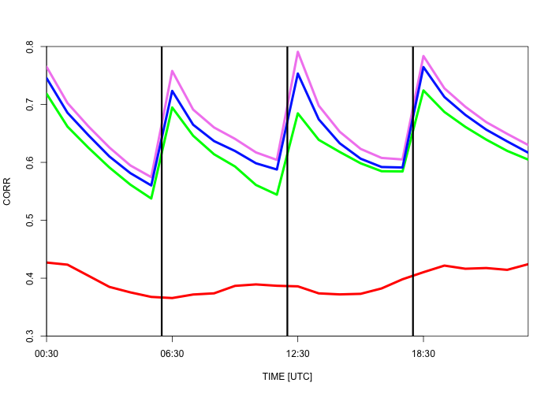
Bias
Rapid growth of Pattern RMSE and reductions in correlation after assimilation points to the limitations of applying a simple aerosol parameterization such as GOCART for predicting air quality over the Continental US. (Verification for 0-6hr forecasts)
Vertical profile of PM_{2.5} increment and potential temperature
Pattern RMSE
Correlation
Evaluation statistics calculated during June-July 15, 2010 demonstrate the advantage of EnKF over 3D-VAR

Slide 20
Outline
Motivation
  Anthropogenic changes in atmospheric composition
  Aerosol Global Observing System
Operational (and Pre-Operational) Aerosol assimilation
  MACC-II (EU)
  NAAPS (Navy)
  GEOS-5 (NASA)
  NEMS (NCEP)
  WRF-CHEM (ESRL)
RAQMS Global Aerosol Forecast Skill Assessment
  CalNex (http://www.esrl.noaa.gov/csd/projects/calnex/)
  ARCPAC (http://www.esrl.noaa.gov/csd/arcpac/)
Current research directions
  Links between aerosols and severe weather (preliminary results)

Slide 21
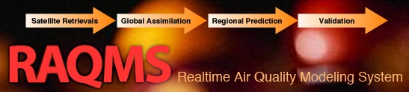

Model Description
Online global chemical and aerosol assimilation/ forecasting system
UW-Madison hybrid θ−η coordinate model (UW-Hybrid) dynamical core
Unified stratosphere/troposphere chemical prediction scheme (LaRC-Combo) developed at NASA LaRC
Aerosol prediction scheme (GOCART) developed by Mian Chin (NASA GSFC).
Statistical Digital Filter (OI) assimilation system developed by James Stobie (NASA/GFSC)
RAQMS has been used to support airborne field missions [Pierce et al, 2003, 2007, 2008], develop capabilities for assimilating satellite trace gas and aerosol retrievals [Pierce et al., 2007, 2008, Fishman et al., 2008, Sunita et al., 2008] and assess the impact of global chemical analyses on regional air quality predictions [Song et al., 2008, Tang et al., 2008]
Notes:
21

Slide 22
Forward model:
,
= ext_{ik}
where q_{ik} is the mass mixing ratio and β_{ik} is the mass specific extinction of aerosol species i at the vertical level k. dz is the thickness of the layer. The mass specific extinction is a function of the local relative humidity.
Inverse model:
1) Obtain new extinction for each species
ext_new_{ik}=ext_guess_{ik}+aodinc_{i}*ext_guess_{ik}/aod_guess_{i}
2) Obtain new dry mass for each species based on mass extinction coefficient
totalmass_new=ext_new_{ik}/mass_ext_{ik}
Effects of hydroscopic growth on aerosol extinction are linear with respect to mass

Slide 23
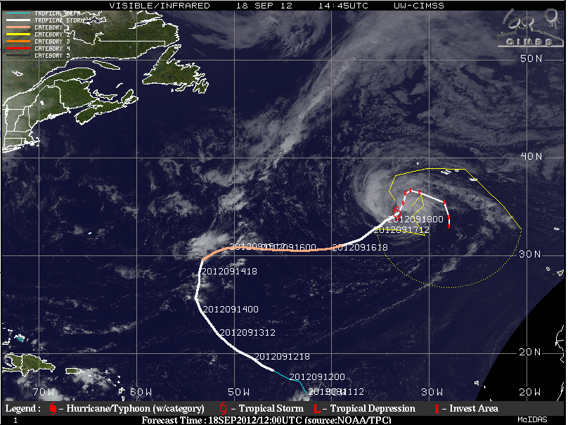
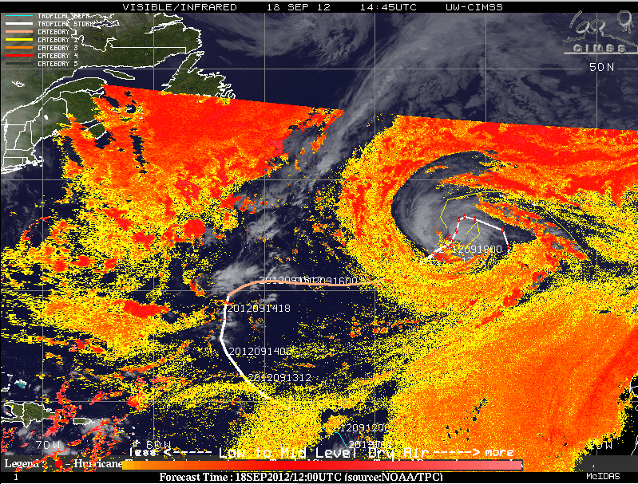
Saharan Dust Forecast
Illustration
Saharan Air Layer (SAL)
Tropical Storm Nadine
12Z Sep 18th, 2012
Track shown from 12Z 09/11

Slide 24
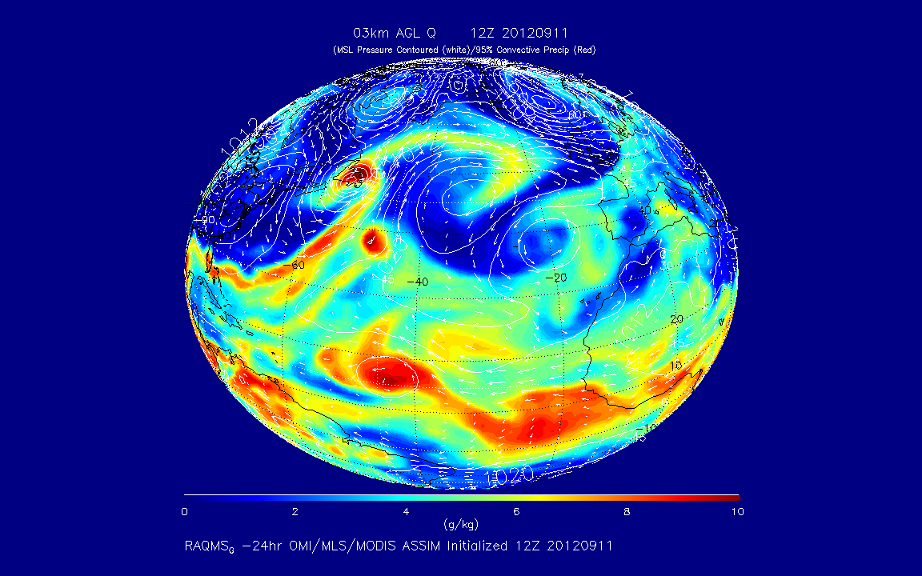
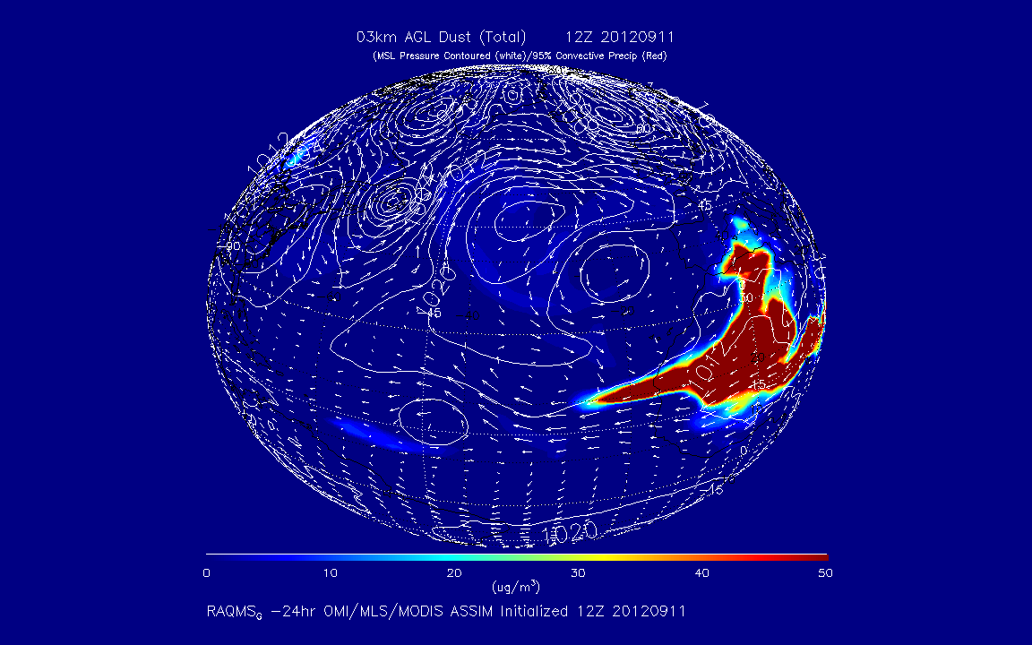
Tropical Storm Nadine
Saharan Air Layer (SAL)
RAQMS
3km WV
RAQMS
3km Dust

Slide 25
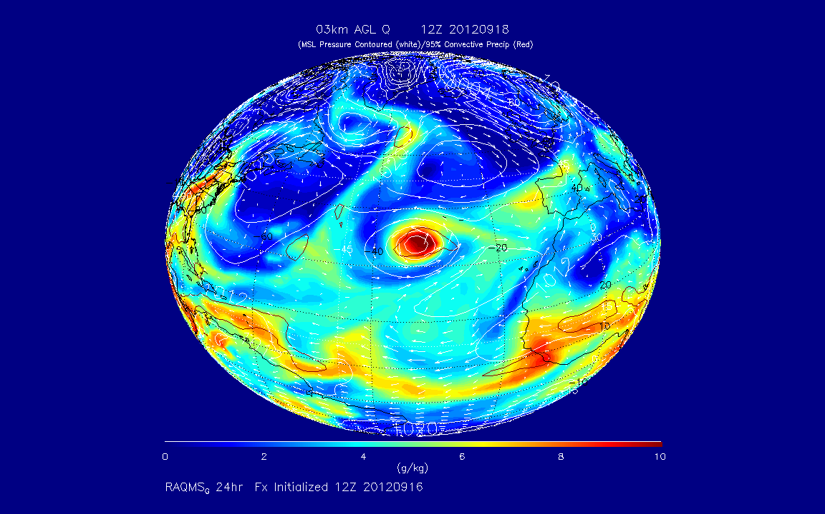
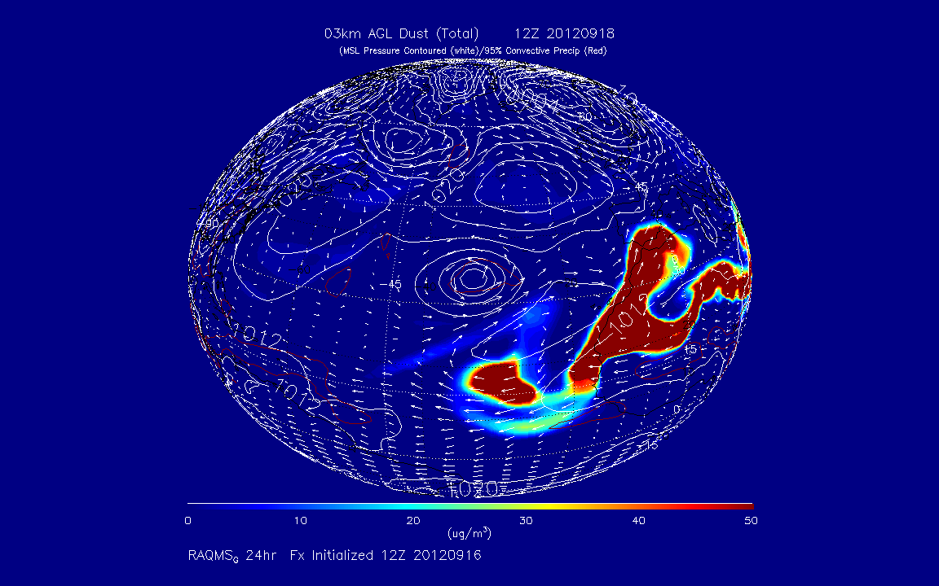
Tropical Storm Nadine
Saharan Air Layer (SAL)
RAQMS
3km WV
RAQMS
3km Dust

Slide 26
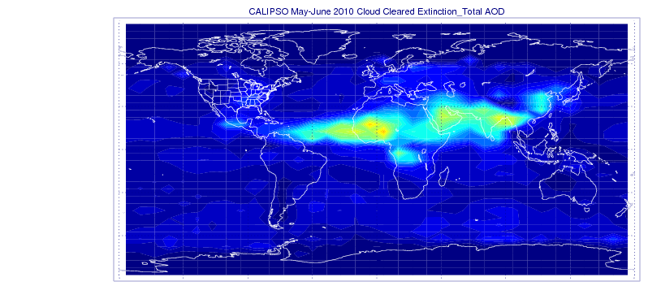
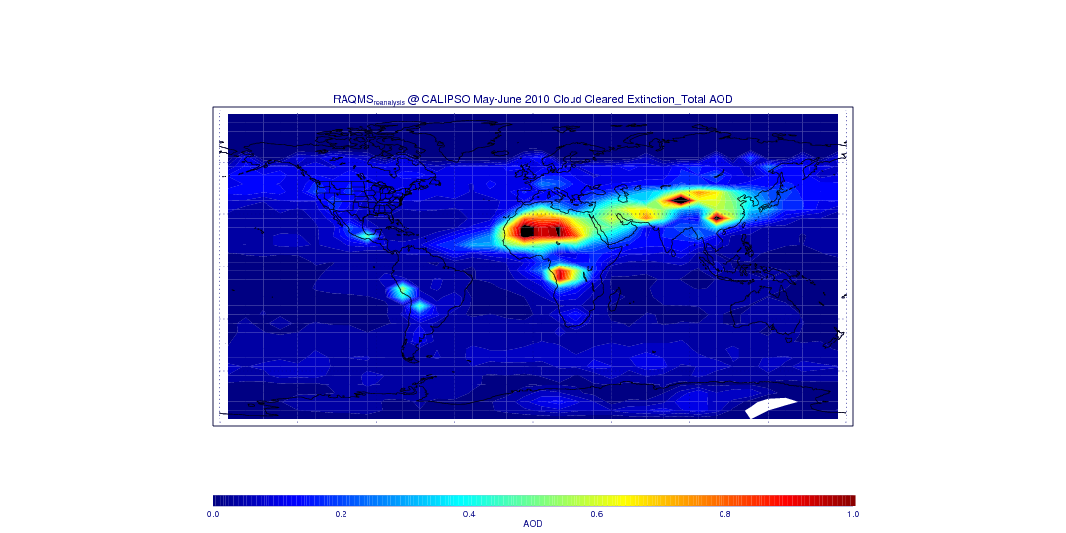
CALIPSO and Co-located RAQMS AOD May-June 2010
V3-01 aerosol profile retrievals
5º Lat, 10º Lon, 1km bins
CAD< -20, COT=0.0
QC=0,1 (unadjusted retrievals)
Clear sky CALIPSO scenes are dominated by Saharan Dust and South Asian emissions during May-June 2010
RAQMS overestimates Saharan Dust and SE Asian and S African biomass burning AOD over source regions relative to CALIPSO during May-June 2010
RAQMS underestimates Saharan Dust transport over Equatorial Atlantic during May-June 2010
New 1x1 degree
Re-analysis with
Corrected dust and
Sea-salt aod calculation

Slide 27
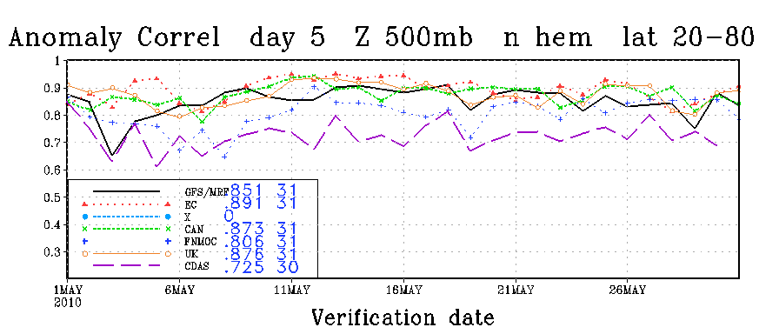
Assessment of RAQMS (2x2) Global 850mb Aerosol Extinction Forecast Skill
  Anomaly Correlations (AC)
    Correlation between forecast and analysis
    May-June mean removed
    Spectrally truncated to wavenumber 20
    Averaged from 20N-80N
useful Skill
http://www.emc.ncep.noaa.gov/gmb/STATS/html/monarch.html

Slide 28
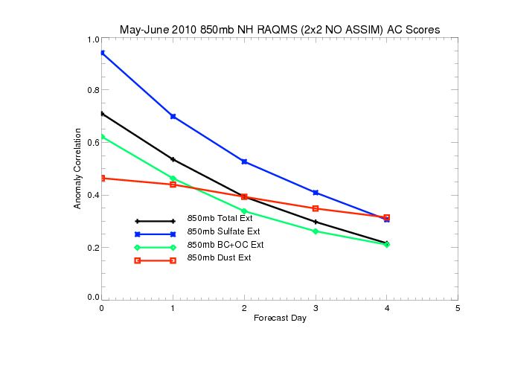
Northern Hemisphere 850mb May-June 2010 Anomaly Correlations (AC)
(No Assimilation)
useful Skill
Only 850mb SO4 extinction forecasts useful skill past 1 day
Black and organic carbon (BC+OC) and dust extinctions are both poorly initialized and
forecasted

Slide 29
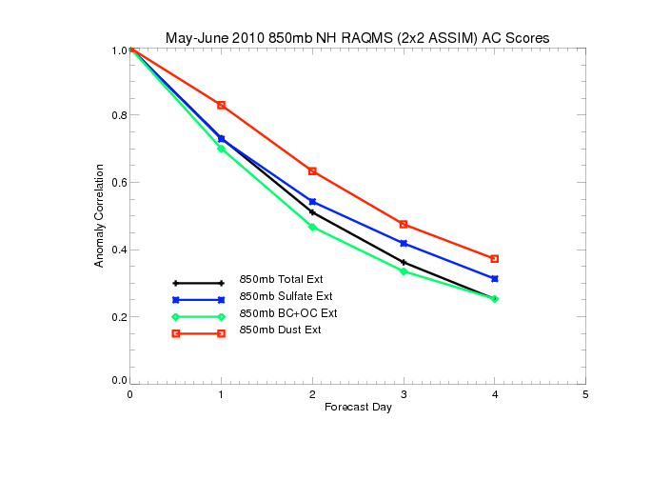
Northern Hemisphere 850mb May-June 2010 Anomaly Correlations (AC)
(With MODIS Assimilation)
useful Skill
MODIS AOD assimilation results in small changes in 850mb SO4 extinction forecasts
MODIS AOD assimilation results in significant improvements in black and organic carbon (BC+OC) and dust forecast skill (dust prediction useful at 2 days)

Slide 30
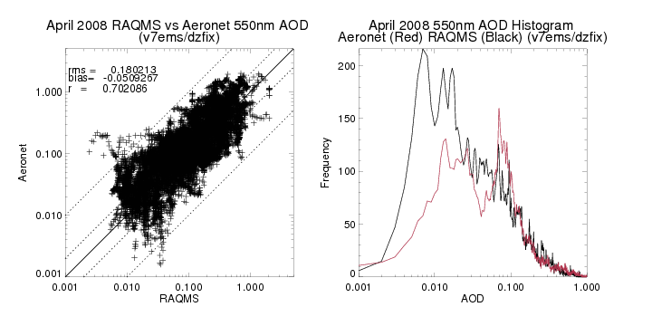
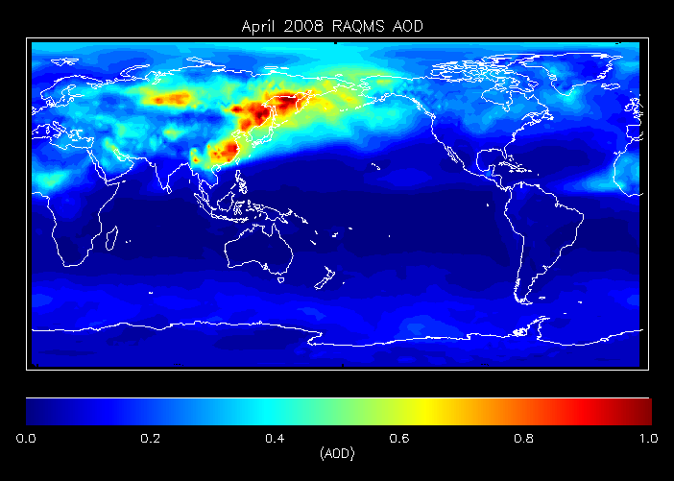
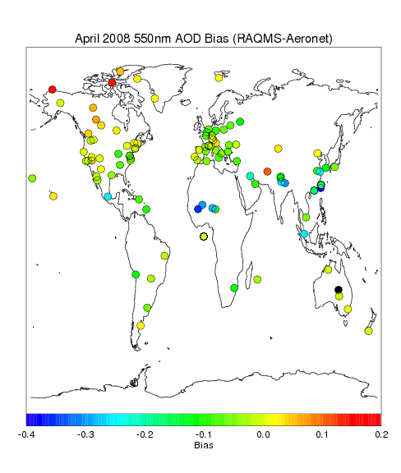
RAQMS
Aeronet
Validation
April 2008

Slide 31
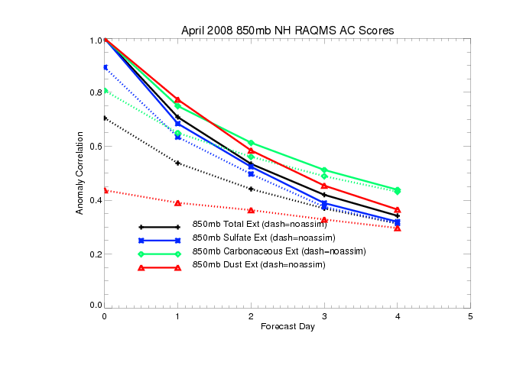
RAQMS (2.0x2.0) Global Aerosol Forecast Skill
(850mb with and without MODIS assimilation)
Skill Threshold
Carbonaceous and Dust extinctions are most significantly impacted by AOD assimilation

Slide 32
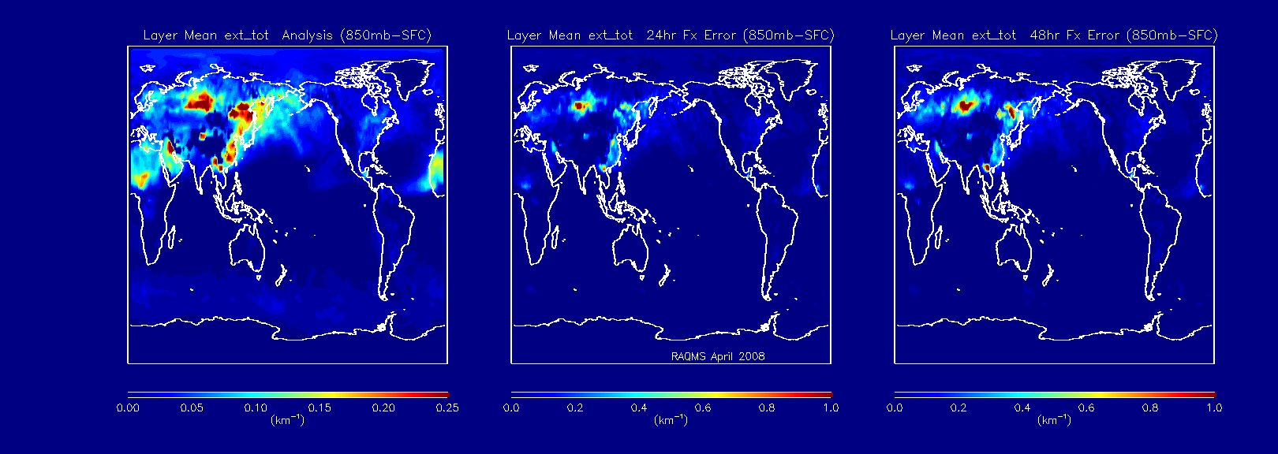
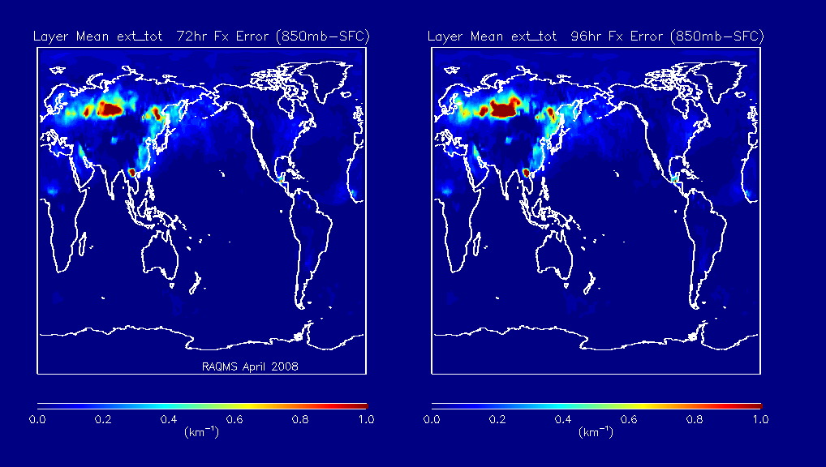
RAQMS April 2008 Aerosol RMS Errors
(Total Extinction 850mb-SFC)
Large errors in Aerosol Extinction forecasts over Southern Siberia (Kazakhstand, Baykal) and S.E. Asia (Thailand)
Note: Fx error color scale is
4x mean extinction color scale!

Slide 33
Outline
Motivation
  Anthropogenic changes in atmospheric composition
  Aerosol Global Observing System
Operational (and Pre-Operational) Aerosol assimilation
  MACC-II (EU)
  NAAPS (Navy)
  GEOS-5 (NASA)
  NEMS (NCEP)
  WRF-CHEM (ESRL)
Global Aerosol Forecast Skill Assessment
  CalNex (http://www.esrl.noaa.gov/csd/projects/calnex/)
  ARCPAC (http://www.esrl.noaa.gov/csd/arcpac/)
Current research directions
  Links between aerosols and severe weather (preliminary results)

Slide 34
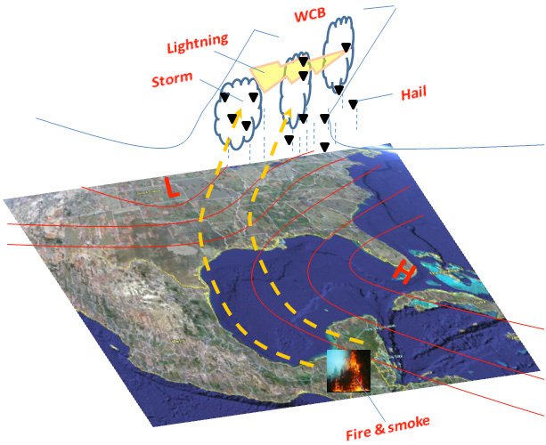
A conceptual model for the link between Central American biomass burning aerosols and severe weather over the south central United States
The indirect aerosol mechanisms pertinent to smoke particles include:
the first indirect effect, where the size of water cloud droplets decreases as smoke particles enhance the number of cloud condensation nuclei available for activation (Twomey 1974);
the semi-direct (choking) effect, where absorption of solar radiation by smoke particles increases atmospheric stability and consequently suppresses the low-level cloud formation (Koren et al 2004);
the second indirect effect, where the smaller cloud droplets arising from the first indirect effect of smoke particles result in longer cloud lifetimes and larger cloud fractions (Albrecht 1989, Kaufman et al 2005);
the invigoration effect, where for strong convection storms the warm rain process is delayed by the smoke through its first and second indirect effects, which in turn allows for more cloud water to be transported vertically, a greater release of latent heat, and a subsequent invigoration of the updrafts, thus supporting the development of intense thunderstorms and large hail (Rosenfeld 1999, Andreae et al 2004, Lin et al 2006).
Wang et al, Environ. Res. Lett. 4 (2009) http://dx.doi.org/10.1088/1748-9326/4/1/015003

Slide 35
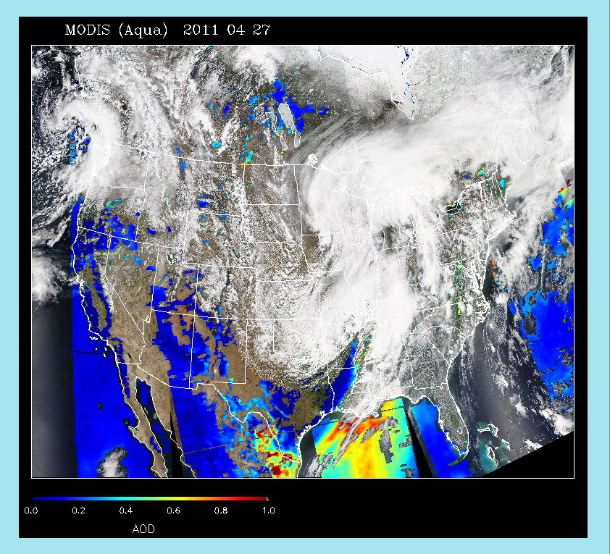
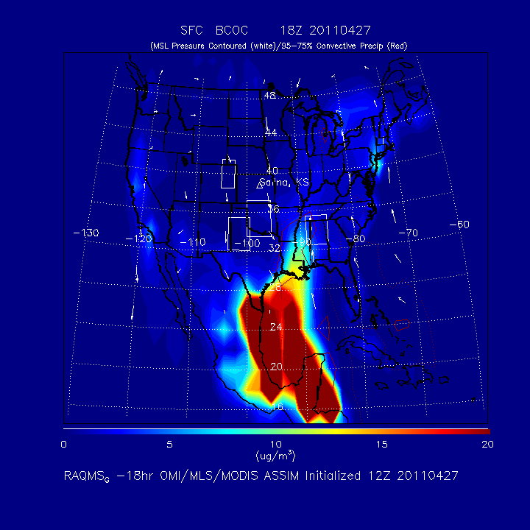
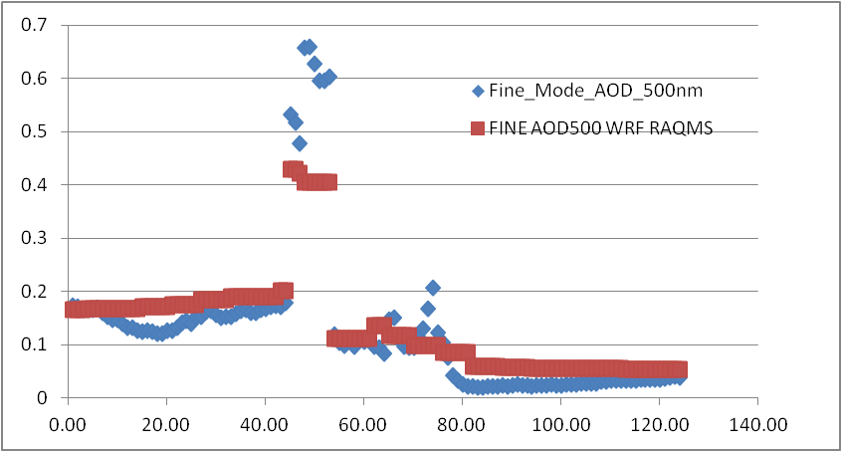
Case Study: Severe weather April 27th, 2011 (Huntsville tornado)
MODIS aerosol optical depth (AOD) shows significant aerosol loading over Gulf within warm sector of storm
RAQMS surface Black and Organic Carbon (BCOC) analysis shows highly elevated aerosols
RAQMS used to initialize and provide lateral boundary conditions for 4km WRF-CHEM with explicit (MOSAIC) aerosol/cloud interaction
27th
Aeronet AOD Louisiana
WRF-Chem
OBS
26th
28th

Slide 36
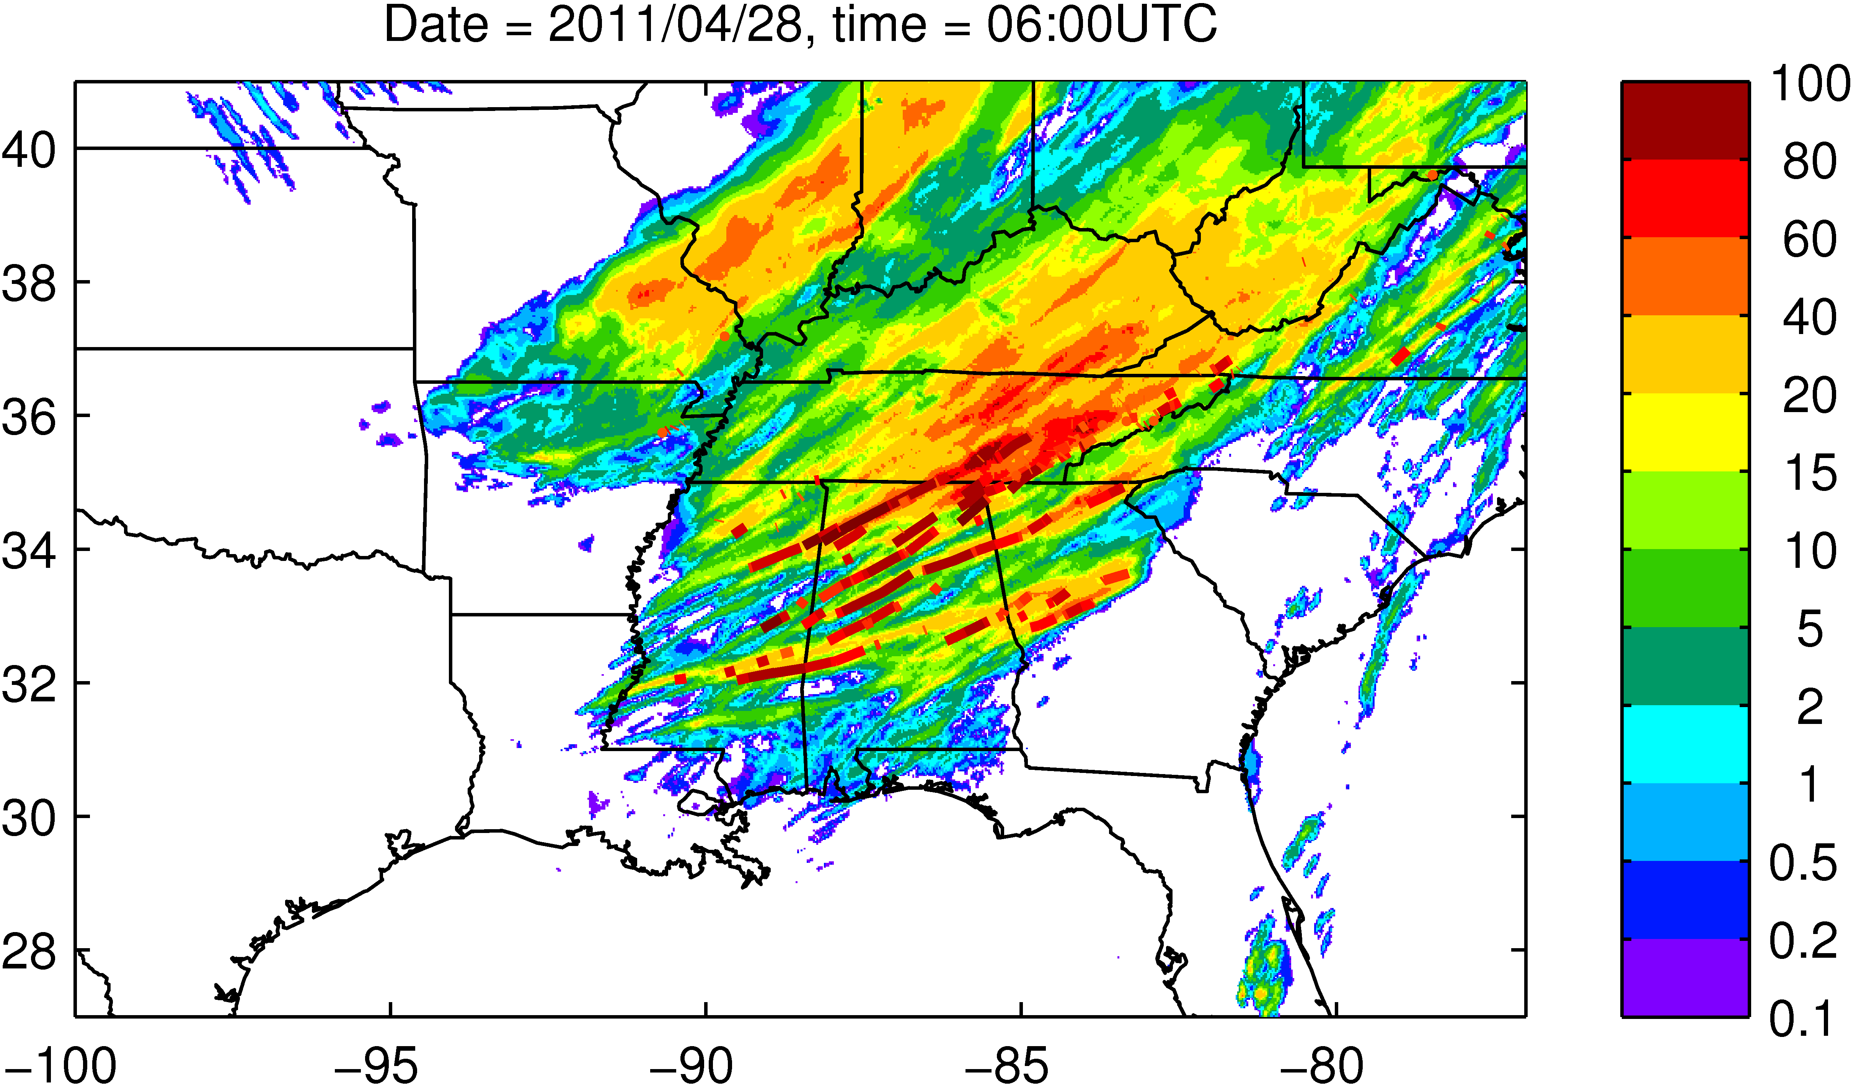
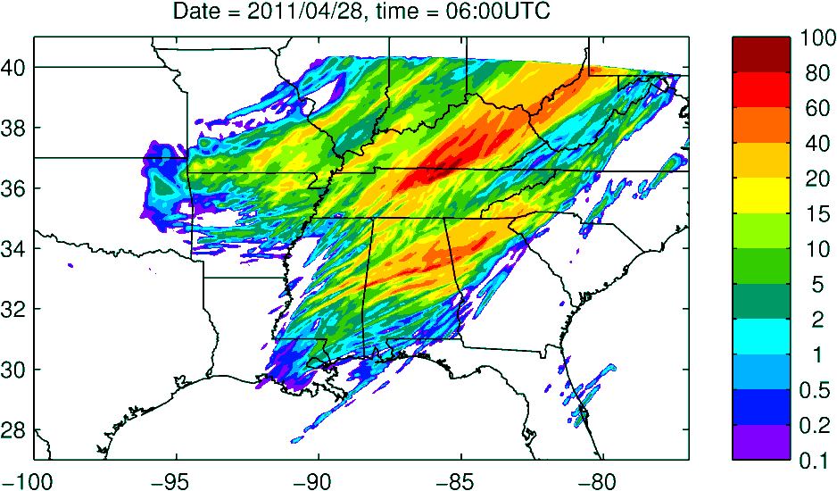
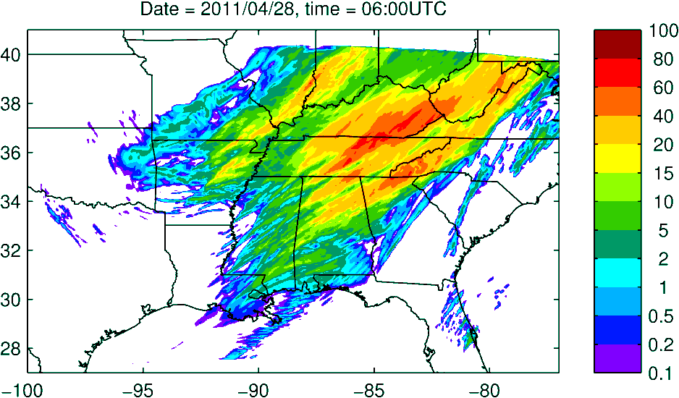
Case Study: Severe weather April 27th, 2011 (Huntsville tornado)
WRF-CHEM simulations conducted by Pablo Saide in collaboration with Greg Carmichael and Scott Spak (U-Iowa)
Inclusion of aerosol cloud interactions significantly impacts the predicted precipitation distribution and improves forecast over Huntsville, AL
SPC 12hr precip and tornado tracks valid 06Z on April 28, 2011
WRF no aerosols
WRF-Chem + RAQMS BC

Slide 37
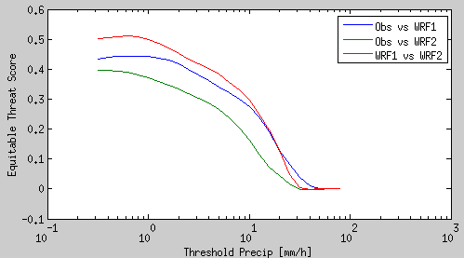
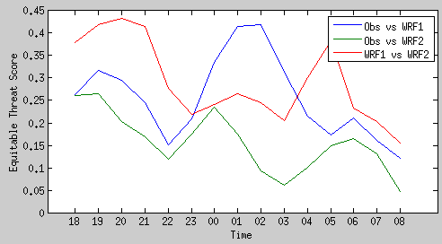
Precip. Obs vs WRF & WRF-Chem
Skill for 3h accum precip. vs different precip. thresholds
Simulations with and without aerosol effects yield very different precipitation fields
Skill to represent observation is reduced for the larger precip. values
There is improved skill when considering aerosol effects
OBS vs WRF-Chem RAQMS
WRF-Chem vs WRF
OBS vs WRF NO-CHEM
Skill for 3h accum. precip. over 10mm
27th
28th
UTC

Slide 38
International Cooperative for Aerosol Prediction (ICAP/AEROCAST)
ICAP is an international forum for aerosol forecast centers, remote sensing data providers, and lead systems developers to share best practices and discuss pressing issues facing the operational aerosol community.
Infrastructure and data protocols need to be developed between operational centers in order to fully support this emerging field.
Participants include ECMWF, ESA, EUMETSAT, FNMOC, GMAO, JAXA, JMA, NCEP, NESDIS, NRL and NASA GMAO, LANCE,and LarC as well as several universities.
Aerosol Emission and Removal Processes: May 14 – 17, 2012, ESA/ESRIN, Frascati, Italy
Inquiries: Angela.Benedetti@ecmwf.int
Ensemble Forecasts and Data Assimilation: 11 - 13 May, 2011 Boulder, CO Inquiries: peter.r.colarco@nasa.gov
Model Verification: 30 September-1 October, 2010 Oxford England (Joint with 9th AEROCOM Workshop)
Inquiries: angela.benedetti@ecmwf.int
Aerosol Observability: 27-29 April, 2010 Monterey CA
Inquiries: jeffrey.reid@nrlmry.navy.mil
http://bobcat.aero.und.edu/jzhang/ICAP/

Slide 39
International Workshop on Air Quality Forecasting Research (IWAQFR)
The goal of the International Workshop on Air Quality Forecasting Research (IWAQFR) is to provide a venue for the discussion of science issues and advancements related to air quality forecasting.
Workshop objectives include improving operational air quality forecasts, promoting collaborations among air quality forecasting researchers and practitioners, and nurturing an international air quality forecasting community.
1st: 2-3 December 2009, NOAA David Skaggs Research Center, Boulder, Colorado
Sponsored by NOAA and Environment Canada (http://www.esrl.noaa.gov/csd/events/iwaqfr/)
2nd: 17-19 November 2010, Quebec City, Canada
Sponsored by Environment Canada's Meteorological Service
3rd: November 29 - December 1, 2011, Potomac, MD
Sponsored by NOAA, Environment Canada and WMO (http://www.arl.noaa.gov/IWAQFR_home.php)
4th: 12-14 December 2012, Geneva, Switzerland
Sponsored by WMO Global Atmosphere Watch (GAW): Urban research (http://www.wmo.int/pages/prog/arep/gaw/IWAQFR_4.html)

Slide 40
Thank you!
brad.pierce@noaa.gov

Slide 41
Extra Material

Slide 42
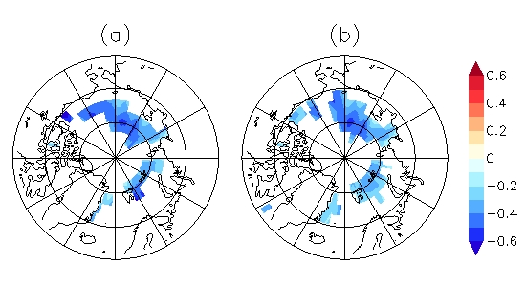
Development of Data Assimilation Capabilities for SEVIRI Volcanic Ash retrievals
With
Georg Grell (NOAA/ESRL)
Martin Stuefer (UAF)
Mike Pavolonis (NOAA/NESDIS)
08Z 4/17 2010
11 μm AOD
As part of the NOAA Volcanic Ash Working Group (VAWG) Science Team we are testing assimilation of SEVIRI volcanic ash optical depth retrievals using WRF-CHEM/GSI.

Slide 43
WRF-CHEM Volcanic Ash Module
A 4-bin WRF-CHEM volcanic ash module developed by George Grell at Earth System Research Laboratory (ESRL) and Martin Stuefer at the University of Alaska, Fairbanks (UAF) is used in forecasting volcanic ash.
Volcanic Ash Forecast Uncertainties
The mass estimates are estimated from the height of the erupted ash. For the Eyjafjatjalla case, eruption heights are constrained with radar data (~150 km from the volcano).
There is high uncertainty with the erupted mass: A 500 meter offset in the height changes the total mass estimate by almost 60% for injection heights <5km.
There is also high uncertainty in the assumed size distribution of the ash particles, which determines the plume lifetime.

Slide 44
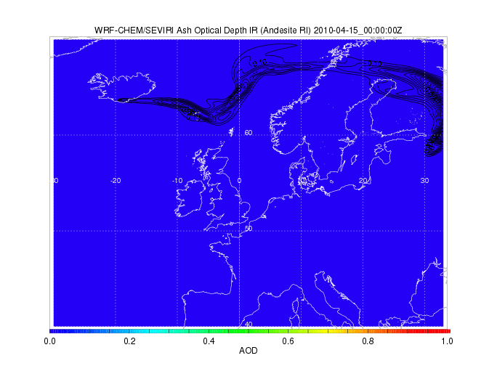
WRF-CHEM Volcanic Ash Forecast (contours) and SEVIRI 11 micron AOD (colored) during the 2010 Eyjafjoll eruption in southern Iceland.

Slide 45
GSI Volcanic Ash Assimilation
The OMI Total column ozone template is used for assimilation of SEVIRI volcanic ash retrievals within the Gridpoint Statistical Interpolation (GSI)
SEVIRI 11 micron volcanic ash extinction is assimilated with modifications made for extinction instead of ozone
11 micron AOD is computed within WRF-CHEM (updated with Andesite optical properties)
Modified NMC method for Background Errors
2 forecasts:
emission heights 1.2 times larger than control experiment
emission heights 0.8 times higher than control
Used differences between 00z April 14 to 00z April 19, 2010 hourly forecast (valid at same time) to build the statistics

Slide 46
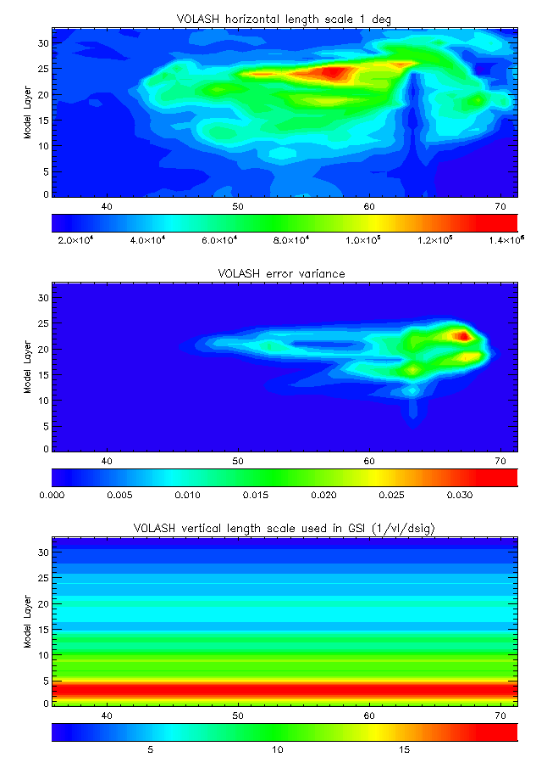
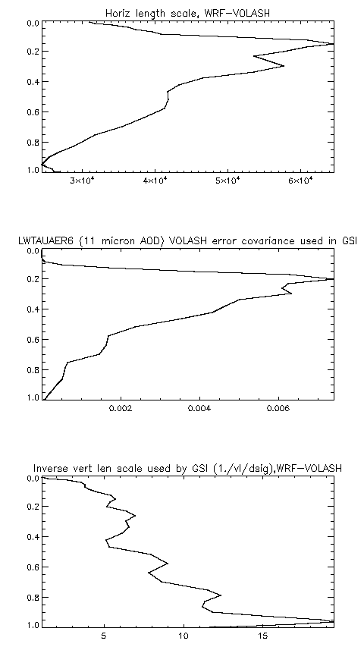
Cross section 35 – 72 N
1-d
Horizontal
Length scale
Error covariance
Vertical length scale
In GSI
(1/vl/dsig )

Slide 47
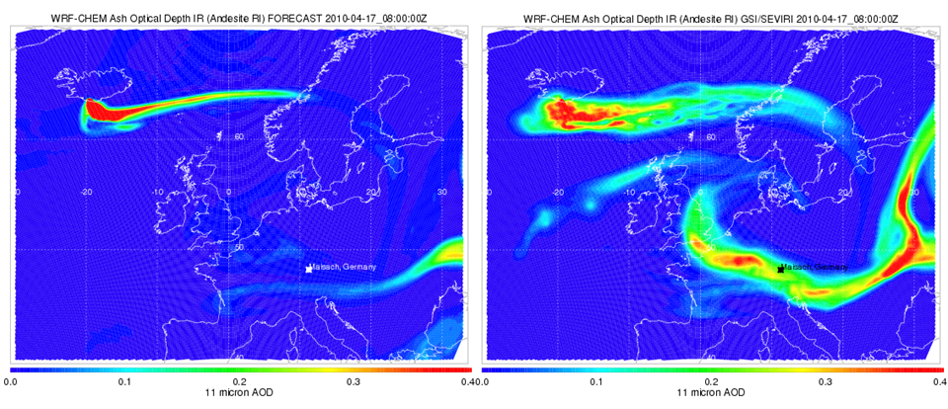
Results
WRF-CHEM Baseline GSI/SEVIRI assimilation
08Z 4/17 2010
11 μm AOD
08Z 4/17 2010
11 μm AOD
Significant increase in 11 micron AOD for older plume with GSI/SEVIRI assimilation

Slide 48
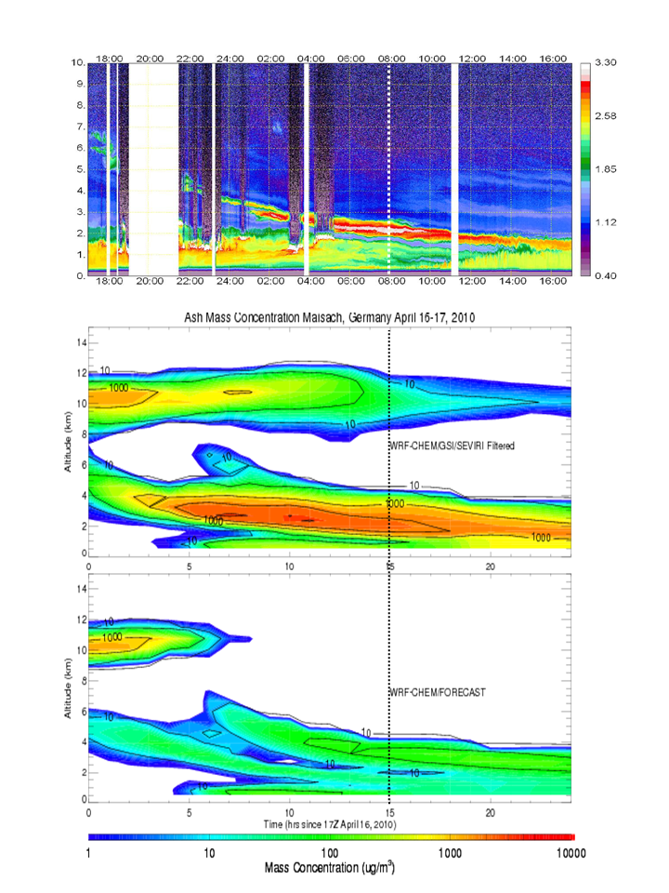
Maisach 1064 nm aerosol backscatter
Verification
Comparisons with RAMAN lidar measurements at Maisach, Germany show that maximum volcanic ash mass concentrations near the vicinity of the observed plume reached 3,226 mgm⁻³ in the GSI/SEVIRI assimilation experiment and only 155 mgm⁻³ in the baseline experiment. Gasteiger et al. [2011] estimated maximum volcanic ash mass concentrations of 1,100 mgm⁻³ (650 to 1,800 mgm⁻³) at an altitude of 2.2km at 08Z on April 17, 2010.
Both experiments show an additional plume at 10km which is not observed.
ASSIM
NO
ASSIM

