Slide 1
High Resolution Trajectory-Based Smoke Forecasts of the Fort McMurray wildfire using VIIRS Aerosol Optical Depth
Brad Pierce
NOAA/NESDIS/STAR
VISIT Satellite Chat May 18, 2016

Slide 2
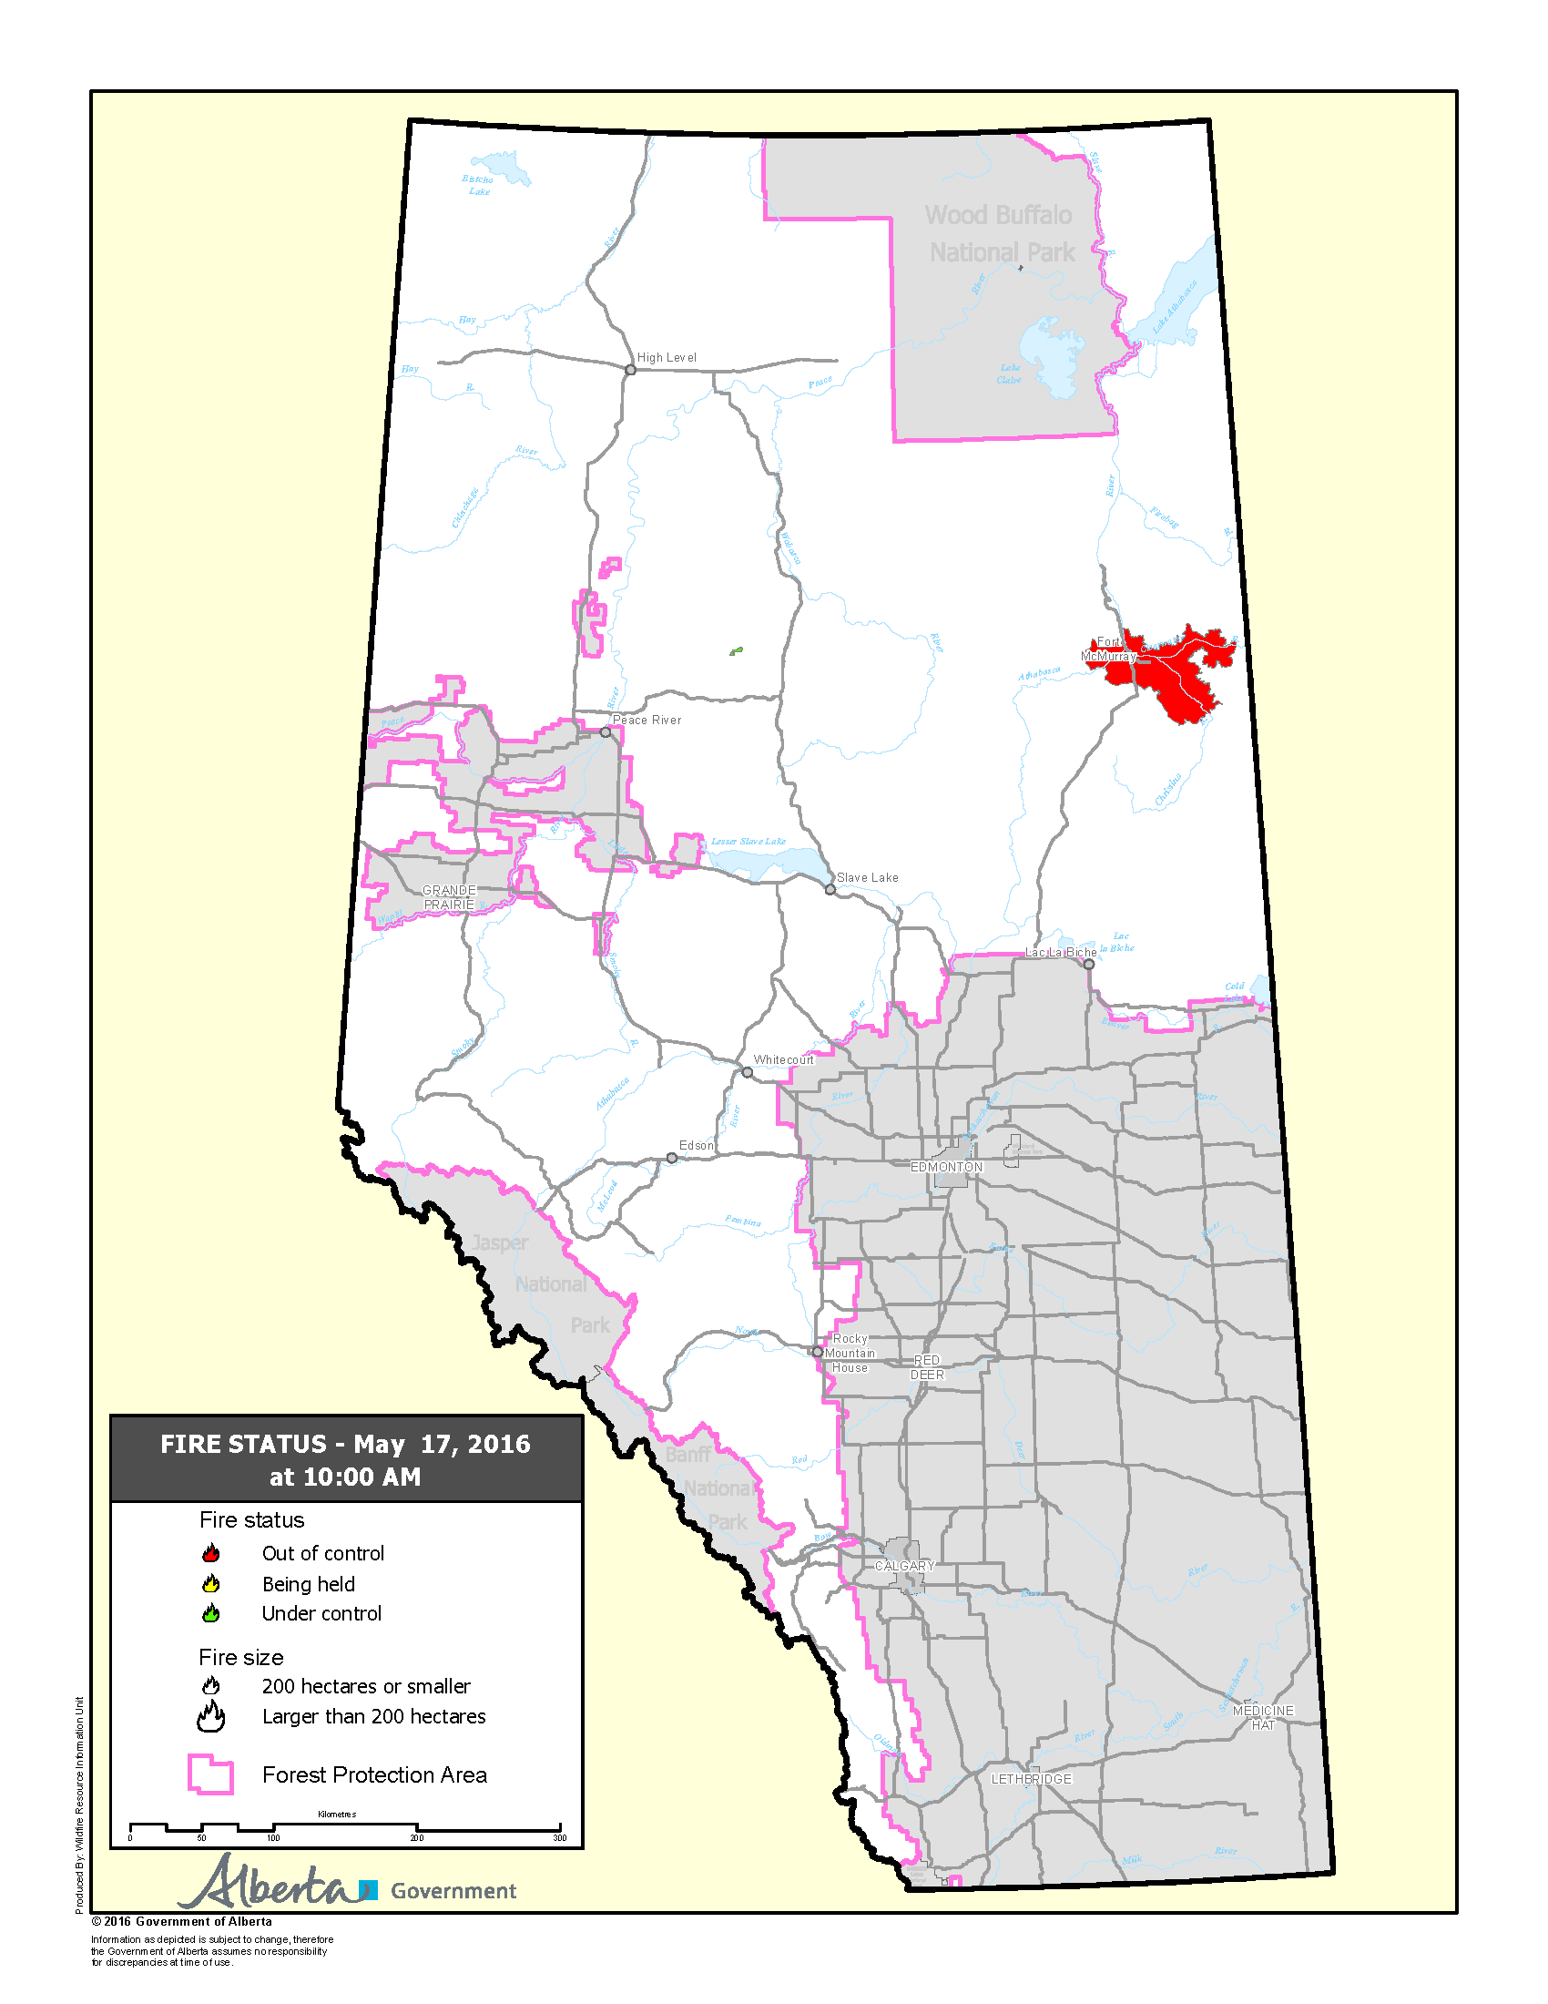
(Fort McMurray, AB – May 1, 2016) – Due to changing wind and weather conditions, the fire southwest of Highway 63 in the area of Gregoire has not abated. As of 9:57 p.m., Mayor Blake has declared a State of Local Emergency in Fort McMurray localized to Gregoire.
(Fort McMurray, AB – May 3, 2016) – As of 11 a.m. on May 3, the forest fire burning southwest of Fort McMurray was approximately 1.2 kilometres west of Highway 63 and Airport Road; it has not crossed the Hangingstone River. Air quality continues to be a potential risk to residents of the Gregoire area and is subject to wind conditions.
(Fort McMurray, AB – May 4, 2016) – Weather patterns are changing and we have been advised by Alberta Forestry that we need to do a mandatory evacuation of Anzac, Gregoire Lake Estates and Fort McMurray First Nation.
(Fort McMurray, AB – May 8, 2016) – The airspace below 3000 ft. above ground level (AGL) is closed over the entire Regional Municipality of Wood Buffalo, including a five nautical mile buffer around the active fire zone.
(Fort McMurray, AB – May 16, 2016) The evacuation zone has increased north of the city of Fort McMurray due to evolving fire conditions. Several camps are affected by this evacuation. Approximately 8,000 people impacted.
http://wildfire.alberta.ca/wildfire-maps/default.aspx

Slide 3
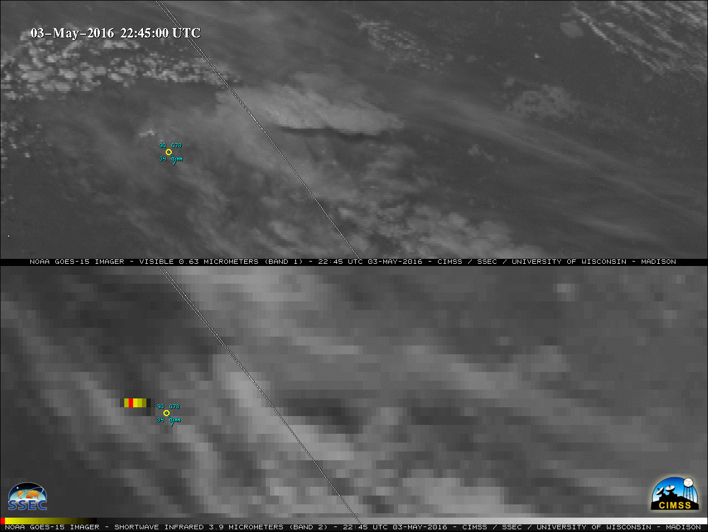
May 03, 2016 GOES-15
First Pyro cumulonimbus
Fort McMurray Wildfire
http://pyrocb.ssec.wisc.edu/wp-content/uploads/2016/05/160502_goes15_visible_shortwaveIR_CYMM_Fire_anim.gif

Slide 4
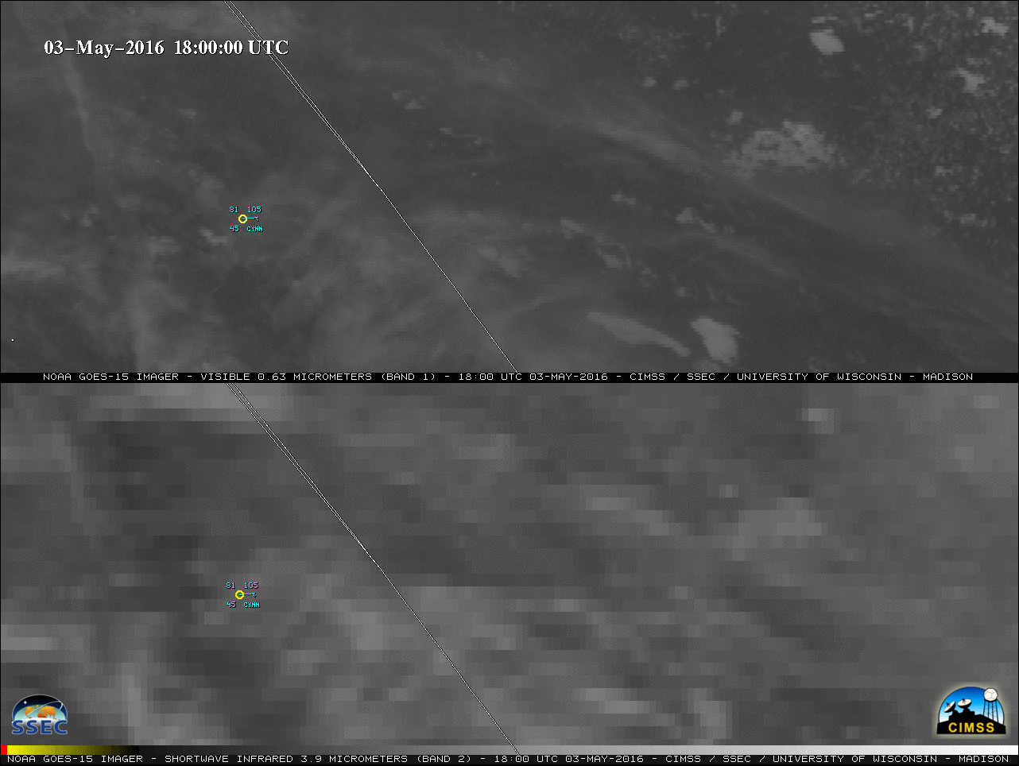
May 03, 2016 GOES-15
First Pyro cumulonimbus
Fort McMurray Wildfire
http://pyrocb.ssec.wisc.edu/wp-content/uploads/2016/05/160502_goes15_visible_shortwaveIR_CYMM_Fire_anim.gif

Slide 5
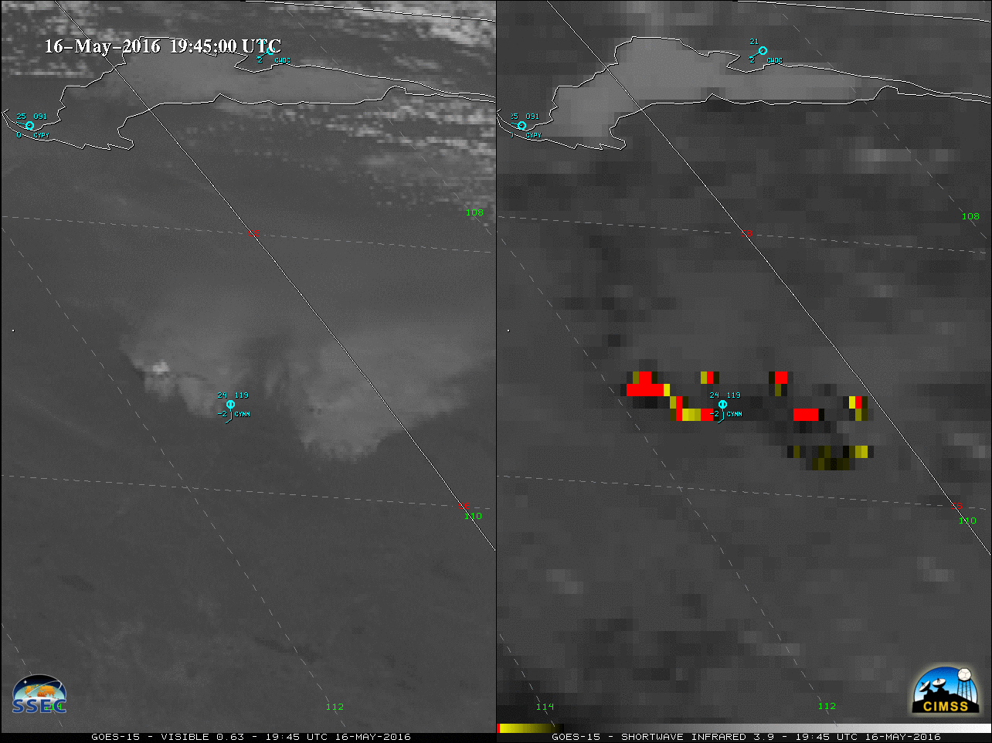
May 16, 2016 GOES-15

Slide 6
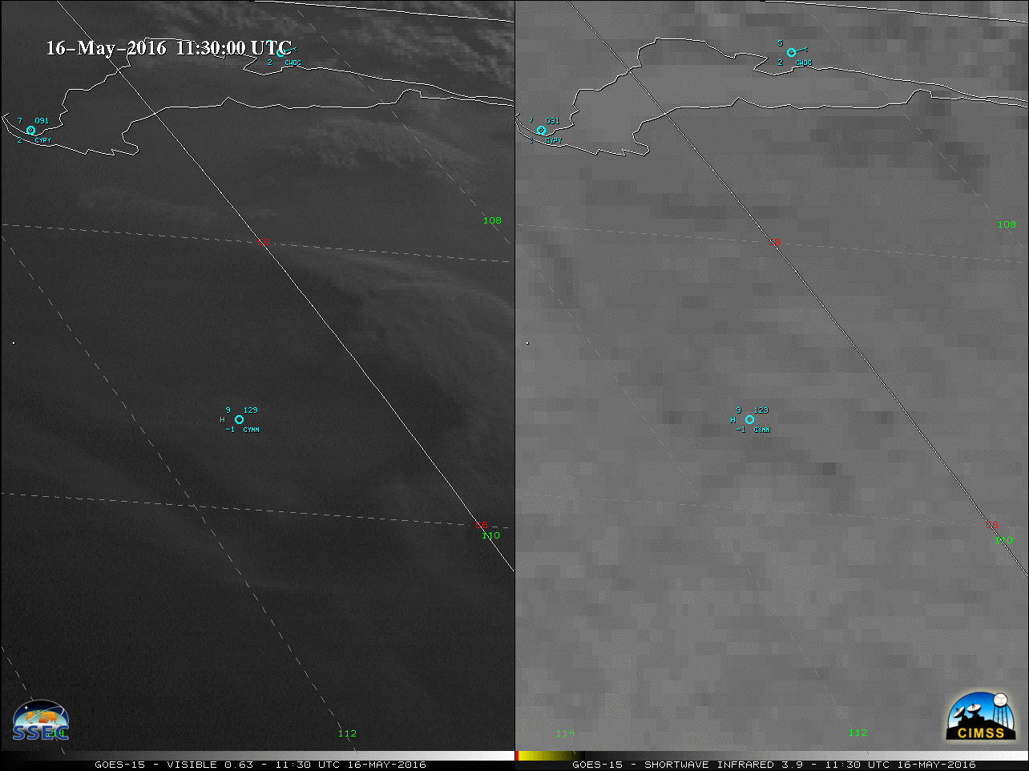
May 16, 2016 GOES-15 0.63 µm Visible (left) and 3.9 µm shortwave Infrared (right)
http://pyrocb.ssec.wisc.edu/wp-content/uploads/2016/05/160516_goes15_visible_shortwaveIR_YMM_fire_anim.gif

Slide 7
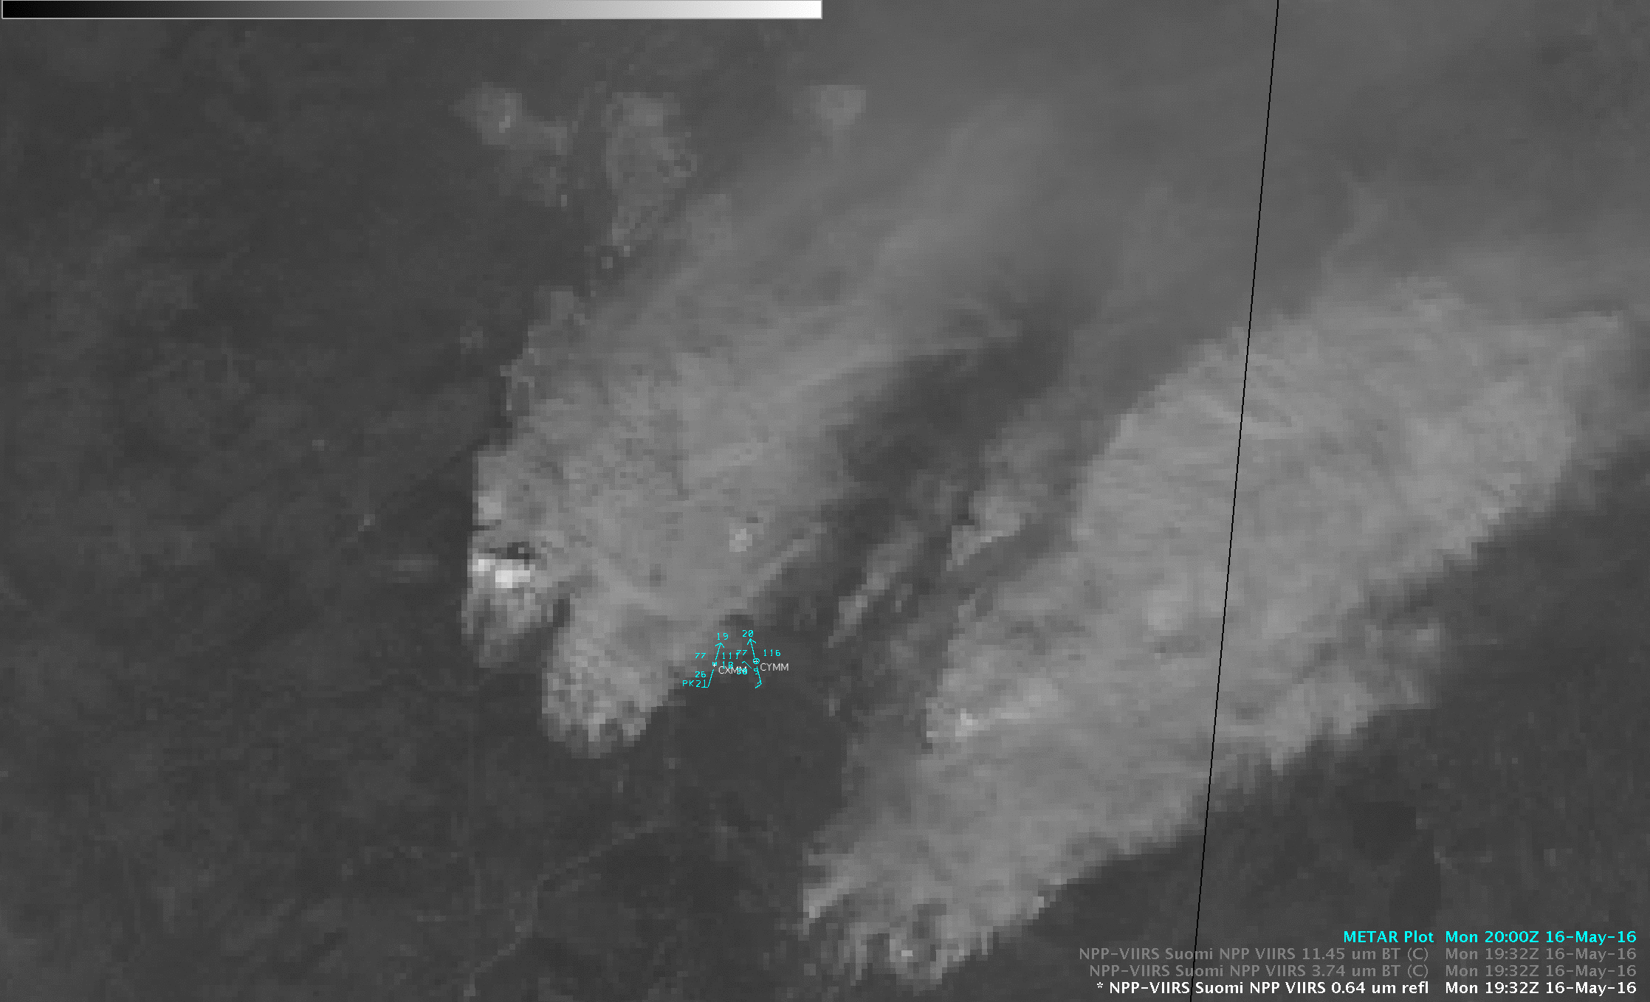

Slide 8
Goal: Provide low latency, web-based, high resolution forecasts of smoke dispersion for use by NWS Incident Meteorologists (IMET) to support on-site decision support services for fire incident management teams.
Project utilizes VIIRS AOD retrievals to initialize trajectory-based, high spatial resolution smoke dispersion forecasts.
Project is an extension of Infusion of satellite Data into Environmental Applications-International (IDEA-I) trajectory based aerosol forecast capabilities and will be tested and released within CSPP prior to transition to Operations at NESDIS.
Notes:
Robyn Heffernan
Chair, Fire Environment Committee
National Wildfire Coordinating Group (NWCG)

Slide 9
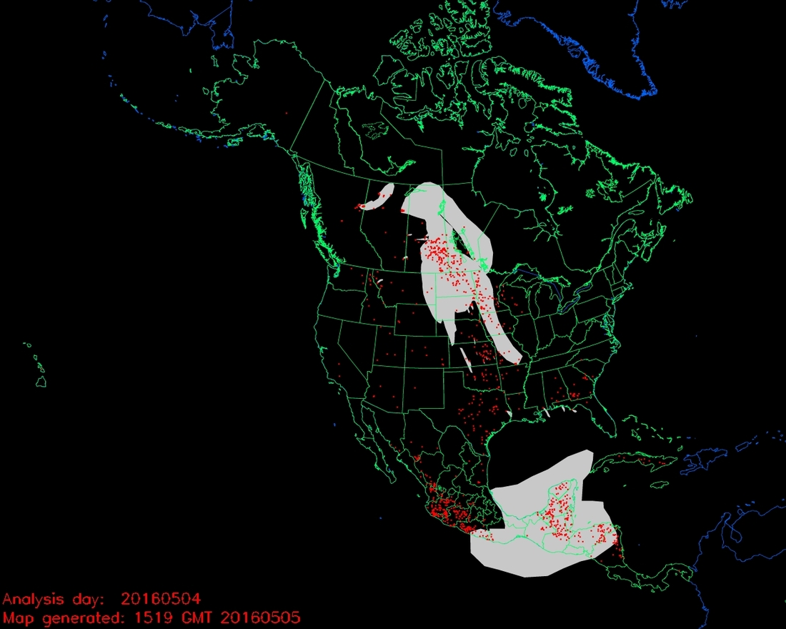
Fort McMurray Wildfire
Canadian Wildfires
May 04, 2016

Slide 10
Fort McMurray Wildfire
Canadian Wildfires
May 04, 2016

Slide 11
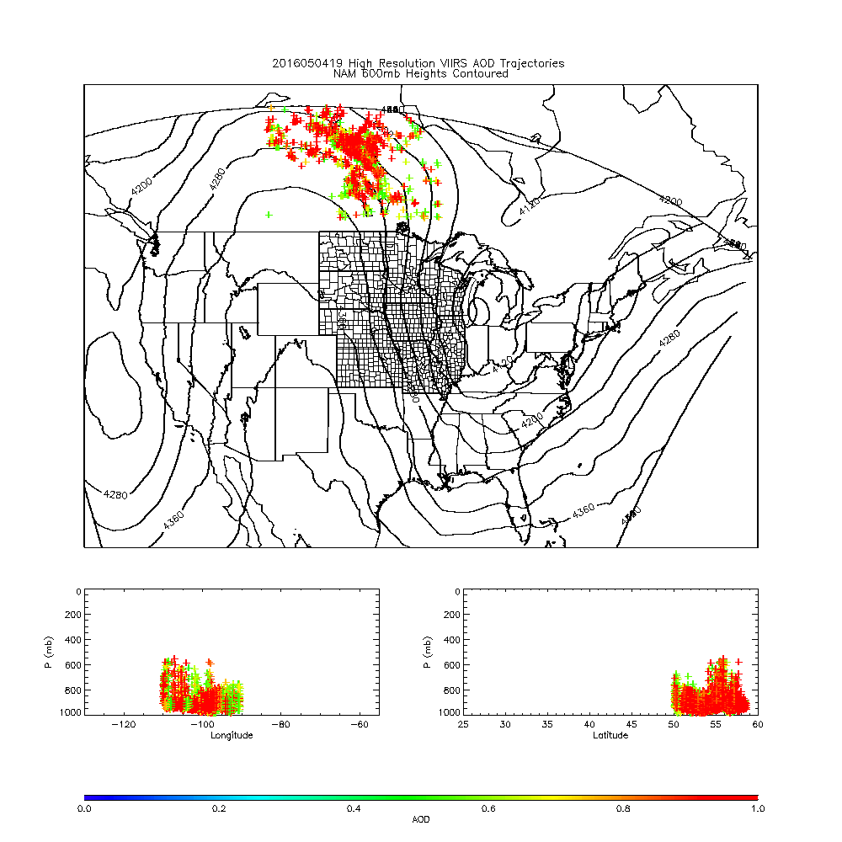
IDEA-I High resolution (NAM 3km) trajectory forecast
Fort McMurray Wildfire
May 04, 2016
IDEA-I high resolution trajectories initialized at each 6km VIIRS pixel (only AOD>0.5 initialized)
Upper panel shows NAM 600mb heights
Lower panels show longitude and latitude cross sections
IDEA-I high resolution trajectory forecast colored by initial AOD

Slide 12
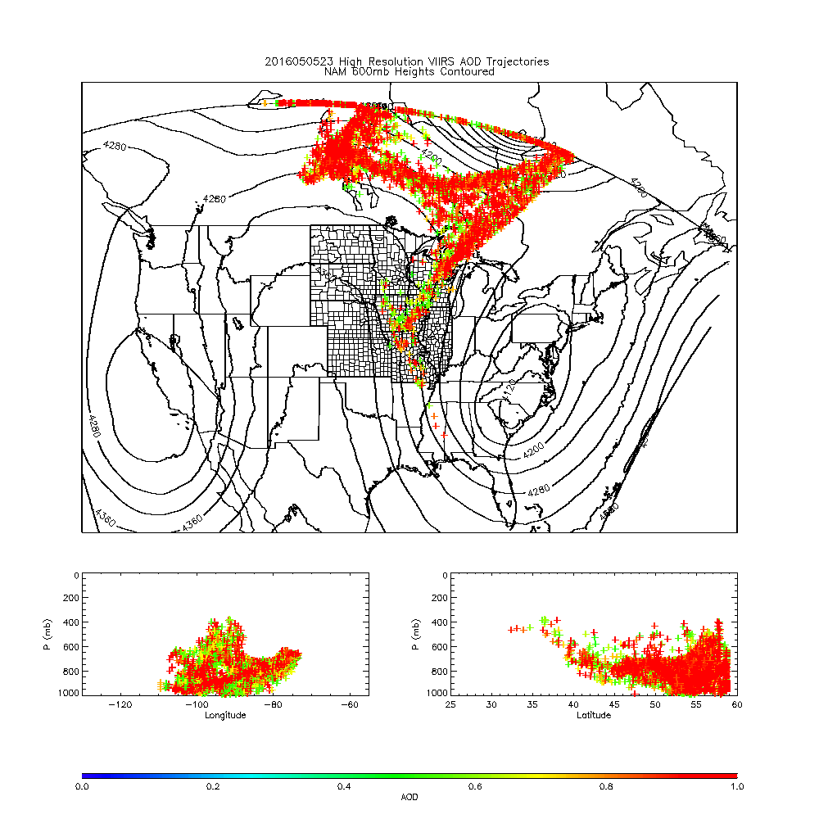
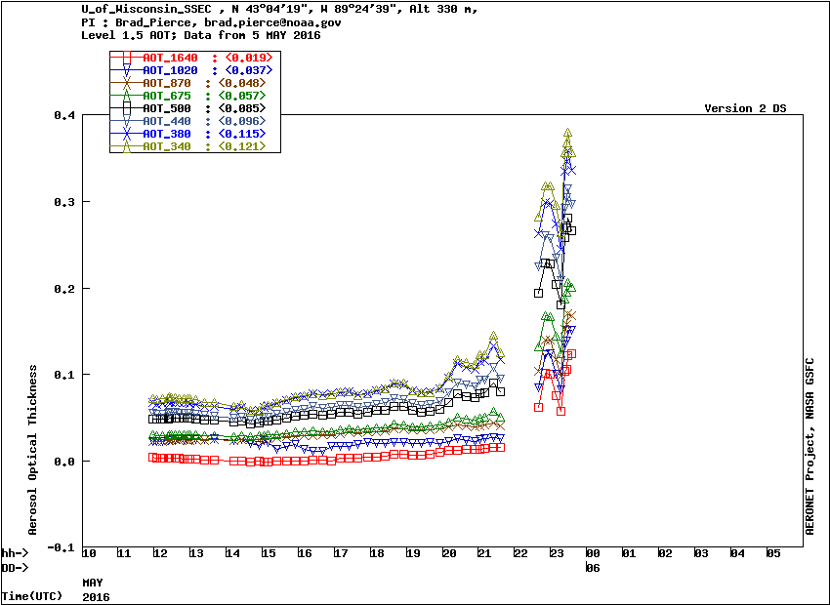
IDEA-I High resolution (NAM 3km) trajectory forecast
Fort McMurray Wildfire
23Z May 05, 2016
Madison, WI
May 05, 2016 AERONET AOD shows plume over Madison, WI at 23Z
IDEA-I high resolution trajectory forecast captures observed arrival very well and shows that the plume is aloft.

Slide 13
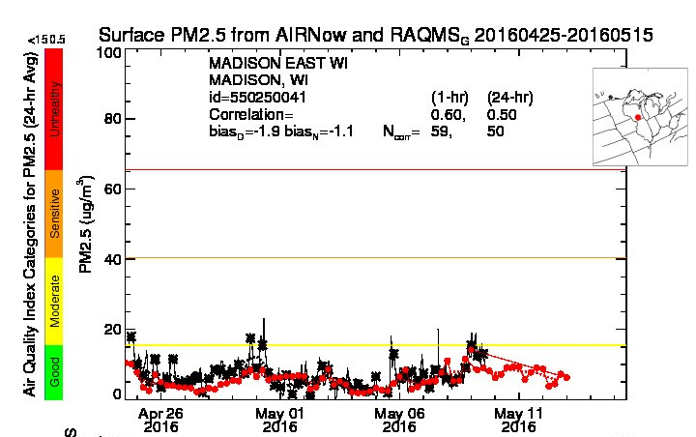
US EPA AIRNow Observed (black) and RAQMS (red) analyzed PM2.5
23Z May 05, 2016

Slide 14
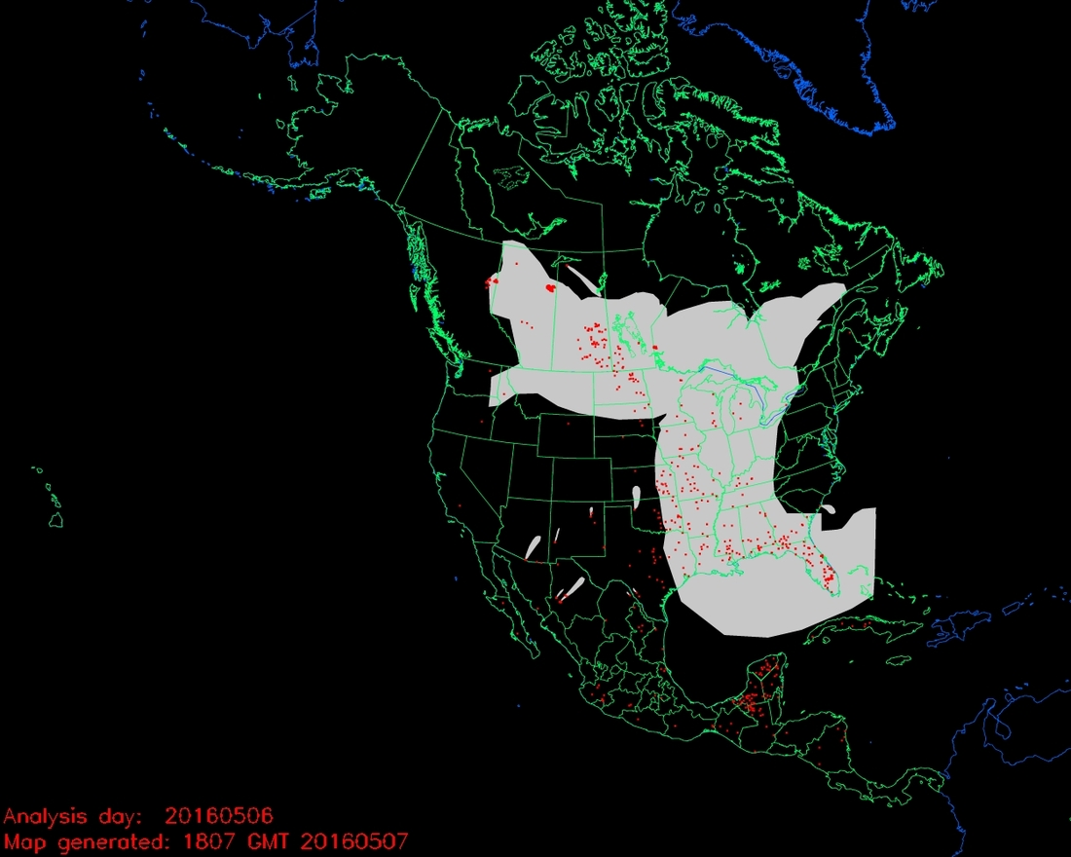
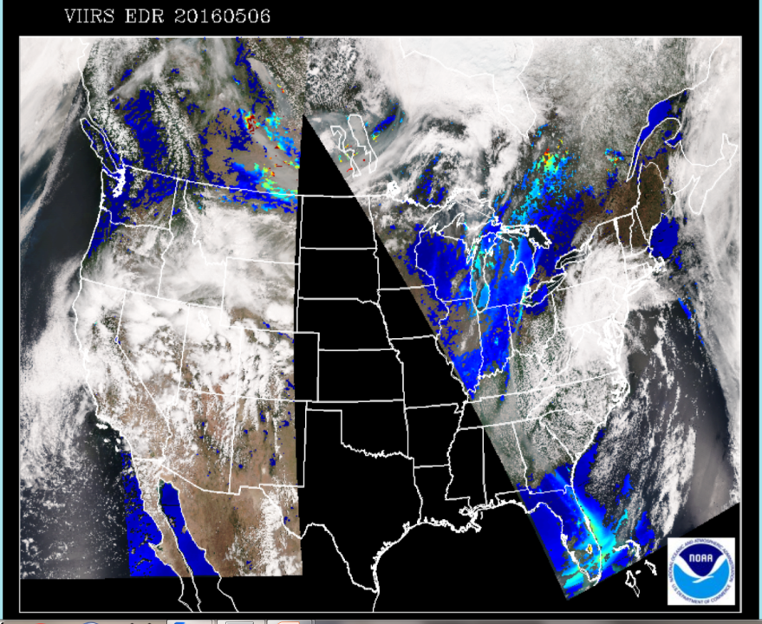
Canadian Wildfires
May 06, 2016

Slide 15
Fort McMurray Wildfire
Canadian Wildfires
May 06, 2016

Slide 16
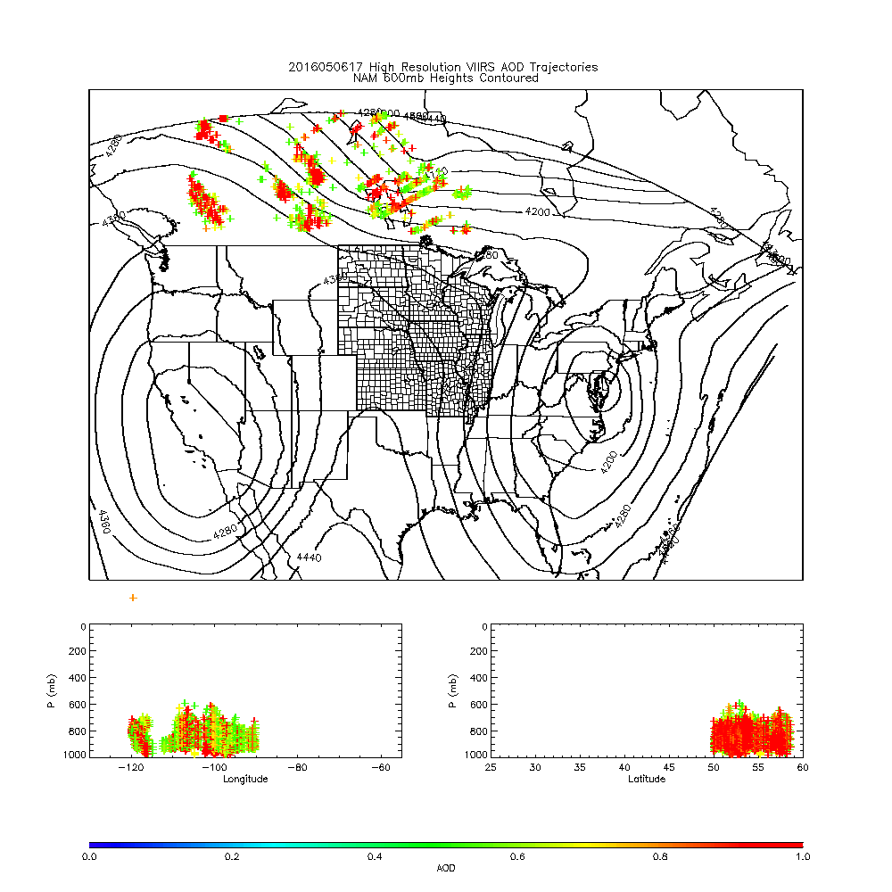

Slide 17
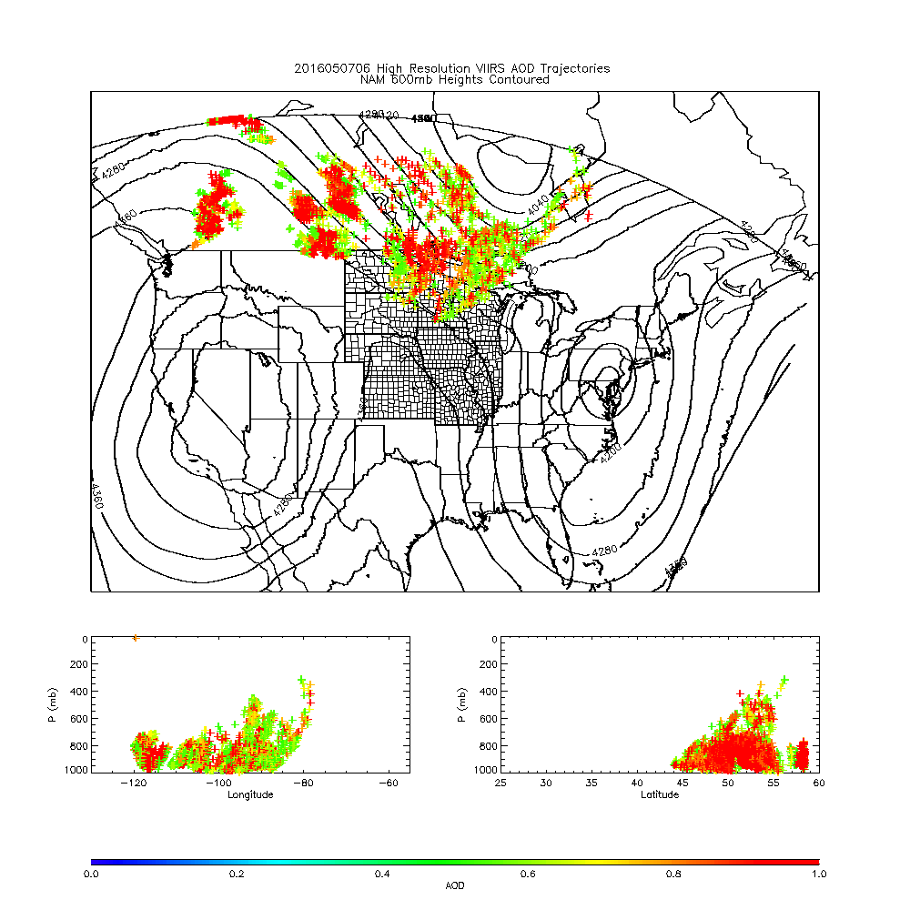
652 WWUS83 KMPX 070627 SPSMPX SPECIAL WEATHER STATEMENT NATIONAL WEATHER SERVICE TWIN CITIES/CHANHASSEN MN 127 AM CDT SAT MAY 7 2016 MNZ042>045-049>053-058>063-066>070-075>078-071100- TODD-MORRISON-MILLE LACS-KANABEC-STEARNS-BENTON-SHERBURNE-ISANTI- CHISAGO-MEEKER-WRIGHT-HENNEPIN-ANOKA-RAMSEY-WASHINGTON-MCLEOD- SIBLEY-CARVER-SCOTT-DAKOTA-NICOLLET-LE SUEUR-RICE-GOODHUE- INCLUDING THE CITIES OF...LONG PRAIRIE...LITTLE FALLS... PRINCETON...MORA...ST CLOUD...FOLEY...ELK RIVER...CAMBRIDGE... CENTER CITY...LITCHFIELD...MONTICELLO...MINNEAPOLIS...BLAINE... ST PAUL...STILLWATER...HUTCHINSON...GAYLORD...CHASKA...SHAKOPEE... HASTINGS...ST PETER...LE SUEUR...FARIBAULT...RED WING 127 AM CDT SAT MAY 7 2016 ...SMOKY CONDITIONS TO PERSIST THROUGH THE OVERNIGHT HOURS... WIDESPREAD SMOKE FROM BOTH THE LARGE CANADIAN WILDFIRES AND A SMALLER WILDFIRE NEAR LAKE HATTIE IN HUBBARD COUNTY MINNESOTA HAS BLOWN INTO CENTRAL MINNESOTA...PARTICULARLY WITHIN AND NEAR THE TWIN CITIES METROPOLITAN AREA...DUE TO STRONG WINDS FROM THE NORTHWEST. VISIBILITIES HAVE BEEN REDUCED TO BETWEEN 1 AND 3 MILES...AND AIR QUALITY HAS BEEN SIGNIFICANTLY IMPACTED. THE SMOKE WILL LIKELY LAST THROUGH THE OVERNIGHT HOURS. LIMIT OUTDOOR ACTIVITIES TO PREVENT INHALING THE POOR QUALITY AIR. KEEP WINDOWS CLOSED TO LIMIT INTAKE INTO HOMES AND BUSINESSES.
From Andy Edman/NWS

Slide 18
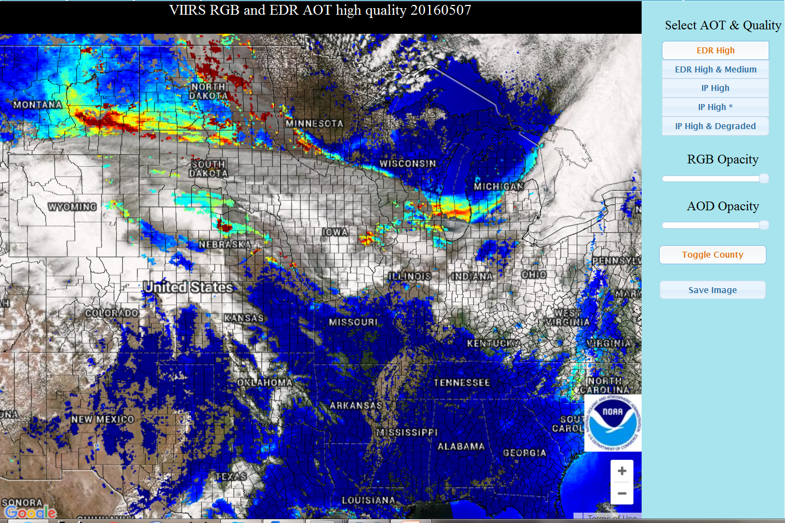
May 07, 2016
http://www.star.nesdis.noaa.gov/smcd/spb/aq/expr/expr2/

Slide 19
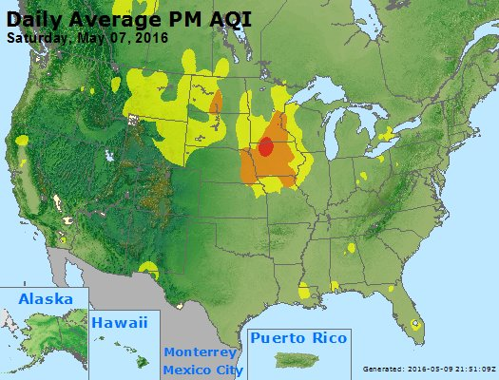
https://www.airnow.gov/

Slide 20
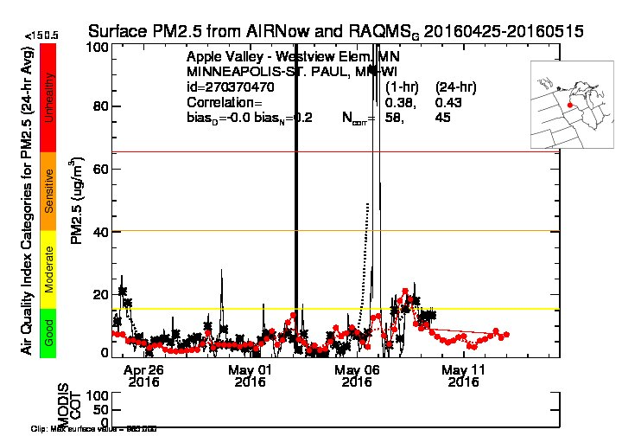
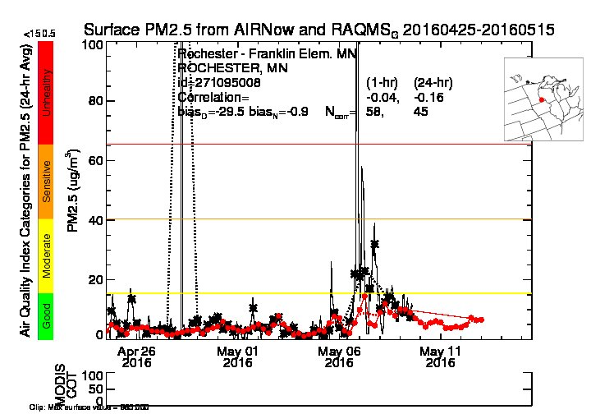
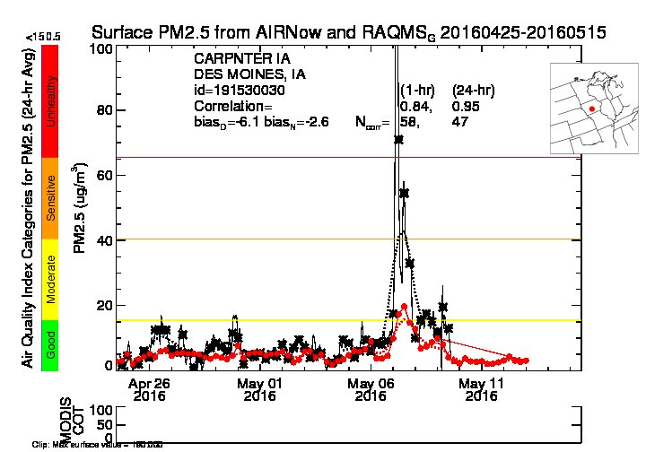
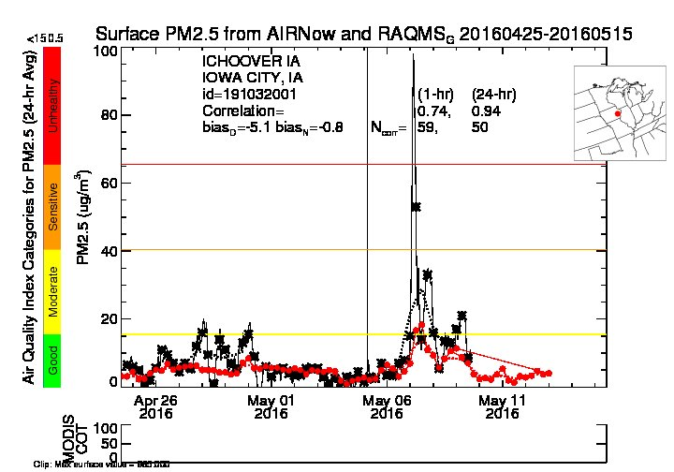
US EPA AIRNow Observed (black) and RAQMS (red) analyzed PM2.5
12Z May 07, 2016
12Z May 07, 2016
12Z May 07, 2016
12Z May 07, 2016

Slide 21
Enhanced IDEA (eIDEA) VIIRS Aerosol Optical Depth Analyses/Forecasts:
http://www.star.nesdis.noaa.gov/smcd/spb/aq/expr/expr2/
SSEC RealEarth Satellite Visualization:
https://realearth.ssec.wisc.edu/
GOES-14 SRSOR:
http://cimss.ssec.wisc.edu/goes/srsor2016/GOES-14_SRSOR.html
SSEC PyroCb Satellite Blog:
http://pyrocb.ssec.wisc.edu/archives/1572

