Slide 1
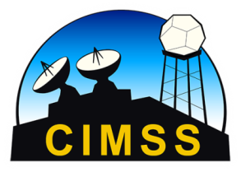
Welcome to Madison
17 November 2012
17 November 2012
14 February 2009
March 2017
Notes:
1

Slide 2
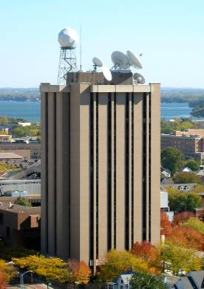
SSEC/CIMSS/ASPB/AOS
AOS
SSEC
Other UW Units
CIMSS
NOAA
ASPB
NCEI
UW-Madison Space Science and Engineering Center (SSEC)
UW-Madison Cooperative Institute for Meteorological Satellite Studies (CIMSS)
NESDIS/STAR Advanced Satellite Products Branch (ASPB)
NESDIS National Centers for Environmental Information (NCEI)
UW-Madison Atmospheric and Oceanic Sciences (AOS)
Symbiotic relationship between CIMSS, SSEC, and AOS
Notes:
The relationship between entities in the building.

Slide 3
Space Science and Engineering Center (SSEC)

Slide 4
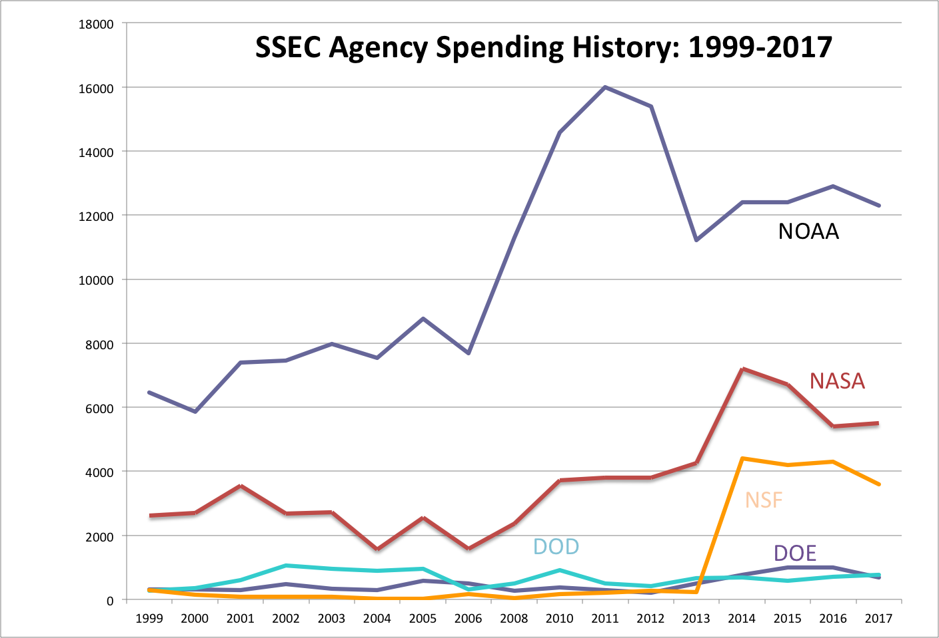
Finances
$10.3M through CA
Notes:
I should show this as how the funding for PIs has leaned more on NOAA, likely because of GOES-R and NPP/JPSS algorithm development. Thus, with impending cuts in those programs we may have some resource issues in the future. We are working to divest through more NASA ROSES proposals.

Slide 5
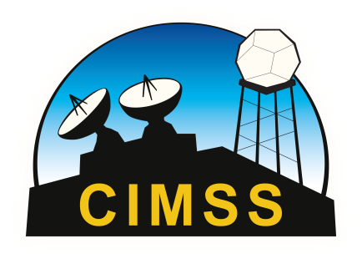
End-to-end satellite, modeling and data assimilation capabilities at SSEC
SSEC and CIMSS scientists collaborate with our federal, university and international colleagues to conduct end-to-end research, designing instruments, calibrating radiances, developing algorithms, products, and data assimilation techniques that are transitioned from research to operational use by NOAA and other international weather agencies.

Slide 6
End-to-end satellite, modeling and data assimilation capabilities at SSEC
Instrument Design
Radiance Calibration
Algorithm Development
Model Development
Data Assimilation
(Impact Assessment)
Model Verification

Slide 7
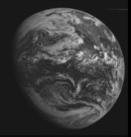
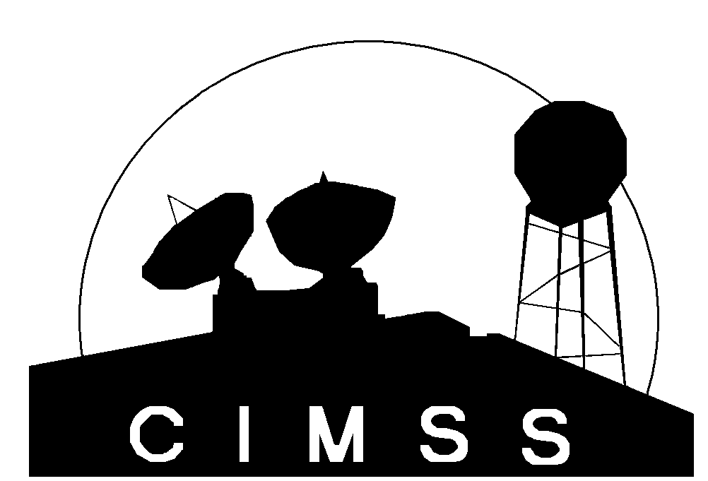
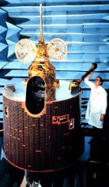
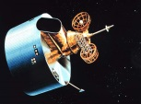
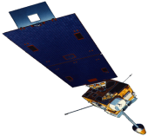
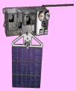
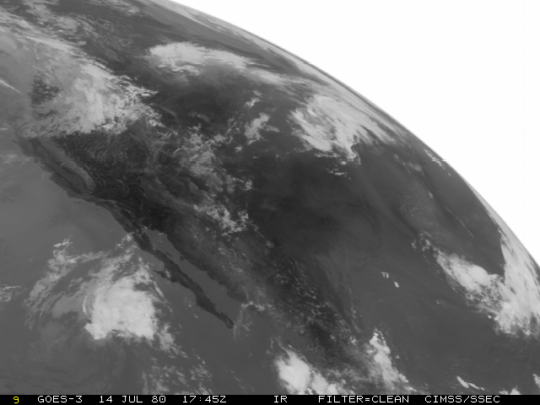
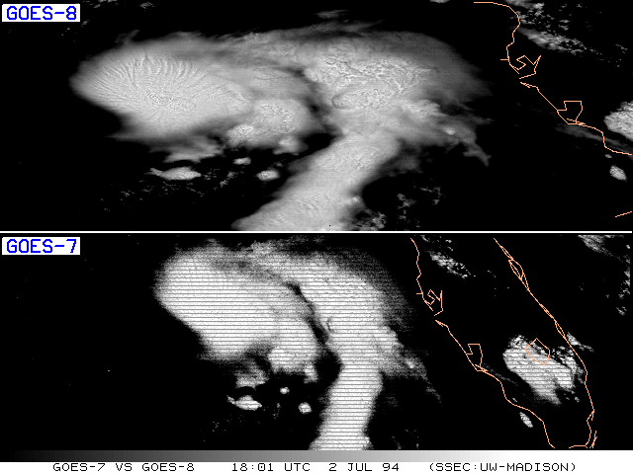
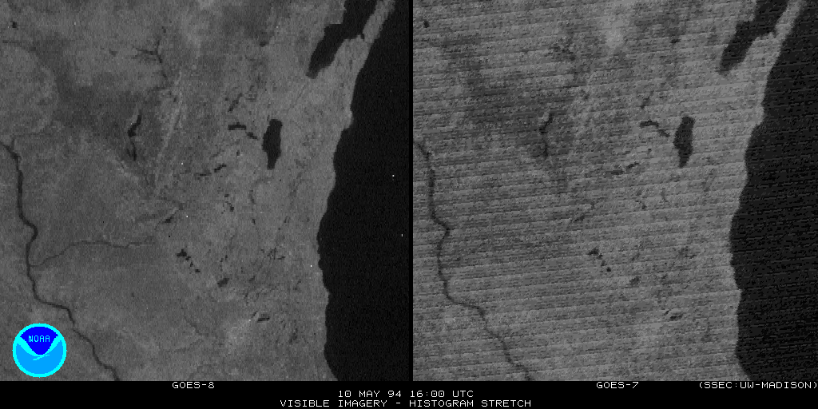
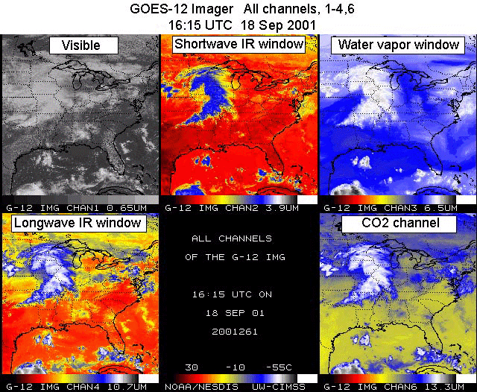
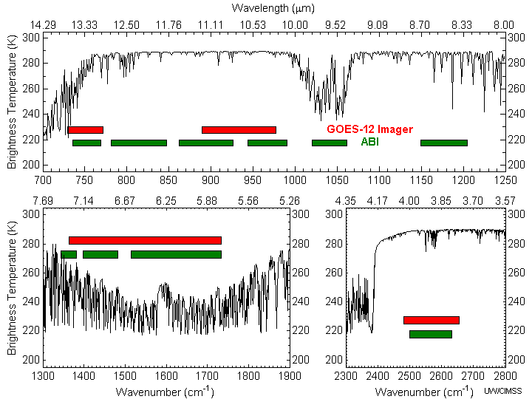
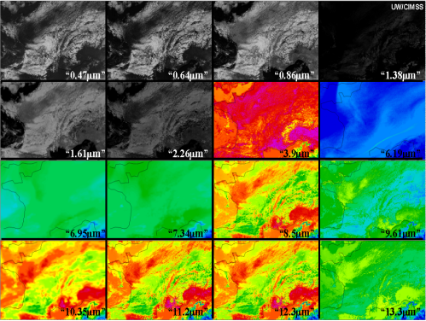
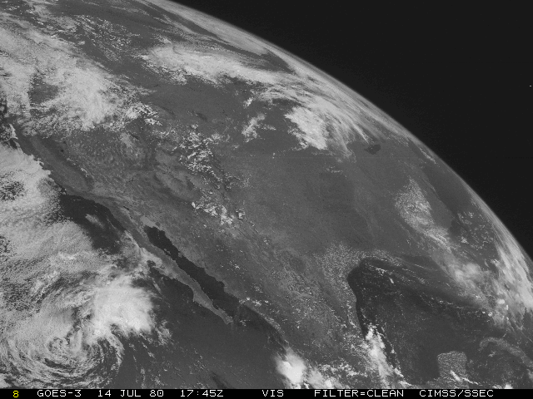
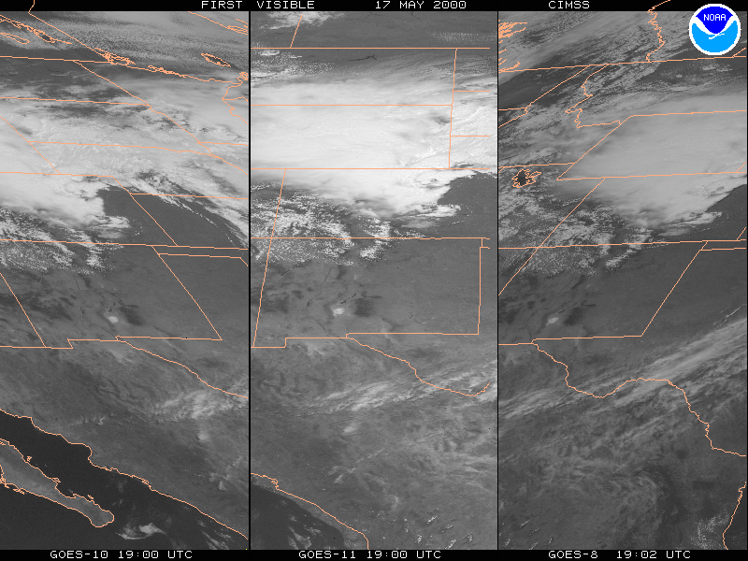
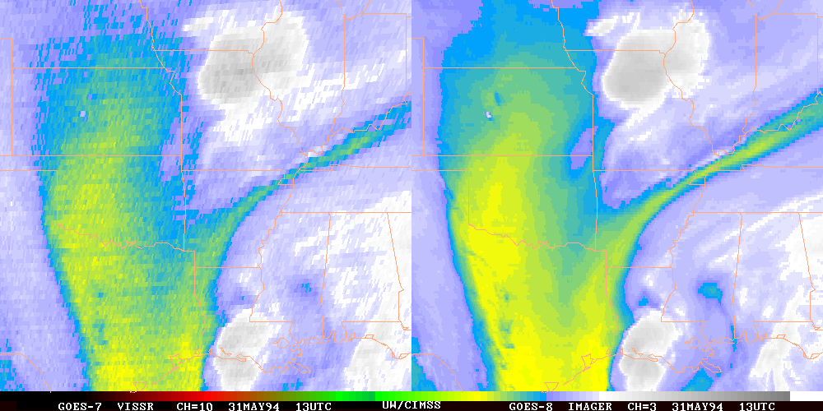
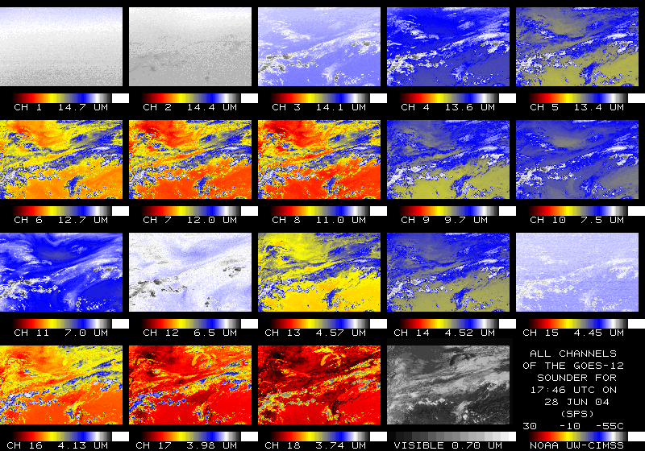
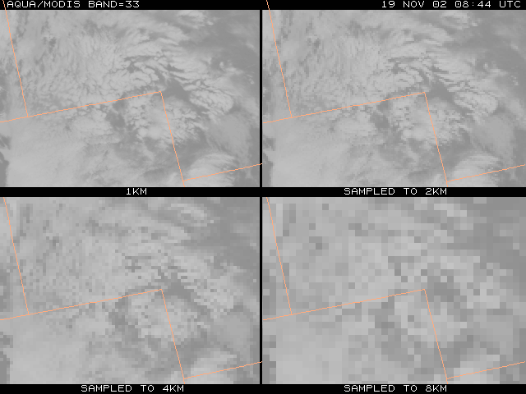
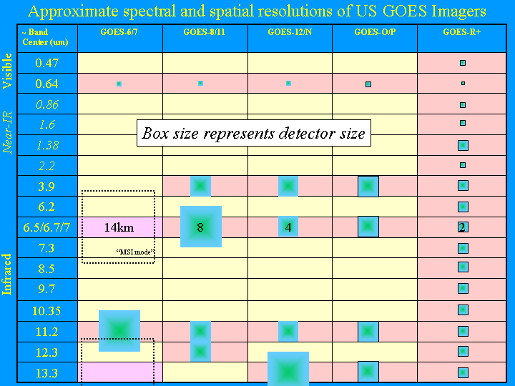
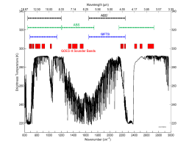
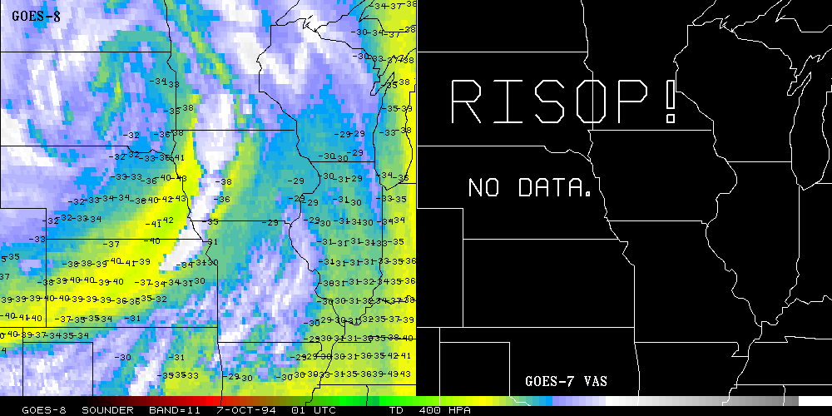
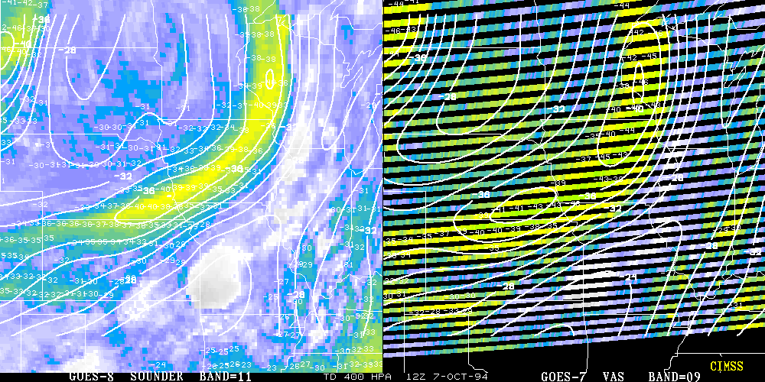
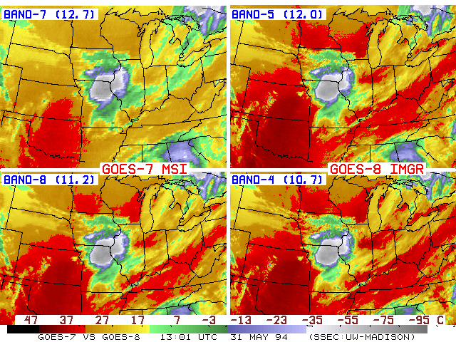
Over 50 Years of Geostationary Measurements -- from 1966 onwards
SSEC has been there for all of them
Timothy J. Schmit ¹, Gary S. Wade ¹, W. Paul Menzel ¹, Anthony J. Schreiner ², Jun Li ², Mat Gunshor ²
¹ NOAA/NESDIS/STAR Advanced Satellite Products Branch (ASPB) ² Cooperative Institute for Meteorological Satellite Studies (CIMSS) Madison, WI
UW-Madison
ATS - SMS - GOES
Launched
1966 ATS
1967
1974 SMS
1975
1975 GOES
1977
1978
Spin-stabilized satellite
Imager Bands
One VIS and one IRW
IR spatial resolution: 8 km
No Sounder
GOES-4/7
Launched
1980
1981
1983
1987
Imager - VISSR
Visible Infrared Spin Scan
Radiometer with VIS & 2 IR bands
Experimental Sounder – VAS
VISSR Atmospheric Sounder
12 IR bands (via filter wheel)
7 or 14 km (depending on
channel/mode)
GOES-8/12
Launched
1994
1995
1997
2000
2001
3-axis Stabilized
Imager with 1 VIS & 4 IR
4-8 km IR IGFOV
Operational Sounder
18 IR bands
10 km
GOES-13/15
Launched
2006
2009
2010
Better navigation/calibration
No eclipse outages
Imager
Same as GOES-12+
Better spatial resolutions for the 13.3 um band on GOES-O/P
Sounder -- Same as GOES-8+
GOES-16/17//T/U
Planned Launch
2016
2018
2020
2022
Many new/improved products
Faster coverage
Imager
16 bands
2 km for IR bands
GOES-3
1 km
2 km
4 km
“GOES-R”
8 km
0.625 cm
0.625 cm
HES’
-
1
Example 1
-
1
0.625cm
HES
1.25cm
2.5cm
Example 2
0.6 cm
-
1
-
1
0.6 cm
-
1
-
1
-
1
“GOES-O/P”
“GOES-M”
IR Spectral Coverage (DS or SW/M)
O
z
o
n
“Traditional Side of
C
e
H2O absorption”
O
5
For more information: http://www.ssec.wisc.edu/data/geo.html http://cimss.ssec.wisc.edu/goes/ http://cimss.ssec.wisc.edu/goes/abi http://cimss.ssec.wisc.edu/goes/hes http://www.earth.nasa.gov/history/goes/goes.html http://www.ssec.wisc.edu/datacenter/ http://osd.goes.noaa.gov/ http://cimss.ssec.wisc.edu/goes/calibration/

Slide 8
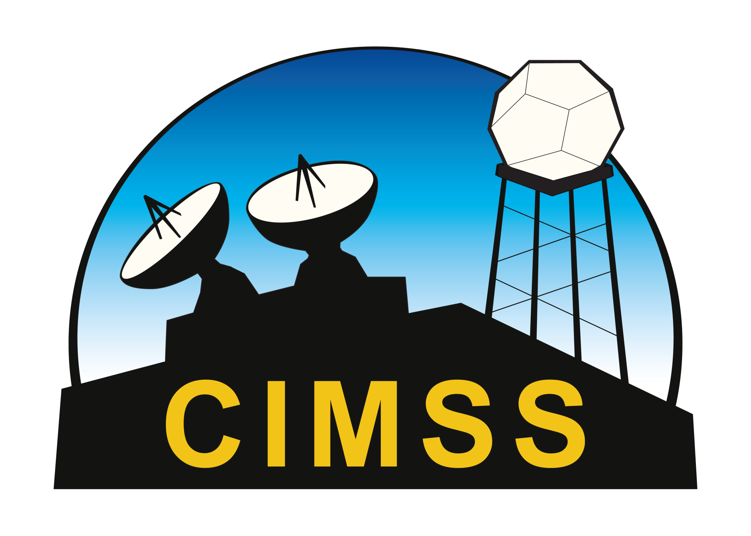
Cooperative Institute for Meteorological
Satellite Studies (CIMSS)

Slide 9
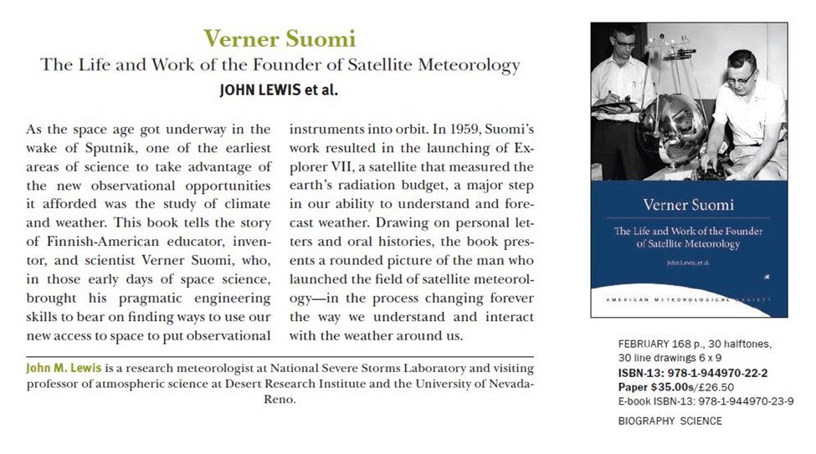
CIMSS Resides in the Home of
Satellite Meteorology

Slide 10
SSEC/CIMSS/ASPB/AOS
AOS
DOD
SSEC
Other UW Units
CIMSS
DOE
NOAA
NSF
ASPB
NCEI
NASA
Symbiotic relationship between CIMSS, SSEC, and AOS
Through its position in SSEC, CIMSS bridges to AOS and across campus and reaps the benefits of cross-agency research collaborations
Notes:
The relationship between entities in the building.

Slide 11
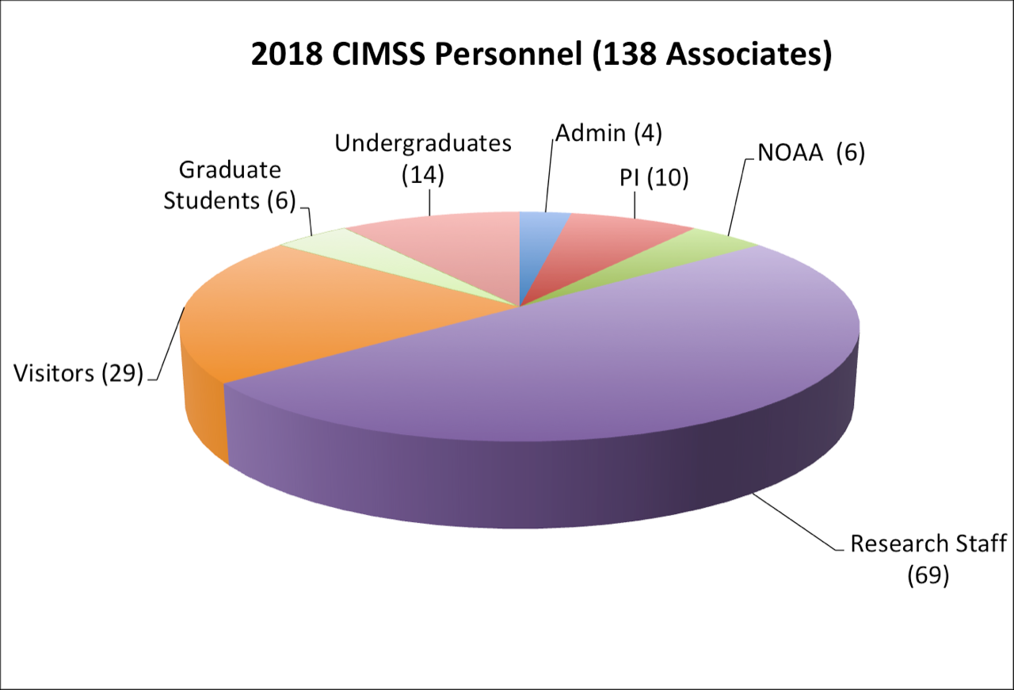
People

Slide 12
CIMSS Theme Areas
Satellite Meteorology Research and Applications
Satellite Sensors and Measurement Techniques
Environmental Models and Data Assimilation
Outreach and Education
To support weather analysis and forecasting through participation in NESDIS product assurance and risk reduction programs and the associated transitioning of research progress into NOAA operations.
To conduct instrument trade studies and sensor performance analysis supporting NOAA’s future satellite needs as well as assisting in the long term calibration and validation of remote sensing data and derived products.
To work with the Joint Center for Satellite Data Assimilation (JCSDA) on improving satellite data assimilation techniques in operational weather forecast models.
To engage the workforce of the future in understanding and using environmental satellite observations for the benefit of an informed society.

Slide 13
CIMSS Core Activities
Modeling
And Data
Assimilation
Future Sensors and Techniques
Advanced Data Products
Calibration and Validation
Outreach and Education
Research to Operations

Slide 14
Research & Development
NOAA collaborations with GOES and POES programs
Transitioning research to operations
Leader in hyperspectral observations
Strong involvement in new satellite missions
Instruments and Field Programs
SSEC Data Center
GIMPAP, GOES-16/17 ABI, GOES-17 data outage mitigation efforts, GRUPAP, Suomi-NPP CrIS and VIIRS performance evaluation, JPSS-2
More than half of NOAA’s GOES-R products are from CIMSS and we are developing and beta testing new operational products (e.g. ProbSevere; LES)
AIRS, CrIS, IASI, HIRAS, EUMETSAT MTG IRS, CMA FY4 GIIRS, AERI, SHIS
JPSS, TEMPO (EVI-1), TROPICS (EVI-3), PREFIRE (EVI-4), CLARREO
Rooftop, SPARC, lidar, microwave, AERI, SHIS
Vital for satellite checkout and applications development

Slide 15
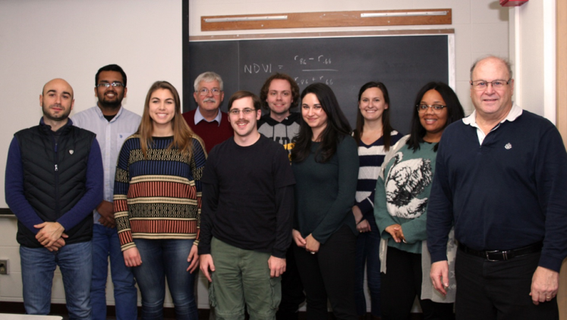
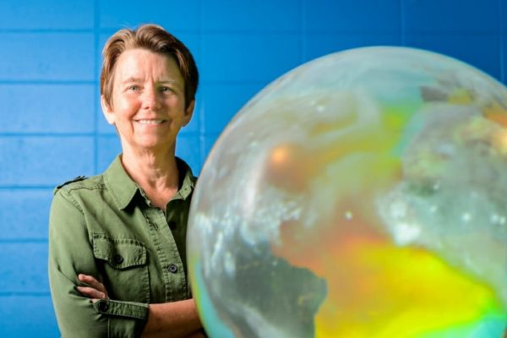
Outreach and Education
Leadership in professional training
Training graduate students
On-line instruction
Public outreach and K-12 education
Remote Sensing short courses, SHyMet, VISITView, CIMSS Satellite Blog
6 current graduate students (and growing)
Professional development, MOOC
Science on a Sphere, blogs, workshops, web site, Through the Atmosphere,
bi-weekly news items, …
Notes:
MOOC – Massive Open Online Courses

Slide 16
http://cimss.ssec.wisc.edu/smith-award/
Notes:
Goldenstern, Whicker, Chen, Bruno, and Ganguly have applied for Smith Scholarship
Will continue to accept paragraphs through the end of this week (Feb. 22)

Slide 17
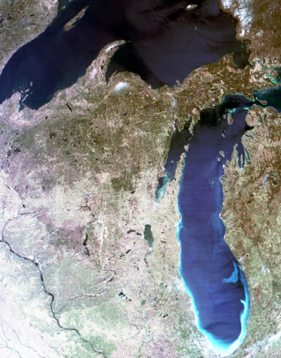
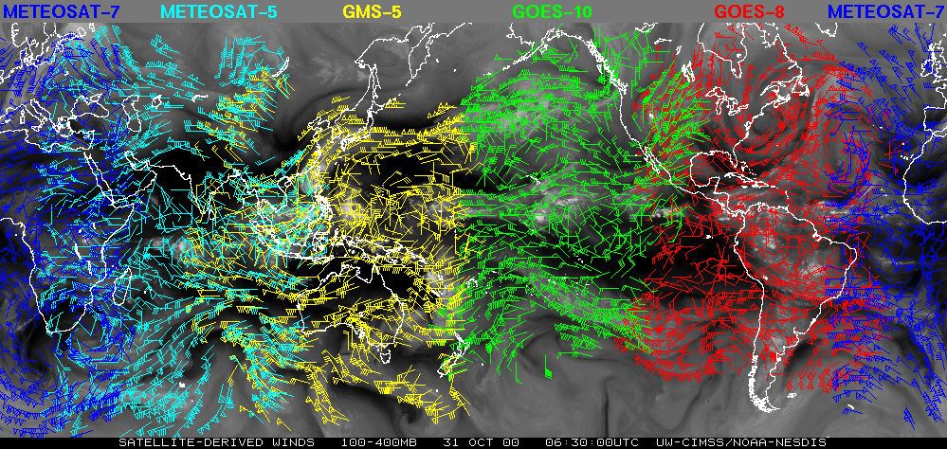
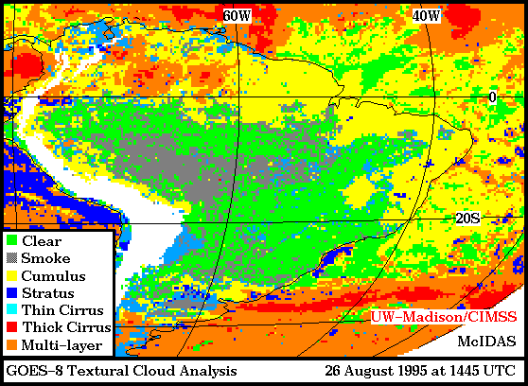
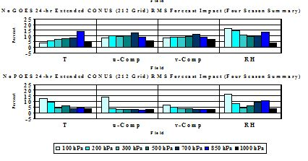
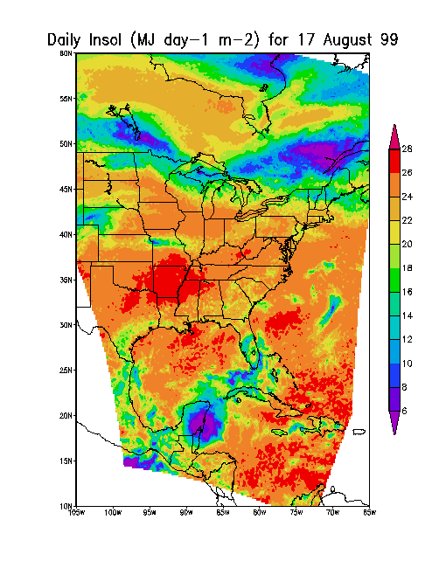
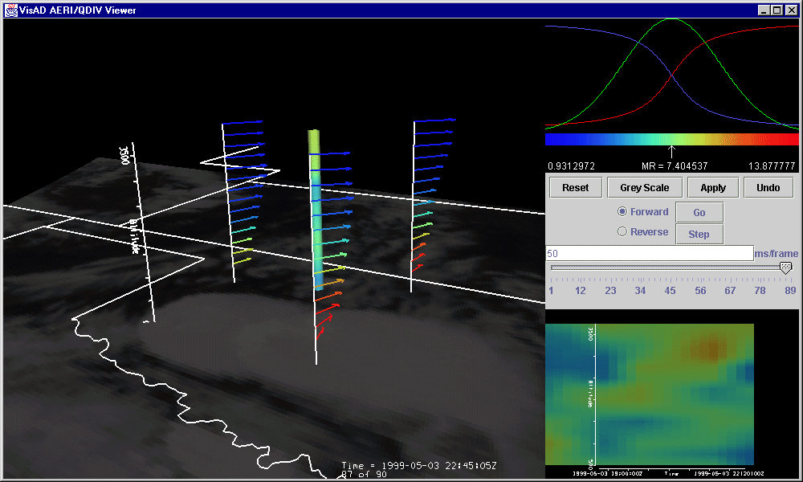
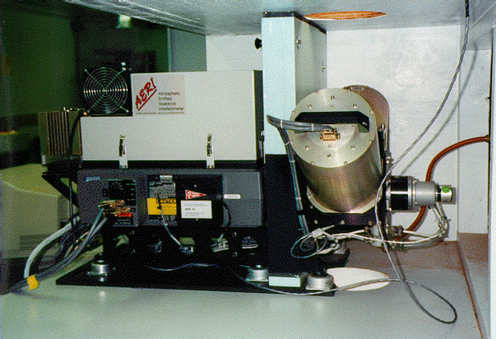
CIMSS Goal – Convert Data to Information to Knowledge to Action

Slide 18
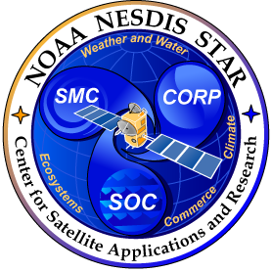
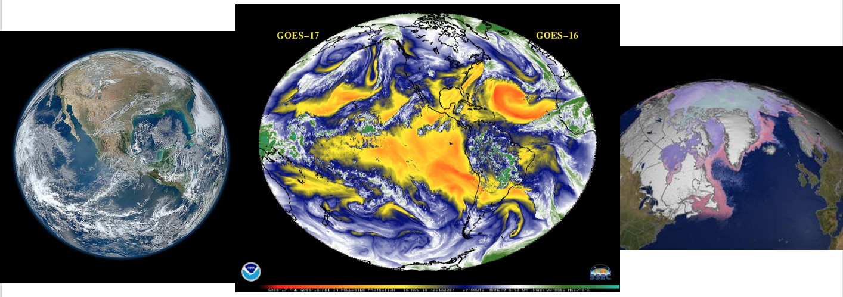
Advanced Satellite Products Branch
Center for Satellite Applications and Research (STAR)
NOAA/NESDIS
ASPB develops products from environmental satellites for short-term weather forecasting and monitoring of the earth-atmosphere system.
Notes:
GOES-17 and -16: http://cimss.ssec.wisc.edu/goes/blog/wp-content/uploads/2018/11/mollweide_ABI_band09.mp4

Slide 19
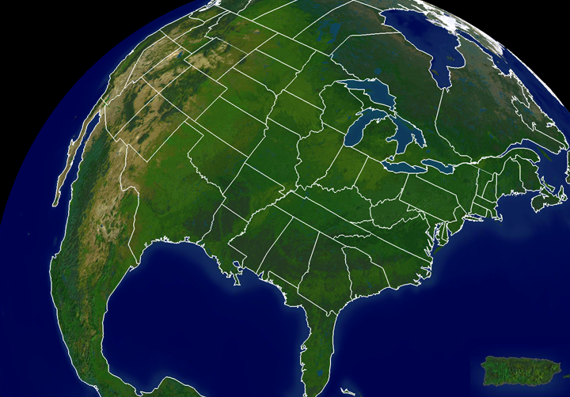
NESDIS Cooperative Research
CIRA-RAMMB
CIMSS-ASPB
CICS- SCSB
Hampton Univ
Bowie State
CREST
City College of NY
City Univ NY
Columbia Univ
Lehman College
Univ. Puerto Rico

Slide 20
ASPB: History
The name has changed, but federal NOAA employees have been in Madison since the mid 1970s.

Slide 21
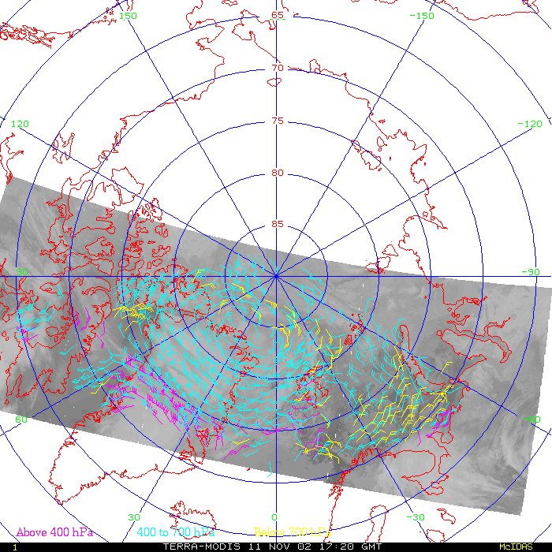
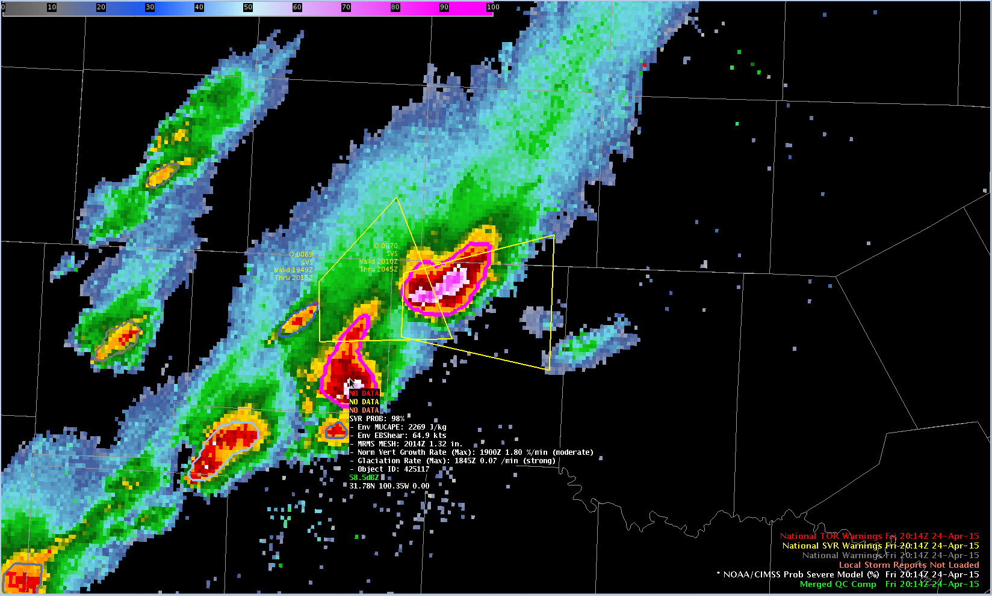
ASPB Priorities
Weather
GOES products: imagery, soundings, winds, fires, clouds, clear-sky brightness temperature, snow/ice, aviation
POES products: polar winds, global clouds, snow/ice, volcanic ash
Air quality modeling and data assimilation
Satellite data assimilation
Nearcasting
Instruments
Calibration
Inter-calibration
Sensor performance analysis
Validation
Instruments: GOES-R/S, JPSS; Tundra Orbit, etc.

Slide 22
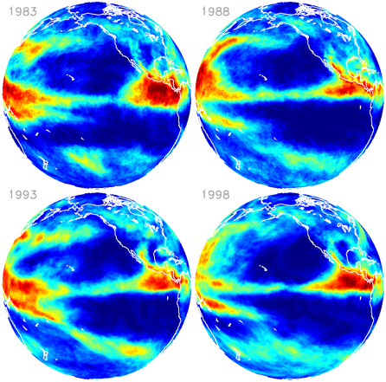
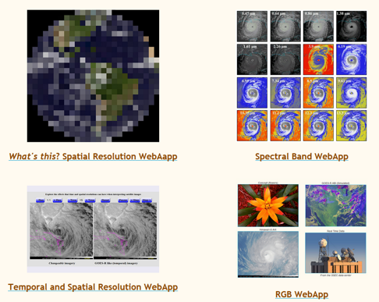
ASPB Priorities, cont.
Climate
Global cloud cover
Polar clouds, winds, snow and ice
Biomass burning
Feedbacks and interactions
Outreach and Service
Bringing new products into AWIPS
Training (e.g., VISITview, distance learning)
Proving Ground
Mentoring graduate and undergraduate students
International activities
Global Cryosphere Watch
GEO/GEOS, CEOS, CGMS, WMO, ESA, EUMETSAT
Notes:
Webapps: http://cimss.ssec.wisc.edu/education/goesr/webapps

