Slide 1
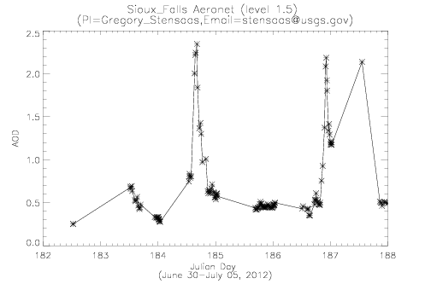
July 2nd
July 4th

Slide 2
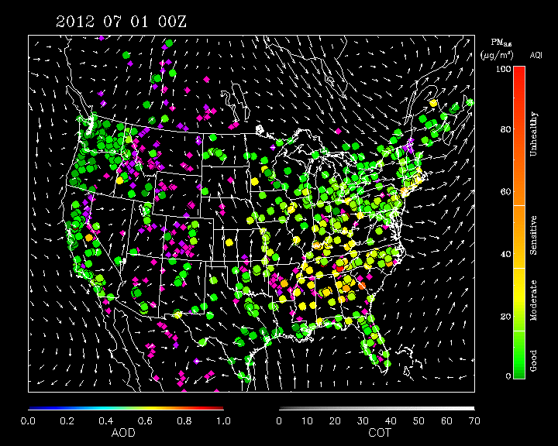
Sioux Falls, SD
Emmetsburg, IA
MODIS shows apparent rapid transport of high AOD from Western Dakotas to Sioux Falls between July 01 and July 02.
850mb winds suggest north-northeast transport from KS with some eastward transport from western Dakotas.
Emmetsburg, IA surface PM2.5 shows apparent significant impact.

Slide 3
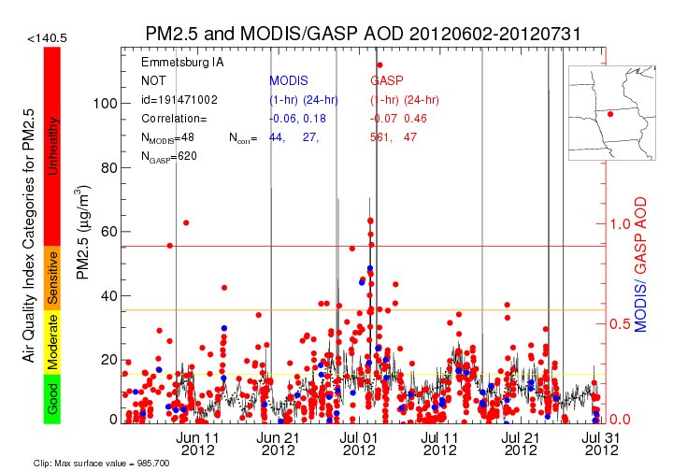

Slide 4
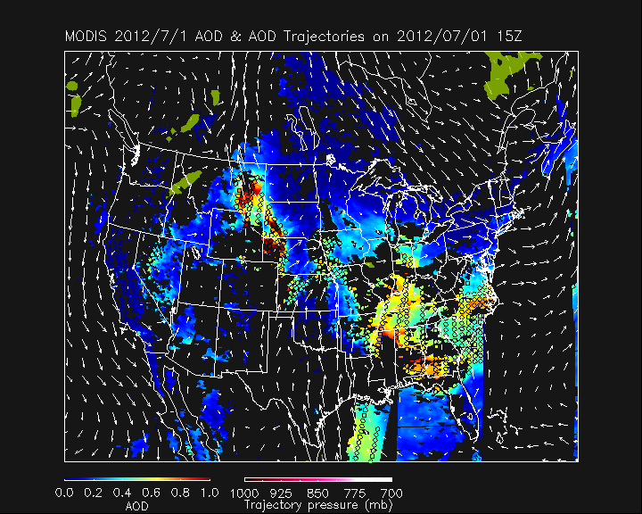
Sioux Falls, SD
Emmetsburg, IA
Trajectory forecast shows northeastward low level (red trajectories) transport from western KS to Sioux Falls, SD then continued transport into MN/WI. High AOD in Eastern MT is rapidly transported Eastward aloft (white trajectories).

Slide 5
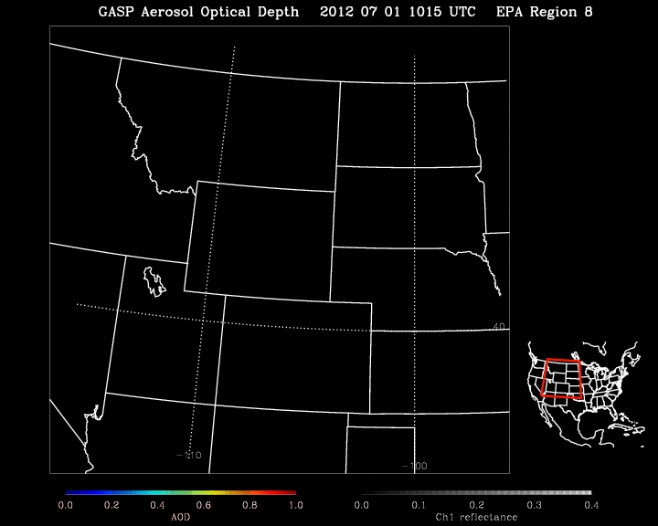
GOES GASP 07/01 AOD/COT shows line of evening convection that develops behind AOD maximum. GFS precipitation forecast (yellow in previous slide) may have underestimated the strength of this convection and it’s interaction with the aerosol transport.

Slide 6
GOES GASP 07/02 AOD/COT shows localized AOD maximum transported to the southeast to Sioux Falls, ND and then continuing southeast into IA.

Slide 7
Low level outflow from evening convection could have played a role in the rapid transport of boundary layer aerosols across SD and into IA where it impacted the surface PM2.5 measurements (transport not captured in GFS forecast due to underestimate in line of evening convection on 07/01)
Alternatively, aerosol loading over Sioux Falls, SD could be aloft and associated with upper level convective outflow from MT (as in trajectory forecast).

Slide 8
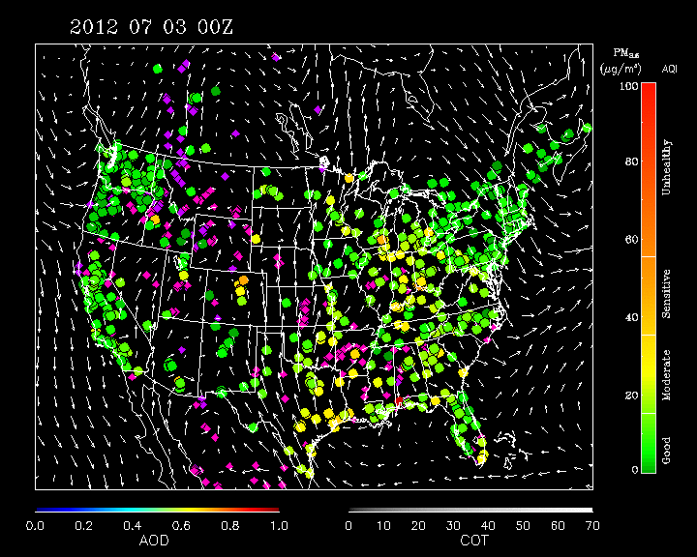
Sioux Falls, SD
MODIS shows apparent rapid development of high AOD plume to northwest of Sioux Falls, SD. No surface PM2.5 monitors in region to determine if the aerosols impact the surface. Note high PM2.5 measurements over SE US during the 4th of July Celebrations!

Slide 9
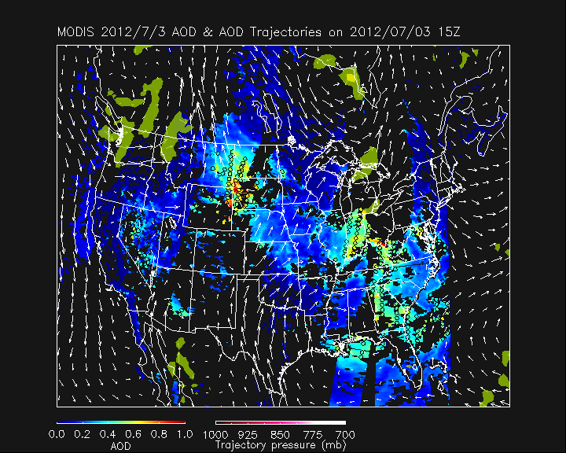
Sioux Falls, SD
Trajectory forecast shows northeastward upper level (white trajectories) transport from western Dakotas to towards Northern MN.

Slide 10
GOES GASP 07/03 AOD/COT shows evening convection developing to the north and south of enhanced AOD over central SD.

Slide 11
GOES GASP 07/04 AOD/COT shows AOD plume south of large cirrus anvil from overnight convection and east (ahead) of a line of continuing convection.

Slide 12
Upper level convergence of outflow from evening convection to the north and south of AOD enhancement on 07/03 could have played a role in the formation of a relatively thin AOD plume observed over SD on 07/04.
Look at high resolution (8km) WRF-CHEM forecasts initialized at 00Z with RAQMS aerosol analyses

Slide 13
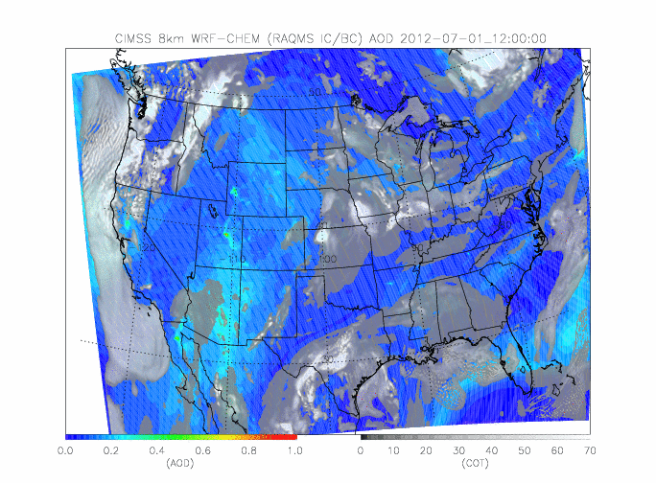
CIMSS 8km WRF-CHEM AOD/COT forecasts 12Z 07/01- 12Z 07/05
WRF-CHEM Initialized at 00Z each day using RAQMS 1x1 degree aerosol analysis and GFS 0.5x0.5 degree meteorological analysis. Image loop shows 12-36 hr FX (12Z to 12Z) each day.
Fires in UT/MT/WY all appear to contribute to predicted AOD enhancements over Central Plains

Slide 14
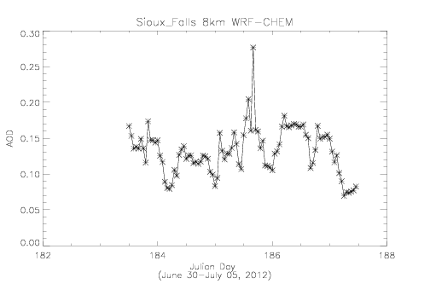
July 2nd
July 4th
WRF-CHEM
simulation doesn’t
capture observed enhancements.
Shows slight enhancement at Sioux Falls, SD one day after it was observed
Note change
in scale!

Slide 15
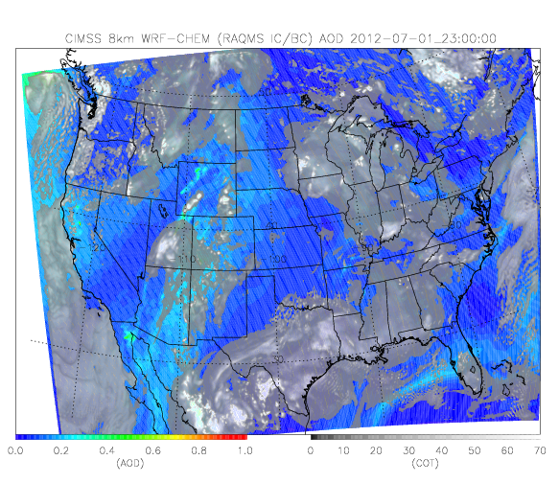
GASP vs WRF-CHEM for July 02 Episode at Sioux Falls, SD
8km WRF-CHEM simulation fails to predict convective line along MT/WY and ND/SD boarder at 23Z on July 01.
WRF-CHEM underestimates AOD over Central Plains compared to GASP

Slide 16
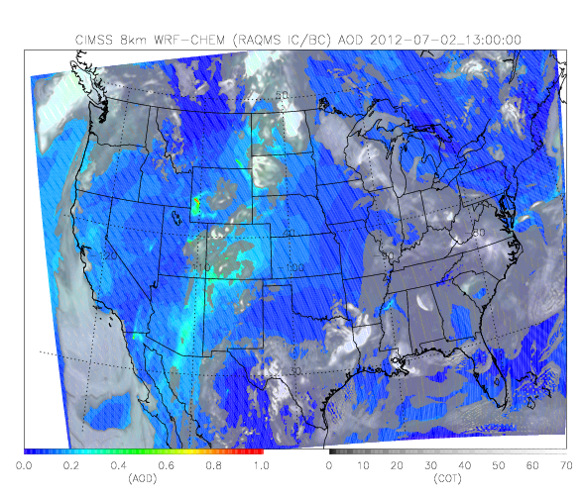
GASP vs WRF-CHEM for July 02 Episode at Sioux Falls, SD
Sioux Falls, SD
WRF-CHEM underestimates AOD west of Sioux Falls, SD compared to GASP. Note that the WRF-CHEM run was re-initialized with a new RAQMS aerosol analysis at 00Z on July 02.

Slide 17
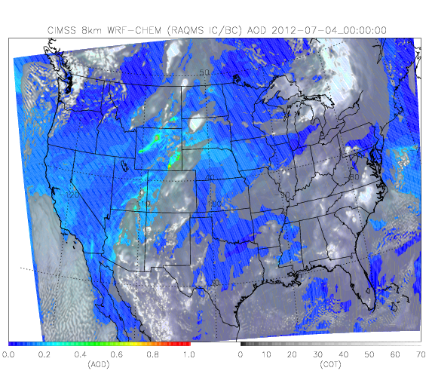
GASP vs WRF-CHEM for July 04 Episode at Sioux Falls, SD
8km WRF-CHEM simulation underestimates strength of convection over eastern MT and shows deep convection over SD that is not observed at 23:45Z on July 04.

Slide 18
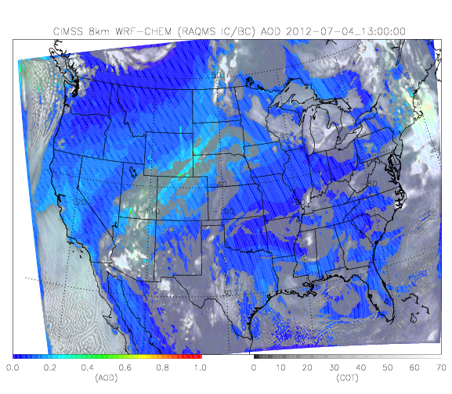
GASP vs WRF-CHEM for July 04 Episode at Sioux Falls, SD
Sioux Falls, SD
Cloud shield associated with remnant MCS over ND/MN boarder significantly underestimated by WRF-CHEM. Synoptic scale aerosol transport is reasonable, but AOD magnitude is underestimated. WRF shows cloud feature to north east of Sioux Falls, SD that is similar to GASP aerosol plume.

