Slide 1
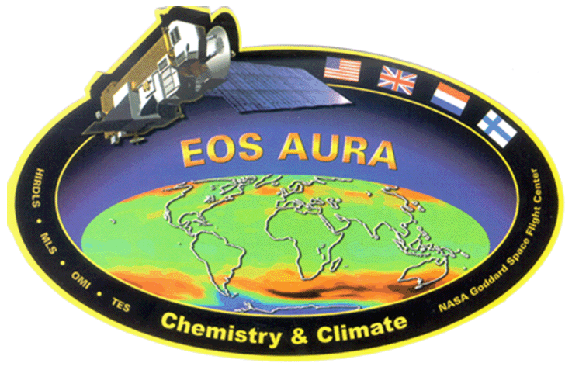
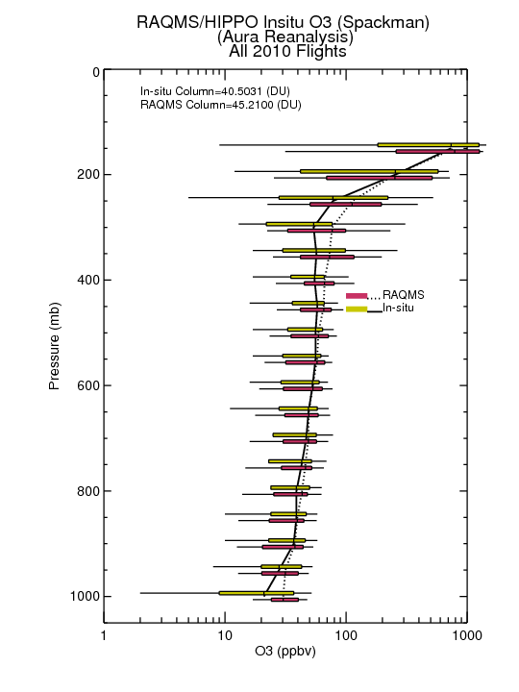
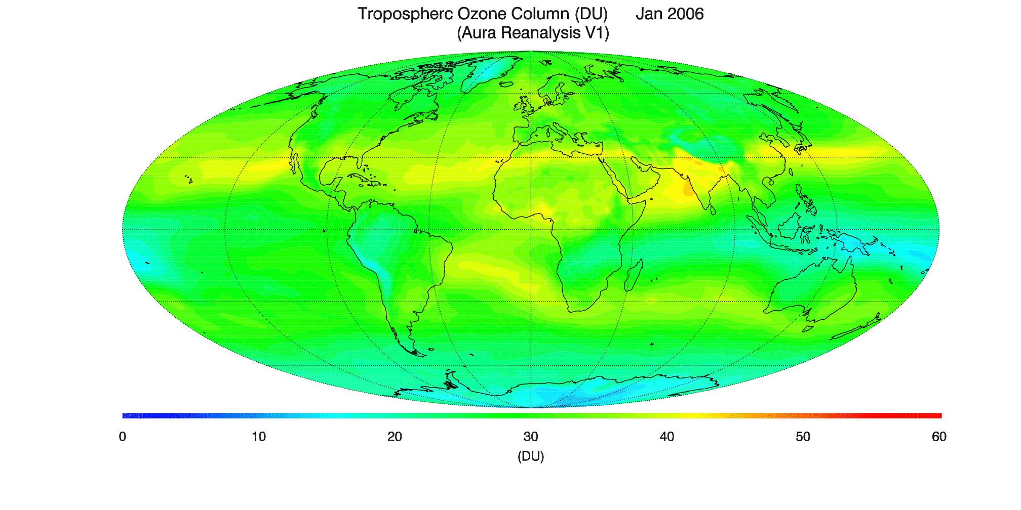
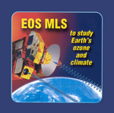
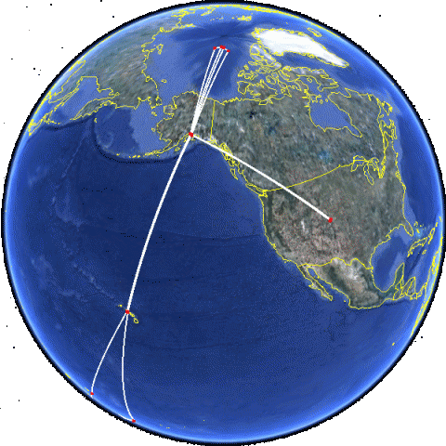
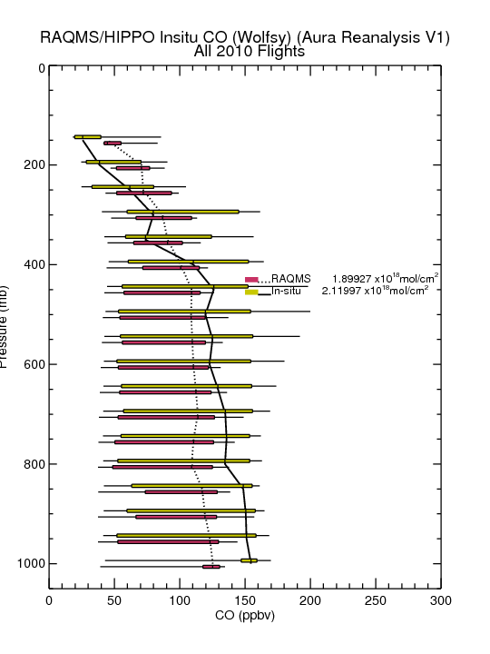
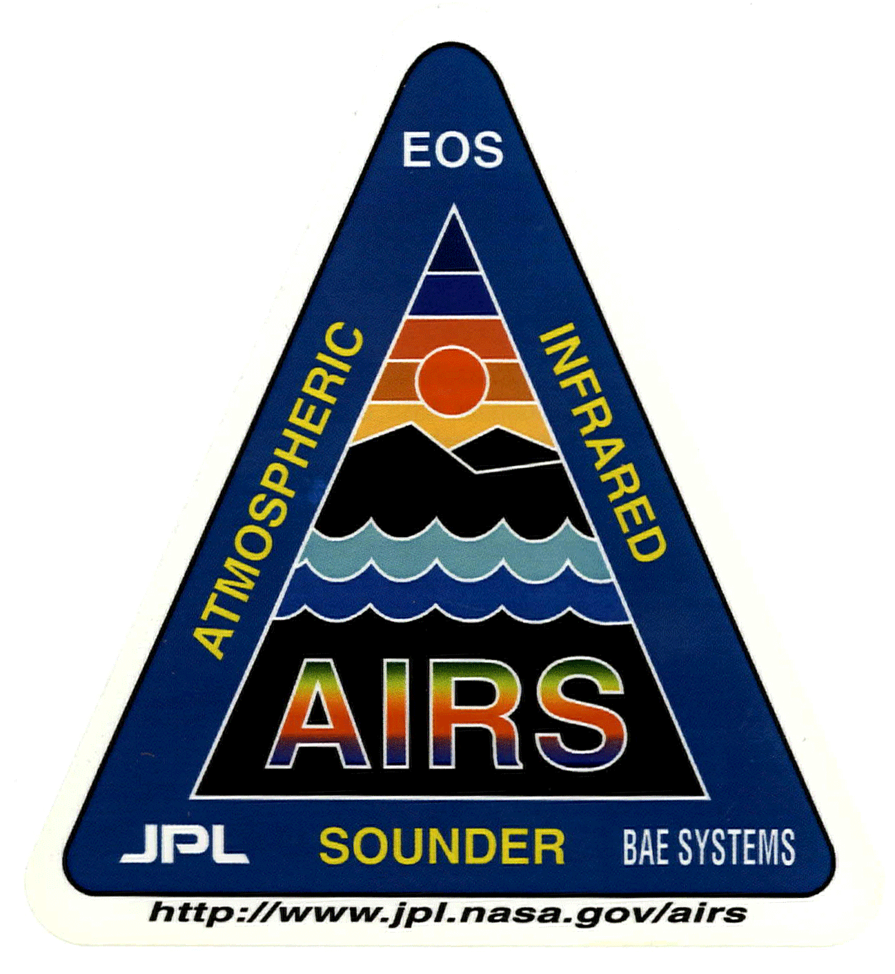
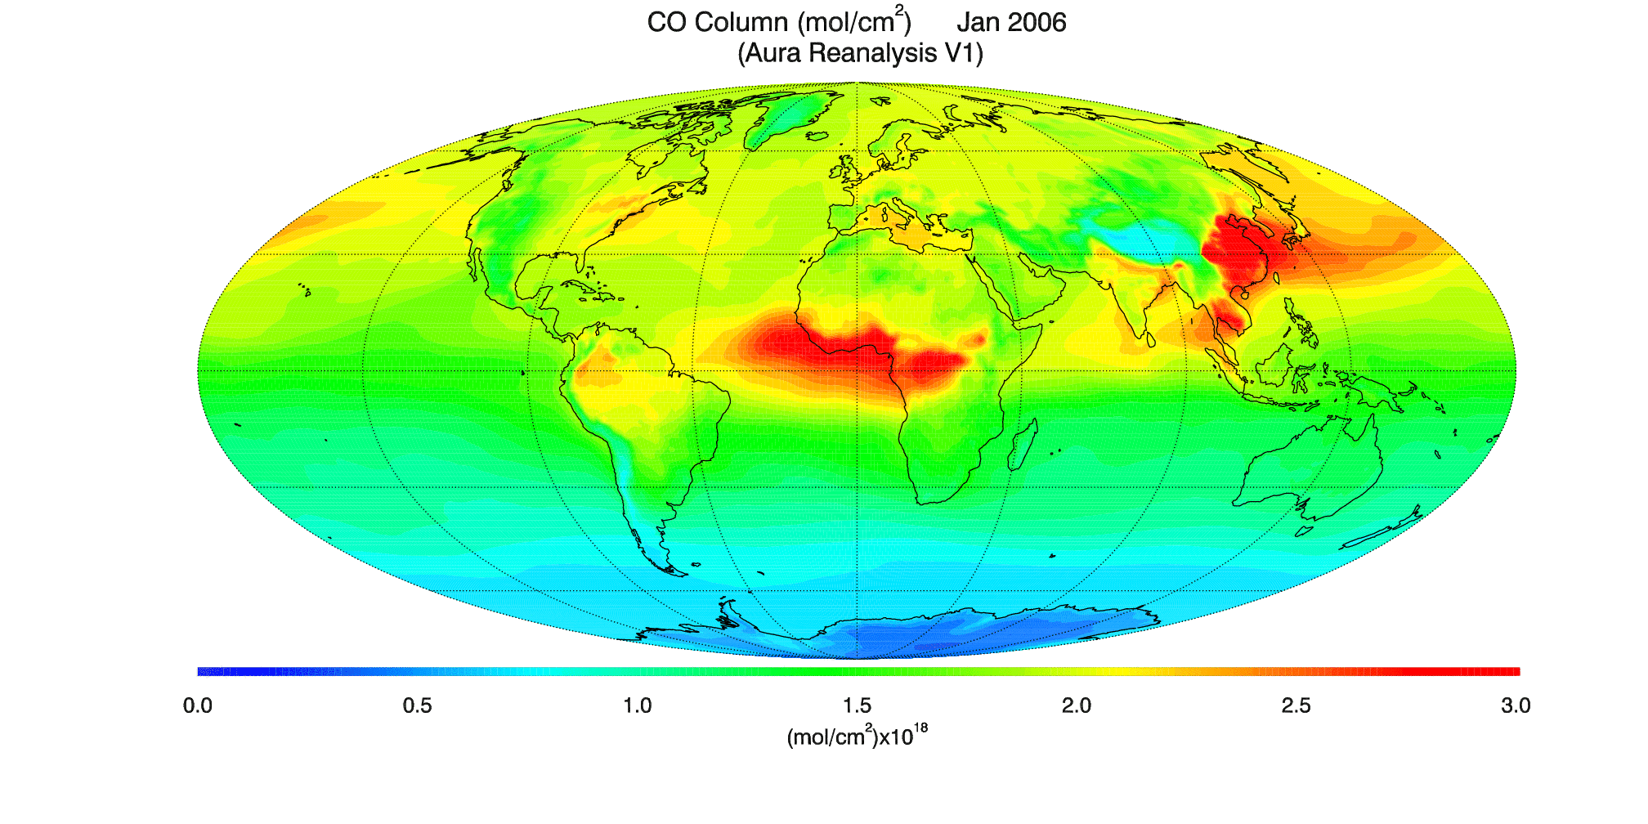
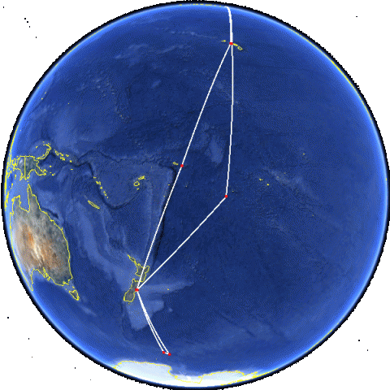
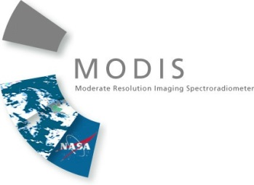
Aura Chemical Reanalysis
2010 O3
Validation
w/ HIPPO
2010 CO
Validation
w/ HIPPO
The Real-time Air Quality Modeling System (RAQMS) Aura Reanalysis is the first complete global chemical and aerosol reanalysis that has been attempted within the US and follows the path lead by European Monitoring Atmospheric Composition and Climate - Interim Implementation (MACC-II) project that is now operational at ECMWF.
Brad Pierce and Allen Lenzen
Notes:
The RAQMS Aura Reanalysis will provide comprehensive chemical and aerosol analyses for assessing global air quality and for providing lateral boundary conditions for regional air quality management such as State Implementation Planning (SIP) activites.

