Slide 1
US EPA Stratospheric Intrusion Working Group
March 18, 2014
Patrick Reddy: It looks like there might be an intrusion event from northern Nevada through northern Utah into southern Colorado on Monday March 17 through the morning of March 18. This might be a good event to look at with the new IDEA tool.
Brad Pierce
NOAA/NESDIS
In collaboration with:
Patrick Reddy
(Air Pollution Control Division,Colorado Department of Public Health & Environment)
Scott Bachmeier, Rebecca Cintineo, James Davies, Elisabeth Weisz, Nadia Smith, and Kathy Strabala (UW-Madison/CIMSS)
Georg Grell and Steve Peckham (NOAA/ESRL)

Slide 2
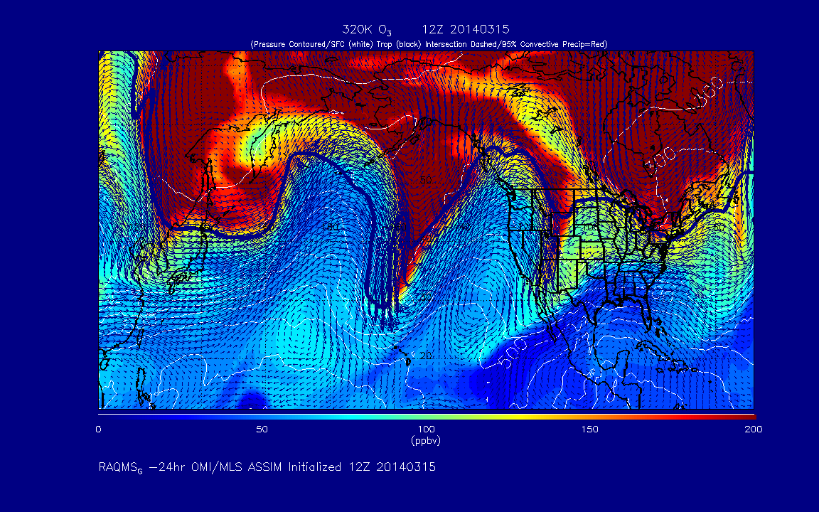
RAQMS 12Z 03/15 – 12Z 03/16 Analysis FX out to 12Z 03/20 (Thursday)
http://raqms-ops.ssec.wisc.edu/

Slide 3
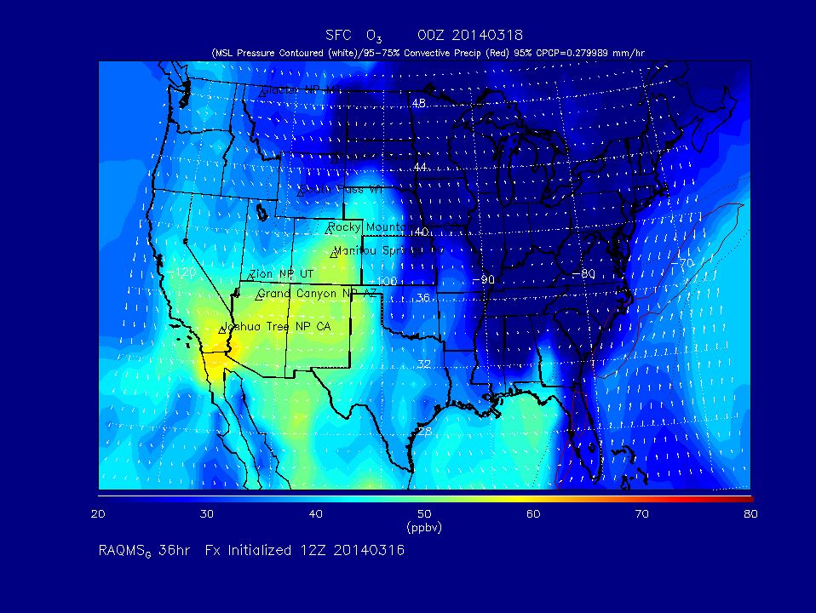
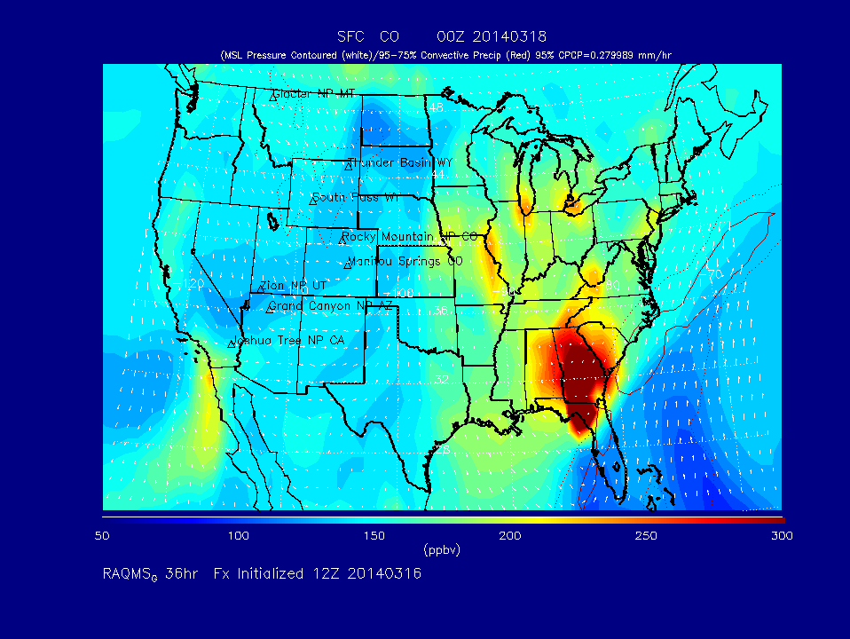
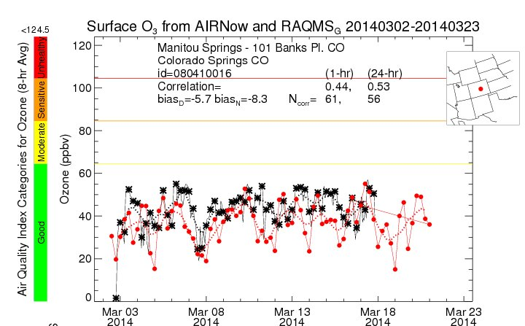
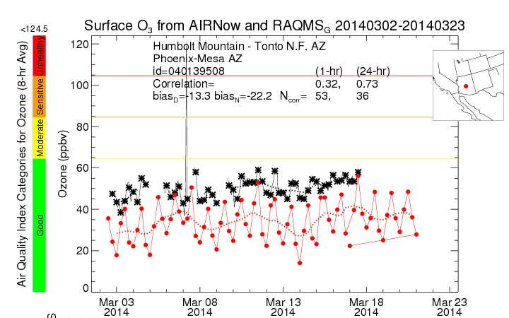
http://raqms.ssec.wisc.edu/forecast/view/20140316
http://raqms.ssec.wisc.edu/o3_verification/

Slide 4
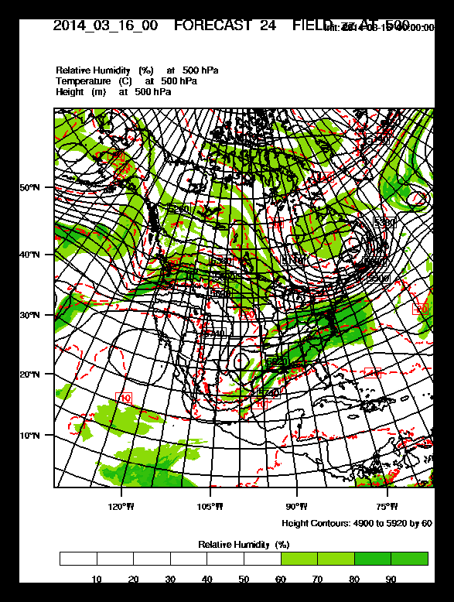
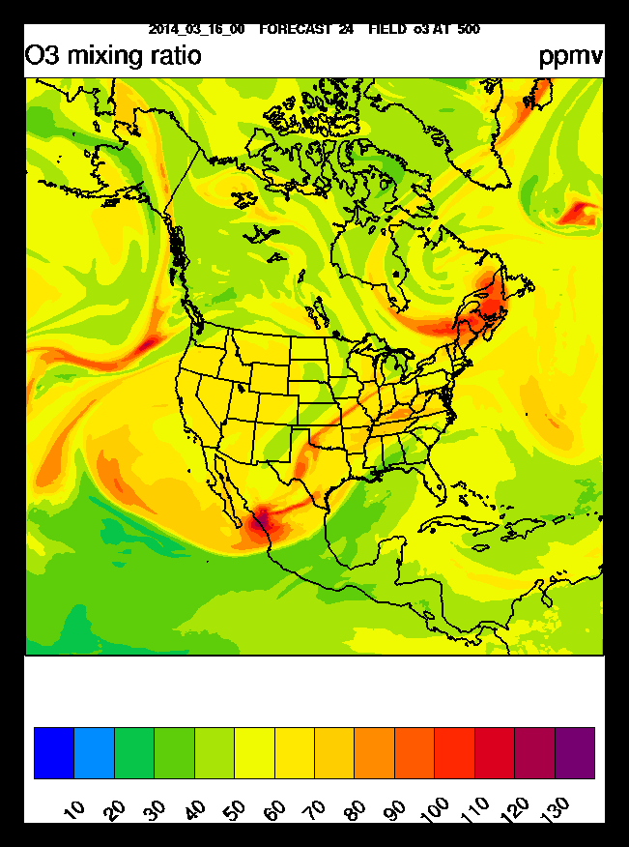
RR-Chem 500mb O3 Forecast (RAQMS LBC)
24hr RR-Chem FX valid Monday March 17, 2014 00Z
http://ruc.noaa.gov/wrf/WG11_RT/

Slide 5
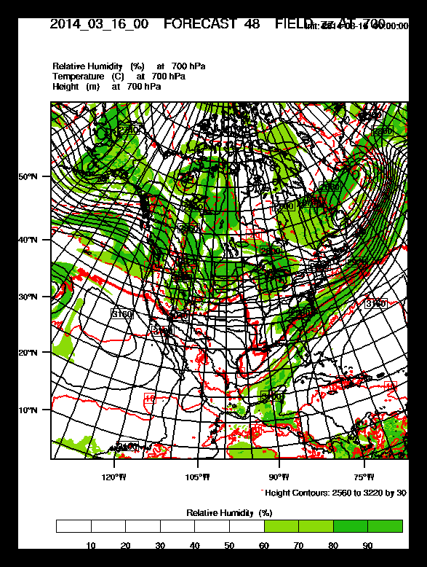
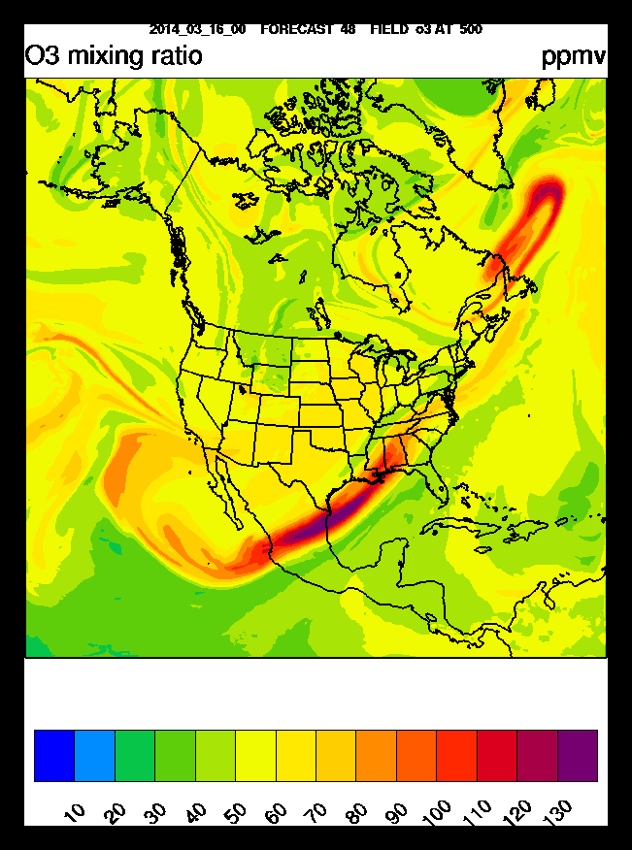
RR-Chem 500mb O3 Forecast (RAQMS LBC)
48hr RR-Chem FX valid Tuesday March 18, 2014 00Z

Slide 6
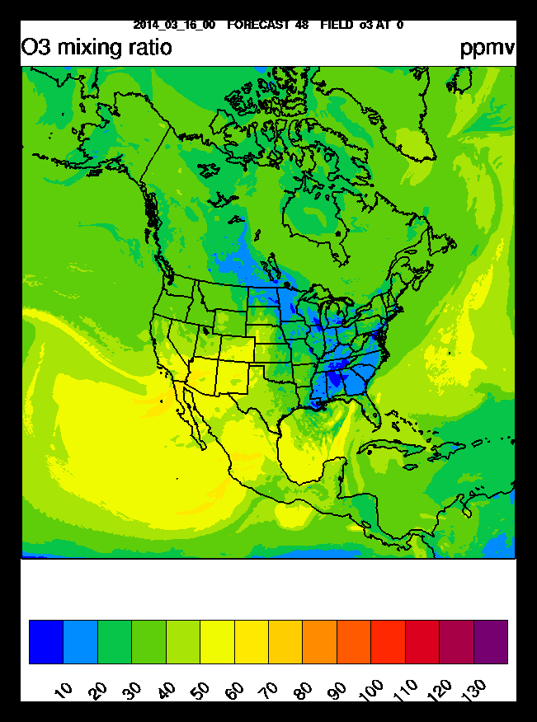
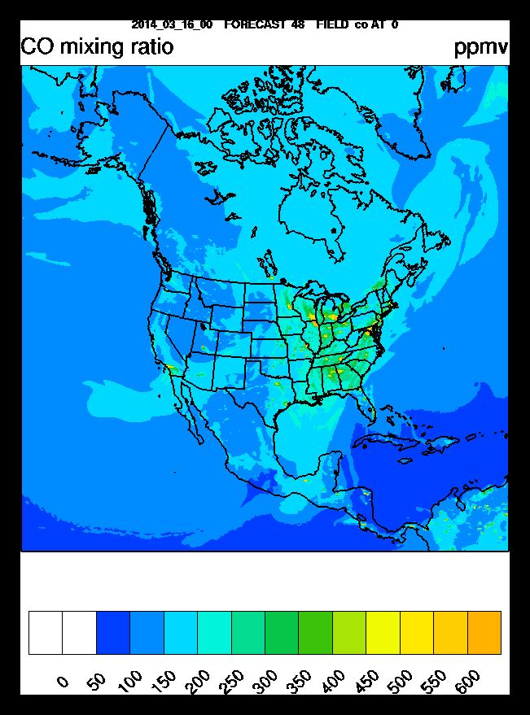
RR-Chem 8m O3 Forecast (RAQMS LBC)
48hr RR-Chem FX valid Tuesday March 18, 2014 00Z

Slide 7
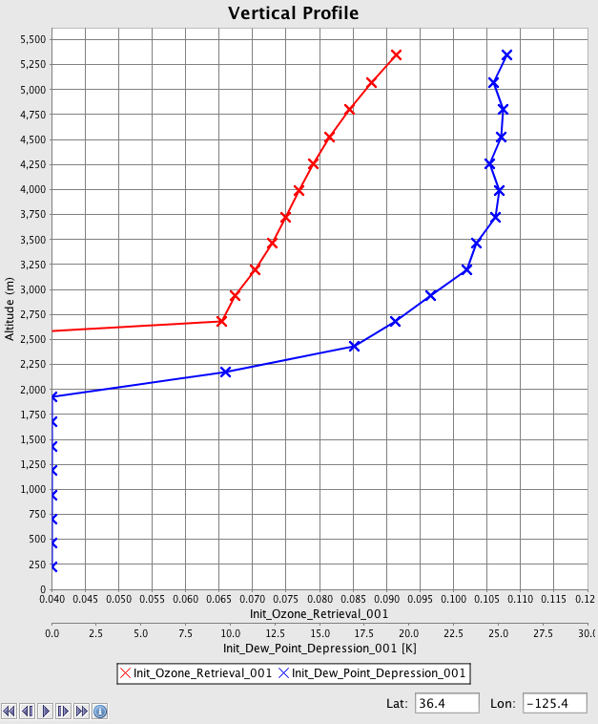
Dual-Regression Retrieval Parameters
atmospheric temperature [K] at 101 pressure levels
atmospheric ozone [ppmv] at 101 pressure levels
atmospheric dew point temperature [K] at 101 pressure levels
Used in SI
initialization
Plevs threshold: >500mb
O3VMR threshold: >80ppbv
Dewpnt-Tair threshold: <-15K
http://cimss.ssec.wisc.edu/cspp/uwhsrtv_edr_v1.1.shtml

Slide 8
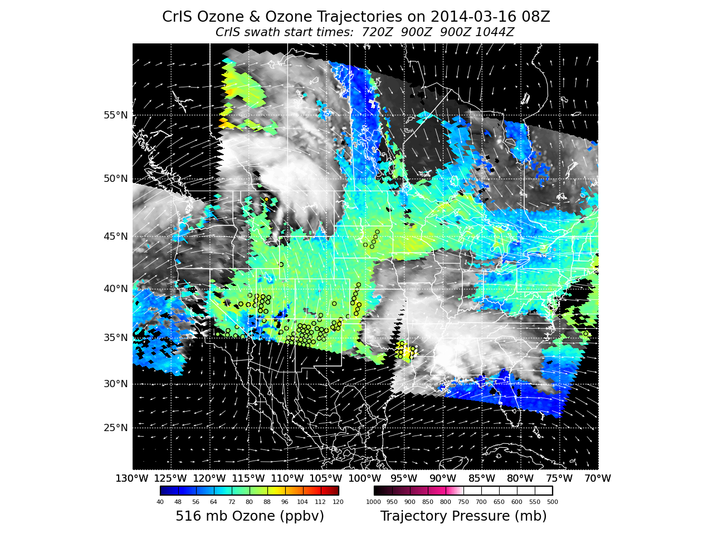
http://cimss.ssec.wisc.edu/idea-i/USozone/

Slide 9
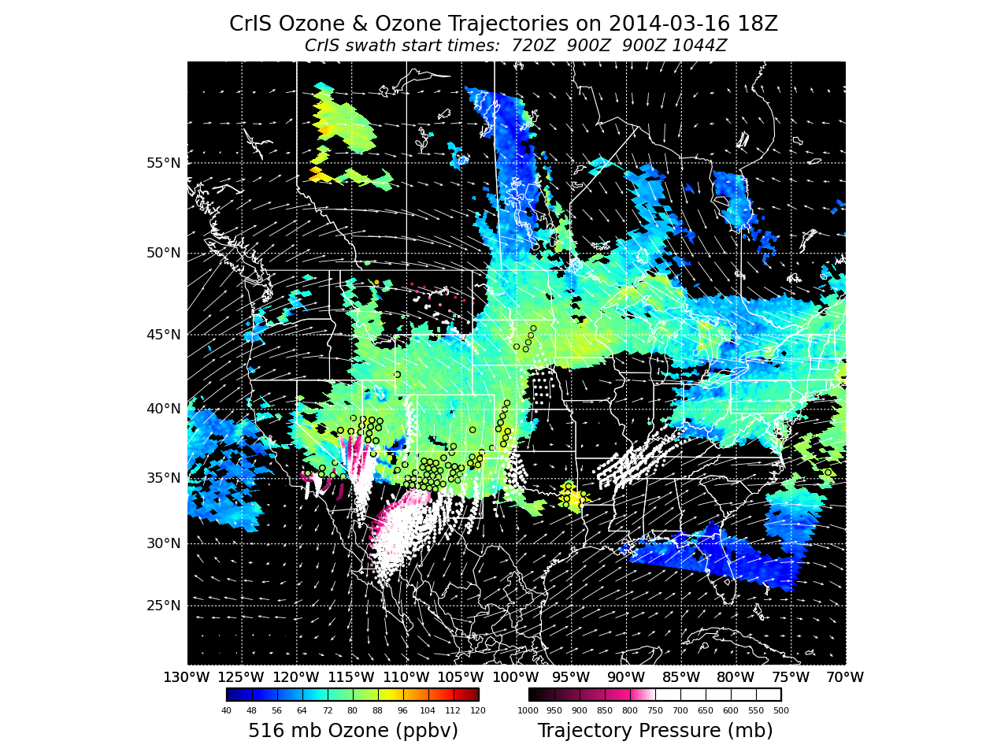

Slide 11
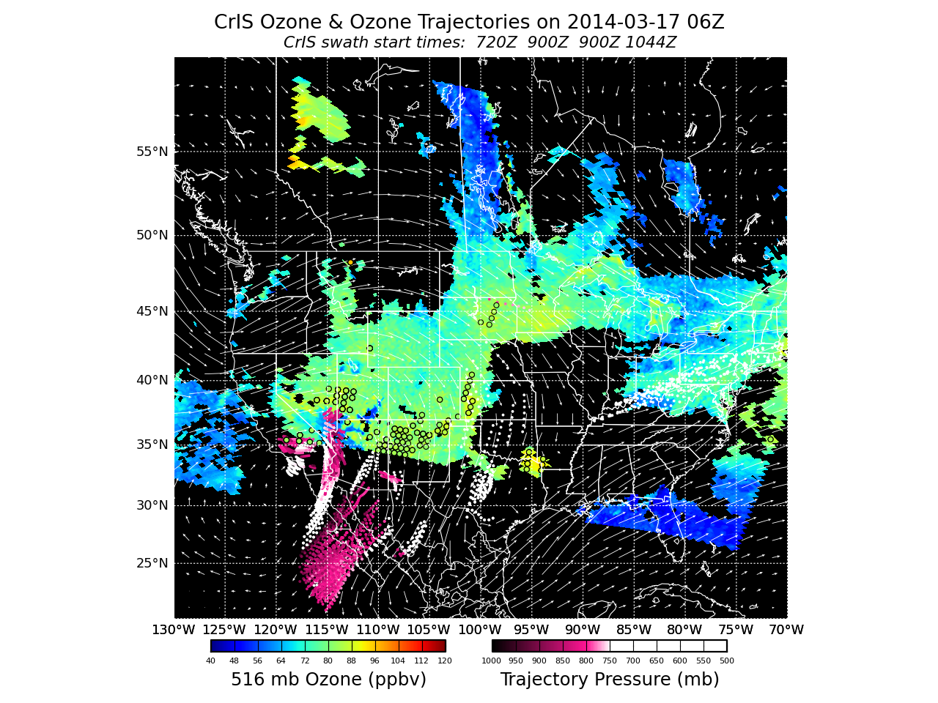

Slide 13
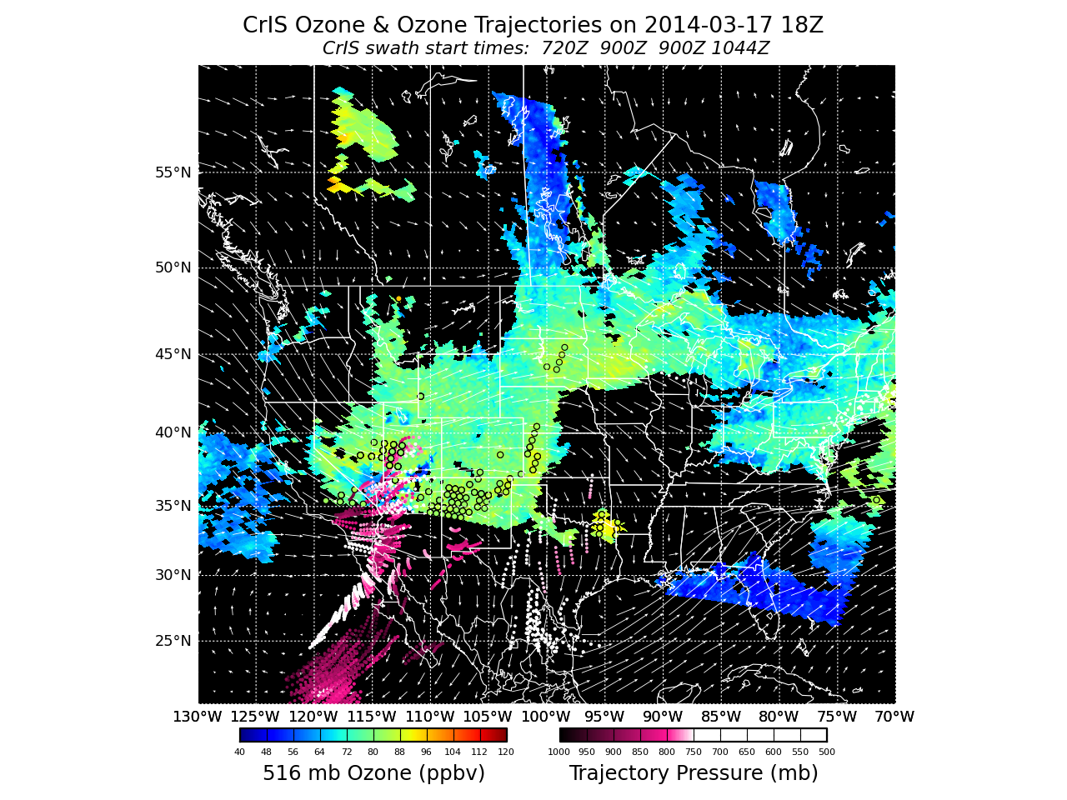

Slide 15
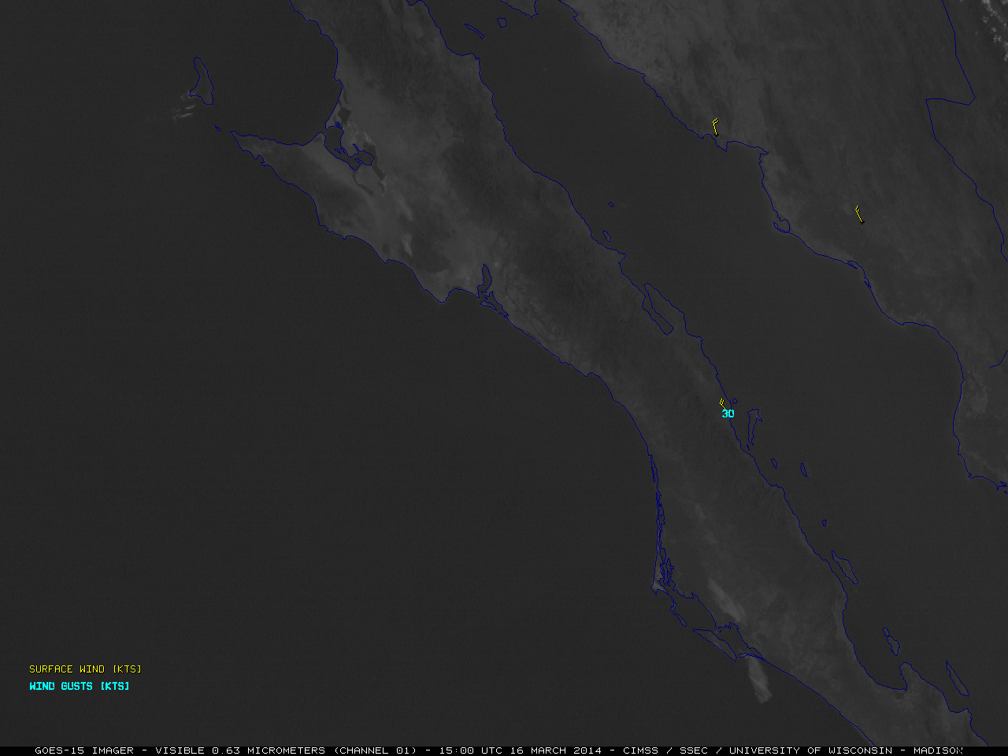
McIDAS images of GOES-15 (GOES-West) 0.63 µm visible channel data revealed large plumes of blowing dust and sand, which were moving south/southwestward from the coast of Baja California and western Mexico on 16 March 2014.
Image from Scott Bachmeier (CIMSS Satellite Blog)
http://cimss.ssec.wisc.edu/goes/blog/archives/15141

Slide 16
