Slide 1
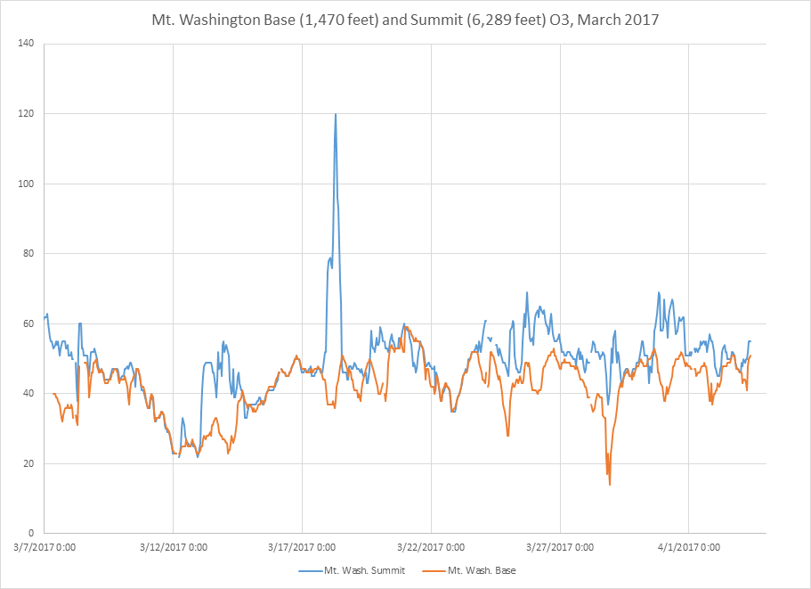
Stratospheric Intrusion Working Group
April 18, 2017
March 18 2017 Mt Washington, NH
RAQMS
From Richard Payton (US EPA)

Slide 2
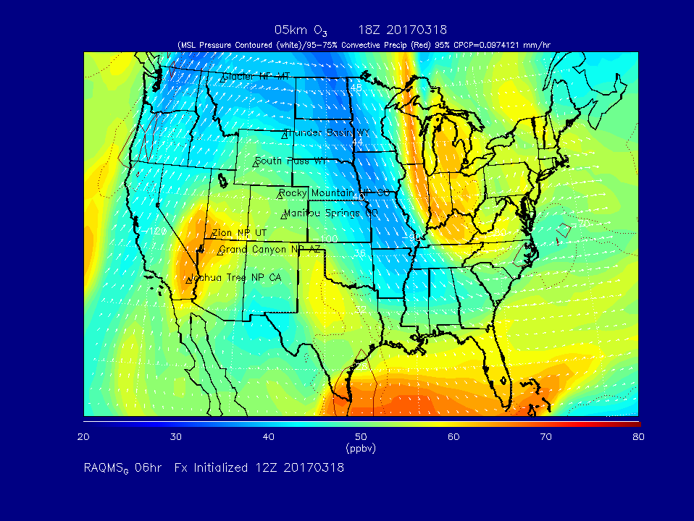

Slide 3
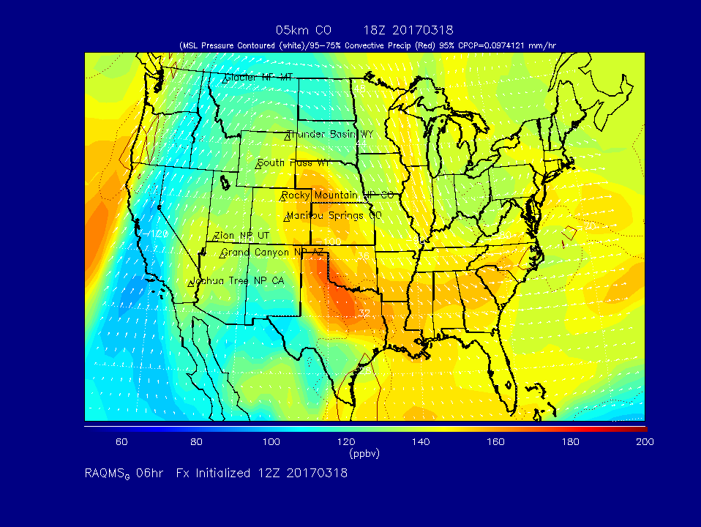

Slide 4
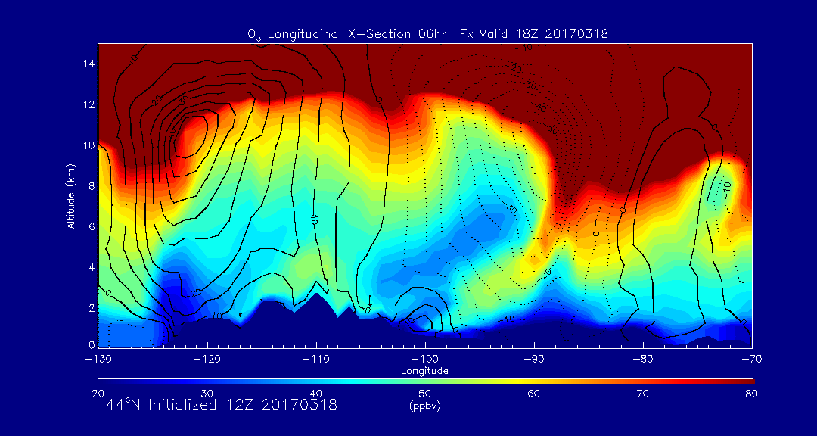
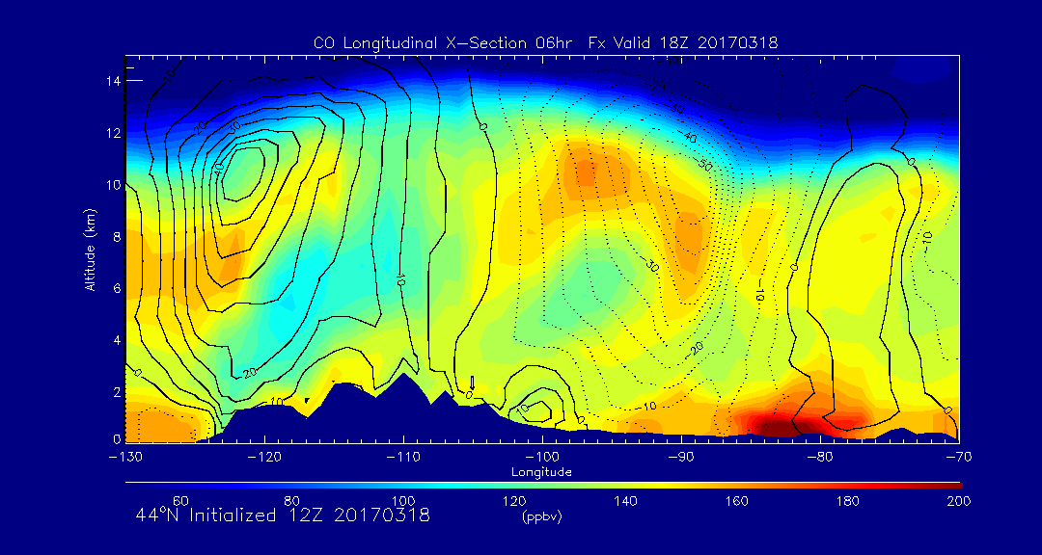
RAQMS 44N
O3 (upper panel)
CO (lower panel)
Strongest SI well to west of Mt Washington
Weak SI over Mt Washington above 6km

Slide 5
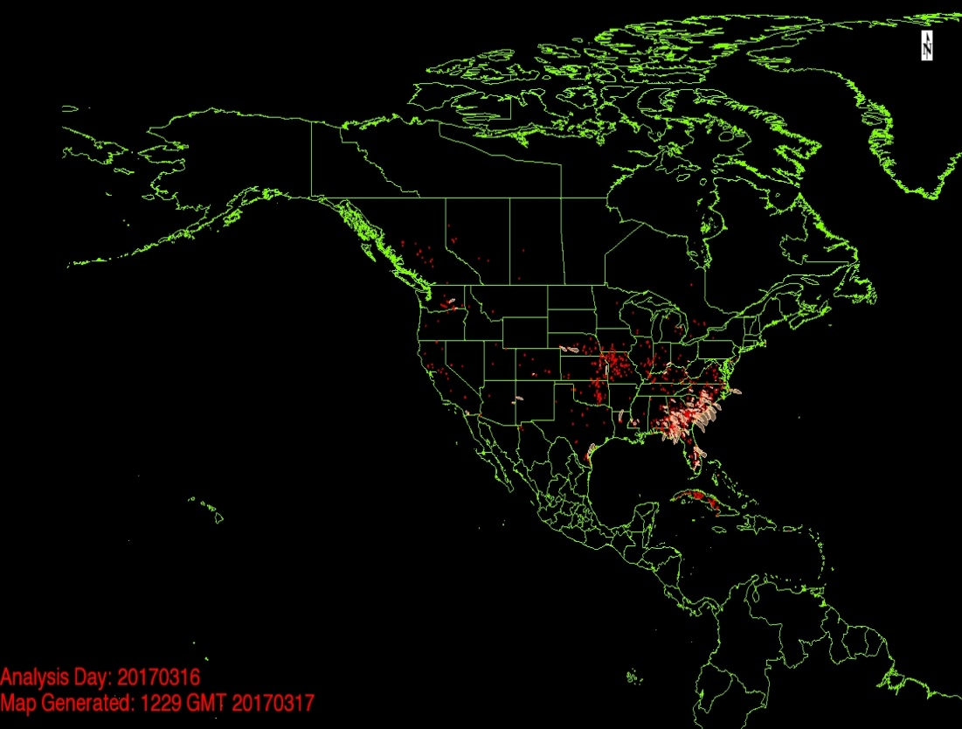
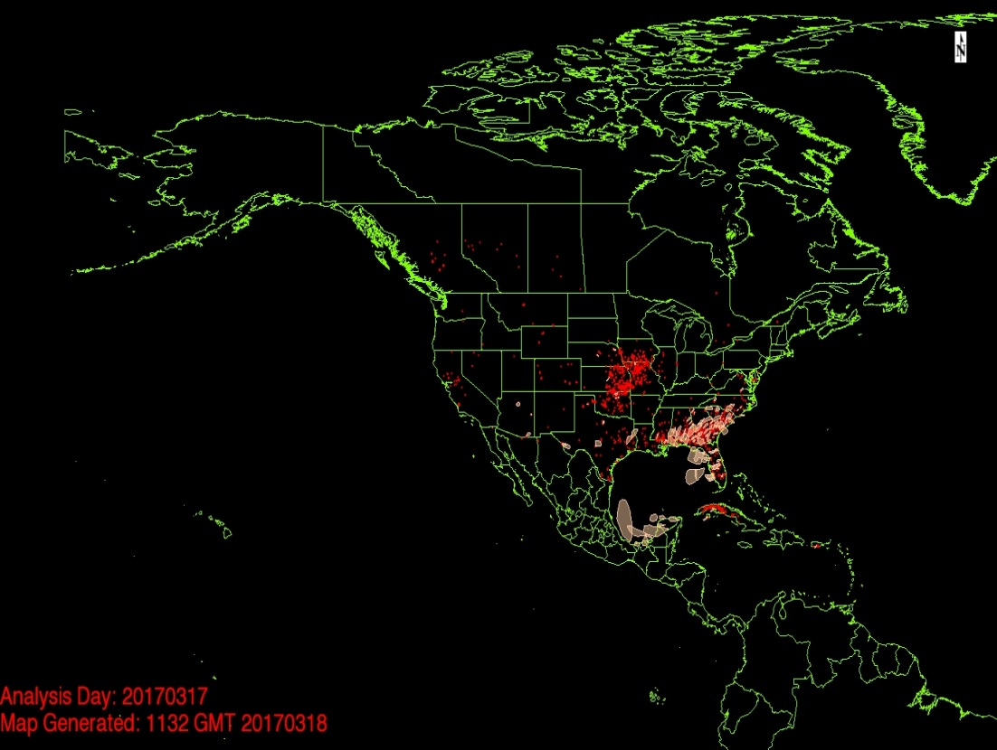
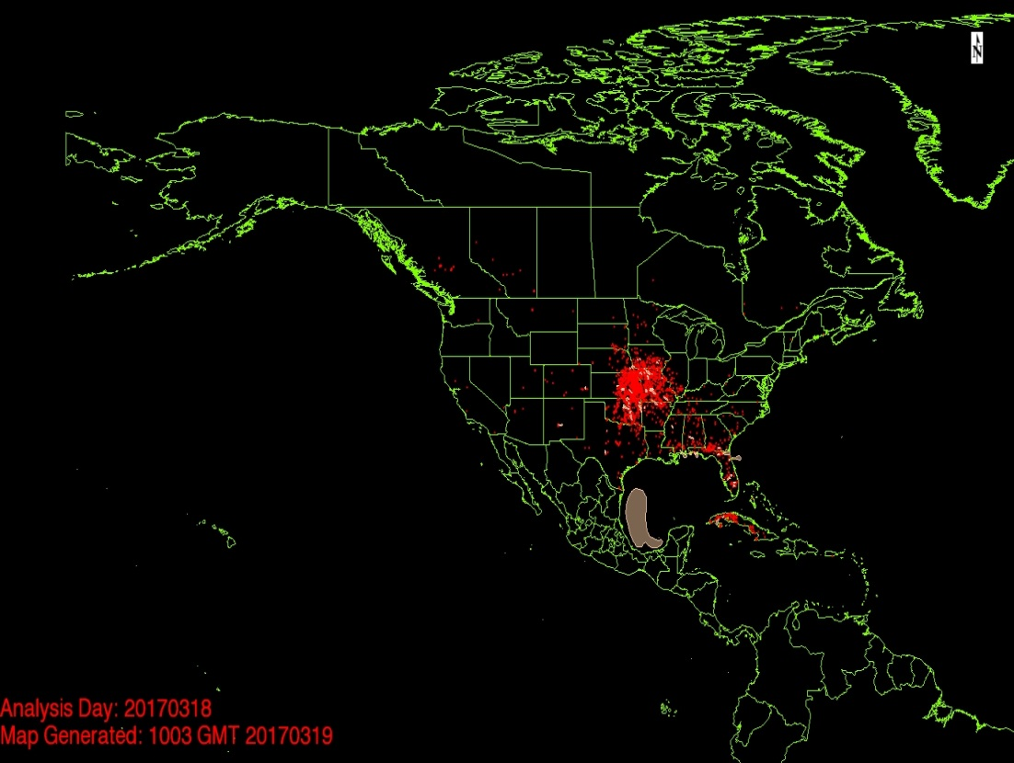
NESDIS Hazard Mapping Service (HMS)
Shows significant agricultural burning SE and Central US proceeding March 18, 2017

Slide 6
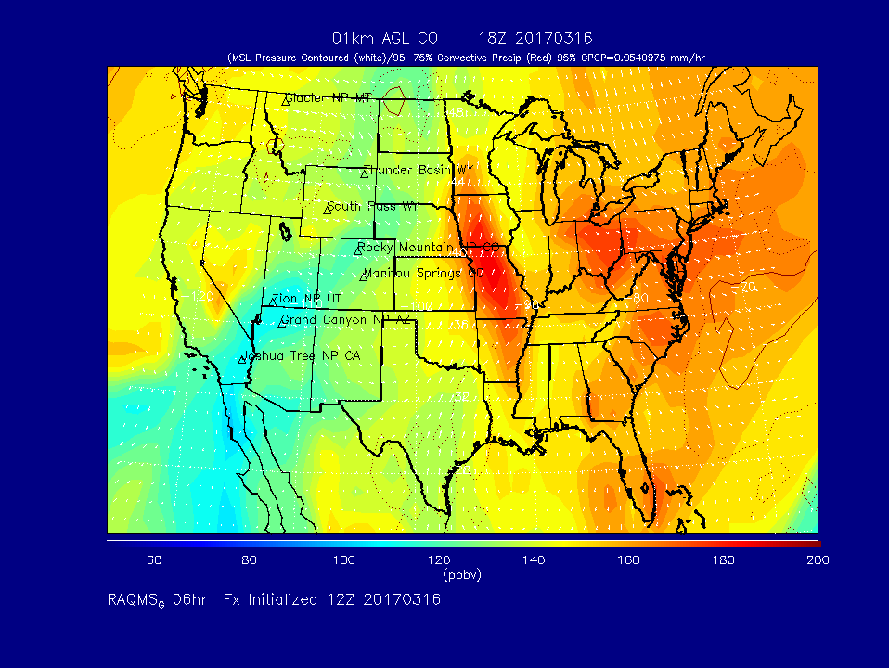
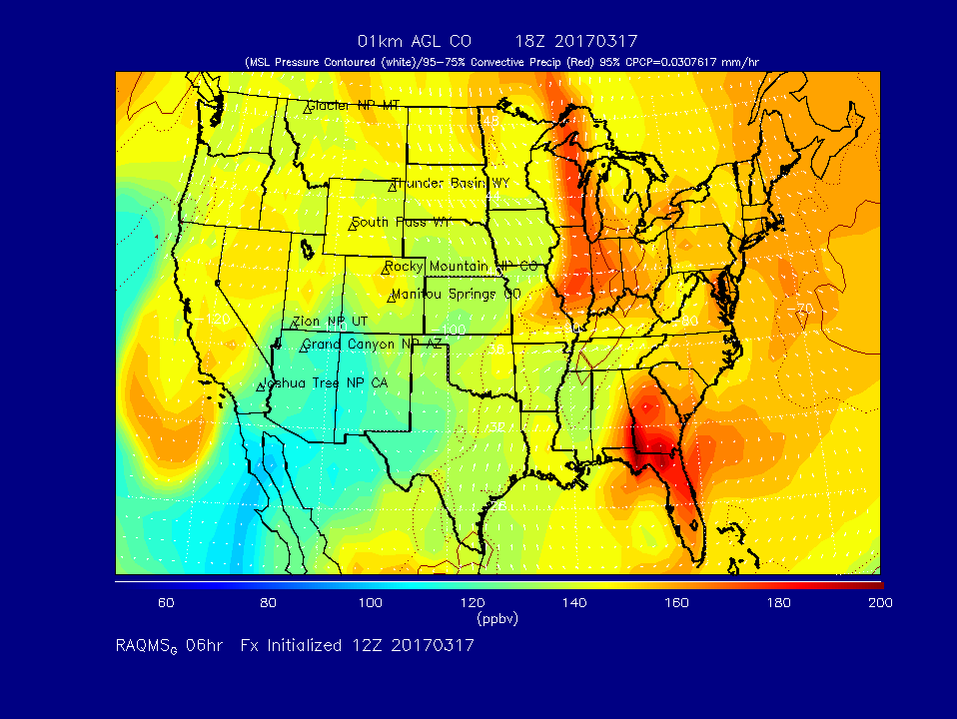
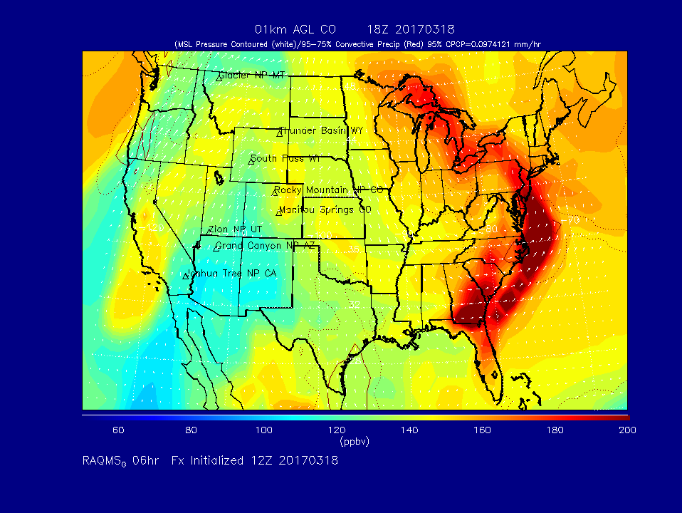
RAQMS 1km AGL CO
18Z on 03/16 (upper left), 03/17 (upper right), 03/18 (lower left)
Transport of high CO from SE and Central US offshore over Mid Atlantic and over NY, PA

Slide 7
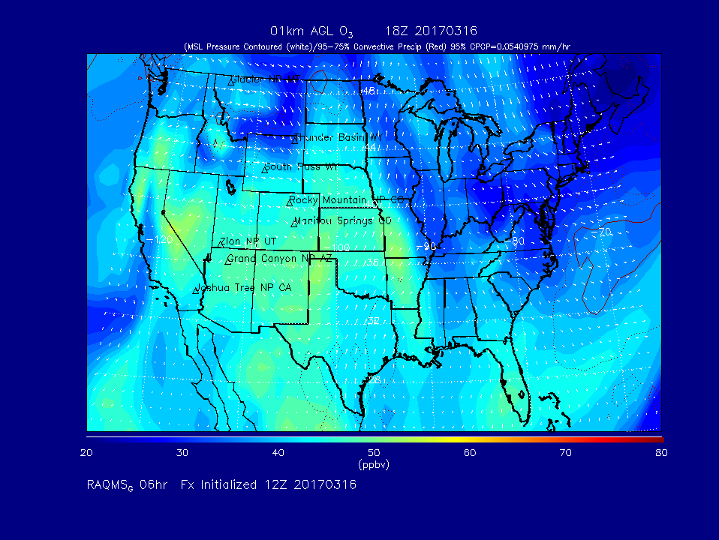
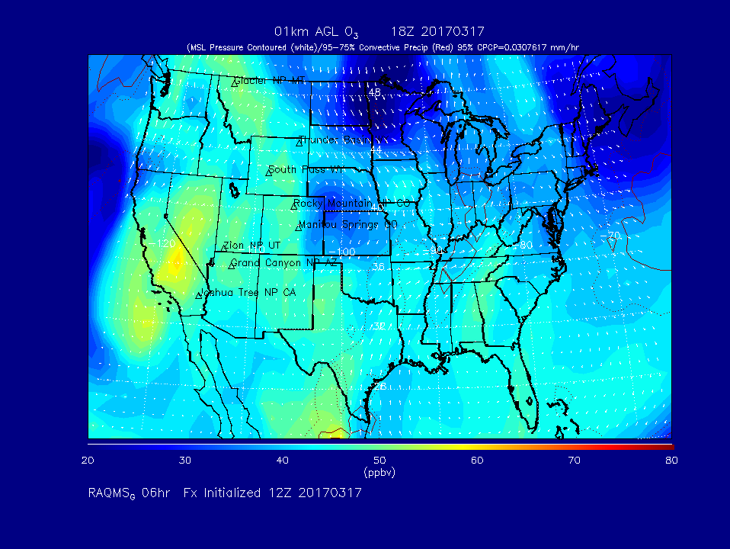
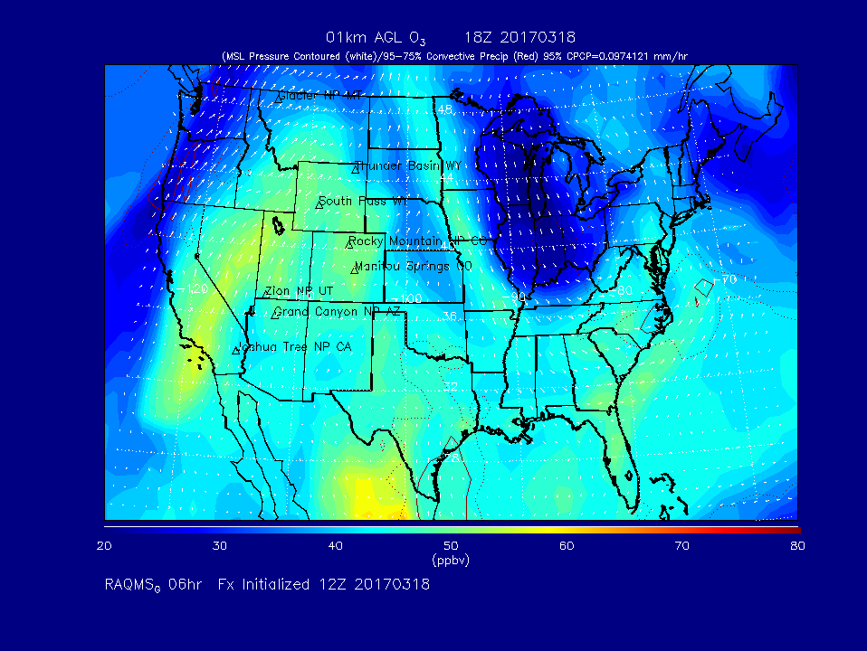
RAQMS 1km AGL O3
18Z on 03/16 (upper left), 03/17 (upper right), 03/18 (lower left)
RAQMS shows only slight enhancements (O3 >55ppbv) associated with elevated CO

Slide 8
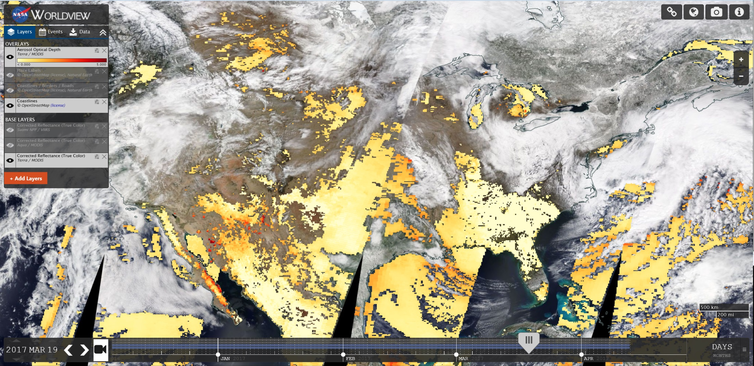
Terra MODIS AOD (colored) over True Color Image (March 19, 2017)
Note elevated AOD extending from Central US across Gulf, out over Atlantic associated with synpotic transport behind storm off NE US

Slide 9
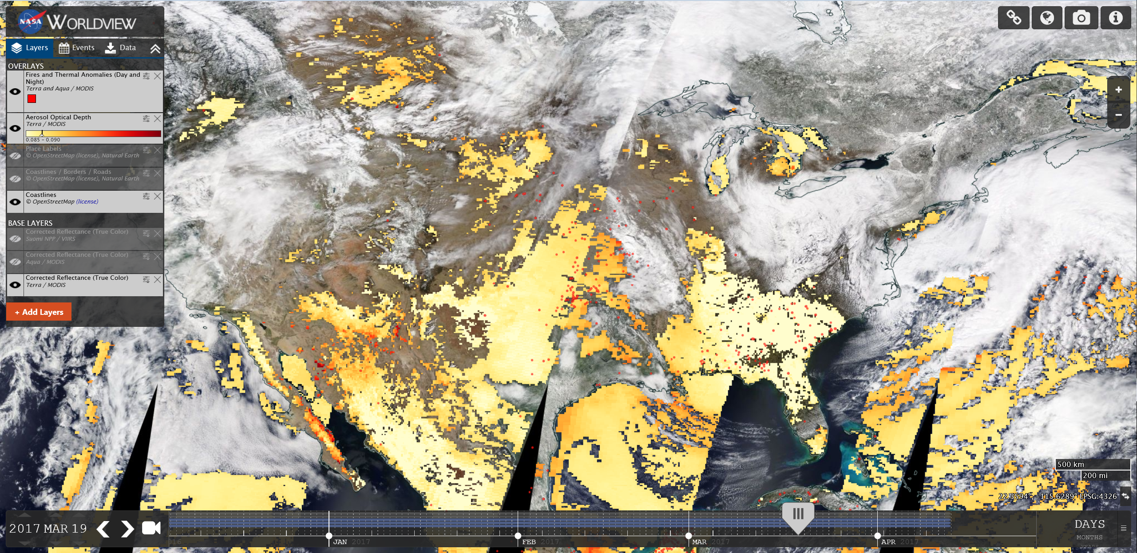
Terra MODIS AOD (colored) and Fire detection (red dots) over True Color Image (March 19, 2017)
Note elevated AOD extending from Central US across Gulf, out over Atlantic associated with synpotic transport behind storm off NE US

Slide 10
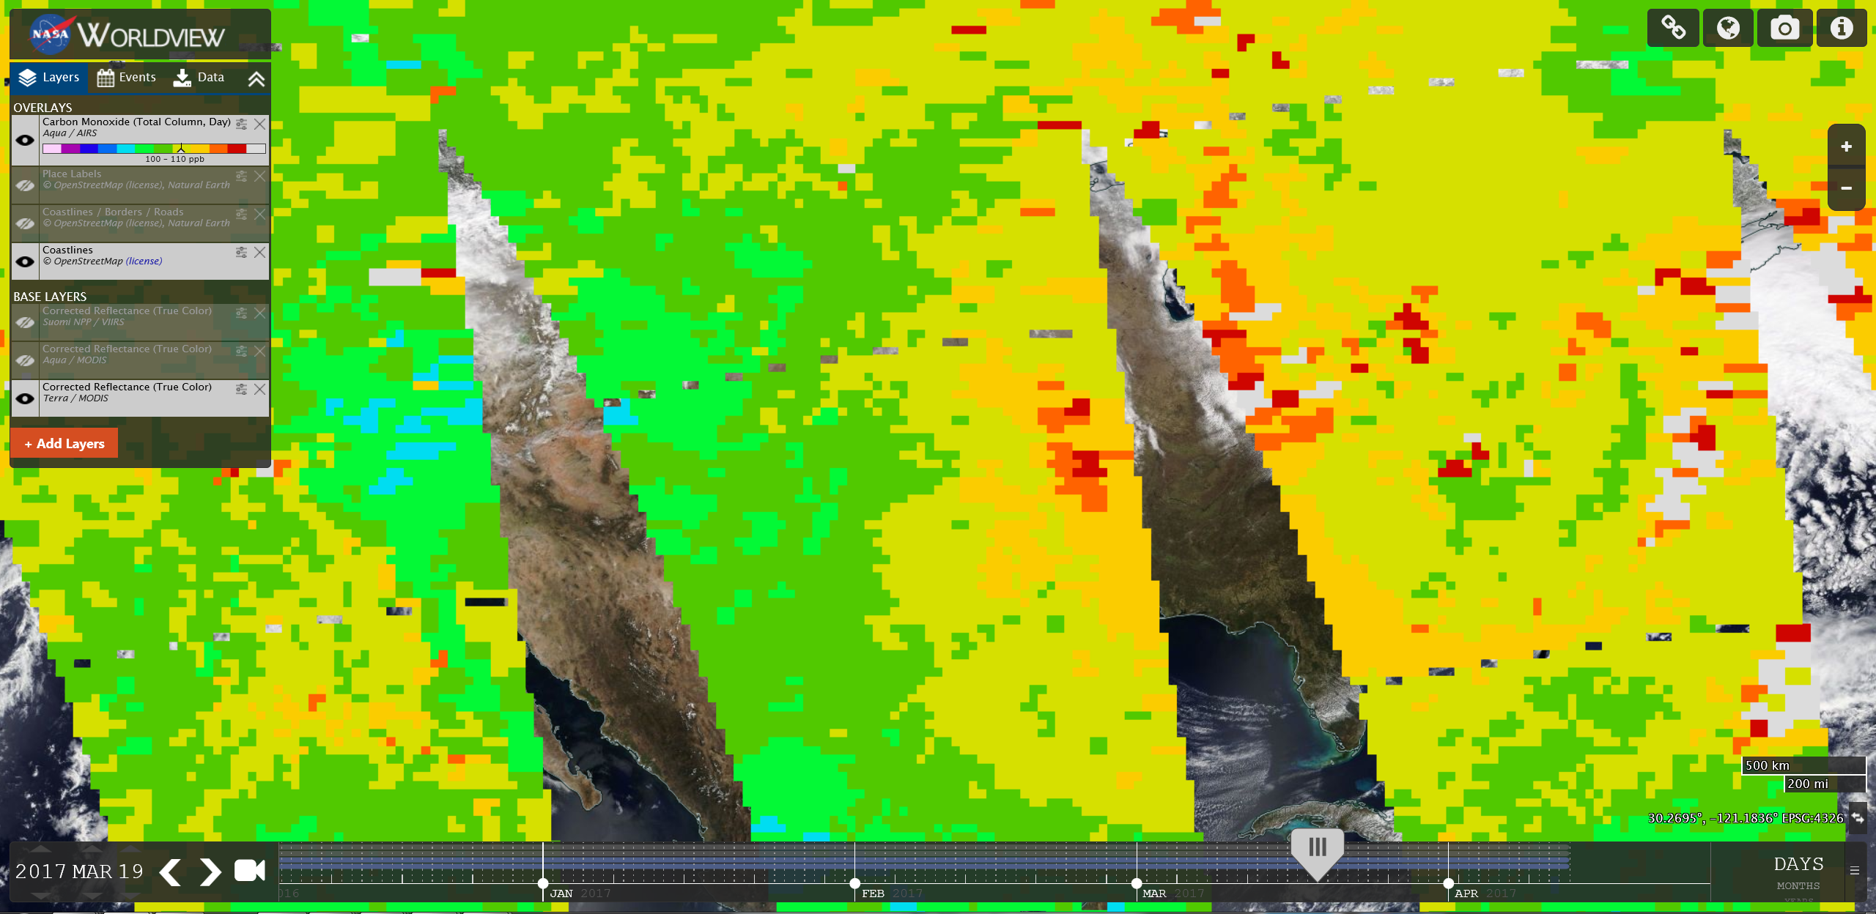
Aqua AIRS CO Column (colored) over True Color Image (March 19, 2017)
Note elevated column CO extending from Central US across Gulf, out over Atlantic associated with synpotic transport behind storm off NE US

