Slide 1
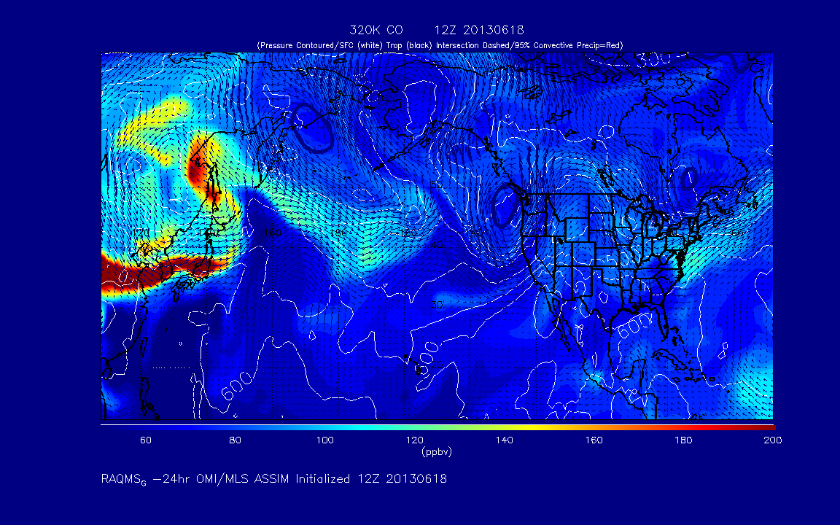
RAQMS CO forecast on 320K isentrope

Slide 2
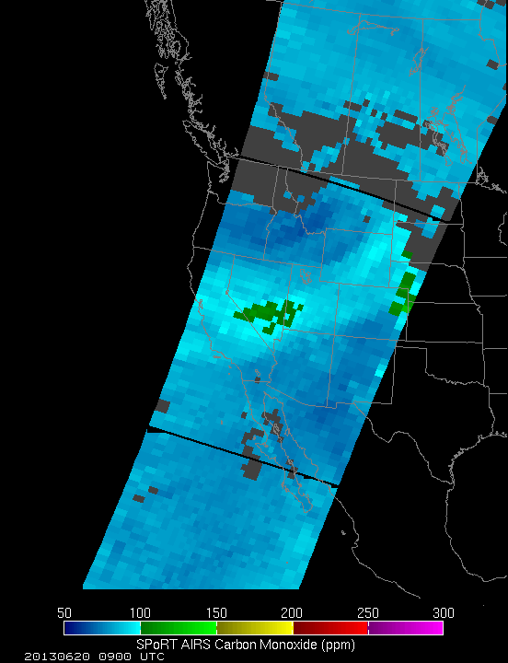

Slide 3
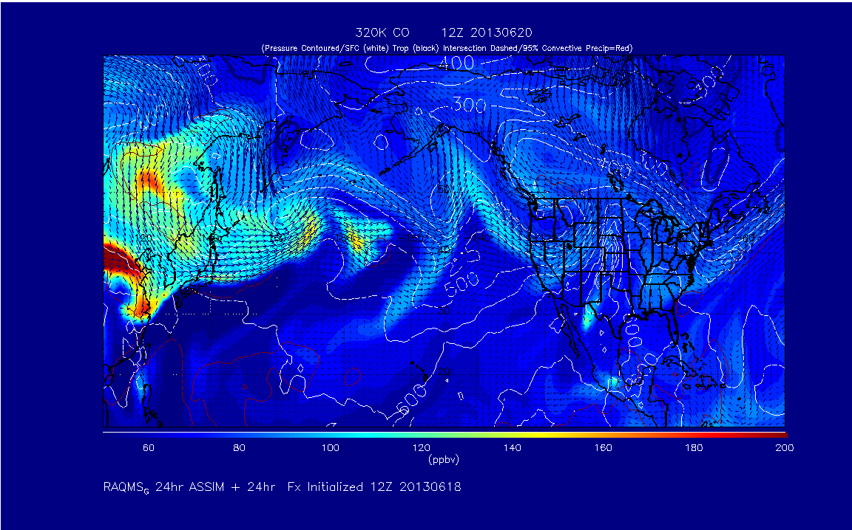
RAQMS CO forecast at 12Z on 06/20 on 320K isentrope

Slide 4
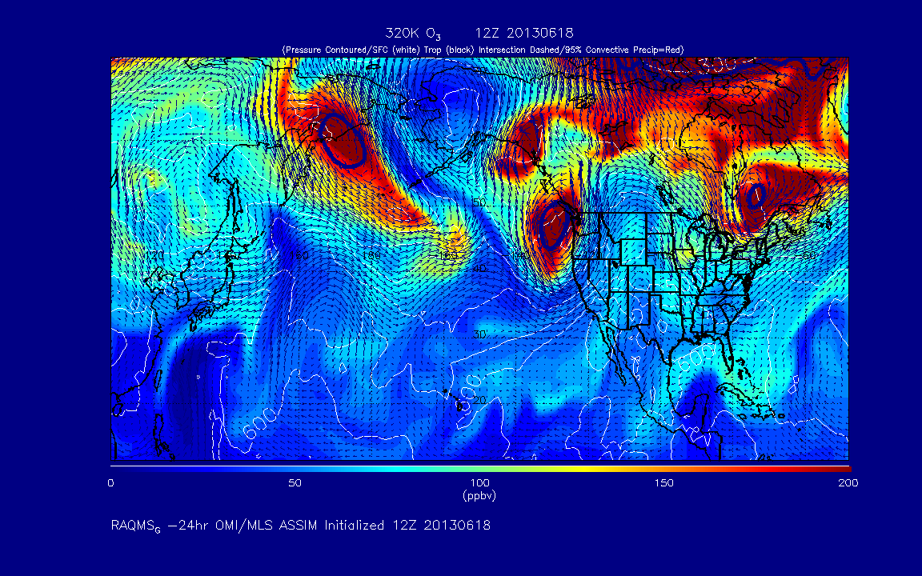
RAQMS O3 forecast on 320K isentrope

Slide 5
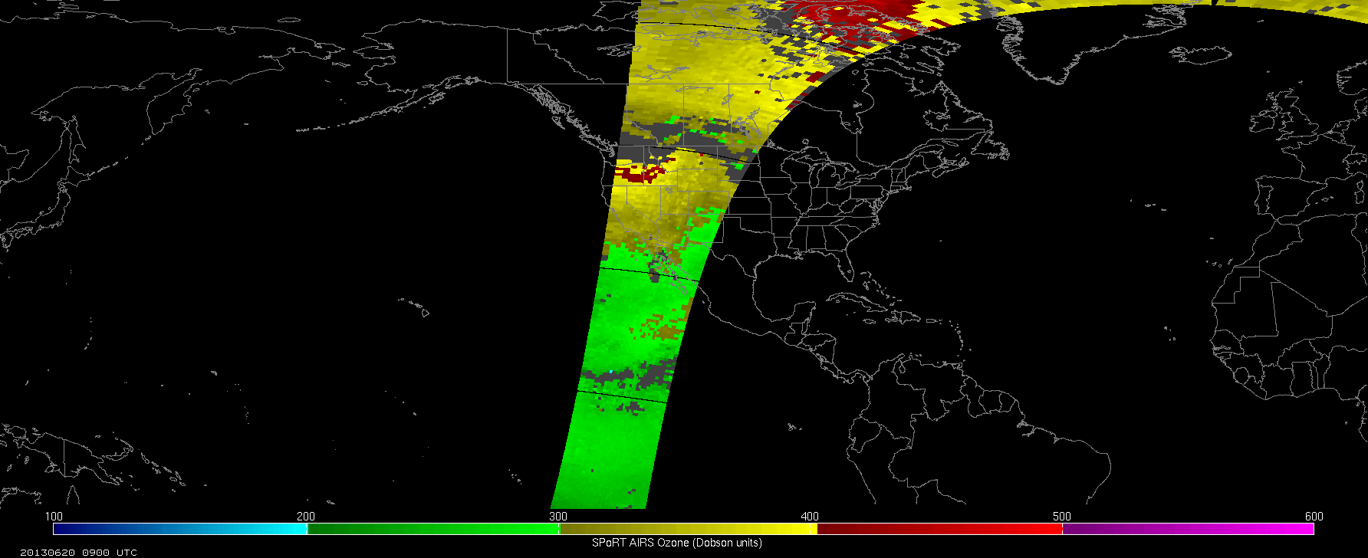

Slide 6
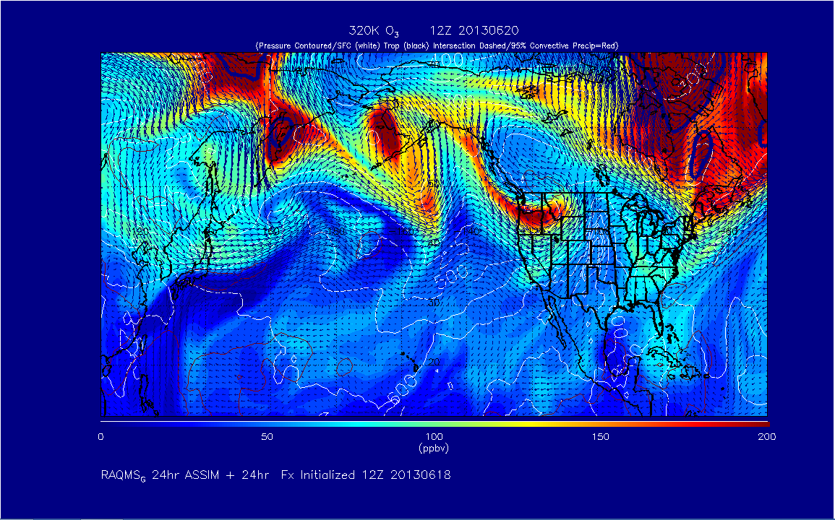
RAQMS O3 Column forecast at 12Z on 06/20
SI event
Long-range transport

Slide 7
RAQMS CO forecast at 12Z on 06/20 on 320K isentrope
SI event
Long-range transport

Slide 8
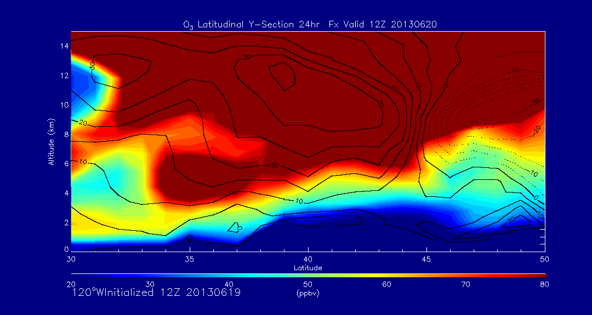
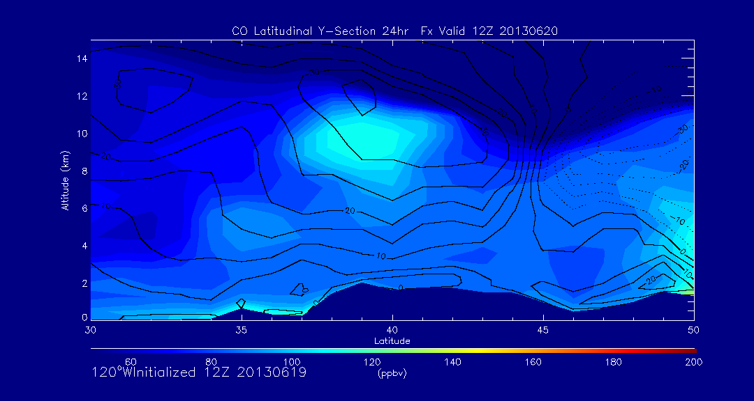
12Z 06/20, 2013
RAQMS O3 120W
RAQMS CO 120W
Majority of enhanced CO from long-range transport is at 10km within Jet core.
Additional CO enhancement near 5km within elevated O3

