Slide 1


Forecasting
Stratospheric Intrusion Events
over the Western US
for
Exceptional Event Demonstration
R. Bradley Pierce, NOAA/NESDIS
Todd Schaack and Allen Lenzen, UW-Madison SSEC
Significant Contributions from:
Patrick J. Reddy
Air Pollution Control Division
Colorado Department of Public Health and Environment
Gail Tonnesen
EPA Region 8
Earth System Research Laboratory, Chemical Sciences Division, October 24, 2012

Slide 2
Stratospheric intrusions (SIs) are fairly common from late winter through late spring in the western US. SIs can lead to exceedances of the 8-hour ozone standards and must be identified and documented by states (with EPA concurrence) as exceptional events or they will count towards attainment/nonattainment status.
Current Regulatory SI Analysis Efforts *
WY and CO are leaders in analysis of stratospheric ozone intrusion and have flagged several events as stratospheric intrusion:
  WY flagged ozone stratospheric intrusion events: February 27-28, March 6-7, and March 10-13, 2009 http://deq.state.wy.us/aqd/Exceptional%20Events/SouthPass/2009Events/SouthPass_Feb27_March7_March10_13_SI_Package.pdf
  CO flagged May 24, 2010, Stratospheric Intrusion http://www.colorado.gov/airquality/documents/TSD_O3_Intrusion_Event_052410.pdf
* Gail Tonnesen, EPA Region 8

Slide 3
Challenges in Analysis of Stratospheric Ozone *
SI ozone may remain above the boundary layer
SI ozone sometimes results in ozone increases during the day time when photochemical production also occurs.
Can be difficult to identify SI versus winter photochemistry.
Lack of ozone vertical profile data.
EPA Ozone SI Workgroup Goals*
Develop standardized technical methods for analysis of SI.
Promote collaboration and data sharing between the states, academics and federal researchers.
Promote archiving of key data sets.
* Gail Tonnesen, EPA Region 8

Slide 4
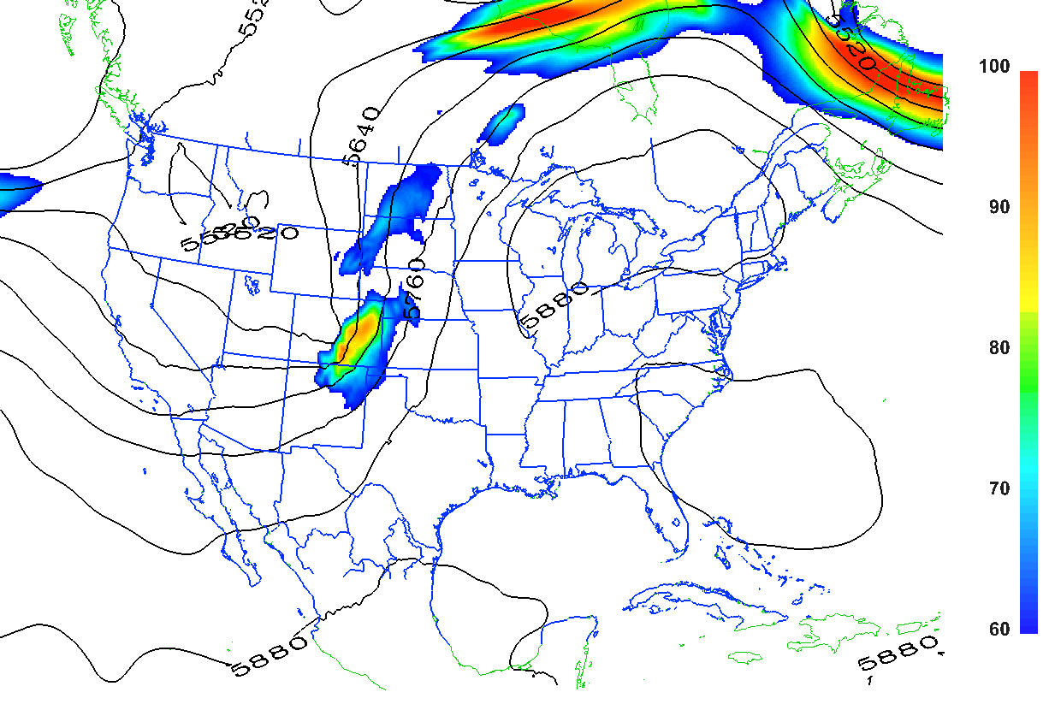
The intrusion of
May 24, 2010,
illustrates many
of the features of
a typical event.
NAM12km 500-mb geopotential heights and wind speeds at 11:00 MST on May 24, 2010
* Patrick J. Reddy, Air Pollution Control Division Colorado Department of Public Health and Environment

Slide 5
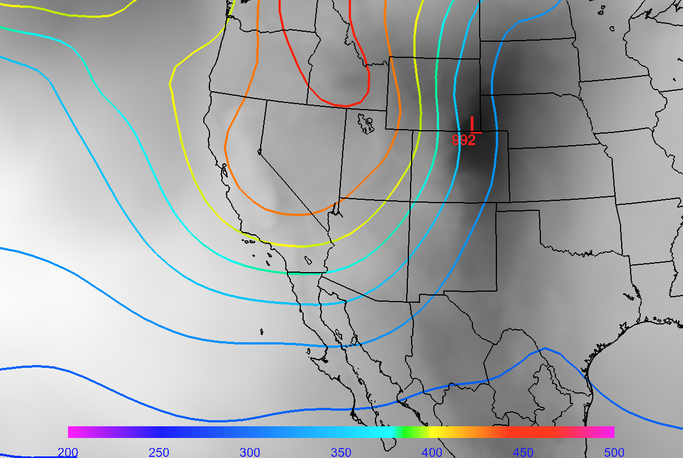
NOAA/NESDIS TOAST Total O3 and surface low for May 24, 2010,
* Patrick J. Reddy, Air Pollution Control Division Colorado Department of Public Health and Environment

Slide 6
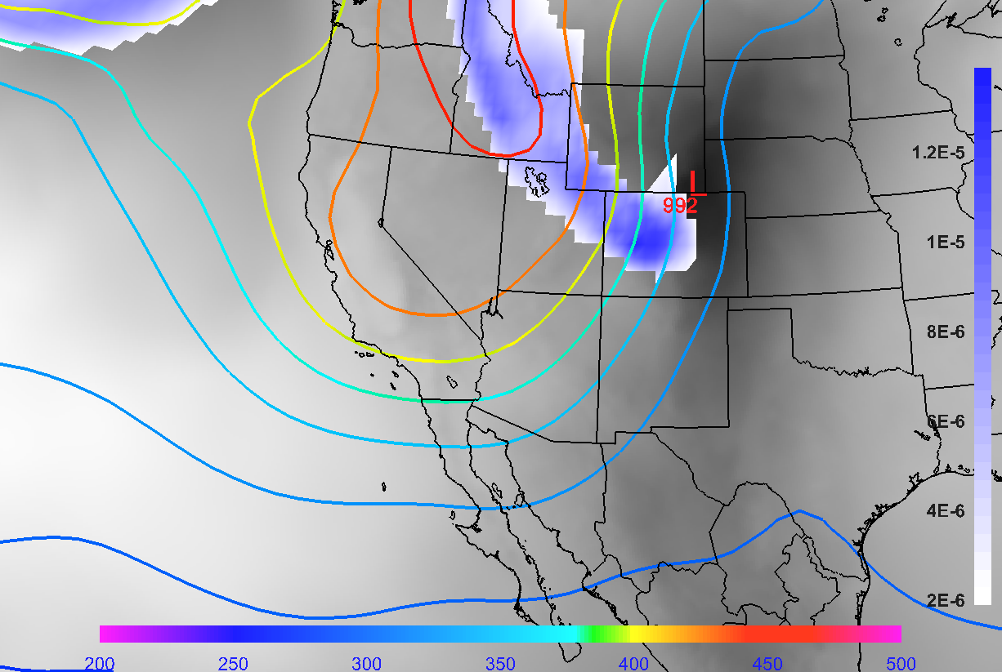
NOAA/NESDIS TOAST Total O3, surface low and 320K IPV for May 24, 2010,
* Patrick J. Reddy, Air Pollution Control Division Colorado Department of Public Health and Environment

Slide 7
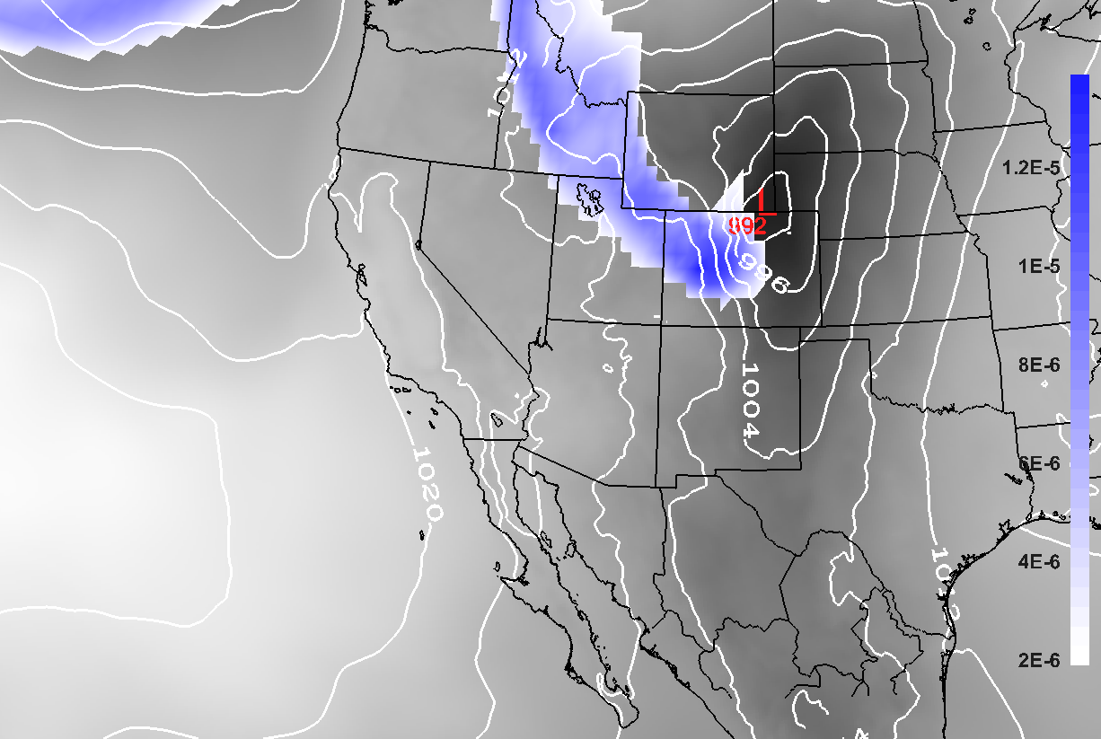
NOAA/NESDIS TOAST Total O3, surface low, 320K IPV, and MSLP for May 24, 2010,
* Patrick J. Reddy, Air Pollution Control Division Colorado Department of Public Health and Environment

Slide 8
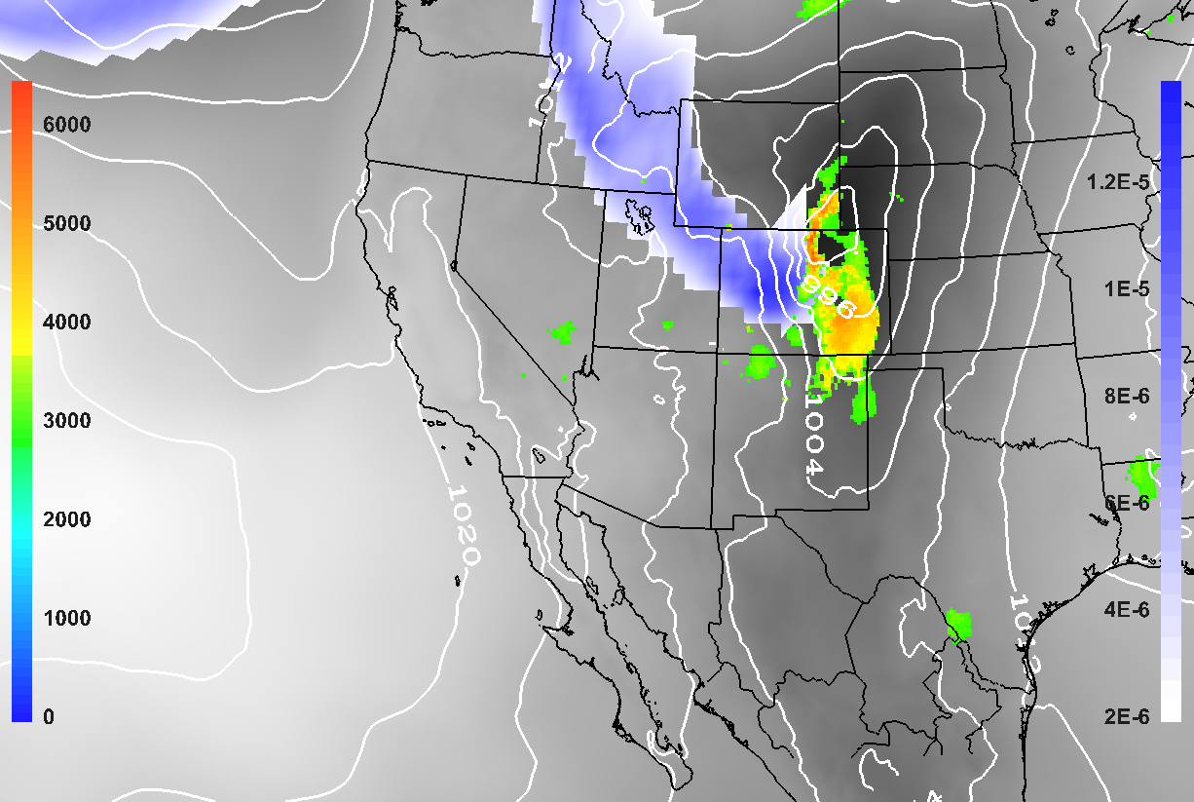
NOAA/NESDIS TOAST Total O3, surface low, 320K IPV, MSLP, and PBL height for May 24, 2010,
* Patrick J. Reddy, Air Pollution Control Division Colorado Department of Public Health and Environment

Slide 9
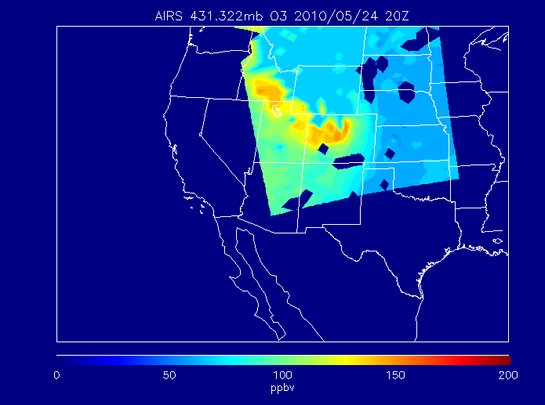
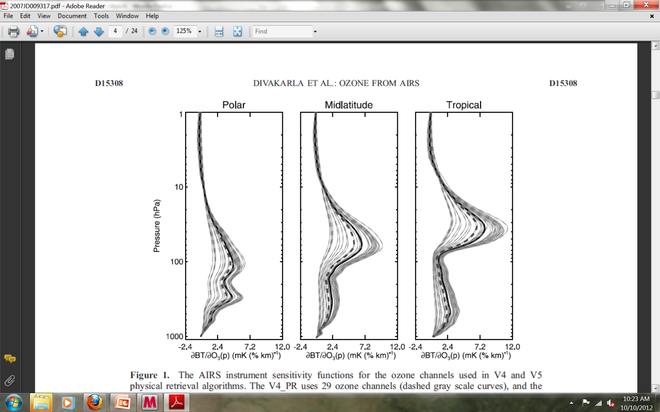
Atmospheric InfraRed Sounder (AIRS) 431mb O3 retrieval shows ozone maxima that is consistent with 320K IPV

Slide 10
Time series of 15 minute Colorado ozone concentrations
May 24, 2010
Aurora (AURE) Chatfield (CHAT), Manitou (MAN), Aspen Park (ASP), Fort Collins West (FTCW), Gothic (GOTH), and Kenosha Pass (KEN). Time in MST and concentrations for the hour ending at the indicated time.
* Patrick J. Reddy, Air Pollution Control Division Colorado Department of Public Health and Environment

Slide 11
Can global ozone chemical analyses/forecasts, coupled with regional ozone predictions help inform SI Exceptional Event analysis?
DC3 (May-June 2012)
  1x1 degree RAQMS* forecast initialized from MLS/OMI ozone analysis
  8km Continental US WRF-CHEM (RACMKPP mechanism)
  May 24, 2012 Manitou Springs, CO SI event
  June 06, 2012 Thunder Basin, WY SI event
*RAQMS realtime forecasts supported NSF GV and NASA DC8 flight planning during DC3 (http://catalog.eol.ucar.edu/cgi-bin/dc3_2012/model/index)

Slide 12
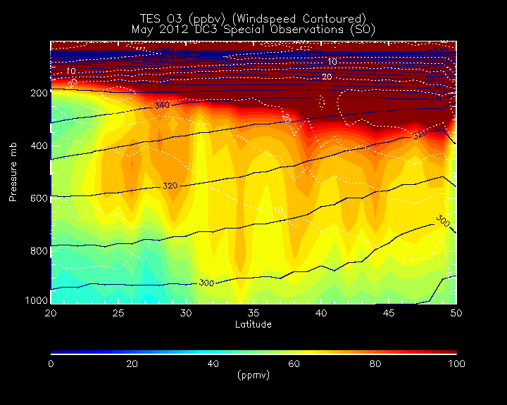
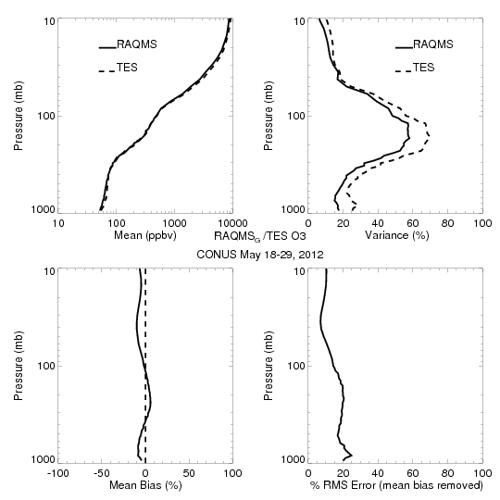
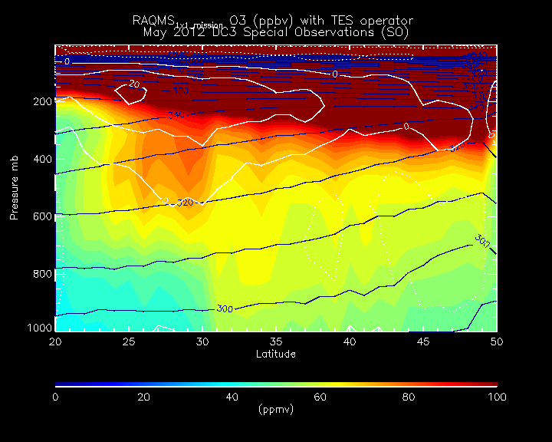
CONUS RAQMS 1x1 O3 analysis vs TES Special Observations during DC3 Mission
(TES Averaging Kernel Applied)
With TES Averaging Kernel, RAQMS O3 is within 10% of TES except at 25N/200mb where biases reach 20%

Slide 13
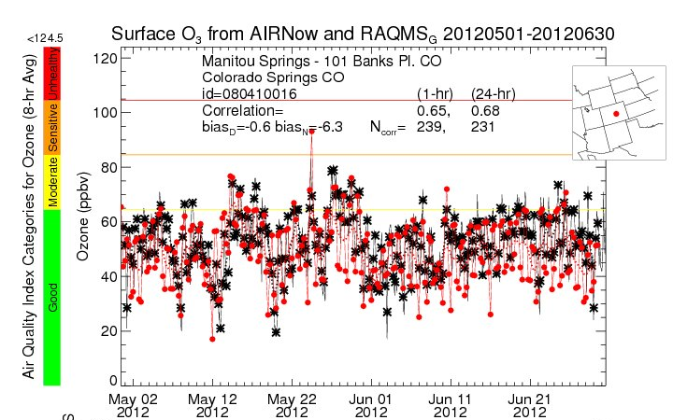
  May 24, 2012 Manitou Springs, CO SI event
RAQMS 1x1 degree ozone analysis captures synoptic variability at Colorado Springs, CO (24hr r=0.68, low daytime bias) but…..

Slide 14
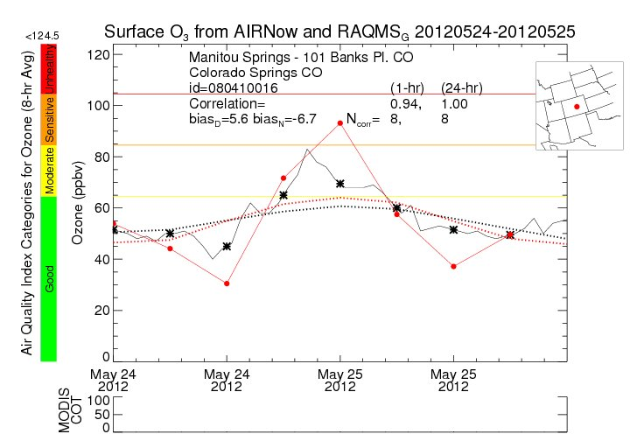
  May 24, 2012 Manitou Springs, CO SI event
RAQMS 1x1 analysis overestimates Manitou Springs, CO surface O3 during SI event

Slide 15
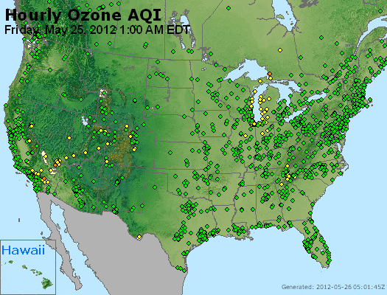
  May 24, 2012 Manitou Springs, CO SI event

Slide 16
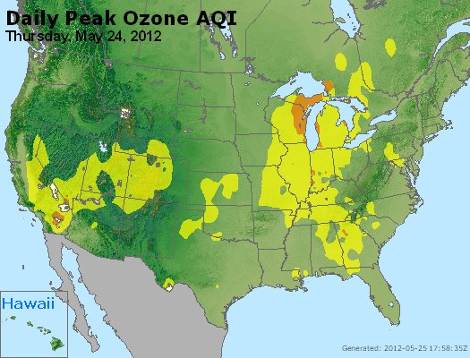
  May 24, 2012 Manitou Springs, CO SI event

Slide 17
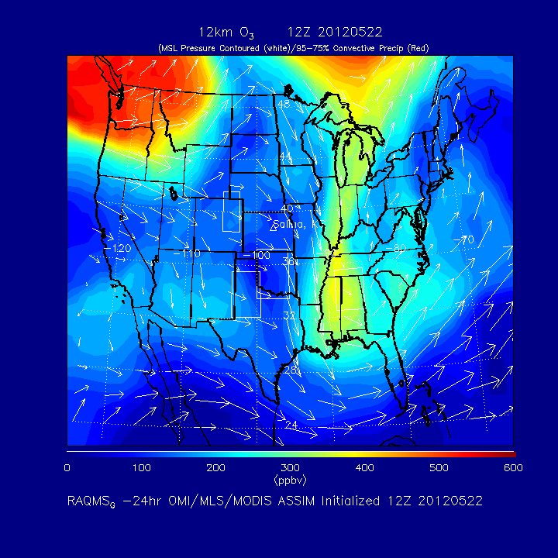

Slide 18
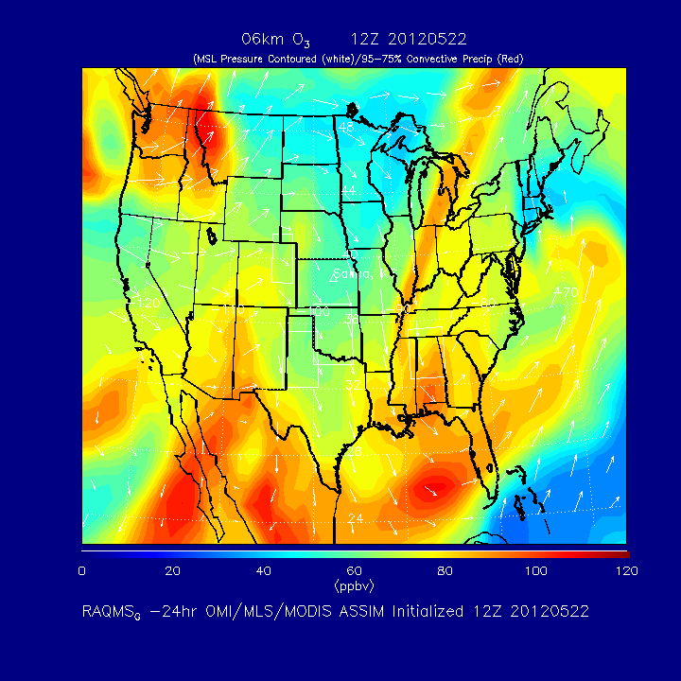

Slide 19
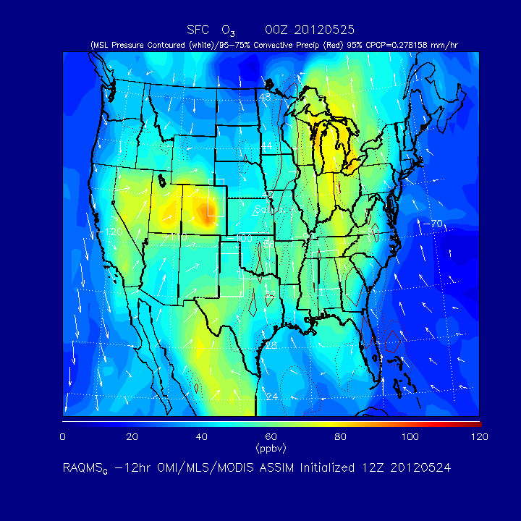

Slide 20
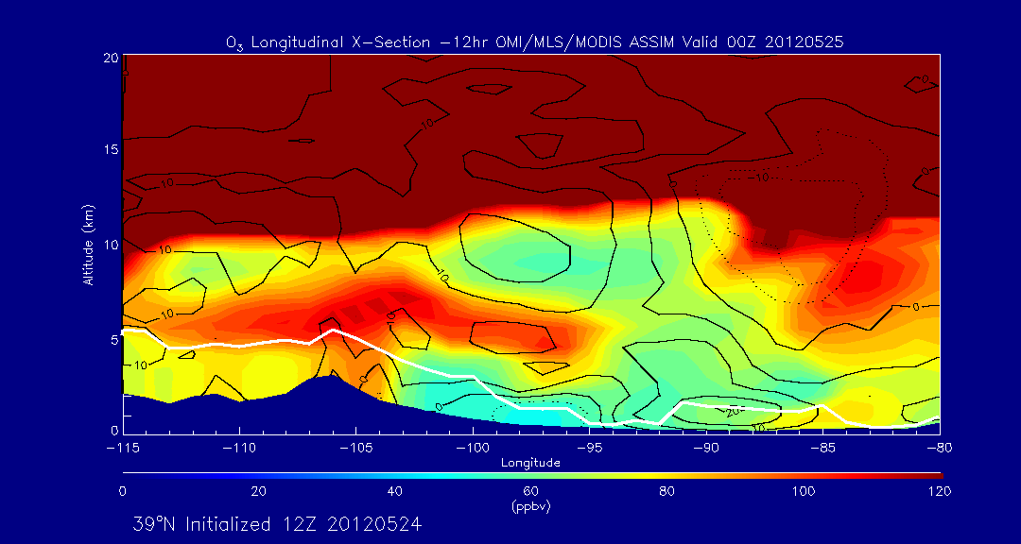
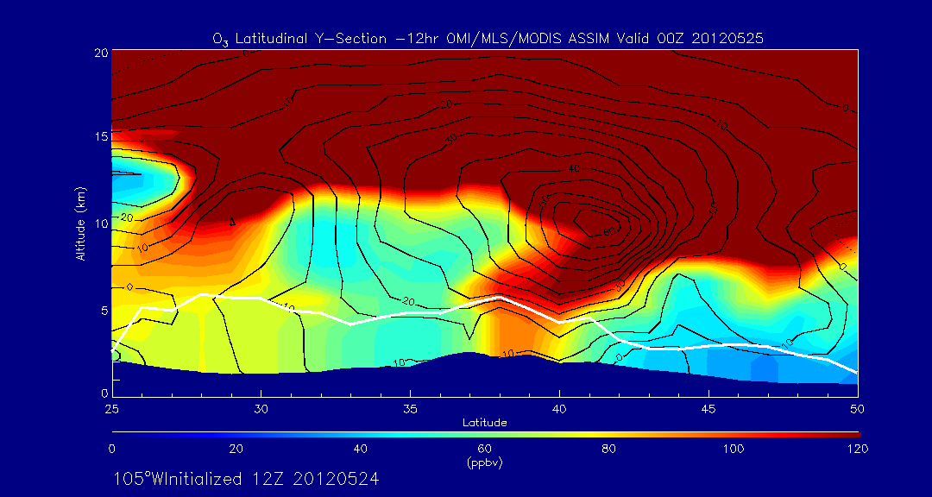
Manitou Springs (Colorado Springs, CO)
Manitou Springs (Colorado Springs, CO)

Slide 21
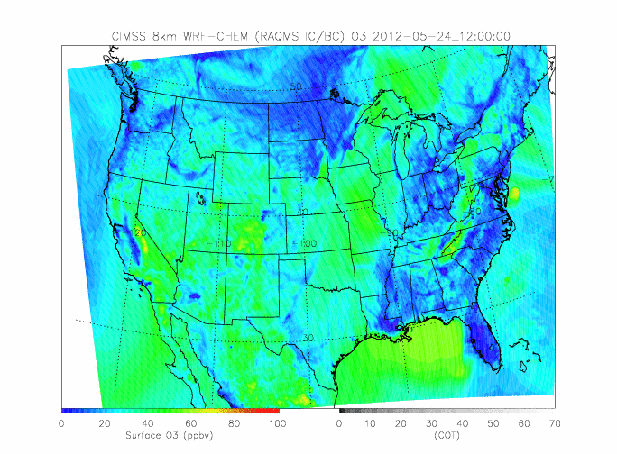
Nested 8km WRF-CHEM Surface Ozone 12Z 05/24-12Z 05/25

Slide 22
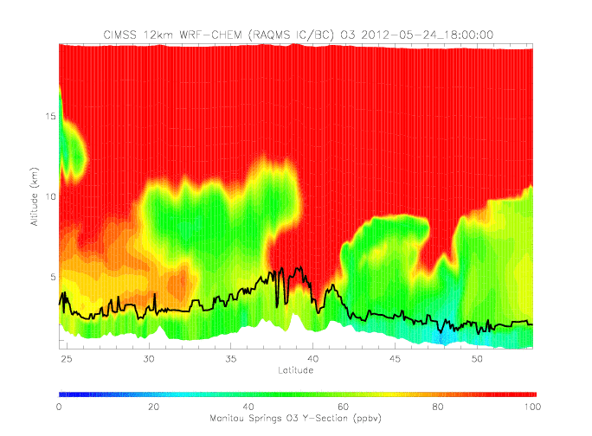
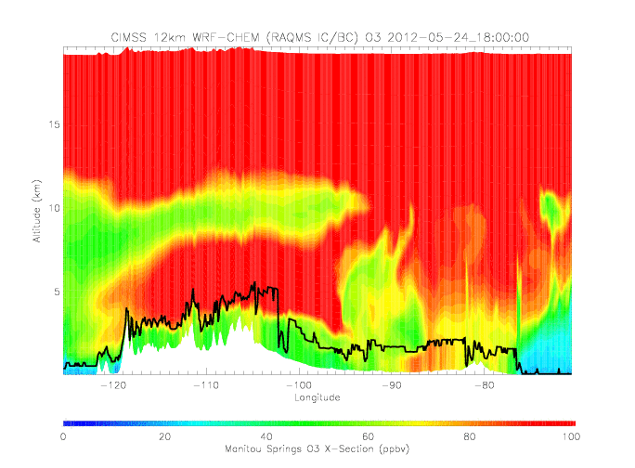
Nested 8km WRF-CHEM Ozone Cross-sections
18Z 05/24-00Z 05/25
North-South Cross-section
East-West Cross-section
CIMSS 8km WRF-CHEM (RAQMS IC/BC) O3
CIMSS 8km WRF-CHEM (RAQMS IC/BC) O3
Manitou Springs
(Colorado Springs, CO)
Manitou Springs
(Colorado Springs, CO)
SI event shows sharper gradient in O3 across top of WRF-CHEM PBL

Slide 23
  May 24, 2012 Manitou Springs, CO SI event
RAQMS 1x1 analysis overestimates Manitou Springs, CO surface O3 during SI event

Slide 24
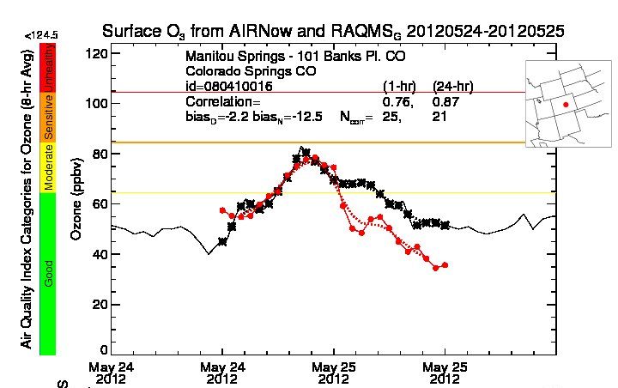
  May 24, 2012 Manitou Springs, CO SI event
Surface O3 from AIRNow and WRFCHEM 20120524-20120525
Significant improvement in 8km WRF-CHEM surface ozone prediction during onset of SI event relative to 1x1 RAQMS surface ozone analysis

Slide 25
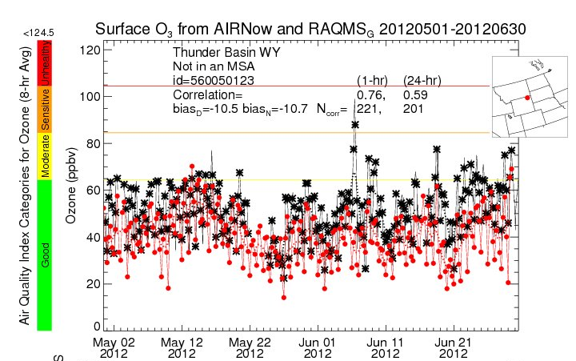
  June 06, 2012 Thunder Basin, WY SI event
RAQMS 1x1 degree ozone analysis underestimates synoptic variability at Thunder Basin, WY (24hr r=0.59, large day and night bias) and…..

Slide 26
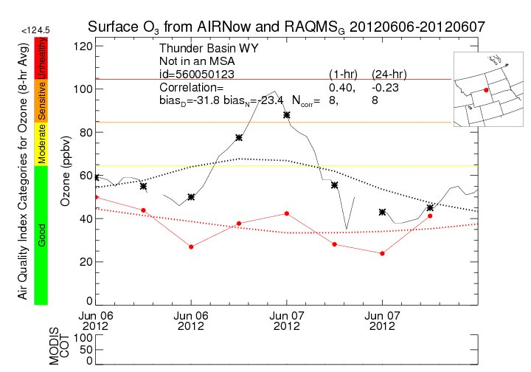
  June 06, 2012 Thunder Basin, WY SI event
RAQMS 1x1 analysis significantly underestimates Thunder Basin, WY surface O3 during SI event

Slide 27
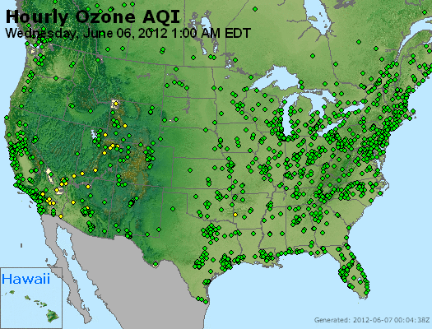
  June 06, 2012 Thunder Basin, WY SI event

Slide 28
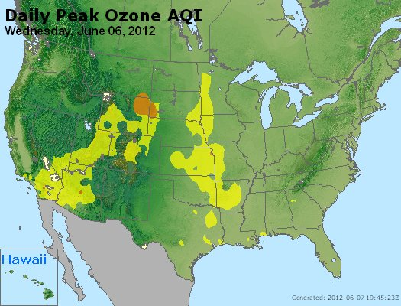
  June 06, 2012 Thunder Basin, WY SI event

Slide 29
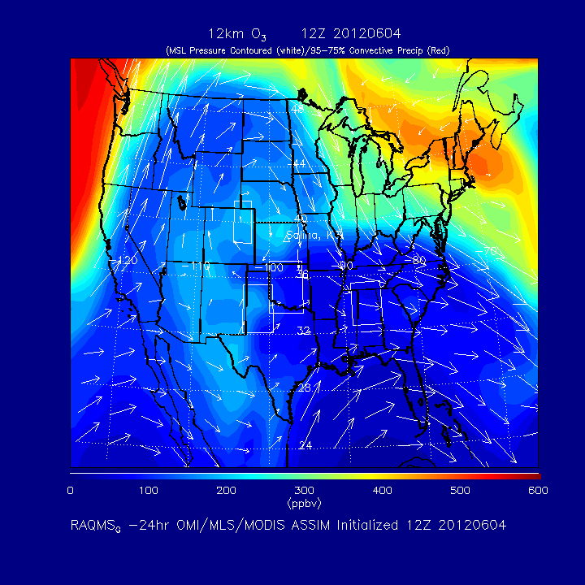

Slide 30
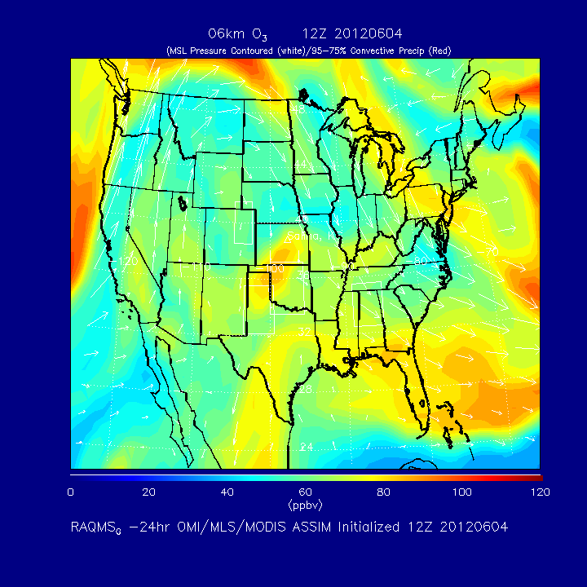

Slide 31
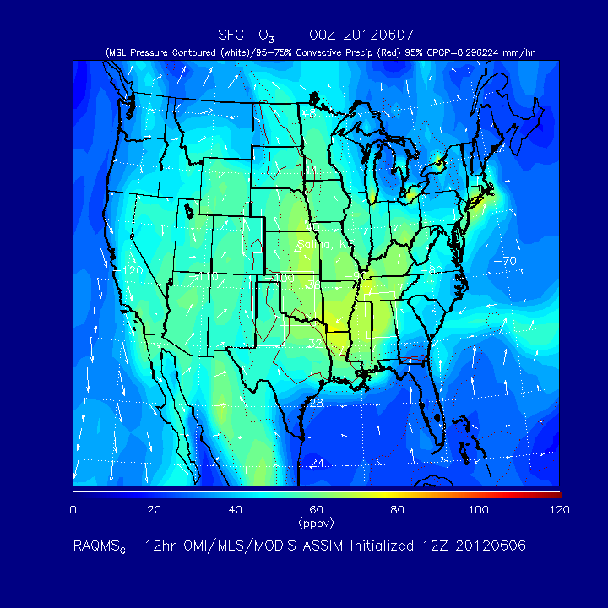

Slide 32
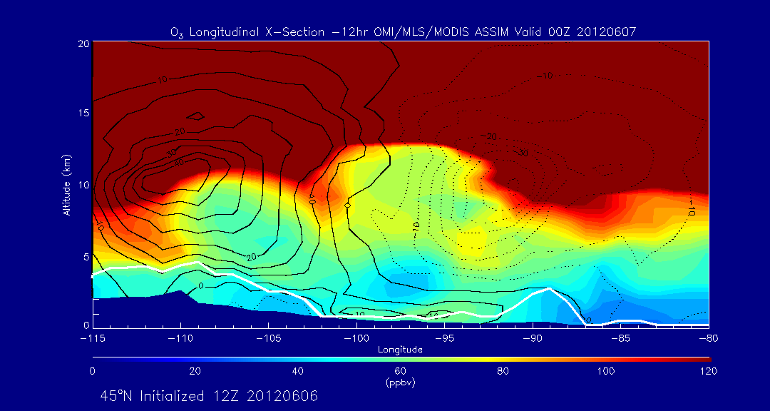
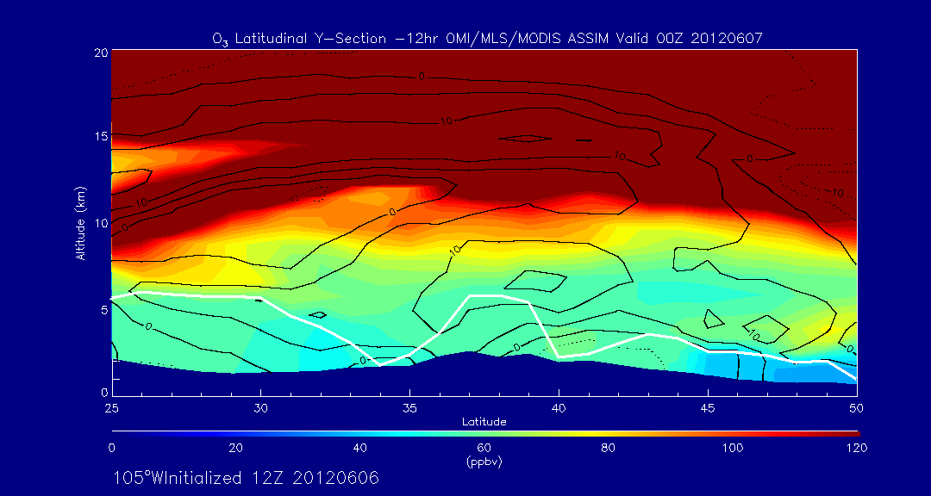
Thunder Basin (WY)
Thunder Basin (WY)

Slide 33
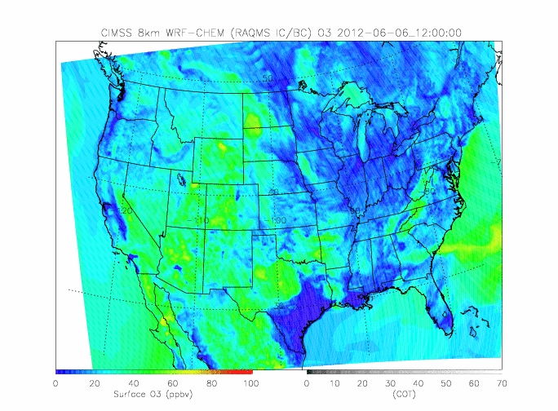
Nested 8km WRF-CHEM Surface Ozone 12Z 06/06-12Z 06/07

Slide 34
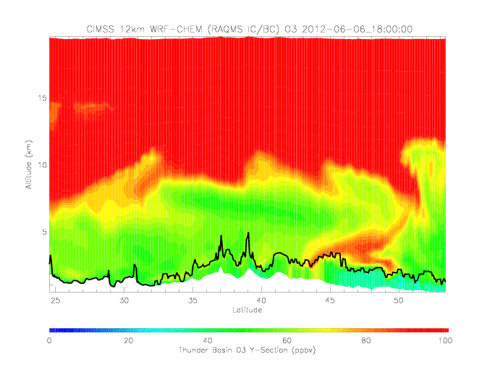
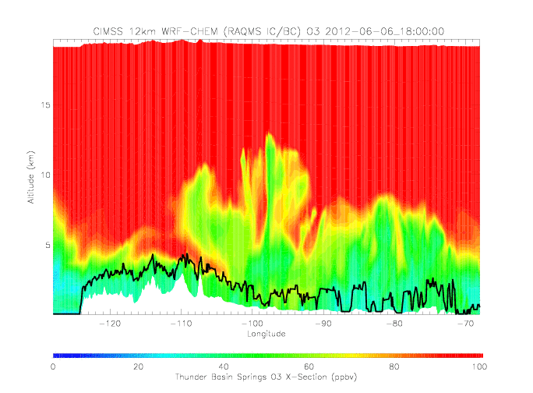
Nested 8km WRF-CHEM Ozone Cross-sections
18Z 06/06-00Z 06/07
North-South Cross-section
East-West Cross-section
CIMSS 8km WRF-CHEM (RAQMS IC/BC) O3
CIMSS 8km WRF-CHEM (RAQMS IC/BC) O3
Thunder Basin (WY)
Thunder Basin (WY)
SI event shows higher O3 above WRF-CHEM PBL but still a sharp gradient in O3 across top of PBL

Slide 35
  June 06, 2012 Thunder Basin, WY SI event
RAQMS 1x1 analysis significantly underestimates Thunder Basin, WY surface O3 during SI event

Slide 36
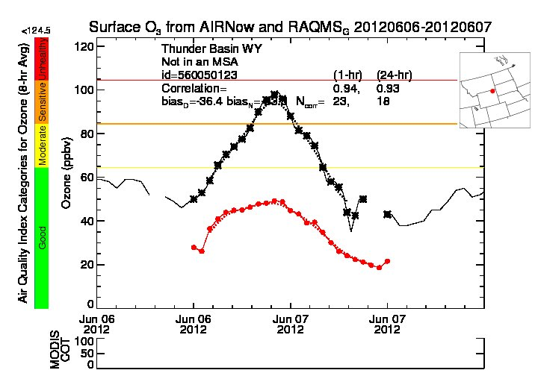
  June 06, 2012 Thunder Basin, WY SI event
Surface O3 from AIRNow and WRFCHEM 20120606-20120607
Very slight improvement in 8km WRF-CHEM surface ozone prediction during onset of SI event relative to 1x1 RAQMS surface ozone analysis

Slide 37
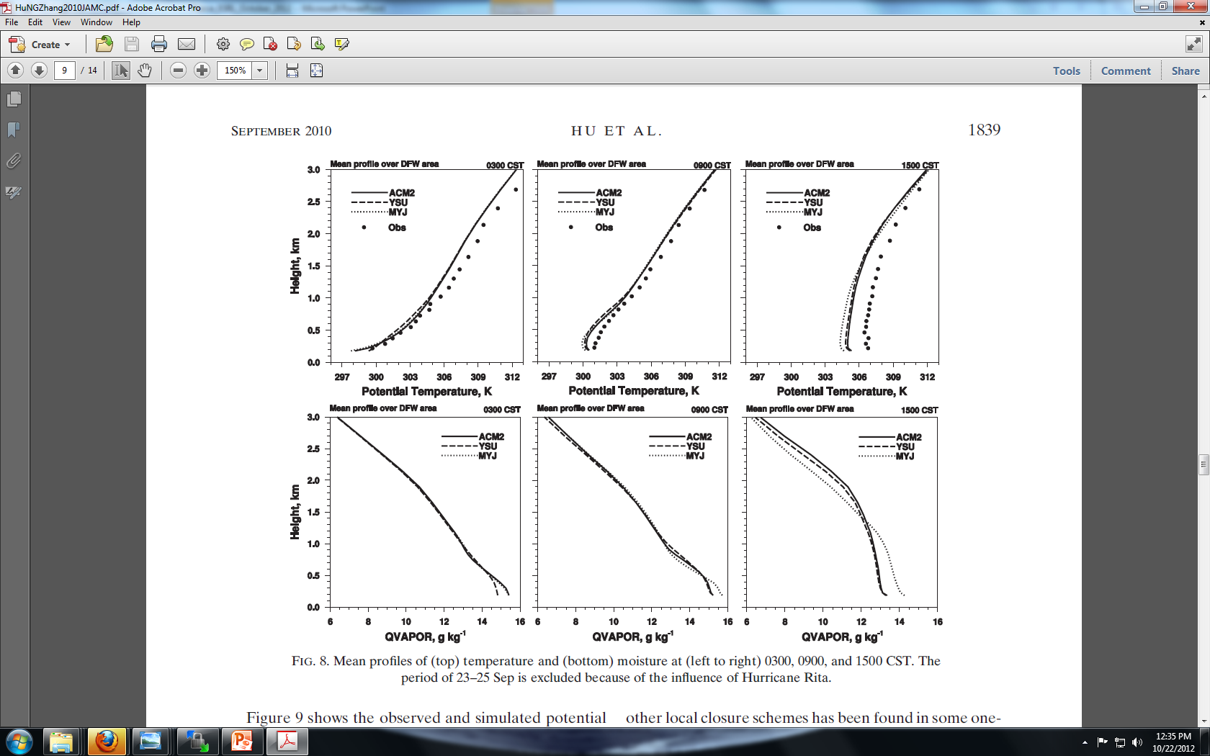
PBL scheme sensitivity
WRF supports three different PBL schemes:
  Mellor–Yamada–Janjic (MYJ)
  Yonsei University (YSU)
  Asymmetric Convective Model, version 2 (ACM2)
MYJ is a local TKE scheme, YSU and ACM2 are non-local schemes based on Bulk Richardson number.
  YSU and ACM2 tend to have more mixing and deeper PBL depths
  WRF-CHEM only supports MYJ and YSU
  8km WRF-CHEM runs used MYJ
Hu et al., 2010, Evaluation of Three Planetary Boundary Layer Schemes in the WRF Model, JAMC, DOI: 10.1175/2010JAMC2432.1

Slide 38
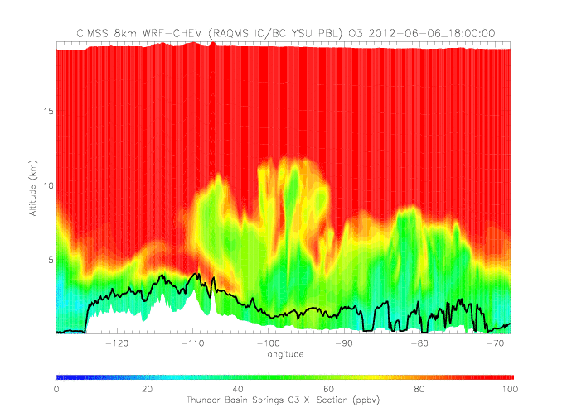

CIMSS 8km WRF-CHEM (RAQMS IC/BC) O3
Thunder Basin (WY)
YSU scheme shows more mixing into PBL over Thunder Basin, WY
ACM2 shows even larger mixing of SI event into PBL
MYJ
Thunder Basin (WY)
Thunder Basin (WY)
YSU
ACM2

Slide 39
  June 06, 2012 Thunder Basin, WY SI event
Surface O3 from AIRNow and WRFCHEM 20120606-20120607
MYJ scheme

Slide 40
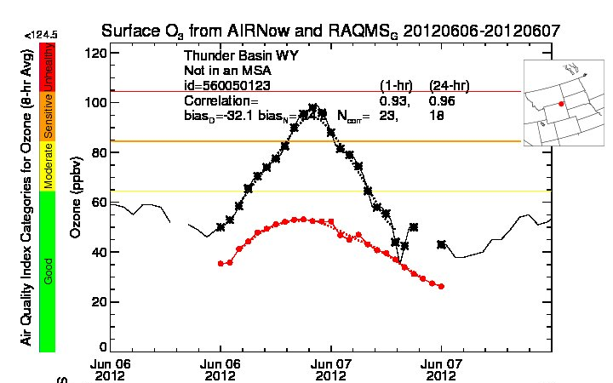
  June 06, 2012 Thunder Basin, WY SI event
YSU scheme shows slight increase in surface O3 relative to MYJ scheme

Slide 41
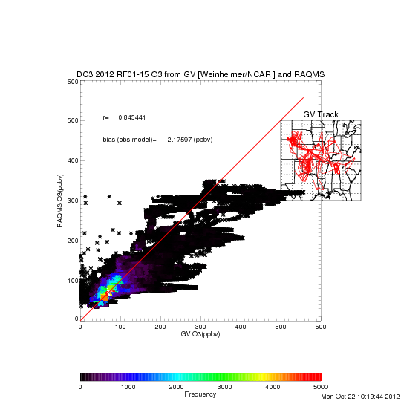
RAQMS vs NCAR GV Insitu O3* during DC3
(May-June 2012)
Comparison with DC3 GV O3 (Andy Weinheimer, NCAR) shows high correlation (r=0.845) and low biases (2.18ppbv) but RAQMS underestimates the highest O3 observed by the GV by a factor of 2-3
*Preliminary DC3 O3 measurements provided by Andy Weinheimer, NCAR

Slide 42
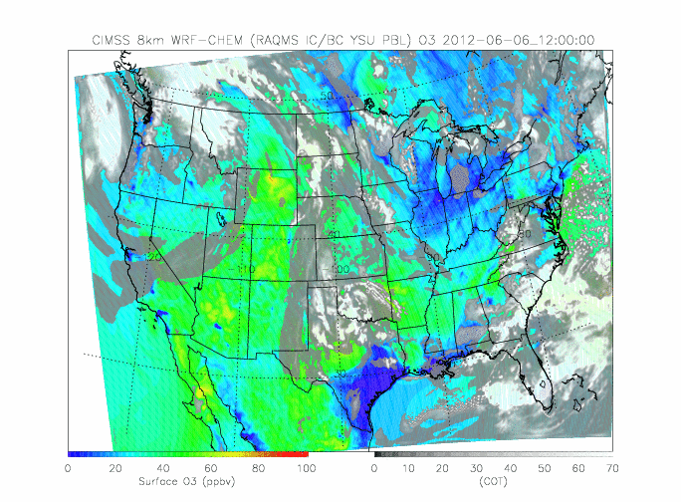
Nested 8km WRF-CHEM Surface Ozone and Cloud Optical Depth
12Z 06/06-12Z 06/07
What role does frequent deep convection along dry line over central plains play in upper tropospheric ozone?

Slide 43
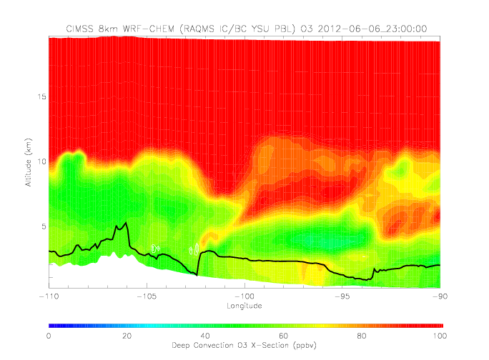
Ozone enhancements due to convective downdrafts

Slide 44
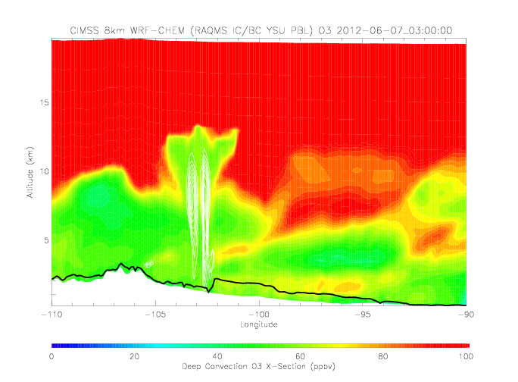
Ozone enhancements due to convective downdrafts
8km horizontal resolution WRF-CHEM is relatively coarse for explicitly resolving convection but does show significant downwelling of high ozone within convective environment

Slide 45
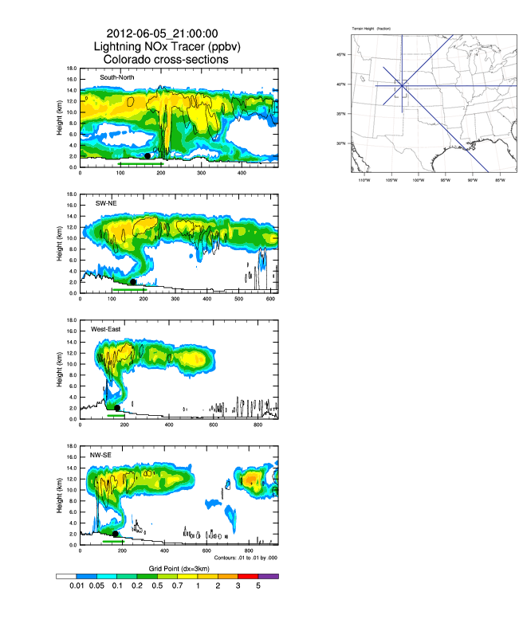
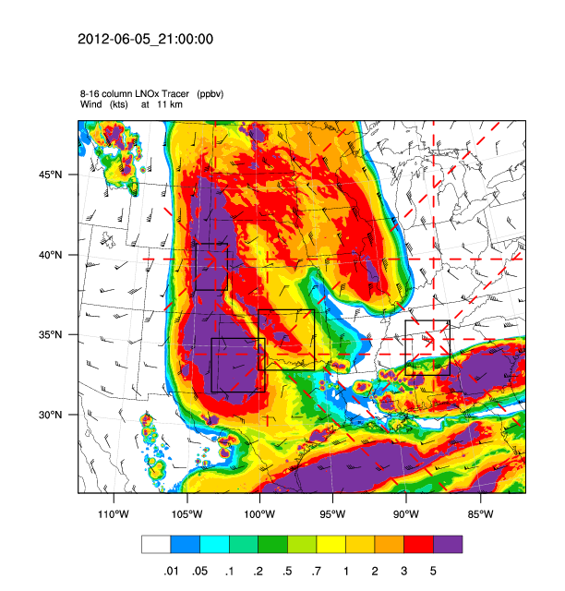
Ozone enhancements due to Lightning NOx production
DC3 lightning NOx forecast* shows significant (1-2 ppbv) NOx between 10-12km in convective outflow over Eastern CO and WY during the previous evening (06/05)
*DC3 WRF 3km Lighting NOx predictions provided by Mary Barth, NCAR

Slide 46
Conclusions
It is relatively straightforward to demonstrate the SI events can lead to significant ozone enhancements that descend to the PBL over the western US
However, it is more difficult to predict the entrainment of SI ozone enhancements into the PBL – different PBL schemes show significantly different degrees of entrainment
Continuous profiling by ground-based ozone lidar would be highly useful for verification of PBL entrainment processes

Slide 47
Conclusions (cont)
RAQMS tends to underestimate the occurrence of highest ozone mixing ratios over the Western US due to:
  relatively coarse horizontal and vertical resolution
  parameterized convection
  underestimates in lightning NOx production
Representation of the springtime accumulation of high ozone in the due to convective processes (downwelling, lightning NOx production) requires multi-week nested simulations

Slide 48
Extra Slides

Slide 49
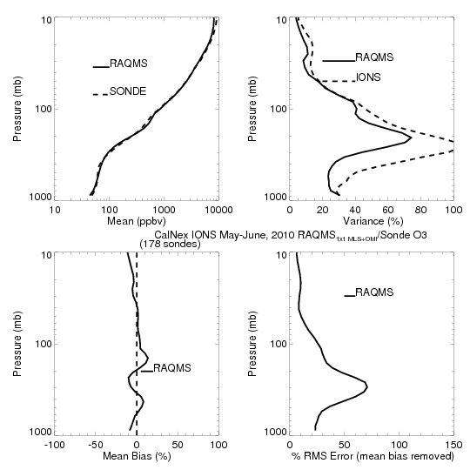
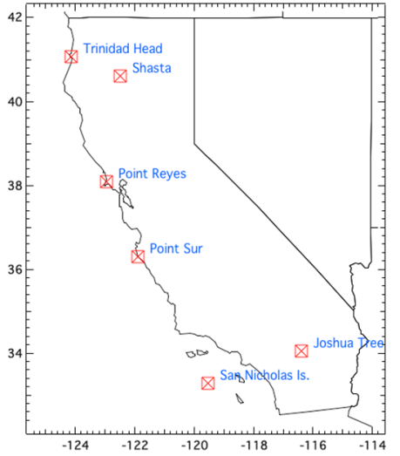
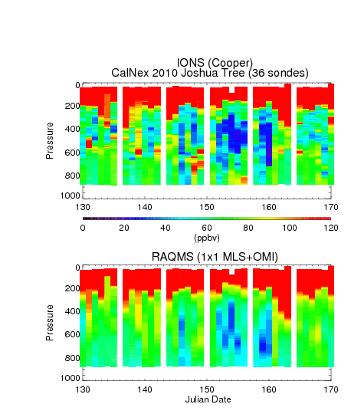
Comparison with CalNex IONS ozonesondes (Owen Cooper, ESRL) shows low (~10%) mean errors but underestimate in tropospheric variability

Slide 50
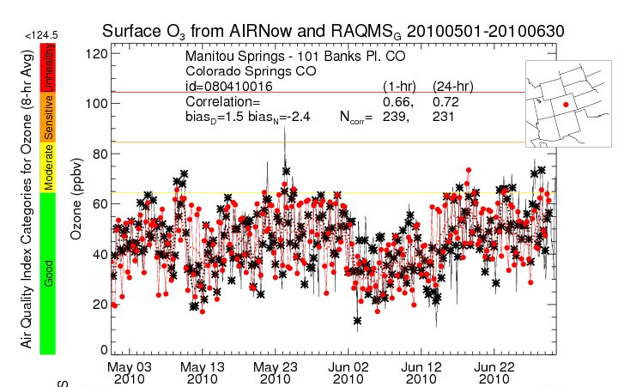
RAQMS 1x1 degree ozone analysis captures synoptic variability at Colorado Springs, CO (24hr r=0.72, low bias) but…..

Slide 51
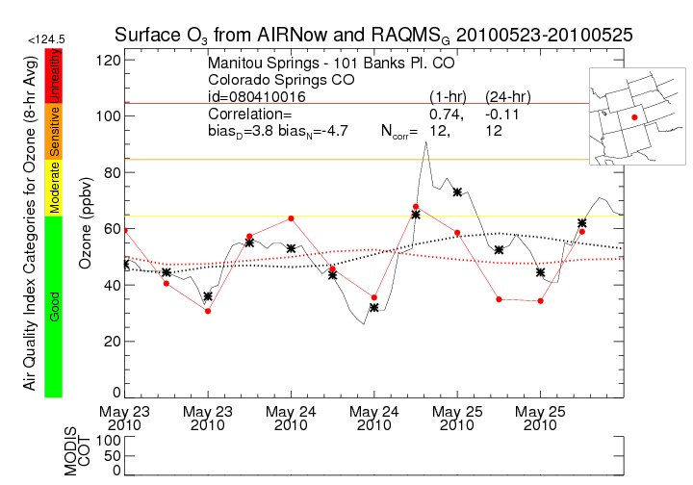
  May 24, 2010 Manitou Springs, CO SI event
RAQMS 1x1 analysis underestimates Manitou Springs, CO surface O3 during SI event

Slide 52

  May 24, 2010 Manitou Springs, CO SI event

Slide 53


Slide 54


Slide 55


Slide 56


Manitou Springs (Colorado Springs, CO)
Manitou Springs (Colorado Springs, CO)

Slide 57

Nested 12km WRF-CHEM Surface Ozone 00Z 05/24-00Z 05/25

Slide 58


Nested 12km WRF-CHEM Ozone Cross-sections
18Z 05/24-00Z 05/25
North-South Cross-section
East-West Cross-section
Manitou Springs
(Colorado Springs, CO)
Manitou Springs
(Colorado Springs, CO)
SI event shows sharp gradient in O3 across top of PBL in 8km WRF-CHEM

Slide 59
  May 24, 2010 Manitou Springs, CO SI event
RAQMS 1x1 analysis underestimates Manitou Springs, CO surface O3 during SI event

Slide 60

  May 24, 2010 Manitou Springs, CO SI event
Surface O3 from AIRNow and WRFCHEM 20100523-20100525
No significant improvement in 12km WRF-CHEM surface ozone prediction relative to 1x1 RAQMS surface ozone analysis for Colorado Springs, CO SI event

Slide 61


CONUS RAQMS 1x1 O3 analysis vs TES Special Observations during DC3 Mission
(Raw RAQMS analysis)
RAQMS “raw” O3 analysis shows high bias of up to 30% below 200mb and low bias of up to 20% above 200mb.

