Slide 1
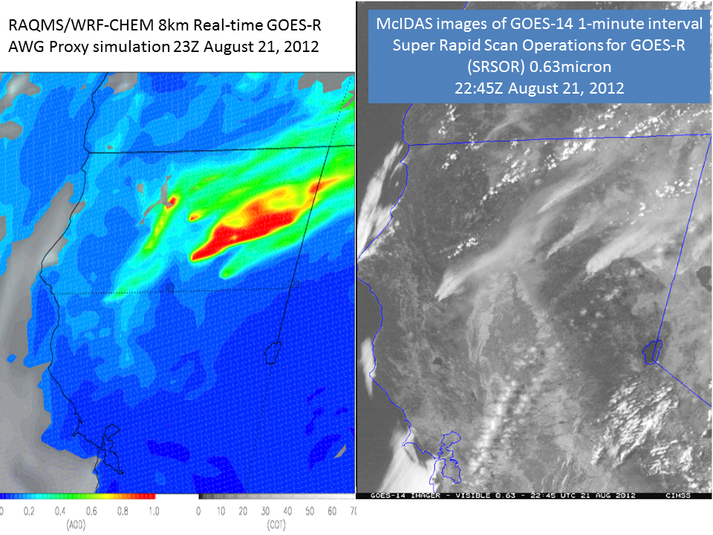
CIMSS/ASPB GOES-R ABI Real-time Proxy
Real-time Proxy Framework Support: WRF-Chem/RAQMS Component
Nested RAQMS/WRF-CHEM aerosol simulations are now being produced in real-time to support GOES-R Proxy Framework
GOES-R Proxy aerosol optical depth (AOD) simulation captures observed smoke due to wildfires in Northern California
Real-time Proxy AOD/COT (left) and GOES-14 visible image (right) of August 21, 2012 Northern California Wildfires
GOES-R Proxy Framework supports GOES-R ABI pre-launch activities by providing real-time GOES Rebroadcast (GRB) files containing synthetic ABI radiances that will be distributed to AIT and Proving Ground partners for testing GOES-R algorithms and data systems in real-time.

Slide 2
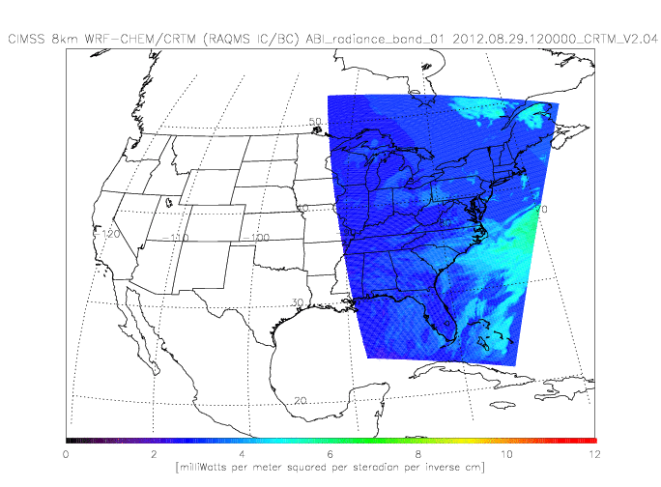
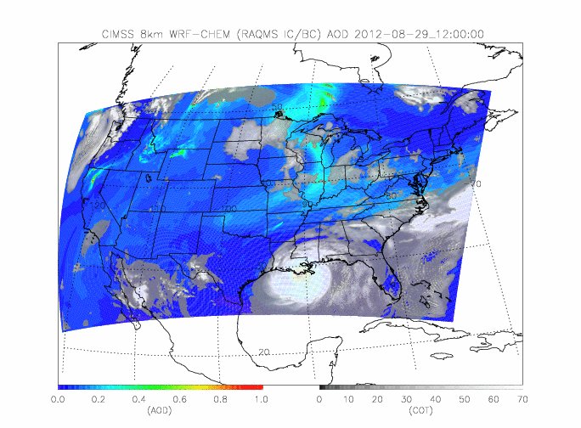
CIMSS/ASPB GOES-R ABI Real-time Proxy
Real-time Proxy AOD/COT (right) and Simulated ABI Band 01 Radiance (left) for August 29-30, 2012 Hurricane Isaac Landfall
Real-time Proxy Framework Support: Real-time Proxy Framework Support: CRTM and Validation Component
CRTM is being used to produce all ABI Bands in real-time to support GOES-R Proxy Framework
Real-time geophysical validation using MODIS AOD/COT is currently being tested.
Real-time radiance validation using GOES visible and IR bands is currently under development
GOES-R Proxy Framework supports GOES-R ABI pre-launch activities by providing real-time GOES Rebroadcast (GRB) files containing synthetic ABI radiances that will be distributed to AIT and Proving Ground partners for testing GOES-R algorithms and data systems in real-time.

