Slide 1
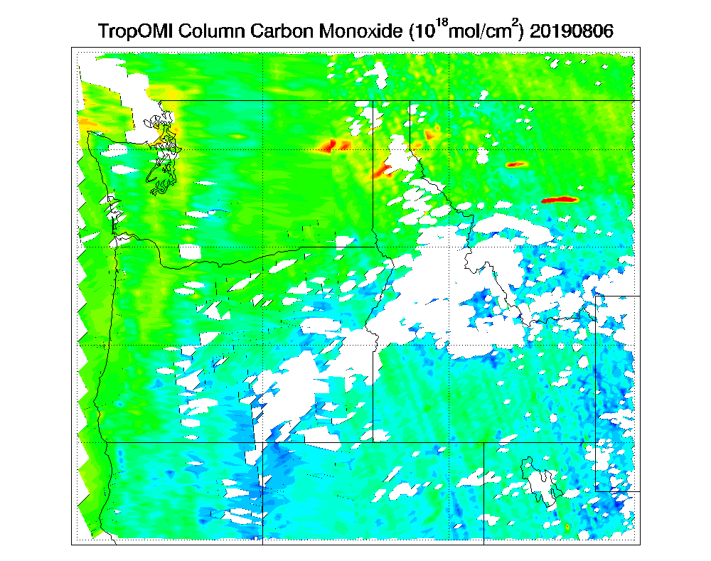
TMP 18/19-09
Exploit TROPOMI Sensor
OPPA TMP 2019
End-Of-year (EOY)
Report Presentation
Williams Flats Fire August 06, 2019
NOAA-20 VIIRS AOD
TROPOMI CO (10¹⁸ mol/cm²)
Presented by:
R. Bradley Pierce
UW-Madison Space Science and Engineering Center
PI: Tim Schmit, CoI’s: Allen Lenzen,
Tommy Jasmin, Collaborator Brad Pierce

Slide 2
Project Summary:
Exploit composition retrievals from the TROPOspheric Monitoring Instrument (TROPOMI) to improve air quality forecasts through better constraints on long-range pollution transport and timely updates of global NOx emission inventories.
Air quality forecast improvements are realized through chemical data assimilation using the TROPOMI carbon monoxide (CO) and nitrogen dioxide (NO2) retrievals within the Next Generation Global Prediction System (NGGPS) Unified Forecast System (UFS) with Real-time Air Quality Modeling System (RAQMS) chemistry.
Supports situational awareness for NWS Incident Meteorologists (IMET) through better estimates of the vertical distribution of pollution from wildfires. This is accomplished by combining the NOAA Unique Combined Atmospheric Processing System (NUCAPS) and TROPOMI CO retrievals to constrain boundary layer CO concentrations.
01/07/2020

Slide 3
Project Objective(s):
Combining NUCAPS and TROPOMI CO retrievals to constrain boundary layer CO concentrations within UFS.
Utilizing TROPOMI tropospheric NO2 retrievals to constrain UFS global nitrogen oxide (NOx) emission inventories.
Developing a multi-sensor level 3 (L3) boundary layer CO product by combining NUCAPS and TROPOMI CO retrievals.
01/07/2020

Slide 4
Strategic Alignment Discussions:
NOAA & NESDIS Strategic Plan
The NOAA Satellite Observing System Architecture (NSOSA) study prioritized atmospheric composition measurements as one of the future product needs for National terrestrial and ocean observation objectives.
Exploitation of TROPOMI atmospheric composition measurements aligns with NESDIS’s Mission to provide global environmental data from satellites to protect the Nation’s environment and quality of life through improved air quality forecasts.
NWS Strategic Plan
Annex 10 “Aerosols and Atmospheric Composition” of the Strategic Implementation Plan for Evolution of NGGPS to a National Unified Modeling System outlines the need for including aerosol and chemistry within the UFS.
Project 10.2 of Annex 10 “Data Assimilation for Atmospheric Composition” identifies essential chemical data assimilation (CDA) and emission data assimilation (EDA) capabilities needed to accomplish these goals
World Meteorological Organization (WMO) 2025 Vision
A constellation of atmospheric composition instruments “including high spectral resolution UV sounder on geostationary orbit and at least a UV sounder on am + pm orbit” for “greenhouse gas monitoring, ozone/UV monitoring, air quality monitoring”.
01/07/2020

Slide 5
FY2019 Accomplishments:
The project milestones and status are listed in the table below.
Milestone | Description | Status
1 | Project Start | Sept, 2019
2 | Collect July-September 2019 NUCAPS and TROPOMI retrievals. Develop and test L3 multi-sensor boundary layer CO retrieval | Complete
3 | Conduct UFS-RAQMS Baseline and 15% wildfire and anthropogenic emissions reduction forecast experiments | Complete
4 | Generate CO and NO₂ background error covariances and NO_{X} wildfire and anthropogenic Jacobians | Complete
5 | Conduct UFS-RAQMS/GSI TROPOMI NO₂ data assimilation experiments and off-line wildfire/anthropogenic NO_{X} emissions adjustments | Complete
6 | Conduct FV3-RAQMSCHEM adjusted NO_{X} emission experiment to assess impact of TROPOMI NO₂ assimilation | Complete
7 | Conduct FV3-RAQMSCHEM NUCAPS, TROPOMI, and NUCAPS+TROPOMI CO assimilation experiments | Partially Completed (TROPOMI CO DA)
8 | Prepare final report | Completed
01/07/2020

Slide 6
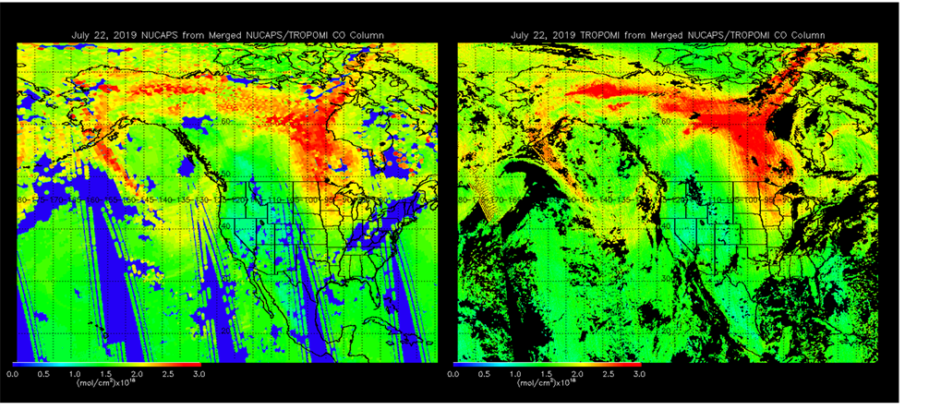
FY2019 Accomplishments:
Develop and test L3 multi-sensor boundary layer CO retrieval
NUCAPS CO Column July 22, 2019
TROPOMI CO Column July 22, 2019
TROPOMI SWIR retrieval uses reflected solar radiances and is sensitive to the total CO column
NUCAPS TIR retrieval uses thermal emission and is most sensitive to mid tropospheric CO concentrations
01/07/2020

Slide 7
FY2019 Accomplishments:
Develop and test L3 multi-sensor boundary layer CO retrieval
VIIRS True Color Imagery July 22, 2019
TROPOMI-NUCAPS CO Column July 22, 2019
Difference (TROPOMI-NUCAPS) highlights boundary layer CO concentrations that show where smoke is near the surface
01/07/2020

Slide 8
FY2019 Accomplishments:
UFS-RAQMS TROPOMI NO2 off-line NOx emission adjustment experiments
Calculate monthly mean NO₂ Jacobian (β) from a 15% NO_{X} emission reduction perturbation experiment following Lamsal et al. 2011
Calculate monthly mean NO₂ analysis increment using UFS-RAQMS/GSI TROPOMI NO₂ assimilation
NOx wildfire emission sensitive background errors (to correct UFS-RAQMS wildfire emissions)
Adjust UFS-RAQMS NO_{x} wildfire emissions using Jacobian and average analysis increment
Lamsal, L. N., et al. (2011), Application of satellite observations for timely updates to global anthropogenic NOx emission inventories, Geophys. Res. Lett., 38, L05810, doi:10.1029/2010GL046476.
01/07/2020

Slide 9
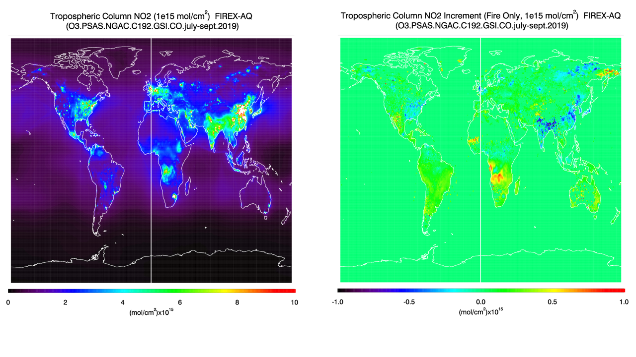
FY2019 Accomplishments:
UFS-RAQMS TROPOMI NO2 off-line NOx emission adjustment experiments
UFS-RAQMS Tropospheric column NO2 (left) and TROPOMI fire only analysis increment (right) for July-September, 2019. Units are 1e¹⁵ mol/cm²
01/07/2020

Slide 10
FY2019 Accomplishments:
UFS-RAQMS TROPOMI NO2 off-line NOx emission adjustment experiments
nox_scale_factor=
UFS-RAQMS TROPOMI based wildfire NOx emission factor (left) for July-September, 2019 and UFS-RAQMS Land Type (right). Both quantities are unitless.
01/07/2020

Slide 11
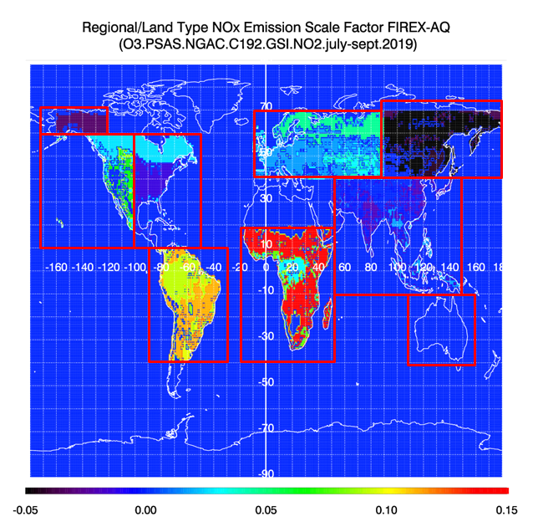
FY2019 Accomplishments:
UFS-RAQMS TROPOMI NO2 off-line NOx emission adjustment experiments
The scale factor is applied as follows:
bb_nox_adjusted=bb_nox+nox_scale_factor*bb_nox
UFS-RAQMS TROPOMI based Regional/Land Type wildfire NOx emission factor for July-Sept, 2019 (unitless).
01/07/2020

Slide 12
FY2019 Accomplishments:
UFS-RAQMS TROPOMI NO2 off-line NOx emission adjustment experiments
Small (~1%) differences
TROPOMI (left) and UFS-RAQMS difference (with minus without emission adjustment, right) on July 12, 2019. Log10 of the TROPOMI tropospheric NO2 column is contoured so that the full dynamic range can be shown except for the difference (lower right). Units are 1e¹⁵ mol/cm²
01/07/2020

Slide 13
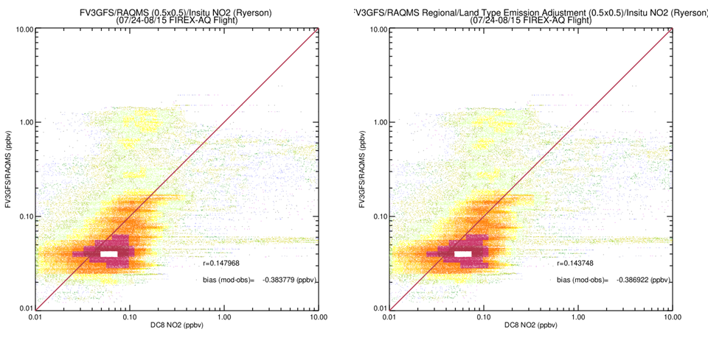
FY2019 Accomplishments:
UFS-RAQMS TROPOMI NO2 off-line NOx emission adjustment experiments
Verification during 2019 NASA/NOAA FIREX-AQ field campaign
Small (~1%) differences
Without DA
With DA
These wildfire NOx emission adjustment experiments during the NASA NOAA FIREX-AQ field campaign demonstrate the difficulties in using TROPOMI tropospheric NO2 columns to provide off-line constraints on global wildfire emissions.
01/07/2020

Slide 14
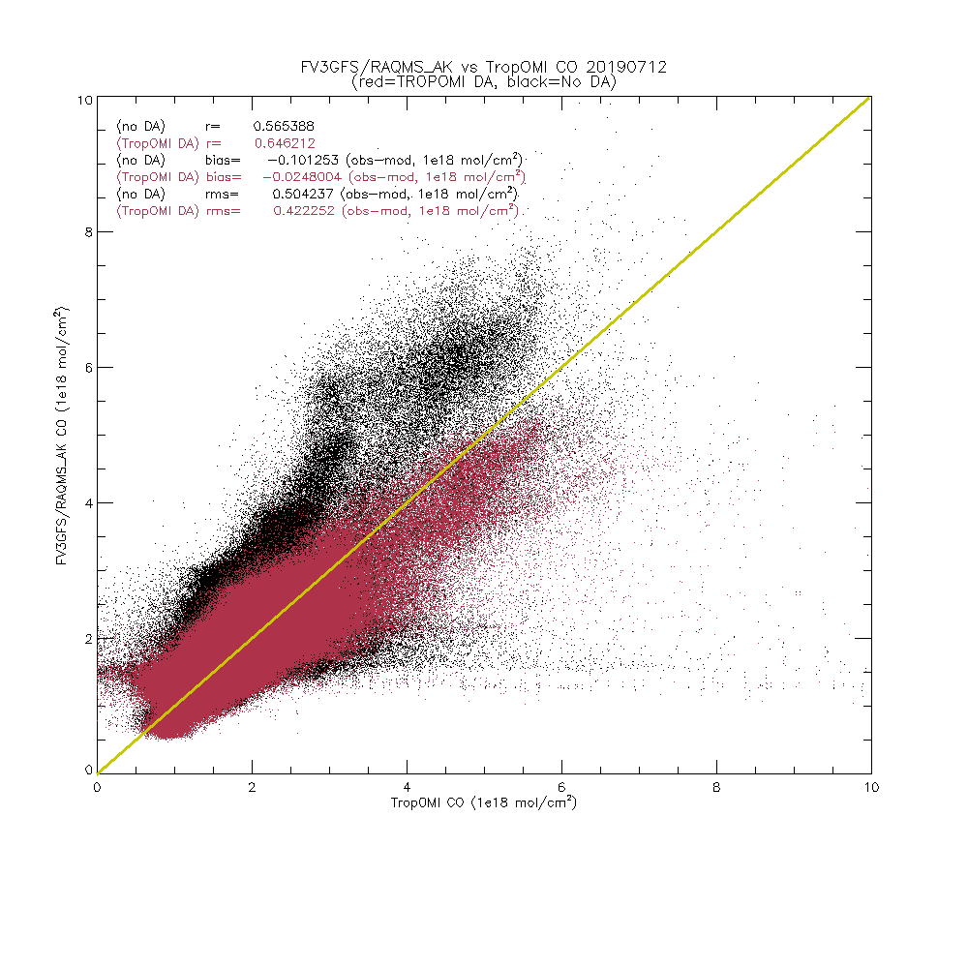
FY2019 Accomplishments:
UFS-RAQMS TROPOMI CO assimilation experiments
TROPOMI O-A July 12, 2019
01/07/2020

Slide 15
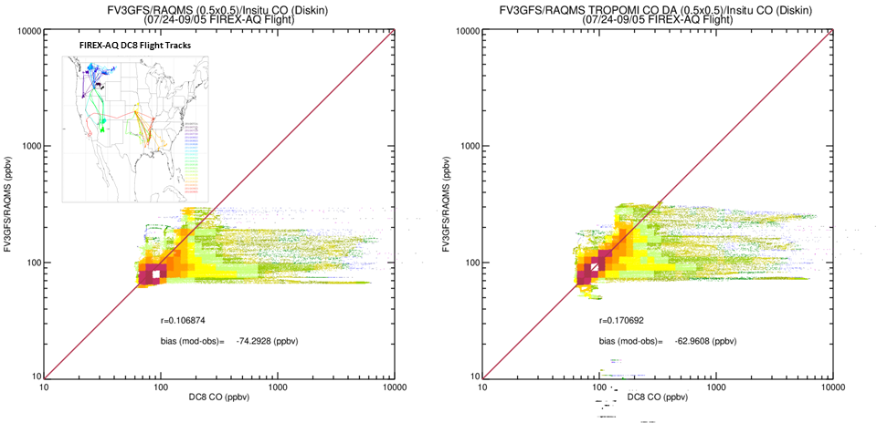
FY2019 Accomplishments:
UFS-RAQMS TROPOMI CO assimilation experiments
Verification during 2019 NASA/NOAA FIREX-AQ field campaign
>1ppmv CO enhancements within 10 km of wildfire source.
Without DA
With DA
These TROPOM CO column assimilation experiments during the NASA NOAA FIREX-AQ field campaign demonstrate the benefits of assimilating column retrievals based on CO absorption of reflected solar radiation (2.3microns) which is able to provide a true estimate of the CO column.
01/07/2020

Slide 16
What was baselined that did not get accomplished?
The only milestones that did not get accomplished were the assimilation of the NUCAPS CO retrievals and joint assimilation of the NUCAPS and TROPOMI CO retrievals.
This was not accomplished within the allotted timeframe due to issues that arose associated with the generation of the NUCAPS science retrievals with averaging kernels and apriori information needed to assimilate the NUCAPS CO.
01/07/2020

Slide 17
What work remains (if any) to get to a final report?:
Final Report Submitted on 10/12/2020
01/07/2020

Slide 18
Summarize how 2019 work transitions and/or relates to FY2020 funded projects:
No FY2020 OPPA/TMP funding, however:
Proposal for evaluation and transition of L3 TROPOMI-NUCAPS boundary layer CO product submitted to Fire and Smoke Initiative of FY21 JPSS PGRR call for proposals
Proposal for transition of UFS-RAQMS chemical data assimilation capabilities to NOAA/ESRL submitted to Fire and Smoke Initiative of FY21 JPSS PGRR call for proposals.
01/07/2020

Slide 19
Technology Readiness Level (TRL) Discussions:
Based on previous work, the entry Technology Readiness Level (TRL) of the TROPOMI data assimilation within UFS-RAQMS is TRL 4 (Component/subsystem validation).
The exit TRL is 6 (Demonstration in a relevant end-to-end environment) with completion of UFS-RAQMS TROPOMI data assimilation experiments.
The TRL of the NUCAPS data assimilation within UFS-RAQMS remains at TRL 4 (Component/subsystem validation).
01/07/2020

Slide 20
2019 Project Cost Assessment and Status:
The following table summarizes the project cost assessment and status. Less than 1% of the original project budget has been costed.
Expense | TMP FY2019 Budget | Spent to Date
Labor & Travel | $124,720 | $124,417
Overhead | 66,101 | 65,462
Total | $190,821 | $189,879
01/07/2020

Slide 21
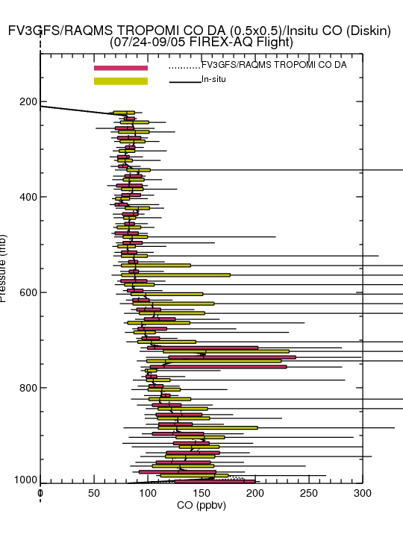
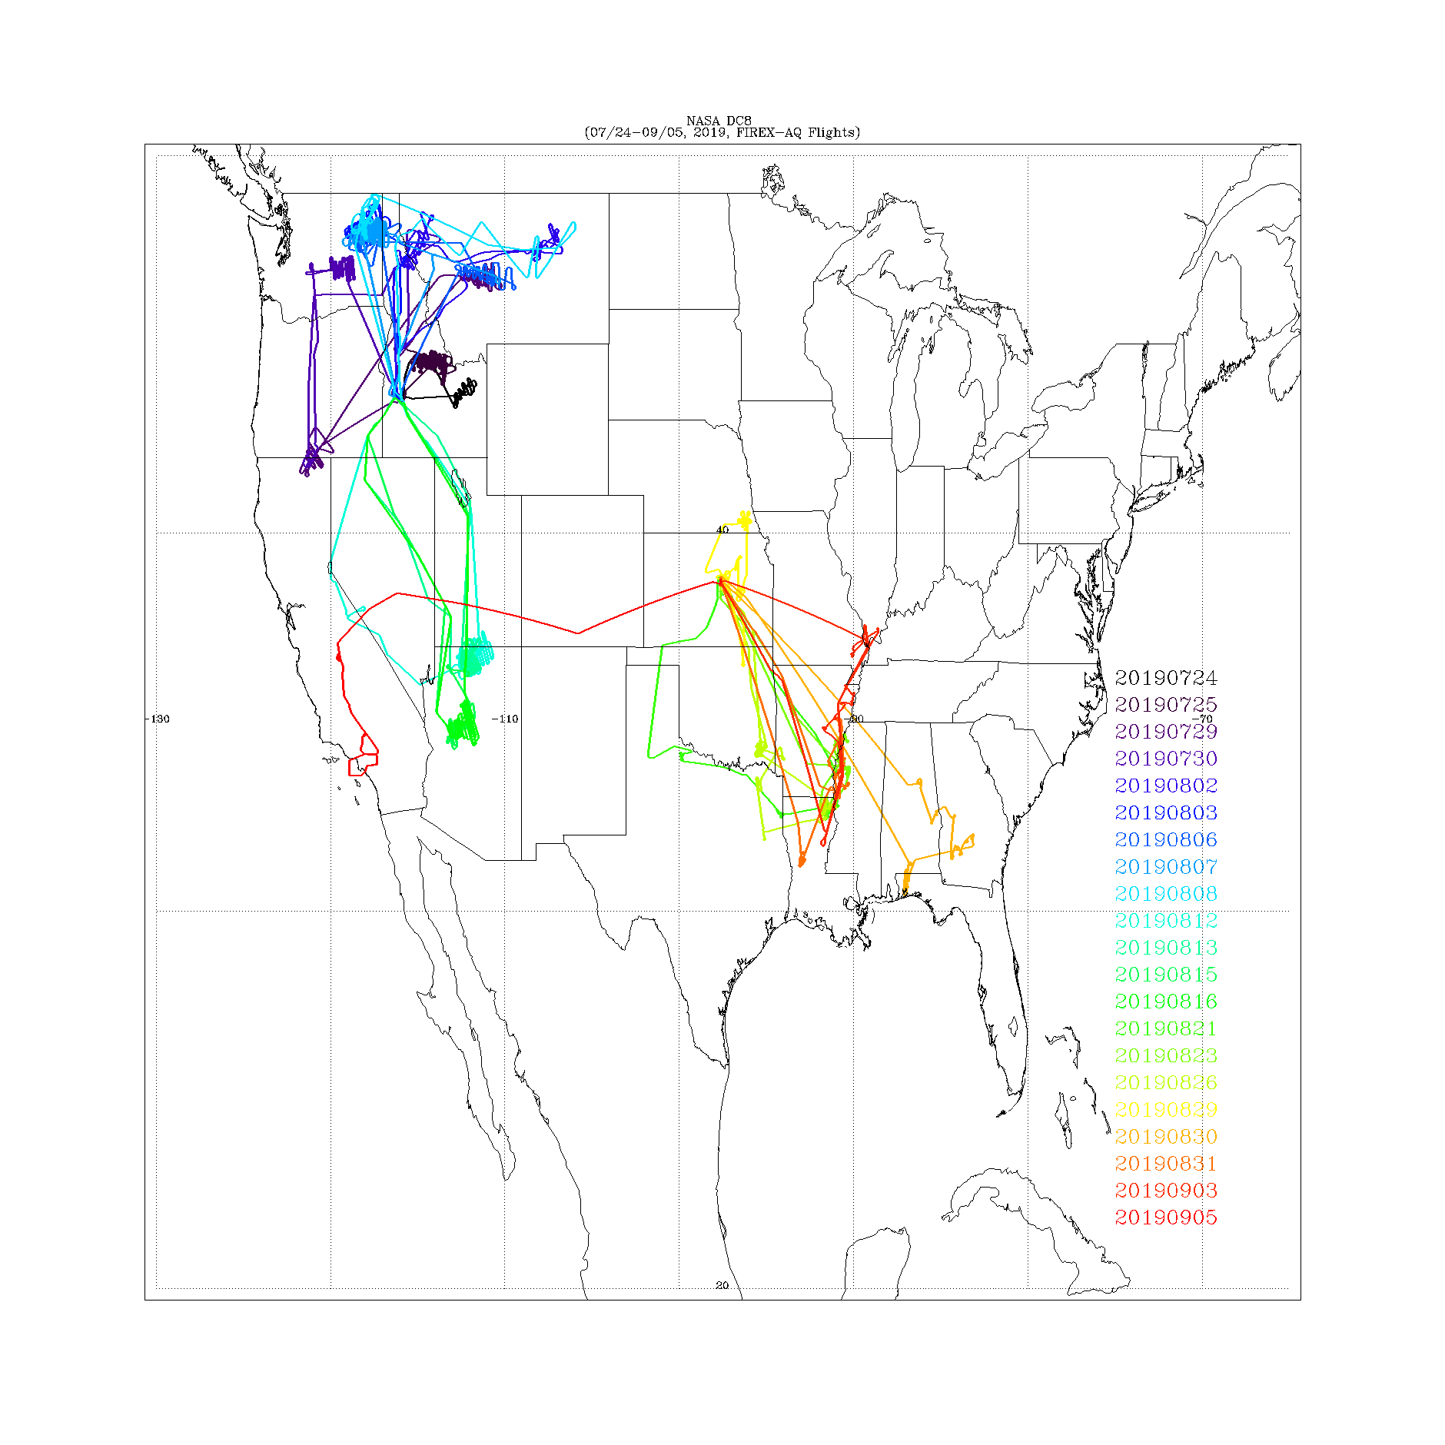
Exploit TROPOMI Sensor (TMP 18/19-09 ) PI:Tim Schmit Organization: NESDIS/STAR
Objective
Combine NUCAPS and TROPOMI CO retrievals to constrain boundary layer CO concentrations within UFS.
Utilize TROPOMI tropospheric NO2 retrievals to constrain UFS global nitrogen oxide (NOx) emission inventories.
Develop a multi-sensor level 3 (L3) boundary layer CO product by combining NUCAPS and TROPOMI CO retrievals.
Key Milestones
Project Start 09/19
Complete UFS-RAQMS Port 12/19
Complete L3 NUCAPS/TROPOMI 03/20
Complete CO assimilation 04/20
Completed NO2 assimilation 06/20
UFS-RAQMS impact study 09/20
EOY Reporting 10/20
TRL_{IN} : 4 TRL_{OUT} : 6
Approach
TROPOMI carbon monoxide (CO) and nitrogen dioxide (NO2) retrievals used for chemical data assimilation within UFS-RAQMS and evaluated using measurements from FIREX-AQ field campaign. supports situational awareness for NWS Incident Meteorologists (IMET) through better estimates of the vertical distribution of pollution from wildfires.
TROPOM CO column assimilation experiments during the NASA NOAA FIREX-AQ field campaign demonstrate the benefits of assimilating column retrievals based on CO absorption of reflected solar radiation (2.3microns) which is able to provide a true estimate of the CO column.
CoI’s: Allen Lenzen, Tommy Jasmin,
Collaborator Brad Pierce

