Slide 1
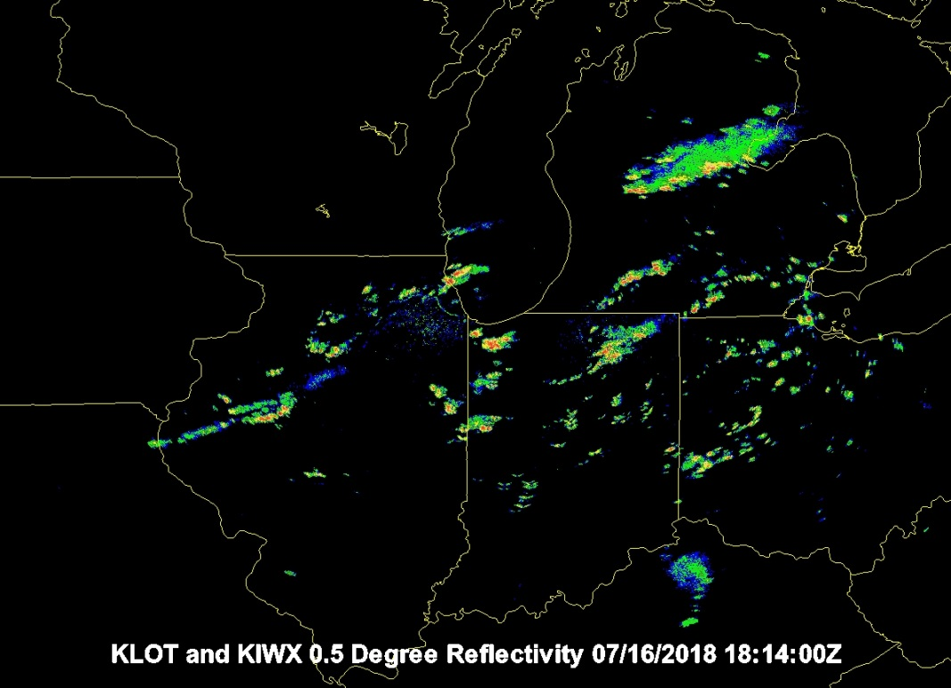
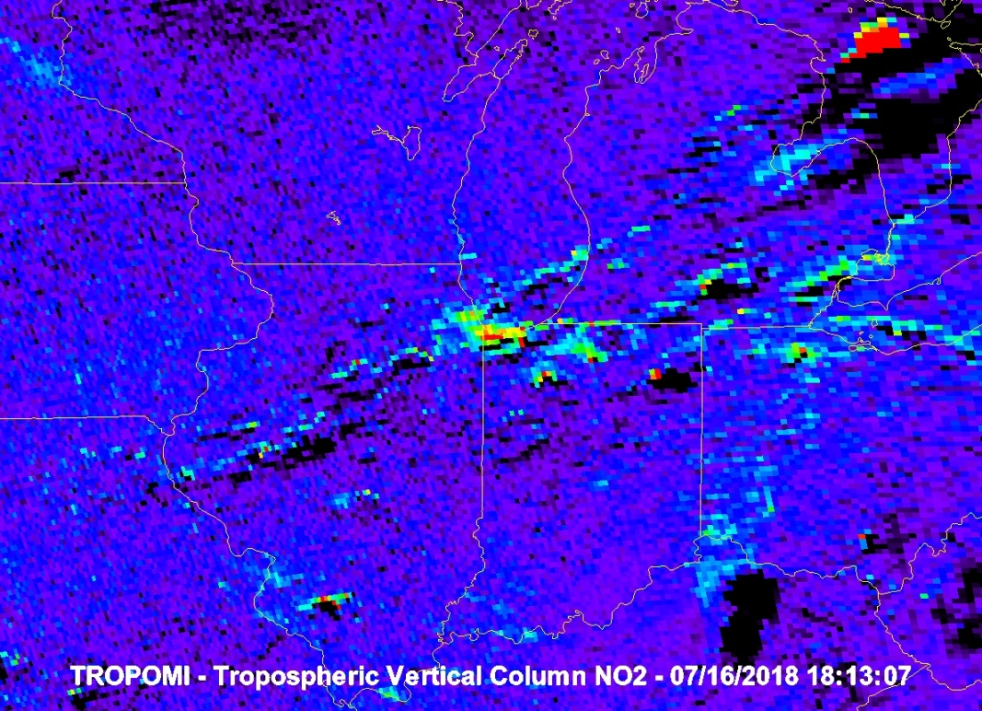
TMP 18-09 Exploit TROPOMI Sensor Project Status Overview
R. Bradley Pierce¹, Allen Lenzen¹, Tommy Jasmin¹, and Tim Schmit²
¹UW-Madison Space Science and Engineering Center (SSEC)
²NESDIS/STAR
13 June 2019
TropOMI Chicago NO2 emissions and lightning NOx enhancements

Slide 2
Outline
Background
TROPOMI Sentinel-5 Precursor (S5P) satellite
NWS Regional Air Quality Forecast (NAM-CMAQ)
Objectives and Approach
FY18 Project Accomplishments
FY19 Project Plan

Slide 3
Background
One of the key objectives for a Weather Ready Nation outlined in the NOAA Next Generation Strategic Plan is “Healthy people and communities due to improved air and water quality services”.
A key to achieving this objective is high-resolution air quality forecasts. To support this objective, data assimilation capabilities need to be developed to exploit the next generation of satellite based air quality measurements.
The FY18 TMP project has focused on developing capabilities to assimilate TROPOMI retrievals within the NWS regional air quality forecasting system (NAM-CMAQ)
The FY19 TMP project will focus on developing capabilities to assimilate TROPOMI within the Next Generation Global Prediction System (NGGPS) FV3-RAQMSCHEM global air quality forecasting system

Slide 4
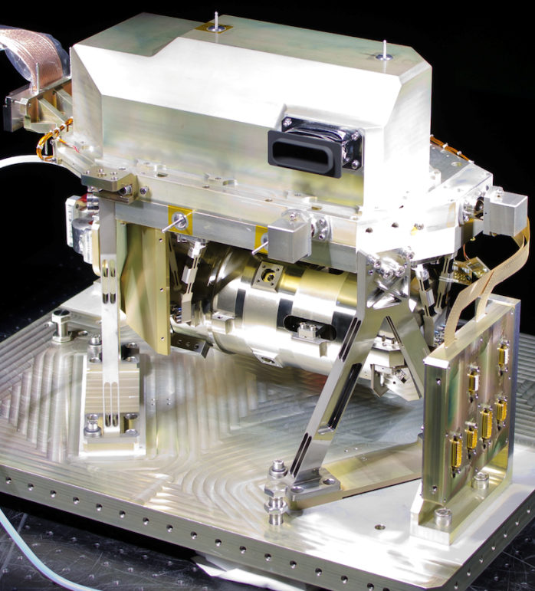
The TROPOspheric Monitoring Instrument (TROPOMI) is the satellite instrument on board the Copernicus Sentinel-5 Precursor (S5P) satellite launched on 13 October 2017.
UV-VIS-NIR-SWIR push-broom grating spectrometer (270-495 nm, 675-775 nm, 2305-2385 nm).
Nadir pixel 7x3.5 km² for all spectral bands, with the exception of the UV1 band (7x28 km²) and SWIR bands (7x7 km²).
S-5P makes measurements within 5-minutes of Suomi-NPP
S5P is a cooperative undertaking between ESA and the Kingdom of the Netherlands.
TROPOMI SWIR module

Slide 5
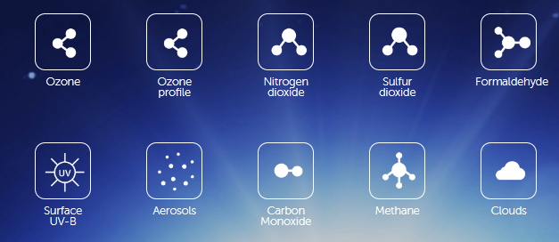
The objective of TROPOMI is to provide accurate and timely observations of key atmospheric species, for services on air quality, climate, and the ozone layer.
The TROPOMI daily global observations will be used for improving air quality forecasts as well as for monitoring the concentrations of atmospheric constituents.

Slide 6
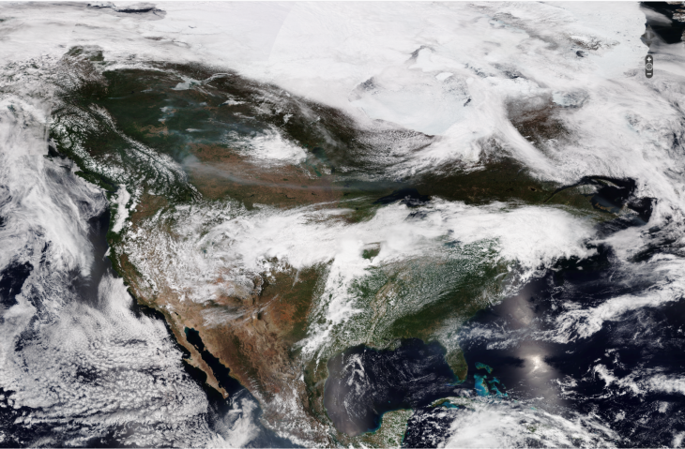
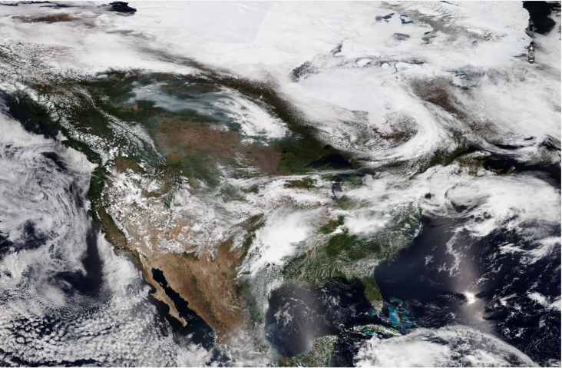
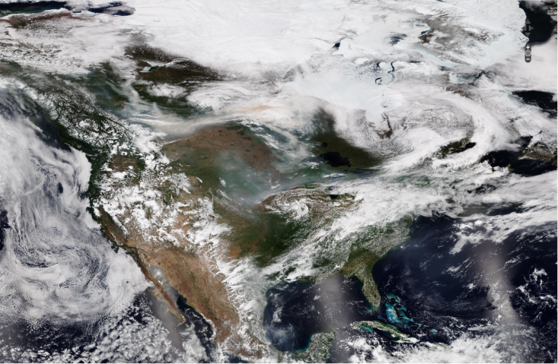
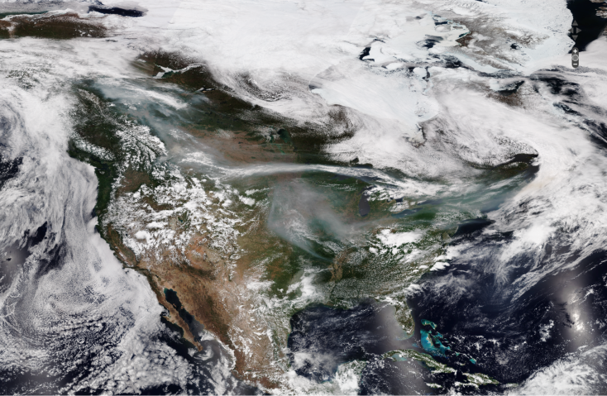
VIIRS True Color Imagery
May 28, 2019
May 29, 2019
May 30, 2019
May 31, 2019

Slide 7
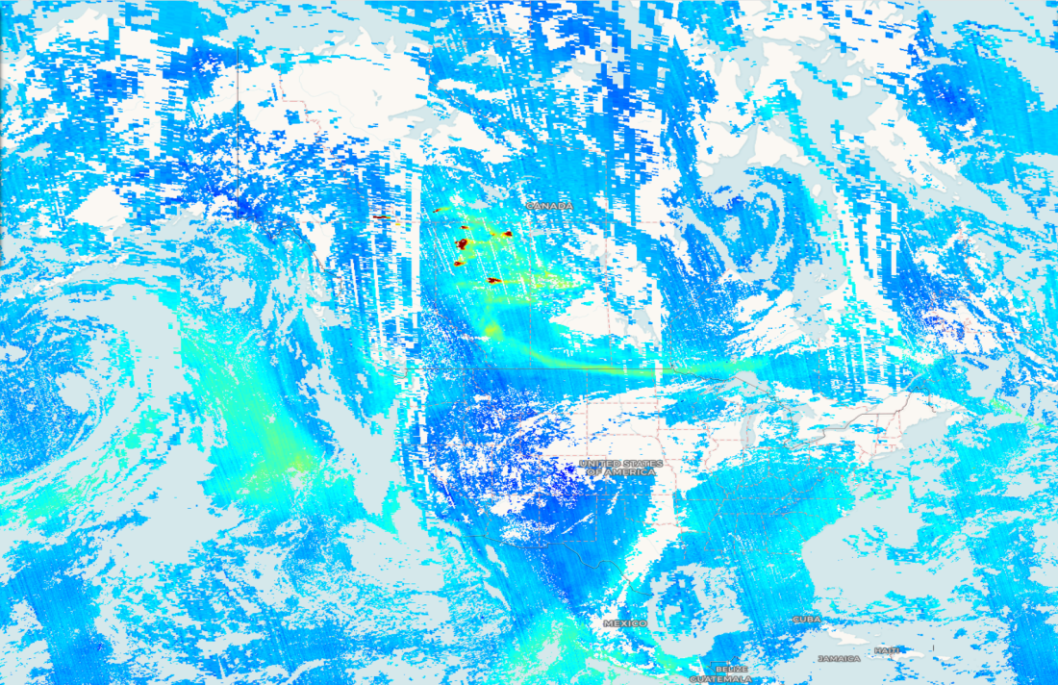
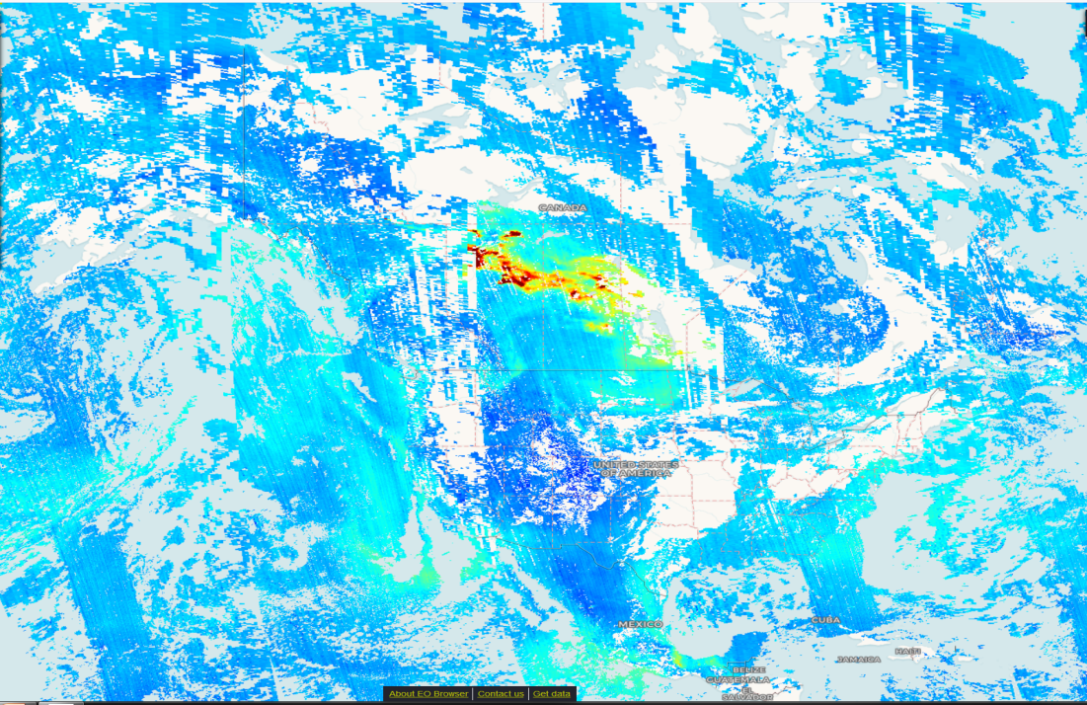
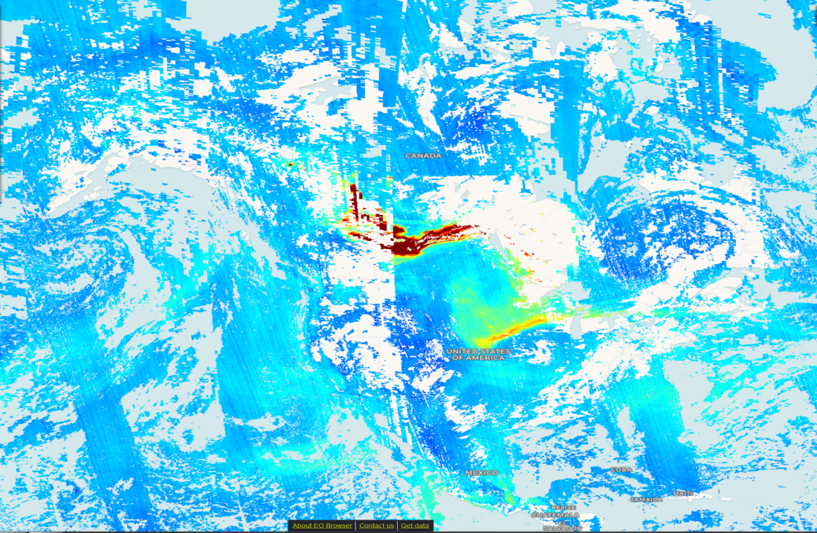
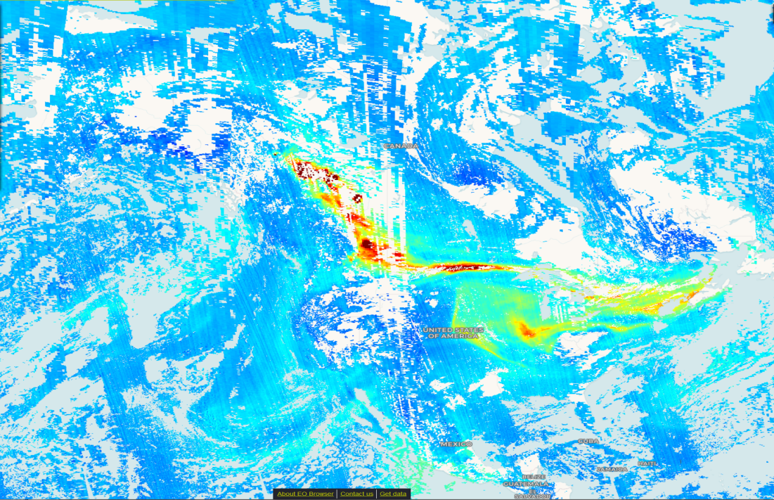
TROPOMI Carbon Monoxide (CO)
May 28, 2019
May 29, 2019
May 30, 2019
https://apps.sentinel-hub.com/eo-browser/
May 31, 2019

Slide 8
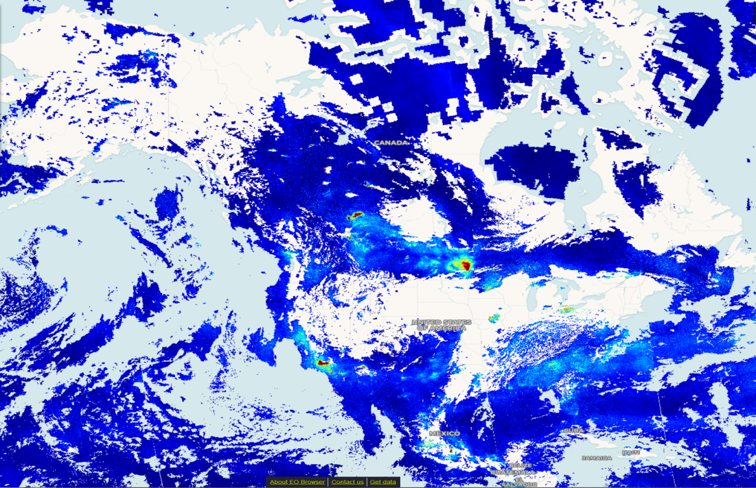
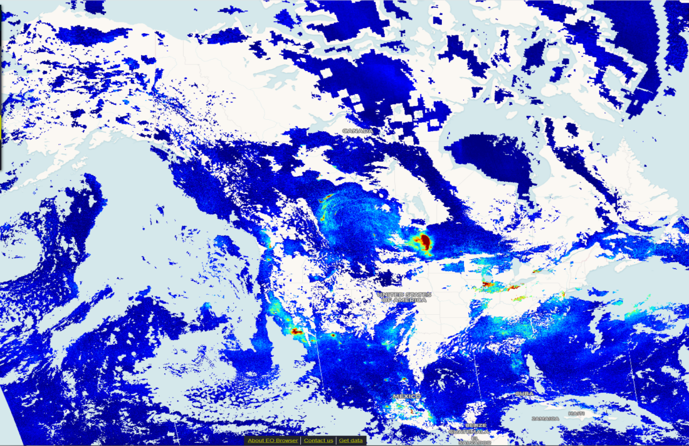
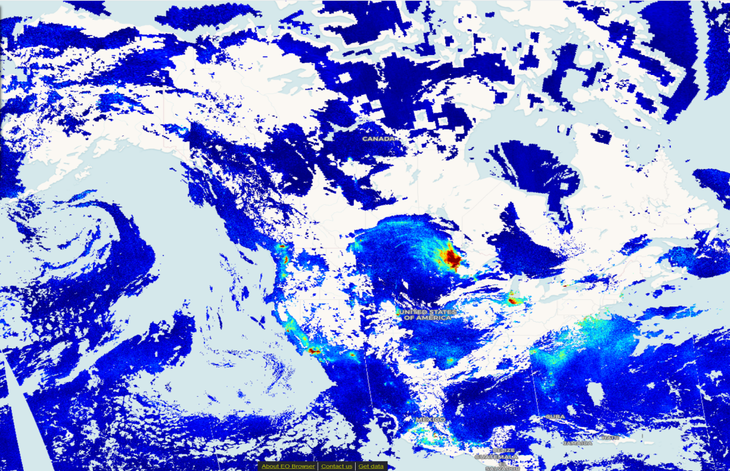
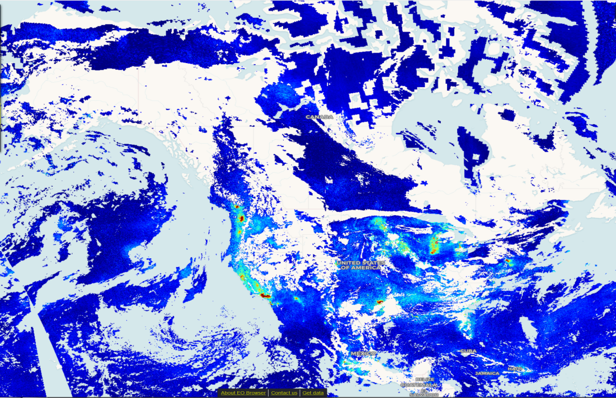
TROPOMI Nitrogen Dioxide (NO2)
May 28, 2019
May 29, 2019
May 30, 2019
https://apps.sentinel-hub.com/eo-browser/
May 31, 2019

Slide 9
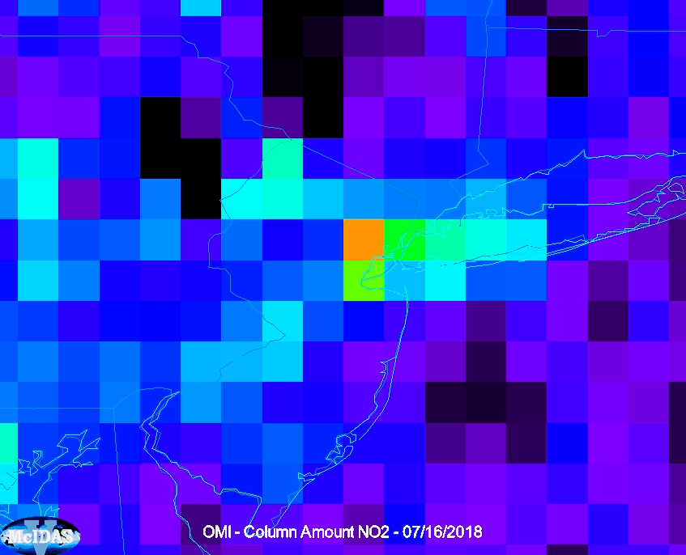
OMI vs TropOMI tropospheric NO2 on 07/16/2018
VIIRS Day-Night-Band included to show urban centers
Notes:
OMI, TropOMI and VIIRS McIDAS images from Tommy Jasmin (UW-Madison/SSEC)

Slide 10
https://www.weather.gov/sti/stimodeling_airquality
From Ivanka Stajner (EGU/2015)

Slide 11
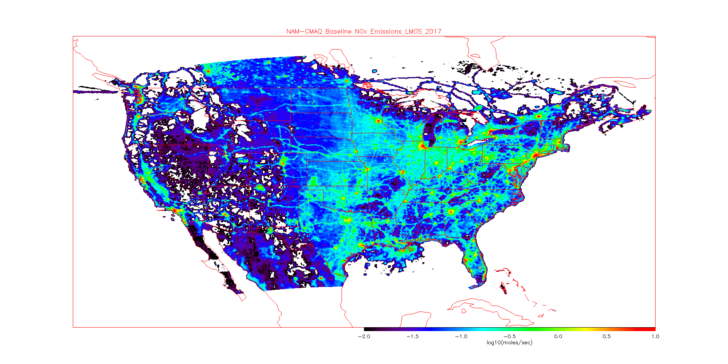
NAM-CMAQ Mean NOx Emissions LMOS 2017 (May-June, 2017)

Slide 12
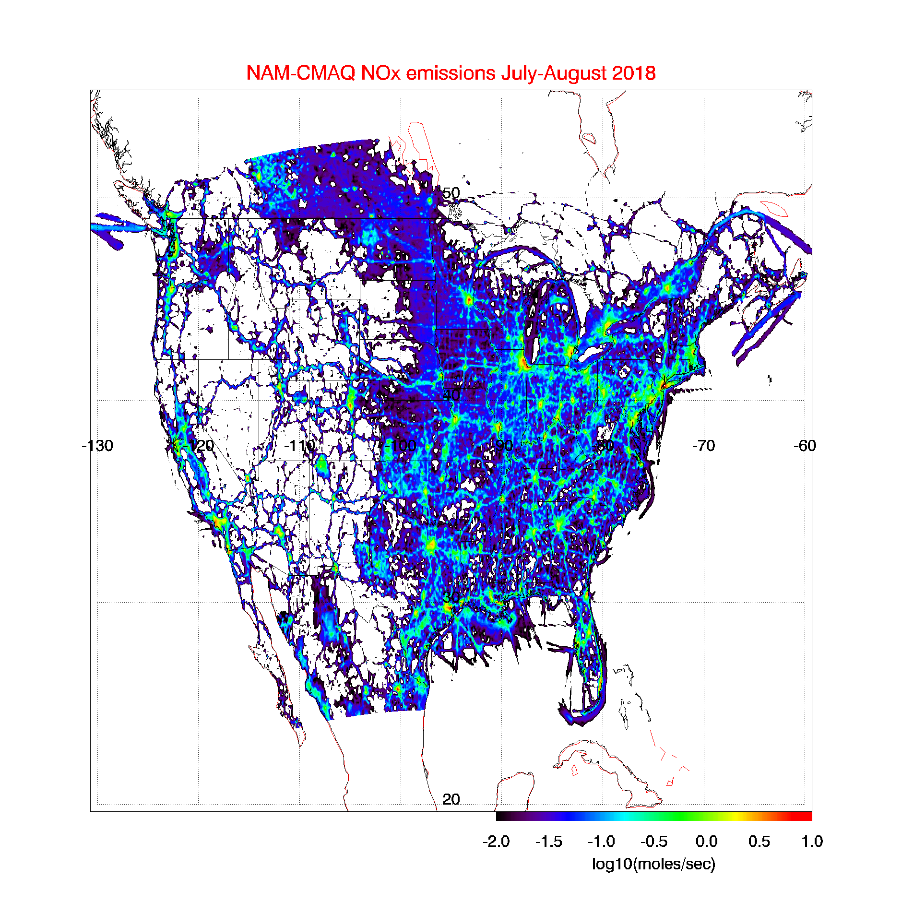
NAM-CMAQ Mean NOx Emissions LISTOS 2018 (July-August, 2018)
ARL parallel run mobile source emissions changed to MOVE2014_v_2 on June 1 2018. Improvement over previous Mobile6 (personal communication, Pius Lee, ARL)

Slide 13
Outline
Background
TROPOMI Sentinel-5 Precursor (S5P) satellite
NWS Regional Air Quality Forecast (NAM-CMAQ)
Objectives and Approach
FY18 Project Accomplishments
FY19 Project Plan

Slide 14
TMP 18-09 Objectives
Implement assimilation system components into the Operational Grid-point Statistical Interpolation (GSI) data assimilation system so that it can assimilate TropOMI CO and NO₂ retrievals. (NO2 Completed, CO underway)
Conduct Observation System Experiment (OSE) during July-August 2018 to quantify the impact of assimilation of TROPOMI tropospheric NO2 columns and off-line adjustment of NAM-CMAQ NO_{x} emission inventories on surface ozone forecasts. (Completed)
Conduct OSE during July-August 2018 to quantify the impact of assimilation of TropOMI carbon monoxide retrievals on forecasting smoke transport. (Underway)
Approach (NO2 OSE)
Acquire and archive NAM-CMAQ air quality forecasts and TropOMI NO₂ retrievals
Develop GSI operator to assimilate TropOMI into NAM-CMAQ
Conduct NAM-CMAQ emission sensitivity experiments
Conduct retrospective DA experiments followed by emission adjustments
Conduct sensitivity experiments with adjusted emissions and assess impact on surface ozone with AirNOW network

Slide 15
Outline
Background
TROPOMI Sentinel-5 Precursor (S5P) satellite
NWS Regional Air Quality Forecast (NAM-CMAQ)
Objectives and Approach
FY18 Project Accomplishments
FY19 Project Plan

Slide 16
NAM-CMAQ/GSI NOx emission adjustment experiments
Calculate monthly mean NO₂ Jacobian (β) from a 15% NO_{X} emission reduction perturbation experiment following Lamsal et al. 2011
Calculate monthly mean NO₂ analysis increment using NAM-CMAQ/GSI TROPOMI NO₂ assimilation
NOx emission sensitive background errors (to correct NAM-CMAQ emissions)
Adjust NAM-CMAQ NO_{x} emissions using Jacobian and average analysis increment
Lamsal, L. N., et al. (2011), Application of satellite observations for timely updates to global anthropogenic NOx emission inventories, Geophys. Res. Lett., 38, L05810, doi:10.1029/2010GL046476.

Slide 17
NAM-CMAQ Beta Calculations for July-August, 2018
Calculate monthly mean NO₂ Jacobian (β) from a 15% NO_{X} emission reduction perturbation experiment following Lamsal et al. 2011
Use baseline NAM-CMAQ and 15% NOx emission reduction experiments

Slide 18
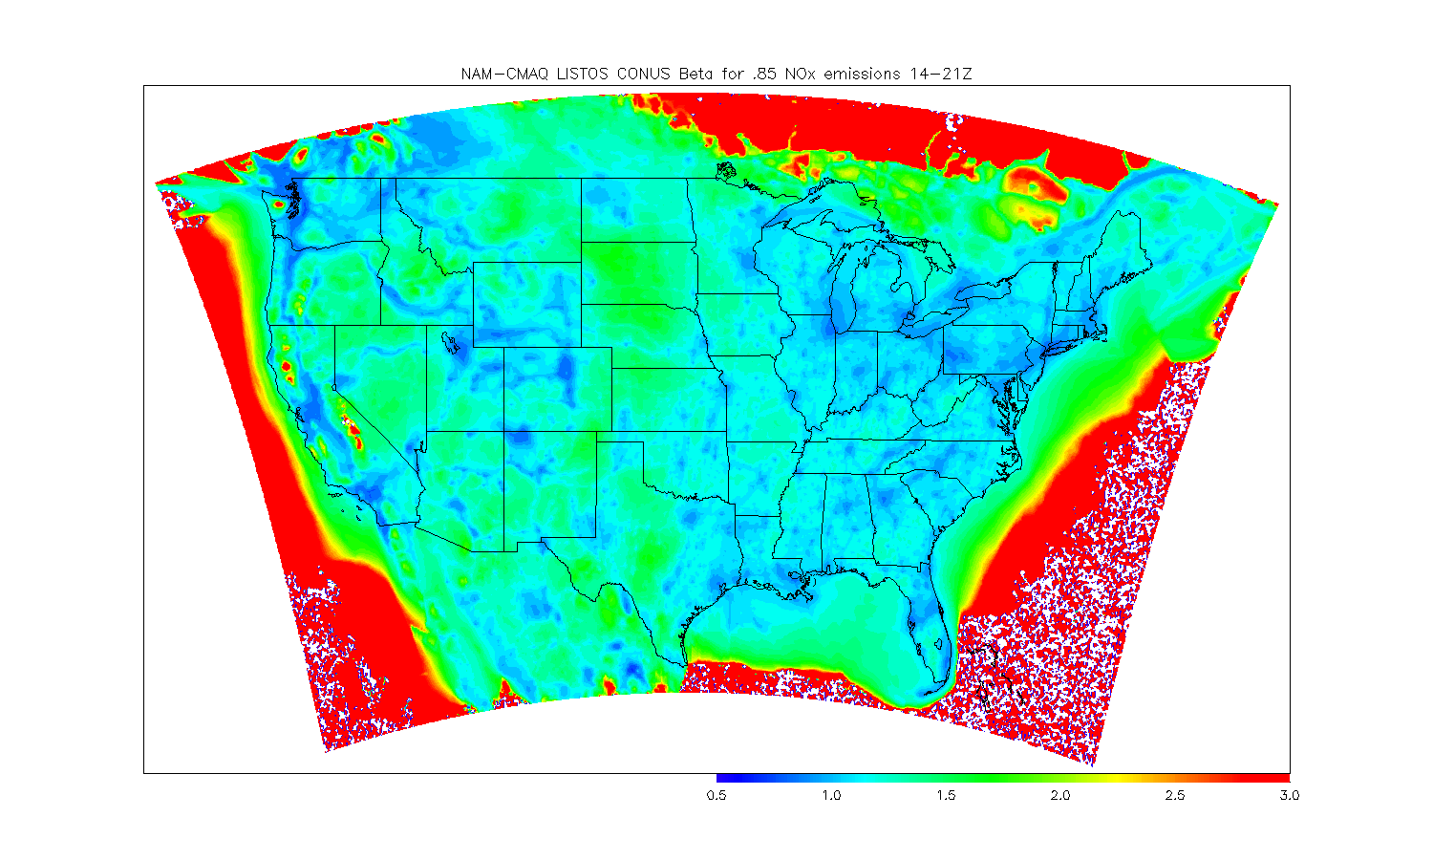
NAM-CMAQ Beta for July-August 2018
Urban areas and transport corridors (β<1), rural areas (β>1)

Slide 19
NAM-CMAQ TROPOMI Analysis Increments for July-August 2018
Calculate monthly mean NO2 analysis increment using NAM-CMAQ/GSI TROPOMI NO2 assimilation
Use baseline NAM-CMAQ and 15% NOx emission reduction experiments to compute NOx emission sensitive background errors

Slide 20
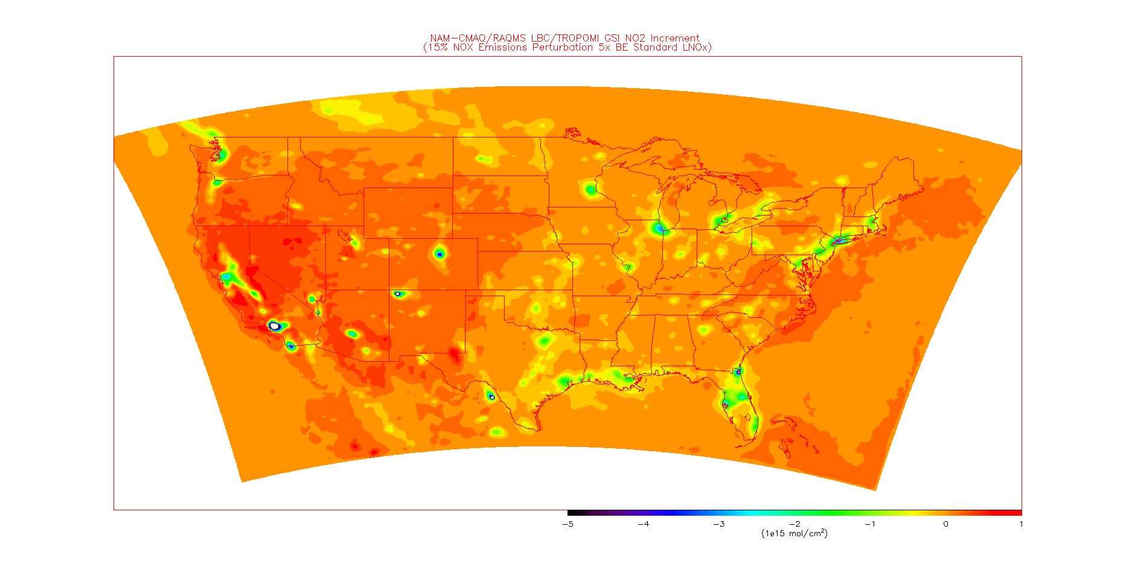
TROPOMI Analysis Increments for July-August 2018
July-August, 2018 mean GSI analysis increment shows large reductions in urban areas.

Slide 21
NAM-CMAQ Emissions Adjustments July-August 2018
Adjust NAM-CMAQ NOx emissions using Jacobian and average analysis increment
Only adjusted daytime emissions since TROPOMI does not provide constraints on nighttime tropospheric NO2 column abundances.

Slide 22
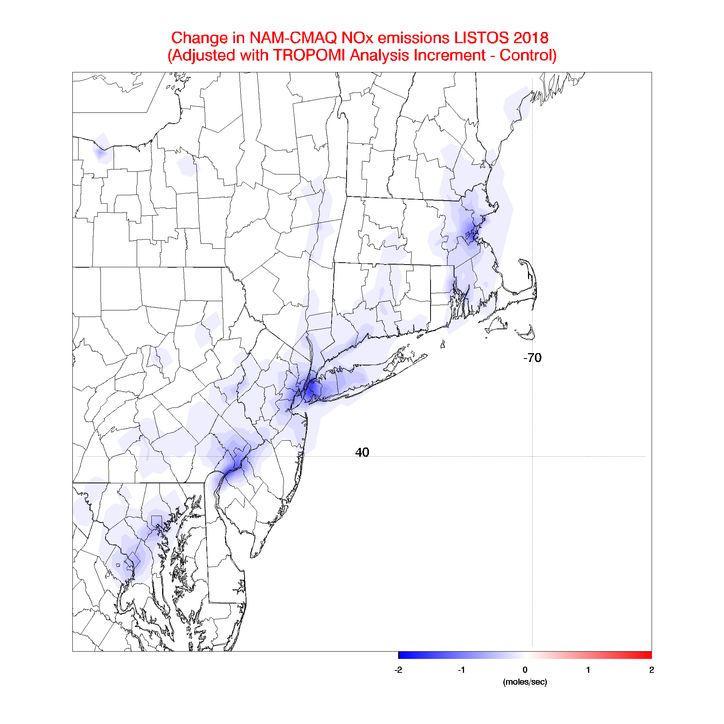
S5-P Tropospheric Ozone Monitoring Instrument (TropOMI) Tropospheric NO2 column Data Assimilation
NOx emissions adjustments (ΔE) are constrained using TropOMI tropospheric NO2 column analysis increments (ΔΩ)
β accounts for the sensitivity of the NO2 column to changes in NOx emissions following Lamsal et al 2011.
Assimilation of TropOMI NO2 results in (~20%) reductions in NOx emissions over NYC during July-August 2018
Notes:
NAM-CMAQ TropOMI data assimilation experiments conducted by Allen Lenzen (UW-Madison/SSEC)

Slide 23
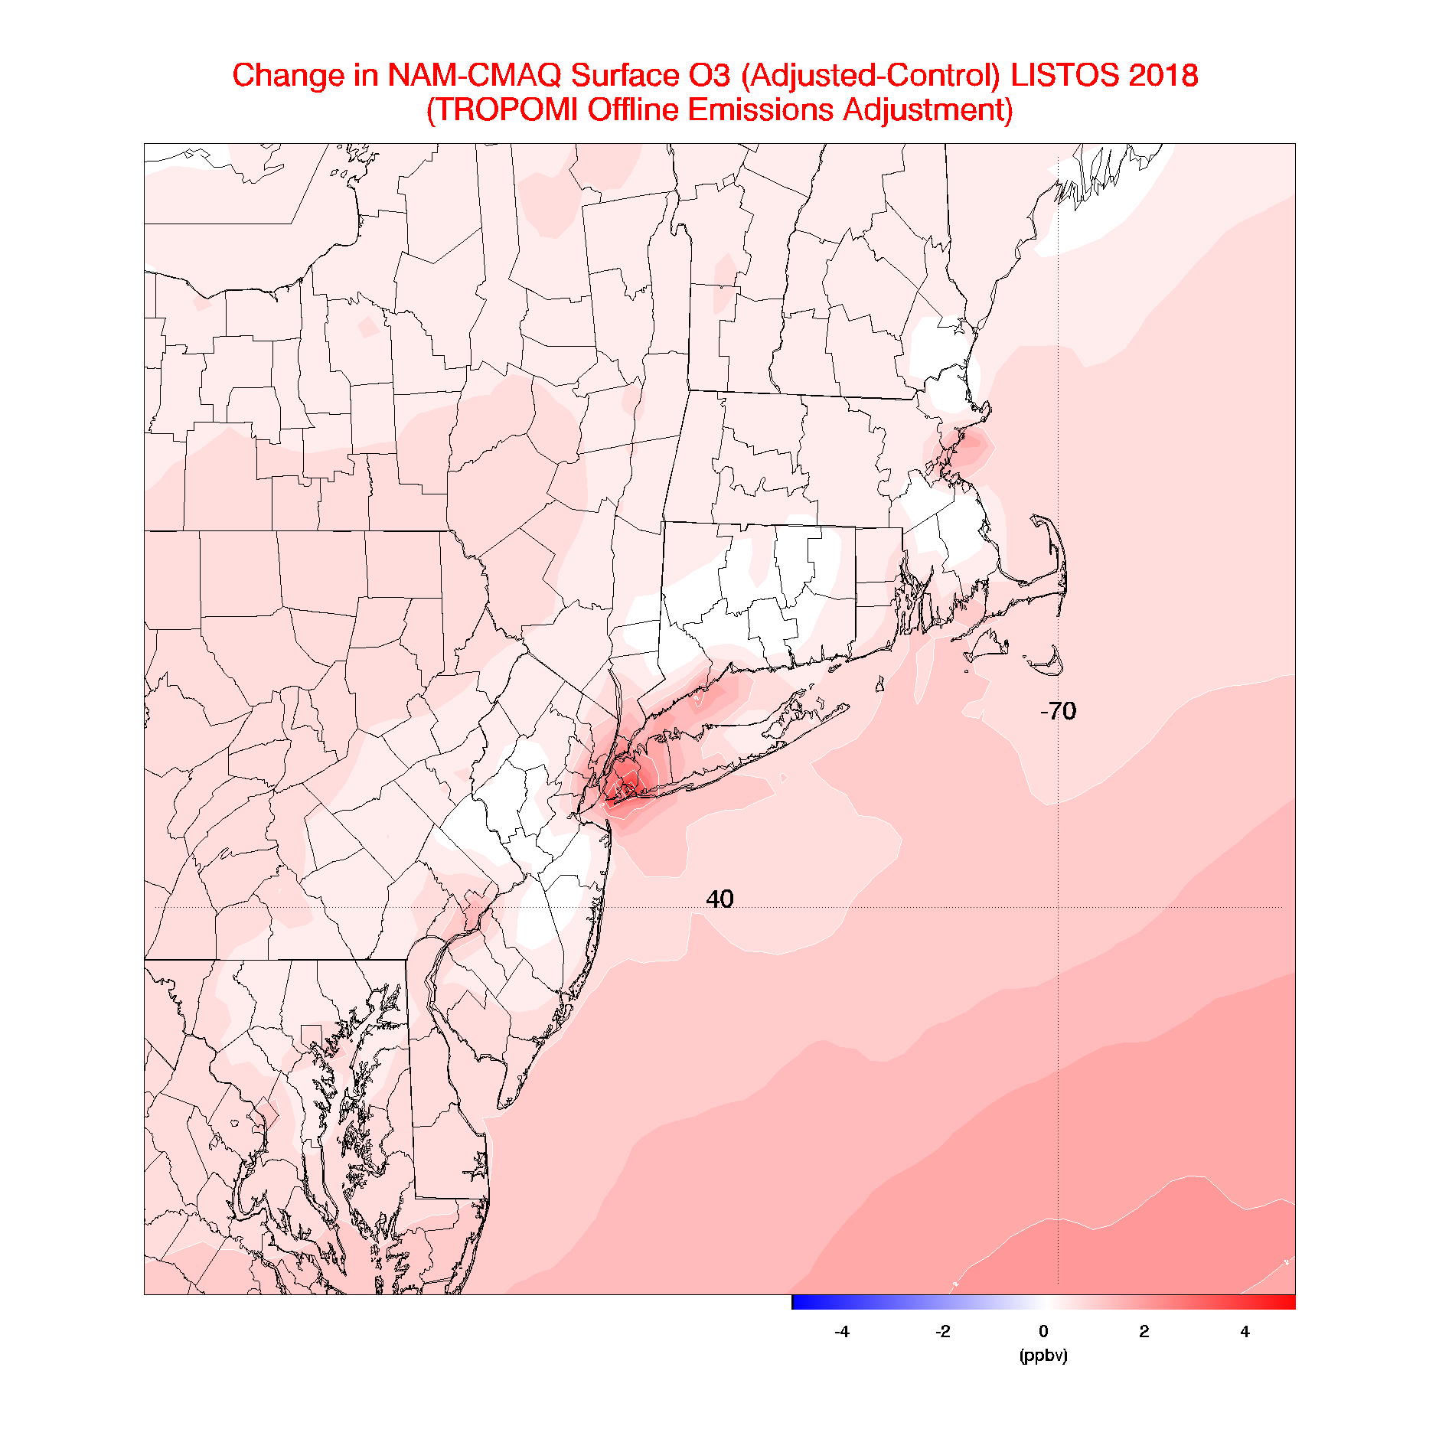
NAM-CMAQ surface ozone response to TropOMI offline NOx Tropospheric NO2 column Data Assimilation
Daytime (14-21Z) change in surface ozone between the Control and TROPOMI adjusted emissions experiments over the New York region during July-August, 2018.
Mean changes of 4ppbv over Southern Long Island
Notes:
NAM-CMAQ TropOMI data assimilation experiments conducted by Allen Lenzen (UW-Madison/SSEC)

Slide 24
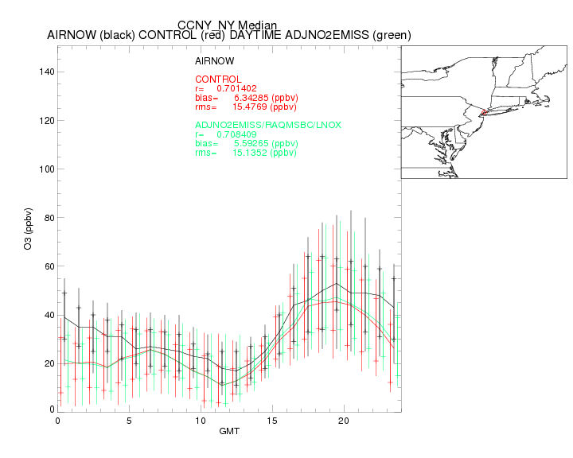

Slide 25
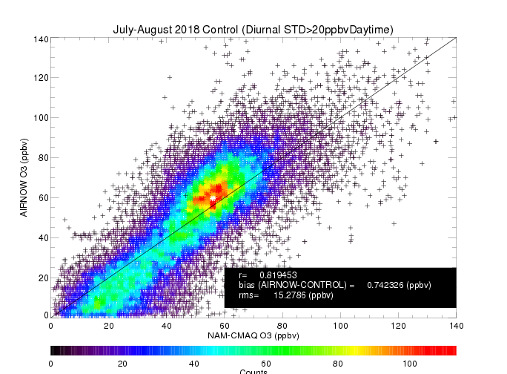
Impact of TropOMI NO2 Offline emission adjustment: Urban Sites
Observed verses predicted daytime surface ozone for the Control Experiment (no emission adjustment).

Slide 26
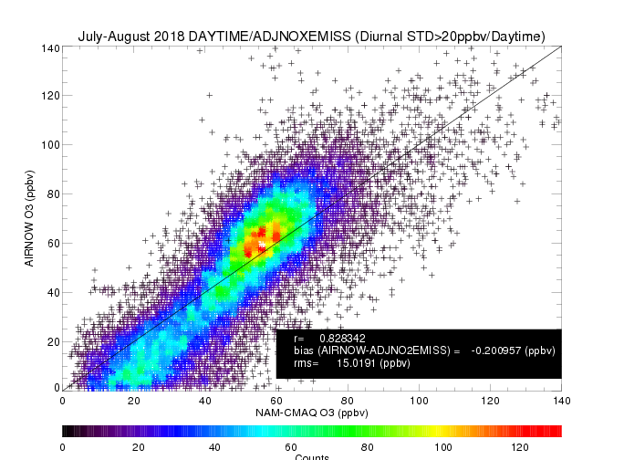
Impact of TropOMI NO2 Offline emission adjustment: Urban Sites
Observed verses predicted daytime surface ozone for the TROPOMI Adjusted Emissions Experiment (adjusted emissions).

Slide 27
Outline
Background
TROPOMI Sentinel-5 Precursor (S5P) satellite
NWS Regional Air Quality Forecast (NAM-CMAQ)
Objectives and Approach
FY18 Project Accomplishments
FY19 Project Plan

Slide 28
FY19 Objectives
Extend the NAM-CMAQ/GSI TROPOMI data assimilation system development to provide constraints on global anthropogenic nitrogen oxide (NOx) emissions and carbon monoxide (CO) predictions within the Next Generation Global Prediction System (NGGPS).
Develop a Level 3 multi-sensor boundary layer CO retrieval by co-locating and subtracting the NOAA Unique Combined Atmospheric Processing System (NUCAPS) CO retrieval from the TROPOMI CO retrievals. This L3 lower-tropospheric CO product will provide NWS Incident Meteorologists (IMET) better estimates of the vertical distribution of pollution from wildfires.

Slide 29
FY19 Tasks
Utilization of TROPOMI tropospheric NO2 retrievals to provide off-line constraints on NGGPS global nitrogen oxide (NOx) emission inventories (with NOAA/ESRL)
Combined assimilation the NUCAPS and TROPOMI carbon monoxide (CO) retrievals within NGGPS/GSI to constrain boundary layer CO concentrations.
Development of a multi-sensor level 3 (L3) boundary layer CO product by combining NUCAPS and TROPOMI CO retrievals.

Slide 30
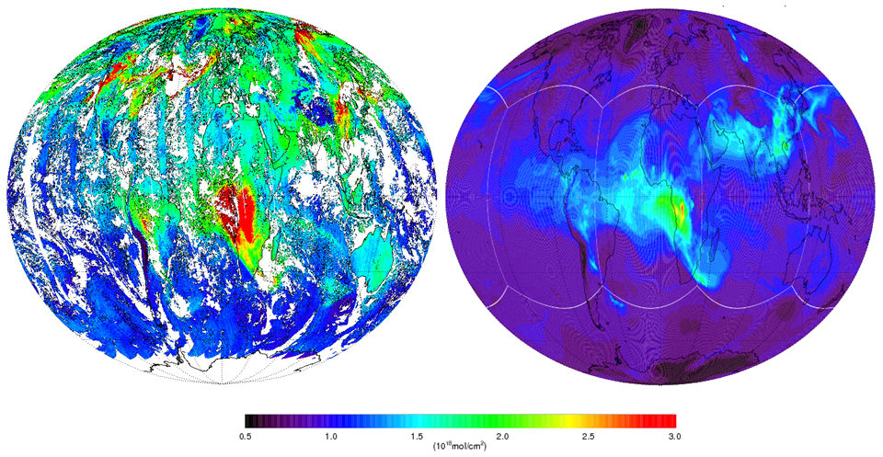
TROPOMI (left) and FV3-RAQMSCHEM (right) column CO on August 14, 2018
FV3-RAQMSCHEM captures global pollution transport patterns but underestimates column abundances, particularly in biomass burning regions

Slide 31
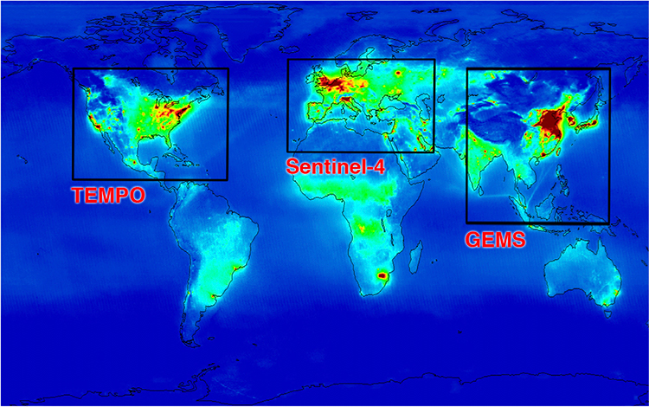
Next Generation Air Quality Constellation
TROPOMI
TROPOMI/S5P is part of the CEOS AQ Constellation–provides the global coverage and acts as a “travelling standard” between the GEOs
http://ceos.org/document_management/Virtual_Constellations/ACC/Documents/AC-VC_Geostationary-Cx-for-Global-AQ-final_Apr2011.pdf

Slide 32
Questions?
rbpierce@wisc.edu
This work was supported by FY18 NESDIS Office of Projects, Planning and Analysis Technology Maturation Program Funding

Slide 33
Extra Slides

Slide 34
Previous Work
1) Capabilities to assimilate global AIRS CO retrievals (NUCAPS predecessor) and use OMI (TROPOMI predecessor) tropospheric NO2 retrievals to provide global NOx emission constraints within GSI were developed under support from NASA ROSES.
2) NUCAPS observation operators developed and tested with the NUCAPS development team lead by Chris Barnet (STC) under support from the NOAA JPSS Proving Ground and Risk Reduction (PGRR) Program
3) Full chemistry implemented into NGGPS following the framework of the National Unified Operational Prediction Capability (NUOPC) coupler (FV3-RAQMSCHEM) and tested under support from the NOAA Research Transition Acceleration Program (RTAP) program.

