Slide 1
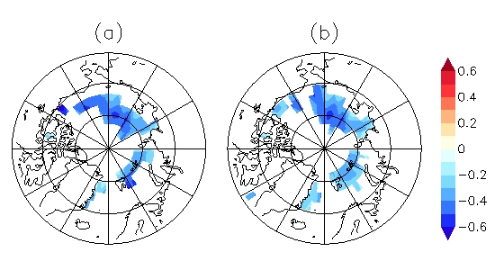
Advances in Real-time Assimilation of Satellite Trace Gas and Aerosol Retrievals for Air Quality Forecasting R. Bradley Pierce NOAA/NESDIS/STAR
NWS Western Region SOO/DOH Call:
Wed 9 April - 1000 MDT/0900 PDT
08Z 4/17 2010
11 μm AOD

Slide 2
Background
NWS National Air Quality Forecasting Capability (NAQFC) provides operational predictions* of ozone and wildfire smoke nationwide and operational predictions of airborne dust over the contiguous 48 states.
Improving the basis for air quality alerts
Providing air quality information for people at risk
*Using the US EPA Community Multi-scale Air Quality (CMAQ) model for ozone and the NOAA Hybrid Single Particle Lagrangian Integrated Trajectory (HYSPLIT) for smoke and dust
From Ivanka Stajner (NAQFC NWS Manager) AMS Annual Meeting, Atlanta, GA, February 5, 2014

Slide 3
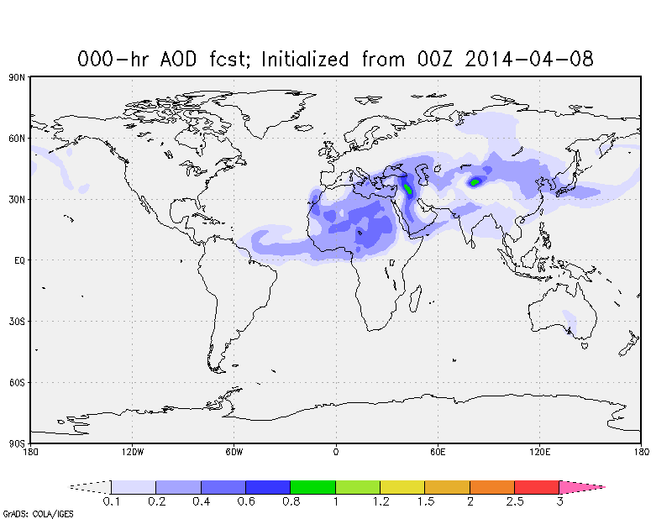
Background (continued)
The NOAA Environmental Modeling System (NEMS) Global Forecast System (GFS) Aerosol Component (NGAC) currently provides operational dust forecasts* globally. Dust forecasts will be expanded to include sulfate, black and organic carbon, and sea salt during Q2FY15 [Sara Lu, personnel communication]
Allows aerosol impacts on medium range weather forecasts (GFS/GSI) to be considered
Provides a first step toward an operational aerosol data assimilation capability at NOAA
Provides lateral aerosol boundary conditions for regional aerosol forecast system
*Using the Goddard Chemistry Aerosol Radiation and Transport Model (GOCART) [Chin et al., 2002] for aerosol predictions.
http://www.emc.ncep.noaa.gov/gmb/sarah/NGAC/html/realtime.ngac.html

Slide 4
Focus of this presentation
Advances in real-time trace gas and aerosol assimilation within the Real-time Air Quality Modeling System (RAQMS)
Collaborative NESDIS/NWS/ESRL real-time nested global/regional air quality forecasting

Slide 5
Online global chemical and aerosol assimilation/forecasting system
UW-Madison sigma-theta hybrid coordinate model (UW-Hybrid) dynamical core
Unified stratosphere/troposphere chemical prediction scheme (LaRC-Combo) developed at NASA LaRC
Aerosol prediction scheme (GOCART) developed by Mian Chin (NASA GSFC).
Statistical Digital Filter assimilation system developed by James Stobie (NASA/GFSC)
Real-time assimilation:
Microwave Limb Sounder (MLS) stratospheric ozone profiles (above 50mb)
Ozone Monitoring Instrument (OMI) total ozone column (cloud cleared)
Moderate Resolution Imaging Spectroradiometer (MODIS) Aerosol Optical Depth (AOD)
Real-time fire detection:
Moderate Resolution Imaging Spectroradiometer (MODIS)
RAQMS has been used to develop capabilities to assimilate global satellite composition measurements and support airborne field missions
http://raqms-ops.ssec.wisc.edu/

Slide 6
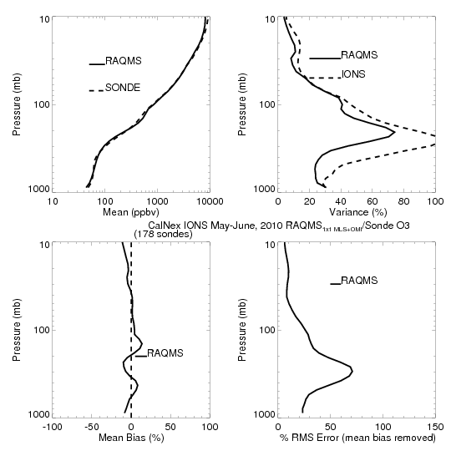
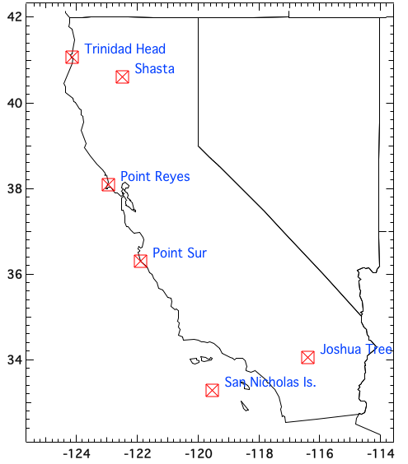
NOAA CalNex Field Mission
CalNex-2010 O₃ sondes
Owen Cooper (NOAA ESRL)
NOAA and the California Air Resources Board (CARB) conducted CalNex during (May-June 2010) to investigate the interactions between air quality and climate change issues.
http://www.esrl.noaa.gov/csd/calnex/

Slide 7
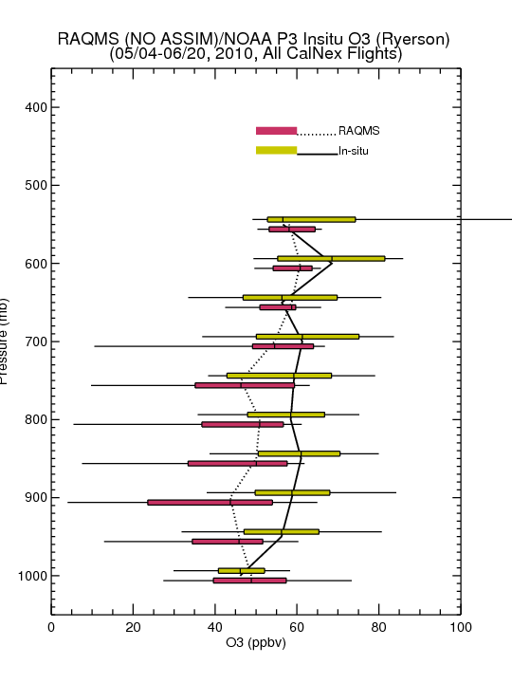
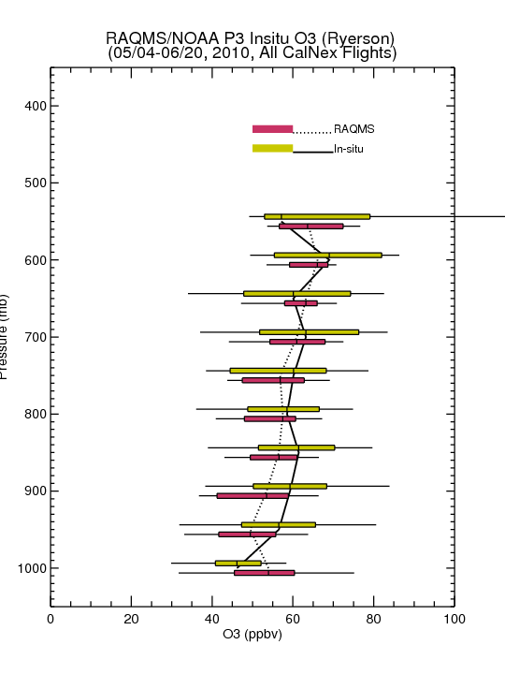
Comparison with NOAA P3 Insitu O3 Measurements
(Primarily LA Basin/Central Valley)
No Assim
MLS+OMI Assim
NOAA P3 Flight Tracks
Assimilation of MLS+OMI O3 retrievals results in increased lower-tropospheric O3 (and improved agreement with airborne insitu O3) over Southern California
Insitu O3 from Tom Ryerson, NOAA ESRL

Slide 8
Evaluation of Real-time AQ Model Forecasts during CalNex
Lead by Stu McKeen (NOAA/ESRL)
Regional Air Quality Forecast models:
Georg Grell, Steven Peckham (NOAA/ESRL/GSD) -WRF/Chem
Wanmin Gong, Sylvain Ménard, Hugo Landry (Environment Canada) – GEM-MACH
Youhua Tang and Jeff McQueen (NOAA/NWS) - CMAQ/NAM (CB-05 - experimental in 2010)
John McHenry and Don Olerud (Baron AMS) – BAMS
From Stu McKeen (NOAA/ESRL) AGU Annual Meeting, San Francisco CA, December, 2010

Slide 9
Evaluation of Real-time AQ Model Forecasts during CalNex
Lead by Stu McKeen (NOAA/ESRL)
Regional Air Quality Forecast models:
Georg Grell, Steven Peckham (NOAA/ESRL/GSD) -WRF/Chem
Wanmin Gong, Sylvain Ménard, Hugo Landry (Environment Canada) – GEM-MACH
Youhua Tang and Jeff McQueen (NOAA/NWS) - CMAQ/NAM (CB-05 - experimental in 2010)
John McHenry and Don Olerud (Baron AMS) – BAMS
RAQMS used for O3 and PM2.5 lateral boundary conditions (LBC) in NWS CMAQ/NAM and ESRL WRF/Chem
From Stu McKeen (NOAA/ESRL) AGU Annual Meeting, San Francisco CA, December, 2010

Slide 10
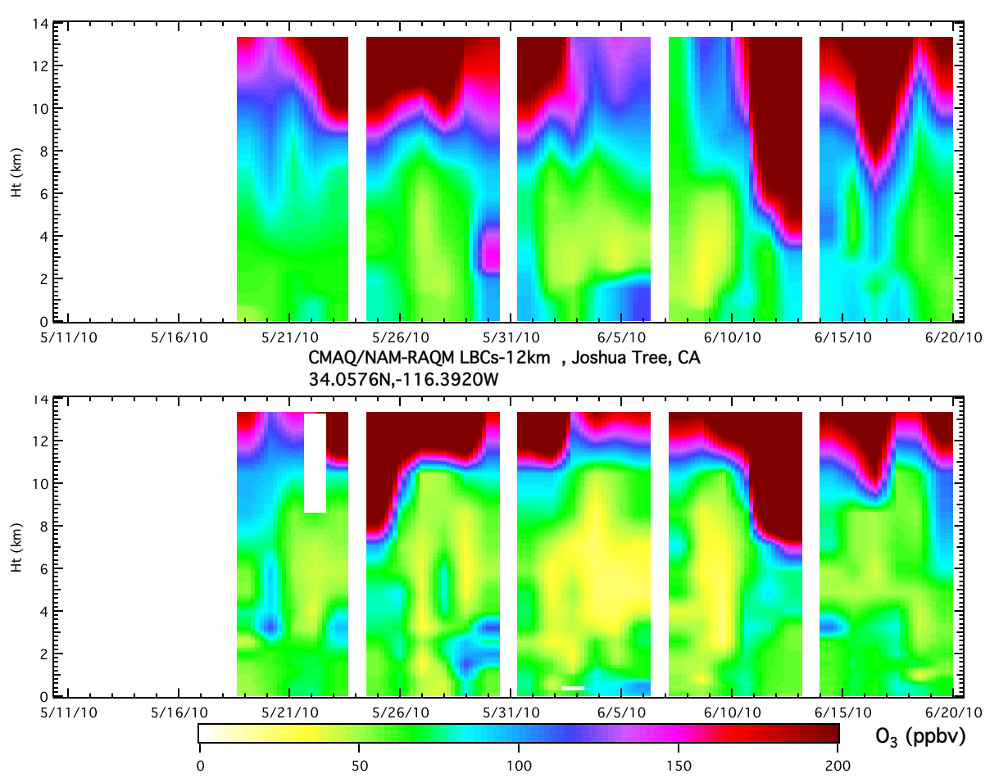
CMAQ/RAQM-LBCs at Joshua Tree
Model
NAM-CMAQ does not resolve sharp gradient in ozone at tropopause resulting in higher ozone in free troposphere
Obs.
From Stu McKeen (NOAA/ESRL) AGU Annual Meeting, San Francisco CA, December, 2010

Slide 11
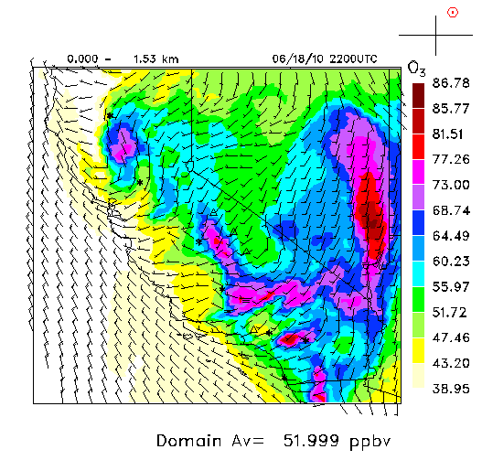
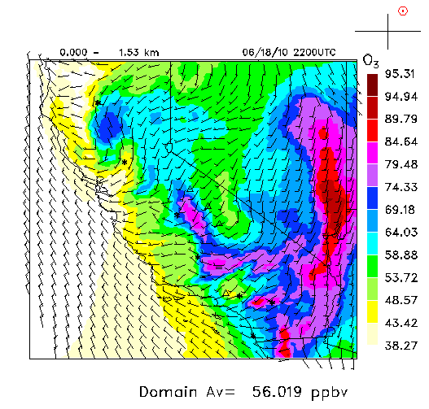
Real-time CMAQ/NAM 0-1.5km Ozone Forecast 22Z July 15, 2010
CMAQ/NAM
CMAQ/NAM with RAQMS LBC
Higher free tropospheric ozone leads to increased surface ozone
http://www.esrl.noaa.gov/csd/modeleval/

Slide 12
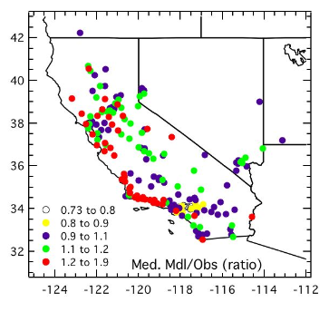
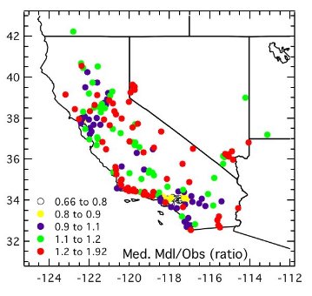
Median Model to Observed Ratio
max 8-hr average O₃ , 5/19/10 - 7/15/10
CMAQ, no RAQMS-LBC
CMAQ, with RAQMS-LBC
Main impact of boundary conditions is further east
Increased surface ozone leads to model high bias along CA/NV boarder
From Stu McKeen (NOAA/ESRL) AGU Annual Meeting, San Francisco CA, December, 2010

Slide 13
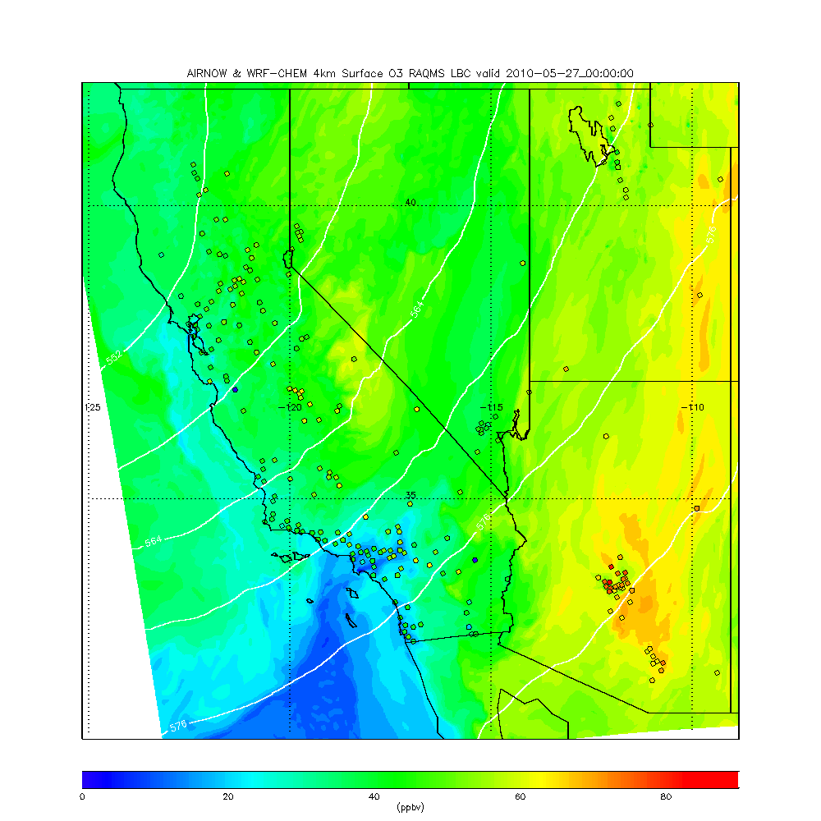
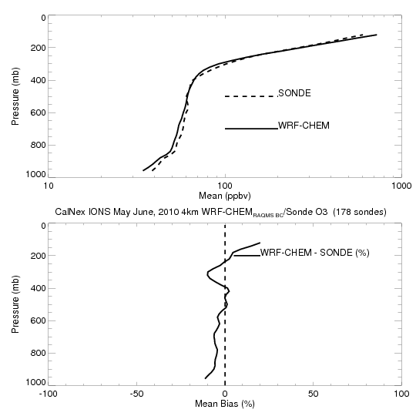
Retrospective 4km WRF-CHEM CalNex forecasts
(RAQMS 1x1 MLS+OMI ozone analyses)
WRF-CHEM does resolve sharp gradient in ozone at tropopause resulting in very small (<10%) biases in free tropospheric ozone
= EPA AIRNow Surface ozone measurements

Slide 14
MODIS True Color Image April 7, 2014
https://earthdata.nasa.gov/labs/worldview/

Slide 15
MODIS Aerosol Optical Depth (AOD) April 7, 2014
https://earthdata.nasa.gov/labs/worldview/

Slide 16
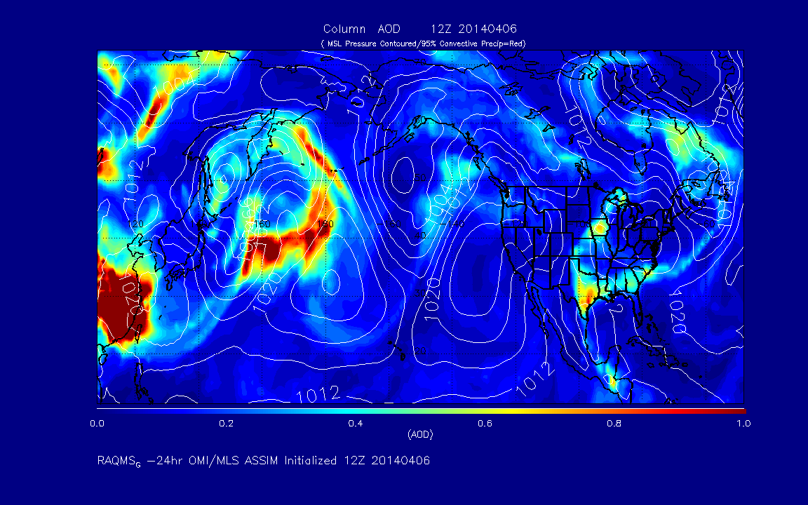
Current real-time RAQMS air quality analysis/forecasts
Aerosol Optical Depth (AOD)
http://raqms-ops.ssec.wisc.edu/

Slide 17
AIRS Carbon Monoxide (CO) Column April 7, 2014
https://earthdata.nasa.gov/labs/worldview/

Slide 18
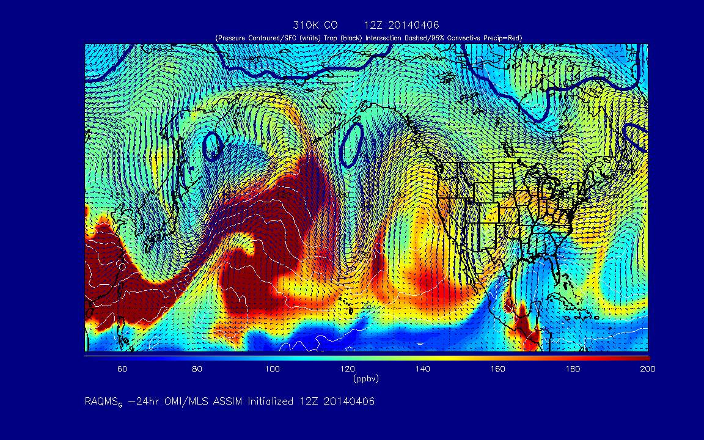
Current real-time RAQMS air quality analysis/forecasts
310K Carbon Monoxide (CO)
http://raqms-ops.ssec.wisc.edu/

Slide 19
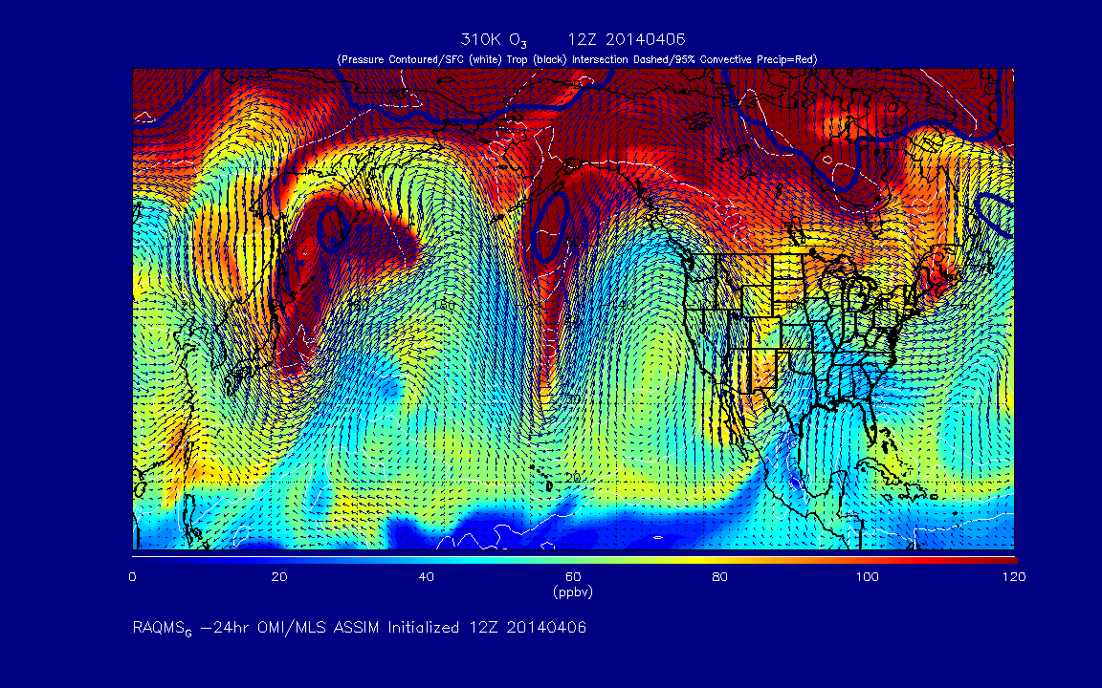
Current real-time RAQMS air quality analysis/forecasts
http://raqms-ops.ssec.wisc.edu/

Slide 20
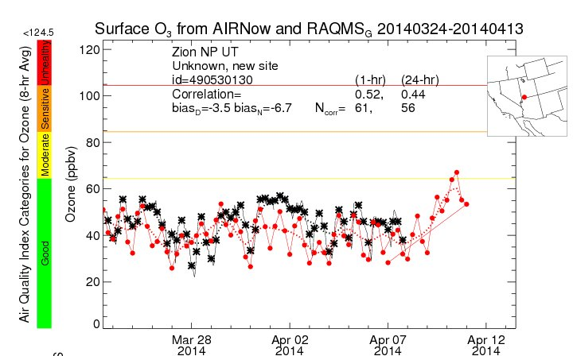
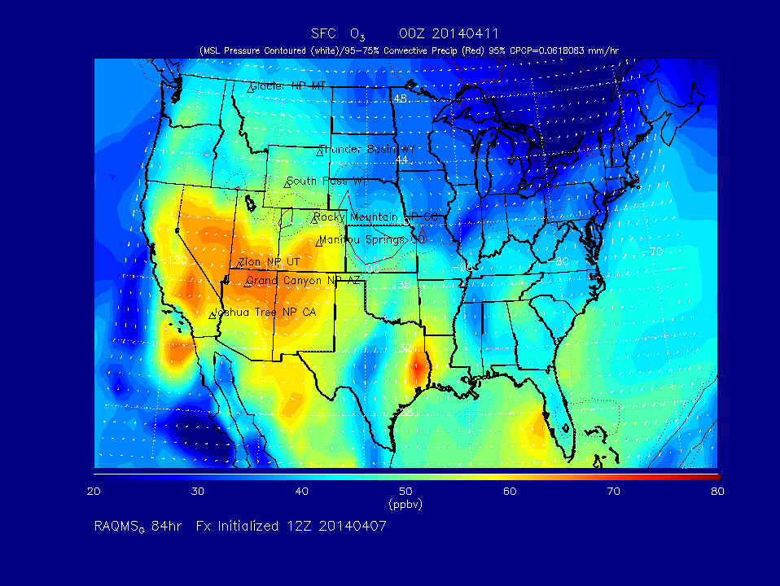
Current real-time RAQMS air quality analysis/forecasts
http://raqms.ssec.wisc.edu/

Slide 21
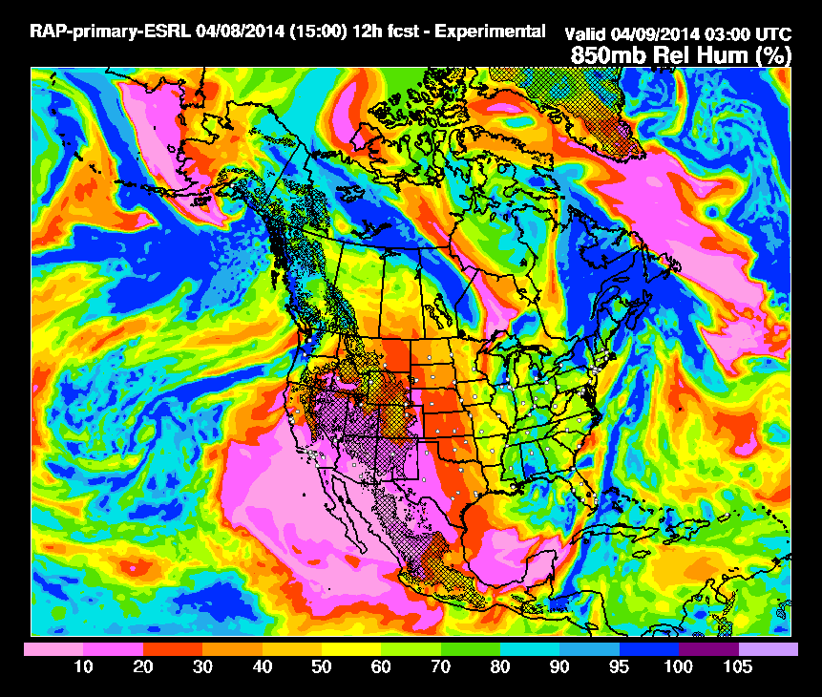
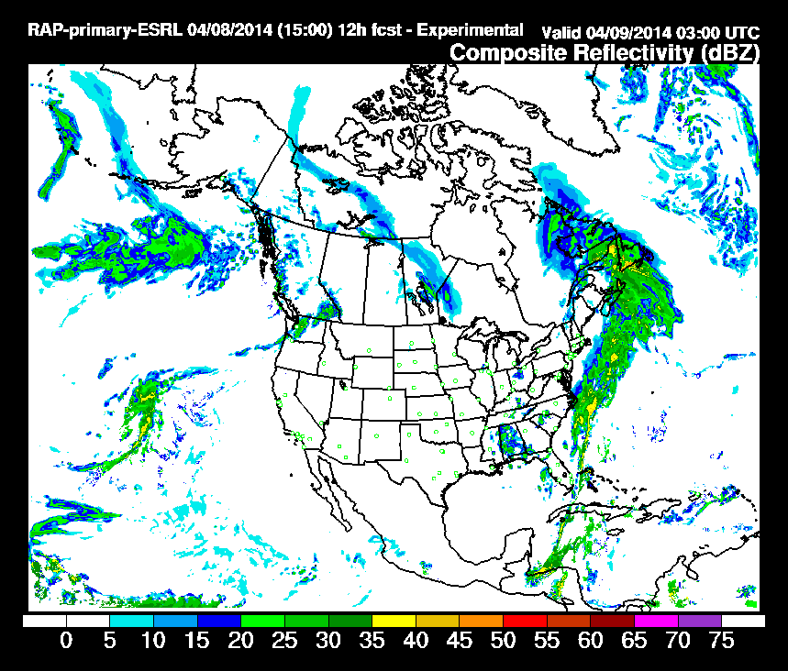
RAQMS/Rapid Refresh (RAP) with Chemistry
Real time weather and air quality forecasts
The Rapid Refresh (RAP) model with chemistry is used to predict air pollution over CONUS twice daily (00Z and 12Z) using RAQMS forecasts for lateral boundary conditions.
RAP is based on the Weather Research and Forecasting (WRF) coupled with chemistry via the RACM chemical mechanism including MOSAIC/VBS for better prediction of secondary orangic aerosols (SOA).
http://rapidrefresh.noaa.gov/

Slide 22
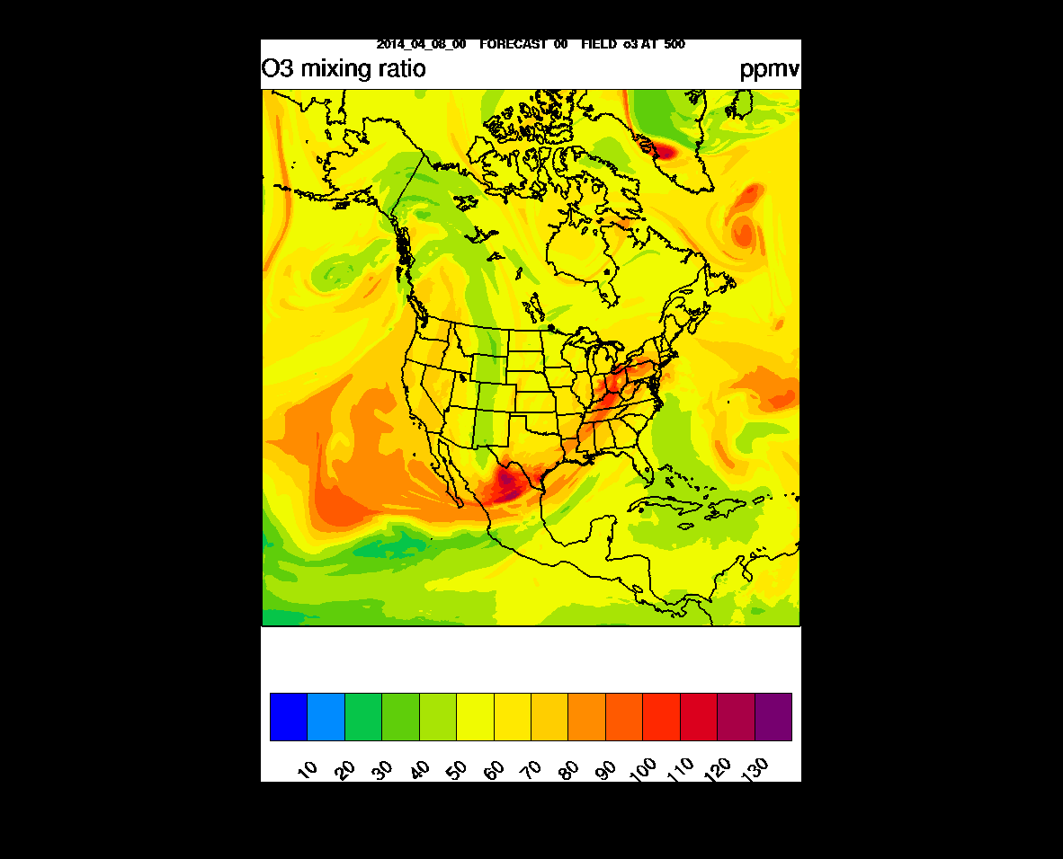
ppbv
RAQMS/RAP-Chem 500mb O3 Forecast
00Z April 08 –
00Z April 10, 2014
http://ruc.noaa.gov/wrf/WG11_RT/

Slide 23
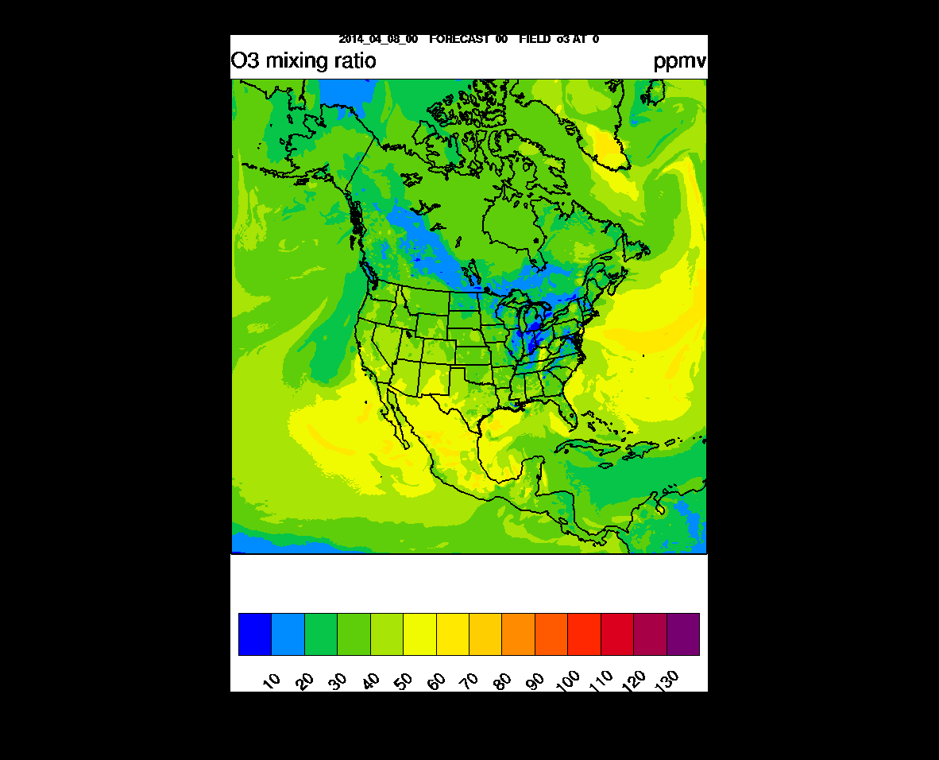
ppbv
RAQMS/RAP-Chem Surface O3 Forecast
00Z April 08 –
00Z April 10, 2014
http://ruc.noaa.gov/wrf/WG11_RT/

Slide 24
Conclusion
Assimilation of trace gas and aerosol retrievals within a global chemical and aerosol data analysis system can provide improved constraints on the impacts of intercontinental pollution transport and stratosphere/tropospheric exchange processes on regional scale air quality predictions.
Future global operational trace gas and aerosol data assimilation/forecasting at NOAA could follow the EU GEMS/MACC path, where aerosol and chemical DA and forecasting is incorporated into the ECMWF global Integrated Forecasting System (IFS).

