Slide 1
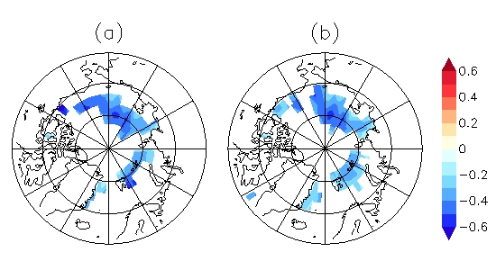
Aerosol Data Assimilation and Forecasting – Volcanic Ash Prediction, Severe Storm Intensification, and Future TEMPO/GOES-R Synergies R. Bradley Pierce NOAA/NESDIS/STAR With Contributions from Greg Carmichael and Pablo Sadie (University of Iowa) Georg Grell (NOAA/ESRL) Martin Stuefer (University of Alaska-Fairbanks) Mike Pavolonis (NOAA/NESDIS) Kelly Chance (SAO)
NOAA Satellite Science Week Virtual Meeting
Non-Convective Forecast Applications (Wed 9:00 - 11:05 am MDT)
08Z 4/17 2010
11 μm AOD
18–22 March, 2013

Slide 2
Real-time Air Quality Modeling System (RAQMS)
Aerosol Optical Depth (AOD) Assimilation Procedure
Forward model:
where q_{ik} is the mass mixing ratio and β_{ik} is the mass specific extinction of aerosol species i at the vertical level k. dz is the thickness of the layer. The mass specific extinction is a function of the local relative humidity.
Notes:
2
2

Slide 3
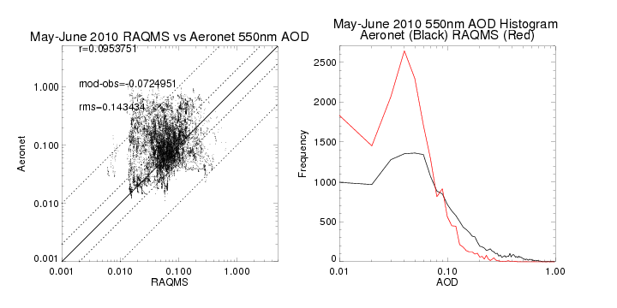
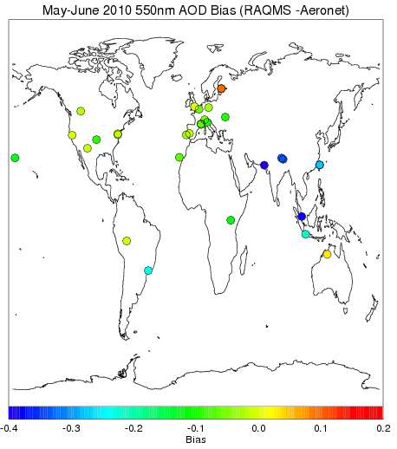
Comparison with Level 2.0 Aeronet Measurements
No MODIS Assimilation
RAQMS (no assim) is not correlated with Aeronet AOD (r=.09) and underestimates clear-sky AOD by 0.07.
RAQMS (no assim) significantly overestimates the frequency of low AOD (<0.1) and significantly underestimates the frequency of high AOD (>0.1).

Slide 4
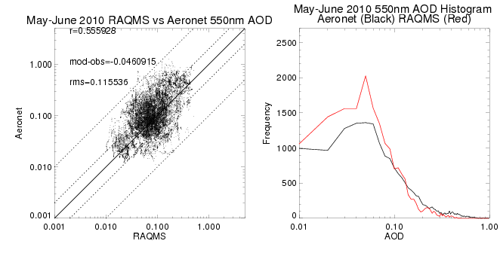
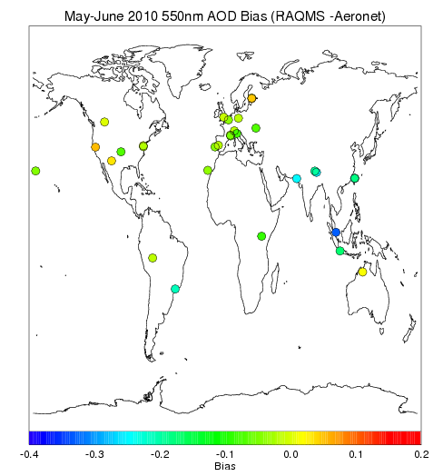
Comparison with Level 2.0 Aeronet Measurements
MODIS Assimilation
MODIS assimilation significantly improves correlation with Aeronet AOD (r=.56) and reduces the overestimates the frequency of low AOD (<0.1) and underestimates the frequency of high AOD (>0.1).

Slide 5
Assessment of Global 850mb Aerosol Extinction Forecast Skill – May-June 2010
Anomaly Correlations (AC)
Correlation between forecast and analysis
May-June mean removed
Spectrally truncated to wavenumber 20
Averaged from 20N-80N
useful Skill
http://www.emc.ncep.noaa.gov/gmb/STATS/html/monarch.html

Slide 6
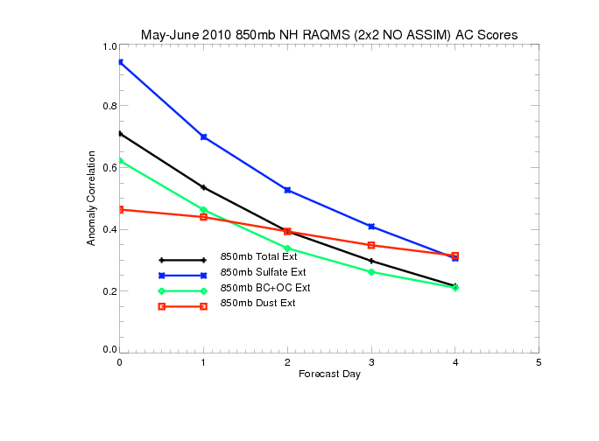
Northern Hemisphere 850mb May-June 2010 Anomaly Correlations (AC)
(No Assimilation)
useful Skill
Only 850mb SO4 extinction forecasts useful skill past 1 day
Black and organic carbon (BC+OC) and dust extinctions are both poorly initialized and
forecasted

Slide 7
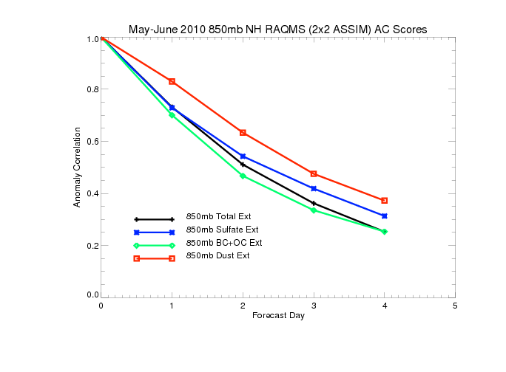
Northern Hemisphere 850mb May-June 2010 Anomaly Correlations (AC)
(With MODIS Assimilation)
useful Skill
MODIS AOD assimilation results in small changes in 850mb SO4 extinction forecasts
MODIS AOD assimilation results in significant improvements in black and organic carbon (BC+OC) and dust forecast skill (dust prediction useful at 2 days)

Slide 8
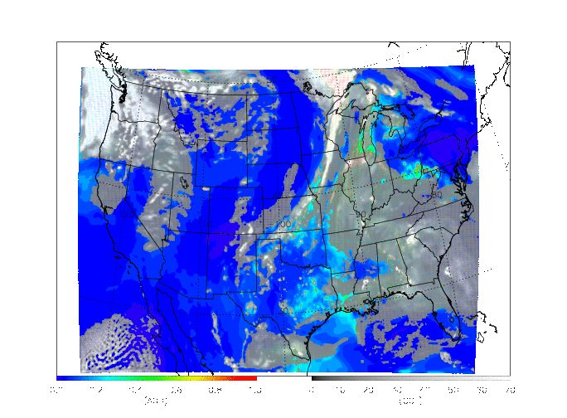
Nested RAQMS/WRF-CHEM
May-June 2010 aerosol analysis
GOCART aerosol module, MODIS AOD assimilation, Two nests: 36km and 12km
12km WRF-CHEM
00Z-24Z May 31st, 2010

Slide 9
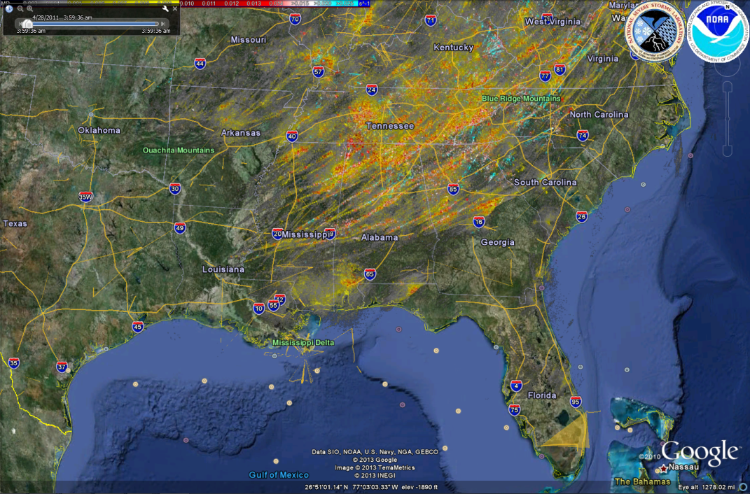
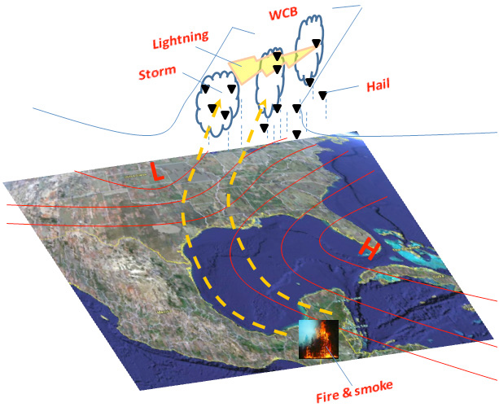
Severe Storm Intensification due to smoke
Tornado rotation tracks on April 27-28, 2011
(NSSL On Demand Severe Weather Verification System¹)
MODIS AOD/COT April 27, 2011²
²http://www.star.nesdis.noaa.gov/smcd/spb/aq/
¹Part of NSSL’s Warning Decision Support System –
Integrated Information (WDSS-II) Multi-Radar/Multi Sensor platform.
The indirect aerosol mechanisms pertinent to smoke particles include³:
the first indirect effect, where the size of water cloud droplets decreases
the semi-direct (choking) effect, where absorption of solar radiation by smoke particles increases atmospheric stability
the second indirect effect, where the smaller cloud droplets result in longer cloud lifetimes
the invigoration effect, where warm rain process is delayed through first and second indirect effects,
³From Wang et al, Environ. Res. Lett. 4 (2009)

Slide 10
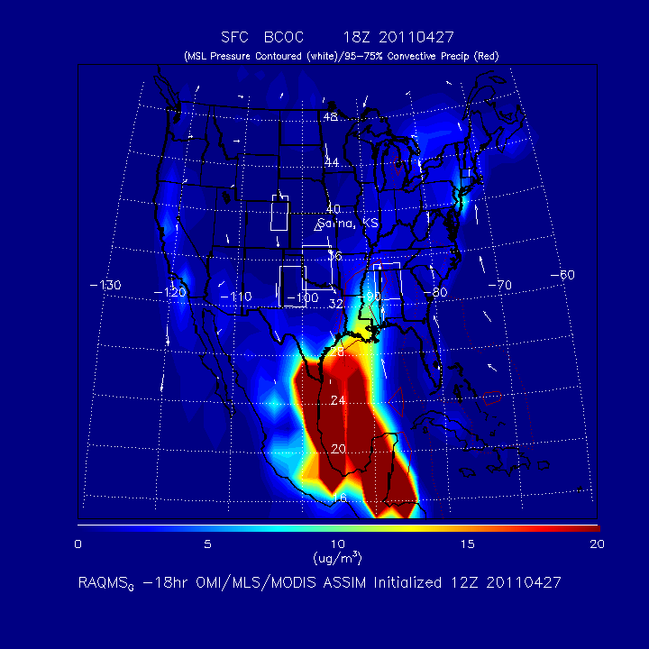
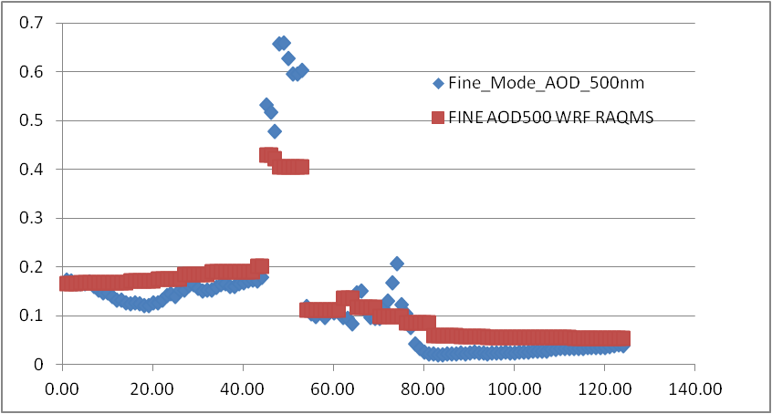
Case Study: Severe weather April 27th, 2011 (Huntsville tornado)
MODIS aerosol optical depth (AOD) shows significant aerosol loading over Gulf within warm sector of storm
RAQMS surface Black and Organic Carbon (BCOC) analysis shows highly elevated aerosols
RAQMS used to initialize and provide lateral boundary conditions for 4km WRF-CHEM with explicit (MOSAIC) aerosol/cloud interaction
27th
Aeronet AOD Louisiana
WRF-Chem
OBS
26th
28th

Slide 11
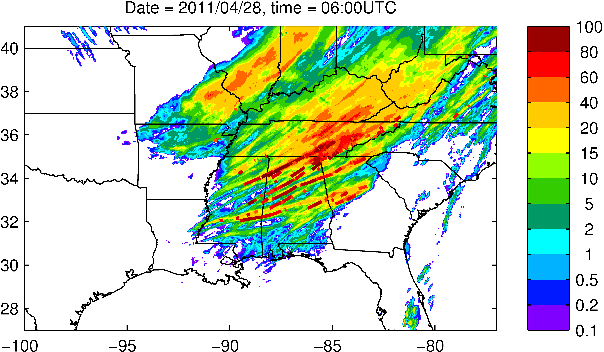
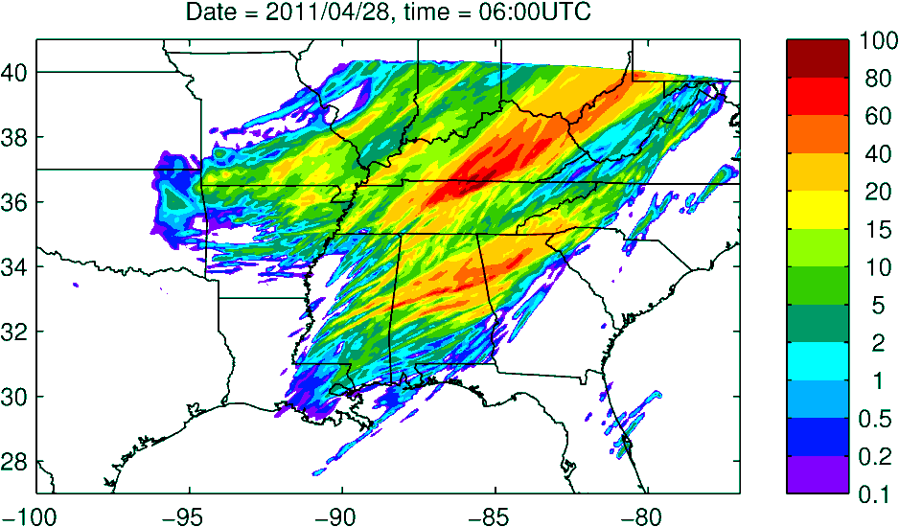
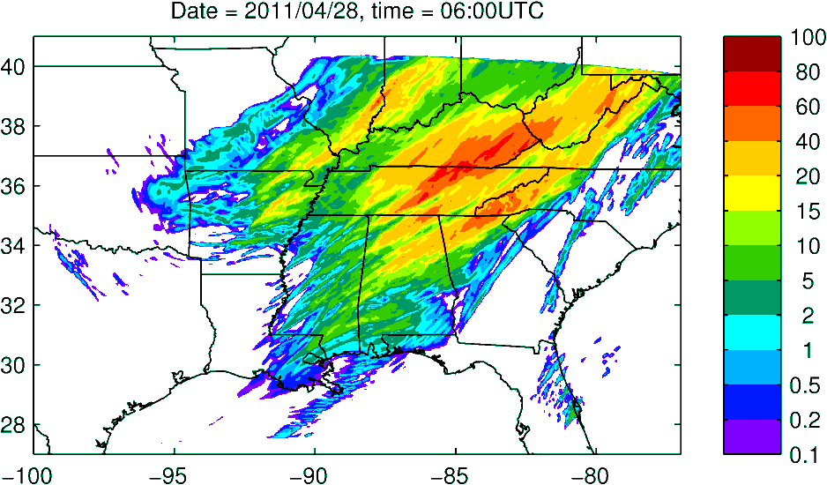
Case Study: Severe weather April 27th, 2011 (Huntsville tornado)
WRF-CHEM simulations conducted by Pablo Saide in collaboration with Greg Carmichael and Scott Spak (U-Iowa)
Inclusion of aerosol cloud interactions significantly impacts the predicted precipitation distribution and improves forecast over Huntsville, AL
SPC 12hr precip and tornado tracks valid 06Z on April 28, 2011
WRF no aerosols
WRF-Chem + RAQMS BC

Slide 12
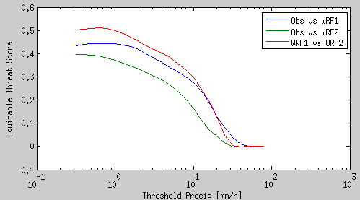
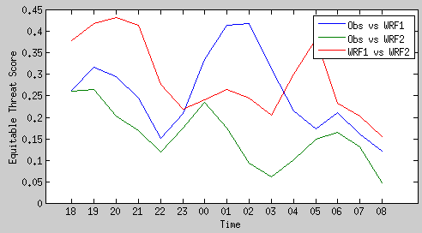
Precip. Obs vs WRF & WRF-Chem
Skill for 3h accum precip. vs different precip. thresholds
Simulations with and without aerosol effects yield very different precipitation fields
Skill to represent observation is reduced for the larger precip. values
There is improved skill when considering aerosol effects
OBS vs WRF-Chem RAQMS
WRF-Chem vs WRF
OBS vs WRF NO-CHEM
Skill for 3h accum. precip. over 10mm
27th
28th
UTC

Slide 13
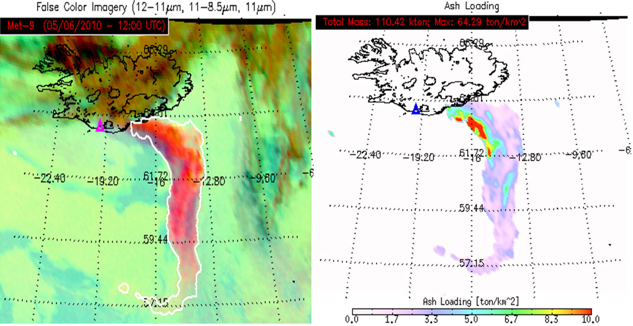
Volcanic Ash Prediction
2010 Eyjafjallajokull volcanic eruption
Ash Detection product (left) and Ash Loading (right) using the GOES-R Volcanic Ash Algorithm applied to Meteosat-9/SEVIRI data¹ (From Mike Pavolonis, NESDIS/STAR, and Justin Sieglaff, CIMSS)
¹http://www.goes-r.gov/products/baseline-volcanic-ash.html

Slide 14
WRF-CHEM Volcanic Ash Module
A 4-bin WRF-CHEM volcanic ash module developed by George Grell at Earth System Research Laboratory (ESRL) and Martin Stuefer at the University of Alaska, Fairbanks (UAF) is used in forecasting volcanic ash.
Volcanic Ash Forecast Uncertainties
The mass estimates are estimated from the height of the erupted ash. For the Eyjafjatjalla case, eruption heights are constrained with radar data (~150 km from the volcano).
There is high uncertainty with the erupted mass: A 500 meter offset in the height changes the total mass estimate by almost 60% for injection heights <5km.
There is also high uncertainty in the assumed size distribution of the ash particles, which determines the plume lifetime.

Slide 15
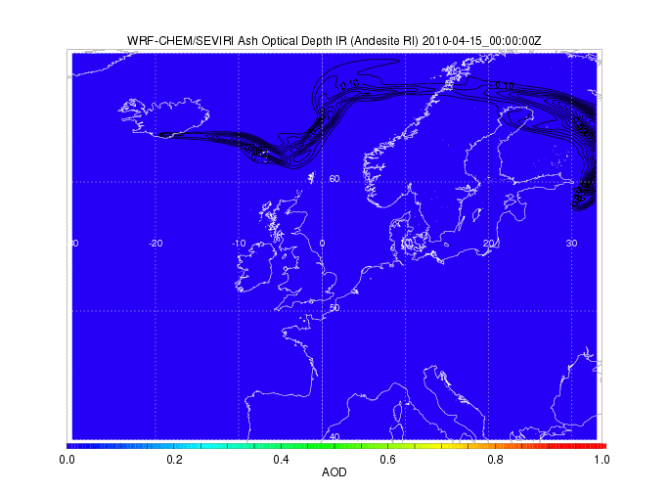
WRF-CHEM Volcanic Ash Forecast (contours) and SEVIRI 11 micron AOD (colored) during the 2010 Eyjafjoll eruption in southern Iceland.

Slide 16
GSI Volcanic Ash Assimilation
SEVIRI volcanic ash retrievals are assimilated into WRF-CHEM using the Gridpoint Statistical Interpolation (GSI)
SEVIRI 11 micron volcanic ash extinction is assimilated
11 micron AOD first guess is computed within WRF-CHEM (updated with Andesite optical properties)
Modified NMC method for Background Errors
2 forecasts:
emission heights 1.2 times larger than control experiment
emission heights 0.8 times higher than control
Used differences between 00z April 14 to 00z April 19, 2010 hourly forecast (valid at same time) to build the statistics

Slide 17
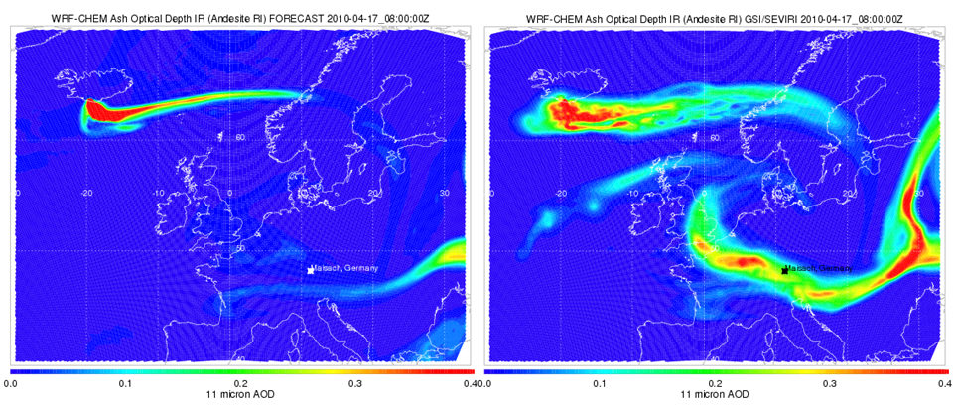
Results
WRF-CHEM Baseline GSI/SEVIRI assimilation
08Z 4/17 2010
11 μm AOD
08Z 4/17 2010
11 μm AOD
Significant increase in 11 micron AOD for older plume with GSI/SEVIRI assimilation

Slide 18
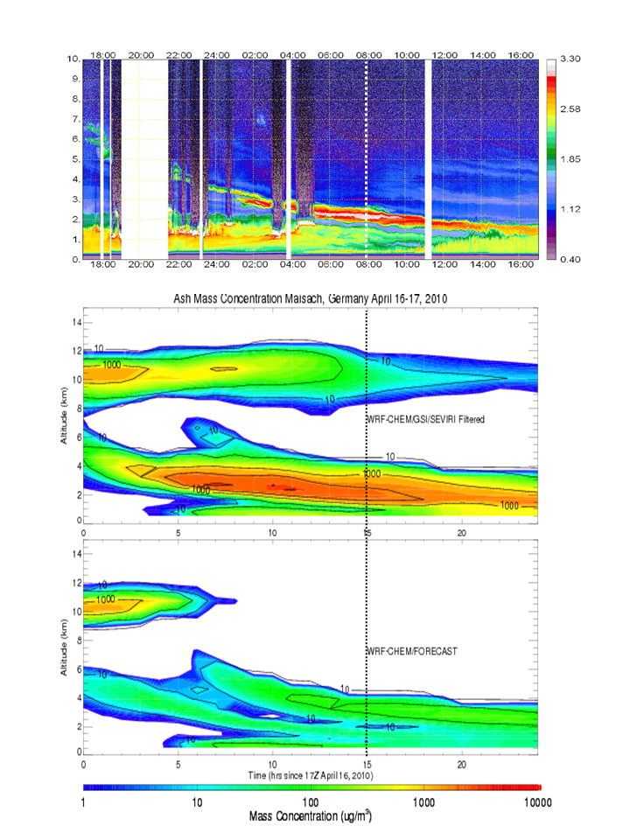
Maisach 1064 nm aerosol backscatter
Verification
Comparisons with RAMAN lidar measurements at Maisach, Germany show that maximum volcanic ash mass concentrations near the vicinity of the observed plume reached 3,226 mgm⁻³ in the GSI/SEVIRI assimilation experiment and only 155 mgm⁻³ in the baseline experiment. Gasteiger et al. [2011] estimated maximum volcanic ash mass concentrations of 1,100 mgm⁻³ (650 to 1,800 mgm⁻³) at an altitude of 2.2km at 08Z on April 17, 2010.
Both experiments show an additional plume at 10km which is not observed.
ASSIM
NO
ASSIM

Slide 19
TEMPO/GOES-R Synergies
Tropospheric Emissions:
Monitoring of Pollution
Tropospheric Emissions: Monitoring of Pollution
PI: Kelly Chance
(Smithsonian Astrophysical Observatory)
TEMPO is NASA's first Earth Venture Instrument award under the agency's Earth System Science Pathfinder program.
TEMPO spectroscopic measurements in the ultraviolet and visible provide a tropospheric measurement suite that includes the key elements of tropospheric air pollution chemistry
TEMPO will be launched on a commercial satellite as a hosted payload with a target launch in 2019
TEMPO will be a component of a global GEO constellation for pollution monitoring along with Europe (Sentinel-4) and Asia (Geostationary Environment Monitoring Spectrometer)

Slide 20
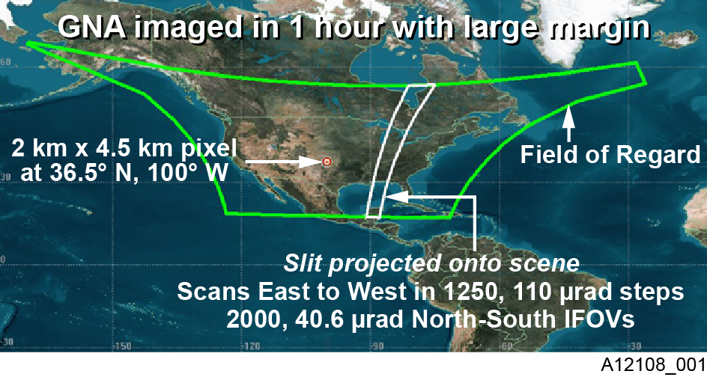
Each 2 km × 4.5 km pixel is a 2K element spectrum from 290-690 nm!
GEO platform selected by NASA for viewing greater North America

Slide 21
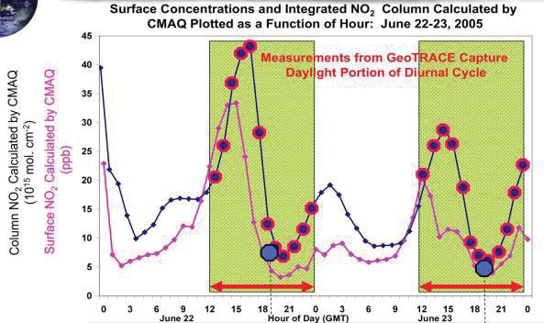
TEMPO measurements will capture the diurnal cycle of NO₂ that is missed by current LEO observations – Will complement GOES-R fire detection and GOES-R GLM for improved emission inventories
Average summertime (April–September) OMI BEHR NO2 column densities for 2005, (From Russell et al., Atmos. Chem. Phys. Discuss., 12, 15419–15452, 2012)

Slide 22
TEMPO UV-Vis observations significantly
improve sensitivity to O3 near the surface
over the use of UV only – Will complement GOES-R Total Column Ozone retrieval

Slide 23
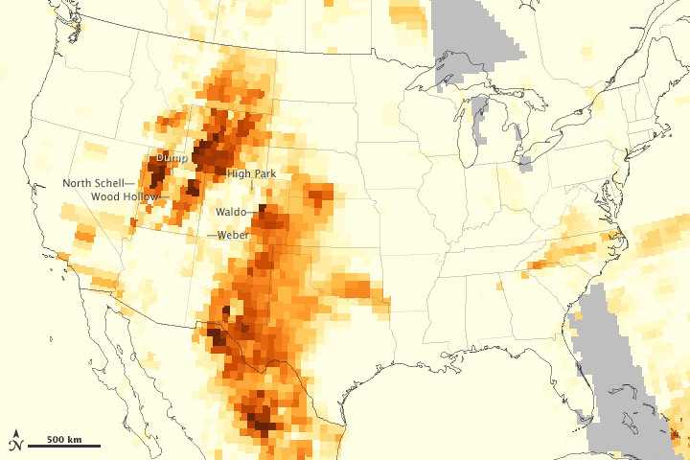
TEMPO measurements will retrieve Absorbing Aerosol Optical Depth (AAOD) to detect elevated layers of absorbing aerosols. – Will complement GOES-R ABI AOD retrieval and allow determination of altitude of smoke, dust and ash plumes
MODIS AOD retrieval from Aqua
OMPS AAOD retrieval from Suomi-NPP
June 26, 2012
Credit: NASA image by Jesse Allen, using OMPS data provided courtesy of Colin Seftor (SSAI)
Source: http://earthobservatory.nasa.gov/IOTD/view.php?id=78389

Slide 24
Summary
Assimilation of MODIS AOD retrievals from polar orbit improves global forecast skill
Assimilation of GOES-R ABI AOD and TEMPO AAOD retrievals will improve regional forecast skill
Aerosol/cloud interactions during significant smoke events have been shown to improve the prediction of precipitation during the April 2011 Tornado outbreak
Neglected microphysical process in current model guidance for severe storm prediction
Assimilation of SEVIRI 11 micron AOD improves volcanic ash forecast skill over Europe
Assimilation of GOES-R ABI volcanic ash and TEMPO AAOD retrievals will improve volcanic ash and SO2 forecast skill over North America

