Slide 1
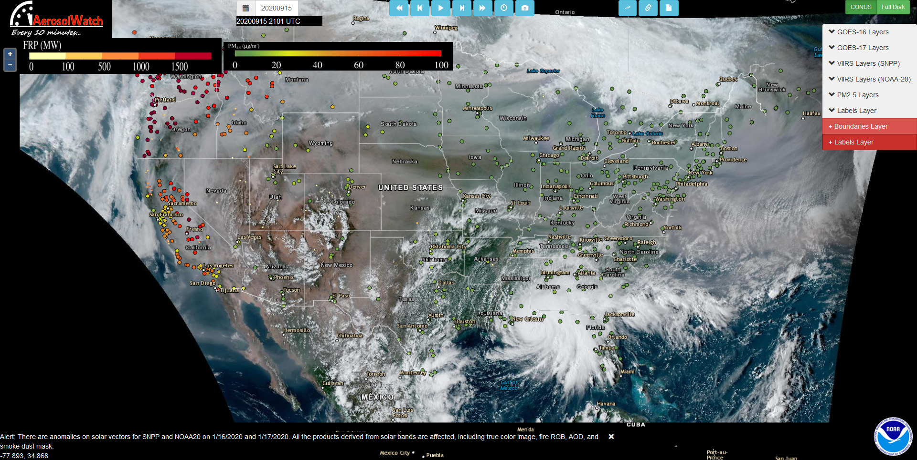
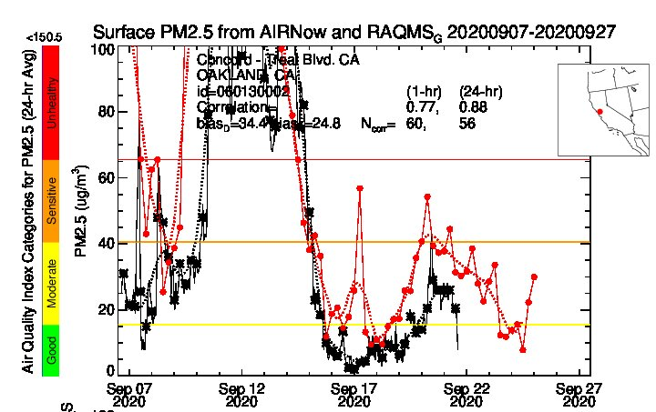
Photo: Sam Hall
Red=RAQMS
Black=AIRNOW
What satellite observations are available (current and future
capabilities)? Assimilation of satellite measurements.

Slide 2
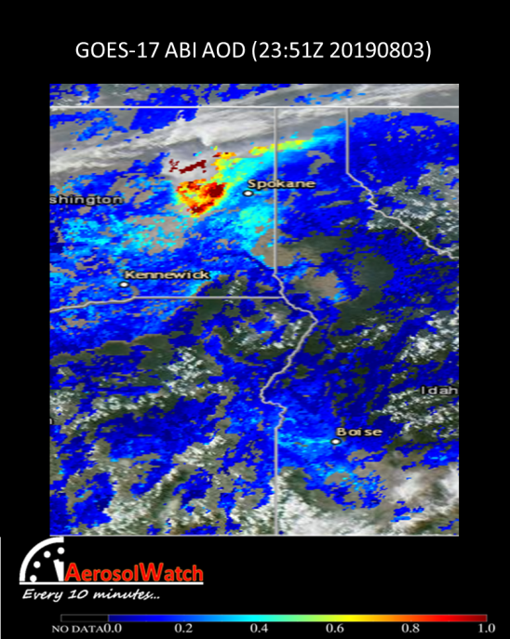
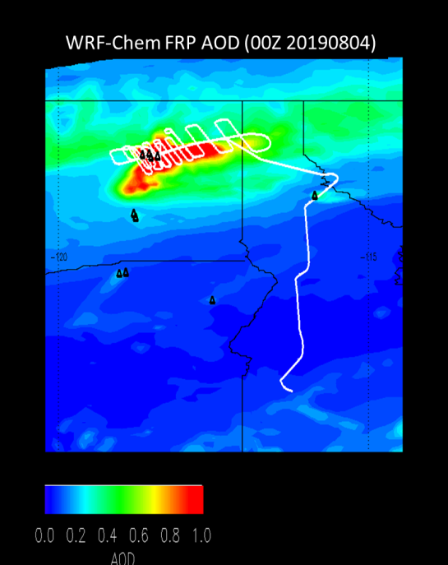
GOES ABI Aerosol Optical Depth (AOD)
and WRF-Chem Fire Radiative Power (FRP) Experiments, August 03, 2019
Use of of 5-minute ABI FRP for wildfire emissions and injection heights following approach VIIRS in HRRR-Smoke
High resolution (8km) WRF-Chem FRP based aerosol AOD forecasts are in good agreement with ABI
Williams Flats Fire
Williams Flats Fire
Aditya Kumar (UW-Madison)

Slide 3
FIREX-AQ High Spectral Resolution Lidar (HSRL)
and WRF-Chem Control and FRP Experiments, August 03, 2019
FIREX-AQ HSRL
John Hair (NASA LaRC)
Use of of 5-minute ABI FRP for wildfire emissions and injection heights following approach VIIRS in HRRR-Smoke
Significant improvement in predicted aerosol backscatter and injection heights
Aditya Kumar (UW-Madison)

Slide 4
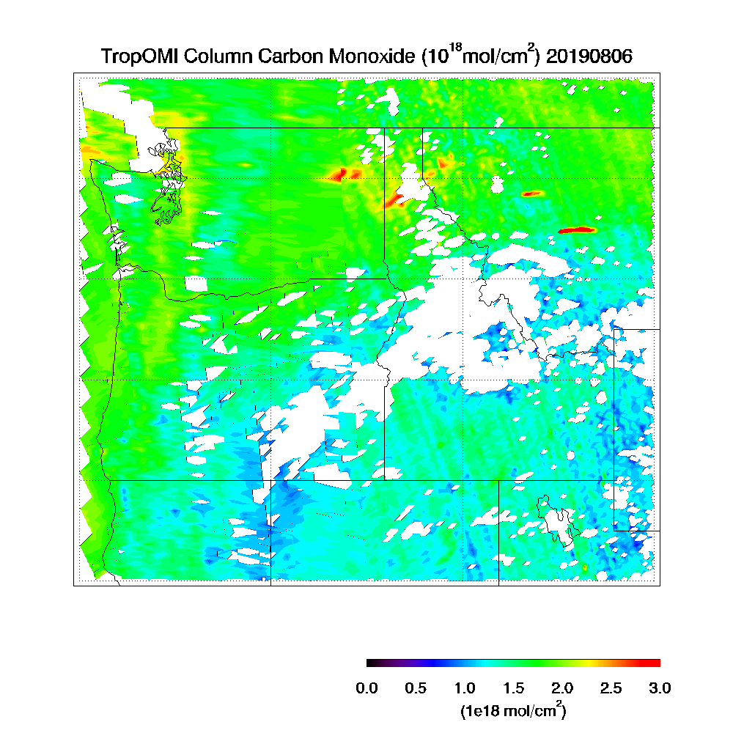
NOAA-20 VIIRS Aerosol Optical Depth (AOD) and TROPOMI Carbon Monoxide (CO) August 06, 2019
NOAA-20 VIIRS AOD
Williams Flats Fire
Williams Flats Fire
https://www.star.nesdis.noaa.gov/smcd/spb/aq/AerosolWatch/

Slide 5
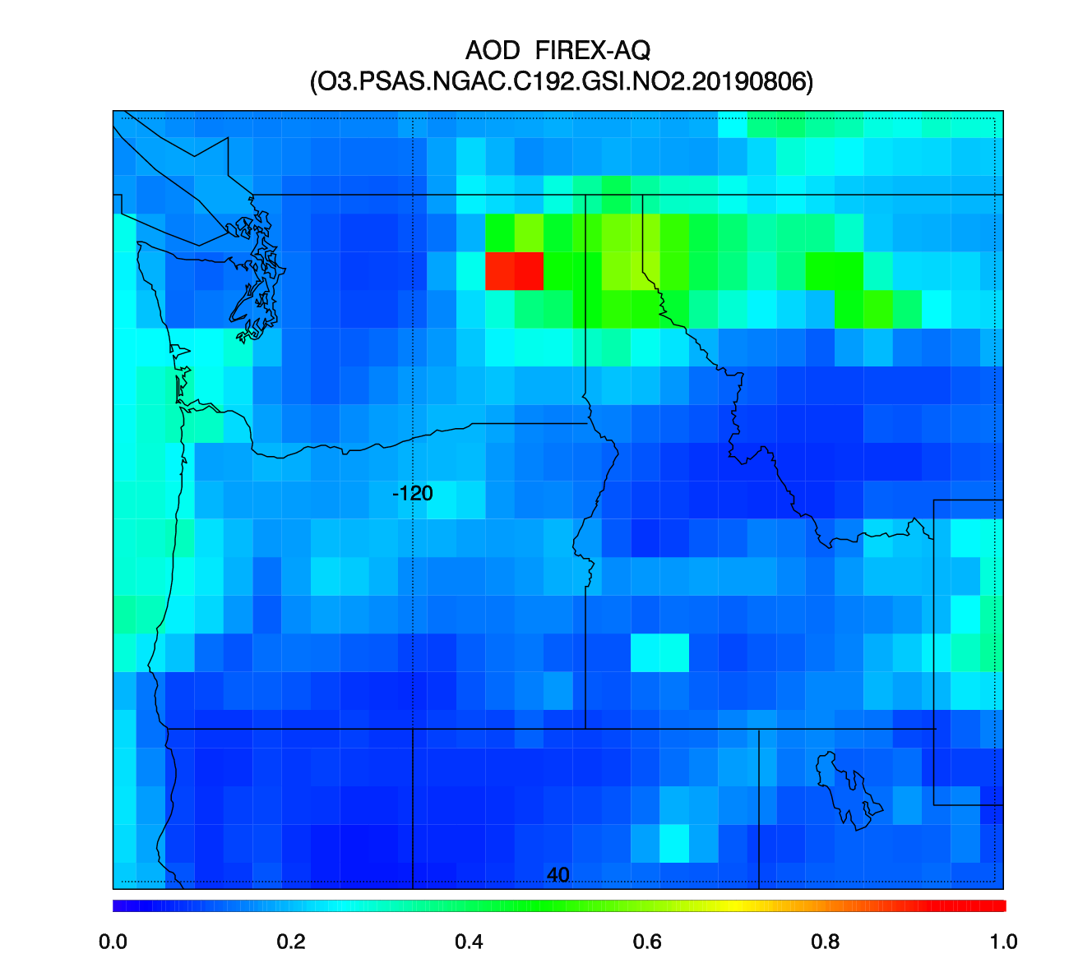
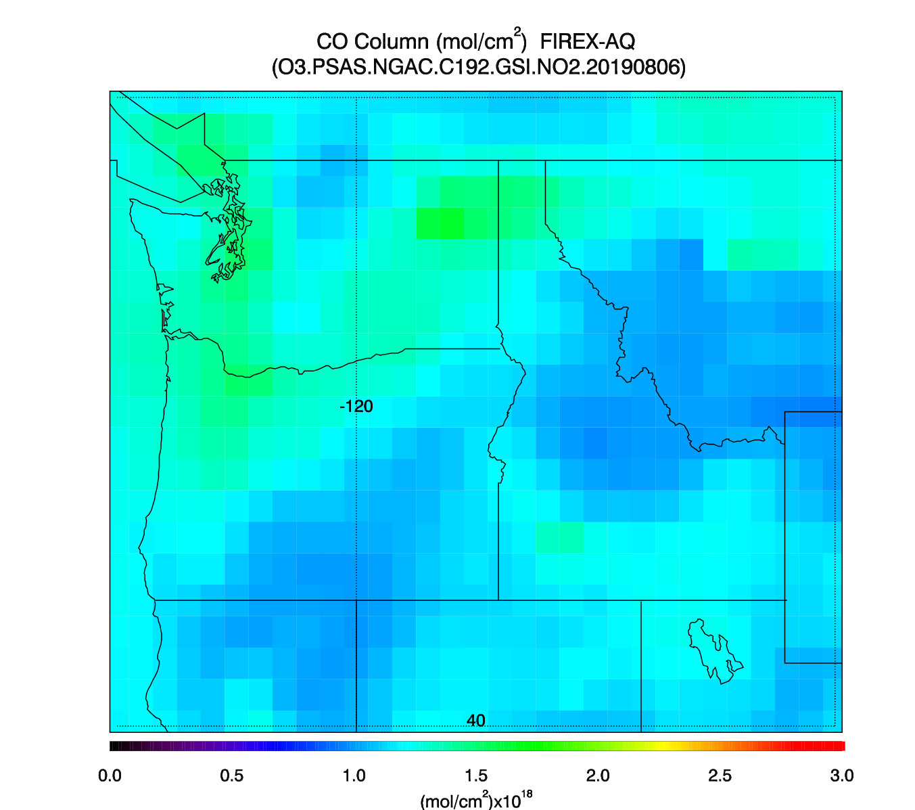
NOAA UFS-RAQMS Aerosol Optical Depth (AOD) and Carbon Monoxide Forecast 21Z August 06, 2019
Williams Flats Fire
Williams Flats Fire

Slide 6
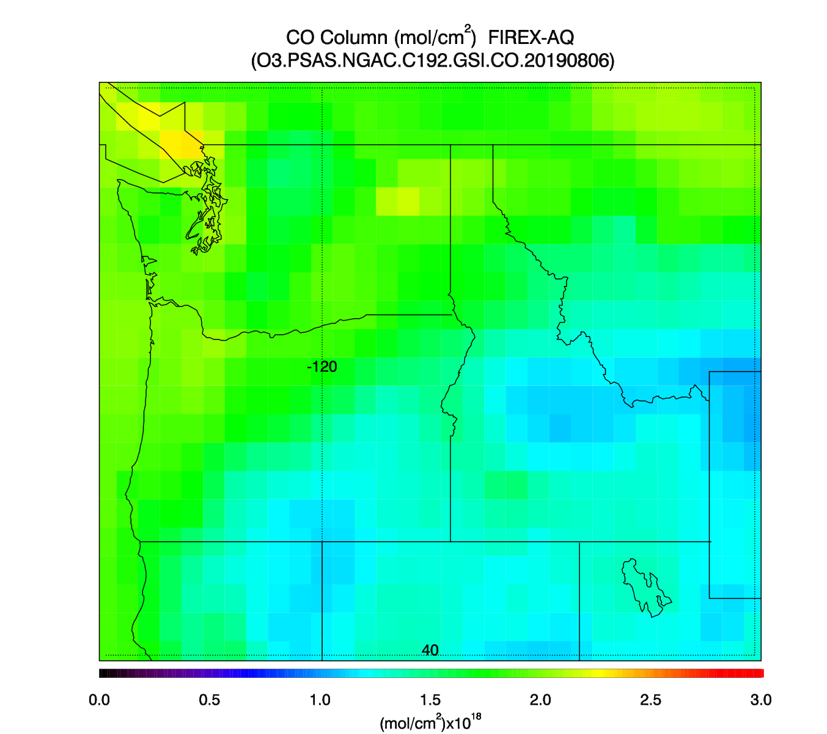
NOAA UFS-RAQMS Aerosol Optical Depth (AOD) and Carbon Monoxide (TROPOMI Data Assimilation) 21Z August 06, 2019
Williams Flats Fire
Williams Flats Fire

Slide 7
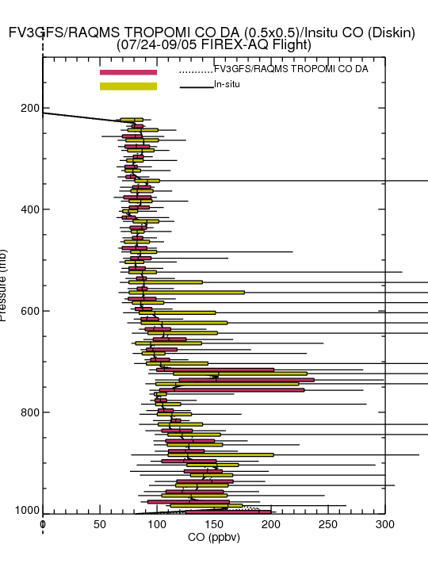
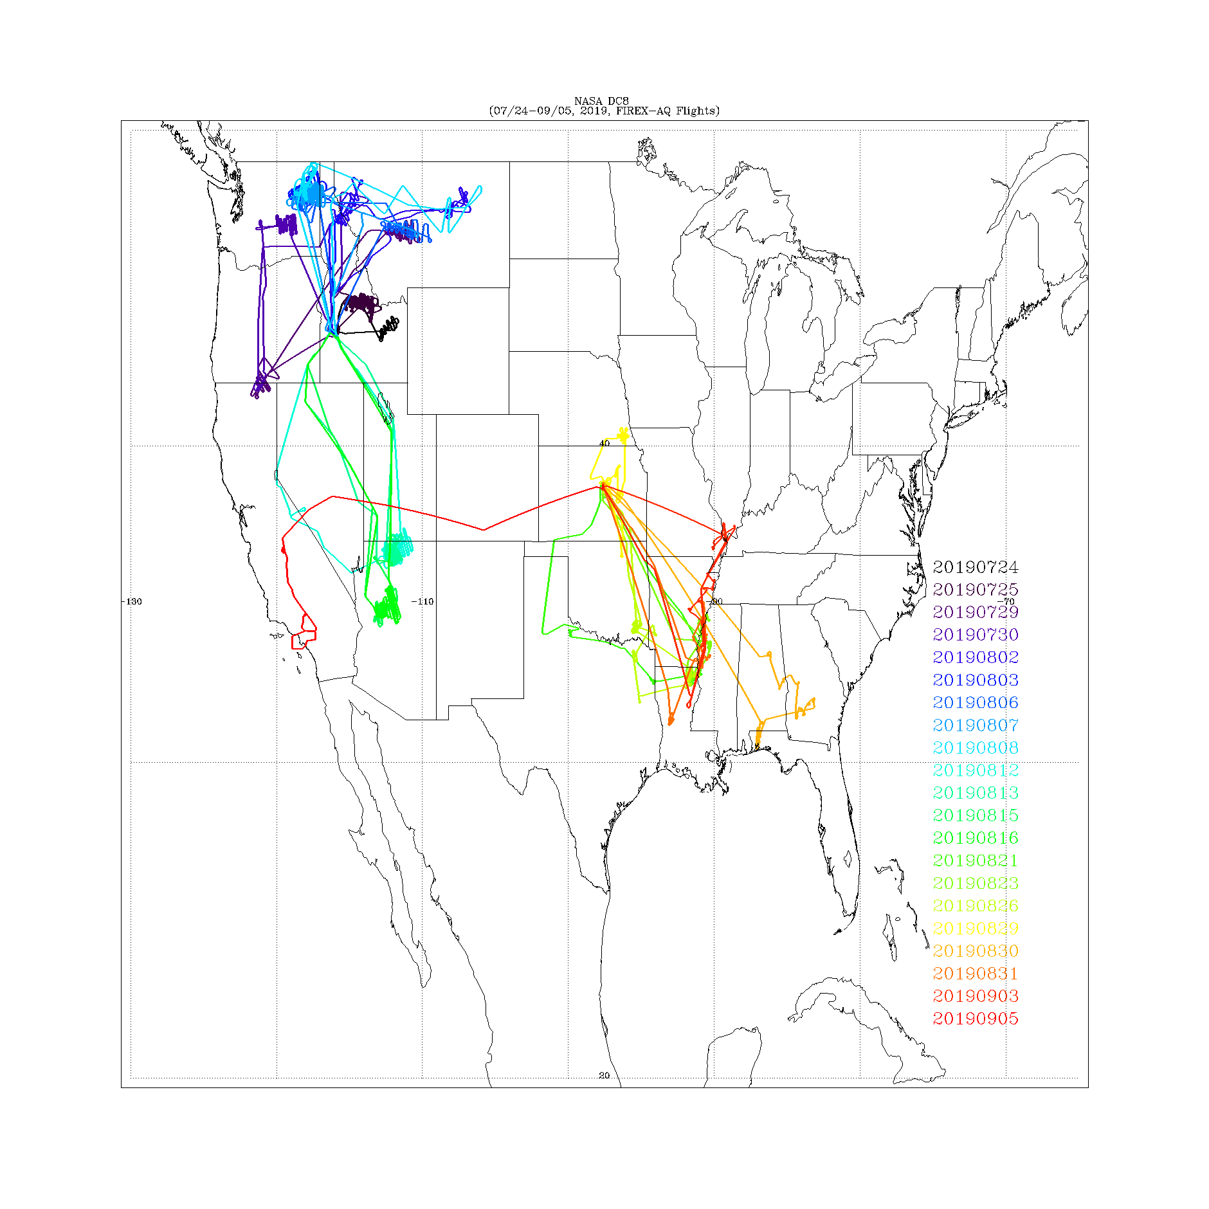
FIREX-AQ insitu CO and UFS-RAQMS TROPOMI CO Data Assimilation Experiments, FIREX-AQ 2019
FIREX-AQ DC8 Flight Tracks
Insitu CO from Glen Diskin (NASA/LaRC)
Assimilation of TROPOMI CO column leads to significant improvements in UFS-RAQMS CO analysis (reduced bias, improved representation of variance within wildfire plumes) and very good agreement with insitu CO measurements

Slide 8
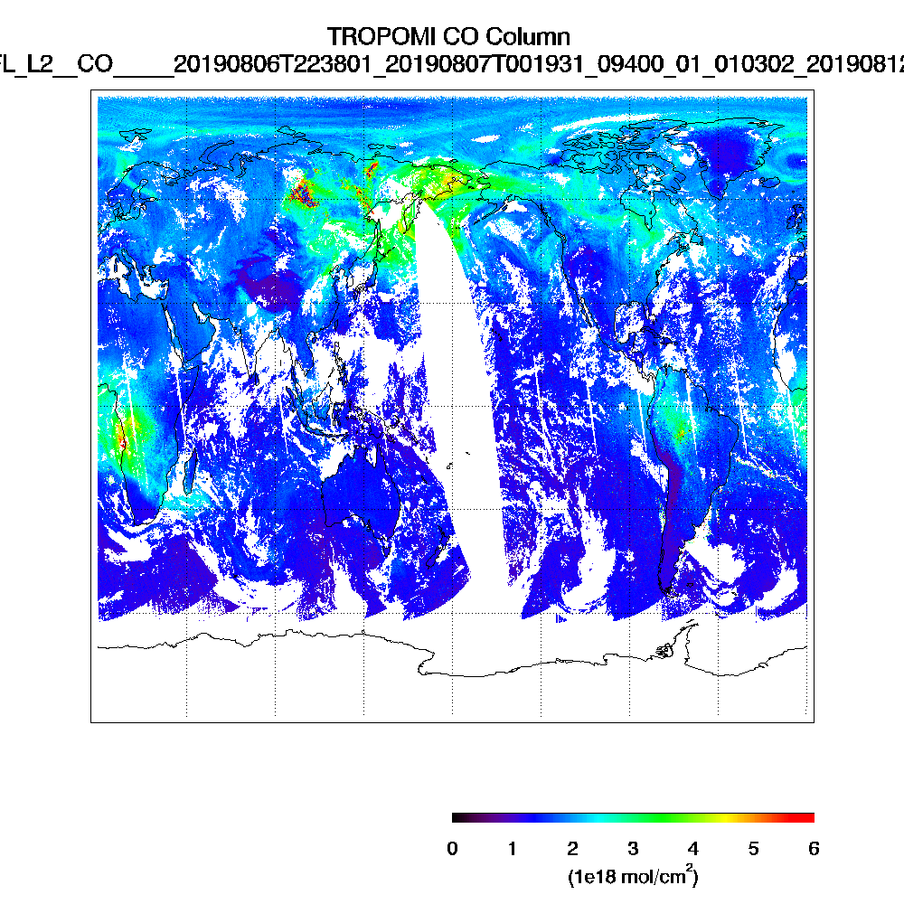
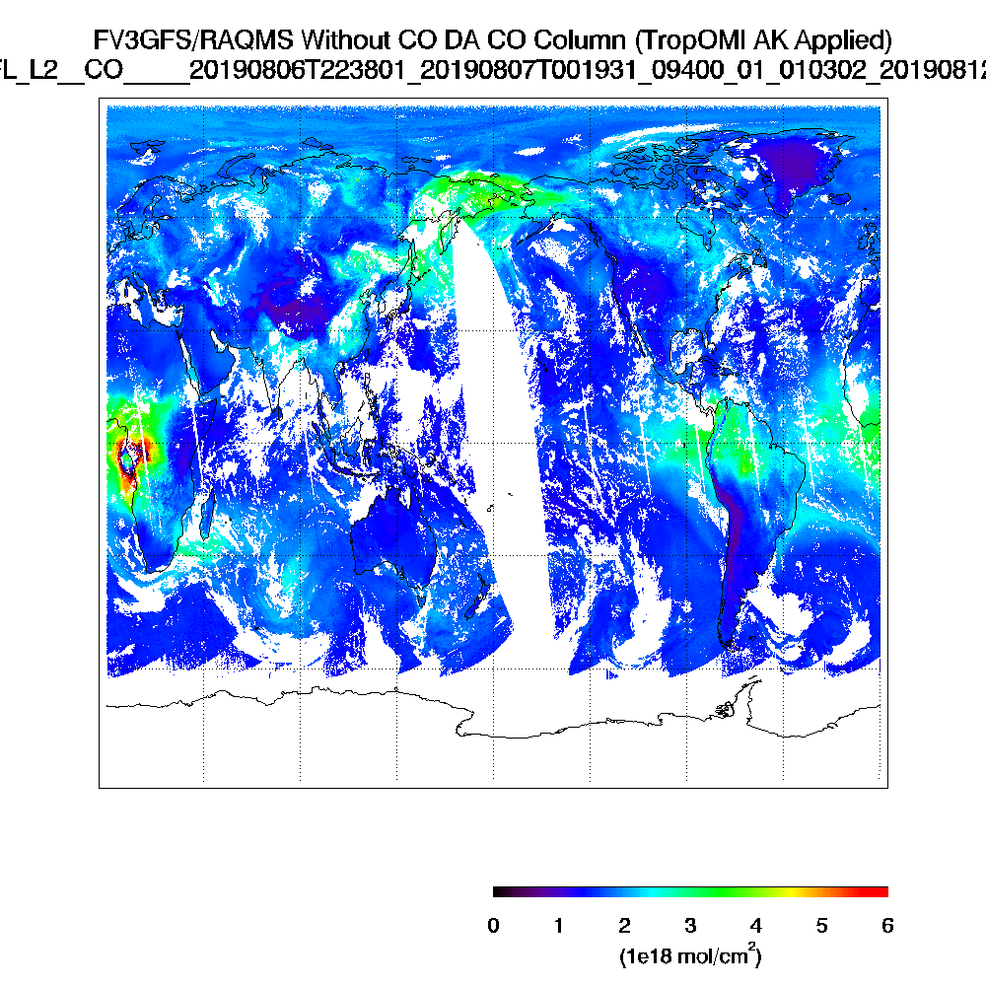
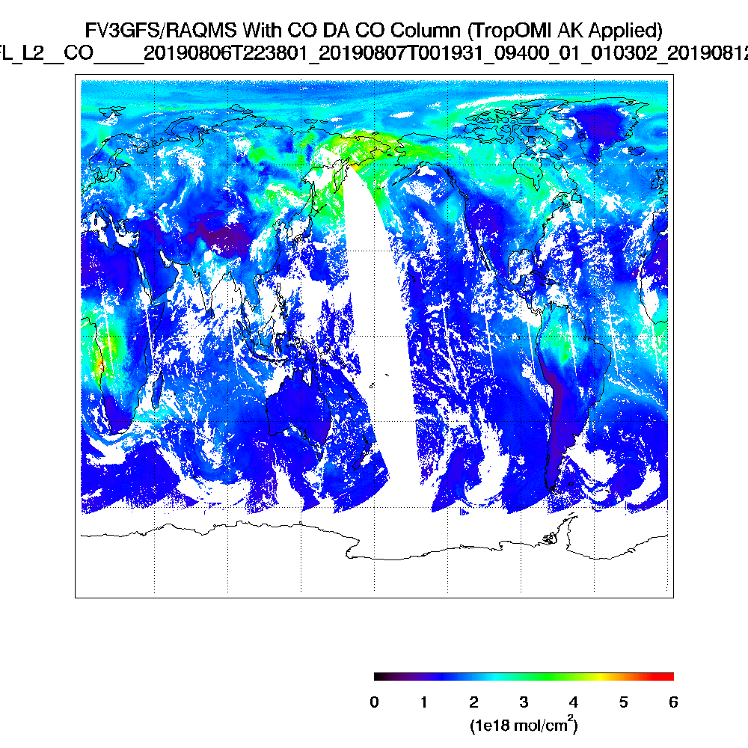
Long-range transport of wildfires can influence regional air quality
TROPOMI Column CO (August 08, 2019)
UFS-RAQMS (Control)
UFS-RAQMS (TROPOMI DA)

Slide 9
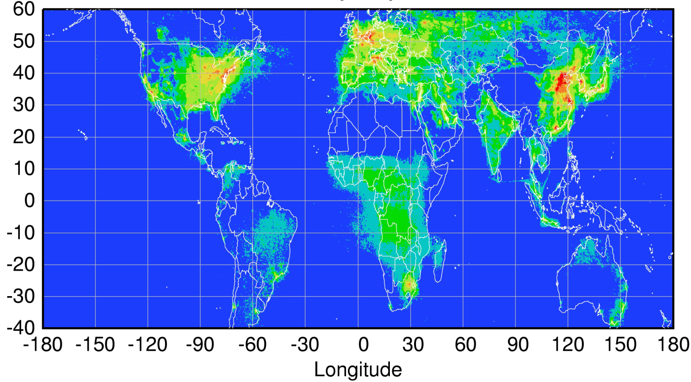
Future: Global GEO/LEO pollution monitoring constellation
The suite of NO₂, H₂CO, C₂H₂O₂, O₃, H₂O, and aerosol measurements from TEMPO will help constrain secondary formation of VOCs and ozone.
TEMPO (GEMS) trace-gas retrievals will complement ABI (AHI) fire detection and aerosol measurements.
Sentinel-4
(hourly)
TEMPO
(hourly)
GEMS
(hourly)
80-115°W
0°
2021+ launch
128.2°E
2019 launch
Sentinel-5P
(once per day)
Courtesy Jhoon Kim,
Andreas Richter
Kelly Chance (Harvard/SAO)

Slide 10
Summary for discussion:
The new Geostationary imagers (ABI/AHI) are comparable to MODIS and VIIRS Polar orbiting satellites: These new sensors provide new temporal information regarding the day-time evolution of wildfire emissions (through FRP) and aerosol loading (through AOD) that can be used to constrain regional air quality forecast models.
The new TROPOMI UV/NIR instrument provides high-resolution trace gas retrievals: This new sensor provides high resolution information about wildfire chemistry through retrievals of CO, HCO, and NO2 that can be used to constrain global air quality forecast models.
Sentinal-5P follows NOAA-20 by only 5 minutes: This allows combined use of TROPOMI, VIIRS, CrIS, and OMPS retrievals for cloud clearing and multi spectral (UV/NIR/TIR) of O3 and CO with improved sensitivity to boundary layer concentrations that are critical for wildfire air quality impacts.
The next generation of UV/VIS Geostationary sensors (TEMPO/GEMS/Sentinal-4) will be comparable to TROPOMI: Combined, these new LEO and GEO satellites will provide unprecedented monitoring of global pollution, including wildfires.
A hyperspectral GEO infrared sounder similar to CrIS or IASI would allow hourly multi-spectral (UV/TIR) of O3 with improved sensitivity to boundary layer concentrations that are critical for wildfire air quality impacts.

