Slide 1
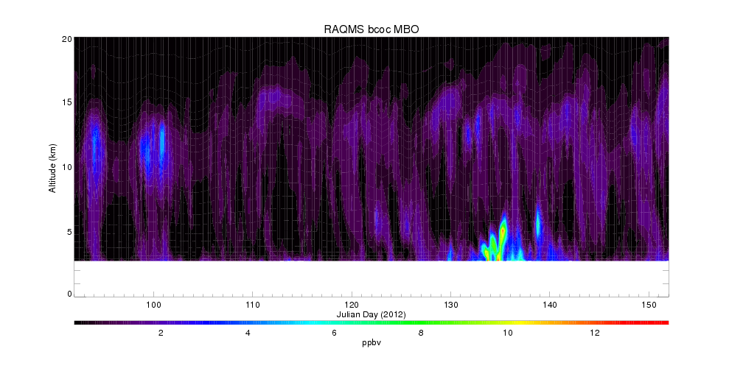
4/29
5/9
5/16-5/19
5/29

Slide 2
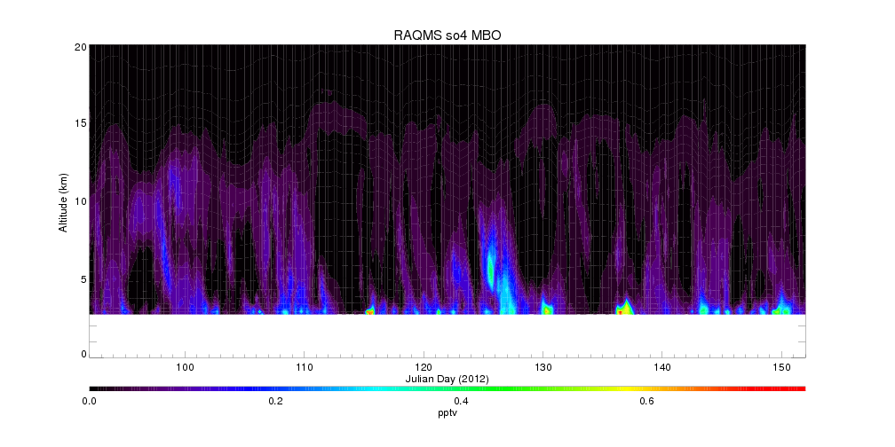
4/29
5/9
5/16-5/19
5/29

Slide 3
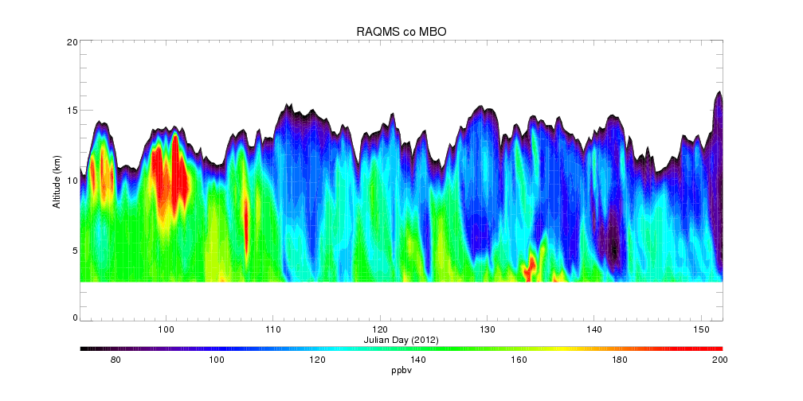
4/29
5/9
5/16-5/19
5/29

Slide 4
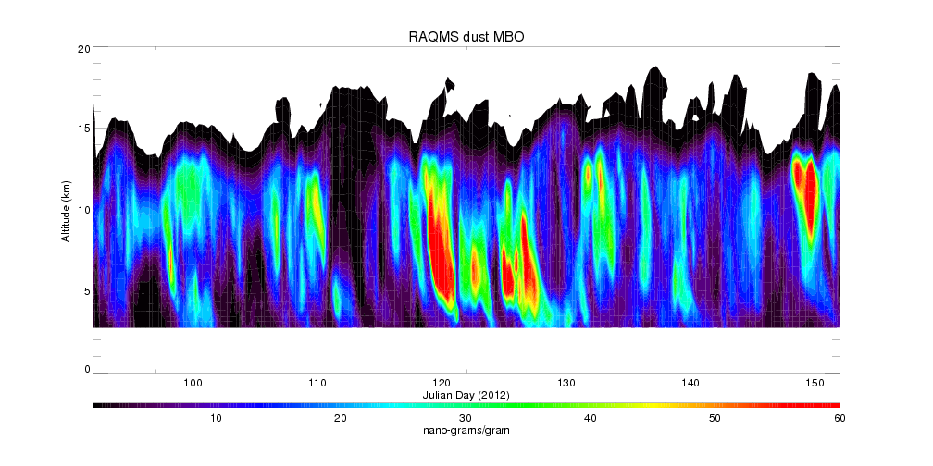
4/29
5/9
5/16-5/19
5/29

Slide 5
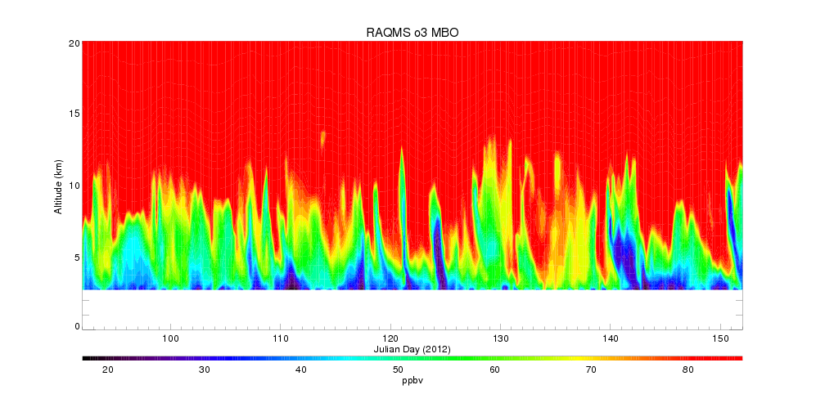
4/29
5/9
5/16-5/19
5/29

Slide 6
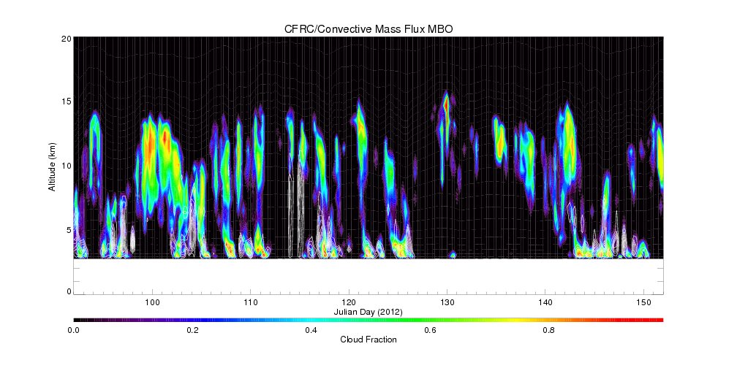
4/29
5/9
5/16-5/19
5/29

Slide 8
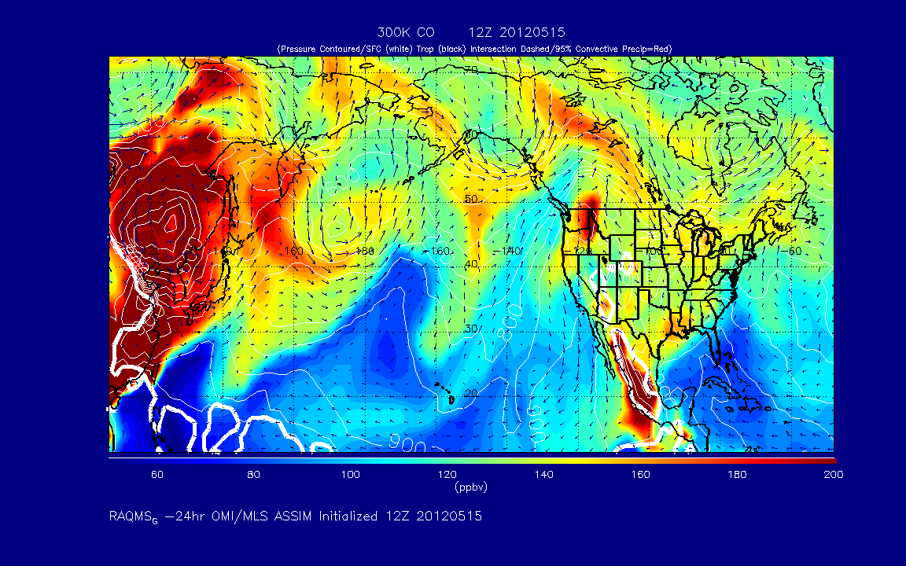

Slide 9
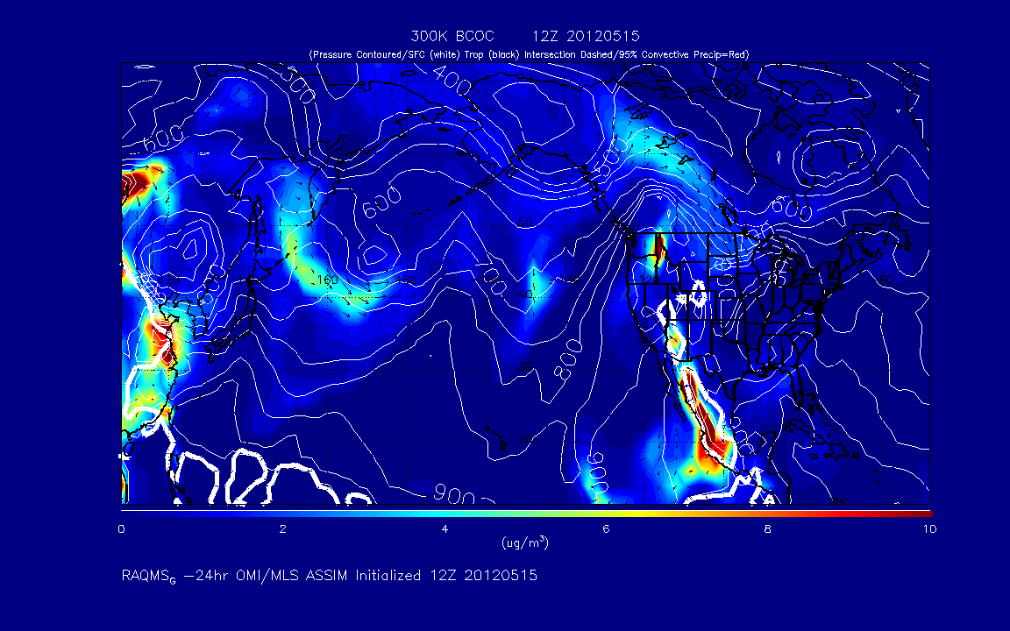

Slide 10
