Slide 1
Satellite data, modeling, and planned field study for better charactering wildfire impacts (FIREX)
Brad Pierce, NOAA/NESDIS
Significant contributions from Carsten Warneke, Georg Grell, Ravan Ahmadov, Jeff McQueen, Chris Barnet, Nadia Smith, Shobha Kondragunta and Tim Schmit
2016 Midwest and Central States Air Quality Workshop, June 21-23, 2016, St. Louis, MO

Slide 2
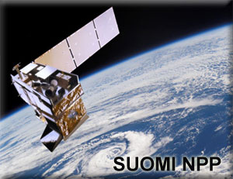
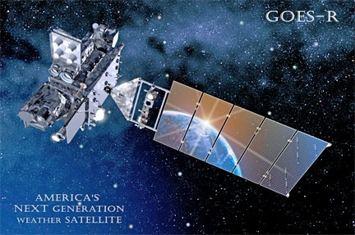
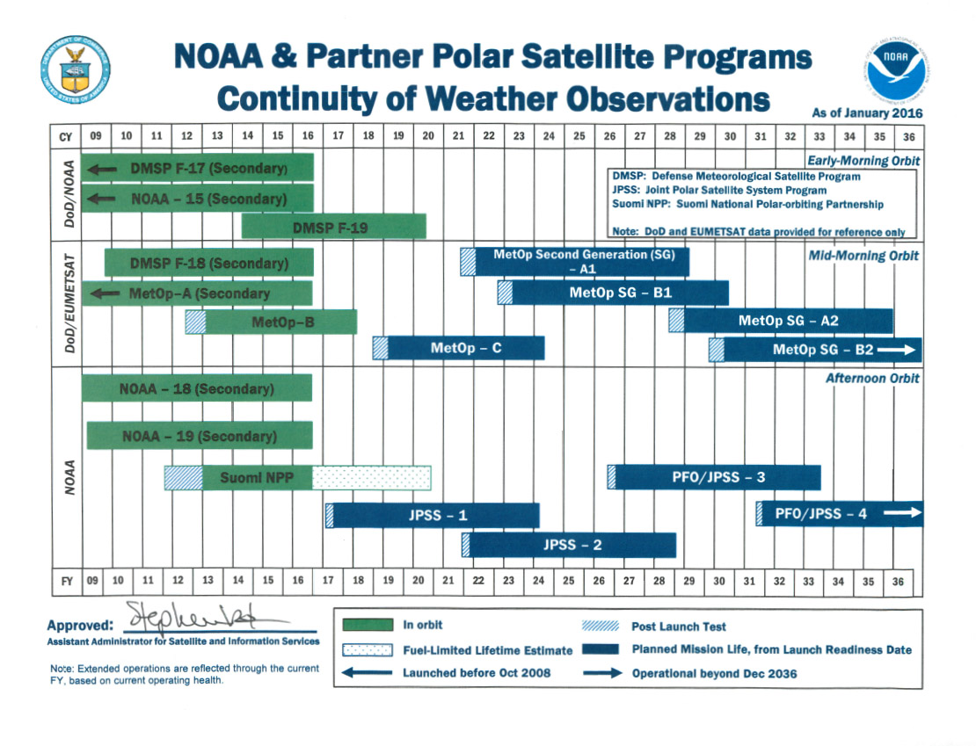
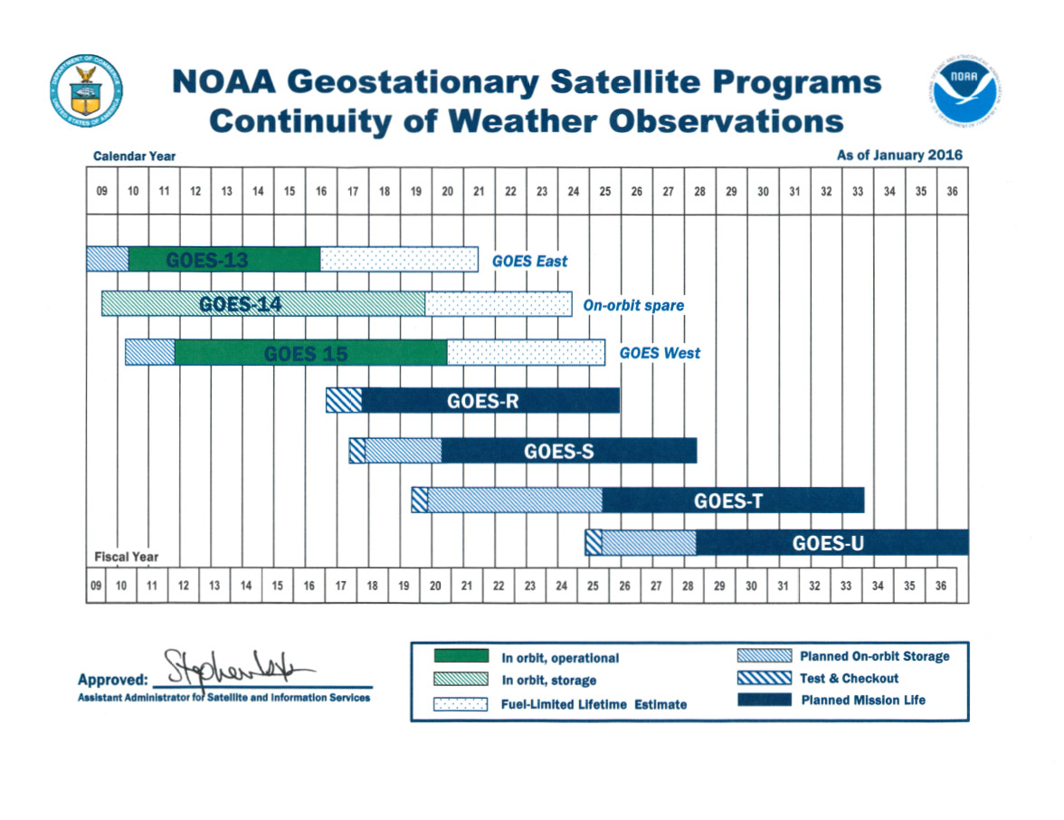
Low Earth Orbit (LEO)
Geostationary Orbit (GEO)
Satellite data
for characterizing
wildfire impacts
October 2011 Launch (JPSS-1 in March 2017)
November 2016 Launch
Visible Infrared Imaging Radiometer Suite (VIIRS)
Cross-track Infrared Sounder (CrIS)
Ozone Mapping Profiler Suite (OMPS)
Advanced Technology Microwave Sounder (ATMS)
Advanced Baseline Imager (ABI)
Geostationary Lightning Mapper (GLM)
http://www.jpss.noaa.gov/index.html
http://www.goes-r.gov/

Slide 3
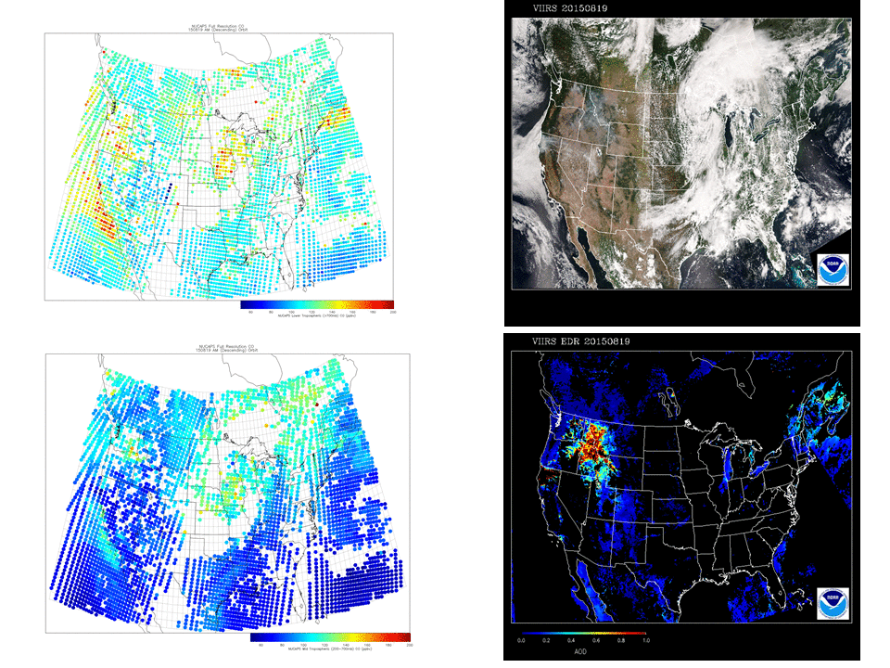
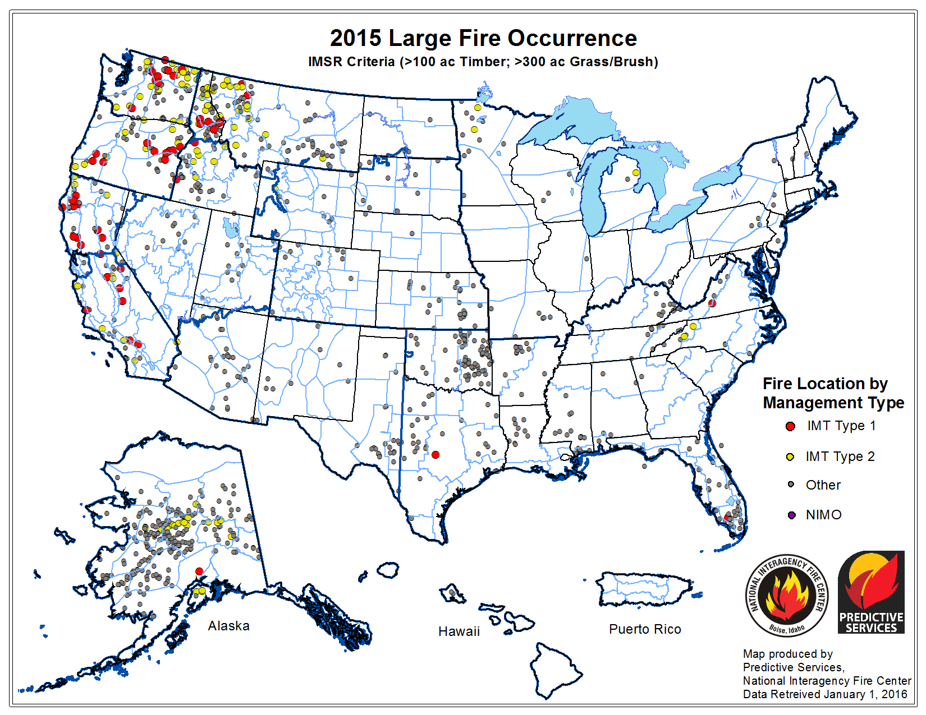
VIIRS Aerosol Optical Depth (AOD) and NOAA-Unique CrIS-ATMS Processing System (NUCAPS) Carbon Monoxide Retrievals
AM NUCAPS CO (Lower Trop)
August 2015
Pacific North West wild fires
AM NUCAPS CO (Middle Trop)

Slide 4
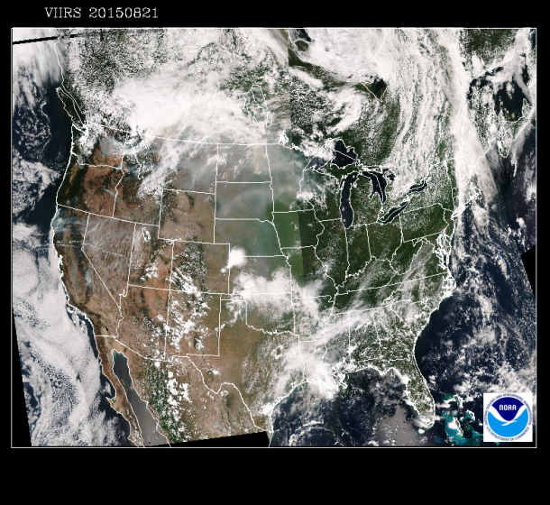
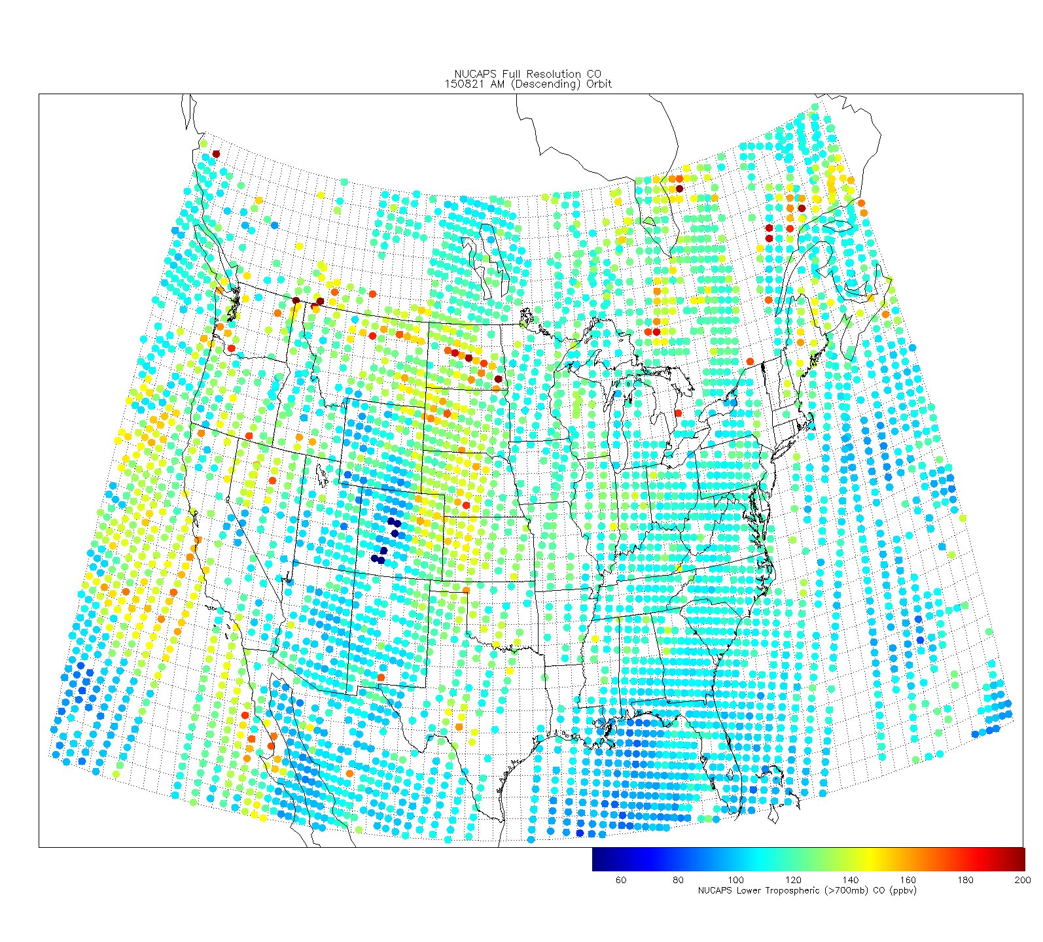
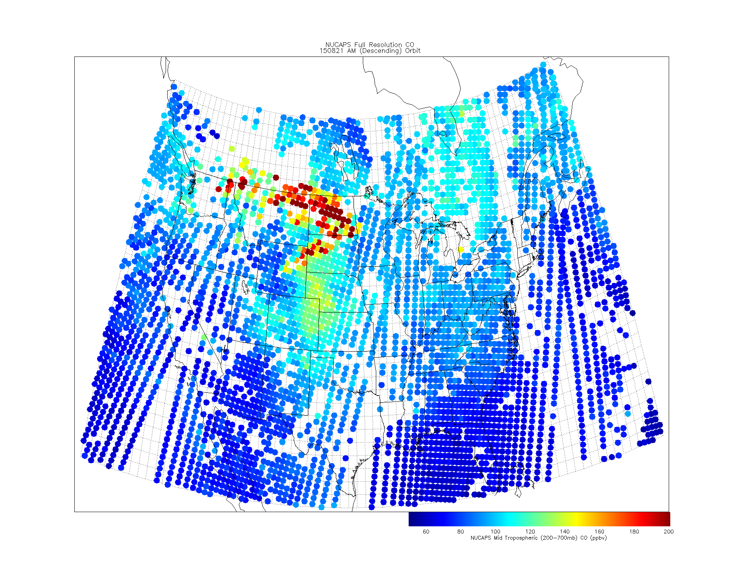
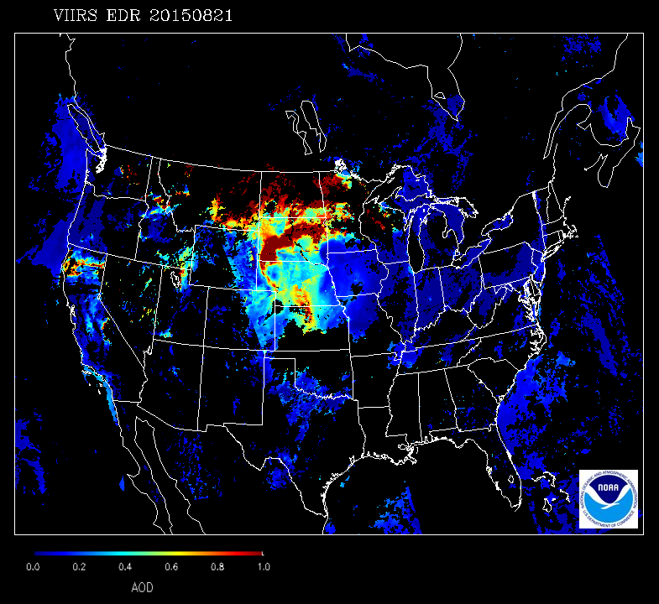
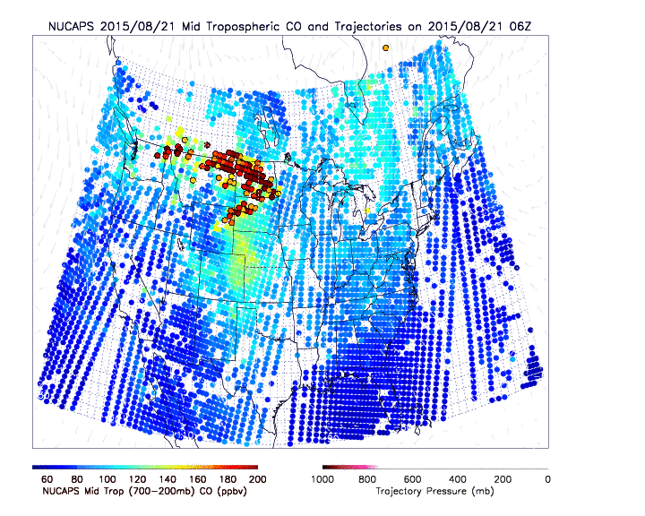
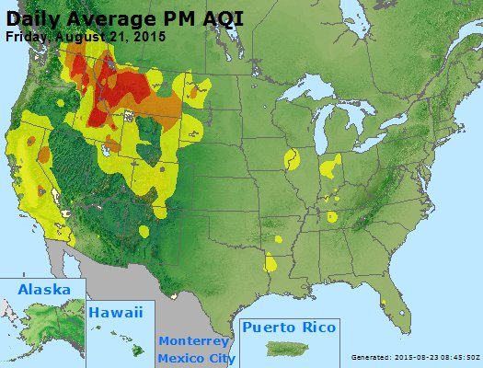
August 21, 2015 NUCAPS CO Trajectory Forecasts
AM NUCAPS low-trop CO
AM NUCAPS mid-trop CO
VIIRS True Color Imagery
VIIRS AOD EDR
EPA Air Quality Index (AQI)
NUCAPS CO shows that most of the smoke over ND/ SD/MN is aloft and will not impact the surface
Notes:
August 15-September 01, 2015 is period of significant western US fire activity and has been selected as the 2015 JPSS Fire and Smoke Initiative Demonstration Period

Slide 5
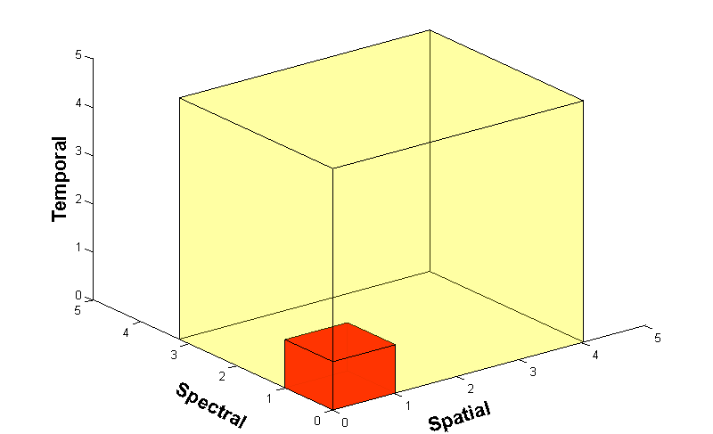
GOES-R Advanced Baseline Imager
AOD Retrievals
GOES-R ABI will have five channels between 0.47 and 2.25 μm that can be used to retrieve aerosol properties over land and ocean similar to MODIS and VIIRS.
Similar to Advanced Himawari Imager (AHI) on Japan Meteorological Agency (JMA) Himawari-8 satellite
5
4
3
X
Faster coverage (5-minute full disk vs. 25-minute)
X
Improved spatial resolution
(2 km IR vs. 4 km)
X
More spectral bands (16 on ABI vs. 5 on the current imager)
Notes:
Slide from J. Gerth, CIMSS.

Slide 6
AHI view of Russian Wildfires on May 10, 2016
AHI 10 minute “True Color” (simulated green band like needed for ABI) over Russia in May 10, 2016 (imagery provided by Dan Lindsey NOAA/NESDIS/STAR)
Notes:
AHI 10 minute “True Color” (simulated green band like needed for ABI) over Russia in May 10, 2016 (slide provided by Dan Lindsey NOAA/NESDIS/STAR)

Slide 7
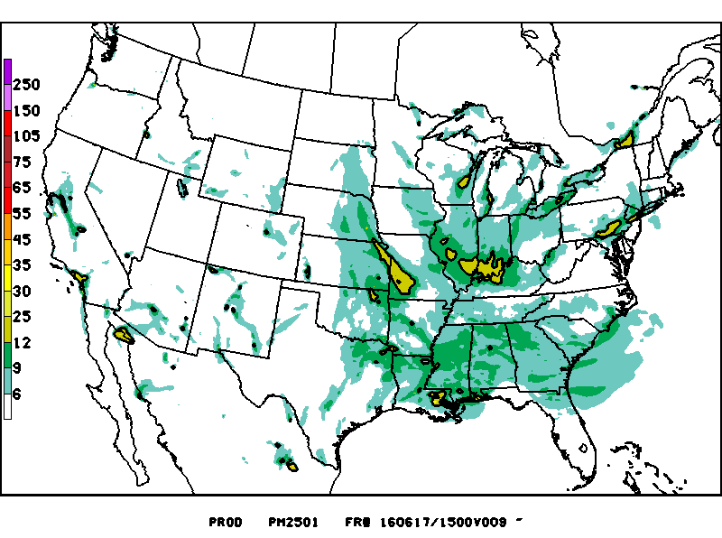
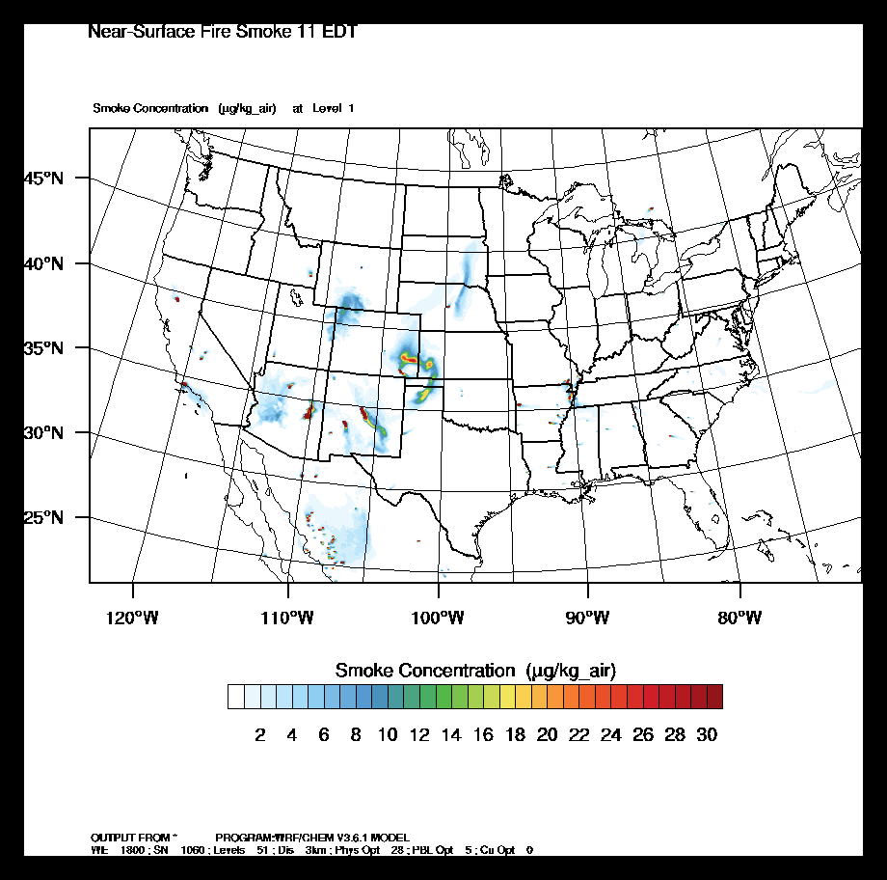
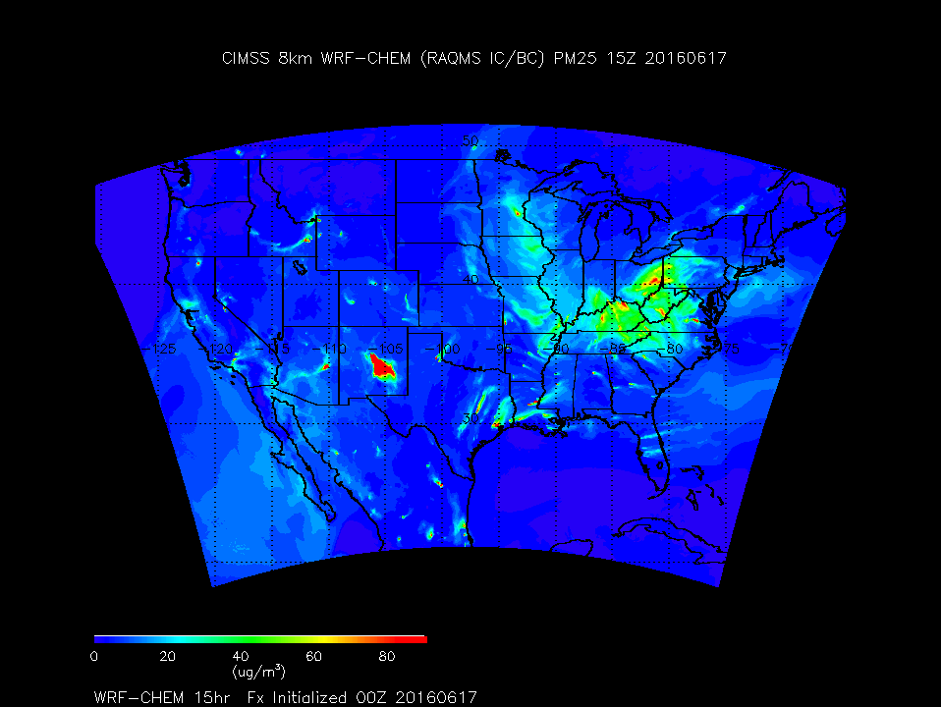
Trajectory or
dispersion forecasts
Air Quality Model forecasts
Predicting
wildfire impacts
NWS Experimental NAM-CMAQ
NWS HYSPLIT
USFS BLUE SKY
ESRL HRRR-Smoke
NESDIS Enhanced IDEA
CIMSS WRF-Chem
NWS HYSPLIT (http://airquality.weather.gov/ )
NWS NAM-CMAQ (http://www.emc.ncep.noaa.gov/mmb/aq/cmaq/web/html/
USFS BLUE SKY (http://www.airfire.org/data/bluesky-daily/ )
NESDIS Enhanced IDEA (http://www.star.nesdis.noaa.gov/smcd/spb/aq/expr/expr2/)
CIMSS WRF-Chem (http://raqms.ssec.wisc.edu/forecast/calendar/)
Forecasts of Assayii Lake Fire, NM valid 15Z Friday June 17,2016

Slide 8
NWS National Air Quality Forecast Capability (NAQFC)
Operational NAM-CMAQ PM2.5 predictions
12km Forecast
Wildfire emissions from
Forest Service BlueSky Smoke Modeling Framework
http://www.nws.noaa.gov/ost/air_quality/Stajner_CMAQ_Readiness_2015.pdf

Slide 9
High Resolution Rapid Refresh with Smoke Tracers (HRRR-Smoke)
Retrospective Smoke forecasts
An experimental version of the High Resolution Rapid Refresh model is being used to predict wildfire smoke transport. The forecast model based on the Weather Research and Forecasting (WRF) numerical model coupled with chemistry (WRF-Chem).
3 km HRRR-Smoke wildfire forecast
Smoke treated as carbon monoxide (CO) tracer
Only wildfire emissions
No dry and wet deposition
No diurnal fire behavior
THESE FORECASTS ARE EXPERIMENTAL
Retrospective HRRR-Smoke forecasts conducted for August 17-31, 2015
Georg Grell and Ravan Ahmadov (NOAA/ESRL/GSD)
http://ruc.noaa.gov/wrf/WG11_RT/#hrrrsmk

Slide 10
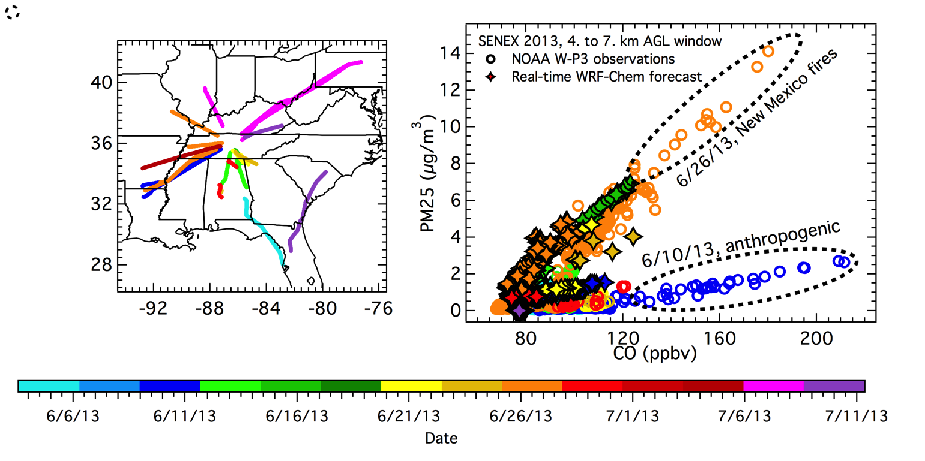
Particulate matter (PM_{2.5}) mass concentrations versus carbon monoxide (CO) mixing ratios measured by aircraft¹ and simulated by WRF-Chem
1150 μg/m³ PM2.5 per ppmv (CO-0.055)
If HRRR-Smoke < 55ppbv (background) then PM2.5=0.0μg/m³
¹NOAA P-3 aircraft flight paths at altitudes greater than 4 km above ground level (AGL) over the southeastern US during the SENEX field campaign, June-July, 2013 (From Greg Frost, ESRL)

Slide 11
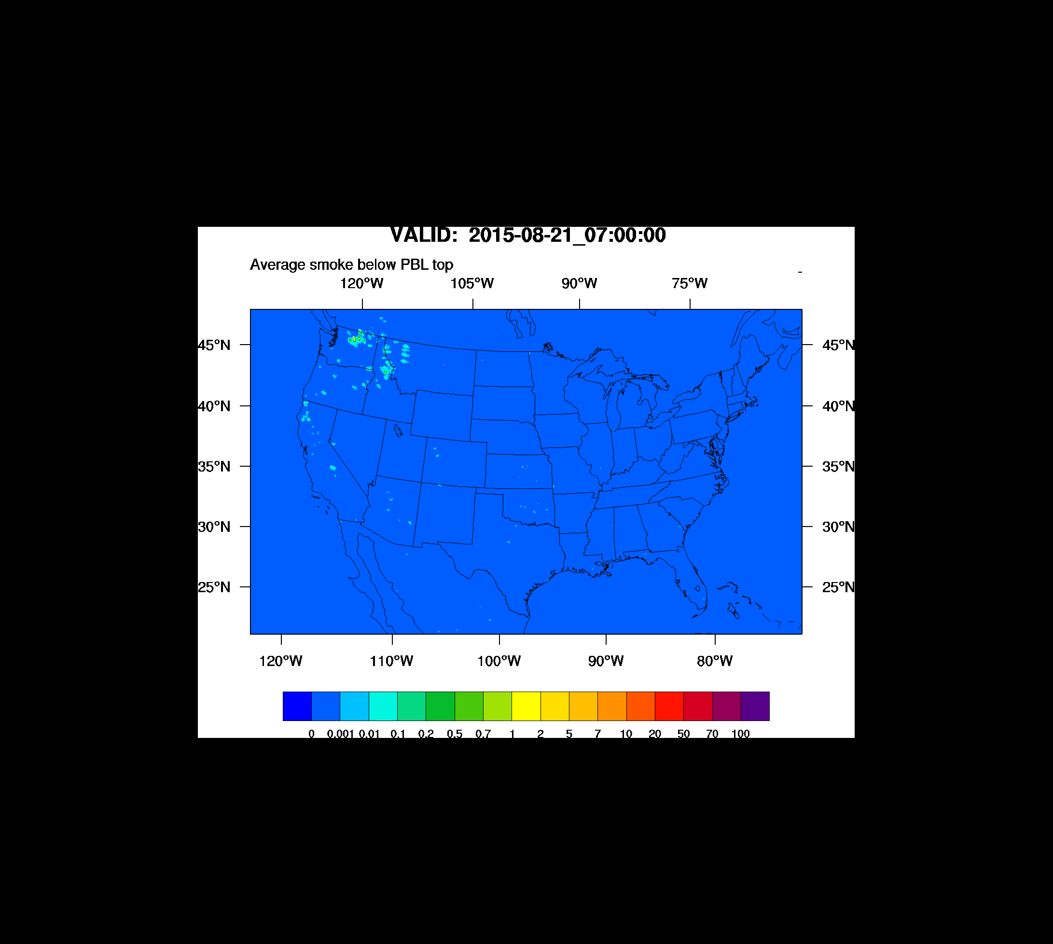
HRRR-smoke real-time experimental forecasts August 21, 2015
EPA Air Quality Index (AQI)

Slide 12
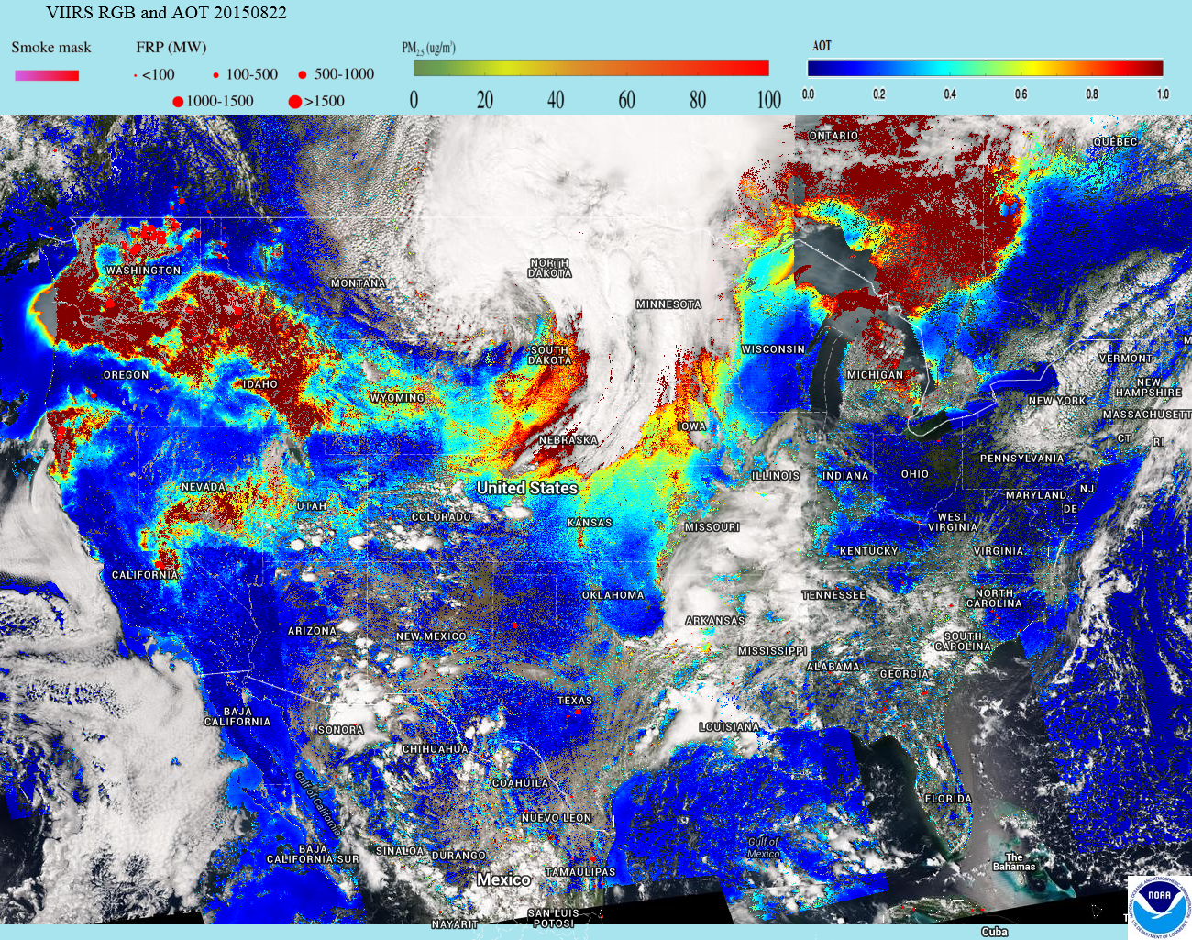
VIIRS Aerosol Optical Thickness (AOT) with FRP
http://www.star.nesdis.noaa.gov/smcd/spb/aq/expr/expr2/

Slide 13
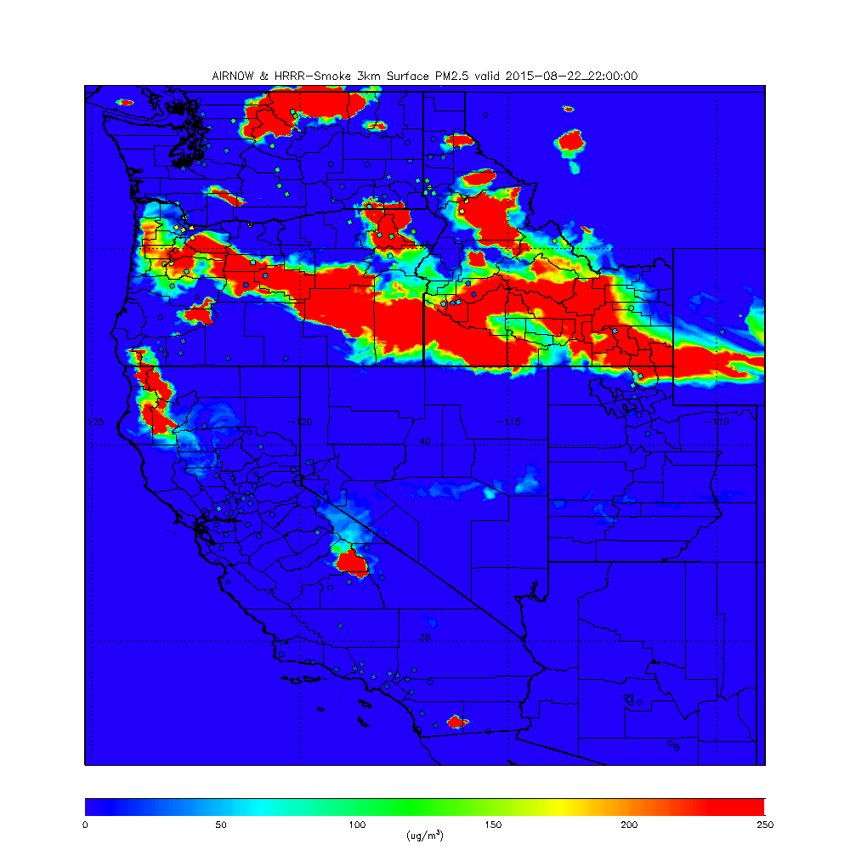
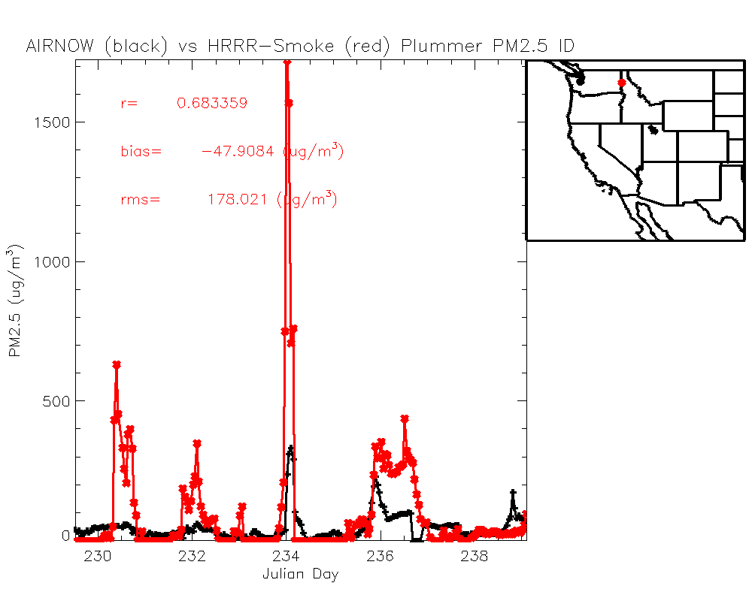
HRRR-Smoke surface PM2.5
22Z August 22, 2015
Downwind smoke plume overestimated due to neglect of deposition processes
Bias=AIRNow - Model

Slide 14
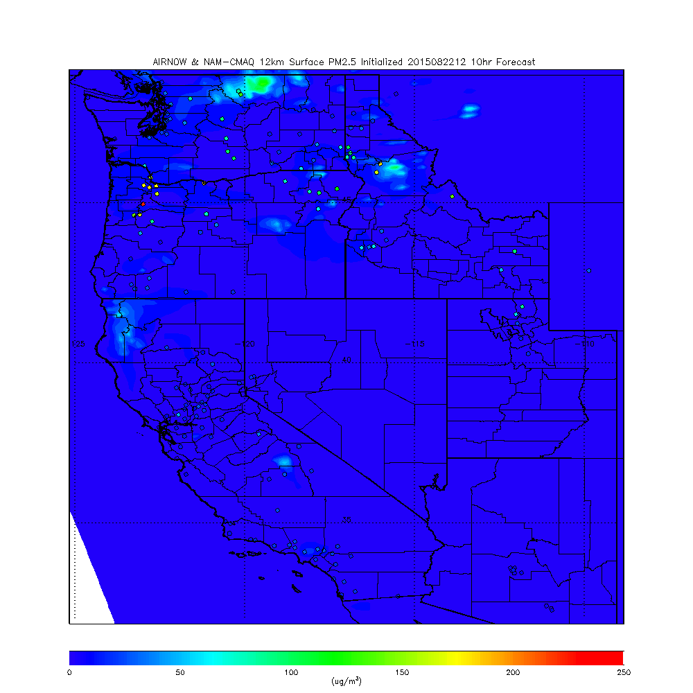
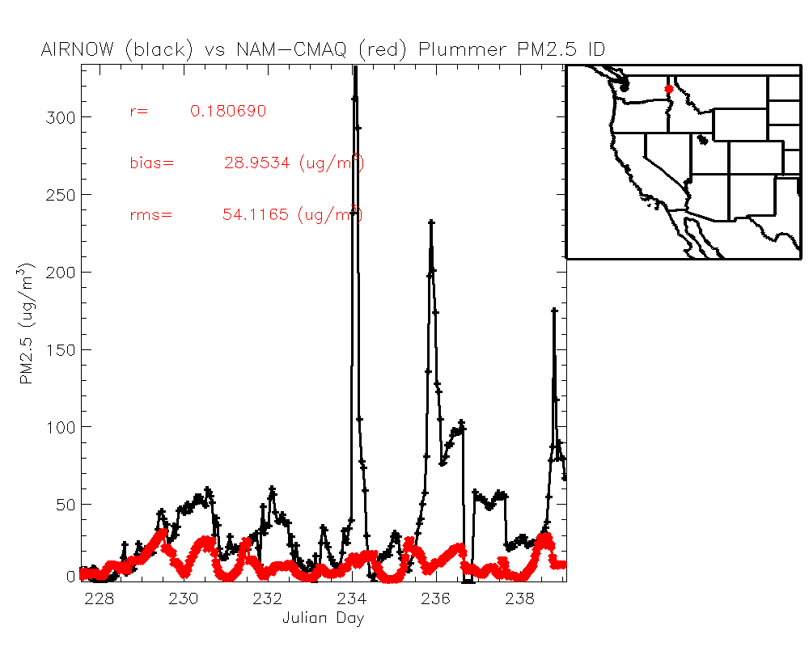
NAM-CMAQ surface PM2.5
22Z August 22, 2015
Wildfire emissions are underestimated in current operational NAM-CMAQ
Bias=AIRNow - Model

Slide 15
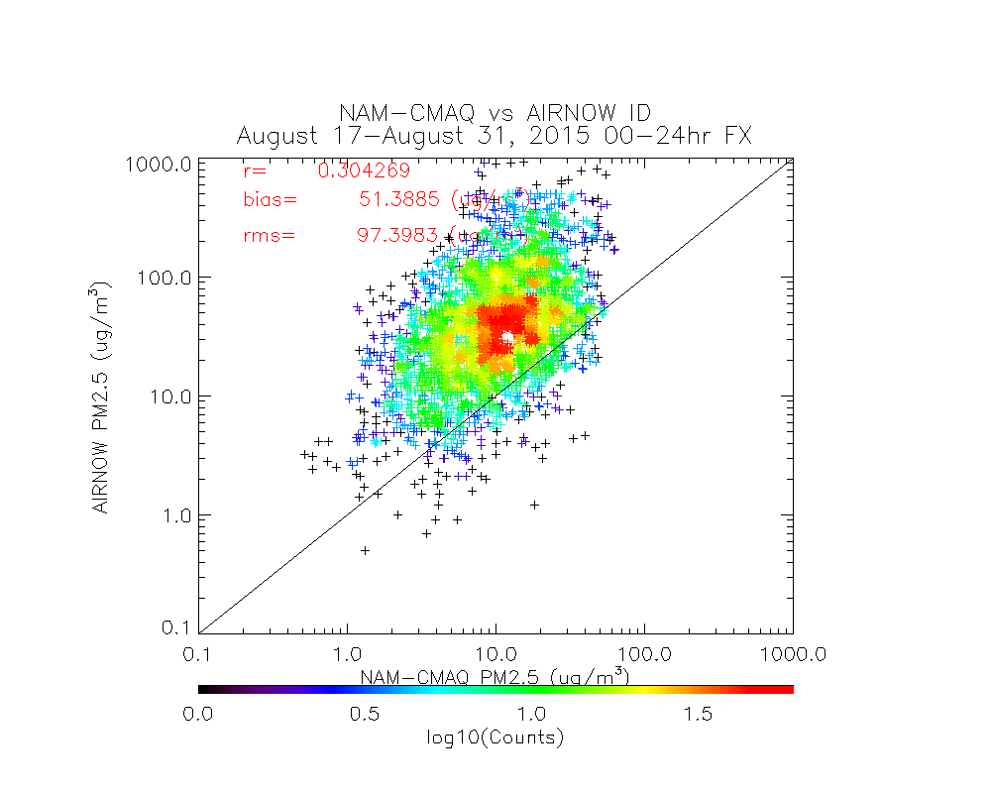
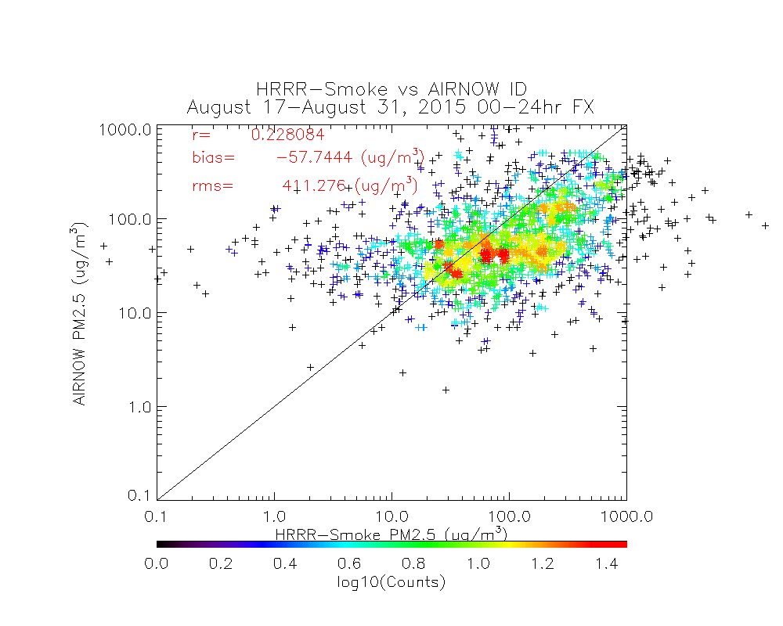
NAM-CMAQ and HRRR-Smoke vs AIRNow - Idaho
True
Positive
False
Positive
False Negative
True Negative
unhealthy
0.00000 0.00000 25.7754 74.2246 sensitive
1.70714 0.288531 46.2130 51.7913 moderate
29.1416 1.15412 55.2777 14.4746
unhealthy
25.7754
74.2246
sensitive
47.9202
52.0798
moderate
NAM-CMAQ
84.3712
15.6288
AIRNow
unhealthy 16.7553 17.6158 10.0734 55.5556 sensitive 29.7140 13.0094 19.7671 37.5095 moderate 50.7213 2.58162 33.9408 12.7563
25% of AIRNow unhealthy
0% of NAM-CMAQ
17% of HRRR-Smoke
48% of AIRNow unhealthy for sensitive groups
2% of NAM-CMAQ
30% of HRRR-Smoke
HRRR-Smoke shows more False Positives and less False Negatives than NAM-CMAQ
HRRR-Smoke

Slide 16
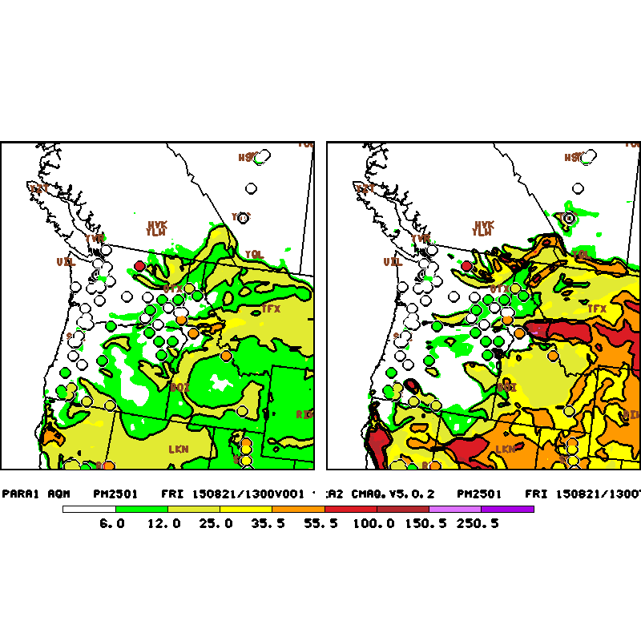
Operational CMAQ V4.6 Forecast
(with Daily HMS fire detection)
Experimental CMAQ V5.02 analysis
(with current HMS fire detection)

Slide 17
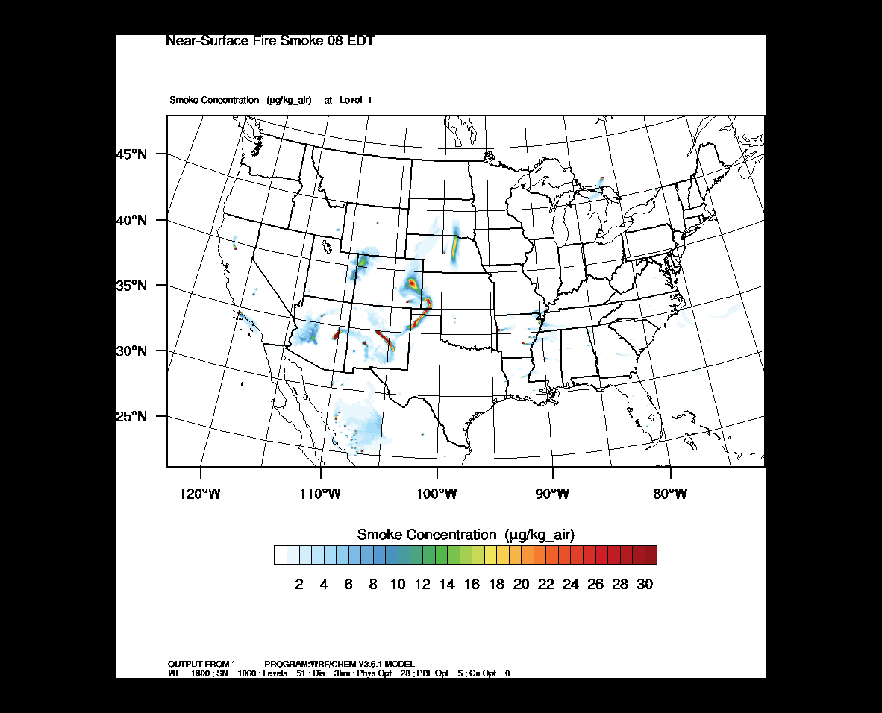
HRRR-smoke real-time forecasts
using VIIRS Fire Radiative Power (FRP) data
Initialized 12Z June 17, 2016
The real-time HRRR-Smoke model simulates two aerosol tracers: 1 – biomass burning OC+BC+ unspeciated PM25, 2- biomass burning and anthropogenic OC+BC+ unspeciated PM25 emissions;
Biomass burning emissions estimated from VIIRS Fire Radiative Power (FRP) based plume rise calculation have been developed and tested.
The web-site to display the model output: http://rapidrefresh.noaa.gov/HRRRsmoke/
Ravan Ahmadov, Georg Grell (NOAA/ESRL/GSD),
Ivan Csiszar (NOAA/NESDIS), Saulo Freitas (NASA)
Collaborators: Brad Pierce (NESDIS/STAR), Marina Tsidulko (NESDIS), Gabriel Pereira (CPTEC, Brazil), Steven Peckham (US Army, CRREL)
ravan.ahmadov@noaa.gov

Slide 18
FIREX: Field Experiment from
NOAA ESRL
Chemical Sciences Division
http://esrl.noaa.gov/csd/projects/firex/

Slide 19
Main FIREX Science Questions in 5 Categories
1) What are the emissions of gases, aerosols, aerosol precursors, air toxics and greenhouse gases from North American fires?
What is the composition and volatility of the previously unidentified fraction of the emissions?
2) What is the chemical transformation of those emissions?
What are the formation mechanisms for secondary species (ozone, SOA and sulfate)?
3) What is the local air quality and visibility impact of North American fires?
How important is nighttime smoke for populated areas?
How well do local air quality forecast models work?
4) What are the regional and long-term impacts of North American fires?
5) What are the climate-relevant properties of BB aerosols?
What role does brown carbon and coatings on black carbon particles play in the optical properties?
What is the composition of PM2.5?
Detailed Science Questions in White Paper
Comments are still welcome!!!
available at: http://esrl.noaa.gov/csd/projects/firex/

Slide 20
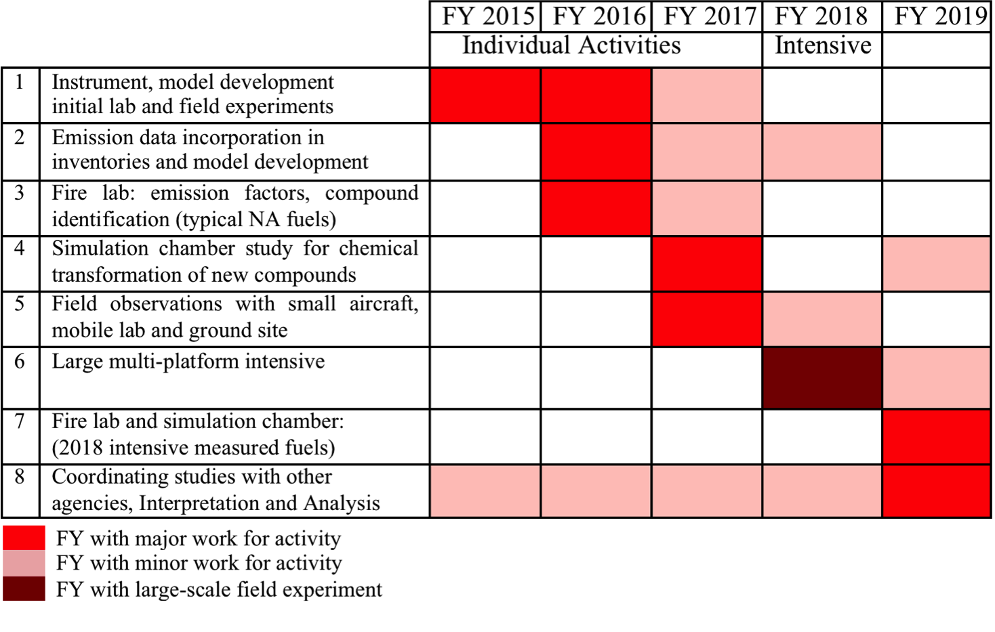
Timetable
3 years building knowledge before large field campaign
Digest previous few years of BB observations
Develop new ideas and approaches
Next generation of satellites

Slide 21
Large field mission with P3 aircraft and other platforms
Fire Ecology and Forest Management
Air Quality Forecasting
Modeling and Satellite
Laboratory Studies
Long Range Transport Studies NASA DC 8
Short Range Studies NCAR/NSF C130
Ground and Mobile Field Studies
Fire Lab Study
Instrument Development
Public Health Information and Outreach
CIRES Simulation Chamber
FIREX Steering Committee
James M. Roberts, Carsten Warneke, Joshua P. Schwarz, Robert J. Yokelson, R. Bradley Pierce, Barry Lefer, James H. Crawford, Kirk R. Baker, Amy P. Sullivan

Slide 22
CSD FIREX Management
Current Point of Contact:
Carsten Warneke, James Roberts, Joshua Schwarz
Instrument Develop.:
CSD Liaison Rebecca Washenfelder
Modeling and Satellite:
Brad Pierce
Kirk Baker
Laboratory Experiments:
CSD Liaison
Jim Burkholder
Fire Lab:
CSD Liaison
Jim Roberts
Bob Yokelson
CIRES Simulation Chamber:
Jose Jimenez
Ground Sites:
CSD Liaison
Jessica Gilman
Remote Sensing:
CSD Liaison
Andy Langford
Chris Senff
Mobile Labs:
Scott Herndon
Other Aircraft:
Barry Lefer
Jim Crawford
Amy Sullivan
P3 aircraft Deployment:
Carsten Warneke
Joshua Schwarz
Broader Research Community
NOAA AC4 support of FIREX for several research groups and coordination with other funding agencies

Slide 23
Fort McMurray Wildfire 1-minute GOES-14 Imagery
(a glimpse at what GOES-R will see)
Visible (Smoke)
Questions…..
comments……
Infrared (Fires)

