Slide 1
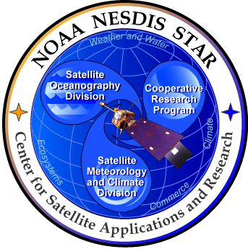
AQAST
NOAA/NESDIS Liaison Highlights
and
Planning for Lake Michigan Ozone Study (LMOS) 2017
Brad Pierce, NOAA/NESDIS
2016 Midwest and Central States Air Quality Workshop, June 21-23, 2016, St. Louis, MO

Slide 2
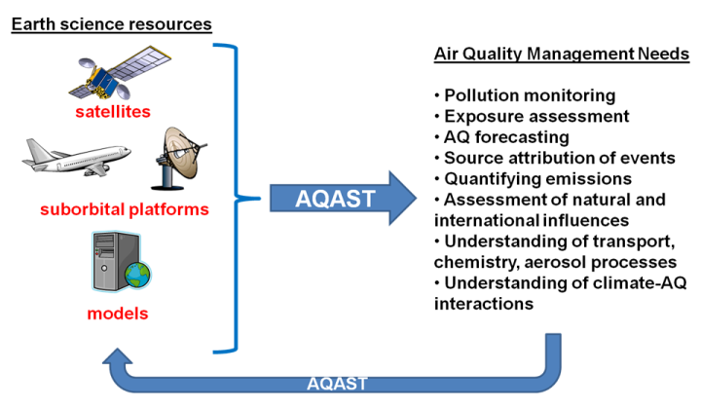
NOAA/NESDIS AQAST Tiger Team Activities
2011: Improved Lateral Boundary Conditions for NAQFC
2012: Forecasting Stratospheric Intrusion Events
2013: Satellite based estimates of surface visibility
2014-15: High resolution OMI NO2 retrievals using VIIRS DNB
NASA Air Quality Applied Sciences Team (AQAST, http://aqast.org/)

Slide 3
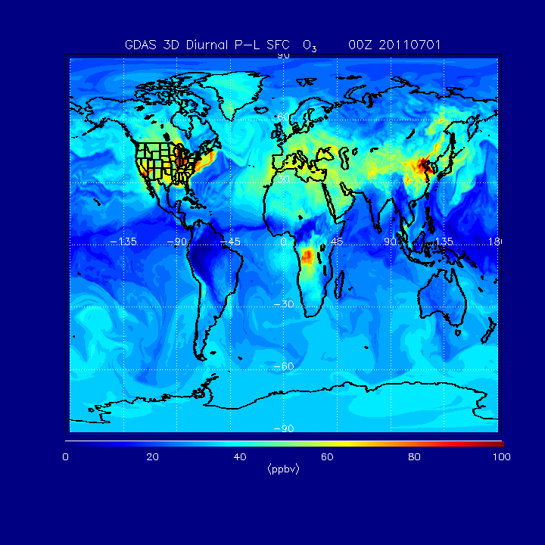
Improved Lateral Boundary Conditions for Operational NAM-CMAQ AQ forecasts
Lin Zhang (Harvard) provided 3hr GEOS-Chem model output (ozone production rate and loss frequency, surface deposition) for July 2011
Monthly mean 3D merged GFS (stratosphere) + GEOS-CHEM (troposphere) ozone PL was developed for use in GFS ozone physics module
Experimental GDAS surface ozone July 2011
Full cycling experiments show that addition of diurnally resolved monthly mean tropospheric ozone production and loss rates does not adversely effect the GFS forecast skill and improves prediction of tropospheric ozone

Slide 4
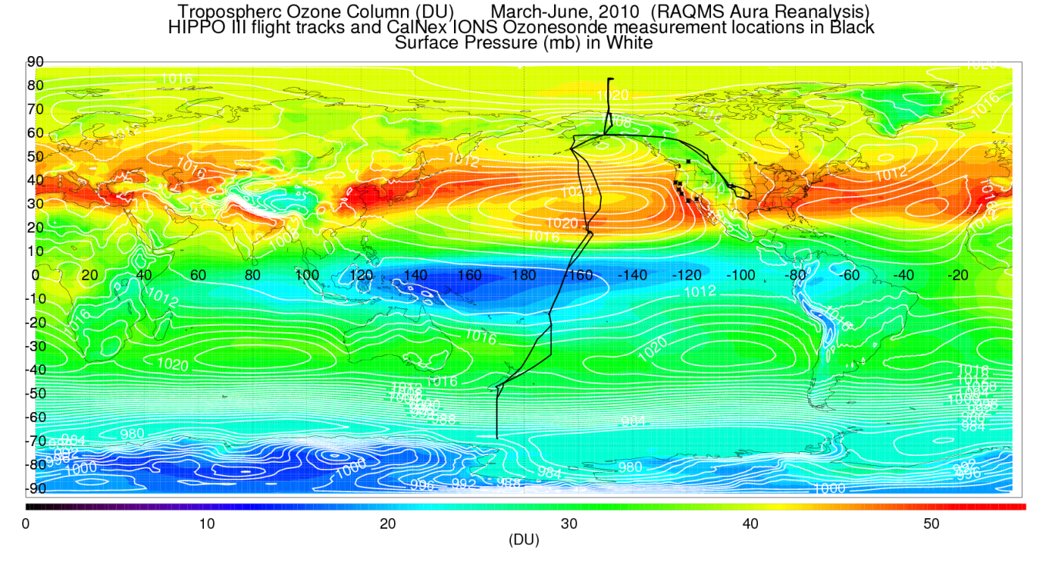
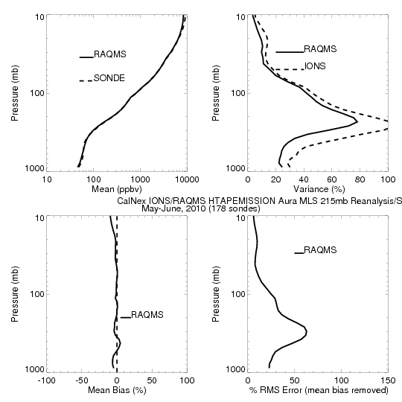
Follow on: Aura Chemical Reanalysis in support Air Quality Applications
Project Summary
Utilize RAQMS/GSI data assimilation system to conduct a multi-year (2006-present) global chemical and aerosol reanalysis using NASA Aura and A-Train measurements.
Project Objectives
Provide the air quality community with a multi-year global chemical and aerosol reanalysis using NASA Aura and A-Train measurements.
Provide global 3 dimensional O3, CH4, N2O production and loss rates for NOAA Next Generation Global Prediction System (NGGPS)
*Aura Science Team project funded through NASA Air Quality Applied Science Program

Slide 5
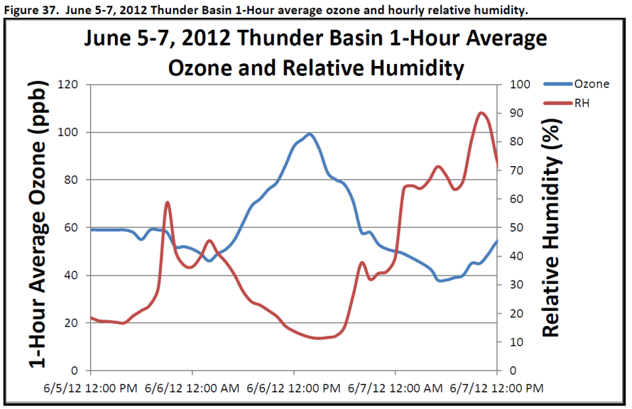
Forecasting Stratospheric Intrusion Events over the Western US for Exceptional Event Demonstration
“The Wyoming Department of Environmental Quality/Air Quality Division (WDEQ/AQD) has determined that a stratospheric intrusion created elevated ozone readings resulting in an 8-hour ozone standard exceedance at the Thunder Basin, Wyoming ozone monitor located in northeastern Wyoming on June 6, 2012” (Executive Summary)
EPA Work Group for Analysis of Ozone Stratospheric Intrusion Events (Lead, Gail Tonnesen, EPA Region 8) includes state agencies, EPA, NOAA, NCAR and NASA researchers.
http://deq.state.wy.us/aqd/Exceptional%20Events/June_6_2012ThunderBasin/June_6_2012_SI_Package.pdf

Slide 6
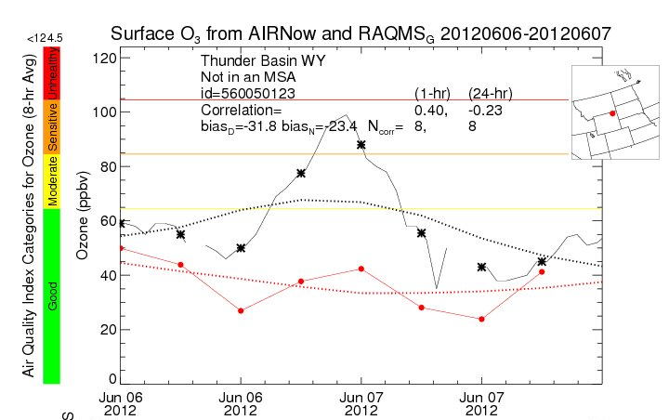
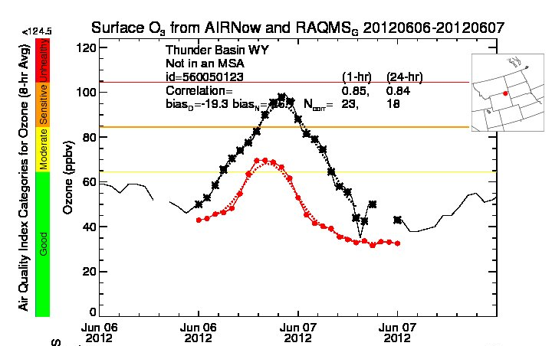
June 6-7, 2012 Surface ozone comparison: Thunder Basin, WY
RAQMS
Nested RAQMS/WRFCHEM
Surface O3 from AIRNow and RAQMS
Surface O3 from AIRNow and Nested RAQMS/WRF-CHEM
RAQMS (red)
AIRNow (black)
WRFCHEM (red)
AIRNow (black)
Improved estimates of ozone within the SI event lead to significant improvements (19.3 vs 31.8ppbv daytime bias) in predictions of ozone at the Thunder Basin, WY surface site in the nested RAQMS/WRF-CHEM simulation. However, peak ozone mixing ratios are still underestimated by nearly 30ppbv
Real-time Air Quality Modeling System (RAQMS, http://raqms-ops.ssec.wisc.edu/index.php)

Slide 7
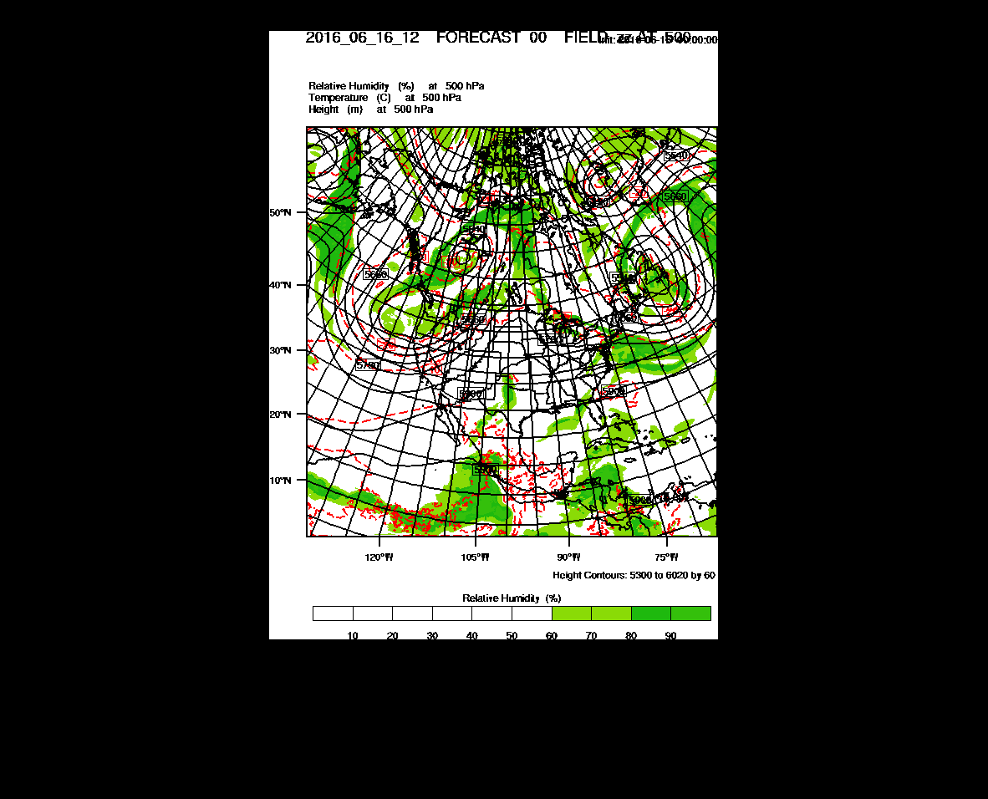
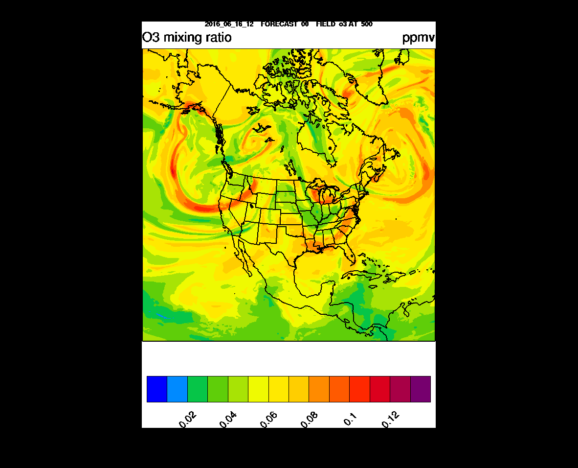
Follow on: NOAA Real-time Nested RAQMS/Rapid Refresh with Chemistry (RAP-Chem) predictions
The RAP-Chem model is a research version of the NOAA Rapid Refresh configuration of the Weather Research and Forecasting model with chemistry (WRF-Chem) run in real-time at NOAA/ESRL using GFS meteorological and RAQMS chemical boundary conditions.
30hr RAP-Chem 500mb Met/O3 forecast initialized 12Z June 16, 2016
RR-Chem is configured and run by Georg Grell and Ravan Ahmadov at NOAA/ESRL.
(http://ruc.noaa.gov/wrf/WG11_RT/)

Slide 8
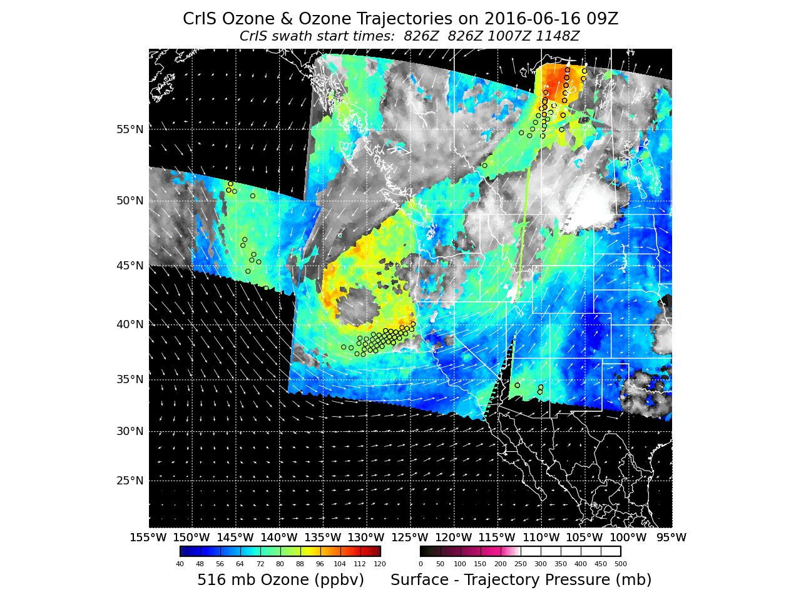
Follow on: IDEA International (IDEA-I) ozone forecast is now used for real-time stratospheric intrusion forecasting
http://cimss.ssec.wisc.edu/idea-i/USozone/index.php

Slide 9
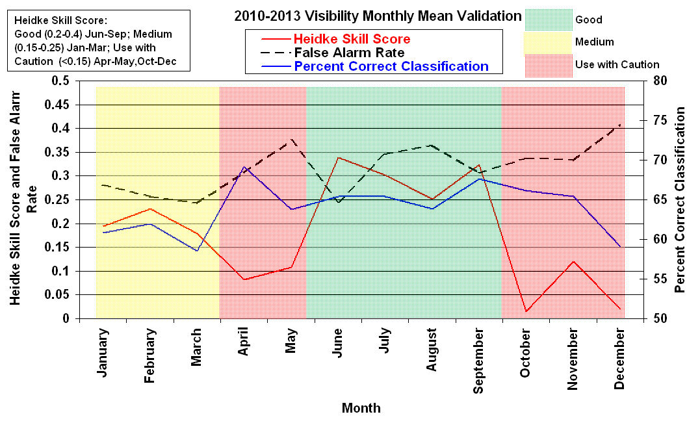
Satellite based estimates of surface visibility for state haze rule implementation planning
Under support from the NOAA GOES-R Algorithm Working Group NESDIS has developed a satellite based visibility retrieval that uses MODIS Aerosol Optical Depth retrievals and GFS forecast data as input and is based on regression against surface extinction measurements from the NWS Automated Surface Observing System (ASOS).
Under this AQAST Tiger Team Project we combine this satellite retrieval with IMPROVE network measurements to assess the utility for use in state haze rule planning
Monthly mean time series of the ASOS validation statistics for the Version 5 ABI Visibility algorithm from January 2010 through December 2013.

Slide 10
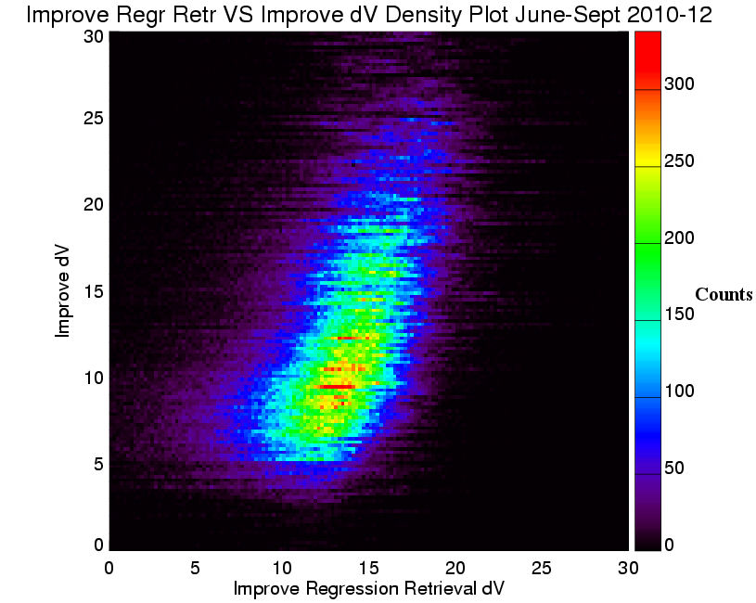
Density plot of collocated dV values for IMPROVE Regression (monthly bias corrected) retrieval versus IMPROVE for June-September 2010-2012.

Slide 11
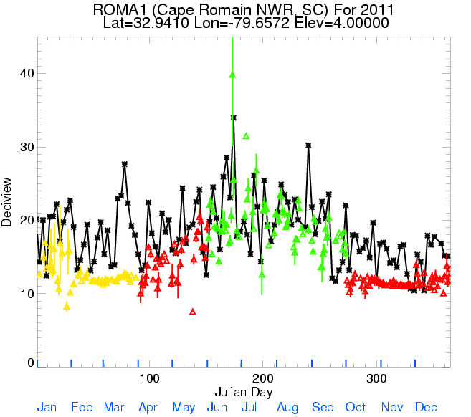
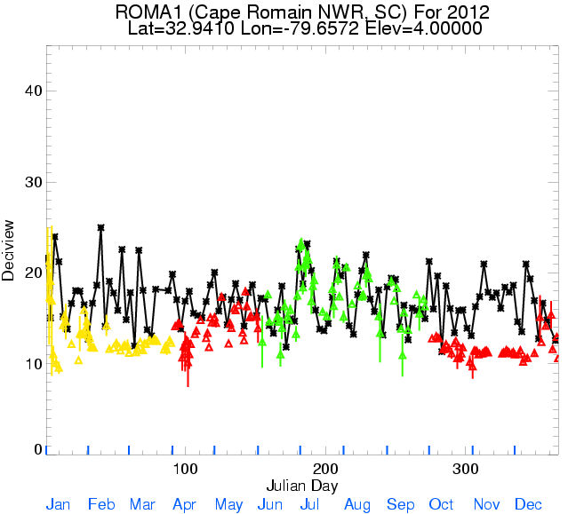
Time series plot of daily mean visibility (dV) for IMPROVE (black line) and bias corrected MODIS retrieval (triangle symbol is daily mean dV with standard deviation line) for 2011 (left) and 2012 (right) Cape Romain National Wildlife Refuge National Wildlife Refuge in South Carolina
Follow-on: Currently implementing MODIS visibility retrieval into IMAPP for Direct Broadcast Community
Brunner, J., Pierce, R. B., and Lenzen, A.: Development and validation of satellite-based estimates of surface visibility, Atmos. Meas. Tech., 9, 409-422, doi:10.5194/amt-9-409-2016, 2016.

Slide 12
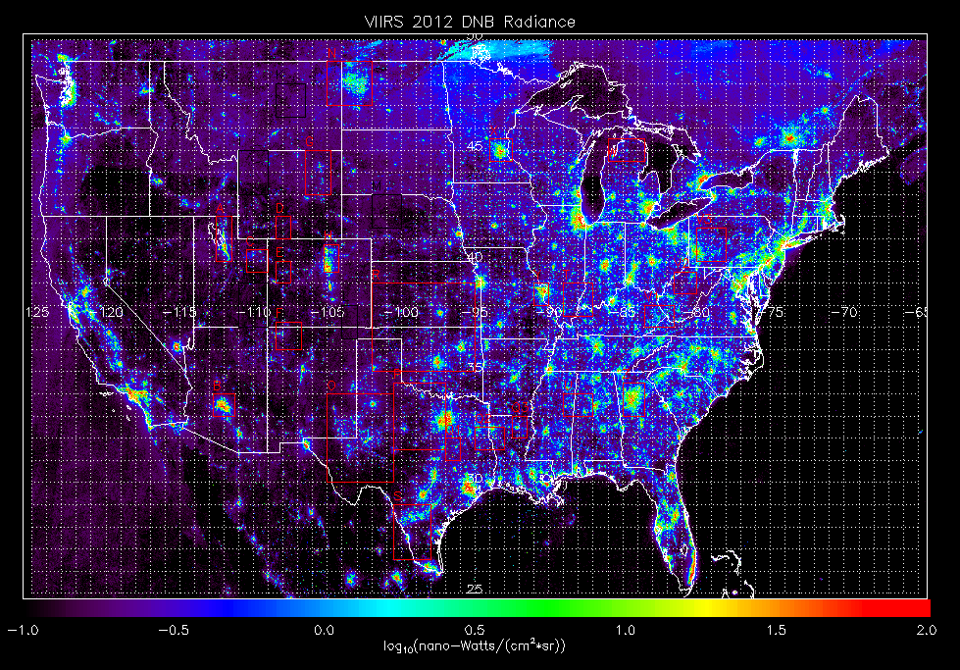
High resolution OMI NO2 retrievals for AQ monitoring using VIIRS day-night-band radiances
Objective: Work with the WRAP, CenSARA, CDPHE, BLM and EPA Region 8 to combine VIIRS Day Night Band (DNB) radiances and OMI tropospheric NO2 column to generate a spatially enhanced product for evaluation of Urban and Oil and Gas (O&G) modeled NOx emission inventories within the major O&G basins in the US
VIIRS DNB cloud free composite from NOAA National Geophysical Data Center

Slide 13
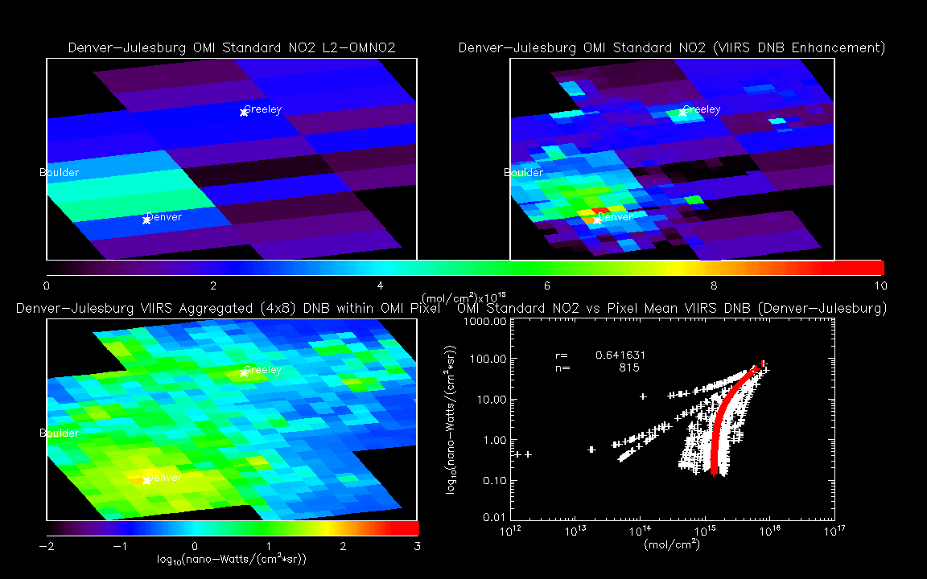
Denver/Denver-Julesburg August 02, 2014
Compute mean DNB radiance for each 4x8 subsectors
Compute linear regression between pixel mean DNB radiance and OMI Standard NO2 for each swath
Use linear regression to redistribute OMI NO2 over sub-pixels
Adjust mean of sub-pixel NO2 to original pixel NO2

Slide 14
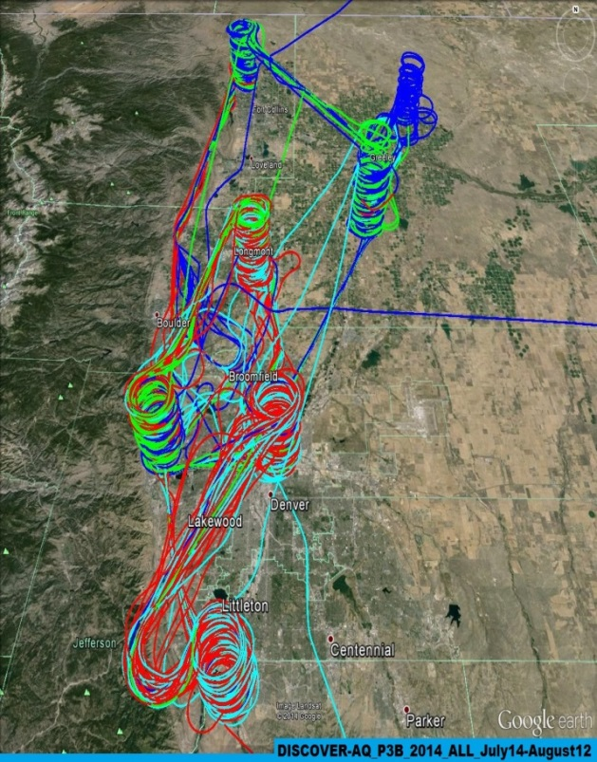
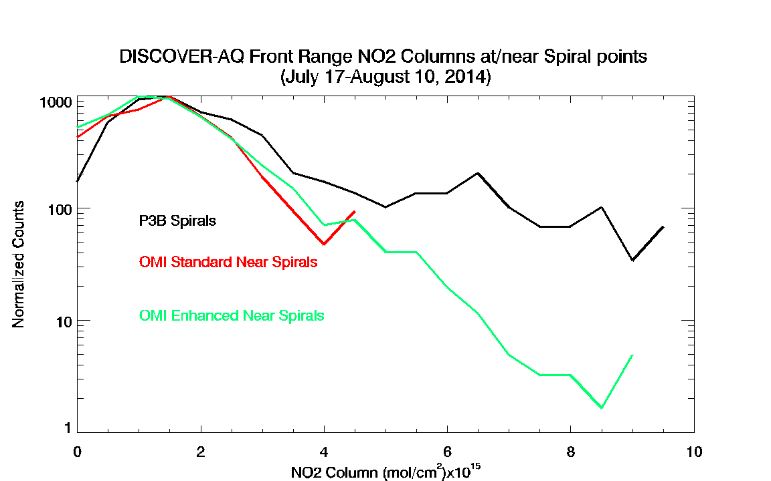
Validation for Denver, CO
July-August 2014 FRAPPE/DISCOVER-AQ
Integration of airborne insitu NO2 profiles collected during DISCOVER-AQ over the depth of the profile provide column NO2 measurements for validating the OMI Standard, and OMI Enhanced NO2 retrievals.
Map of DISCOVER-AQ flights
Histograms of the airborne NO2 columns (black) show a long tail towards higher values from profiles over the Denver metropolitan area which is better captured by the OMI Enhanced retrieval (green) than the OMI Standard retrieval (red)

Slide 15
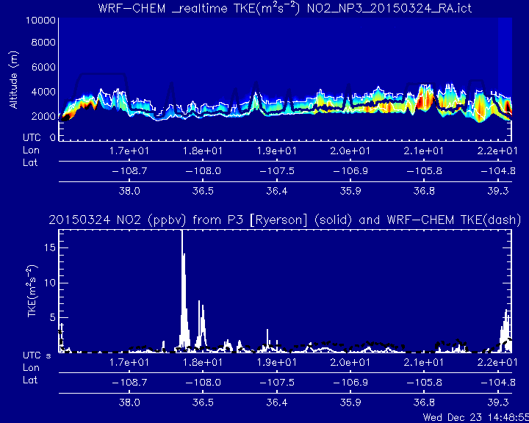
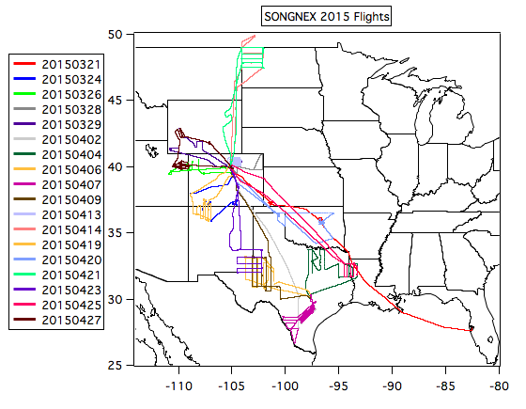
Validation for Western US O&G Basins
March-April 2015 SONGNEX
The NOAA/ESRL SONGNEX 2015 Shale Oil and Natural Gas Nexus field campaign was conducted in March-April, 2015. The primary goal was to quantify emissions from oil and gas basins in the western U.S.
8km WRF-CHEM TKE used to determine Boundary Layer Depth along Flight Track
http://www.esrl.noaa.gov/csd/projects/songnex/

Slide 16
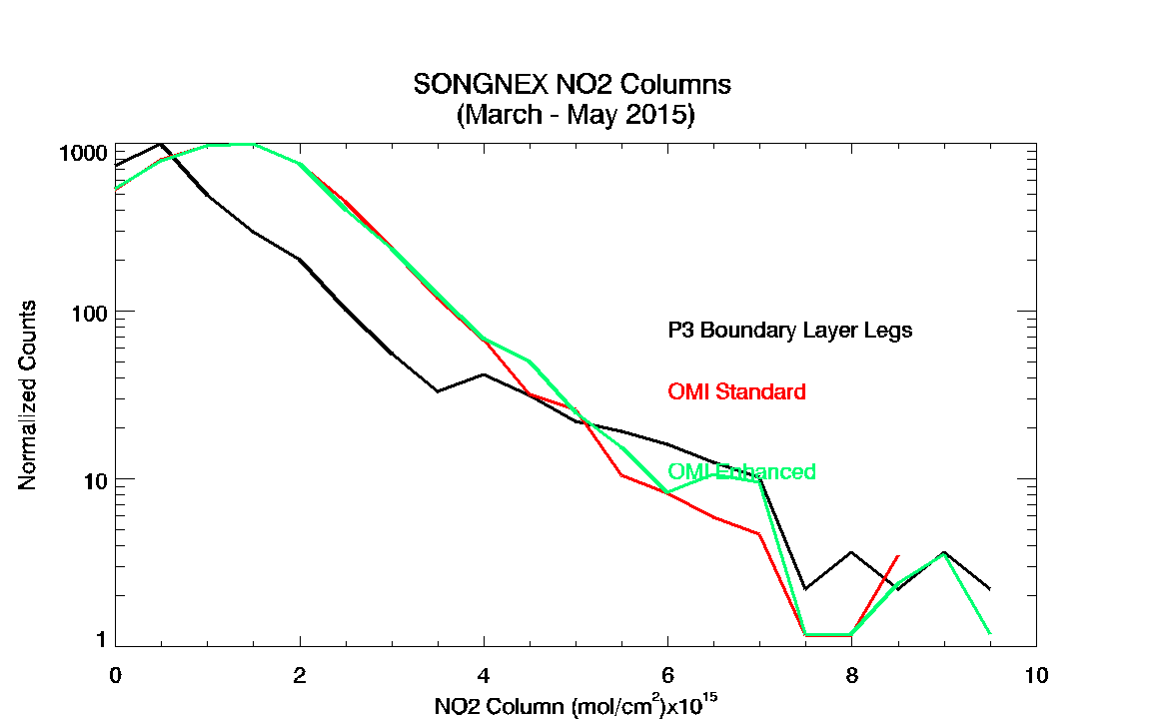
Histograms of the airborne NO2 columns (black) show a long tail towards higher values from profiles over Western Region O&G fields which is slightly better captured by the OMI Enhanced retrieval (green) than the OMI Standard retrieval (red)

Slide 17
Great Lakes Ozone Study Planning Overview
Lake Michigan Ozone Study (LMOS) 2017
Brad Pierce (NOAA/NESDIS)
Angela Dickens (WDNR)
Rob Kaleel and Donna Kenski (LADCO)
Tim Bertram (UW-Madison)
Charles Stanier (U-Iowa)
A small to medium size ground/airborne/satellite campaign¹ in summer 2017 with primary science objectives focusing on characterizing the recirculation, aging, and mixing of the Chicago and Milwaukee urban plumes as they move over Lake Michigan and their impact on surface ozone.
Initial inception for this field mission occurred during the St Louis AQAST meeting (AQAST9)
¹Requesting NASA facility airborne remote sensing instruments (GEOTASO, HSRL)
http://www.ladco.org/reports/ozone/post08/Great_Lakes_Ozone_Study_White_Paper_Draft_v6.pdf

Slide 18
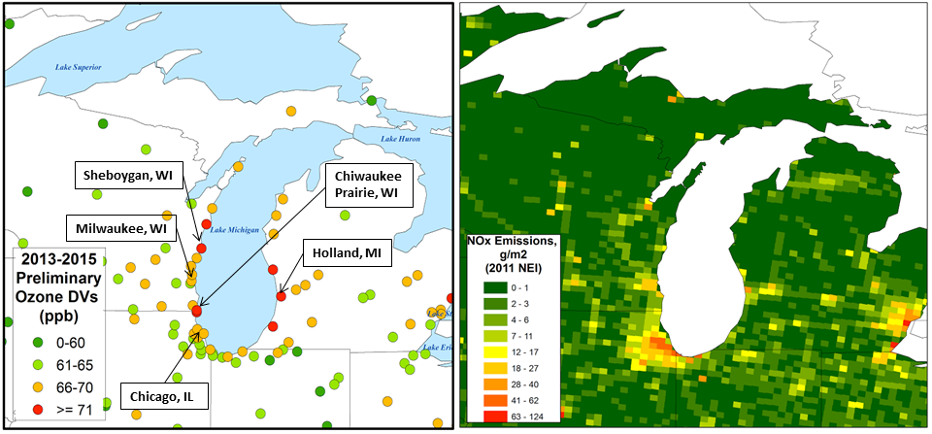
Motivation
Despite dramatic reductions in ozone precursor emissions, many areas bordering Lake Michigan continue to violate federal air quality standards. This problem has persisted for decades and is one of the most challenging air quality issues in the eastern U.S.
2013-2015 - 8-Hour Ozone Design Values New Ozone Standard – 70 ppb
Anticipated new non-attainment areas with new, lower ozone standard and persistent exceedances of the old (2008) ozone standard.
Impact of high ozone on public health in high density urban areas (Chicago, Milwaukee, Detroit, Windsor). Also, these areas serve as large emissions sources.

Slide 19
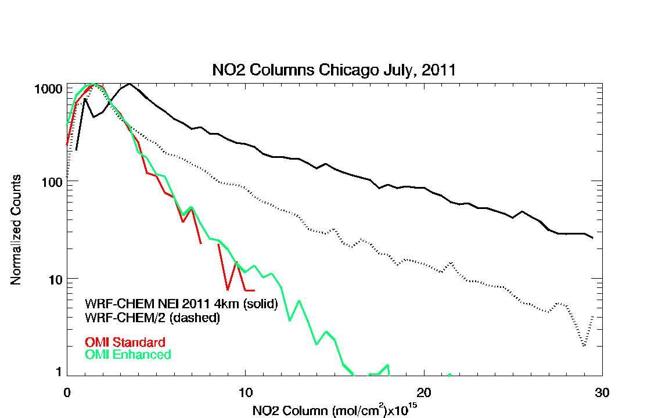
Comparison of modeled and observed NO2 columns
Histograms of the 4km WRF-CHEM NO2 columns (black) show median values that are 2x larger then either the OMI Enhanced retrieval (green) than the OMI Standard retrieval (red)

Slide 20
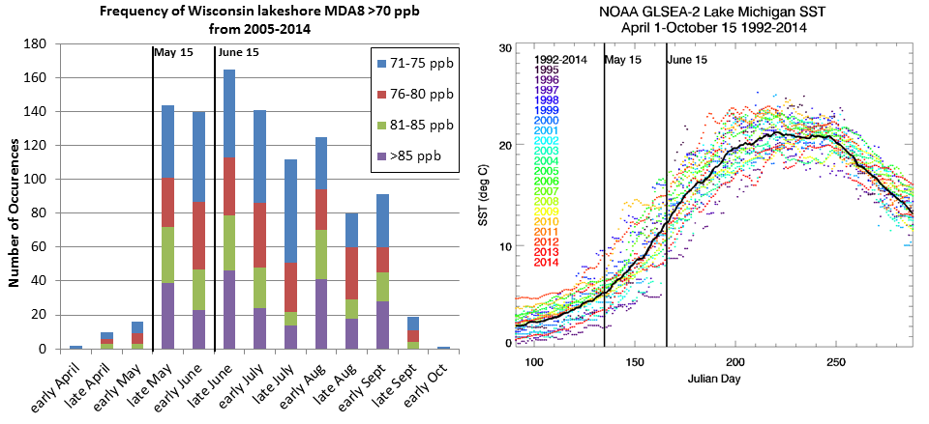
Campaign Study Period
Seasonality of (left) high maximum daily 8-hour average ozone concentrations (MDA8) at Wisconsin Lakeshore monitors and (right) mean Lake Michigan surface temperature (SST) from April 1 through October 15. MDA8 values are shown for the years 2005-2014 and SST for 1992-2014.

Slide 21
Mission Science Objectives
The overall objectives of the study are to better characterize ozone formation chemistry, emissions, meteorology and transport along the Great Lakes’ shorelines with the ultimate goal of improving photochemical modeling along the lakeshores. Specifically, we will focus on:
Constraining the factors controlling ozone chemistry, including:
NOx versus VOC limitations on ozone formation.
Constraints on NOx emissions sources (such as urban, mobile and marine shipping sources).
Chemical aging of urban plumes and how this affects ozone formation.
Losses of ozone and precursors via deposition.
Understanding controls on meteorology and transport of emissions affecting ozone episode development, including:
Better constraints on the lake breeze, including its vertical structure, height of the boundary layer, extent of inland penetration, and conditions leading to the presence/absence and different types and locations of lake breezes.
Determine the relative importance of local vs regional emissions transported from upwind areas via synoptic circulation (e.g., from the Ohio River Valley and other regions).
Improve understanding of sources of model forecast errors (marine boundary layer structure, interplay between synoptic and lake breeze fronts, coastal impacts, over lake processing

Slide 22
Please feel free to join the LMOS 2017 planning team for an informal discussion of LMOS 2017 at the bar following today’s meeting
Sponsors:
NASA Applied Sciences Program
NASA International MODIS/AIRS Processing Package (IMAPP) Program
NOAA GOES-R Algorithm Working Group
Questions…..
comments……
recommendations?
brad.pierce@noaa.gov

