Slide 1
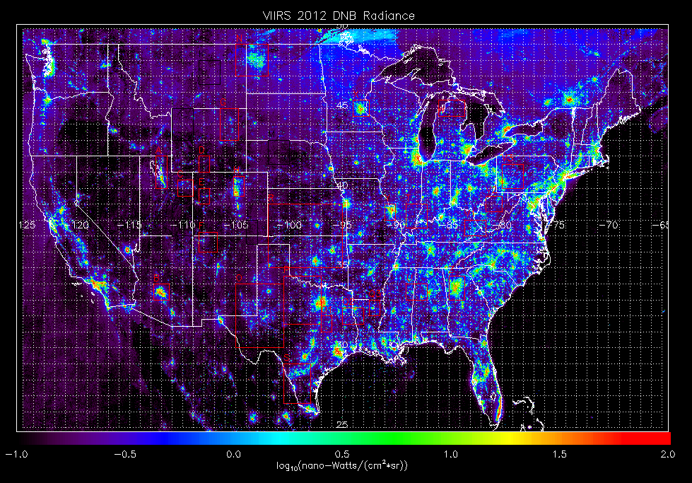
High resolution OMI NO2 retrievals for urban scale AQ monitoring using VIIRS day-night-band radiances
Application to
Wisconsin DNR/LADCO Lake Breeze Study
Brad Pierce
NOAA/NESDIS
VIIRS DNB cloud free composite from NOAA National Geophysical Data Center
OMI July 2014 cloud free composite from NASA Aura Satellite
LADCO Project Team Conference Call July 27, 2015

Slide 2
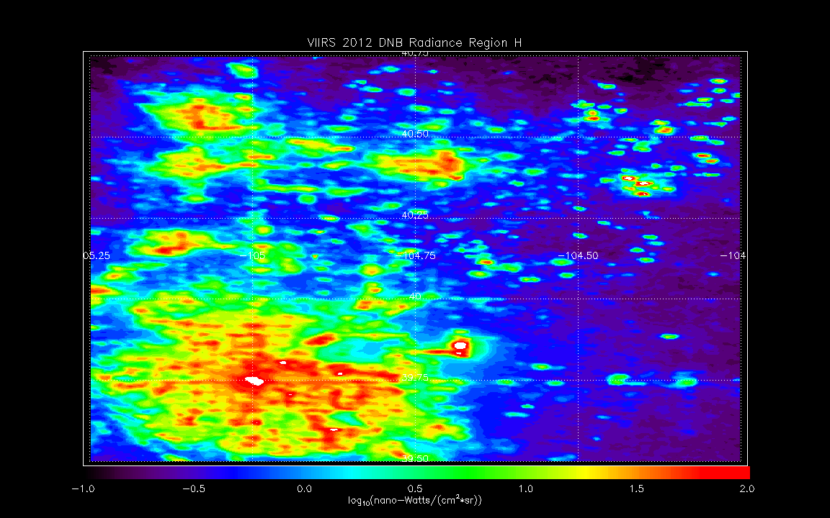
Using VIIRS Day Night Band (DNB) radiances to add sub-pixel (~4x4km) variability to native (13x24km) OMI NO2 retrieval
Sub-divide each OMI pixel into 4x8 subsectors
Denver, CO VIIRS Day Night Band (DNB) nighttime lights

Slide 3
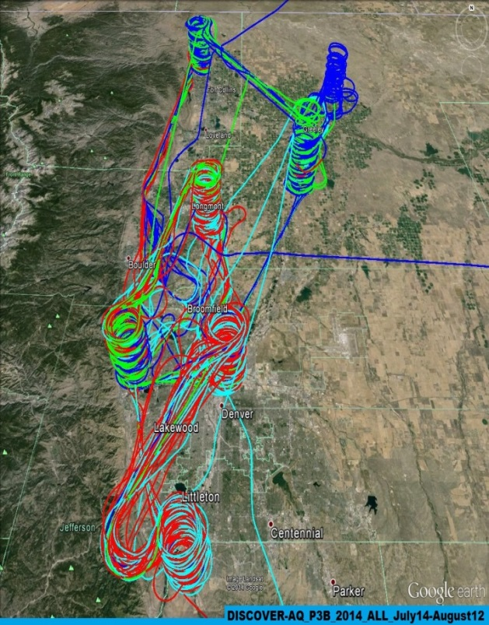
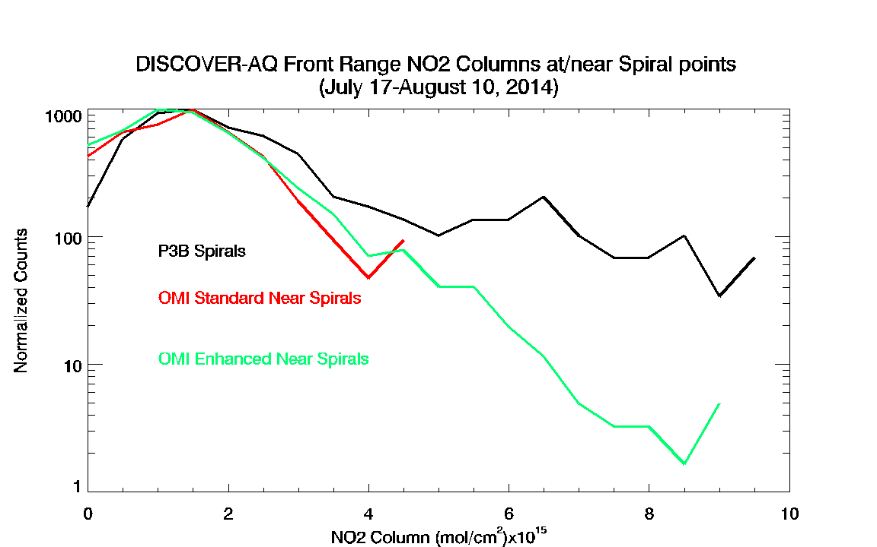
Validation for Denver, CO
July-August 2014 FRAPPE/DISCOVER-AQ
Integration of airborne insitu NO2 profiles collected during DISCOVER-AQ over the depth of the profile provide column NO2 measurements for validating the OMI Standard, and OMI Enhanced NO2 retrievals.
Map of DISCOVER-AQ flights
Histograms of the airborne NO2 columns (black) show a long tail towards higher values from profiles over the Denver metropolitan area which is better captured by the OMI Enhanced retrieval (green) than the OMI Standard retrieval (red)

Slide 4
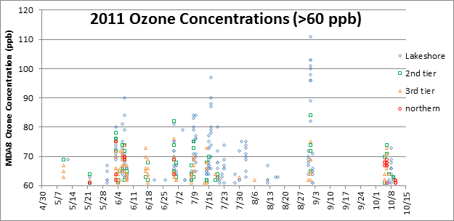
Application to
Wisconsin DNR/LADCO Lake Breeze Study
(July 2011)
With Rob Kaleel (LADCO) and Angie Dickens (WDNR)
Focusing on the July 17, 2011 event
12km CONUS and 4km Midwest runs for July 01-31, 2011
From Angie Dickens, WDNR

Slide 5
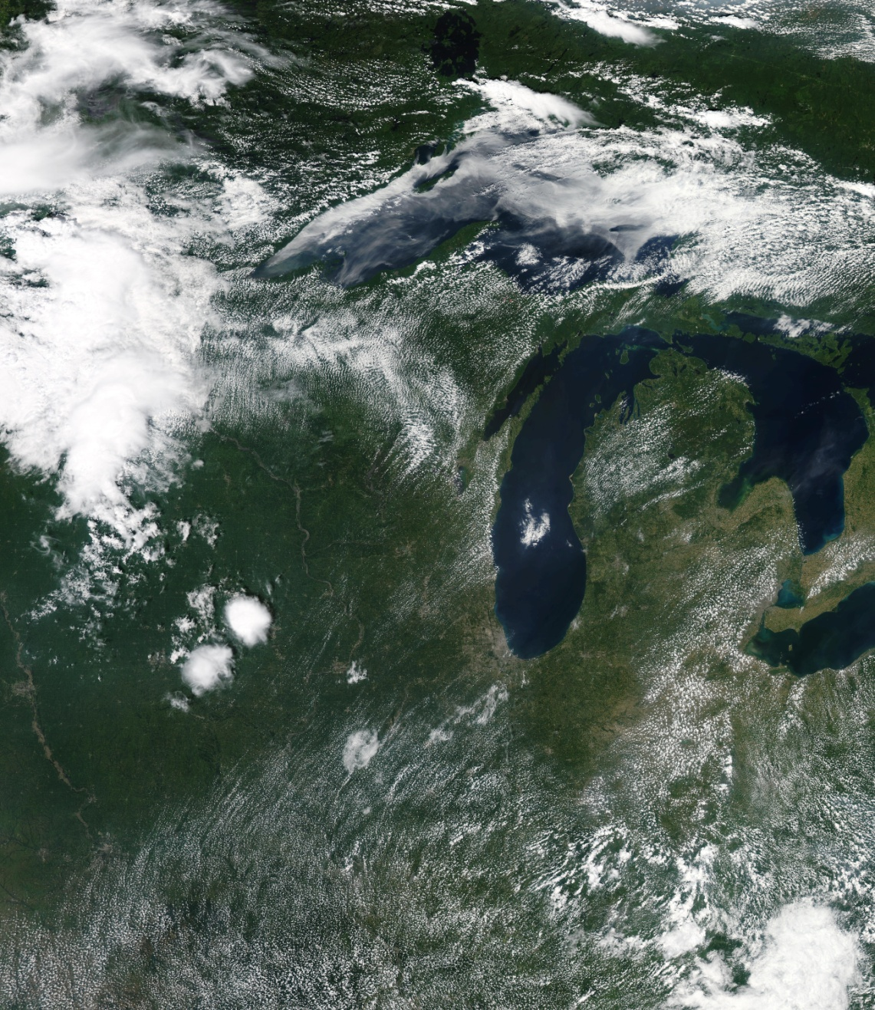
MODIS Image July 17, 2011
From Mike Majewski, WDNR

Slide 6
MODIS Image July 17, 2011
Lake Breeze
Front
Prevailing winds
From Mike Majewski, WDNR

Slide 7
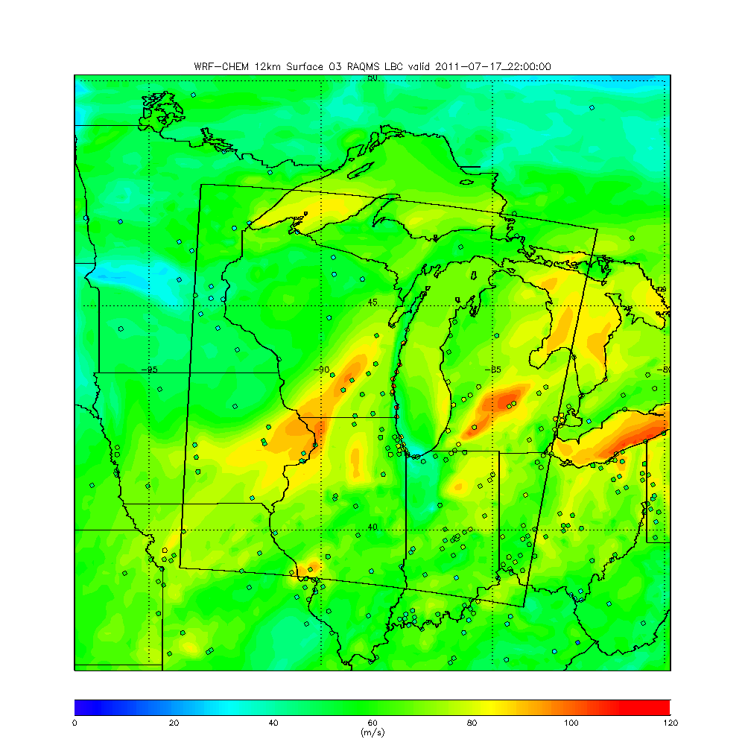
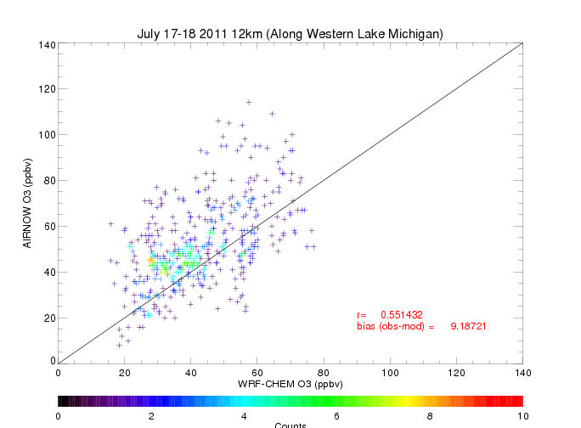
12km WRF-CHEM Surface O3 22Z (5:00pm Central) July 17, 2011
R=0.55
Bias(obs-mod)= 9.19ppbv
12km run significantly under predicts surface ozone along Western Shore of Lake Michigan – Shows minimum ozone along coast where highest ozone is observed

Slide 8
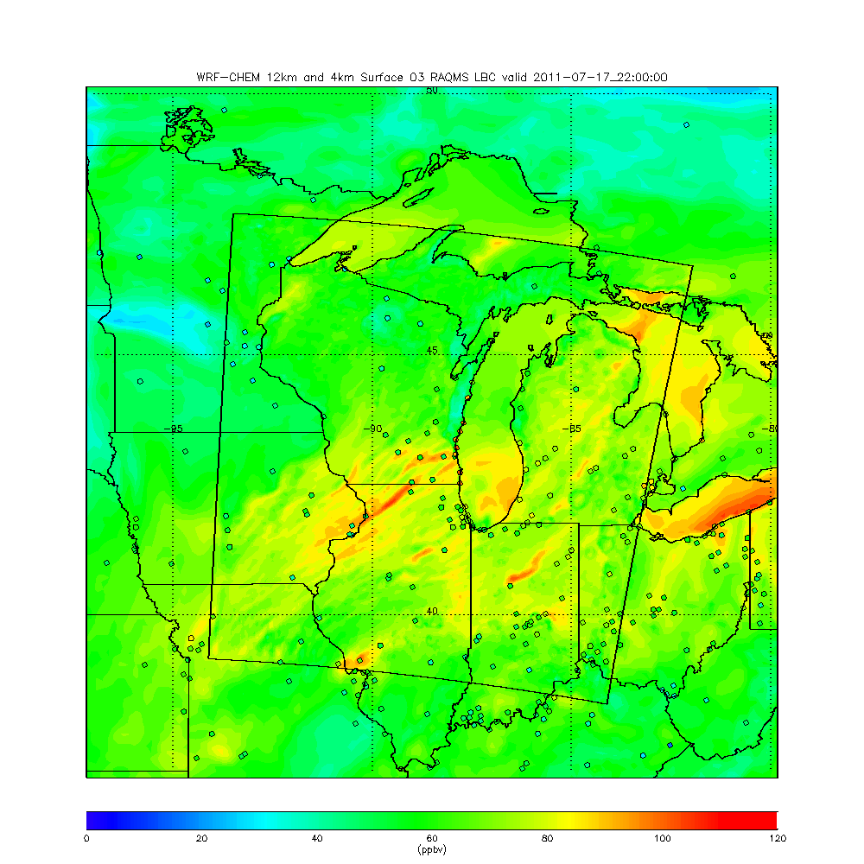
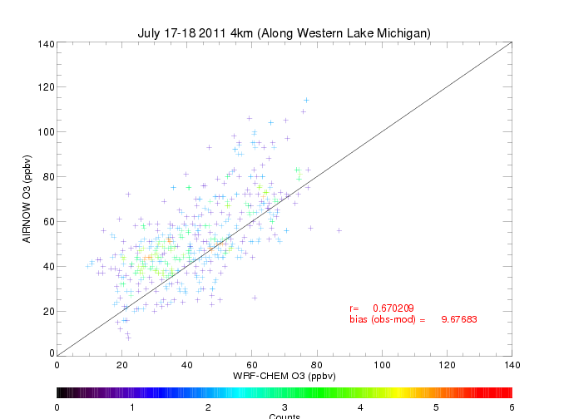
4km WRF-CHEM Surface O3 22Z (5:00pm Central) July 17, 2011
R=0.67
Bias(obs-mod)= 9.68ppbv
4km also significantly under predicts surface ozone along Western Shore of Lake Michigan – Captures SE Wisconsin better but shows lower minimum in ozone North of Milwaukee

Slide 9
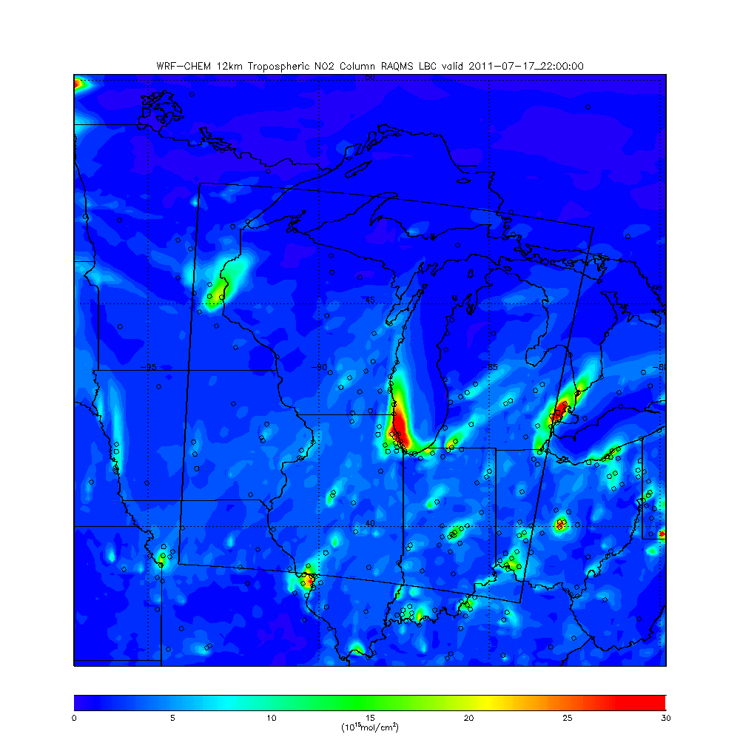
12km WRF-CHEM Tropospheric NO2 Column 22Z (5:00pm Central) July 17, 2011
12km Tropospheric NO2 column shows values in excess of 30x10¹⁵ mol/cm² North of Chicago

Slide 10
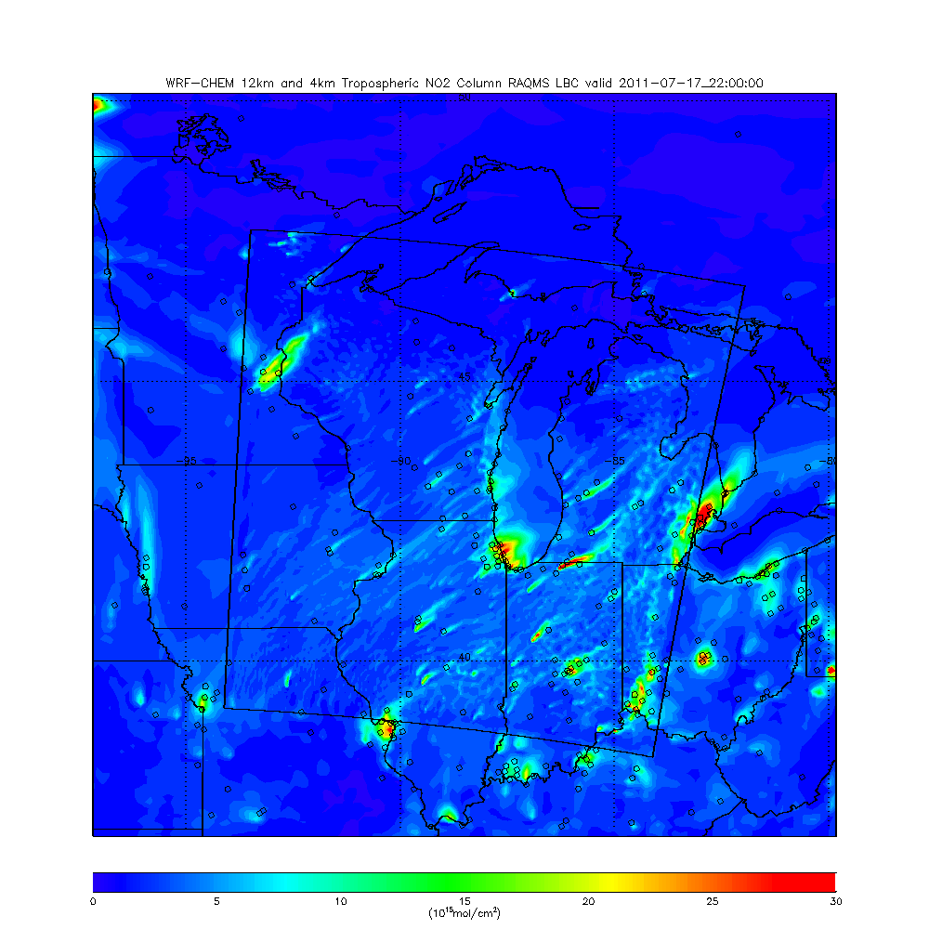
4km WRF-CHEM Tropospheric NO2 Column 22Z (5:00pm Central) July 17, 2011
4km Tropospheric NO2 column shows values in excess of 25x10¹⁵ mol/cm² only immediately offshore of Chicago

Slide 11
Comparisons between near nadir OMI Standard
and
Spatially Enhanced NO2 column retrievals
and
4km WRF-CHEM NO2 columns

Slide 12
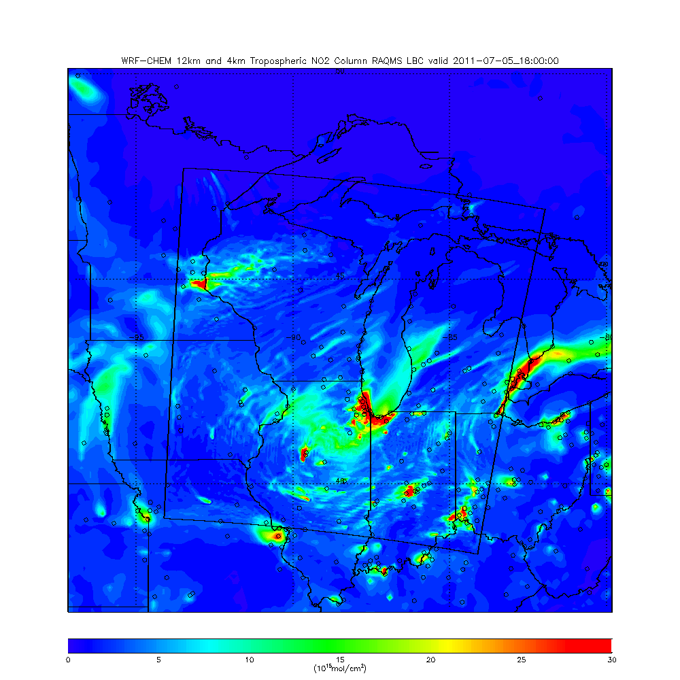
4km WRF-CHEM Tropospheric NO2 Column 18Z (1:00pm Central 07/05, 2011
4km Tropospheric NO2 column shows values in excess of 30x10¹⁵ mol/cm² over Chicago, IL and Gary, IN

Slide 13
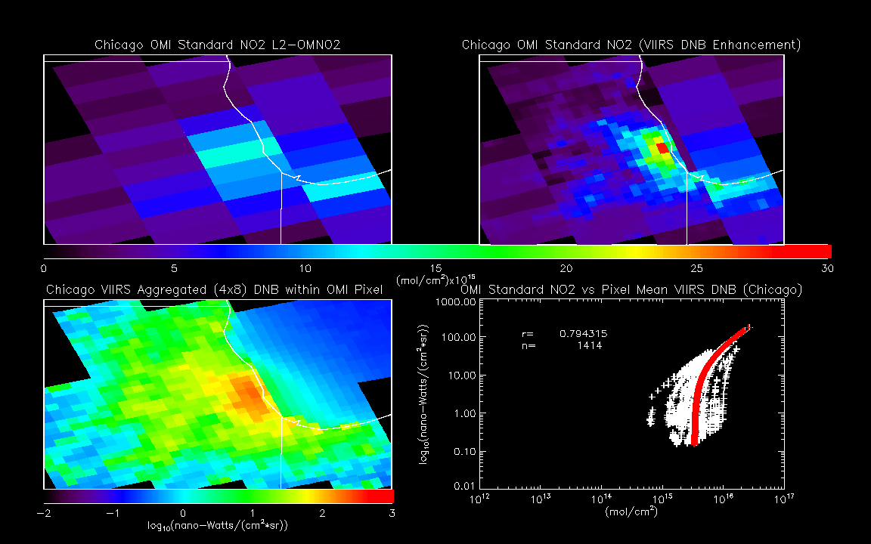
Chicago OMI Standard and Enhanced NO2 Columns
17:47Z July 05, 2011
OMI Enhanced Tropospheric NO2 column shows values in 15-30x10¹⁵ mol/cm² over Chicago

Slide 14
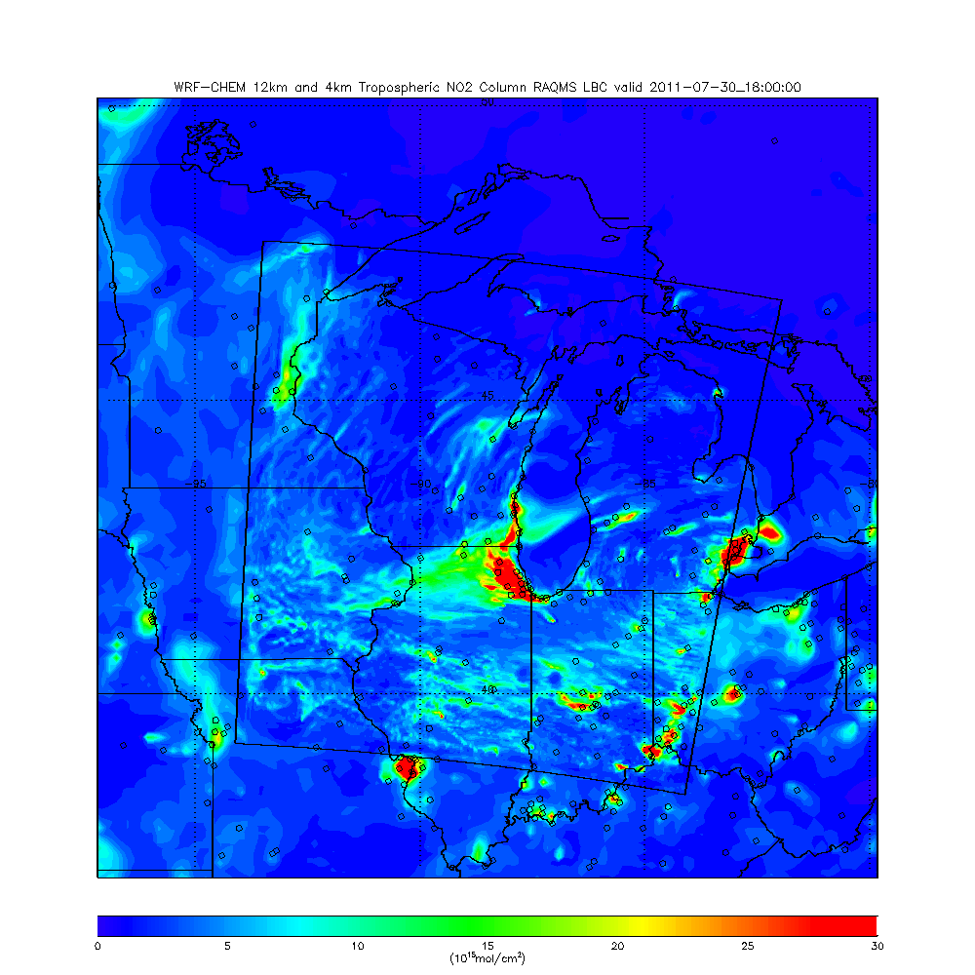
4km WRF-CHEM Tropospheric NO2 Column 18Z (1:00pm Central 07/30, 2011
4km Tropospheric NO2 column shows values in excess of 30x10¹⁵ mol/cm² over Chicago

Slide 15
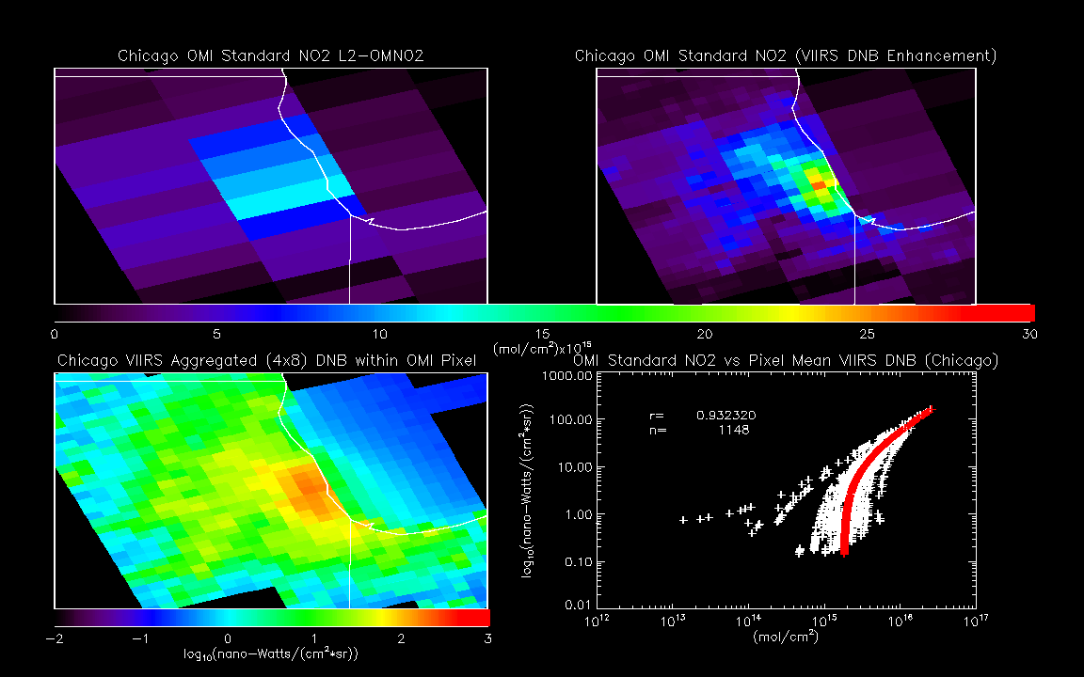
Chicago OMI Standard and Enhanced NO2 Columns
17:39Z July 30, 2011
OMI Enhanced Tropospheric NO2 column shows values in 15-25x10¹⁵ mol/cm² over Chicago

Slide 16
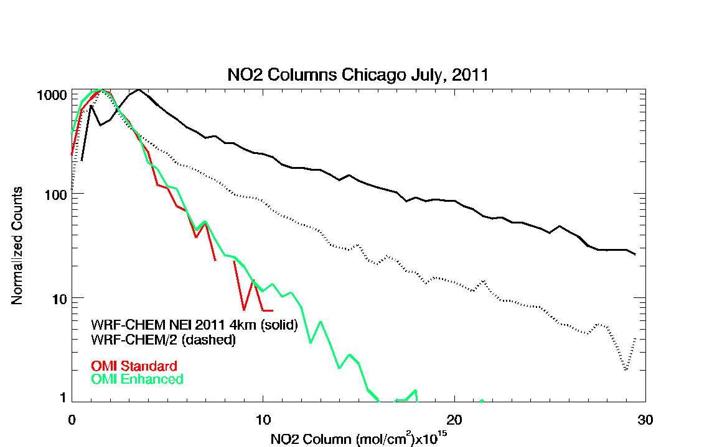
Histograms of the 4km WRF-CHEM NO2 columns (black) show median values that are 2x larger then either the OMI Enhanced retrieval (green) than the OMI Standard retrieval (red)

Slide 17
4km WRF-CHEM Surface O3 22Z (5:00pm Central) July 17, 2011
R=0.67
Bias(obs-mod)= 9.68ppbv
4km with NEI 2011 Standard NO emissions significantly under predicts surface ozone along Western Shore of Lake Michigan

Slide 18
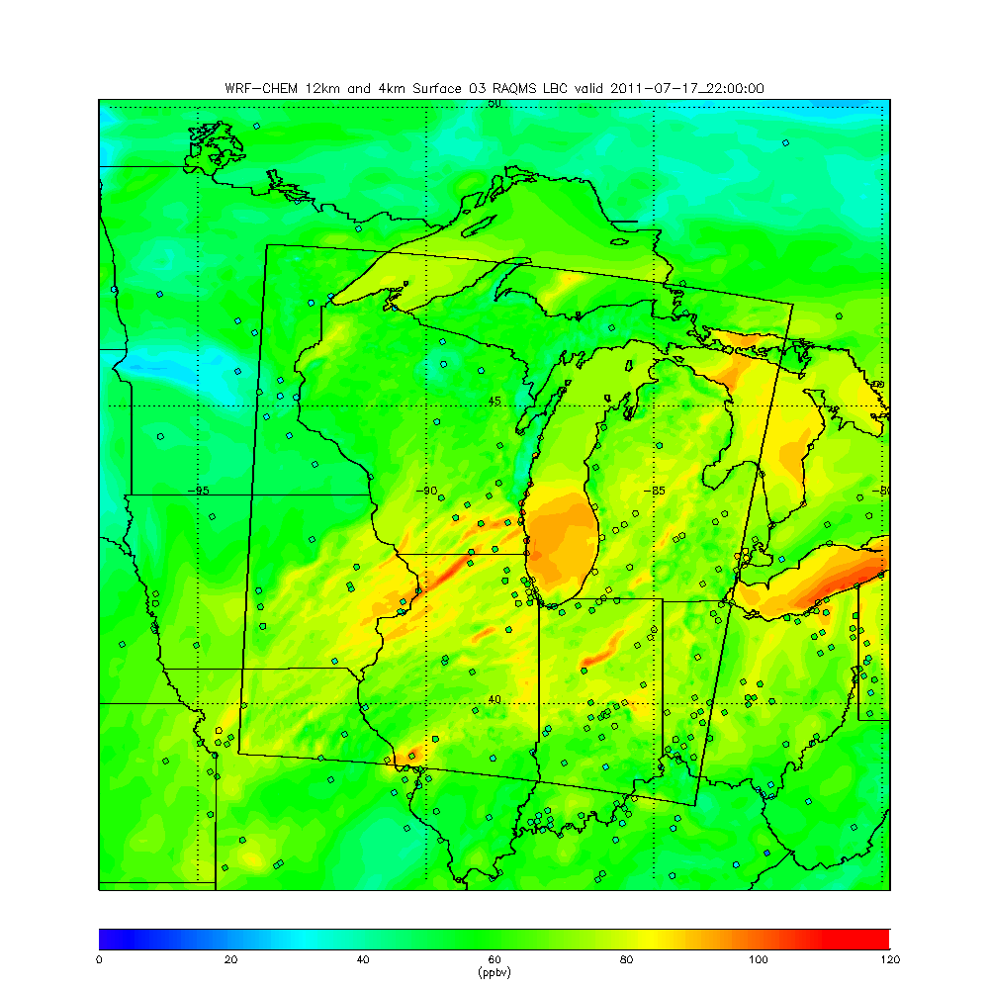
4km reduced Chicago NO WRF-CHEM Surface O3 22Z (5:00pm Central) July 17, 2011
R=0.70
Bias(obs-mod)= 8.49ppbv
4km with reduced Chicago NO emissions shows higher O3 over Southern Lake Michigan but still shows low minimum in ozone along coast North of Milwaukee

Slide 19
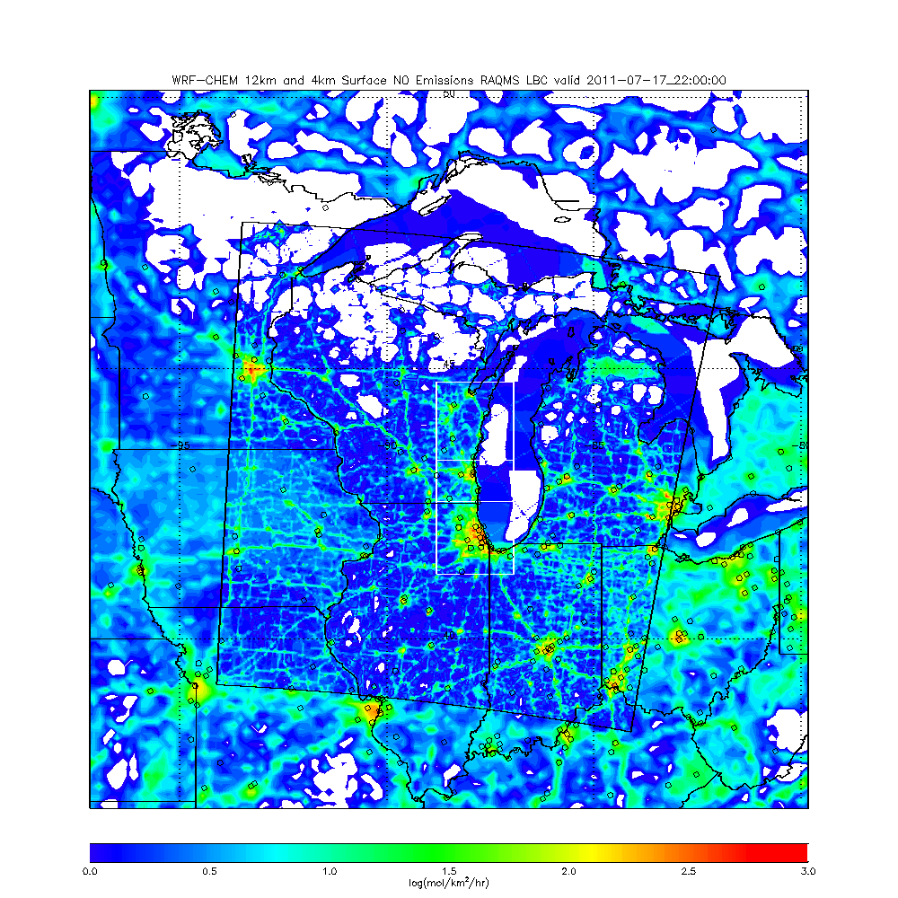
4km WRF-Chem NEI NO emission O3 sensitivity studies July, 2011
Green Bay (GB) domain
Milwaukee (ML) domain
Chicago (CH) domain
Green Bay domain includes mobile sources long Western Lake Michigan and Fox River Valley

Slide 20
Summary of 4km WRF-Chem NEI NO emission O3 sensitivity studies for Western Lake Michigan AIRNow sites July 17-18, 2011
Correlation
50% reductions in Chicago (CH), Chicago & Milwaukee (CH&ML), Chicago & Milwaukee & Green Bay (CH&ML&GB) NO emissions show progressive increases in correlations and reductions in biases during the July 17, 2011 ozone episode.
Bias (ppbv)

Slide 21
Conclusions:
The utility of using the OMI spatially enhanced NO2 retrieval to understand urban NO2 distributions is demonstrated by looking at the impact of NEI 2011 NO emissions on modeled ozone enhancements associated with lake breeze circulations along the western shore of Lake Michigan
High NO2 emissions in the Chicago area lead to excessive ozone titration within a lake breeze driven plume of high NO2 column for both 12 and 4 km standard NEI 2011 simulations
Comparisons between OMI Standard and Spatially Enhanced NO2 column retrievals and 4km WRF-CHEM NO2 columns over Chicago during July 2011 shows that the WRF-CHEM NO2 columns are high by a factor of 2
Sensitivity experiments show that reductions in Chicago NO emissions by 50% lead to higher surface ozone over Southern Lake Michigan but little improvement in surface ozone predictions North of Milwaukee
Sensitivity experiments including reductions in Chicago, Milwaukee, and Green Bay NO emissions show overall improvement in the correlation with AIRNow and reductions in the biases along western Lake Michigan but are still not able to capture the high surface ozone observed North of Milwaukee on July 17, 2011.

Slide 22
The TROPOspheric Monitoring Instrument (TROPOMI) is a European satellite instrument to be launched in 2016 for a mission of seven years. TROPOMI will measure ozone (O3), nitrogen dioxide (NO2), formaldehyde (HCHO), Sulphur dioxide (SO2) and aerosols. In addition a NIR channel and a SWIR-module are added for enhanced cloud detection, aerosol height distribution and detection of carbon monoxide (CO) and methane (CH4) at a high spatial resolution of 7x7 km²
http://www.tropomi.eu/

