Slide 1
Update on Modeling Smoke/Air Chemistry Project
Brad Pierce (NESDIS/STAR)
HRRR-Smoke:
Georg Grell, Steve Peckman, Ravan Ahmadov
(ESRL)
NAM-CMAQ:
Jeff McQueen
(NAQFC/NWS)
SOO Science Call - Wed, May 25, 2016 11:00 AM - 12:00 PM CDT

Slide 2
Outline
Experimental HRRR-Smoke and Operational NAM-CMAQ Aerosol predictions (JPSS Fire and Smoke Initiative)
Western US August 15-31, 2015
AIRNow surface PM2.5 verification
High Resolution Trajectory-Based Smoke Forecasts (JPSS Fire and Smoke Initiative)
Fort McMurray wildfire
VIIRS Aerosol Optical Depth (AOD)
New GOES-R Research Theme: High Impact Weather-Fires
Support NWS Incident Meteorologists (IMET) situational awareness
HRRR-Smoke GOES-R aerosol data assimilation
Introduce Fire Behavior Forecasts into HRRR-Smoke

Slide 3
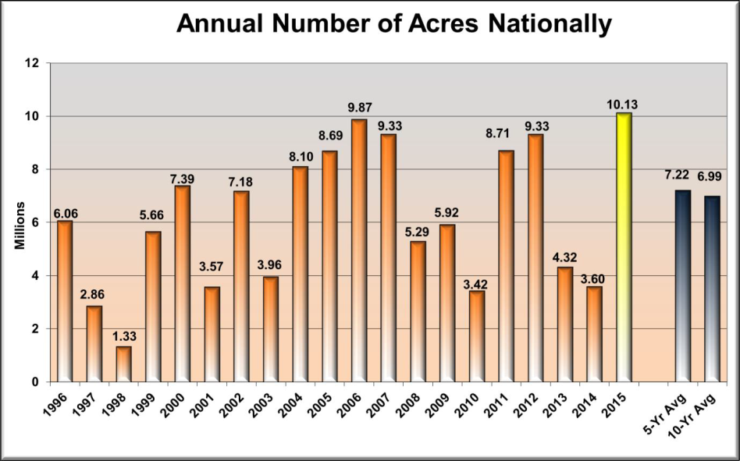
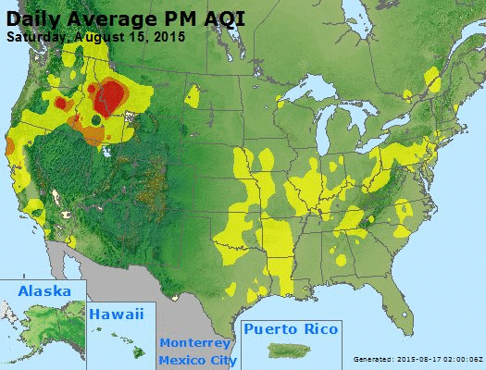
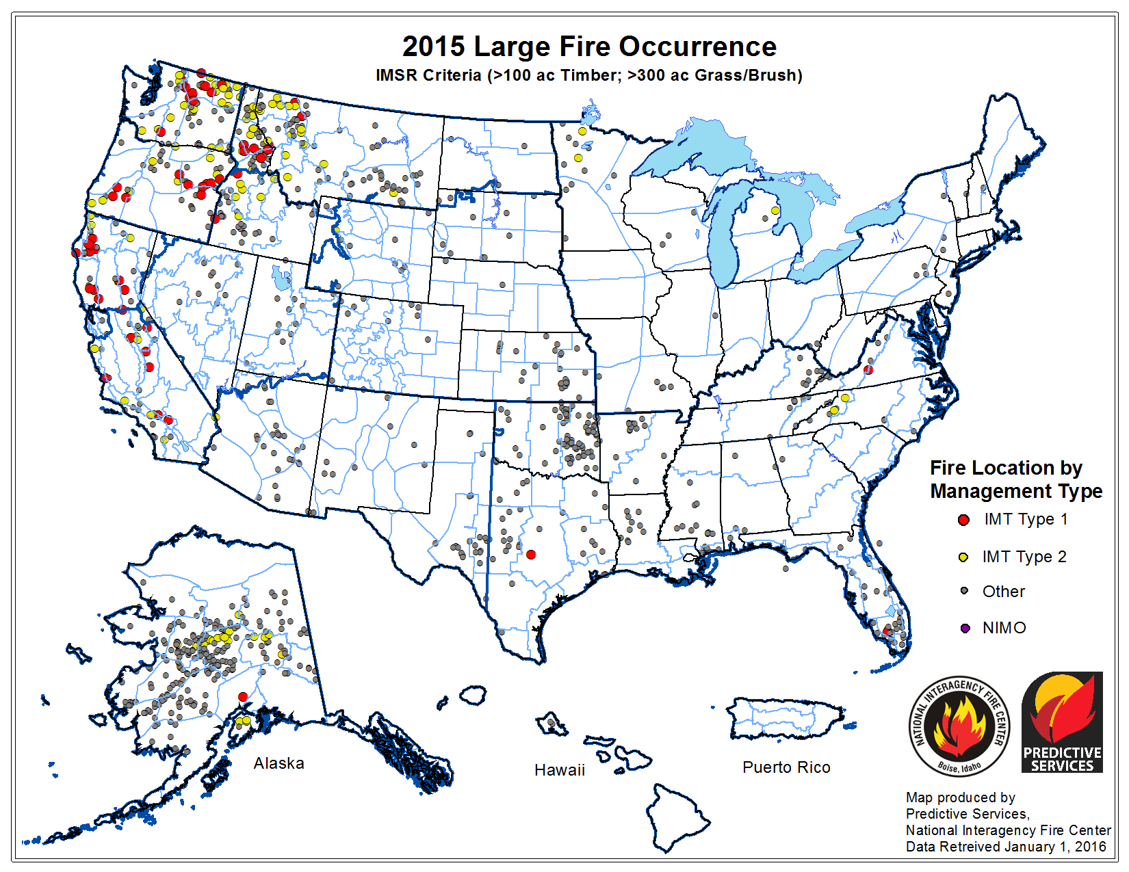
2015 had the highest area burned since 1996
https://www.airnow.gov/
Alaska (420% percent), Northwest (229%), Northern California (163%) and Northern Rockies (139%) were the only Geographic Areas to experience above average acres burned.
http://www.predictiveservices.nifc.gov/intelligence/2015_Statssumm/annual_report_2015.pdf

Slide 4
High Resolution Rapid Refresh with Smoke Tracers (HRRR-Smoke)
Retrospective Smoke forecasts
An experimental version of the High Resolution Rapid Refresh model is being used to predict wildfire smoke transport. The forecast model based on the Weather Research and Forecasting (WRF) numerical model coupled with chemistry (WRF-Chem).
3 km HRRR-Smoke wildfire forecast
Smoke treated as carbon monoxide (CO) tracer
Only wildfire emissions
No dry and wet deposition
No diurnal fire behavior
THESE FORECASTS ARE EXPERIMENTAL
Retrospective HRRR-Smoke forecasts conducted for August 17-31, 2015
Georg Grell and Ravan Ahmadov (NOAA/ESRL/GSD)
http://ruc.noaa.gov/wrf/WG11_RT/#hrrrsmk

Slide 5
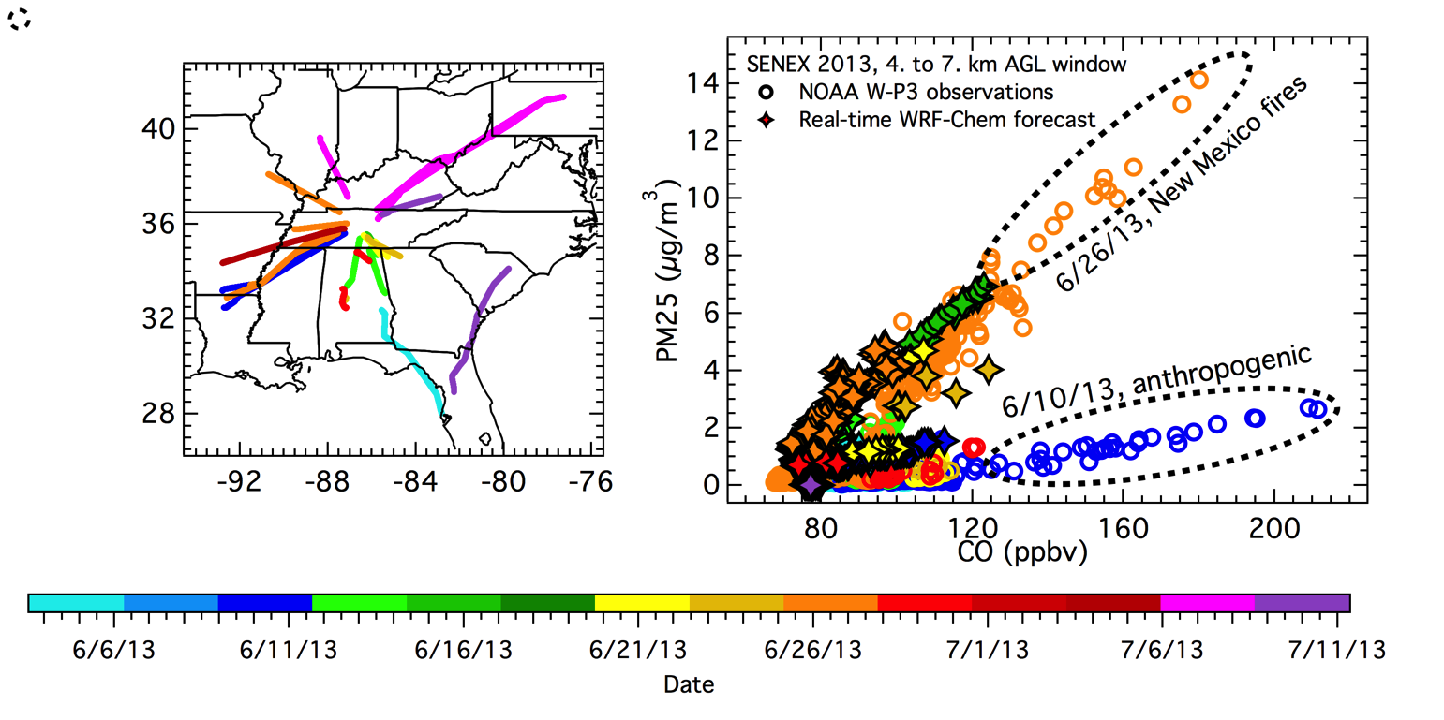
Particulate matter (PM_{2.5}) mass concentrations versus carbon monoxide (CO) mixing ratios measured by aircraft¹ and simulated by WRF-Chem
1150 μg/m³ PM2.5 per ppmv (CO-0.055)
If HRRR-Smoke < 55ppbv (background) then PM2.5=0.0μg/m³
¹NOAA P-3 aircraft flight paths at altitudes greater than 4 km above ground level (AGL) over the southeastern US during the SENEX field campaign, June-July, 2013 (From Greg Frost, ESRL)

Slide 6
NWS National Air Quality Forecast Capability (NAQFC)
Operational NAM-CMAQ PM2.5 predictions
12km Forecast
Wildfire emissions from
Forest Service BlueSky Smoke Modeling Framework
http://www.nws.noaa.gov/ost/air_quality/Stajner_CMAQ_Readiness_2015.pdf

Slide 7
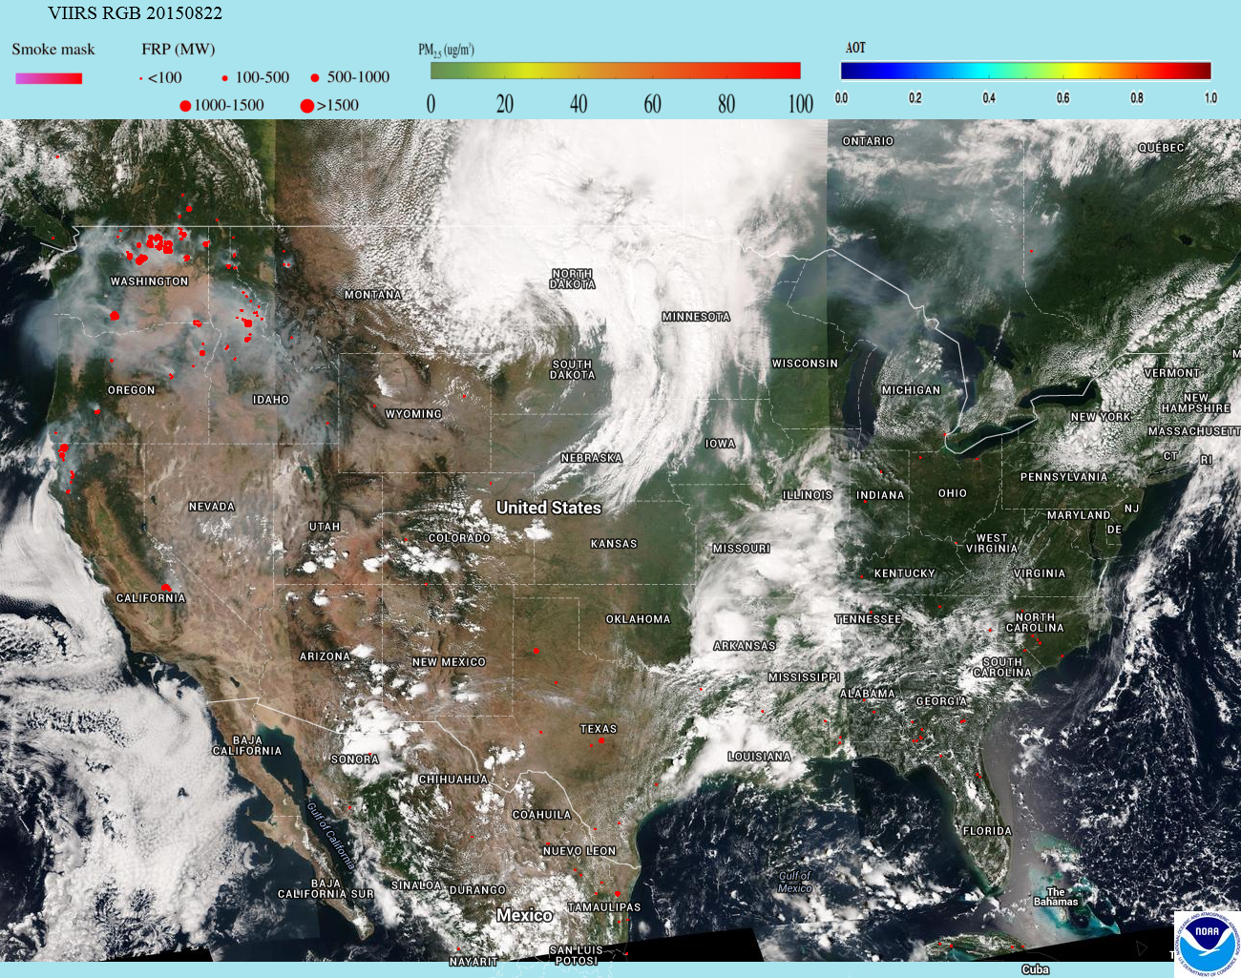
VIIRS True Color Image with Fire Radiative Power (FRP)
http://www.star.nesdis.noaa.gov/smcd/spb/aq/expr/expr2/

Slide 8
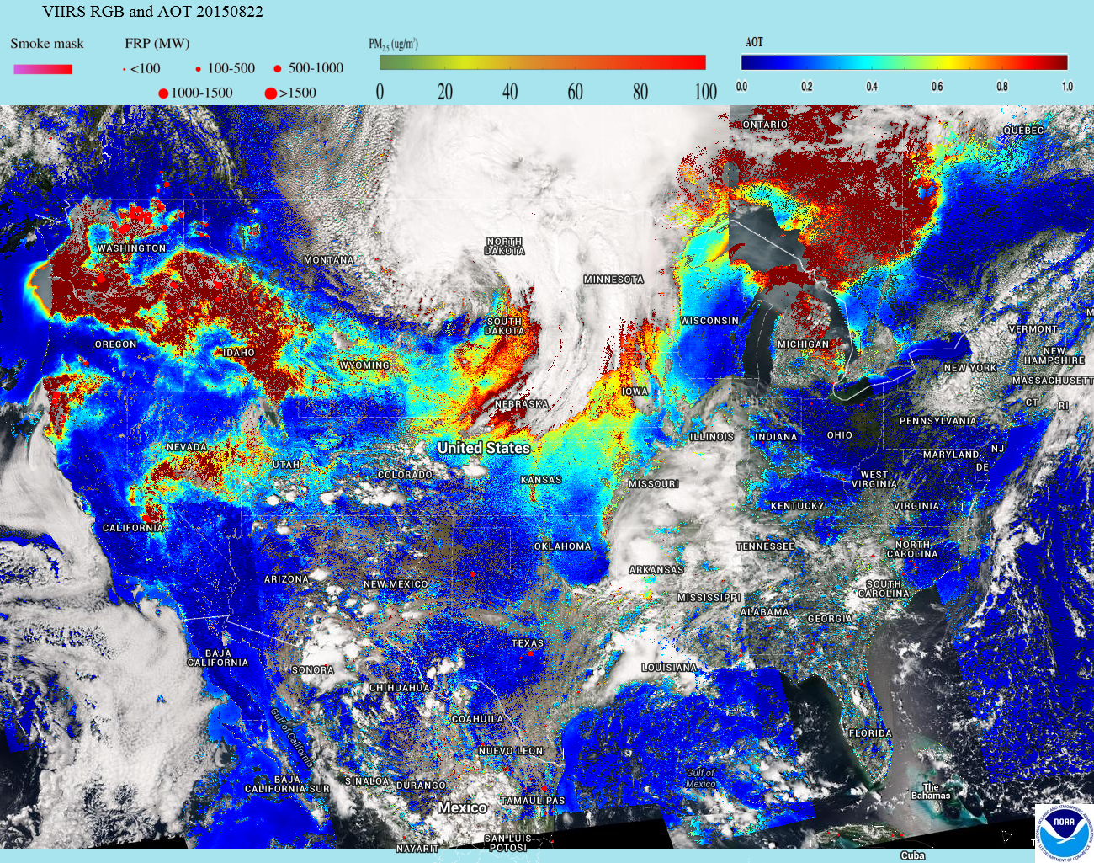
VIIRS Aerosol Optical Thickness (AOT) with FRP
http://www.star.nesdis.noaa.gov/smcd/spb/aq/expr/expr2/

Slide 9
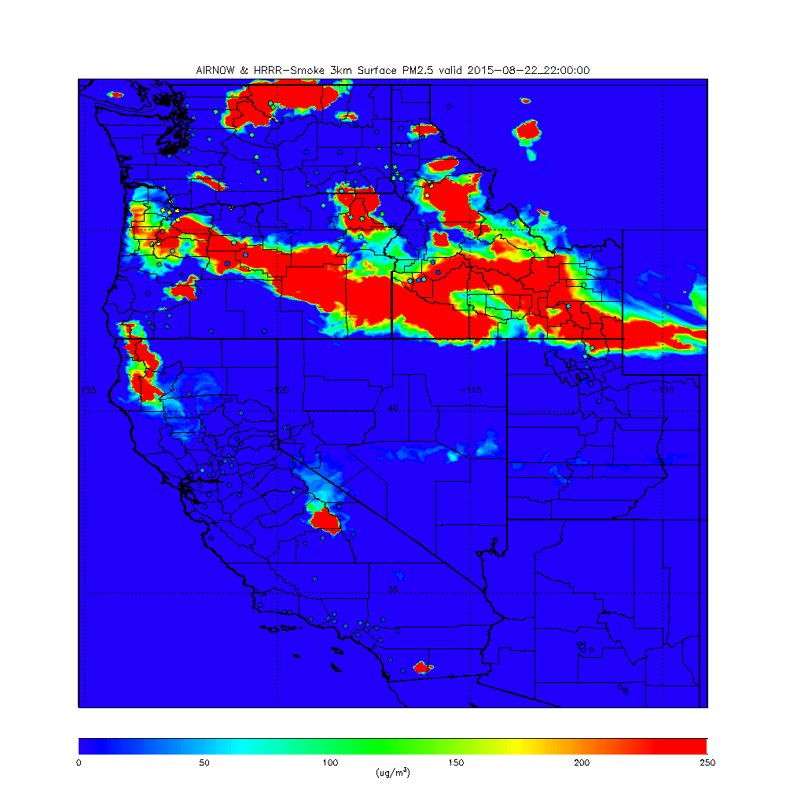
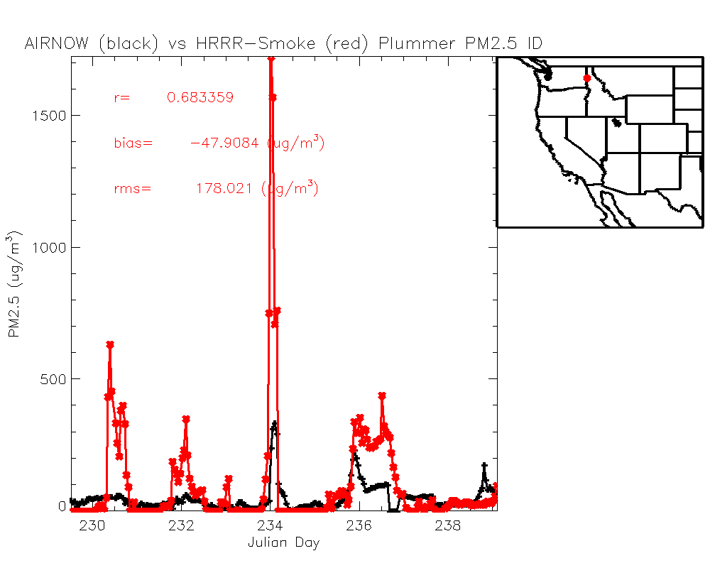
HRRR-Smoke surface PM2.5
22Z August 22, 2015
Downwind smoke plume overestimated due to neglect of deposition processes
Bias=AIRNow - Model

Slide 10
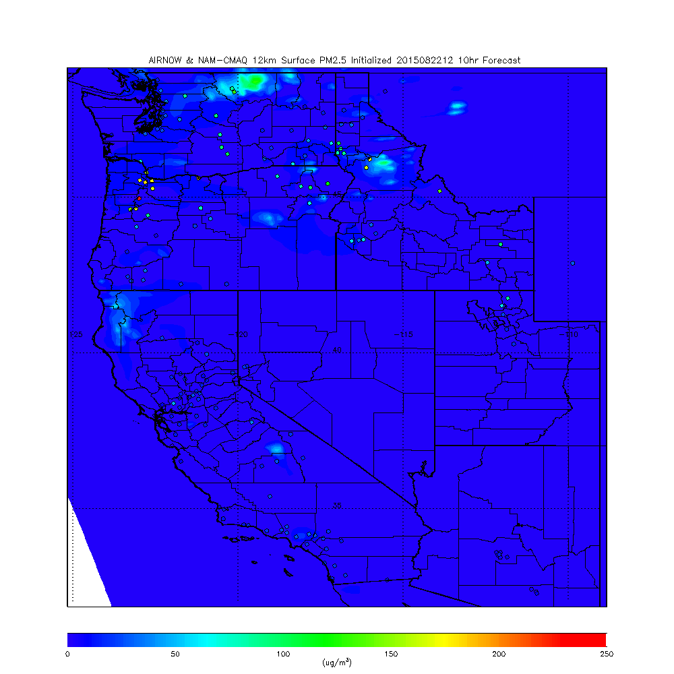
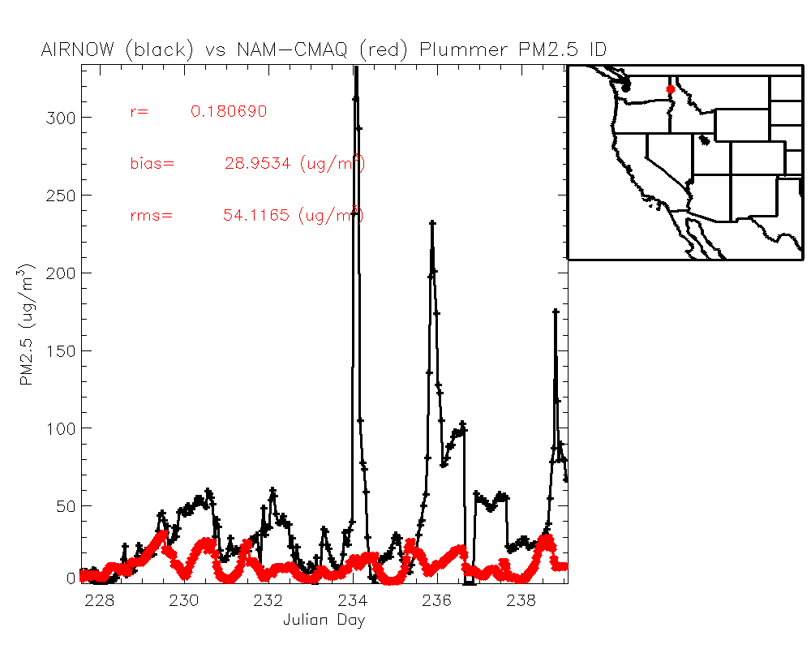
NAM-CMAQ surface PM2.5
22Z August 22, 2015
Wildfire emissions are underestimated in current operational NAM-CMAQ
Bias=AIRNow - Model

Slide 11
Statistical Analysis
Scatter Plots
Idaho, Oregon, Washington and California
Model vs Observed (AIRNow) Surface PM2.5
Correlation, bias, rms error
Contingency Tables
PM2.5 Air Quality Index (AQI)
Unhealthy, Unhealthy for Sensitive Groups, and Moderate Categories

Slide 12
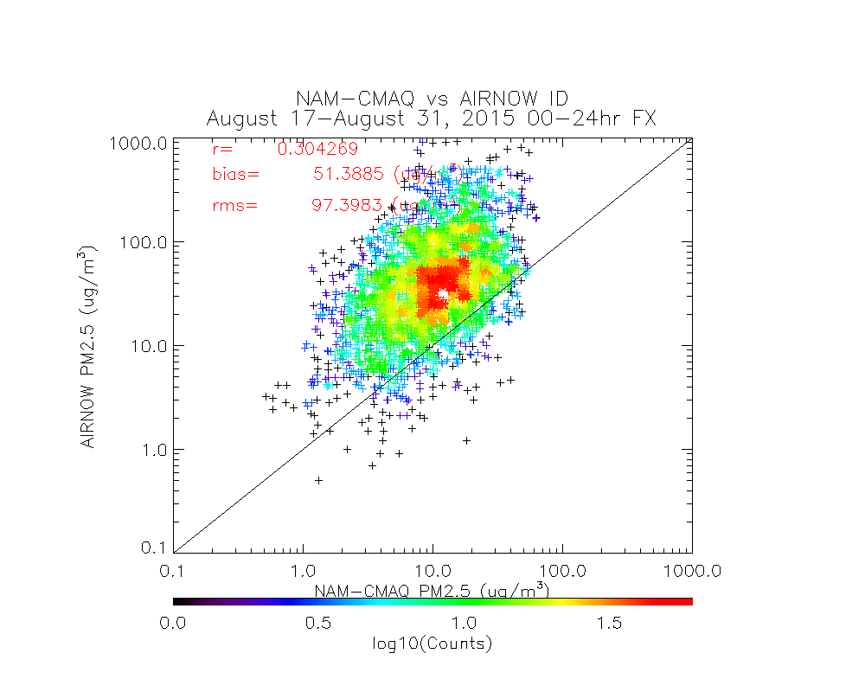
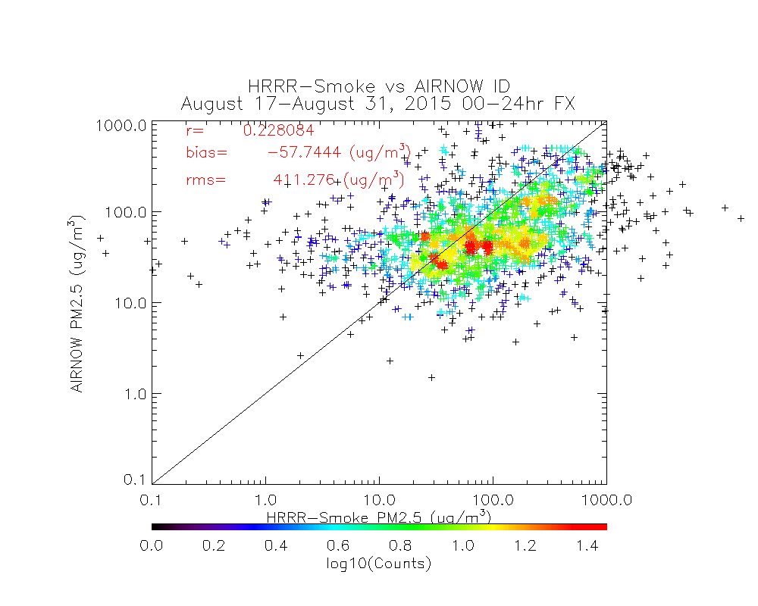
NAM-CMAQ and HRRR-Smoke vs AIRNow - Idaho
True
Positive
False
Positive
False Negative
True Negative
unhealthy
0.00000 0.00000 25.7754 74.2246 sensitive
1.70714 0.288531 46.2130 51.7913 moderate
29.1416 1.15412 55.2777 14.4746
unhealthy
25.7754
74.2246
sensitive
47.9202
52.0798
moderate
NAM-CMAQ
84.3712
15.6288
AIRNow
unhealthy 16.7553 17.6158 10.0734 55.5556 sensitive 29.7140 13.0094 19.7671 37.5095 moderate 50.7213 2.58162 33.9408 12.7563
25% of AIRNow unhealthy
0% of NAM-CMAQ
17% of HRRR-Smoke
48% of AIRNow unhealthy for sensitive groups
2% of NAM-CMAQ
30% of HRRR-Smoke
HRRR-Smoke shows more False Positives and less False Negatives than NAM-CMAQ
HRRR-Smoke

Slide 13
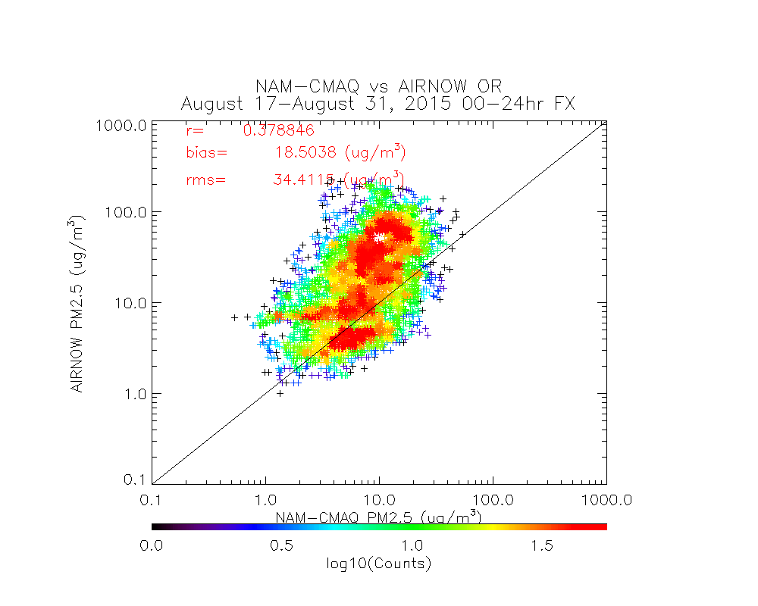
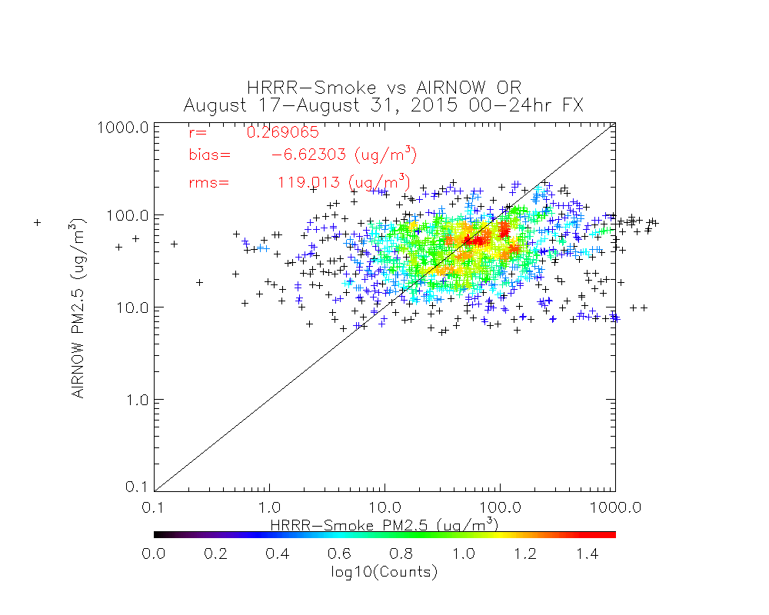
NAM-CMAQ and HRRR-Smoke vs AIRNow - Oregon
True
Positive
False
Positive
False Negative
True Negative
unhealthy
0.00000 0.00000 10.3864 89.6136 sensitive
0.0782105 0.031284 23.5570 76.3335 moderate
11.3718 2.61223 39.0114 47.0358
unhealthy
10.3864
89.6136
sensitive
23.6352
76.3648
moderate
NAM-CMAQ
50.3519
49.6481
AIRNow
unhealthy 4.31120 8.82061 6.60720 80.2610 sensitive 11.5791 7.23489 13.1814 68.0046 moderate 24.6779 1.65180 26.7592 46.9111
10% of AIRNow unhealthy
0% of NAM-CMAQ
4% of HRRR-Smoke
23% of AIRNow unhealthy for sensitive groups
0% of NAM-CMAQ
12% of HRRR-Smoke
HRRR-Smoke shows more False Positives and less False Negatives than NAM-CMAQ
HRRR-Smoke

Slide 14
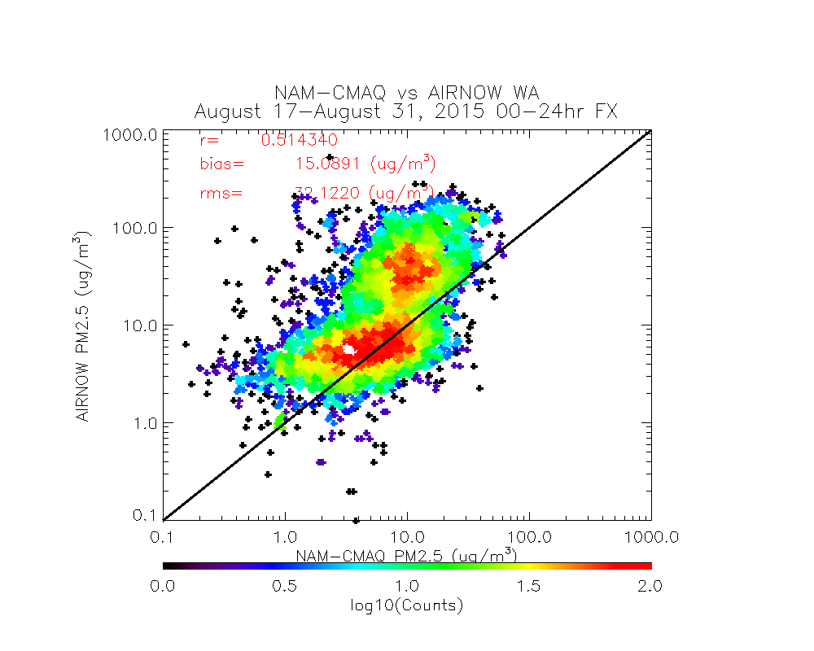
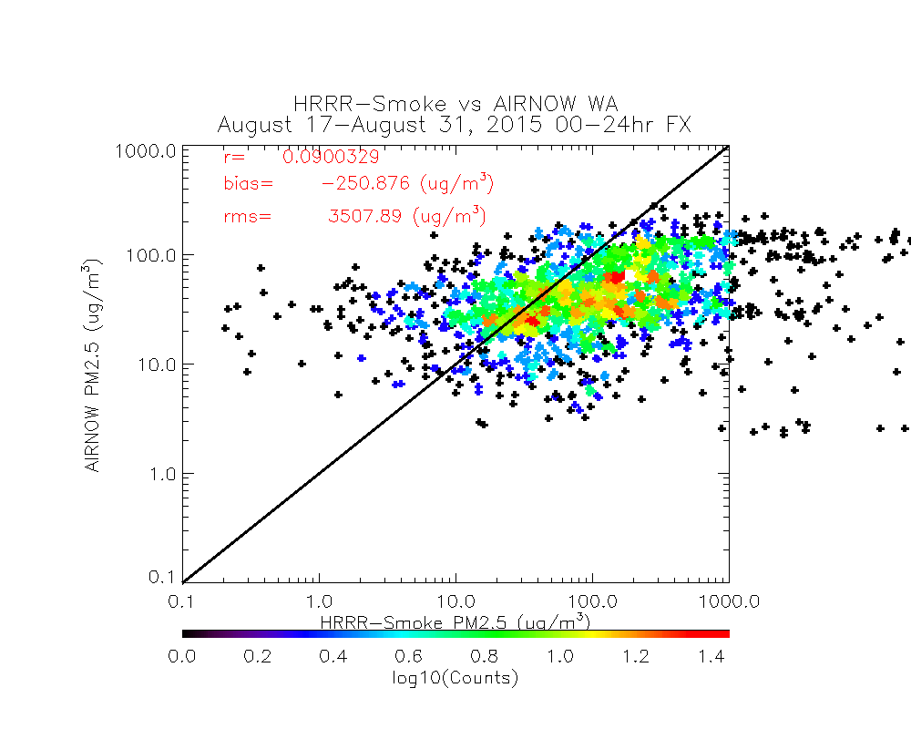
NAM-CMAQ and HRRR-Smoke vs AIRNow - Washington
True
Positive
False
Positive
False Negative
True Negative
unhealthy
0.00000 0.00000 8.20973 91.7903 sensitive 0.344947 0.0459929 18.3282 81.2809 moderate
10.2909 2.15017 28.7570 58.8019
unhealthy
8.19936
91.8006
sensitive
18.6495
81.3505
moderate
NAM-CMAQ
38.9986
61.0014
AIRNow
unhealthy
5.35563 9.82673 3.21095 81.6067 sensitive 10.4447 7.50030 8.19096 73.8641 moderate
20.4895 1.89022 18.5751 59.0452
8% of AIRNow unhealthy
0% of NAM-CMAQ
5% of HRRR-Smoke
19% of AIRNow unhealthy for sensitive groups
0% of NAM-CMAQ
10% of HRRR-Smoke
HRRR-Smoke shows more False Positives and less False Negatives than NAM-CMAQ
HRRR-Smoke

Slide 15
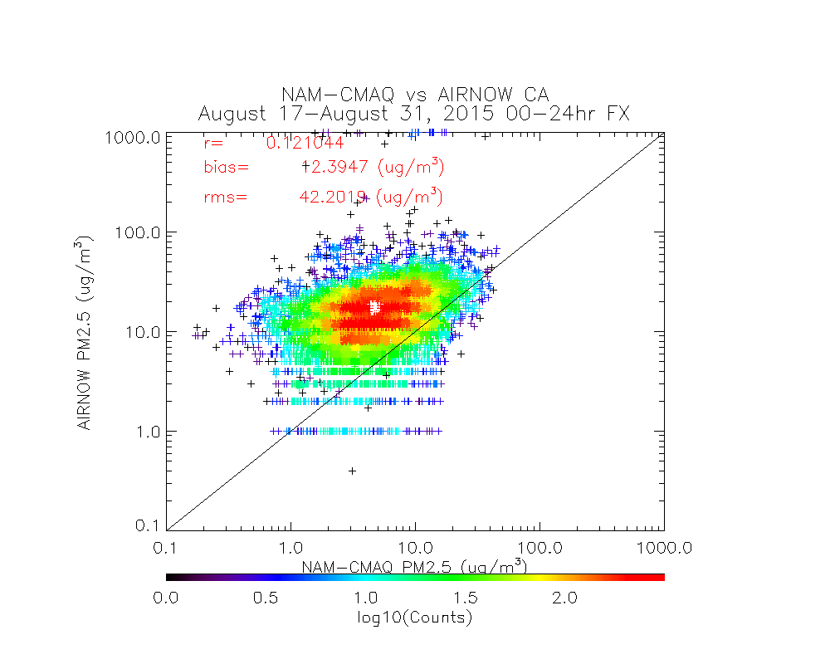
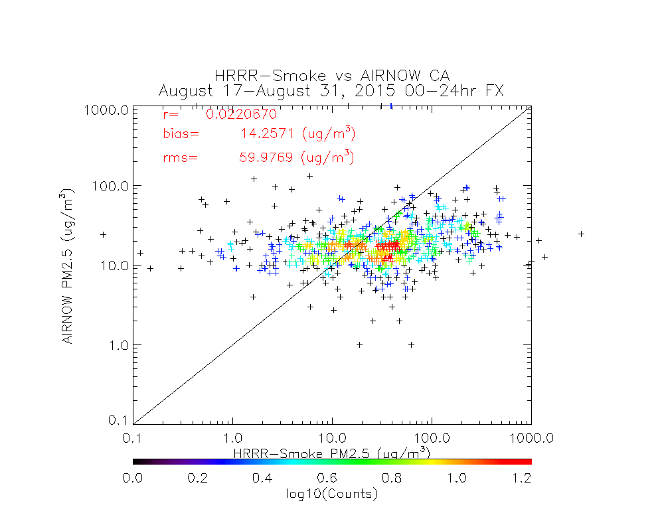
NAM-CMAQ and HRRR-Smoke vs AIRNow - California
True
Positive
False
Positive
False Negative
True Negative
unhealthy 0.00000 0.00000 0.836265 99.1637 sensitive 0.0265481 0.0066370 2.79419 97.1726 moderate 4.01540 0.862813 48.1914 46.9370
unhealthy
0.836265
99.1637
sensitive
2.82073
97.1793
moderate
NAM-CMAQ
52.2002
47.7998
AIRNow
unhealthy 0.0772092 1.30554 0.779111 97.8381 sensitive 0.343932 1.97235 2.42156 95.2622 moderate 2.80059 1.41082 48.9015 46.8871
Note: Majority of HRRR-Smoke < 55ppbv CO background and set to 0.0μg/m³ (does not capture CA anthropogenic aerosol)
HRRR-Smoke

Slide 16
Case Study Summary
Comparisons with AIRNow measurements during August 17-31, 2015 in regions of significant wild fire activity (ID, WA, OR, and CA) show that:
NAM-CMAQ generally shows better correlation, lower bias, and lower rms error than HRRR-Smoke predictions over the Western US during this period
HRRR-Smoke does a better job of predicting the frequency of “unhealthy” and “unhealthy for sensitive groups” PM2.5 categories (reduced false negatives, increased true positives) for ID, WA, and OR
However, HRRR-Smoke has an increased frequency of False Positives for both “unhealthy” and “unhealthy for sensitive groups” categories
HRRR-Smoke results assume a fixed relationship between PM2.5 and CO based on NOAA SENEX fire sampling

Slide 17
Current ESRL HRRR-Smoke development (in collaboration with CPTEC, Brazil)
HRRR-Smoke model is being updated to include 4 aerosol species: smoke tracer, primary PM2.5, and two additional aerosol species for microphysics scheme to simulate indirect feedback. The updated HRRR-Smoke is being tested for August 15-31, 2015.
NESDIS (I.Csiszar) provided VIIRS Fire Radiative Power (FRP) data in ASCII format for August 15-31, 2015 time period. Also available in real time.
Work is ongoing to modify the plume rise calculations in WRF-Chem to be able to use the new VIIRS FRP data sets.
The new HRRR-Smoke will be run in real time during 2016 fire season including grib2 data sets for display in AWIPS-II or RealEarth (https://realearth.ssec.wisc.edu)
Ravan Ahmadov, Georg Grell (NOAA/ESRL/GSD),
Ivan Csiszar (NOAA/NESDIS)
Collaborators: Brad Pierce (NESDIS/STAR), Saulo Freitas and Gabriel Pereira (CPTEC, Brazil), Steven Peckham (US Army, CRREL)
ravan.ahmadov@noaa.gov

Slide 18
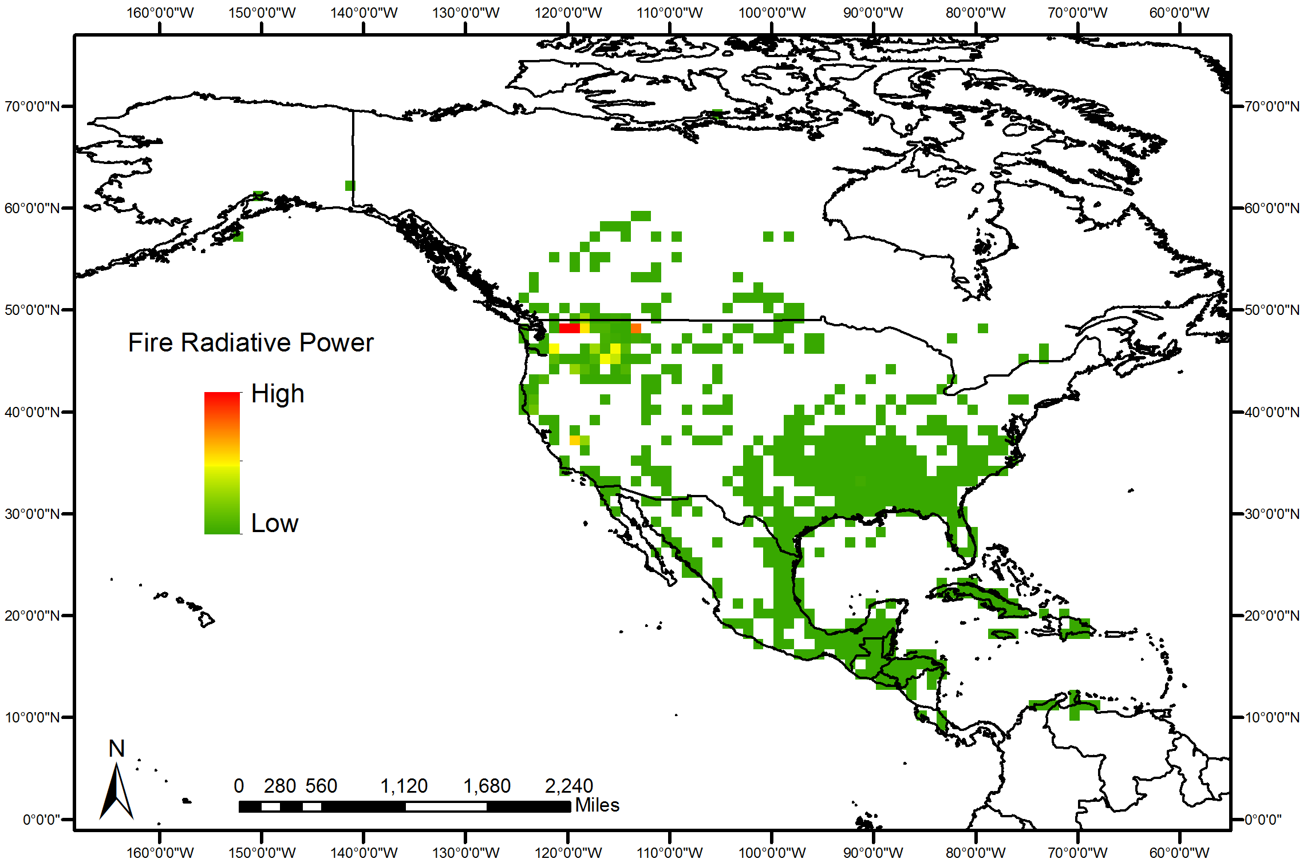
VIIRS FRP data for August 15-31, 2015

Slide 19
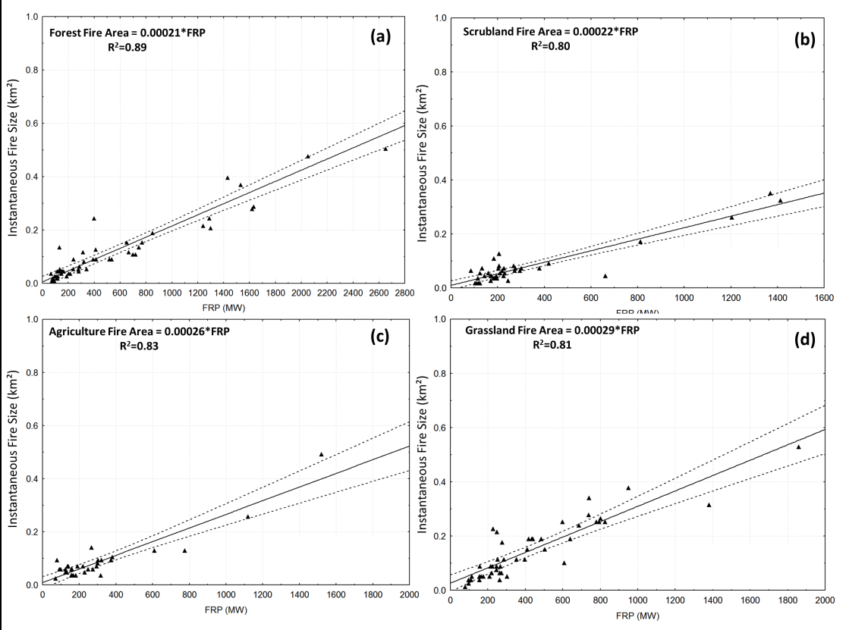
Flaming Fire Size coefficients based on Fire Radiative Power (FRP) for 5
vegetation types (Forest, grassland, agriculture, savannah and scrubland)

Slide 20
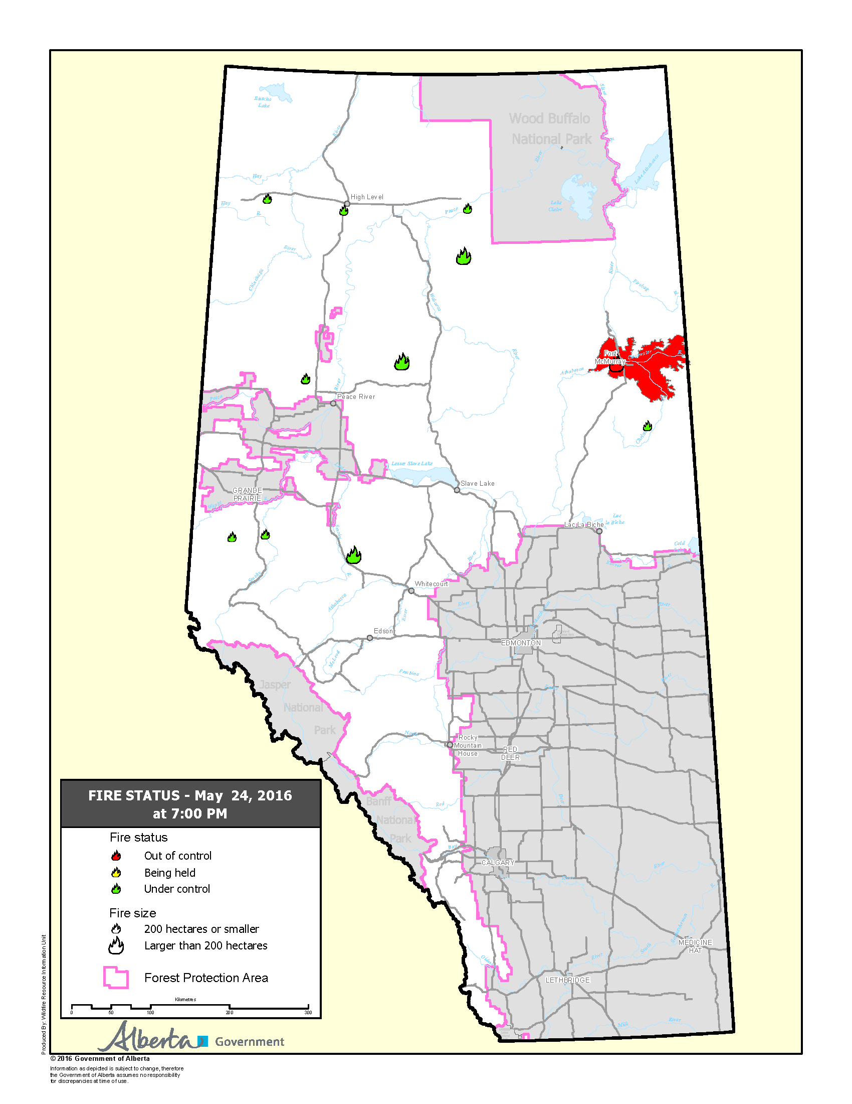
High Resolution Trajectory-Based Smoke Forecasts of the Fort McMurray Wildfire
(May 1, 2016) – 9:57 p.m., Mayor Blake has declared a State of Local Emergency in Fort McMurray localized to Gregoire.
(May 4, 2016) –Mandatory evacuation of Anzac, Gregoire Lake Estates and Fort McMurray First Nation.
(May 8, 2016) – Airspace below 3000 ft. above ground level (AGL) is closed over a five nautical mile buffer around the active fire zone.
(May 16, 2016) The evacuation zone has increased north of the city of Fort McMurray.
(May 18, 2016) A voluntary, phased re-entry for the safe return of Fort McMurray residents will begin June 1 if future wildfire conditions do not delay restoration efforts.
http://wildfire.alberta.ca/wildfire-maps/default.aspx

Slide 21
High Resolution Trajectory-Based Smoke Forecasts
Goal: Provide low latency, web-based, high resolution forecasts of smoke dispersion for use by NWS Incident Meteorologists (IMET) to support on-site decision support services for fire incident management teams.
Project utilizes VIIRS AOD retrievals to initialize trajectory-based, high spatial resolution smoke dispersion forecasts.
Project is an extension of Infusion of satellite Data into Environmental Applications-International (IDEA-I) trajectory based aerosol forecast capabilities and will be tested and released within CSPP prior to transition to Operations at NESDIS.
Notes:
Robyn Heffernan
Chair, Fire Environment Committee
National Wildfire Coordinating Group (NWCG)

Slide 22
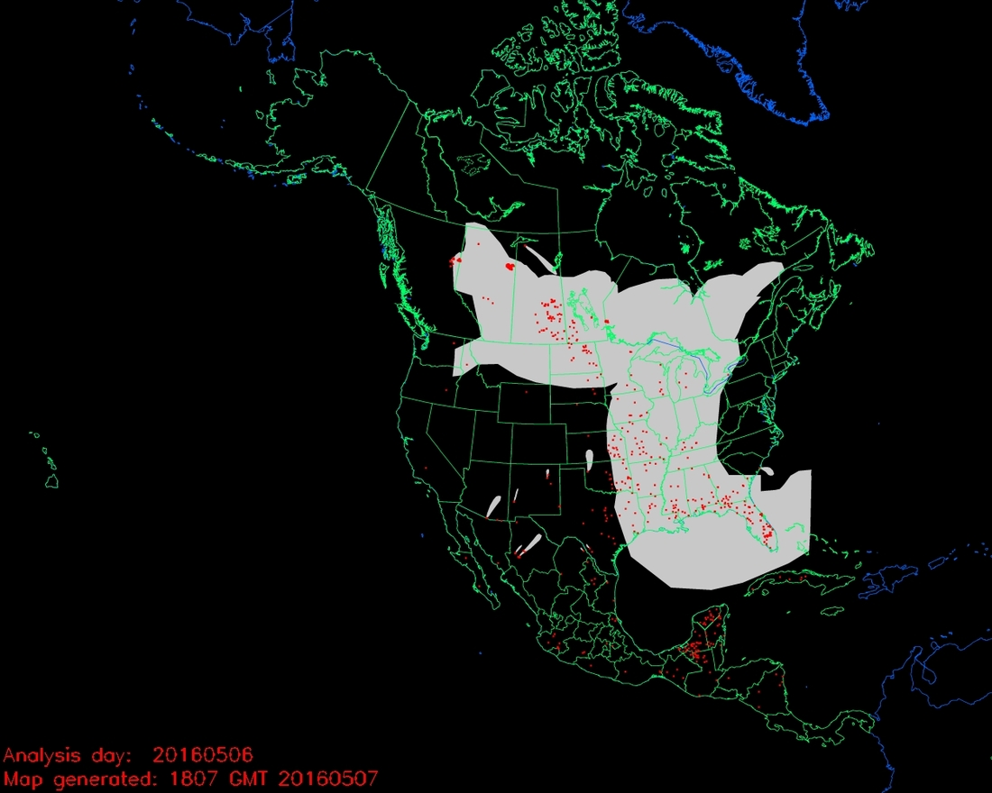
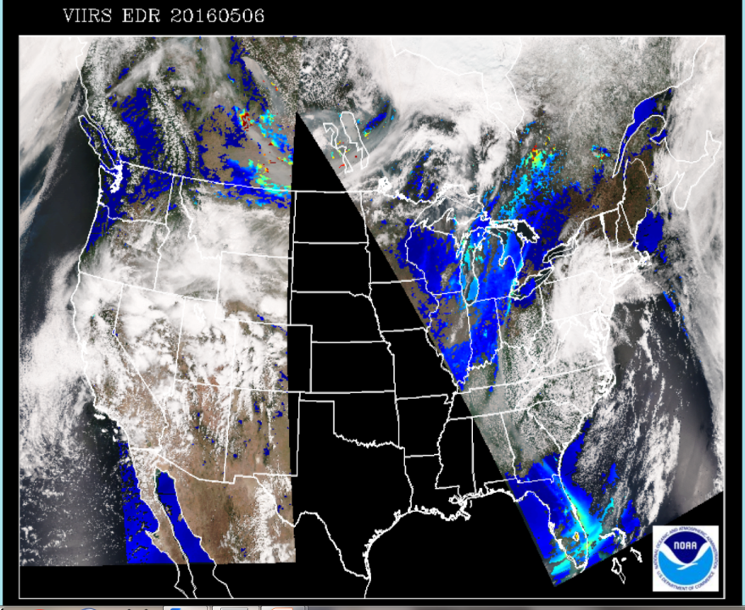
Canadian Wildfires
May 06, 2016

Slide 23
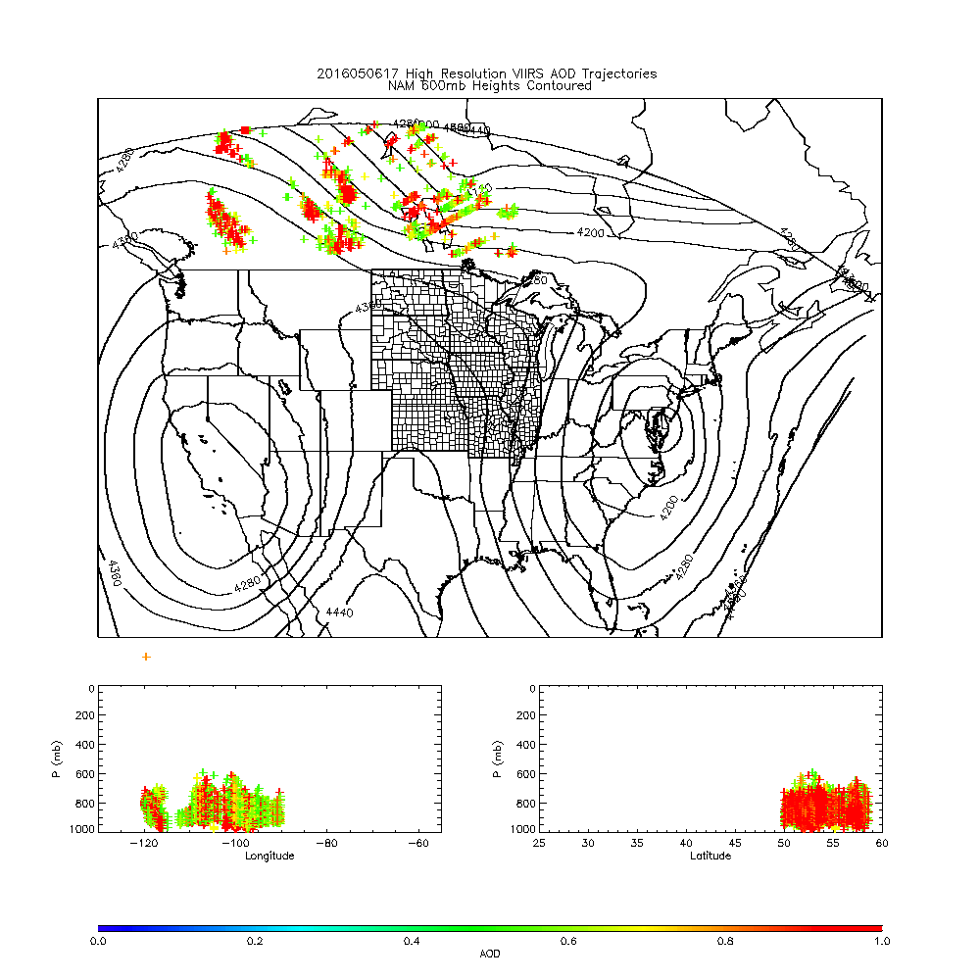

Slide 24
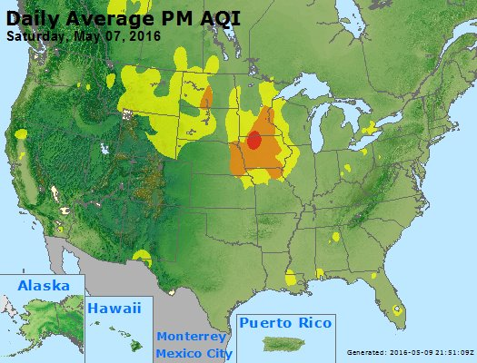
https://www.airnow.gov/

Slide 25
New GOES-R Research Theme:
High Impact Weather-Fires¹
Support NWS Incident Meteorologists (IMET)
Develop fire clustering algorithms to track behavior (movement, intensity)
Use ABI Fire Detection and GLM Lighting detection to develop probabilistic lightning wildfire ignition source
Support NWS aerosol (smoke) data assimilation
HRRR-Smoke GSI data assimilation using GOES-R AOD and FRP
Demonstration/Verification during 2018 NOAA FIREX field campaign
Support NWS Fire Behavior Forecasting
Validate HRRR lightning forecasts with GLM lighting detection
Test WRF-Fire/ABI FRP atmos-fire interaction within HRRR-Smoke (validate with ABI fire cluster observations)
Incorporate probabilistic lighting ignition source into WRF-Fire
¹Leverages the established collaboration between NESDIS/STAR and OAR/ESRL

Slide 26
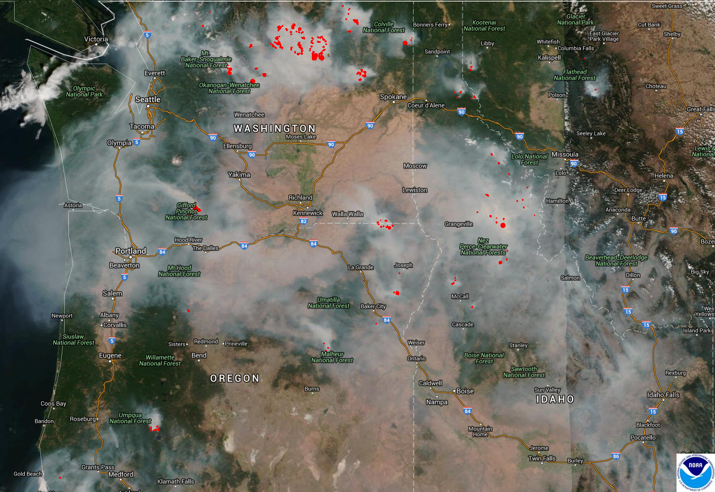
What is NOAA doing to build a Weather-Ready Nation?
NOAA’s National Weather Service is transforming its operations to help America respond.
NOAA’s Office of Oceanic and Atmospheric Research and National Environmental Satellite, Data, and Information Service are moving new science and technology into National Weather Service operations that will improve forecasts and ultimately increase weather-readiness.

