Slide 1
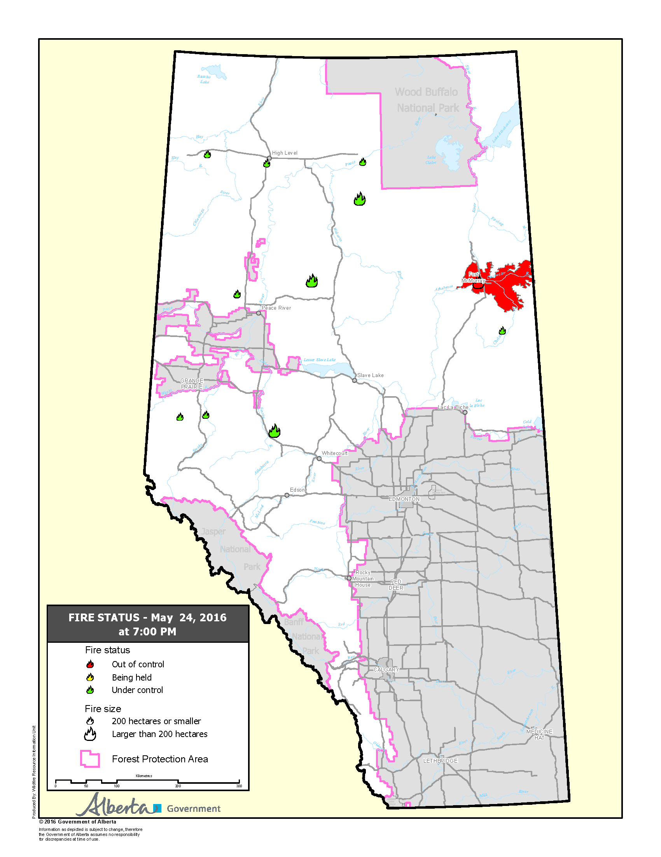
Evaluation of NUCAPS CO Retrieval and High Resolution Smoke Trajectory Forecasting
Brad Pierce (NOAA/NESDIS/STAR)
Collaborators:
Nadia Smith, Antonia Gambacorta and Chris Barnet (STC)
Jim Davies and Kathy Strabala (CIMSS)
Greg Frost and John Holloway (NOAA/ESRL)
Shobha Kondragunta (NESDIS/STAR)
Fort McMurray wildfire Case study
(May 1, 2016) – 9:57 p.m., Mayor Blake has declared a State of Local Emergency in Fort McMurray localized to Gregoire.
(May 4, 2016) –Mandatory evacuation of Anzac, Gregoire Lake Estates and Fort McMurray First Nation.
(May 16, 2016) The evacuation zone has increased north of the city of Fort McMurray.
(May 18, 2016) A voluntary, phased re-entry for the safe return of Fort McMurray residents will begin June 1 if future wildfire conditions do not delay restoration efforts.

Slide 2
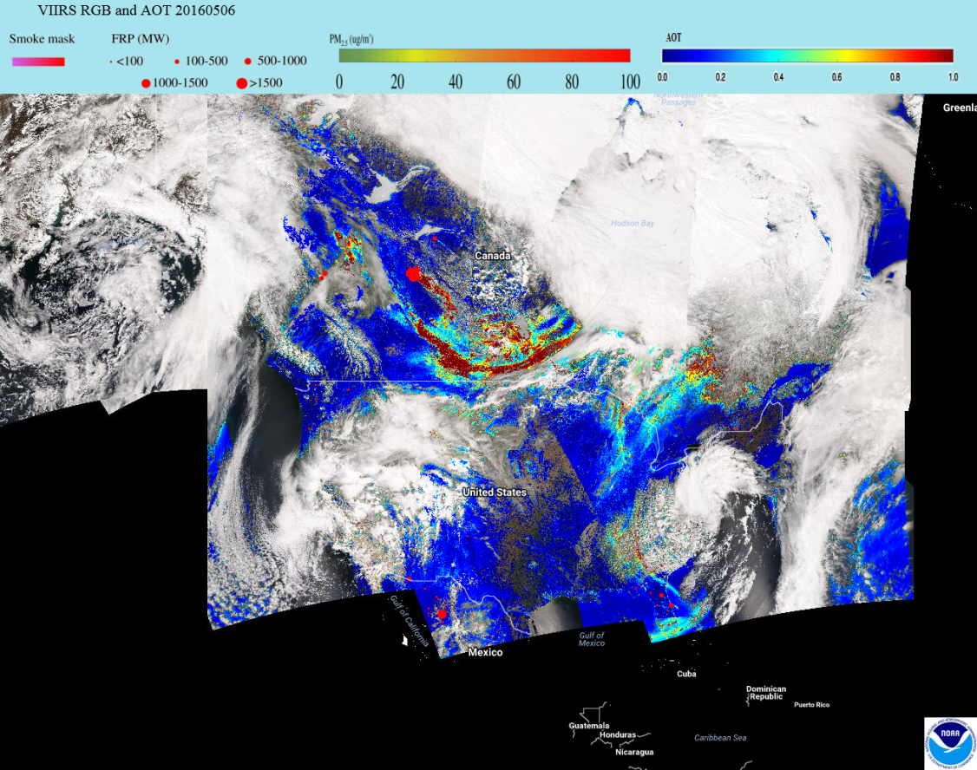
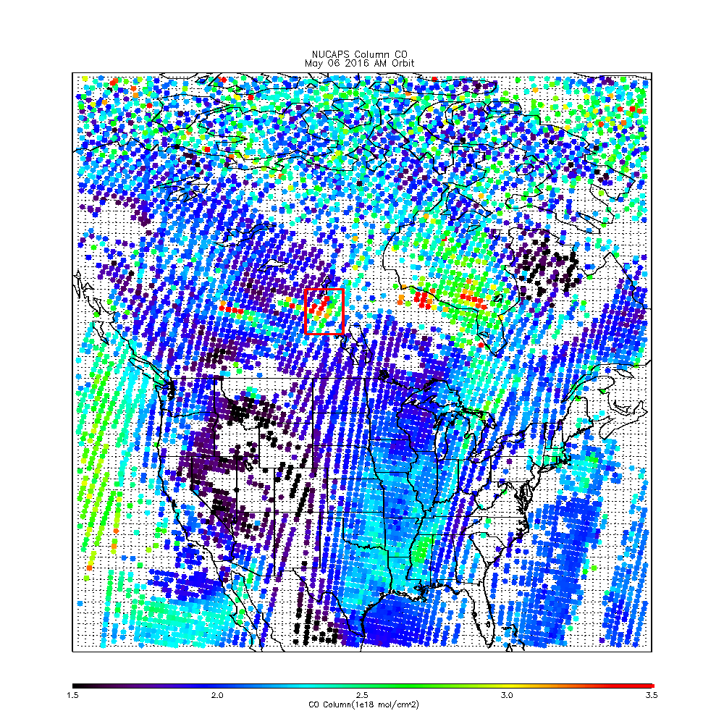
CSPP NUCAPS trace gas EDR
Include averaging kernel, apriori, interpolation and inverse matrices for applying to model (or insitu) profiles for data assimilation (or validation) activities.
eIDEA (http://www.star.nesdis.noaa.gov/smcd/spb/aq/expr/expr2/)
Files also include surface parameters, degrees of freedom, and combined microwave and infrared quality flags.
Will be used within CSPP for IDEA-I NUCAPS smoke forecasts and also in collaboration with colleagues at NOAA/ESRL for NUCAPS CH4 and CO retrieval validation activities.

Slide 3
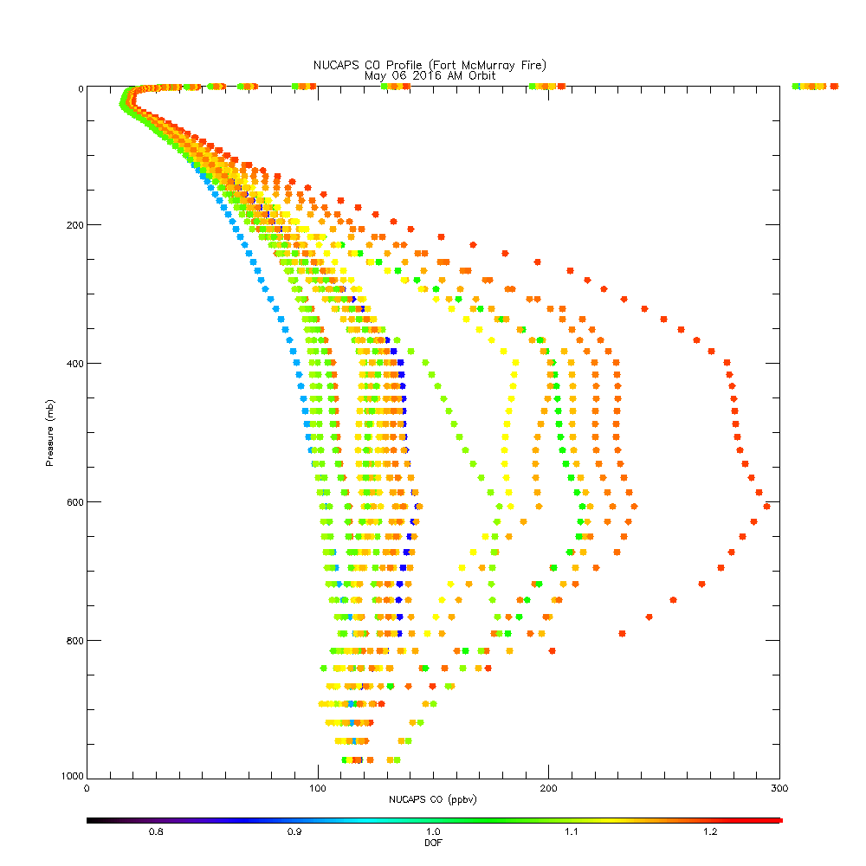
CSPP NUCAPS trace gas EDR
Include averaging kernel, apriori, interpolation and inverse matrixes for applying to model (or insitu) profiles for data assimilation (or validation) activities.

Slide 4
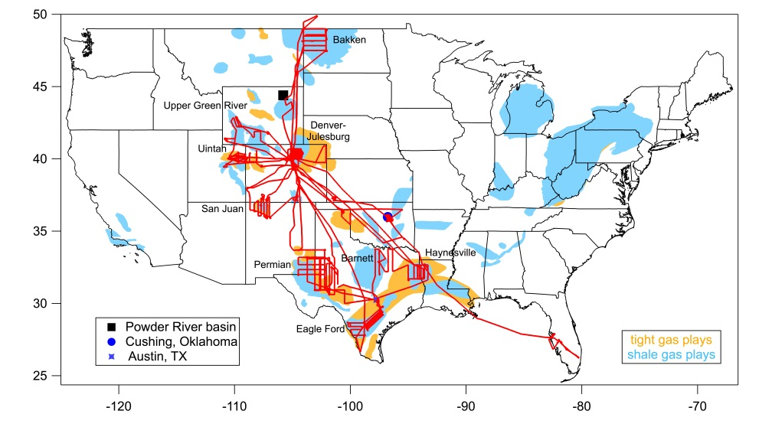
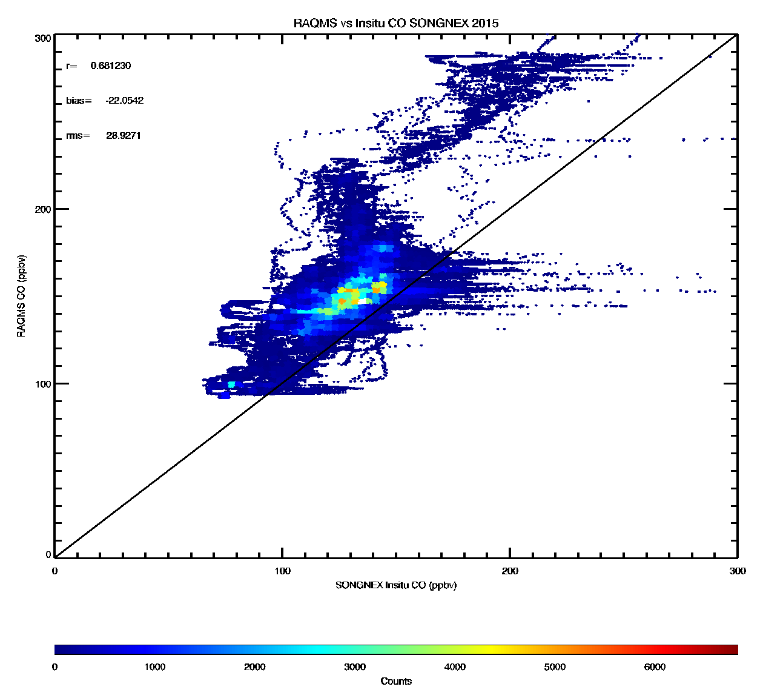
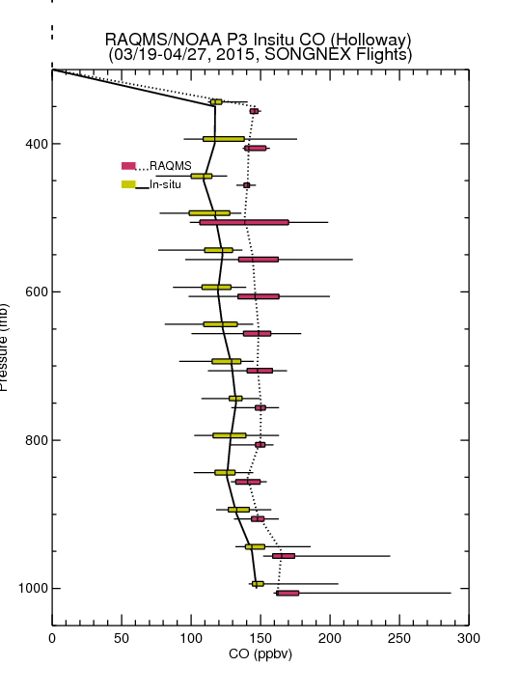
SONGNEX 2015
Shale Oil and Natural Gas Nexus
Evaluate RAQMS vs insitu CO during NOAA/ESRL SONGNEX 2015 for indirect NUCAPS CO validation
RAQMS vs Insitu SONGNEX 2015
(March 19-April 27, 2015)
r=0.681230
bias= 22.0542
(RAQMS-insitu)
rms= 28.9271
RAQMS CO (ppbv)
Insitu CO (ppbv)

Slide 5
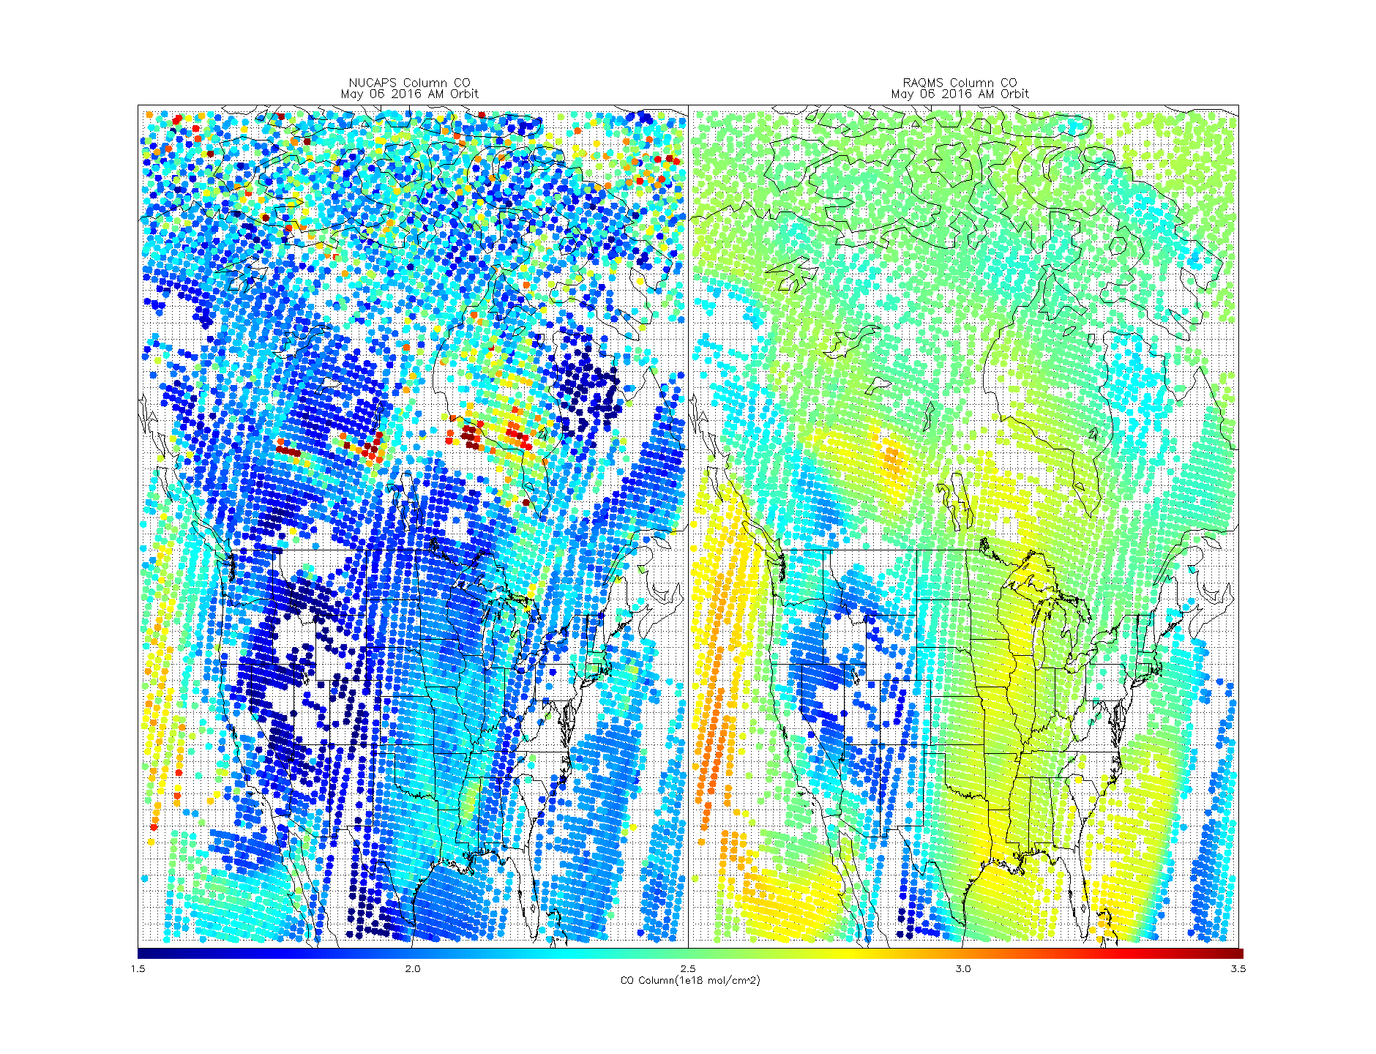
NUCAPS verses RAQMS Column CO May 06, 2016 AM Orbit

Slide 6
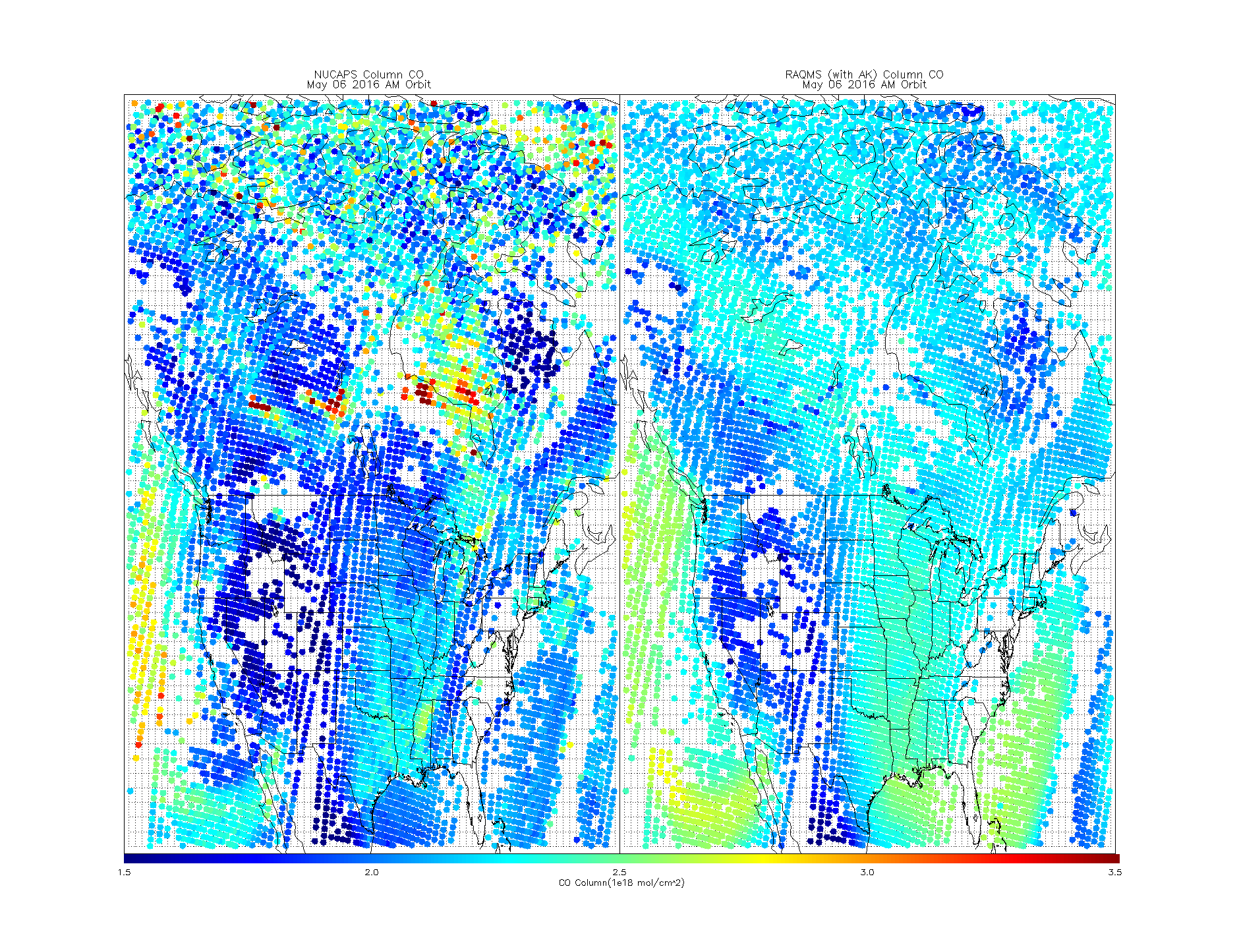
NUCAPS verses RAQMS (AK) Column CO May 06, 2016 AM Orbit

Slide 7
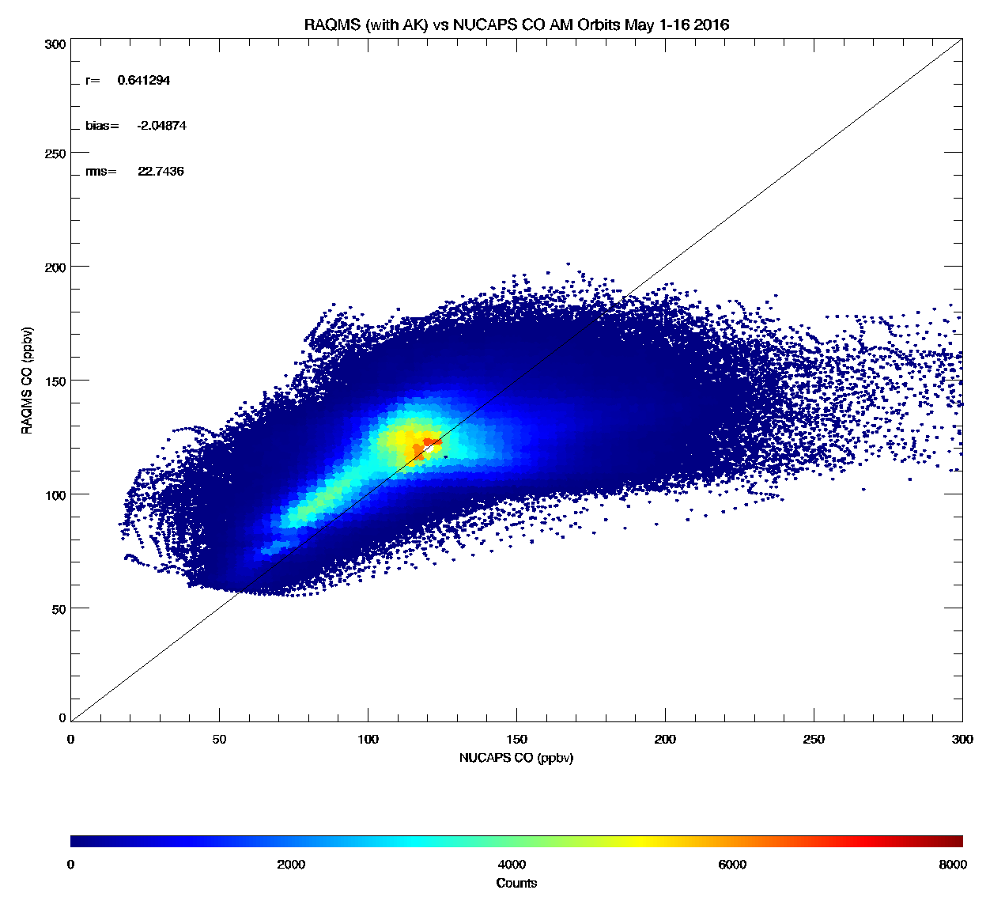
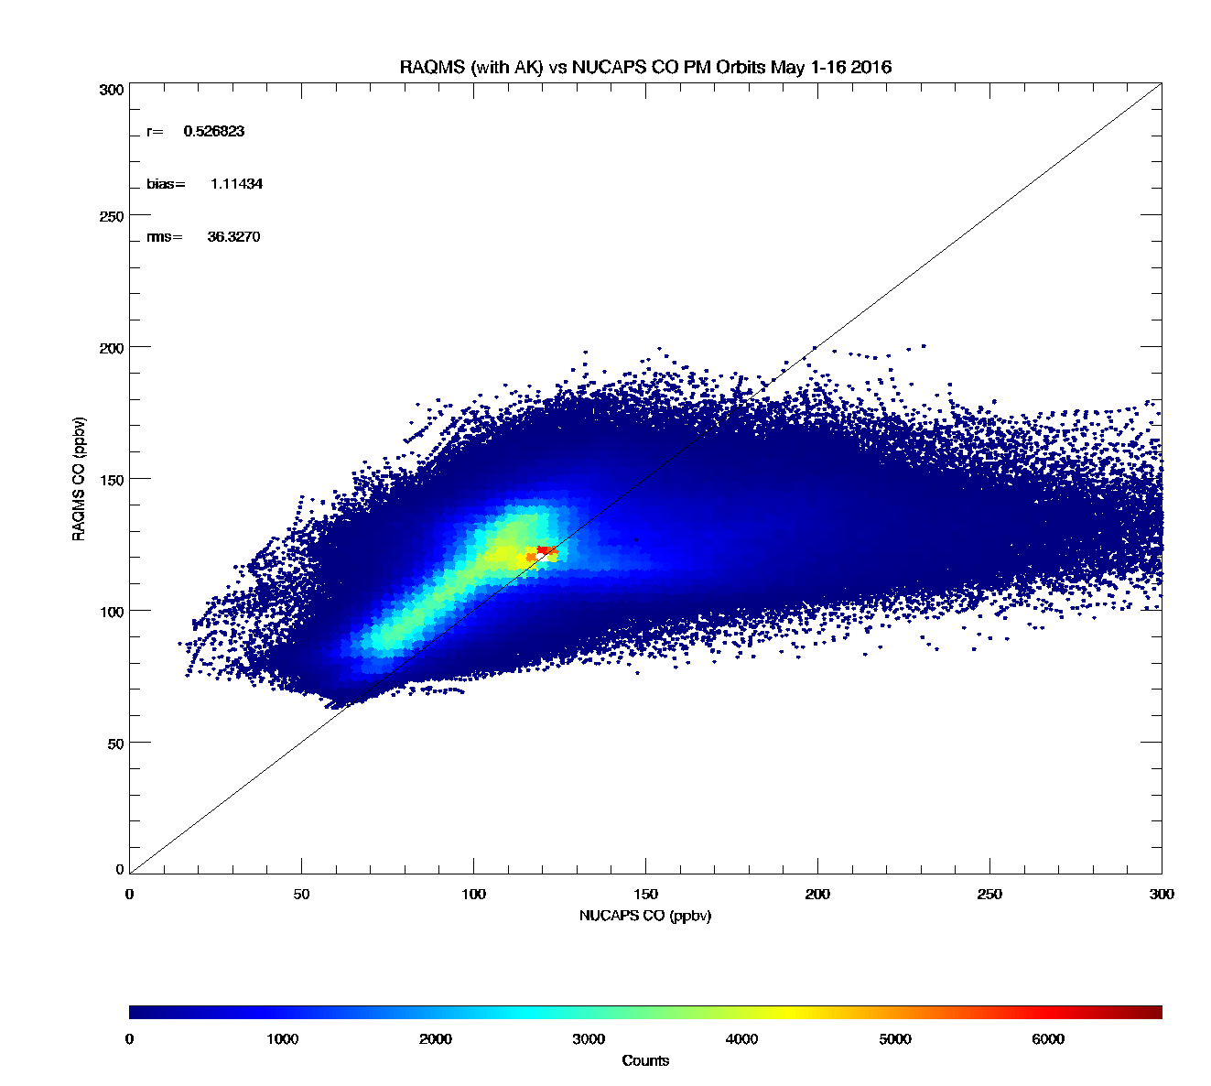
RAQMS vs Insitu SONGNEX 2015
(March 19-April 27, 2015)
r=0.681230
bias= 22.0542
(RAQMS-insitu)
rms= 28.9271
RAQMS CO (ppbv)
Insitu CO (ppbv)
RAQMS vs NUCAPS AM Orbit
(May 1-16, 2016)
RAQMS vs NUCAPS PM Orbit
(May 1-16, 2016)
r=0.641294
bias=2.04874
(RAQMS-NUCAPS)
rms=22.7430
r=0.526823
bias=-1.11434
(RAQMS-NUCAPS)
rms=36.3270
RAQMS CO (ppbv)
RAQMS CO (ppbv)
NUCAPS CO (ppbv)
NUCAPS CO (ppbv)

Slide 8
High Resolution Trajectory-Based Smoke Forecasts
Goal: Provide low latency, web-based, high resolution forecasts of smoke dispersion for use by NWS Incident Meteorologists (IMET) to support on-site decision support services for fire incident management teams.
Project utilizes VIIRS AOD and NUCAPS CO retrievals to initialize trajectory-based, high spatial resolution smoke dispersion forecasts.
Project is an extension of Infusion of satellite Data into Environmental Applications-International (IDEA-I) trajectory based aerosol forecast capabilities and will be tested and released within CSPP prior to transition to Operations at NESDIS.
JPSS Proving Ground and Risk Reduction Fire and Smoke Initiative

Slide 9
Canadian Wildfires
May 06, 2016
eIDEA (http://www.star.nesdis.noaa.gov/smcd/spb/aq/expr/expr2/)

Slide 10
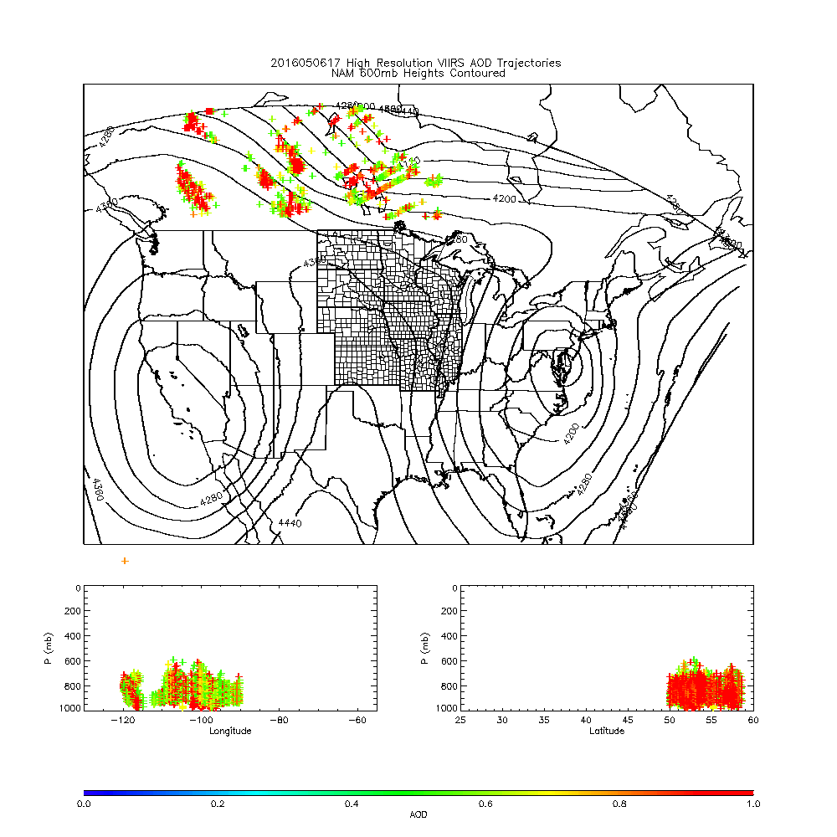
IDEA-I High resolution (NAM 4km) trajectory forecast
Fort McMurray Wildfire
May 06, 2016
IDEA-I high resolution trajectories initialized at each 6km VIIRS pixel (only AOD>0.5 initialized)
Upper panel shows NAM 600mb heights
Lower panels show longitude and latitude cross sections
IDEA-I high resolution trajectory forecast colored by initial AOD

Slide 11
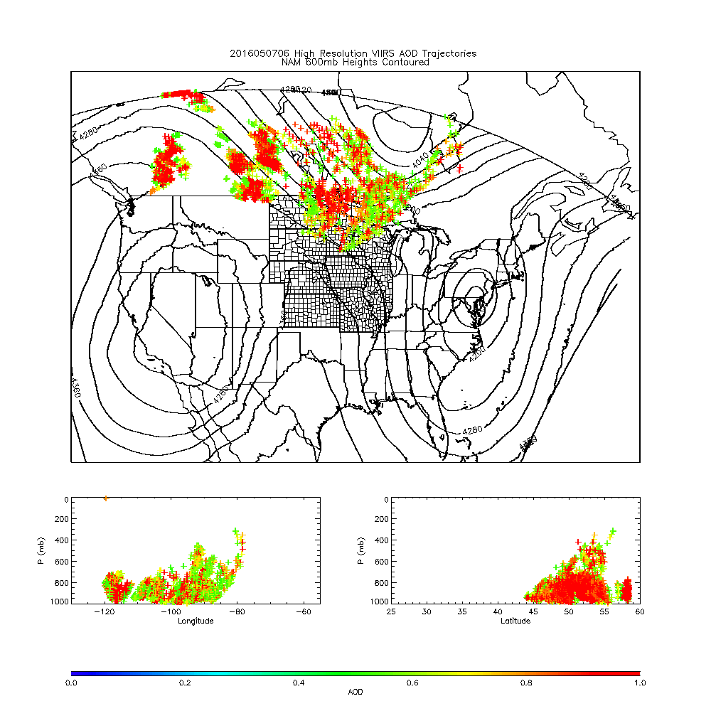
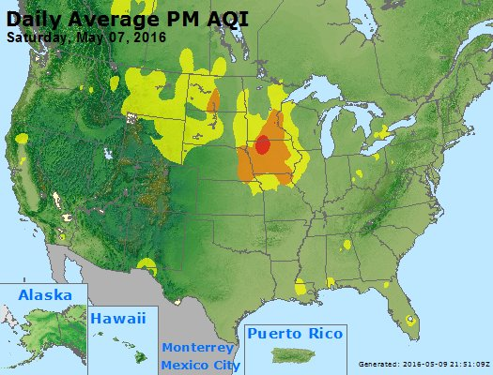
652 WWUS83 KMPX 070627 SPSMPX SPECIAL WEATHER STATEMENT NATIONAL WEATHER SERVICE TWIN CITIES/CHANHASSEN MN 127 AM CDT SAT MAY 7 2016 ...SMOKY CONDITIONS TO PERSIST THROUGH THE OVERNIGHT HOURS... WIDESPREAD SMOKE FROM BOTH THE LARGE CANADIAN WILDFIRES AND A SMALLER WILDFIRE NEAR LAKE HATTIE IN HUBBARD COUNTY MINNESOTA HAS BLOWN INTO CENTRAL MINNESOTA...PARTICULARLY WITHIN AND NEAR THE TWIN CITIES METROPOLITAN AREA...DUE TO STRONG WINDS FROM THE NORTHWEST. VISIBILITIES HAVE BEEN REDUCED TO BETWEEN 1 AND 3 MILES...AND AIR QUALITY HAS BEEN SIGNIFICANTLY IMPACTED.
From Andy Edman/NWS
https://www.airnow.gov/

Slide 12
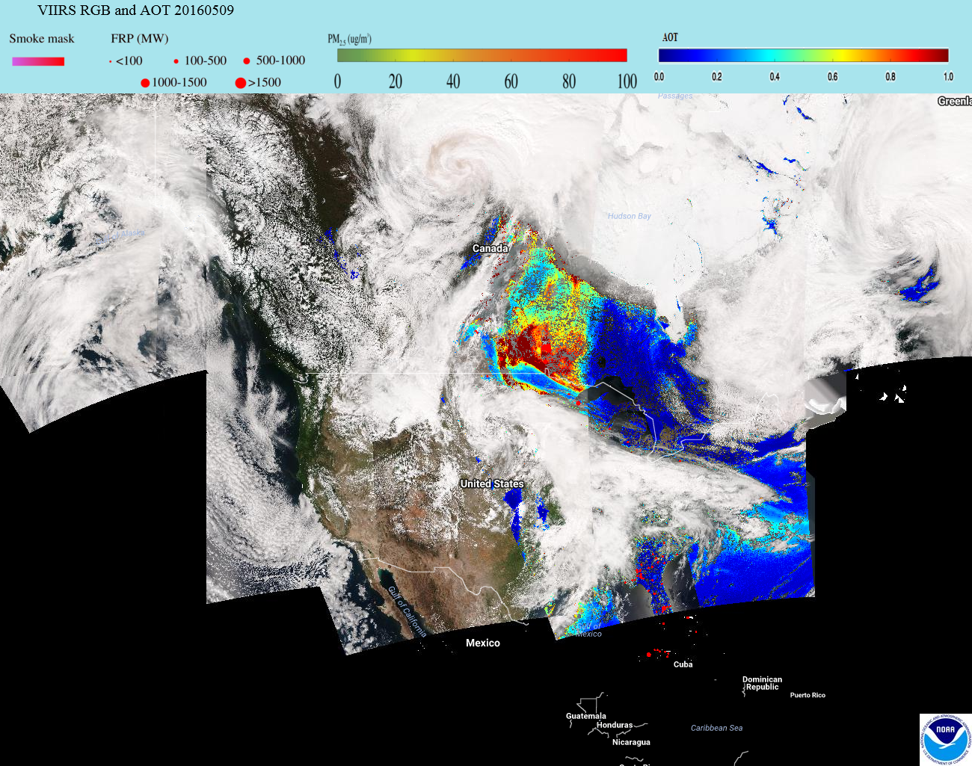
eIDEA (http://www.star.nesdis.noaa.gov/smcd/spb/aq/expr/expr2/)

Slide 13
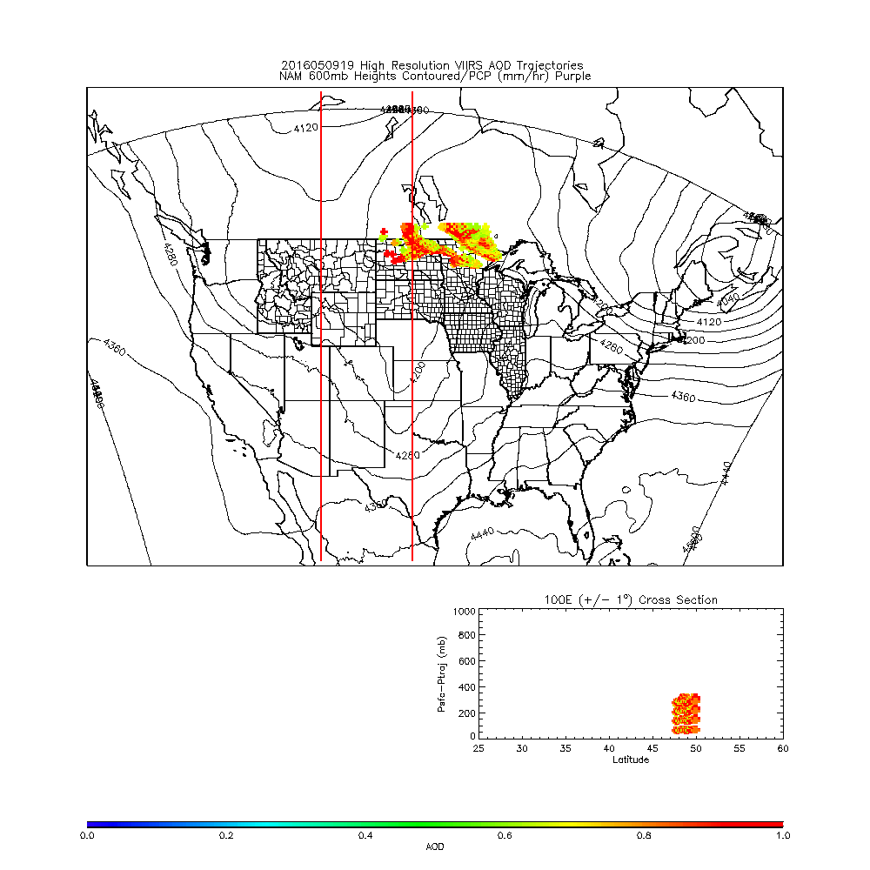

Slide 14
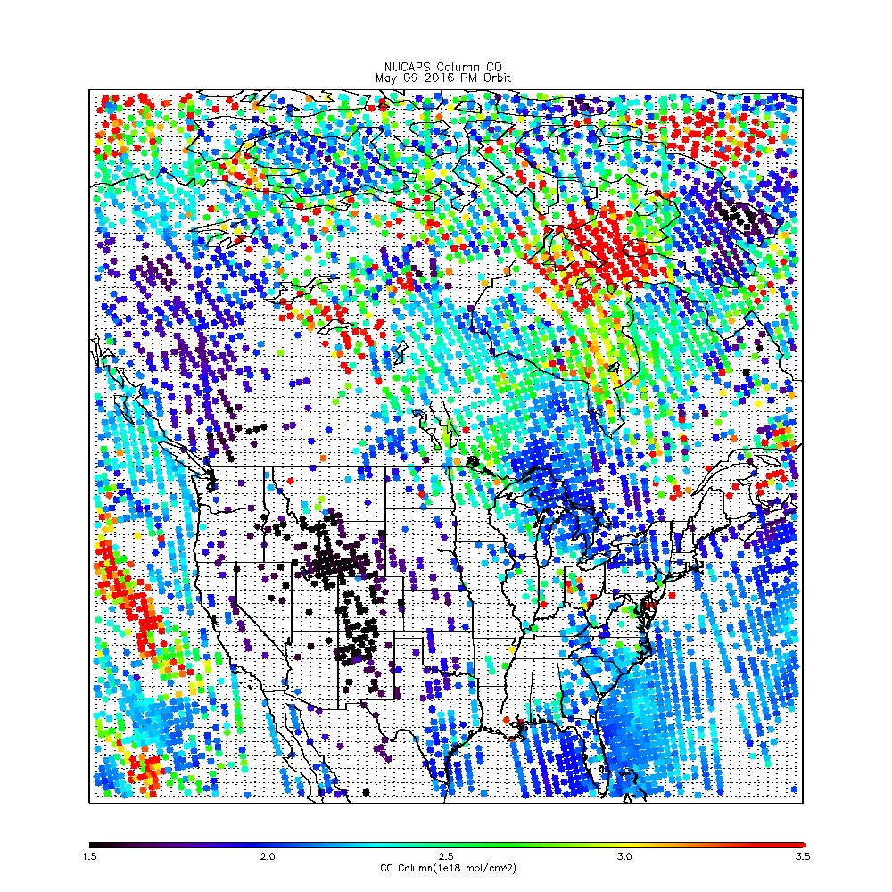

Slide 15
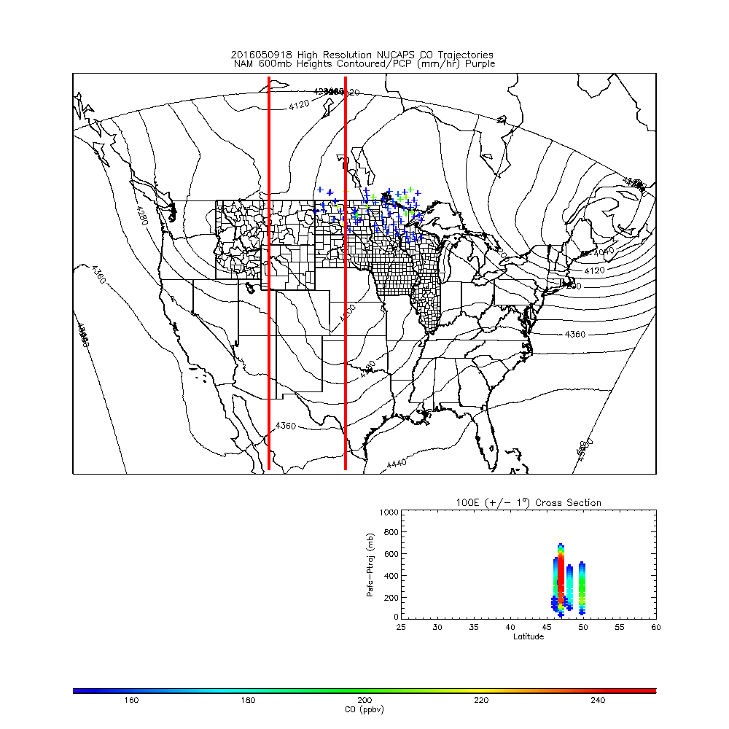

Slide 16
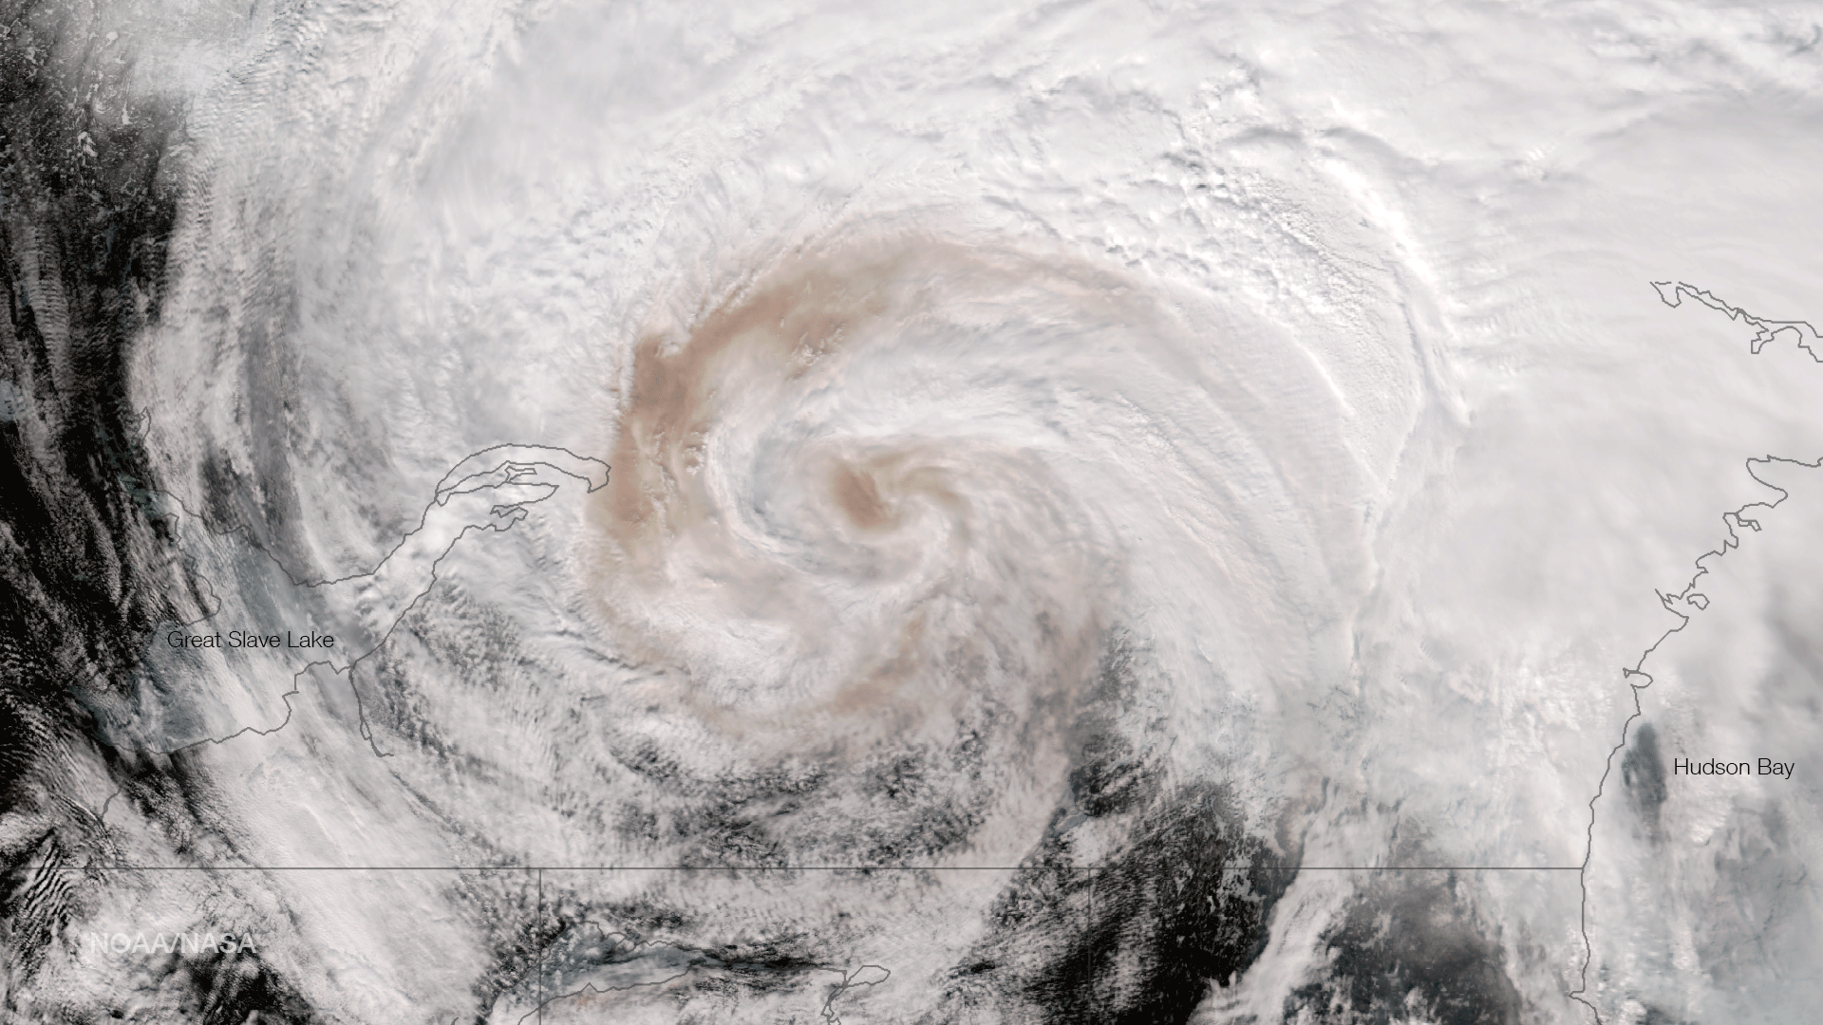
VIIRS True Color Image May 9, 2016 20:15 UTC
Smoke from Fort McMurray fire imbedded with low pressure system over northern Canada
Questions?
(From NOAA Environmental Visualization Laboratory)

