Slide 1
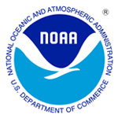
JPSS Fire and Smoke Initiative Blended Fire & Smoke Product Demonstration Workgroup RealEarth Live Demo/Overview
Brad Pierce (NESDIS/STAR) Russ Dengel (UW-Madison/SSEC)
Blended Fire & Smoke Product Demonstration Workgroup December 3, 2015

Slide 2
Background
Goal:Provide low latency, web-based, high resolution forecasts of smoke dispersion for use by NWS Incident Meteorologists (IMET) to support on-site decision support services for fire incident management teams.
Project utilizes VIIRS Aerosol Optical Depth (AOD) and CrIS/ATMS NUCAPS carbon monoxide (CO) retrievals to initialize trajectory-based, high spatial resolution North American smoke dispersion forecasts.
Currently developing capabilities to visualize VIIRS and NUCAPS blended smoke products within RealEarth (http://wms.ssec.wisc.edu/) for interactive web-based visualization
RealEarth as real-time visualization system and not an archive system. However, we have loaded a “JPSS - Fire and Smoke” case study with products for the period from August 19-25, 2015 for this demonstration

Slide 3
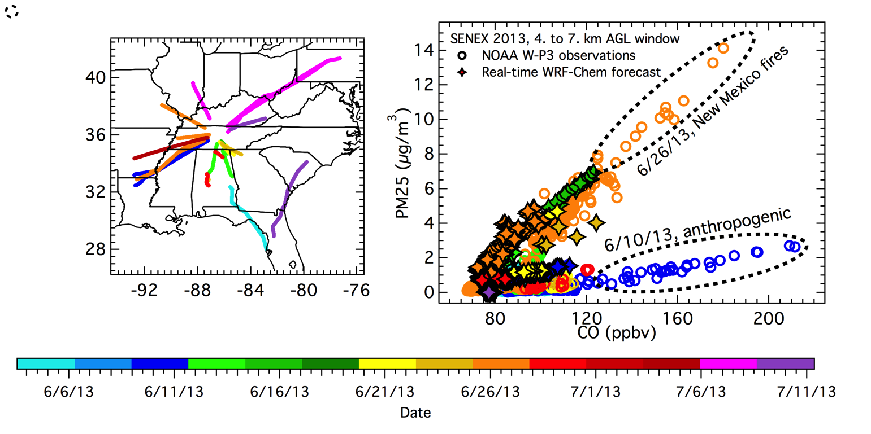
Smoke particulates (PM2.5) and carbon monoxide (CO) are both combustion products and therefore highly correlated
(Left panel) NOAA P-3 aircraft flight paths at altitudes greater than 4 km above ground level (AGL) over the southeastern US during the SENEX field campaign, June-July, 2013.
(Right panel) A scatter plot of particulate matter (PM_{2.5}) mass concentrations versus carbon monoxide (CO) mixing ratios measured by the aircraft and simulated by the real time WRF-Chem simulations.
The concentration/mixing ratio data are colored according to the different flight days shown on the left panel. One-second observations are averaged over model grid-cells.
Figure provided by Greg Frost (NOAA/ESRL)

Slide 4
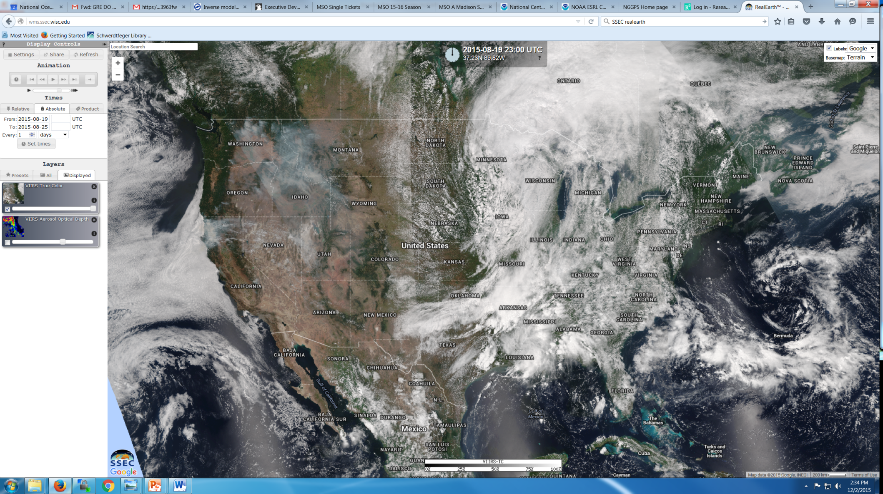
VIIRS True Color Image Example in RealEarth: August 19, 2015
Go to “All” tab under “Layers” and select the “JPSS – Fire and Smoke” (this will show the full set of products currently available for the case study)
Select “VIIRS True Color” and slide it onto the RealEarth map
Select either “Absolute” or “Product” tab under “Times”, select time window, and the click “Set times”

Slide 5
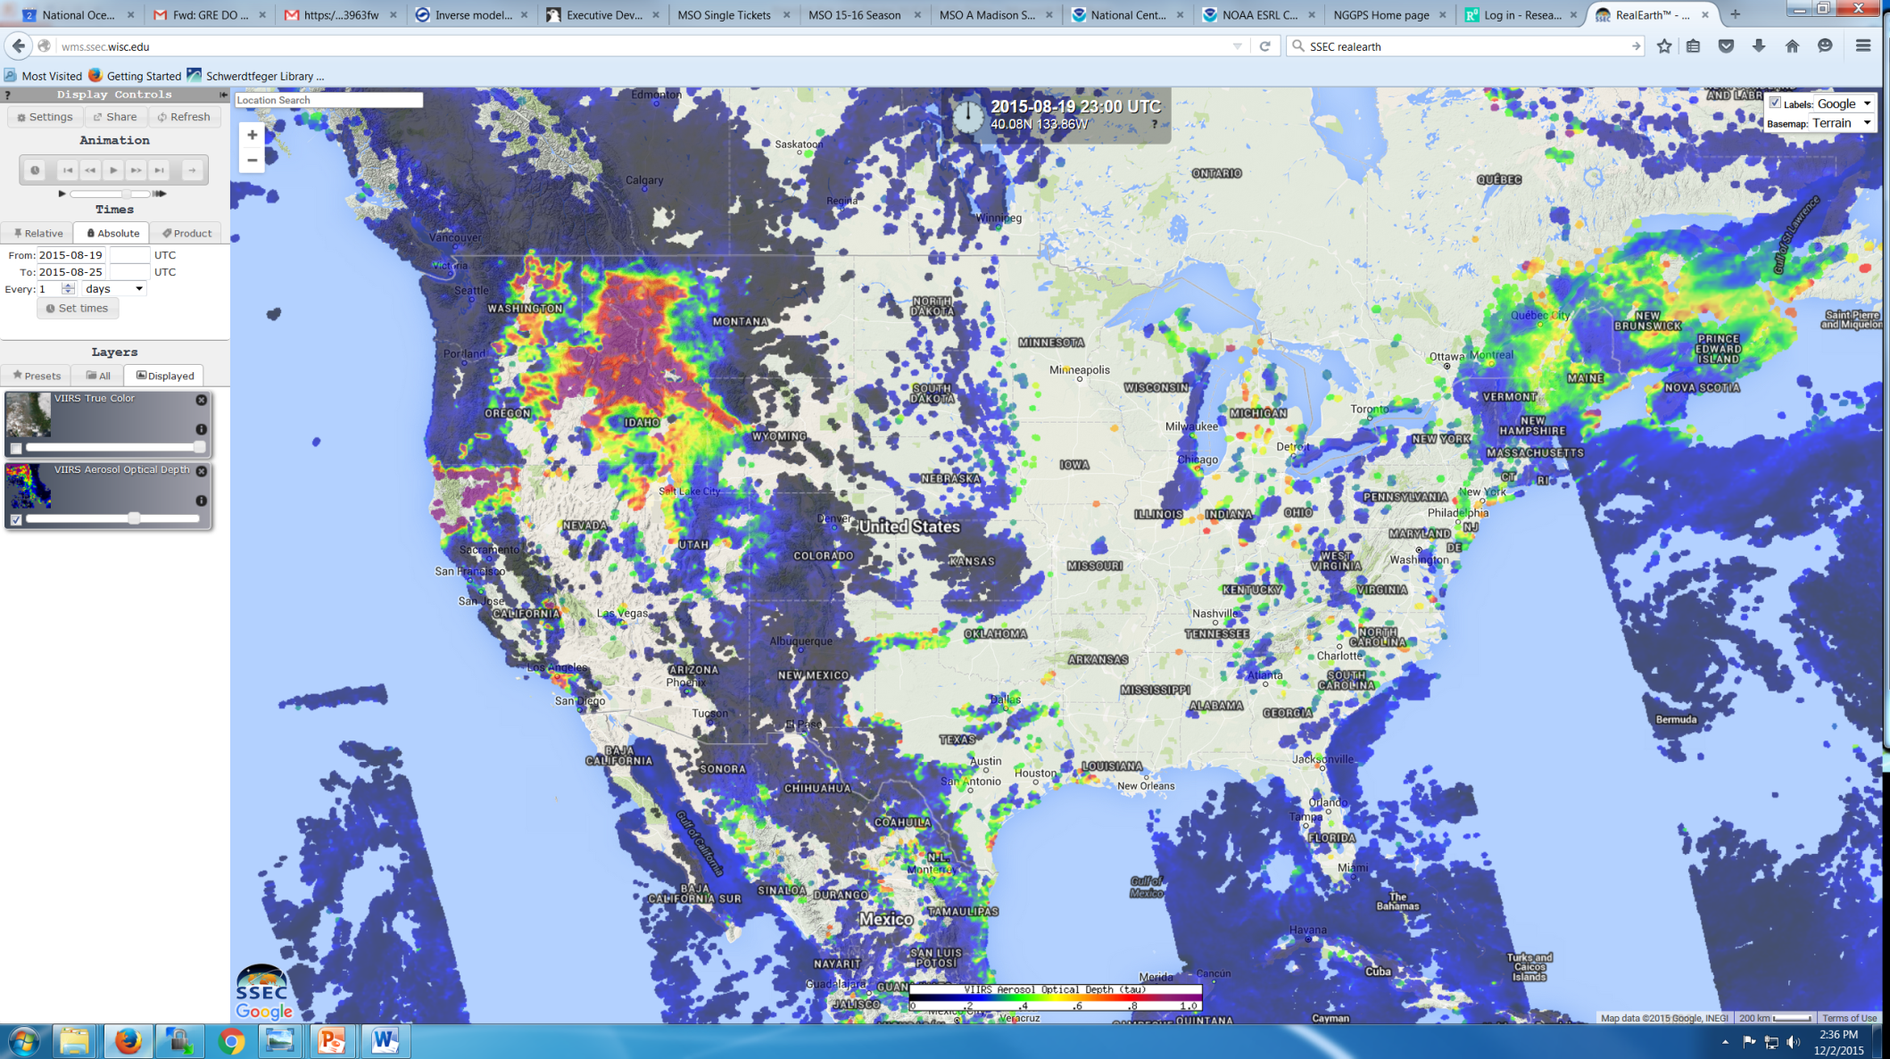
VIIRS AOD Example in RealEarth: August 19, 2015
Select “VIIRS Aerosol Optical Depth” and slide it onto the RealEarth map
Toggle off the VIIRS True Color by clicking the box in the lower left side of the True Color panel
Toggle on the VIIRS Aerosol Optical Depth by clicking the box in the lower left side of the AOD panel

Slide 6
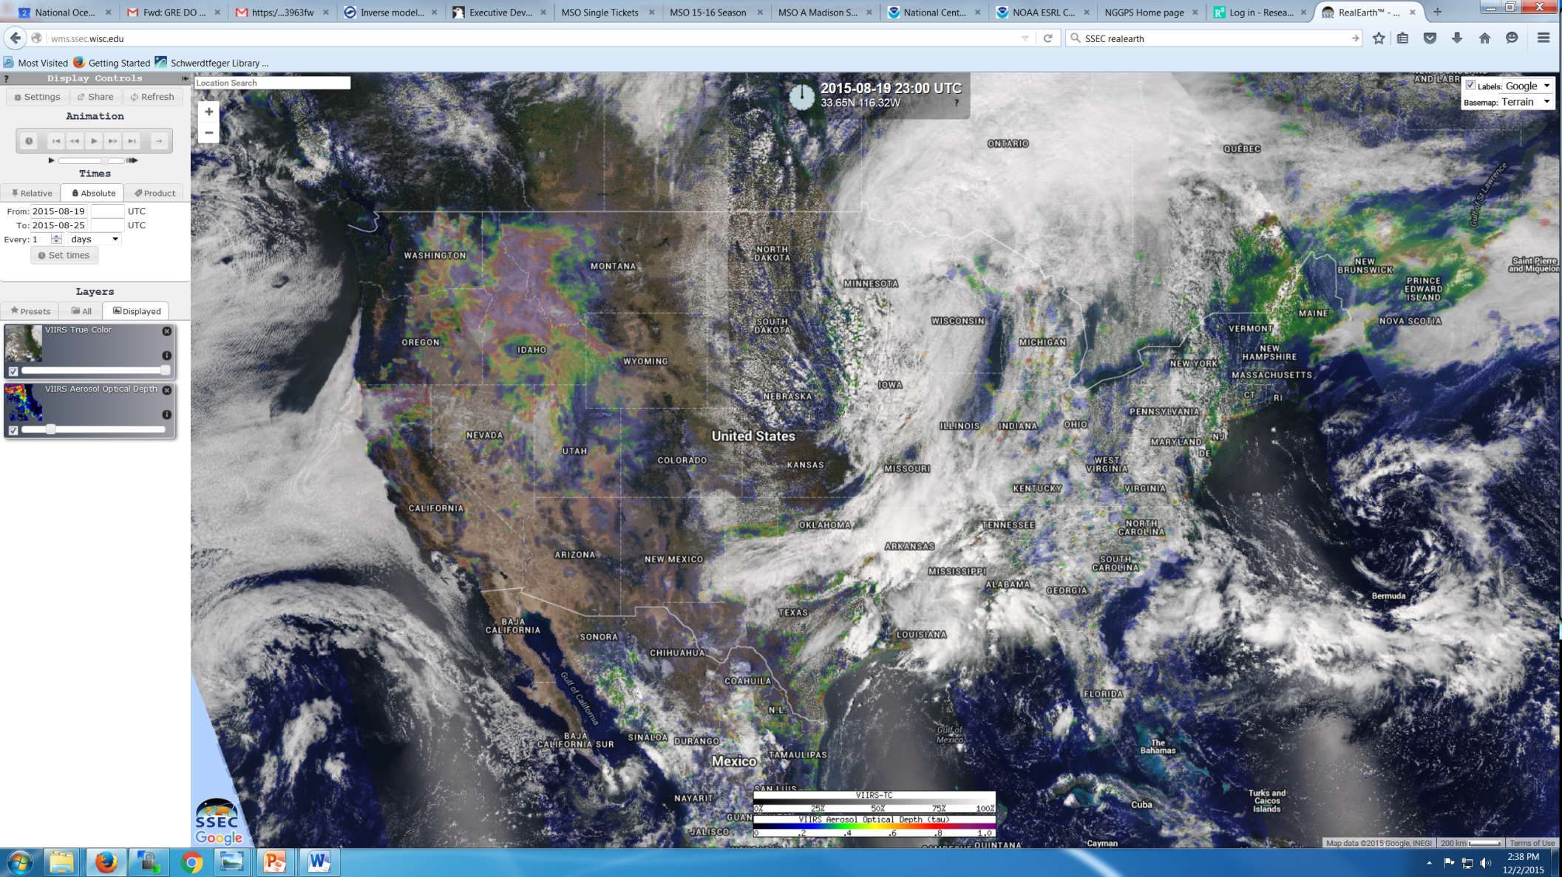
VIIRS True Color + Transparent AOD Example in RealEarth: August 19, 2015
Toggle on the VIIRS True Color by clicking the box in the lower left side of the True Color panel
Set the transparency of the VIIRS Aerosol Optical Depth by sliding the bar on the bottom of the of the AOD panel

Slide 7
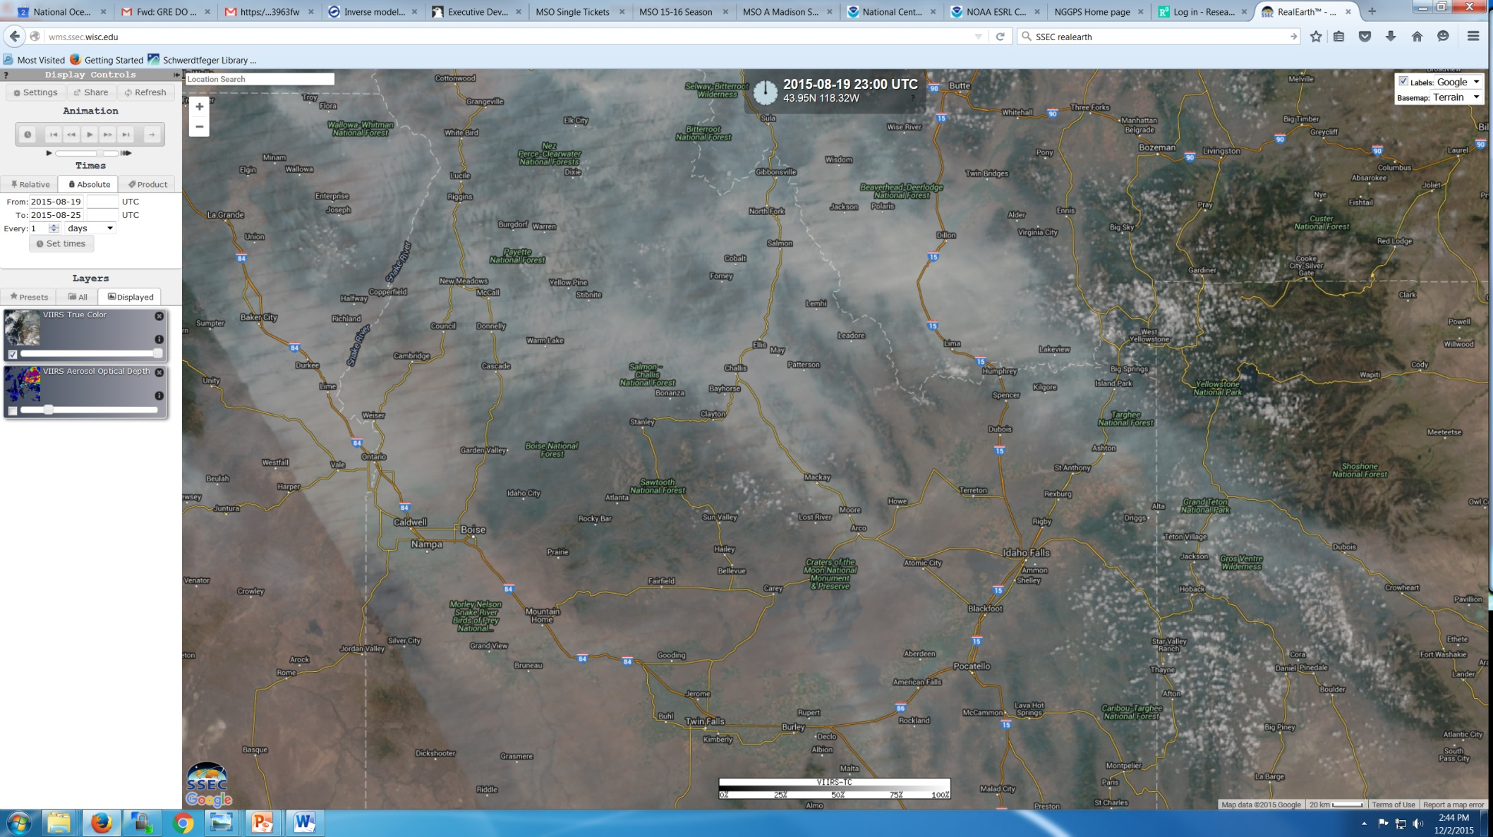
VIIRS True Color Zoom Example in RealEarth: August 19, 2015
Hold down the “Shift” Key and click and drag to select a box for zooming in
Note the dense smoke within the valleys to the North of Craters of the Moon National Monument

Slide 8
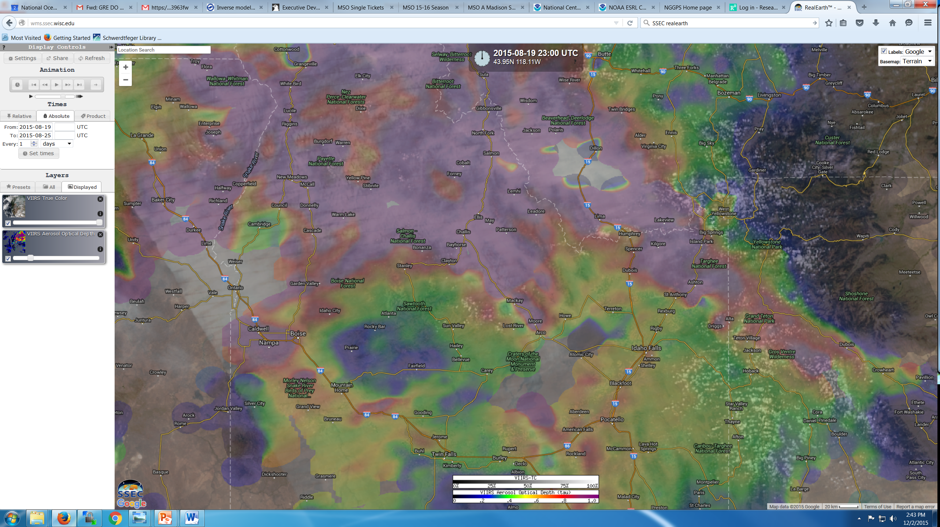
VIIRS True Color + Transparent AOD Zoom Example in RealEarth
Toggle “on” the transparent VIIRS AOD

Slide 9
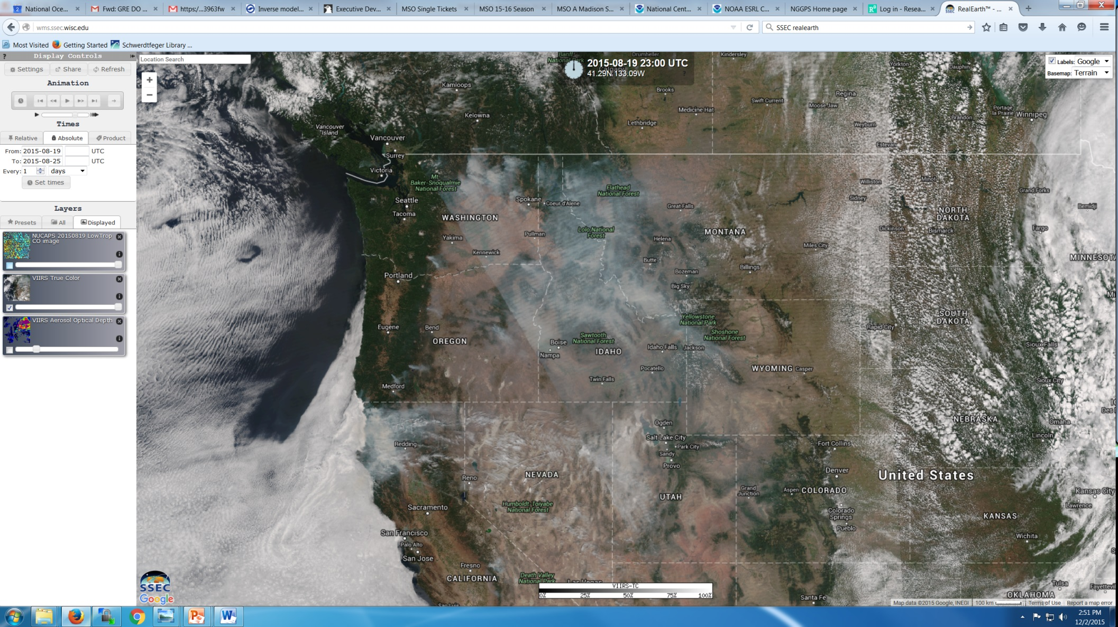
VIIRS True Color Day Time Orbit Example in RealEarth: August 19, 2015
Returning to Pacific Northwest view to illustrate NUCAPS CO capabilities
Currently focusing on lower tropospheric (>700mb) and mid tropospheric (200-700mb) average CO mixing ratios to characterize altitude of the smoke plume

Slide 10
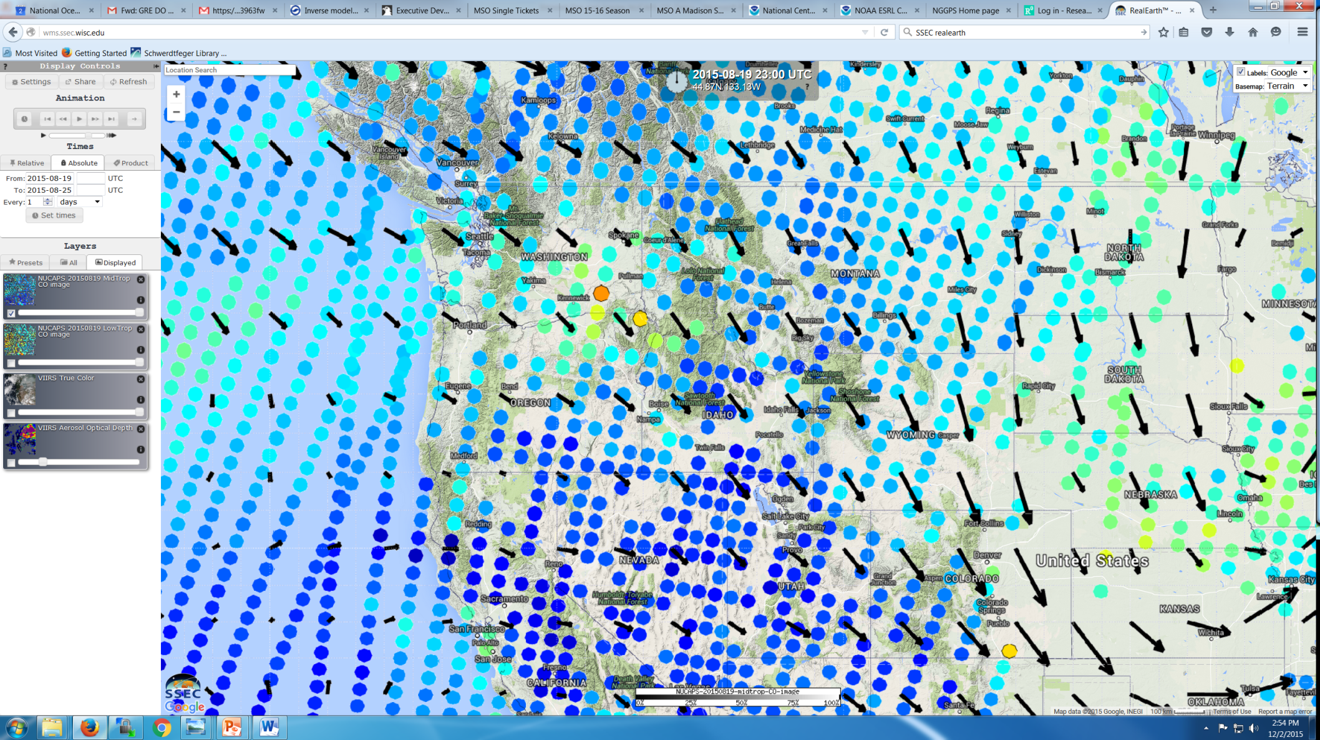
NUCAPS Mid Trop (200-700mb) CO Night time orbit Example in RealEarth: August 19, 2015
Select “NUCAPS 20150819 MidTrop CO image” and slide it onto the RealEarth map
Select “NUCAPS 20150819 LowTrop CO image” and slide it onto the RealEarth map
Toggle off all layers except MidTrop CO image”
NUCAPS CO retrieval provides a vertical profile at a coarser horizontal resolution then VIIRS imagery
Note generally low mid tropospheric CO mixing ratios (blue ~50ppbv, green ~100ppbv, red ~200ppbv)

Slide 11
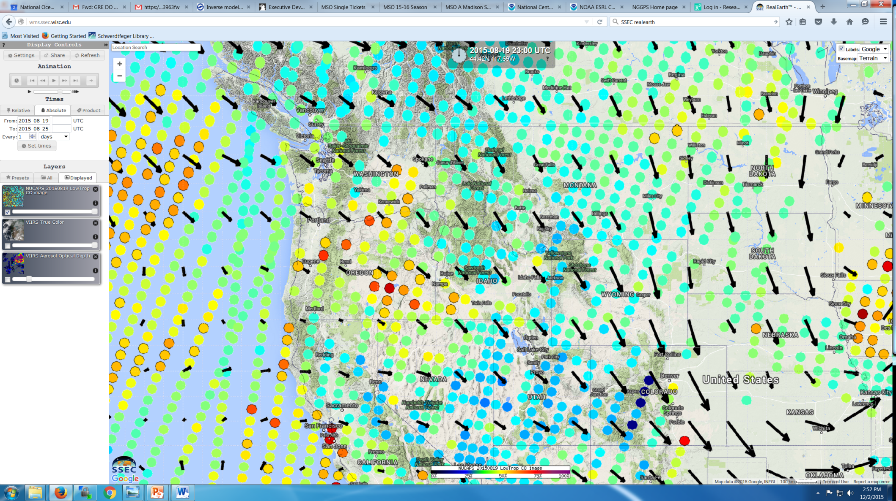
NUCAPS Lower Trop (>700mb) CO Night time orbit Example in RealEarth
Remove “NUCAPS 20150819 MidTrop CO image” by clicking on x within black circle
Select “NUCAPS 20150819 LowTrop CO image” and slide it onto the RealEarth map
Toggle off all layers except LowTrop CO image”
Note significantly higher lower tropospheric CO mixing ratios (blue ~50ppbv, green ~100ppbv, red ~200ppbv)

Slide 12
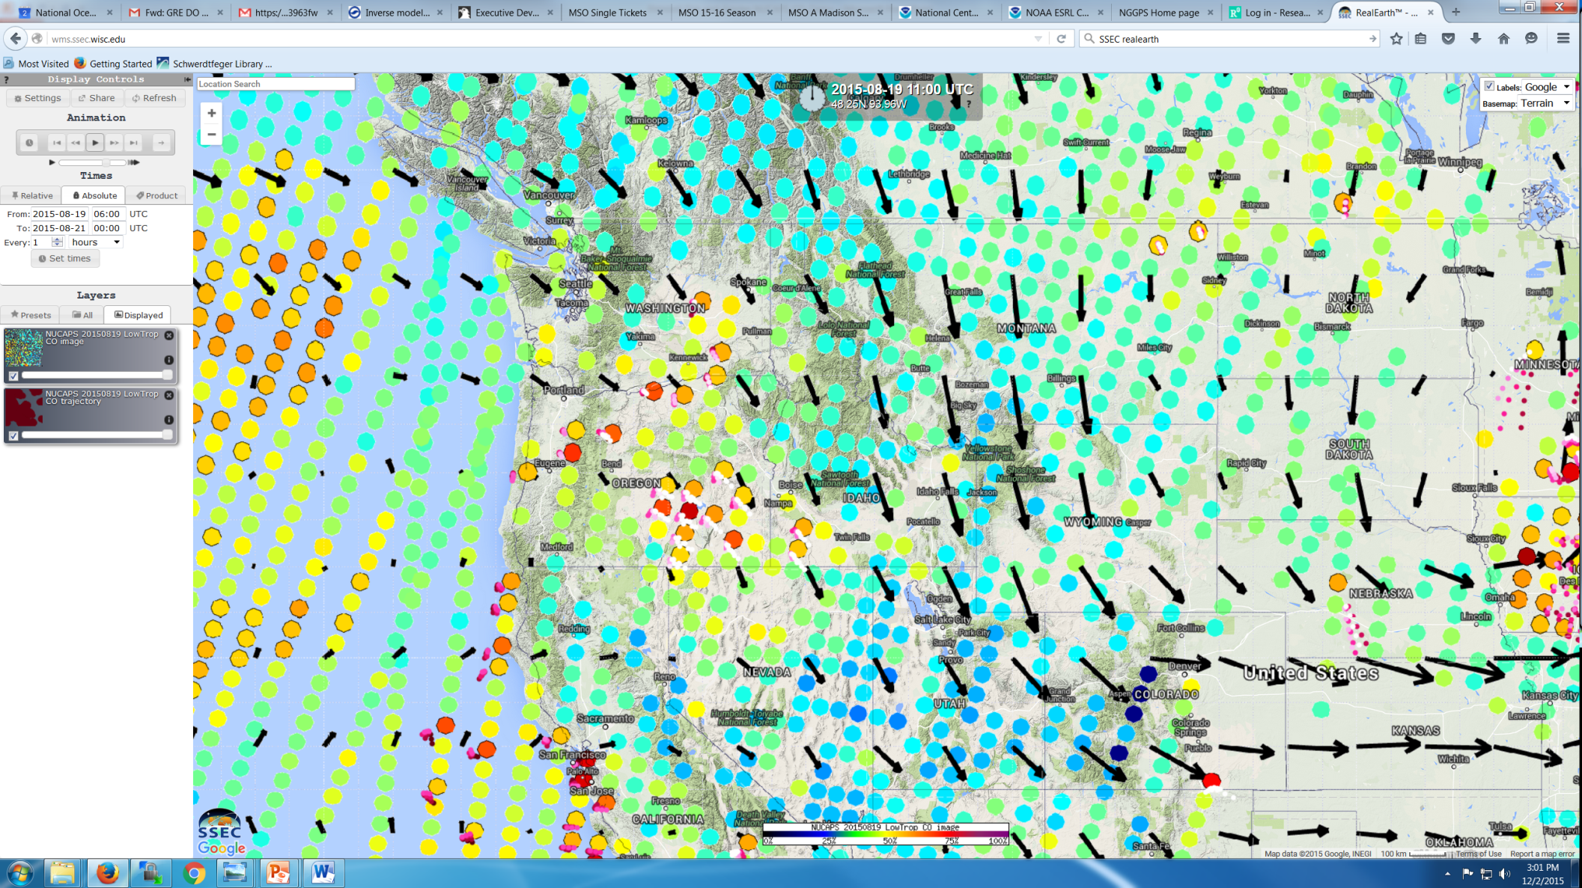
NUCAPS Lower Trop (>700mb) CO Night time orbit with Trajectories Example in RealEarth
Select “NUCAPS 20150819 LowTrop CO trajectory” and slide it onto the RealEarth map
Select 48hr time window and turn on “Animation”
Trajectories initialized where lower tropospheric CO is greater than 150ppbv. Color of trajectory denotes the altitude of the trajectory (pink to red means below 700mb, white means above 700mb)

Slide 13
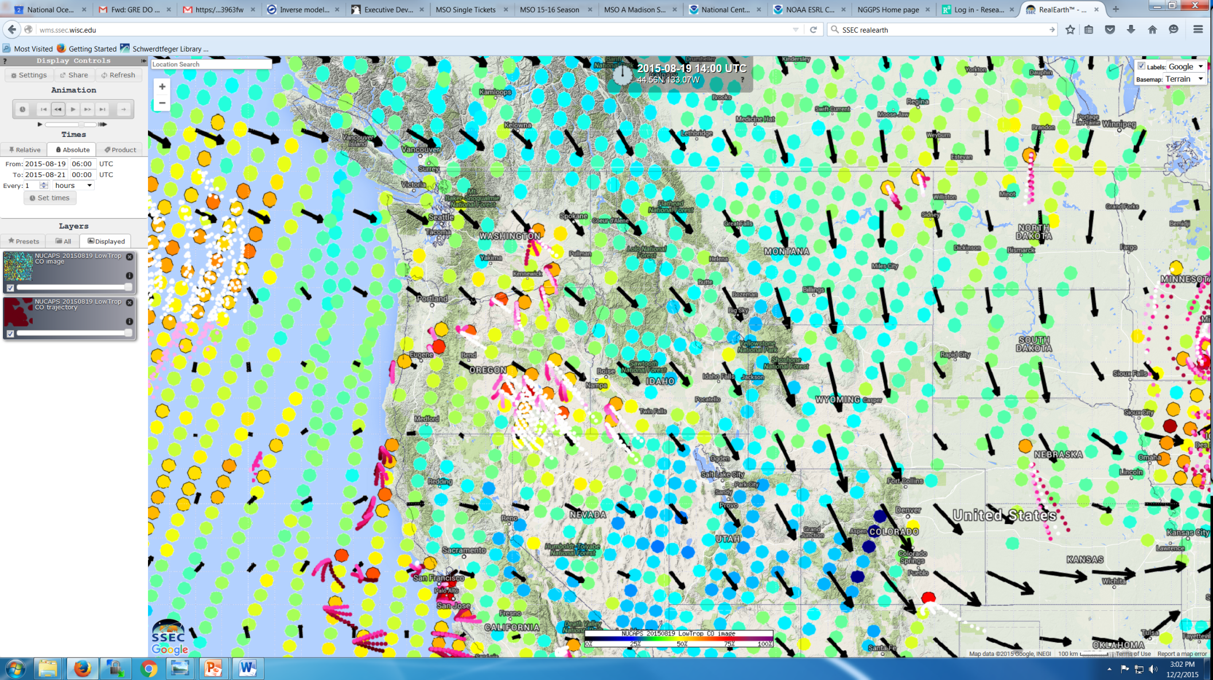
NUCAPS Lower Trop (>700mb) Night time orbit with Trajectories Example in RealEarth
Select “NUCAPS 20150819 LowTrop CO trajectory” and slide it onto the RealEarth map
Select 48hr time window and turn on “Animation”
Trajectories initialized where lower tropospheric CO is greater than 150ppbv. Color of trajectory denotes the altitude of the trajectory (pink to red means below 700mb, white means above 700mb)

Slide 14
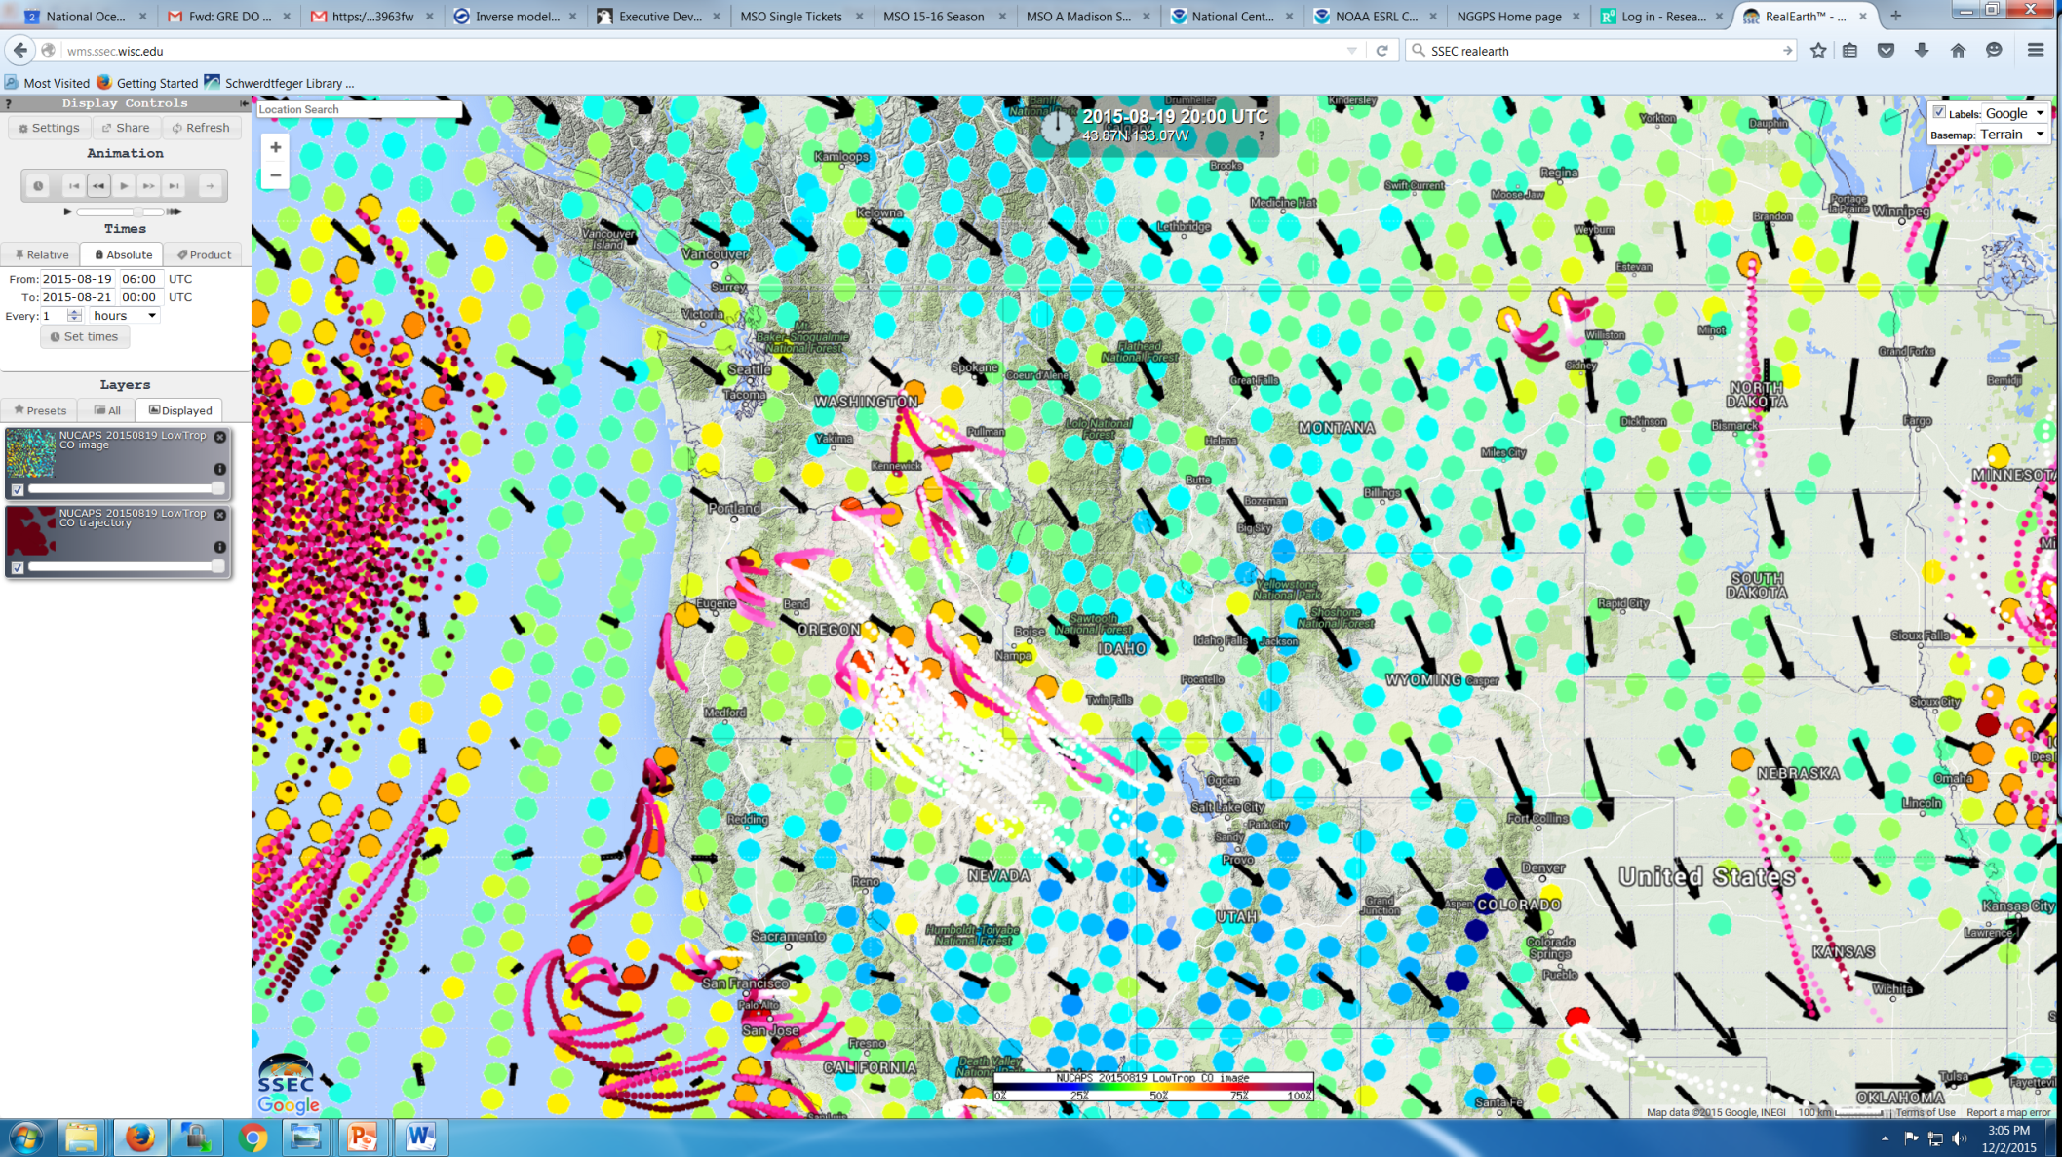
NUCAPS Lower Trop (>700mb) Night time orbit with Trajectories Example in RealEarth
Select “NUCAPS 20150819 LowTrop CO trajectory” and slide it onto the RealEarth map
Select 48hr time window and turn on “Animation”
Trajectories initialized where lower tropospheric CO is greater than 150ppbv. Color of trajectory denotes the altitude of the trajectory (pink to red means below 700mb, white means above 700mb)

Slide 15
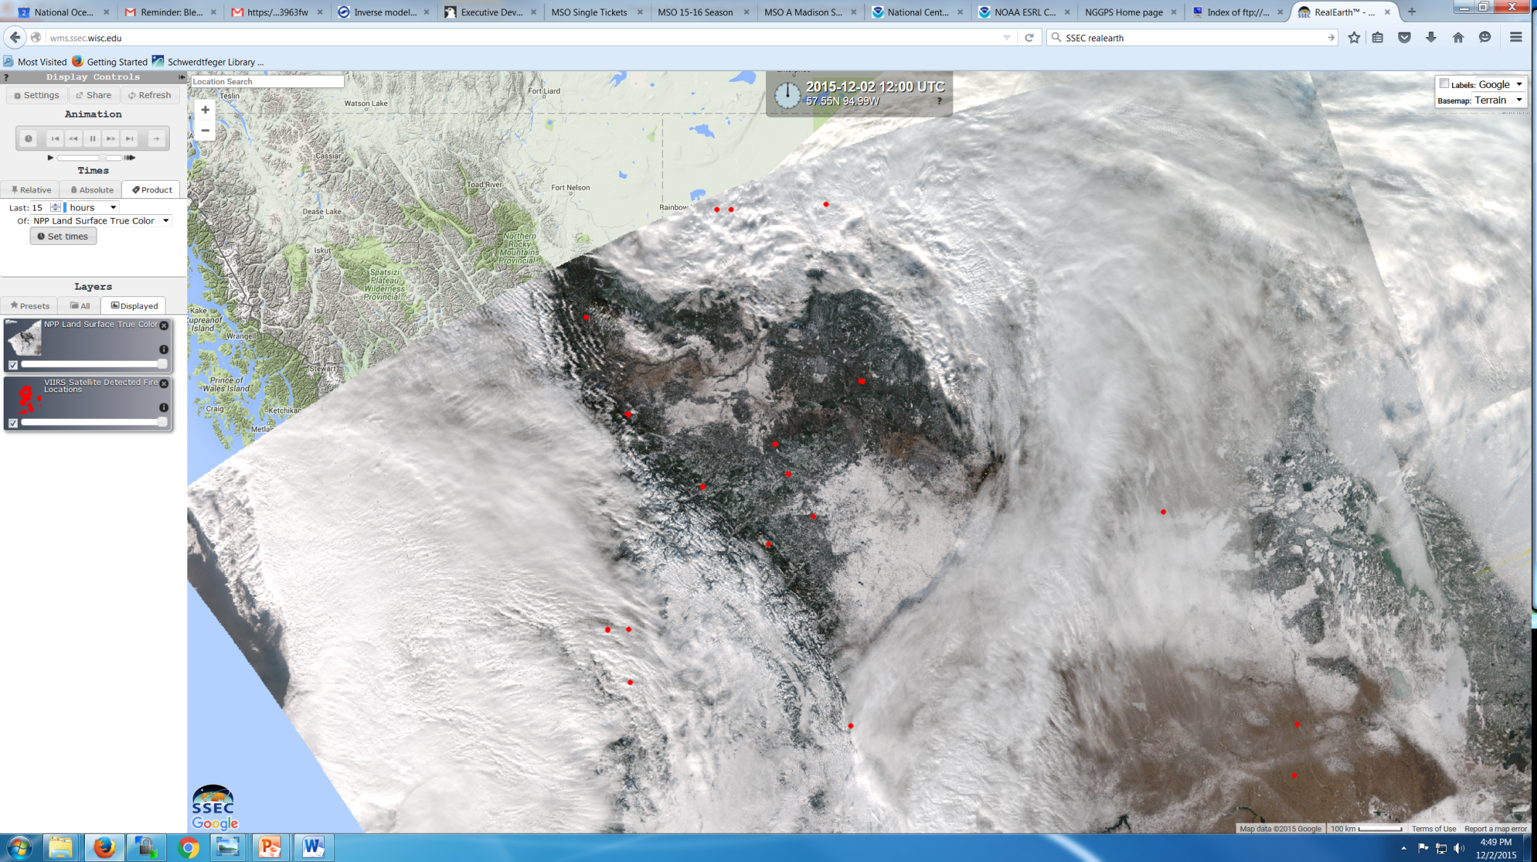
Realtime VIIRS True Color + VIIRS Fire Detection Example in RealEarth: December 02, 2015
Go to “All” tab under “Layers” and select the “VIIRS” (this will show the full set of VIIRS products currently available for realtime applications)
Select “NPP Land Surface True Color” and slide it onto the RealEarth map
Select “VIIRS Satellite Detected Fire Locations” and slide it onto the RealEarth map
Note that the VIIRS fire detection product is in the real-time application but currently not in the case study period

