Slide 1
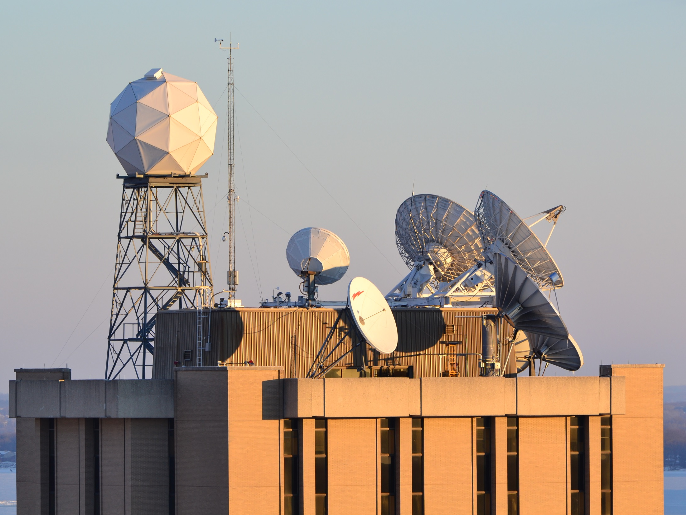
UW-Madison SSEC
Virtual Hail & Fairwell October 22, 2020
New Science Ideas
and
Shop Talk Breakout

Slide 2
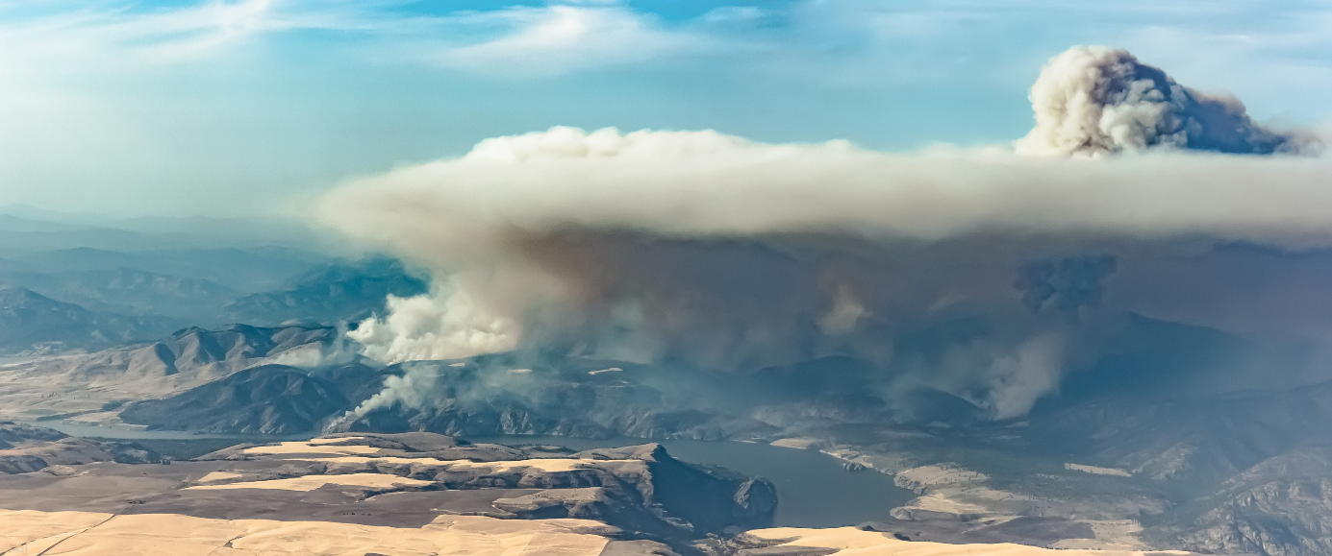



https://www.esrl.noaa.gov/csl/projects/firex-aq/
Photo: Sam Hall

Slide 3
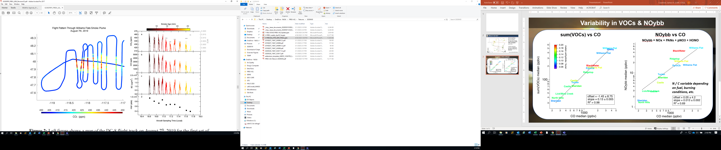
Connecting satellite and in situ observations

Slide 4
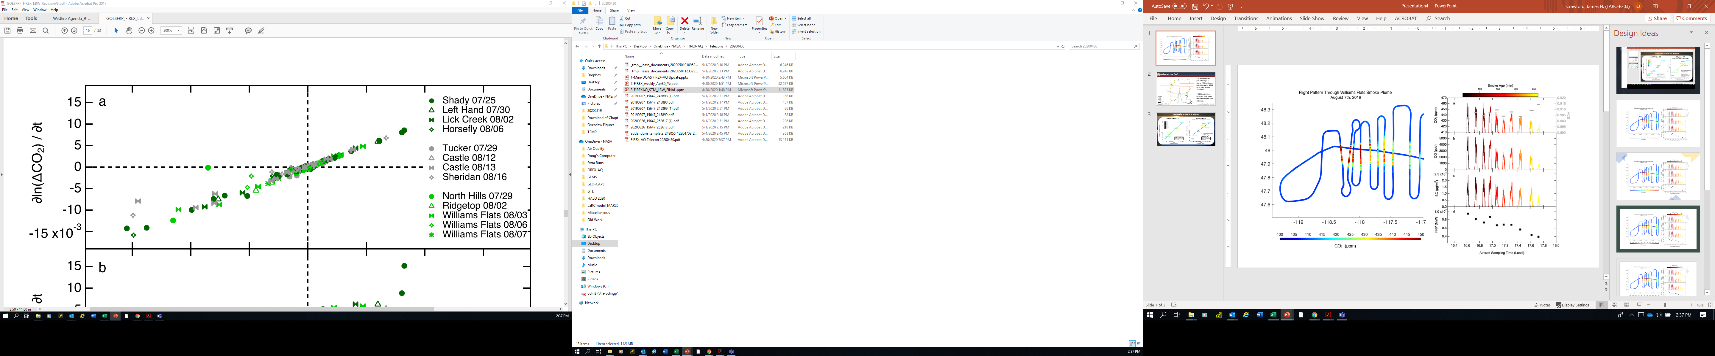
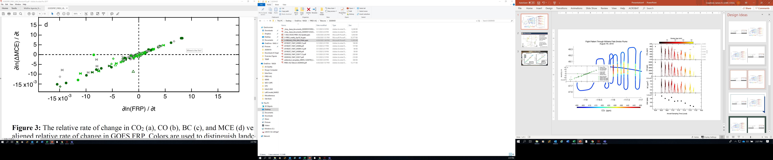
Connecting satellite and in situ observations
Wiggins et al, 2020, High Temporal Resolution Satellite Observations of Fire Radiative Power Reveal Link Between Fire Behavior and Aerosol and Gas Emissions (In review, GRL)

Slide 5
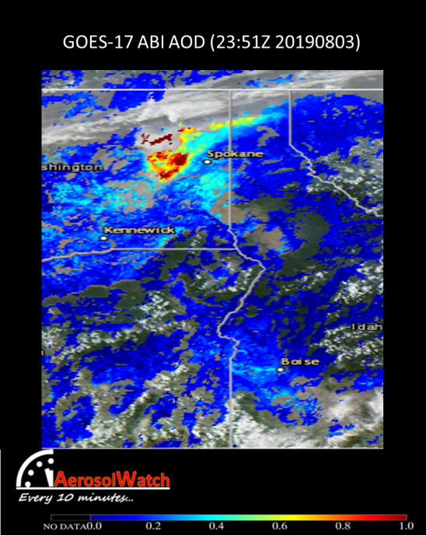
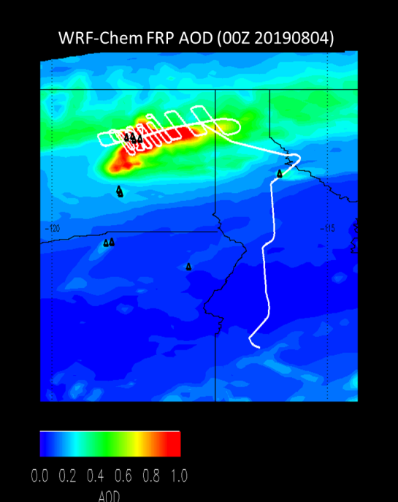
NASA/NOAA FIREX-AQ field campaign
GOES FRP based wildfire emissions
Williams Flats Fire
Use of of 5-minute ABI FRP for wildfire emissions and injection heights following approach VIIRS in HRRR-Smoke
High resolution (8km) WRF-Chem FRP based aerosol AOD forecasts are in good agreement with ABI
WRF-Chem Aditya Kumar (UW-Madison)

Slide 6
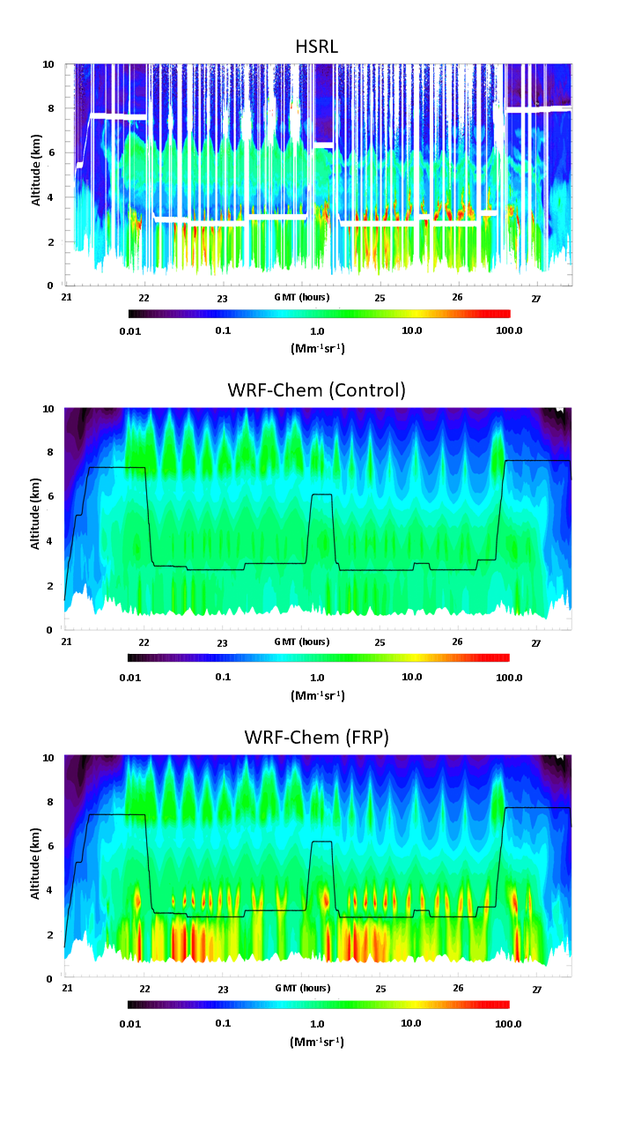
NASA/NOAA FIREX-AQ field campaign
GOES FRP based wildfire emissions
HSRL John Hair (NASA LaRC)
Use of of 5-minute ABI FRP for wildfire emissions and injection heights following approach VIIRS in HRRR-Smoke
Significant improvement in predicted aerosol backscatter and injection heights
WRF-Chem Aditya Kumar (UW-Madison)

Slide 7
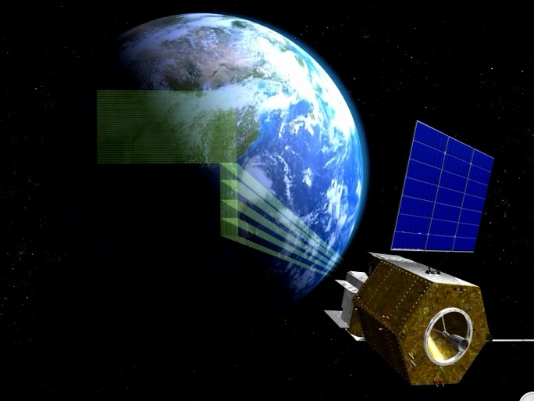
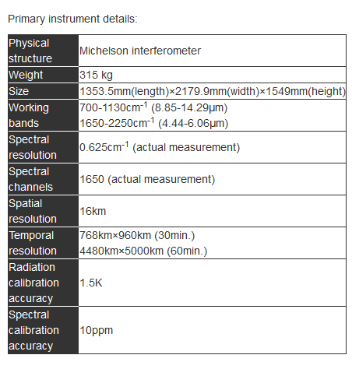



Geostationary Interferometric Infrared Sounder (GIIRS)
National Satellite Meteorological Center, CMA

Slide 8
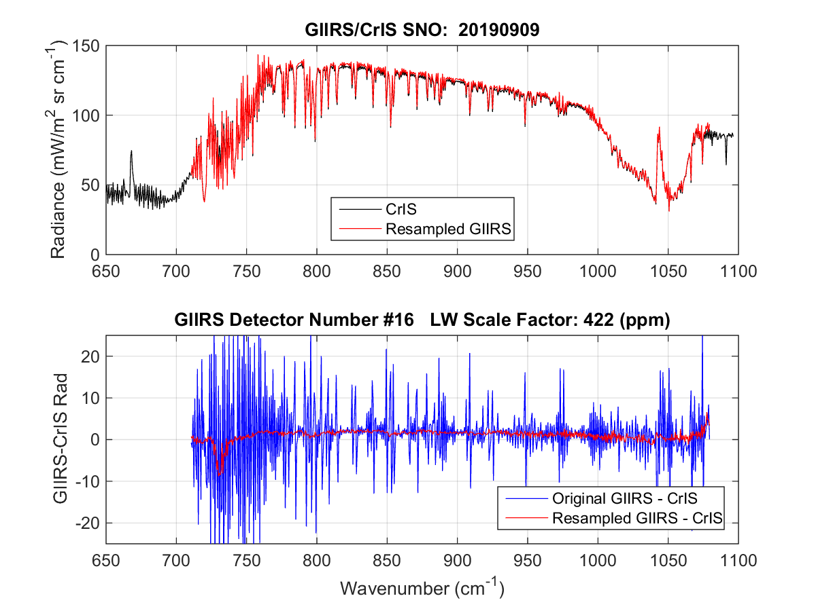
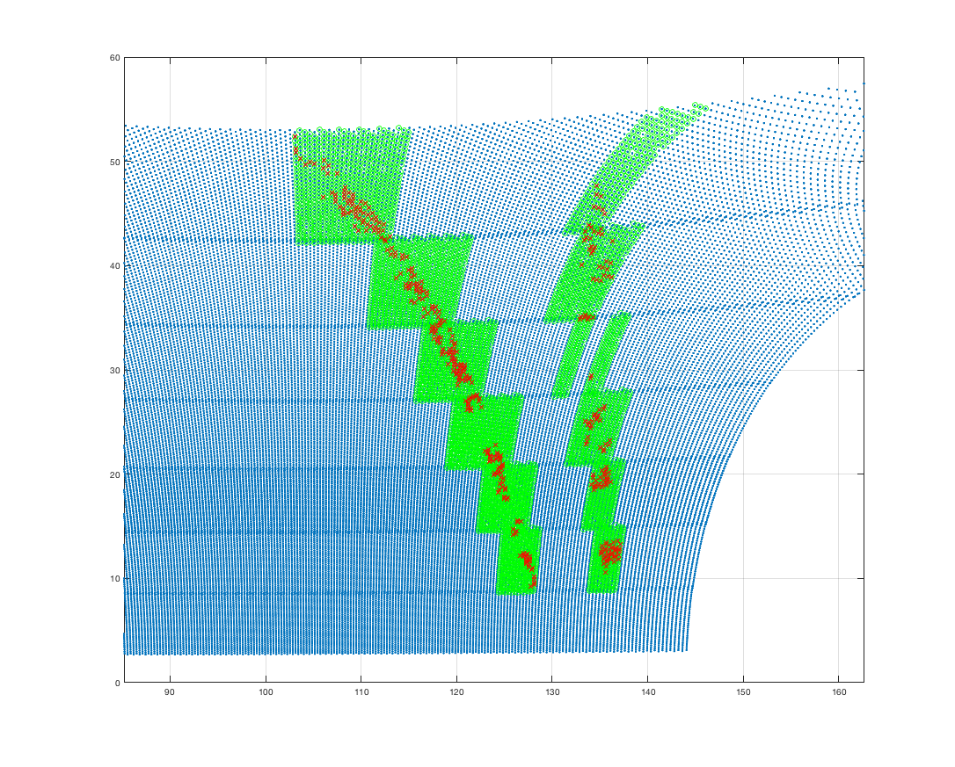
Highlights of SSEC GIIRS project
Near Real Time monitoring of GIIRS at JCSDA
GIIRS in JEDI
http://nrt.jcsda.org/hofx/giirs-fy4a.html (Since September 1 2020)
The GIIRS data is reprocessed at SSEC on the S4 Supercomputer
Routine Quality Monitoring at SSEC
GIIRS and NOAA-20 CrIS
Time/Space Coincident
Matchups
Daily Matchup datasets
CO2
Temperature
Sounding
Band
Frequency
Shift
Corrected
Red Dots indicate Matchups between GIIRS (blue dots)
and CrIS. Green indicates GIIRS granules used.
Bob Knutson (SSEC), Wei Han (JCSDA Visiting Scientist), and others…

Slide 9
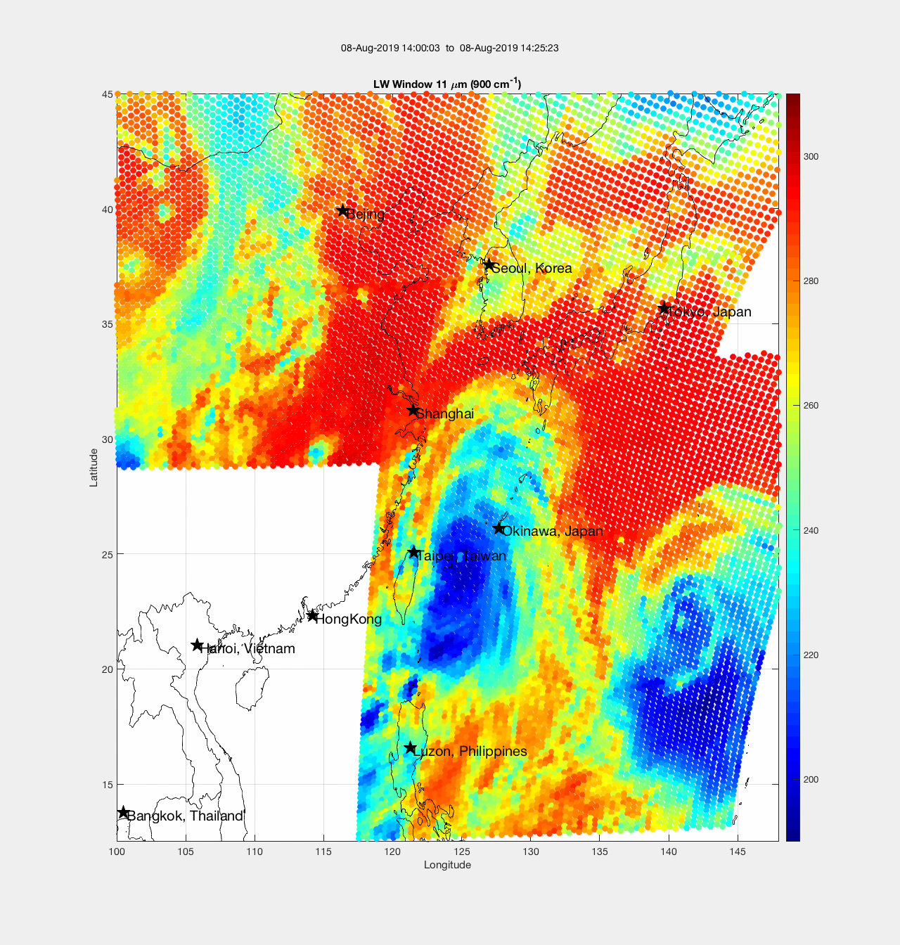
GIIRS Demonstration of Spatial Temporal Sampling
30 minute Repeat Time
Notes:
https://en.wikipedia.org/wiki/Typhoon_Lekima_(2019)

Slide 10
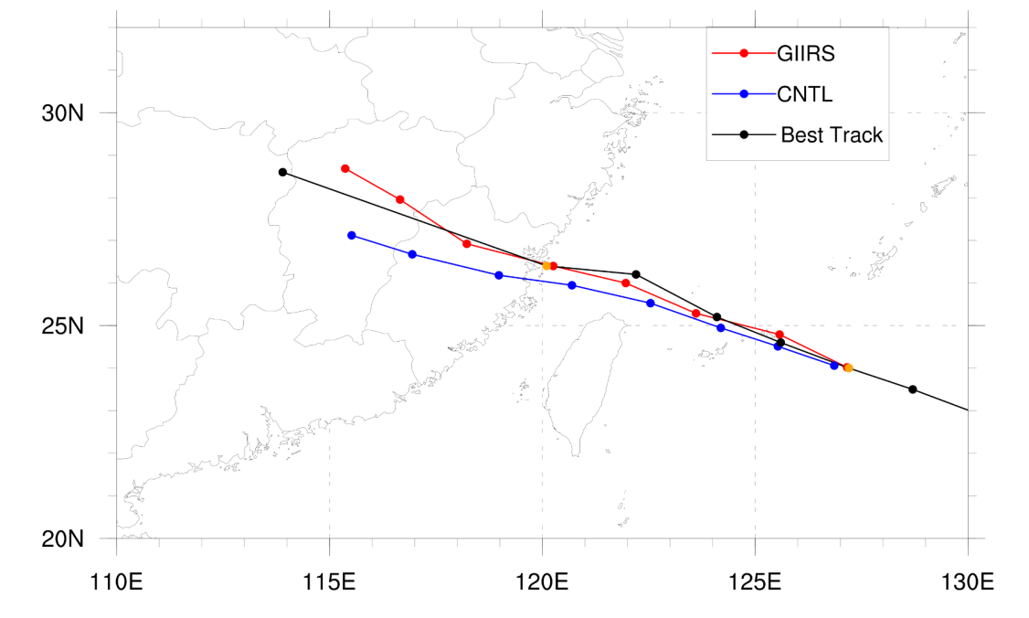
Highlights of SSEC GIIRS project
Data assimilation experiments
Typhoon forecasts (2018, 2019, 2020)
Convection(2019,2020)
Assimilation of high-temporal GIIRS(15 minutes ) using 4D-Var in 1h time window
Impact on Typhoon Maria(2018) forecasts
Time window: 1 hour
Time slot: 15 minutes
Wei Han (JCSDA Visiting Scientist)

