Slide 1
Comparison of Model¹ Simulations
to
Satellite Observations
R. Bradley Pierce
NOAA/NESDIS
¹Use 1x1 degree Real-time Air Quality Modeling System (RAQMS)
HTAP2 Webinar 10 November, 2015

Slide 2
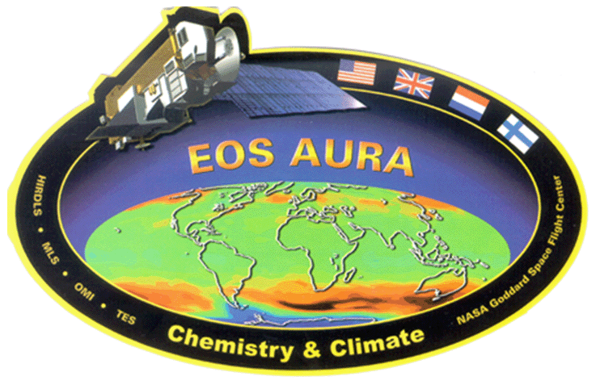
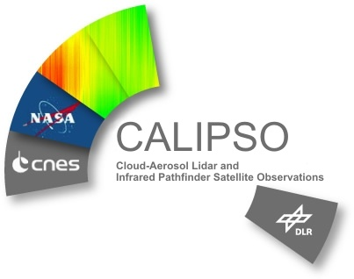
Consider three different Satellite measurements:
Atmospheric Infrared Sounder (AIRS) Carbon Monoxide (Collection 6)
Ozone Monitoring Instrument (OMI) Tropospheric NO2 (Version 3)
CloudSat and the Cloud-Aerosol Lidar and Infrared Pathfinder Satellite Observation (CALIPSO) aerosol extinction profile (Version 3)
Focus on July 1, 2010 to demonstrate approach

Slide 3
OMI Tropospheric NO2 (Version 3)
OMI Orbits between 00-3.5Z on July 01, 2010
OMI Tropospheric NO2 Column Swath is 13x24 km (at nadir)

Slide 4
OMI Tropospheric NO2 (Version 3)
Latitudes >+/-25º have swath overlap
OMI Orbits between 00-3.5Z on July 01, 2010
Single local time (i.e. 1:00pm) will not capture multiple observations/day north of +/-25º
OMI Tropospheric NO2 Column Swath is 13x24 km (at nadir)

Slide 5
The OMI Slant Column Amount (S) is the retrieved total NO2 slant column and is the total areal density of NO2 molecules along the effective optical path from the sun into the atmosphere, and then toward the satellite.
The OMI Tropospheric NO2 Column Amount NO2 estimates of the tropospheric vertical column (V) derived from S.
The OMI Scattering Weight (A) is a vector that describes the relationship between slant Column (S_{i}) and the vertical column (V_{i}) for each atmospheric layer.
The OMI Air Mass Factor (AMF) accounts for assumed NO2 profile shape, cloud fraction, viewing angles, reflectivity, and topography.
To calculate the model tropospheric NO2 column (with AMF) one integrates the model no2 profile, weighted by the scattering weight, from the surface to the tropopause and then divides by the tropospheric airmass factor:
Modno2amf =modno2amf+modsctwt(l)*dpprof(l)*no2prof(l)*fac/omi_amftrop

Slide 6
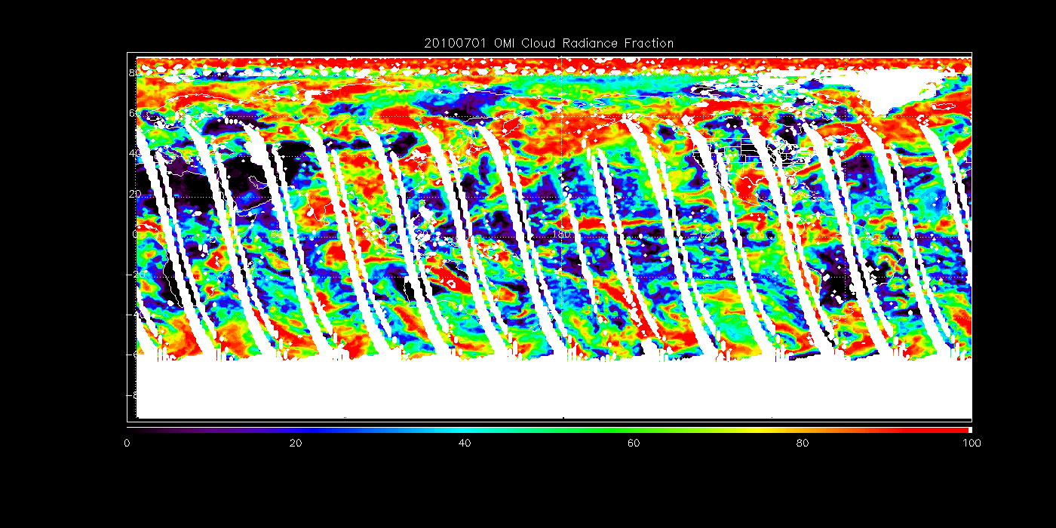
OMI Cloud Radiance Fraction on July 01, 2010.
Recommend limiting cloud radiance fraction to <30% for tropospheric NO2 retrievals.

Slide 7
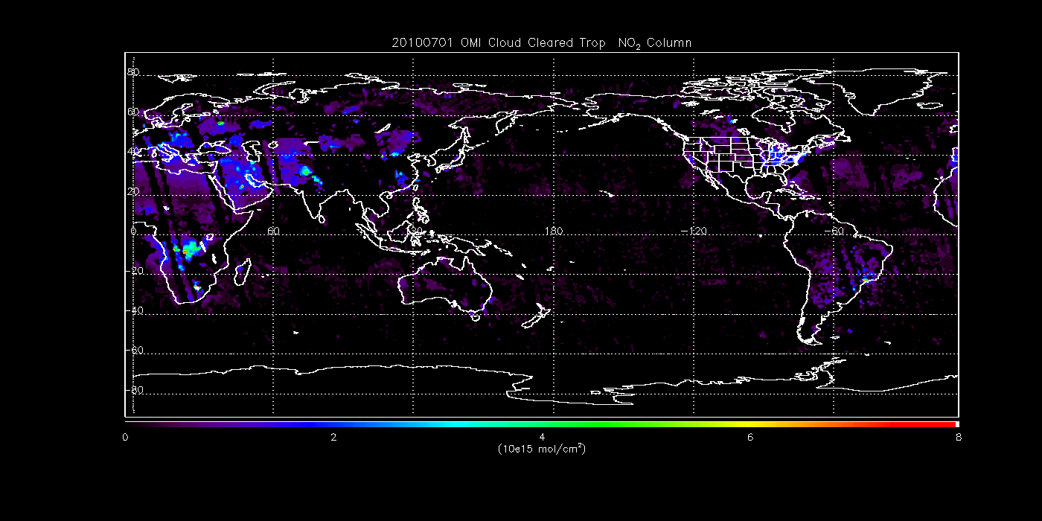
OMI Tropospheric NO2 column on July 01, 2010.

Slide 8
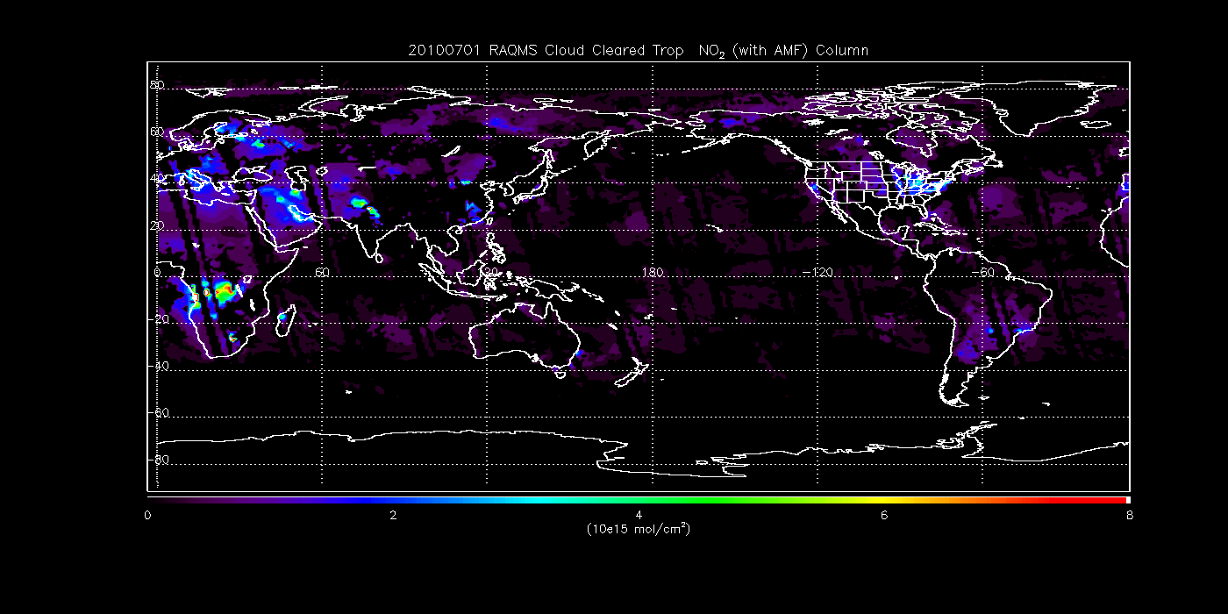
RAQMS (with AMF) Tropospheric NO2 column on July 01, 2010.

Slide 9
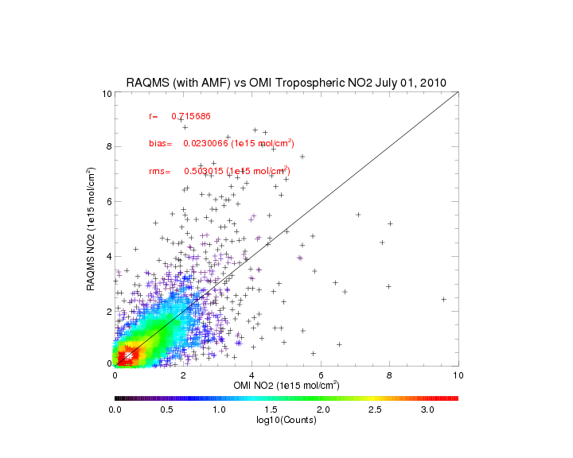

Slide 10
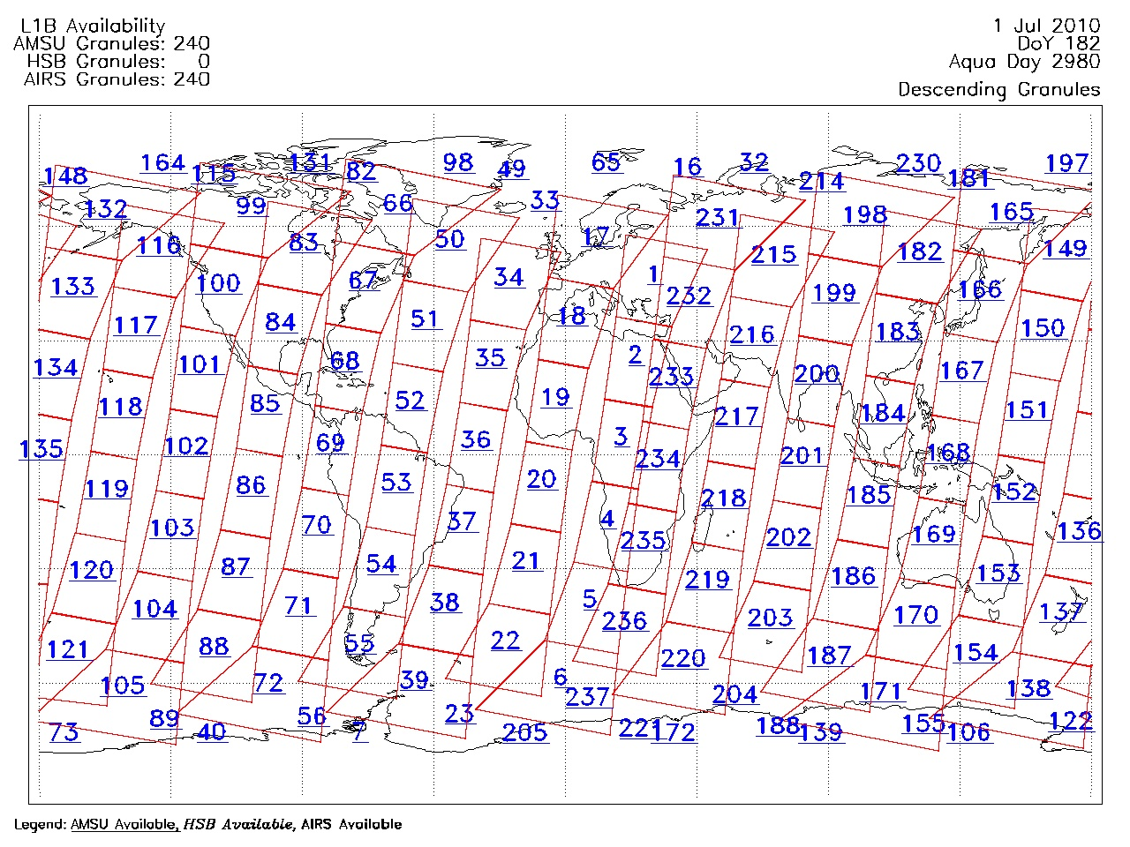
Version 6.0 AIRS Carbon Monoxide July 01, 2010
AIRS product granules contain 6 minutes of data. There are nominally 240 Level 1B and 240 Level 2 granules of 6-minute duration generated each day.
AIRS CO retrieved at 45km (at nadir) horizontal resolution with an accuracy of 15%

Slide 11
Version 6.0 AIRS Carbon Monoxide July 01, 2010
Latitudes >+/-45º have swath overlap
AIRS product granules contain 6 minutes of data. There are nominally 240 Level 1B and 240 Level 2 granules of 6-minute duration generated each day.
AIRS CO retrieved at 45km (at nadir) horizontal resolution with an accuracy of 15%

Slide 12
Need to apply the AIRS Averaging Kernels (AK) to enable convolution of model profile with apriori¹ to account for smoothing errors in AIRS retrieval process. The convolution can be performed two ways:
By coarse layer averaging the truth, retrieval, and a priori profiles on the retrieval grid. This is an approximation and does not account for the fact that the retrieval algorithm does not allow the retrieved profile to move in non-trapezoidal shapes.
convolve the "truth" with the averaging kernel the equation is : ln( co' ) = ln(co_apriori) + A * ln(cotrue / co_apriori)
As prescribed in Maddy and Barnet, IEEE TGRS, 2008 (MB08) convert the profile to coarse slab values using the effective averaging kernel (Equation 11 MB08). The second way is more accurate (Eric S. Maddy, personnel communication)
convolve the "truth" with the averaging kernel the equation is : ln( co' ) = ln(co_apriori) + F*A*Finv * ln(cotrue / co_apriori)
¹AIRS V6 CO has monthly NH and SH apriori profiles

Slide 13
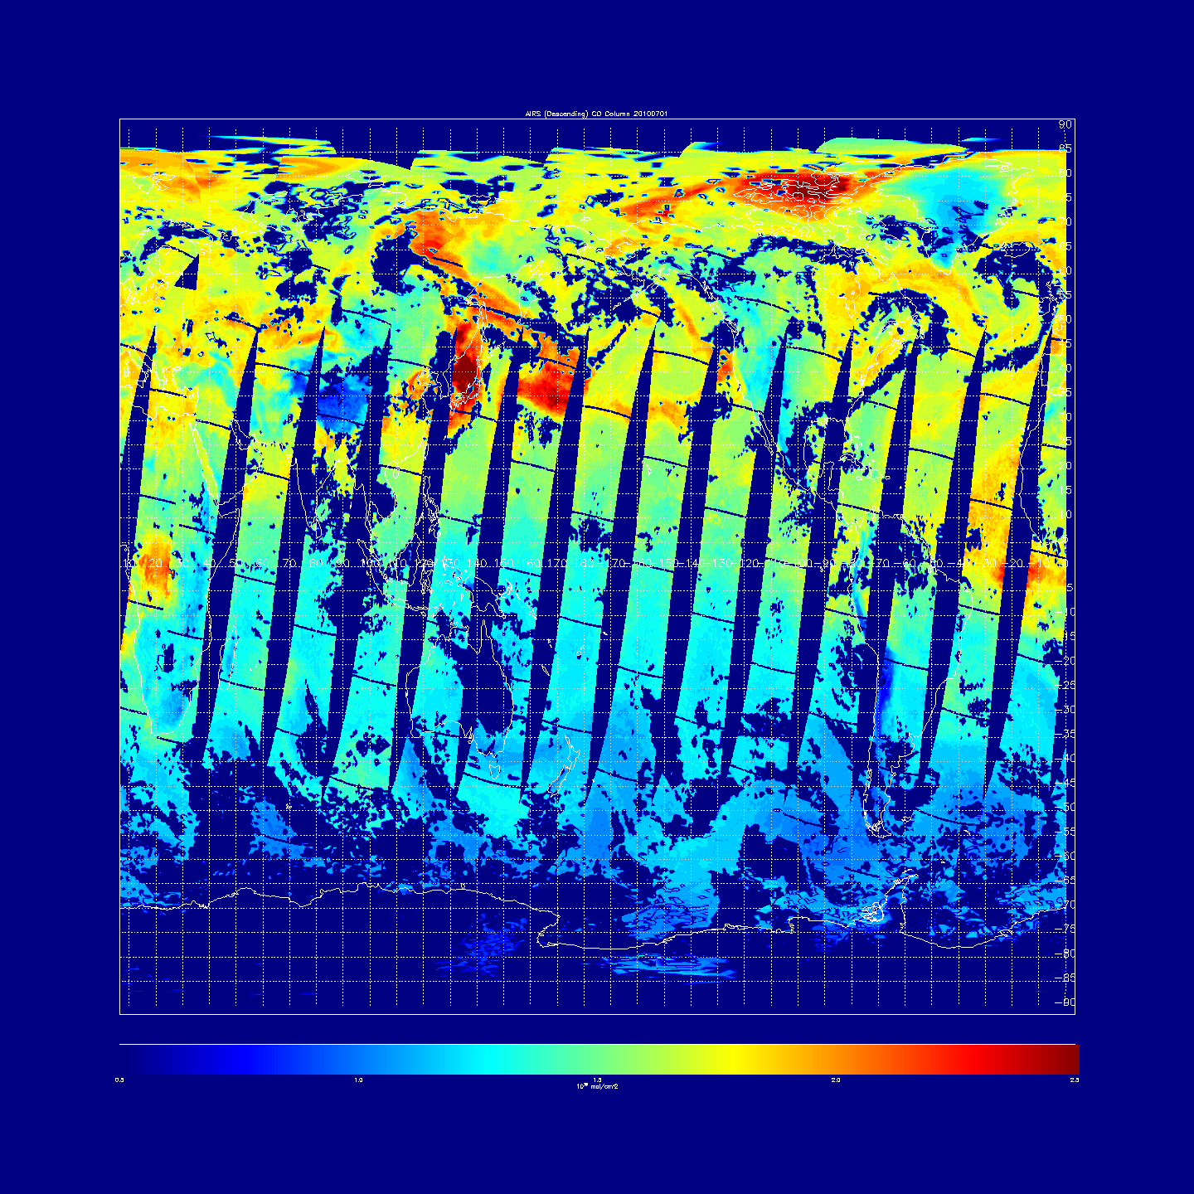
AIRS CO column Daytime (Descending) orbit July 01, 2010
0.0
1.0
1.5
2.0
2.5
10¹⁸ mol/cm²

Slide 14
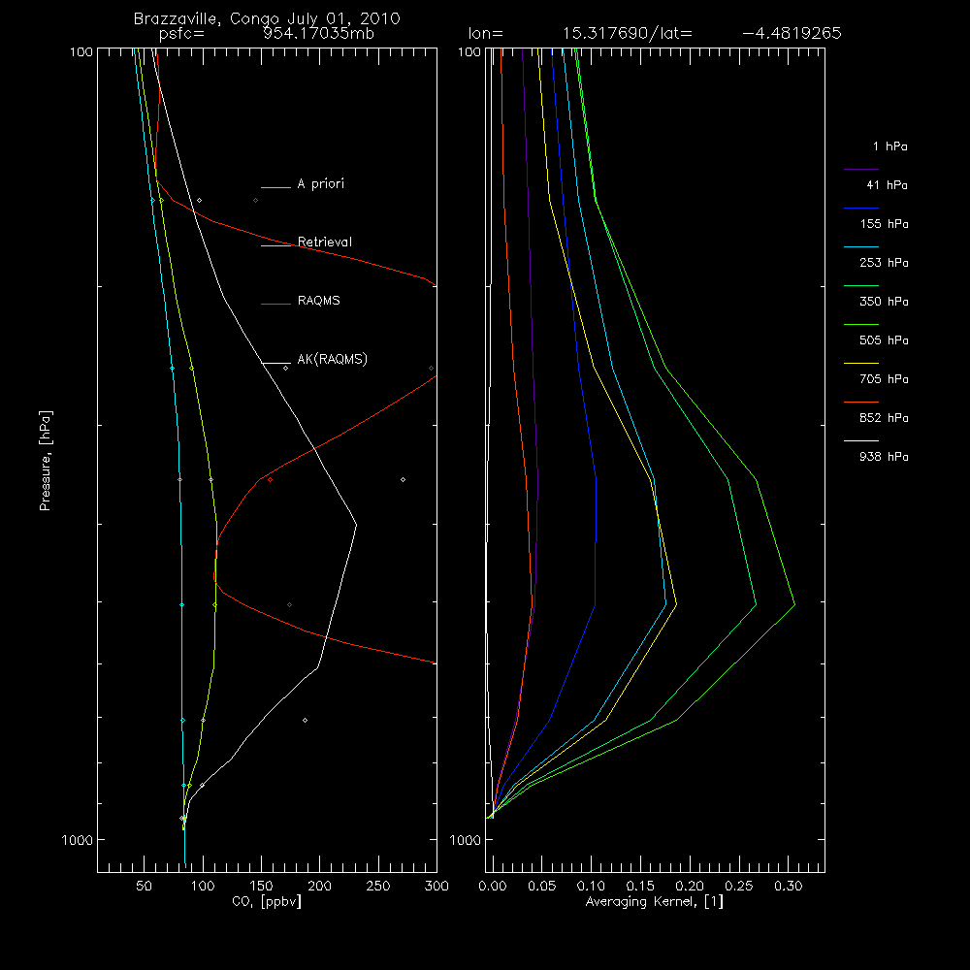
RAQMS significantly overestimates AIRS CO over Brazzaville, even with AK applied
AIRS CO retrieval is unable to capture high surface CO and high upper tropospheric CO due to lack of upper tropospheric and lower tropospheric sensitivity

Slide 15
More accurate Coarse Layer profiles capture more of high upper tropospheric CO
Coarse layer profiles
AIRS CO retrieval is unable to capture high surface CO and high upper tropospheric CO due to lack of upper tropospheric and lower tropospheric sensitivity
Fine layer profiles

Slide 16
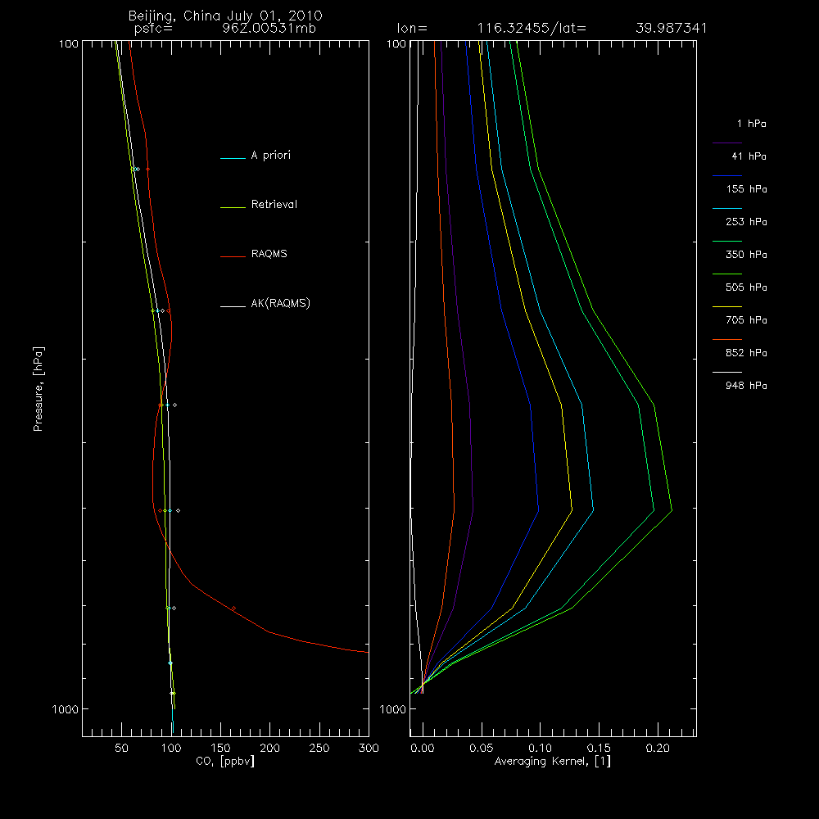
RAQMS slightly overestimates AIRS CO over Beijing with AK applied
AIRS CO retrieval is unable to capture high surface CO lower tropospheric sensitivity

Slide 17
AIRS CO column Daytime (Descending) orbit July 01, 2010
0.0
1.0
1.5
2.0
2.5
10¹⁸ mol/cm²

Slide 18
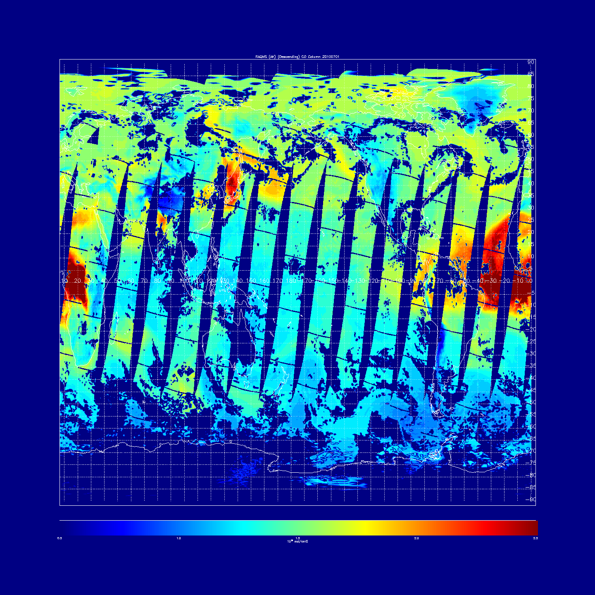
RAQMS (AK applied) CO column Daytime (Descending) orbit July 01, 2010
0.0
1.0
1.5
2.0
2.5
10¹⁸ mol/cm²

Slide 19
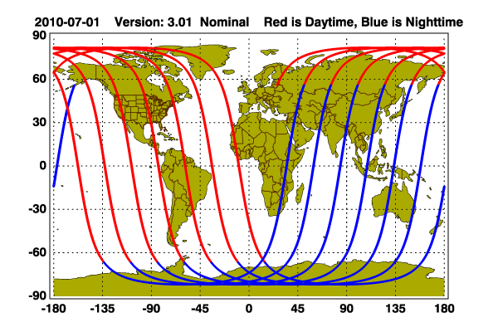
Version 3.00 of the CALIOP Level 2 Aerosol Profile product July 01, 2010
July 01, 2010 data availability only 48.2% due to XBAND Data loss between 06/30/10 22:27:52 and 07/01/10 13:17:46 due to ground station anomaly

Slide 20
Version 3.00 of the CALIOP Level 2 Aerosol Profile product July 01, 2010
Latitudes >+/-70º have orbit overlap
July 01, 2010 data availability only 48.2% due to XBAND Data loss between 06/30/10 22:27:52 and 07/01/10 13:17:46 due to ground station anomaly

Slide 21
CALIPSO V3 Quality Flags
Bit Value Interpretation 1 0 unconstrained retrieval; initial lidar ratio unchanged during solution process 1 1 constrained retrieval 2 2 Initial lidar ratio reduced to prevent divergence of extinction solution 3 4 Initial lidar ratio increased to reduce the number of negative extinction coefficients in the derived solution 4 8 Calculated backscatter coefficient exceeds the maximum allowable value 5 16 Layer being analyzed has been identified by the feature finder as being totally attenuating (i.e., opaque) 6 32 Estimated optical depth error exceeds the maximum allowable value 7 64 Solution converges, but with an unacceptably large number of negative values 8 128 Retrieval terminated at maximum iterations 9 256 No solution possible within allowable lidar ratio bounds 16 32768 Fill value or no solution attempted

Slide 22
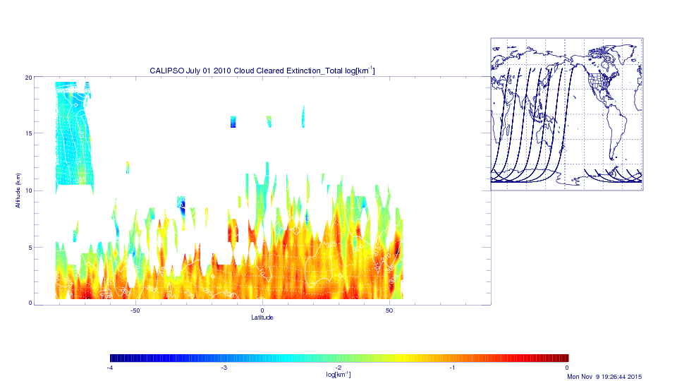
CALIPSO Mean Nighttime Extinction July 01, 2010

Slide 23
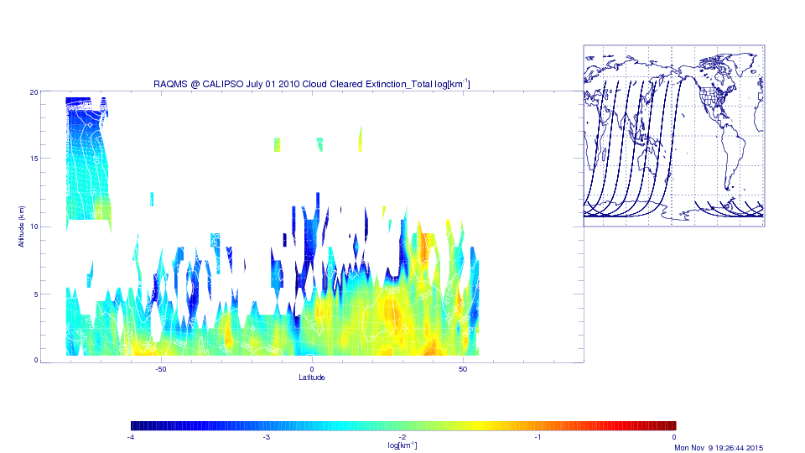
RAQMS Mean Nighttime Extinction July 01, 2010

Slide 24
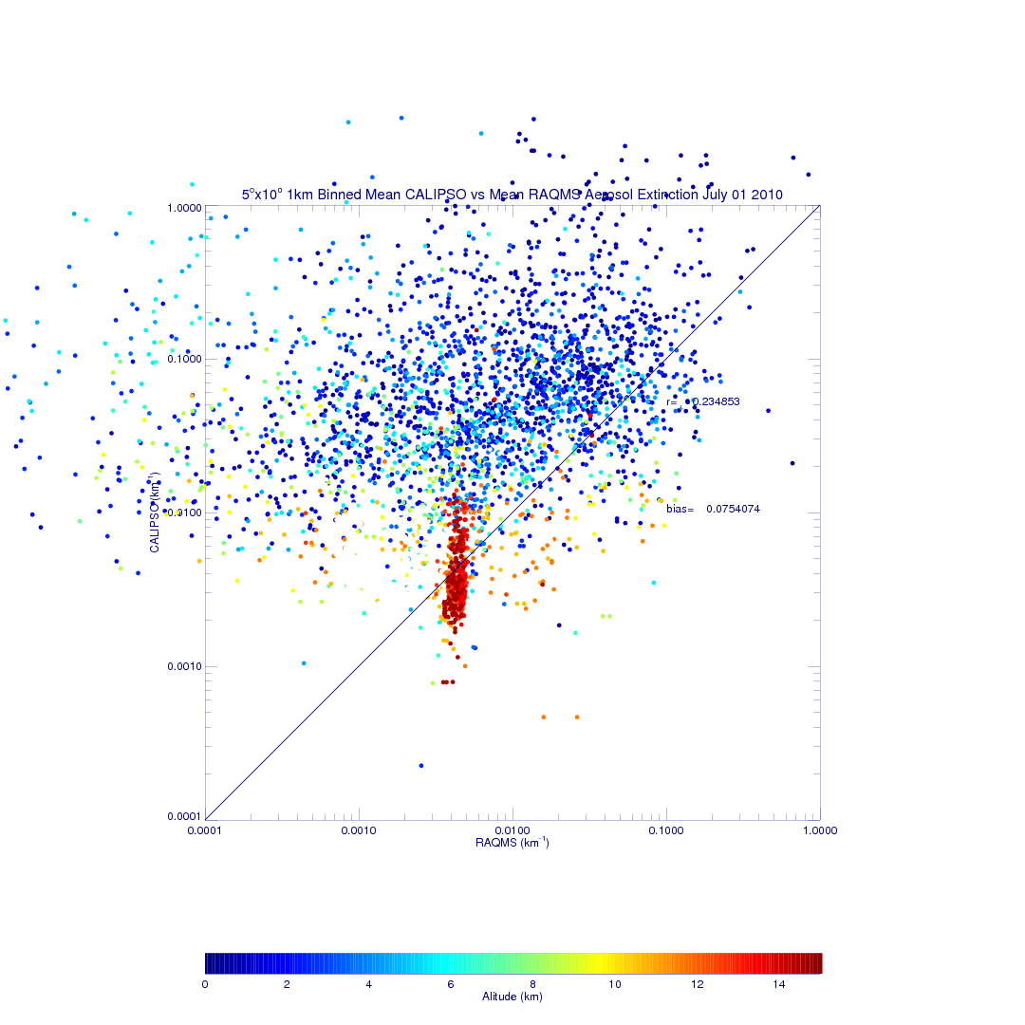
RAQMS vs CALIPSO Mean Nighttime Extinction July 01, 2010

Slide 25
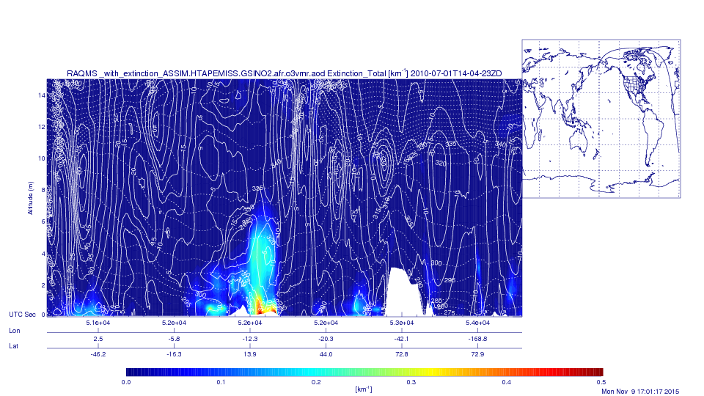
RAQMS CO column Daytime (Descending) orbit July 01, 2010
RAQMS 14Z Daytime Extinction July 01, 2010

Slide 26
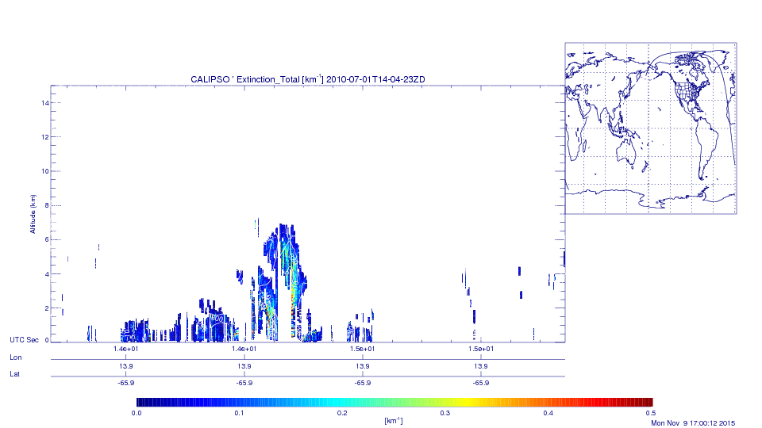
AIRS CO column Daytime (Descending) orbit July 01, 2010
CALIPSO 14Z Daytime Extinction July 01, 2010

Slide 27
Conclusions and Discussion points
Care must be taken to account for cloud clearing, apriori assumptions, and retrieval sensitivity to use satellite retrievals for model evaluations
Recommend that HTAP modeling groups map daily model profiles to L2 (orbital) geolocation (latitude, longitude, and GMT) to avoid issues with overlapping swaths
Willing to provide HTAP with simple ascii, comma delimitated L2 files with AIRS, OMI, and CALIPSO geolocation for January and July 2010 for testing
Modelers return model CO, NO2, aerosol extinction, surface pressure, and pressure profiles on model levels.
Interpolation, application of AIRS Averaging Kernels and OMI Scattering Weights, and column integration is CPU intensive. Need to consider where to perform this step (RSIG?)

