Slide 1
GSI Review Committee NESDIS
R. Bradley Pierce
Jim Jung and Kevin Garrett
20 August 2012

Slide 2
List of NESDIS GSI Projects
Kevin Garrett:
Hybrid/Ensemble Data Assimilation Experiments for ATMS and CrIS
Tong Zhu: Joint OSSE Study: Radiance Simulation and Evaluation for a Joint OSSE
R. Bradley Pierce, Todd Schaack, Georg Grell, Martin Stuefer, Mike Pavolonis:
Development of Data Assimilation Capabilities for SEVIRI Volcanic Ash retrievals
R. Bradley Pierce, Todd Schaack, Allen Lenzen and Pius Lee:
Implementation of GOES Total Column Ozone Assimilation within NAM-CMAQ to improve Operational Air Quality Prediction
Sharon Nebuda: GOES-R AMV Assimilation
Brett Hoover & David Santek: Forecast Impact of High-Latitude, Mixed-Platform AMVs on GDAS/GFS
Marouane Temimi, Kibrewossen Tesfagiorgis, Sid Boukabara:
Assessment of assimilating ATMS land surface sensitive observations in the NOAA
data assimilation system
Red Projects will be summarized here

Slide 3
List of NESDIS GSI Projects
Li Bi: OSCAT Assimilation
Man Zhang, Milija Zupanski : Satellite Radiance Assimilation in TC Inner Core Using HWRF and a Regional Hybrid Data Assimilation System
Banglin Zhang: The Impacts of Raising HWRF Model Top and increasing vertical resolution on Hurricane Forecasts
Jim Jung: S4/JIBB/Vapor Benchmark Experiments, JIBB Data Denial Experiments
Gregory Krasowski: Migration of Data for Experimental Use
Jianjun Xu: Application of hyper-spectral satellite data (AIRS, IASI, CRIS, FY3) in weather forecasts with GSI/WRF regional data assimilation system
Shobha Kondragunta:
Assimilation of Aerosol Optical Depth (AOD) in CMAQ Model to Improve Surface
PM2.5 Forecasts

Slide 4
List of NESDIS GSI Projects
R. Bradley Pierce, Todd Schaack, Allen Lenzen, Craig Long, Chris Barnet, Daniel Jacob &Arlene Fiore: Improved Lateral Boundary Conditions for NAQFC NAM-CMAQ AQ Forecasts
Karina Apodaca, Man Zhang & Milija Zupanski: Regional Hybrid Variational-Ensemble Data Assimilation Development and Applications
Bin Li: Satellite Ocean Data Assimilation Capability
Xiaoyan Zhang: CrIS data assimilation activity (NPP)
Jinlong Li:
High impact weather study w/combined GEO & LEO data
Sean Casey:
Joint OSSE Study: Real vs Synthetic AIRS radianced
Zaizhong MA: NPP Cal Val

Slide 5
JIBB – S4 – Vapor inter-comparison (Jim Jung)
May 2011 version (NWPROD executables)
No restricted data
Aircraft data may be added
No prep step
Use non-restricted prepbufr files from NCEP operational run
Two month – two season comparison
Dec-Jan and Aug – Sep
T382
Identical input files

Slide 6
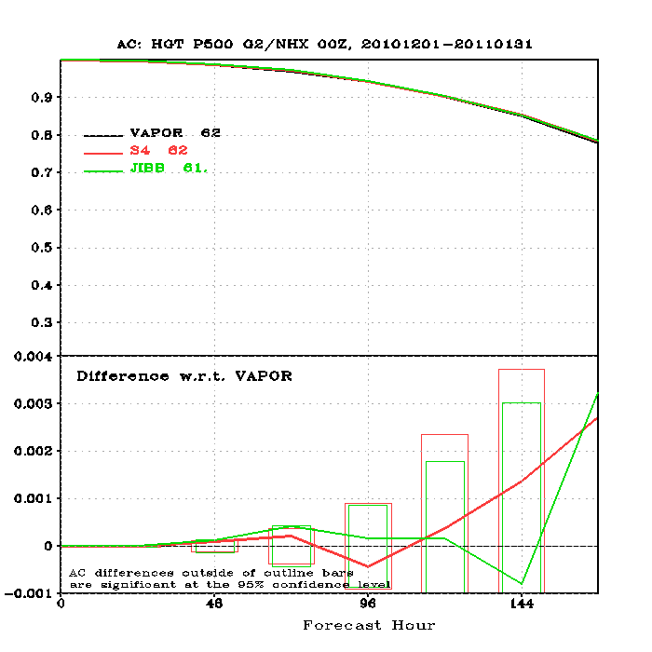
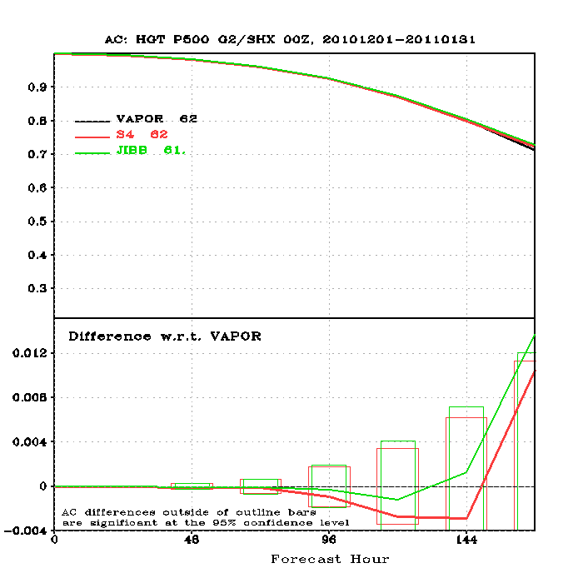
Anomaly Correlation die off curve at 500 hPa for 1 Dec 2010 – 31 Jan 2011
Northern Hemisphere
Southern Hemisphere

Slide 7
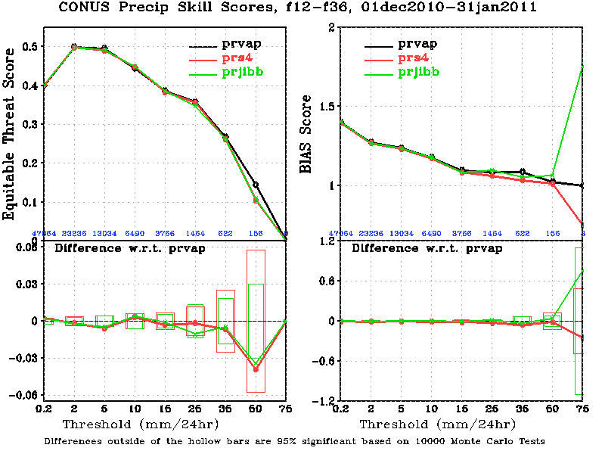
12-36 hr accumulated precipitation scores over CONUS

Slide 8
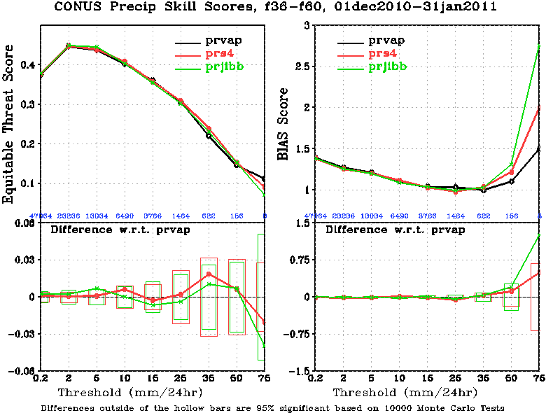
36-60 hr accumulated precipitation scores over CONUS

Slide 9
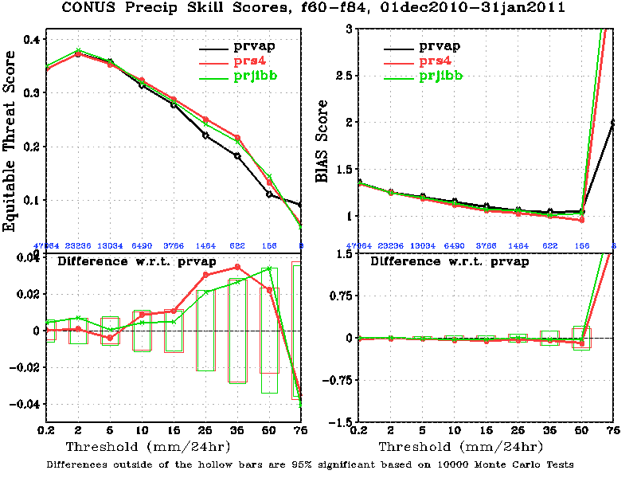
60-84 hr accumulated precipitation scores over CONUS

Slide 10
Standard Deviations
Standard deviation of difference between:
Analyses
48 hr forecast
Comparisons between:
S4 – Vapor
JIBB – Vapor
S4 – JIBB

Slide 11
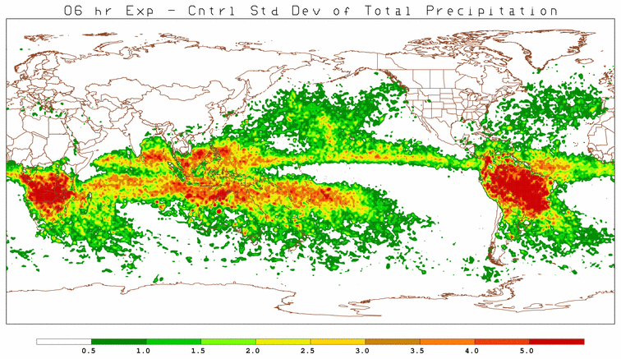
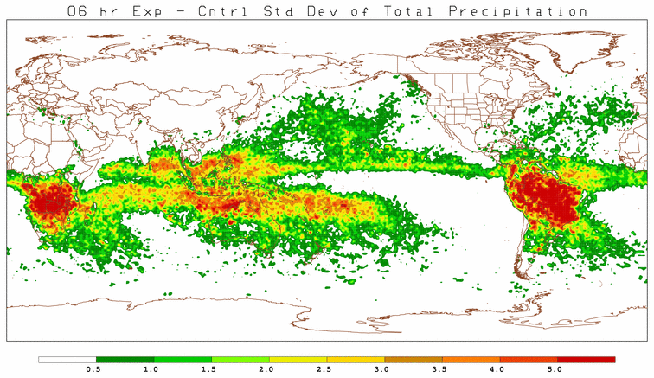
(a)
(b)
(c)
Standard Deviation of 6 hr total precipitation a) S4-Vapor, b) JIBB-Vapor, and c) S4-JIBB

Slide 12
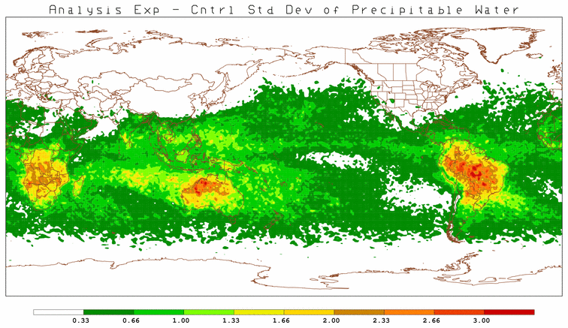
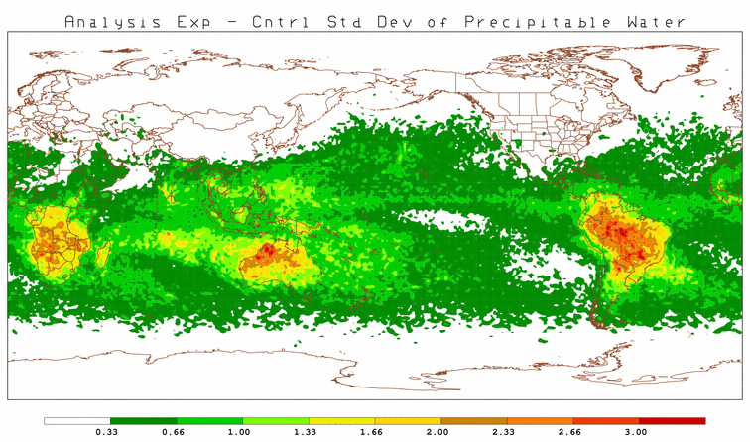
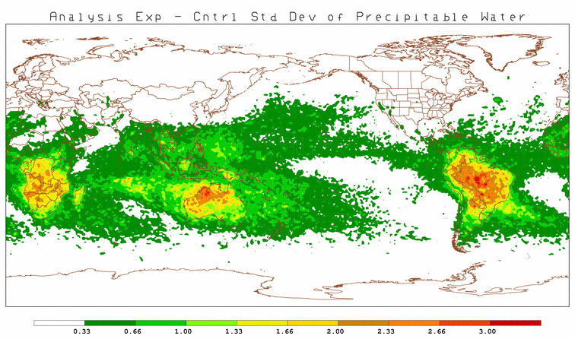
(a)
(b)
(c)
Standard Deviation for Analysis of Precipitable Water a) S4-Vapor, b) JIBB-Vapor, and c) S4-JIBB

Slide 13
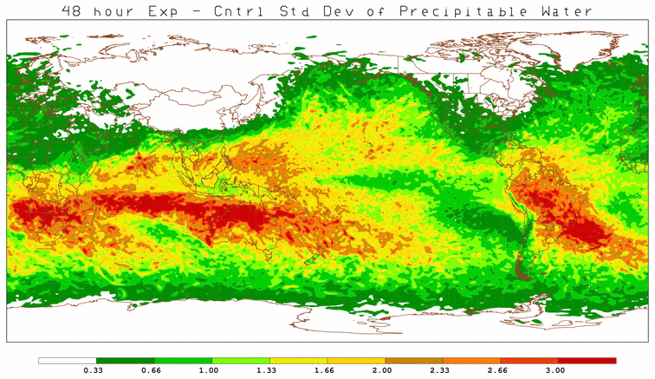
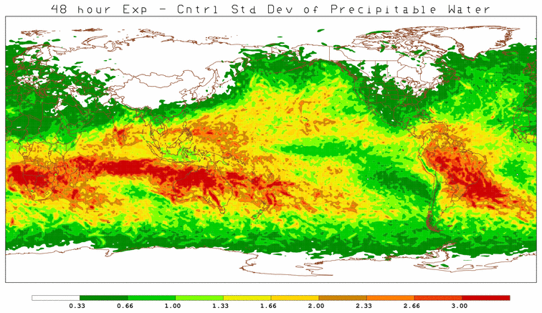
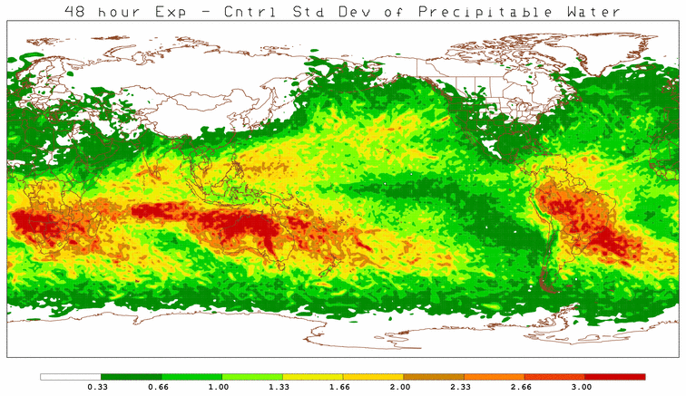
(a)
(b)
(c)
Standard Deviation for 48 hr forecast of Precipitable Water a) S4-Vapor, b) JIBB-Vapor, and c) S4-JIBB

Slide 14
Several regions (southern Africa, Australia and northern South America) show local increases in difference standard deviations in 6hr rainfall (and precipitable water and relative humidity) for all three computer combinations
This translates into increased difference standard deviations for the same regions in the 48-hour forecast.
We suspect that the systematic geographical structure is due to the binary/stochastic nature of the convective scheme.
The differences in the behavior of the convective scheme lead to geographically systematic changes in moisture, diabatic heating, and larger scale circulation patterns.
JIBB and S4 are closer to each other than either is to Vapor (architecture differences)

Slide 15
Observing System Experiments Using the NCEP Global Data Assimilation System
(Jim Jung)
NCEP Operational GDAS/GFS May 2011 version
T574L64 operational resolution
Two Seasons
Aug-Sept 2010
Dec 2010-Jan 2011
Cycled experiments
7 Day forecast at 00Z
Control late analysis (GDAS) used for verification
On JIBB computer

Slide 16
Experiments
No Satellite Data
No Conventional Data
AMSU-A
MHS
AMVs
GPS-RO
Hyperspectral
GOES Sounder
HIRS
WindSat
Rawinsondes
Aircraft
Ship / Buoy
Profilers
VAD winds
Also experiments with individual
Sensors/convectional data turned off

Slide 17
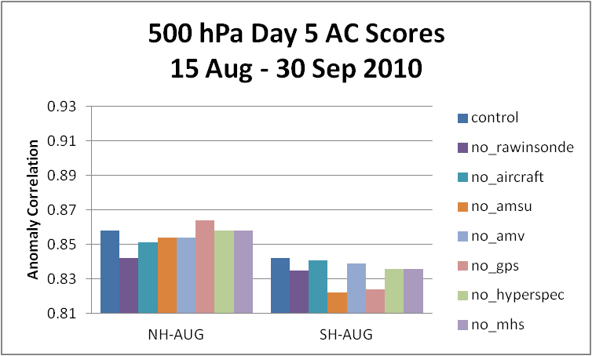
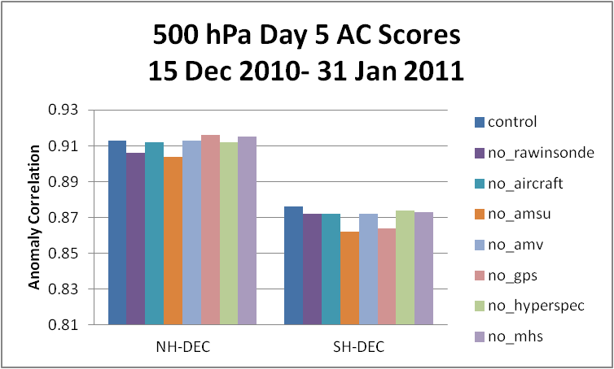
500 hPa, Day 5, Instrument Average AC scores

Slide 18
Anomaly Correlation Conclusions
500 hPa Summary
No satellite and no conventional data experiments are similar to previous studies.
No Satellite has greatest impact, especially in Southern Hemisphere.
Single instrument scores are much smaller than entire suite denial
Both No Satellite and No Conventional experiments are statistically significant for all seasons and hemispheres
Few instruments have statistically significant impact at day 5:
Rawinsonde, Aircraft (Aug-NH)
Rawinsonde, GPS-RO (Aug-SH)
Rawinsonde, AMSU-A (Dec-NH)
AMSU-A, GPS-RO (Dec-SH)
Implies robust Observing System (less impact of loss of individual sensor)

Slide 19
Hybrid/Ensemble ATMS Radiance Assimilation
(Kevin Garrett)
(with John Derber, Andrew Collard, Daryl Kleist (NCEP/EMC))
Goal: Determine the ATMS assimilation impact on forecast
Use updated GFS and GDAS with GSI Hybrid Ensemble Kalman Filter (ENKF)/3DVAR
Control run
ATMS run
Forecast/analysis model resolution at T574
80 ensemble members during analysis at T254
Begin Dec. 15, 2011
ATMS bias spun-up by NCEP
Allow model spin-up on S4 for 1 month of data
Assessment period Jan. 15, 2012 – Mar. 15, 2012

Slide 20
Experiment Overview
Control run
Conventional data (RAOB, aircraft, ship, buoys), AMVs, surface synoptic
Satellite data:
AMSU-A (N15, N18, N19, AQUA)
MHS (N18, N19, MetOp-A)
HIRS (N19, MetOp-A)
IASI (MetOp-A)
AIRS (AQUA)
AVHRR (N18, N19, MetOp-A)
GOES Sounder (13)
Seviri (Meteosat 9)
ASCAT, WindSat
ATMS run
All control obs plus NPP ATMS TDR (Antena temperatures)
FOVs 1-3 and 94-96 not assimilated
All channels except for 15 (57 GHz)
All channels averaged to 3.3 beam resolution (AAPP)

Slide 21
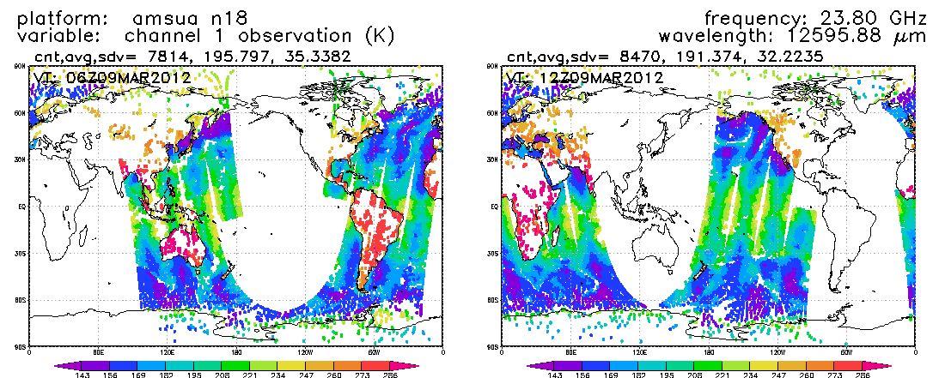
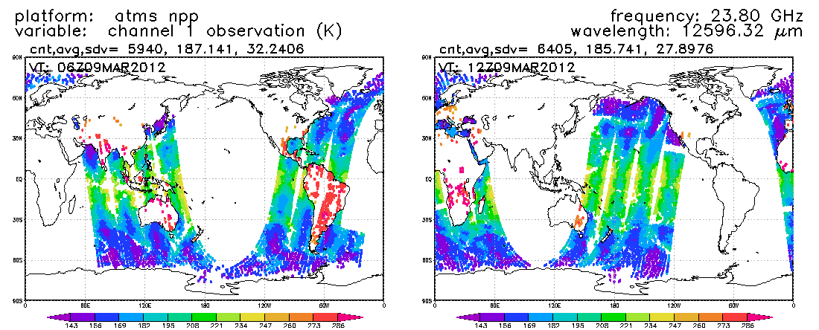
ATMS Coverage
N18 AMSU-A 23 GHz
NPP ATMS
23 GHz

Slide 22
Anomaly Correlation
Neutral Impact

Slide 23
Future Work
Finalize assessment of ATMS impact from data denial experiment
Work on alignment of control runs between s4 and CCS (benchmark)
Assess impact of ATMS replacement of POES/Metop (remove redundancy)
Coordinate with parallel efforts to assess the overall global observing system and how ATMS fits in
Coordinate efforts to begin impact assessment of assimilation NOAA products into NOAA models, in collaboration with CIRA (water vapor), CIMSS (temperature sounding), and CREST (surface products)
Port and Benchmark of Hybrid Ensemble on S4 is being aligned with Zeus and CCS (Jim Jung, Lead)

Slide 24
Joint OSSE: Radiance Simulation and Evaluation
(Tong Zhu, Fuzhong Weng
Michiko Masutani and Jack S. Woollen)
Satellite data simulated:
Current sensors: 13 months data for AMSU-A/B on NOAA 15, 16 and 17; GOES-10/12 Sounder, HIRS2, HIRS3, AIRS, and MSU;
Future sensors: 1 week GOES-R ABI, 5 weeks ATMS.
Satellite data examined:
NOAA-15 AMSU-A/B, GOES-12 Sounder;
HIRS3, GOES-12 Imager;

Slide 25
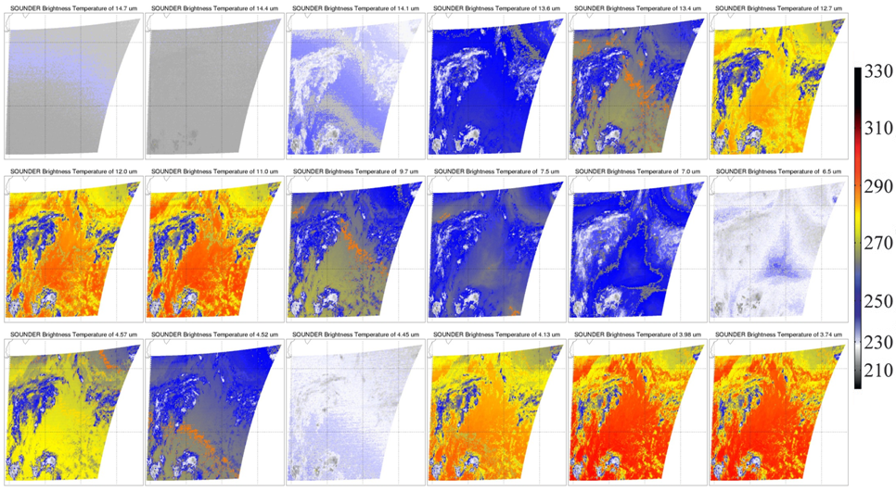
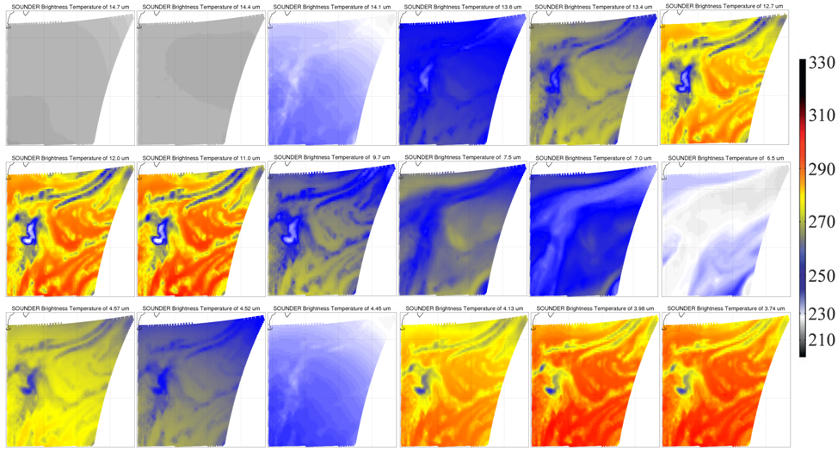
GOES-12 Sounder 18 IR channels over North Atlantic region
Observation
1200 UTC October 1, 2005
NR Simulation
1200 UTC October 1, 2005
Less fine moisture and cloud structures;
Large difference at Ch-15, due largely to the shifting of SRF for about +8.4 cm⁻¹.

Slide 26
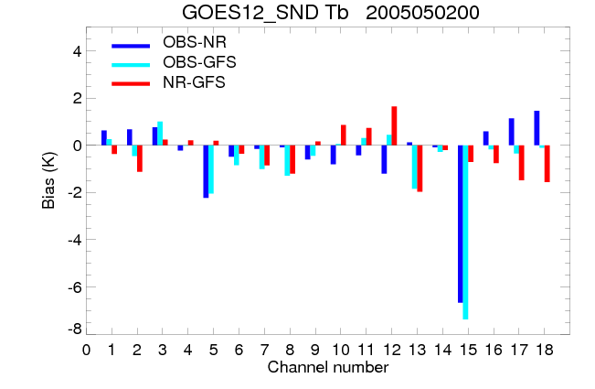
Comparison of GOES-12 Sounder O-B Biases
Biases of OBS-NR and OBS-GFS have similar sign and magnitude at most channels, except following bands:
Large differences in O-B can be found at Ch10-12, atmospheric moisture bands (NR field is more moist than GFS field)
Compared with GFS Tb, there is about 1 K – 2 K cold bias of NR simulated Tb at Ch7-8, ch13, Ch16-18 (PBL and surface temperature bands).
At short wave window bands, NR Tb is close to OBS, while GFS Tb is close to OBS at longwave window.

Slide 27
Joint OSSE: Forecast Impact studies Simulated vs. Real AIRS Data
(Sean Casey, Michiko Masutani, Jack Woollen, Zaizhong Ma, Lars Peter Riishojgaard)
For all experiments:
July 15 – August 31st 2005 (two-week spin-up)
“Control” (black curve): no AIRS
“Experiment” (red curve): AIRS included
Differences between experiments:
Top figures: Real observations
Lower left: Simulated observations, no error added
Lower right: Simulated observations, random error added

Slide 28
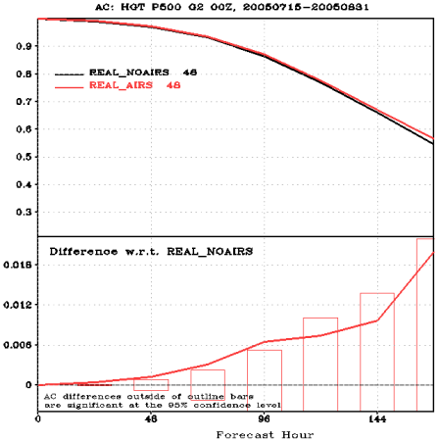
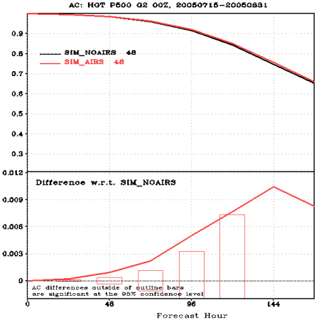
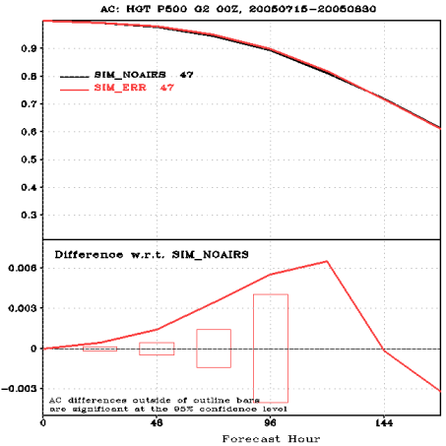

Slide 29
Summary
Lower biases, RMSE, higher AC scores seen with simulated data than with real data
Lower AC scores, higher RMSE with simulated data + random error than with just simulated data
Magnitude of differences between AIRS vs. NOAIRS changes among experiments; not enough to change results (positive vs. negative impact), but might effect significance of impact
Online archives of VSDB results:
Real: http://www.jcsda.noaa.gov/vsdb/users/scasey/realairs/vsdb.php
Simulated, no error: http://www.jcsda.noaa.gov/vsdb/users/scasey/simperairs/vsdb.php
Simulated, random error: http://www.jcsda.noaa.gov/vsdb/users/scasey/simerrairs/vsdb.php

Slide 30
Work in Progress and future work
OSCAT Assimilation
Surface IR/MW Emissivity
LEO/GEO AMV
Regional DA
GDAS Chemical DA
CMAQ Aerosol DA

Slide 31
Status of OSCAT assimilation
(Li Bi)
Number | Action | Computer Resources | Status
I | Receive and archive OSCAT BUFR data | S4 | Closed
II | Dump OSCAT data to EMC tanks | S4 and Zeus | Open
III | Benchmark GSI on Zeus | Zeus | Closed
IV | Run PREP and GFS on Zeus | Zeus | Open
V | Start OSCAT assimilation and optimal current thinning algorithm | Zeus | Open
VI | Demonstrate ASCAT assimilation on S4 | S4 | Closed

Slide 32
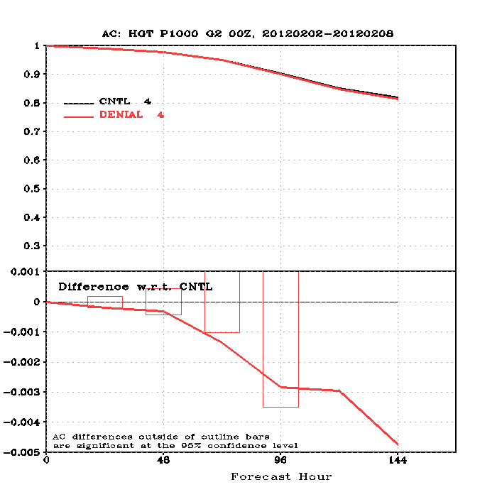
Results from ASCAT denial experiment on S4
CNTL:
Same setup as operation
DENIAL:
Turn off ASCAT obs
Notes:
10 of 11: Li Bi

Slide 33
Summary and Future Work
Resolve Tanking/Dumping issue* as the 1st priority. (JSDI POC: Wanchun Chen)
Start test PREP on Zeus and work with the various thinning techniques.
Demonstrated ASCAT denial experiment on S4, waiting for PREP to be ported.
Working progress of OSCAT project is on track and will focus on the remaining open action items.
*Difficulty reading sample BUFR file due to UNIX/AIX and GNU/Linux environment difference
Notes:
11 of 11: Li Bi

Slide 34
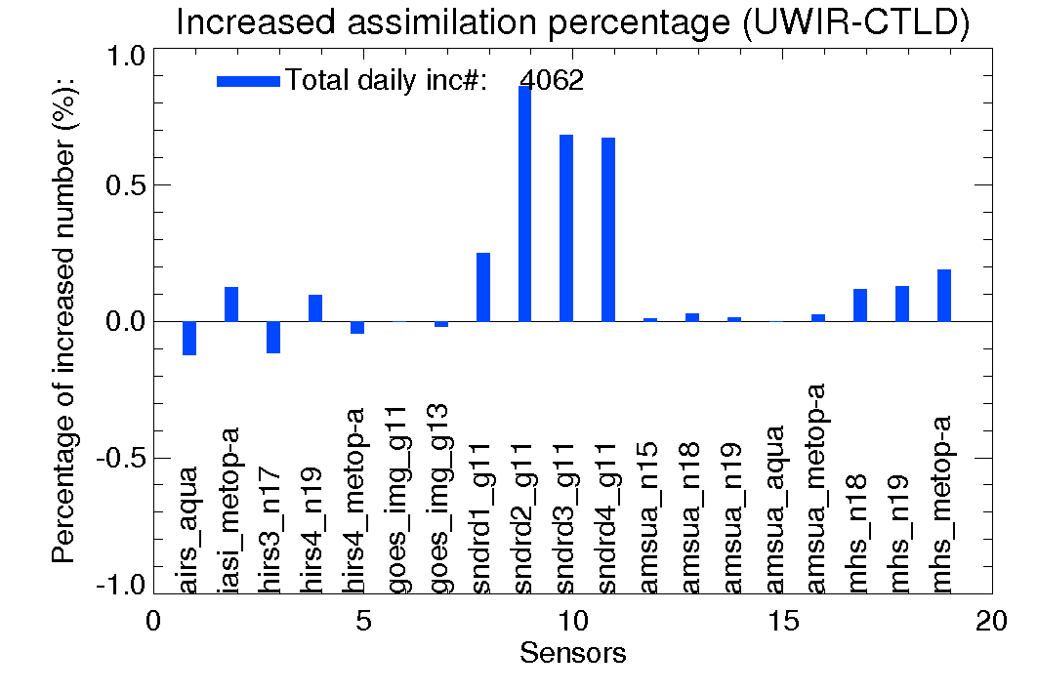
Evaluation of new IR land surface emissivity data base in GDAS (Tong Zhu)
Evaluation of IASI and UWir emissivity data:
The major difference of the two emissivity models is over desert regions. Over North Africa UW emissivity is smaller than IASI for about 0.01 – 0.02.
The GSI assimilated observation numbers are increased over atmospheric window bands for IR sensors, such as IASI and HIRS sensors.
GSI analysis with UWir emissivity model results in warm temperature and dry moisture fields over lower atmospheric levels over Sahara desert region as compared with IASI emissivity model.
Notes:
3 of 3: Tong Zhu

Slide 35
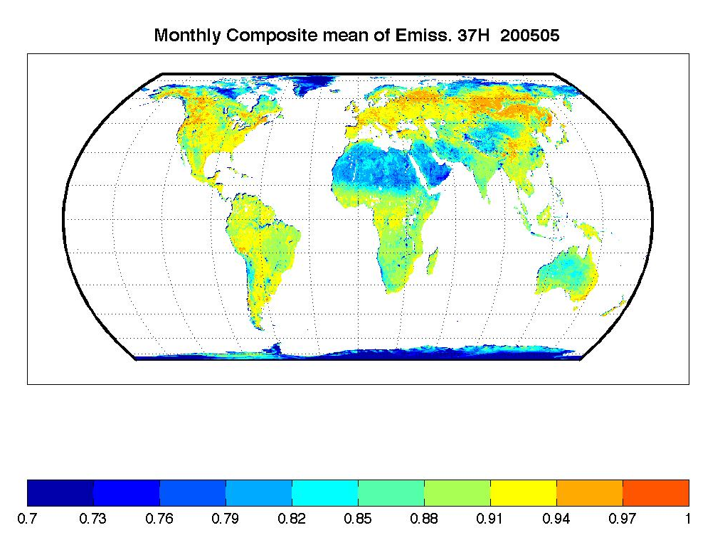
Assessment of assimilating ATMS land surface
sensitive observations in the NOAA data assimilation system
(Marouane Temimi, Kibrewossen Tesfagiorgis, Sid Boukabara)
Currently NOAA operational forecast system does not account for radiances observed in window channels which are highly sensitive to surface parameters.
Assimilating dynamic land surface emissivity values has positive impact on weather prediction (e.g. Karbou et al., 2010).
In this study:
Land surface emissivity will be assimilated into the Hybrid version of GSI (EnKF/VAR)
We intend to make use of ATMS microwave observations
Cloud free/thin cloud observations will be assimilated
We will assess the improvement in the forecast of extreme event like major hurricane and the prediction of their tracks.
Example of CREST microwave land emissivity product

Slide 36
Forecast Impact of High-Latitude, Mixed-Platform AMVs on GDAS/GFS
(Brett Hoover and Dave Santek)
Experiments use May 2011 GDAS/GFS
northern hemisphere warm season (02 May – 24 July 2011)
northern hemisphere cold season (23 November 2011 – 09 February 2012).
10-week experiment is run assimilating mixed-platform low-earth-orbiting (LEO) and geostationary-earth-orbiting (GEO) satellite AMVs in every 6-hr cycle, producing a 7-day forecast every day at 0000 UTC.
LEO/GEO AMVs were read into the GDAS from a separate archive at the same time that conventional AMVs were read in from the prepBUFr file.
LEO/GEO AMVs were screened with a simple quality control to reject any observation with a QI value below 0.75 but to otherwise let the GDAS perform quality control on them as if they were conventional MODIS AMVs.
Notes:
1 of 1: Brett Hoover, Project name listed as: MODIS-and AVHRR-Derived Polar Winds Experiments Using the NCEP
Brett Hoover¹, Dave Santek¹, Matthew Lazzara¹, Rich Dworak¹, Chris Velden¹, Jeff Key², and Nick Bearson¹ ¹Cooperative Institute for Meteorological Satellite Studies (CIMSS), Space Science and Engineering Center (SSEC), University of Wisconsin – Madison. 1225 W. Dayton St. Madison, WI, USA
²National Oceanographic and Atmospheric Administration (NOAA), National Environmental Satellite, Data, and Information Service (NESDIS), Center for Satellite Applications and Research (STAR), Advanced Satellite Products Branch, 1225 W. Dayton St. Madison, WI, USA

Slide 37
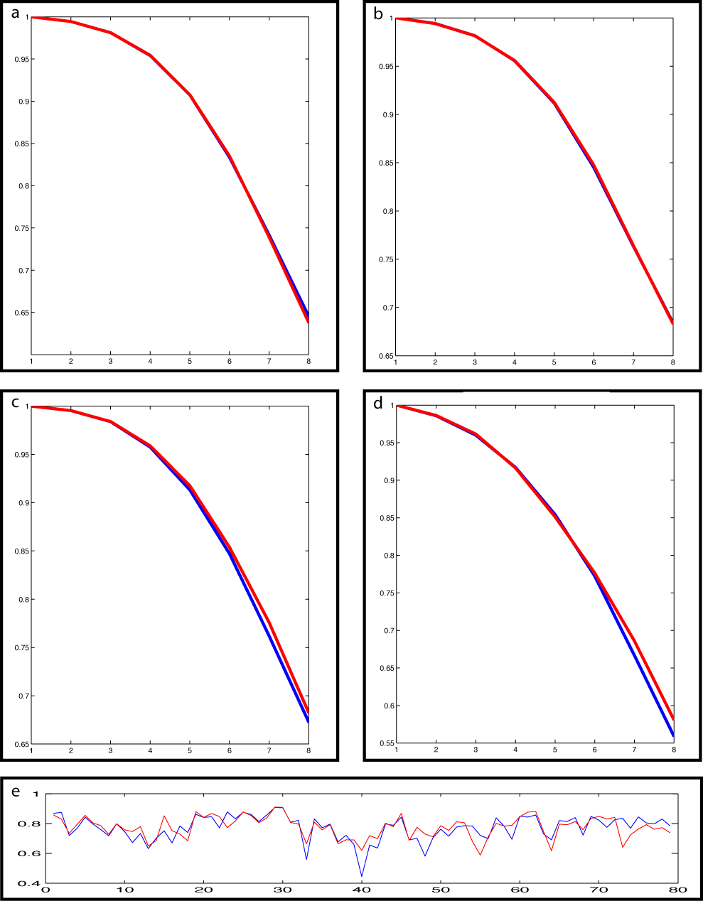
Forecast Impact of LEO/GEO AMVs in the GFS Model
12-week LEO/GEO experiments (red) conducted in both warm and cold seasons are compared to controls (blue) with only conventional data.
Assimilation of LEO/GEO AMVs into the GDAS/GFS produces a negligible impact on mean scores in the northern hemisphere (a, b), and a positive impact in the southern hemisphere beyond four days (c, d).
Impact is relegated largely to dropout events (e); while dropouts in the northern hemisphere occur, they are rare enough that their mitigation has a neutral impact on the mean anomaly correlation scores.
500mb Z
500mb Z
NH SUMMER
NH WINTER
500mb Z
500mb Z
SH WINTER
SH SUMMER
NOAA GOES-R Risk Reduction Program: NA06NES4400002
500mb Z SH Winter (Day 5)

Slide 38
Progress on regional assimilation experiments using GSI (Jun Li, Pei Wang, Jinlong Li)
GSI has been implemented for experiments with WRF-ARW on S4;
Conducted experiments on microwave sounders (4 AMSU) and IR sounder (AIRS) radiance measurements on tropical cyclone (Irene 2011) forecasts, GTS (conventional data)
GTS+AIRS
GTS+AIRS+AQUA(1AMSU from Aqua)
GTS+AIRS+4AMSUA (NOAA 15, NOAA18, Metop-A and Aqua)

Slide 39
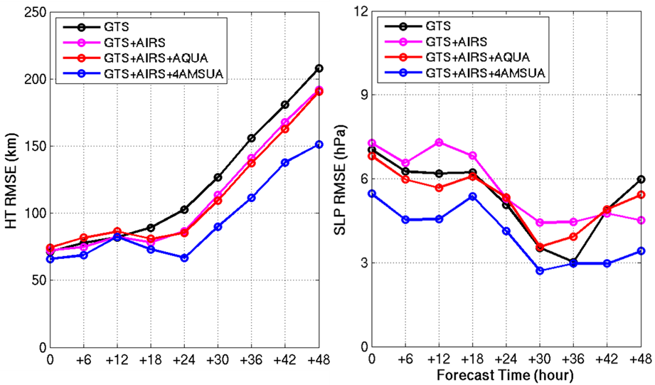
Assimilation and forecast experiments for Hurricane Irene (2011)
Data are assimilated every 6 hours from 06 UTC August 22 to 00 UTC August 24, 2011 followed by 48-hour forecasts (WRF regional NWP model with 12 km resolution). Hurricane track (HT) (left) and central sea level pressure (SLP) root mean square error (RMSE) are calculated
Notes:
In all the assimilation experiments, data are assimilated every 6 hours from 06 UTC August 22 to 00 UTC August 24, 2011 followed by 48-hour forecasts, the spatial resolution of WRF is 12 km in these experiments. Figure 2 shows the track and intensity (central sea level pressure) root mean square error (RMSE) for the forecasts of 00 hour, 06 hour, …., and 48 hours. The 00 hour forecast is from the analysis after assimilation. The AIRS and AMSU channels used are the same as that that used in the NCEP global NWP models, and AIRS and AMSU radiances are used in these experiments. It can be seen than when AIRS and all available AMSU (NOAA15, NOAA18, Aqua and Metop –A) are used, the track and intensity forecasts have the best accuracy (smallest RMSEs) during the forecast period, indicating that both advanced IR and microwave sounder data are needed for improving the tropical cyclone forecasts. Since the soundings are ingested into the PrepBUFR format, our next work is to compare assimilation of radiances and assimilation of soundings.

Slide 40
Future Plans
Test and use the newer GSI (May 2012) which includes NPP ATMS data
Compare GSI regional assimilation of AIRS radiances versus soundings, find pros and cons
Ingest total precipitable water (TPW) into PrepBUFR format for GSI, prepare for regional assimilation of TPW from GOES-R, ATMS, GCOM AMSR-2
Conduct regional experiments on assimilating NPP ATMS data with GSI.

Slide 41
Improved Lateral Boundary Conditions for NAQFC NAM-CMAQ AQ Forecasts
(Brad Pierce, Todd Schaack and Allen Lenzen)
Using climatological 3-dimensional (3D) tropospheric P-L distributions to predict background ozone concentrations within GFS provides a cost effective means of improving background ozone predictions within National Air Quality Forecast Guidance Capability (NAQFC) NAM-CMAQ.
Funded by the NASA Air Quality Applied Science Team (AQAST) to support assimilation of IASI/CrIS ozone profile retrievals within GDAS under JSDI
Have conducted GDAS/GFS cycling experiments with GEOS-CHEM monthly mean POX, LOX during July 2011 to assess impact on GFS meteorological forecast skill
Positive or neutral impact needed to move forward with development
Next step: Generate full year (or multi year) AM3 POX, LOX climatologies for use in GDAS/GFS
Notes:
1 of 1: R. Bradley Pierce, Todd Schaack, Allen Lenzen, Craig Long, Chris Barnet, Daniel Jacob and Arlene Fiore

Slide 42
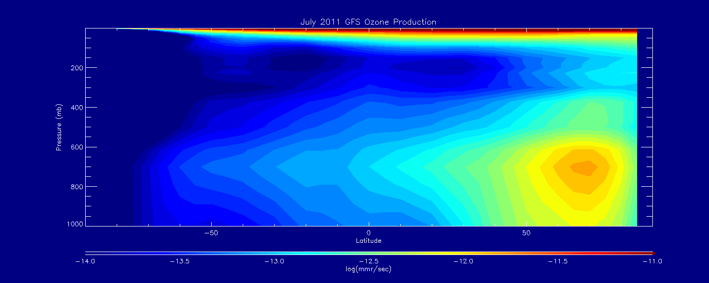
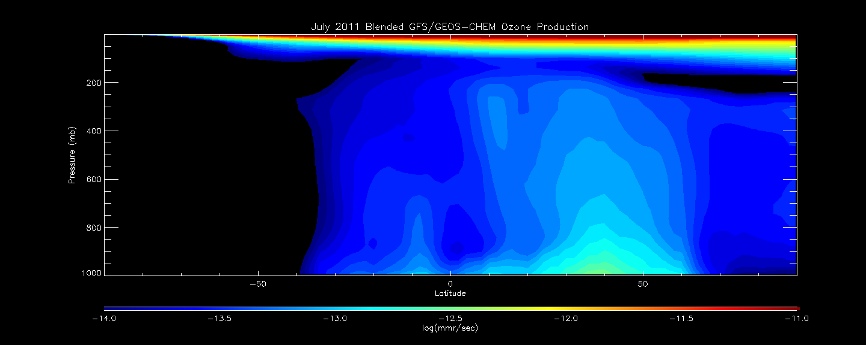
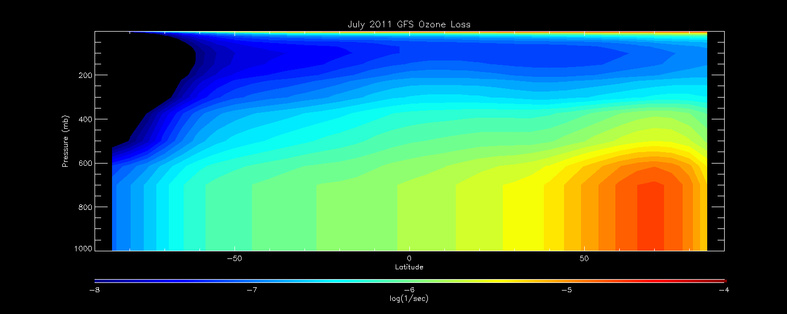
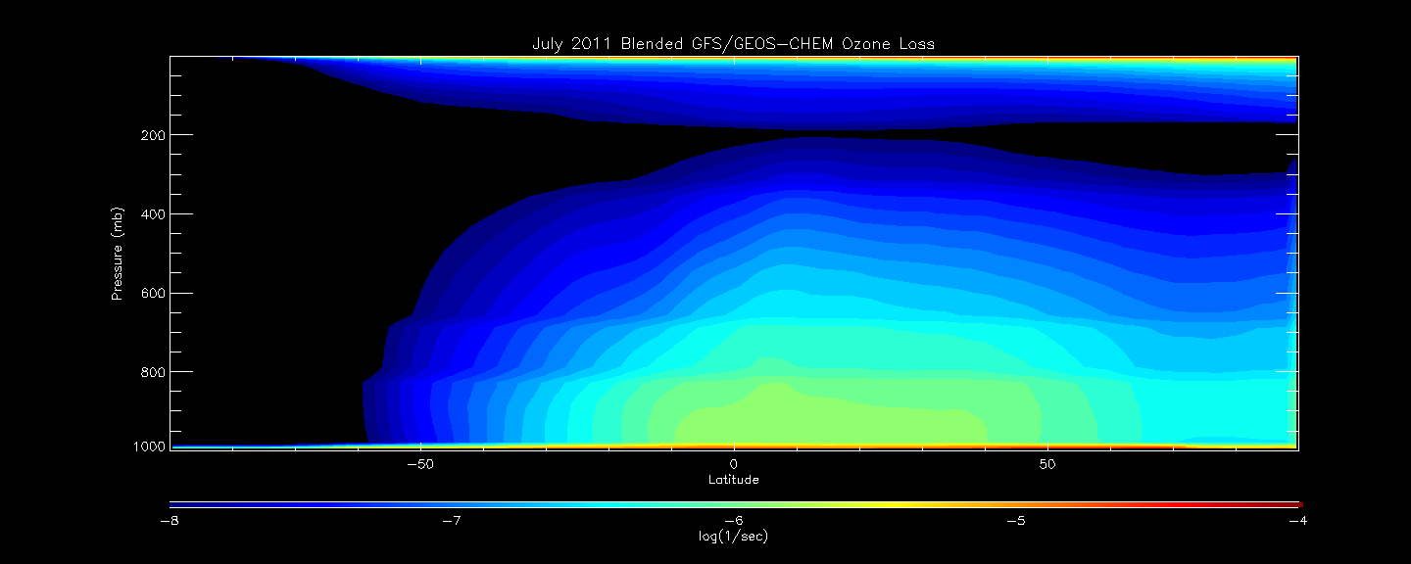
July 2011 3D merged
GFS + GEOS-CHEM O3 L
Default GFS July O3 PL

Slide 43
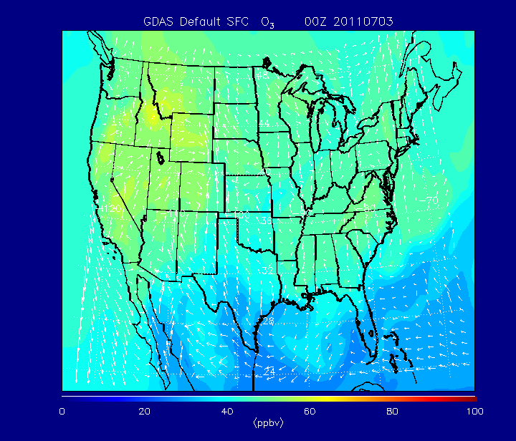
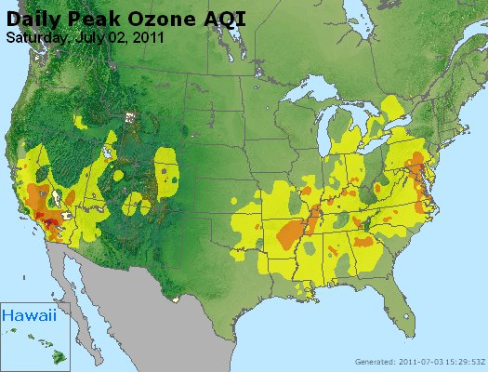
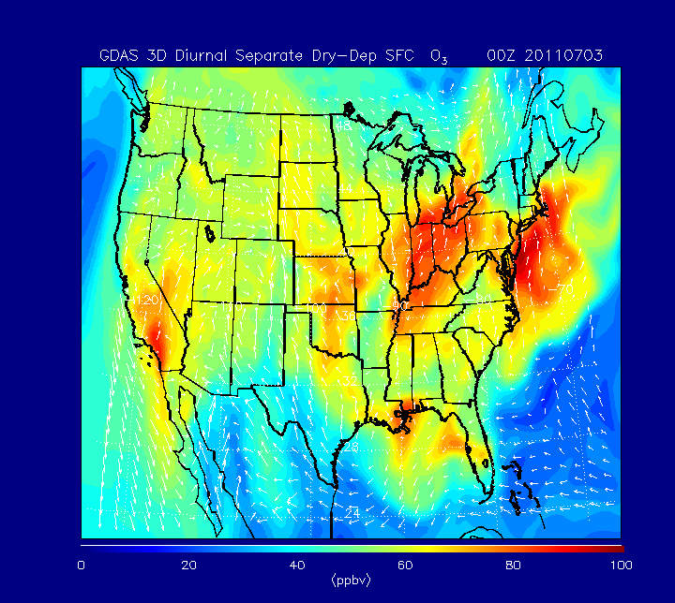
July 02, 2011 Observed Daily Peak Ozone AQI

Slide 44
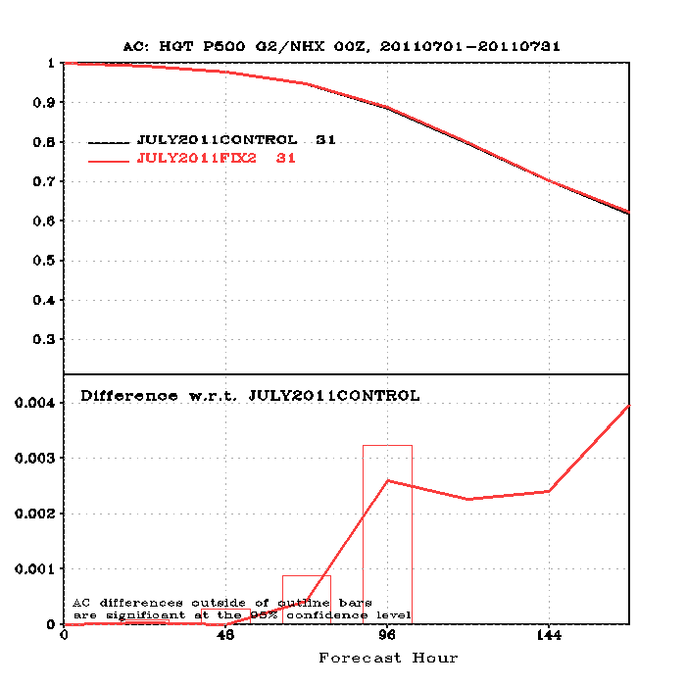
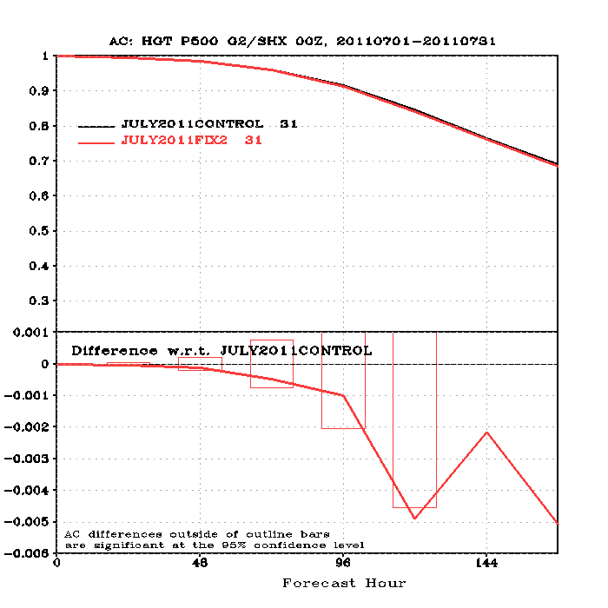
July 2011 GDAS/GFS 3D O3 PL Forecast Experiments
Neutral Impact (slightly positive in NH, slightly negative in SH)

Slide 45
Assimilation of Aerosol Optical Depth (AOD) in CMAQ Model to Improve Surface PM2.5 Forecasts
Objective
Develop GSI capability to assimilate operational AOD products in a regional air quality model to improve surface PM2.5 forecasts
Accomplishments
GOES AOD to BUFR format converter – To satisfy NCEP’s requirement for observational inputs in BUFR format. Currently works for GOES-11, -12 and -13 satellites and can be easily adaptable for other satellites
CMAQ IOAPI to NEMSIO format converter – To satisfy NCEP’s requirement for model I/O data. Combines data from multiple CMAQ IOAPI files into a single NEMSIO data file
GOES AOD read module – A section of code to read GOES AOD BUFR data
CMAQ first guess input module – A collection of subroutines to read CMAQ model first guess fields in NEMSIO format and to convert from CMAQ’s C-grid to analysis grid (A-grid)
CMAQ aerosol property module – To define aerosol data type holding CMAQ aerosol related variables. Options to compute model AOD from the CMAQ aerosol fields with or without CRTM
Model AOD background error statistics – The AOD background error standard deviations and correlation length scales were estimated with different methods.

Slide 46
Summary
Significant resources invested in porting and benchmarking GDAS/GSI on S4 and JIBB
GDAS/GSI Data Denial Experiments completed on JIBB
Hybrid Ensemble ATMS Experiments completed on S4
Established protocol for validating port to new systems (Jung et al., 2012)
Used for GDAS/GSI port to S4
Will be applied to current effort aligning port of Hybrid/Ensemble on S4 and Zeus
Have established stronger ties with NCEP GDAS/GSI development team
NCEP participation in NESDIS DA meetings (GAADA) appreciated and welcome
NESDIS participation in NCEP GSI meetings has been very informative and helpful
Continuing to work towards alignment of new development with Operational weather models (Hybrid/Ensemble, HWRF, NMMB)
Currently NESDIS development is passed onto NCEP for review
NESDIS internal review process may be necessary
James A. Jung, R. Bradley Pierce, Dave Santek, Allen Lenzen, “The NCEP GDAS/GFS porting procedures, verification metrics and benchmarking results between the NOAA R&D (Vapor), JCSDA-NASA (JIBB), and JCSDA-NESDIS (S4) computers”, NOAA Tech Report (under internal review)

Slide 47
Extra Slides

Slide 48
S4 Overview
Brief Technical Description
The S4 system is a Linux cluster (Dell hardware)
3072 CPU cores in 64 compute nodes with 8TB of total RAM
520 TB in 26 storage nodes
Quad data rate (40 Gbps) Infiniband interconnects between all compute and storage nodes
Lustre high performance filesystem for scratch space (4 x 80TB) and data storage (200 TB)
Hosted in the UW/SSEC Data Center (with UPS)
Major activities
(1) Undertake satellite data assimilation experiments at global and/or regional scales and the assessment of their impacts on forecast models skills, using currently flying satellite sensors and allowing scientists to test new science/methodology and
(2) In support of the activity above, undertake all necessary satellite data simulations, calibration, algorithms development/improvement, radiative transfer modeling and validation, quality control (QC) procedures, etc
(3) Perform Observing System Simulation Experiments (OSSEs) for new sensors (such as GOES-R and JPSS).
Supercomputer for Satellite Simulations and data assimilation Studies (S4), hosted by University of Wisconsin.

Slide 49
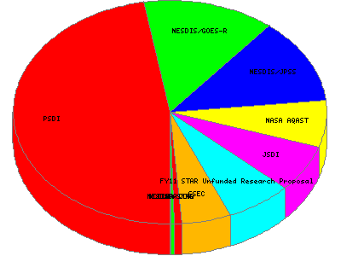
S4 Usage
Per Application Statistics
Per Funding Statistics
From Sun Mar 4 00:00:00 2012 UTC to Wed Apr 4 00:00:00 2012 UTC
Notes:
https://s4-web.ssec.wisc.edu/accounting/perJob_details_month.html

Slide 50
GDAS/GFS Ensemble Port to S4 (Jim Jung)
Libraries (w3, sp, ip, bacio, bufr, etc.)
Subversion library trunk
CRTM 2.0.5 is used by the GSI and POST
Subversion CRTM trunk
Global Forecast Model
Subversion gfs trunk
Utils directory and NCEPPOST
Copied from Zeus
ENKF pieces (for EUPD, ECEN, EPOS, etc.)
Subversion trunk

Slide 51
Contd.
Intel-12.1 compiler used vice Intel-11.0
All source code is compiled for the libraries and executables.
Anal, angu, fcst, post, vrfy, and arch are working
Initial tests and tuning are underway.
Hope to start the next inter-comparison in Sep.
Prep step is still work in progress
Most pieces are working but not verified
Separate inter-comparison will be conducted when the prep step is completed.

