Slide 1
GSI Review Committee NESDIS
R. Bradley Pierce
Jim Jung
15 January 2013

Slide 2
List of NESDIS GSI Related Projects
Marouane Temimi, Kibrewossen Tesfagiorgis and Collaborator Sid Boukabara
Assessment of assimilating ATMS land surface sensitive observations in the NOAA data assimilation system
James Jung: Port of GDAS Hybrid Ensemble to S4, JIBB, ZEUS
Brad Pierce, Todd Schaack , Allen Lenzen, Craig Long, Chris Barnet, Daniel Jacob and Arlene Fiore: IASI O3 band radiance data denial experiments
Jinlong Li and Jun Li:
GEO & LEO High impact weather study
Allen Lenzen:
HWRF Port to S4
Fuzhong Weng, Banglin Zhang, Lin Lin, Wei Han, Xiaoyan Zhang and Zaizhong Ma STAR HWRF 2012 Hurricane Forecasts: Assimilation of microwave imager data
Man Zhang & Milija Zupanski: Utility of GOES-R ABI Proxy Data for Hurricane Data Assimilation and Forecasting
Brett Hoover and Dave Santek:
A Context-Sensitive MODIS AMV Quality Control: Ratio of Expected Error to Observed Wind Speed
Li Bi, J. Whiting, X. Su:
OSCAT Assimilation
Bin Li: Satellite Ocean Data Assimilation Capability
Kevin Garrett and Xiaoyan Zhang: ATMS Impact Assessment
Milija Zupanski, Man Zhang, and Karina Apodaca: Regional Hybrid Variational-Ensemble Data Assimilation Development and Applications
David Santek: Polar Winds in GDAS/GFS & Leo/Geo high latitude AMVS
Sean Casey:
Early morning orbit OSSE Analysis
Sharon Nebuda J. Daniels, X. Su: GOES-R AMV Assimilation
Li Fang:
Dual Assimilation of Microwave and Thermal Infrared Observations of Soil Moisture
GDAS
WRF/GSI
HWRF/GSI

Slide 3
Port of HYB GDAS onto S4/JIBB/ZEUS
(Jim Jung, UW-Madison/SSEC)
All steps of GDAS (Prep, Hurricane location, Ensemble) have been ported to S4/JIBB/ZEUS
Minor version differences between CCS, Zeus, and JCSDA machines
JIBB and S4 have identical code, global_gsi, global_fcst, nceppost and libraries are different on Zeus
JIBB, Zeus and S4 are compared to NCEP operations.
Winter Season Jan 15-Feb 29, 2012 completed
Increased daily variability in AC scores are observed wrt previous comparisons due to:
Prep step
Hybrid ensembles

Slide 4
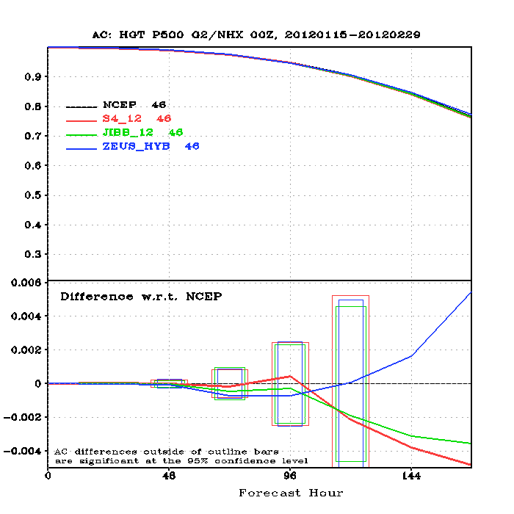
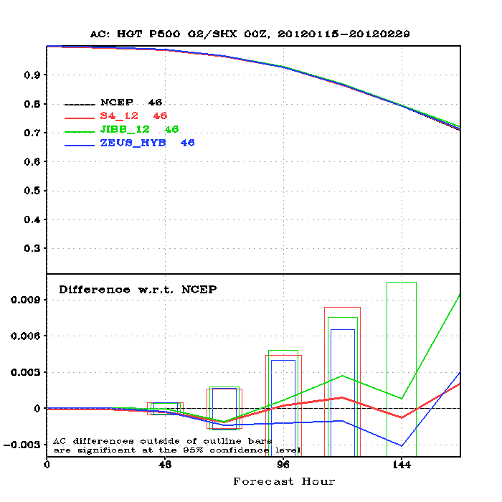
HGT Anomaly Correlation die off curve at 500 hPa
15 January – 29 February 2012
No statistically significant differences in NH or SH 500hPa 0-5 day Height FX at the 95% confidence level.

Slide 5
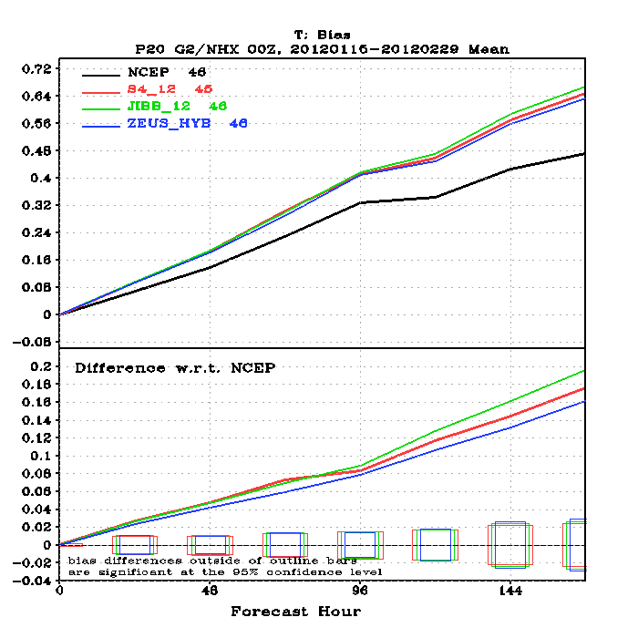
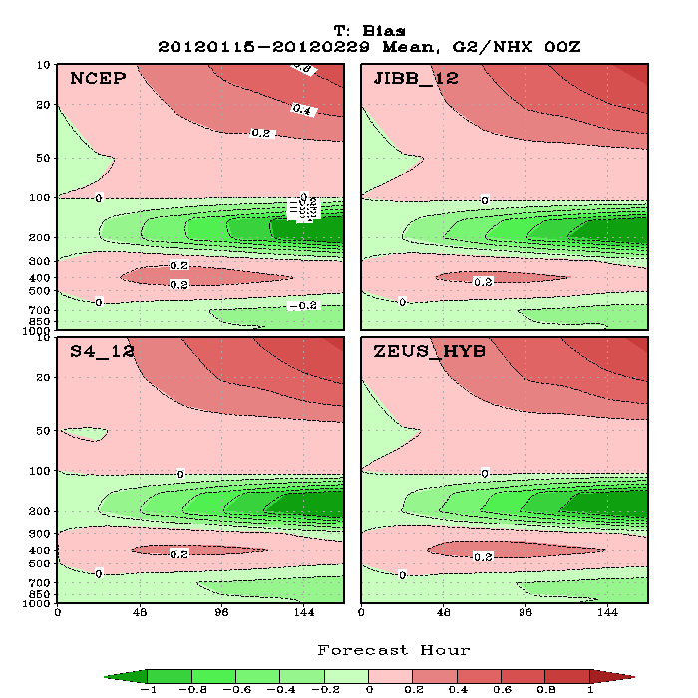
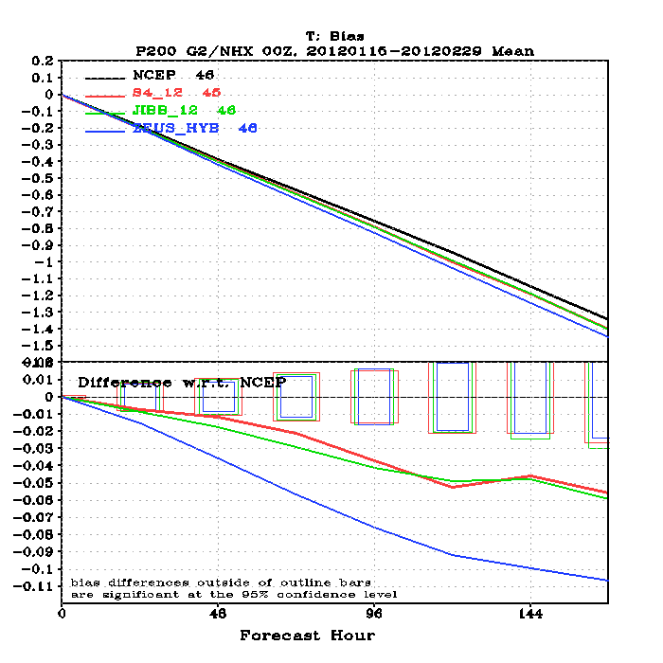
Northern Hemisphere T Bias
15 January – 29 February 2012
Statistically significant differences in Northern
Hemisphere Temperature Biases.

Slide 6
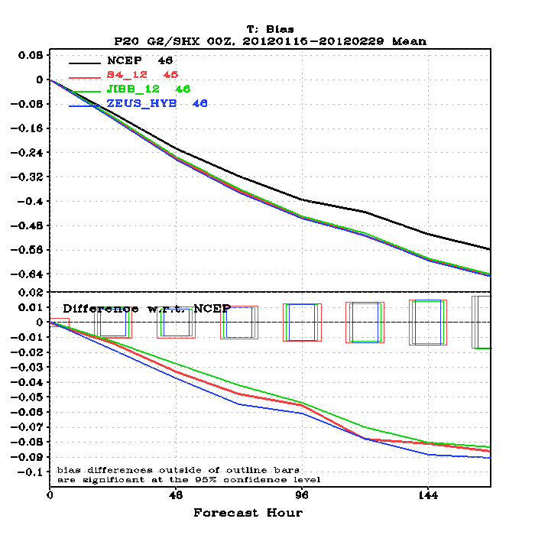
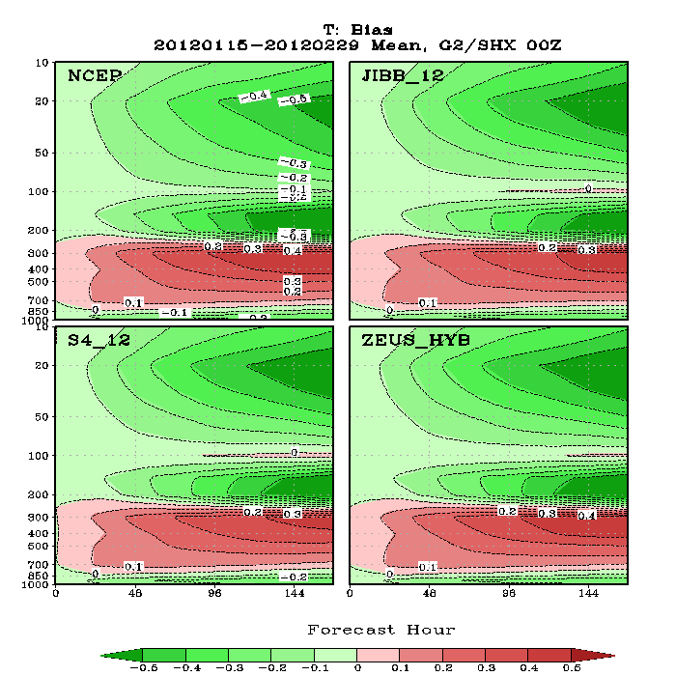
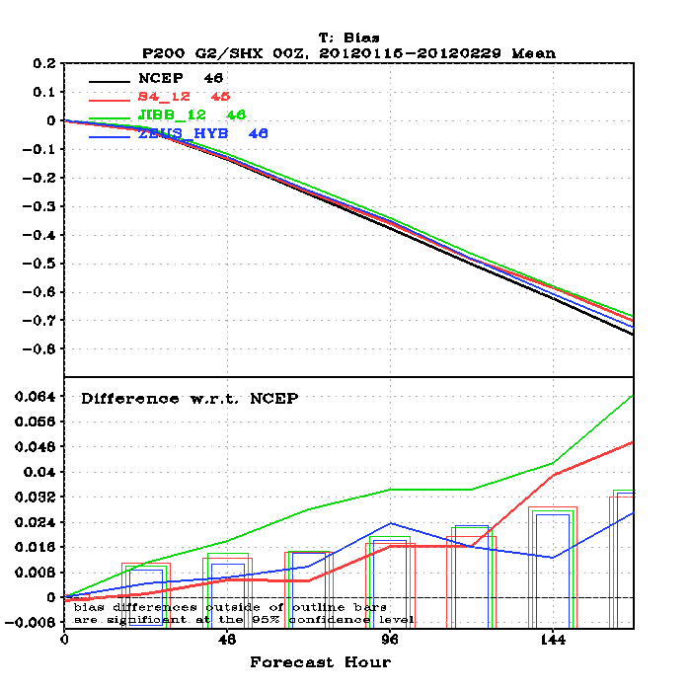
Southern Hemisphere T Bias
15 January – 29 February 2012
Statistically significant differences in Southern
Hemisphere Temperature Biases.

Slide 7
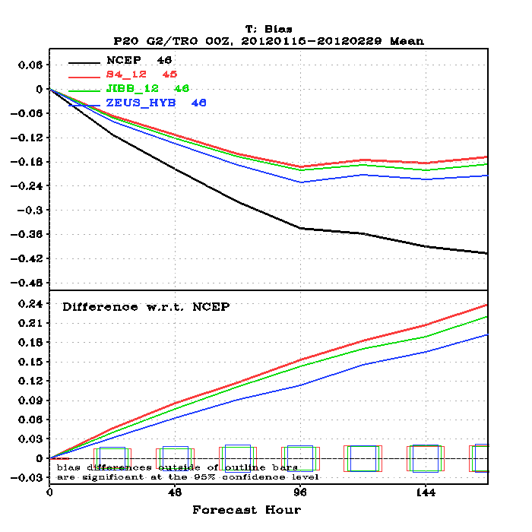
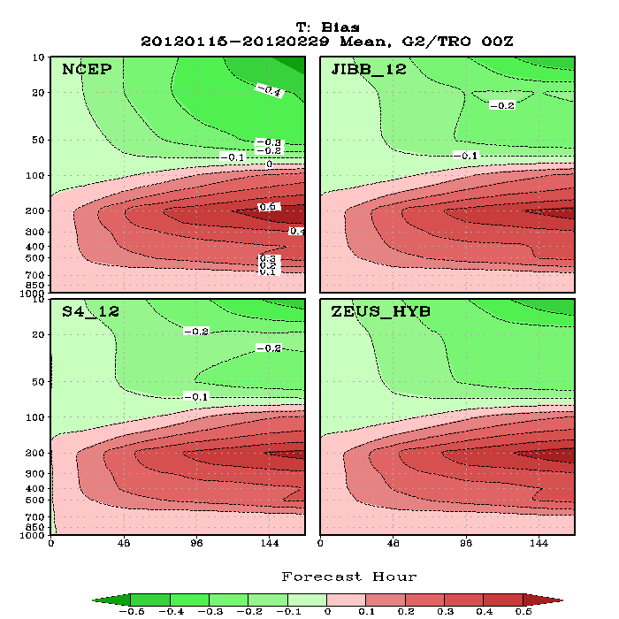
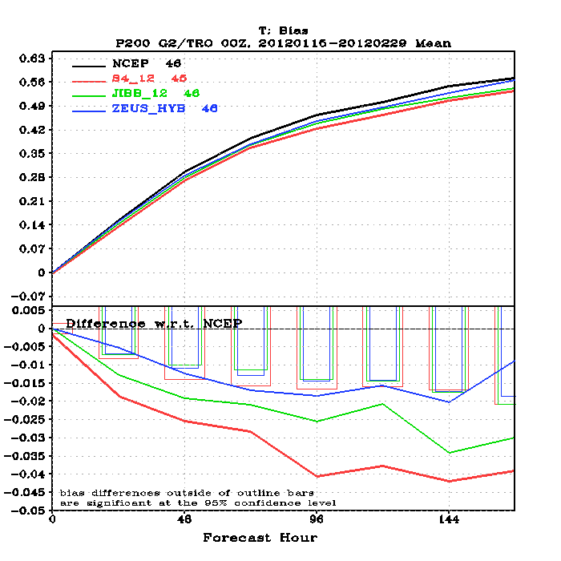
Tropical T Bias
15 January – 29 February 2012
Statistically significant differences in Tropical
Temperature Biases.

Slide 8
Impact of IASI ozone channel radiance assimilation
(Brad Pierce, NESDIS/STAR)
Zeus, JIBB, and S4 experiments had IASI ozone channel radiance assimilation OFF
Could account for some of the temperature bias differences
May 2011 NCO GDAS port to S4 had IASI Metop-A ozone channels ON (no polar flag).
Conducted July 2011 experiment to test impact of IASI ozone channels
Global_satinfo.txt
iasi616_metop-a 1479 -1 1.990 6.000 10.00 0.000
iasi616_metop-a 1509 -1 2.120 6.000 10.00 0.000
iasi616_metop-a 1513 -1 2.090 6.000 10.00 0.000
iasi616_metop-a 1521 -1 2.080 6.000 10.00 0.000
iasi616_metop-a 1536 -1 2.100 6.000 10.00 0.000
iasi616_metop-a 1574 -1 1.910 6.000 10.00 0.000
iasi616_metop-a 1579 -1 1.700 6.000 10.00 0.000
iasi616_metop-a 1585 -1 1.770 6.000 10.00 0.000
iasi616_metop-a 1587 -1 1.830 6.000 10.00 0.000
iasi616_metop-a 1626 -1 1.910 6.000 10.00 0.000
iasi616_metop-a 1639 -1 1.990 6.000 10.00 0.000
iasi616_metop-a 1643 -1 1.990 6.000 10.00 0.000
iasi616_metop-a 1652 -1 2.070 6.000 10.00 0.000
iasi616_metop-a 1658 -1 2.020 6.000 10.00 0.000
iasi616_metop-a 1671 -1 2.060 6.000 10.00 0.000

Slide 9
HGT Anomaly Correlation die off curve at 500 hPa
1 July – 31 July 2011
Northern Hemisphere
Southern
Hemisphere
No statistically significant differences in NH or SH 500hPa 0-5 day Height FX at the 95% confidence level.

Slide 10
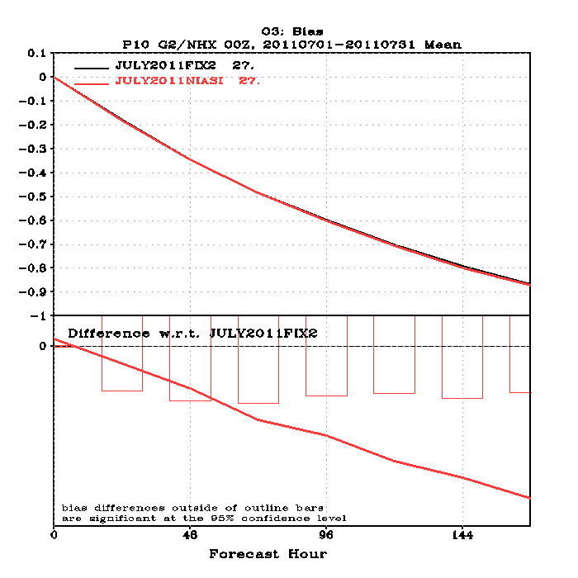
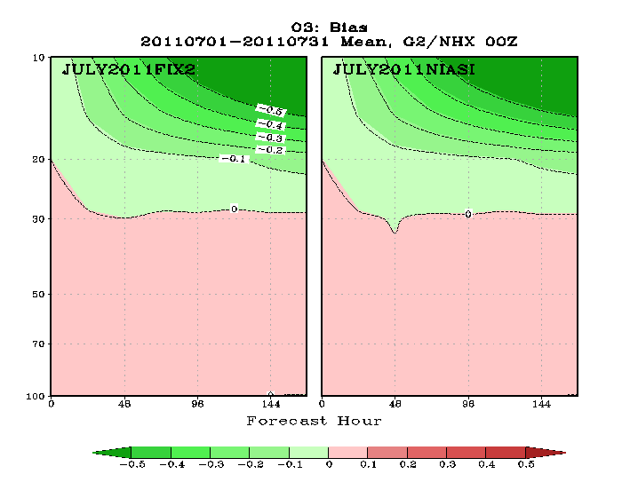
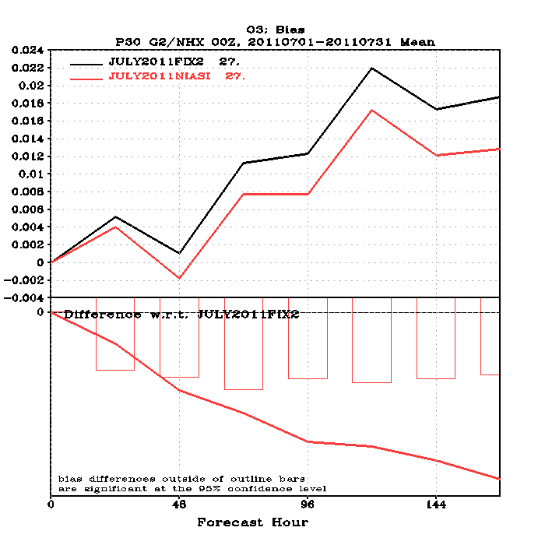
Northern Hemisphere O3 Bias
1 July – 31 July 2011
Statistically significant differences in Northern Hemisphere
Ozone Biases without IASI O3 channel assimilation.

Slide 11
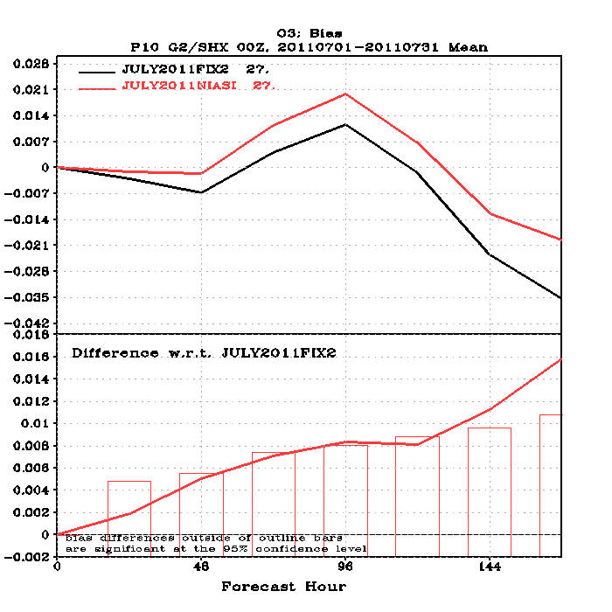
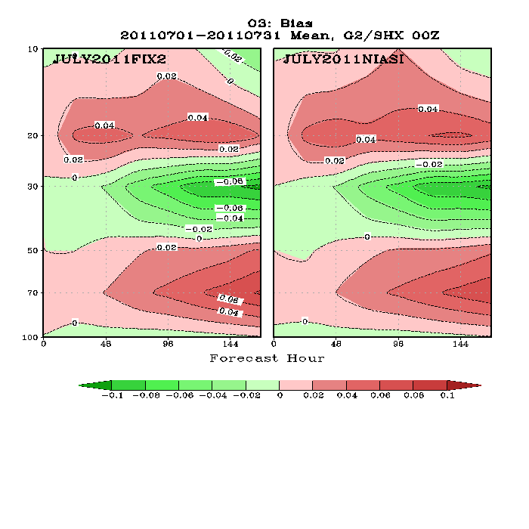
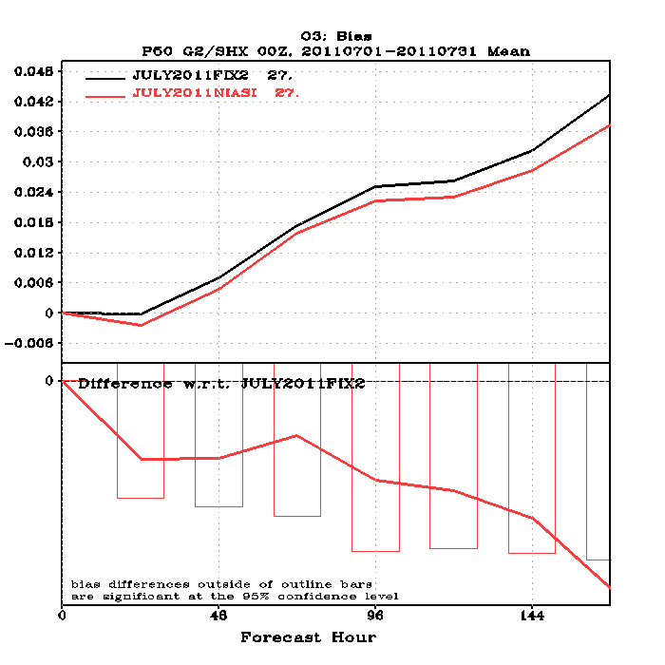
Southern Hemisphere O3 Bias
1 July – 31 July 2011
No statistically significant differences in Southern Hemisphere
Ozone Biases without IASI O3 channel assimilation.

Slide 12
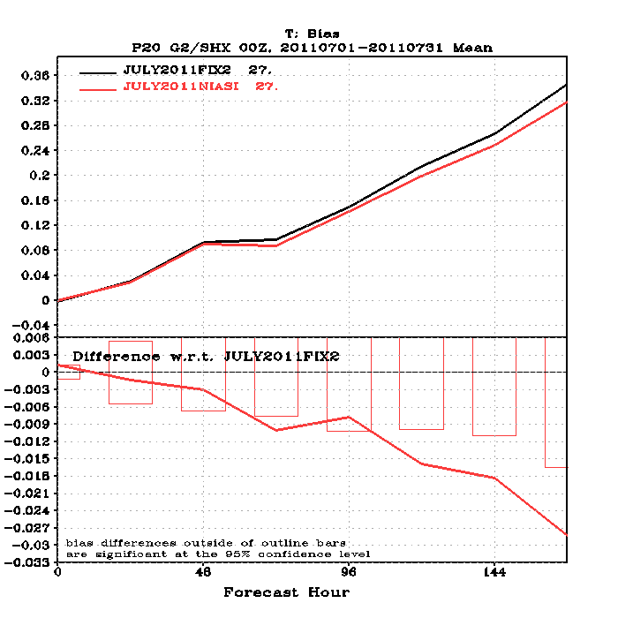
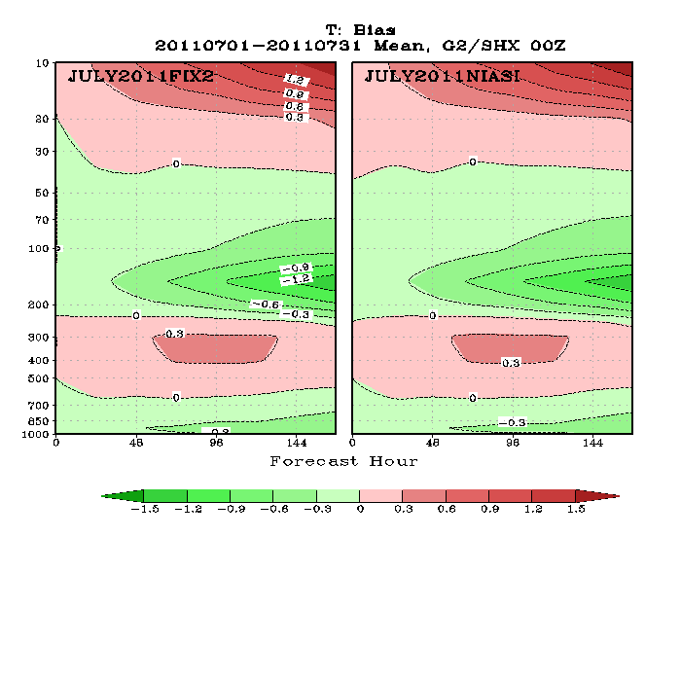
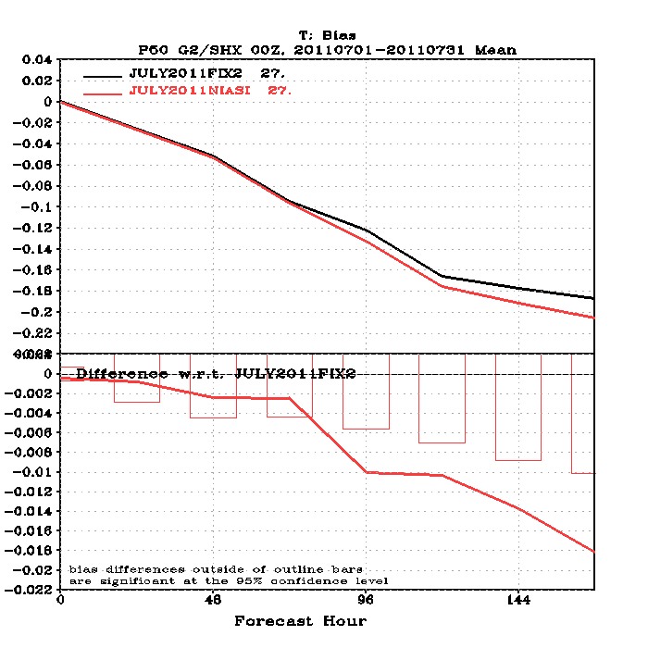
Southern Hemisphere T Bias
1 July – 31 July 2011
Statistically significant differences in Southern Hemisphere
T Biases without IASI O3 channel assimilation.

Slide 13
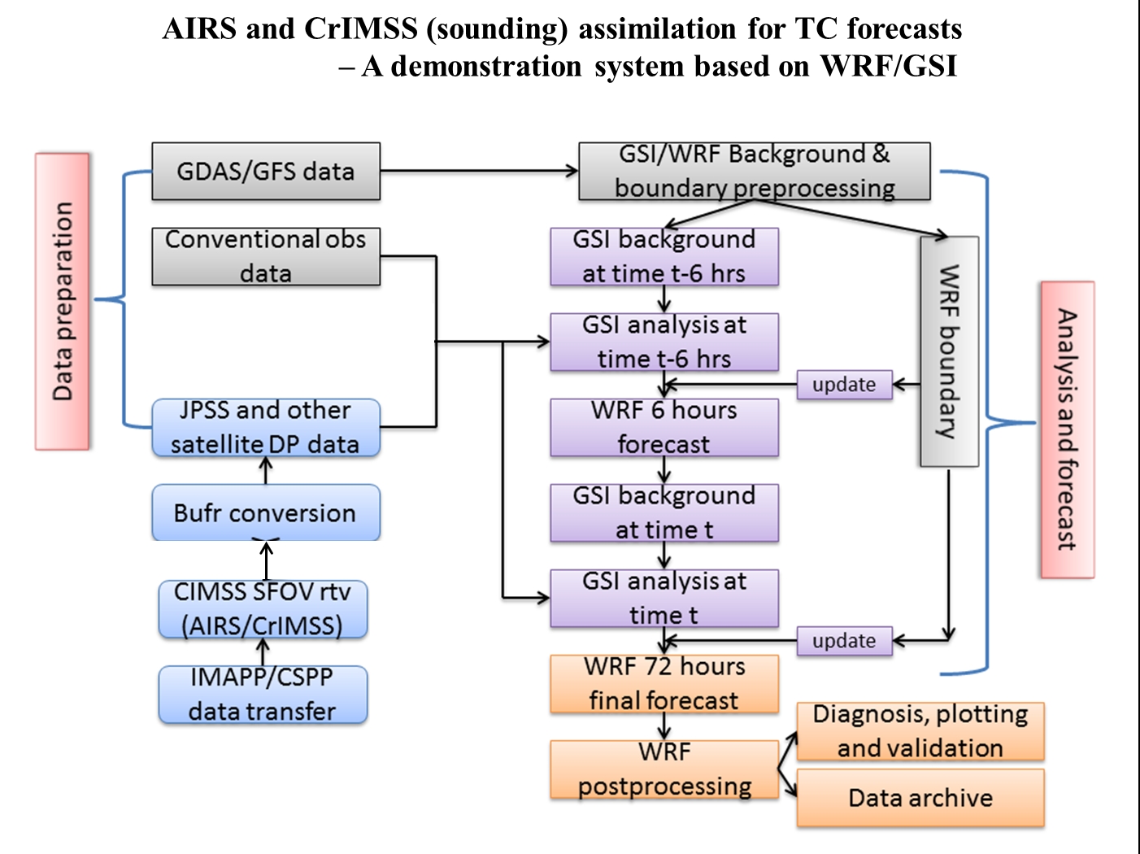
Improving tropical cyclone forecasts with advanced sounding measurements
(Jun Li, UW-Madison/CIMSS)

Slide 14
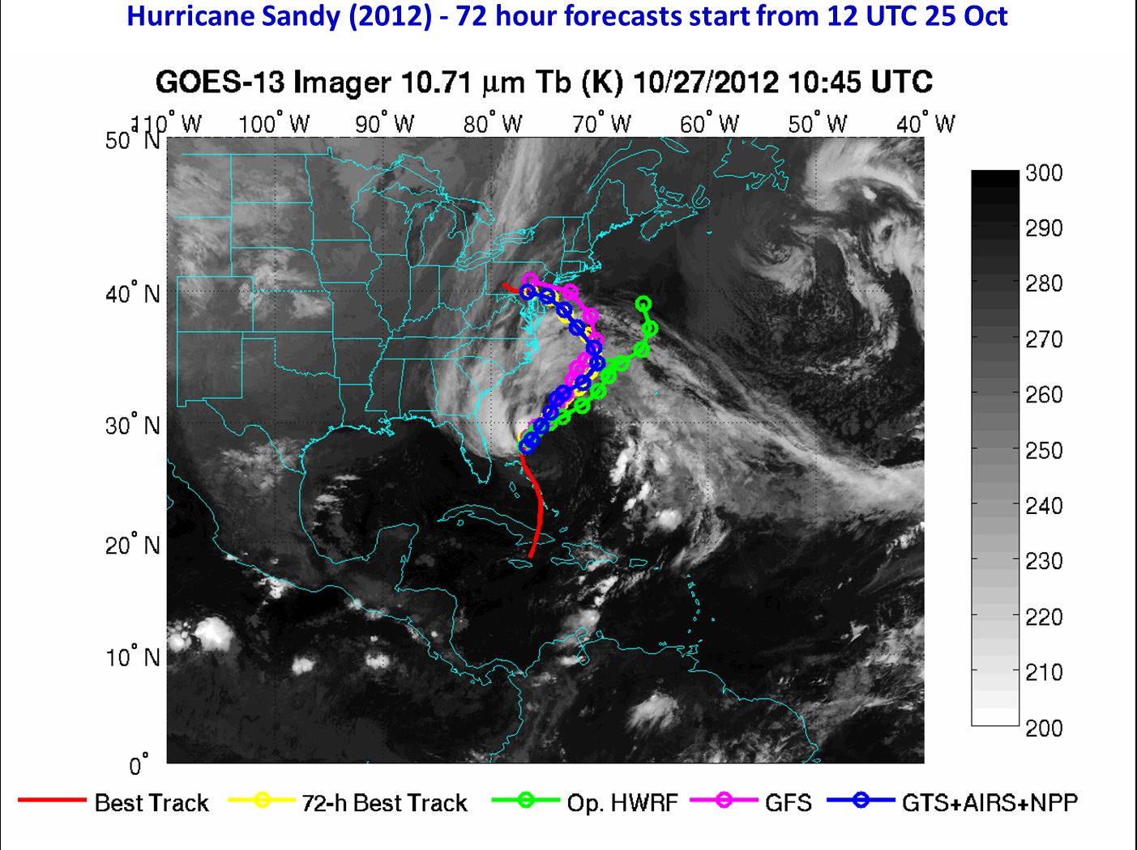

Slide 15
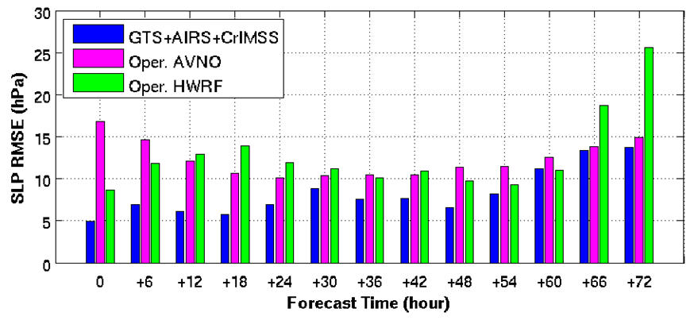
Sandy (2012) forecasts experiments – 72 hour track and intensity forecast RMSE
Track forecast RMSE
SLP forecast RMSE
Sandy forecast RMSE (km) from CIMSS experimental (WRF/GSI with 12 km resolution) with GTS, AIRS and CrIMSS data assimilated, operational HWRF, and GFS (AVNO). Forecasts start from 12 UTC 25 Oct and valid 18 UTC 30 Oct 2012.

Slide 16
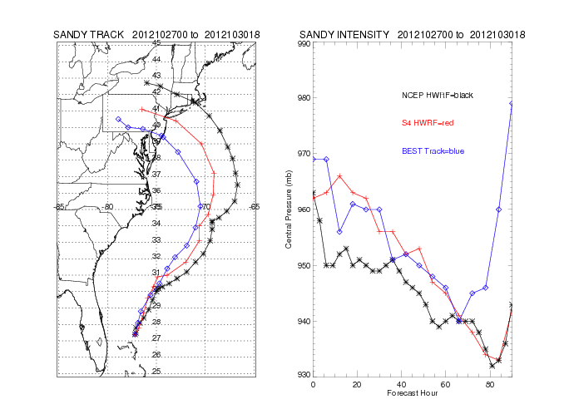
Benchmark of HWRF S4 Port (Allen Lenzen, UW-Madison SSEC)
HWRF on S4 is DTC trunk as of November 20, 2012
Rev: 926 Last Changed Date: 2012-09-28
Code was compiled on S4 with minor changes to a few perl and ksh scripts.
Tests completed for 2012 hurricanes NADINE (cold start and cycling) and SANDY (cold start, cycling experiments underway)
Need to align with operational cold start/cycling procedure
Error in ocean_init.sh (lack of loop current data) no ocean coupling

Slide 17
Near-term Focus (next 6 months):
GDAS:
Complete summer season HYB GDAS benchmark
Setup and Test T1148L64 GDAS
Conduct ATMS data denial experiments (Kevin Garrett)
Quality Control experiments with the MODIS polar winds (Dave Santek)
Complete one season OSCAT assimilation experiments (Li Bi)
Complete one season GOES-R proxy AMV experiments (Sharon Nebuda)
HWRF
Coordinate with NCEP (Vijay Tallapragada’s team) to align benchmark of HWRF S4 port with NCEP 2012 hurricane season benchmark (Allen Lenzen, Xiaoyan Zhang)
GSI:
Implement 1dvar version of Microwave Integrated Retrieval System (MiRS) into GSI (Kevin Garrett)

