Slide 1
GSI Review Committee NESDIS
R. Bradley Pierce
Jim Jung
7 May 2014

Slide 2
List of NESDIS GSI Related Projects
Kevin Garrett : ATMS Impact Assessment (On hold until next GSI upgrade)
MiRS 1DVAR preprocessor implementation
James Jung: AIRS/IASI/CrIS Water vapor experiments
Dave Santek:
Polar Wind QC
Sharon Nebuda/J. Daniels
GOES-R AMV Assimilation
Jun Li:
Satellite Data Assimilation for Tropical storm forecasts – SDAT
Tong Zhu:
GSI Thinning Optimization
David Groff, Paul van Delst, Quanhua Liu, Emily Liu
FASTEM5 diffuse downwelling reflection correction
Ming Chen and Fuzhong Weng
Land Physical MW Emissivity Model Updates and Testing
Other things to mention (not finalized)
- GPM data assimilation (by Erin Jones, with Kevin)
- AMSR2 data assimilation (Erin Jones, with Kevin as well)
- AMV data assimilation optimization (by E. Maddy).
GDAS/GFS
GOES-R
Regional GSI DA
CRTM
Further information available at the JCSDA Directed Research Review Website
(http://www.jcsda.noaa.gov/DRT.php)

Slide 3
Passive Microwave Data Assimilation
Update on MIIDAPS integration into GSI
First look MIIDAPS – SSMI/S assessment
The Multi-Instrument Inversion and Data Assimilation pre-Processing System (MIIDAPS) is a Quality Control (QC) and pre-processing system used as a tool to pre-process satellite data (microwave and IR sensors) before they are assimilated into the GSI system.
Kevin Garrett

Slide 4
GSI Radiance Preprocessing
Preprocessing to characterize and gather the best observations for the analysis
Characterize surface – surface type, emissivity
Characterize atmosphere – clear sky, rain/cloud/ice amount
Perform Quality Control (Can the observation be modeled?)
Select most optimal set of radiances to assimilate
Goals
Enhanced Quality Control
Clear-sky radiance assimilation
Increased utilization of satellite radiances assimilated
Surface sensitive channels
Cloudy/precipitation impacted radiances
The preprocessing tool being integrated in GSI is the MIIDAPS
Application dependent
Kevin Garrett

Slide 5
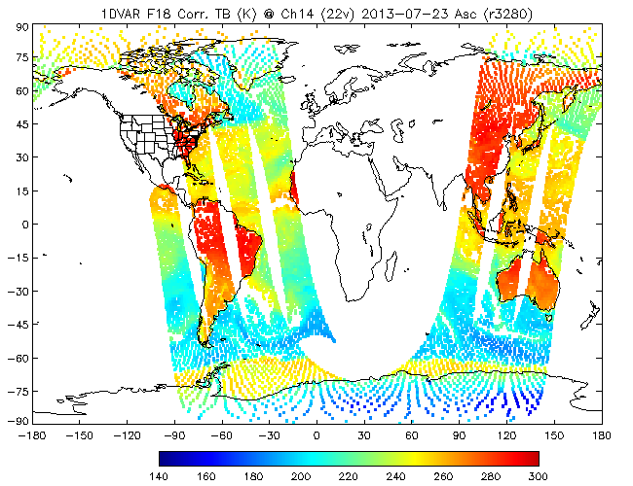
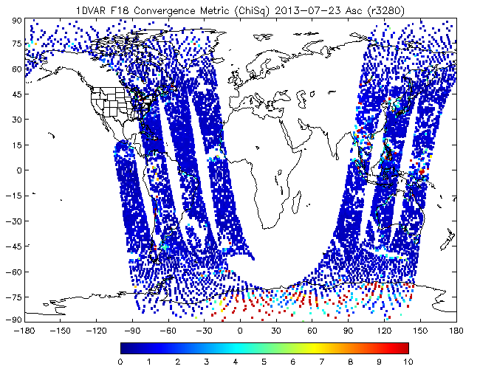
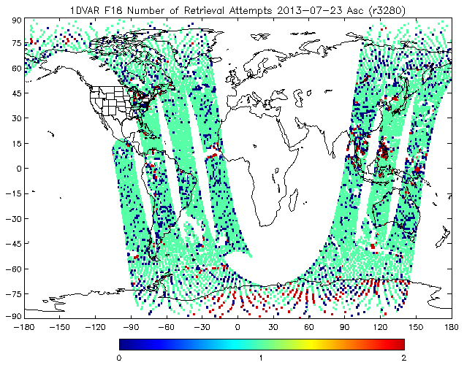
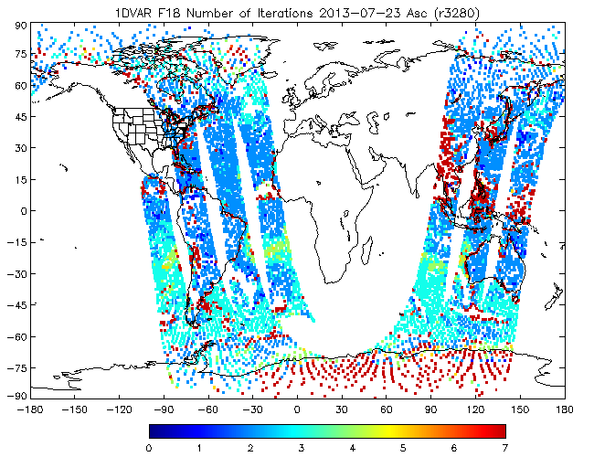
1DVAR Preprocessor – SSMI/S
a)
b)
(a) F18 SSMI/S 22 GHz Corrected Brightness Temperature, and 1DVAR QC outputs including (b) ChiSq, (c) Number of Retrieval Attempts (max 2), and (d) Number of iterations for minimization (max 7)
c)
d)
Many points in (c) show zero retrieval attempts which needs to be investigated.
Case day 2013-08-23 (00Z Cycle)
Kevin Garrett

Slide 6
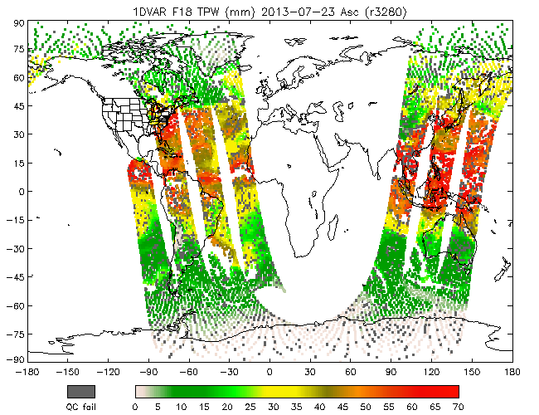
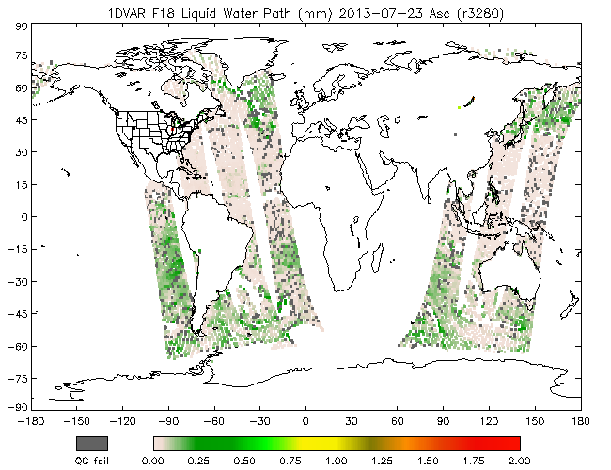
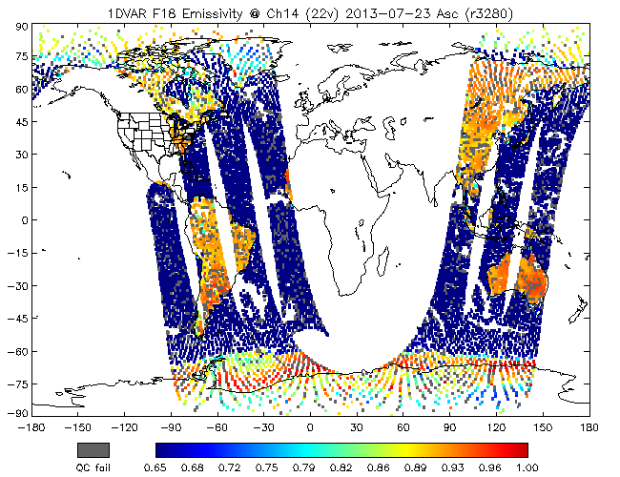
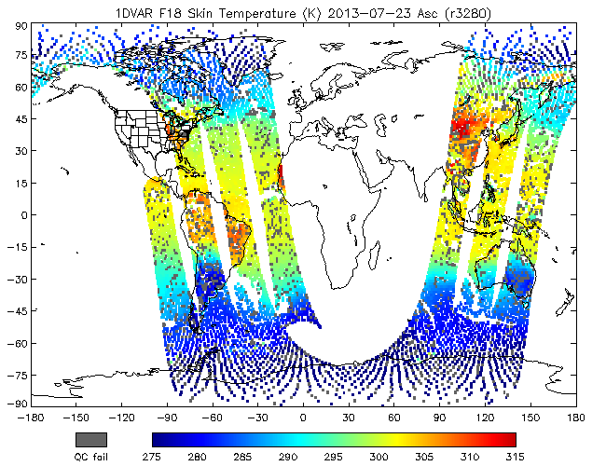
1DVAR Preprocessor – SSMI/S
a)
b)
(a) 1DVAR retrieved TPW (b) Liquid Water Path, (c) 22 GHz surface emissivity, and (d) skin temperature
c)
d)
Case day 2013-08-23 (00Z Cycle)
Kevin Garrett

Slide 7
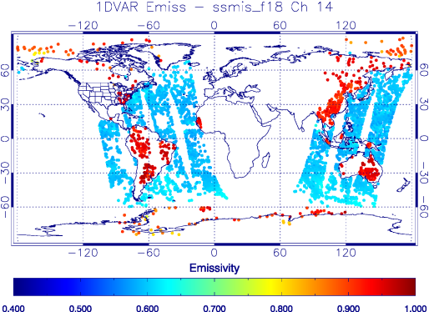
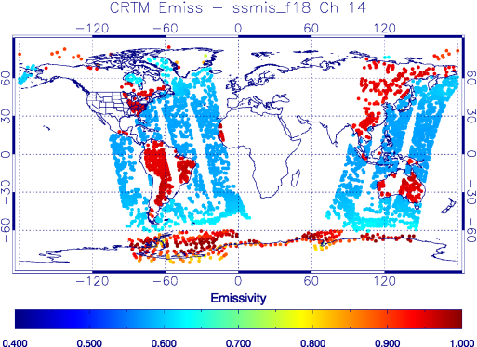
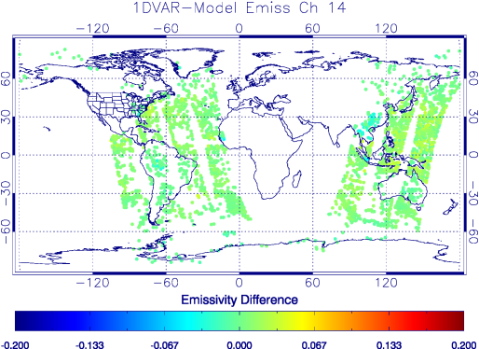
1DVAR Impact on Assimilation
O-B using 1DVAR Dynamic Emissivity as input to simulation
O-B using Emissivity from model as input to simulation (default)
Case day 2013-08-23 (00Z Cycle)
Kevin Garrett

Slide 8
Future Work
Preliminary integration of the 1DVAR preprocessor has been completed and tuned (further tuning is required)
ATMS
Assessments for data quality, spatial averaging, thinning
Retune QC based on MIIDAPS output
Use of dynamic emissivity to increase surface channel obs assimilation
Begin assessment of ATMS data/MIIDAPS in non-clear sky application in GSI
Impact experiments
SSMI/S (led by Deyong)
Perform SSMI/S radiance quality assessment (including F19), spatial averaging – focus on imaging channels
Optimize processing/QC based on MIIDAPS (similar to ATMS work)
Use of dynamic emissivity (similar to ATMS work)
Begin assessment of ATMS data/MIIDAPS in non-clear sky application in GSI
Impact experiments
AMSR2/GMI (led by Erin)
Finish GSI plumbing
Follow tasks from SSMI/S, ATMS work
Kevin Garrett

Slide 9
Water Vapor Experiments: Phase 1 Jung
Completed 2 season experiments
Clipping supersaturation before, during and after assimilation
Use clipping supersaturation and q instead of RH from ensembles to determine background error (with Daryl Kleist)
NCEP wiki tickets #346 and #338 for more information
Merged to NCEP trunk 3/17/2014
To use: Add to setup namelist
clip_supersaturation=.true.
factqmax=50.0 (tunable)
q_hyb_ens=.true.
Jim Jung

Slide 10
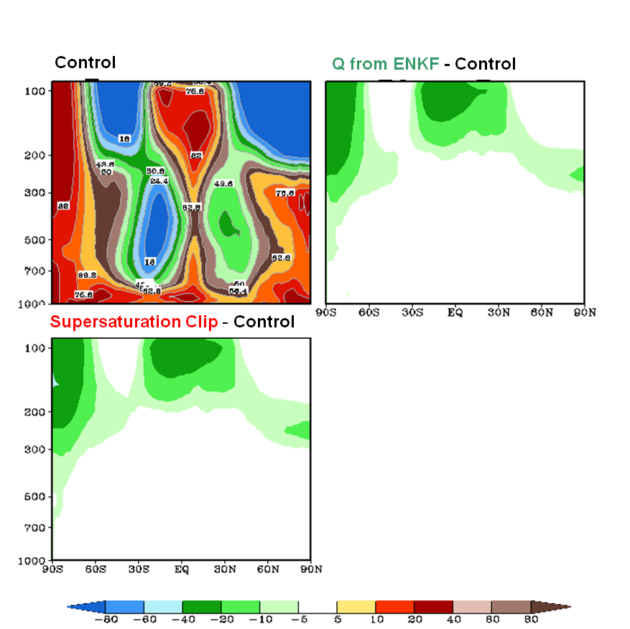
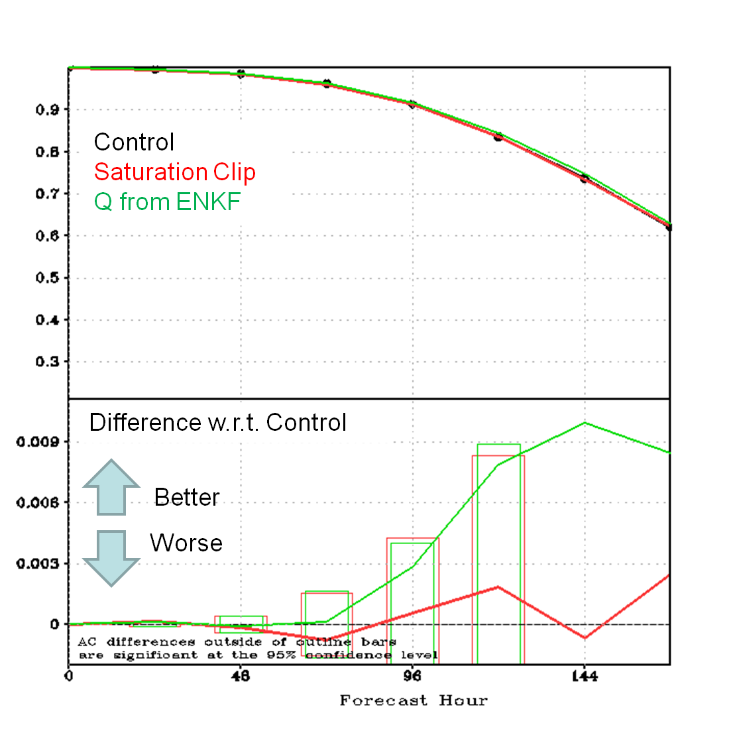
Water Vapor Experiments: Phase 1 Results Jung
Northern Hemisphere
500 hPa
Zonal mean analysis of relative humidity for the control.
Mean analysis differences for the supersaturation clip and Q from ENKF experiments.
Analysis is drier, especially in the mid and upper troposphere and less clouds for Supersaturation Clip.
Minor differences for Supersaturation Clip + Q from ENKF
Most statistics are neutral for Supersaturation Clip and better for Supersaturation Clip + Q from ENKF
Jim Jung

Slide 11
Water Vapor Experiments; phase 2 Jung
Finish NCEP GDAS/GFS upgrade on JIBB and S4
Review QC procedures for MW and IR water vapor channels currently used by GDAS.
Adjust gross error check
Adjust assimilation weights
Review water vapor channel selection for AIRS, IASI, and CrIS.
Remove AIRS stratospheric channels
Add tropospheric channels for IASI and CrIS.
Two season impact tests.
Jim Jung

Slide 12
Polar Wind QC NA10NES4400011
David Santek, Brett Hoover, Sharon Nebuda
r29119 hybrid GDAS/GFS on S4
Quality Control experiments with satellite-derived polar winds:
Subversion branch SANTEK_POLAR_AMV
Modified setupw.f90 and read_satwnd.f90 for assimilating AVHRR polar winds.
Modified code to use Log Normal Vector Departure (LNVD: OMB_Vector_Departure/log(Wind_Speed)) for all polar winds; results are encouraging and most experiments will be ending soon:
Control (Fall 2012) (complete)
MODIS using LNVD (complete)
AVHRR using Control QC; AVHRR AMVs replace MODIS (complete)
AVHRR using LNVD (50% complete)
Control (Spring 2013) (50% complete)
MODIS using LNVD (complete)
This project ends 31 May 2014. Working with Iliana Genkova to get code changes checked in.
Dave Santek

Slide 13
MODIS using LNVD
1 September to 25 October 2012: The die off curves for the MODIS winds using the LNVD show a statistically significant improvement in the 500 hPa ACC for the 4- and 5-day Southern Hemisphere forecast.
ACC of the 500 hPa geopotential heights over the Southern Hemisphere (20°S-80°S) for the control (black) and experiment (red), using a LNVD threshold of 3.
The impact over the Northern Hemisphere is neutral (not shown).
Significant
ACC averaged over 46 days
Dave Santek

Slide 14
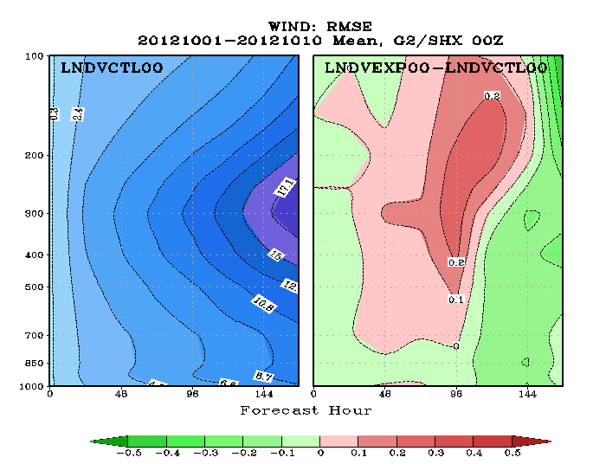
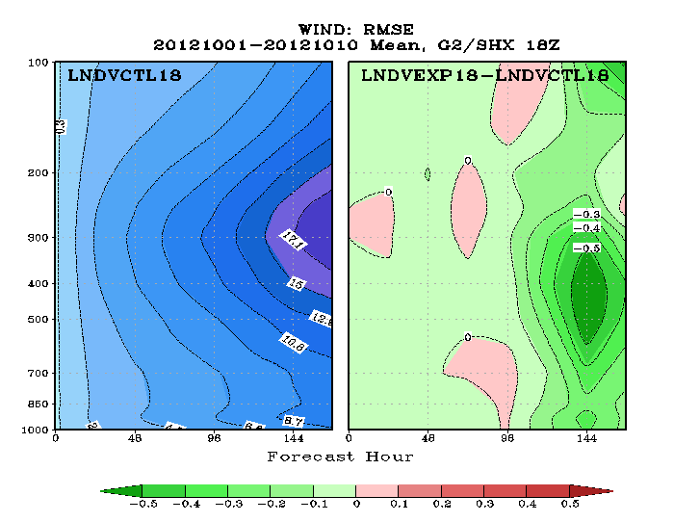
Different Verification Time
Forecast impact typically measured with 00 UTC model run (Most input data)
What is AMV impact when radiosondes not available?
Examine impact for 18 UTC model run (initial results: 1-10 October 2012) for MODIS LNVD experiment vs. the Control using the operational MODIS winds QC.
00 UTC verification (left) shows a negative impact (red) to Day 4 in the troposphere.
18 UTC verification (right) shows a mostly positive impact throughout, with peak at Day 6.
00 UTC
18 UTC
Green: Reduce vector RMSE Red: Increase vector RMSE
500 hPa Wind RMSE 1-10 October 2012
Dave Santek

Slide 15
GOES-R AMV Assimilation
Developing Assimilation Techniques for Atmospheric Motion Vectors (AMV)
Derived via a New Nested Tracking Algorithm Derived for the GOES-R ABI
CIMSS/SSEC Contributors: James Jung, Sharon Nebuda, David Santek
NOAA Collaboration Project Partners: Jaime Daniels, NESDIS/STAR
Progress Aug 2013 – Apr 2014:
Selected QC procedures and determined optimal observation error settings
Completed and evaluating 2 seasons experiment and control with 6 hourly proxy
GOES-R AMVs using GFS T574 ENKF
Collaborating with EMC by sharing code modifications and results
through biweekly meetings
Intended Project Outcomes:
Develop GOES-R AMV assimilation QC procedures
Evaluate data assimilation and forecast impact using GOES-R AMVs
Assist in transitioning the newly-developed QC techniques into the NCEP operational model
Future Work:
Investigate hourly GOES-R AMVs impact on the GFS with consideration given to the
appropriate observation error and thinning strategies
Reevaluate near surface restrictions over ocean to allow lower AMVs
Sharon Nebuda
Notes:
15

Slide 16
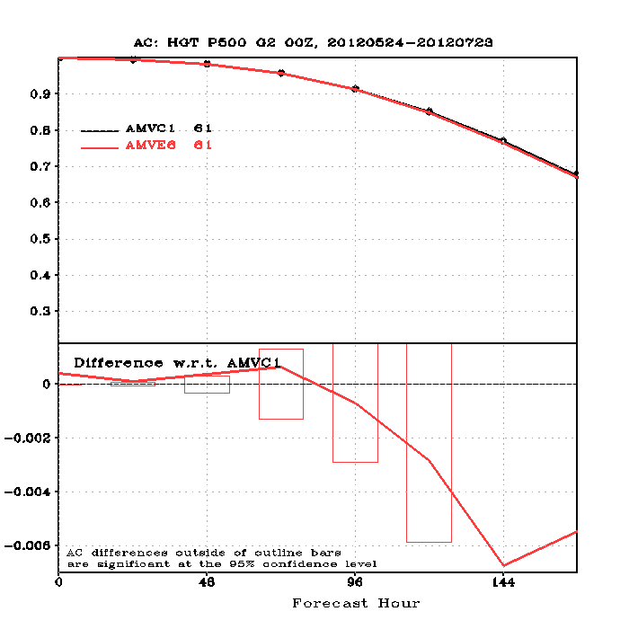
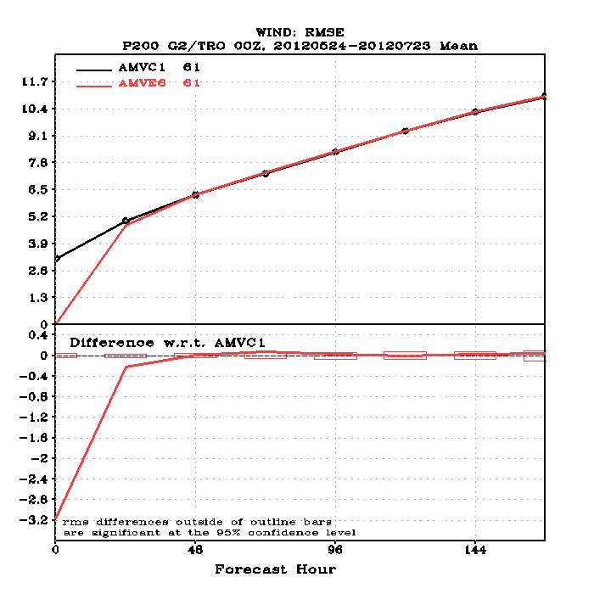
GFS Assimilation Results
Two seasonal simulations were completed using 6 hourly GOES-R AMVs as well as their corresponding
control simulations without the GOES-R AMVs. Forecast skill impact was neutral to slightly positive.
Results from 24 May – 23 July, 2012 are shown for the experiment AMVE6 and the control AMVC1.
500 hPA HGT AC
200 hPa Tropical WIND RMSE
Sharon Nebuda

Slide 17
Satellite Data Assimilation for Tropical storm forecasts - SDAT
Goal(s):
Develop a near real time (NRT) system on the assimilation of advanced sounder data (radiance and/or retrievals), to improve the high impact weather (e.g., TC) forecasts;
Collaborate with users (e.g., NHC) to make direct application of SDAT forecasts;
Serve as research testbed for improving the assimilation of satellite data in regional NWP (e.g., handling clouds in radiance assimilation, using GOES-R WV information, etc.);
Provide a pathway towards JPSS/GOES-R data assimilation in operational TC forecast models (i.e. HWRF).
Satellite sensors used:
GOES Sounder, AMSU-A (N15, N18, N19, metop-a, aqua), ATMS (Suomi-NPP), HIRS4 (N19, metop-a), AIRS (aqua), IASI (metop), and MHS (N18, N19, metop).
Targeted NOAA users: NHC
Funding sources: JCSDA, JPSS PGRR, GOES-R HIW
Jun Li

Slide 18
Recent update
Tools have been developed to convert various derived products for GSI assimilation
Soundings (done)
TPW/LPW (done)
Cloud-cleared AIRS radiances (done)
Cloud-cleared CrIS radiances (ongoing)
Rapid Scan AMVs (planned in June/July time frame)
Forward and linear model of TPW/LPW in GSI
Forward/Jacobian have been implemented and tested in GSI
TPW/LPW now can be assimilated with GSI, which is useful for assimilating high temporal and spatial resolution GOES-R WV information in regional NWP.
Assimilation of TPW/LPW from GOES Sounder, AMSR-2, MODIS, SSMIS in SDAT (ongoing)
Studies have been conducted with WRF/GSI on handling clouds for IR radiance assimilation
A paper has been published on GRL recently: Wang, Pei, Jun Li, Jinlong Li, Zhenglong Li, Timothy J. Schmit, and Wenguang Bai, 2014: Advanced infrared sounder subpixel cloud detection with imagers and its impact on radiance assimilation in NWP, Geophysical Research Letters, 41,1773- 1780, doi:10.1002/ 2013GL059067.
SDAT (WRF/GSI) has been running in near real time (NRT) (http://cimss.ssec.wisc.edu/sdat) since August 2013 and is very stable. 2013 hurricane forecasts from SDAT show promising, we are working with NHC/NWS to put SDAT forecasts into the Automated Tropical Cyclone Forecast (ATCF) system that NHC uses.
Jun Li

Slide 19
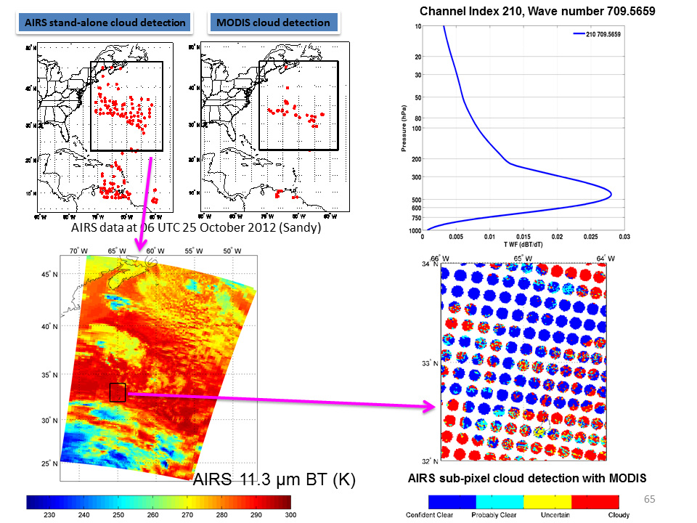
Wang et al. (2014, GRL)
Jun Li

Slide 20
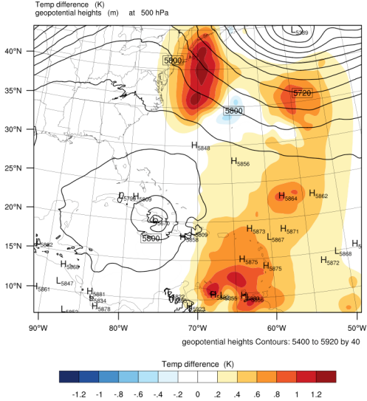
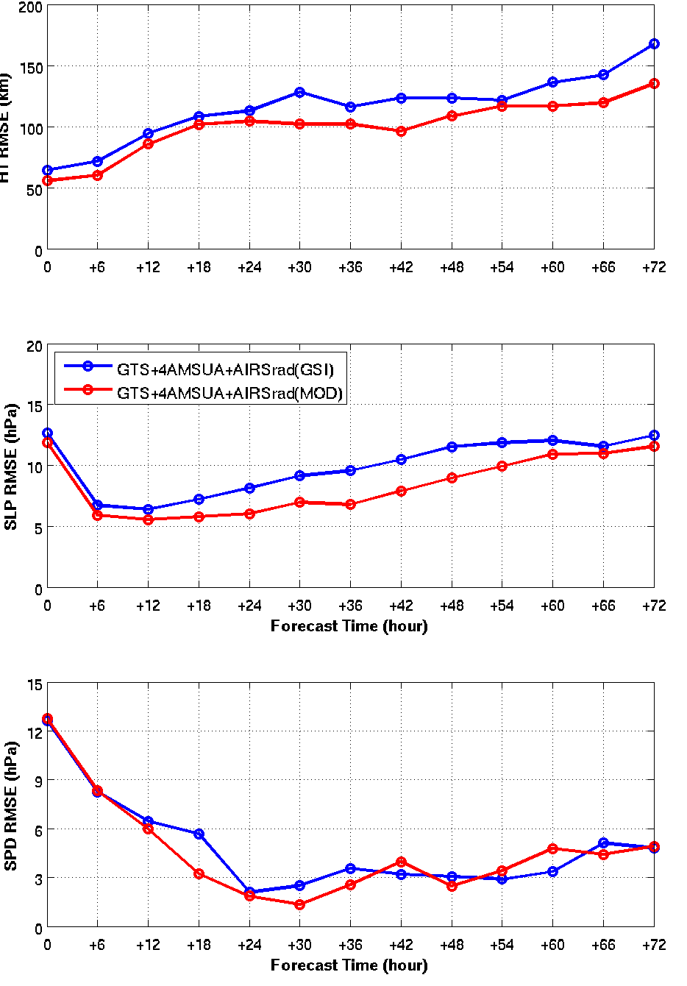
Hurricane Sandy (2012) forecast RMSE
(m/s)
500 hPa temperature analysis difference (AIRS(MOD) - AIRS(GSI))
Wang et al. 2014 (GRL)
72-hour forecasts of Sandy from 06 UTC 28 to 00 UTC 30 Oct, 2012
Jun Li

Slide 21
Near Future Plans
CrIS cloud-cleared radiances in GSI Bufr
Assimilating CrIS CC radiances in SDAT
Rapid scan AMVs into GSI Bufr
Assimilating RS AMVs in SDAT
Implementing hybrid GSI (e.g., using global ensembles)
Test SDAT with HWRF instead of WRF, compare WRF/GSI and HWRF/GSI
Jun Li

Slide 22
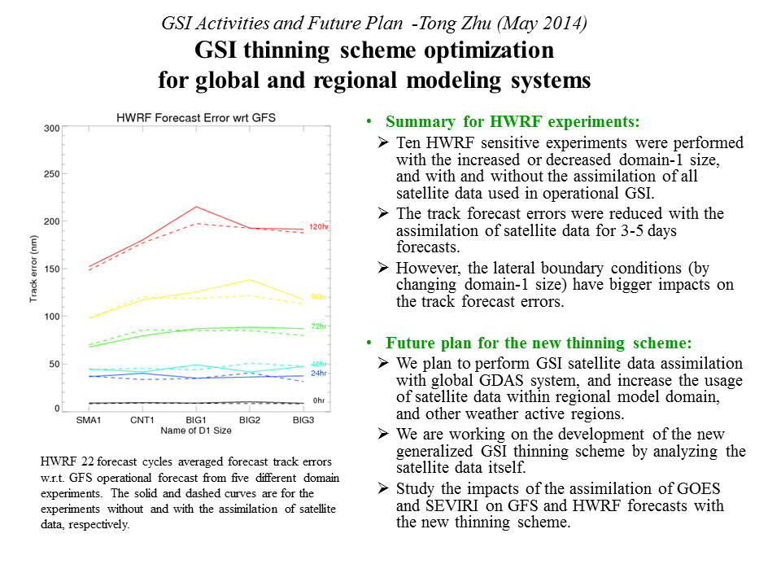
Tong Zhu

Slide 23
CRTM Surface Emissivity Changes
Emily Liu demonstrated that the inclusion of clouds in first guess fields was increasing the magnitude of (O-B) differences for AMSUA surface sensitive channels
Initially all input CRTM clouds were assigned as being non-precipitating.
The CRTM team identified that the FASTEM5 diffuse downwelling reflection correction component was incorrectly being turned off for non-scattering clouds.
David Groff

Slide 24
Example Reflection Correction Off (Compliments of Emily Liu)
David Groff

Slide 25
Example Reflection Correction On (Compliments of Emily Liu)
David Groff

Slide 26
Surface Emissivity Changes (cont.)
Currently multiple stream CRTM calculations do not account for a diffuse surface reflection component.
Need to add non-zero off diagonal contributions into the surface scattering matrices that are applied in scattering radiative transfer solver.
David Groff

Slide 27
Integration of Land Physical MW Emissivity Model Updates and Testing in GSI
A clean version of the updated land physical MW emissivity model was integrated in CRTM for testing in GSI.
Canopy RT formulation to account for the difference between canopy temperature and surface skin temperature
Column scattering with user-defined canopy structure in terms of leaf inclination angle distribution
Multi-layer soil by Burke (1979) and Desert model by Grody & Weng (2008)
Performed single-cycle low-resolution for initial evaluation of the impacts of the land physical MW emissivity model updates.
Ming Chen

Slide 28
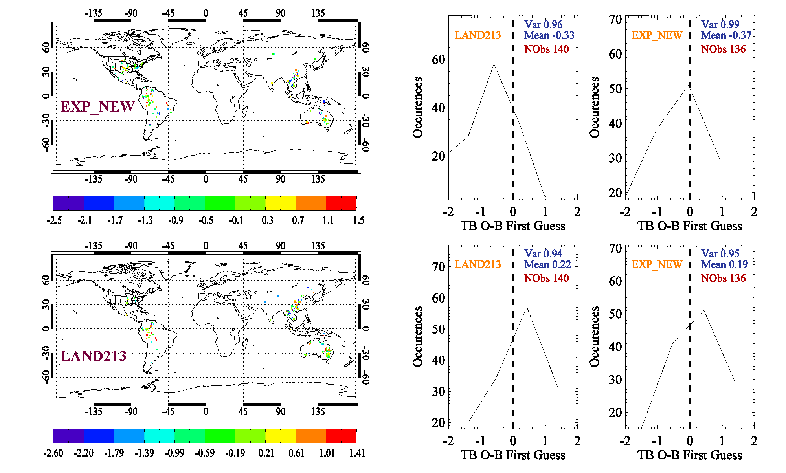
Map & Histogram of TB O – B FirstGuess
ATMS_NPP 183±7GHz
Before Bias Correction
After Bias Correction
Ming Chen

Slide 29
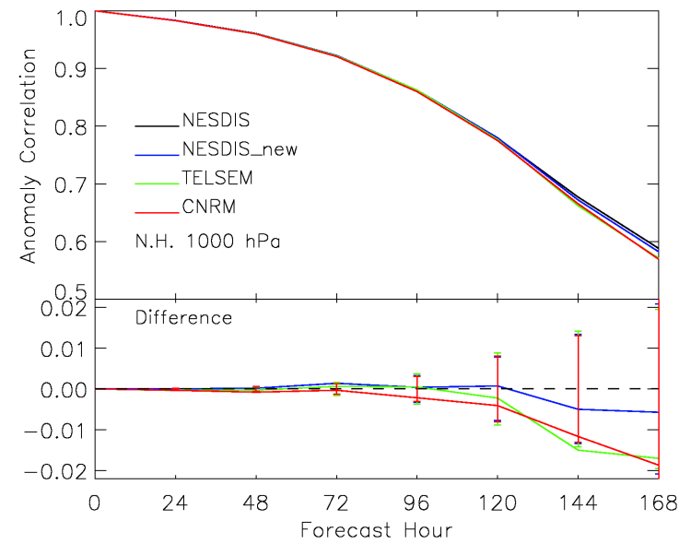
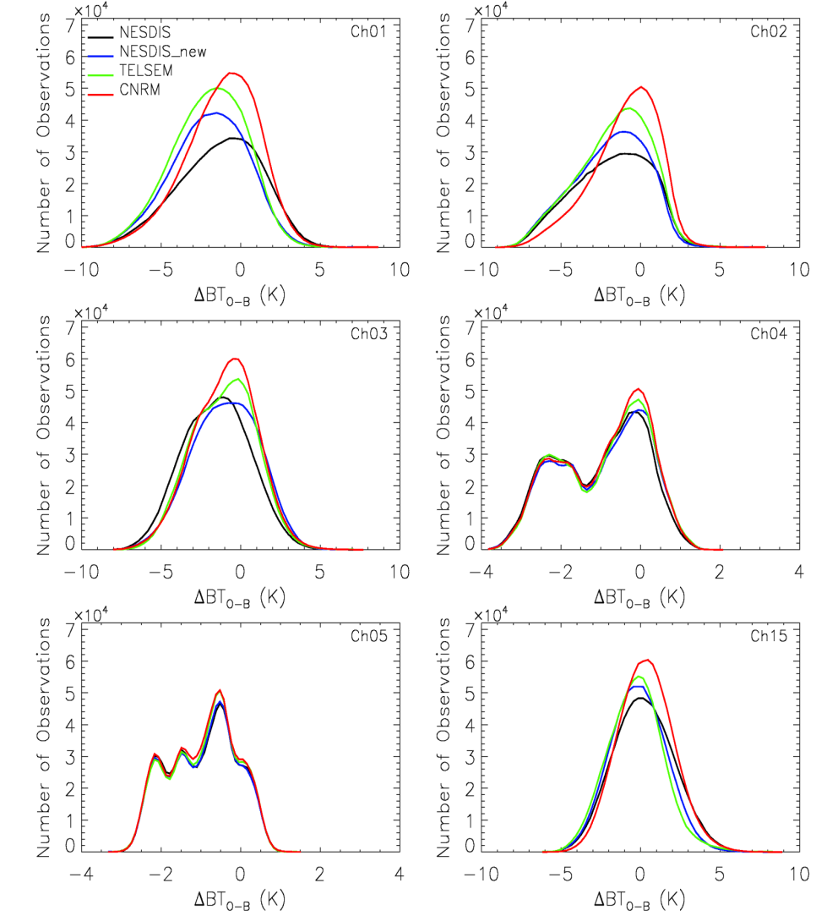
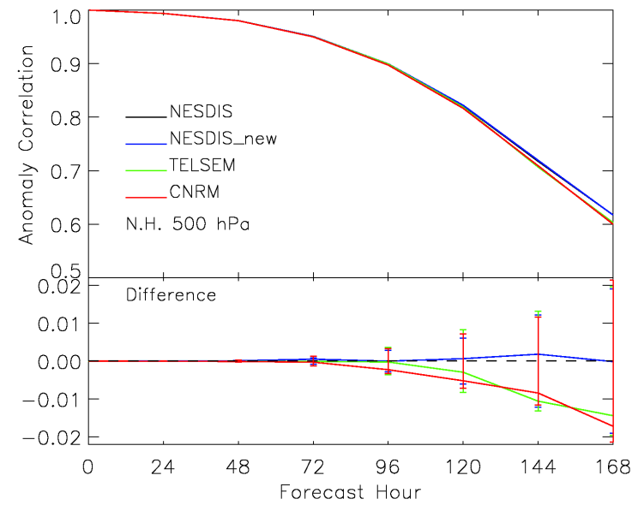
Assimilated Data Histograms Before Bias Correction
Forecast Impact: Geopotential Height
Ming Chen

Slide 30
Ming Chen

Slide 31
Ming Chen

Slide 32
Ming Chen

Slide 33
CSEM Plans
The current CSEM will be reconstructed into an open and relatively independent system. The CSEM is designed to allow for easy integration of the new surface modeling components, particularly various empirical microwave snow/sea ice emissivity models and static data bases (e.g., TELSEM and TELSI). The new modeling components could be developed by the broader community funded through JCSDA and other programs.
Plan to develop and test new MW and IR emissivity data bases for CRTM application in NOAA GSI. Such data bases include the hyperspectral emissivity from SNPP CrIS high spectral resolution data, the high spatial emissivity from SNPP VIIRS imaging channels. Existing data bases (e.g, TELSI) from external collaborators will be integrated into CSEM and evaluated in CRTM and NOAA GSI.
In addition, the GCOM-W AMSR2 and GMI derived emissivity after the removal of RFI (radio frequency interference) will be used to verify the performance of land microwave emissivity model which have been improved recently.
Ming Chen

