Slide 1
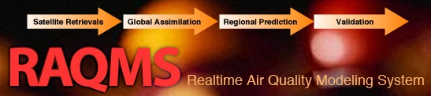

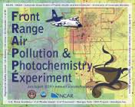

Real-time aerosol data assimilation experiments during the 2014 FRAPPE/DISCOVER-AQ field mission
Brad Pierce (NOAA/NESDIS/STAR/CIMSS)
Fall 2014 AGU Characterizing Global Aerosol Through Multi-sensor and Model Synergy

Slide 2
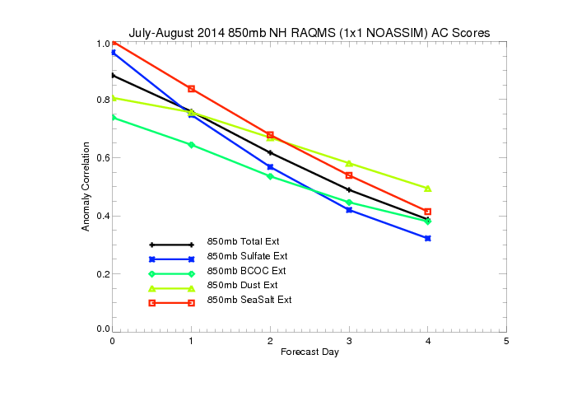
Northern Hemisphere 850mb July-August 2014 Anomaly Correlations (AC)
(Without MODIS Assimilation)
useful Skill
Only 850mb dust and sea salt extinction forecasts useful skill past 2 days
Black and organic carbon (BC+OC) extinctions are poorly initialized and forecasted

Slide 3
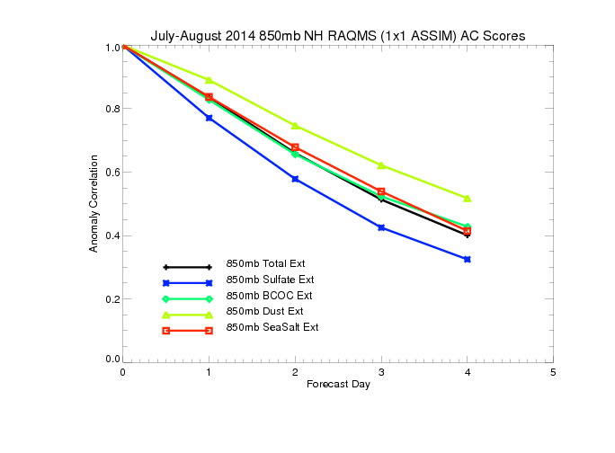
Northern Hemisphere 850mb July-August 2014 Anomaly Correlations (AC)
(With MODIS Assimilation)
useful Skill
MODIS AOD assimilation results in significant improvements in black and organic carbon (BCOC) forecast skill

Slide 4
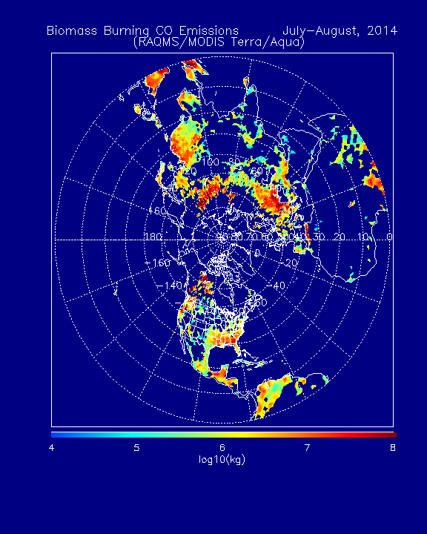
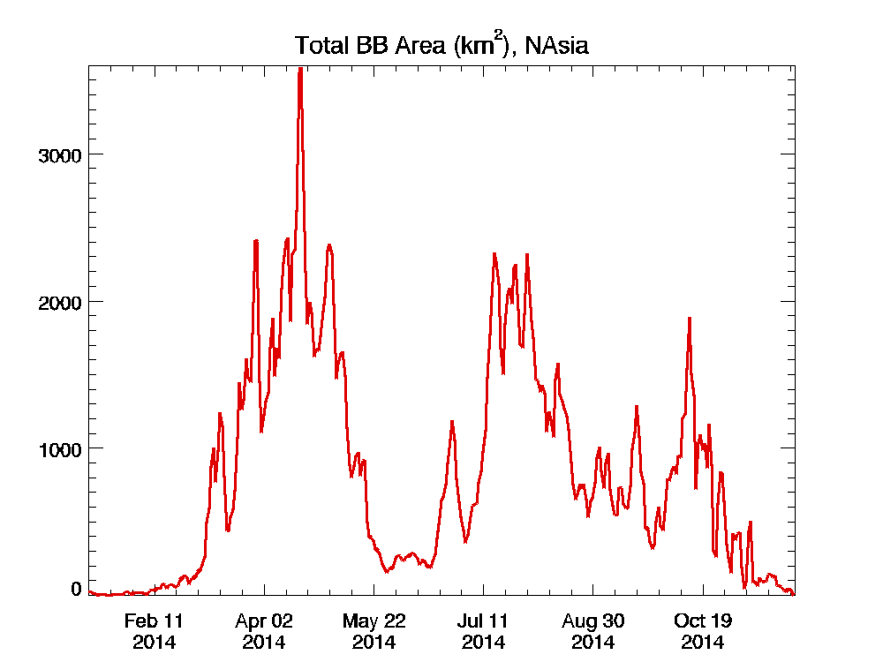
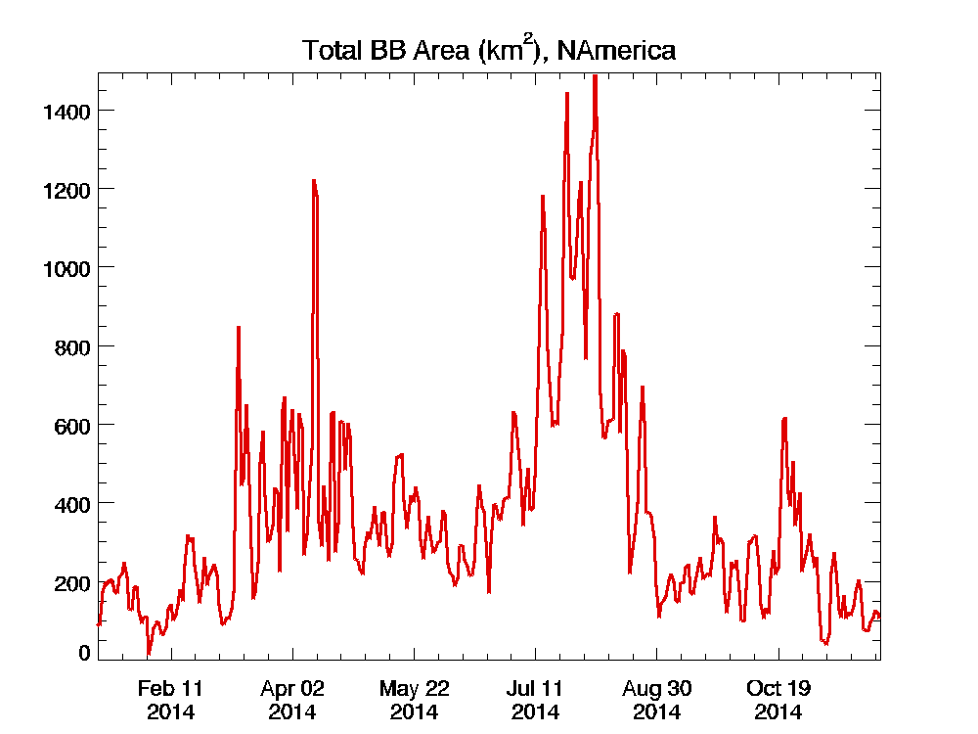
RAQMS Real-time
Biomass Burning Emissions
July-August, 2014
July 16-20

Slide 5
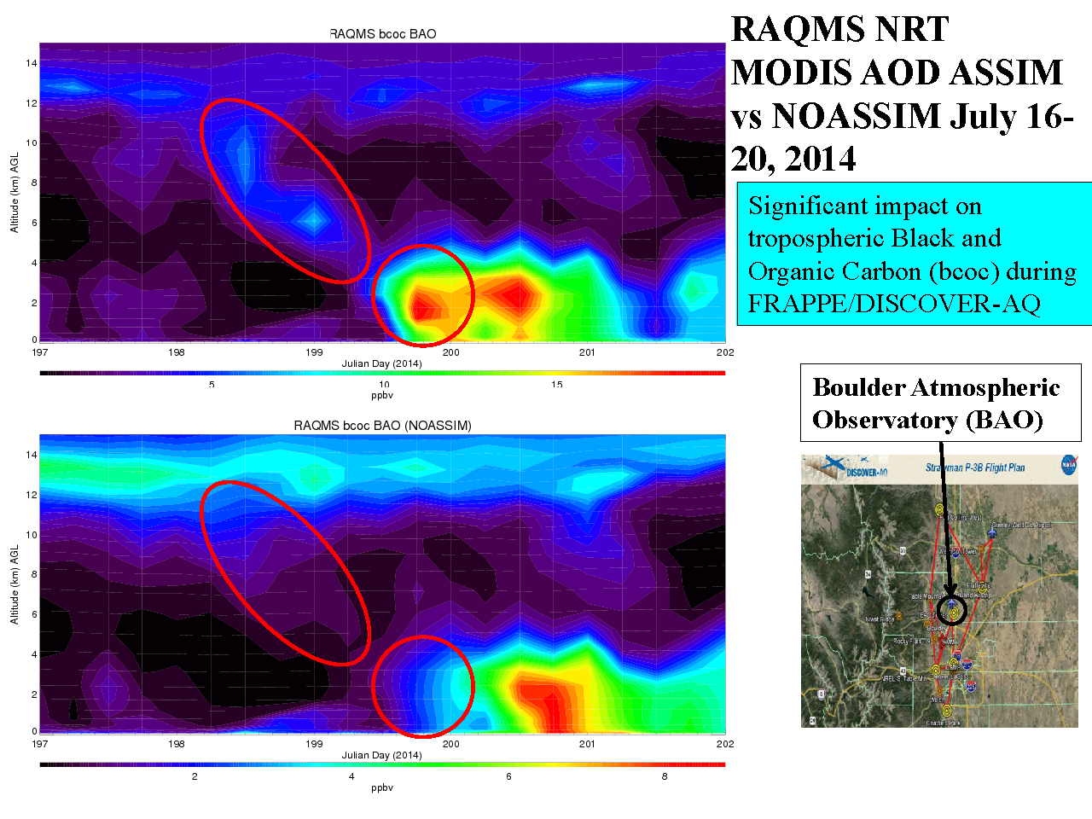
RAQMS Smoke prediction (with MODIS AOD Assimilation)
RAQMS MODIS AOD ASSIM vs
NO ASSIM
July 16-20, 2015
RAQMS Smoke prediction (no MODIS AOD Assimilation)

Slide 6
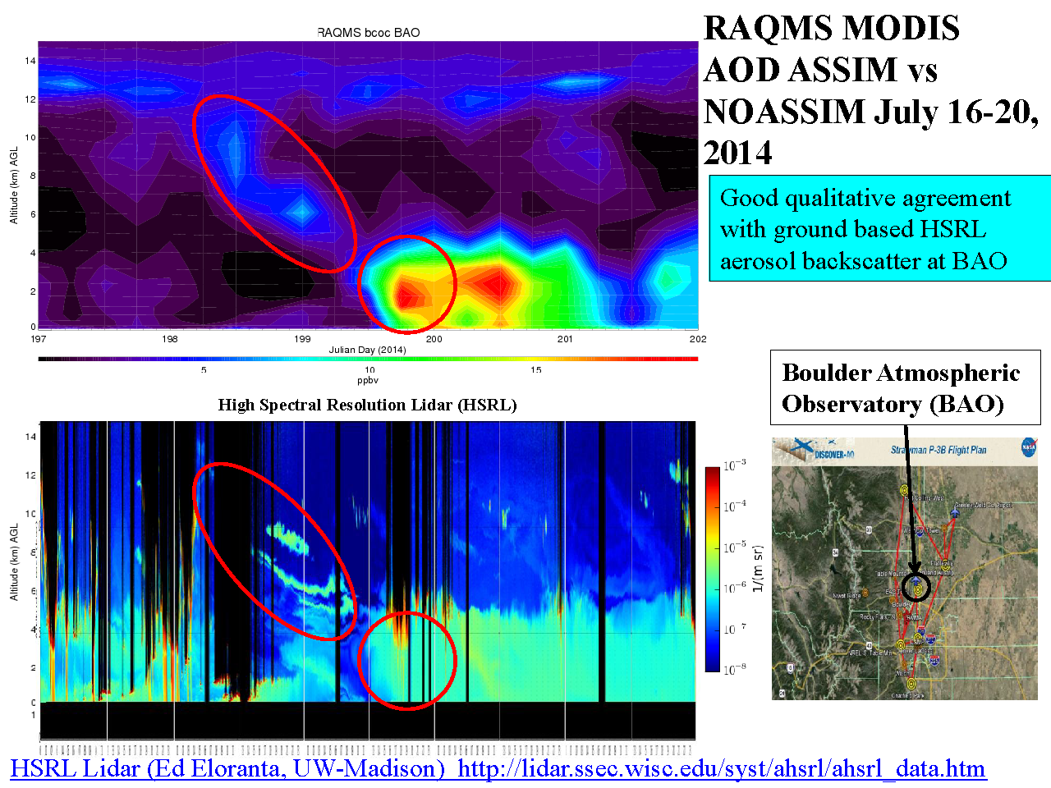
RAQMS Smoke prediction (with MODIS AOD Assimilation)
RAQMS MODIS AOD ASSIM vs
UW HSRL
July 16-20, 2015

Slide 7
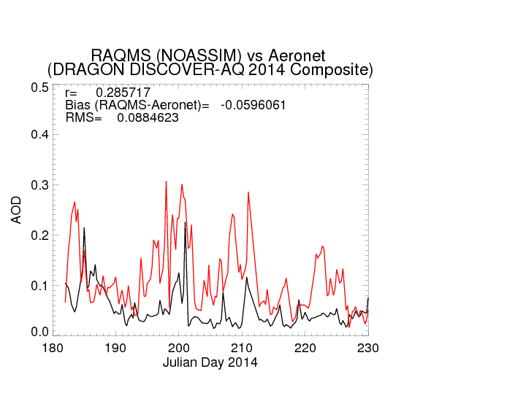
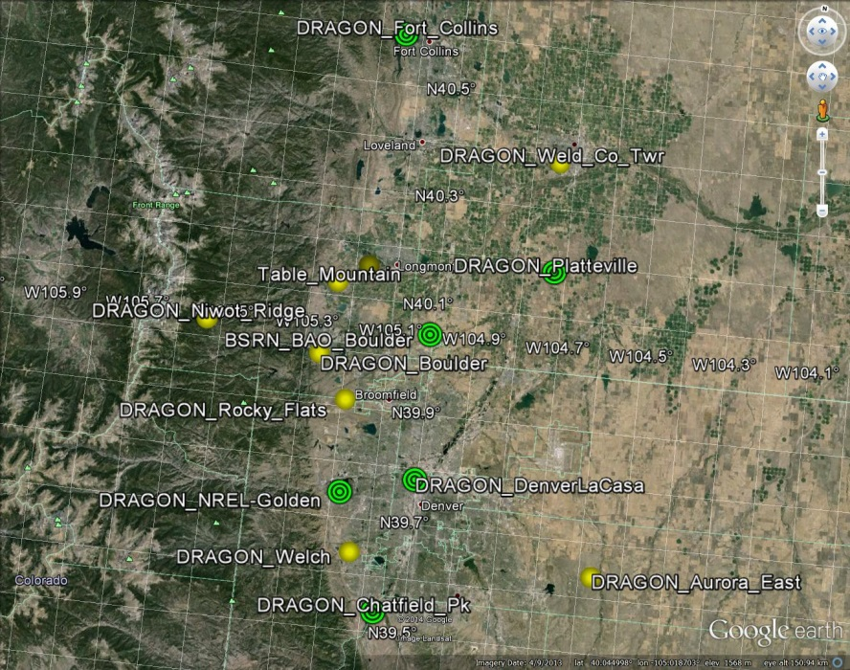
Distributed Regional Aerosol Gridded Observation Networks (DRAGON)-USA
2014 Colorado Front Range Urban Corridor
July 16-20
DRAGON
RAQMS
(DRAGON-USA, Brent Holben, NASA/GSFC)
http://aeronet.gsfc.nasa.gov/new_web/DRAGON-USA_2014_Colorado.html

Slide 8
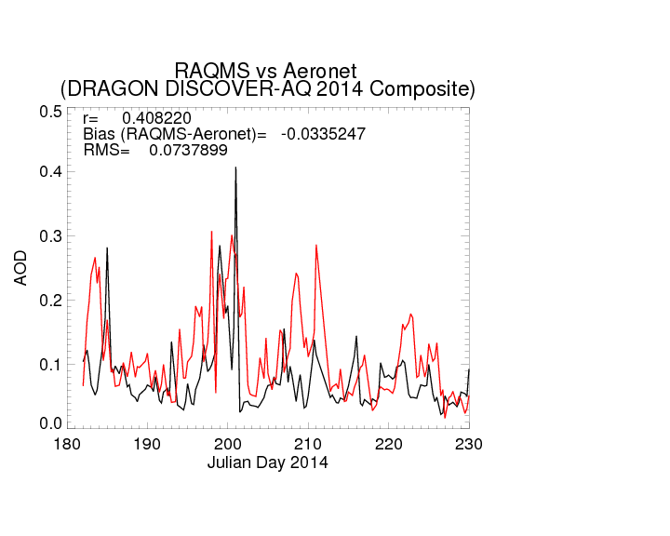
Distributed Regional Aerosol Gridded Observation Networks (DRAGON)-USA
2014 Colorado Front Range Urban Corridor
July 16-20
DRAGON
RAQMS
(DRAGON-USA, Brent Holben, NASA/GSFC)
http://aeronet.gsfc.nasa.gov/new_web/DRAGON-USA_2014_Colorado.html

