Slide 1
Nested Global and Regional Scale Modeling of the Impacts of Intercontinental Pollution Transport and Stratospheric Intrusion on Surface Air Quality in the Western US
R. Bradley Pierce¹, Todd Schaack², Allen Lenzen², Andrew Wentland³, Georg Grell⁴, Steve Peckham⁴, Emma Yates⁵, Laura Iraci⁵, Thomas McGee⁶, John Sullivan⁷
¹NOAA/NESDIS/STAR
²UW-Madison/SSEC
³UW-Madison/AOS (Now at ENVIRON)
⁴NOAA/ESRL
⁵NASA Ames
⁶NASA/GSFC
⁷UMBC/JCET
Meteorology And Climate - Modeling for Air Quality (MAC-MAQ), September 16-18 2015, Sacramento, CA

Slide 2
Can nested global/regional ozone predictions help inform Stratospheric Intrusion (SI) Exceptional Event and Intercontinental Transport 179B demonstrations?
Nested RAQMS¹/WRF-CHEM² Configurations
1x1 degree RAQMS global ozone analysis
Unified stratosphere/troposphere chemistry/GOCART aerosols
UW-Hybrid sigma-theta dynamical core
Constrained with Microwave Limb Sounder (MLS) stratospheric ozone profiles and Ozone Monitoring Instrument (OMI) cloud cleared Total Column Ozone
12km WRF-CHEM v3.4.1 (Eastern Pacific Domain)
GOCART RACM-KPP mechanism
YSU PBL scheme (Yonsei University, Non-local-K scheme)
13km NOAA/ESRL RR-CHEM (North American Domain)
RADM2 chemical mechanism/MADE Aerosol parameterization
YSU PBL scheme (Yonsei University, Non-local-K scheme)
¹Realtime Air Quality Modeling System (RAQMS, http://raqms.ssec.wisc.edu/)
²Weather Research and Forecasting (WRF) model with chemistry (WRF-CHEM, http://ruc.noaa.gov/wrf/WG11/)

Slide 3
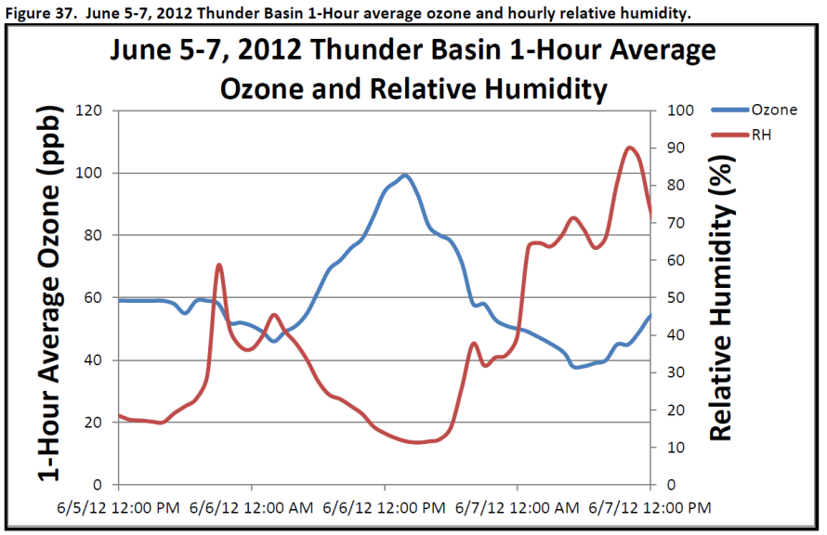
Thunder Basin Wyoming
Ozone Standard Exceedance
June 6, 2012
“The Wyoming Department of Environmental Quality/Air Quality Division (WDEQ/AQD) has determined that a stratospheric intrusion created elevated ozone readings resulting in an 8-hour ozone standard exceedance at the Thunder Basin, Wyoming ozone monitor located in northeastern Wyoming on June 6, 2012” (Executive Summary)
Yates, et al. 2013, Atmos. Chem. Phys., 13, 12481–12494, 2013, www.atmos-chem-phys.net/13/12481/2013/ doi:10.5194/acp-13-12481-2013

Slide 4
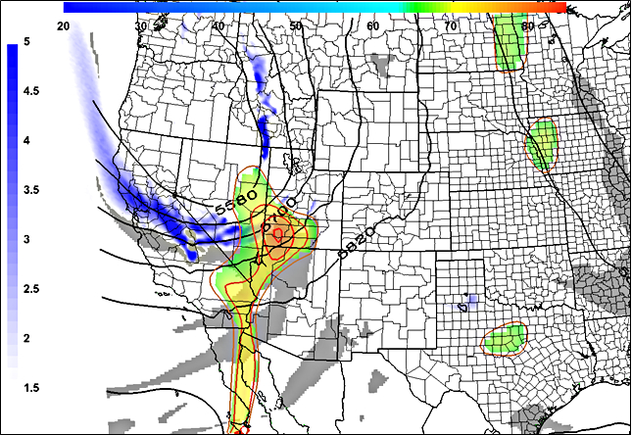
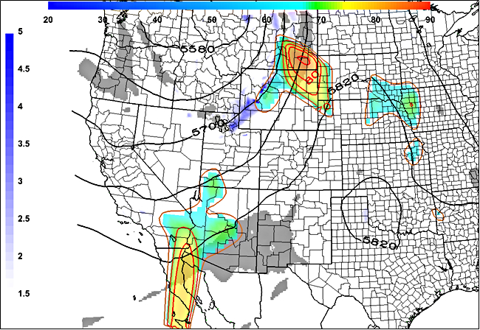
Synoptic conditions prior to Thunder Basin, WY ozone exceedance
June 5, 2012 NAM-12 analysis, 11 am MST
June 6, 2012 NAM-12 analysis, 11am MST
Thunder Basin, WY
Thunder Basin, WY
High Isentropic Potential Vorticity (IPV) and low relative humidity (RH) at base of large amplitude trough over CA/NV on June 5 is associated with high surface ozone over SW Utah on June 5 and NE WY on June 6, 2012
Legend:
500 mb heights in meters (contours)
600 mb IPV >= 1.5 PVUs (blue)
600 mb RH <= 10% (grey)
EPA AQS Daily Max 8-hour O3 in ppb >= 65 ppb (rainbow contours and shading)
Figures courtesy Patrick Reddy (Colorado Department of Public Health and Environment)

Slide 5
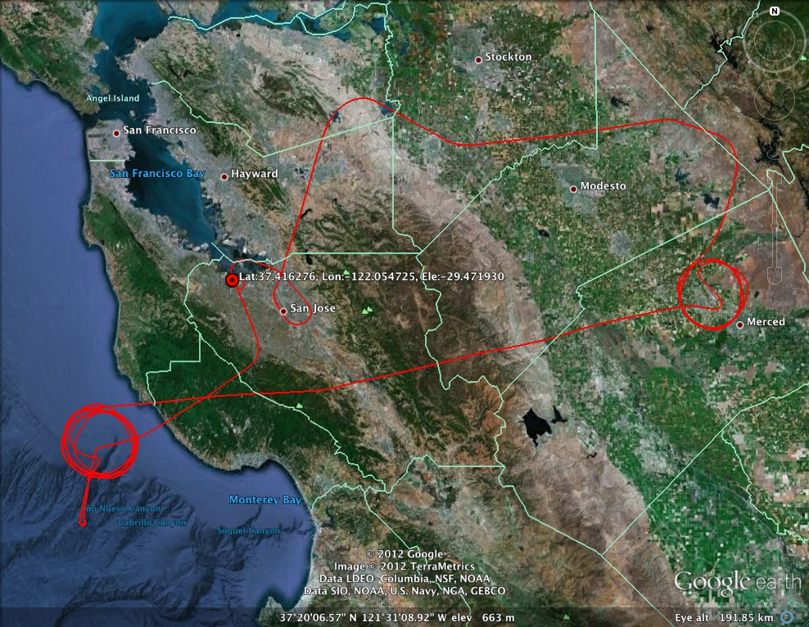
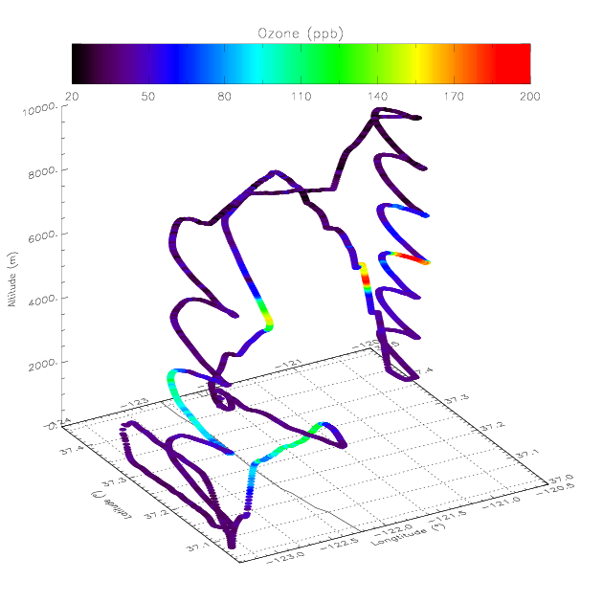
Alpha Jet Atmospheric eXperiment (AJAX) (Emma Yates and Laura Iraci, NASA Ames)
Description:
Based at and operated from Moffett Field, CA
Flight duration:
Approximately 2.5 hrs
Measurements:
O3, CH4, CO2, water vapor
O₃ Mission San Joaquin Valley/Off Shore
5 June 2012
Filament of high (>190ppbv) O3 sampled during onshore profile
https://espo.nasa.gov/missions/ajax/content/AJAX

Slide 6
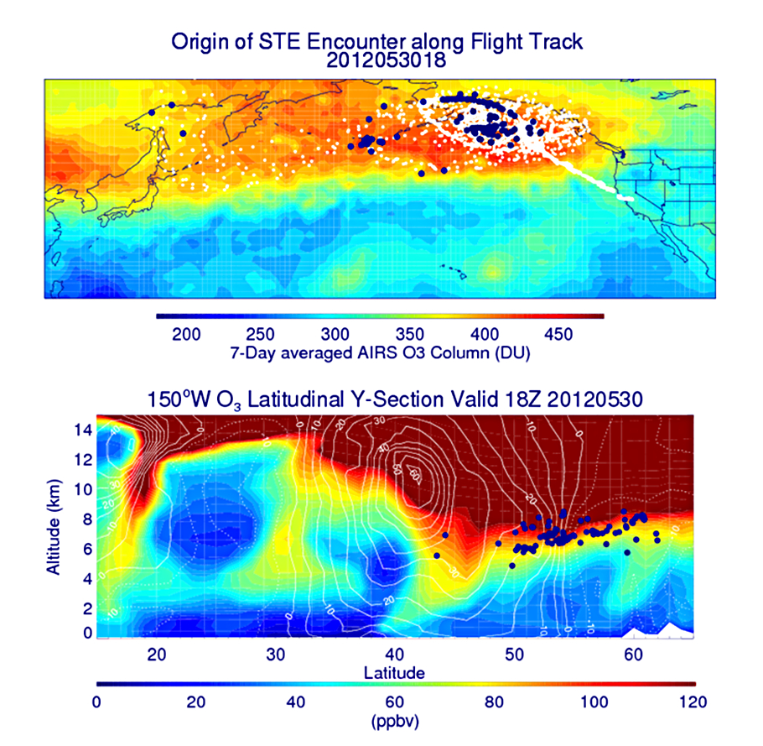
Origin of the tropospheric fold and subsequent Stratospheric Intrusion (SI)
Backward trajectories (white) beginning at the AJAX Flight 47 path, and ending on May 30, 2012 (blue) overlayed on mean AIRS total column ozone
RAQMS ozone analysis at 150º W at 18Z on May 30, 2012 combined with the location of the SI trajectories on May 30, 2012 (blue)
Back-trajectory analysis shows that the origin of the SI event was within a region of high total column ozone over the Gulf of Alaska

Slide 7
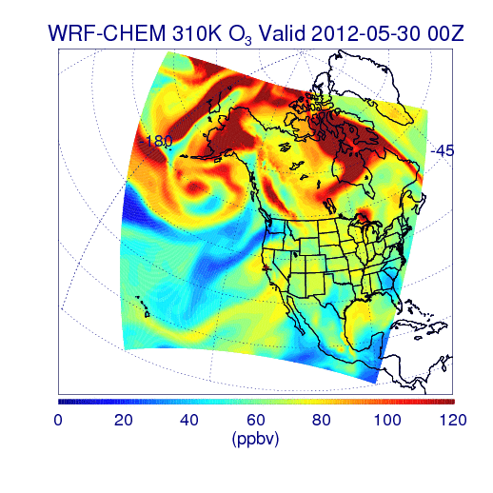
310K O3 from RAQMS/WRF-CHEM Simulation
00Z 05/30 – 00Z 06/07, 2012
Stratosphere/tropospheric exchange processes within a quasi-stationary low pressure system over the Gulf of Alaska played a critical role in the SI event

Slide 8
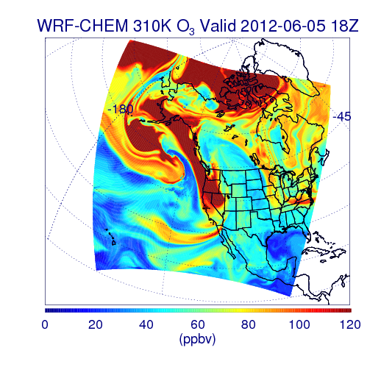
310K O3 from RAQMS/WRF-CHEM Simulation
Southeasterly transport of stratospheric air along the 310K isentropic surface leads to the SI event sampled by the AJAX flight over CA on June 5, 2012

Slide 9
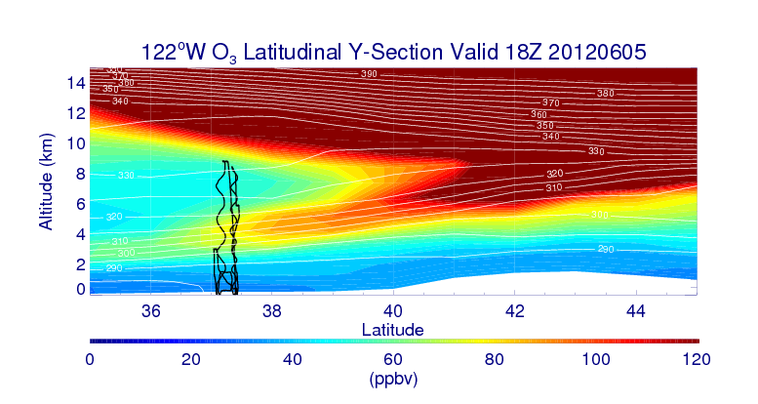
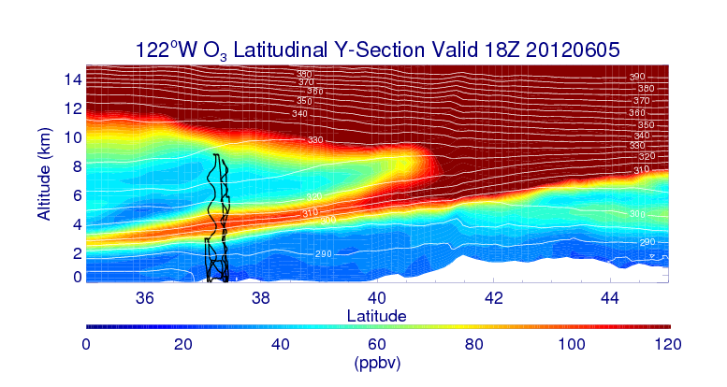
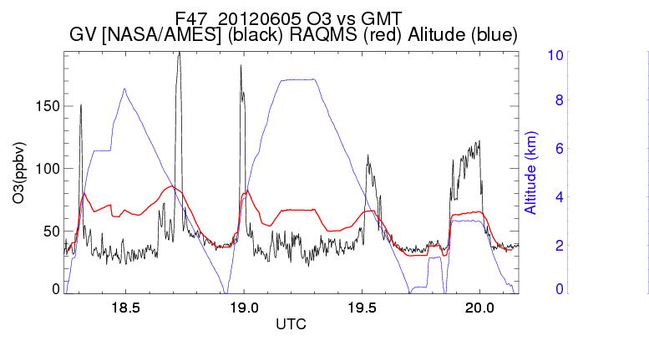
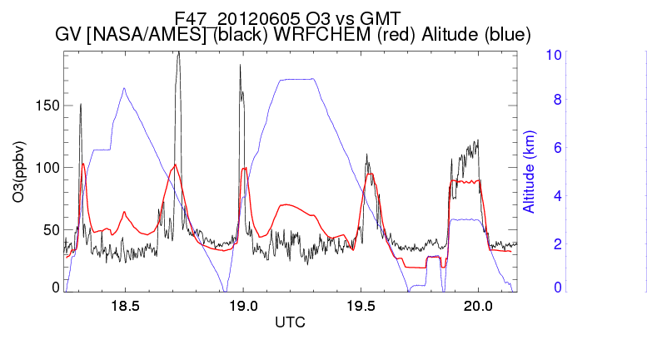
NASA AJAX Flight 47, June 5, 2012
RAQMS
Nested RAQMS/WRFCHEM
310K isentrope
RAQMS (red)
AJAX (black)
WRFCHEM (red)
AJAX (black)
(A)
(B)
(A)
(B)
Nested RAQMS/WRFCHEM simulations significantly improve the agreement with AJAX measurements during the off-shore spiral (B) but still underestimate ozone within the narrow filament sampled during the spiral over the San Joaquin Valley, CA (A)

Slide 10
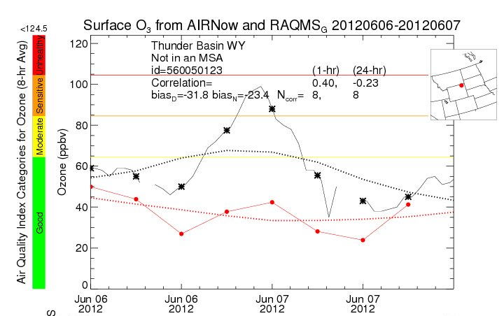
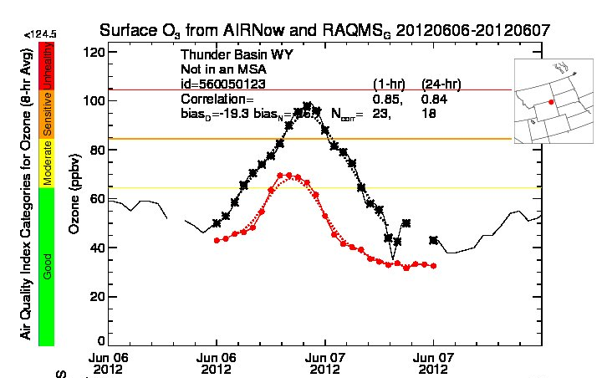
June 6-7, 2012 Surface ozone comparison: Thunder Basin, WY
RAQMS
Nested RAQMS/WRFCHEM
Surface O3 from AIRNow and RAQMS
Surface O3 from AIRNow and Nested RAQMS/WRF-CHEM
RAQMS (red)
AIRNow (black)
WRFCHEM (red)
AIRNow (black)
Improved estimates of ozone within the SI event lead to significant improvements (19.3 vs 31.8ppbv daytime bias) in predictions of ozone at the Thunder Basin, WY surface site in the nested RAQMS/WRF-CHEM simulation.
However, peak ozone mixing ratios are still underestimated by nearly 30ppbv

Slide 11
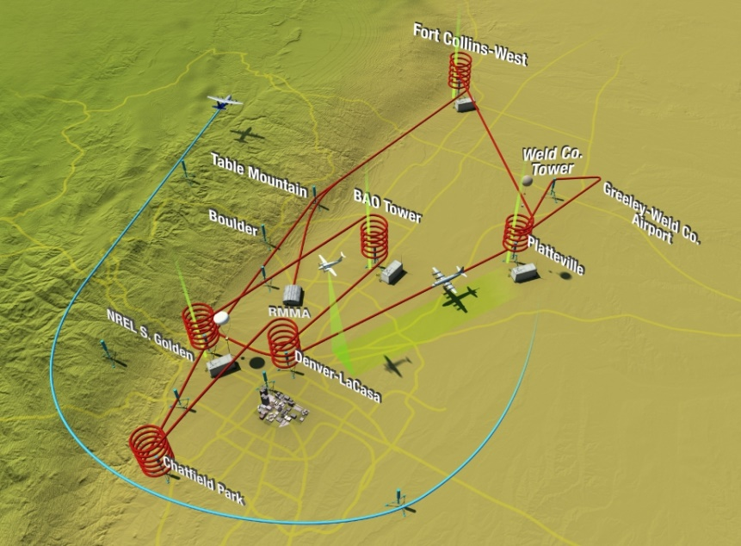
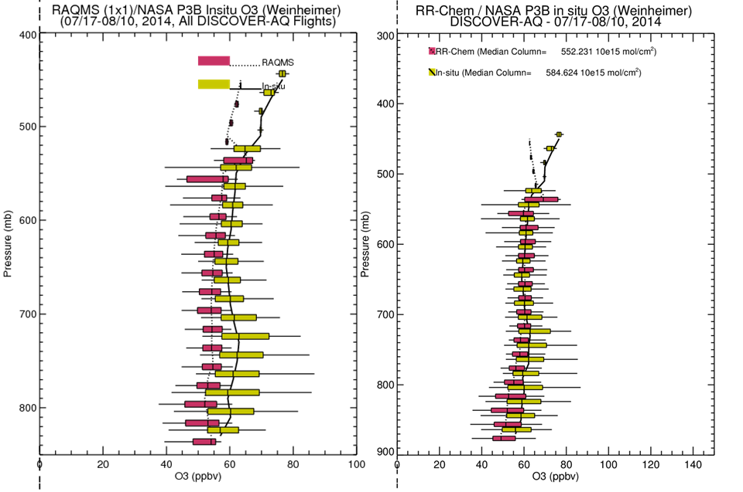
RAQMS/RR-Chem Real-time forecasts during the 2014 FRAPPE/DISCOVER-AQ mission
Nested RAQMS/RR-Chem forecasts show reduced biases and improved variability compared to airborne insitu measurements between 700-500mb.
However, biases are similar (15-20 ppbv) below 700mb and neither model captures the upper 90% of the observed ozone
Reduced bias

Slide 12
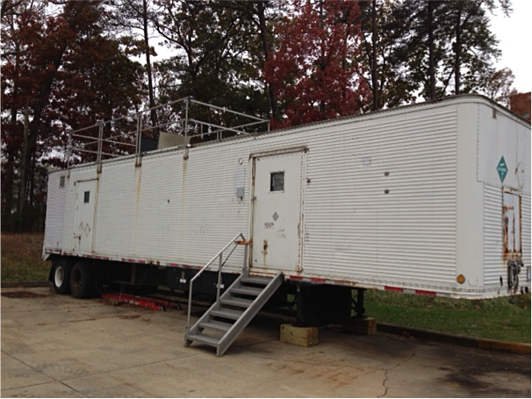
NASA Goddard Space Flight Center TROPospheric OZone DIfferential Absorption Lidar (GSFC TROPOZ DIAL)
(Thomas McGee, GSFC and John Sullivan UMBC)

Slide 13
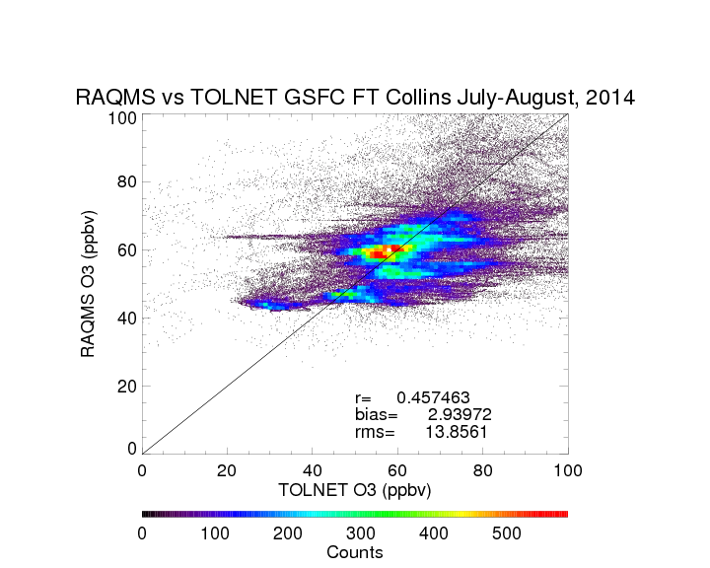

Slide 14
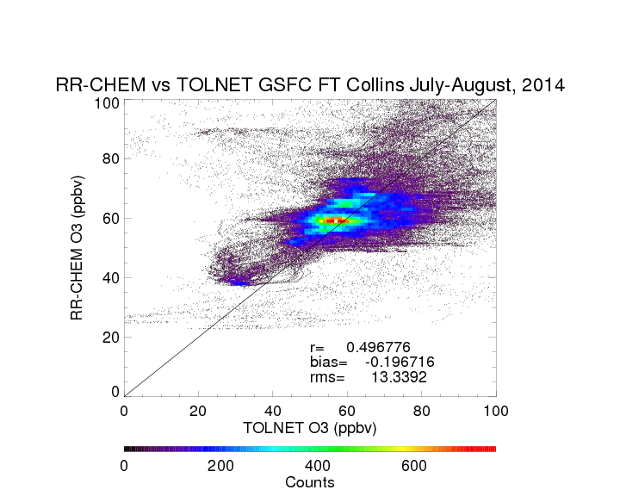
RR-CHEM shows improved correlation, reduced bias, and similar RMS errors compared to 1 degree RAQMS analysis

Slide 15
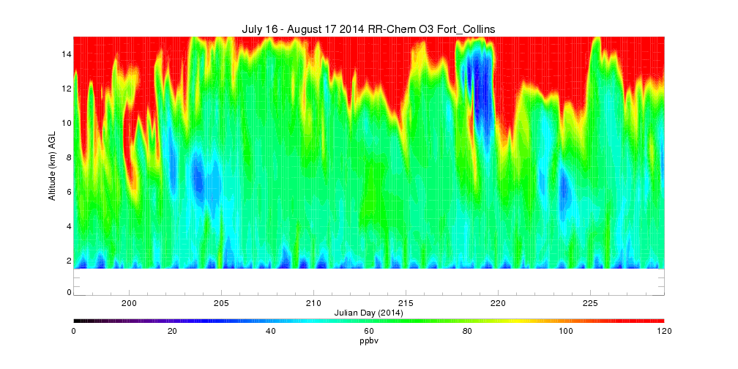
July 16 – August 17, 2014 RR-Chem Ozone timeseries
(Fort Collins, CO)

Slide 16
July 16 – August 17, 2014 RR-Chem Ozone timeseries
(Fort Collins, CO)
August 6: STE
John T. Sullivan et al., 2015, under review, JGR

Slide 17
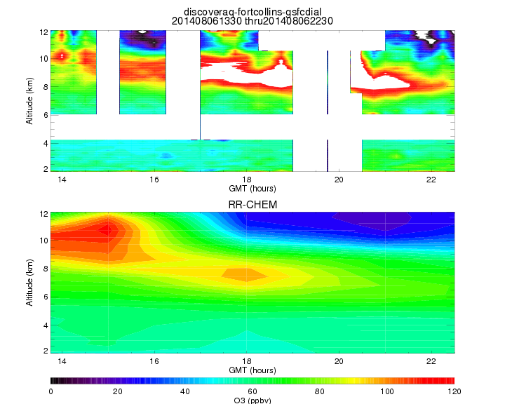
August 06, 2014 TROPOZ and RR-Chem Ozone timeseries
(Fort Collins, CO)
RR-CHEM captures altitude of STE and low ozone tropical air aloft but underestimates the ozone mixing ratio within the STE

Slide 18
July 16 – August 17, 2014 RR-Chem Ozone timeseries
(Fort Collins, CO)
August 9: CONUS PBL
August 6: STE

Slide 19
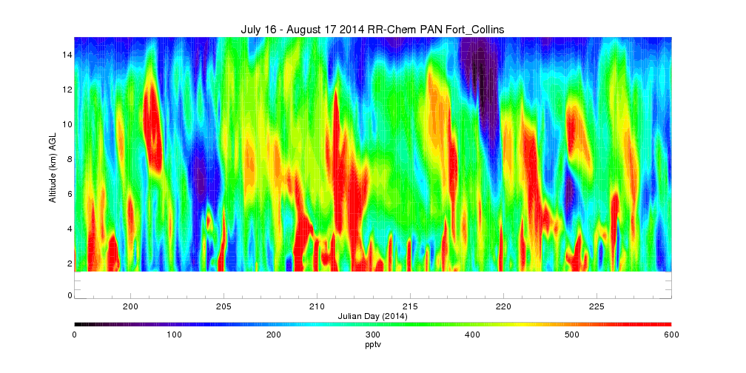
July 16 – August 17, 2014 RR-Chem PAN timeseries
(Fort Collins, CO)
August 9: CONUS PBL
August 6: STE

Slide 20
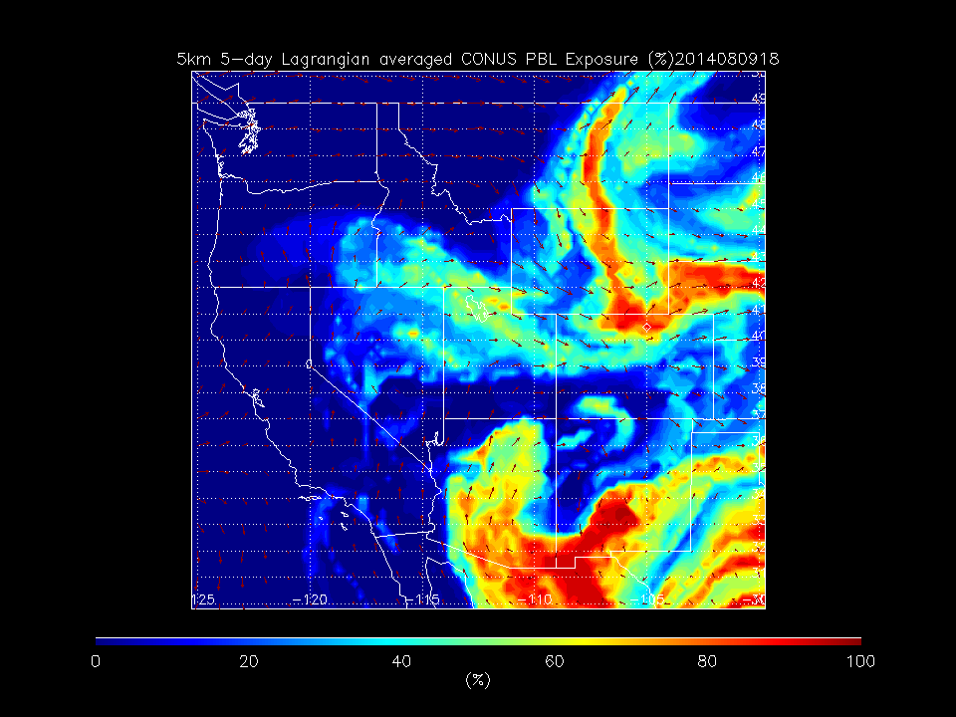
RAQMS Reverse Domain Filling (RDF) show that high PAN airmass over Fort Collins on 08/06 had it’s origins within the Continental US boundary layer
Pierce, R. B. 2008, J. Geophys. Res., 114, D00F09, doi:10.1029/2008JD011337

Slide 21
July 16 – August 17, 2014 RR-Chem PAN timeseries
(Fort Collins, CO)
August 11:East Asian Transport
August 9: CONUS PBL
August 6: STE

Slide 22
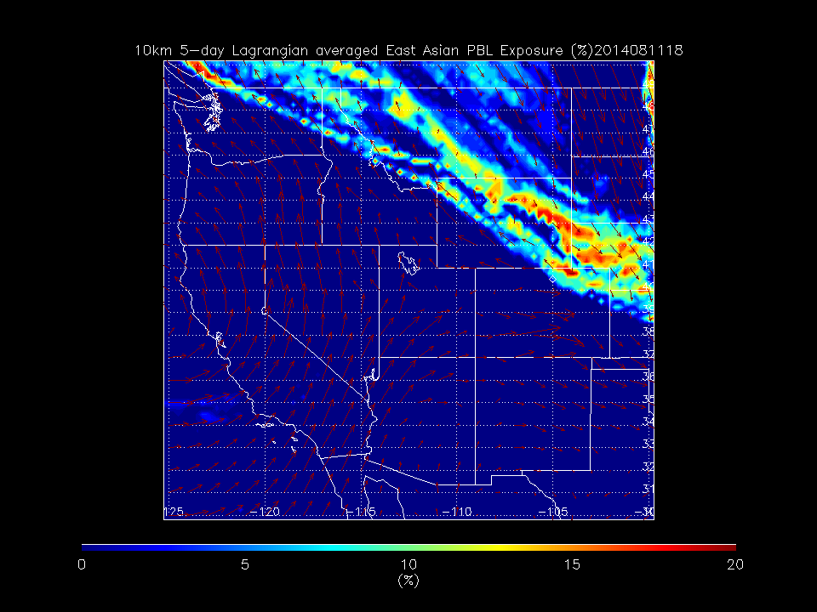
RAQMS RDF shows that high PAN air mass over Fort Collins on 08/11 had it’s origins within the East Asian boundary layer

Slide 23
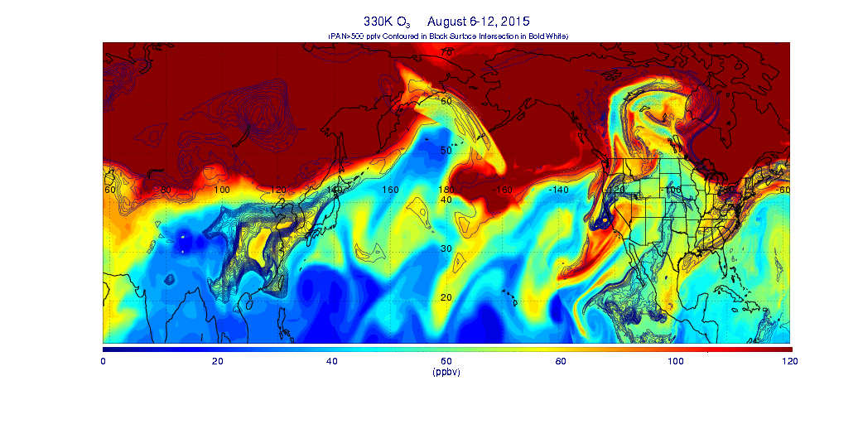
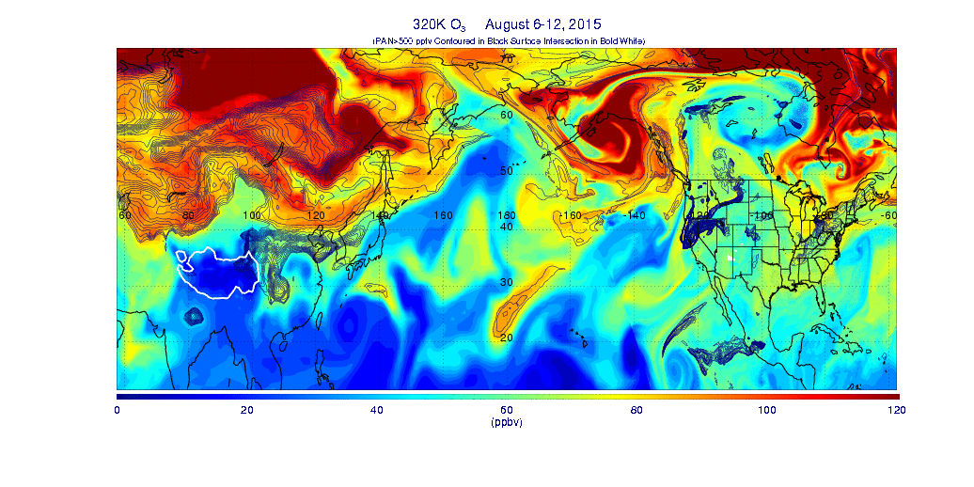
330K Nested
RAQMS/RR-CHEM
O3 (colored)
PAN (Black contours)
Surface intersection
(White)
320K Nested
RAQMS/RR-CHEM
O3 (colored)
PAN (Black contours)
Surface intersection
(White)
Discontinuity at LBC due to animation of RAQMS Analysis (forecast used in nesting)

Slide 24
Backup Slides

Slide 25
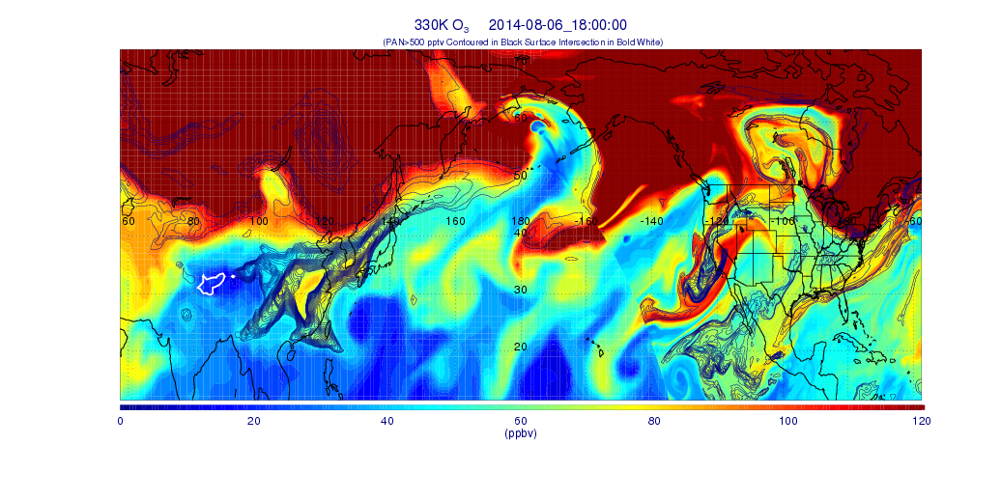
August 6: STE

Slide 26
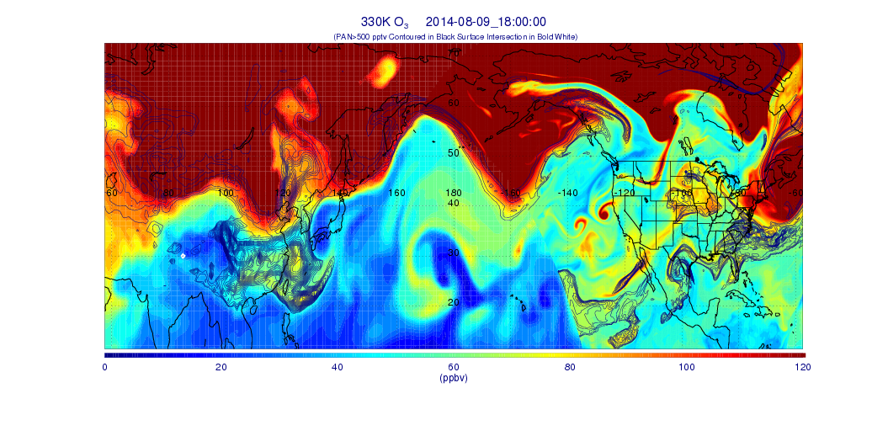
August 9: CONUS

Slide 27
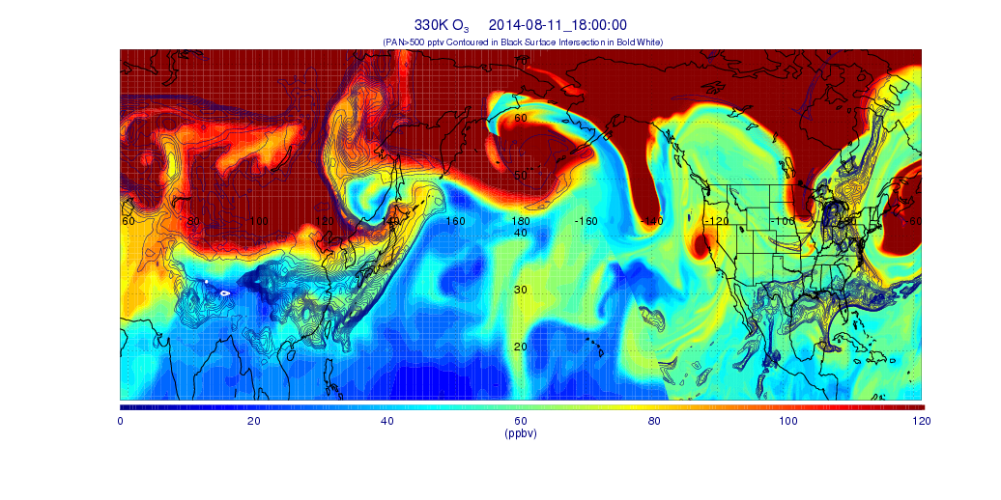
August 11: EASIA

