Slide 1
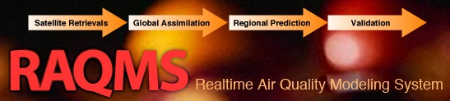

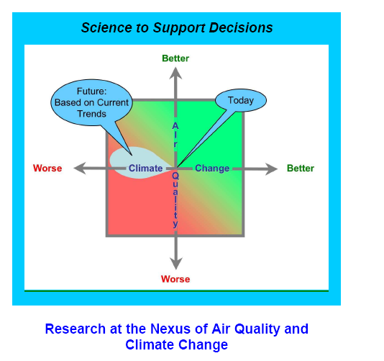


Air quality forecasting and data assimilation for NOAA Airborne field missions
Brad Pierce (NOAA/NESDIS)
UW-Madison Environmental Studies Introduction to Air Quality (ES401), Sept 26, 2013

Slide 2
The NOAA Air Quality research program has traditionally focused on field experiments
Regional forecast model development and evaluation is driven by comparisons with in-situ composition measurements from airborne platforms and surface monitoring
Data collected during field missions is used to support State and Local Air Quality managment
NOAA Air Quality Research Program (from Steve Fine, NOAA/OAR)

Slide 3
More recent NOAA Air Quality field experiments have focused understanding issues at the nexus of air quality and climate change
Assess the fidelity of global and regional air quality and climate model predictions
Provide scientific information regarding the tradeoffs faced by decision makers when addressing these two inter-related issues.

Slide 4
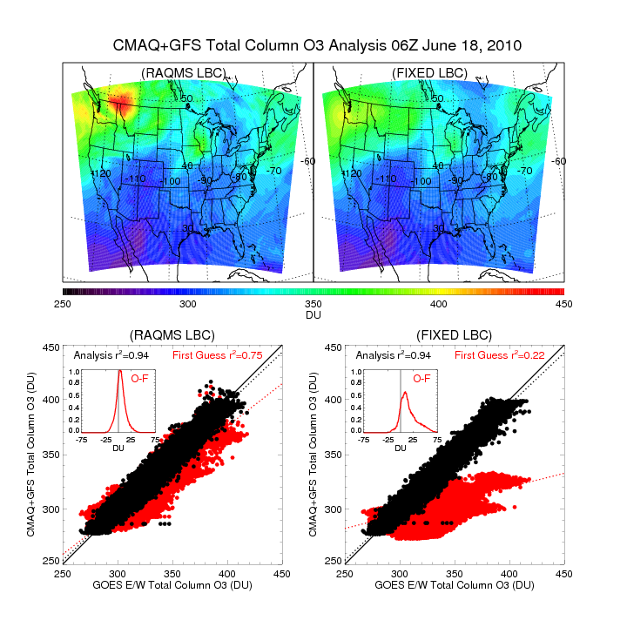
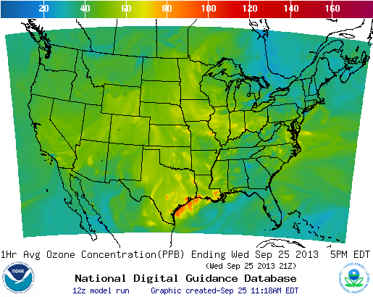
Air quality forecasting and data assimilation
National Weather Service
Air Quality forecast
Joint Center for Satellite Data Assimilation
GOES Total Column Ozone Assimilation
http://airquality.weather.gov/sectors/conus.php
http://www.jcsda.noaa.gov/

Slide 5
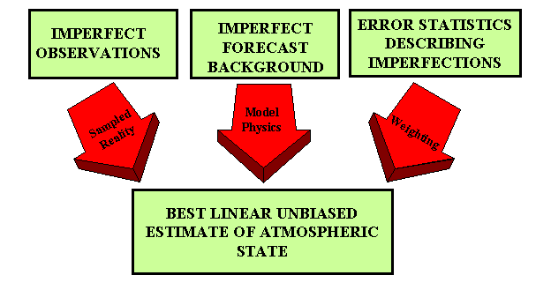

Analysis/Forecast Cycle
Current observations are combined with previous knowledge (first guess) to produce a forecast of the weather
Observations
Model
Forecast
Increment:
OBS-FX
Analysis
FX IC
Statistical
Blending

Slide 6
Online global chemical and aerosol assimilation/forecasting system
Modeling Framework:
UW-Madison hybrid θ−η coordinate model (UW-Hybrid) dynamical core
Unified stratosphere/troposphere chemical prediction scheme developed at NASA LaRC
Aerosol prediction scheme (GOCART) developed by Mian Chin (NASA GSFC).
Real-time assimilation:
Microwave Limb Sounder (MLS) stratospheric ozone profiles (above 50mb)
Ozone Monitoring Instrument (OMI) total ozone column (cloud cleared)
Moderate Resolution Imaging Spectroradiometer (MODIS) Aerosol Optical Depth (AOD)
Real-time fire detection:
Moderate Resolution Imaging Spectroradiometer (MODIS)
Notes:
6

Slide 7
Three different NOAA Air Quality Field Missions
2006 Texas Air Quality Study - Gulf of Mexico Atmospheric Composition and Climate Study
2008 Aerosol, Radiation, and Cloud Processes affecting Arctic Climate
2010 California Research at the Nexus of Air Quality and Climate Change

Slide 8
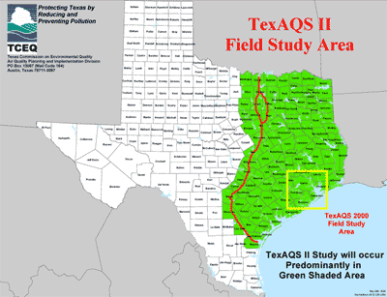
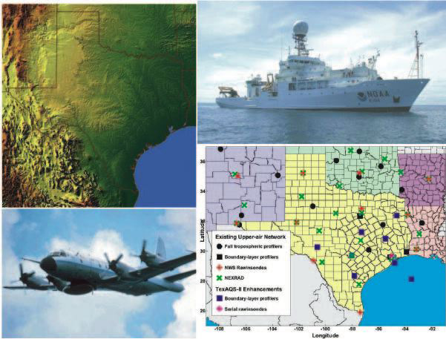
TexAQS / GoMACCS 2006
Texas Air Quality Study - Gulf of Mexico Atmospheric
Composition and Climate Study
Where: East Texas and the Gulf of Mexico
When: August - September 2006
The TexAQS II study provided support Texas Commission on Environmental Quality (TCEQ)
to develop strategies for the new federal eight-hour ozone standard and regional-haze requirements.

Slide 9
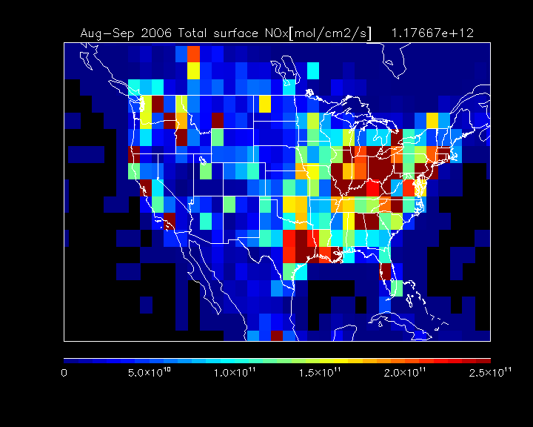
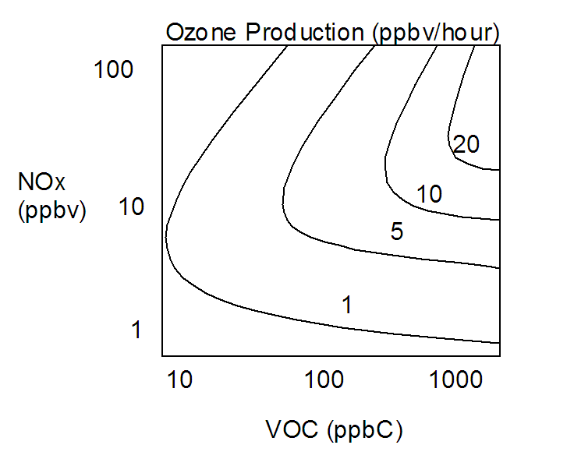
TEXAQS Science Questions
How do emissions from local and distant sources interact to determine the air quality in Texas, and which areas outside of Texas adversely affect the air quality of non-attainment areas within Texas?
RAQMS is used to investigate the impact of continental scale ozone production on Houston and Dallas air quality from July 15 through October 15, 2006.
Ensemble trajectory analysis is used to determine the source regions associated with enhanced regional ozone production for the Houston and Dallas receptor regions.
RAQMS NOx emissions during TEXAQS: Aug-Sep 2006

Slide 10
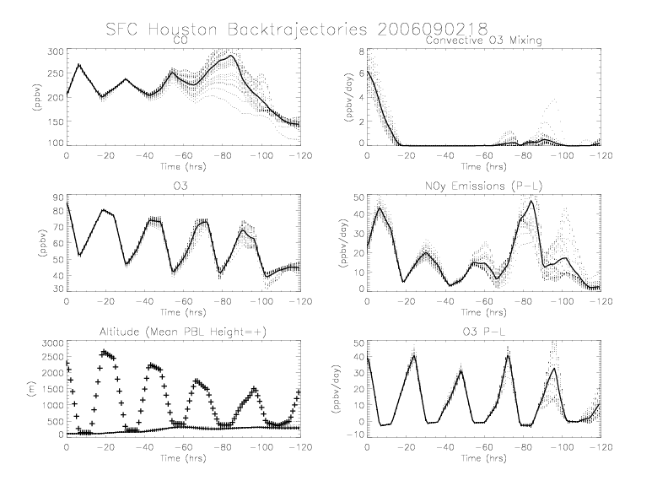
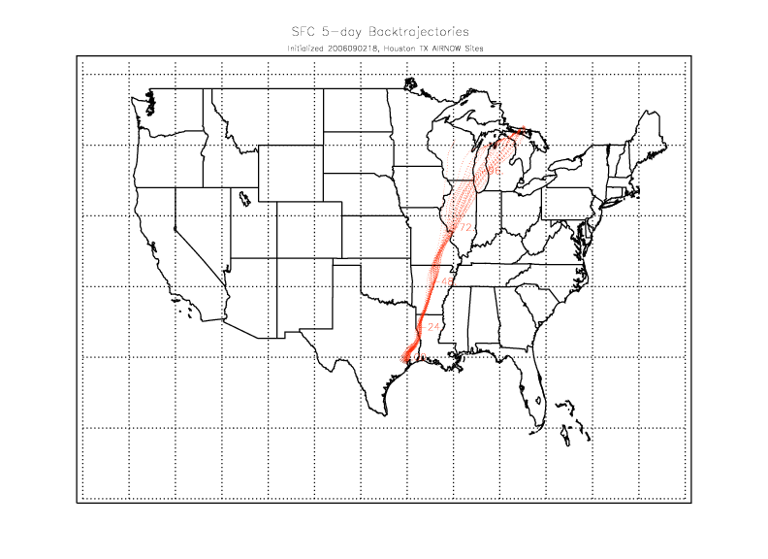
Impacts of background ozone production on Houston, TX
Average O3 Production – Loss (P-L) rates along the back trajectories are used as a metric to classify back trajectories from Houston, TX AIRNow Sites
Pierce, R. B., et al. (2009), Impacts of background ozone production on Houston and Dallas, Texas, air quality during the Second Texas Air Quality Study field mission, J. Geophys. Res., 114, D00F09, doi:10.1029/2008JD011337.

Slide 11
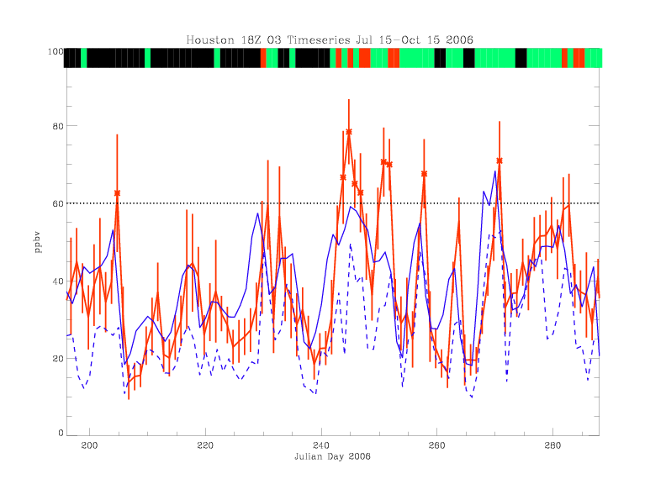
Impacts of background ozone production: Houston July 15-October 15, 2006
Red=AIRNow MSA mean+Std
Blue=RAQMS MSA (solid) Regional (dashed) bias corrected mean
Classifications:
RED=Class1: Enhanced back ground ozone production (ensemble mean 5-day Lagrangian averaged O3 P-L > 10 ppbv/day)
GREEN=Class 2: Moderate back ground ozone production (ensemble mean 5-day Lagrangian averaged O3 P-L > 0 ppbv/day and < 10 ppbv/day).
BLACK=Class 3: Back ground ozone destruction (ensemble mean 5-day Lagrangian averaged O3 P-L < 0 ppbv/day).

Slide 12
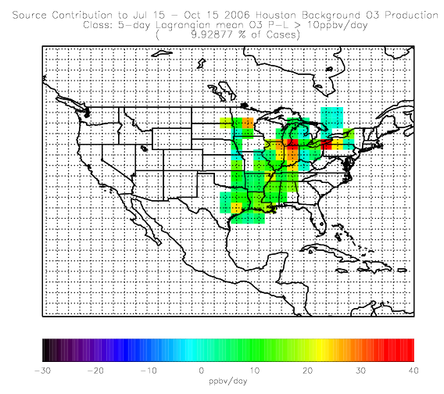
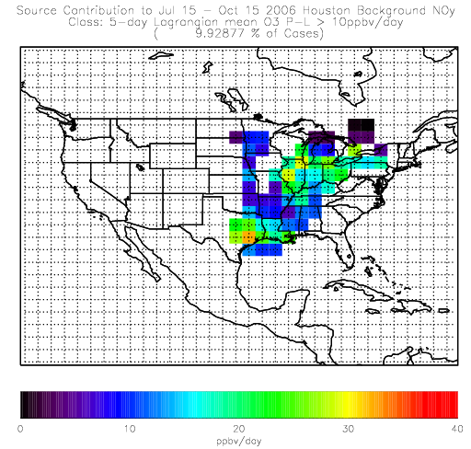
Houston Class 1 Source Contributions July 15-Oct 15, 2006
O3 P-L (ppbv/day)
NOy emissions (ppbv/day)
Class 1➔Midwest/Ohio River Valley source with significant O3 P-L (40ppbv/ day) due to NOx sources along the southern Great Lakes.

Slide 13
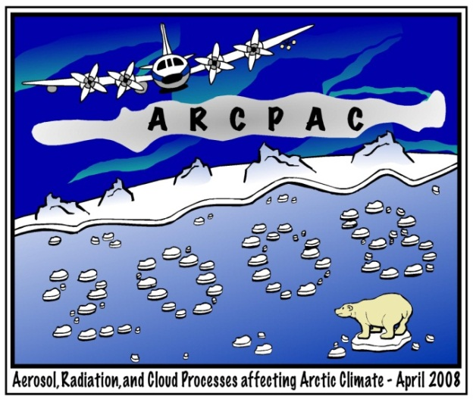
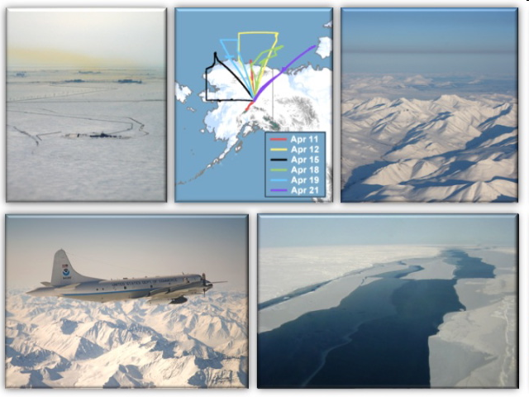

ARCPAC
Aerosol, Radiation, and Cloud Processes affecting Arctic Climate
Where: Fairbanks, Alaska
When: late March - April 2008
This experiment was a NOAA Climate Program Project for the International Polar Year 2008

Slide 14
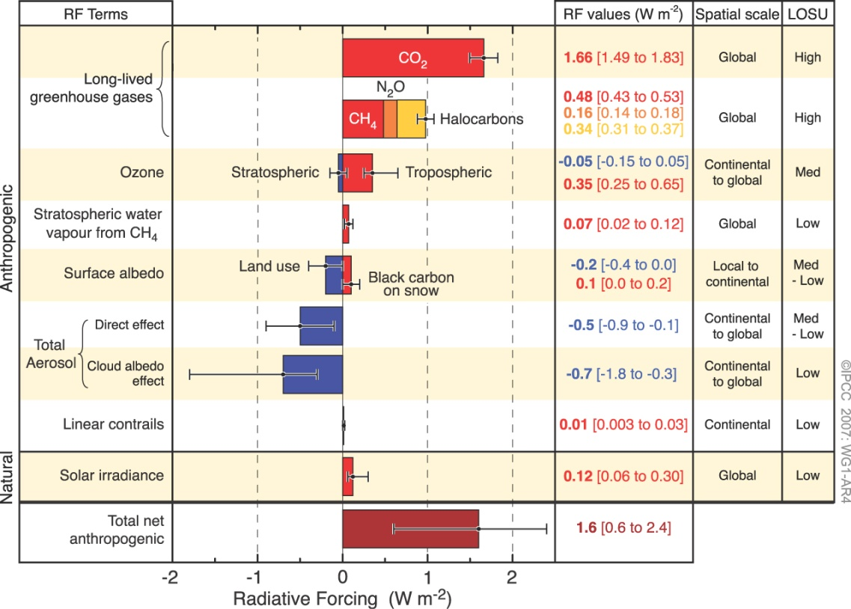
ARCPAC Science Questions
What are the direct and indirect effects of Asian Biomass burning on the Arctic during Spring 2008?
Fourth Assessment Report of the Intergovernmental Panel on Climate Change, 2007

Slide 15
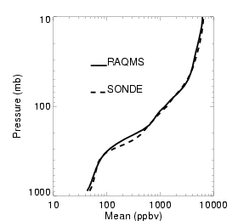
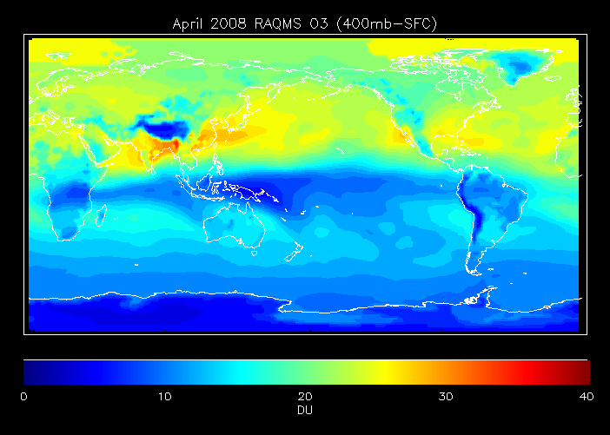

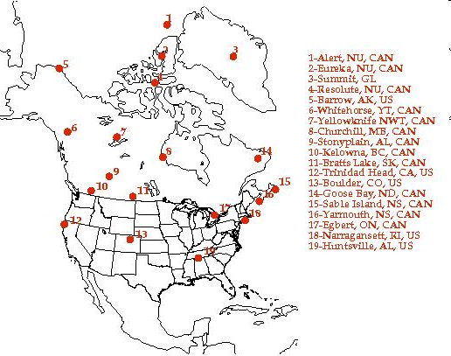
RAQMS
Ozonesonde
Validation
April 2008
April 2008 RAQMS vs ARCIONS ozonesonde
(182 North American sondes)
Tropospheric ozone

Slide 16
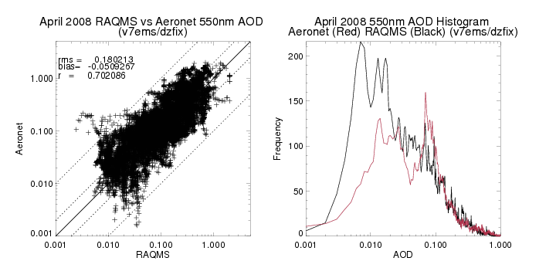
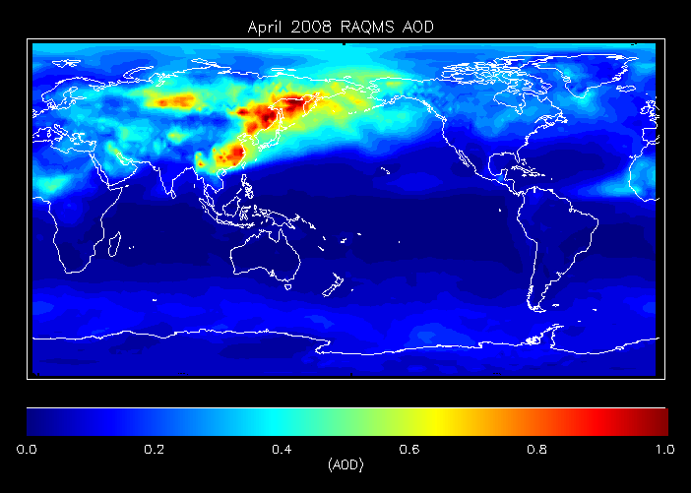
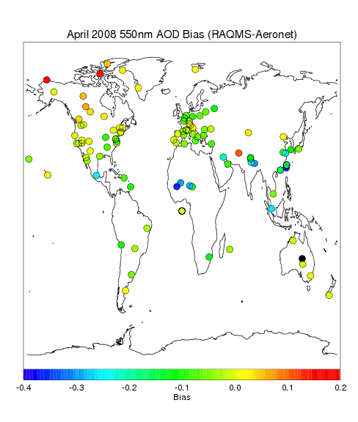
RAQMS
ARCPAC
Aeronet
Validation
April 2008

Slide 17
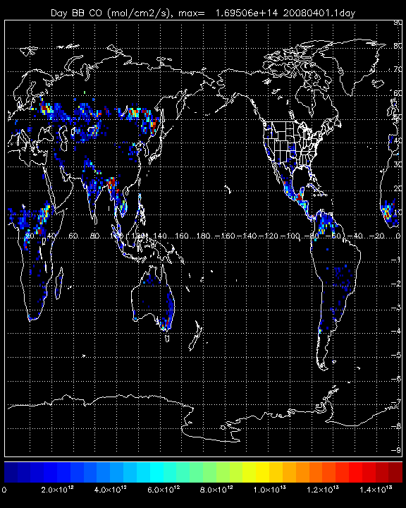
April 2008 Biomass Burning Emissions
Kazakhstan
Baykal
Thailand

Slide 18
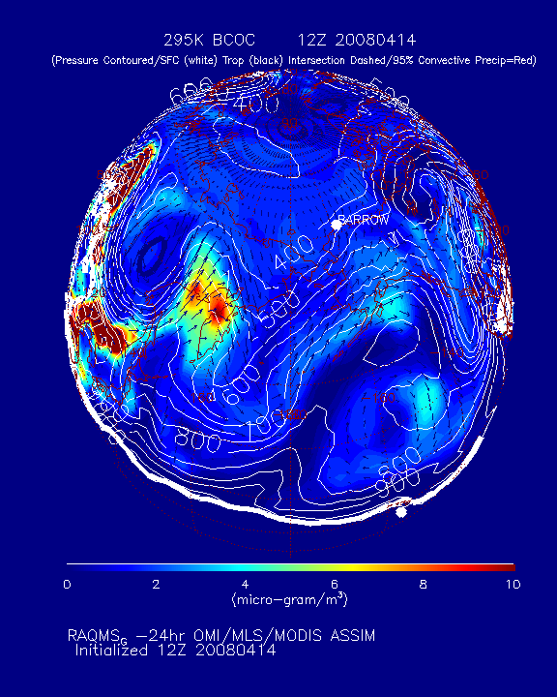

Slide 19
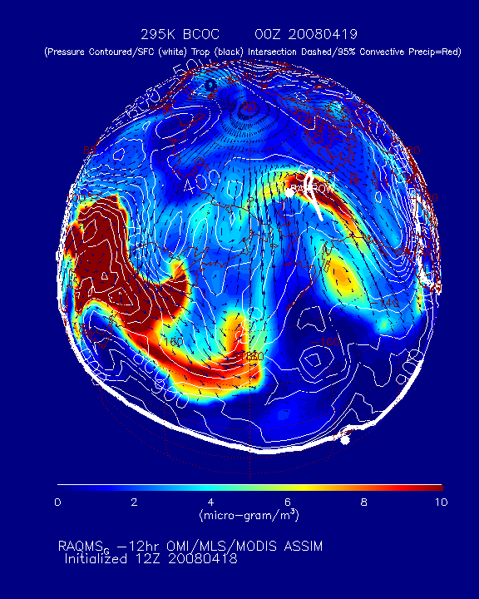
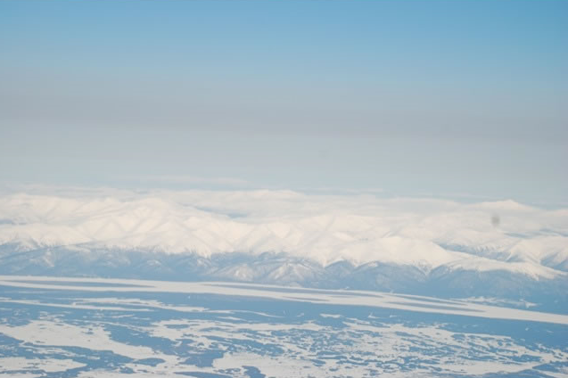
Arctic haze layer above the Brooks Range from NOAA P3
Biomass burning aerosols at ~5km (295K) in Arctic upper troposphere

Slide 20
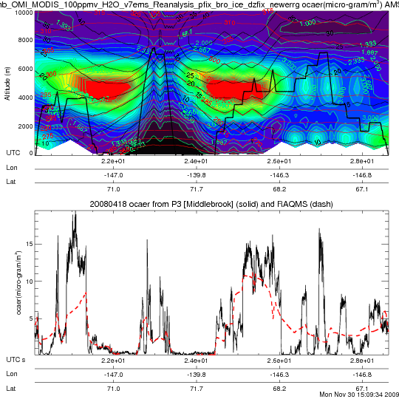
RAQMS vs P3 Insitu Organic Carbon
Biomass burning aerosols at ~5km (295K) in Arctic upper troposphere
Insitu OC provided by Ann Middlebrook (NOAA/ESRL)

Slide 21
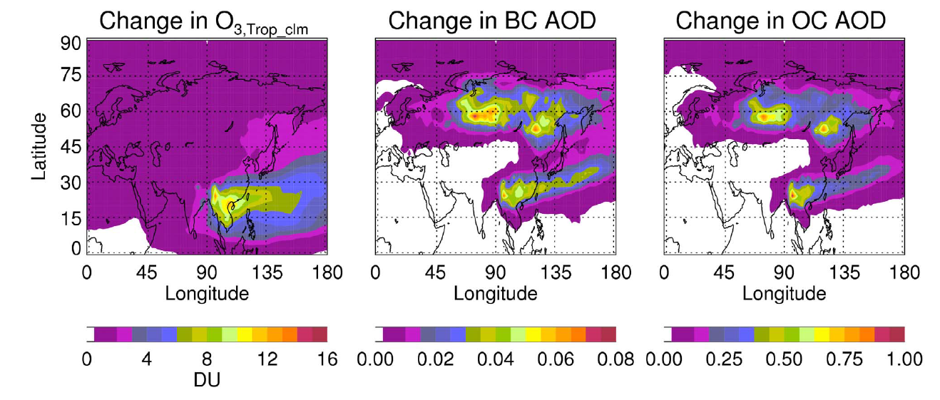
Increase in the tropospheric ozone, black carbon (BC) and organic carbon (OC) aerosol caused by the Asian fires
(April 2008)
Natarajan, M., R. B. Pierce, T. K. Schaack, A. J. Lenzen, J. A. Al-Saadi, A. J. Soja, T. P. Charlock, F. G. Rose, D. M.
Winker, and J. R. Worden (2012), Radiative forcing due to enhancements in tropospheric ozone and carbonaceous aerosols caused by Asian fires during spring 2008, J. Geophys. Res., 117, D06307, doi:10.1029/2011JD016584.

Slide 22
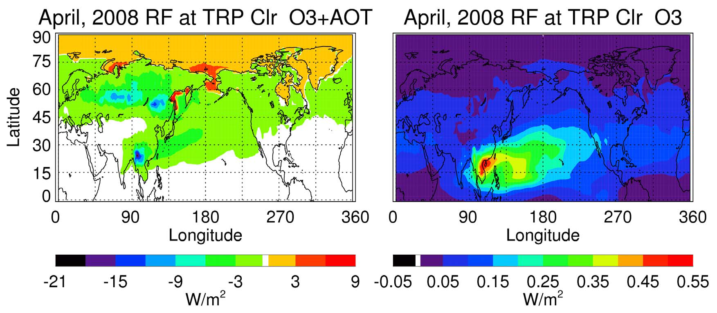
Clear Sky Tropopause (TRP) Radiative forcing (W/m2) due to changes in tropospheric ozone+(BC and OC) and ozone for April 2008
Aerosol scattering effects (cooling) dominate absorbing effects (heating) for clear sky conditions except in the Arctic region due to the presence of absorbing aerosols above a reflecting surface (sea ice)
Ozone from the Asian wildfires shows a small, but positive (heating) impact downwind of the Thailand wildfires

Slide 23
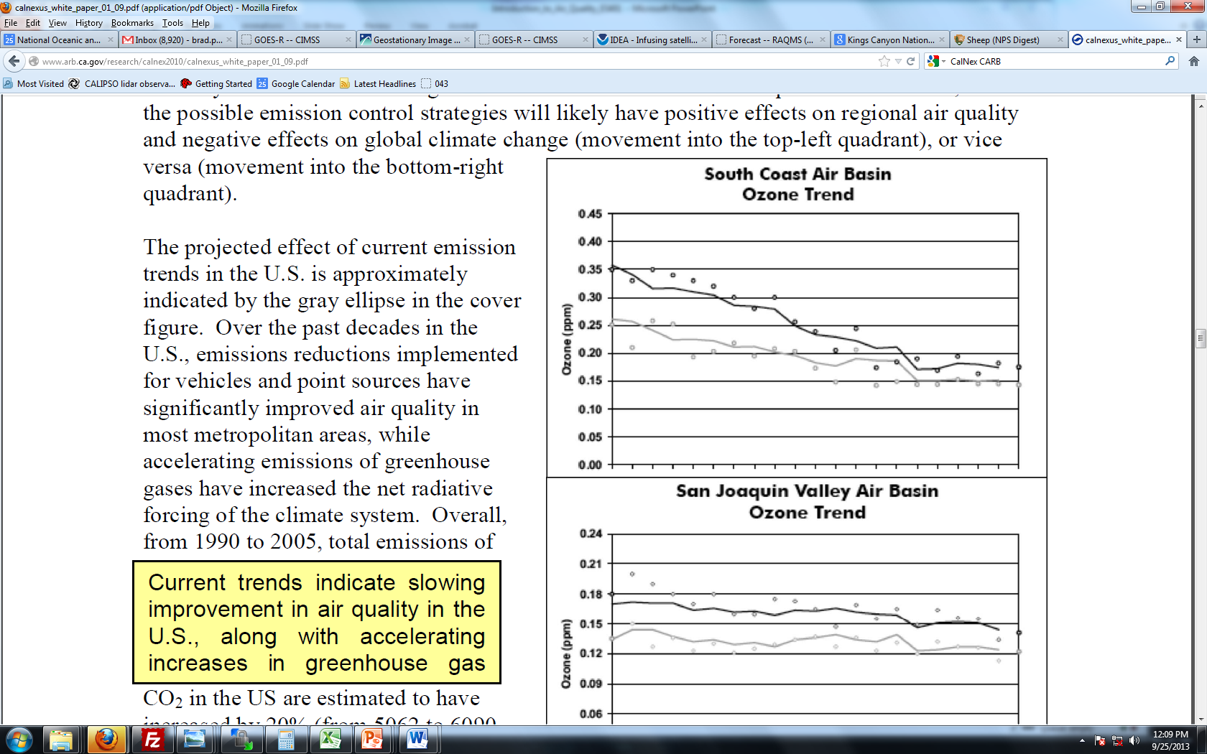

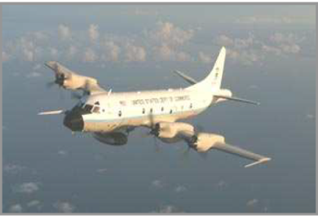
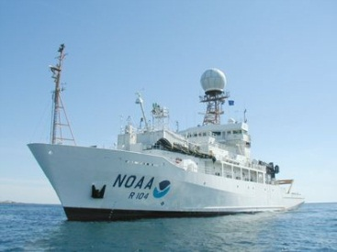
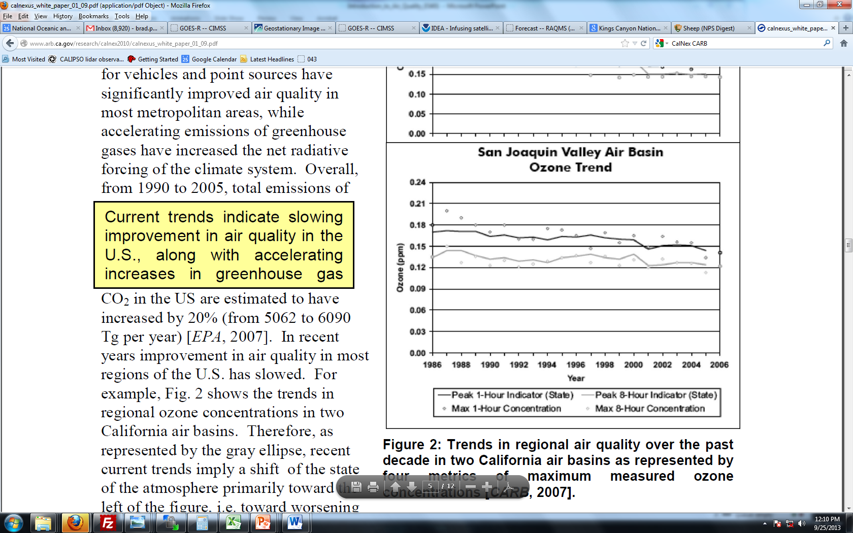
CalNex 2010
California Nexus
Research at the Nexus of Air Quality and Climate Change
Where: California and the eastern Pacific coastal region
When: May - July 2010
The CalNex study provided support to the California Air Resources Board (CARB) to improve emission inventories of greenhouse gases, traditional air pollutants and precursors and inform ARB’s air quality models used in State Implementation Plan (SIP) development.

Slide 24
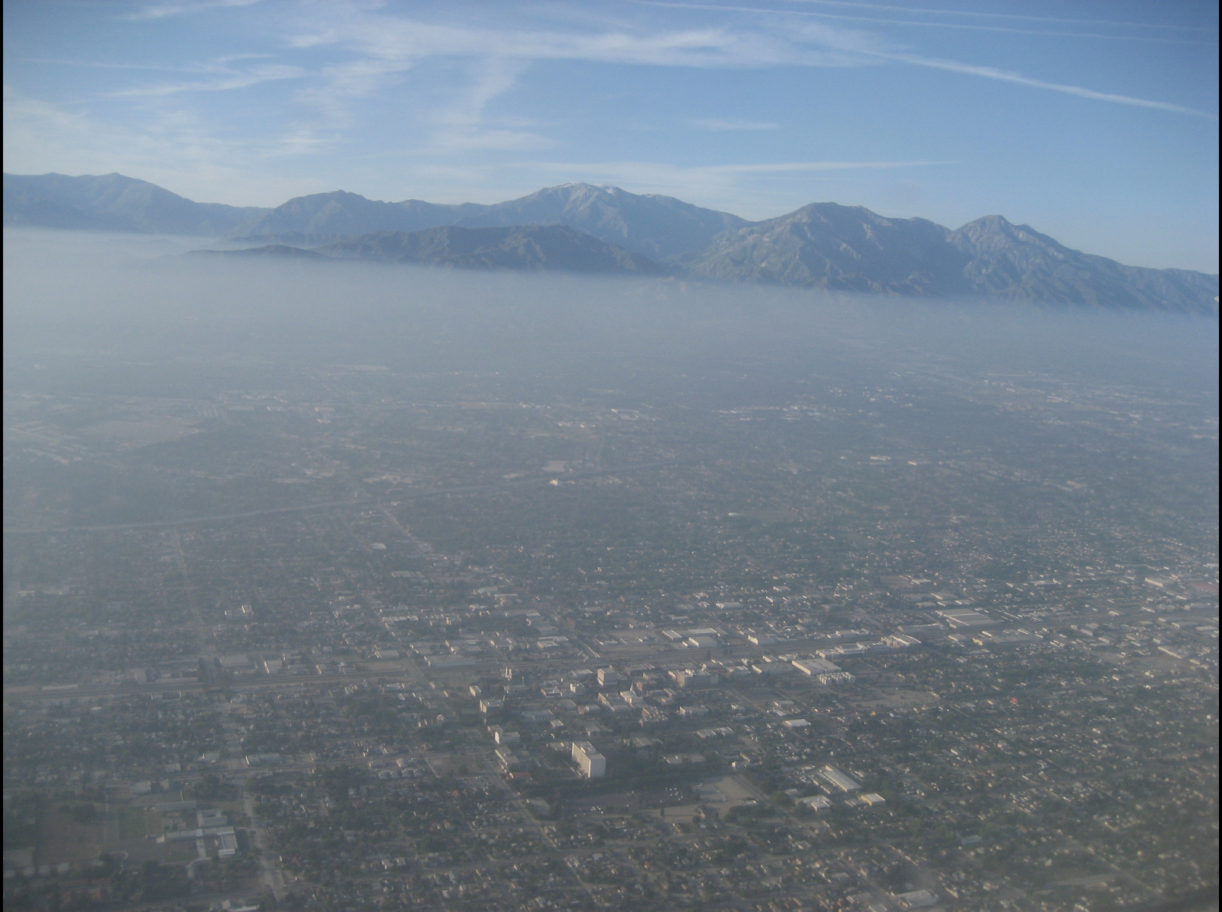
LA Basin as seen from the NOAA P3 during CalNex
CalNex Science Questions
What are the effects of long-range transport on California Air Quality during May-June 2010?
Does assimilation of satellite ozone and aerosol retrievals improve forecasts of intercontinental transport?

Slide 25
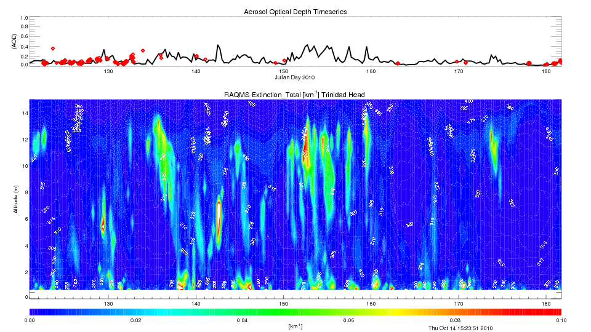
Comparison with Level 1.5 Aeronet Measurements
Trinidad Head (Remote site, PI Ellsworth G. Dutton)
RAQMS Total AOD is in good agreement with Aeronet at Trinidad Head (Remote Site)
Periods of high AOD are associated lofted carbon and dust aerosol extinction

Slide 26
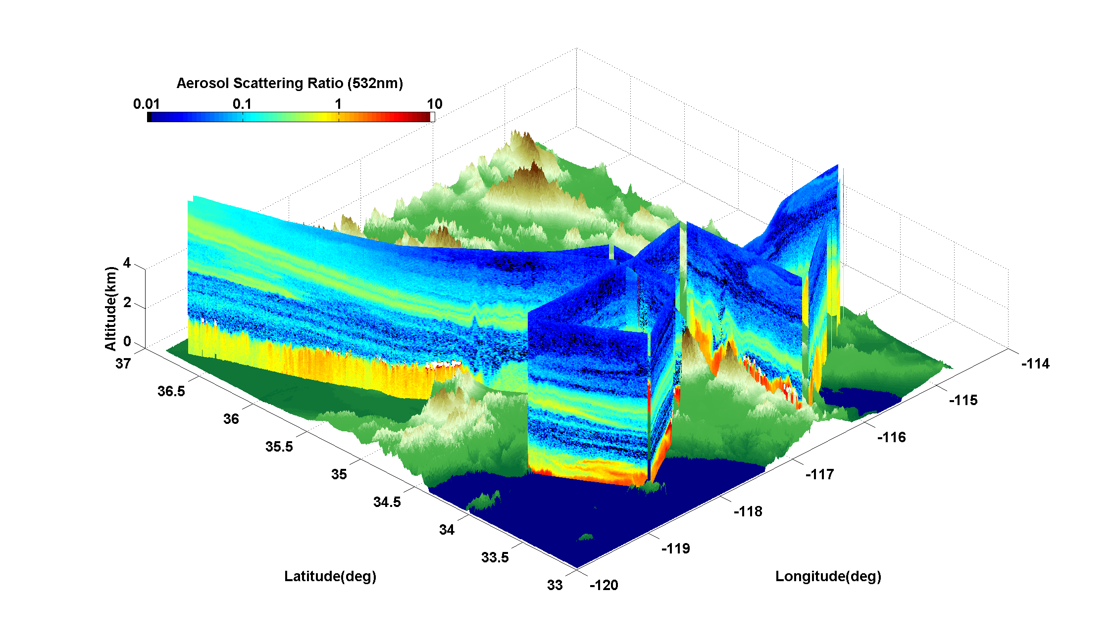
Saturday, May 22, 2010 Airborne High Spectral Resolution Lidar (HSRL) aerosol measurements

Slide 27
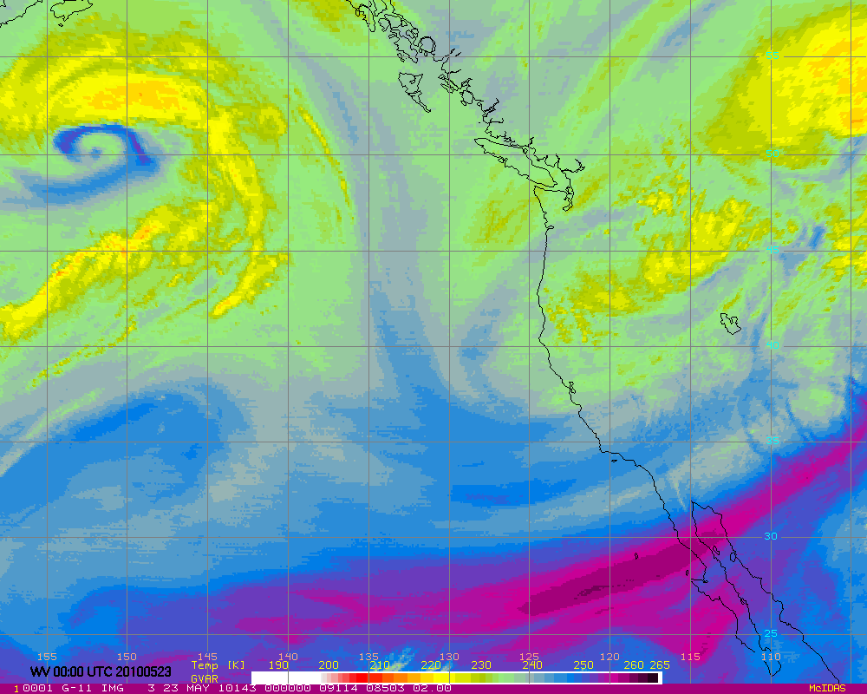
GOES WV 00Z 20100523 (Saturday Afternoon)
Dry Air at base of Trough

Slide 28
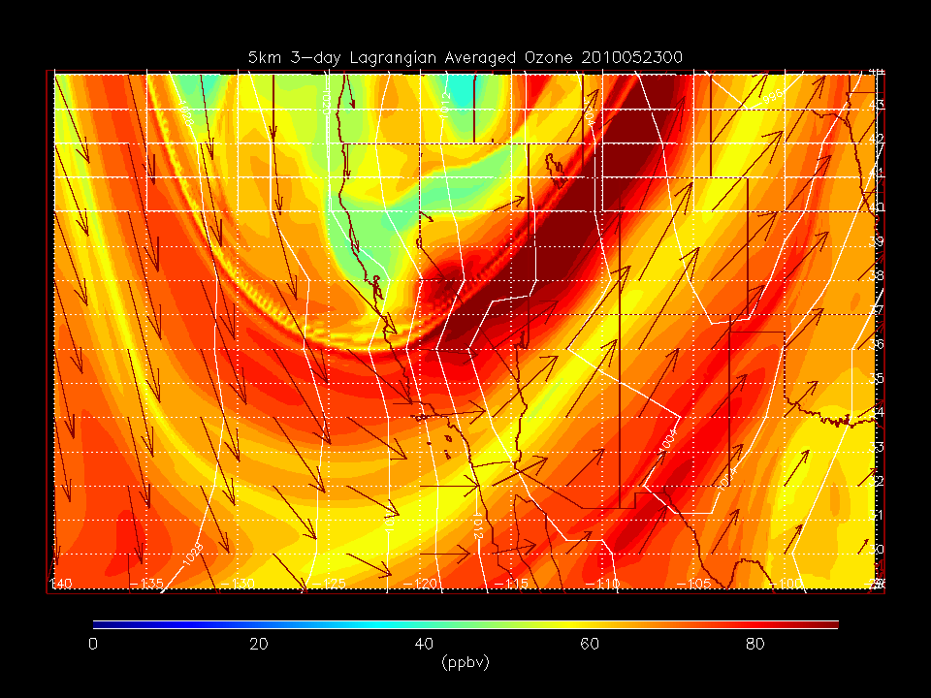
GOES WV 00Z 20100523 (Saturday Afternoon)
RAQMS 5km O3

Slide 29
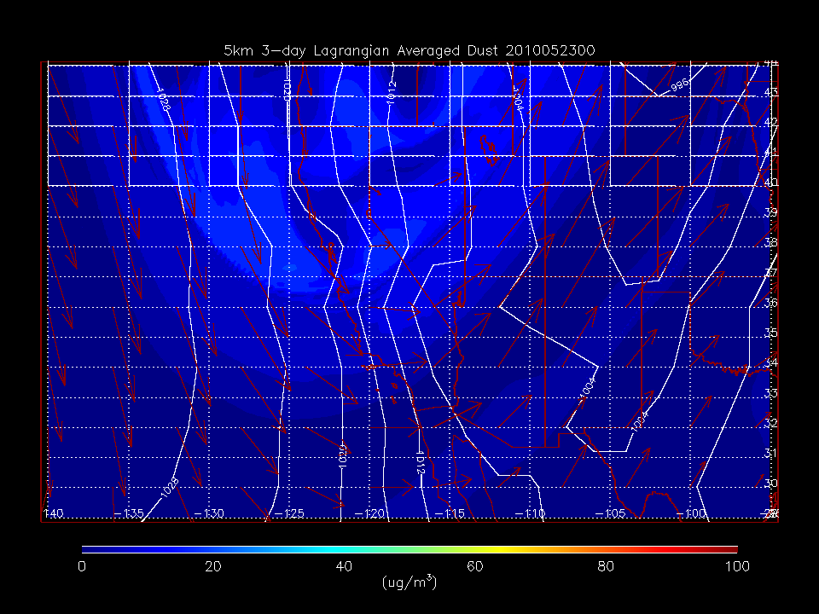
GOES WV 00Z 20100523 (Saturday Afternoon)
RAQMS 5km Dust

Slide 30
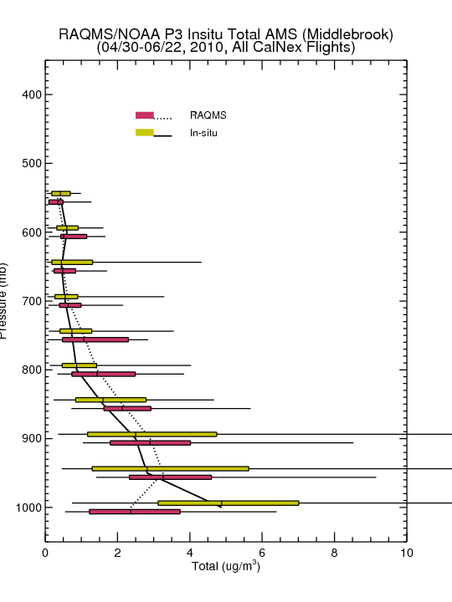
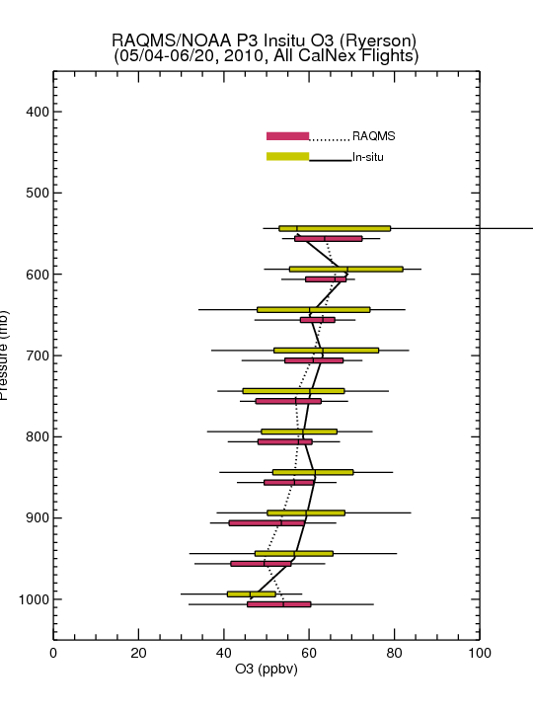
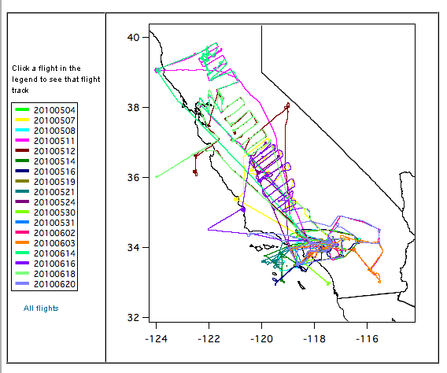
Comparison with NOAA P3 Insitu O3 Measurements
(Primarily LA Basin/Central Valley)
Assimilation of MLS+OMI O3 retrievals results in increased lower-tropospheric O3 (and improved agreement with airborne insitu O3) over Southern California
MODIS AOD Assim
MLS+OMI Assim
Boundary Layer underestimates in aerosol mass arise due to underestimates in local LA sources and neglect of nitrate aerosol in GOCART module
Insitu O3 from Tom Ryerson, insitu Aerosol from Anne Middlebrook
(NOAA ESRL)

Slide 31
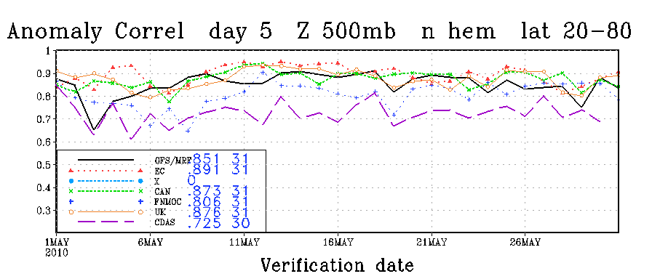
Assessment of Global 850mb O3 and Aerosol Extinction Forecast Skill
  Anomaly Correlations (AC)
    Correlation between forecast and analysis
    May-June mean removed
    Spectrally truncated to wavenumber 20
    Averaged from 20N-80N
useful Skill
http://www.emc.ncep.noaa.gov/gmb/STATS/html/monarch.html

Slide 32
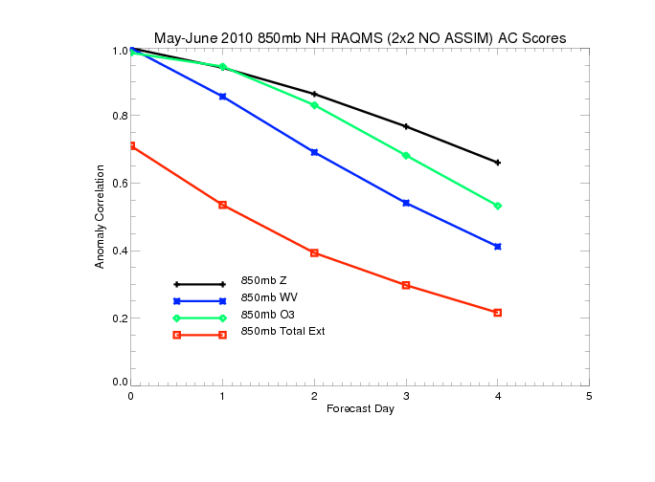
Northern Hemisphere 850mb May-June 2010 Anomaly Correlations (AC)
(No Assimilation)
useful Skill
850mb ozone forecasts have useful skill past 3 days (significantly better than water vapor)
850mb extinction forecasts do not have useful skill at 1 day

Slide 33
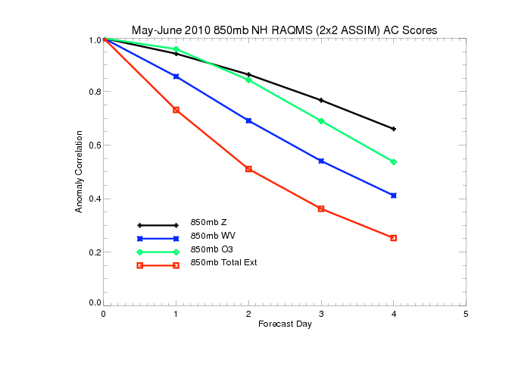
Northern Hemisphere 850mb May-June 2010 Anomaly Correlations (AC)
(With MLS/OMI/MODIS Assimilation)
useful Skill
Assimilation of O3 retrievals results in slight improvements in 850mb ozone forecasts
Assimilation of AOD retrievals results in significant improvement in 850mb extinction
forecasts with useful skill at ~1.5 days

Slide 34
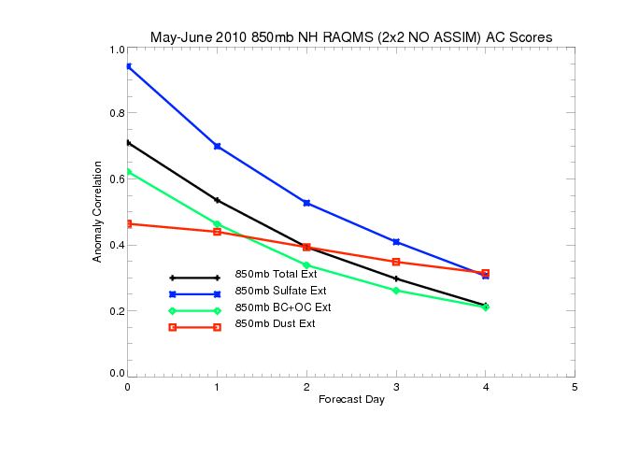
Northern Hemisphere 850mb May-June 2010 Anomaly Correlations (AC)
(No Assimilation)
useful Skill
Only 850mb SO4 extinction forecasts useful skill past 1 day
Black and organic carbon (BC+OC) and dust extinctions are both poorly initialized and
forecasted

Slide 35
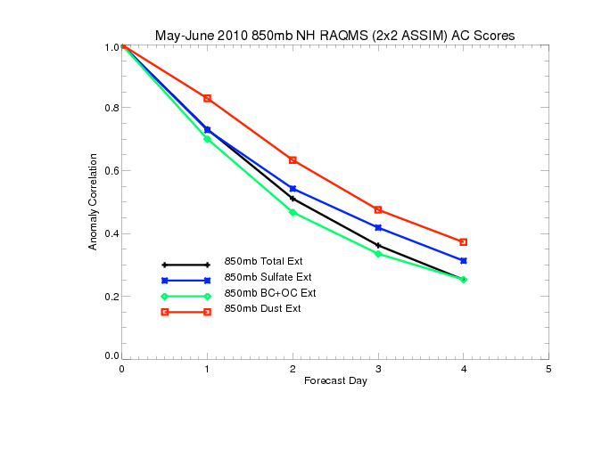
Northern Hemisphere 850mb May-June 2010 Anomaly Correlations (AC)
(With MODIS Assimilation)
useful Skill
MODIS AOD assimilation results in small changes in 850mb SO4 extinction forecasts
MODIS AOD assimilation results in significant improvements in black and organic carbon (BC+OC) and dust forecast skill (dust prediction useful at 2 days)

Slide 36
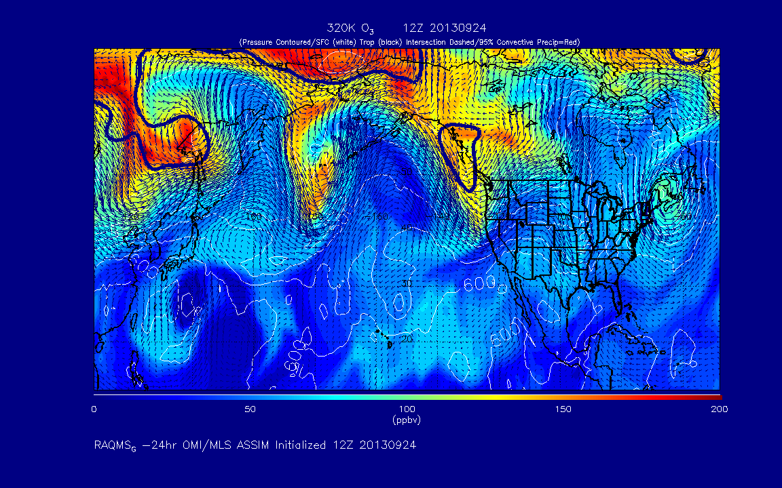
http://raqms-ops.ssec.wisc.edu/

Slide 37
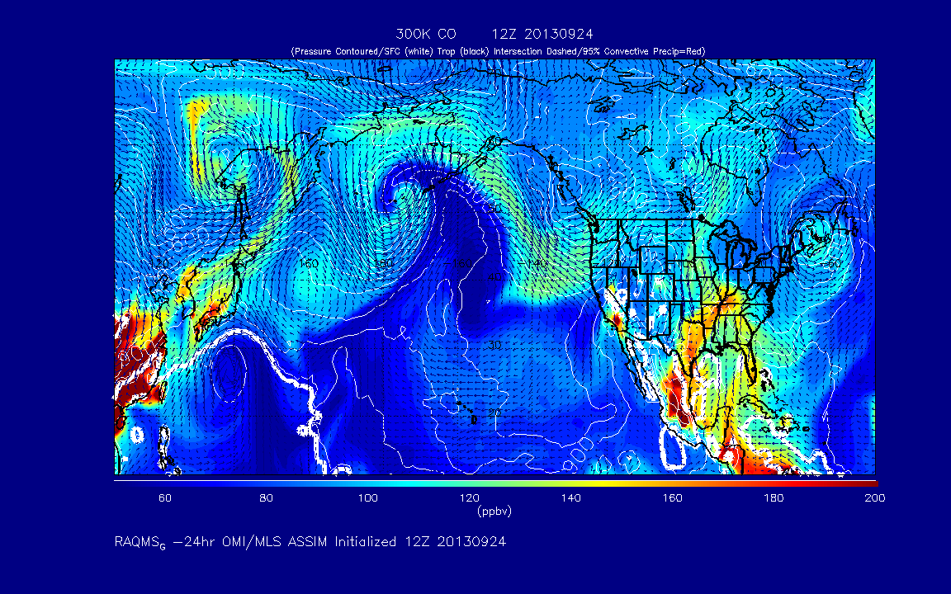
http://raqms-ops.ssec.wisc.edu/

Slide 38

http://raqms-ops.ssec.wisc.edu/

Slide 39

http://raqms-ops.ssec.wisc.edu/

Slide 40

http://raqms-ops.ssec.wisc.edu/

Slide 41

http://raqms-ops.ssec.wisc.edu/

Slide 42


Understanding issues at the nexus of
air quality and climate change
Global NO2 Trends 2002-2011
Global Aerosol Optical Depth Trends 1997-2010
Schneider, P., and R. J. van der A (2012), A global single-sensor analysis of 2002–2011 tropospheric nitrogen dioxide trends observed from space, J. Geophys. Res., 117, D16309, doi:10.1029/2012JD017571.
Hsu, N. C., et al., (2012) Global and regional trends of aerosol optical depth over land and ocean using SeaWiFS measurements from 1997 to 2010, Atmos. Chem. Phys., 12, 8037-8053, doi:10.5194/acp-12-8037-2012, 2012.
Vision for the future: an operational air quality modeling system capable of utilizing space based composition measurements for global and regional air quality prediction and climate monitoring

