Slide 1
2017 Lake Michigan Ozone Study (LMOS)
Brad Pierce
NOAA/NESDIS/STAR
Turning NOAA Science into Information for Societal Benefit
NOAA/NESDIS Cooperative Research Program (CoRP), Annual Science Symposium, Madison WI, 6 – 7 June 2018

Slide 2
Ozone Pollution health & ecosystem effects
Tropospheric ozone (O3) is formed by photochemical reactions involving sunlight and precursor pollutants, including volatile organic compounds (VOCs), nitrogen oxides (NOX), and carbon monoxide (CO).
In the troposphere, O3 acts as a powerful oxidizing agent, which can harm living organisms and materials.
Short-term exposure to elevated O3 concentrations leads to respiratory and cardiovascular effects and increased mortality
Long-term exposure to elevated O3 concentrations leads to reduced vegetation growth, productivity, and yield and quality of agricultural crops
U.S. EPA. Integrated Science Assessment (ISA) of Ozone and Related Photochemical Oxidants (Final Report, Feb 2013). U.S. Environmental Protection Agency, Washington, DC, EPA/600/R-10/076F, 2013.

Slide 3
Ozone Pollution health & ecosystem effects
Tropospheric ozone (O3) is formed by photochemical reactions involving sunlight and precursor pollutants, including volatile organic compounds (VOCs), nitrogen oxides (NOX), and carbon monoxide (CO).
In the troposphere, O3 acts as a powerful oxidizing agent, which can harm living organisms and materials.
Short-term exposure to elevated O3 concentrations leads to respiratory and cardiovascular effects and total mortality
Long-term exposure to elevated O3 concentrations leads to reduced vegetation growth, productivity, and yield and quality of agricultural crops
Tropospheric Formaldehyde (HCHO, a VOC), Nitrogen Dioxide (NO2, part of NOx), CO and O3 columns can all be observed from Satellites
U.S. EPA. Integrated Science Assessment (ISA) of Ozone and Related Photochemical Oxidants (Final Report, Feb 2013). U.S. Environmental Protection Agency, Washington, DC, EPA/600/R-10/076F, 2013.

Slide 4
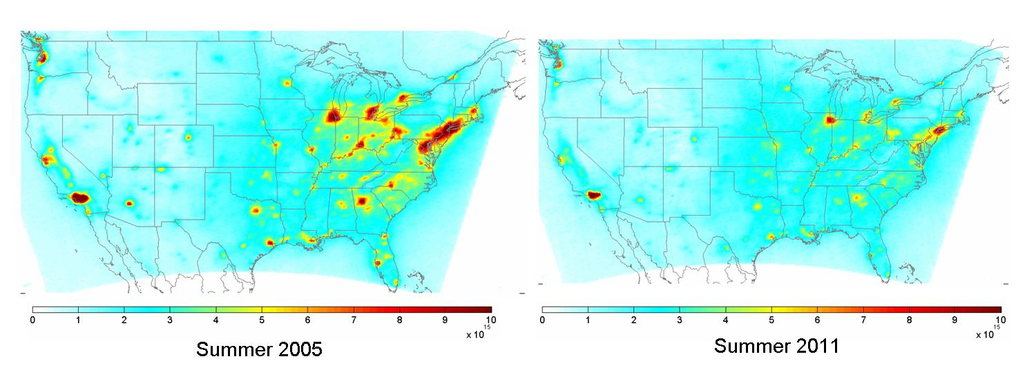
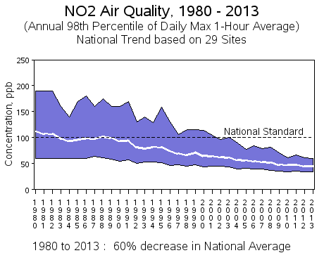
Background: National Trends in Nitrogen Dioxide (NO2) Levels
OMI Berkeley High-Resolution (BEHR) NO2 Column Retrievals
Overall, surface and column NO2 amounts are declining over the US due to regulations from the Clean Air Act
EPA NO2 trends from ground monitoring
32±7% reduction 2005-2011
http://www.epa.gov/airtrends/nitrogen.html
Russell et al., ACP 12, 12197-12209, doi:10.5194/acp-12-12197-2012, 2012.

Slide 5
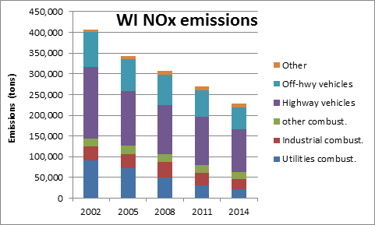
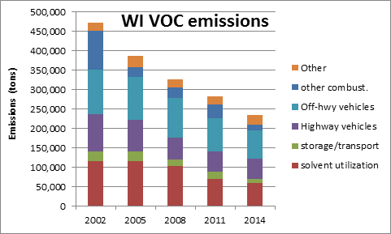
Wisconsin emissions are declining and ozone is improving
NOx= NO+NO2 (nitrogen oxides) VOC=Volatile Organic Compounds, both are ozone precursors
Provided by Angie Dickens (WDNR)
and Donna Kenski (LADCO)

Slide 6
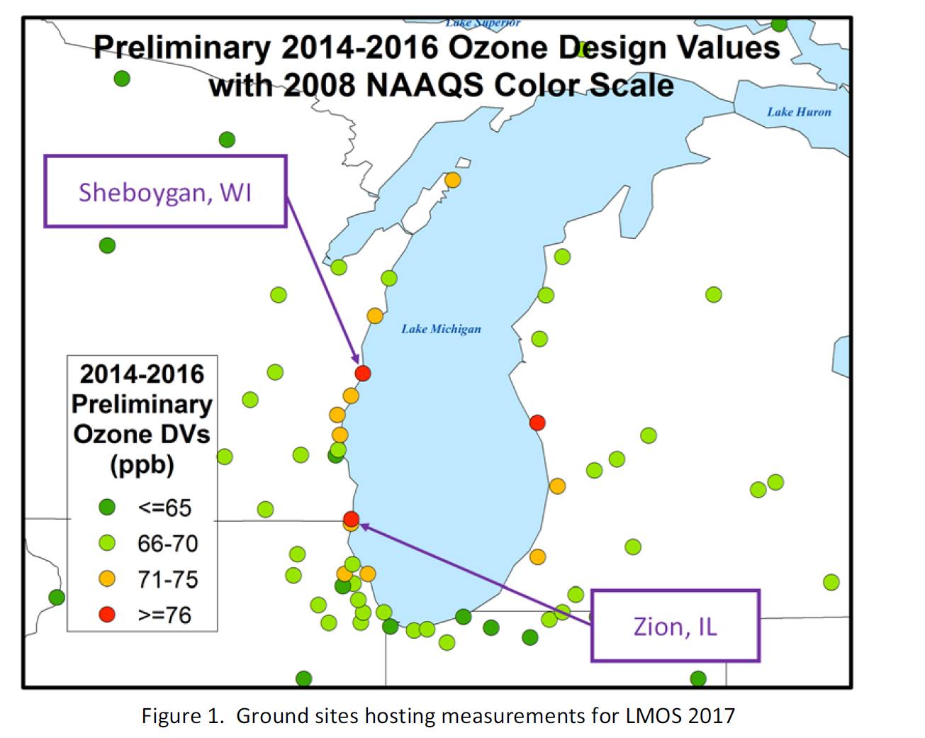
But there are still coastal sites which are still above the new ozone standard (70ppbv)
Anticipated new non-attainment areas with new, lower ozone standard and persistent exceedances of the old (2008) ozone standard.
Impact of high ozone on public health in high density urban areas (Chicago, Milwaukee, Detroit, Windsor). Also, these areas serve as large emissions sources.
2017 Lake Michigan Ozone Study White Paper: http://www.ladco.org/

Slide 7
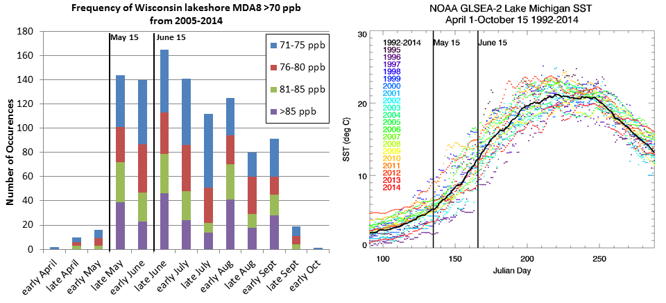
Lake Michigan Ozone Study (LMOS) 2017
Campaign Study Period May 22- June 22, 2017
Primary science objectives focusing on characterizing the recirculation, aging, and mixing of the Chicago and Milwaukee urban plumes as they move over Lake Michigan and their impact on surface ozone.
2017 Lake Michigan Ozone Study White Paper: http://www.ladco.org/

Slide 8
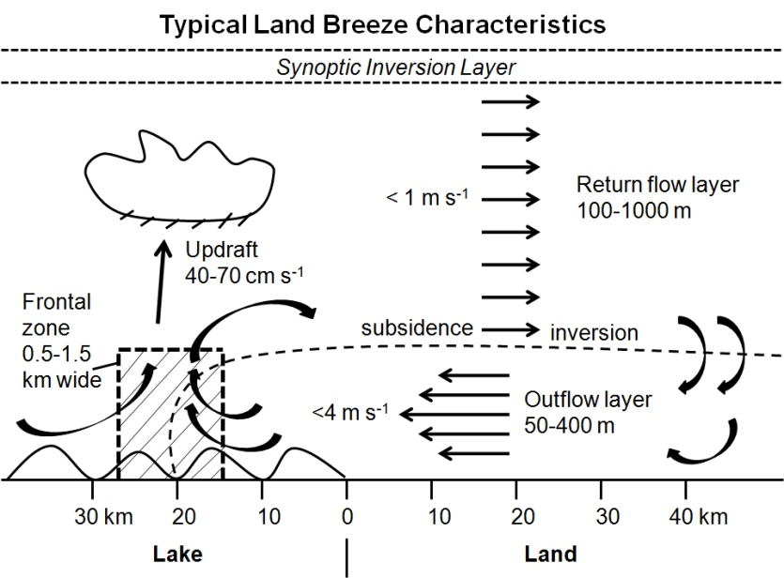
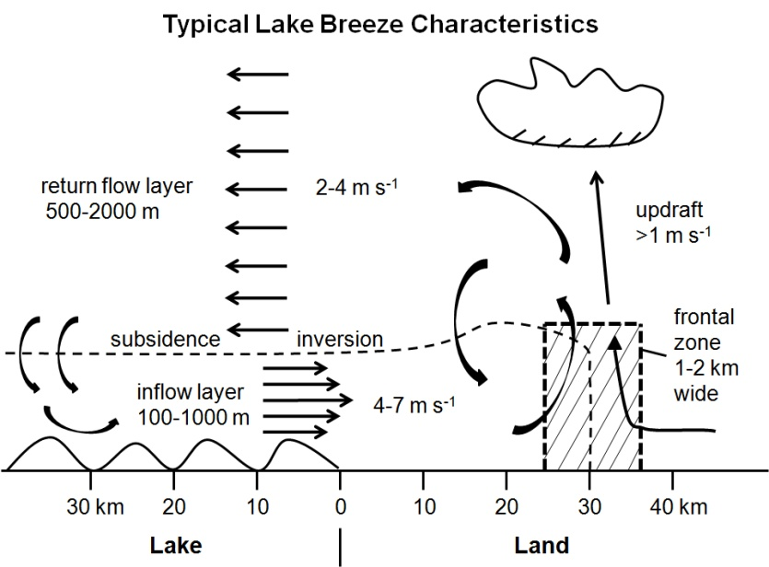
Lake Michigan and Ozone Formation
Land breeze blows ozone precursor compounds from rush hour over lake.
The boundary layer height is low due to cold water chilling the air above.
The pollutants are concentrated near the surface where ozone forms.
An afternoon lake breeze transports the ozone back onto land.
2017 Lake Michigan Ozone Study White Paper: http://www.ladco.org/

Slide 9
Summary of measurements made during the LMOS 2017 field campaign
Location | Measurement* | Research Institution*
Ground Sites
Spaceport Sheboygan | Remote sensing of meteorology (SPARC Trailer) | UW-Madison -SSEC
 | In situ measurements of pollutants | U.S. EPA ORD
Zion, IL | Remote sensing of meteorology (Sodar/MW Radiometer) | Univ. Northern Iowa
 | Detailed in situ chemical measurements | Univ. Iowa, UW-Madison, Univ. Minnesota
 | Routine measurements of ozone | Illinois EPA
Various† | Remote sensing of pollutants and boundary layer height | U.S. EPA ORD
Sheboygan transect | In situ measurements of ozone at four locations | U.S. EPA ORD
Airborne Platforms
Lakeshore region | Airborne remote sensing of NO₂ (GeoTASO) | NASA
 | Airborne remote sensing of clouds (AirHARP) | Univ. Maryland, Baltimore County
 | Airborne in situ profiling of pollutants and meteorology | Scientific Aviation (and NOAA?)
Shipboard Platform
Lake Michigan | In situ measurements of pollutants | U.S. EPA ORD
 | Remote sensing of pollutants and boundary later height | U.S. EPA ORD
Mobile Platforms
Northeast IL and Southeast WI | In situ measurements of pollutants (GMAP) | U.S. EPA Region 5
Grafton to Sheboygan | In situ measurements of ozone and meteorology | UW-Eau Claire
GeoTASO = Geostationary Trace gas and Aerosol Sensor Optimization instrument
AirHARP = Airborne Hyper Angular Rainbow Polarimeter
GMAP = Geospatial Mapping of Pollutants
† These measurements were made at Spaceport Sheboygan, Zion, two Wisconsin DNR monitoring locations (Grafton and Milwaukee SER) and one Illinois EPA monitoring location (Schiller Park).

Slide 10
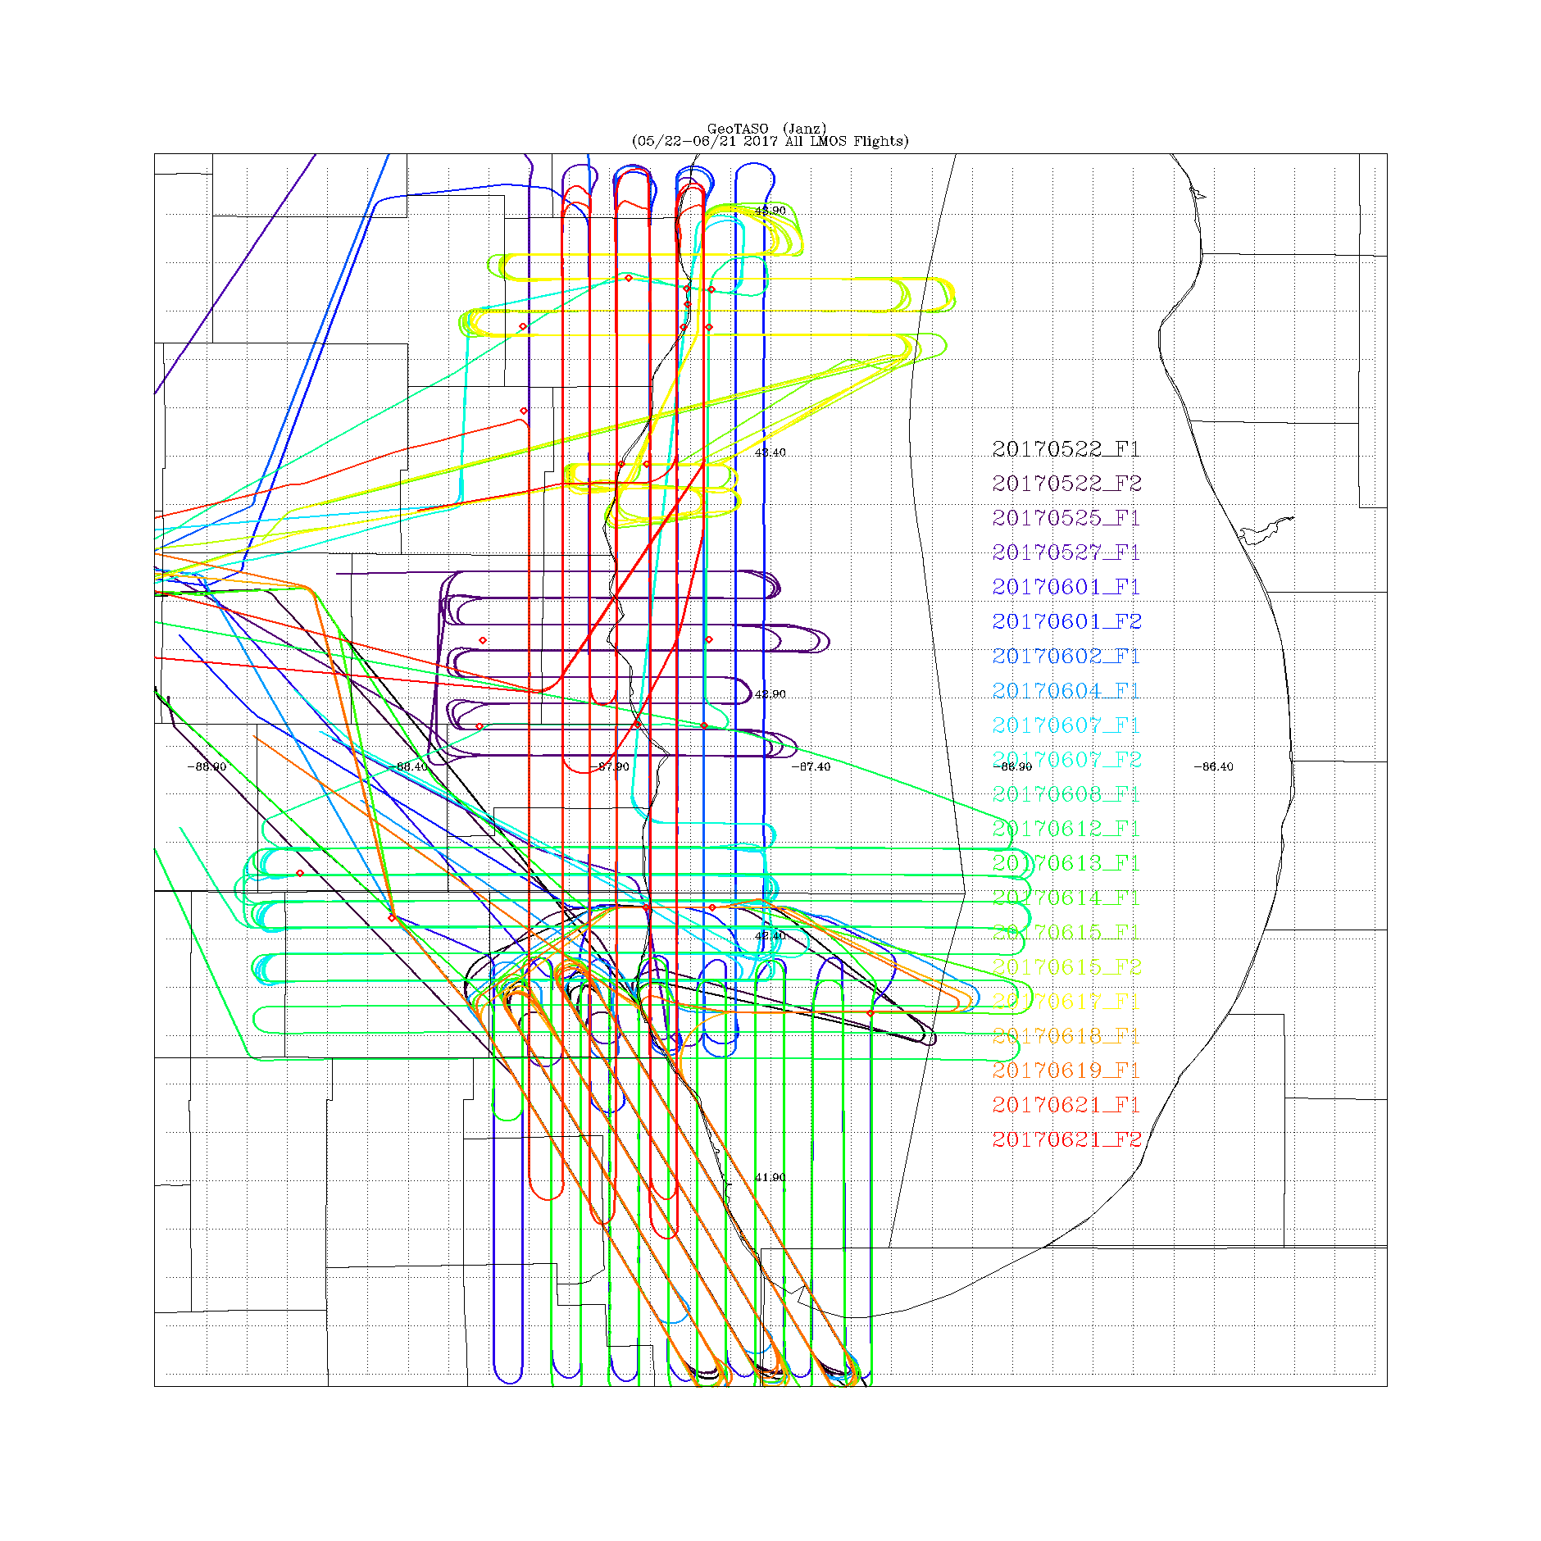
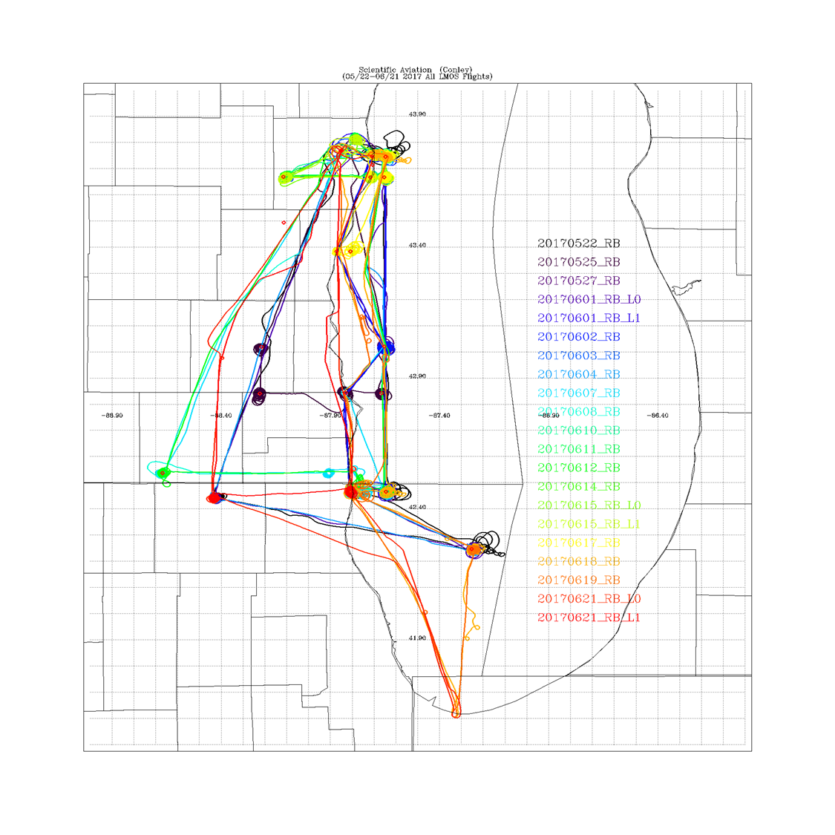
LMOS 2017 Aircraft Measurements
NASA GeoTASO remote sensing Flights
Scientific Aviation insitu sampling Flights
GeoTASO (Geostationary Trace gas and Aerosol Sensor Optimization) is an airborne hyperspectral mapping instrument that is being used as an airborne testbed for future high-resolution trace-gas observations from geostationary sensors such as TEMPO
The Electric Power Research Institute (EPRI) provided funding for Scientific Aviation Flights during LMOS

Slide 11
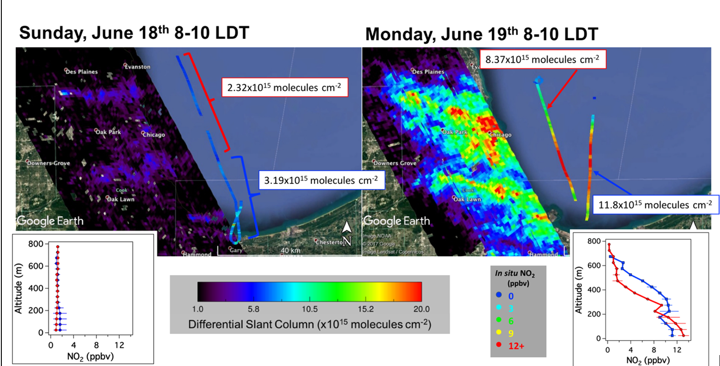
Chicago Emission Mapping Weekend/Weekday
GeoTASO (Geostationary Trace gas and Aerosol Sensor Optimization) is an airborne hyperspectral mapping instrument built by Ball Aerospace (Leitch et al., 2014) and is being used as an airborne testbed for future high-resolution trace-gas observations from geostationary sensors such as TEMPO (Analysis by Laura Judd, NASA/LaRC)

Slide 12
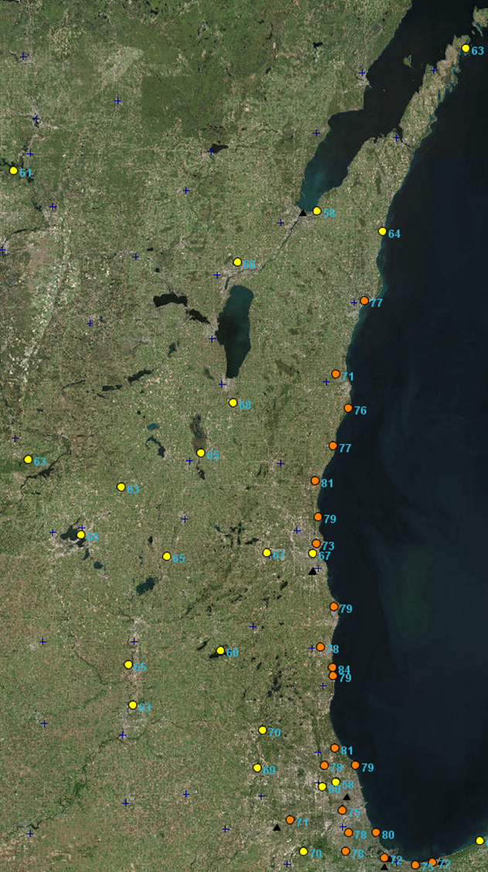
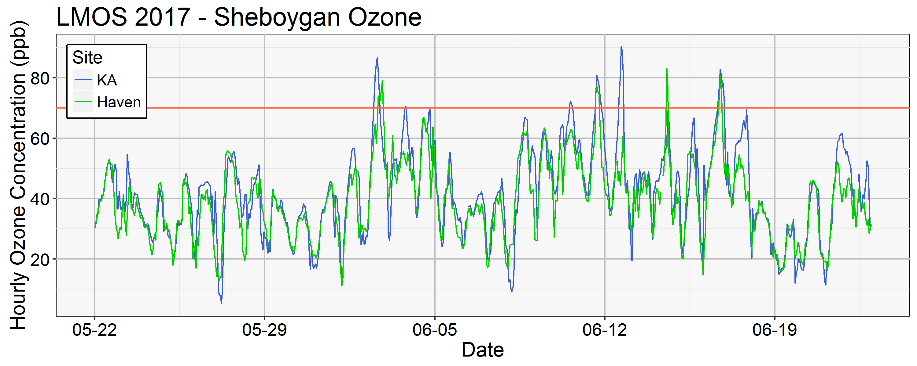
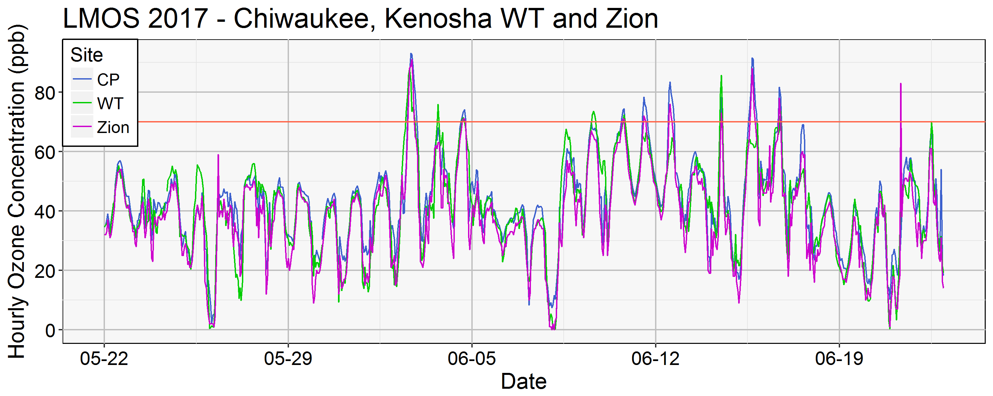
Lakeshore ozone during LMOS 2017
June 02, 2017 MDA8
June 02, 2018
June 02, 2018
Provided by Angie Dickens (WDNR)
MDA8=Maximum Daily 8 hour Average

Slide 13
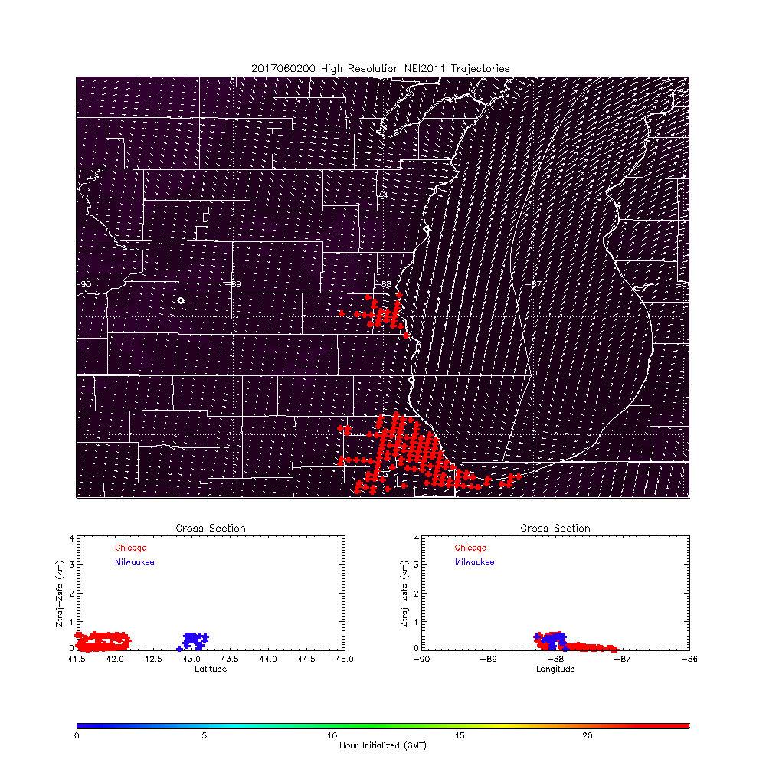
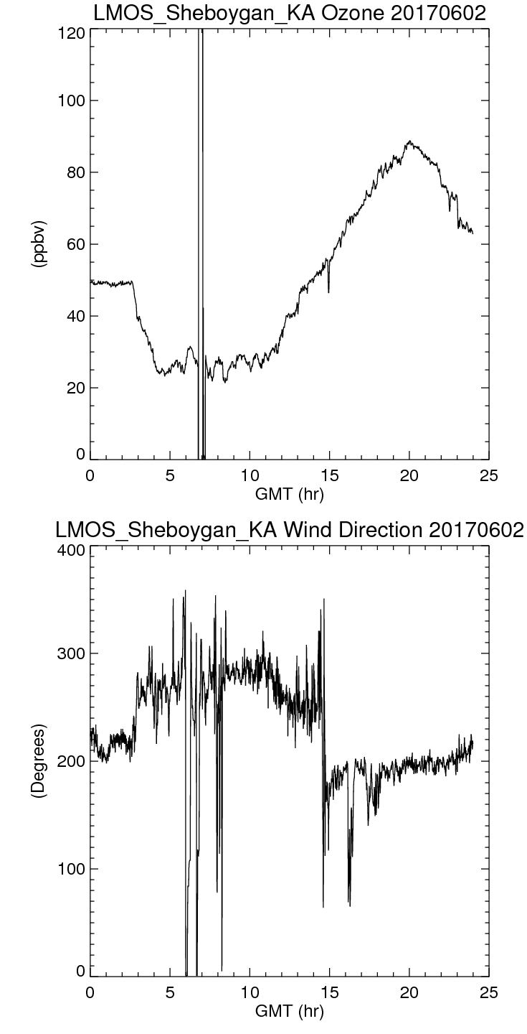
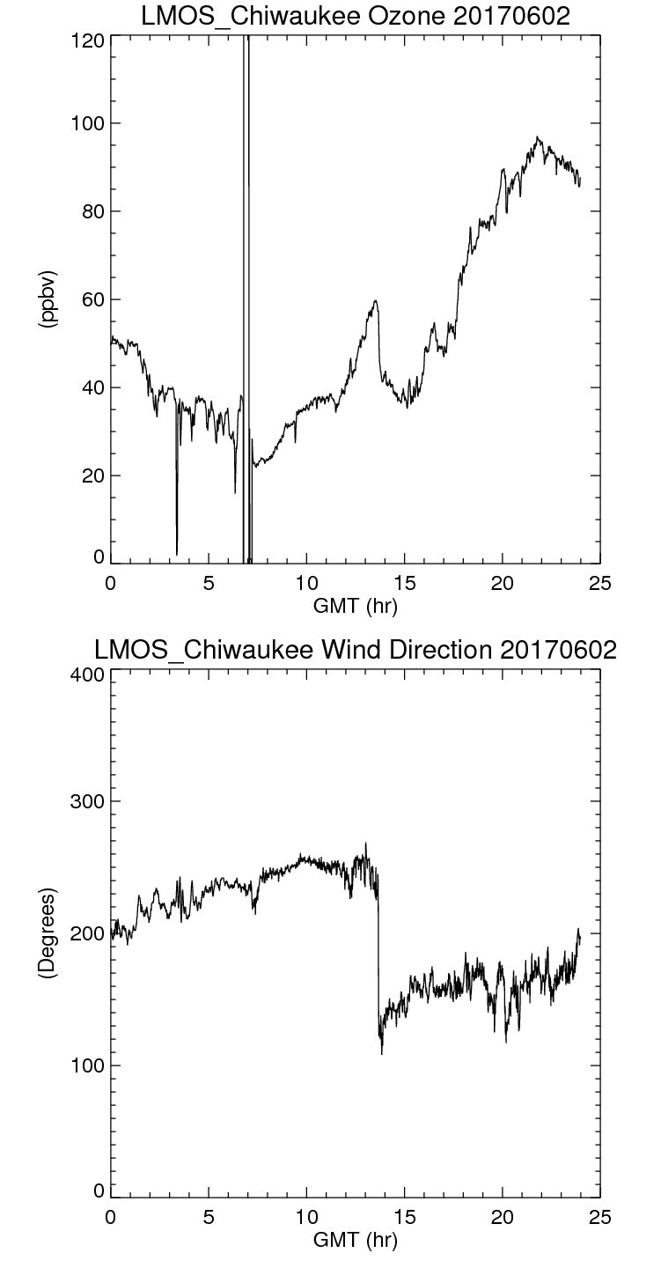
Coastal Ozone Exceedance Day
Sheboygan Kohler-Andrea and Chiwaukee surface ozone and wind direction on June 02, 2017
High resolution (3km) NAM Nest June 02, 2017 trajectory forecasts showing transport of Milwaukee and Chicago NOx emissions

Slide 14
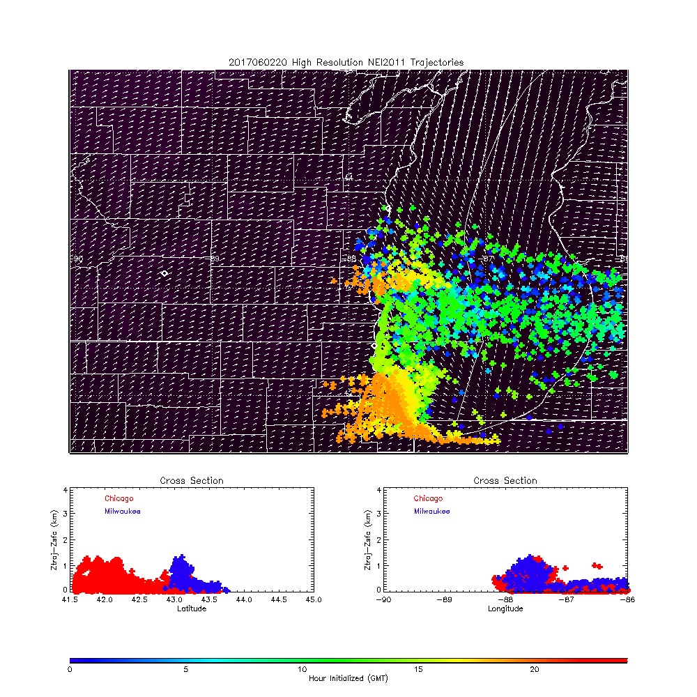
Coastal Ozone Exceedance Day
Sheboygan Kohler-Andrea and Chiwaukee surface ozone and wind direction on June 02, 2017
High resolution (3km) NAM Nest June 02, 2017 trajectory forecasts showing transport of Milwaukee and Chicago NOx emissions

Slide 15
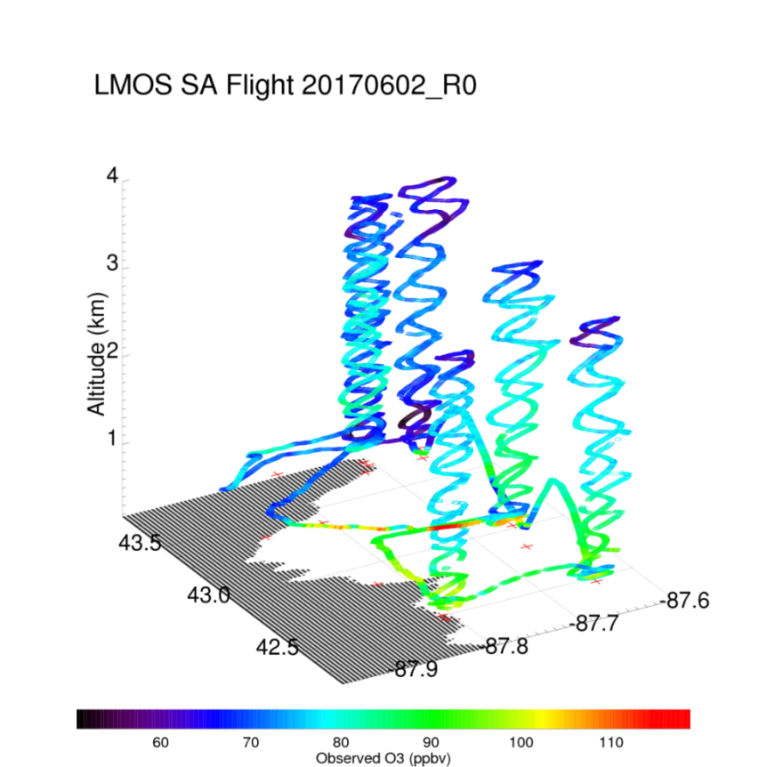
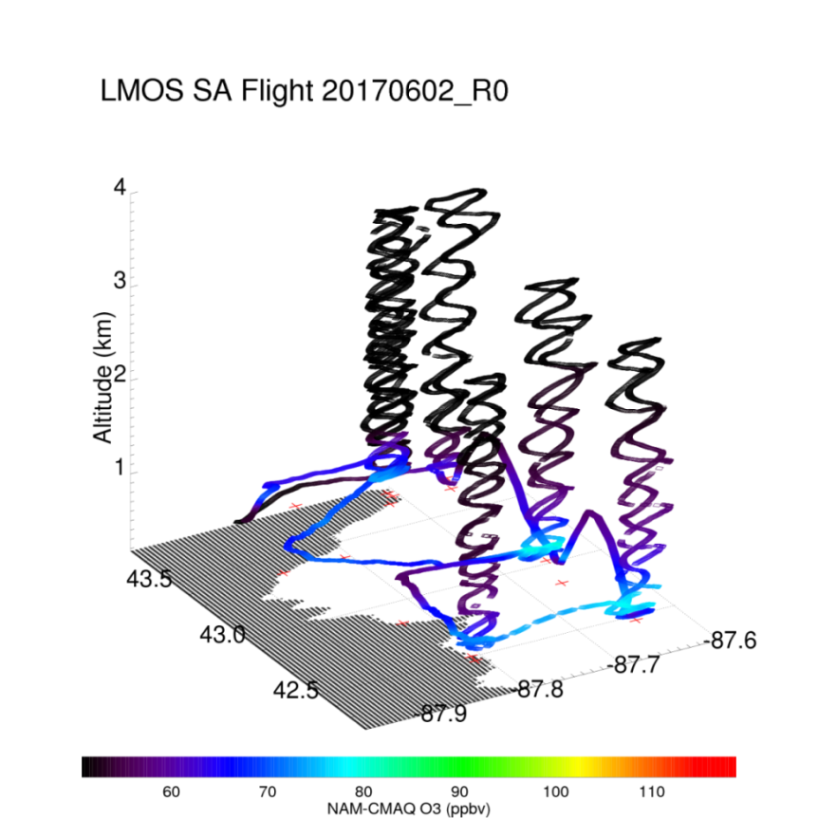
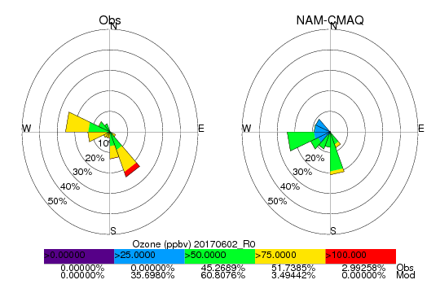
Coastal Ozone Exceedance Day
NWS NAM-CMAQ significantly underestimates ozone concentrations within the marine boundary layer
Max Observed O3 > 110ppbv
Max NAM-CMAQ O3 < 80ppbv

Slide 16
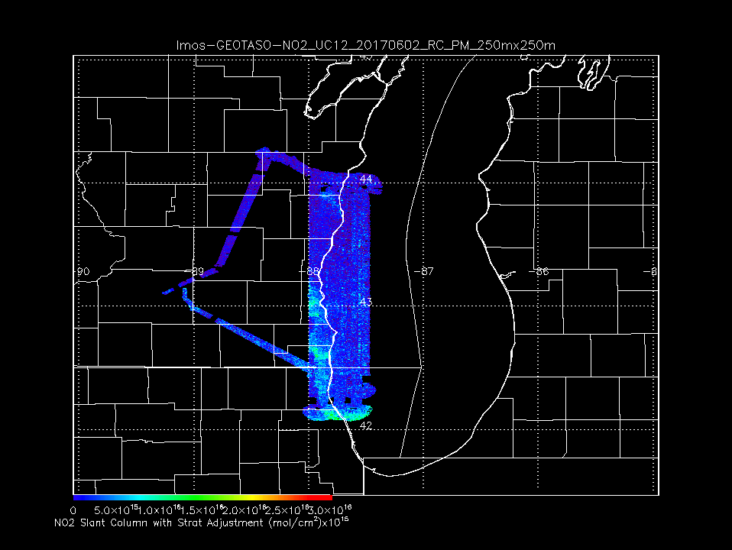
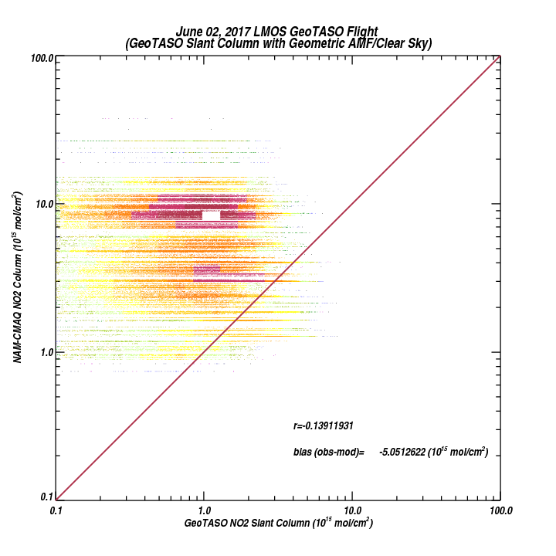
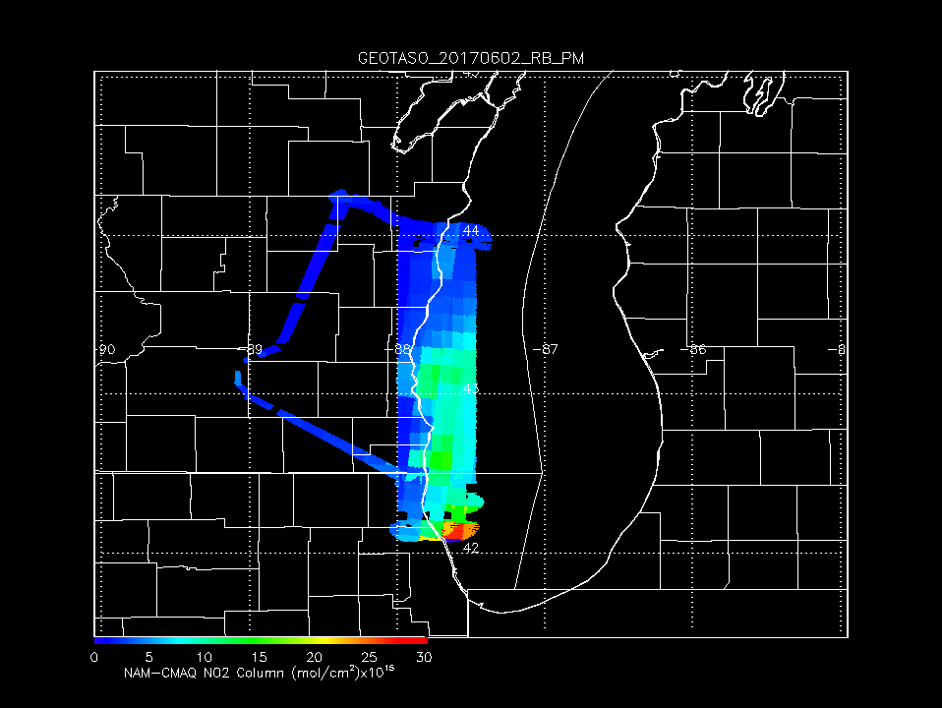
GeoTASO NO2 Slant Column June 02, 2017
GeoTASO Coastal Survey Flight
June 02, 2017
NWS NAM-CMAQ significantly overestimates observed NO2 column
NAM-CMAQ NO2 Column June 02, 2017

Slide 17
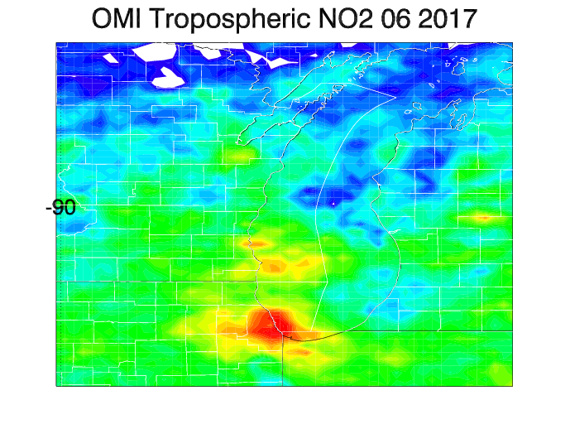
Aura Ozone Monitoring Instrument (OMI) Tropospheric NO2 column Data Assimilation
OMI Tropospheric NO2 column during June 2017
NOx emissions adjustments (ΔE) are constrained using OMI tropospheric NO2 column analysis increments (ΔΩ)
β accounts for the sensitivity of the NO2 column to changes in NOx emissions following Lamsal et al 2011.
Lamsal, L. N., et al. (2011), Application of satellite observations for timely updates to global anthropogenic NOx emission inventories, Geophys. Res. Lett., 38, L05810, doi:10.1029/2010GL046476.

Slide 18
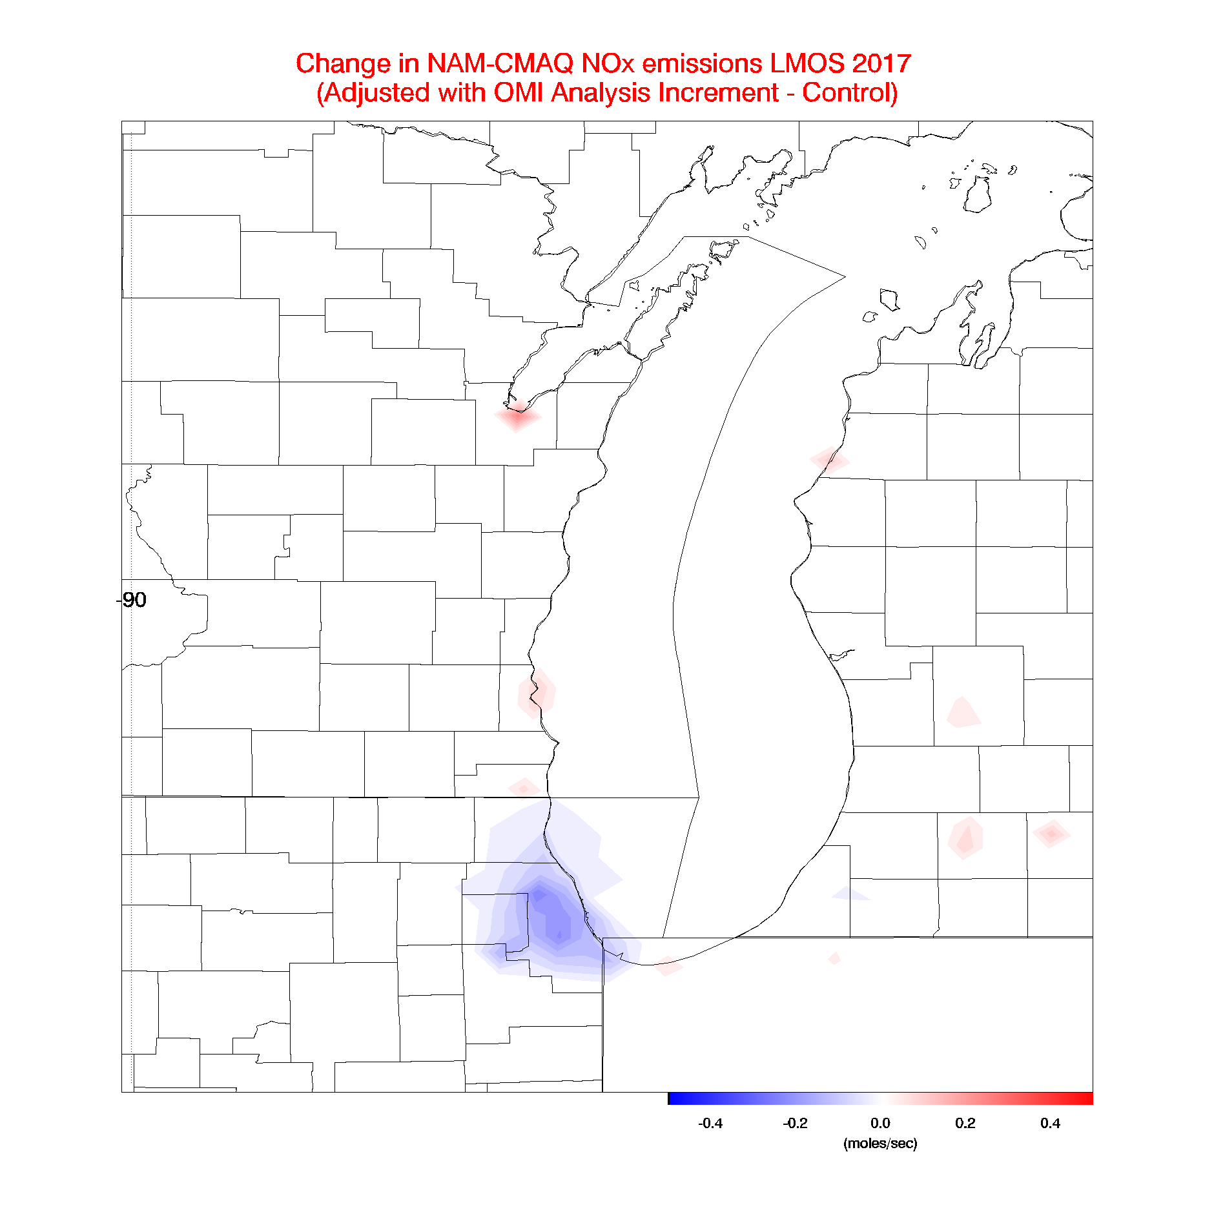
Aura Ozone Monitoring Instrument (OMI) Tropospheric NO2 column Data Assimilation
OMI Tropospheric NO2 column during LMOS 2017
Assimilation of OMI NO2 results in small (~4%) reductions in NOx emissions over Chicago
Lamsal, L. N., et al. (2011), Application of satellite observations for timely updates to global anthropogenic NOx emission inventories, Geophys. Res. Lett., 38, L05810, doi:10.1029/2010GL046476.

Slide 19
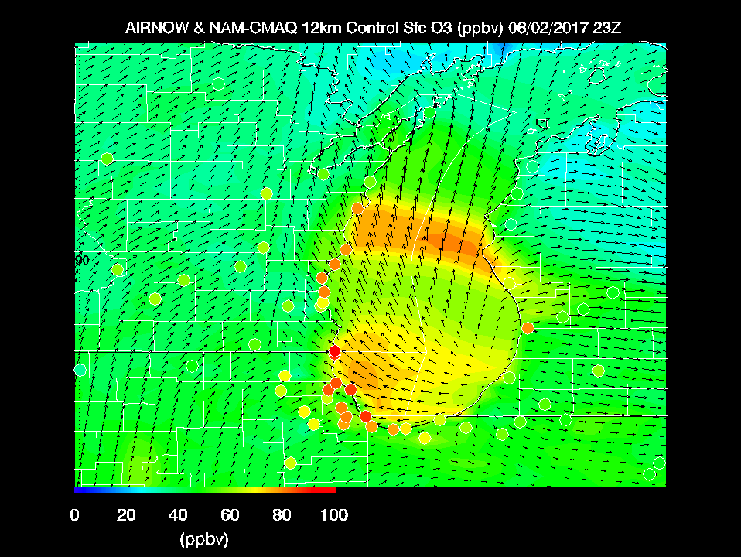
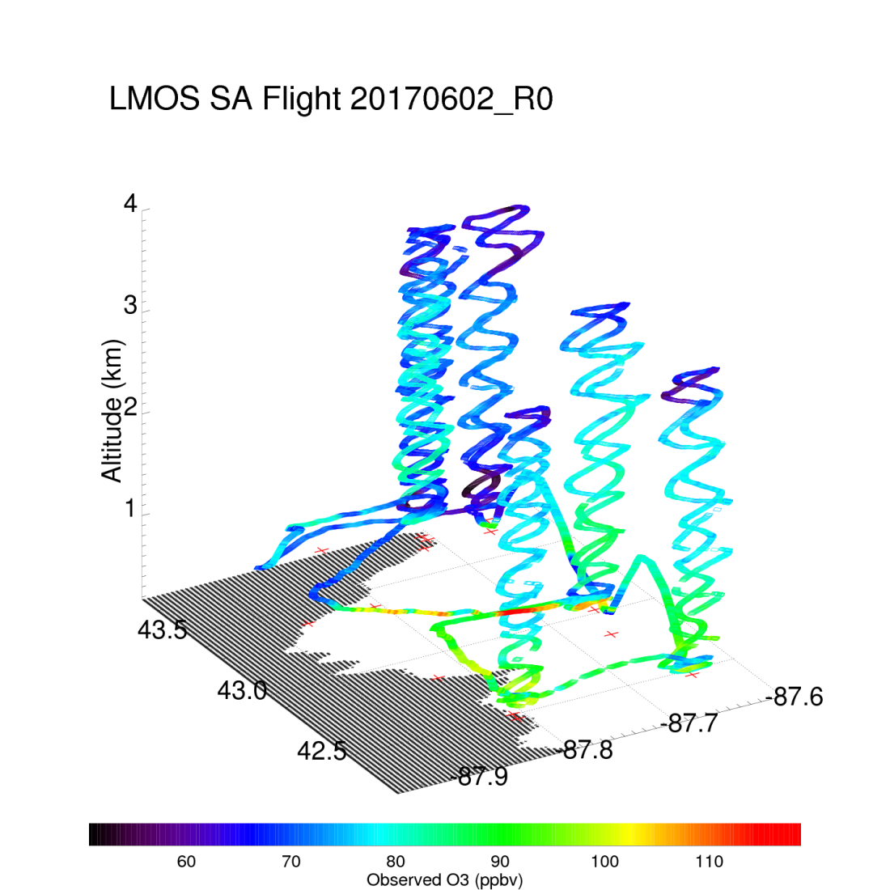
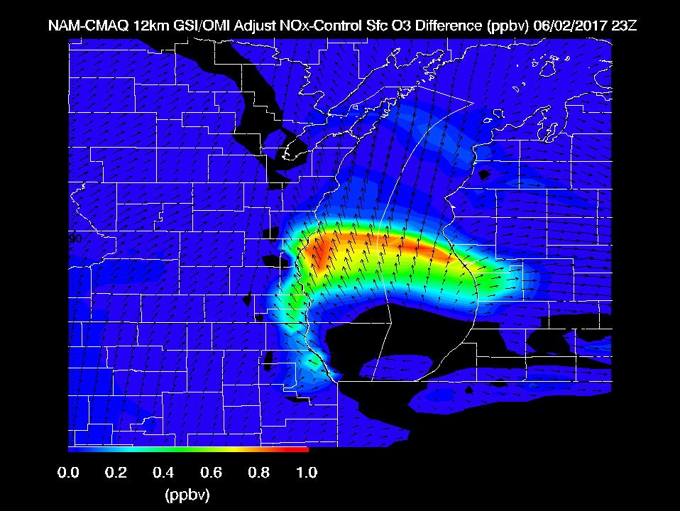
Max Observed O3 > 110ppbv
Reductions in NOx emissions on high ozone day leads to slight (~1ppbv) increases in surface ozone

Slide 20
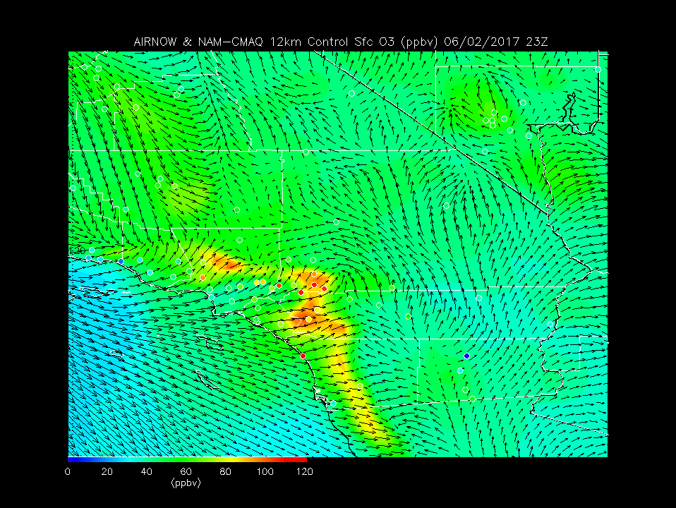
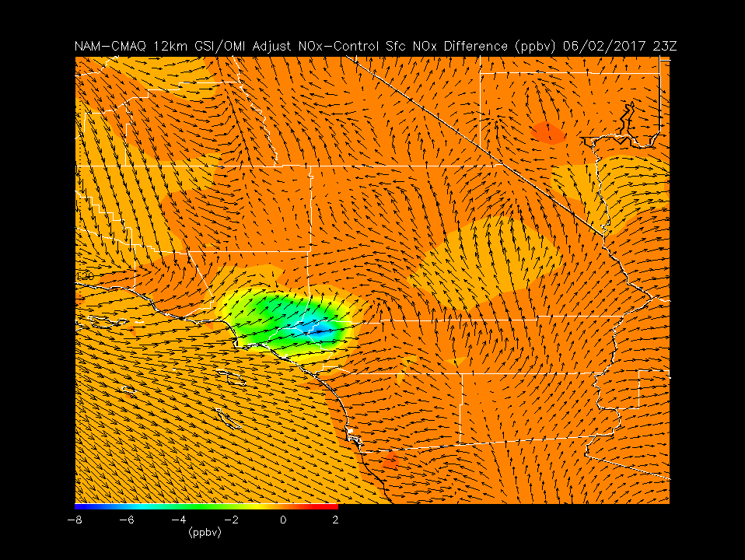
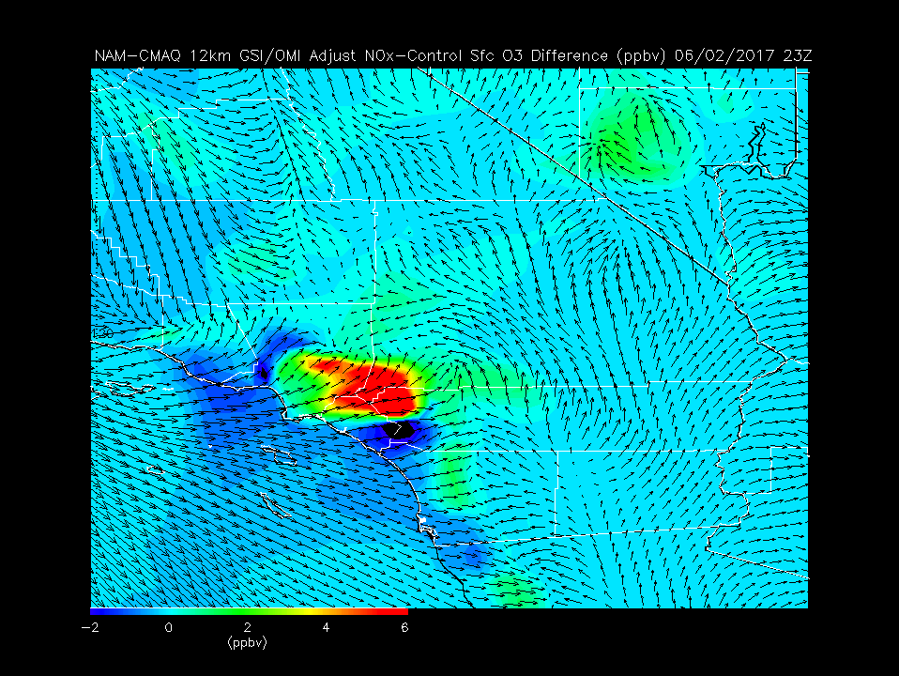
NAM-CMAQ LA Ozone Sensitivities to updated NOx emissions:
Up to 8 ppbv reductions in NOx on high ozone day leads to 6 ppbv increases in surface ozone
Improvement in prediction relative to AIRNow

Slide 21
Summary and Conclusions
Comparisons between National Weather Service (NWS) Community Multi-scale Air Quality (CMAQ) forecasts and in situ and remote airborne measurements showed that NAM-CMAQ underestimated peak ozone concentrations and overestimated NO2 concentrations during ozone exceedance events during LMOS 2017.
Using OMI tropospheric NO2 column retrievals to constrain CMAQ NOx emissions results in significant reductions in surface ozone biases in some regions (LA Basin), but had only small impacts over Lake Michigan
Emissions sensitivity studies (not shown) suggest that both reductions in anthropogenic NOx emissions and increases in anthropogenic volatile organic compounds (VOCs) emissions are necessary to increase the predicted surface ozone during these high ozone events during LMOS 2017.

