Slide 1
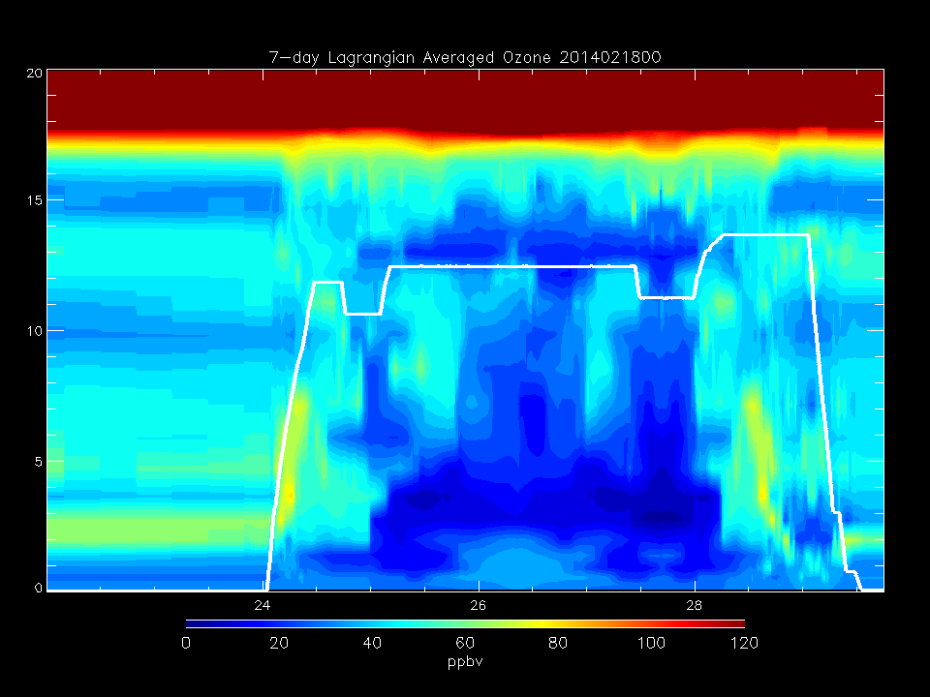
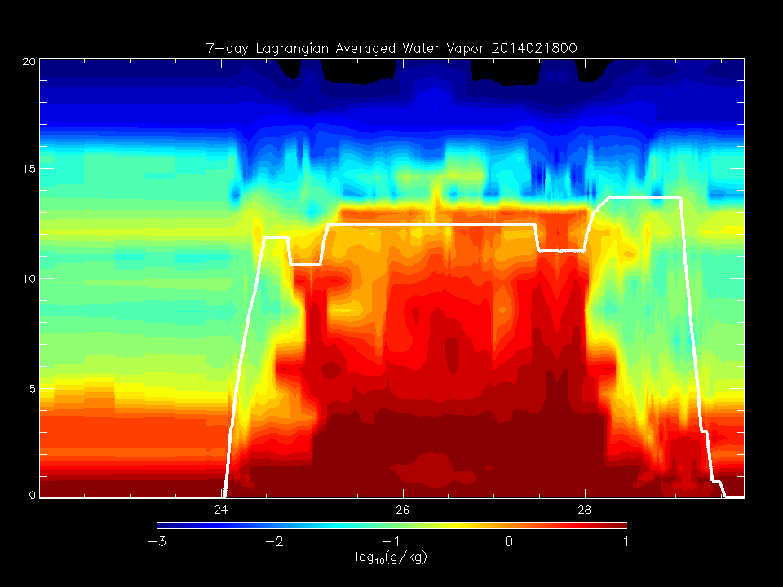
Determine origin of RDF back-trajectories with high O3/low WV for RF12
Select back-trajectories initialized at GMT=24:00-24:30Z, Altitude 2.5-8km

Slide 2
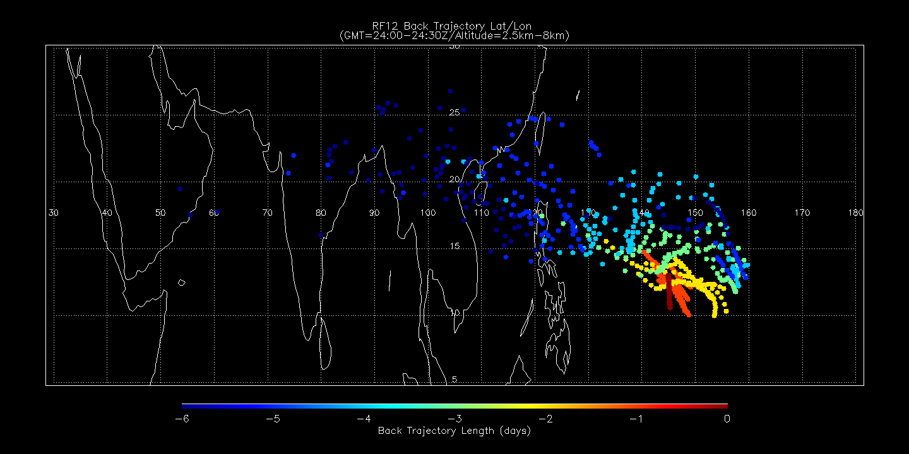
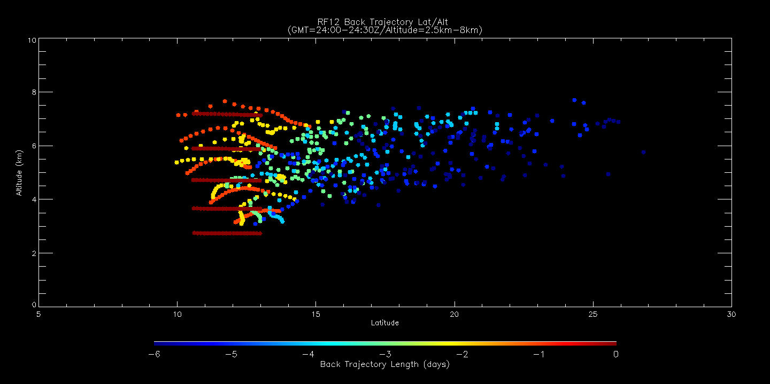
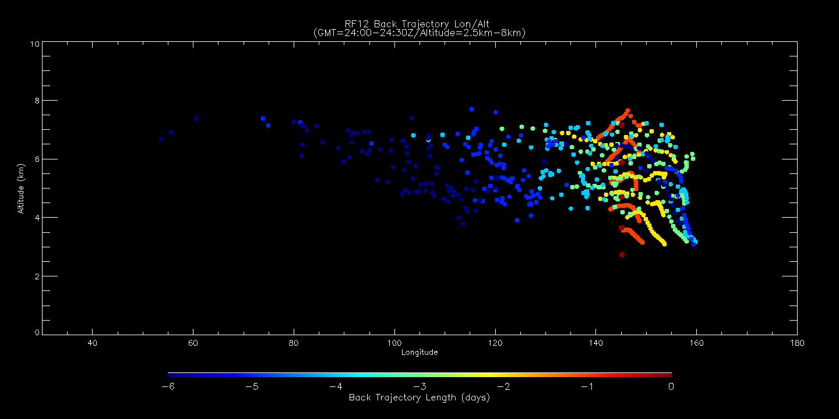
Back trajectory age (days) shows 6 day cluster with origin at ~105W/20N/5km
Lat/Lon
Lat/Alt
Lon/Alt

Slide 3
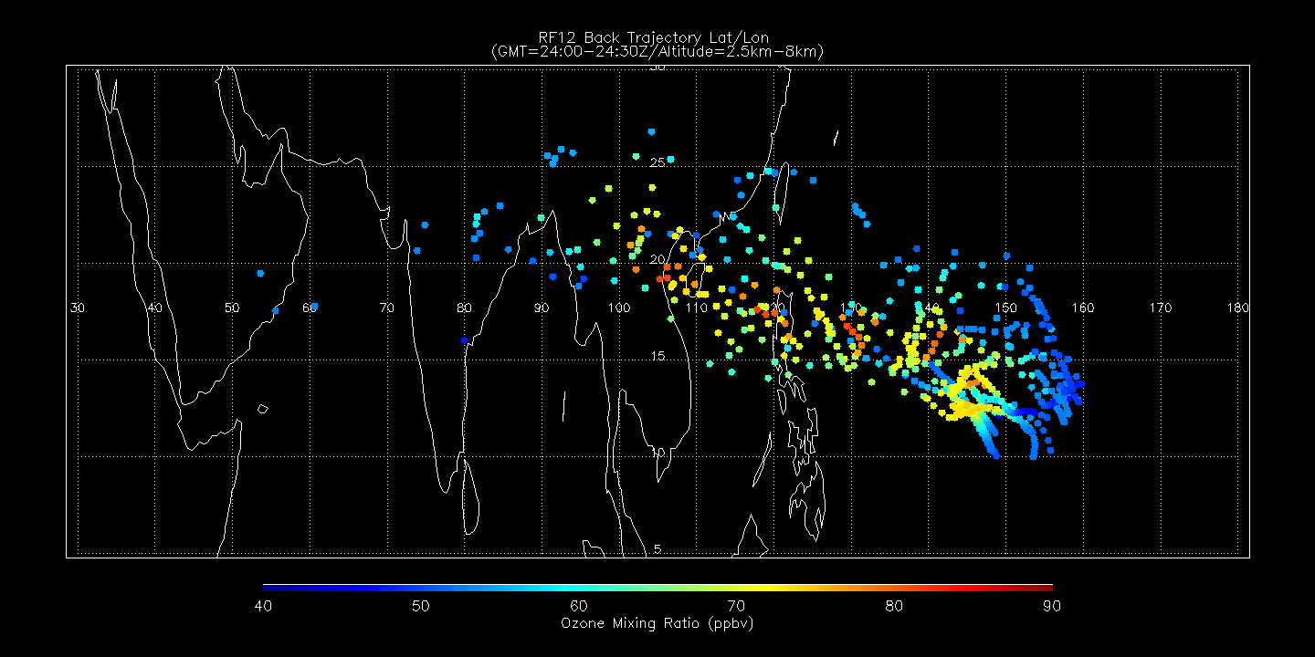
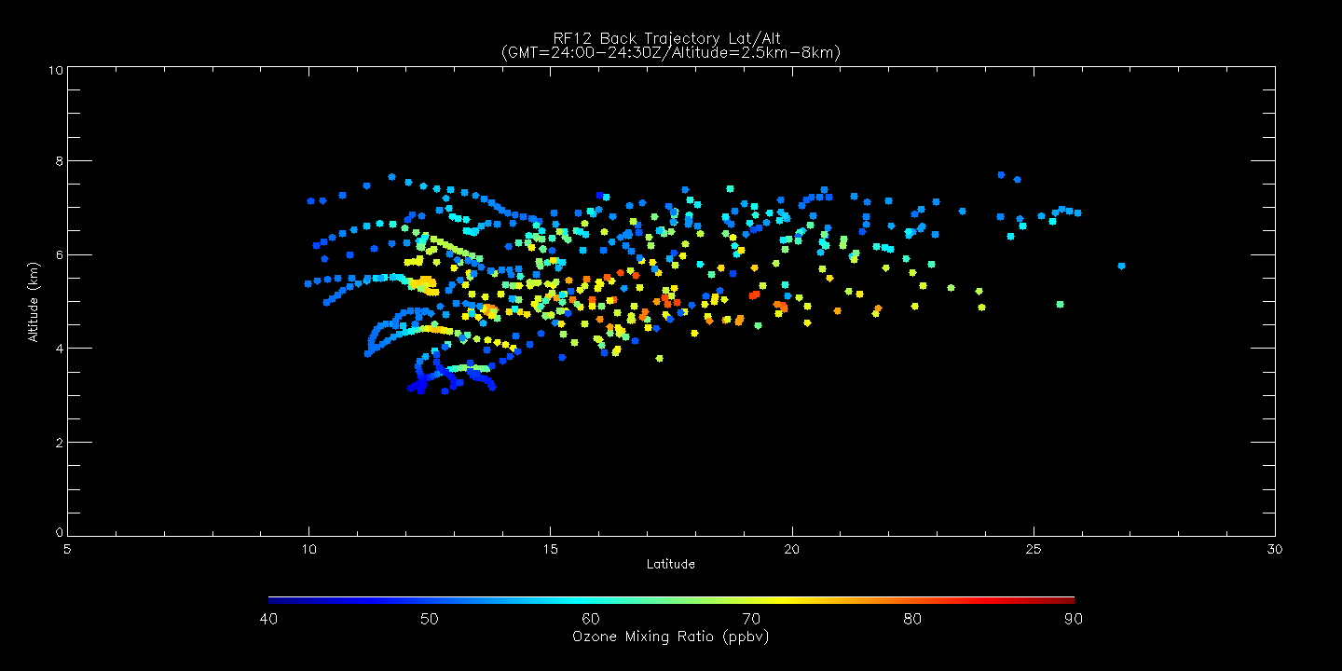
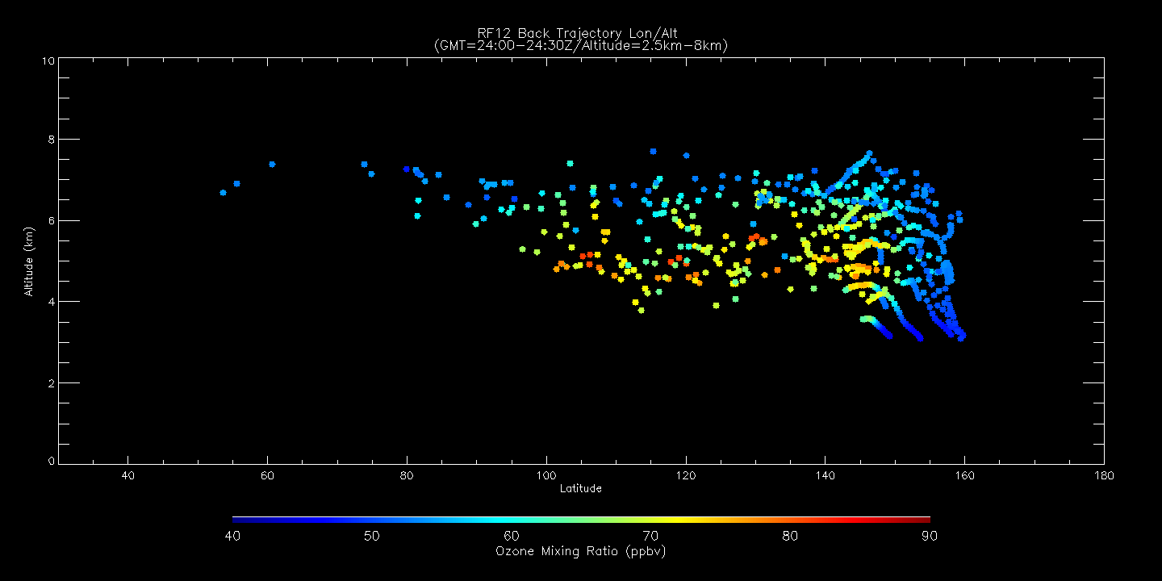
Back trajectory O3 (ppmv) shows high O3 within cluster at ~105W/20N/5km
Lat/Lon
Lat/Alt
Lon/Alt

Slide 4
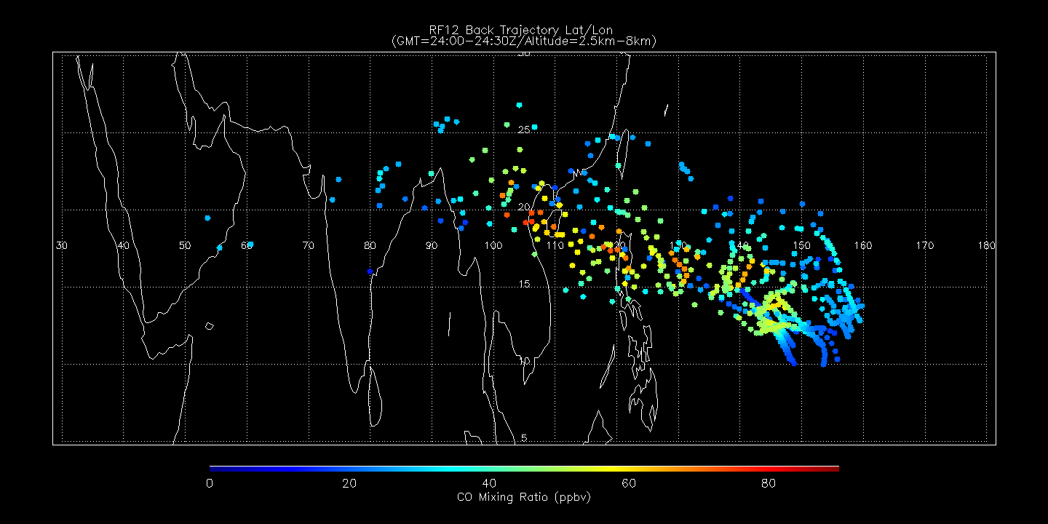
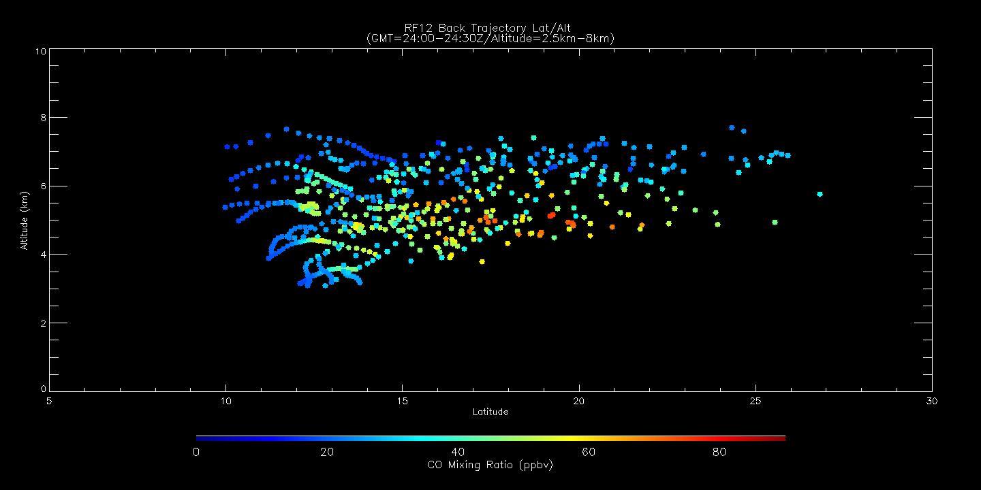
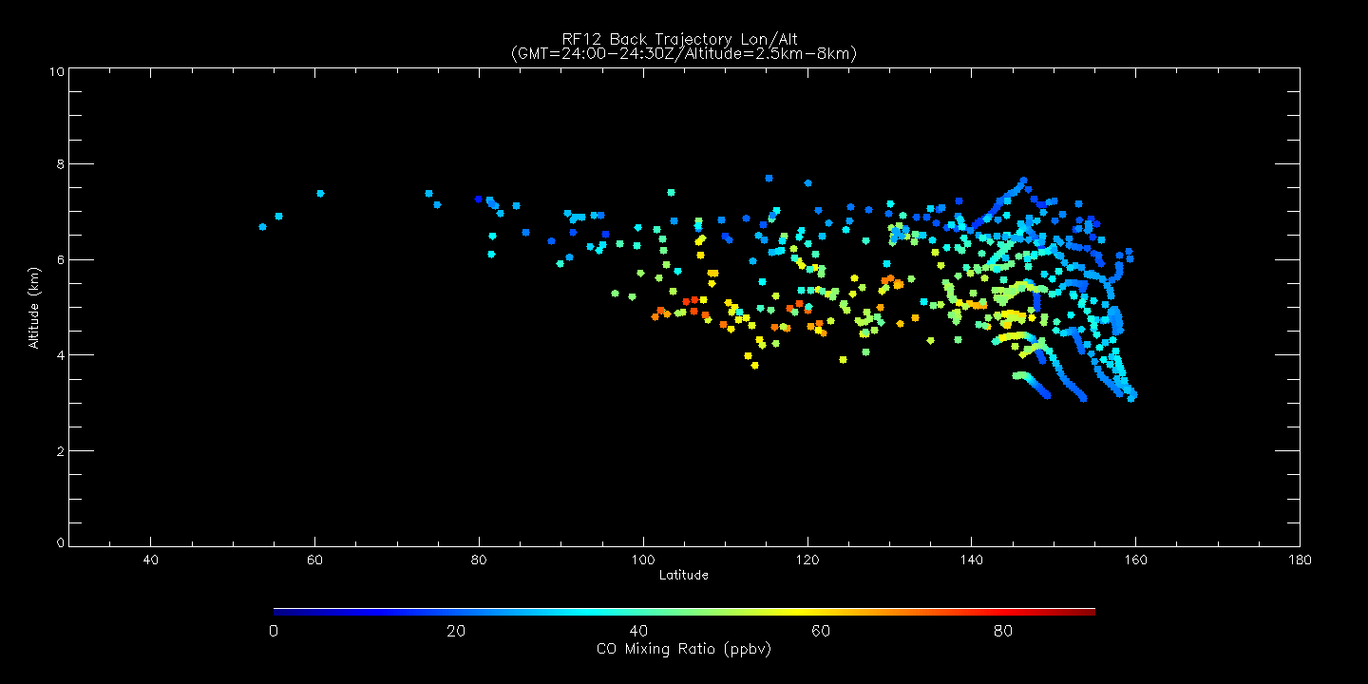
Back trajectory O3 (ppmv) shows high CO within cluster at ~105W/20N/5km
Lat/Lon
Lat/Alt
Lon/Alt

Slide 5
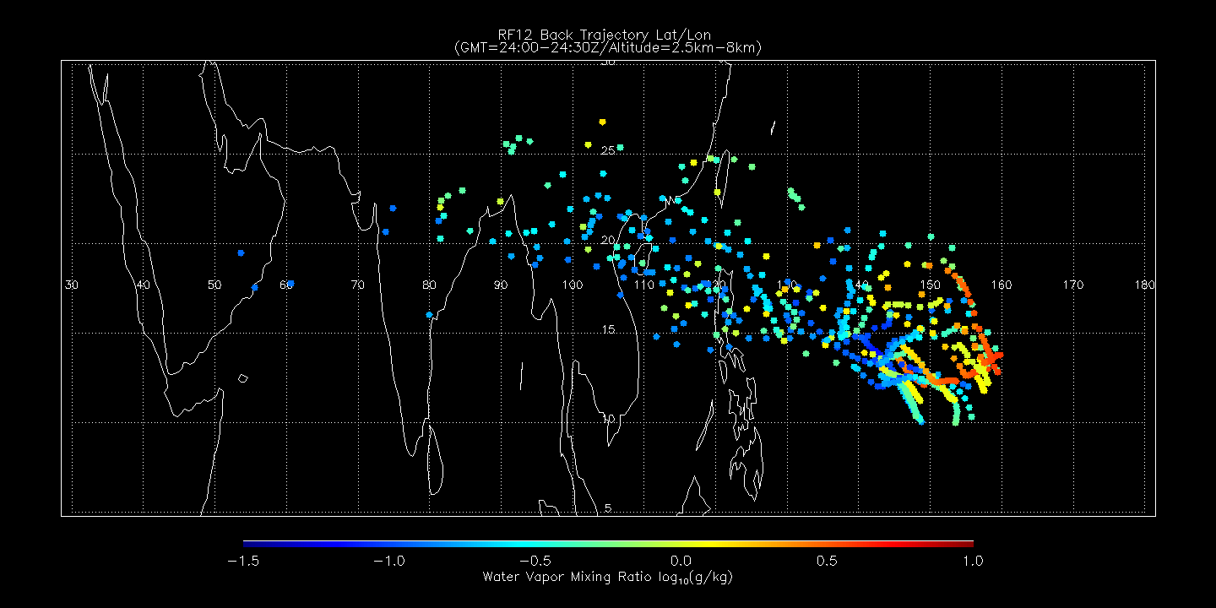
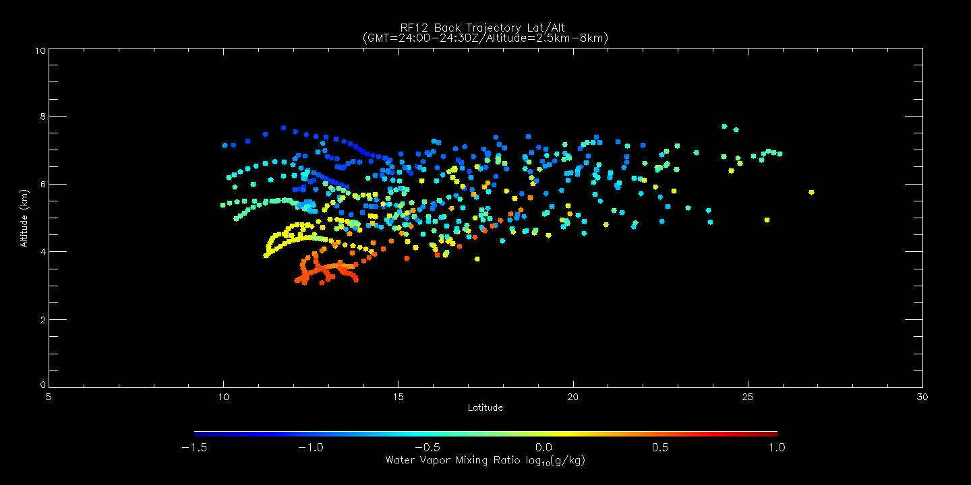
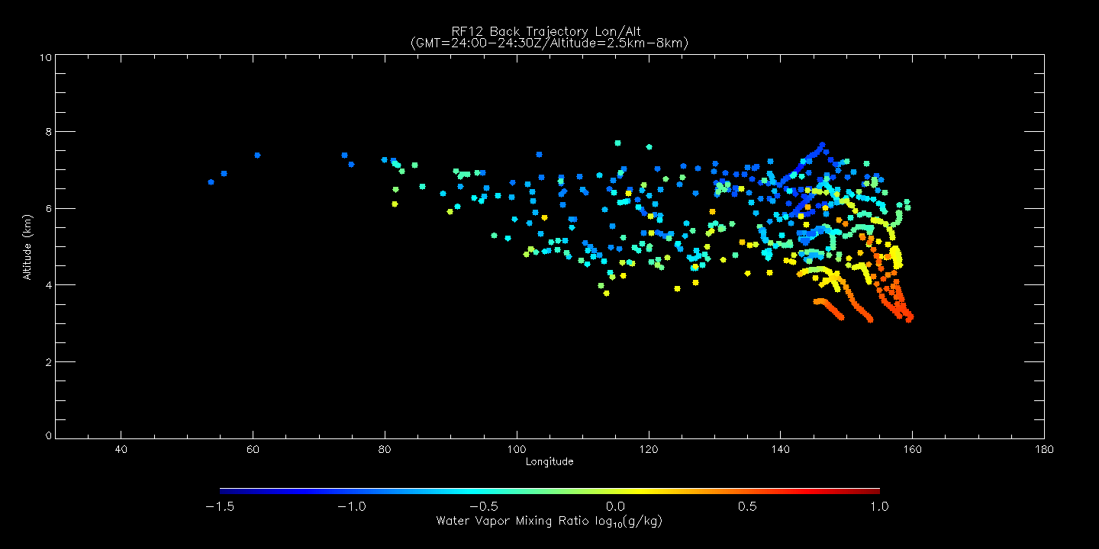
Back trajectory O3 (ppmv) shows low WV within cluster at ~105W/20N/5km
Lat/Lon
Lat/Alt
Lon/Alt

Slide 6
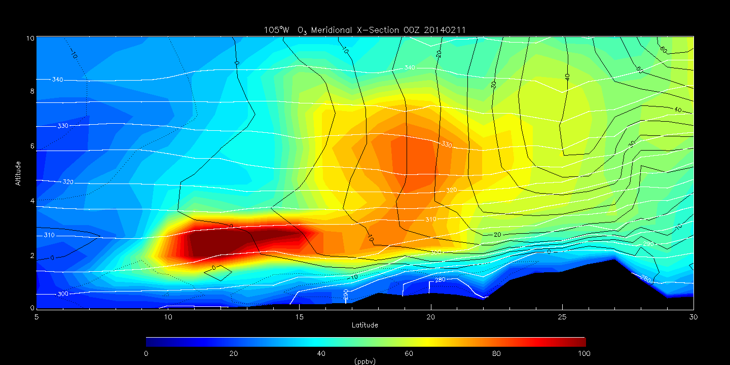
RAQMS analyzed O3 Meridional X-Section at 105W at 00Z on 20140211
(6 days prior to 24:00Z on 20140216)
325K isentrope intersects cluster with high O3

Slide 7
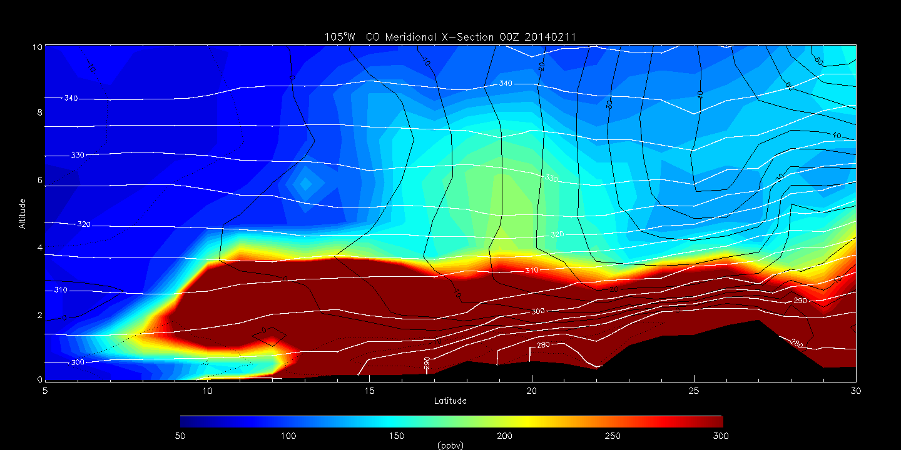
RAQMS analyzed CO Meridional X-Section at 105W at 00Z on 20140211
(6 days prior to 24:00Z on 20140216)
325K isentrope intersects cluster with moderate CO

Slide 8
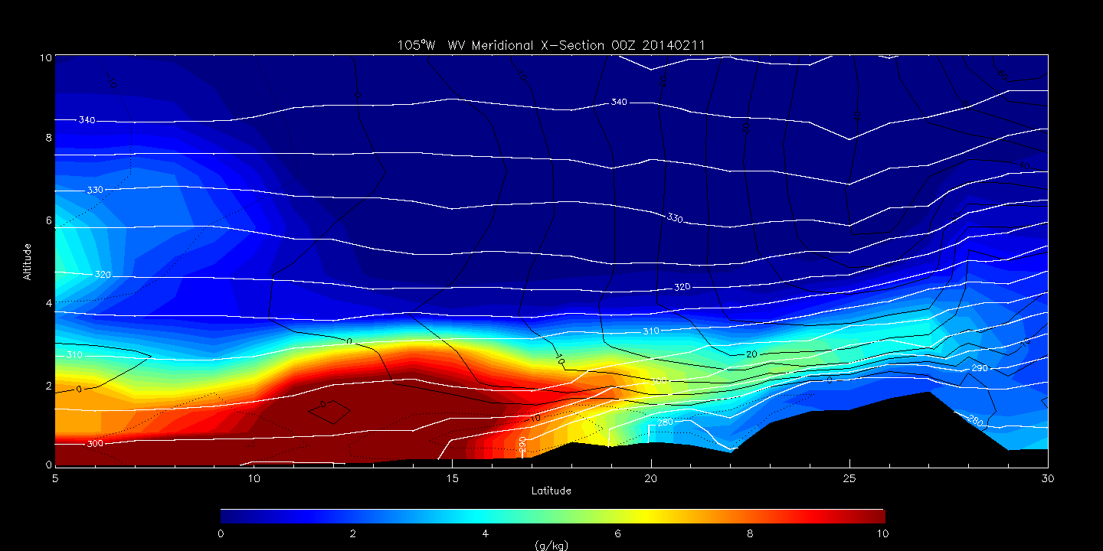
RAQMS analyzed WV Meridional X-Section at 105W at 00Z on 20140211
(6 days prior to 24:00Z on 20140216)
325K isentrope intersects cluster with low WV

Slide 9
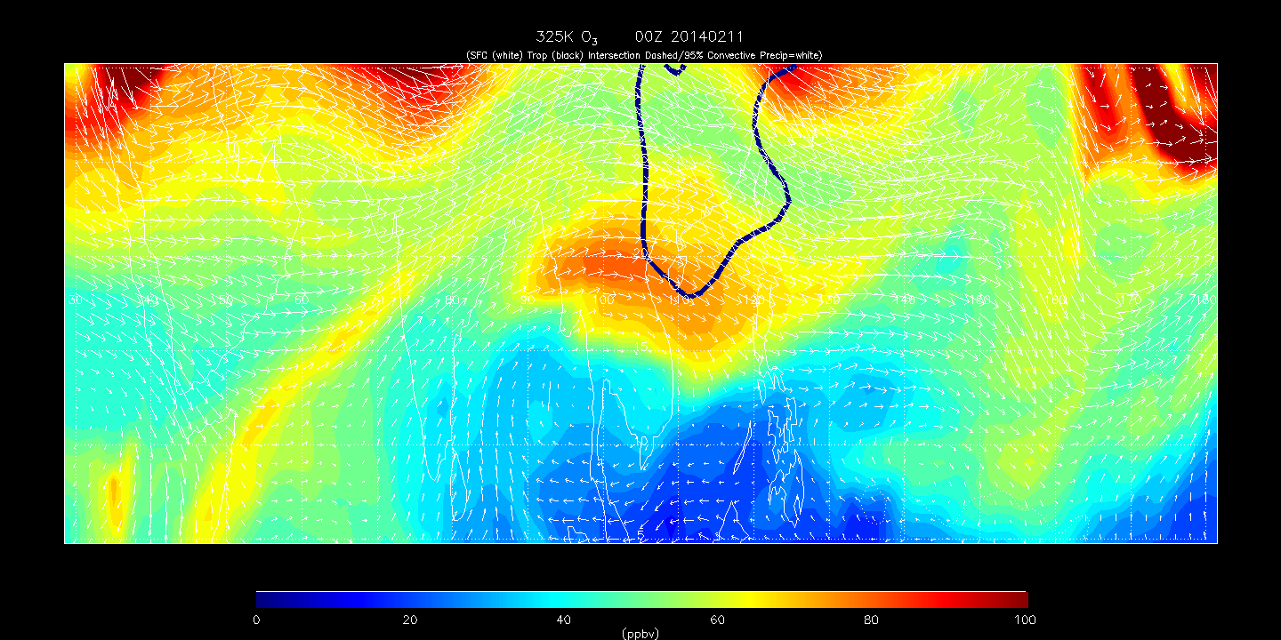
RAQMS analyzed 325K O3 at 00Z on 20140211 (6 days prior to 24:00Z on 20140216)
Location of RF12 6 day cluster with origin at ~105W/20N/5km
Intersection of 325K isentrope with thermal tropopuase

Slide 10
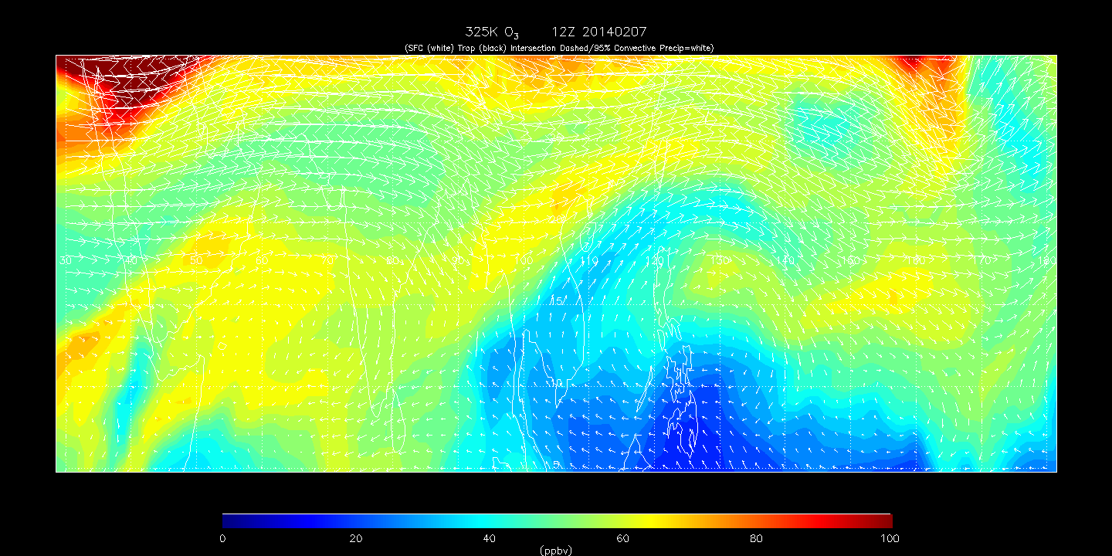
RAQMS analyzed 325K O3 12Z 20140207- 00Z 20140217
Location of RF12 6 day cluster with origin at ~105W/20N/5km

Slide 11
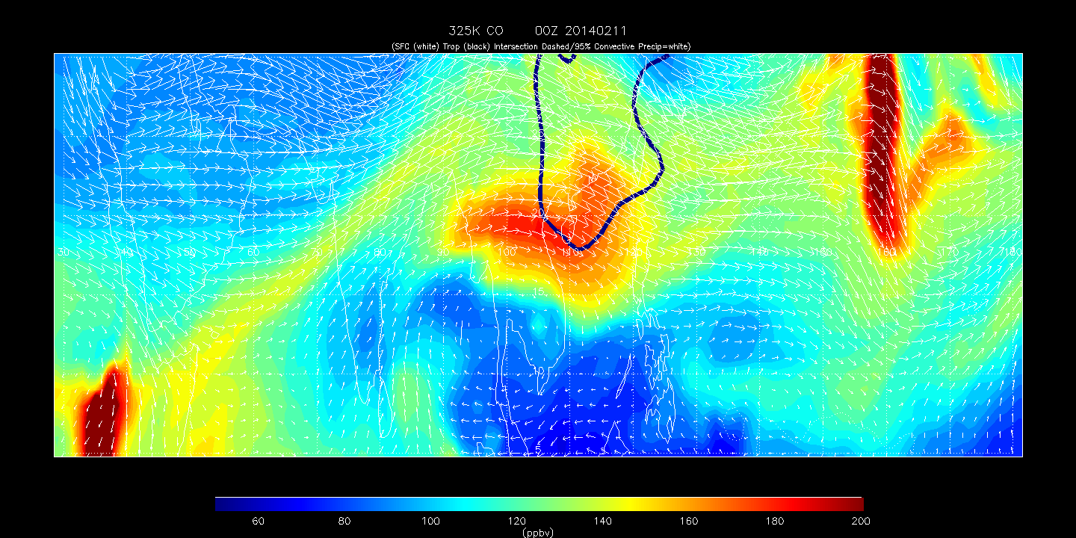
RAQMS analyzed 325K CO at 00Z on 20140211 (6 days prior to 24:00Z on 20140216)
Location of RF12 6 day cluster with origin at ~105W/20N/5km
Intersection of 325K isentrope with thermal tropopuase

Slide 12
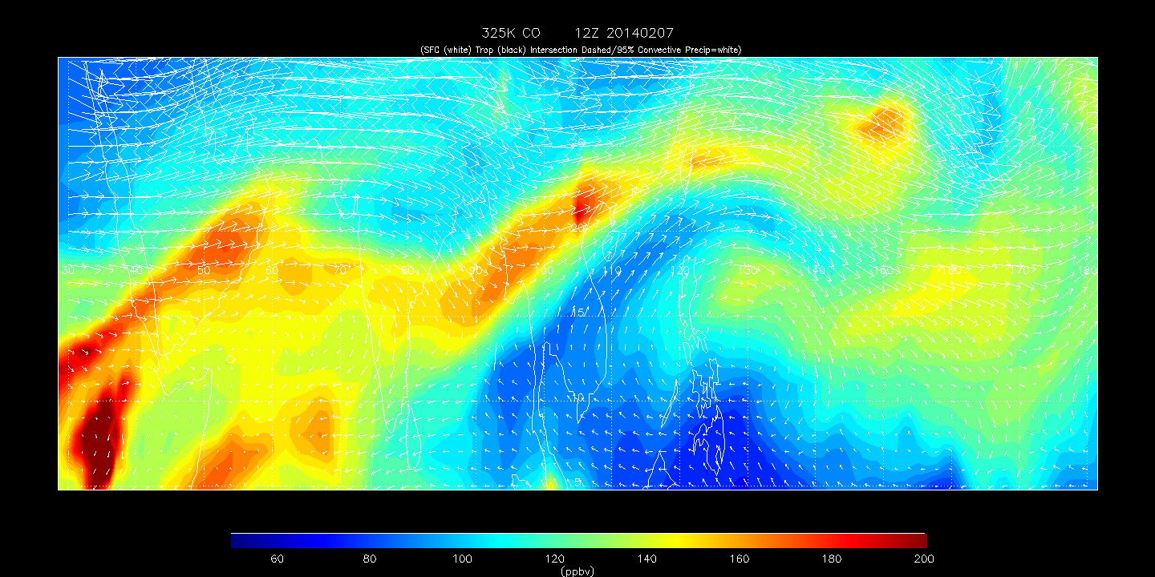
RAQMS analyzed 325K CO at 00Z on 20140211 (6 days prior to 24:00Z on 20140216)
Location of RF12 6 day cluster with origin at ~105W/20N/5km

Slide 13
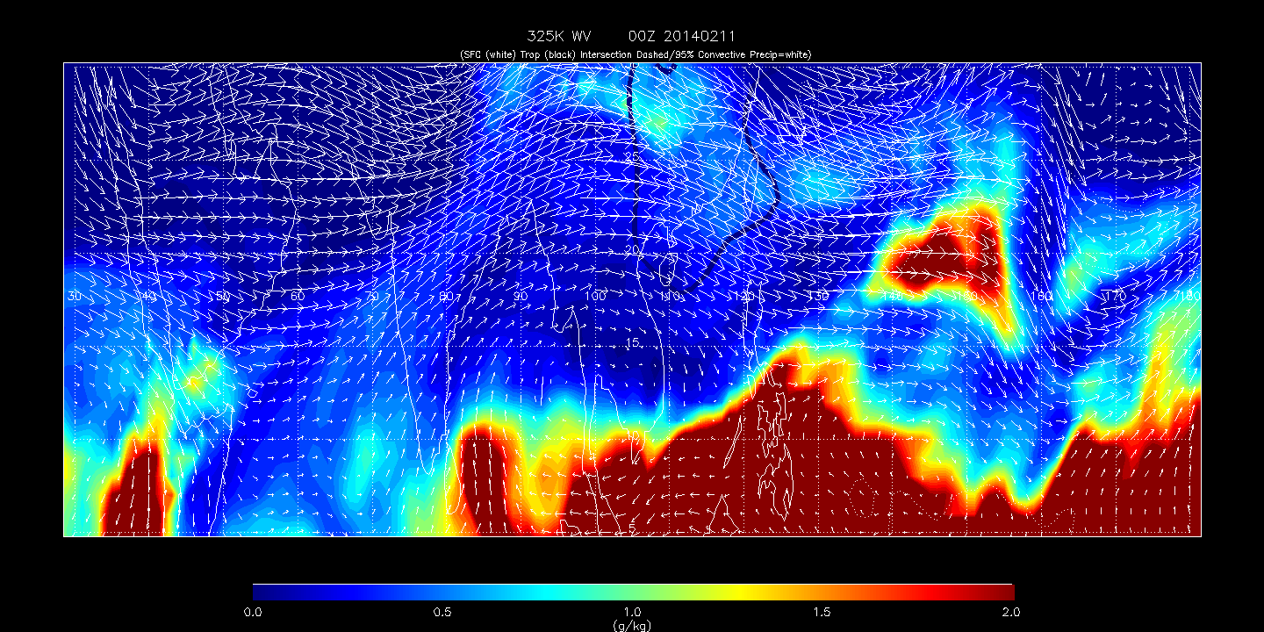
RAQMS analyzed 325K WV at 00Z on 20140211 (6 days prior to 24:00Z on 20140216)
Location of RF12 cluster with origin at ~105W/20N/5km
Intersection of 325K isentrope with thermal tropopuase

Slide 14
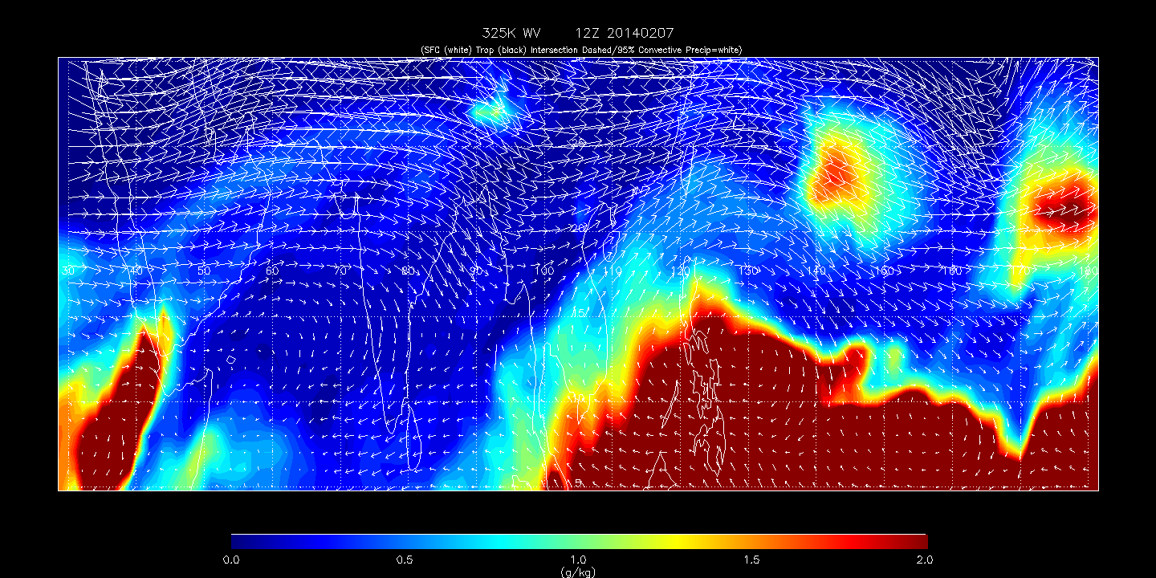
RAQMS analyzed 325K WV at 00Z on 20140211 (6 days prior to 24:00Z on 20140216)
Location of RF12 6 day cluster with origin at ~105W/20N/5km

