Slide 1
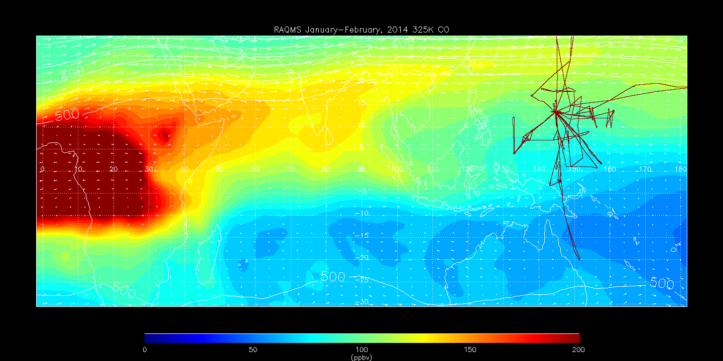
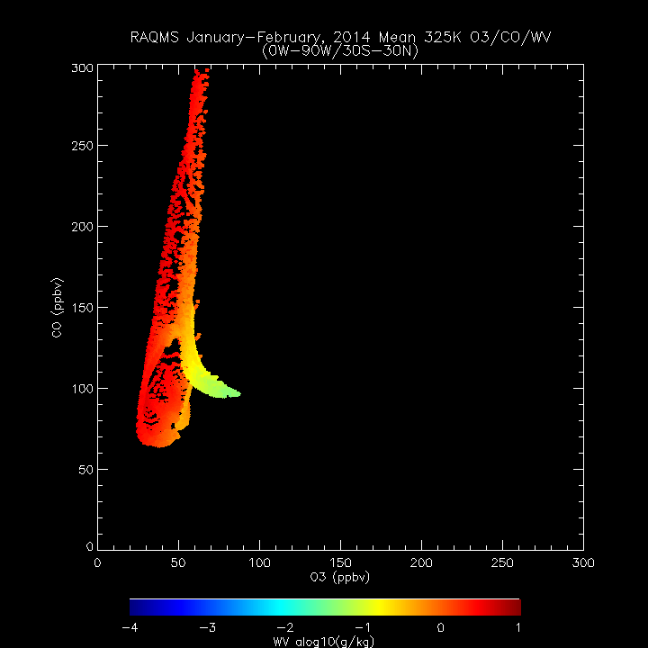
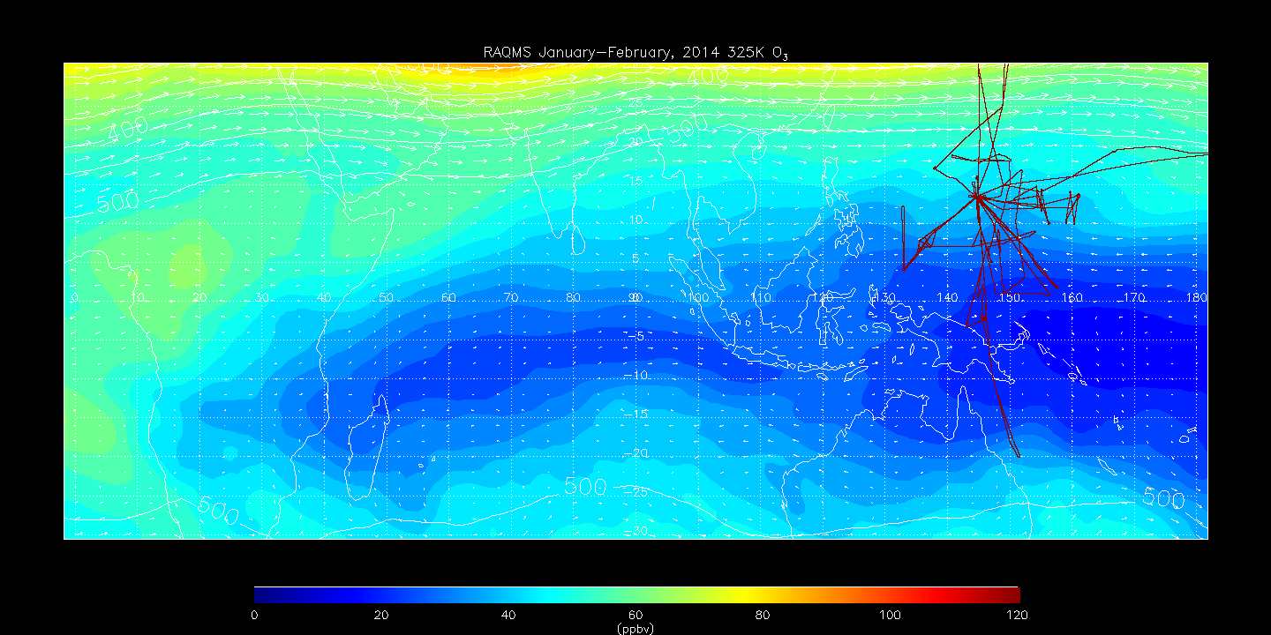
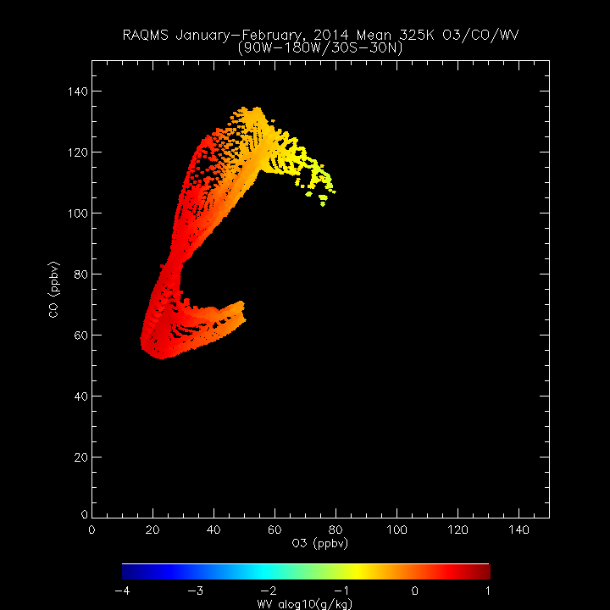
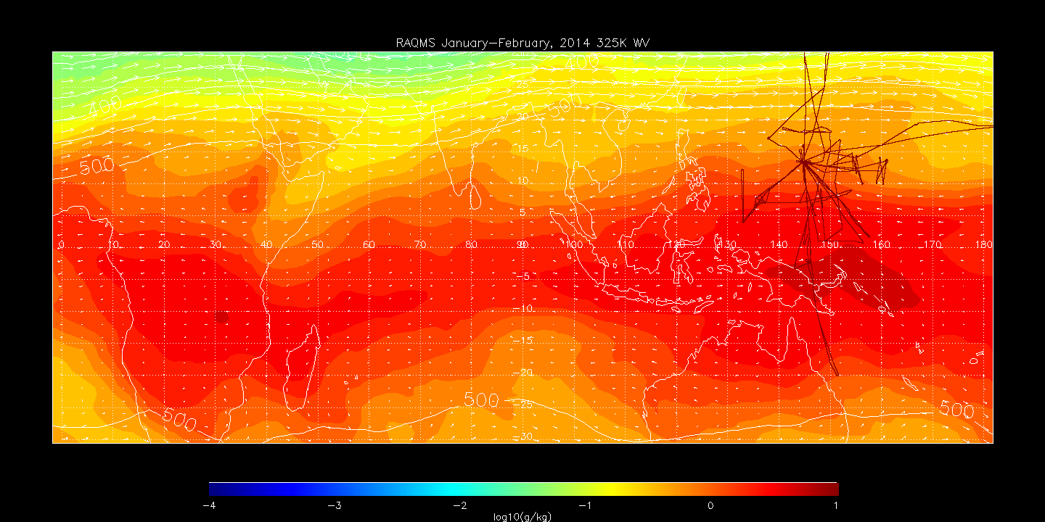
RAQMS January-February 2014 325K CO
0E-90E: Moist, fresh biomass burning (BB) outflow (A) is transported to the east and mixes with:
dry strato-spherically influenced air (C) and
moist, aged marine boundary layer (MBL) air (B)
resulting in:
large reductions in CO, some reductions in O3, and drying of aged BB outflow (D) and
moistening of strato-spherically influenced air (F) between 90E-180E
Also, cleaner southern hemisphere mid-latitude air (G) mixes with fresh MBL air (E) at 90E-180E
0E-90E
C
F
90E-180E
A
D
A=Fresh BB outflow
B=Aged MBL
C=Strat Influence
A
B
E
G
C
B
RAQMS January-February 2014 325K O3
0E-90E
C
F
90E-180E
D
A
B
E
D
G
F
RAQMS January-February 2014 325K WV
0E-90E
C
F
90E-180E
D
G
E
A
D=Aged BB outflow
E=Fresh MBL
F=Strat Influence
G=SH Midlat
B
E
G

Slide 2
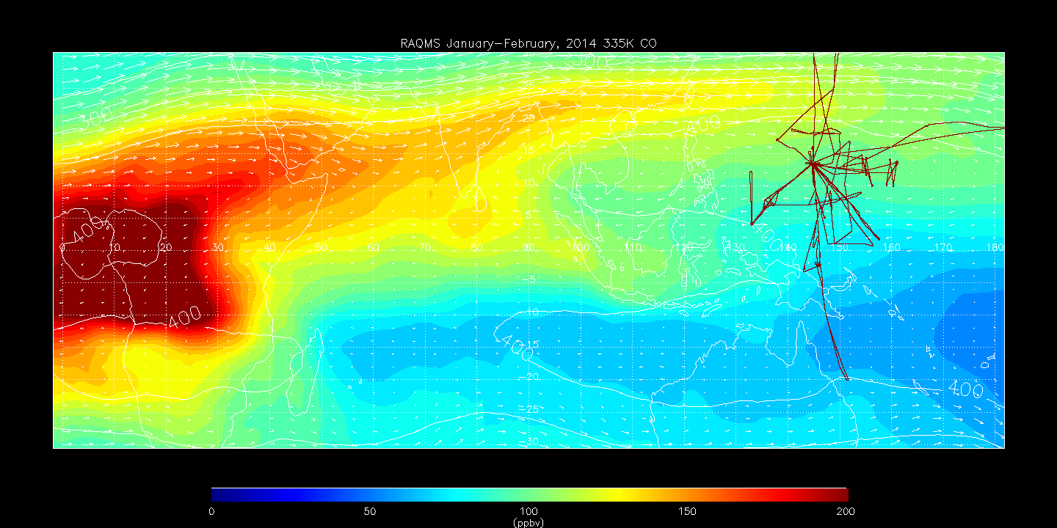
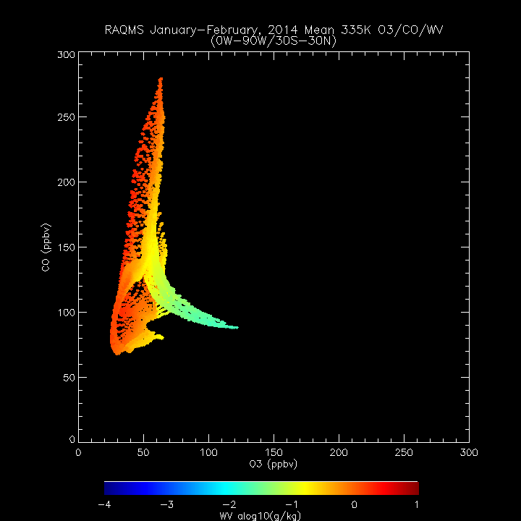
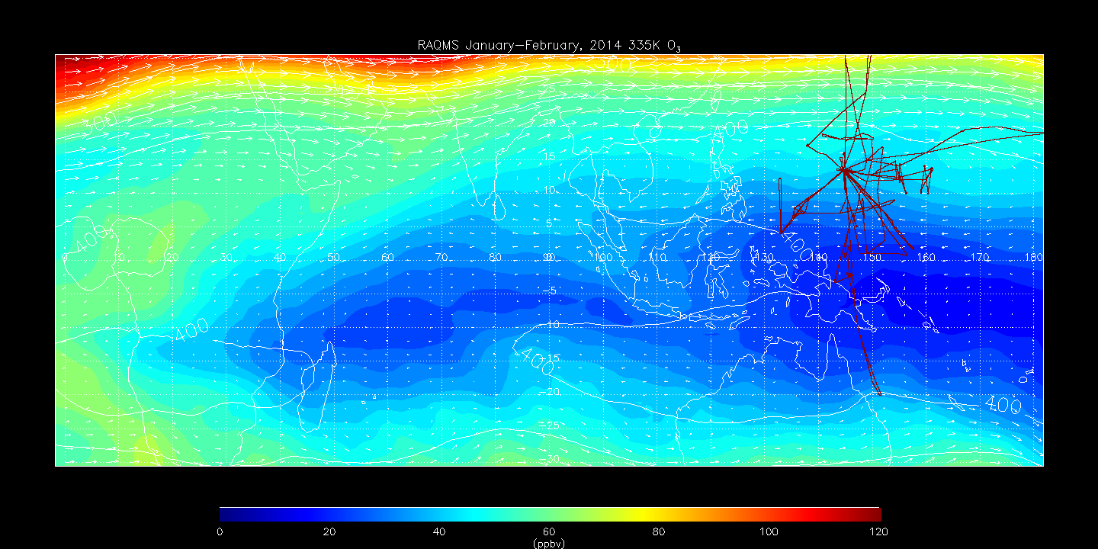
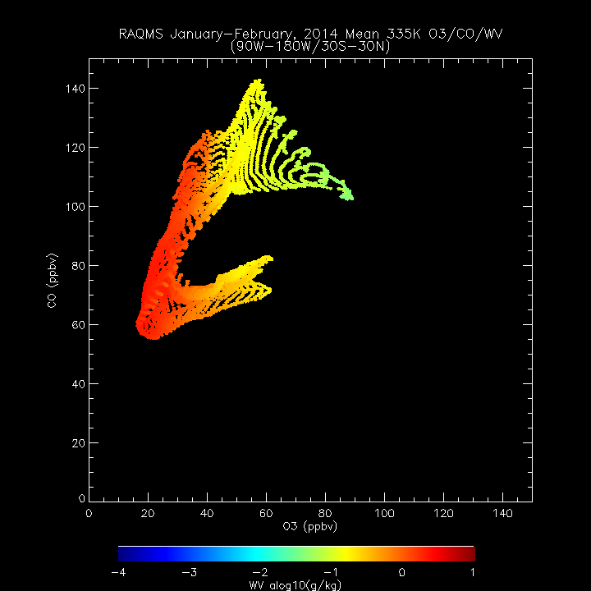
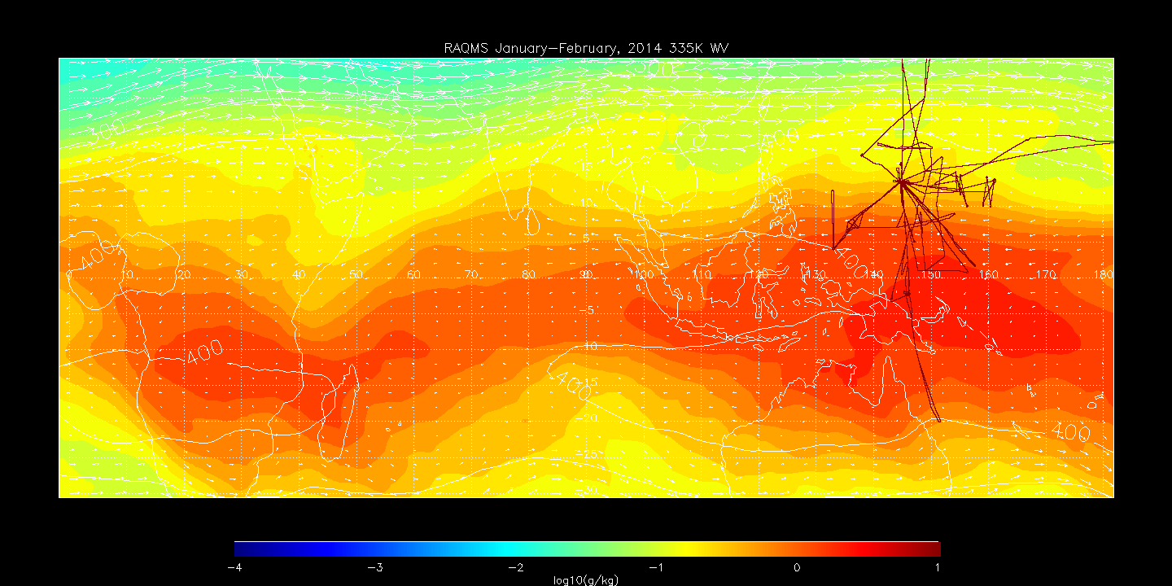
RAQMS January-February 2014 335K CO
0E-90E
C
D
90E-180E
F
A
A=Fresh BB outflow
B=Aged MBL
C=Strat Influence
Same as 325K, except Strato-spherically influenced air (C) is dryer, resulting in more drying of aged BB air (D)
A
B
E
G
B
C
RAQMS January-February 2014 335K O3
0E-90E
C
D
90E-180E
F
A
B
E
D
G
F
RAQMS January-February 2014 335K WV
0E-90E
C
D
90E-180E
F
G
E
A
D=Aged BB outflow
E=Fresh MBL
F=Strat Influence
G=SH Midlat
B
E
G

Slide 3
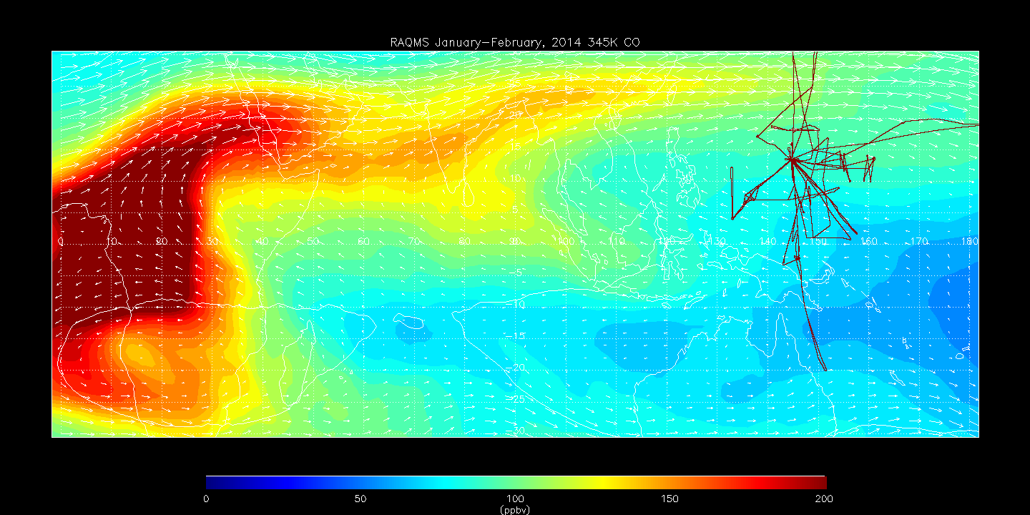
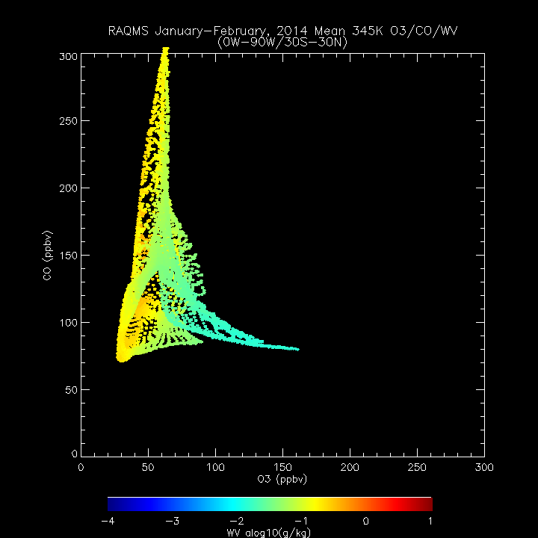
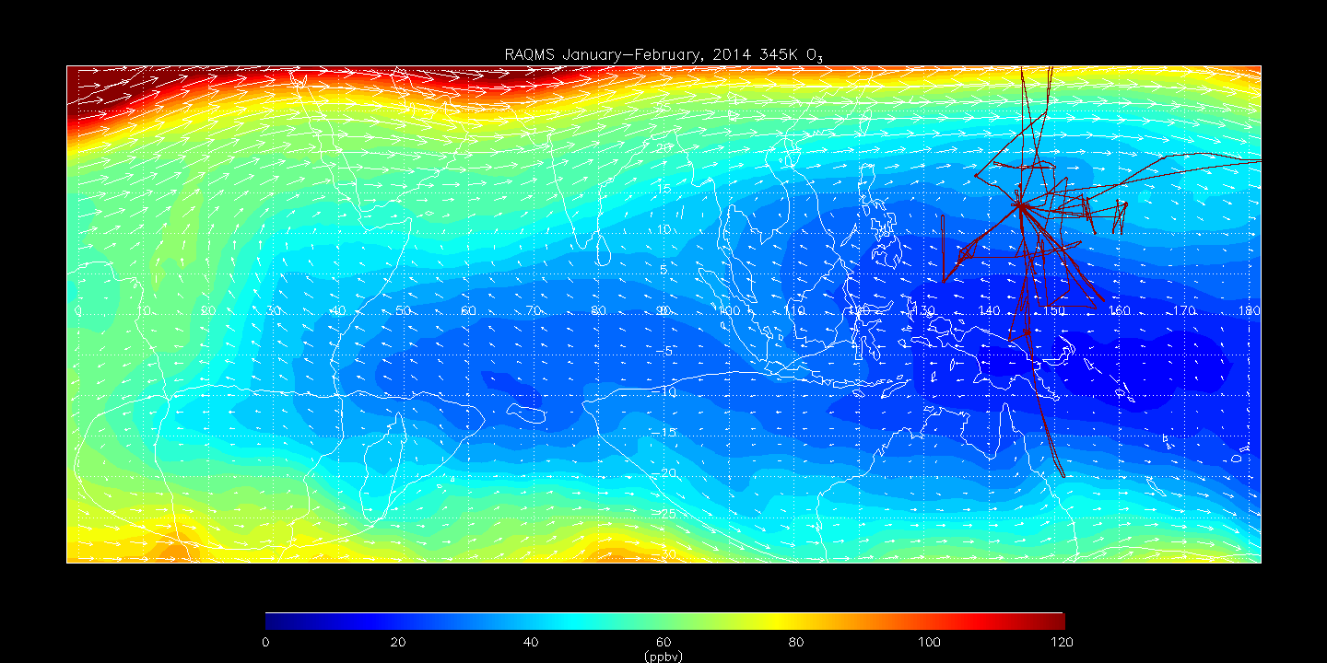
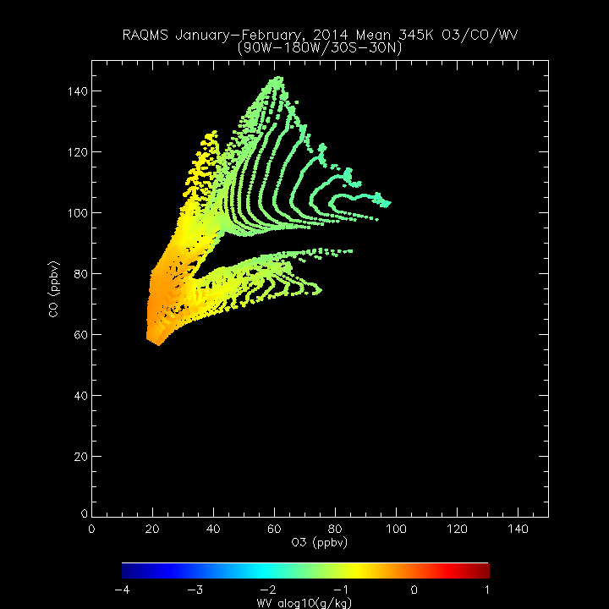
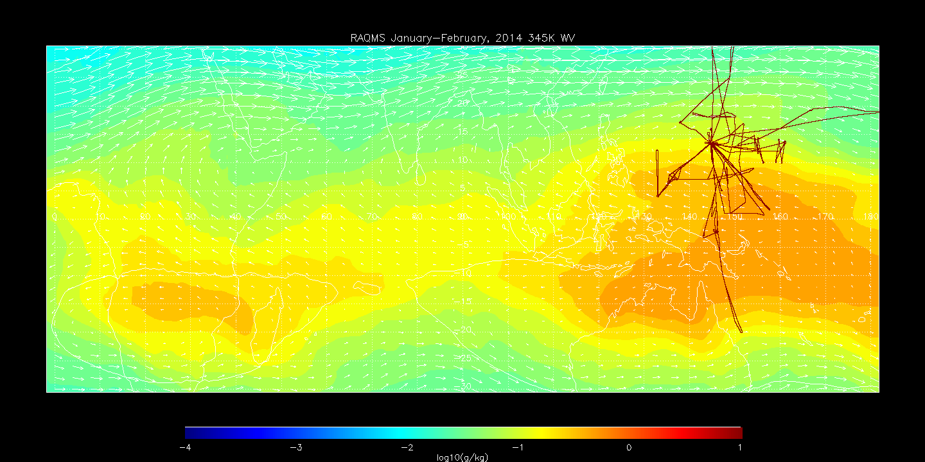
RAQMS January-February 2014 345K CO
0E-90E
C
D
90E-180E
F
A
A=Fresh BB outflow
B=Aged MBL
C=Strat Influence
A
Same as 335K, except both fresh (E) and aged (B) MBL air is drier than at 335K resulting in even drier aged BB air (D)
B
E
G
B
C
RAQMS January-February 2014 345K O3
0E-90E
C
D
90E-180E
F
A
B
E
D
G
F
RAQMS January-February 2014 345K WV
0E-90E
C
D
90E-180E
F
G
A
E
D=Aged BB outflow
E=Fresh MBL
F=Strat Influence
G=SH Midlat
B
E
G

Slide 4
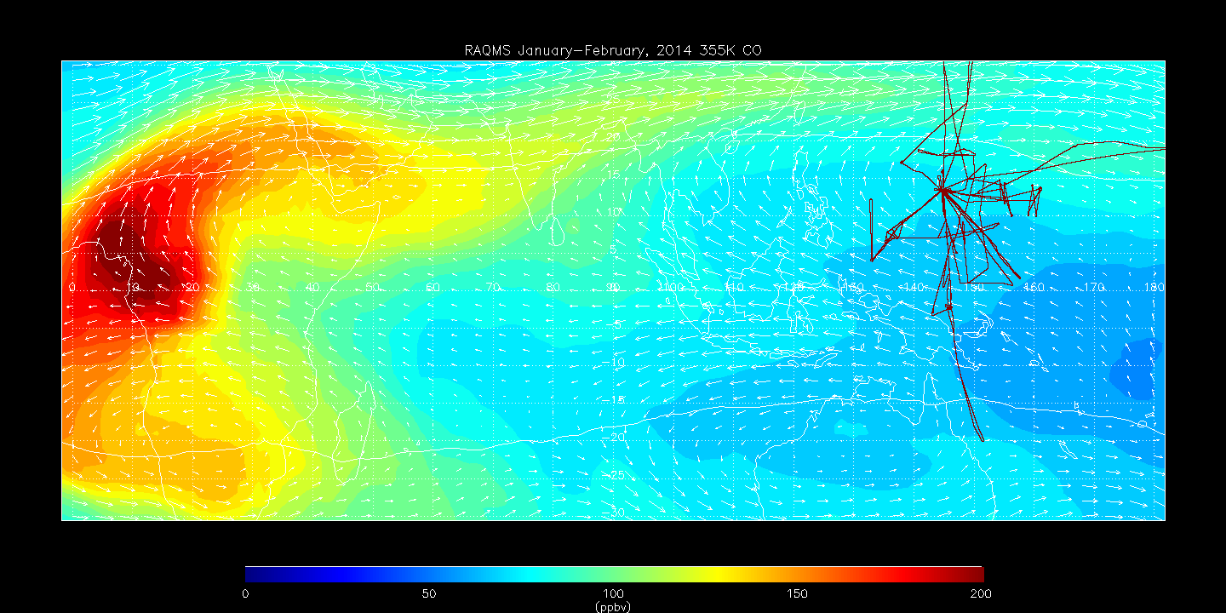
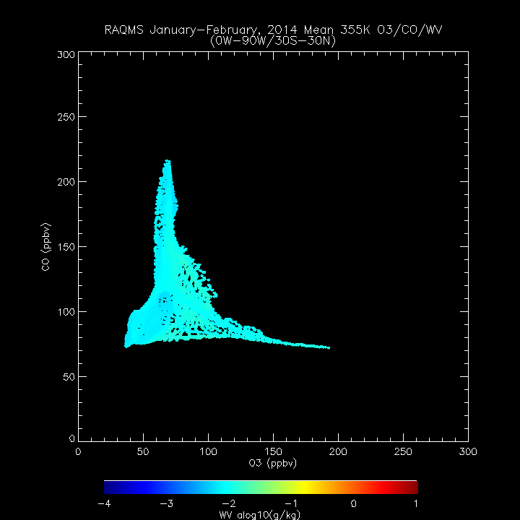
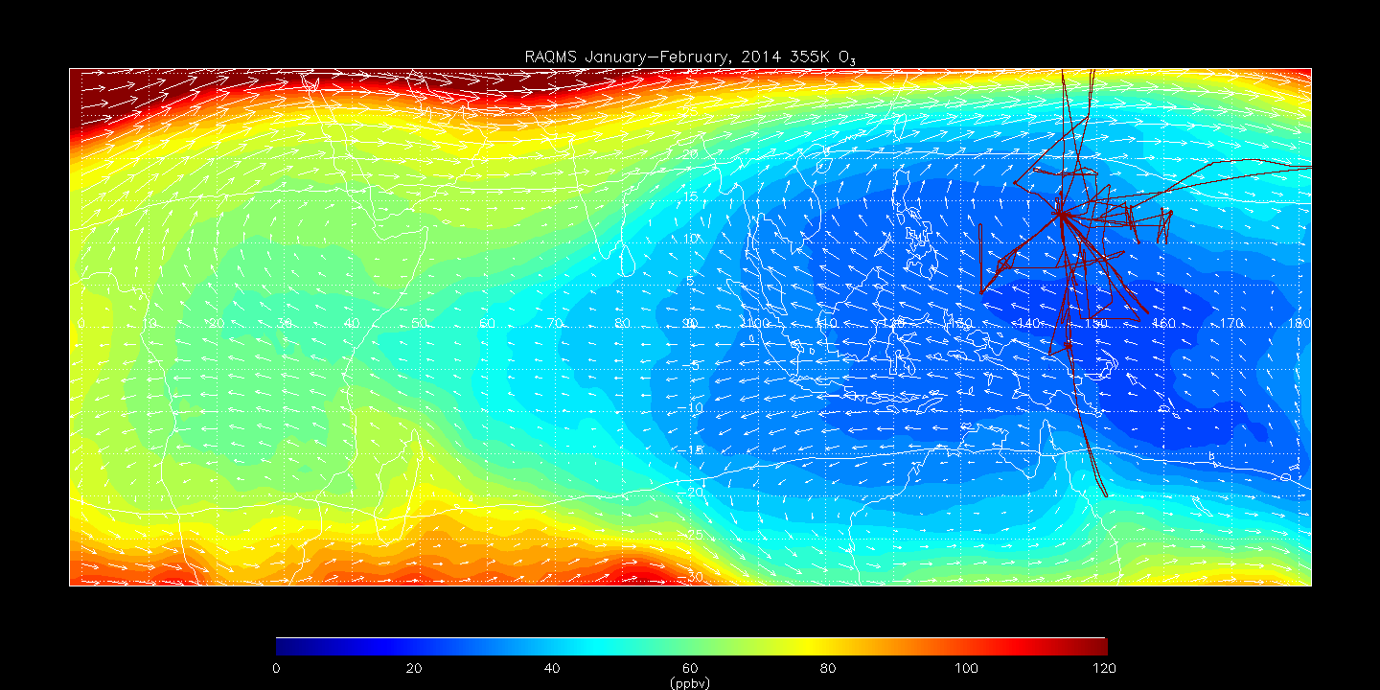
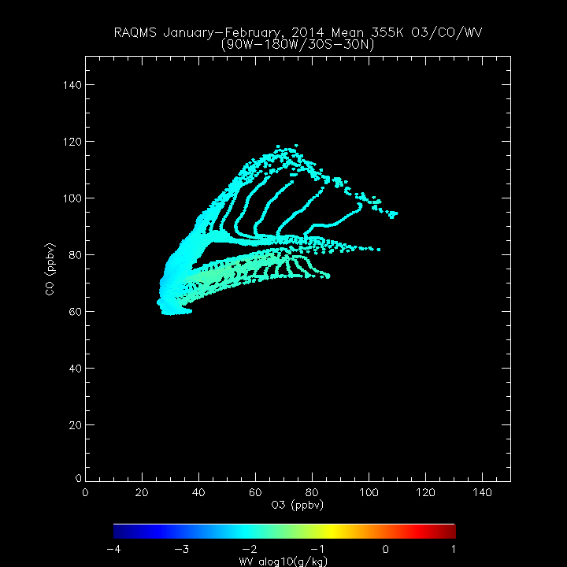
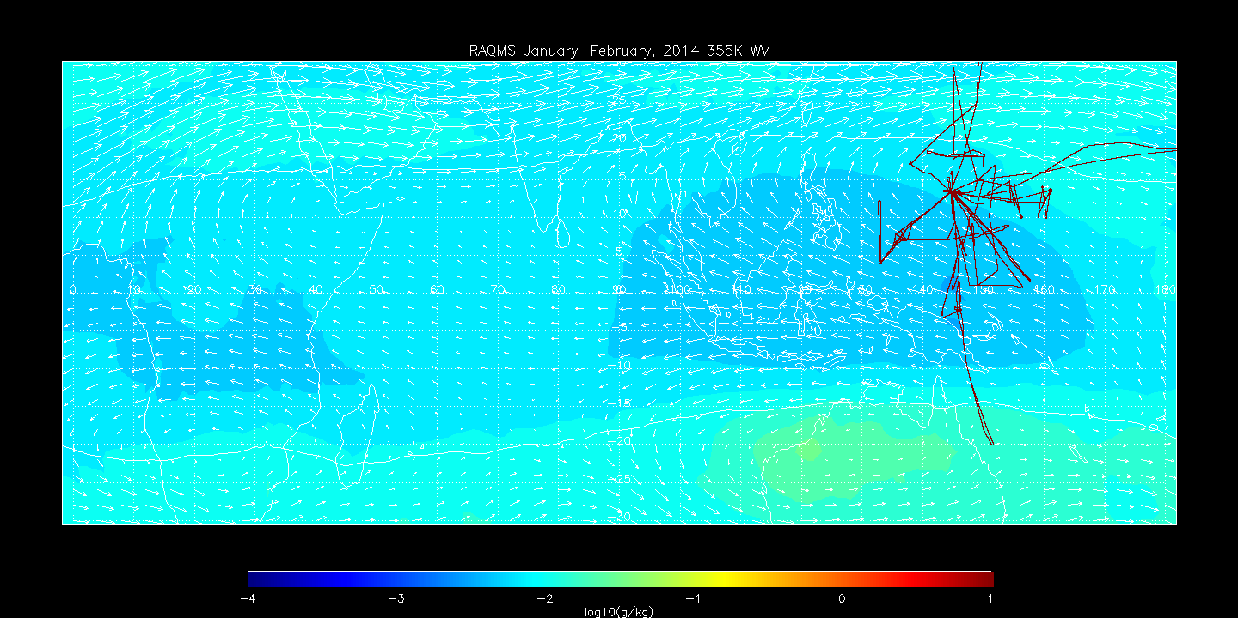
RAQMS January-February 2014 355K CO
0E-90E
C
D
90E-180E
F
A=Fresh BB outflow
B=Aged MBL
C=Strat Influence
Same as 345K, except now entire layer is drier so BB air (A, D) is as dry as stratospherically influenced air (C, F).
BB CO enhancement (A) has diminished resulting in smaller CO enhancement within aged BB outflow (D)
A
A
B
E
G
B
C
RAQMS January-February 2014 355K O3
0E-90E
C
D
90E-180E
F
A
B
E
G
D
RAQMS January-February 2014 355K WV
F
0E-90E
C
D
90E-180E
F
G
E
A
D=Aged BB outflow
E=Fresh MBL
F=Strat Influence
G=SH Influence
B
E
G

Slide 5
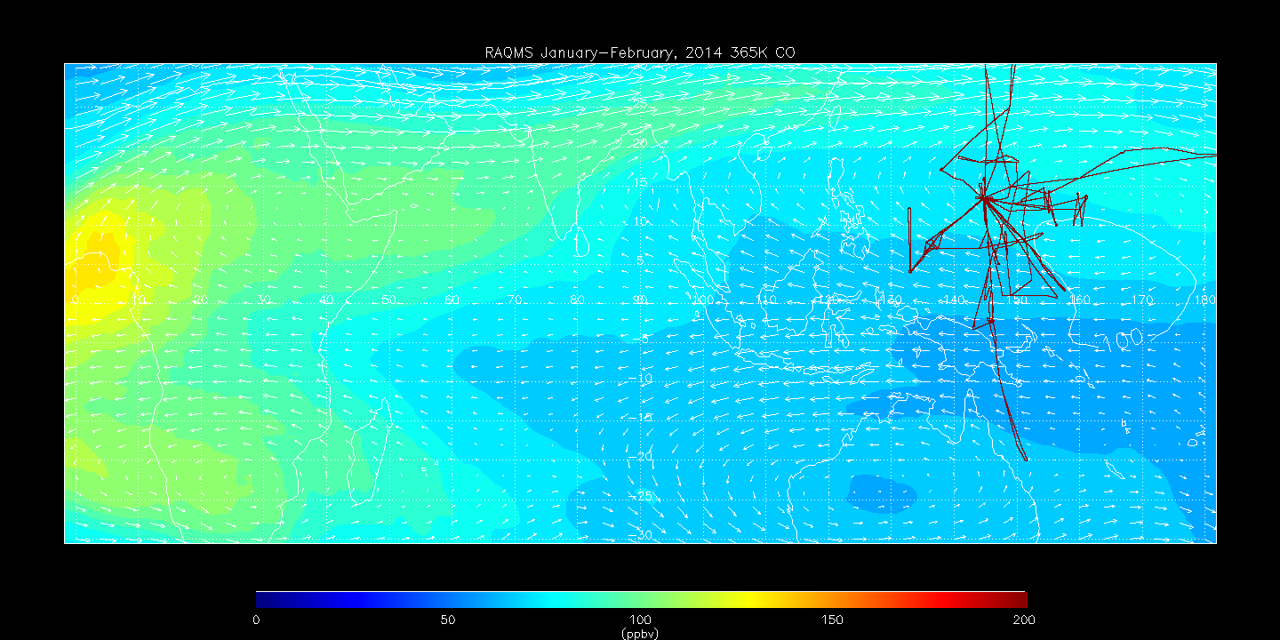
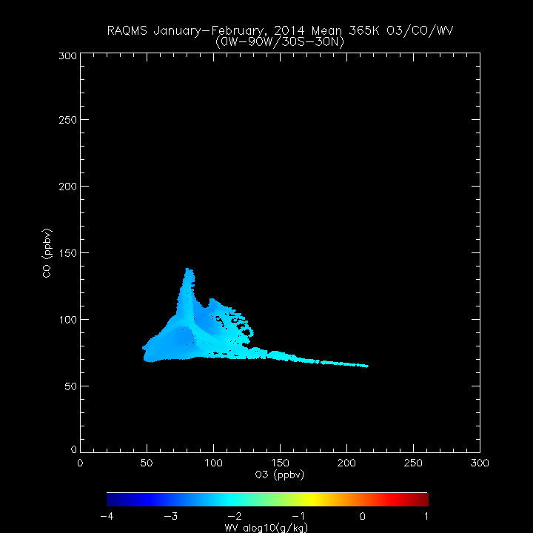
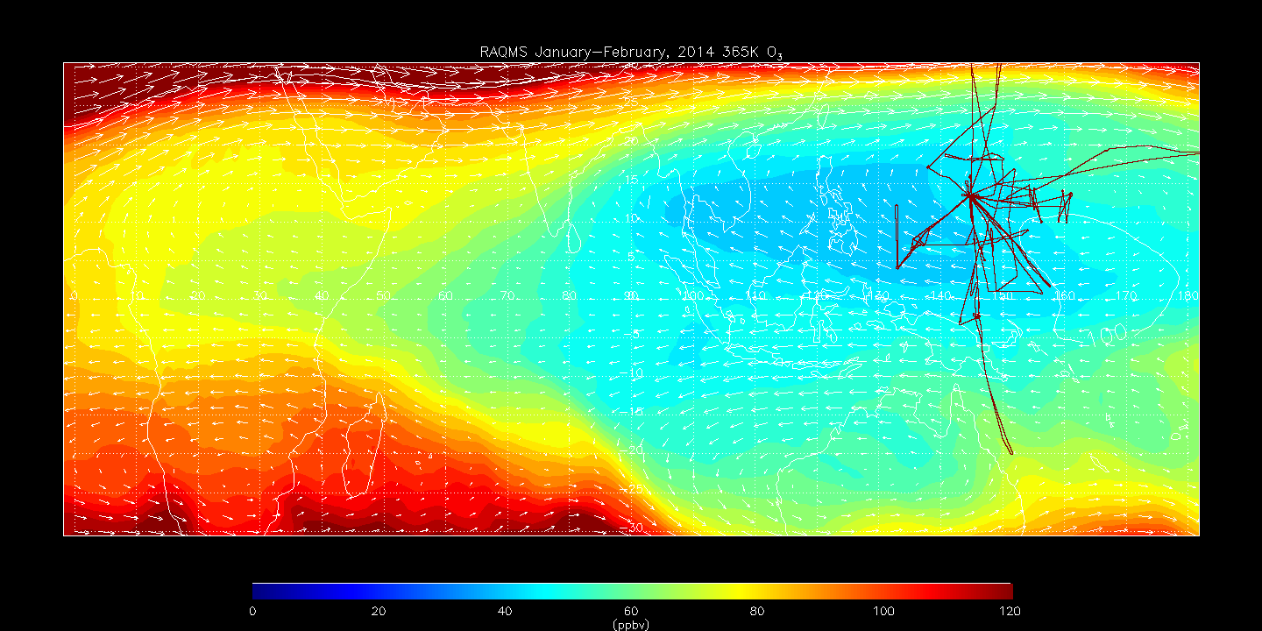
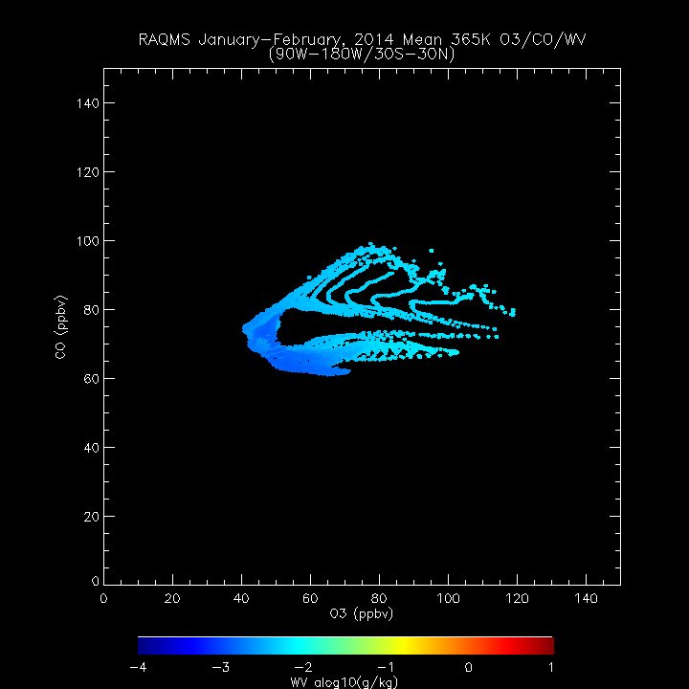
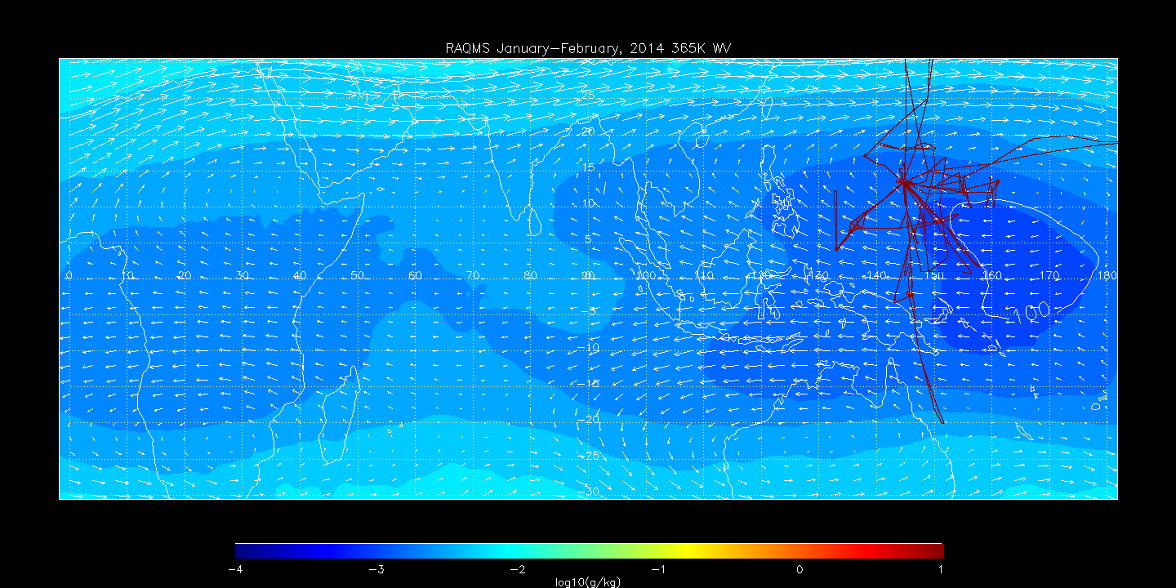
RAQMS January-February 2014 365K CO
0E-90E
C
D
90E-180E
F
A=Fresh BB outflow
B=Aged MBL
C=Strat Influence
E
Same as 355K, except now MBL (B, E) BB air is drier than stratospherically influenced air (C, F) or SH midlatitude (G).
BB CO enhancement (A) has further diminished resulting in even smaller CO enhancement within aged BB outflow (D)
A
B
A
G
B
C
RAQMS January-February 2014 365K O3
0E-90E
C
D
F
90E-180E
E
A
B
G
D
RAQMS January-February 2014 365K WV
0E-90E
C
D
90E-180E
F
F
E
G
E
A
D=Aged BB outflow
E=Fresh MBL
F=Strat Influence
G=SH Influence
B
G

Slide 6
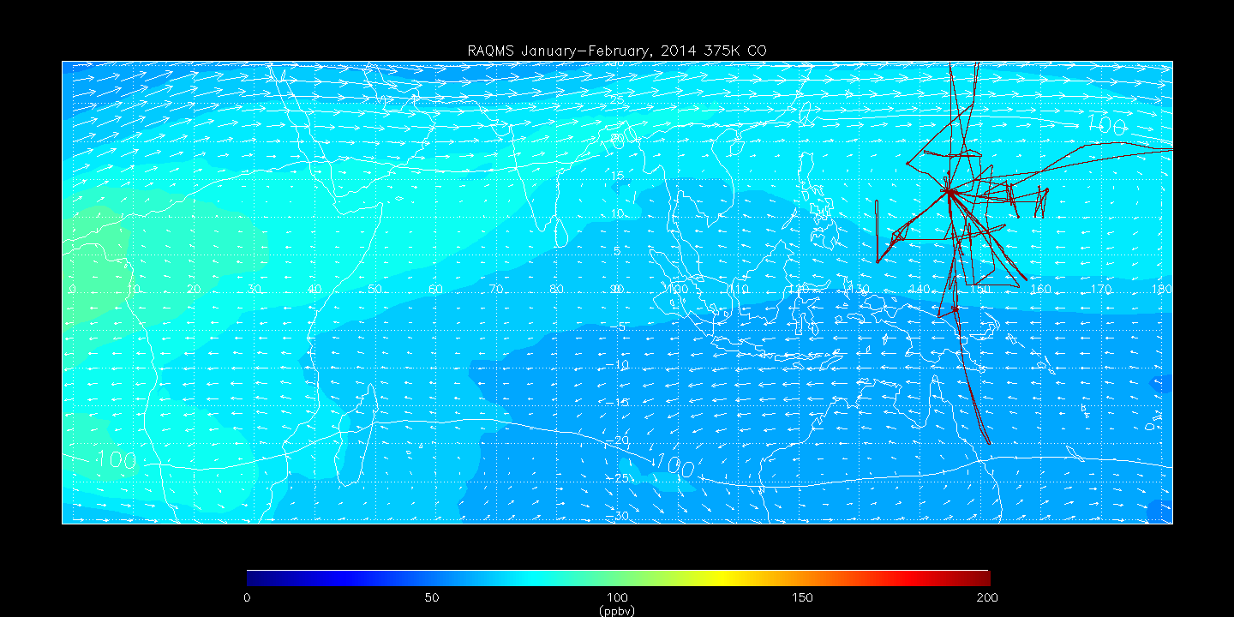
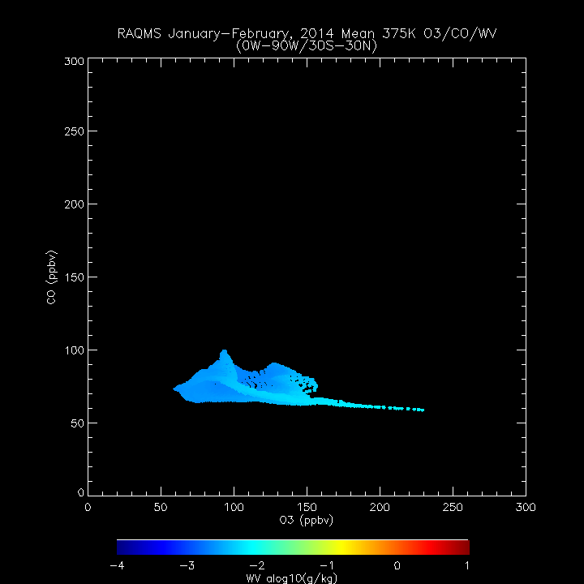
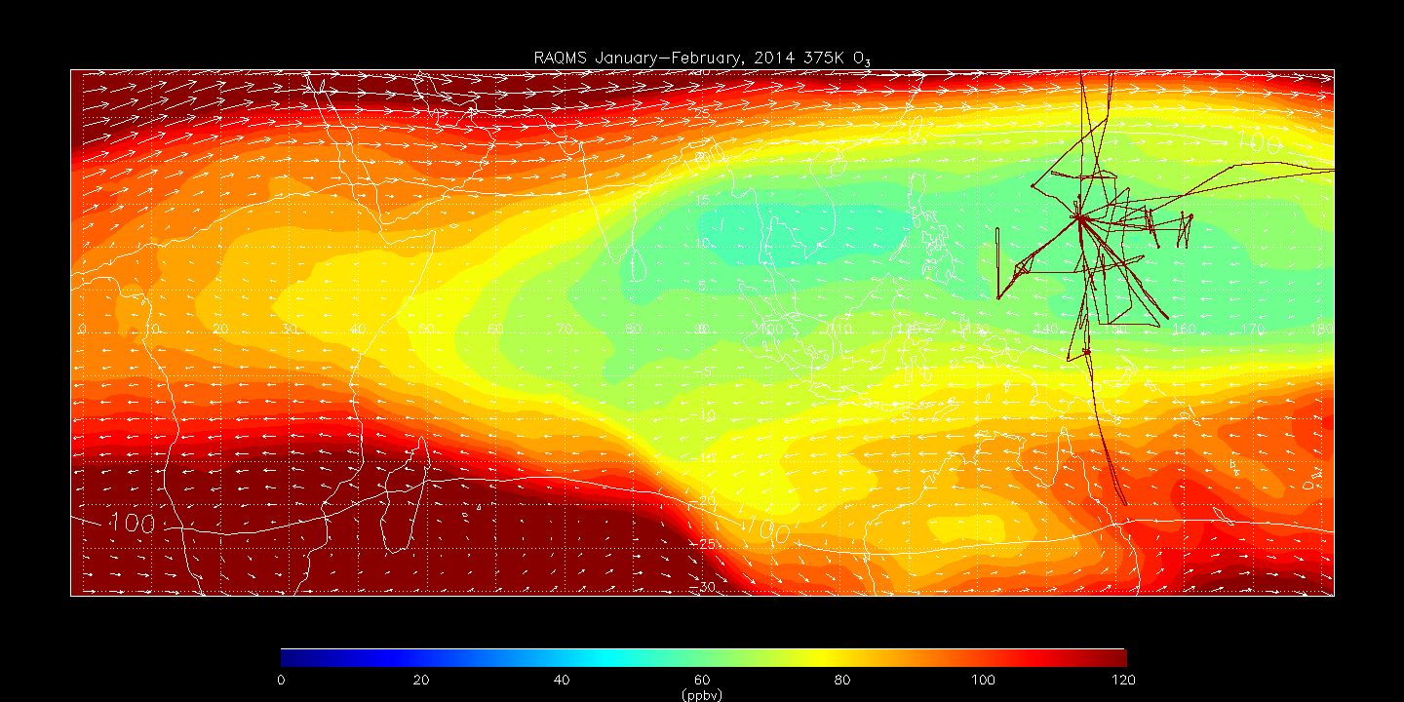
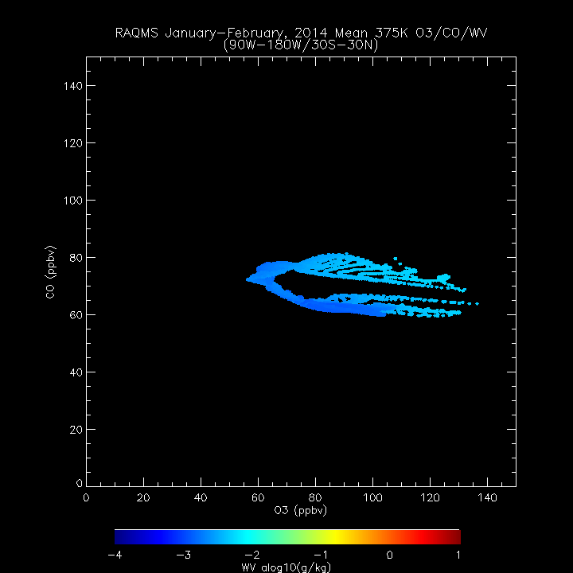
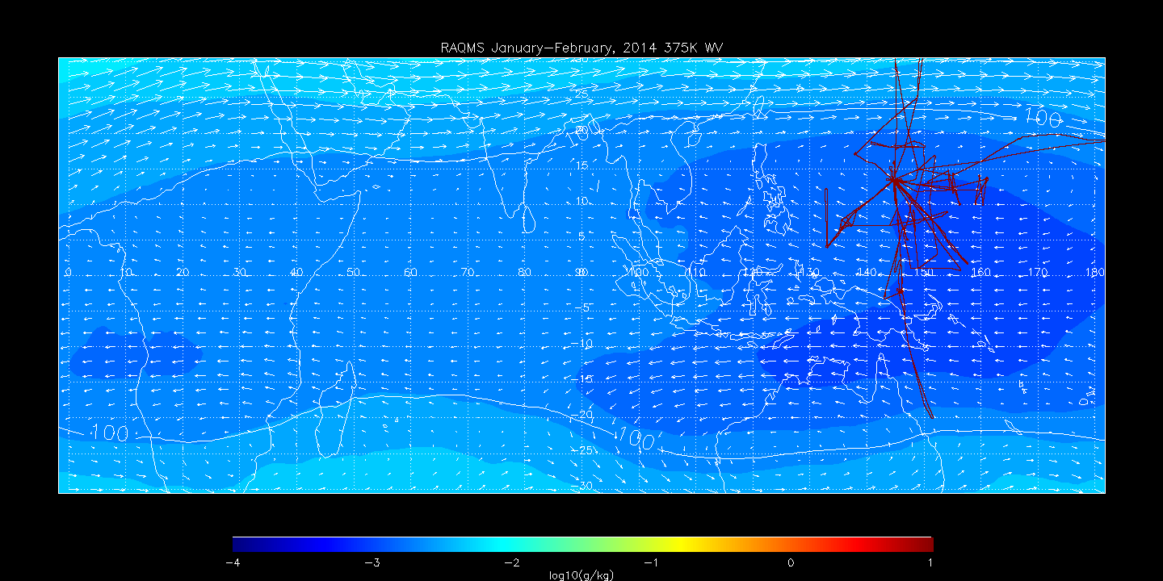
RAQMS January-February 2014 375K CO
0E-90E
C
D
90E-180E
F
A=Fresh BB outflow
B=Aged MBL
C=Strat Influence
B
E
Same as 365K, except BB CO enhancement (A) is small and most of the mixing occures between dry MBL air and slightly moister stratospherically influenced (C, F) and southern hemisphere (G) air
A
G
A
B
C
RAQMS January-February 2014 375K O3
0E-90E
C
D
90E-180E
F
B
E
A
G
RAQMS January-February 2014 375K WV
D
0E-90E
C
D
90E-180E
F
E
F
B
E
G
A
D=Aged BB outflow
E=Fresh MBL
F=Strat Influence
G=SH Influence
G

