Slide 1


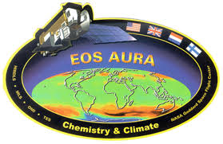

Aura Chemical Reanalysis in support Air Quality Applications
PI Brad Pierce
(NOAA/NESDIS)
Presented by
Allen Lenzen
(UW-Madison, SSEC)
Contributions from
Monica Harkey
(UW-Madison, SAGE)
2016 NASA Health and Air Quality Applications Program Review, September 20-21, 2016, Asheville, NC

Slide 2
Aura Chemical Reanalysis in support Air Quality Applications
Solicitation – ROSES 2013 Aura Science Team
Project Summary
  Utilize the Real-time Air Quality Modeling System (RAQMS) in conjunction with the NOAA Operational Gridpoint Statistical Interpolation (GSI) 3-dimensional variational data assimilation (DA) system to conduct a multi-year global chemical and aerosol reanalysis using NASA Aura and A-Train measurements.
Project Objectives
  Provide the air quality community with a multi-year global chemical and aerosol reanalysis using NASA Aura and A-Train measurements.
  Conduct regional chemical data assimilation experiments to quantify the influences in changes in NOx emissions on US air quality during the Aura period.
  Provide global 3 dimensional O3, CH4, N2O production and loss rates for next generation NOAA global forecast system.
  Collaborate with International, Federal, State and Local air quality management communities in the utilization of the Aura and A-Train measurements and reanalysis for air quality assessment activities.
|‌ 2
Notes:
Same as last year, can go through rather quickly

Slide 3
Aura Chemical Reanalysis in support Air Quality Applications
As of June 2, 2016
Budget – NASA’s Monthly Financial Report
  The uncosted FY15 amount due to costing/reporting from multiple entities –
  Cooperative Institute for Meteorological Satellite Studies (CIMSS), NESDIS Center
  for Satellite Applications and Research (STAR) Cooperative Research Program (CoRP)
  FY16 funds were accepted by NESDIS on July 19, 2016 due to delays in MOU approval by NOAA legal but the funds will carry over until FY17. The CIMSS proposal to NESDIS has been submitted, so we should have our FY16 funding sometime in early FY17.
Notes:
Program Year 2016 (PY16) funds just received by NESDIS/STAR on July 19, 2016 (long delay).
A bit behind in spending PY15 funds (CIMSS Year 2 proposal goes from 1 July 2015 to 30 June 2016)

Slide 4
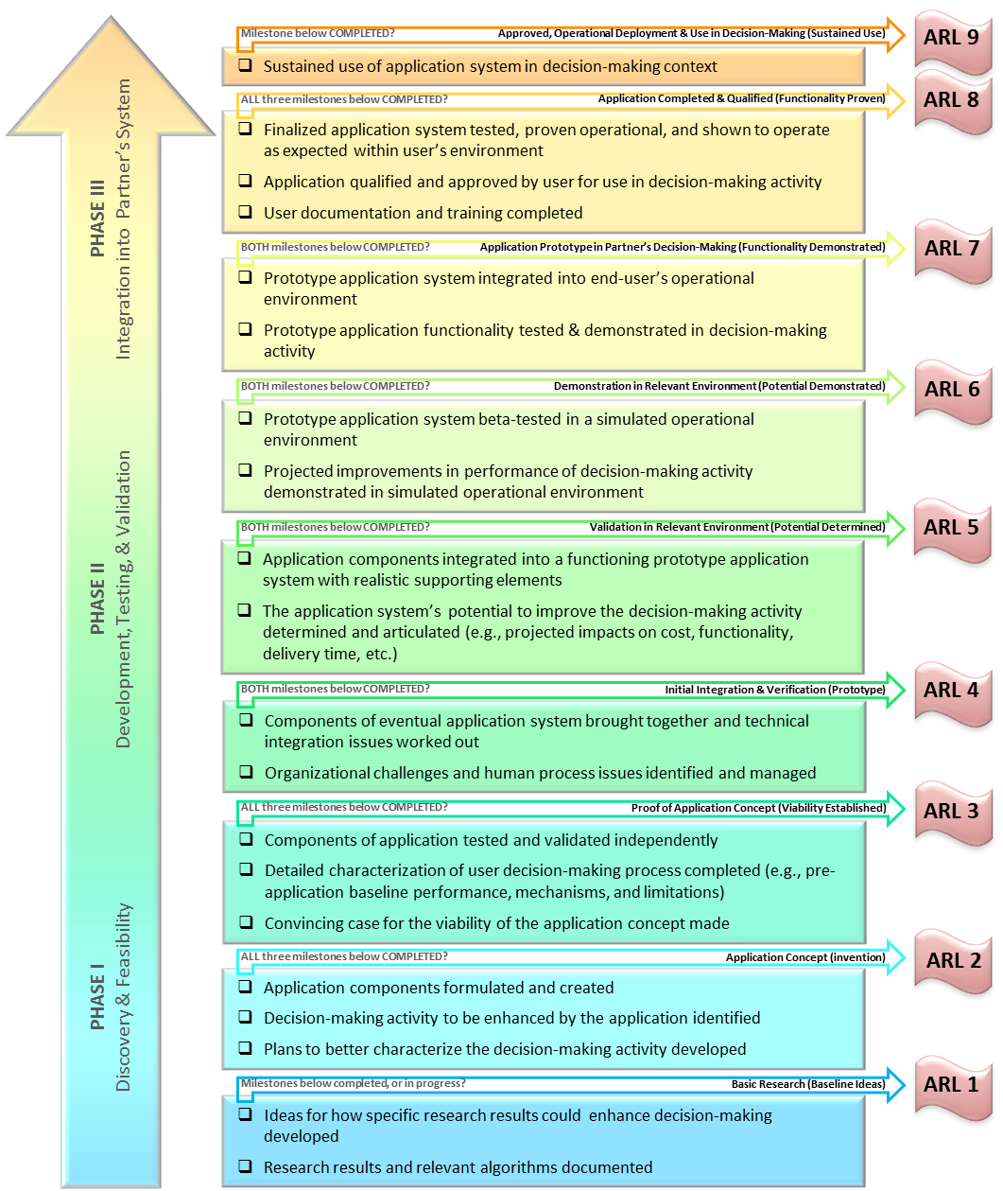
Applications Readiness Level (ARL)
Aura Chemical Reanalysis in support Air Quality Applications
As of July 16, 2015
Started at ARL 3 (Proof of Application Concept) with real-time RAQMS Data assimilation
Currently at ARL 4 (Initial Integration and Verification) based on successfully completing the RAQMS/GSI Data Denial experiments
Anticipate reaching ARL 5 (Validation in Relevant Environment) upon completion of 2010 RAQMS/GSI analysis by December 2016
Anticipate reaching ARL 6 (Demonstration in Relevant Environment) upon completion of full 2006-present RAQMS/GSI Reanalysis
Will reach ARL 7 by the end of the 3-year funding cycle with delivery of RAQMS Aura Reanalysis to DAAC.
|‌ 4
Notes:
Currently at Applications Readiness Level (ARL) 4 (Initial Integration and Verification) will reach ARL 7 (Functional) with delivery to DAAC
PI still not getting “ebook” notifications of reporting, will update August entry

Slide 5
Aura Chemical Reanalysis in support Air Quality Applications
Results and Milestones (Year 2)
  Developed approach to use RAQMS NOx emission sensitivity experiments and RAQMS/GSI OMI NO2 data assimilation adjust 2010 global Hemispheric Transport of Air Pollution (HTAP) monthly NO2 emissions
  Developed an approach to use the adjusted HTAP NO2 emissions and multiple linear regression of OMI urban NO2 trends to generate 2005-2015 global NO2 HTAP emissions
  Conducted July 2011 CMAQ NOx emissions sensitivity studies for generation of regional background error covariances and adjustment of NEI 2011 NOx emissions CMAQ/GSI OMI NO2 assimilation experiments
  2010 data denial studies conducted for MODIS Aerosol Optical Depth (AOD) and AIRS Carbon Monoxide (CO) retrievals (finalizes suite of satellite measurements for Aura Reanalysis)
Notes:
This is the focus of the rest of the presentation, no need to read these, will walk through one at a time

Slide 6
Aura Chemical Reanalysis in support Air Quality Applications
Results and Milestones (Year 2)
  Developed approach to use RAQMS NOx emission sensitivity experiments and RAQMS/GSI OMI NO2 data assimilation adjust 2010 global Hemispheric Transport of Air Pollution (HTAP) monthly NO2 emissions
  Developed an approach to use the adjusted HTAP NO2 emissions and multiple linear regression of OMI urban NO2 trends to generate 2005-2015 global NO2 HTAP emissions
  Conducted July 2011 CMAQ NOx emissions sensitivity studies for generation of regional background error covariances and adjustment of NEI 2011 NOx emissions CMAQ/GSI OMI NO2 assimilation experiments
  2010 data denial studies conducted for MODIS Aerosol Optical Depth (AOD) and AIRS Carbon Monoxide (CO) retrievals (finalizes suite of satellite measurements for Aura Reanalysis)
Notes:
Will first discuss “Constraining 2010 Hemispheric Transport of Air Pollution (HTAP) NO2 emissions with RAQMS/GSI OMI NO2 data assimilation”

Slide 7
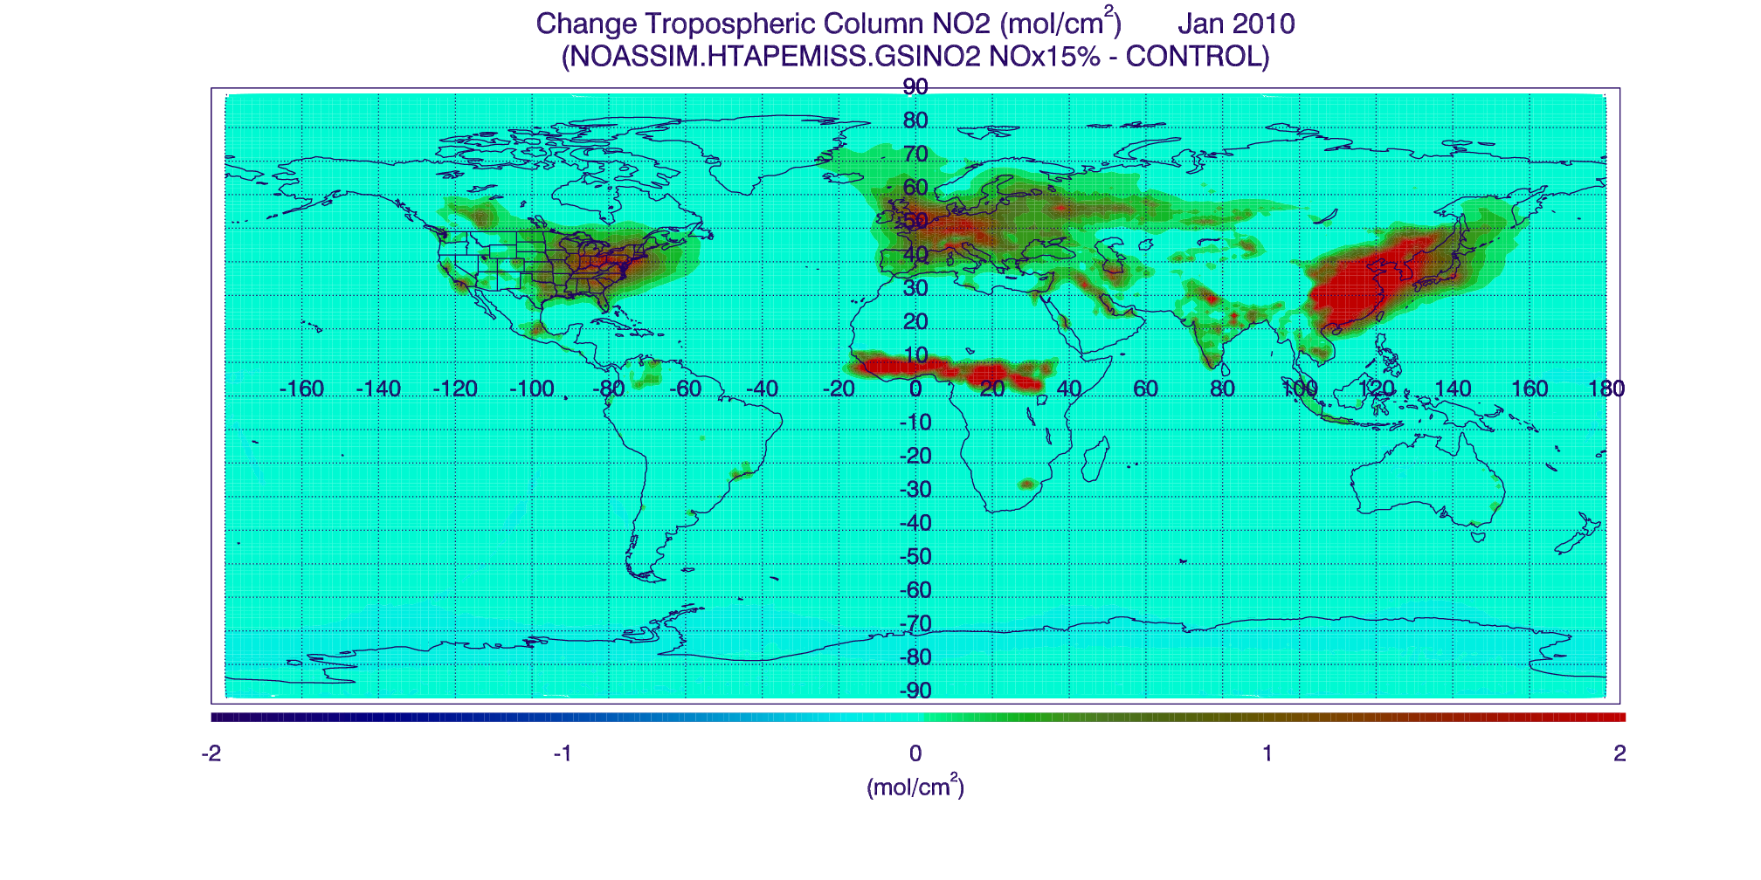
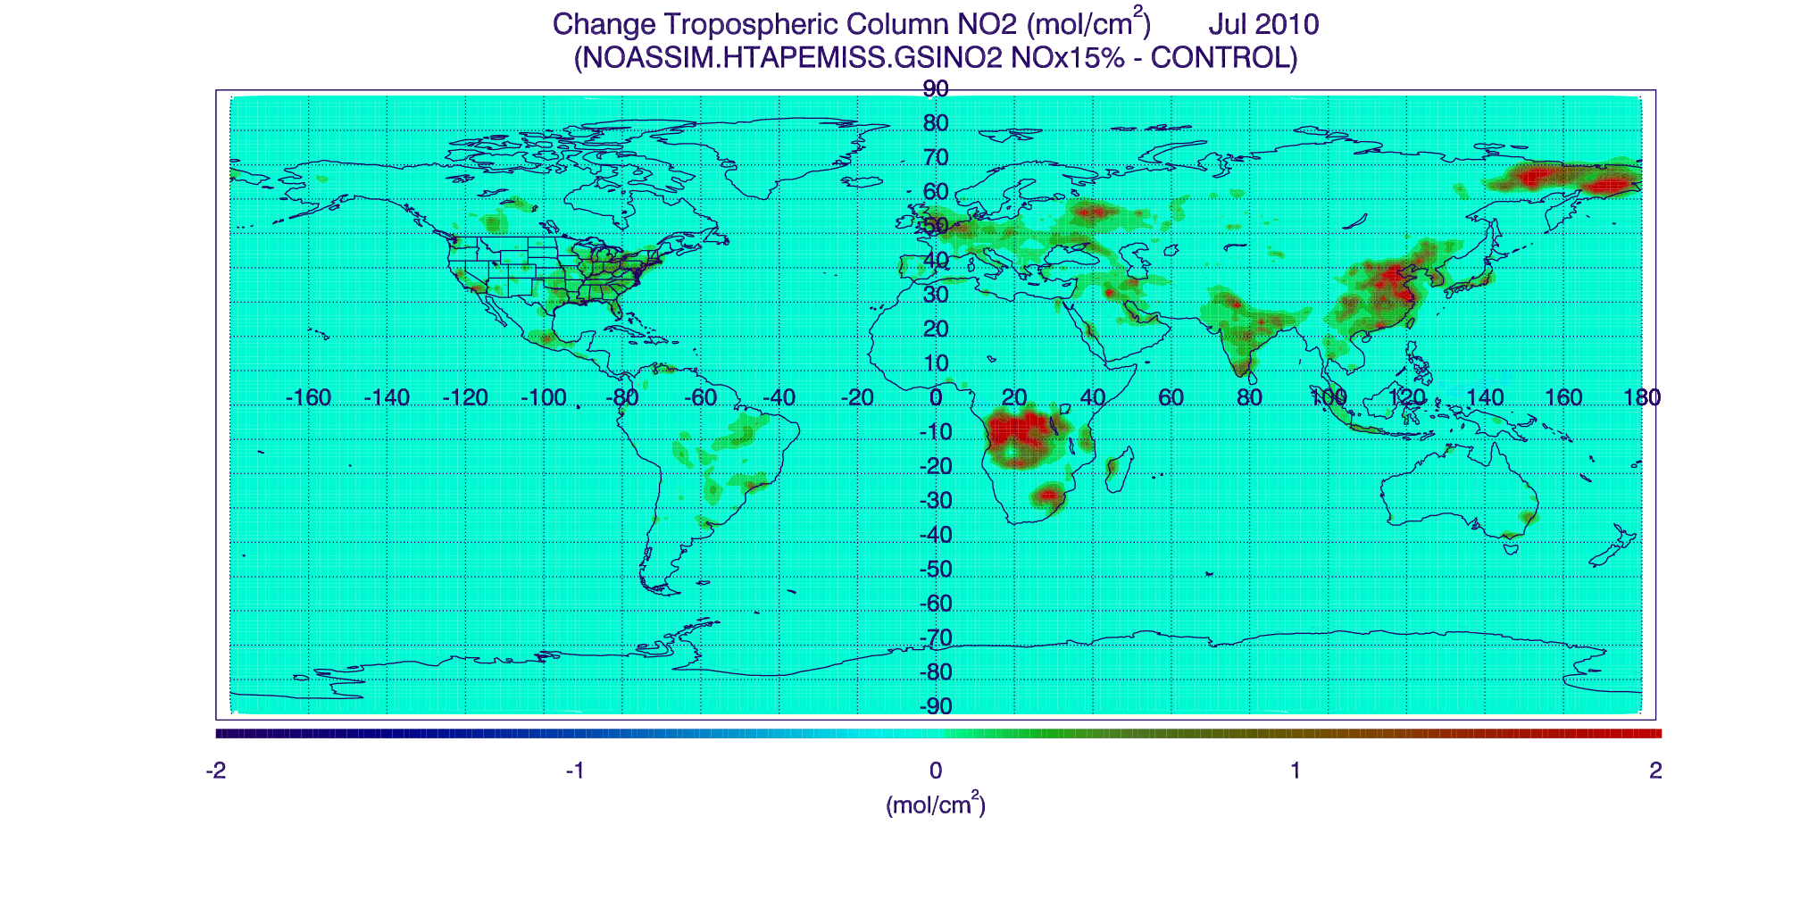
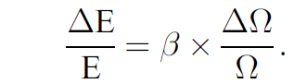
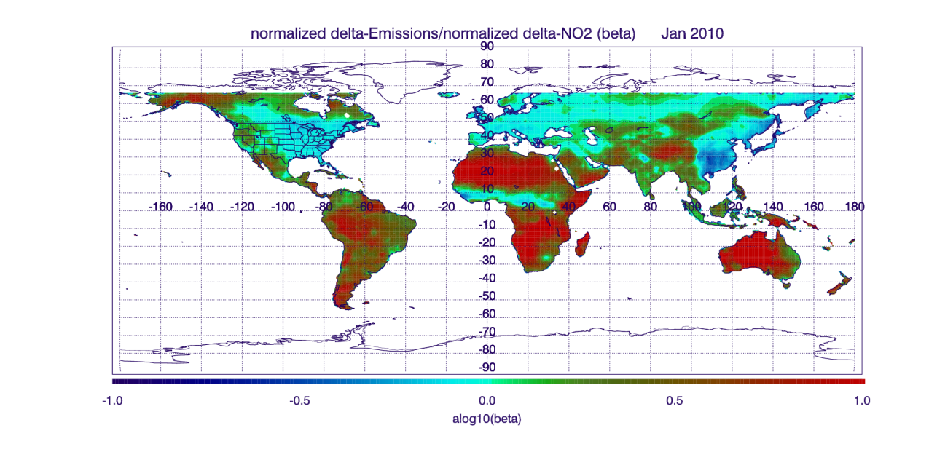
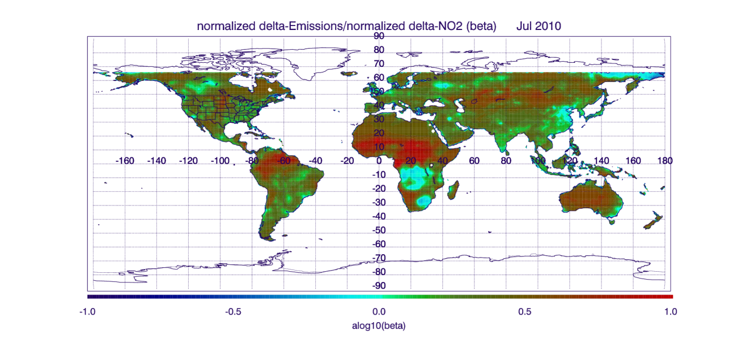
Constraining 2010 HTAP NO2 emissions with RAQMS/GSI OMI NO2 data assimilation
Change in Tropospheric NO2 Column (10¹⁵ mol/cm²) January 2010
(15% emission perturbation-Control)
Change in Tropospheric NO2 Column (10¹⁵ mol/cm²) July 2010
(15% emission perturbation-Control)
(10¹⁵ mol/cm²)
(10¹⁵ mol/cm²)
Monthly mean NO2 Jacobians (β=normalized delta-Emissions/normalized delta-NO2) are computed from the 2010 RAQMS NO2 emission perturbation experiment following (Lamsal, et al, 2012)
Lamsal, L. N., et al. (2011), Application of satellite observations for timely updates to global anthropogenic NOx emission inventories, Geophys. Res. Lett., 38, L05810, doi:10.1029/2010GL046476.
Notes:
Based on the work of Lamsal et al (2011) determine relationship between change in emissions and change in tropospheric NO2 column (NO2 Jacobians, or βετα) to account for non-linear response
Showing results from 15% emissions sensitivity experiment for January (left) and July (right) 2010
Show what is being calculated in equation on right
Regions of high beta (red) are regions with low changes and are associated with transport from source regions (not important)
Regions with high change in NO2 column have beta values that are generally less than 1 (blue)
The beta values vary with season due to different NO2 lifetimes

Slide 8
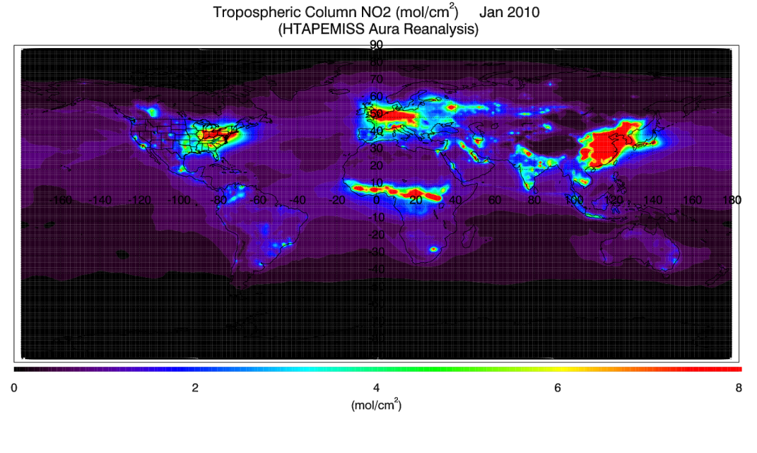
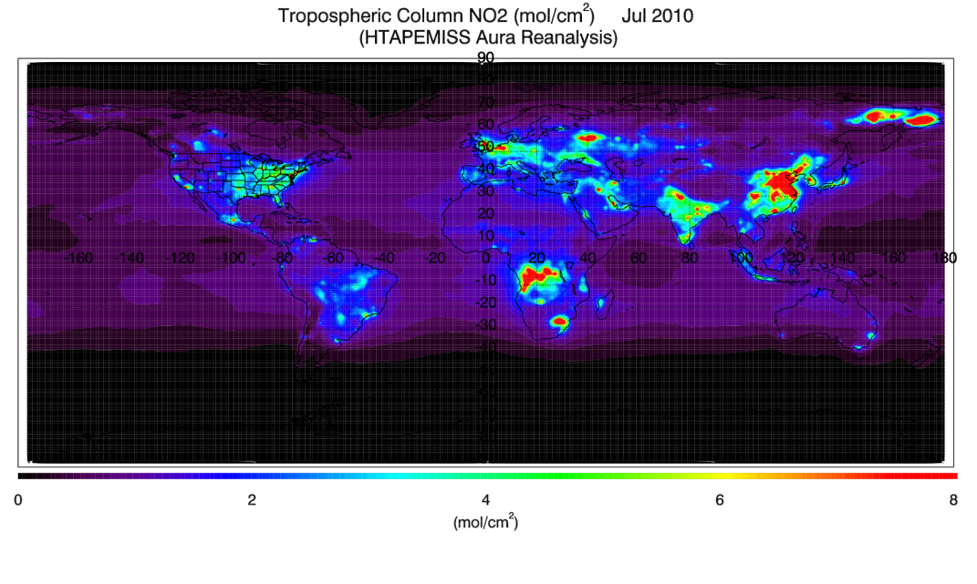
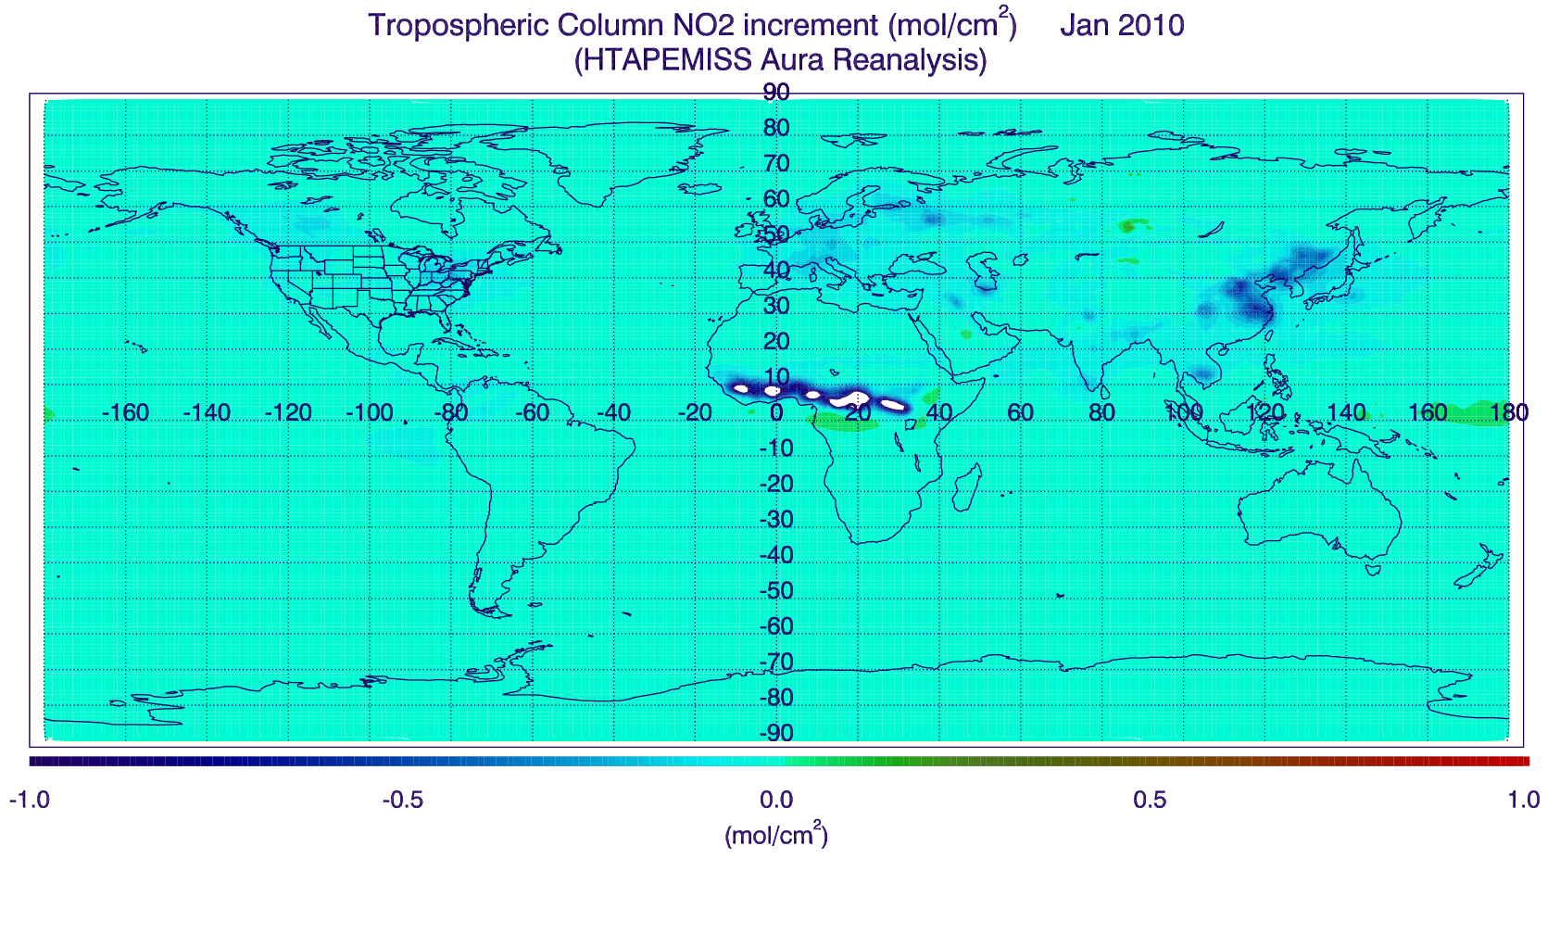
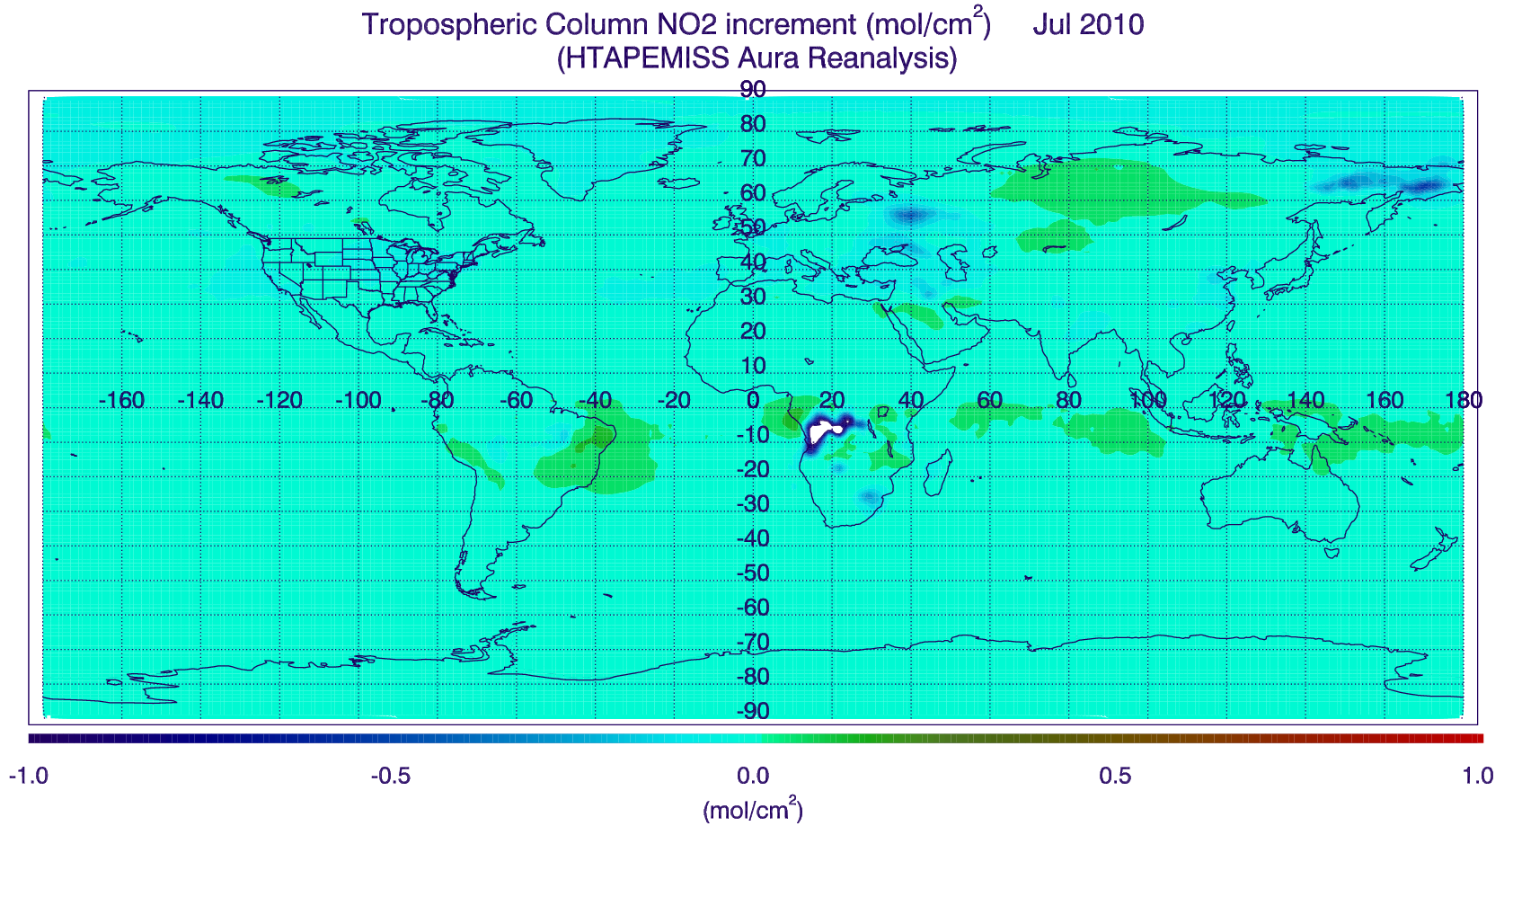
Constraining 2010 HTAP NO2 emissions with RAQMS/GSI OMI NO2 data assimilation
Tropospheric NO2 Column (10¹⁵ mol/cm²) January 2010
(HTAPEMISS Aura Reanalysis)
Tropospheric NO2 Column (10¹⁵ mol/cm²) July 2010
(HTAPEMISS Aura Reanalysis)
(10¹⁵ mol/cm²)
(10¹⁵ mol/cm²)
Monthly mean tropospheric NO2 column assimilation increments are computed from the 2010 RAQMS Aura Reanalysis OMI NO2 assimilation (used to define normalized delta-NO2)
Tropospheric NO2 Column Increment (10¹⁵ mol/cm²) January 2010
(HTAPEMISS Aura Reanalysis)
Tropospheric NO2 Column Increment (10¹⁵ mol/cm²) July 2010
(HTAPEMISS Aura Reanalysis)
(10¹⁵ mol/cm²)
(10¹⁵ mol/cm²)
Notes:
RAQMS/GSI NO2 assimilation provides a delta NO2 column that can now be used to adjust the emissions
Note that delta NO2 and high NO2 columns over Equatorial Africa (January) and Eastern Siberia and Southern Africa (July) are associated with fires

Slide 9
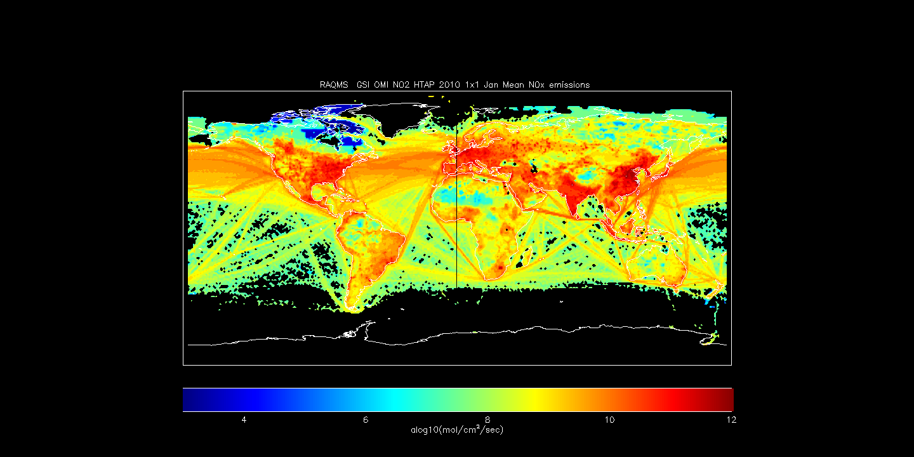
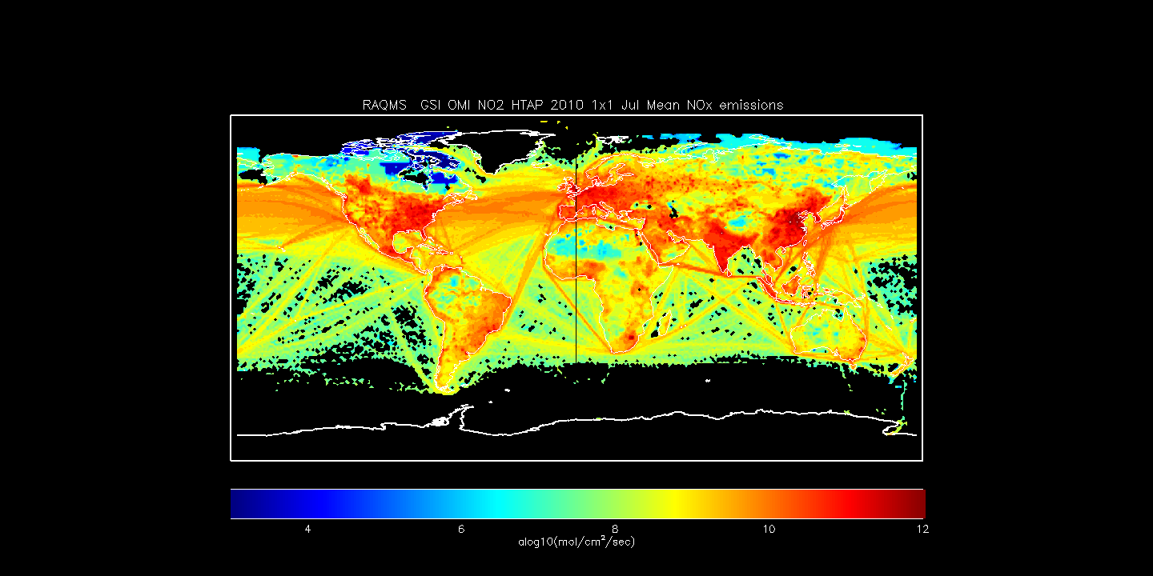
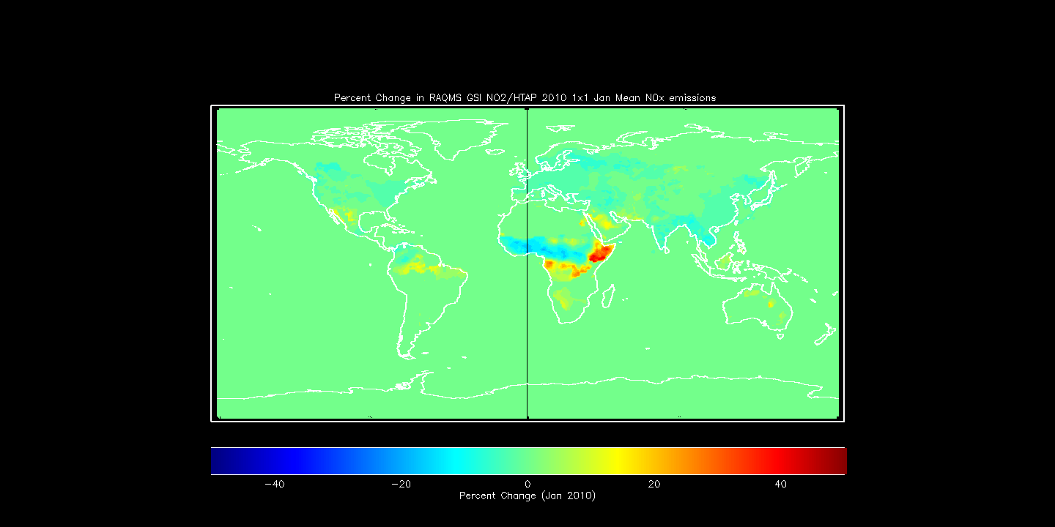
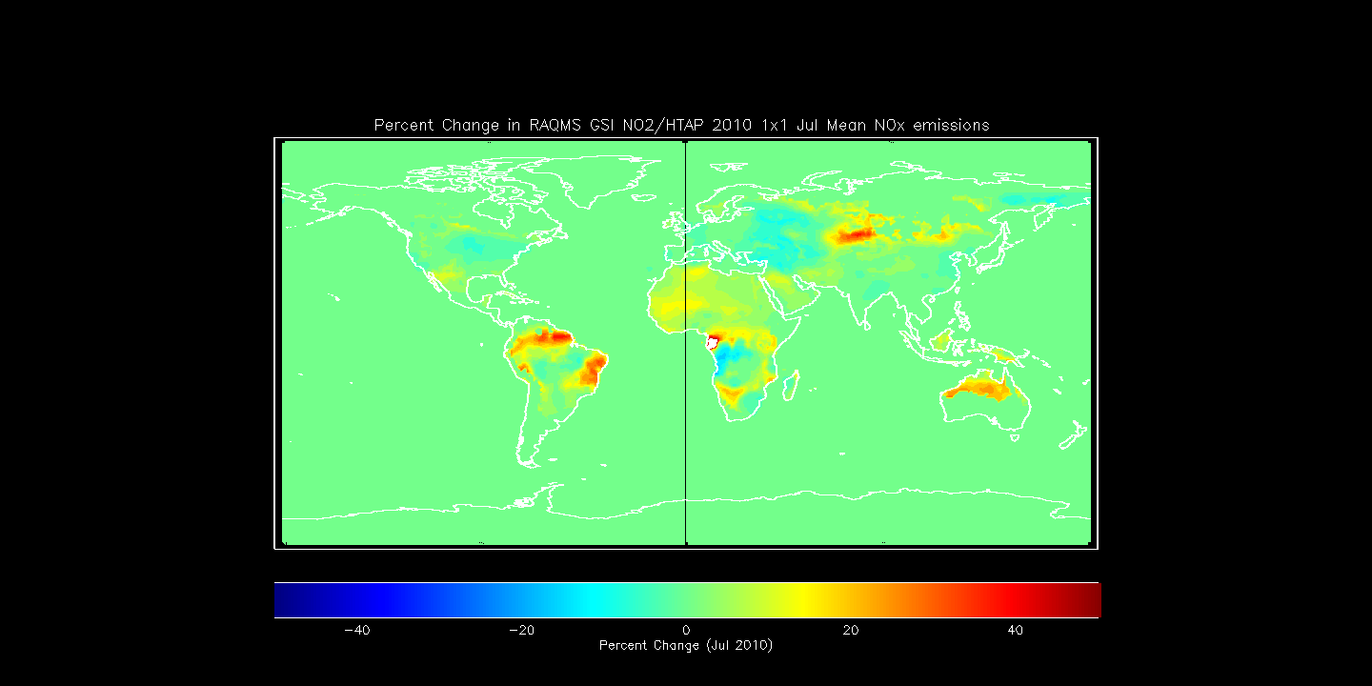
Constraining 2010 HTAP NO2 emissions with RAQMS/GSI OMI NO2 data assimilation
Adjusted HTAP NO2 Emissions (10¹⁵ mol/cm²) January 2010
(Aura Reanalysis RAQMS/GSI OMI DA )
Adjusted HTAP NO2 Emissions (10¹⁵ mol/cm²) July 2010
(Aura Reanalysis RAQMS/GSI OMI DA )
delta-NO2 from OMI NO2 DA and Jacobian (β) from NO2 emissions perturbation experiment are used to adjust monthly HTAP NO2 emissions
Percent Change in HTAP NO2 Emissions January 2010
Percent Change in HTAP NO2 Emissions July 2010
Notes:
Now use delta NO2 from DA and beta to adjust emissions, next slide will point out main features
If someone asks about high adjustments near fires then say we need to add constraint of >50% total emissions from HTAP to remove fire regions.

Slide 10
Constraining 2010 HTAP NO2 emissions with RAQMS/GSI OMI NO2 data assimilation
Adjusted HTAP NO2 Emissions (10¹⁵ mol/cm²) January 2010
(Aura Reanalysis RAQMS/GSI OMI DA )
Adjusted HTAP NO2 Emissions (10¹⁵ mol/cm²) July 2010
(Aura Reanalysis RAQMS/GSI OMI DA )
Adjustment leads to reductions in emissions in industrialized areas (regions of large positive changes have low anthropogenic emissions)
Percent Change in HTAP NO2 Emissions January 2010
Percent Change in HTAP NO2 Emissions July 2010
Notes:
If someone asks about high adjustments near fires then say we need to add constraint of >50% total emissions from HTAP to remove fire regions.

Slide 11
Aura Chemical Reanalysis in support Air Quality Applications
Results and Milestones (Year 2)
  Developed approach to use RAQMS NOx emission sensitivity experiments and RAQMS/GSI OMI NO2 data assimilation adjust 2010 global Hemispheric Transport of Air Pollution (HTAP) monthly NO2 emissions
  Developed an approach to use the adjusted HTAP NO2 emissions and multiple linear regression of OMI urban NO2 trends to generate 2005-2015 global NO2 HTAP emissions
  Conducted July 2011 CMAQ NOx emissions sensitivity studies for generation of regional background error covariances and adjustment of NEI 2011 NOx emissions CMAQ/GSI OMI NO2 assimilation experiments
  2010 data denial studies conducted for MODIS Aerosol Optical Depth (AOD) and AIRS Carbon Monoxide (CO) retrievals (finalizes suite of satellite measurements for Aura Reanalysis)
Notes:
Now discuss building multi-year (2005-2015) HTAP NO2 emissions for Aura Reanalysis

Slide 12
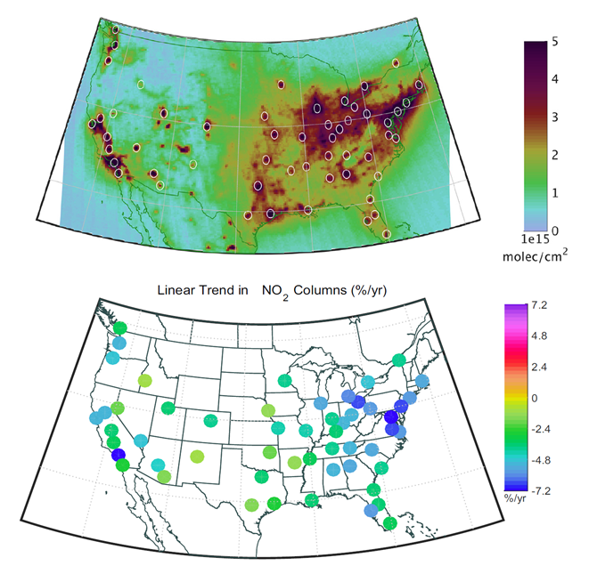
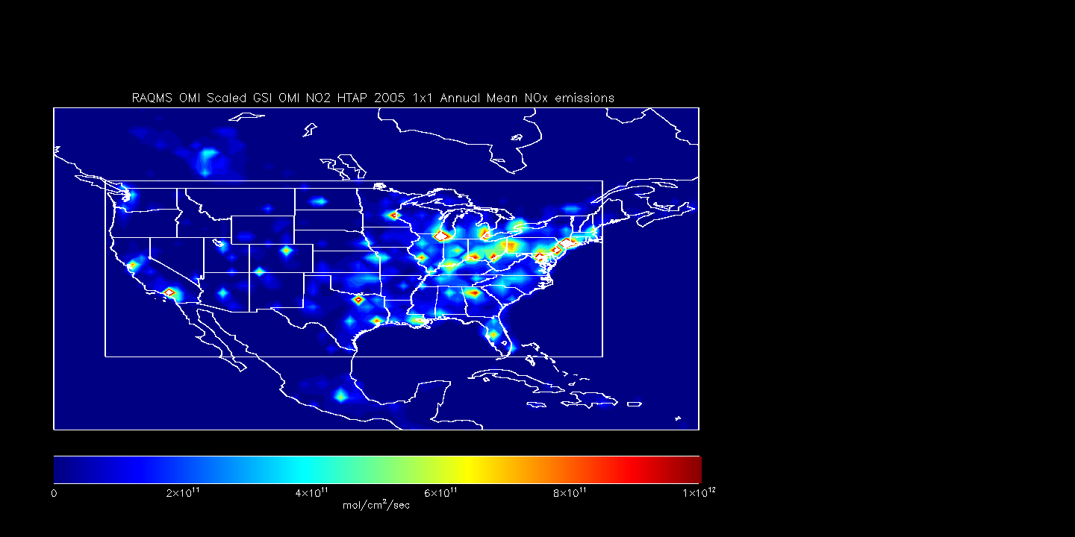
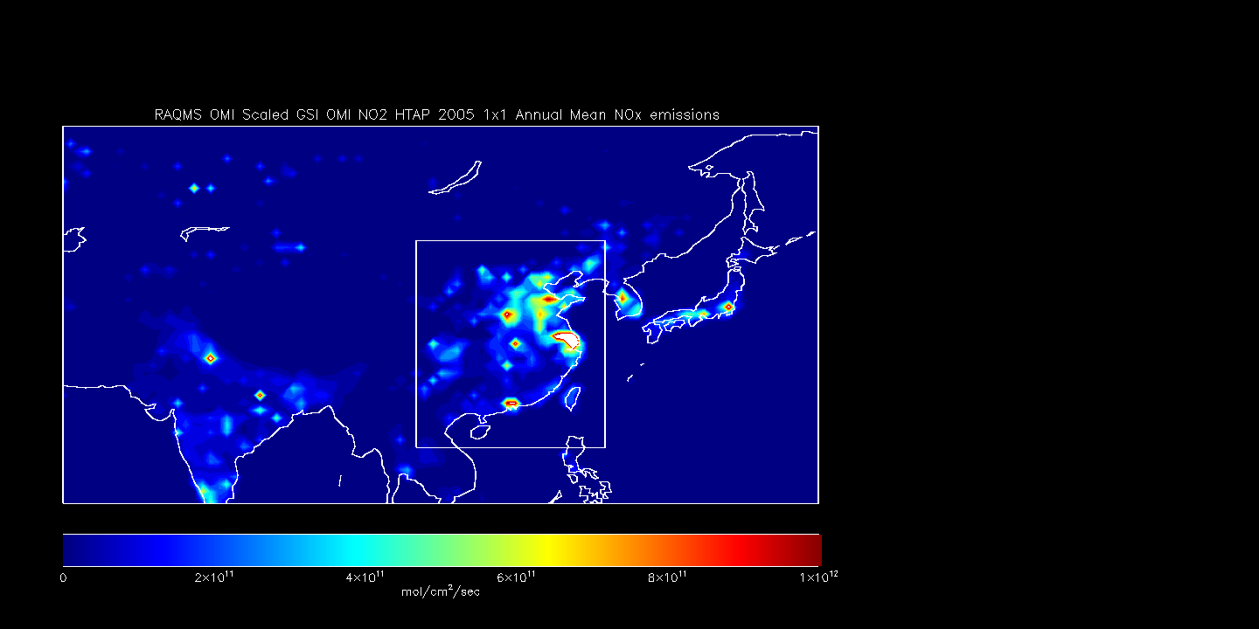
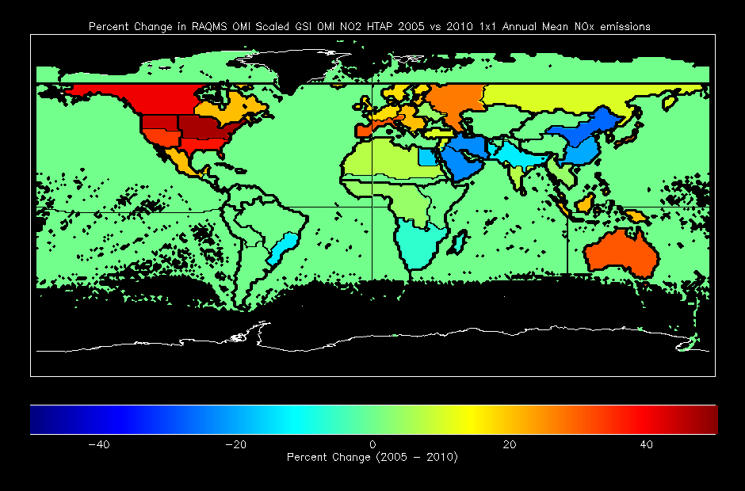
2005-2015 HTAP NO2 emissions for Aura Reanalysis
Multiple Linear Regression
Of OMI urban NO2 trends
Multiple Linear Regression of OMI urban NO2 trends used to generate 2005-2015 global NO2 emissions (applied uniformly across each HTAP region)
Benjamin de Foy, B. et al. (2016), Impacts of control strategies, the Great Recession and weekday variations on NO2 columns above North American cities, http://dx.doi.org/10.1016/j.atmosenv.2016.04.038
Notes:
Collaboration with Ben de Foy at Saint Louis University who provided multiple linear regression of OMI NO2 trends for global cities
Start in Upper left (OMI NO2 with US city locations identified), then map of trends (%/year), then say same done for each HTAP region (note that there are 4 in the US)
Then go to right hand side to discuss results
Trends from multiple cities within each HTAP sub region are used, trend is applied uniformly across each HTAP region
Timeseries are all changes in percent relative to 2010
US time series shows a minimum during the 2007 recession followed by a slight increase and then decline
SE Asian time series shows a maximum in 2011 with sharp decline during 2012 Beijing Olympics and then continuing decline

Slide 13
Aura Chemical Reanalysis in support Air Quality Applications
Results and Milestones (Year 2)
  Developed approach to use RAQMS NOx emission sensitivity experiments and RAQMS/GSI OMI NO2 data assimilation adjust 2010 global Hemispheric Transport of Air Pollution (HTAP) monthly NO2 emissions
  Developed an approach to use the adjusted HTAP NO2 emissions and multiple linear regression of OMI urban NO2 trends to generate 2005-2015 global NO2 HTAP emissions
  Conducted July 2011 CMAQ NOx emissions sensitivity studies for generation of regional background error covariances and adjustment of NEI 2011 NOx emissions CMAQ/GSI OMI NO2 assimilation experiments
  2010 data denial studies conducted for MODIS Aerosol Optical Depth (AOD) and AIRS Carbon Monoxide (CO) retrievals (finalizes suite of satellite measurements for Aura Reanalysis)
Notes:
Now will talk about July 2011 CMAQ NOx emissions sensitivity studies

Slide 14
July 2011 CMAQ NOx emissions sensitivity studies
In support of the Lake Michigan Air Directors Consortium (LADCO) State Implementation Plan (SIP) modeling we are conducting July 2011 CMAQ simulations to investigate:
how model bias in ozone precursors (NO2 and HCHO as proxies for total NOx and VOCs) is sensitive to model processes and emissions inputs
how simulated ozone is sensitive to changes in precursors, via changing model processes and inputs
The CMAQ NOx emission sensitivity studies, along with CMAQ/GSI OMI NO2 DA, will be used to adjust NEI 2011 NOx emission inventories following the procedure outlined for the RAQMS Aura Reanalysis
Notes:
Strong collaboration with LADCO
Task lead by Monica Harkey (UW-Madison, SAGE)
LADCO work leveraged to prepare for CMAQ/GSI OMI NO2 DA

Slide 15
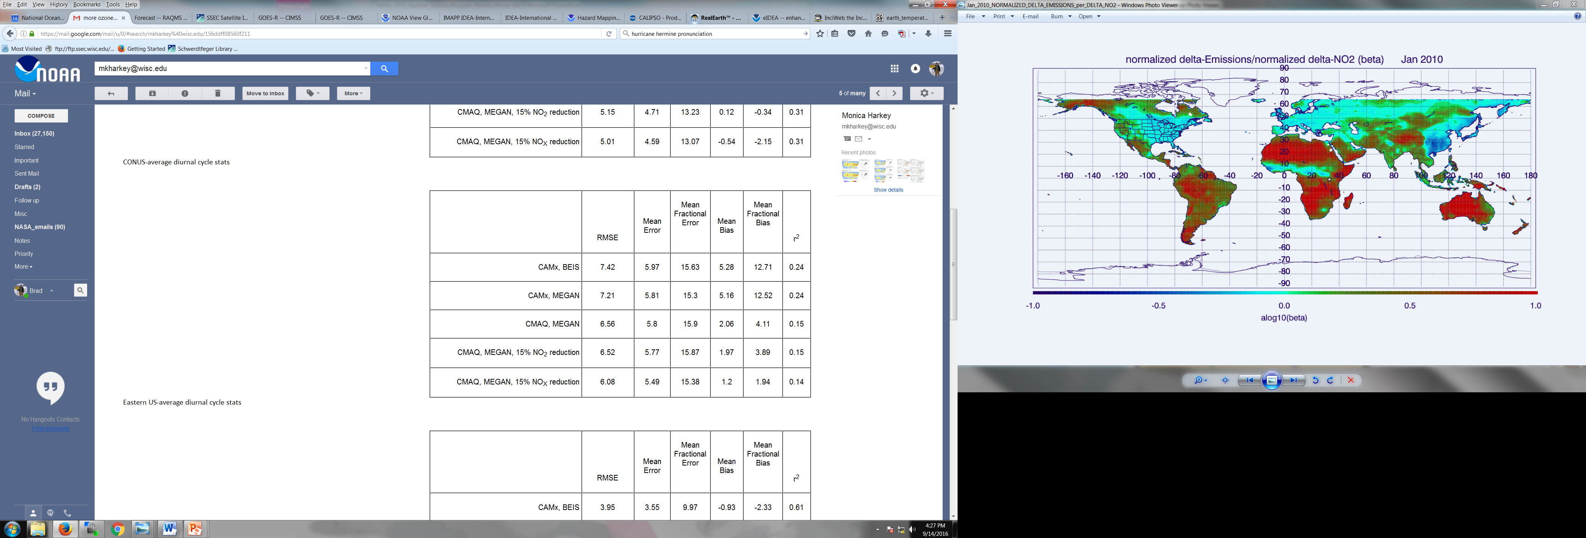
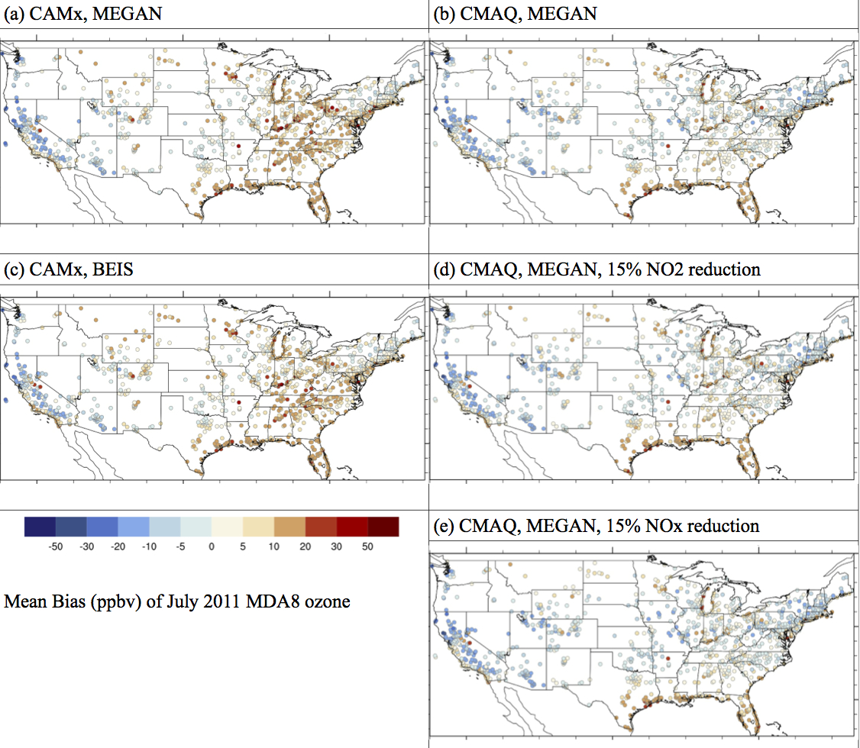

July 2011 CMAQ NOx emissions sensitivity studies: Ozone Response
July 2011 MDA8 ozone
Eastern US
Western US
Bias CMAQ-AIRNow (ppbv)
Notes:
This slide summarizes the surface ozone response to changes in NOx emissions
Spend time explaining different figures (next slide will summarize):
Left, comparison of Maximum Daily 8 hour average (MDA8) surface ozone between CMAQ and AIRNow observations (at the observation sites)
Blue means CMAQ<AIRNow, red means CMAQ is > AIRNow
Upper left is control (CMAQ with MEGAN biogenic emissions which are not relevant for the NO2 perturbation study but are relevant for the Volatile Organic Carbon or VOC chemistry)
Middle left is 15% NO2 emission reduction
Lower left it 15% NOx (NO+NO2) emission reduction
Tables on right show statistics for Eastern (upper right) and Western (lower right) US

Slide 16
July 2011 CMAQ NOx emissions sensitivity studies: Ozone Response
July 2011 MDA8 ozone
Eastern US
Western US
Uniform 15% NOx reductions improves agreement between CMAQ and observed July 2011 MDA8 ozone in the Eastern US but worsens the agreement in the Western US
Bias CMAQ-AIRNow (ppbv)
Notes:
Green boxes indicate overall improvement
Red boxes indicate overall worse

Slide 17
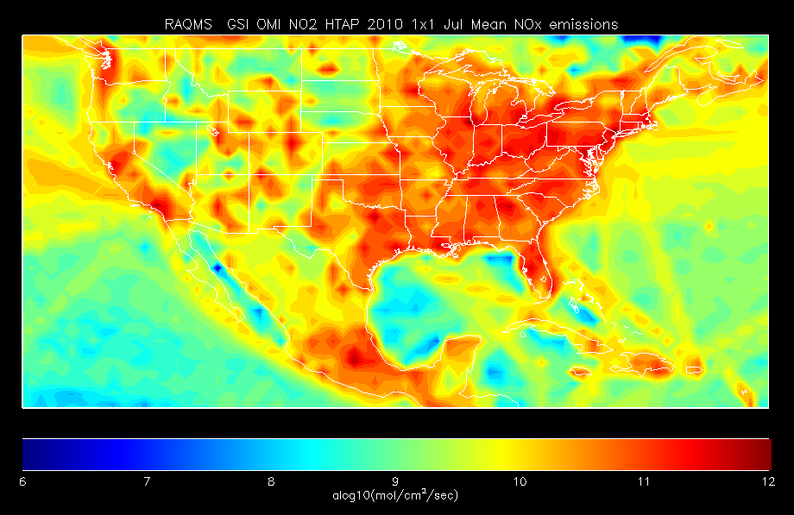
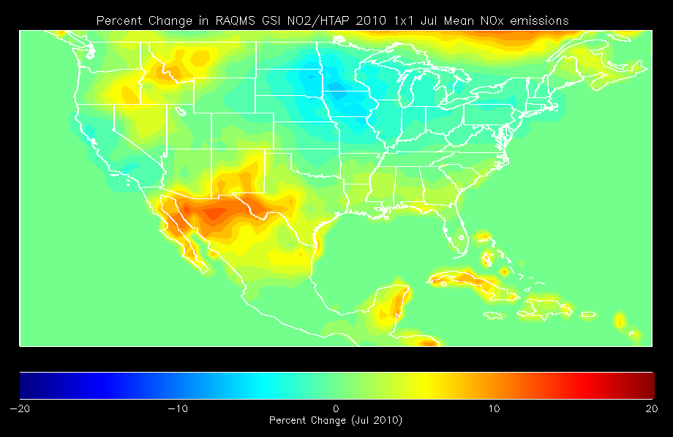
July 2011 CMAQ/GSI OMI NO2 DA Studies: Anticipated Results
Adjusted HTAP NO2 Emissions (10¹⁵ mol/cm²) July 2010
(Aura Reanalysis RAQMS/GSI OMI DA )
The July 2010 emissions adjustments from the RAQMS/GSI OMI NO2 DA experiments show reductions in emissions in the North East and Mid West and increases in emissions in the intermountain West.
If the July 2011 CMAQ/GSI OMI NO2 DA experiments show similar responses, then we anticipate improved prediction of MDA8 ozone in CMAQ
Percent Change in HTAP NO2 Emissions July 2010
Notes:
Returning to results of RAQMS/GSI OMI NO2 DA study to discuss anticipated results of CMAQ/GSI OMI NO2 DA experiment

Slide 18
Aura Chemical Reanalysis in support Air Quality Applications
Results and Milestones (Year 2)
  Developed approach to use RAQMS NOx emission sensitivity experiments and RAQMS/GSI OMI NO2 data assimilation adjust 2010 global Hemispheric Transport of Air Pollution (HTAP) monthly NO2 emissions
  Developed an approach to use the adjusted HTAP NO2 emissions and multiple linear regression of OMI urban NO2 trends to generate 2005-2015 global NO2 HTAP emissions
  Conducted July 2011 CMAQ NOx emissions sensitivity studies for generation of regional background error covariances and adjustment of NEI 2011 NOx emissions CMAQ/GSI OMI NO2 assimilation experiments
  2010 data denial studies conducted for MODIS Aerosol Optical Depth (AOD) and AIRS Carbon Monoxide (CO) retrievals (finalizes suite of satellite measurements for Aura Reanalysis) – See Extra Slides
Notes:
Assuming that you are nearly out of time now so say that
In the interest of time we’ll defer the discussion of the MODIS and AIRS data denial studies to the end, but these studies finalze suite of satellite measurements for Aura Reanalysis)

Slide 19
Aura Chemical Reanalysis in support Air Quality Applications
Ongoing activities
Collaboration with Wisconsin Department of Natural Resources (WDNR) and Lake Michigan Air Directors Consortium (LADCO) on influence of Chicago NO2 emissions on ozone exceedances at Sheboygan, WI (exceeded limit for the 2013-15 design value in 2015)
  Lead effort to coordinate 2017 Lake Michigan Ozone Study (LMOS 2017) to use NASA satellite data and aircraft measurements to understand the reasons for the ozone exceedances along the Western Shore of Lake Michigan.
PI is member of Aerosol and Atmospheric Composition Task Force for development of NOAA’s Next Generation Global Prediction System (NGGPS)
  NOAA Research Transition Acceleration Program (RTAP) proposal for implementation of reduced troposphere/stratosphere chemistry algorithms into NGGPS accepted for FY17 funding.
Notes:
Strong partnership with LADCO and Wisconsin DNR, LMOS 2017 mission concept arose from NASA Air Quality Applied Science Team (AQAST) meetings
NASA committed to providing Geostationary Trace gas and Aerosol Sensor Optimization (GeoTASO) airborne sensor (UVVIS spectrometer like TEMPO to measure O3, NO2, HCHO (formaldehyde)
Link to NOAA Operational global modeling/DA effort through NGGPS
Archived stratospheric halogen (ClOx/BrOx) ozone production from Aura Reanalysis will be used within NGGPS chemistry algorithm

Slide 20
Acknowledgements
Thanks to Randall Martin (Dalhousie University) for guidance on the use of OMI NO2 columns to constrain NOx emissions
Thanks to Benjamin de Foy (Saint Louis University) for providing multiple regression based OMI NO2 trends for major world cities

Slide 21
Extra Slides

Slide 22
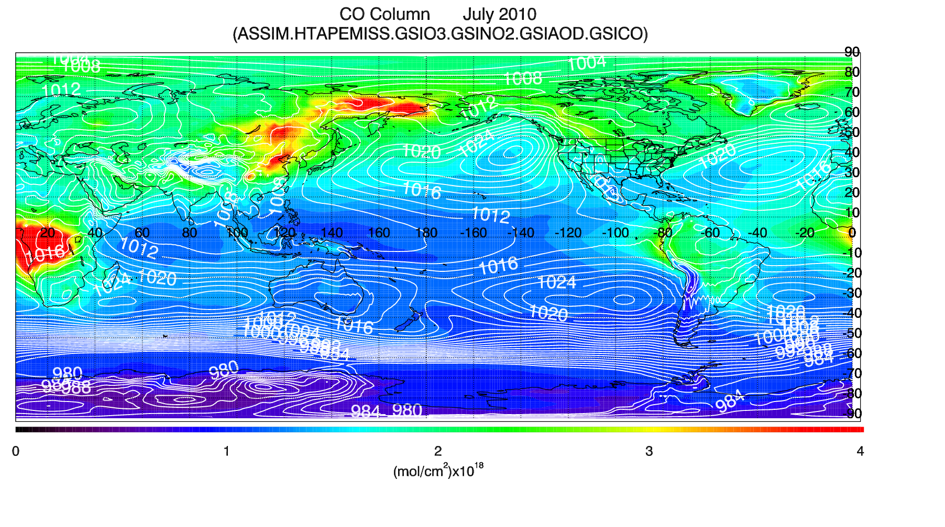
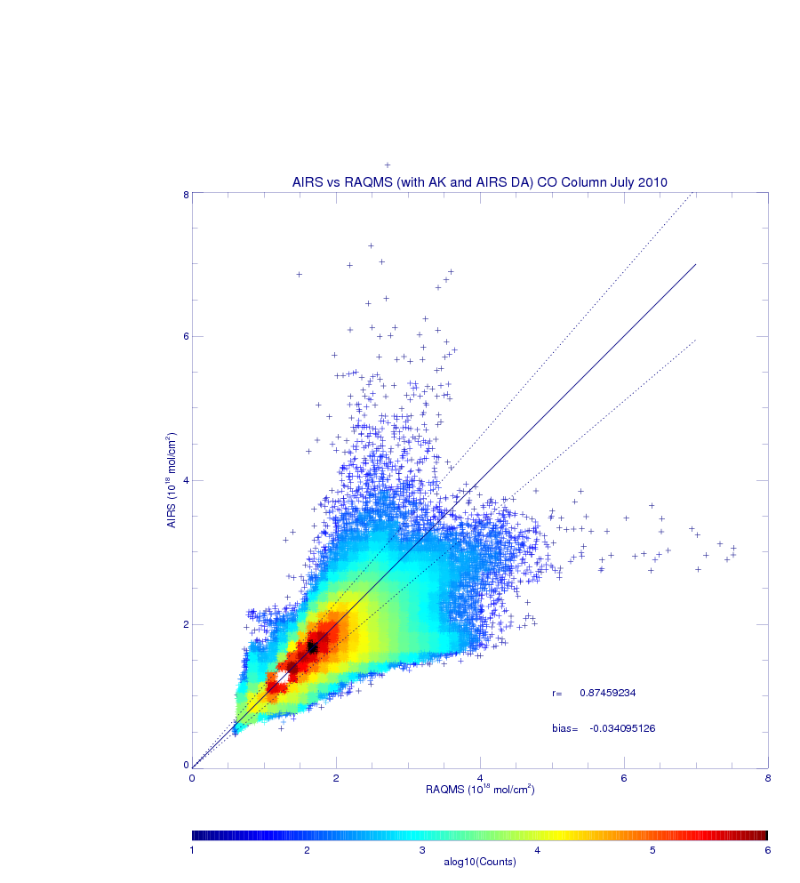
RAQMS/GSI AIRS CO July 2010 Data Assimilation
Observation-Analysis (O-A):
(Instantaneous comparisons)
r=0.875
Bias=-0.034x10¹⁸mol/cm²
With Averaging Kernels
The AIRS CO observation operator¹, was implemented within GSI and assimilation experiments were conducted to optimize the AIRS CO profile assimilation.
¹Applies AIRS CO averaging kernels and apriori profiles to the RAQMS CO predictions, tangent linear observation operator implemented within GSI inner loop. Based on GMAO MOPITT DA

Slide 23

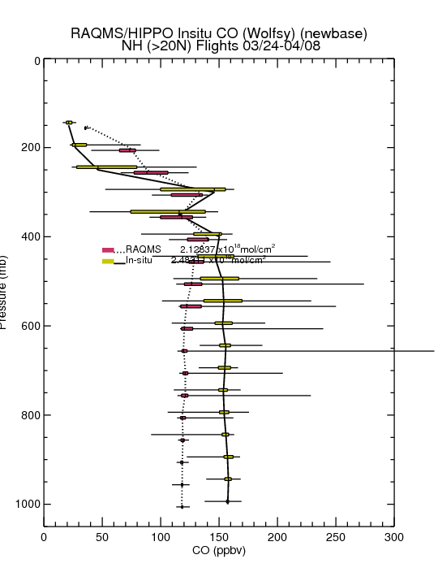
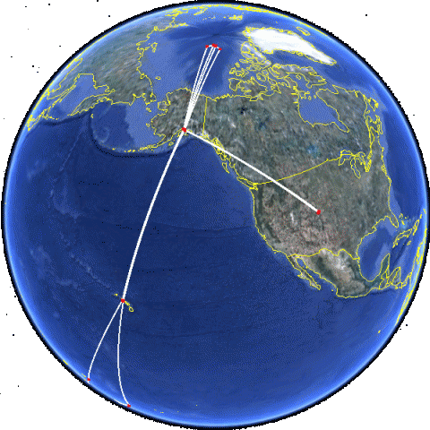
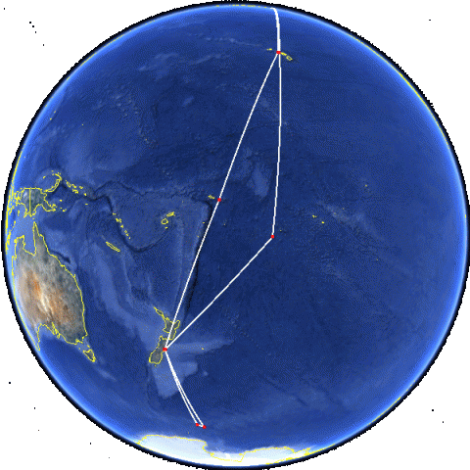
Aura Reanalysis Data Denial Studies: AIRS CO
HIPPO III Flight Tracks
March 20, 2010 to April 20, 2010
The NSF HIAPER Pole-to-Pole Observations (HIPPO) III measured pole-to-pole cross sections of atmospheric concentrations from the surface to the tropopause across the mid-Pacific ocean.
RAQMS (no assimilation) overestimates CO in upper troposphere/lower stratosphere
HIPPO III measurements provide an opportunity to assess the impact of AIRS CO assimilation on carbon monoxide within the Aura Reanalysis over the mid-Pacific (upwind from North America)
RAQMS (no assimilation) underestimates CO below 500mb

Slide 24
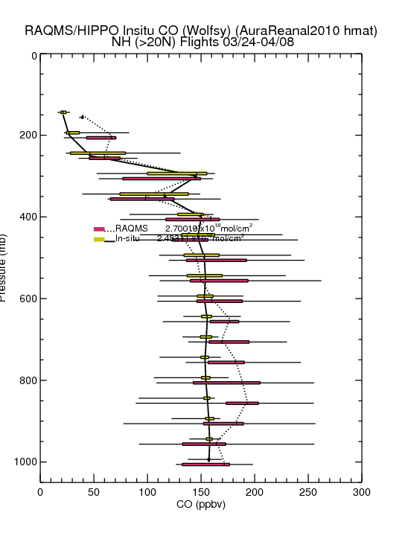
Aura Reanalysis Data Denial Studies: AIRS CO
HIPPO III Flight Tracks
March 20, 2010 to April 20, 2010
The NSF HIAPER Pole-to-Pole Observations (HIPPO) III measured pole-to-pole cross sections of atmospheric concentrations from the surface to the tropopause across the mid-Pacific ocean.
RAQMS Aura Reanalysis improves CO in the upper troposphere/lower stratosphere
HIPPO III measurements provide an opportunity to assess the impact of AIRS CO assimilation on carbon monoxide within the Aura Reanalysis over the mid-Pacific (upwind from North America)
RAQMS Aura Reanalysis improves CO in the middle and lower troposphere but introduces high bias near 800mb

Slide 25
MODIS AOD July 2010 Assimilation Studies
Two MODIS AOD DA Experiments:
  One using the CRTM computed AOD and Jacobians
  One using the RAQMS computed AOD and Jacobians
Major differences:
RAQMS Sea-salt AOD uses two bins (fine and coarse mode) and limits sea-salt aerosol size to 10 microns in hydroscopic growth
CRTM Sea-salt AOD uses all 4 sea-salt bins and doesn’t limit hydroscopic growth

Slide 26
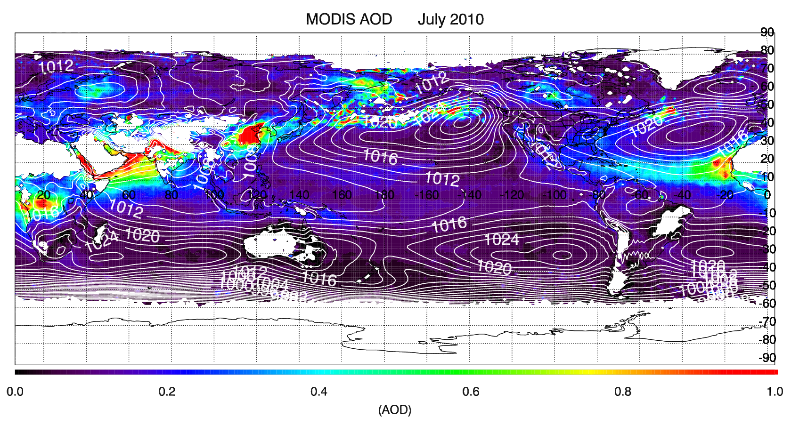
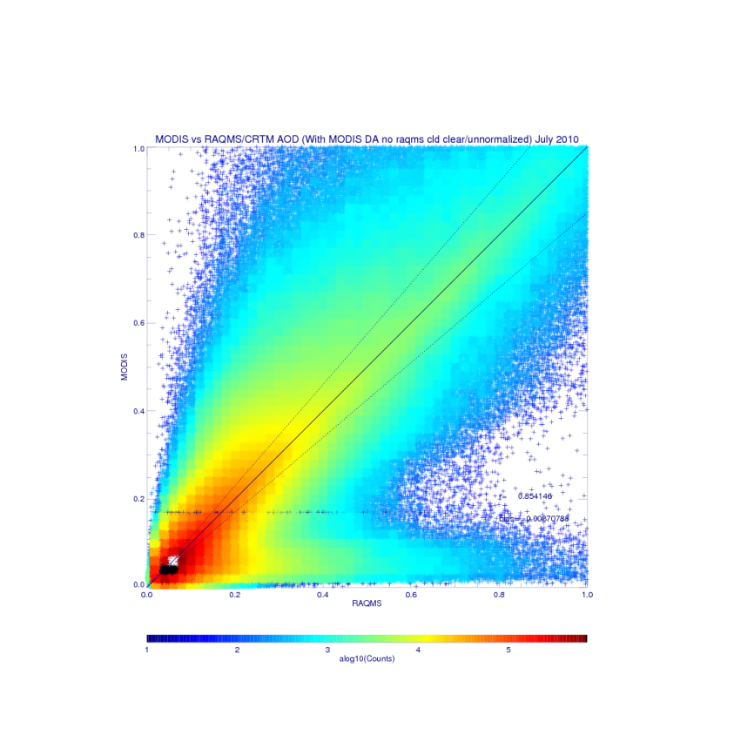
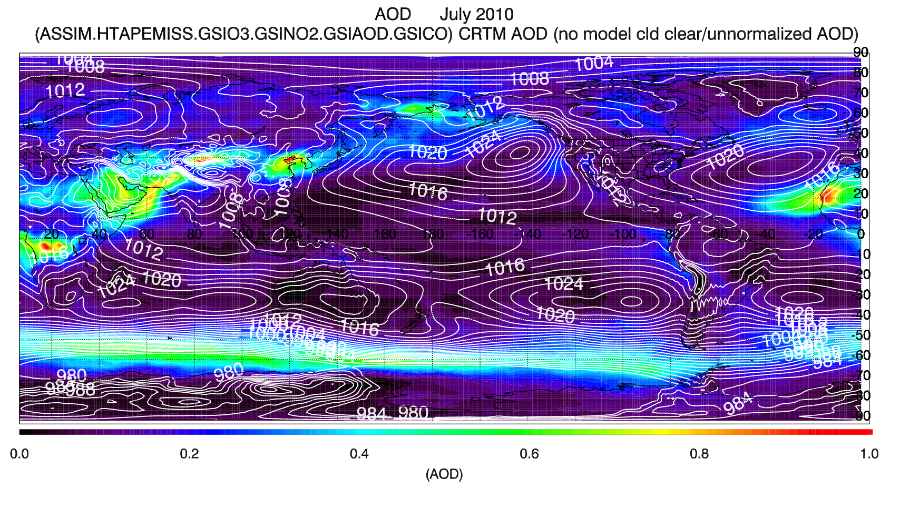
CRTM AOD and Jacobians
r=0.854
bias=-0.009
CRTM AOD within GSI

Slide 27
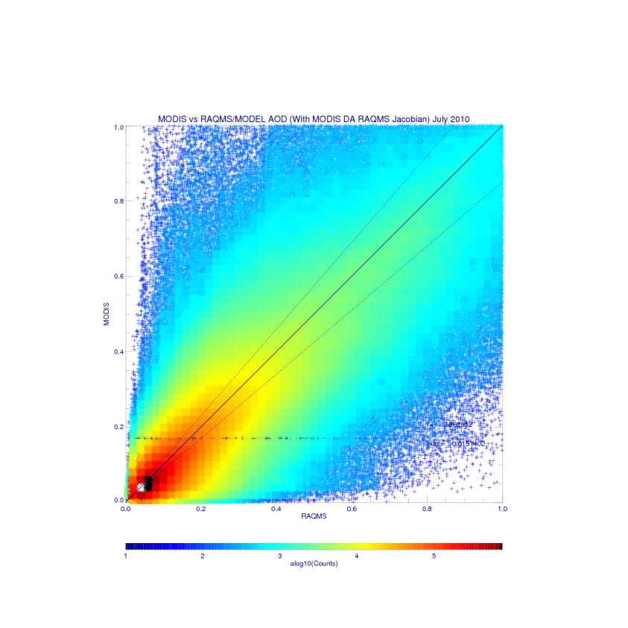
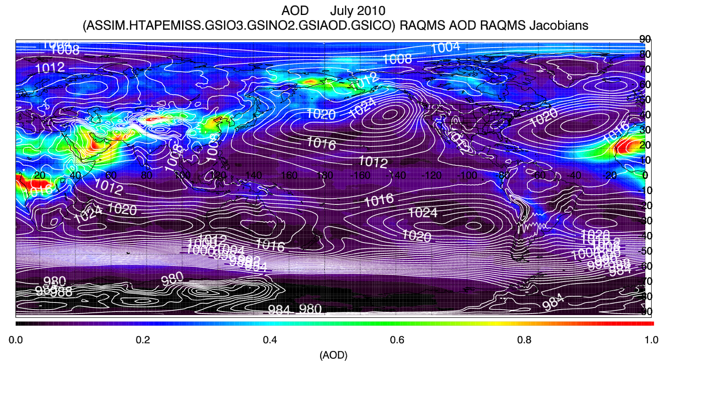
RAQMS AOD and Jacobians
r=0.862
bias=-0.015
RAQMS AOD within GSI

Slide 28
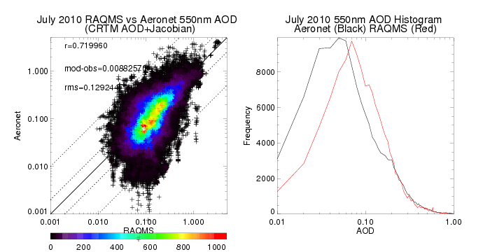
July 2010 Aeronet verification CRTM AOD

Slide 29
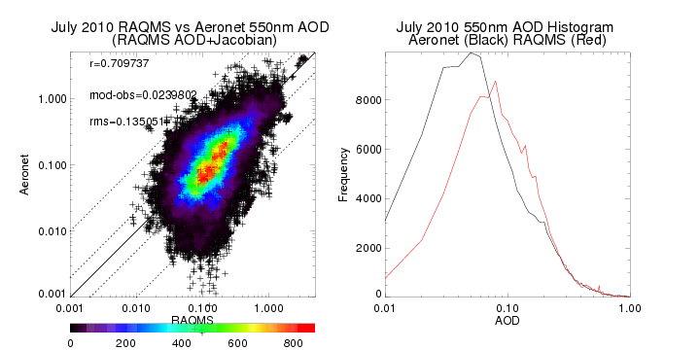
July 2010 Aeronet verification RAQMS AOD
Improved agreement for AOD>0.2

