Slide 1
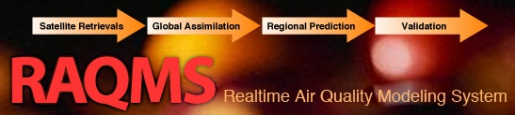
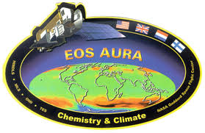


Development of an Aura Chemical Reanalysis in support Air Quality Applications
R. Bradley Pierce
(NOAA/NESDIS/STAR)
Allen Lenzen, Todd Schaack
(UW-Madison SSEC)
Fall AGU 2015: Data Assimilation and Inverse Modeling for Atmospheric Composition Applications

Slide 2
Aura Chemical Reanalysis in support Air Quality Applications
Project Summary
  Utilize the Real-time Air Quality Modeling System (RAQMS) in conjunction with the NOAA Operational Gridpoint Statistical Interpolation (GSI) 3-dimensional variational data assimilation (DA) system to conduct a multi-year (2006-present) global chemical and aerosol reanalysis using NASA Aura and A-Train measurements.
Project Objectives
  Provide the air quality community with a multi-year global chemical and aerosol reanalysis using NASA Aura and A-Train measurements.
  Provide global 3 dimensional O3, CH4, N2O production and loss rates for next generation NOAA global forecast system.
  Collaborate with International, Federal, State and Local air quality management communities in the utilization of the Aura and A-Train measurements and reanalysis for air quality assessment activities.
|‌ 2

Slide 3
Model Description
Online global chemical and aerosol assimilation/ forecasting system
UW-Madison hybrid θ−η coordinate model (UW-Hybrid) dynamical core
Unified stratosphere/troposphere chemical prediction scheme (LaRC-Combo) developed at NASA LaRC
Aerosol prediction scheme (GOCART) developed by Mian Chin (NASA GSFC)
The EDGAR Task Force on Hemispheric Transport of Air Pollution (TF HTAP) emissions provide anthropogenic emissions
NOAA Operational Gridpoint Statistical Interpolation (GSI) 3-dimensional variational data assimilation (DA) system
Notes:
3

Slide 4
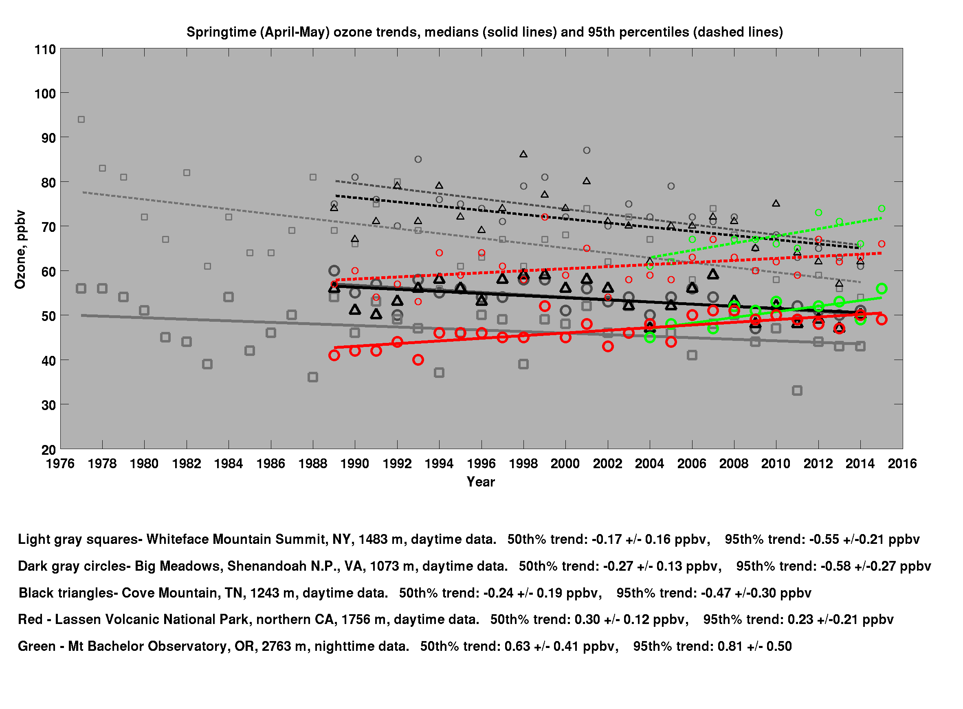
Eastern US shows declining trends
Whiteface Mountain (NY)
Shenandoah N.P. (VA)
Cove Mountain (TN)
Western US shows increasing trends
Mount Bachelor Observatory (OR)
Lassen Volcanic National park (CA)
Motivation
95% at Mount Bachelor could exceed new NAAQS
New NAAQS
“Sentinel” surface sites
HTAP Webinar: Friday, 4 December: Owen Cooper (NOAA/ESRL/CIRES) Inflow to Western North America
Notes:
The Mount Bachelor data shown are nighttime values to eliminate the impact of daytime upslope flow. At night this site at 2763 m is representative of the lower free troposphere, air which is dominated by baseline flow from across the North Pacific Ocean.

Slide 5
Eastern US shows declining trends
Whiteface Mountain (NY)
Shenandoah N.P. (VA)
Cove Mountain (TN)
Western US shows increasing trends
Mount Bachelor Observatory (OR)
Lassen Volcanic National park (CA)
Motivation
95% at Mount Bachelor could exceed new NAAQS
New NAAQS
“Sentinel” surface sites
HTAP Webinar: Friday, 4 December: Owen Cooper (NOAA/ESRL/CIRES) Inflow to Western North America
Notes:
The Mount Bachelor data shown are nighttime values to eliminate the impact of daytime upslope flow. At night this site at 2763 m is representative of the lower free troposphere, air which is dominated by baseline flow from across the North Pacific Ocean.

Slide 6
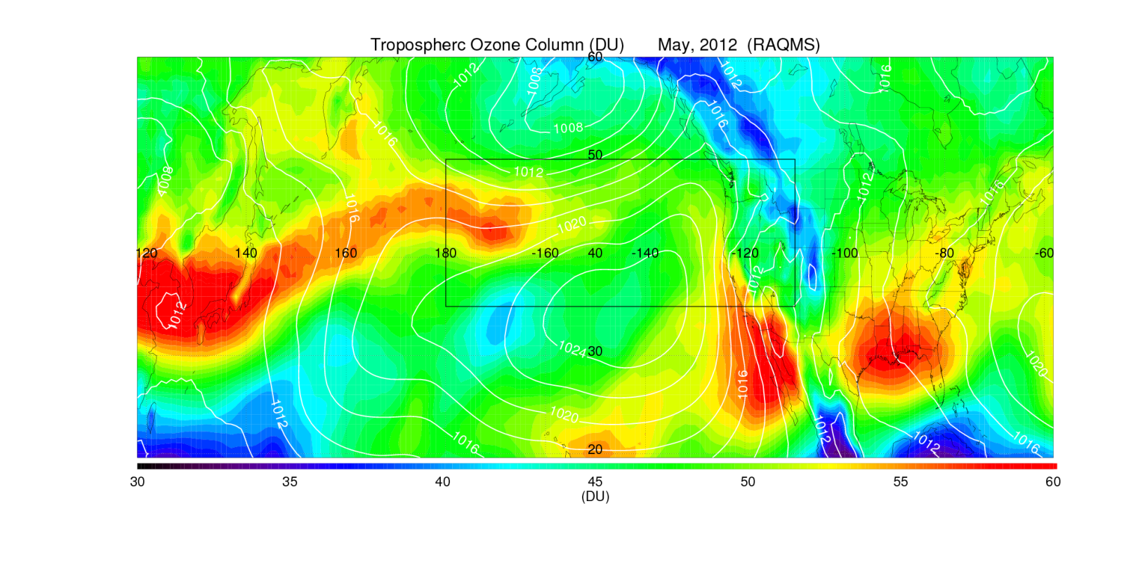
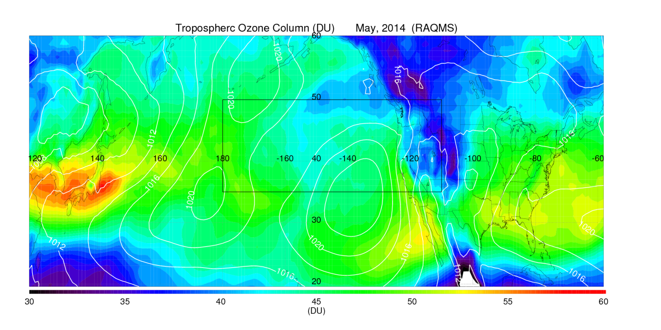
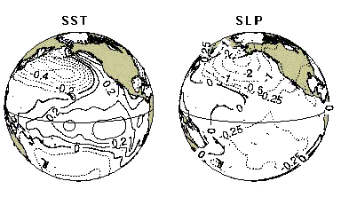
Motivation (cont)
L
H
2012
2013
2014
Pacific Decadal Oscillation
H
From “Elevated Springtime 2012 Ozone in the Western U.S.”
Pao M. Baylon, Dan A. Jaffe, R. Bradley Pierce, Mae S. Gustin (Submitted, ES&T)

Slide 7
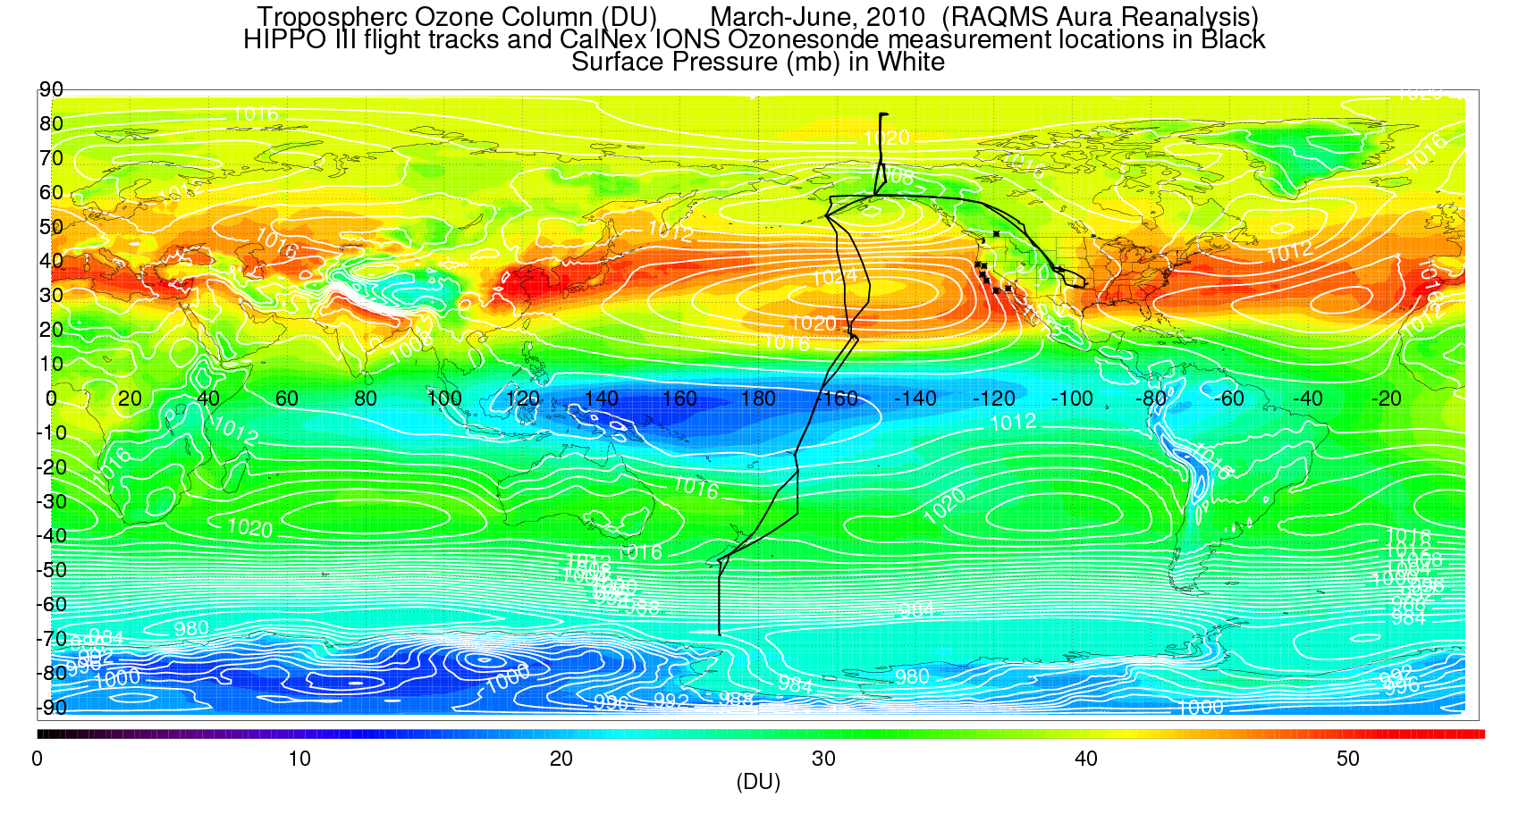
Aura Reanalysis Data Denial Studies: MLS/OMI O3
Impact of assimilation of MLS stratospheric ozone profiles and OMI total column ozone within the RAQMS Aura Reanalysis using aircraft (HIPPO III) and ozonesonde (CalNex) measurements

Slide 8

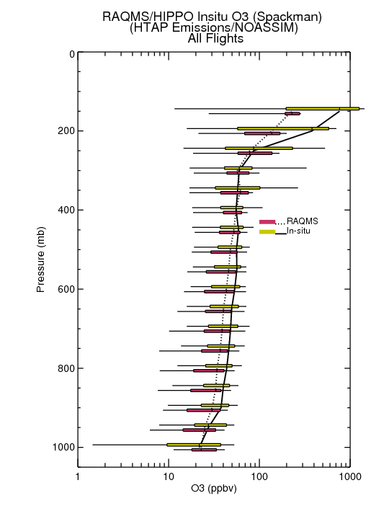
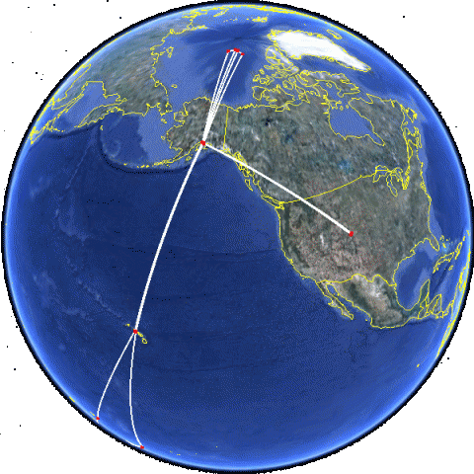
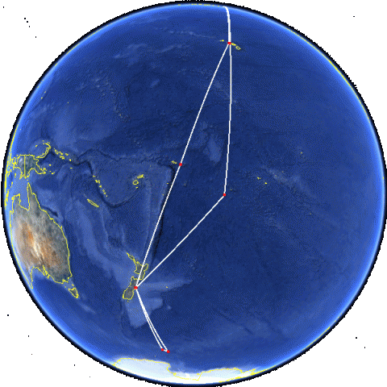
Aura Reanalysis Data Denial Studies: MLS/OMI O3
HIPPO III Flight Tracks
March 20, 2010 to April 20, 2010
RAQMS baseline (no assimilation) underestimates ozone in the upper troposphere/lower stratosphere
The NSF HIAPER Pole-to-Pole Observations (HIPPO) III measured pole-to-pole cross sections of atmospheric concentrations from the surface to the tropopause across the mid-Pacific ocean.
RAQMS baseline (no assimilation) underestimates ozone in the mid- troposphere
HIPPO III measurements provide an opportunity to assess the impact of MLS and OMI O3 assimilation on ozone within the Aura Reanalysis over the mid-Pacific (upwind from North America)

Slide 9
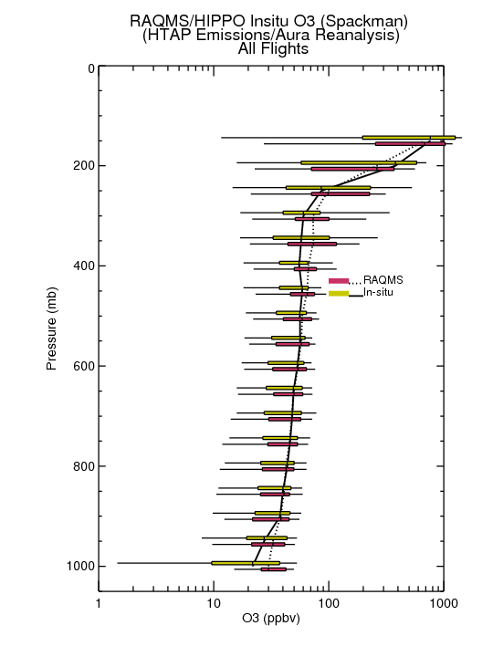
Aura Reanalysis Data Denial Studies: MLS/OMI O3
HIPPO III Flight Tracks
March 20, 2010 to April 20, 2010
RAQMS Aura Reanalysis improves ozone in the upper troposphere/lower stratosphere
The NSF HIAPER Pole-to-Pole Observations (HIPPO) III measured pole-to-pole cross sections of atmospheric concentrations from the surface to the tropopause across the mid-Pacific ocean.
RAQMS Aura Reanalysis improves ozone in the mid- troposphere
HIPPO III measurements provide an opportunity to assess the impact of MLS and OMI O3 assimilation on ozone within the Aura Reanalysis over the mid-Pacific (upwind from North America)

Slide 10
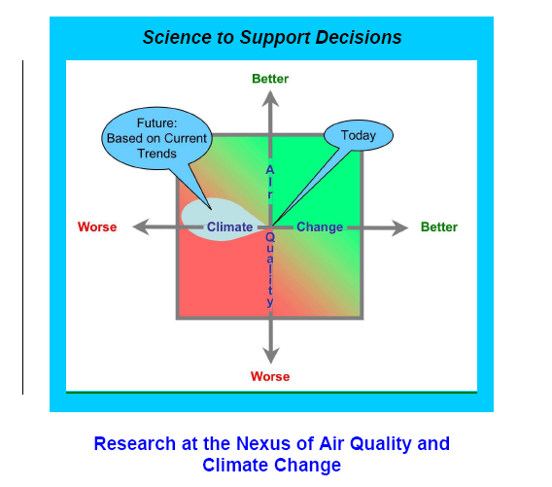
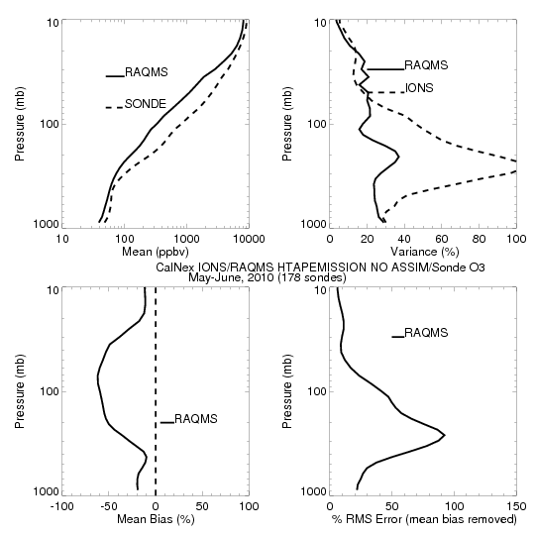
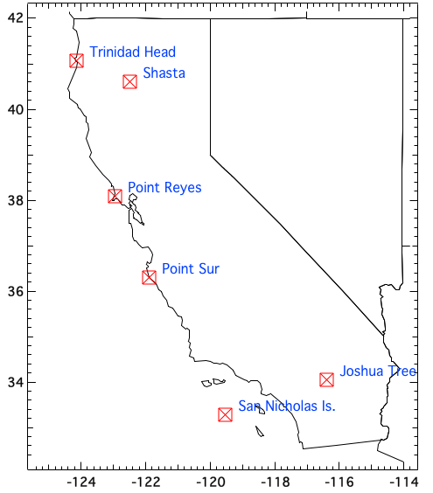
Aura Reanalysis Data Denial Studies: MLS/OMI O3
CalNex-2010 O₃ sondes – Owen Cooper (NOAA ESRL)
CalNex Ozonesonde
May-June, 2010
CalNex was organized by the California Air Resources Board (CARB) and NOAA to investigate scientific issues at the nexus between air quality and climate change.
RAQMS baseline (no assimilation) underestimates ozone and ozone variance in the stratosphere and troposphere
+/- 10%
CalNex ozonesonde measurements provide an opportunity to assess the impact of MLS and OMI O3 assimilation on ozone within the Aura Reanalysis along the California coast

Slide 11
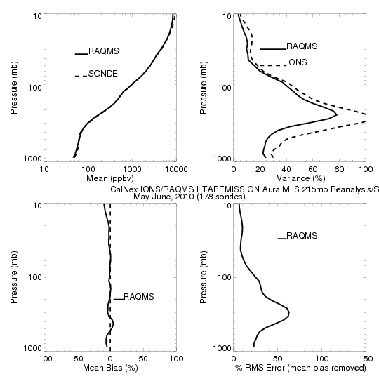
Aura Reanalysis Data Denial Studies: MLS/OMI O3
CalNex-2010 O₃ sondes – Owen Cooper (NOAA ESRL)
CalNex Ozonesonde
May-June, 2010
CalNex was organized by the California Air Resources Board (CARB) and NOAA to investigate scientific issues at the nexus between air quality and climate change.
RAQMS Aura Reanalysis improves ozone and ozone variance in the stratosphere and troposphere
+/- 10%
CalNex ozonesonde measurements provide an opportunity to assess the impact of MLS and OMI O3 assimilation on ozone within the Aura Reanalysis along the California coast

Slide 12
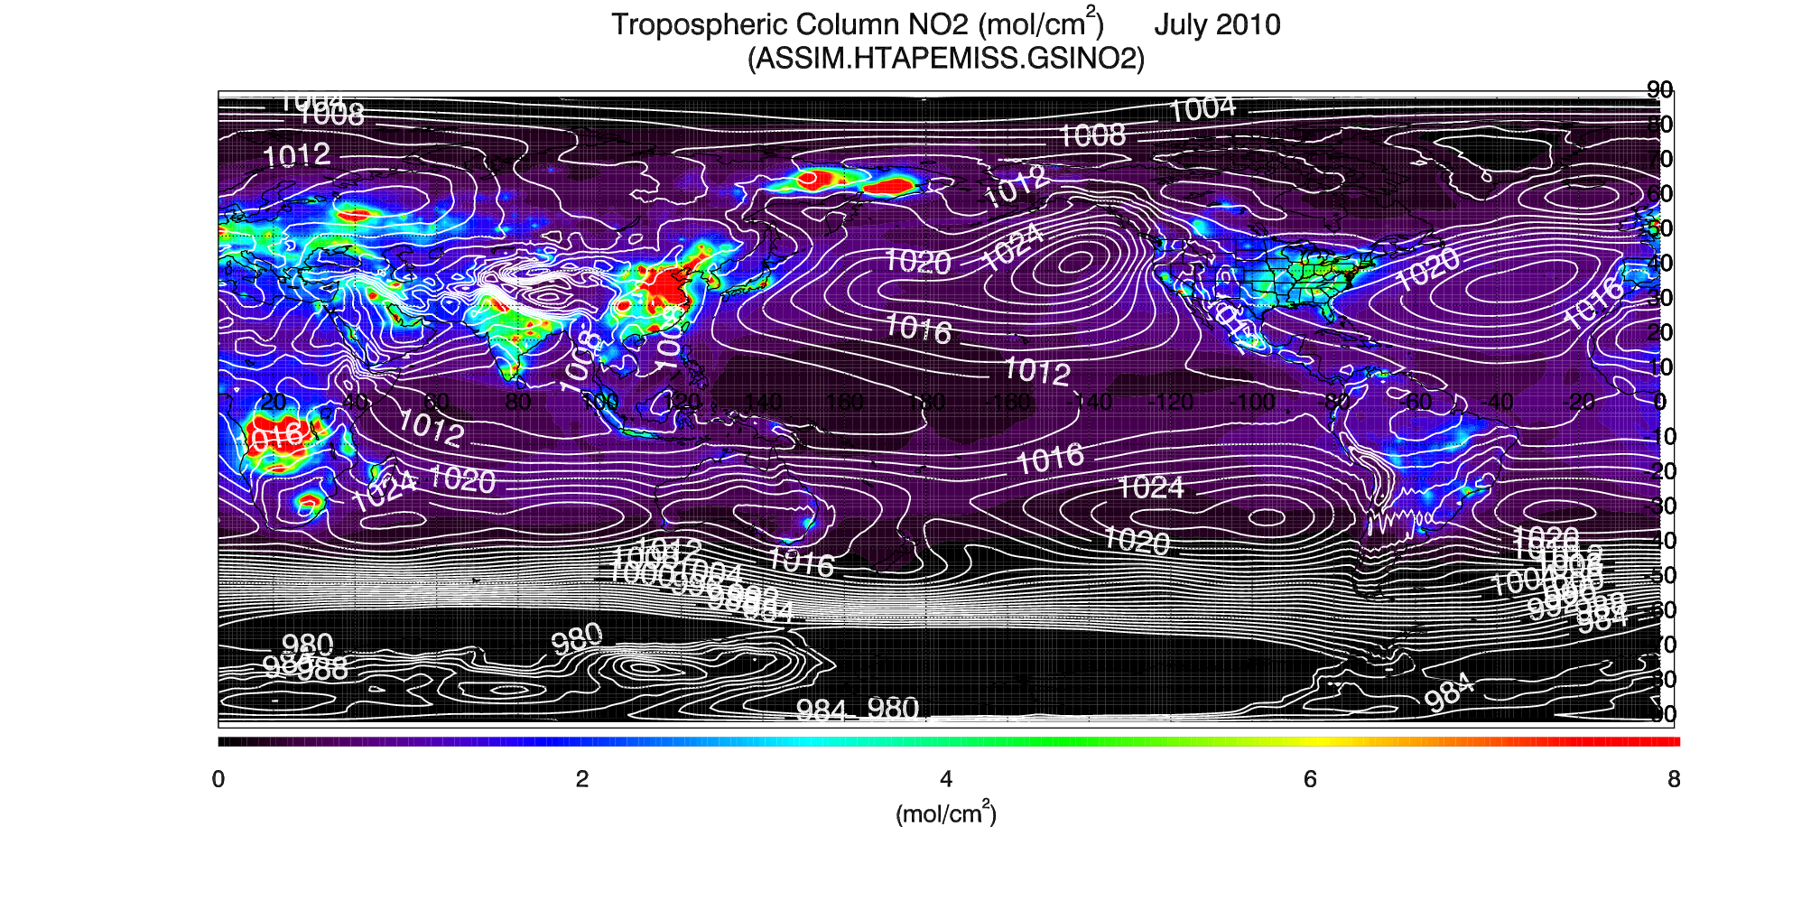
Aura Reanalysis Data Denial Studies: MLS/OMI O3+NO2
July 2010 OMI NO2 Data Assimilation Studies
RAQMS Tropospheric NO2 Column: July 2010
High Tropospheric NO2 over major urban/industrial and biomass burning regions

Slide 13
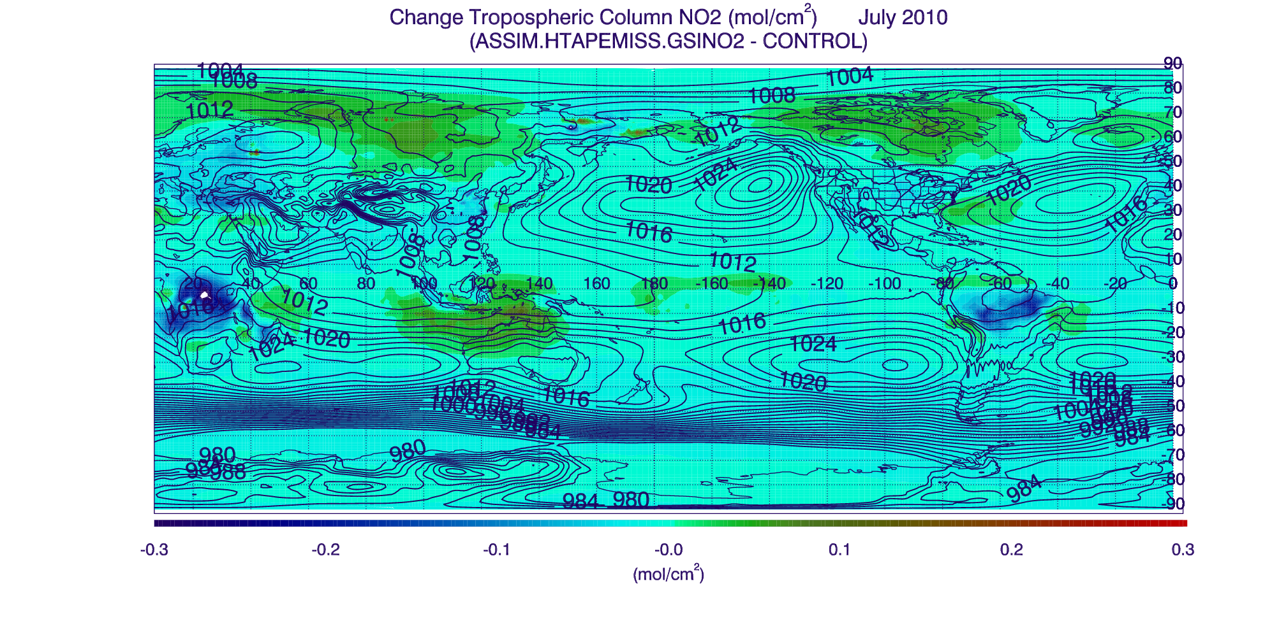
Aura Reanalysis Data Denial Studies: MLS/OMI O3+NO2
July 2010 OMI NO2 Data Assimilation Studies
Impact on Tropospheric NO2 Column due to OMI Tropospheric NO2 assimilation : July 2010
Largest reduction over South Africa and South American Biomass burning regions
Largest increase over Asia and North America at high latitudes

Slide 14
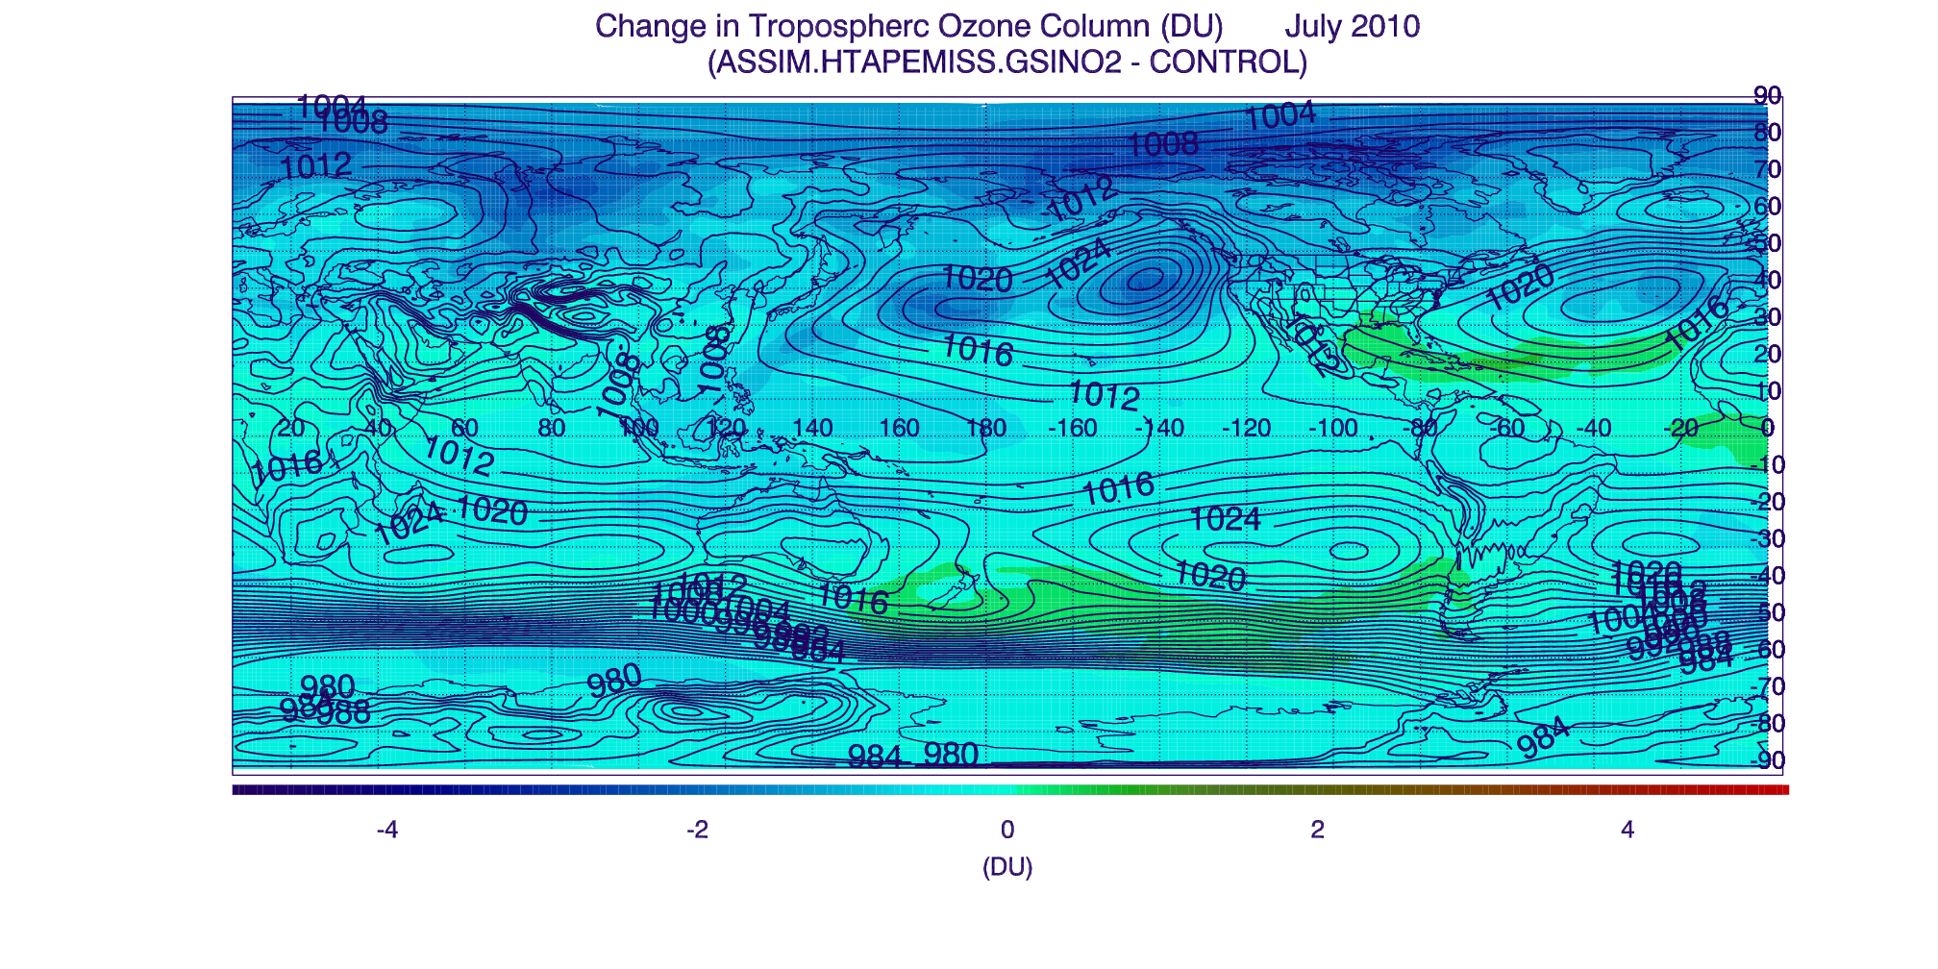
Aura Reanalysis Data Denial Studies: MLS/OMI O3+NO2
July 2010 OMI NO2 Data Assimilation Studies
Change in Tropospheric Ozone due to Tropospheric NO2 Column assimilation : July 2010
Largest reduction is over Arctic and within Oceanic high pressure systems
Largest increase is over Gulf of Mexico and South of Atlantic High pressure system

Slide 15
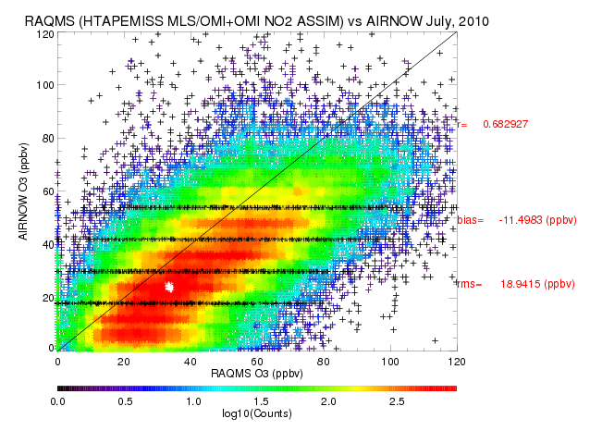
Aura Reanalysis Data Denial Studies: MLS/OMI O3+NO2
RAQMS Aura Reanalysis shows good correlation (0.68) with AIRNow over US during July 2010 but shows systematic high bias of nearly 12ppbv

Slide 16
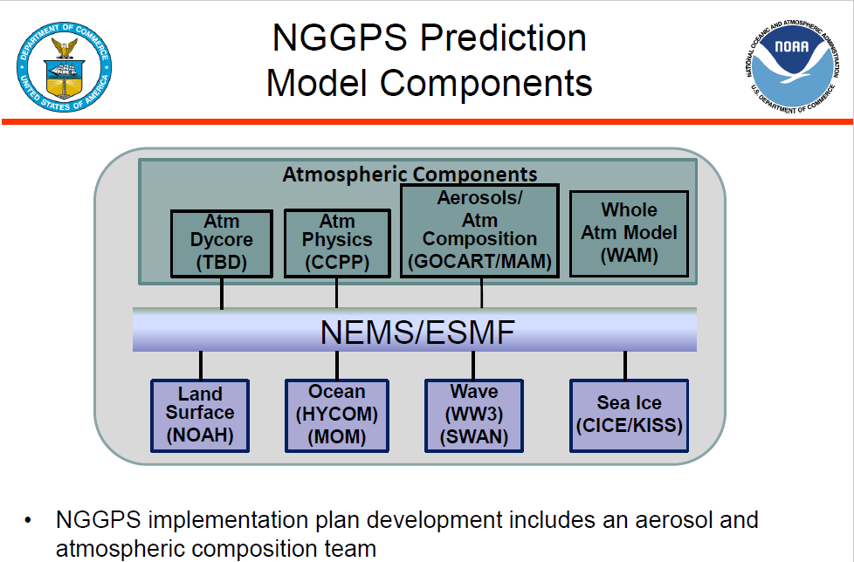
Next Generation Global Prediction System (NGGPS)
  Planning on FY16 testing of the use of climatological tropospheric ozone production and loss rates generated from RAQMS/GSI Aura Reanalysis within NGGPS Atmospheric Composition forecast

Slide 17
Funded by the NASA Applied Science Program and the Aura Science Team
Thanks to Dan Jaffe and Owen Cooper for surface ozone measurements and trend analysis
See poster “Record High Free Tropospheric Ozone in the Spring of 2015 over the Western US and Its Influence on Surface Air Quality“ by Jaffe et al on Thursday

Slide 18
Funded by the NASA Applied Science Program and the Aura Science Team
Thanks to Dan Jaffe and Owen Cooper for surface ozone measurements and trend analysis
See poster “Record High Free Tropospheric Ozone in the Spring of 2015 over the Western US and Its Influence on Surface Air Quality“ by Jaffe et al on Thursday
Questions?

