Slide 1
Atmospheric Chemistry Briefing
to
Harry Cikanek
(NESDIS/STAR Director)
and
Satya Kalluri
(Chief, Cooperative Research Programs Division)
By
R. Bradley Pierce
NESDIS/STAR/CoRP/ASPB

Slide 2
Outline:
Development of reduced troposphere/ stratosphere chemistry algorithms for the NOAA Next Generation Global Prediction System (NGGPS)
Aura Chemical Reanalysis in support Air Quality Applications
Lake Michigan Ozone Study 2017

Slide 3
Development of reduced troposphere/stratosphere chemistry algorithms for the NOAA Next Generation Global Prediction System (NGGPS)
Transition Project Lead: R. Bradley Pierce (NOAA/NESDIS/STAR) member of the NGGPS Aerosol and Atmospheric Composition Team (Led by Ivanka Stajner, NWS)
Lead Collaborator: Vijay Tallapragada (NOAA/EMC) Branch Chief of the Global Climate and Weather Modeling branch at EMC.
Selected “Tier 1” under Internal FY17 Announcement of Opportunity for the Research Transition Acceleration Program (pending receipt of the full $10M budget request)
Supports NGGPS through:
Improved predictions of ozone radiative heating in the upper troposphere and lower stratosphere
Improved data assimilation through better use of infrared radiance measurements
Supports implementation of aerosol models by providing oxidation rates
Supports the National Air Quality Forecasting Capability (NAQFC) through improved estimates of background concentrations of ozone and ozone precursors
Project period: October 01, 2016 – September 30, 2019
Currently no FY17 funding available

Slide 4
H.R.353 - Weather Research and Forecasting Innovation Act of 2017
SEC. 102. Weather research and forecasting innovation.
Program Element 3: Research and development, and transfer of knowledge, technologies, and applications to the National Weather Service and other appropriate agencies and entities, including the United States weather industry and academic partners, related to—
(F) atmospheric chemistry and interactions essential to accurately characterizing atmospheric composition and predicting meteorological processes, including cloud microphysical, precipitation, and atmospheric electrification processes, to more effectively understand their role in severe weather;

Slide 5
Aura Chemical Reanalysis in support Air Quality Applications
Funding: NASA ROSES 2013 Aura Science Team
Project Summary
Utilize the Real-time Air Quality Modeling System (RAQMS) in conjunction with the Operational Gridpoint Statistical Interpolation (GSI) 3-dimensional variational data assimilation (DA) system to conduct a multi-year global chemical and aerosol reanalysis using NASA Aura and A-Train measurements.
Supports development of capabilities to use JPSS (NUCAPS trace gas, VIIRS aerosol optical depth) within NGGPS Data Assimilation

Slide 6
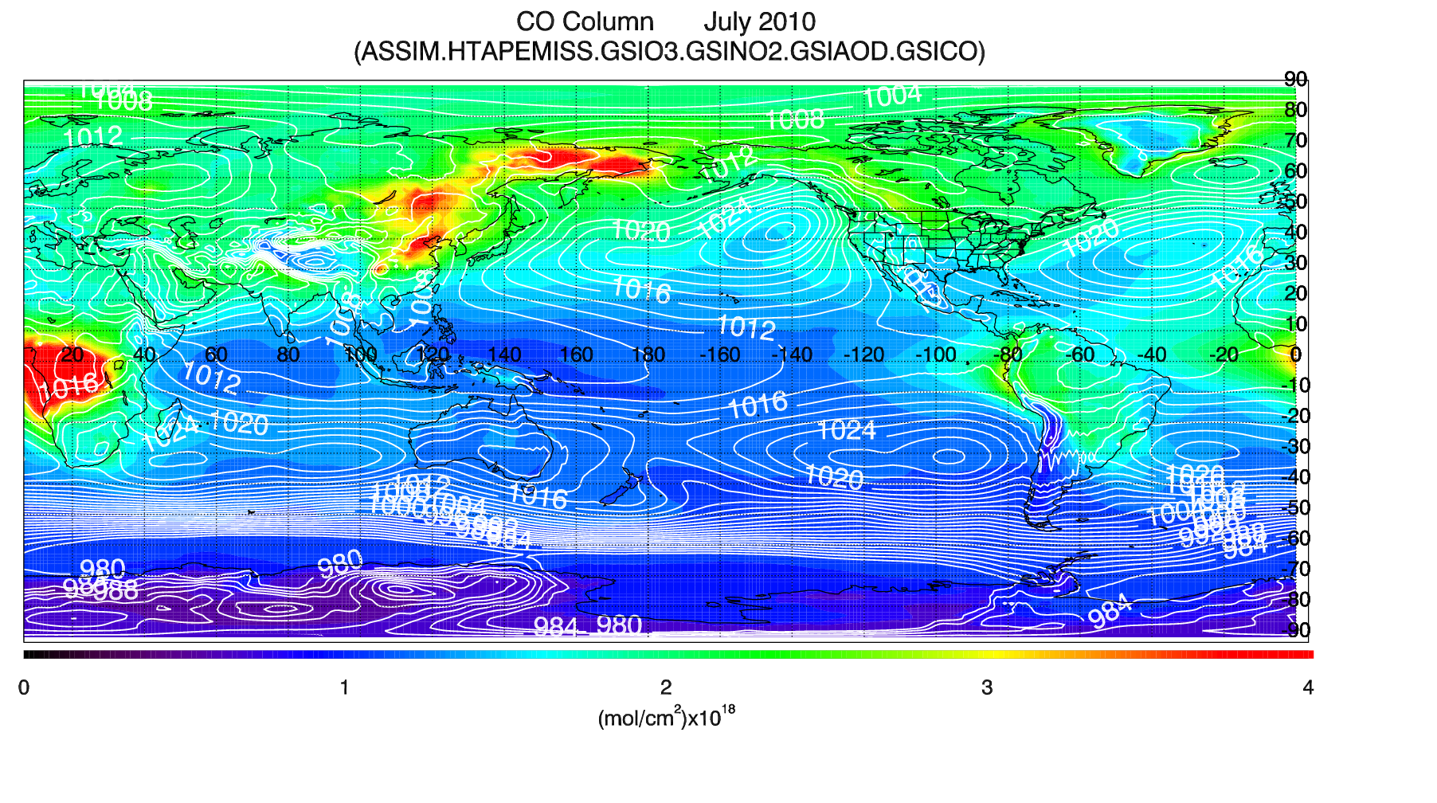
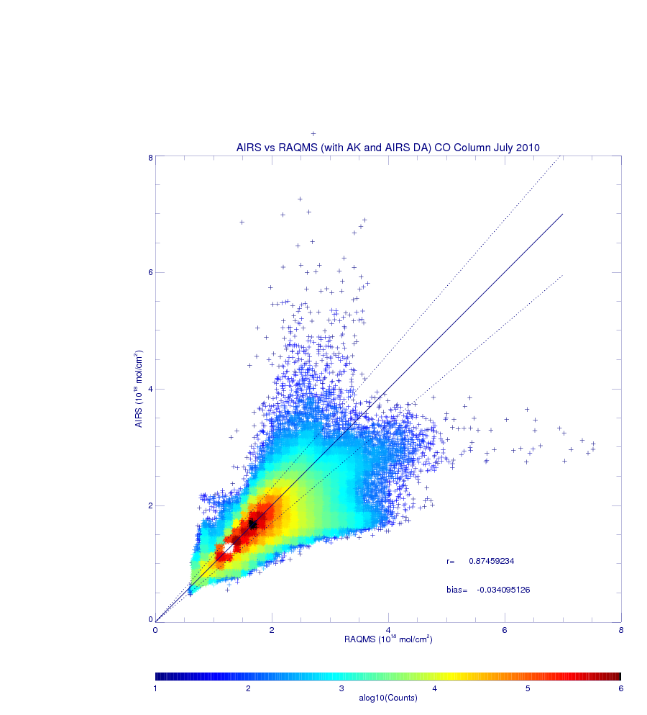
RAQMS/GSI AIRS CO July 2010 Data Assimilation
Observation-Analysis (O-A):
(Instantaneous comparisons)
r=0.875
Bias=-0.034x10¹⁸mol/cm²
With Averaging Kernels
The AIRS CO observation operator¹, was implemented within GSI and assimilation experiments were conducted to optimize the AIRS CO profile assimilation.
¹Applies AIRS CO averaging kernels and apriori profiles to the RAQMS CO predictions, tangent linear observation operator implemented within GSI inner loop. Based on GMAO MOPITT DA

Slide 7
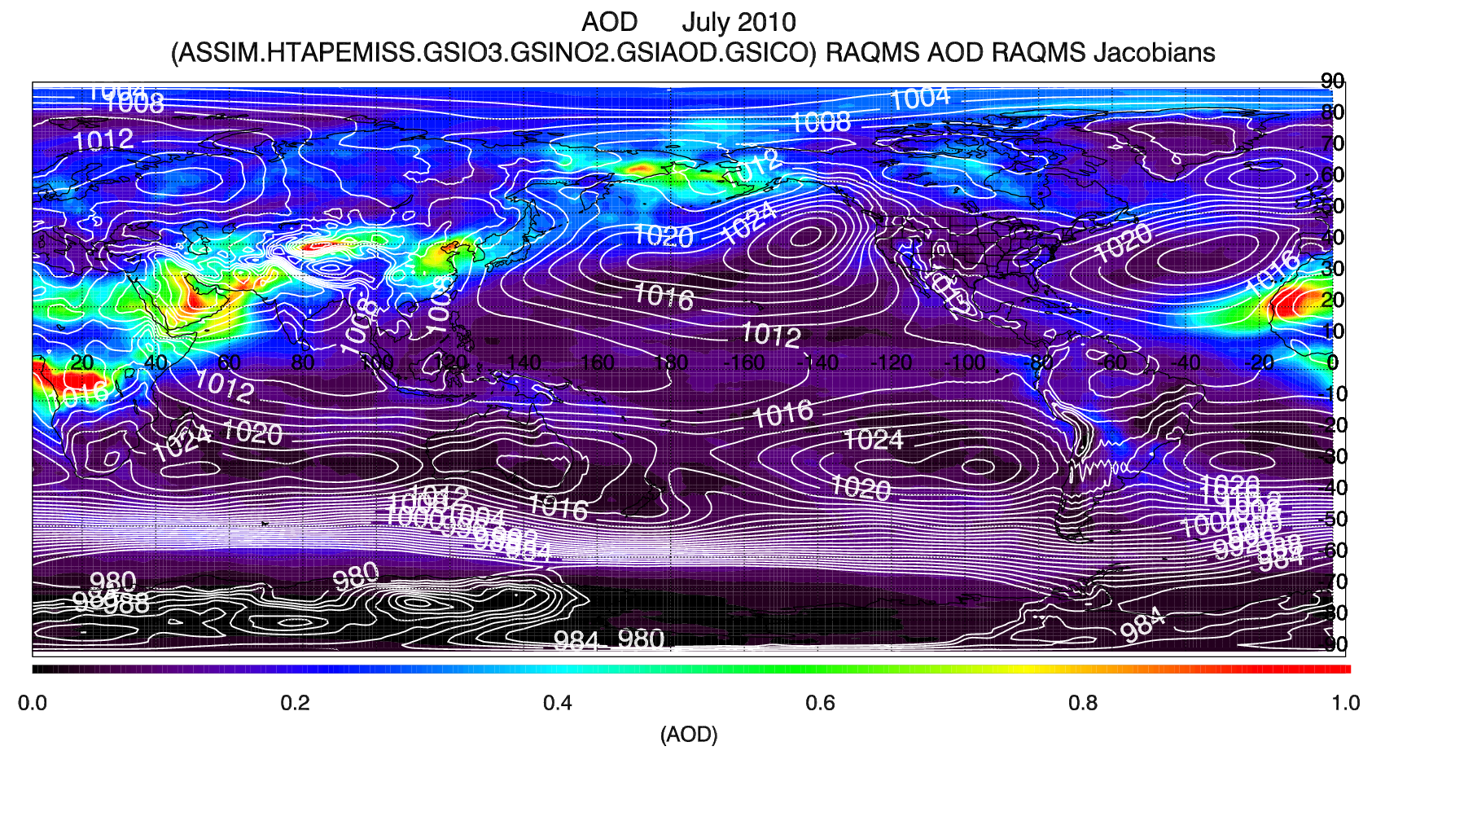
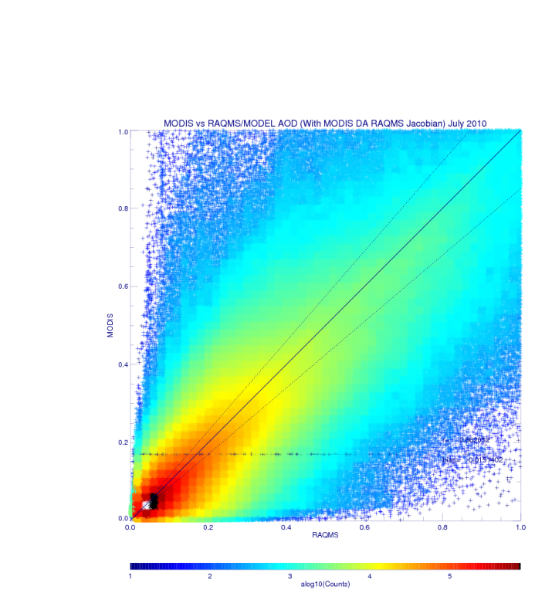
RAQMS MODIS AOD July 2010 Data Assimilation
Observation-Analysis (O-A):
(Instantaneous comparisons)
r=0.862
Bias=-0.015
Beta version of GSI aerosol assimilation code obtained from Mariusz Pagowski (NOAA/ESRL)
Two MODIS AOD DA Experiments:
One using the CRTM computed AOD and Jacobians
One using the RAQMS computed AOD and Jacobians

Slide 8
Lake Michigan Ozone Study 2017
Funding: NASA/NOAA/EPA/NSF/EPRI/LADCO
Project Summary
A collaborative, multi-agency field study of ozone chemistry and meteorology along the Wisconsin-Illinois Lake Michigan shoreline using a combination of aircraft, ground‐based and ship-based measurements.
The goal of the study is to better understand ozone formation and transport around Lake Michigan; in particular, why ozone concentrations are generally highest along the lakeshore and drop off sharply inland and why ozone concentrations peak in rural areas far from major emission sources.
Supports improved NWS air quality forecasting within the National Air Quality Forecasting Capability (NAQFC)
Supports GOES-16 L2 Product validation during PLT

Slide 9
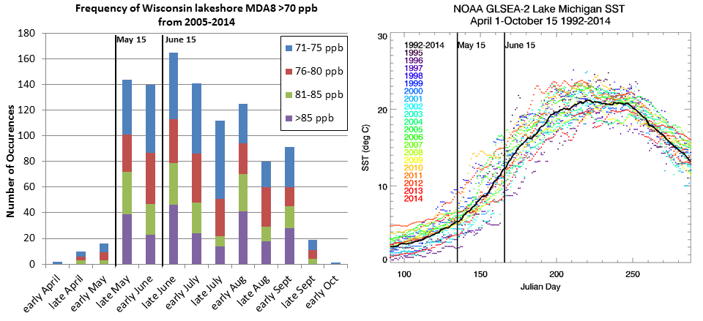
Campaign Study Period May 22- June 22, 2017
Primary science objectives focusing on characterizing the recirculation, aging, and mixing of the Chicago and Milwaukee urban plumes as they move over Lake Michigan and their impact on surface ozone.
White Paper: http://www.ladco.org/

Slide 10
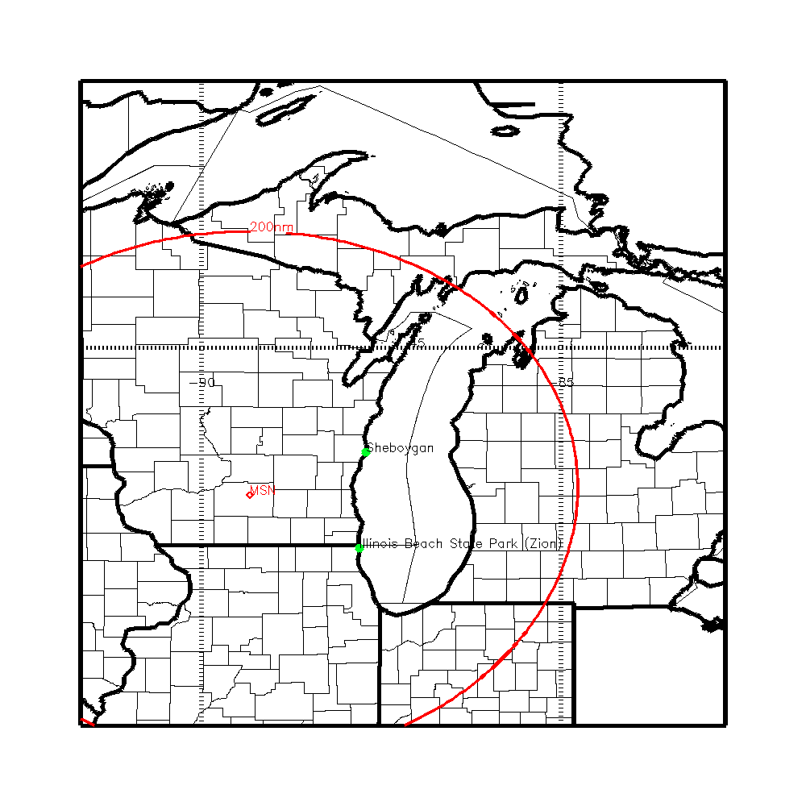
LMOS Measurement Suite
SSEC SPARC Trailer
(HALO Wind Lidar, AERI T/Q profiles, HSRL aerosol extinction, CIMEL aerosol optical depth),
EPA Pandora (Column NO2, HCHO), insitu (O3, NOx, HCHO)
NASA airborne column NO2, HCHO, O3, and aerosols
(GEOTASO Airborne UV-VIS Spectrometer, AirHARP Polarimeter)
NOAA Ship (EPA Pandora, ceilometer, insitu O3, (tethered Kite and shipboard),
EPA Geospatial Measurement of Air Pollution (GMAP) mobile van
(O3)
UNI Microwave Radiometer T/Q profiles, SoDAR winds, Pandora (Column NO2, O3)
Insitu super site (UW-Madison/UofM NOy/VOC U-Iowa Aerosol)
Scientific Aviation insitu O3, NO2

Slide 11
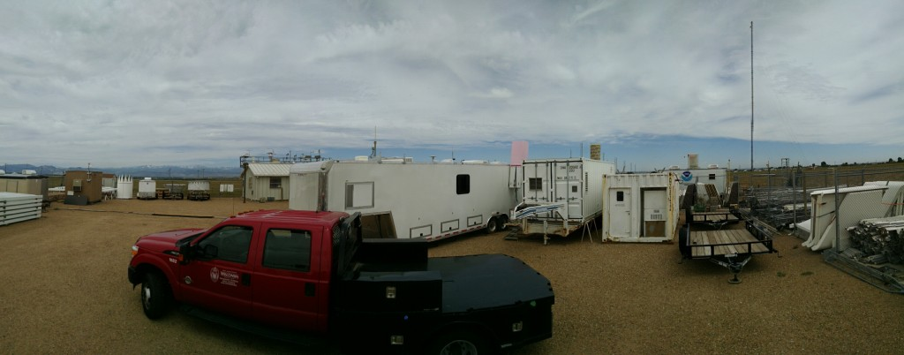
Sheboygan Ground Site: Spaceport Sheboygan
UW-Madison SPARC Trailer
Boundary Layer Meteorology/Surface Meteorology Tim Wagner, Univ. of Wisconsin. SPARC: the SSEC Portable Atmospheric Research Center (funded by NOAA)
Profiles: (T, Q, wind, extinction) Atmospheric Emitted Radiance Interferometer (AERI), HSRL Lidar, Doppler lidar wind profiler.
In situ meteorology: Vaisala T, RH, pressure, wind speed, wind direction, precipitation.
O3 Profiles by Tethered Kite (ozone and meteorology), in conjunction with Dept. of Atmospheric Science, Univ. Wisconsin.
SPARC
The SSEC Portable Atmospheric Research Center (SPARC) during the Front Range Air Pollution Experiment (FRAPPE).

Slide 12
Enhanced Measurements During LMOS 2017
for
GOES-16 ABI Baseline Product Validation
GOES-R Baseline Product | Enhanced Validation Measurements
Aerosol Detection (Including Smoke and Dust) Aerosol Optical Depth (AOD) | High Spectral Resolution LIDAR (HSRL) Airborne AOD retrievals (AirHARP) CIMEL sunphotometer
Clear Sky Masks Cloud Optical Depth Cloud Top Height | GeoTASO (clear sky mask only) High Spectral Resolution LIDAR (HSRL)
Derived Motion Winds | Halo Doppler LIDAR SoDAR
Derived Stability Indices Total Precipitable Water Legacy Vertical Moisture Profile Legacy Vertical Temperature Profile | Atmospheric Emitted Radiance Interferometer (AERI) Radiometrics MP-3000A profiling microwave radiometer

Slide 13
Enhanced Measurements During LMOS 2017
for
GOES-16 ABI Future Product Validation
GOES-R Future Product | Enhanced Validation Measurements
Aerosol Particle Size | CIMEL Sunphotometer Airborne AirHARP
Cloud Layers/Heights | High Spectral Resolution LIDAR (HSRL) Airborne AirHARP
Ozone Total | Pandora spectrometer
SO2 Detection | GeoTASO
Visibility | High Spectral Resolution LIDAR (HSRL) CIMEL sunphotometer Airborne AirHARP Atmospheric Emitted Radiance Interferometer (AERI) Radiometrics MP-3000A profiling microwave radiometer

Slide 14
Leveraged Resources
*Does not include FTE or travel cost from participating Federal Agencies.

