Slide 1
The 2017 Lake Michigan Ozone Study
(LMOS 2017)
R. Bradley Pierce (NOAA/NESDIS)
LMOS 2017 Steering Committee:
Brad Pierce (NOAA/NESDIS), Angela Dickens (Wisconsin DNR), Rob Kaleel and Donna Kenski (LADCO), Tim Bertram (UW-Madison), Charles Stanier (U-Iowa)
Initial inception for this field mission occurred during the June 2-4, 2015 NASA Air Quality Applied Science Team (AQAST) meeting in St Louis, MO (AQAST9)
White paper:
http://www.ladco.org/reports/ozone/post08/Great_Lakes_Ozone_Study_White_Paper_Draft_v6.pdf
September 22, 2016 Air Quality Research Subcommittee (AQRS), Committee on Environment, Natural Resources, and Sustainability (CENRS), National Science and Technology Council (NSTC) Meeting, Washington DC

Slide 2
The 2017 Lake Michigan Ozone Study
(LMOS 2017)
Outline
Motivation
Background
Science Objectives
Measurement requirements
Funding Avenues

Slide 3
The 2017 Lake Michigan Ozone Study
(LMOS 2017)
Outline
Motivation
Background
Science Objectives
Measurement requirements
Funding Avenues

Slide 4
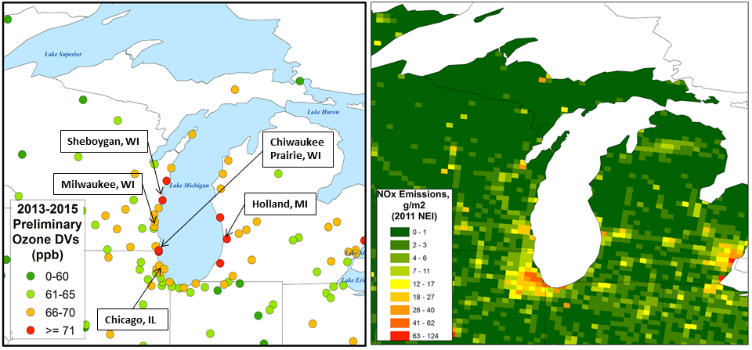
Motivation
Despite dramatic reductions in ozone precursor emissions, many areas bordering Lake Michigan continue to violate federal air quality standards. This problem has persisted for decades and is one of the most challenging air quality issues in the eastern U.S.
2013-2015 - 8-Hour Ozone Design Values New Ozone Standard – 70 ppb
Anticipated new non-attainment areas with new, lower ozone standard and persistent exceedances of the old (2008) ozone standard.
2014-16 ozone (used for nonattainment area designations) was much higher than the 2013-15 values shown here
Impact of high ozone on public health in high density urban areas (Chicago, Milwaukee, Detroit, Windsor). Also, these areas serve as large emissions sources.

Slide 5
The 2017 Lake Michigan Ozone Study (LMOS 2017) campaign will be designed to collect field measurements to address persistent violations of the ozone National Ambient Air Quality Standard in the coastal communities around Lake Michigan.
The campaign is designed to address the following questions related to enhancements in ozone concentrations observed in coastal regions along Lake Michigan:
  What is the relative contribution of inter- and intra-state NOx and VOC emissions and emissions sources on ozone production rates along Lake Michigan?
  To what extent do lake breeze circulations effect ozone production?
  What is the spatio-temporal distribution of ozone and its precursors over Lake Michigan?
  How can remote sensing products (e.g., measurements of NO2 and HCHO) be used to constrain ozone predictions?
  How well do regional models capture ozone production chemistry as assessed through evaluation of critical measurement indicators (e.g., H2O2:HNO3 ratio, HCHO:NOx ratio, NOy and VOC lifetime and partitioning).

Slide 6
The 2017 Lake Michigan Ozone Study
(LMOS 2017)
Outline
Motivation
Background
Science Objectives
Measurement requirements
Funding Avenues

Slide 7
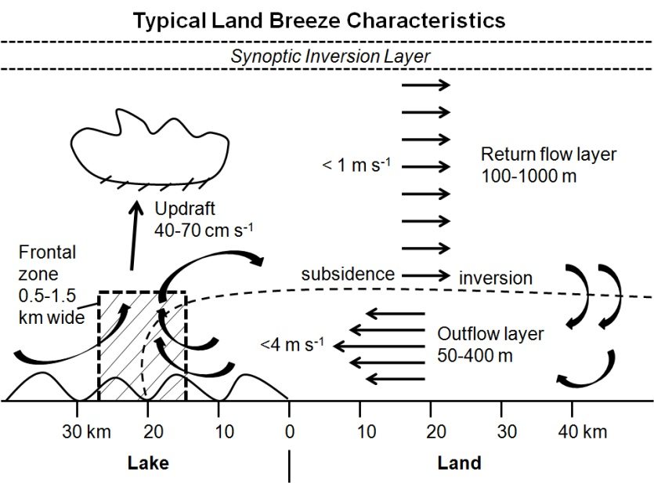
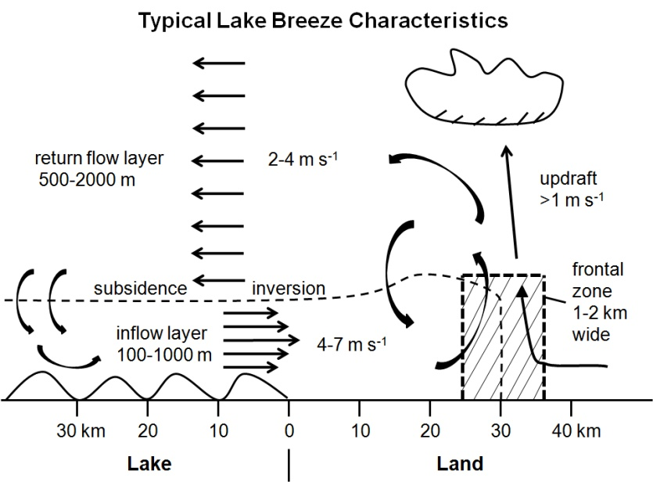
Background: Lake Michigan and Ozone Formation
The unique meteorology and ozone chemistry of Lake Michigan are only partially understood, as is the exact role of medium- and long-range transport of ozone and ozone precursors in this region.
Land breeze blows ozone precursor compounds from rush hour over lake.
The boundary layer height is low due to cold water chilling the air above.
The pollutants are concentrated near the surface where ozone forms.
An afternoon lake breeze transports the ozone back onto land.
Highest lakeshore ozone occurs under southerly flow regimes
From Foley et al, Lake Michigan air quality: The 1994-2003 LADCO Aircraft Project (LAP), Atmos. Env. 2011
Notes:
Foley et al 2011 Atmospheric Environment

Slide 8
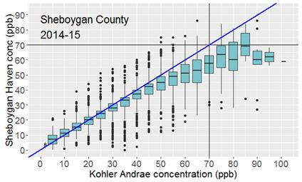
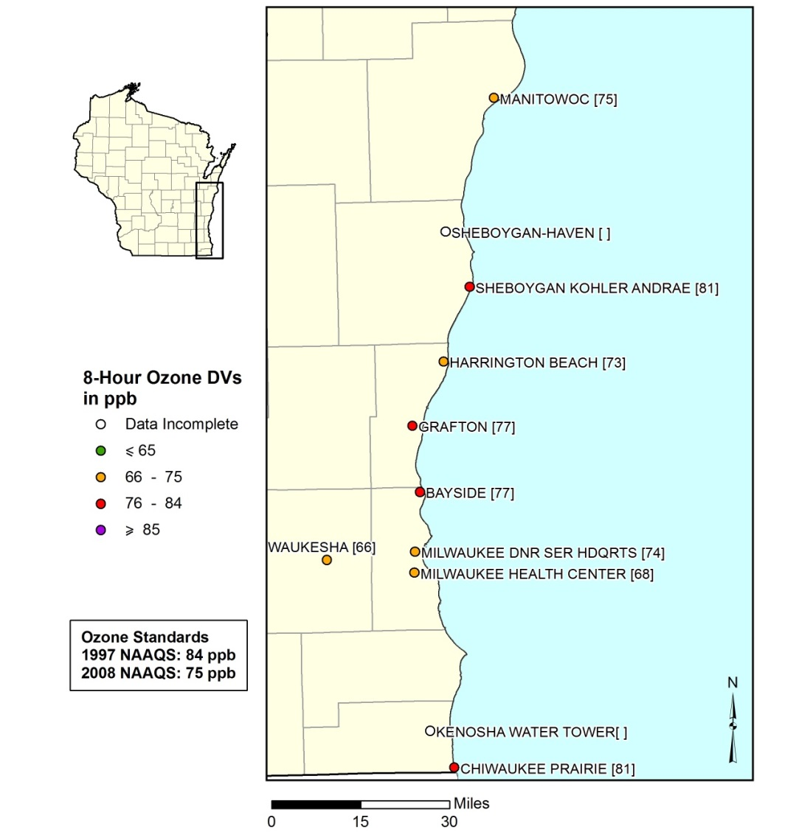
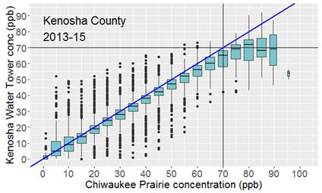
Wisconsin Department of Natural Resources (DNR) lakeshore and inland monitor comparisons
One-hour ozone concentrations (April-October)
Operated 2014-2015
3.25 miles inland
Operated 2013-2015
3.5 miles inland
Exceedances are largely confined to the lakeshore

Slide 9
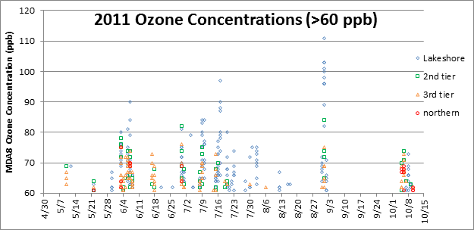
12km and 4km WRF-CHEM Lake Breeze Modeling Study
(July 2011)
Focusing on the July 17, 2011 event
MDA8 ozone analysis from Angie Dickens, WDNR

Slide 10
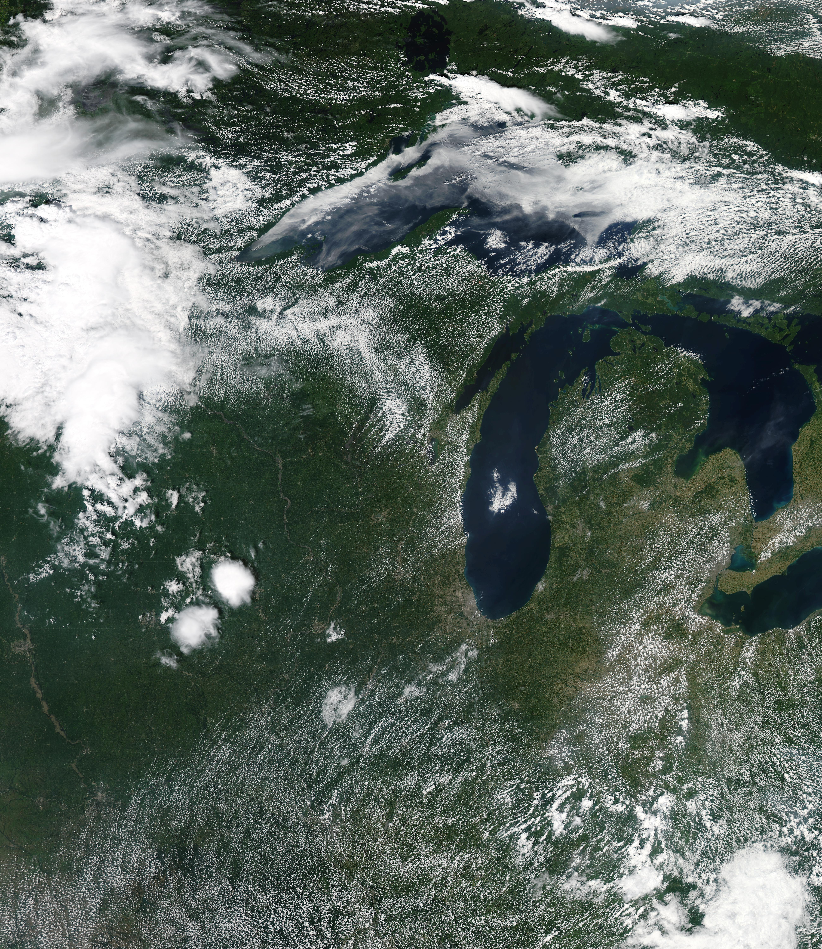
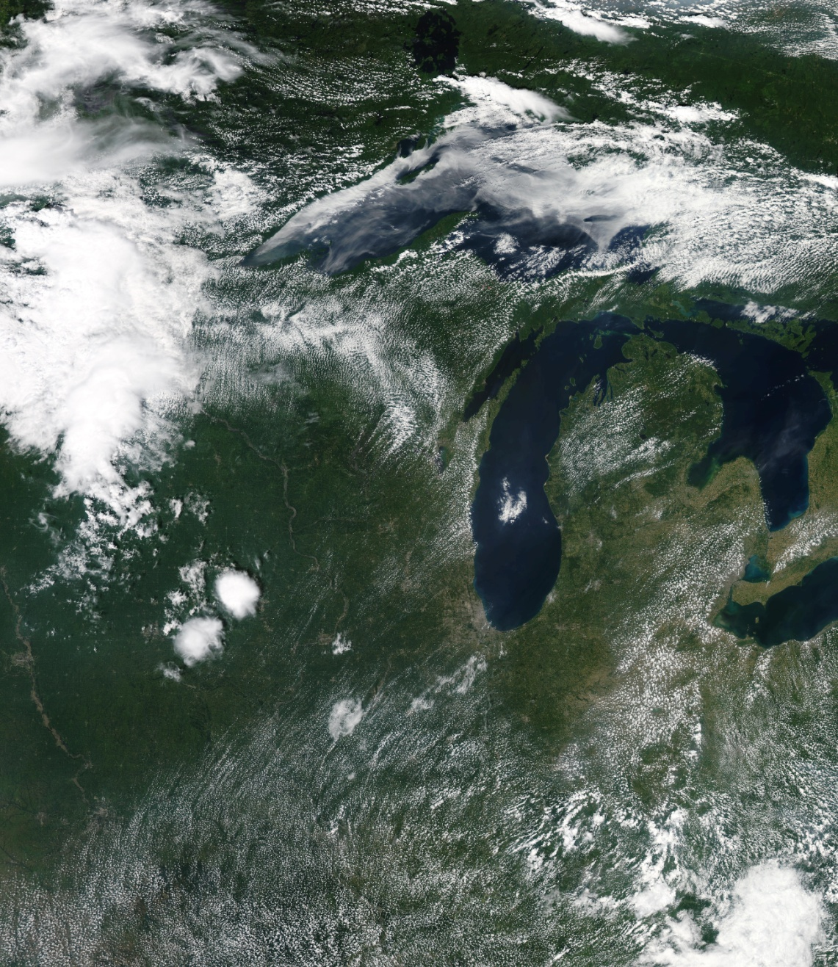
MODIS Image July 17, 2011
Lake Breeze
Front
Prevailing winds
From Mike Majewski, WDNR

Slide 11
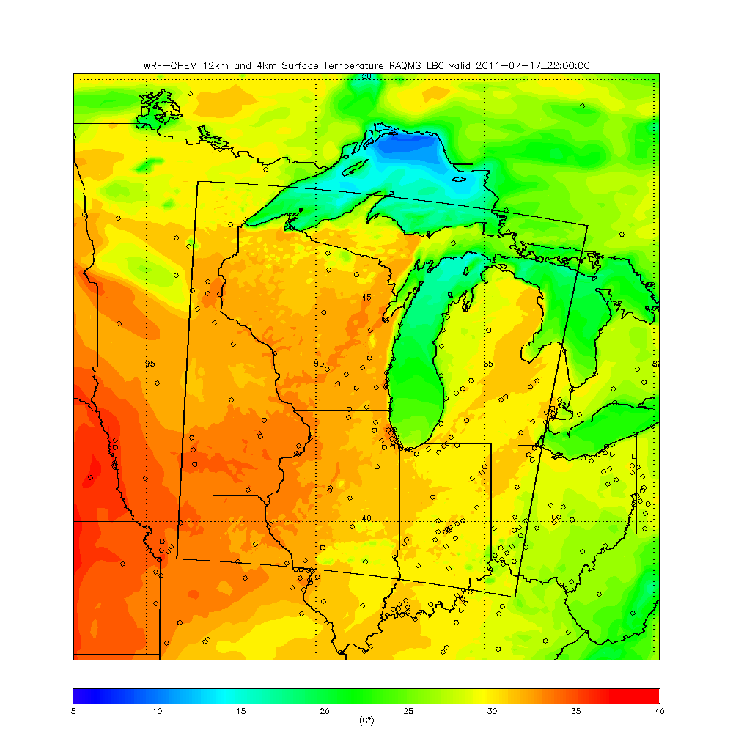
4km WRF-CHEM
Surface Temperature
22Z 07/17, 2011
(5:00pm Central 07/17, 2011)
4km WRF-CHEM shows sharp lake breeze front in good agreement with MODIS

Slide 12
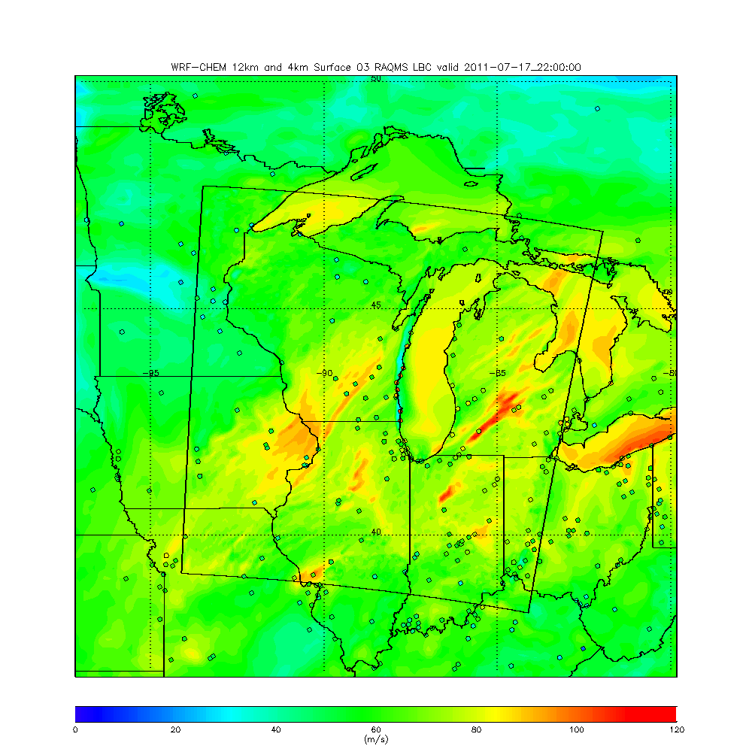
4km WRF-CHEM
Surface O3
22Z 07/17, 2011
(5:00pm Central 07/17, 2011)
Observed O3 shown at monitoring sites
4km WRF-CHEM shows O3 enhancement over lake but predicts large coastal ozone deficit
(ppbv)

Slide 13
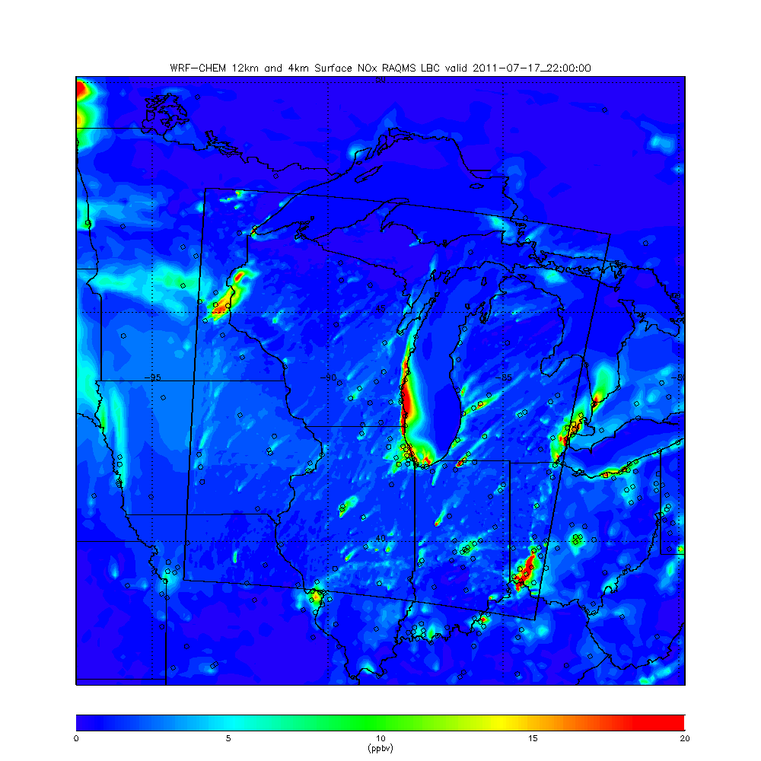
4km WRF-CHEM
Surface NOx
22Z 07/17, 2011
(5:00pm Central 07/17, 2011)
4km WRF-CHEM shows significant NOx transport along coast line

Slide 14
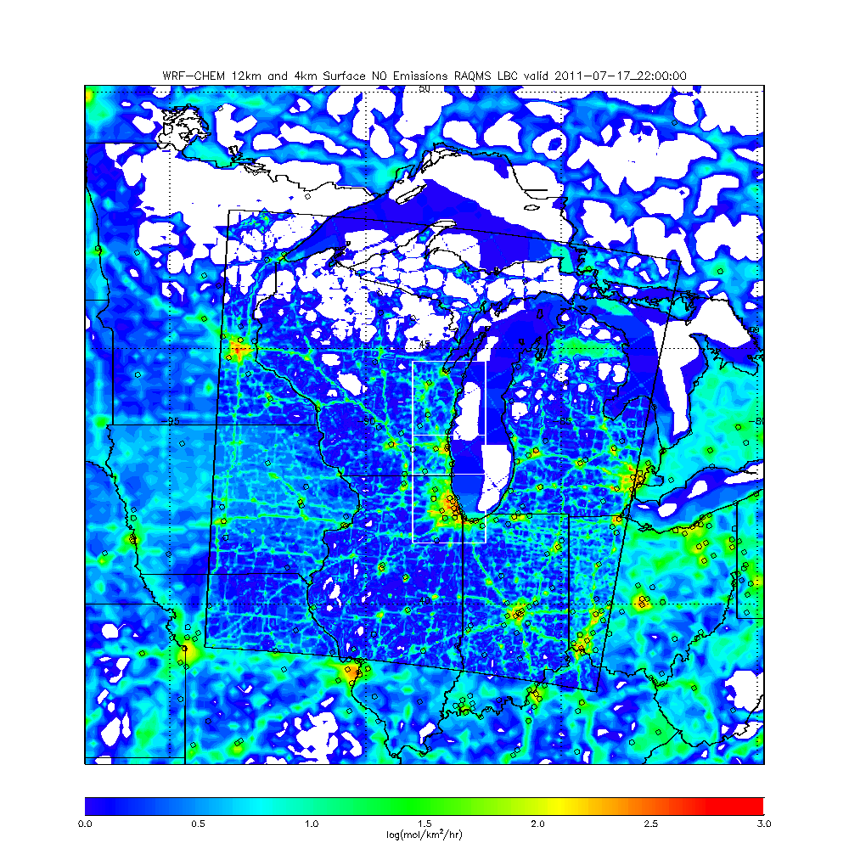
4km WRF-Chem NEI NO emissions July, 2011
O3 sensitivity study: reduce CH, CH+ML, and CH+ML+GB NO emissions by 50%
Green Bay (GB) domain
Milwaukee (ML) domain
Chicago (CH) domain
Green Bay domain includes mobile sources long Western Lake Michigan and Fox River Valley

Slide 15
Summary of O3 sensitivity studies for Western Lake Michigan AIRNow sites July 17-18, 2011
Correlation
50% reductions in Chicago (CH), Chicago & Milwaukee (CH&ML), Chicago & Milwaukee & Green Bay (CH&ML&GB) NO emissions show progressive increases in correlations and reductions in biases during the July 17, 2011 ozone episode.
Bias (ppbv)

Slide 16
The 2017 Lake Michigan Ozone Study
(LMOS 2017)
Outline
Motivation
Background
Science Objectives
Measurement requirements
Funding Avenues

Slide 17
LMOS 2017 Mission Science Objectives
The overall objectives of the study are to better characterize ozone formation chemistry, emissions, meteorology and transport along the Great Lakes’ shorelines with the ultimate goal of improving photochemical modeling along the lakeshores. Specifically, we will focus on:
Constraining the factors controlling ozone chemistry, including:
  NOx versus VOC limitations on ozone formation.
  Constraints on NOx emissions sources (such as urban, mobile and marine shipping sources).
  Chemical aging of urban plumes and how this affects ozone formation.
  Losses of ozone and precursors via deposition.
Understanding controls on meteorology and transport of emissions affecting ozone episode development, including:
  Better constraints on the lake breeze, including its vertical structure, height of the boundary layer, extent of inland penetration, and conditions leading to the presence/absence and different types and locations of lake breezes.
  Determine the relative importance of local vs regional emissions transported from upwind areas via synoptic circulation (e.g., from the Ohio River Valley and other regions).
Improve understanding of sources of model forecast errors (marine boundary layer structure, interplay between synoptic and lake breeze fronts, coastal impacts, over lake processing

Slide 18
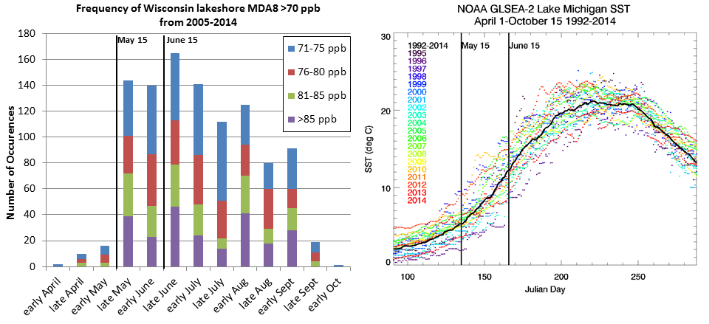
Campaign Study Period: May 15- June 15, 2017
Seasonality of (left) high maximum daily 8-hour average ozone concentrations (MDA8) at Wisconsin Lakeshore monitors and (right) mean Lake Michigan surface temperature (SST) from April 1 through October 15. MDA8 values are shown for the years 2005-2014 and SST for 1992-2014.

Slide 19
The 2017 Lake Michigan Ozone Study
(LMOS 2017)
Outline
Motivation
Background
Science Objectives
Measurement requirements
Funding Avenues

Slide 20
Measurement Requirements:
Operational network
  AQS, PAMS, ASOS, IMPROVE, Rural Monitoring sites, etc)
Airborne remote sensing (GEOTASO)
  GEOTASO - NO2 emission mapping, lake driven transport, HCHO/NO2 ratio
Ground based remote sensing
  Wind Lidar - lake breeze transport, diurnal/synoptic variation, PBL turbulence
  AERI T/Q - PBL thermodynamics, lake breeze influences
  HSRL – PBL growth, diurnal variation, lake breeze influences
  PANDORA – Column NO2, possibly HCHO (TROPOMI validation, GEOTASO calibration)
  Ceilometer – Mixed layer height
Ground based in situ supersite to supplement the existing PAMS network
  NO, NO2, O3, J(NO2), ceilometer, basic meteorology
  High time resolution speciated NOy (CIMS; HNO3, N2O5, ClNO2, HONO)
  High time resolution peroxide measurements (CIMS)
  High time resolution speciated VOC (PTRMS), HCHO (LIP)
Satellite contribution
  GOES-R – High frequency clouds, aerosols, land/water surface temperature
  VIIRS- clouds, aerosols, land/water surface temperature, Day Night Band
  CrIS/ATMS - Atmospheric T/Q profiling, CO
  MODIS - clouds, aerosols, land/water surface temperature
  OMI – NO2, HCHO columns
  OMPS – HCHO columns
  TROPOMI – NO2, HCHO, CO (high resolution, validation opportunity)
Notes:
Added PANDORA (remote sensor)

Slide 21
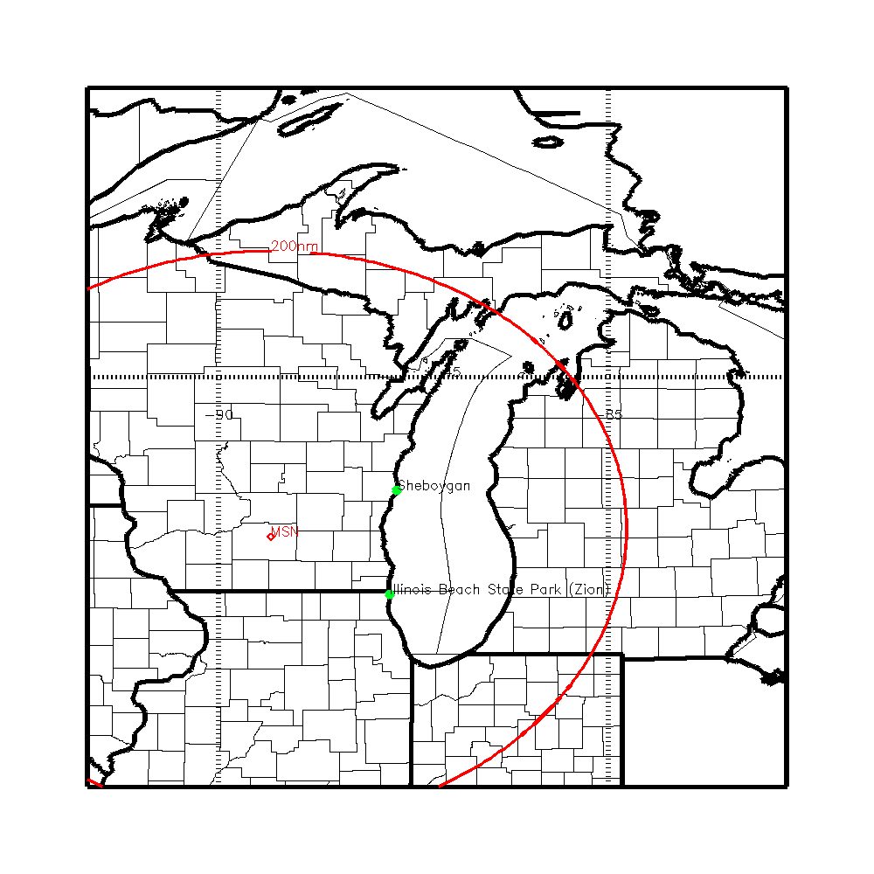
LMOS Measurement Suite (as of September, 2016)
NASA airborne column NO2, HCHO, O3, and aerosols
(GeoTASO Airborne UV-VIS Spectrometer)
Nominal airborne remote sensing flight plans
  Transects along western Lake Michigan Lake breeze convergence zone
  Transects across Lake Michigan (Sheboygan to Holland)
  Urban emission mapping
  Upwind/downwind sampling
  Larger Scale survey flights (may require suitcase flights)

Slide 22
LMOS Measurement Suite (as of September, 2016)
NASA airborne column NO2, HCHO, O3, and aerosols
(GeoTASO Airborne UV-VIS Spectrometer)
PANDORA direct-sun measurements of total columns of ozone and other trace gases in the atmosphere will be used to calibrate GeoTASO airborne retrievals
EPA Ground based column NO2, HCHO, O3 (PANDORA)

Slide 23
LMOS Measurement Suite (as of September, 2016)
SSEC SPARC Trailer
(HALO Wind Lidar, AERI T/Q profiles, HSRL aerosol extinction, CIMEL aerosol optical depth)
NASA airborne column NO2, HCHO, O3, and aerosols
(GeoTASO Airborne UV-VIS Spectrometer)
UW-Madison NOy/VOC
U-Iowa Aerosol
 |  |  | Group
 | Ozone* | UV absorption
 | NO, NO₂* | Chemiluminescence
 | Total NOy
 | Photolysis Rates (JNO₂, JO₃) † | Radiometer
 | Boundary Layer Height† | Ceilometer
 | CO, CO₂, CH₄† | CRDS
 | NMHC (speciated)* | GC-MS, PAMS
 | oVOC (alcohols, aldehydes) | PTR-MS, LIP | Bertram (PTR-MS)
 | Alkyl Nitrates (RONO₂) | CIMS (I⁻) | Bertram (PTR-MS)
 | Peroxy Nitrates (RO₂NO₂) | CIMS (I⁻) | Bertram (PTR-MS)
 | Nitric Acid (HNO₃) † | CIMS (I⁻) | Bertram (PTR-MS)
 | H₂O₂, organic peroxides | Derivatization or CIMS
 | N₂O₅, ClNO₂ | CIMS (I⁻) | Bertram (PTR-MS)
 | HONO | CIMS (I⁻) | Bertram (PTR-MS)
 | OH, HO₂, OH Reactivity | LIF
 | NH₃† | CIMS or CRDS
 | Hg†
 | Inorganic Ion (NO₃⁻)† | Various options | Stone Group (IA)*
 | Size Distributions | SMPS | Stanier
 | Inorganic Ions (NH₄⁺, SO⁴⁻)† | Various options | Stone Group (IA)*
 | OC/EC† | Various options | Stone Group (IA)*
 | Speciated organics | Various options | Stone Group (IA)*
 | Hg†
 | Metals† | Filter + ICPMS or XRF
EPA Ground based column NO2, HCHO, O3 (PANDORA)

Slide 24
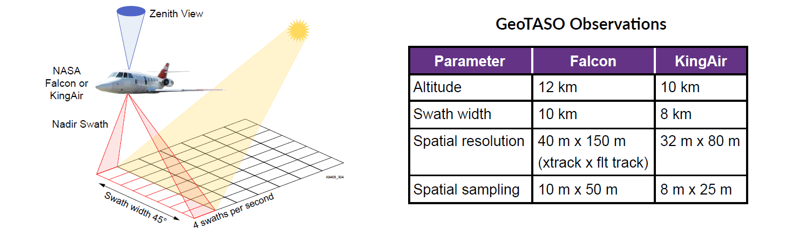
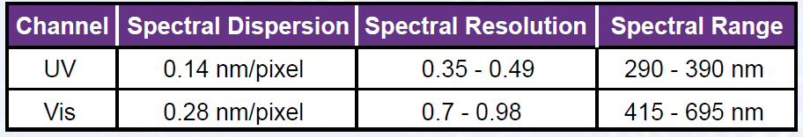
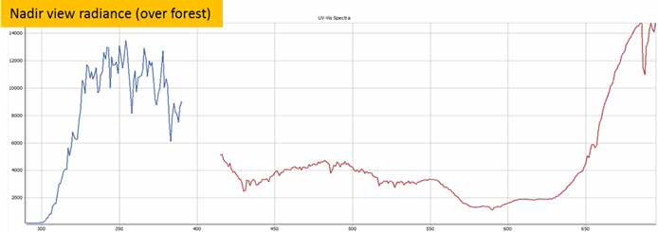
GeoTASO
NASA GEO-CAPE program will provide the Langley Research Center King Air aircraft with the Geostationary Trace gas and Aerosol Sensor Optimization (GeoTASO) instrument and conduct approximately 100 local flight hours.
Typical signal from the UV(blue) and Vis (red) channels
Advances TEMPO retrieval readiness through testing of trace gas and aerosol retrievals
Engages Air Quality Management (including TEMPO early adopters) via targeted observations
From Leitch, et al, 6th Annual HyspIRI Data Product Symposium and Aquatic Forum, June 1-3, 2016 NASA GSFC (http://hyspiri.jpl.nasa.gov/downloads/2016_Symposium/2016_HyspIRI_Agenda_final.pdf

Slide 25
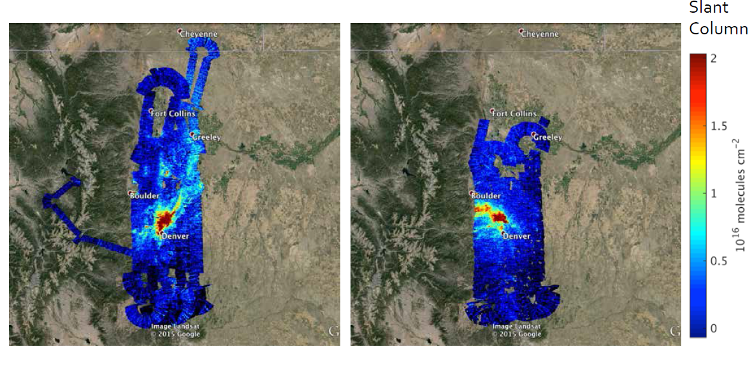
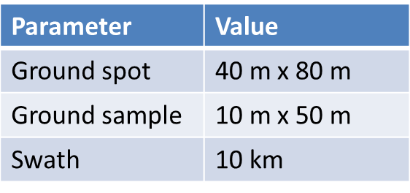
GeoTASO
NASA GEO-CAPE program will provide the Langley Research Center King Air aircraft with the Geostationary Trace gas and Aerosol Sensor Optimization (GeoTASO) instrument and conduct approximately 100 local flight hours.
NO₂ over Denver, 2 August 2014
8:00-11:30 am
2:00-4:00 pm
From Caroline Nowlan (Harvard-Smithsonian Center for Astrophysics, Cambridge, MA)

Slide 26
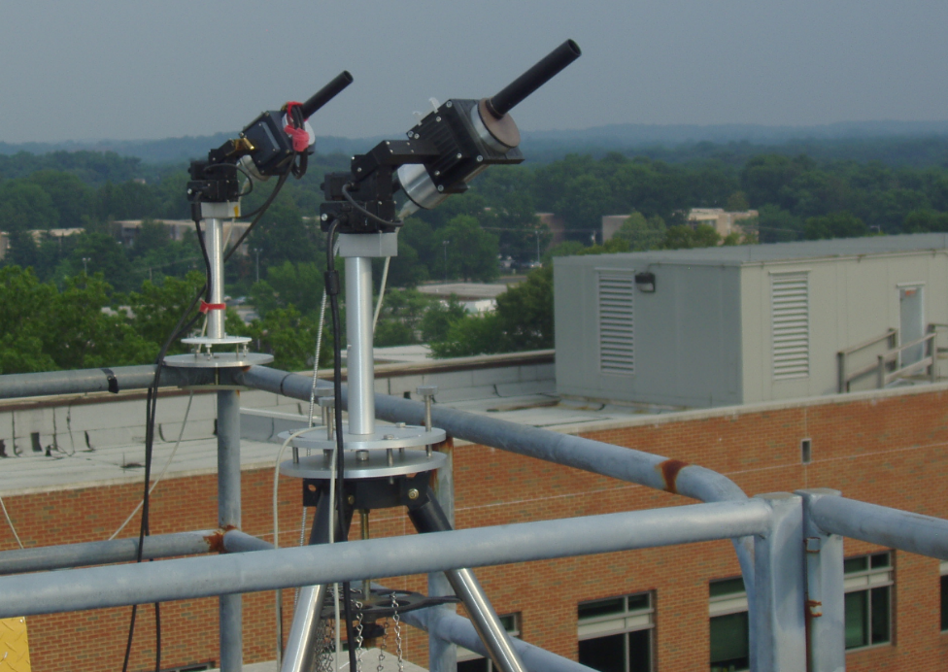
PANDORA
EPA National Exposure Research Laboratory (NERL) has offered to provide 3 PANDORA instruments for LMOS 2017 deployment. Pandora is a small spectrometer system for direct-sun measurements of total columns of ozone and other trace gases in the atmosphere.
Instrument Specifications
Developed at NASA Goddard
Total Column O₃, SO₂, HCHO, BrO, NO₂ and H₂O every 80 seconds
http://acdb-ext.gsfc.nasa.gov/Projects/Pandora/index.html

Slide 27
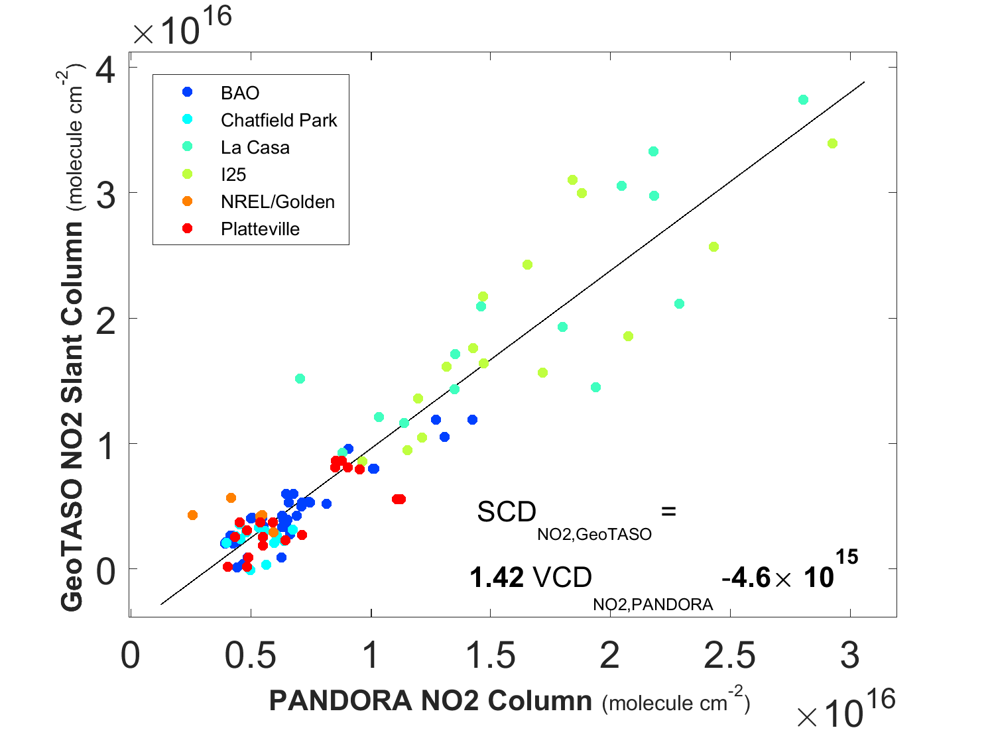
DISCOVER-AQ Colorado
GeoTASO NO2 Slant Column versus PANDORA NO2 vertical column density
(29 July to 11 August 2014 between 0800 – 1400 LST)
PANDORA measurements provide continuous (cloud free) daytime NO2 columns to tie the GeoTASO NO2 column airborne sampling.
From Luke Valin and James Szykman, US EPA

Slide 28
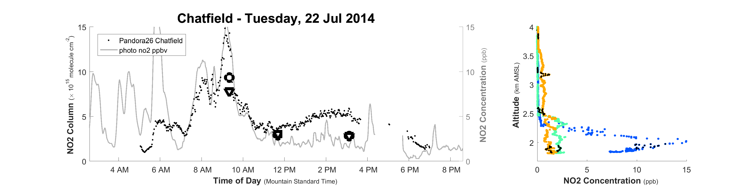
DISCOVER-AQ Colorado
PANDORA NO2 vertical column density versus surface NO2
P3B sub-columns (circles and triangle)
NO2 Profiles from P3B spirals
The PANDORA NO2 column density can be used to infer variations in surface NO2.
The integrated P3B in situ columns and surface NO2 measurements are largely consistent with PANDORA NO2 columns, with the exception of the afternoon, which may be associated with increases in stratospheric NO2 contributions.
blue (morning)
cyan (midday)
orange (afternoon)
From Luke Valin and James Szykman, US EPA

Slide 29
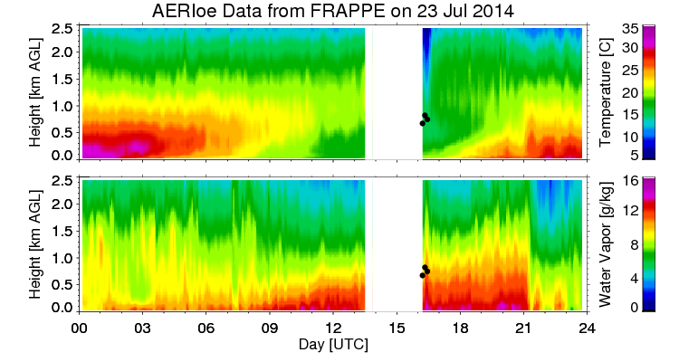
UW-Madison Space Science and Engineering Center (SSEC)
Atmospheric Emitted Radiance Interferometer (AERI)
Ground-based platform
Vertical profile retrievals of temperature (T), humidity (Q)
Developing capabilities for carbon monoxide (CO), ozone (O3), methane (CH4), and nitrous oxide (N2O).
AERI accuracy of 1K and 10% for T and Q, respectively, most accurate in the boundary layer.
AERI data during 2014 FRAPPE/DISCOVER-AQ Mission
Notes:
Add Ground Based

Slide 30
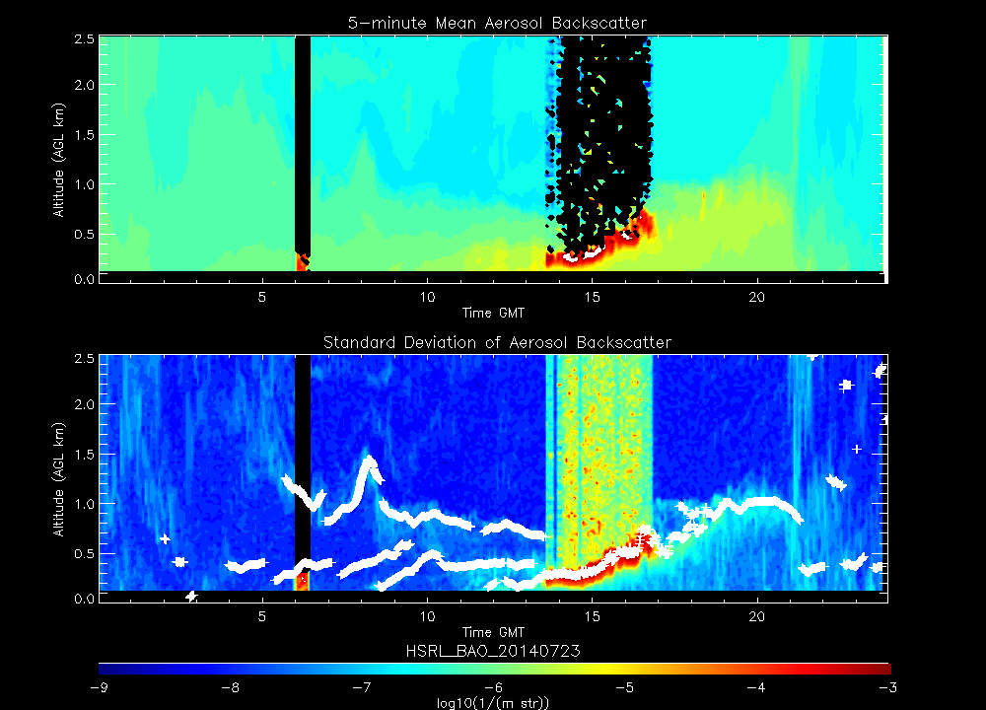
UW-Madison Space Science and Engineering Center (SSEC)
High Spectral Resolution Lidar (HSRL)
  Ground based measurements of aerosol backscatter cross section, depoloarization, and extinction at 532nm
  Provide measurements of clouds, boundary layer height
HSRL data during 2014 FRAPPE/DISCOVER-AQ Mission
Notes:
Add Ground Based note that HSRL provides clouds and pbl height

Slide 31
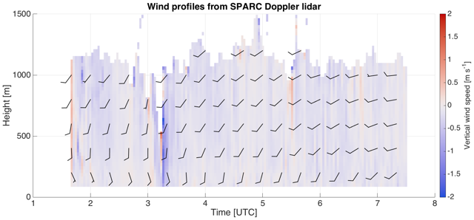
UW-Madison Space Science and Engineering Center (SSEC)
Halo Doppler Wind Lidar
The colors represent vertical winds (red is upward, blue is downward, gray is neutral) while the sticks represent the horizontal winds: full barb is 10 m/s while a half barb is 5 m/s.

Slide 32
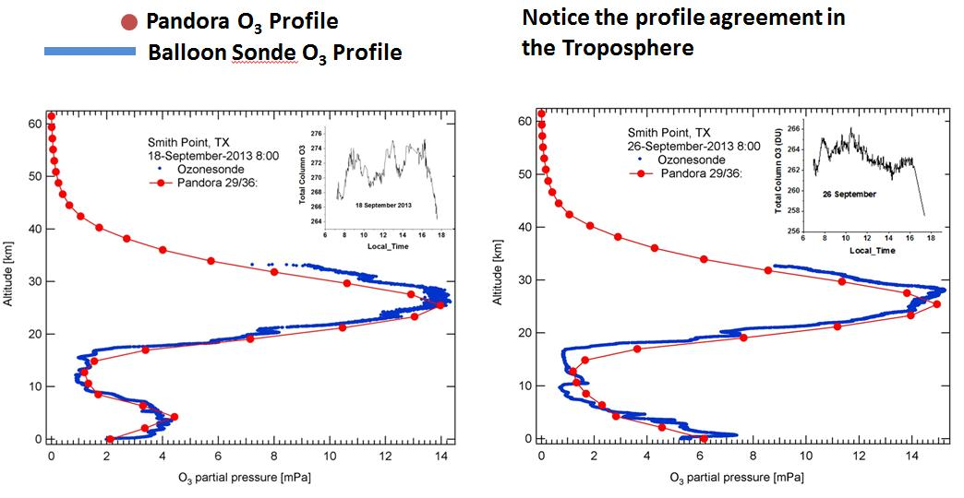
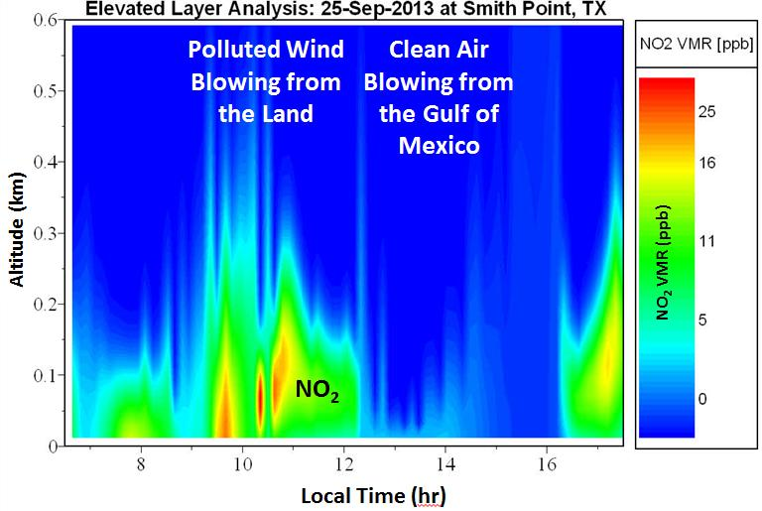
Additional Measurements
Sky observations (scanning the sky from the horizon to zenith) are also under development for deriving PANDORA trace gas altitude profiles (e.g., NO2 and O3).
Credit: Jay Herman and Elena Spinei (UMBC/GSFC)
http://acdb-ext.gsfc.nasa.gov/Projects/Pandora/index.html

Slide 33
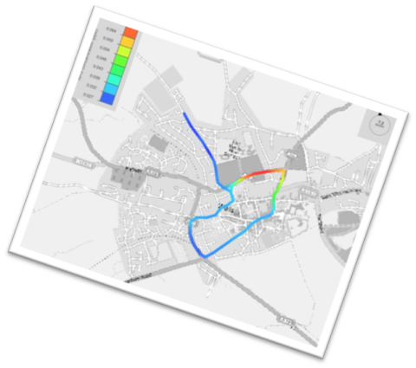
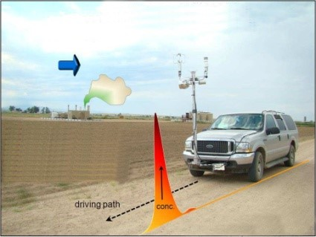
Additional Measurements (cont)
EPA Region 5 is interested in deploying their Geospatial Measurement of Air Pollution (GMAP) mobile monitoring system during LMOS 2017.
GMAP has an integrated Differential Ultra Violet Absorption Spectroscopy (DUVAS) model DV3000-F¹ that can provide high frequency (1 second) VOC, AQM, measurements while moving or parked – spectra are archived for post analysis
¹http://www.duvastechnologies.com/index.php?option=com_content&view=featured&Itemid=435

Slide 34
The 2017 Lake Michigan Ozone Study
(LMOS 2017)
Outline
Motivation
Background
Science Objectives
Measurement requirements
Funding Avenues

Slide 35
Funding Avenues
NASA GEO-CAPE program will provide the Langley Research Center King Air aircraft with the Geostationary Trace gas and Aerosol Sensor Optimization (GeoTASO) instrument and conduct approximately 100 local flight hours.
EPA National Exposure Research Laboratory (NERL) has offered to provide 3 PANDORA instruments for LMOS 2017 deployment.
Funding for ground site preparation ($25K) provided by LADCO States
Funding for UW-Madison ($50K) and University of Iowa ($68K) insitu ground measurements being pursued through NSF Rapid Response Research (RAPID) grant (in preparation)
Funding for SPARC trailer ($75K) remote ground measurements being pursued through NOAA GOES-R Program Office (GOES-R ABI validation)
Funding for additional ground measurements (TBD) being pursued through EPA PAMS program office

