Slide 1

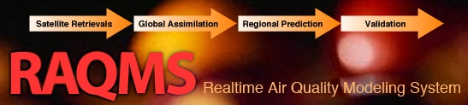

Trans-boundary Ozone Pollution
A Global Chemical and Aerosol Data Assimilation Perspective
Brad Pierce
NOAA/NESDIS

Slide 2
Model Description
Online global chemical and aerosol assimilation/ forecasting system
UW-Madison hybrid θ−η coordinate model (UW-Hybrid) dynamical core
Unified stratosphere/troposphere chemical prediction scheme (LaRC-Combo) developed at NASA LaRC
Aerosol prediction scheme (GOCART) developed by Mian Chin (NASA GSFC).
Statistical Digital Filter (OI) assimilation system developed by James Stobie (NASA/GFSC)
RAQMS has been used to support airborne field missions [Pierce et al, 2003, 2007, 2008], develop capabilities for assimilating satellite trace gas and aerosol retrievals [Pierce et al., 2007, 2008, Fishman et al., 2008, Sunita et al., 2008] and assess the impact of global chemical analyses on regional air quality predictions [Song et al., 2008, Tang et al., 2008]
Notes:
2

Slide 3
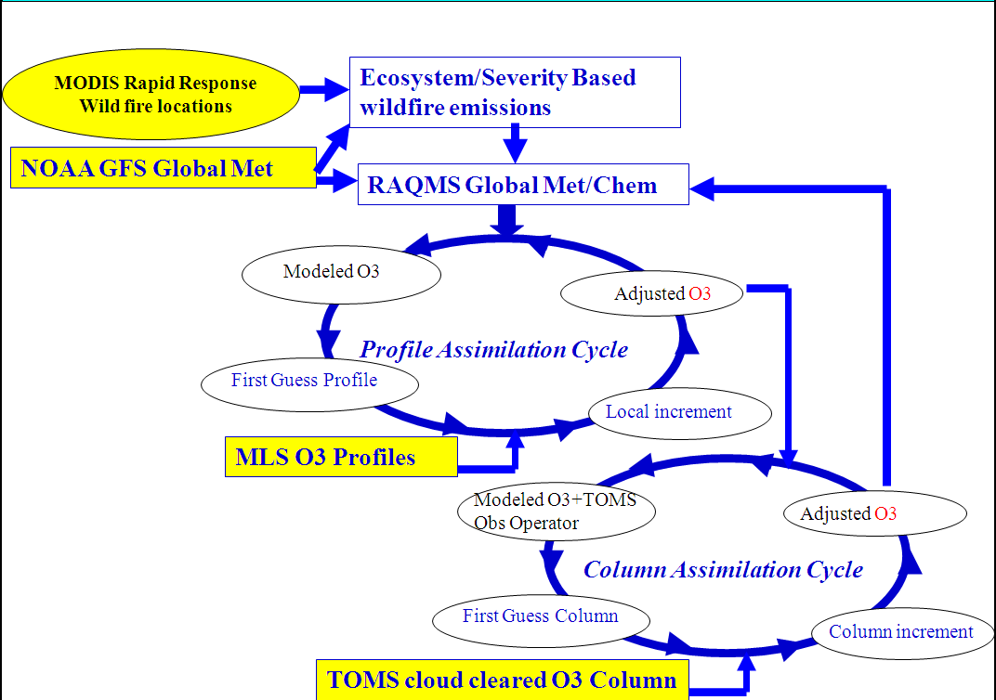
RAQMS O3 Assimilation Procedure
OMI cloud cleared O3 column
Demonstration of:
Real-time assimilation of Microwave Limb Sounder (MLS) stratospheric ozone profiles
Real-time assimilation of Ozone Monitoring Instrument (OMI) total ozone column
Real-time incorporation of Moderate Resolution Imaging Spectroradiometer (MODIS) fire detection
Notes:
3

Slide 4
Satellite Data Used in RAQMS Ozone Analysis

Slide 5
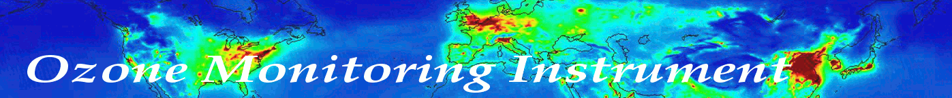
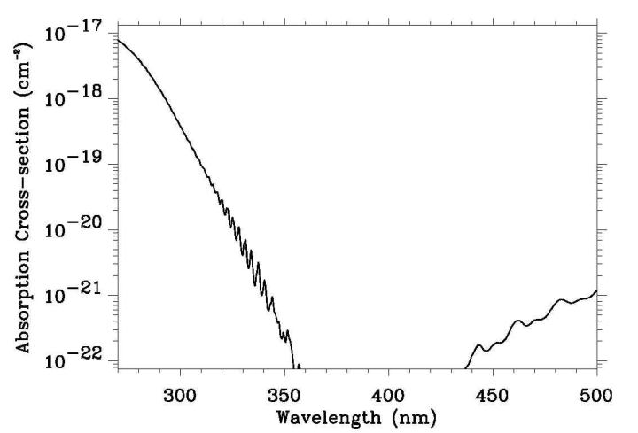
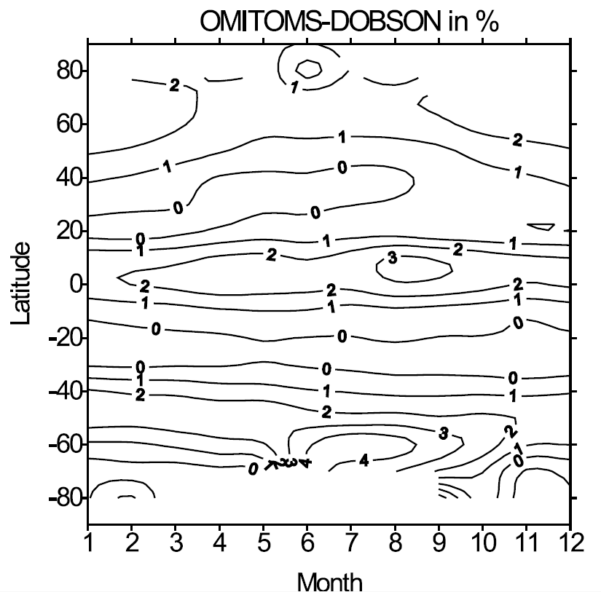
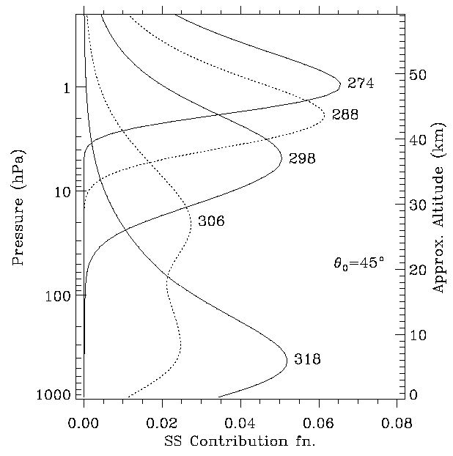
The Ozone Monitoring Instrument (OMI) measures the radiation backscattered by the Earth’s atmosphere and surface in the wavelength range 270-500 nm. Total column O3 error is generally less than 2%. Pixel size is 13x24km.
O3 Absorption Spectrum at OMI Wavelengths
Radiance Contribution Functions
Balis, D., et al. (2007), Validation of Ozone Monitoring Instrument total ozone column measurements using Brewer and Dobson spectrophotometer ground-based observations, J. Geophys. Res., 112, D24S46, doi:10.1029/2007JD008796.

Slide 6

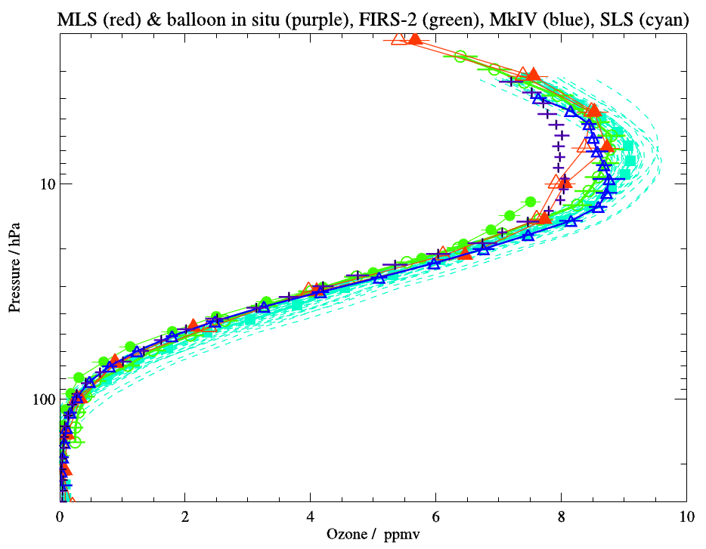
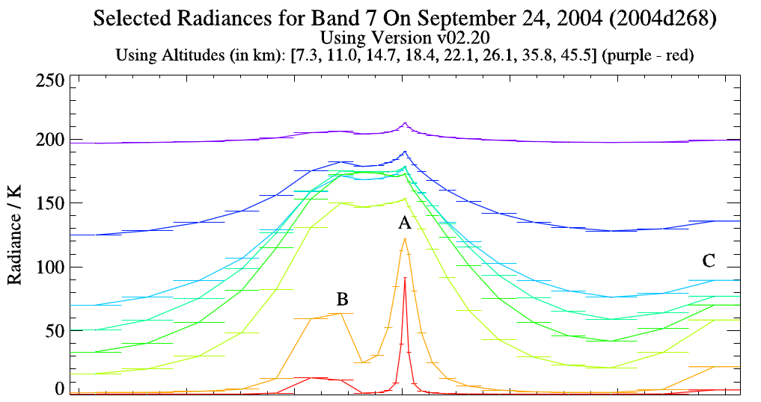
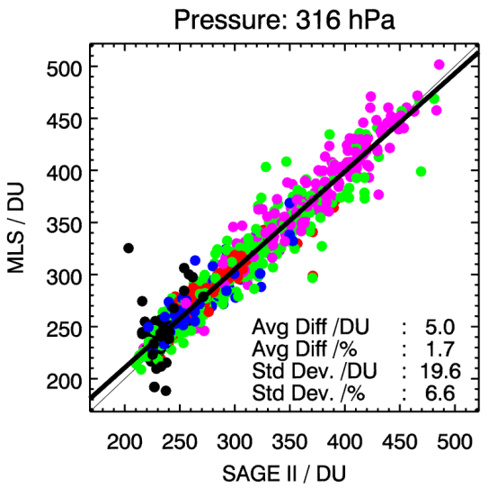
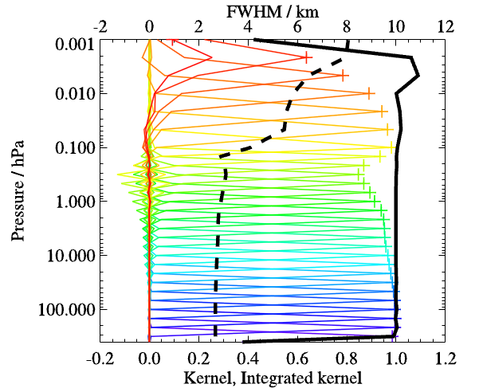
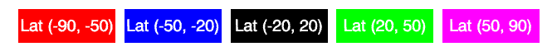
The Microwave Limb Sounder (MLS) MLS measures millimeter and sub-millimeter emission by scanning the Earth’s atmospheric limb. Accuracy of MLS ozone profile is about 8% or better. Provides profile retrievals every 165km along the suborbital track.
Band 7 (240 GHz) radiances vs altitude
A=primary ozone emission line
MLS Averaging Kernels
Froidevaux, L., et al. (2008), Validation of Aura Microwave Limb Sounder stratospheric ozone measurements, J. Geophys. Res., 113, D15S20, doi:10.1029/2007JD008771.

Slide 7
Contribution of Asian Wildfires to Intercontinental Pollution Transport
(April 2008 ARCPAC/ARCTAS Campaigns)

Slide 8
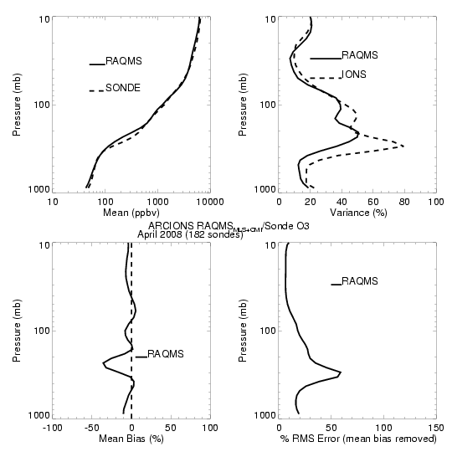
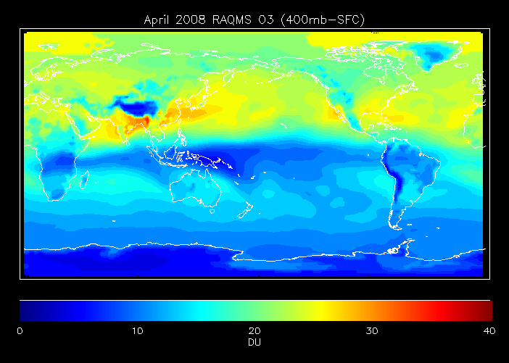

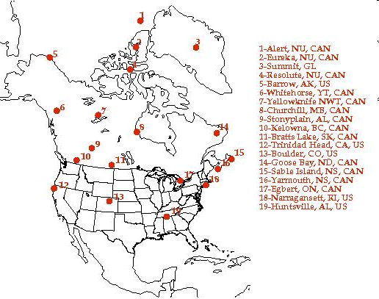
April 2008 RAQMS vs ARCIONS ozonesonde
(182 North American sondes)
RAQMS OMI+MLS
Ozonesonde
Validation
April 2008
+/-20%

Slide 9
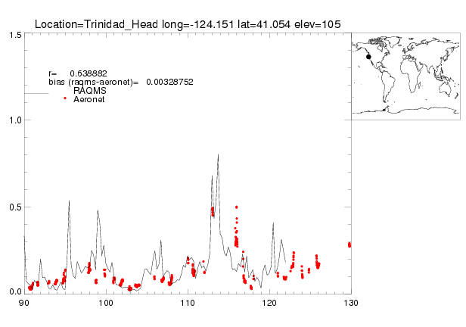
Trinidad Aeronet vs RAQMS AOD: April 2008
April 22nd,2008
Biomass burning aerosols observed at Trinidad Head on April 22, 2008
RAQMS analysis overestimates AOD associated with biomass burning plume relative to Aeronet

Slide 10
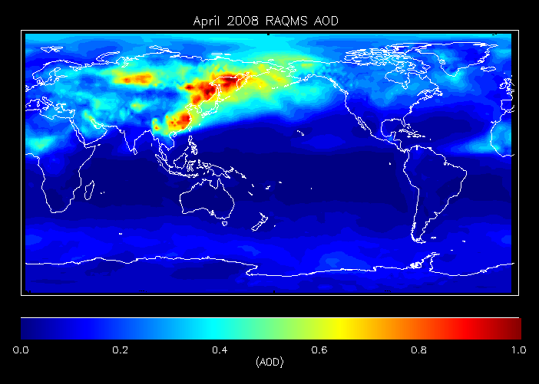
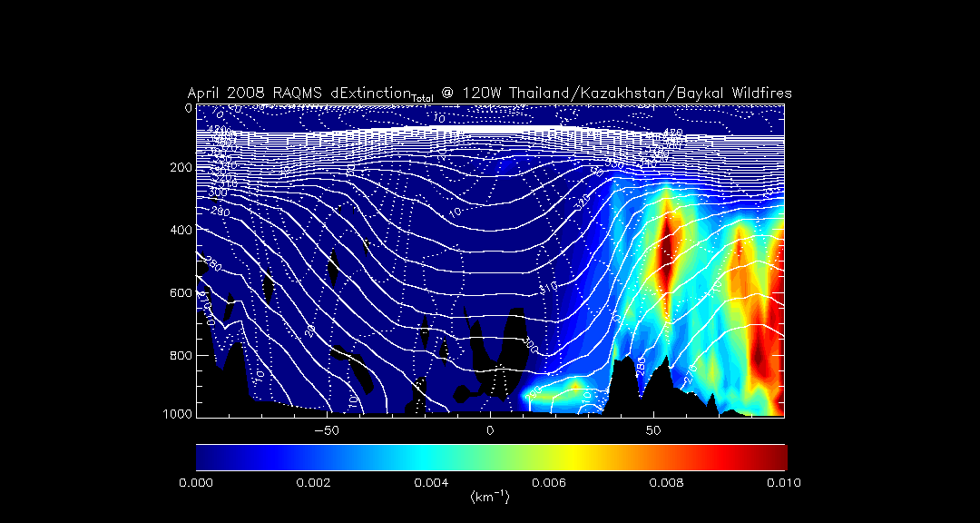
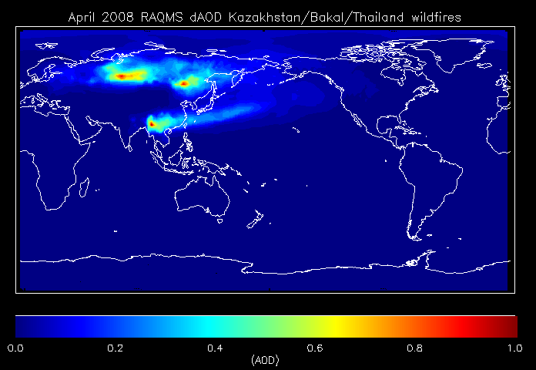
Impacts of Kazakhstan/Baykal/Thailand wildfires
120W
120W
Impact of Kazakhstan/Baykal/Thailand wildfires on tropospheric aerosols extends into North America with potential US Air Quality impacts
Natarajan, M., et al. (2012), Radiative forcing due to enhancements in tropospheric ozone and carbonaceous aerosols caused by Asian fires during spring 2008, J. Geophys. Res., 117, D06307, doi:10.1029/2011JD016584.
Notes:
10

Slide 11
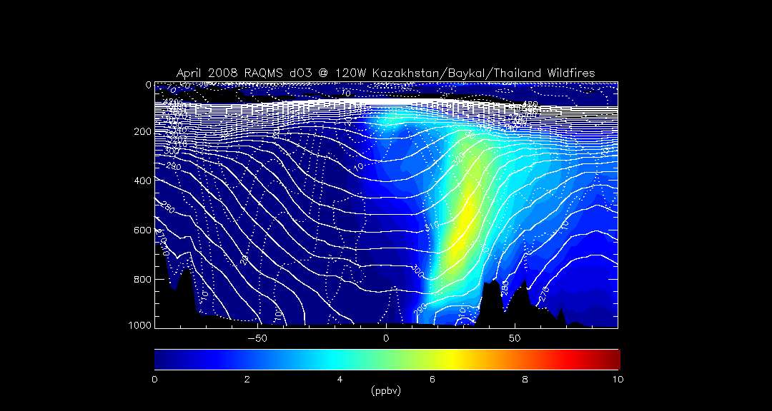
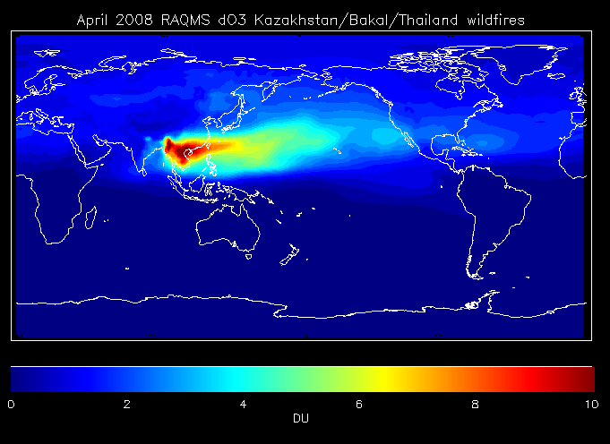
Impacts of Kazakhstan/Baykal/Thailand wildfires
120W
Impact of Kazakhstan/Baykal/Thailand wildfires on tropospheric ozone production extends into North America with potential US Air Quality impacts
Natarajan, M., et al. (2012), Radiative forcing due to enhancements in tropospheric ozone and carbonaceous aerosols caused by Asian fires during spring 2008, J. Geophys. Res., 117, D06307, doi:10.1029/2011JD016584.
Notes:
11

Slide 12
Contribution from East Asian Emissions to Intercontinental Pollution Transport
(May-June 2010 CalNex Campaign)

Slide 13
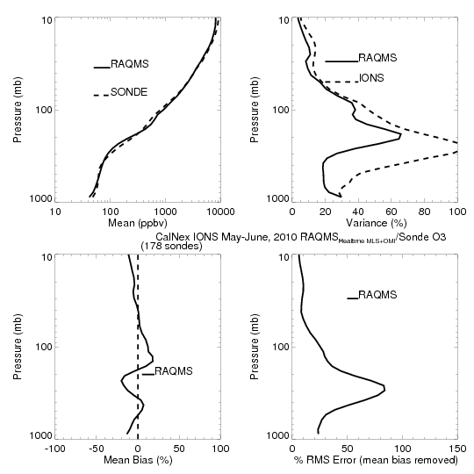
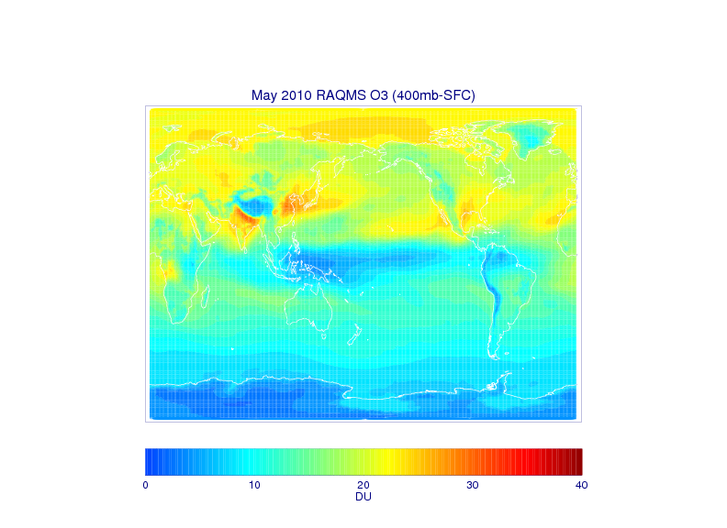
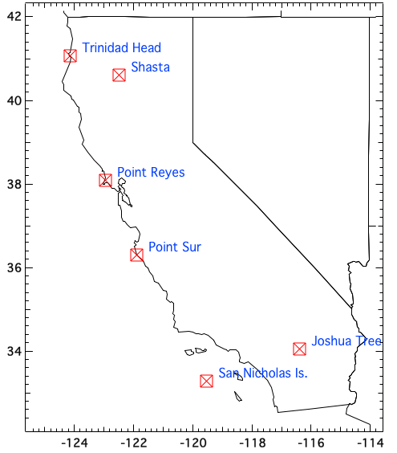
CalNex-2010 O₃ sondes – Owen Cooper (NOAA ESRL)
CalNex Ozonesonde
RAQMS OMI+MLS
Ozonesonde
Validation
May-June 2010
+/-20%

Slide 14
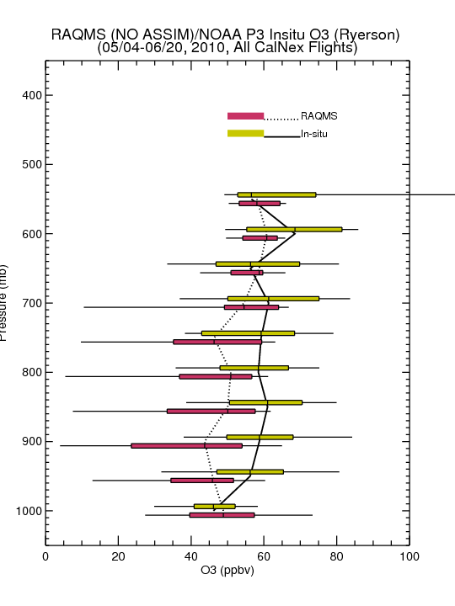
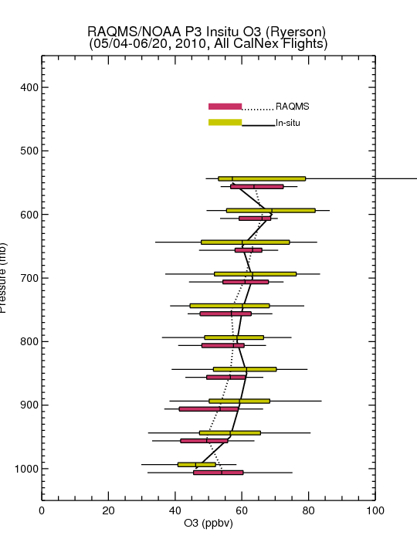
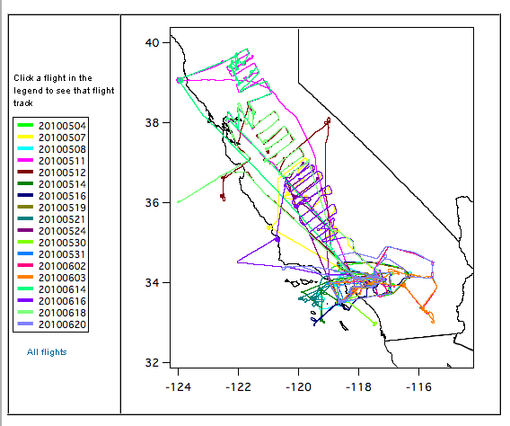
Comparison with NOAA P3 Insitu O3 Measurements
(Primarily LA Basin/Central Valley)
No Assim
MLS+OMI Assim
Assimilation of MLS+OMI O3 retrievals results in increased lower-tropospheric O3 (and improved agreement with airborne insitu O3) over Southern California

Slide 15
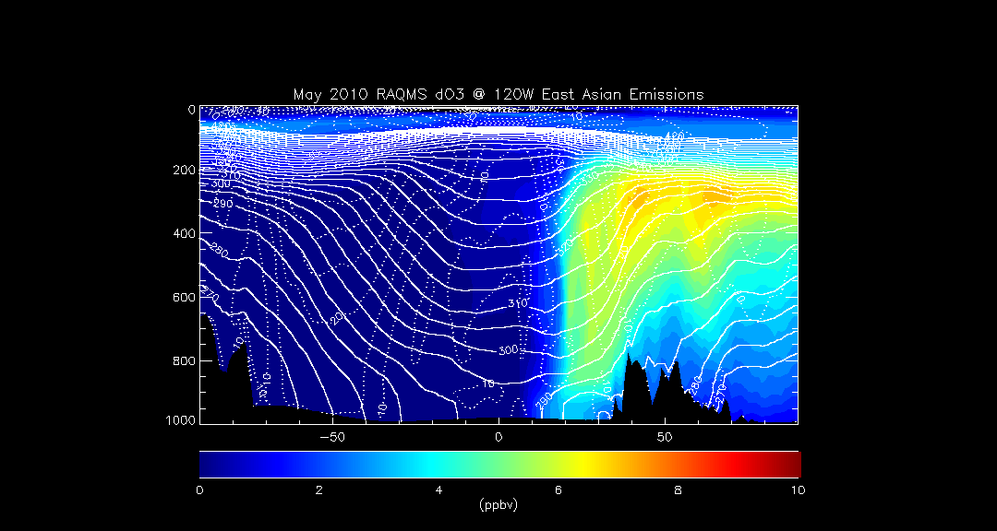
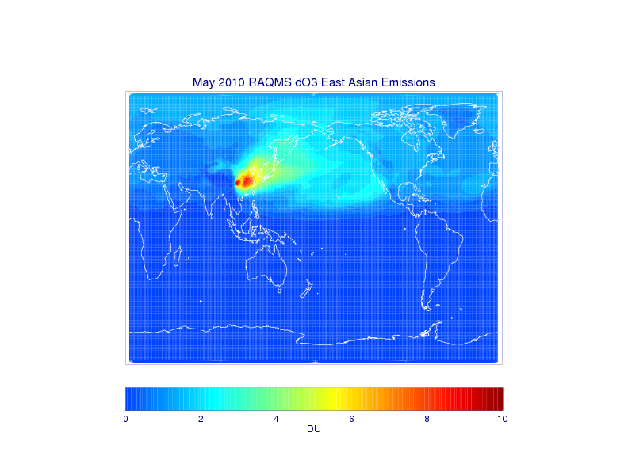
Impacts of East Asian Emissions – May 2010
120W
Impact of East Asian ozone production extends into North America with potential US Air Quality impacts
The Task Force on Hemispheric Transport of Air Pollution (TF HTAP) is an international scientific cooperative effort to improve the understanding of the intercontinental transport of air pollution across the Northern Hemisphere.
Notes:
15

Slide 16
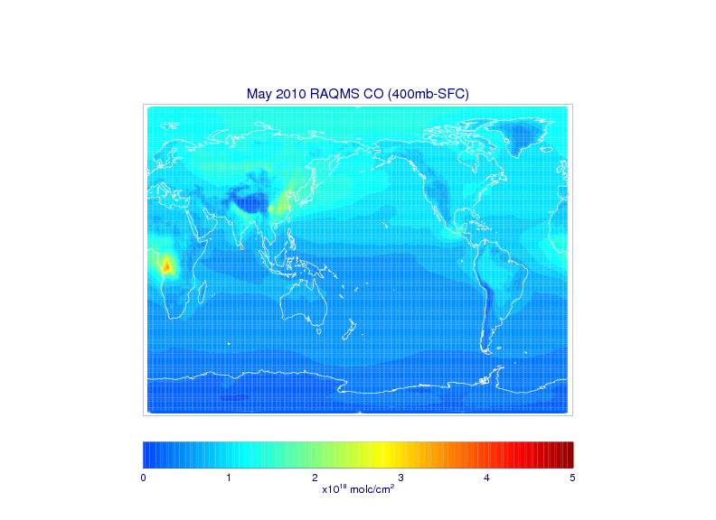
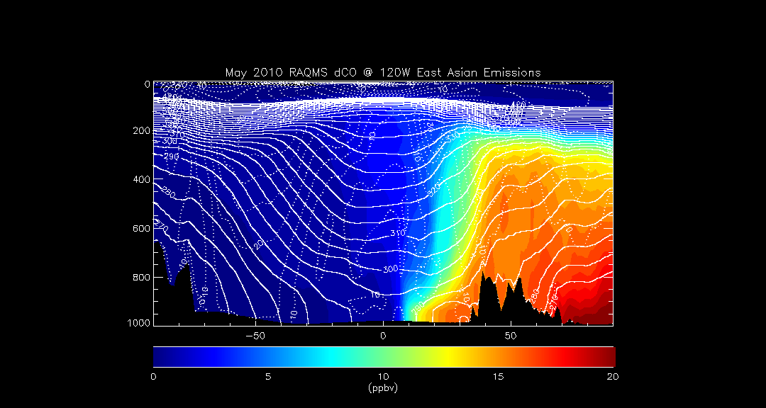
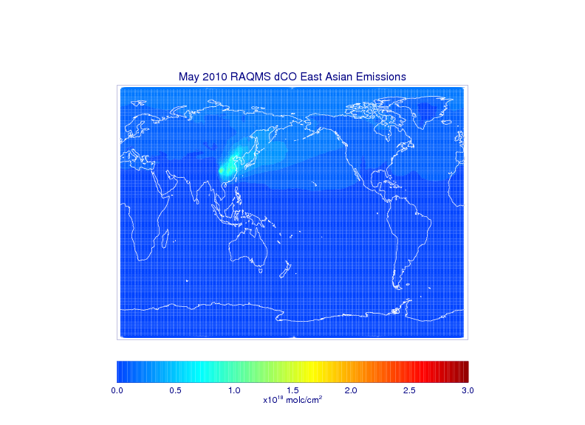
Impacts of East Asian Emissions – May 2010
120W
Impact of East Asian ozone production extends into North America with potential US Air Quality impacts
The Task Force on Hemispheric Transport of Air Pollution (TF HTAP) is an international scientific cooperative effort to improve the understanding of the intercontinental transport of air pollution across the Northern Hemisphere.
Notes:
16

Slide 17
2012-2014 distribution of O3/CO Fluxes
(135W-125W)
Total, and “Pollution” (O3>60ppbv, CO>150ppbv) contributions

Slide 18
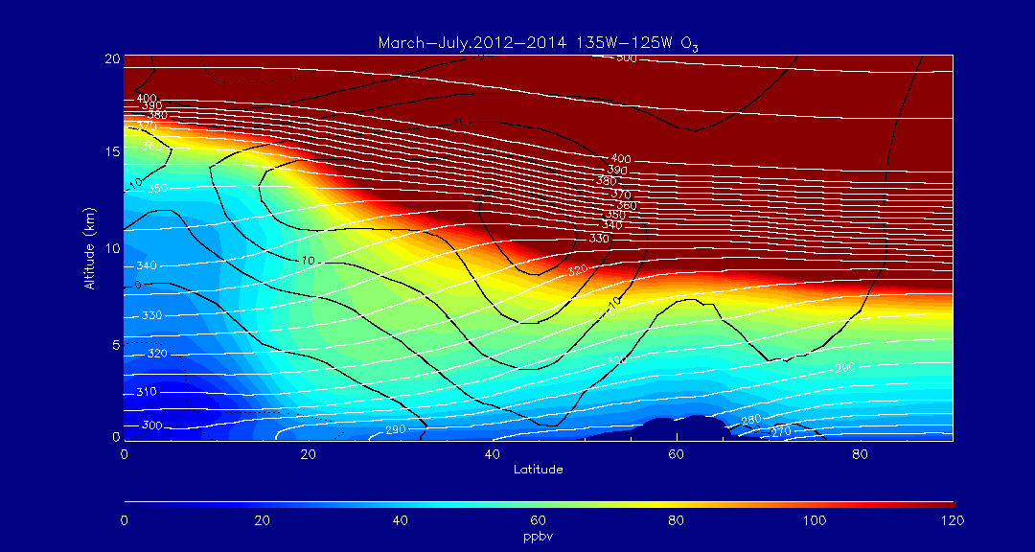
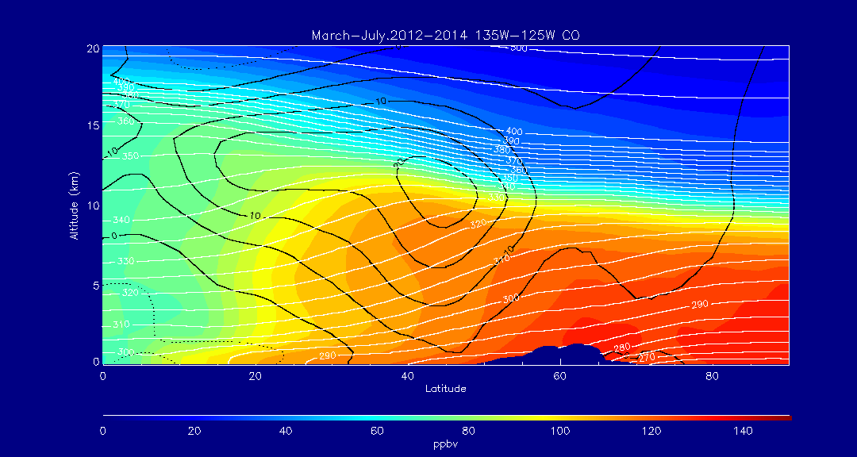
135W-125W Zonal Mean O3 March-July 2012-14
Mean O3 >60ppbv
extends below 3km at 25N
135W-125W Zonal Mean CO March-July 2012-14
Mean CO shows significant NS gradient above O3>60ppbv isopeth – mixing of stratospheric (high O3/low CO) air

Slide 19
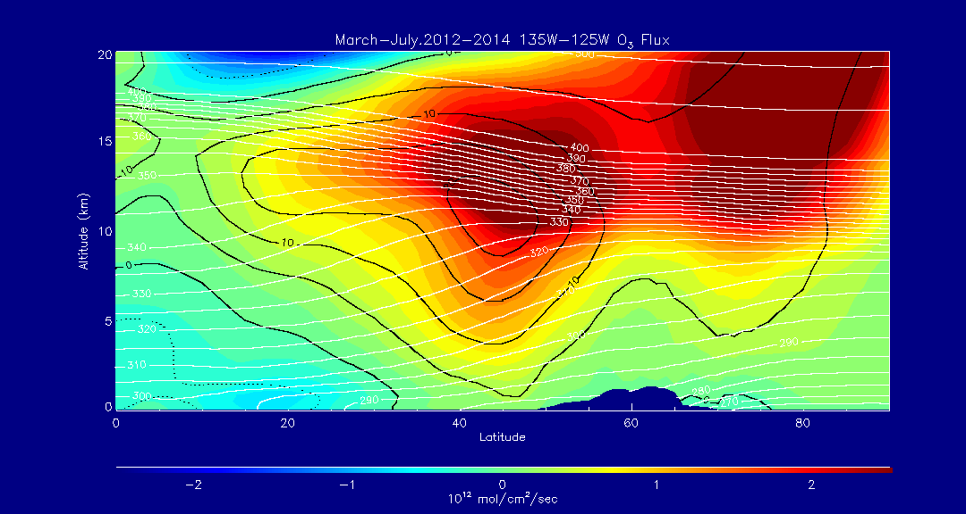
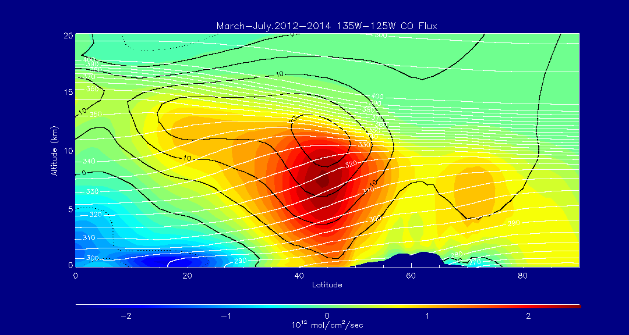
135W-125W Zonal Mean O3 Flux March-July 2012-14
Largest O3 Flux is near the tropopause – upper right quadrant of mid-latitude jet
135W-125W Zonal Mean CO Flux March-July 2012-14
Largest CO Flux is near 7km – lower portion of mid-latitude jet

Slide 20
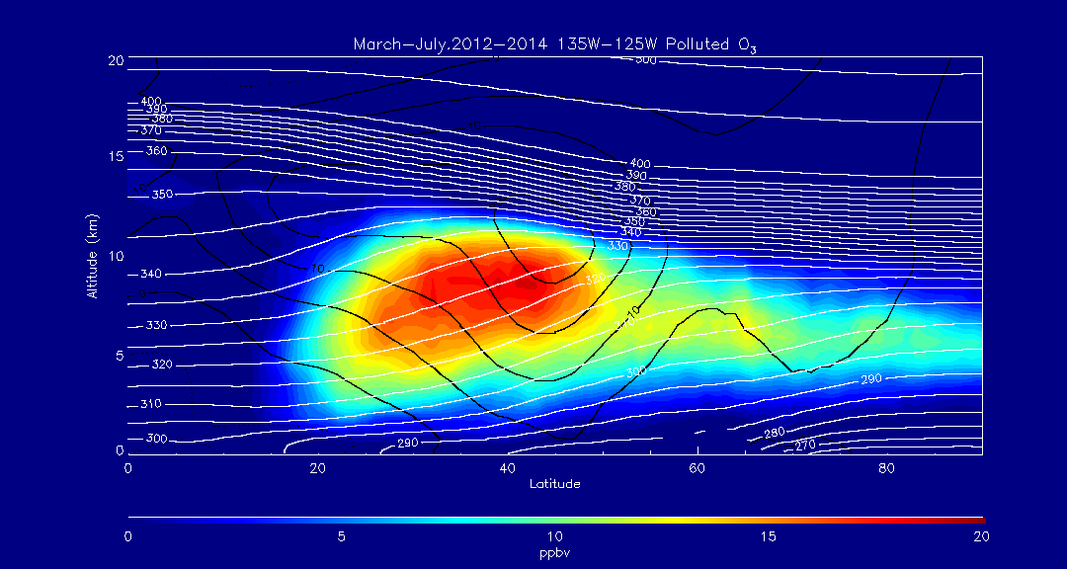
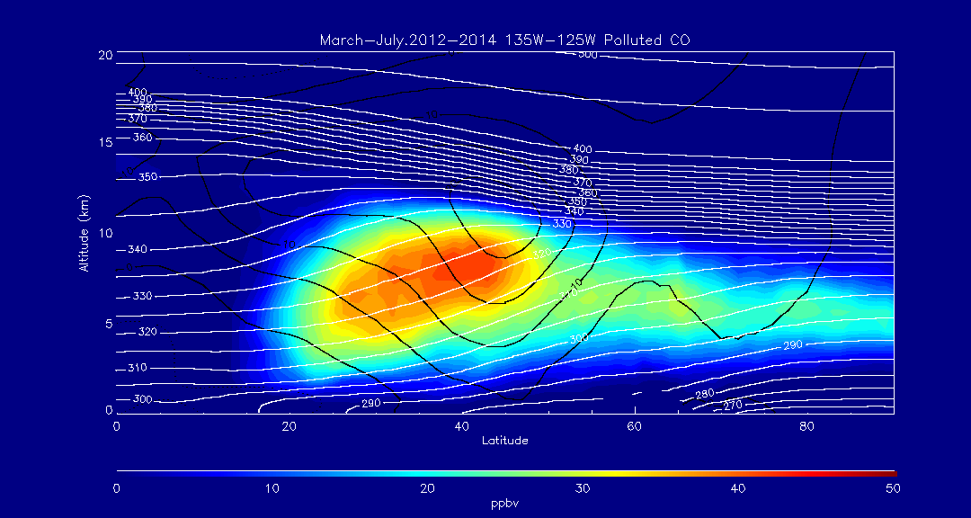
135W-125W Zonal Mean “Pollution” O3 March-July 2012-14
Mean Pollution O3 >15ppbv
Pollution
(O3>60ppbv,CO>150ppbv))
135W-125W Zonal Mean “Pollution” CO March-July 2012-14
Mean Pollution CO >40ppbv

Slide 21
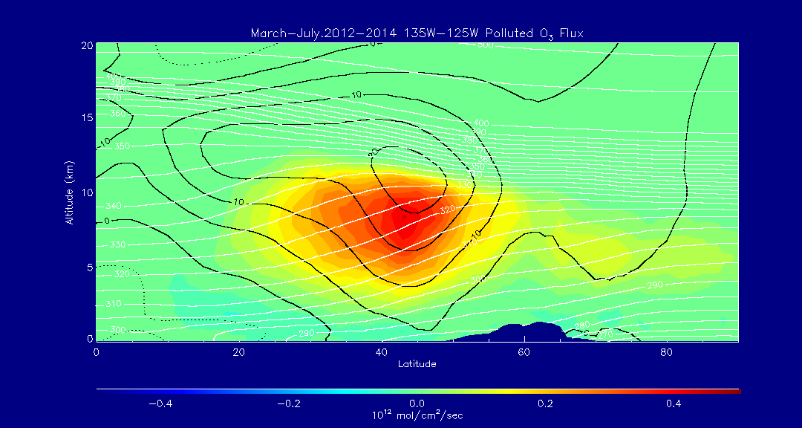
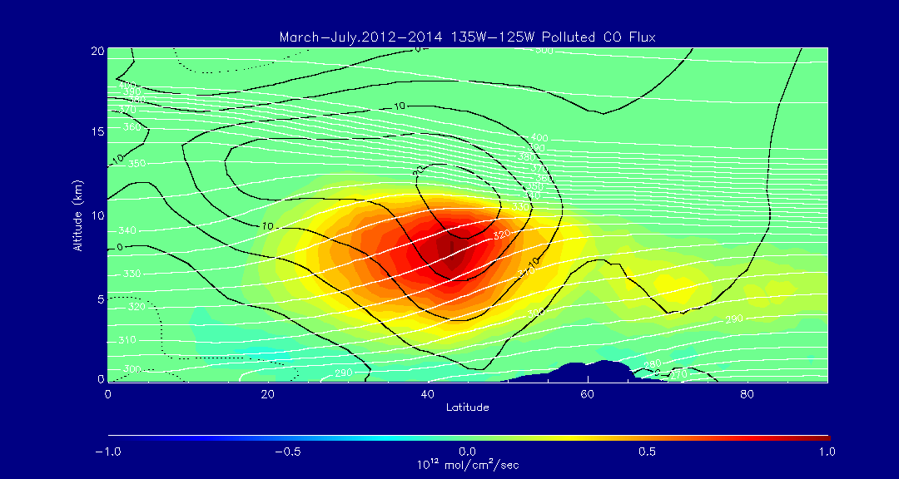
135W-125W Zonal Mean “Pollution” O3 Flux March-July 2012-14
Pollution
(O3>60ppbv,CO>150ppbv)
Largest polluted O3 an CO Fluxes are collocated near 7km – lower portion of mid-latitude jet
135W-125W Zonal Mean “Pollution” CO Flux March-July 2012-14

Slide 22
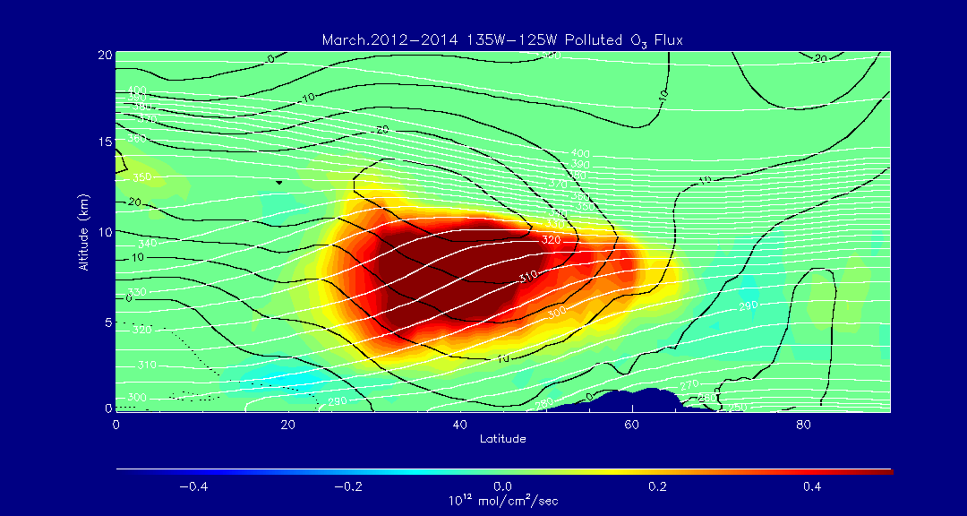
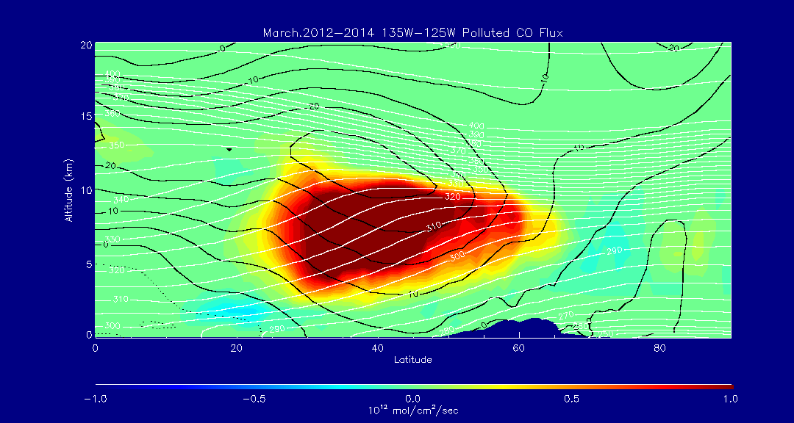
135W-125W Zonal Mean “Pollution” O3 Flux March 2012-14
Pollution
(O3>60ppbv,CO>150ppbv)
Largest polluted O3 an CO Fluxes are collocated near 7km – lower portion of mid-latitude jet
135W-125W Zonal Mean “Pollution” CO Flux March 2012-14

Slide 23
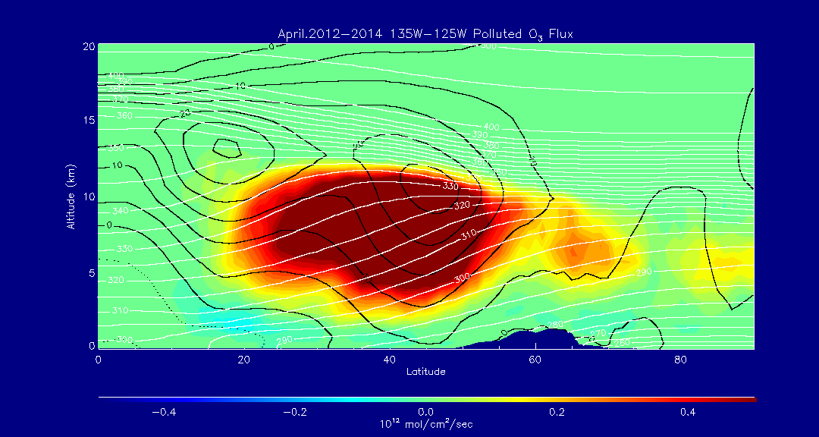
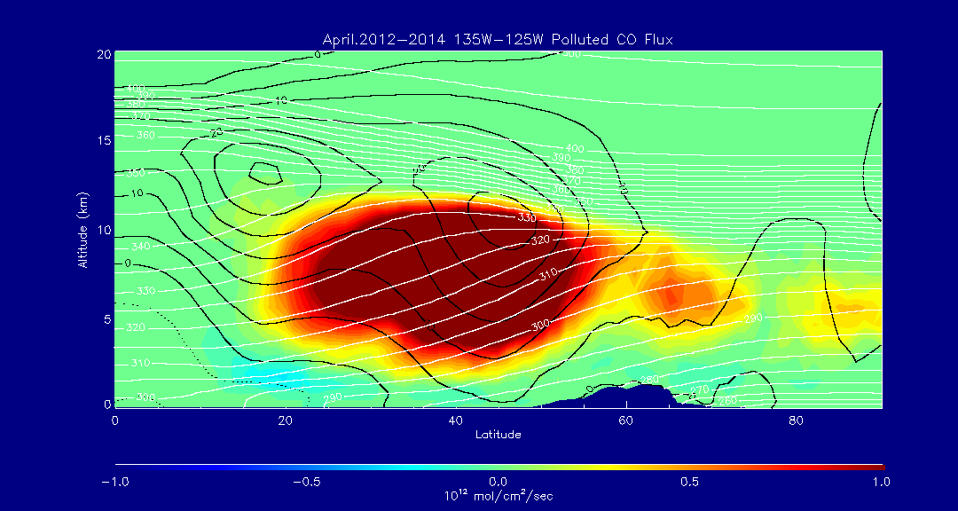
135W-125W Zonal Mean “Pollution” O3 Flux April 2012-14
Pollution
(O3>60ppbv,CO>150ppbv)
Largest polluted O3 an CO Fluxes are collocated near 7km – lower portion of mid-latitude jet
135W-125W Zonal Mean “Pollution” CO Flux April 2012-14

Slide 24
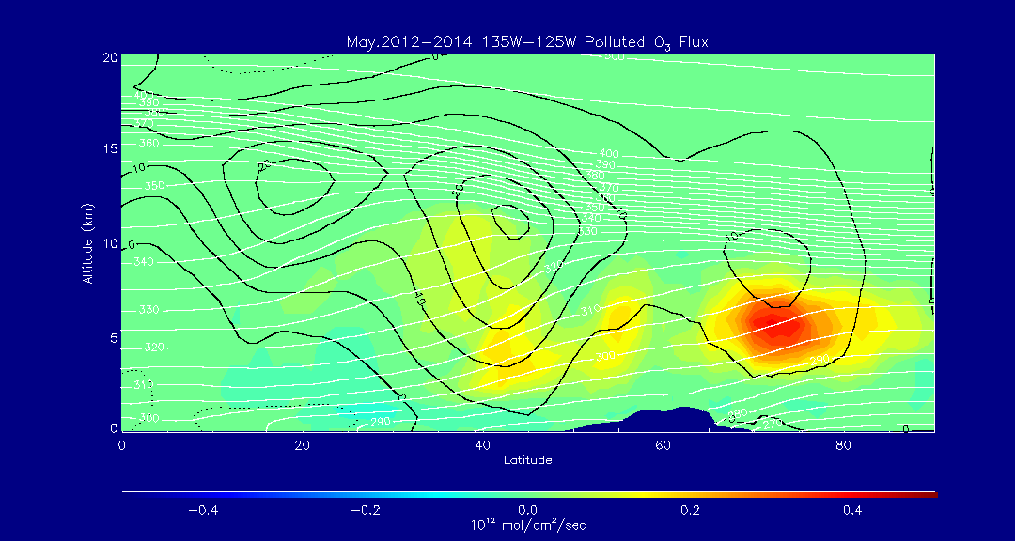
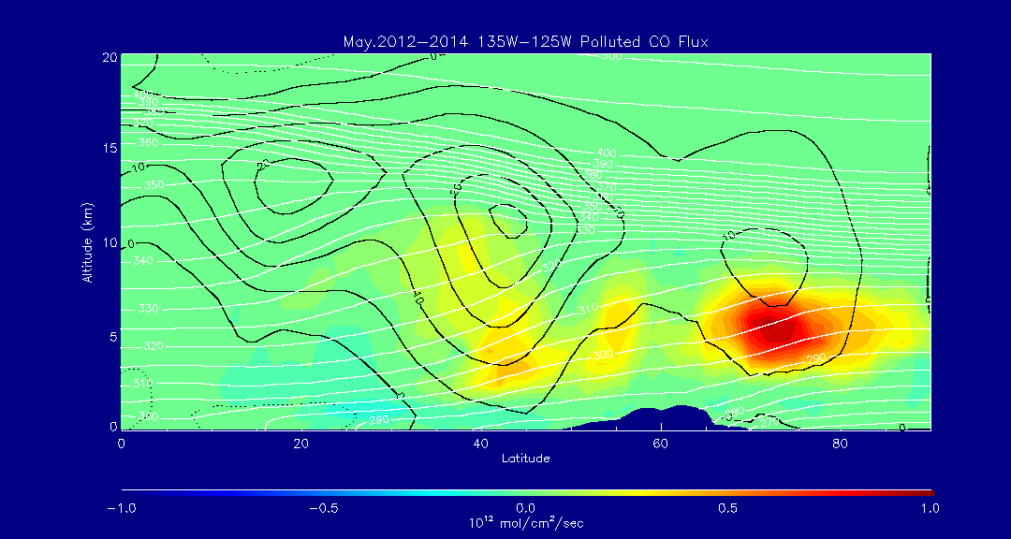
135W-125W Zonal Mean “Pollution” O3 Flux May 2012-14
Pollution
(O3>60ppbv,CO>150ppbv)
Largest polluted O3 an CO Fluxes are collocated near 5km –North of mid-latitude jet
Significant reduction in polluted fluxes within mid-latitude ject
135W-125W Zonal Mean “Pollution” CO Flux May 2012-14

Slide 25
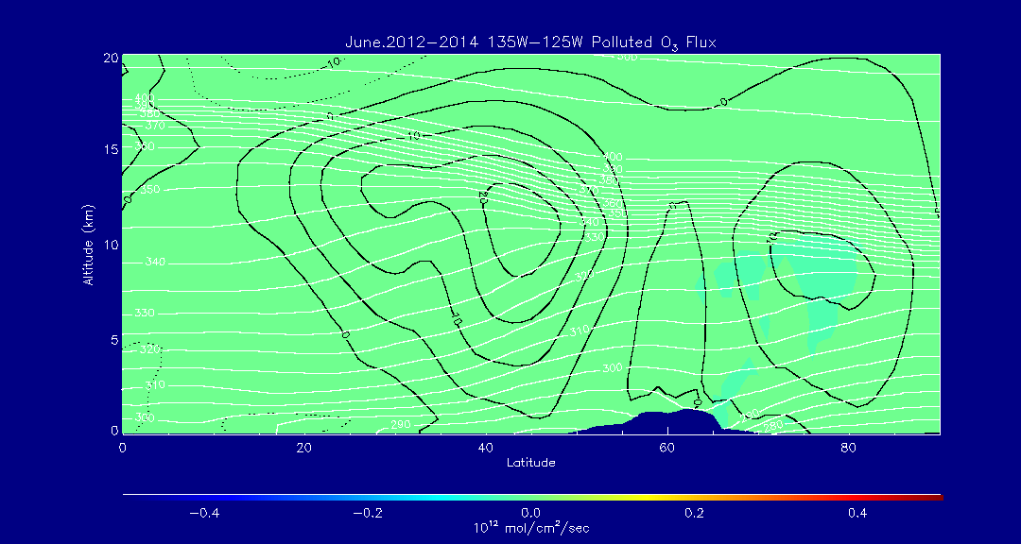

135W-125W Zonal Mean “Pollution” O3 Flux June 2012-14
Pollution
(O3>60ppbv,CO>150ppbv)
Polluted O3 an CO Fluxes are near zero (no events within threshold)
135W-125W Zonal Mean “Pollution” CO Flux June 2012-14

Slide 26
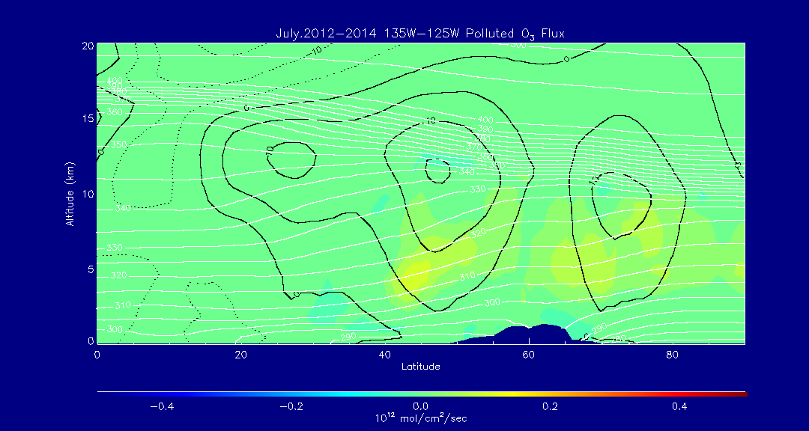
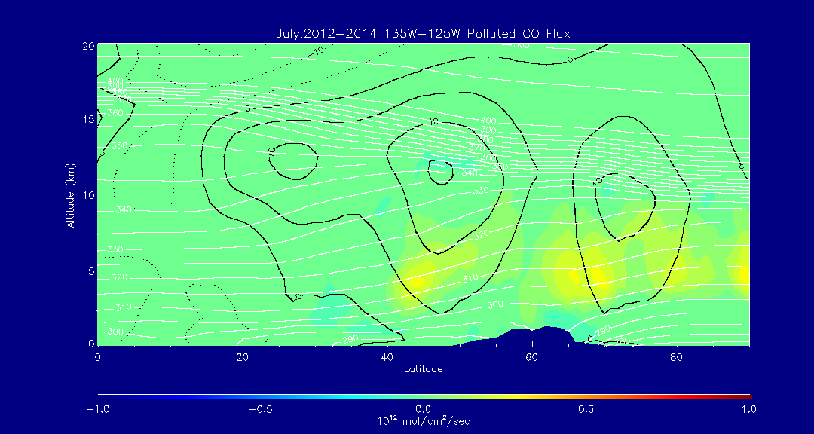
135W-125W Zonal Mean “Pollution” O3 Flux July 2012-14
Pollution
(O3>60ppbv,CO>150ppbv)
Largest polluted O3 an CO Fluxes are near 5km – below mid-latitude and polar jets
135W-125W Zonal Mean “Pollution” CO Flux July 2012-14

Slide 27
Spring 2015 Intercontinental Pollution Transport Event
(March 22-24, 2015)

Slide 28
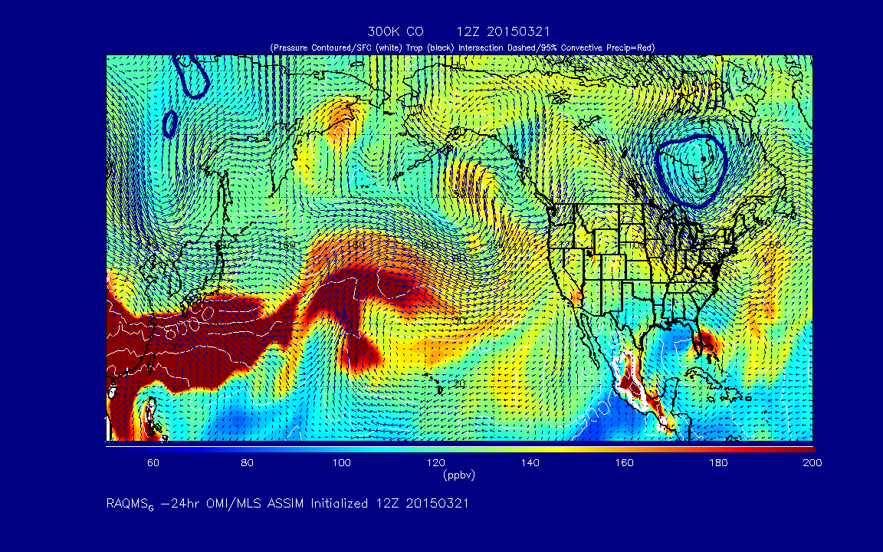
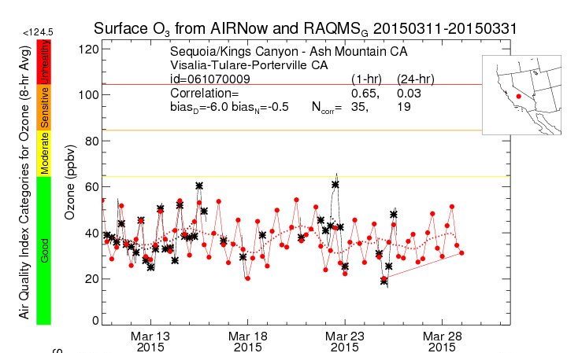


?
?

Slide 29
Reverse Domain Filling (RDF)
Analysis
Pierce, R. B. et. al. (2009), Impacts of background ozone production on Houston and Dallas, TX Air Quality during the TexAQS field mission, J. Geophys. Res., 114, D00F09, doi:10.1029/2008JD011337

Slide 30




Lagrangian Averaged O3
3km AGL
5 Day
RDF Analysis
18Z 03/22/2015
Lagrangian Averaged CO
Lagrangian Averaged O3 P-L
East Asian PBL Exposure

Slide 31




Lagrangian Averaged O3
3km AGL
5 Day
RDF Analysis
18Z 03/23/2015
Lagrangian Averaged CO
Lagrangian Averaged O3 P-L
East Asian PBL Exposure

Slide 32




Lagrangian Averaged O3
3km AGL
5 Day
RDF Analysis
18Z 03/24/2015
Lagrangian Averaged CO
Lagrangian Averaged O3 P-L
East Asian PBL Exposure

Slide 33
Extra Slides

Slide 34



Alpha Jet Atmospheric eXperiment (AJAX)
(Emma Yates and Laura Iraci, NASA Ames)
Description:
Based at and operated from Moffett Field, CA
Flight duration:
Approximately 2.5 hrs
Measurements:
O3, CH4, CO2, water vapor
O₃ Mission
San Joaquin Valley/Off Shore
5 June 2012

Slide 35

Origin of the tropospheric fold and subsequent Stratospheric Intrusion (SI)
Backward trajectories (white) beginning
at the AJAX Flight 47 path, and ending on May 30, 2012 (blue)
RAQMS ozone analysis at 150º W at 18Z on May 30, 2012 combined with the location of the SI trajectories on May 30, 2012 (blue)
Back-trajectory analysis shows that the origin of the SI event was within a region of high total column ozone over the Gulf of Alaska

Slide 36




NASA AJAX Flight 47, June 5, 2012
RAQMS
Nested RAQMS/WRFCHEM
310K isentrope
RAQMS (red)
AJAX (black)
WRFCHEM (red)
AJAX (black)
(A)
(B)
(A)
(B)
Nested RAQMS/WRFCHEM simulations significantly improve the agreement with AJAX measurements during the off-shore spiral (B) but still underestimate ozone within the narrow filament sampled during the spiral over the San Joaquin Valley, CA (A)

