Slide 1
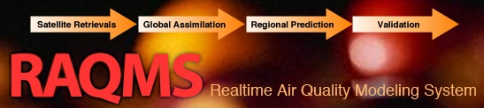

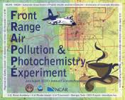

Real-time aerosol data assimilation experiments during the 2014 FRAPPE/DISCOVER-AQ field mission
Brad Pierce (NOAA/NESDIS/STAR/CIMSS)
AOS Colloquium, Monday, November 24, 3:30pm Room 811

Slide 2
The Front Range Air Pollution and Photochemistry Éxperiment (FRAPPÉ) field campaign took place from July 16 to August 18, 2014.
  FRAPPE was collaborative effort between the Colorado Department of Public Health and the Environment, the University of Colorado and Colorado State University, UC Berkeley, and other university collaborators, local projects and agencies including local school districts, NASA, NOAA, and NCAR.
The mission was closely coordinated with the NASA DISCOVER-AQ project, which agreed to conduct their final aircraft deployment in the Colorado Front Range.
  DISCOVER-AQ, a NASA Earth Venture program funded mission, stands for Deriving Information on Surface Conditions from Column and Vertically Resolved Observations Relevant to Air Quality.
Principal Investigators: Gabi Pfister and Frank Flocke (NCAR), Jim Crawford (NASA).

Slide 3
Online global chemical and aerosol assimilation/forecasting system
Modeling Framework (1x1 degree):
UW-Madison hybrid θ−η coordinate model (UW-Hybrid) dynamical core
Unified stratosphere/troposphere chemical prediction scheme developed at NASA LaRC
Aerosol prediction scheme (GOCART) developed by Mian Chin (NASA GSFC).
Statistical Digital Filter (SDF) aerosol and chemical data assimilation developed by Jim Stobie (NASA GSFC)
Real-time assimilation:
Microwave Limb Sounder (MLS) stratospheric ozone profiles (above 50mb)
Ozone Monitoring Instrument (OMI) total ozone column (cloud cleared)
Moderate Resolution Imaging Spectroradiometer (MODIS) Aerosol Optical Depth (AOD)
Real-time fire detection:
Moderate Resolution Imaging Spectroradiometer (MODIS)
Developed in partnership with NASA LaRC and maintained at UW-Madison
(Prof. Don Johnson, Allen Lenzen, Todd Schaack)
http://raqms-ops.ssec.wisc.edu/index.php (North America/Pacific Sector)
http://raqms.ssec.wisc.edu/index.php (CONUS)
Notes:
3

Slide 4
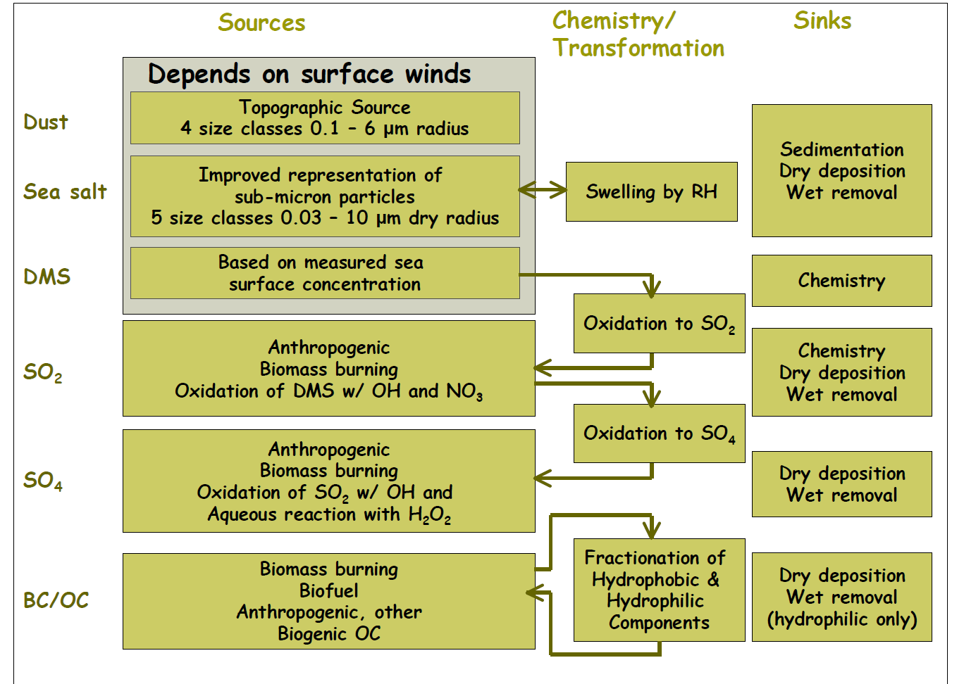
GOCART Aerosol Module

Slide 5
Why Include Aerosols in the Predictive Systems?
Radiation: Aerosols affect radiation both directly (via scattering and absorption) and indirectly (through cloud-radiation interaction)
Hurricane forecasts: Dust-laden Saharan air layer reduces occurrence of deep convection and suppresses tropical cyclone activities
Data Assimilation: Aerosols are one of key sources of errors in SST retrievals and an important component for accurate radiance data assimilation
Regional air quality: Aerosol (lateral an upper) boundary conditions are needed for regional air quality predictions
Aviation and visibility: Emissions from large wild fires and volcanic eruption affect aviation route planning and visibility forecasts
Public Health: Fine particulate matter (PM2.5) is the leading contributor to premature deaths from poor air quality
From Sarah Lu (NCEP) NEMS/GFS Modeling Summer School

Slide 6
Development of NEMS GFS Interactive Atmosphere-Aerosol Forecast System
In-line chemistry advantage
  Consistency: no spatial-temporal interpolation, same physics parameterization
  Efficiency: lower overall CPU costs and easier data management
  Interaction: Allows for aerosol feedback to meteorology
NEMS GFS Aerosol Component
  Model Configuration:
    Forecast model: Global Forecast System (GFS) based on NOAA Environmental Modeling System (NEMS), NEMS-GFS
    Aerosol model: NASA Goddard Chemistry Aerosol Radiation and Transport Model, GOCART
  NEMS GFS and GOCART are interactively connected using ESMF coupler components
  Despite the ESMF flavor in how GOCART is implemented, GOCART is incorporated into NEMS GFS as a column process
http://www.emc.ncep.noaa.gov/gmb/sarah/NGAC/html/realtime.fcst.glb.html
From Sarah Lu (NCEP) NEMS/GFS Modeling Summer School

Slide 7
Future Operational Benefits Associated with
NEMS GFS Aerosol Component
Enables future operational global short-range (e.g., 5-day) aerosol prediction
Provides a first step toward an operational aerosol data assimilation capability at NOAA
Allows aerosol impacts on medium range weather forecasts to be considered
Allows NOAA to explore aerosol-chemistry-climate interaction in the Climate Forecast System (CFS)
Provides global aerosol information required for various applications (e.g., satellite radiance data assimilation, satellite retrievals, SST analysis, UV-index forecasts, solar electricity production)
Provides lateral aerosol boundary conditions for regional aerosol forecast system
From Sarah Lu (NCEP) NEMS/GFS Modeling Summer School

Slide 8
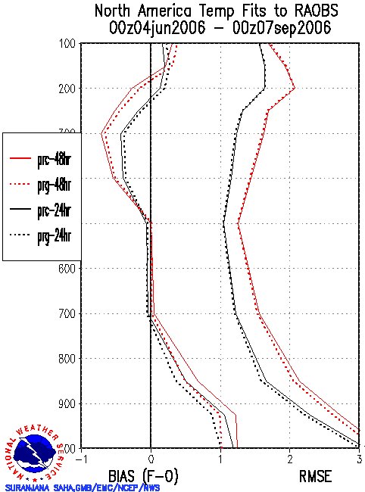
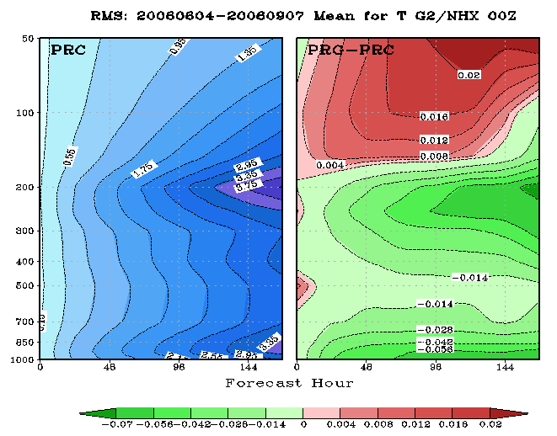
Aerosol-Radiation Feedback:
Impact of Aerosols on Weather Forecasts
Verification against analyses and observations indicates a positive impact in temperature forecasts due to realistic time-varying treatment of aerosols.
T126 L64 GFS/GSI# experiments for the 2006 summer period
PRC uses the OPAC climatology (as in the operational applications)
PRG uses the in-line GEOS4-GOCART% dataset (updated every 6 hr)
#: 2008 GFS package
%: In-line GEOS4-GOCART
From Sarah Lu (NCEP) NEMS/GFS Modeling Summer School

Slide 9
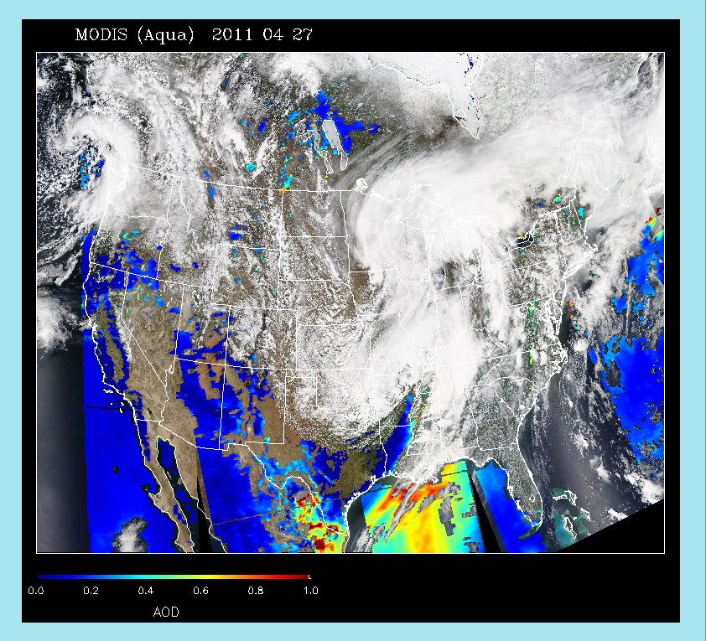
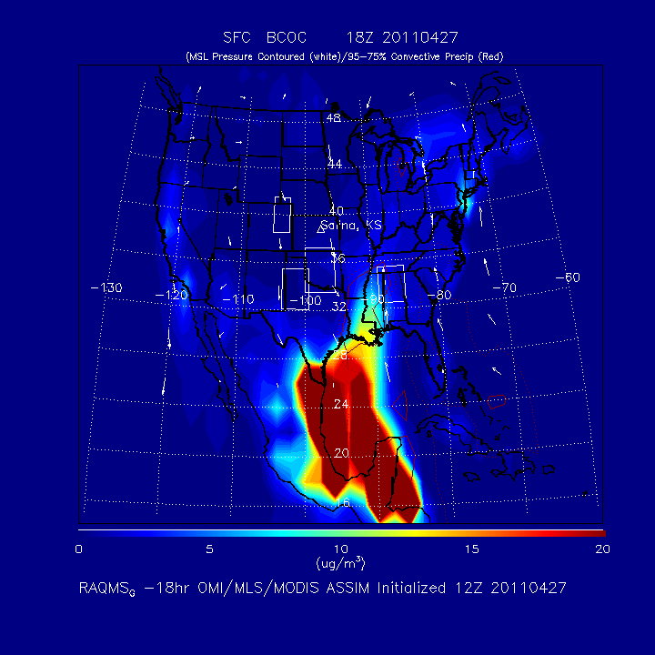
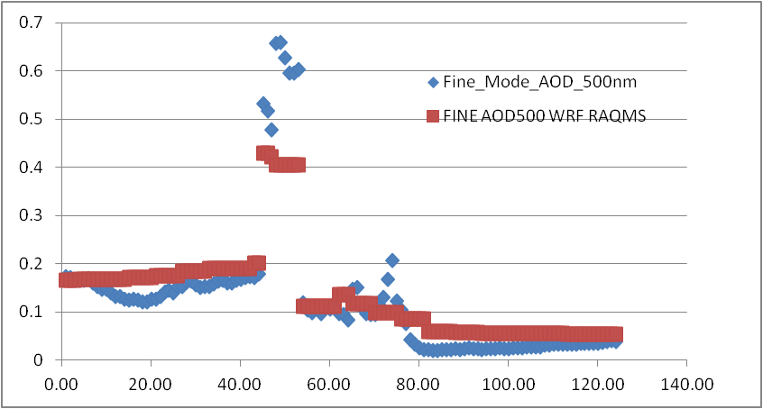
Case Study: Severe weather April 27th, 2011 (Huntsville tornado)
MODIS aerosol optical depth (AOD) shows significant aerosol loading over Gulf within warm sector of storm
RAQMS surface Black and Organic Carbon (BCOC) analysis shows highly elevated aerosols
RAQMS used to initialize and provide lateral boundary conditions for 4km WRF-CHEM with explicit (MOSAIC) aerosol/cloud interaction
27th
Aeronet AOD Louisiana
WRF-Chem
OBS
26th
28th

Slide 10
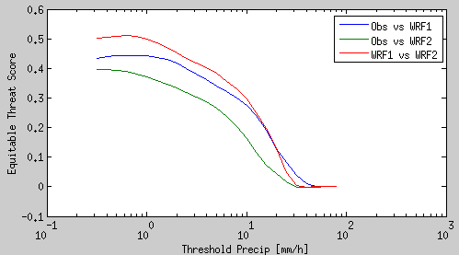
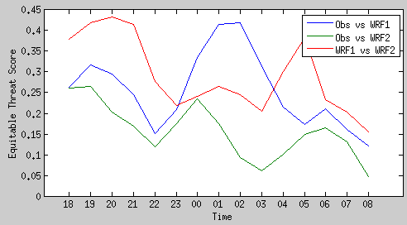
Precip. Obs vs WRF & WRF-Chem
Skill for 3h accum precip. vs different precip. thresholds
Simulations with and without aerosol effects yield very different precipitation fields
Skill to represent observation is reduced for the larger precip. values
There is improved skill when considering aerosol effects
OBS vs WRF-Chem RAQMS
WRF-Chem vs WRF
OBS vs WRF NO-CHEM
Skill for 3h accum. precip. over 10mm
27th
28th
UTC

Slide 11
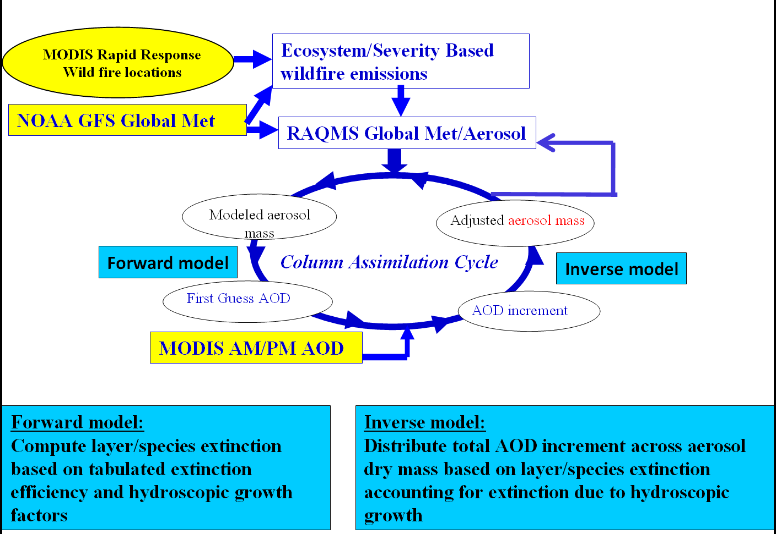
Real-time Air Quality Modeling System (RAQMS)
Aerosol Optical Depth (AOD) Assimilation Procedure
Forward model:
where q_{ik} is the mass mixing ratio and β_{ik} is the mass specific extinction of aerosol species i at the vertical level k. dz is the thickness of the layer. The mass specific extinction is a function of the local relative humidity.
Notes:
11
11

Slide 12
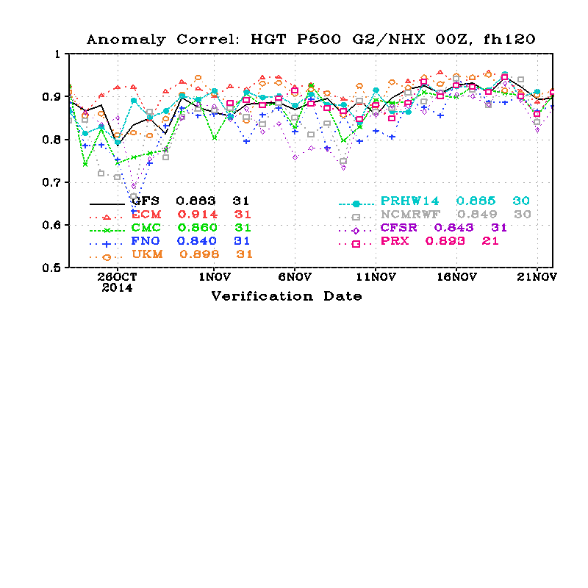
Assessment of Global 850mb Aerosol Extinction Forecast Skill –July-August 2014
  Anomaly Correlations (AC)
    Correlation between forecast and analysis
    July-August mean removed
    Spectrally truncated to wavenumber 20
    Averaged from 20N-80N
useful Skill
http://www.emc.ncep.noaa.gov/gmb/STATS/html/monarch.html

Slide 13
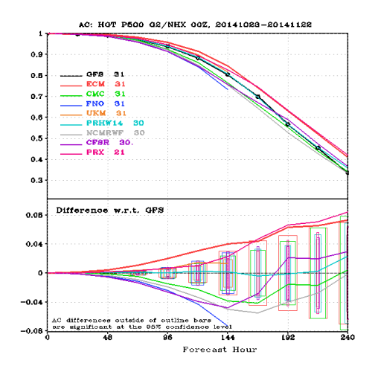
Anomaly correlation “Die-off” Curves
Time average of anomaly correlations for forecasts of 500-hPa heights as a function of forecast day, verifying Oct 23- Nov 22, 2014
useful Skill

Slide 14
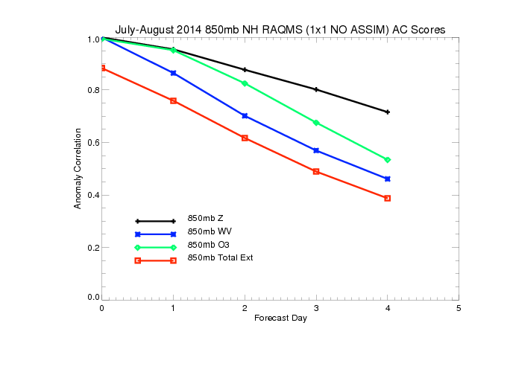
Northern Hemisphere 850mb July-August 2014 Anomaly Correlations (AC)
(No Assimilation)
useful Skill
850mb ozone forecasts have useful skill past 3 days (significantly better than water vapor)
850mb extinction forecasts have useful skill to 2 days (significantly worse than water vapor)

Slide 15
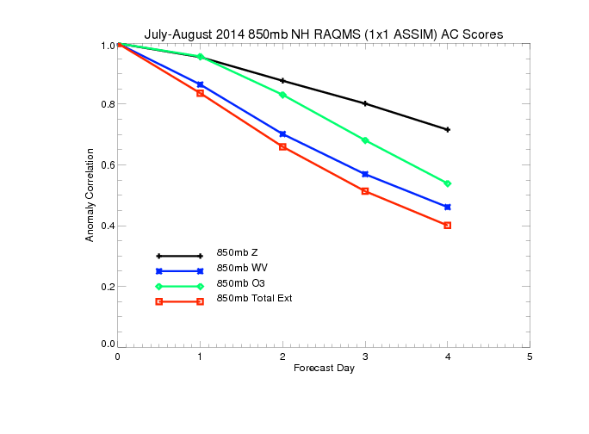
Northern Hemisphere 850mb July-August 2014 Anomaly Correlations (AC)
(With O3/AOD Assimilation)
useful Skill
Assimilation of O3 retrievals results in slight improvements in 850mb ozone forecasts
Assimilation of AOD retrievals results in significant improvement in 850mb extinction
forecasts with useful skill at ~2.5 days

Slide 16
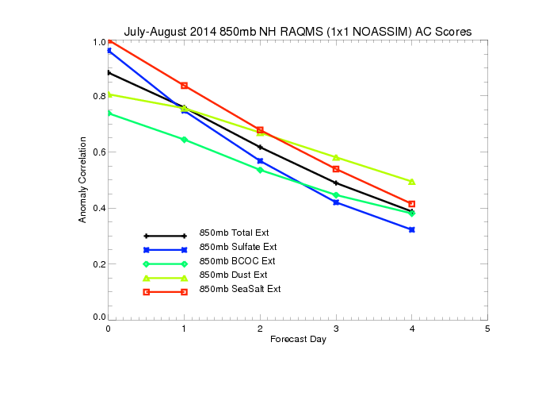
Northern Hemisphere 850mb July-August 2014 Anomaly Correlations (AC)
(Without MODIS Assimilation)
useful Skill
Only 850mb SO4 extinction forecasts useful skill past 1 day
Black and organic carbon (BC+OC) and dust extinctions are both poorly initialized and
forecasted

Slide 17
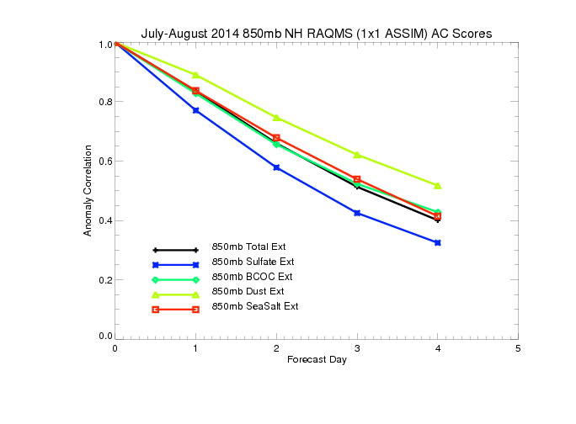
Northern Hemisphere 850mb July-August 2014 Anomaly Correlations (AC)
(With MODIS Assimilation)
useful Skill
MODIS AOD assimilation results in significant improvements in black and organic carbon (BC+OC) and dust forecast skill (dust prediction useful at 3 days, smoke prediction useful at 2 days)

Slide 18
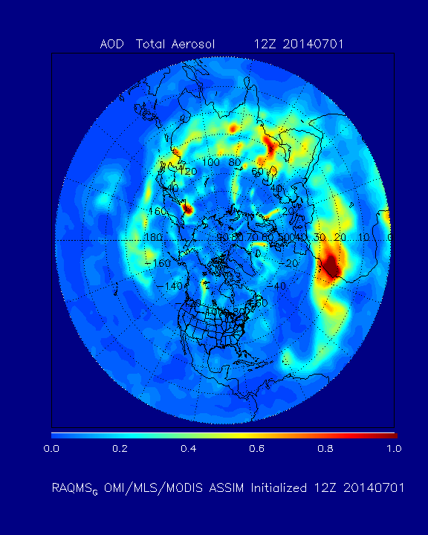
RAQMS Real-time
Total AOD Analysis
July-August, 2014

Slide 19
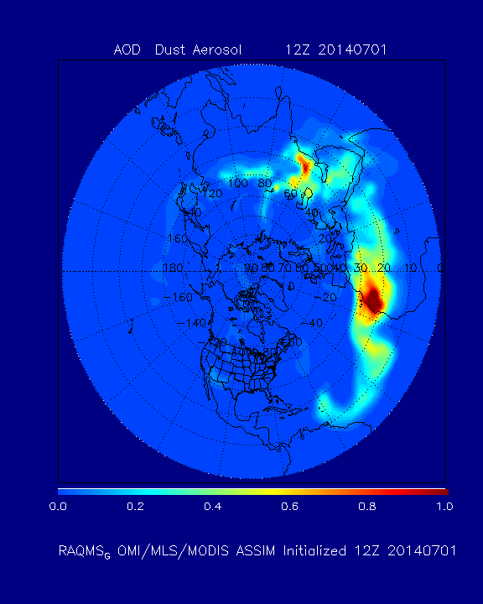
RAQMS Real-time
Dust AOD Analysis
July-August, 2014

Slide 20
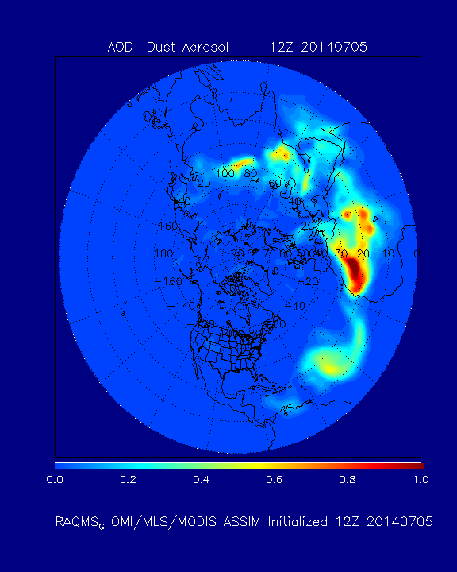
RAQMS Real-time
Dust AOD Analysis
12Z July 05, 2014

Slide 21
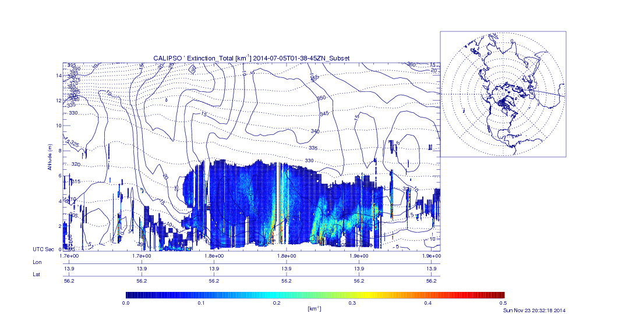
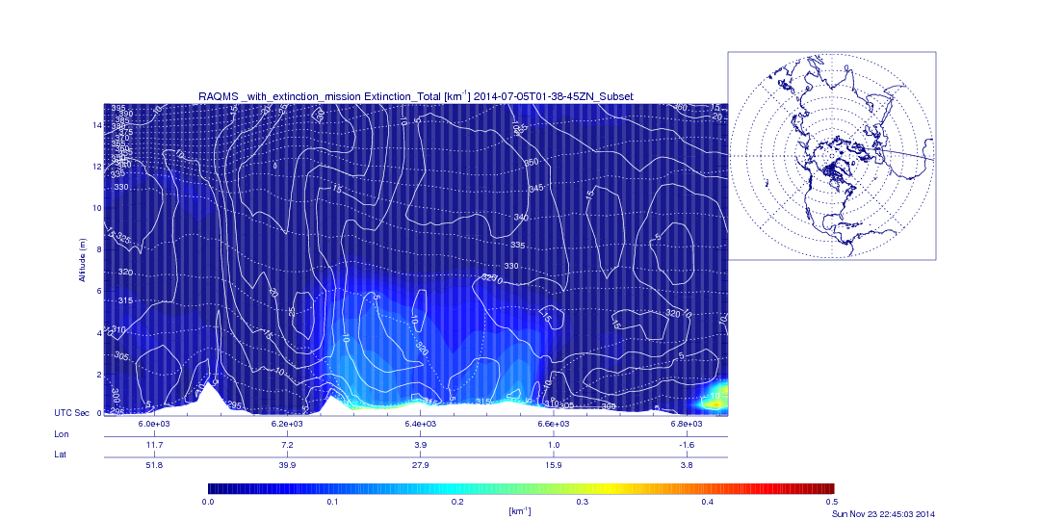
CALIPSO vs RAQMS Aerosol Extinction Profile (km⁻¹) 01:38Z July 05, 2014

Slide 22
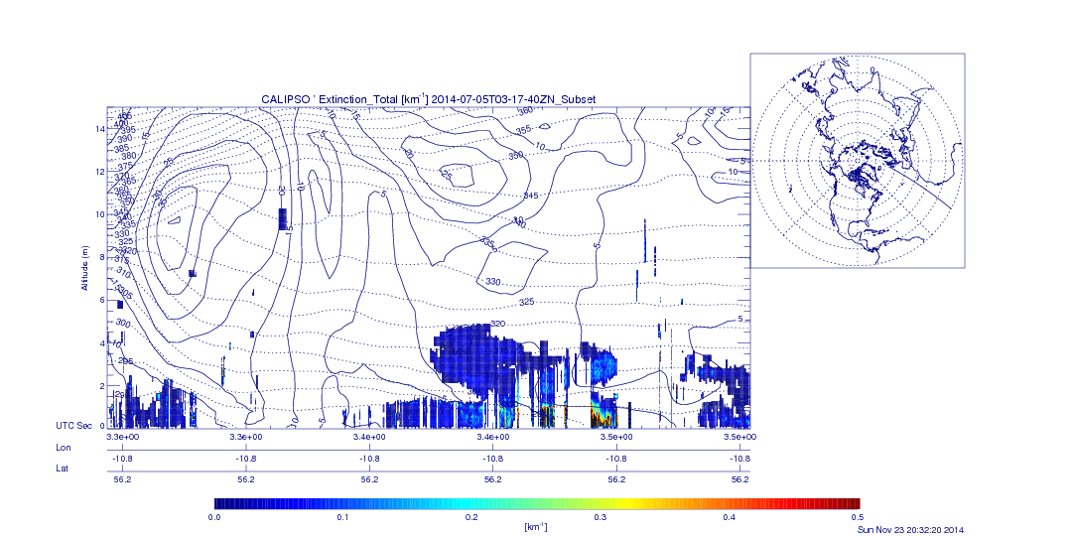
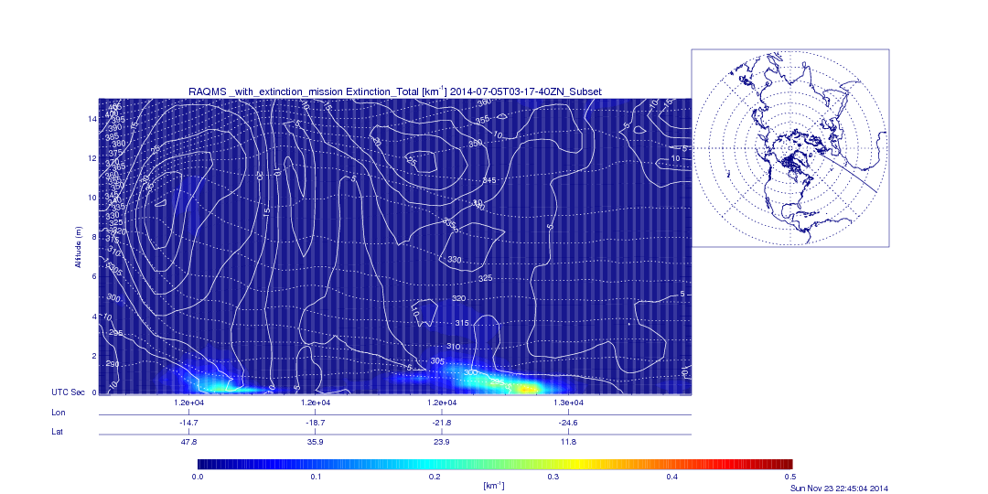
CALIPSO vs RAQMS Aerosol Extinction Profile (km⁻¹) 03:17Z July 05, 2014

Slide 23
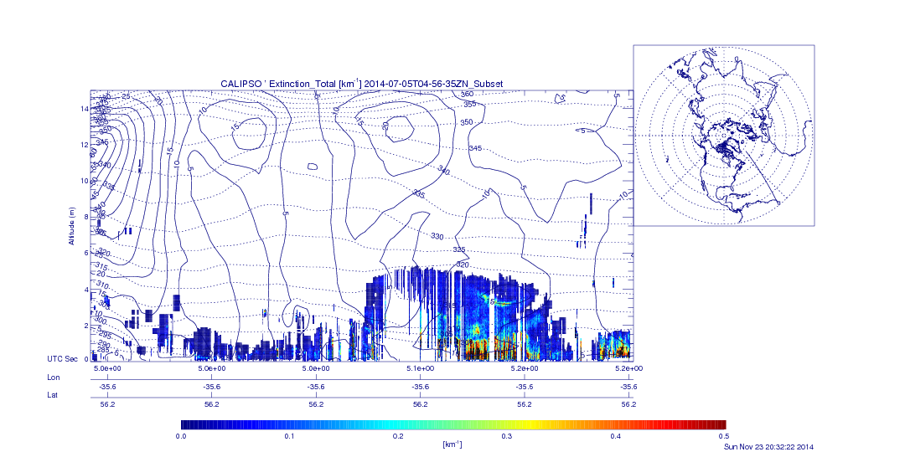
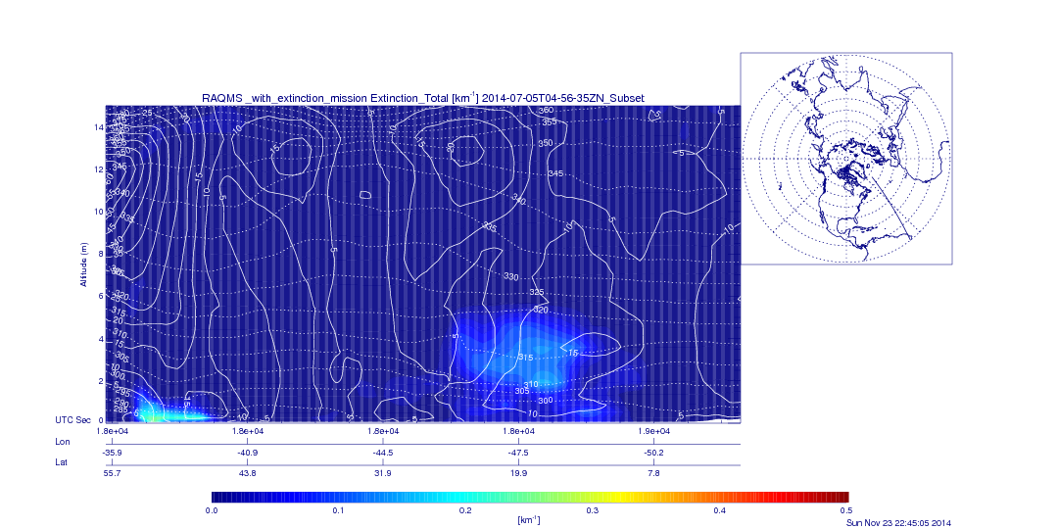
CALIPSO vs RAQMS Aerosol Extinction Profile (km⁻¹) 04:56Z July 05, 2014

Slide 24
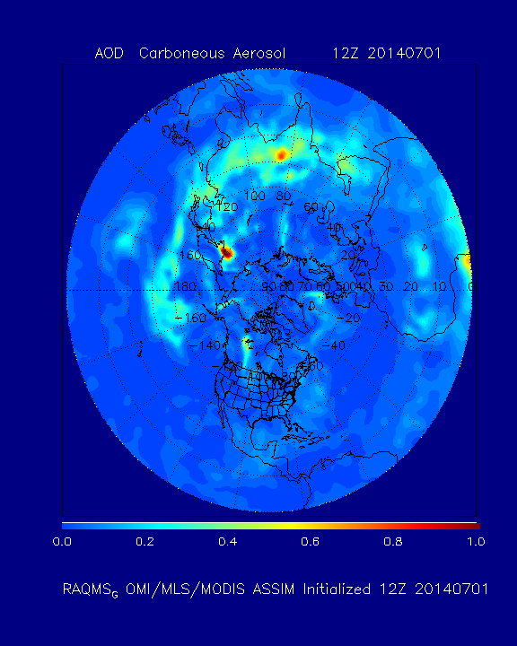
RAQMS Real-time
BCOC AOD Analysis
July-August, 2014

Slide 25
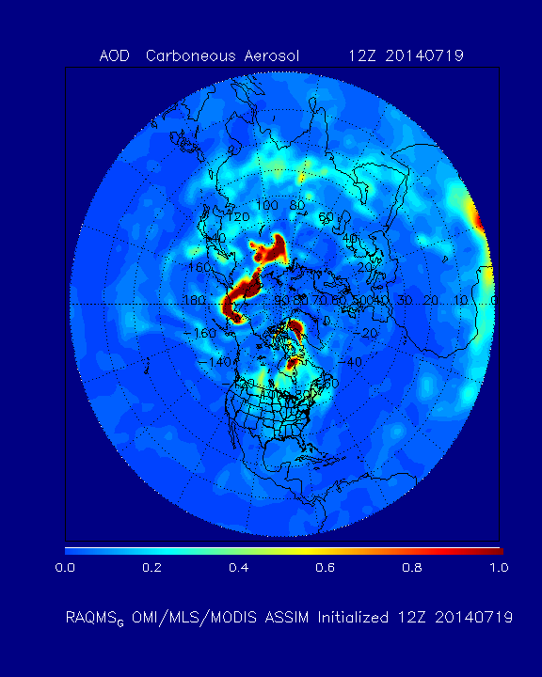
RAQMS Real-time
BCOC AOD Analysis
12Z July 19, 2014

Slide 26
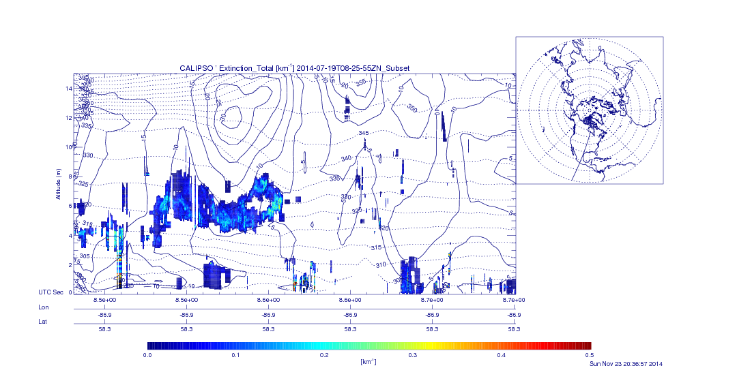
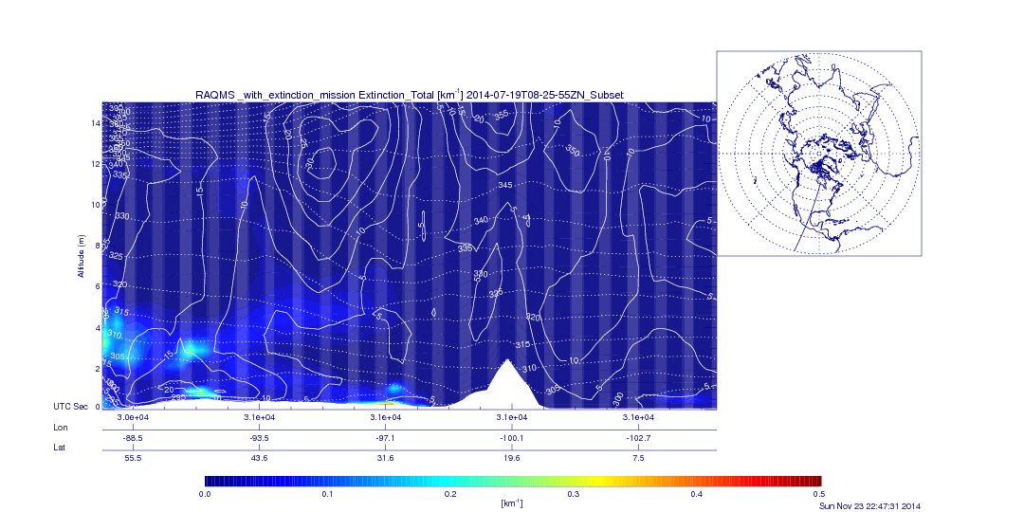
CALIPSO vs RAQMS Aerosol Extinction Profile (km⁻¹) 08:25Z July 19, 2014

Slide 27
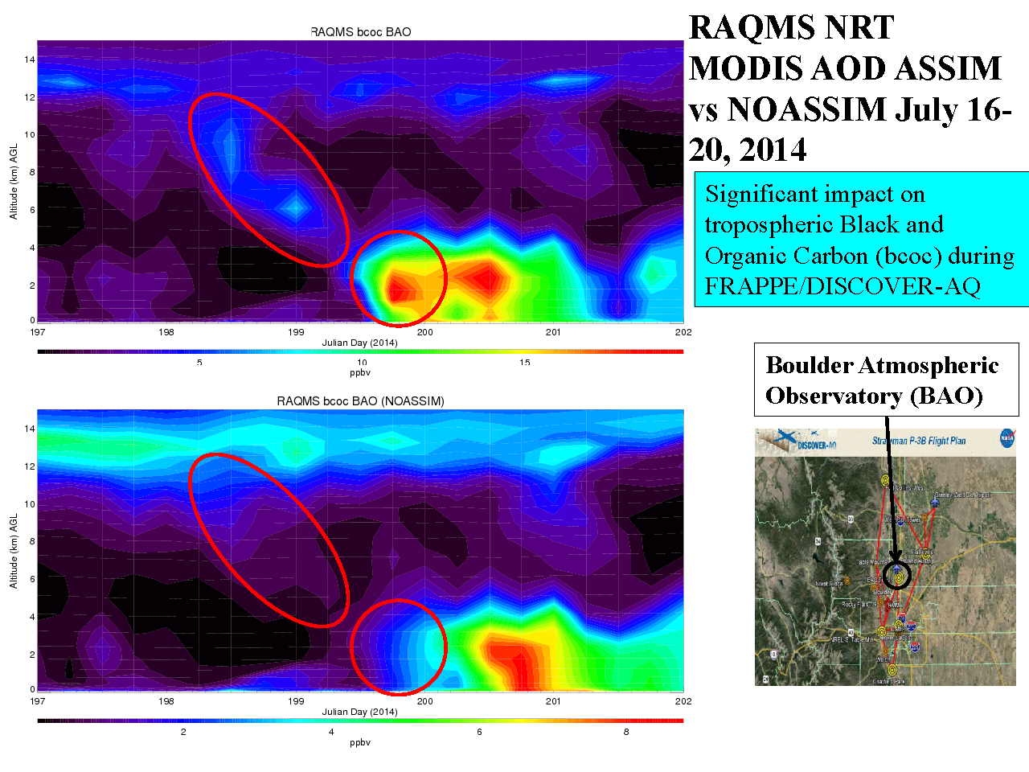
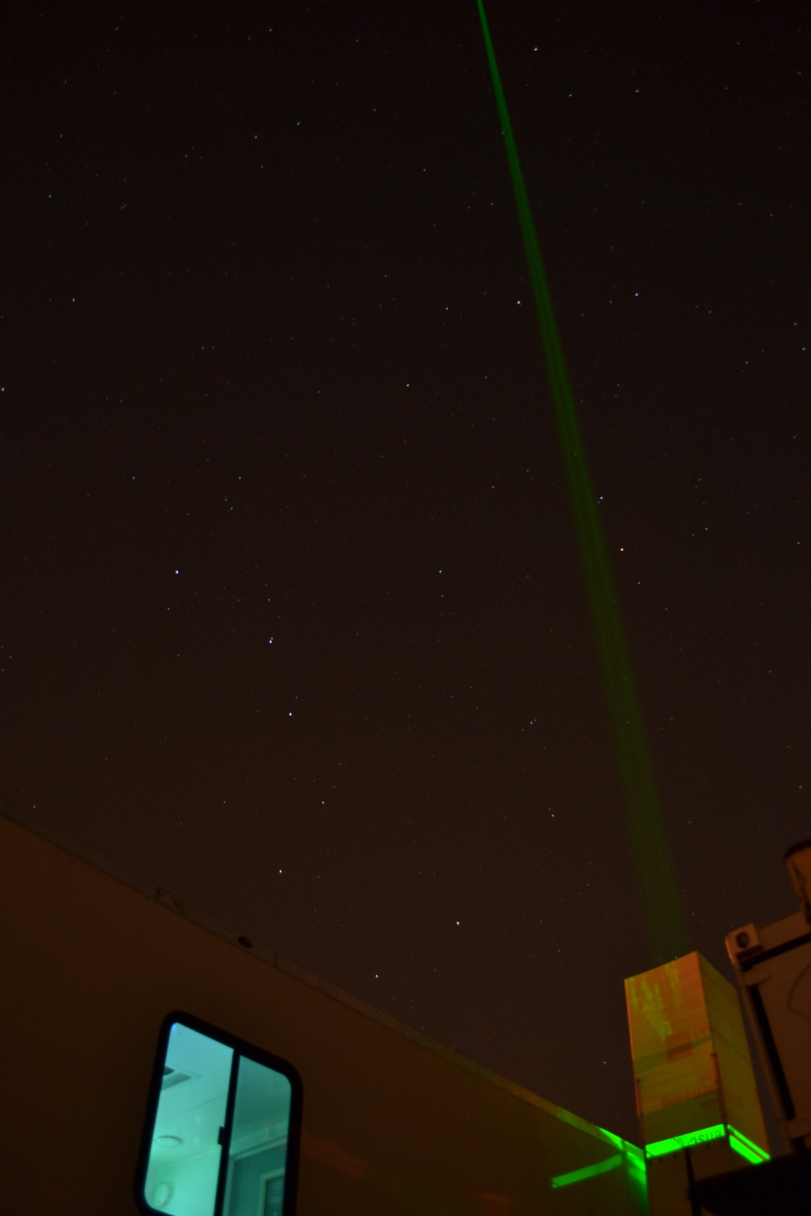
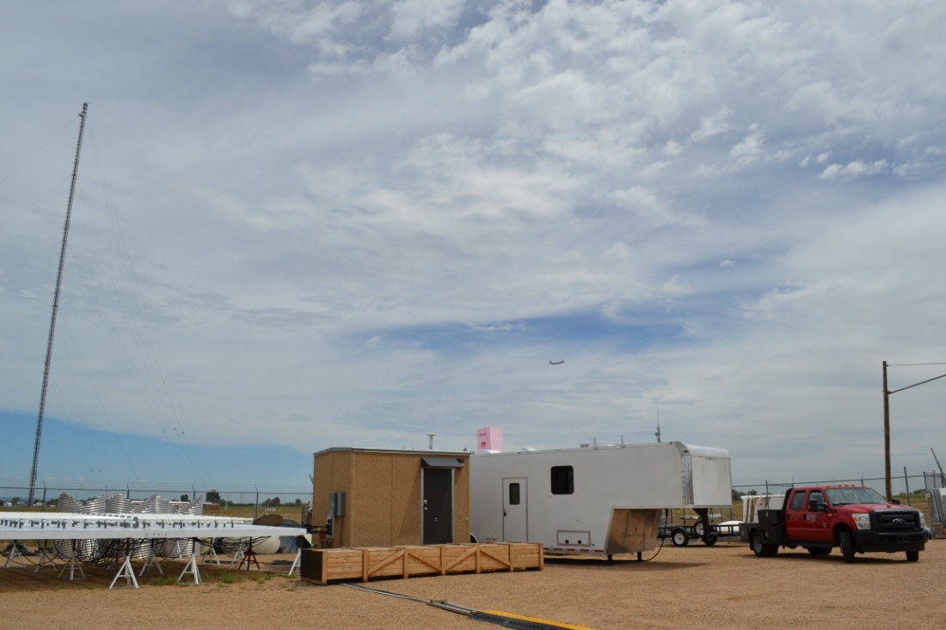
Under support from the State of Colorado UW-Madison/SSEC deployed HSRL Lidar and AERI instruments at BAO during FRAPPE/DISCOVER-AQ
Photo credits: John Lalande, SSEC

Slide 28
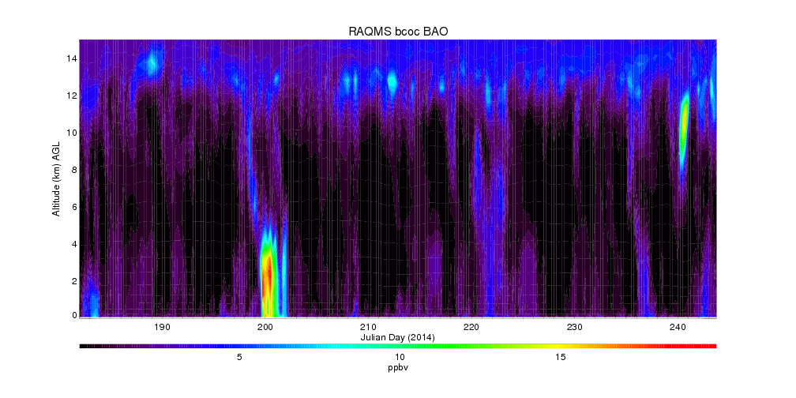
RAQMS smoke (Black and Organic Carbon) Analysis
BAO July-August 2014
July 16-20, 2014

Slide 29
RAQMS Smoke prediction (with MODIS AOD Assimilation)
RAQMS MODIS AOD ASSIM vs
NO ASSIM
July 16-20, 2015
RAQMS Smoke prediction (no MODIS AOD Assimilation)

Slide 30
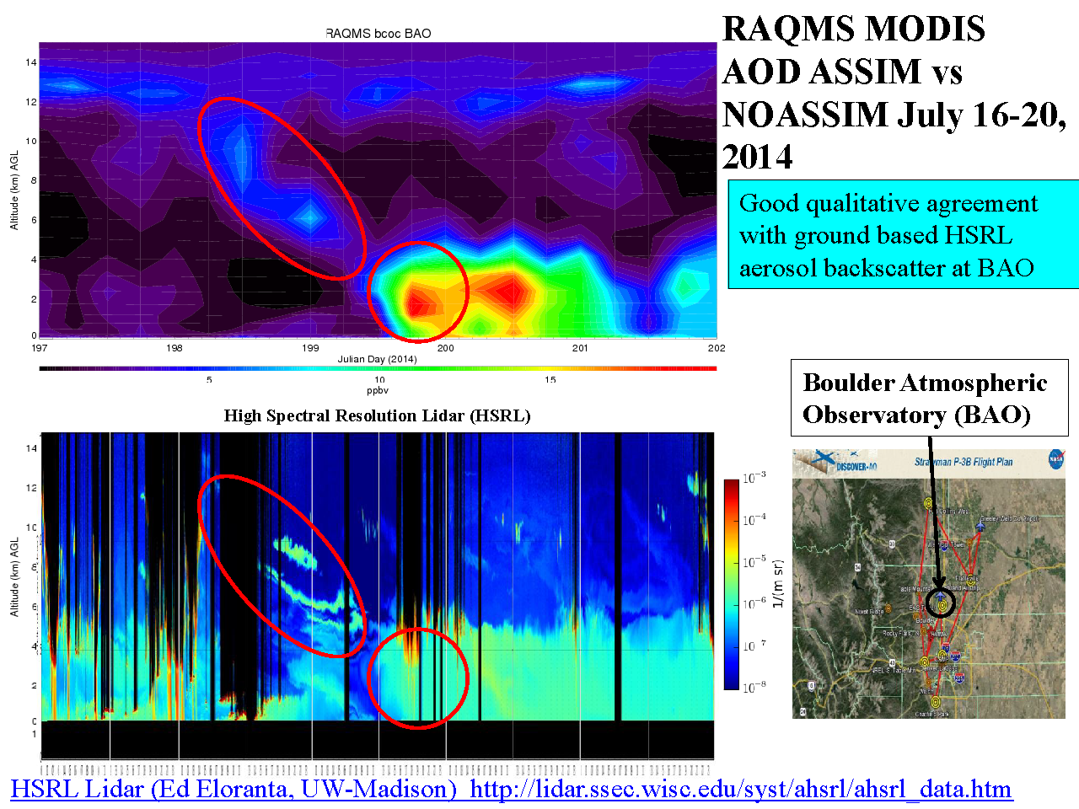
RAQMS Smoke prediction (with MODIS AOD Assimilation)
RAQMS MODIS AOD ASSIM vs
UW HSRL
July 16-20, 2015

Slide 31
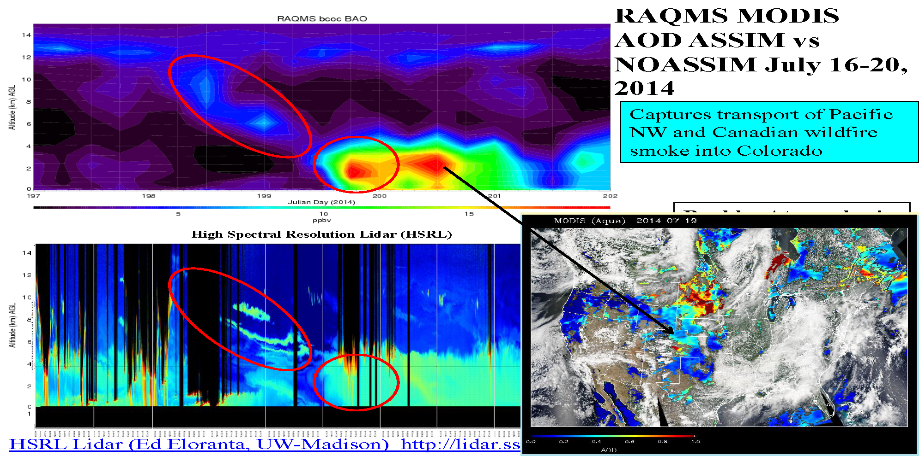
RAQMS Smoke prediction (with MODIS AOD Assimilation)
RAQMS MODIS AOD ASSIM vs
UW HSRL
July 16-20, 2015

Slide 32
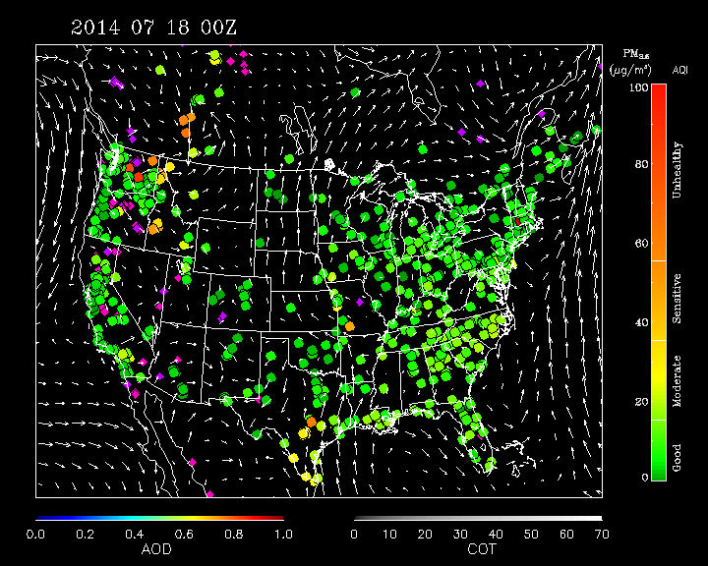
IDEA wildfire, AirNow, MODIS Composite July 18-21, 2014
Infusion Satellite Data into Environmental Applications
(IDEA, http://www.star.nesdis.noaa.gov/smcd/spb/aq/

Slide 33
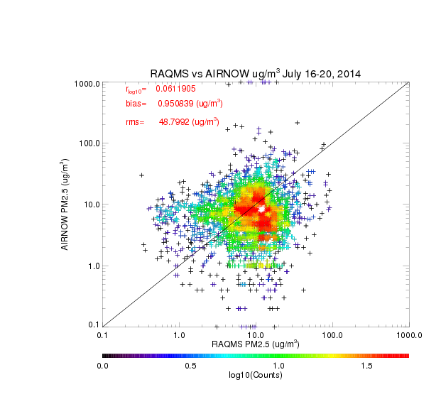
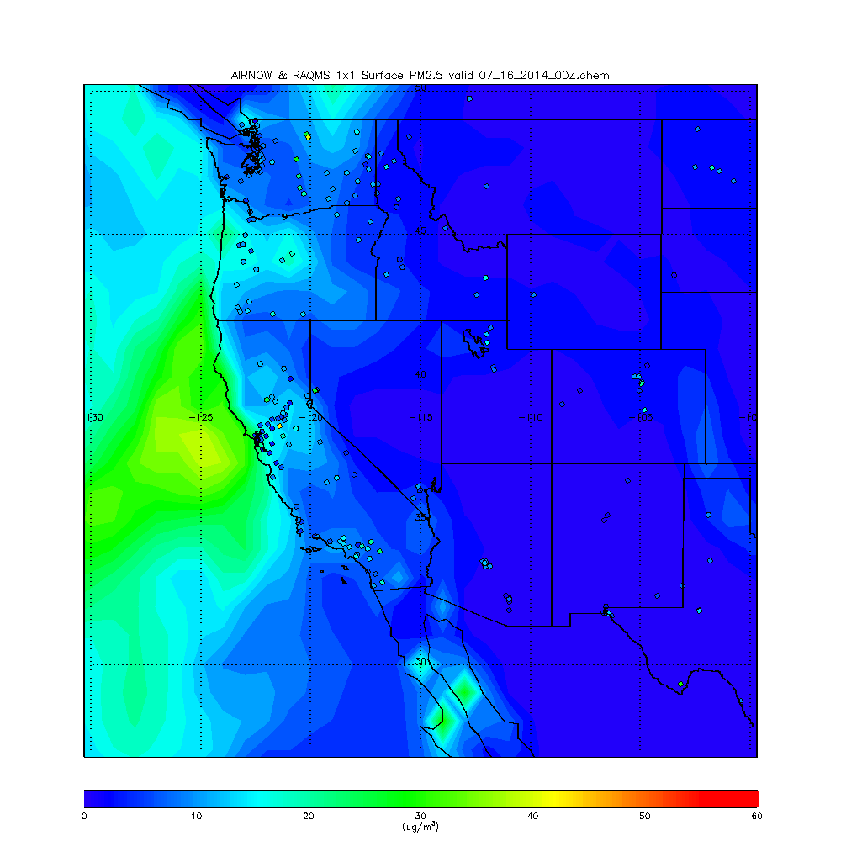
Western US RAQMS vs AIRNow PM2.5 July 16-20, 2015
RAQMS PM2.5 slows relatively low bias (0.95ug/m³) but large RMS errors (48.99 ug/m³) over Western US fire region
Log(PM2.5) correlation = 0.06

Slide 34
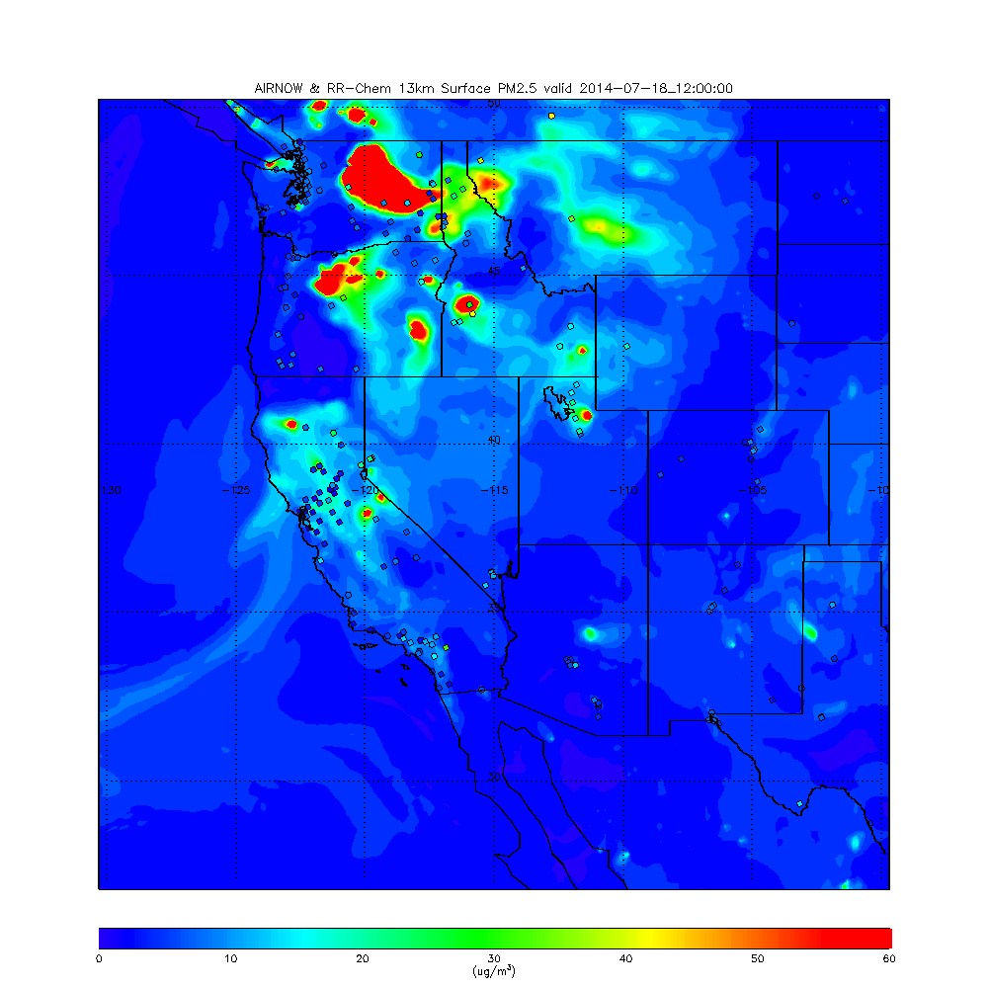
Rapid Refresh with Chemistry
Real time forecasts predicting weather and air quality
NOAA/ESRL forecast model based on a 13km Weather Research and Forecasting (WRF) coupled with chemistry via the RACM chemical mechanism including MOSAIC/VBS for better prediction of secondary orangic aerosols (SOA).
Chemical/Aerosol transport performed online with the meteorology.
Lateral chemical boundary conditions obtained from RAQMS model real time forecasts
http://ruc.noaa.gov/wrf/WG11_RT/ (Georg Grell and Steve Peckham, NOAA/ESRL)

Slide 35
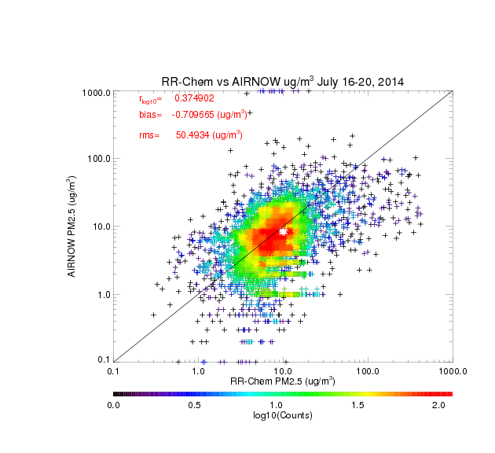
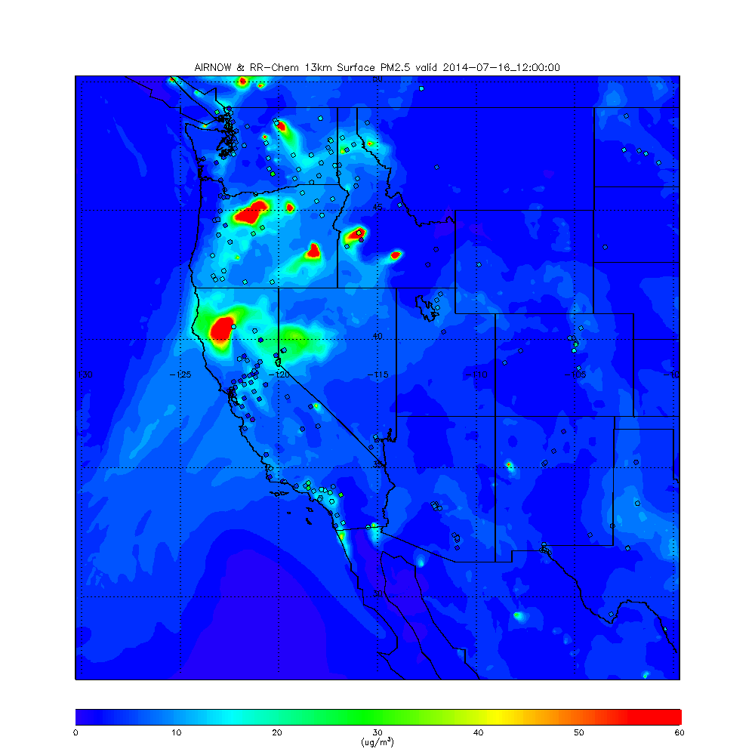
Western US RR-Chem vs AIRNow PM2.5 July 16-20, 2015
RR-Chem PM2.5 slows relatively low bias (-0.71 ug/m³) but still has large RMS errors (50.49 ug/m³) over Western US fire region
Log(PM2.5) correlation = 0.37

Slide 36
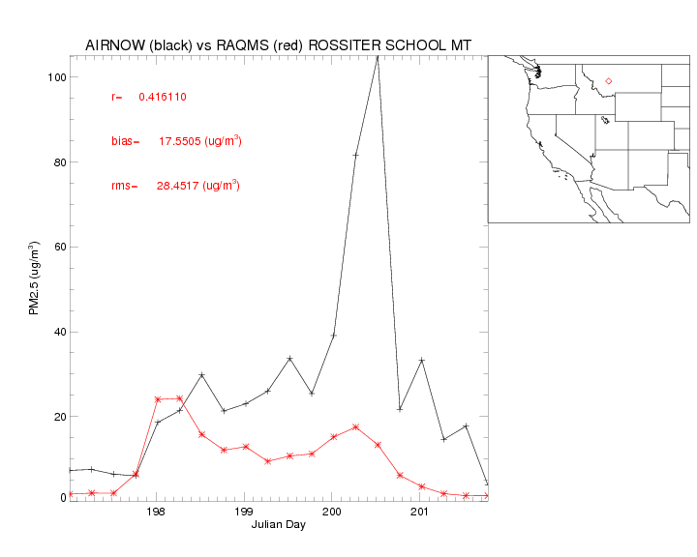

Slide 37
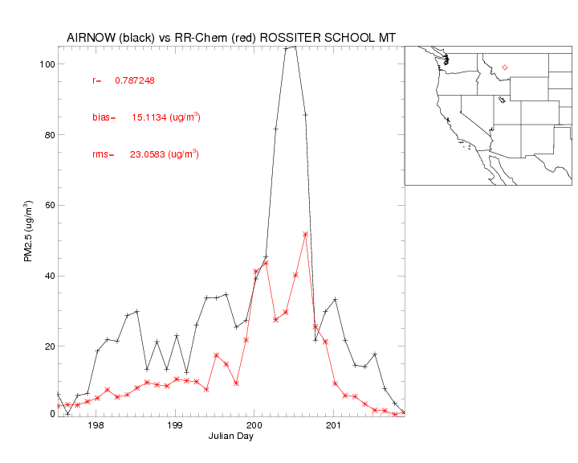

Slide 38
Conclusions
Real-time assimilation of Aerosol Optical Depth (AOD) retrievals from the MODIS instrument on NASA Terra and Aqua satellites within the Real-time Air Quality Modeling System (RAQMS) results in significant improvements in global dust and smoke forecasts.
  These assimilation experiments help to guide the development of future operational aerosol forecasting systems within the NOAA Environmental Modeling System (NEMS).
However, global scale aerosol analyses do not show skill in estimating surface PM2.5 concentrations associated with wildfires in the western US during FRAPPE/DISCOVER-AQ (July-August, 2014) due to the coarse resolution of the analyses
  Nested real-time aerosol predictions using RAQMS and 13km RR-Chem show improved skill in estimating surface PM2.5 during this timeperiod, but still have large rms errors
  These errors are likely due to uncertainties in wildfire emissions and errors in smoke transport within complex topography
NOAA/ESRL is currently conducting 3km High Resolution Rapid Refresh (HRRR) smoke forecasts over the western US to try to improve smoke predictions during wildfire events

Slide 39
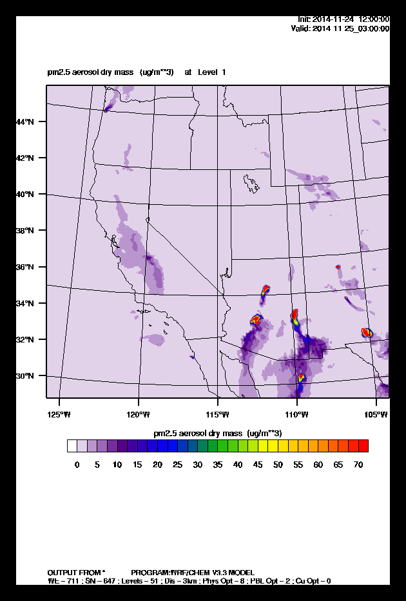
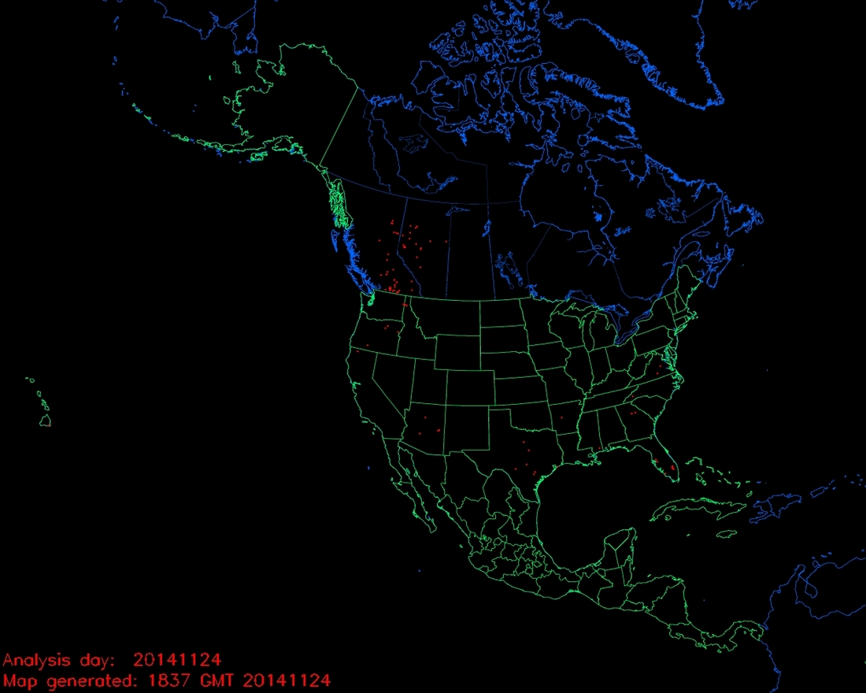
HRRR-Chem Smoke forecast November 24, 2014
NOAA NESDIS Hazard Mapping System (HMS)
http://rapidrefresh.noaa.gov/HRRR/Welcome.cgi?dsKey=hrrr_chem_zeus

Slide 40
HRRR-Chem Smoke forecast November 24, 2014
NOAA NESDIS Hazard Mapping System (HMS)
Questions?
http://rapidrefresh.noaa.gov/HRRR/Welcome.cgi?dsKey=hrrr_chem_zeus

