Slide 1
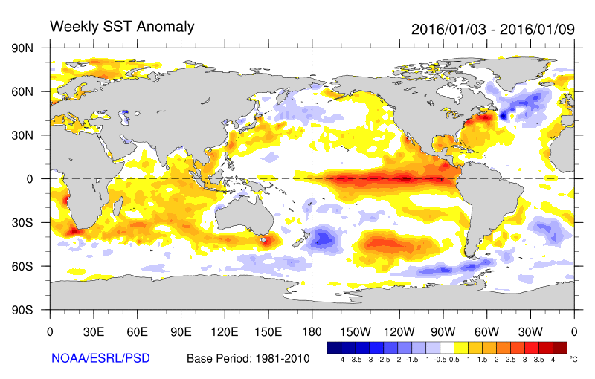
JPSS Observations of Intercontinental Pollution and Atmospheric River Transport Processes during the
2016 NOAA El Niño Rapid Response (ENRR) Field Campaign
R. Bradley Pierce (NOAA/NESDIS/STAR)
Chris Barnet, Nadia Smith, Antonia Gambacorta (Science and Technology Corporation, STC)
and
Ryan Spackman (STC at NOAA/ESRL)
Thanks to ENRR Co-Leads Ryan Spackman and Randy Dole (CIRES, NOAA/ESRL) for access to NOAA Gulfstream IV dropsonde data

Slide 2
ENRR Field Campaign Focus
Impacts
Tropical Pacific
convection
Measure the initial atmospheric response in the chain linking
El Niño to its tropical and extratropical impacts
For more information, see field campaign website: http://www.esrl.noaa.gov/psd/enso/rapid_response/

Slide 3
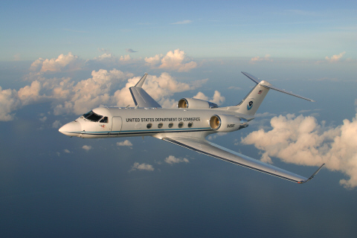
Campaign ran from January 19th through March 10th, 2016
NOAA G-IV deployed from Honolulu International Airport
Twenty-two 8-hour flights,
~25-35 dropsondes/flight
NOAA Gulfstream IV (G-IV)
(22 flights, 593 dropsondes)
Final week saw the development of a intense atmospheric river – will focus on final transit flight on March 10, 2016

Slide 4
VIIRS True Color Image March 10, 2016
“Atmospheric River”

Slide 5
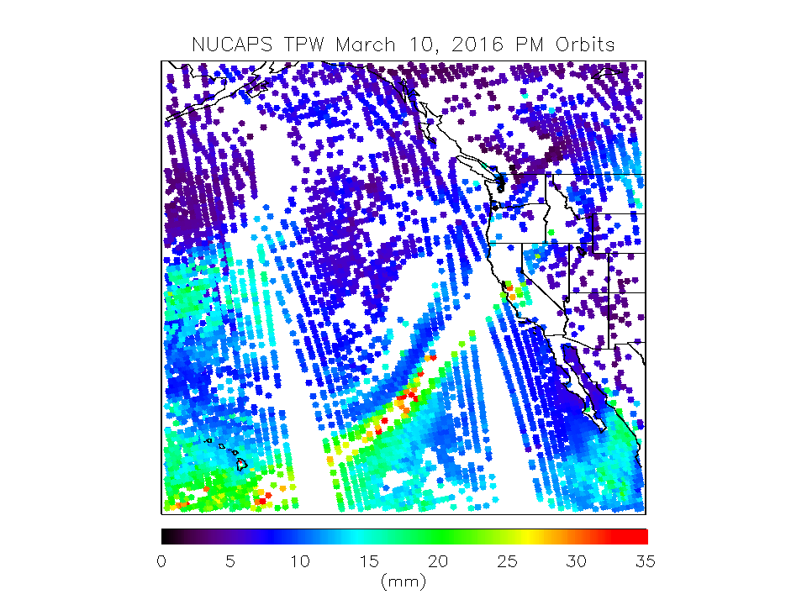
Near-real-time NOAA-Unique Combined Atmospheric Processing System’s (NUCAPS) soundings were provided to ENRR science team for flight planning
AM overpass (~12:30 UT, 2:30 HST)
Provide analysis to flight forecasters during the daily forecast briefing
PM overpass (~0:30 UT, 14:30 HST)
Provide scientists an in-flight snapshot at proposed dropsonde locations
“Atmospheric River”
Plume of high Total Precipitable Water (TPW) extends from Hawaiian Islands to Northern California

Slide 6
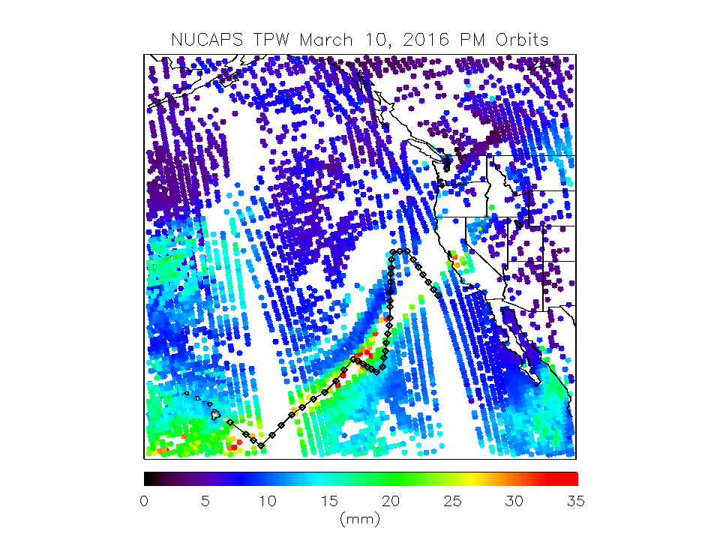
NOAA G-IV flight track during final transit
Locations of dropsondes indicated by diamonds
“Atmospheric River”
NOAA G-IV sampled Plume of high Total Precipitable Water (TPW) on final Transit Flight

Slide 7
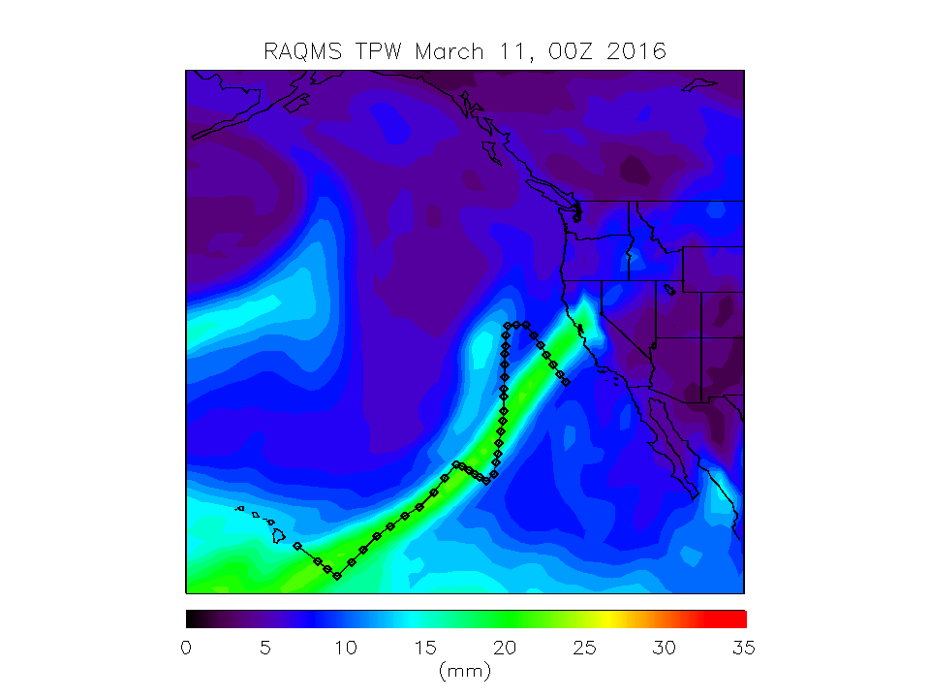
The Real-time Air Quality Modeling System (RAQMS) is used for post mission science studies
1x1 degree global online chemistry and aerosol predictions
Daily 12Z chemical and aerosol data assimilation cycle
Initialized with 6hourly GFS meteorological analyses
“Atmospheric River”
RAQMS water vapor analysis also captures plume of high Total Precipitable Water (TPW)

Slide 8
Lagrangian Back-trajectory analysis
March 10, 2016 Transit
7-Day back trajectory curtains are initialized for every measurement along the NOAA G-IV dropsonde profiles (on native RAQMS model levels)
Sample NUCAPS Water Vapor Retrievals and RAQMS analyses during previous 7 days
nearest neighbor within 1 degree radius
every 6 hours, +/-3 hour time window
interpolate retrieval profile to trajectory pressure
Lagrangian average NUCAPS Water Vapor and RAQMS analyses along back-trajectories
Remap onto initial dropsonde curtain and then interpolate to the actual dropsonde measurement location

Slide 9
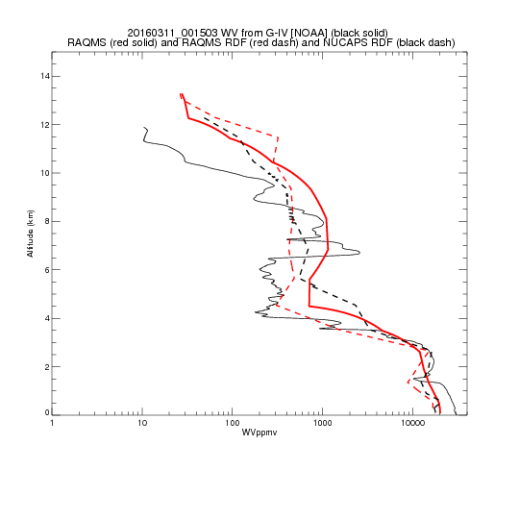
Lagrangian averaged RAQMS and NUCAPS Water Vapor Dropsonde comparisons
“Atmospheric River”
Dropsonde
Lagrangian Mean NUCAPS
RAQMS
Lagrangian Mean RAQMS
Lagrangian averaging sharpens vertical water vapor gradients due to differential shear

Slide 10
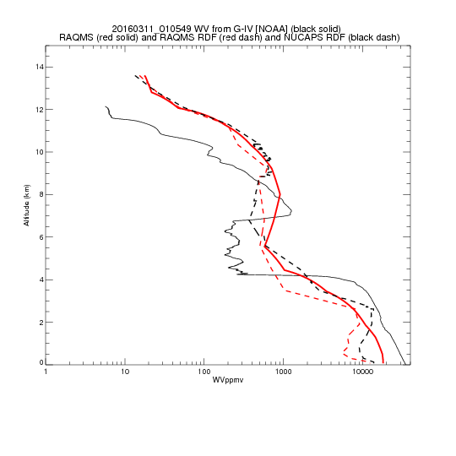
Lagrangian averaged RAQMS and NUCAPS Water Vapor Dropsonde comparisons
“Atmospheric River”
Dropsonde
Lagrangian Mean NUCAPS
RAQMS
Lagrangian Mean RAQMS
Lagrangian averaging sharpens vertical water vapor gradients due to differential shear

Slide 11
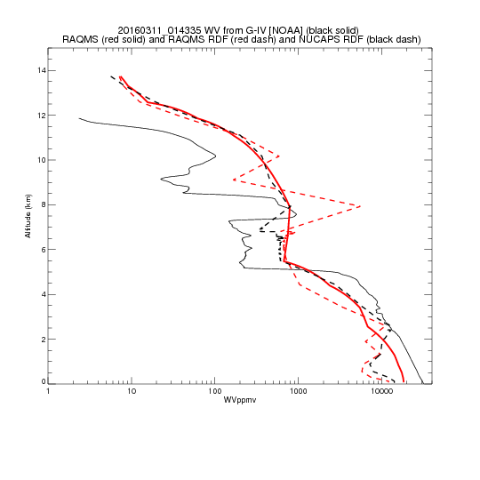
Lagrangian averaged RAQMS and NUCAPS Water Vapor Dropsonde comparisons
“Atmospheric River”
Dropsonde
Lagrangian Mean NUCAPS
RAQMS
Lagrangian Mean RAQMS
Lagrangian averaging sharpens vertical water vapor gradients due to differential shear

Slide 12
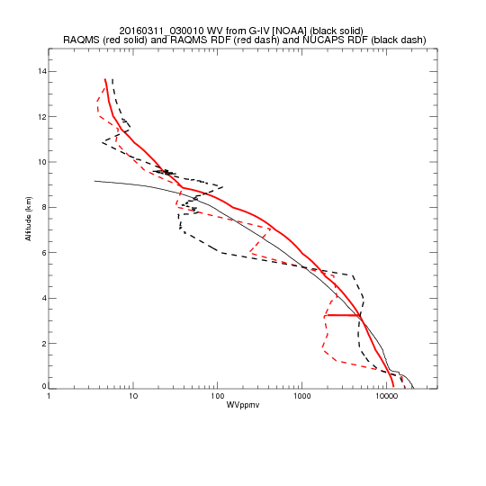
Lagrangian averaged RAQMS and NUCAPS Water Vapor Dropsonde comparisons
“Atmospheric River”
Dropsonde
Lagrangian Mean NUCAPS
RAQMS
Lagrangian Mean RAQMS
Lagrangian averaging can introduce spurious noise due to trajectory errors

Slide 13
Reverse Domain Filling (RDF) Procedure: March 10, 2016 Transit
5-Day back trajectories initialized at 18Z on March 10, 2016 on uniform 0.25 degree grid over western US Eastern Pacific domain (on native RAQMS model levels)
Sample RAQMS and NUCAPS water vapor and Full Spectral Resolution (FSR) CO retrievals during previous 5 days
nearest neighbor within 1 degree radius
every 6 hours, +/-3 hour time window
interpolate retrieval profile to trajectory pressure
Lagrangian average RAQMS and NUCAPS water vapor and FSR CO along backtrajectories
Remap onto initial 0.25 degree grid and interpolate to constant altitudes (SFC, 1-9km)

Slide 14
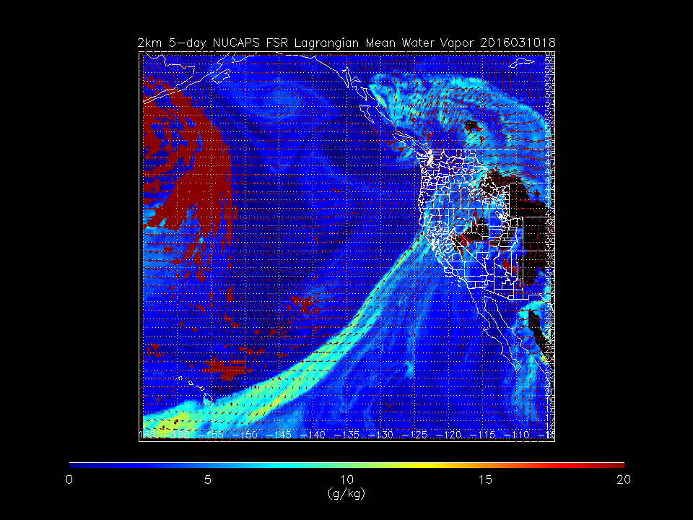
NOAA-Unique Combined Atmospheric Processing System’s (NUCAPS) RDF WV analysis shows narrow plume of high water vapor at 2km
“Atmospheric River”
(Red region south of Aleutians has no coincidences along back trajectories)
Lagrangian averaging sharpens horizontal water vapor gradients due to differential advection

Slide 15
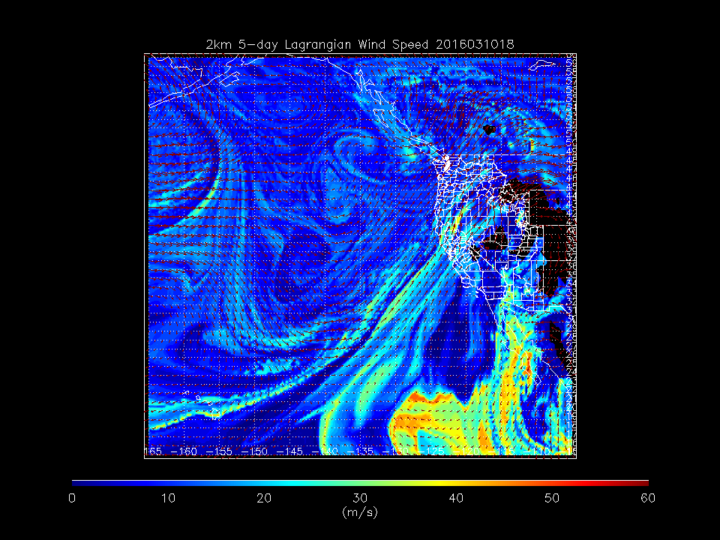
RAQMS RDF wind speed analysis shows narrow region of reduced Lagrangian mean windspeed within the core of the water vapor plume at 2km
“Atmospheric River?”
The “atmospheric river” has lower Lagrangian mean wind speeds then surrounding environment

Slide 16
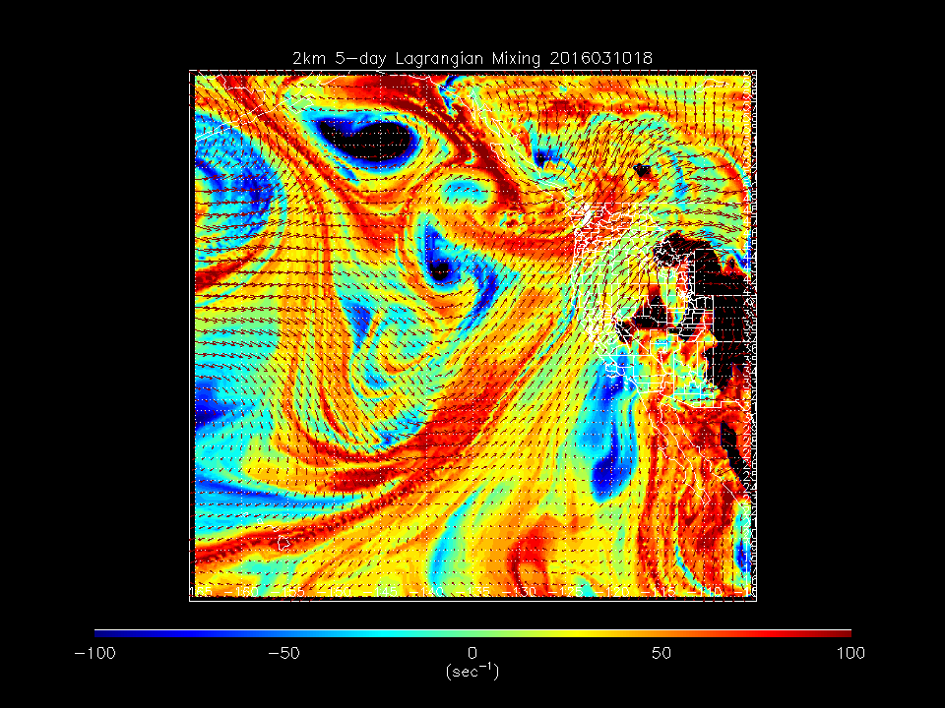
RAQMS Lagrangian mixing analysis shows narrow region of enhanced mixing in the vicinity of the water vapor plume at 2km
“Atmospheric River”
¹Aref, H. (1984) ‘Stirring by chaotic advection’, Journal of Fluid Mechanics, 143, pp. 1–21. doi: 10.1017/S0022112084001233.
The “atmospheric river” is characterized as region of efficient mixing (chaotic advection¹)

Slide 17
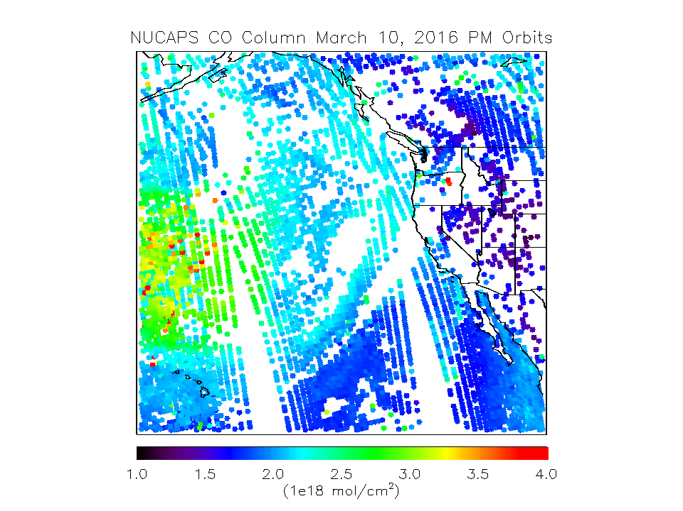
NOAA-Unique Combined Atmospheric Processing System’s (NUCAPS) Full Spectral Resolution Carbon Monoxide (CO) retrievals allow us to explore long range transport of pollution during ENRR
“Atmospheric River”
Pollution
NUCAPS FSR CO retrieval shows region of high CO column to the north of Hawaii

Slide 18
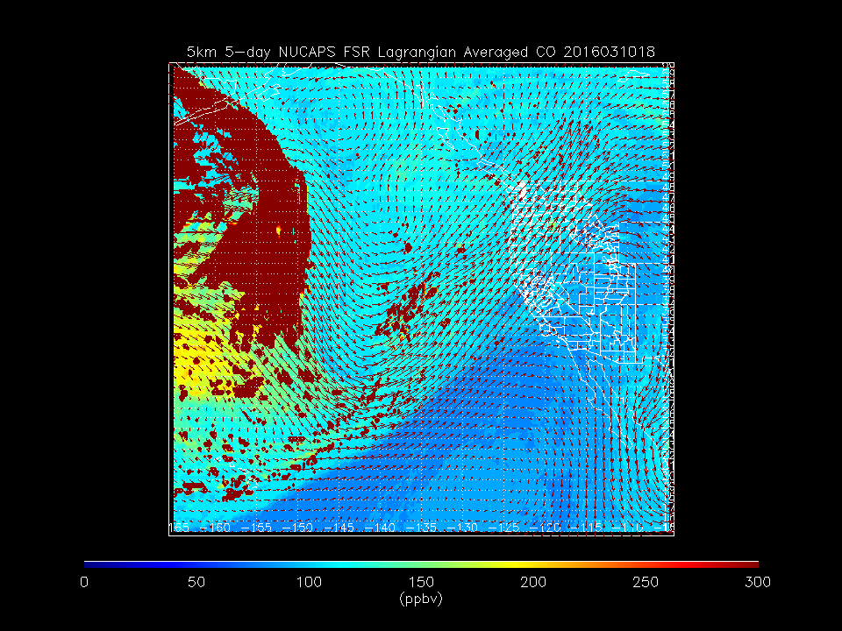
NOAA-Unique Combined Atmospheric Processing System’s (NUCAPS) RDF CO analysis shows region of enhanced CO at 5km
“Atmospheric River”
(Red region south of Aleutians has no coincidences along back trajectories)
Pollution
Lagrangian averaging sharpens horizontal pollution gradients due to differential advection

Slide 19
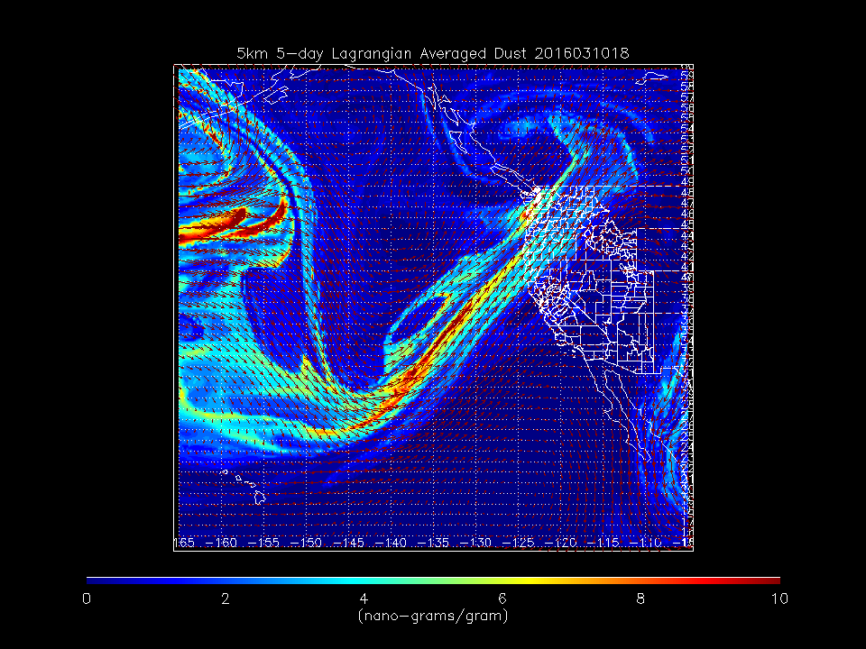
RAQMS RDF dust analysis shows narrow region of elevated dust extending from the region with NUCAPS CO enhancements at 5km
“Atmospheric River”
Dust
The “atmospheric river” includes a narrow plume of polluted dust transport to the Pacific Northwest

Slide 20
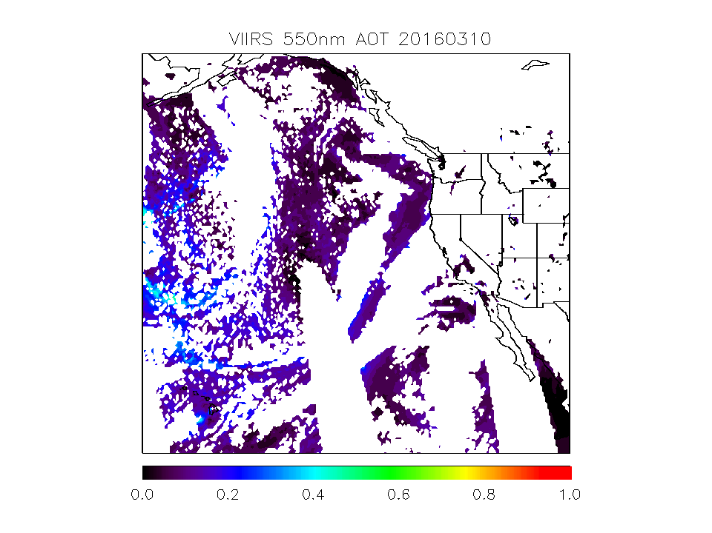
VIIRS 550nm Aerosol Optical Thickness (AOT) can be used in combination with NUCAPS CO retrievals to characterize the transport of pollution over the Pacific during ENRR
“Atmospheric River”
Dust
VIIRS AOT confirms the RAQMS analysis of polluted dust transport to the Pacific Northwest

Slide 21
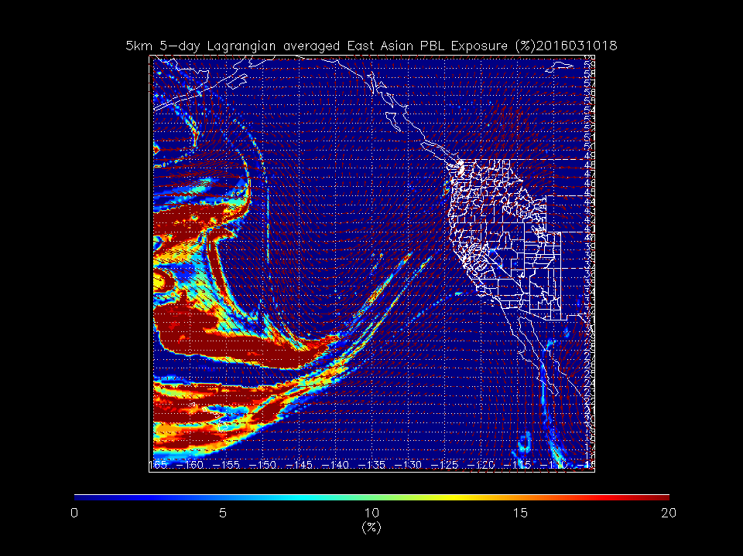
RAQMS Lagrangian mean East Asian PBL Exposure can be used to identify the source of the polluted dust
“Atmospheric River”
Percent of the time during that previous 5-days that the trajectories were either within the East Asian PBL or coupled to the East Asian PBL though convective mixing
Dust
Polluted dust had it’s origins in the East Asian planetary boundary layer (PBL)

Slide 22
Conclusions
JPSS VIIRS AOT and NUCAPS water vapor and carbon monoxide retrievals help to characterize the large scale distribution of water vapor and pollution transport during the 2016 NOAA El Niño Rapid Response (ENRR) Field Campaign
Lagrangian analyses techniques applied to NUCAPS and RAQMS provide a unique view of transport processes during the March 10, 2016 ENRR transit flight - Lagrangian mean wind speeds are lower within the “atmospheric river”
Large positive Lagrangian mixing (chaotic advection) due to large-scale shear deformation can potentially lead to efficient mixing of filaments of moist tropical air and polluted dust from East Asia – do aerosol/cloud interactions effect precipitation efficiencies?
Funding provided by the NOAA JPSS Proving Ground and Risk Reduction program

