Slide 1
Forecasting Stratospheric Intrusion Events over the Western US for Exceptional Event Demonstration
R. Bradley Pierce
Center for Satellite Applications and Research (STAR), NOAA/NESDIS
Madison, WI, USA
Patrick J. Reddy
Air Pollution Control Division, Colorado Department of Public Health and Environment
Denver, CO, USA
Gail Tonnesen
Region 8, Air Program, U.S. Environmental Protection Agency,
Denver, CO, USA
Ryan McCammon
Air Quality Division, Wyoming Department of Environmental Quality
Cheyenne, WY, USA
Emma Yates and Laura Iraci
Atmospheric Science Branch, NASA Ames Research Center
Moffett Field, CA, USA
Todd Schaack and Allen Lenzen
Space Science and Engineering Center, University of Wisconsin
Madison, WI, USA
A54H-01 Fall AGU 2013 – The Nexus of Geophysical Processes and Exposure Science II, 9-13 December, San Francisco, CA

Slide 2
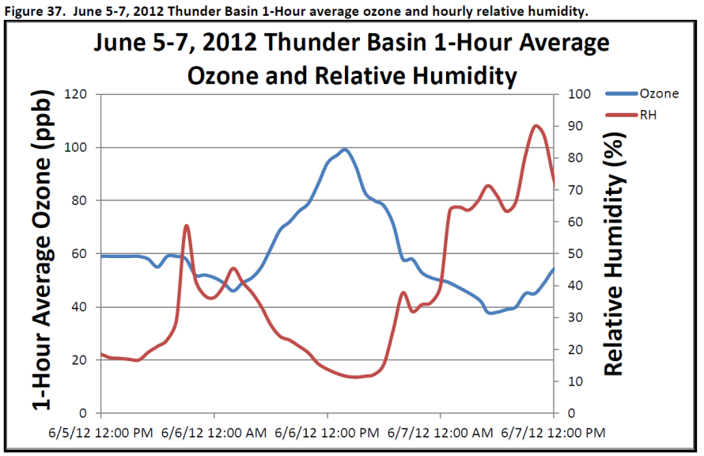
Background
The Clean Air Act requires that states and tribes attain the National Ambient Air Quality Standard (NAAQS) for ozone¹.
If the NAAQS is violated, EPA may designate areas nonattainment for the ozone standard, necessitating the development of plans for improvement in air quality.
Ozone caused by exceptional events can be excluded from determinations of nonattainment with appropriate documentation.
¹Currently defined as a 3-year average of the 4th highest daily 8-hour average ozone greater than 75 ppb.
“The Wyoming Department of Environmental Quality/Air Quality Division (WDEQ/AQD) has determined that a stratospheric intrusion created elevated ozone readings resulting in an 8-hour ozone standard exceedance at the Thunder Basin, Wyoming ozone monitor located in northeastern Wyoming on June 6, 2012” (Executive Summary)
http://deq.state.wy.us/aqd/Exceptional%20Events/June_6_2012ThunderBasin/June_6_2012_SI_Package.pdf

Slide 3
Can global ozone chemical analyses, coupled with regional ozone predictions help inform Stratospheric Intrusion (SI) Exceptional Event analysis?
Nested RAQMS¹/WRF-CHEM²
1x1 degree RAQMS global ozone analysis
Constrained with Microwave Limb Sounder (MLS) stratospheric ozone profiles and Ozone Monitoring Instrument (OMI) cloud cleared Total Column Ozone
12km WRF-CHEM v3.4.1
GOCART RACM-KPP mechanism
YSU PBL scheme (Yonsei University, Non-local-K scheme)
¹Realtime Air Quality Modeling System (RAQMS, http://raqms.ssec.wisc.edu/)
²Weather Research and Forecasting (WRF) model with chemistry (WRF-CHEM, http://ruc.noaa.gov/wrf/WG11/)

Slide 4
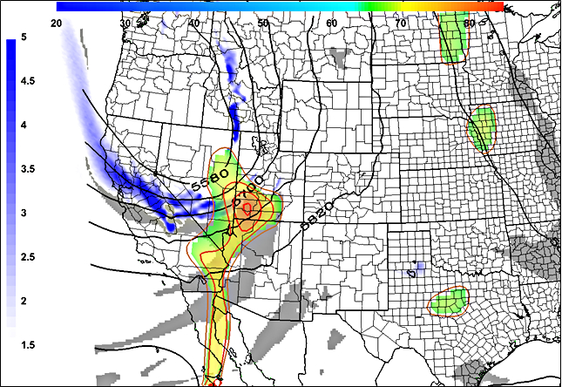
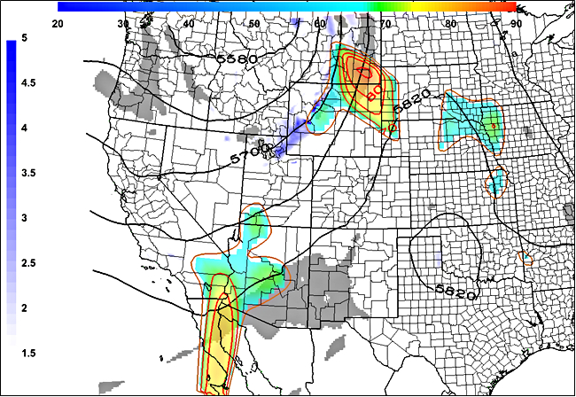
Synoptic conditions prior to Thunder Basin, WY ozone exceedance
June 5, 2012 NAM-12 analysis, 11 am MST
June 6, 2012 NAM-12 analysis, 11am MST
Thunder Basin, WY
Thunder Basin, WY
High Isentropic Potential Vorticity (IPV) and low relative humidity (RH) at base of large amplitude trough over CA/NV on June 5 is associated with high surface ozone over SW Utah on June 5 and NE WY on June 6, 2012
Legend:
500 mb heights in meters (contours)
600 mb IPV >= 1.5 PVUs (blue)
600 mb RH <= 10% (grey)
EPA AQS Daily Max 8-hour O3 in ppb >= 65 ppb (rainbow contours and shading)
Figures courtesy Patrick Reddy (Colorado Department of Public Health and Environment)

Slide 5
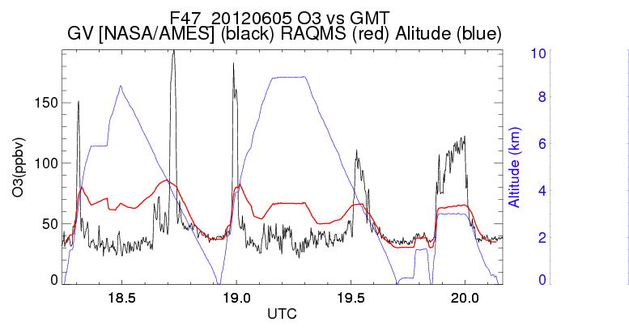
NASA AJAX¹ Flight 47, June 5, 2012
(Emma Yates and Laura Iraci, NASA Ames)
RAQMS (red)
AJAX (black)
(A)
(B)
AJAX measurements show a narrow (>1km) filament of high (>180ppbv) ozone during the spiral over San Joaquin Valley, CA (A) and a broader filament during the off-shore spiral (B)
RAQMS global ozone analysis underestimates the ozone mixing ratio within the fold for both onshore and offshore spirals but captures the timing and location fairly well.
¹Alpha Jet Atmospheric eXperiment (AJAX, https://espo.nasa.gov/missions/ajax) aircraft is based and operated from NASA Ames Research Center at Moffett Field, CA [Yates E. L. et al, (2013), accepted Nov 23, 2013 ACP]

Slide 6
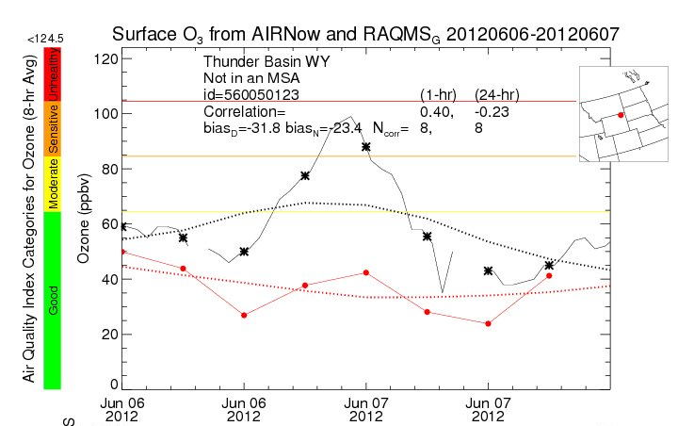
June 6-7, 2012 Surface ozone comparison: Thunder Basin, WY
Surface O3 from AIRNow and RAQMS 20120606-20120607
RAQMS (red)
AIRNow (black)
RAQMS ozone underestimates within the SI event lead to significant underestimates (31.8ppbv daytime bias) in ozone at the Thunder Basin, WY surface site.

Slide 7
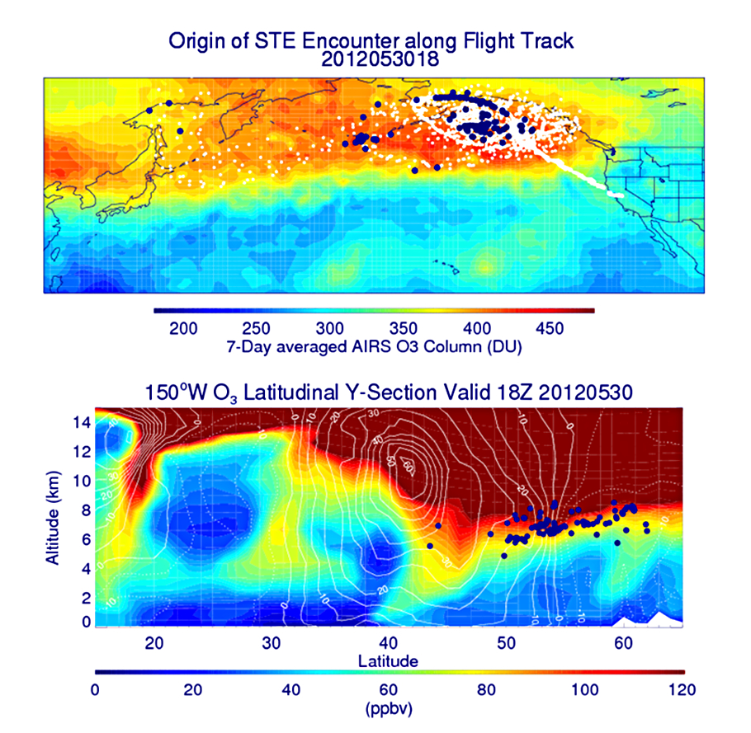
Origin of the tropospheric fold and subsequent Stratospheric Intrusion (SI)
Backward trajectories (white) beginning
at the AJAX Flight 47 path, and ending on May 30, 2012 (blue)
RAQMS ozone analysis at 150º W at 18Z on May 30, 2012 combined with the location of the SI trajectories on May 30, 2012 (blue)
Back-trajectory analysis shows that the origin of the SI event was within a region of high total column ozone over the Gulf of Alaska

Slide 8
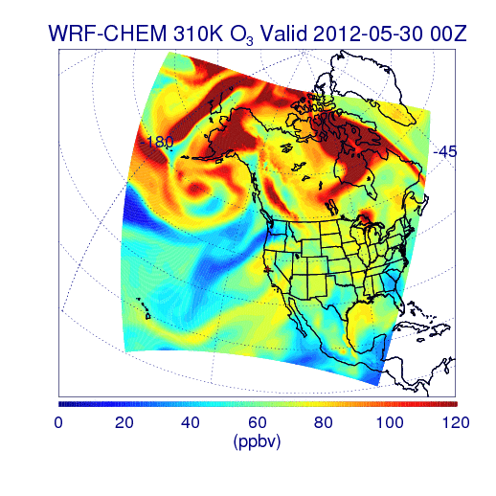
310K O3 from RAQMS/WRF-CHEM Simulation
00Z 05/30 – 00Z 06/07, 2012
Stratosphere/tropospheric exchange processes within a quasi-stationary low pressure system over the Gulf of Alaska played a critical role in the SI event

Slide 9
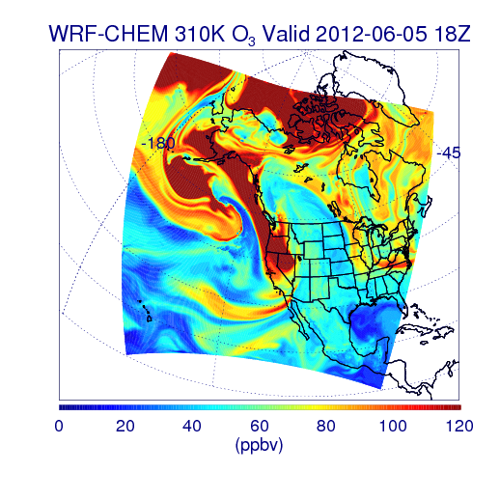
310K O3 from RAQMS/WRF-CHEM Simulation
Southeasterly transport of stratospheric air along the 310K isentropic surface leads to the SI event sampled by the AJAX flight over CA on June 5, 2012

Slide 10
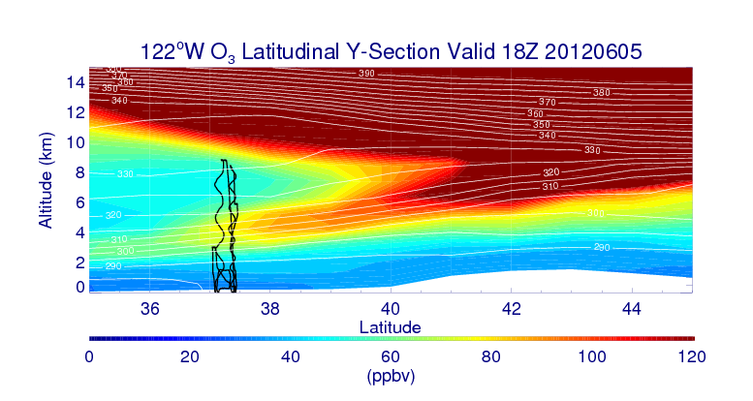
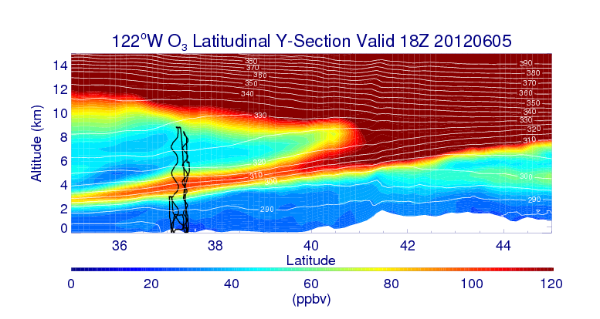
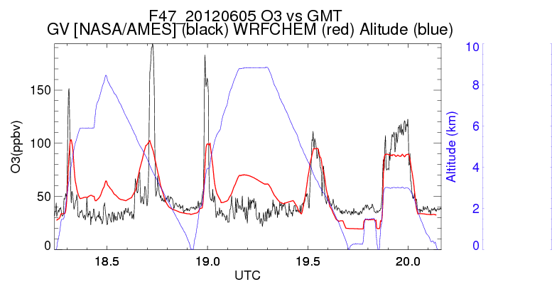
NASA AJAX Flight 47, June 5, 2012
RAQMS
Nested RAQMS/WRFCHEM
310K isentrope
RAQMS (red)
AJAX (black)
WRFCHEM (red)
AJAX (black)
(A)
(B)
(A)
(B)
Nested RAQMS/WRFCHEM simulations significantly improve the agreement with AJAX measurements during the off-shore spiral (B) but still underestimate ozone within the narrow filament sampled during the spiral over the San Joaquin Valley, CA (A)

Slide 11
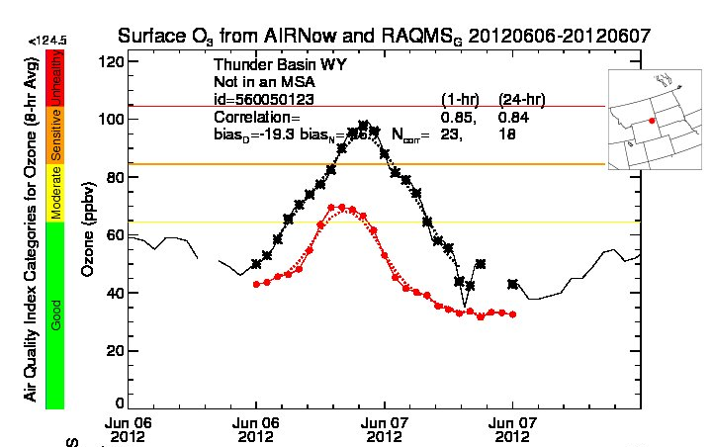
June 6-7, 2012 Surface ozone comparison: Thunder Basin, WY
RAQMS
Nested RAQMS/WRFCHEM
Surface O3 from AIRNow and RAQMS
Surface O3 from AIRNow and Nested RAQMS/WRF-CHEM
RAQMS (red)
AIRNow (black)
WRFCHEM (red)
AIRNow (black)
Improved estimates of ozone within the SI event lead to significant improvements (19.3 vs 31.8ppbv daytime bias) in predictions of ozone at the Thunder Basin, WY surface site in the nested RAQMS/WRF-CHEM simulation.
However, peak ozone mixing ratios are still underestimated by nearly 30ppbv

Slide 12
Summary and Conclusions
Nested RAQMS/WRFCHEM simulations provide support for the Wyoming Department of Environmental Quality/Air Quality Division (WDEQ/AQD) determination that a stratospheric intrusion caused elevated ozone readings at Thunder Basin, Wyoming on June 6, 2012
Comparison of RAQMS with upwind ozone measurements from the NASA Ames AJAX flight on June 5, 2012 shows that:
Global scale ozone analyses, constrained with satellite ozone retrievals, are able to capture the timing and location of the SI event but significantly underestimate the ozone mixing ratios within the fold and thus the impact on surface ozone
Back-trajectory analysis from the AJAX flight shows that:
Stratosphere/tropospheric exchange processes within a quasi-stationary low pressure system over the Gulf of Alaska played a critical role in the SI event
Nested RAQMS/WRFCHEM simulations of the SI event show that:
High resolution simulations are necessary to improve the prediction of ozone lamina but still underestimate the surface impact for this event

Slide 13
Acknowledgments
NASA Air Quality Applied Sciences Team
(AQAST, Daniel Jacob, Harvard, Lead)
EPA Stratospheric Intrusion Working Group
(Gail Tonnesen, EPA Region 8, Lead)
NASA Ames Alpha Jet Atmospheric eXperiment
(AJAX, Emma Yates and Laura Iraci, NASA Ames, Leads)
NOAA Earth System Research Laboratory (ESRL) is currently running twice daily 13km “Rapid Refresh with Chemistry” Air Quality forecasts using lateral boundary conditions from RAQMS (Georg Grell and Steve Peckham, ESRL) which can be used to support future SI exceptional event forecasting
http://ruc.noaa.gov/wrf/WG11_RT/Welcome.cgi

