Slide 1
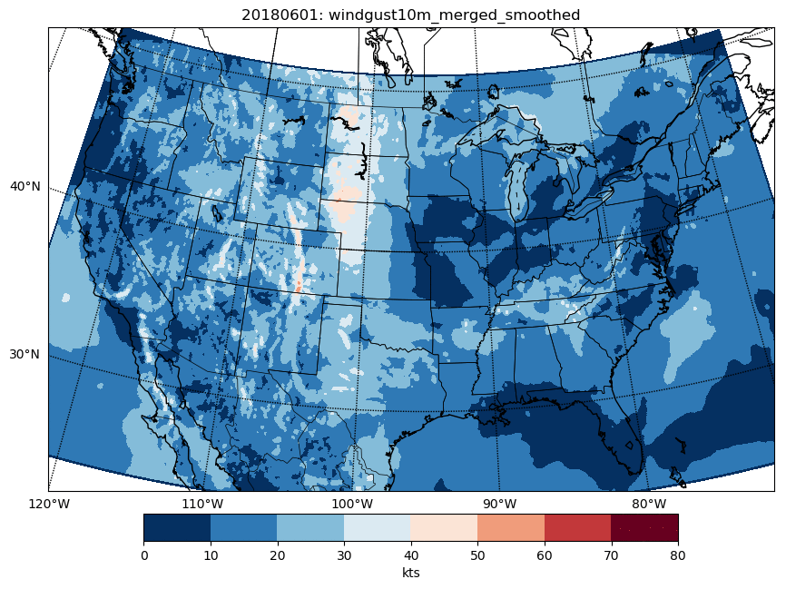
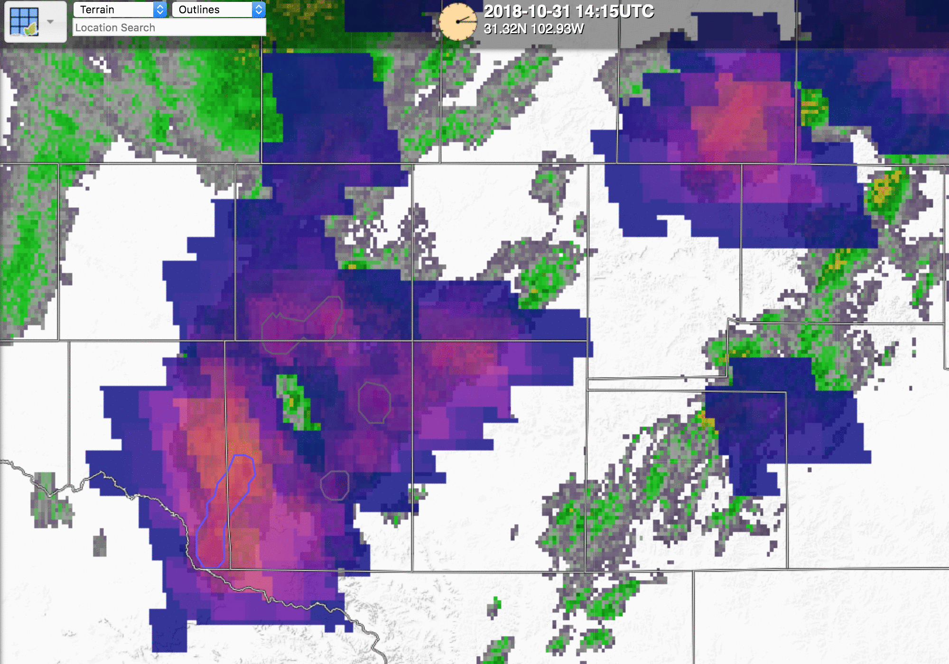
Development, R2O, and O2R of the NOAA/CIMSS ProbSevere Model
Mike Pavolonis (NESDIS); John Cintineo, Justin Sieglaff, Lee Cronce, and Jason Brunner (CIMSS)
ProbSevere v1 will be operational at NCEP by 30 June 2019
Sustained NWS interaction has been crucial to model development and R2O
R2O needs to be more nimble to keep with science development
ProbSevere development is ongoing and doesn’t end with R2O

