Slide 1
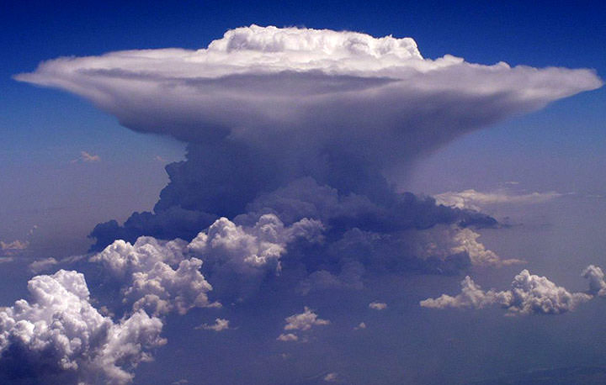
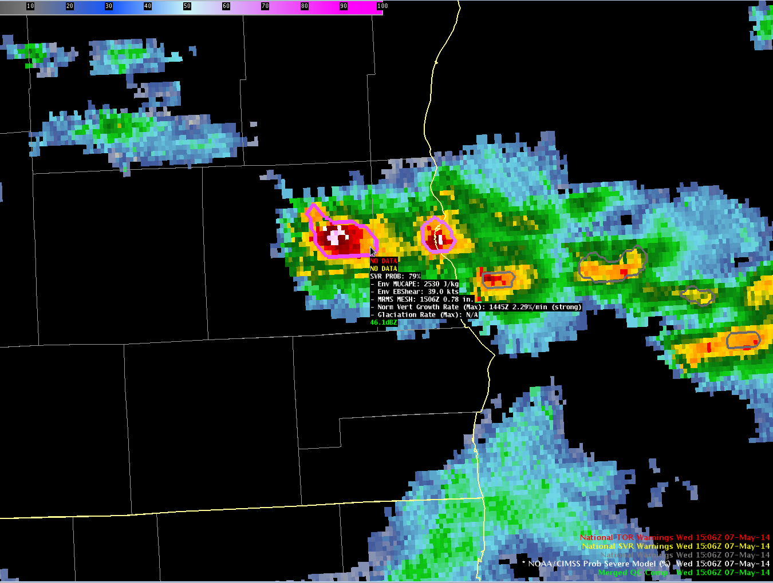
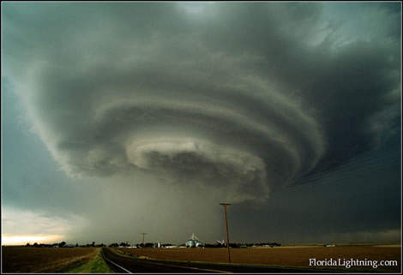
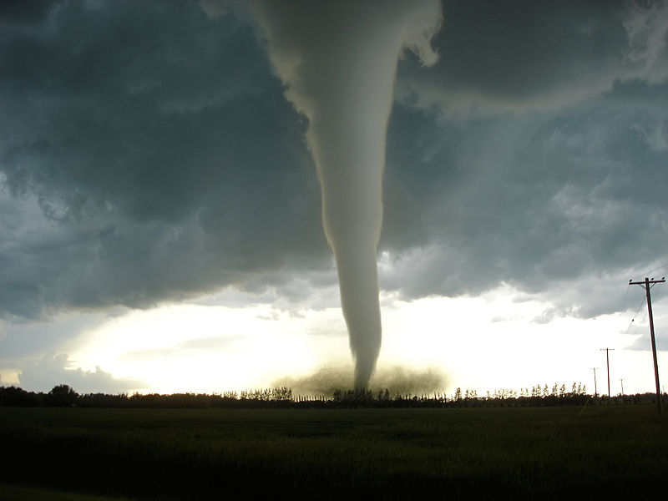


The Importance of Satellite-based Predictors in the NOAA/CIMSS ProbSevere Model
Justin Sieglaff (UW-CIMSS)
Michael J. Pavolonis (NOAA/NESDIS)
John Cintineo (UW-CIMSS)

Slide 2
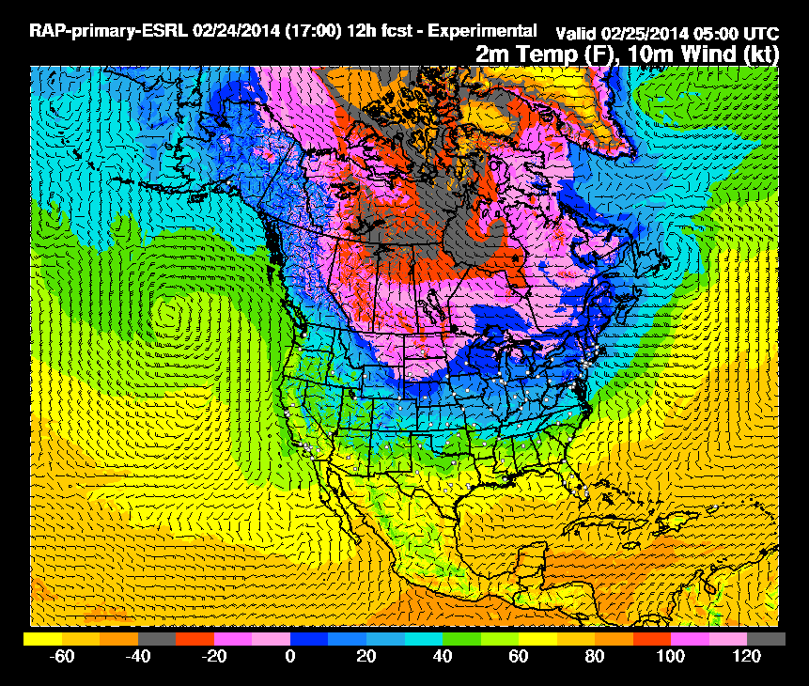
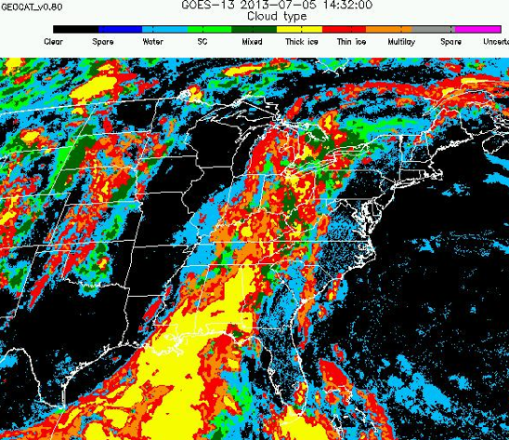
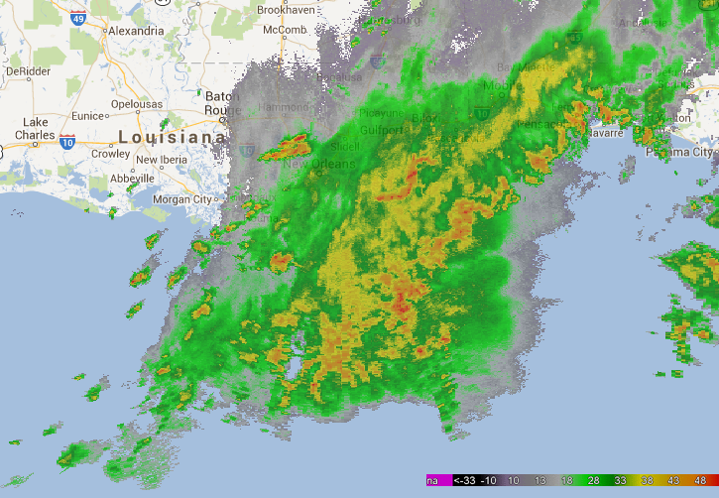
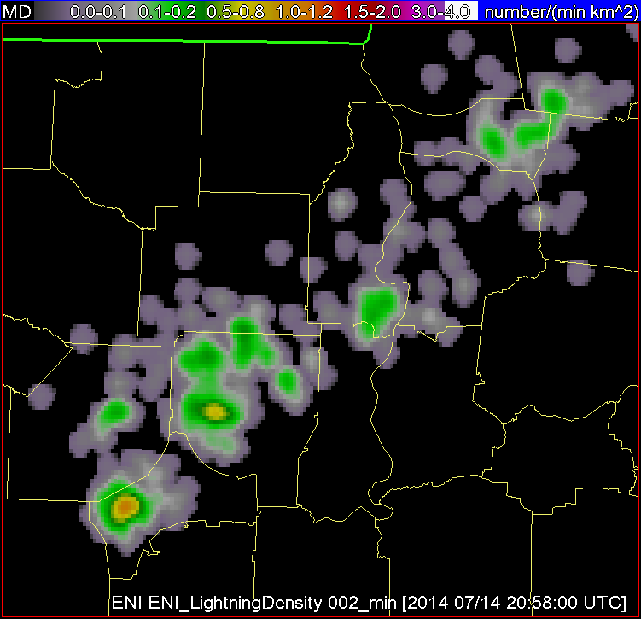
Data to Environmental Intelligence
High-resolution NWP Data
Satellite Imagery and Derived Products
Radar Imagery and Derived Products
Total Lightning
Storm Environment
Evolution of Cumulus to Cumulonimbus
Storm Tracking and Hydrometeor Properties
Storm Electrification
Probability a thunderstorm will produce severe weather in the future (up to 90 minutes)
Notes:
NWP forms the model apriori (climatology)—given CAPE/shear probability a thunderstorm will become severe.
Track clouds with satellite imagery to diagnose IR BT cooling rate and satellite-derived cloud top phase changes.
Track radar reflectivity to keep ‘record’ of the storm and include MRMS MESH.
Co-locate ENI total lightning data within the radar objects. Total lightning is combined with effective bulk shear.
Statistical model is analogous to the SHIPS model for hurricane intensity
Output is visualized as a color shaded polygon by probability.

Slide 3
NOAA/CIMSS ProbSevere Model
Probability derived from: environment observations
RAP NWP: MUCAPE and Effective Bulk Shear
OBSERVATIONAL PREDICTORS:
2 satellite growth rates
1 instantaneous radar field
1 instantaneous total lightning/effective bulk shear field
The statistical model is driven by observations. The model does not predict cloud growth, but observes cloud growth, precipitation core intensity, and total storm electrification.
Supplemental Training Link

Slide 4
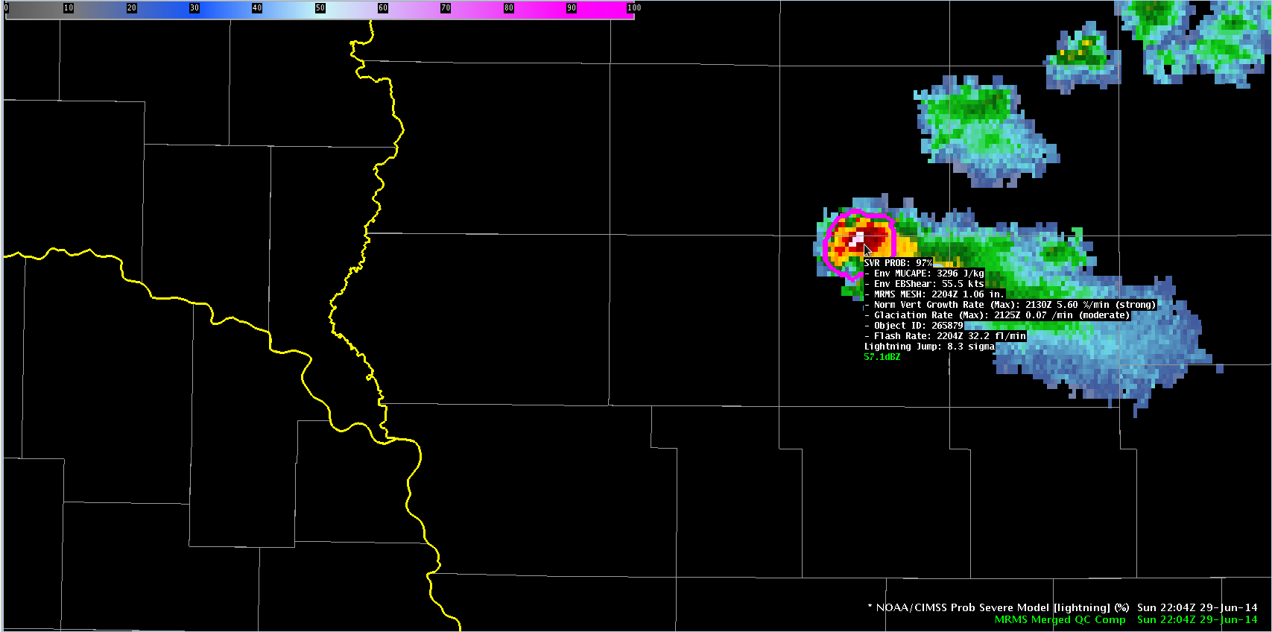
ProbSevere Sample Output
Model output are shapefiles contoured around radar storm cells.
Enhancement designed for overlay atop radar reflectivity—but can be overlaid on any field (satellite, radar velocity, etc.).
Sampling offers readout of model probability as well as each model predictor.

Slide 5
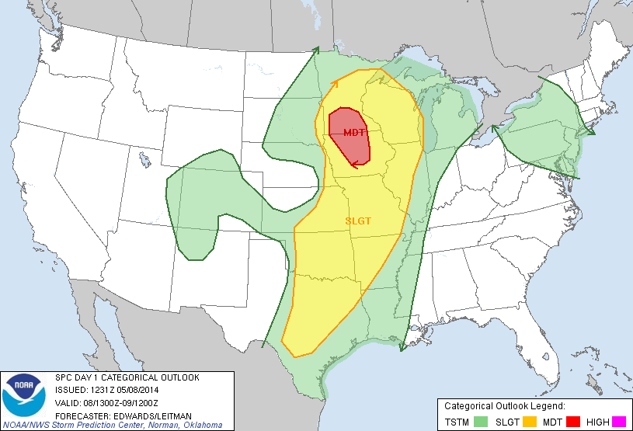
08 May 2014
Notes:
Now getting to examples, the first example is over southeastern South Dakota on the western edge of a slight risk region as depicted by the Storm Prediction Center outlook.

Slide 6
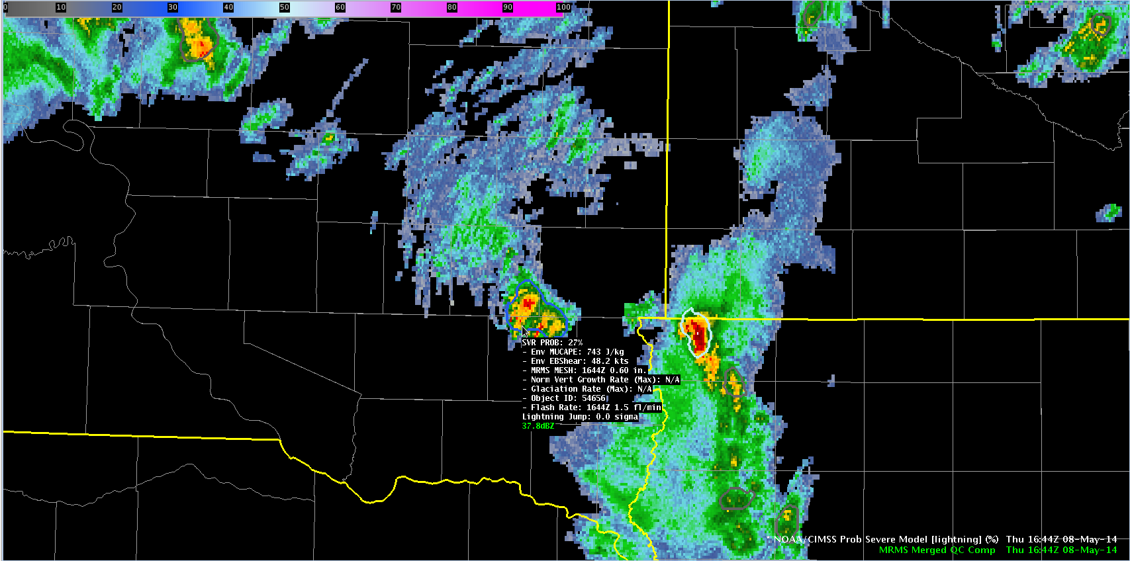
1644 UTC May-08-2014
MUCAPE ~ 750 J kg⁻¹
Eff. shear ~ 48 kts
Prob = 27%
Highly sheared environment
Low MESH
Low lightning
SD
IA
Notes:
In these examples, MRMS composite reflectivity is shaded and the ProbSevere contours are overlaid on the reflectivity data with the text read-out provided for the storm of interest. At 1644UTC a developing storm had marginal instability but significant shear. The probability at this time was low—only 27% as the MRMS MESH and total lightning were fairly low.

Slide 7
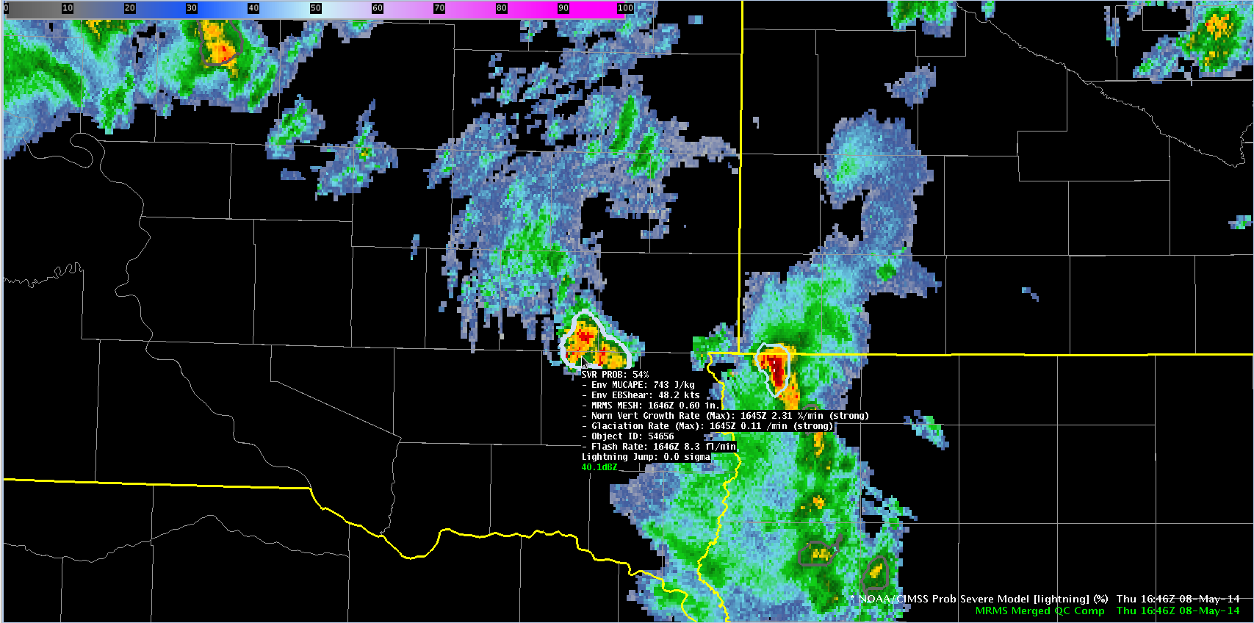
1646 UTC May-08-2014
MUCAPE ~ 750 J kg⁻¹
Eff. shear ~ 48 kts
Prob = 54%
Strong satellite growth and glaciation rates.
Small increase in lightning.
SD
IA
Notes:
At 1646 UTC, satellite growth rates were diagnosed and included into the ProbSevere calculation. Both the vertical growth rate and glaciation rate were in the ‘strong’ category, which drove the probability up to 54%.

Slide 8
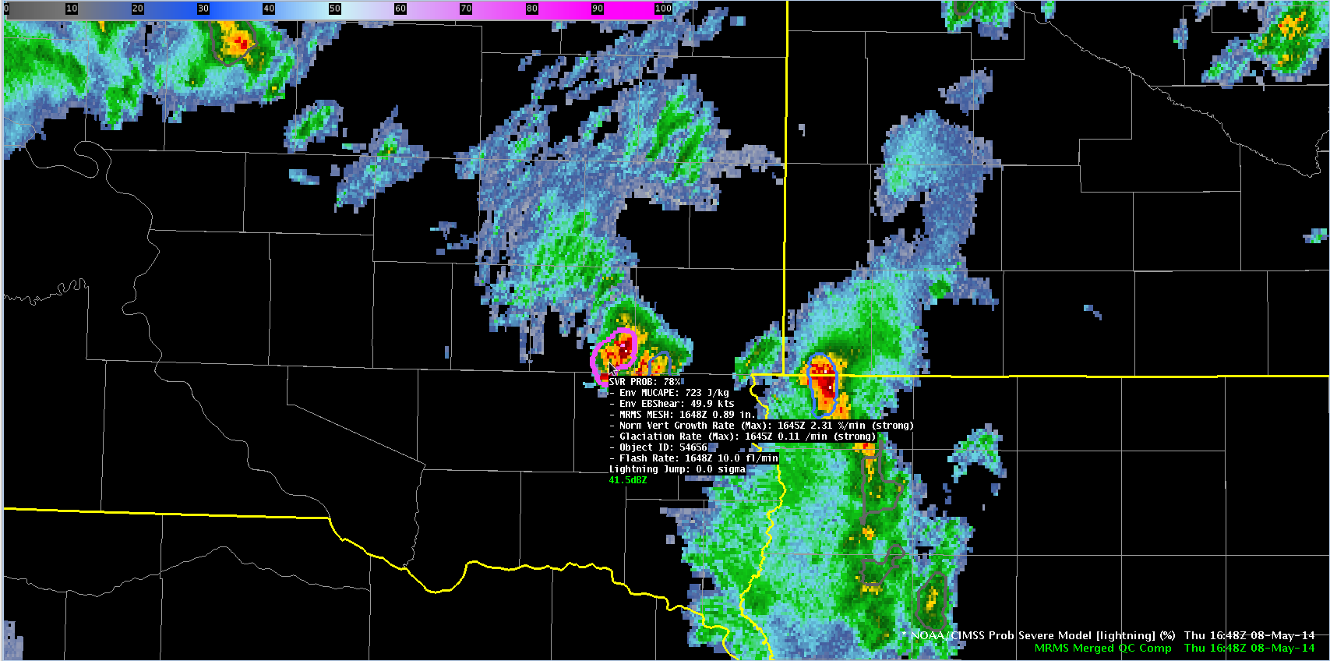
1648 UTC May-08-2014
MUCAPE ~ 750 J kg⁻¹
Eff. shear ~ 48 kts
Prob = 78%
Strong satellite growth and glaciation rates.
MESH increases to 0.89”.
Lightning continues to increase.
SD
IA
Notes:
Two minutes later, the storm continued to intensify as indicated by the MESH and total lightning read-outs. The probably again jumped, now to 78%.

Slide 9
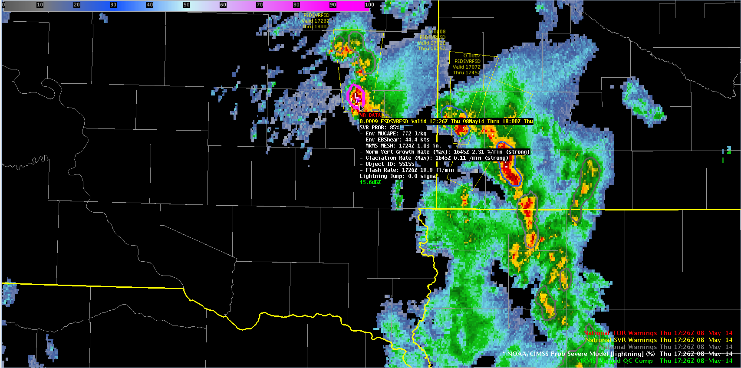
1726 UTC May-08-2014
MUCAPE ~ 750 J kg⁻¹
Eff. shear ~ 48 kts
Prob = 85%
KFSD issues SVR warning @ 1726 UTC.
Golf ball sized hail report @ 1732 UTC.
SD
IA
Notes:
The storm continued to exhibit high probabilities and at 1726 UTC a severe thunderstorm warning was issued by the Sioux Falls WFO. 6 minutes later the first severe report of golf ball sized hail was received. This example demonstrates how ProbSevere can be used to identify a storm that is likely to produce severe weather and potentially be used to increase lead-time. [For those interested, the storms over extreme northwestern Iowa/southwestern MN had lower probabilities and did not produce severe reports.]

Slide 10
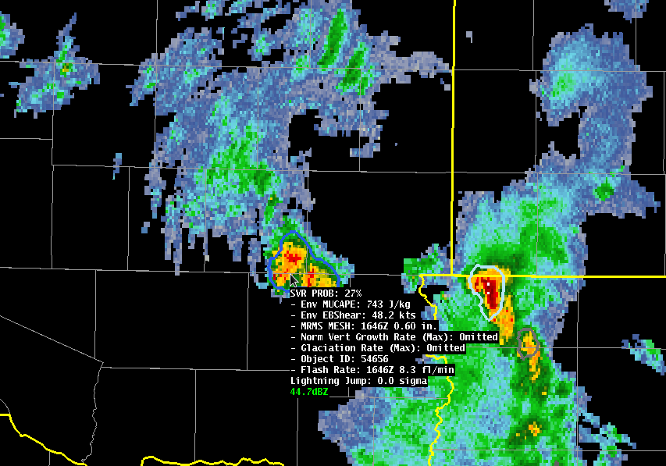
Impact of GOES Data
1646 UTC May-08-2014
Prob = 54%
Prob = 27%
NWP + Satellite + Radar + Lightning
NWP + Satellite + Radar + Lightning
Time (UTC) | With Satellite | Without Satellite
1644 | 27% (no sat. growth yet) | 27%
1646 | 54% | 27%
1648 | 78% | 54%
1728 | 85% | 65%
Notes:
We are often asked, what value do the satellite growth rates provide? Using this example, you can see at 1646 UTC, by removing the satellite observations, the ProbSevere probability is reduced by HALF! Additionally, removing the satellite growth rates reduces the amount of lead-time gained.

Slide 11
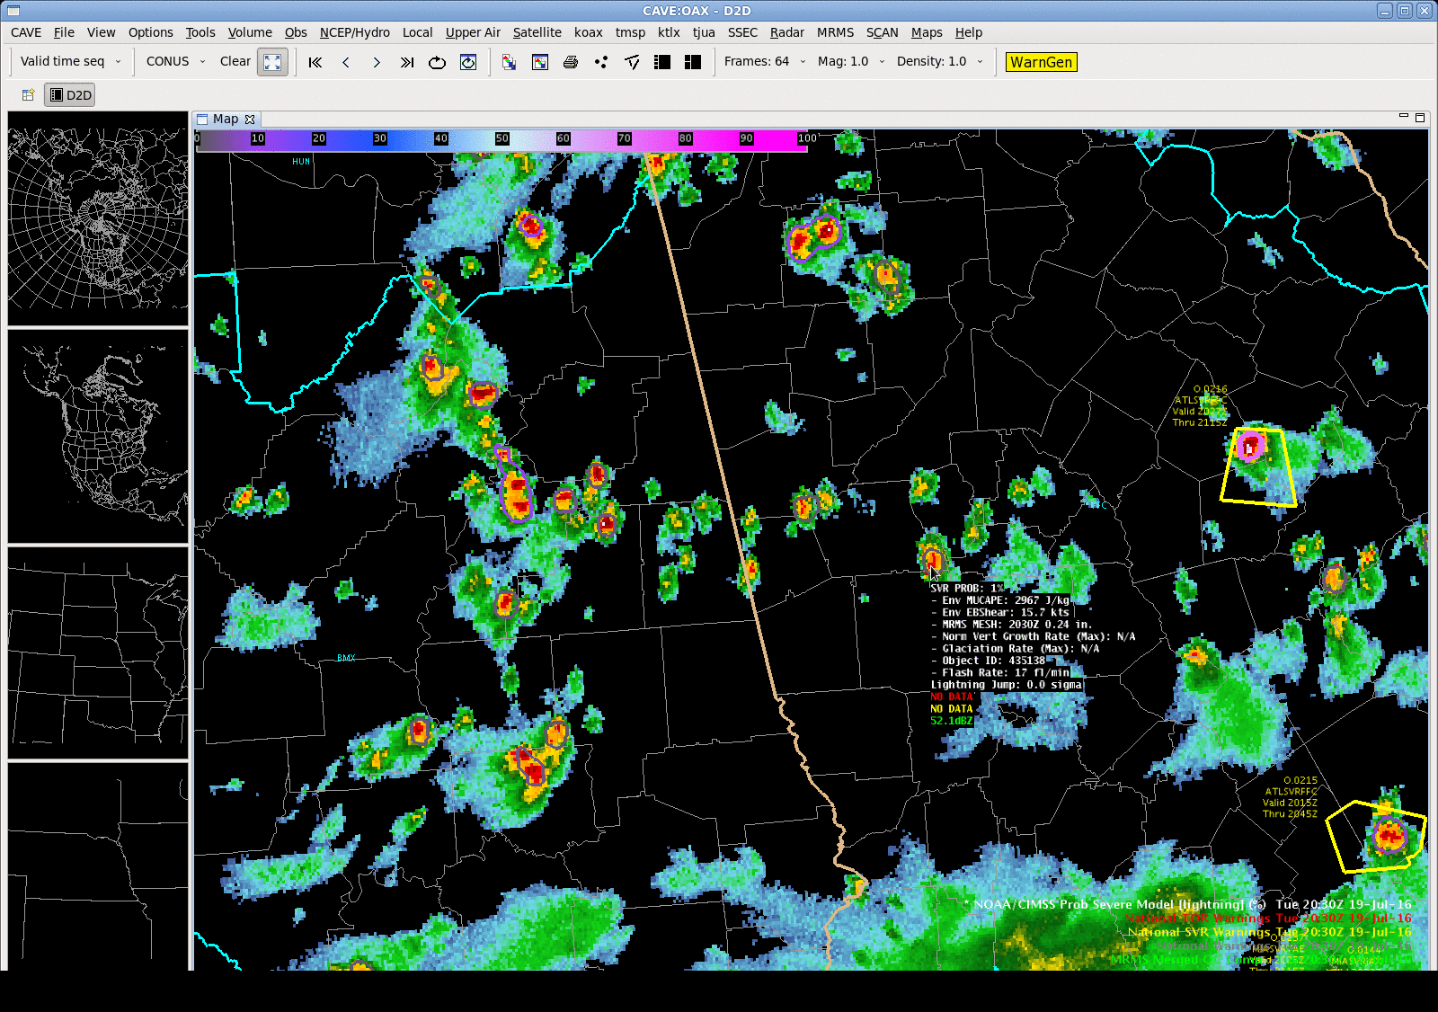
Notes:
A strong normalized satellite growth rate helps jump the probability from 36% to 72%. 1” hail and two wind reports at 21:31Z (13 min after last frame), as the probability is going down (I’m guessing the core is descending). No warning on this storm. Note many storms with 60+ dBZ and low probs—good for picking out intense storms.

Slide 12
ProbSevere – Without Satellite & Lightning
26 min
16 min
Notes:
A validation for about 12,000 storms on 40 convectively active days during May and June 2016 was performed. (Using manual analysis from Ben) FIRST REPORT ONLY
1,553 severe storms
11,163 non-severe storms
All CONUS

Slide 13
ProbSevere – With Satellite & Lightning
36 min
16 min
Notes:
A validation for about 12,000 storms on 40 convectively active days during May and June 2016 was performed. (Using manual analysis from Ben) FIRST REPORT ONLY
1,553 severe storms
11,163 non-severe storms
All CONUS

Slide 14
Model Performance - Skill
Including total lightning/effective bulk shear 2-D predictor increased skill at all probability thresholds (compared to ProbSevere without lightning (2015 and prior)).
Roughly constant CSI between 50 and 80% allows forecaster to choose higher POD/FAR, more lead-time vs lower POD/FAR, less lead-time.
Notes:
While the previous slide demonstrated skill toward the FIRST report with each storm for storms in 2016, this slide assesses ProbSevere skill for ALL storm reports during 5 days of late May, June, July, and August 2014. The sample sizes include 2,125 storm reports and over 600,000 ProbSevere storm forecasts.

Slide 15
WFO-based Skill Analysis
PRELIMINARY
Notes:
PRELIM-First reports only from 2016 (40 days).
We also perform validation as a function of environment, e.g., low CAPE/high shear, high CAPE/high shear, high CAPE/low shear, etc.

Slide 16
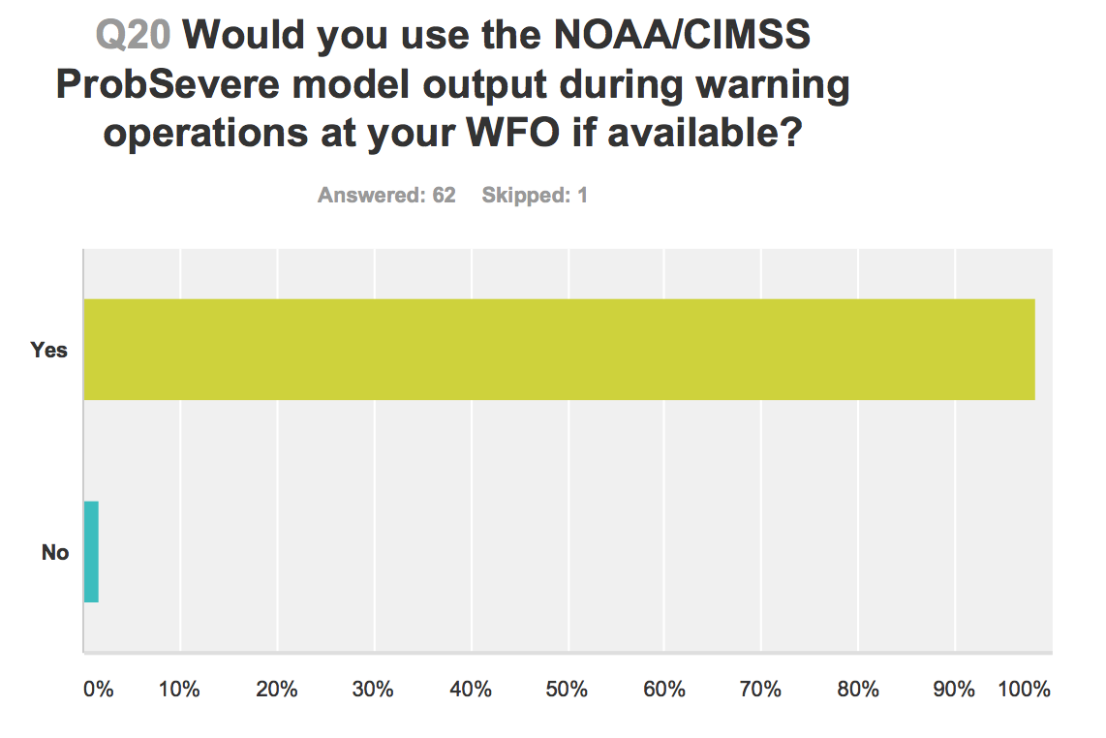
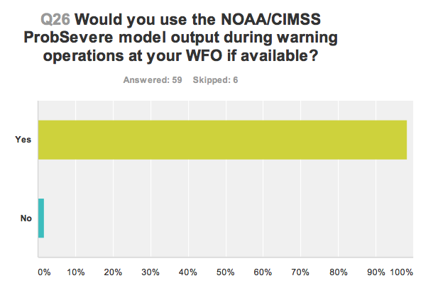
NWS Evaluation
2016
2014
2015
2016: ProbSevere is being evaluated in over 75 WFOs.
See: http://goesrhwt.blogspot.com
Notes:
Evaluated @ SPC’s HWT 2014-2016.
In 2016 being evaluated in over 75 WFOs organized via the NWS Operations Proving Ground in Kansas City.

Slide 17
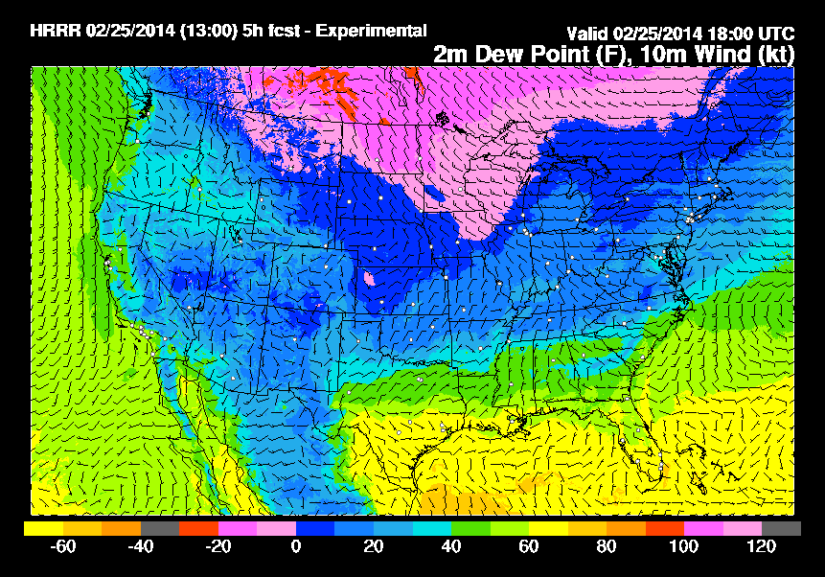
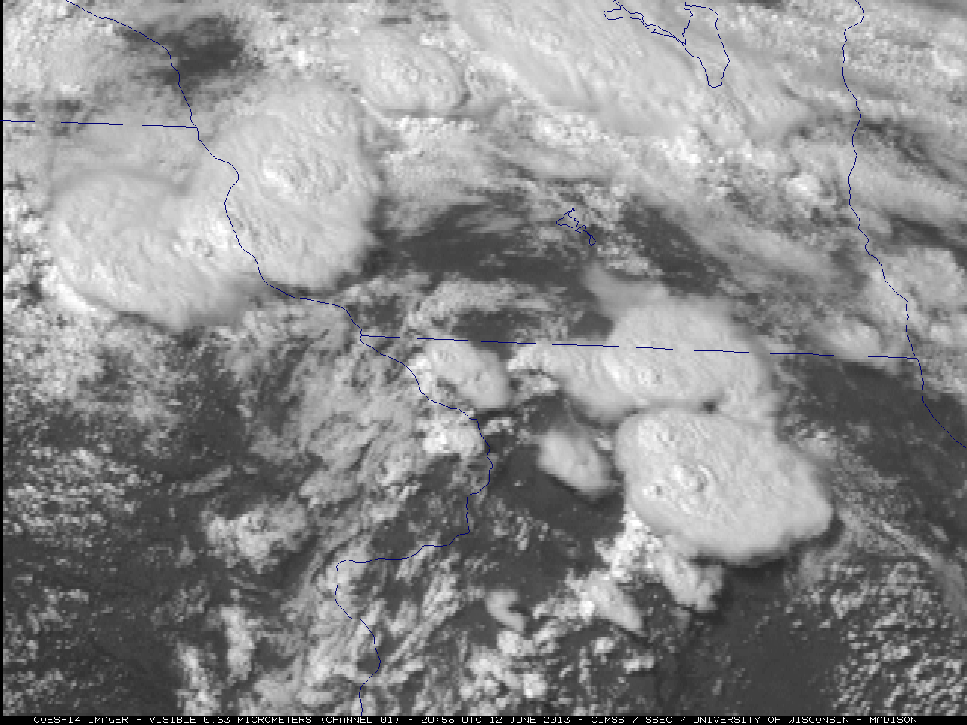
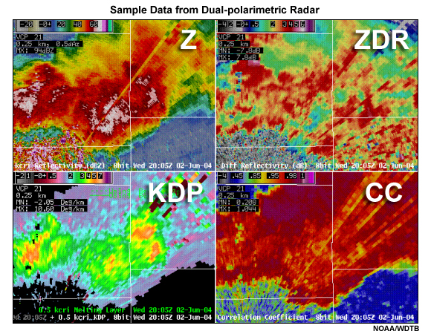
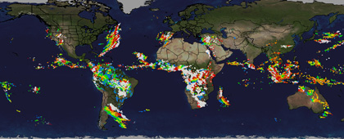
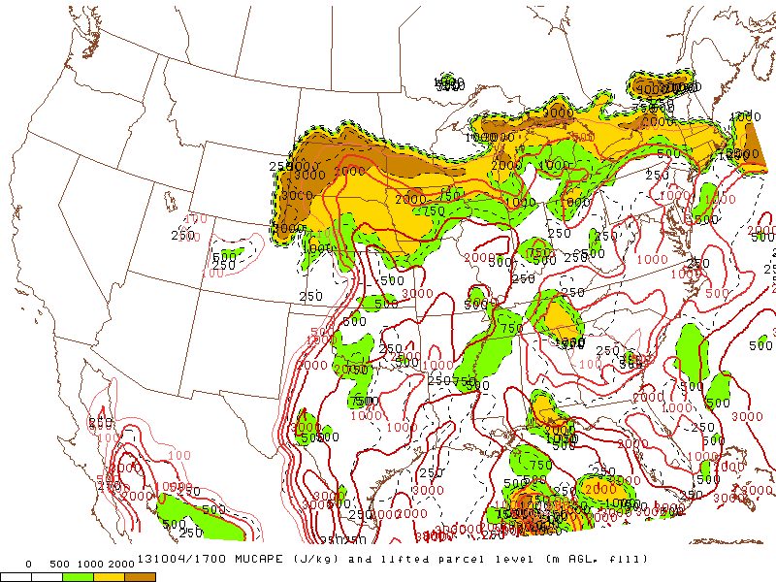
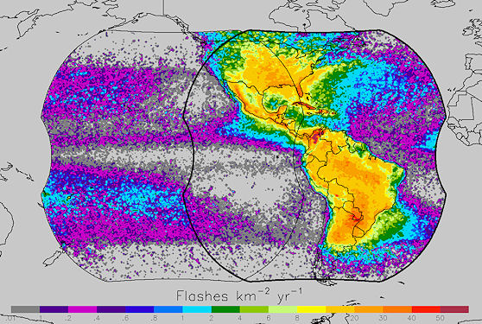
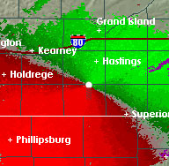
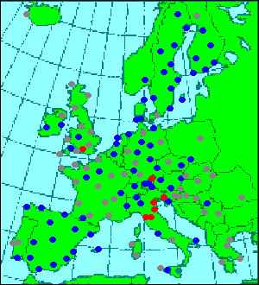
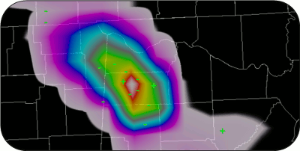
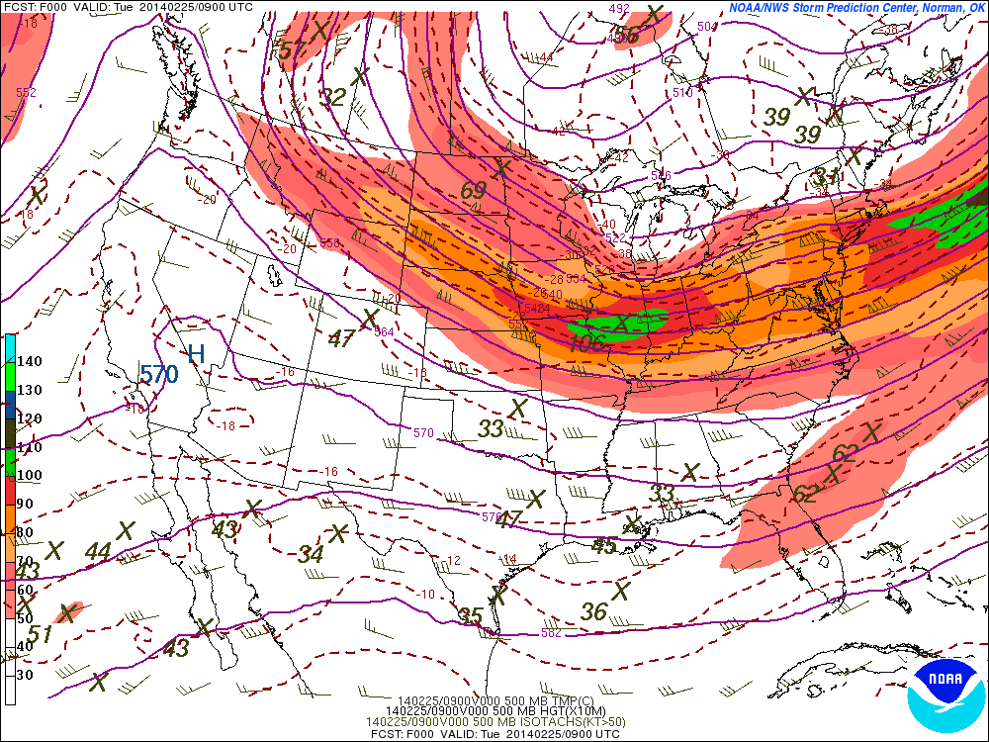
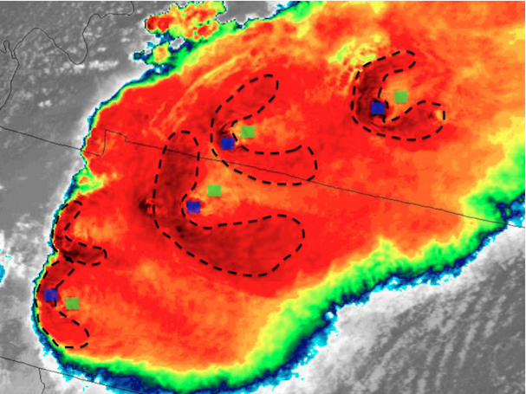
Continued Development
NWP
GOES-R
NEXRAD
Other
HRRR
Super-rapid scan
Dual-pol products
Global lightning
SPC-OA
GLM
Doppler velocities
Additional radars
Create more refined and specific forecasts of severe weather (tornado, hail, wind)
SREF
Cb properties

Slide 18
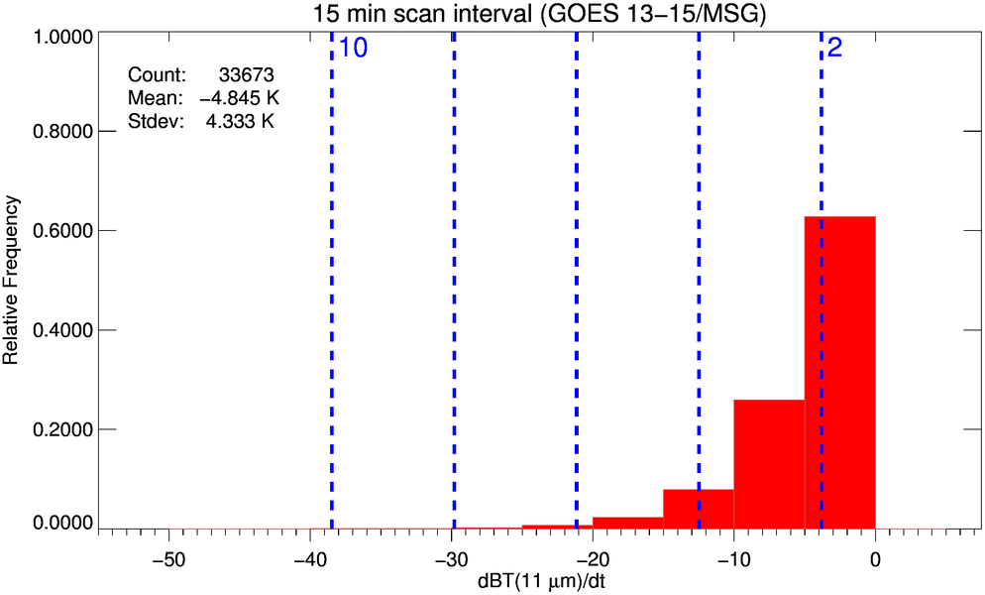
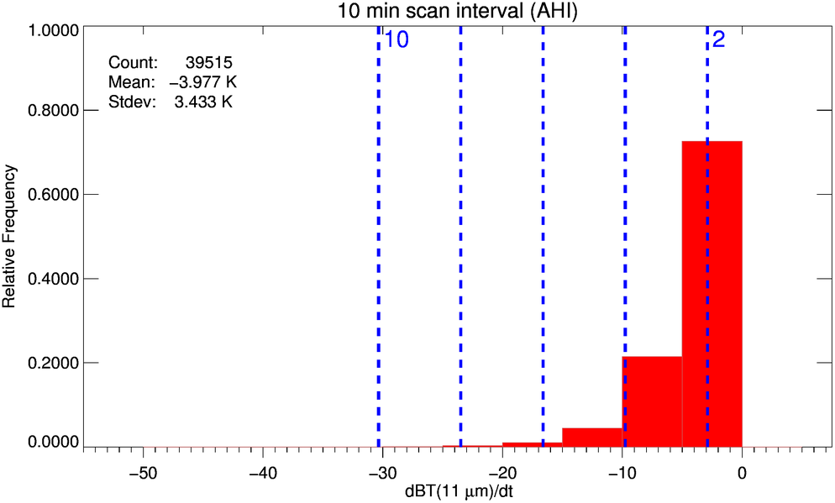
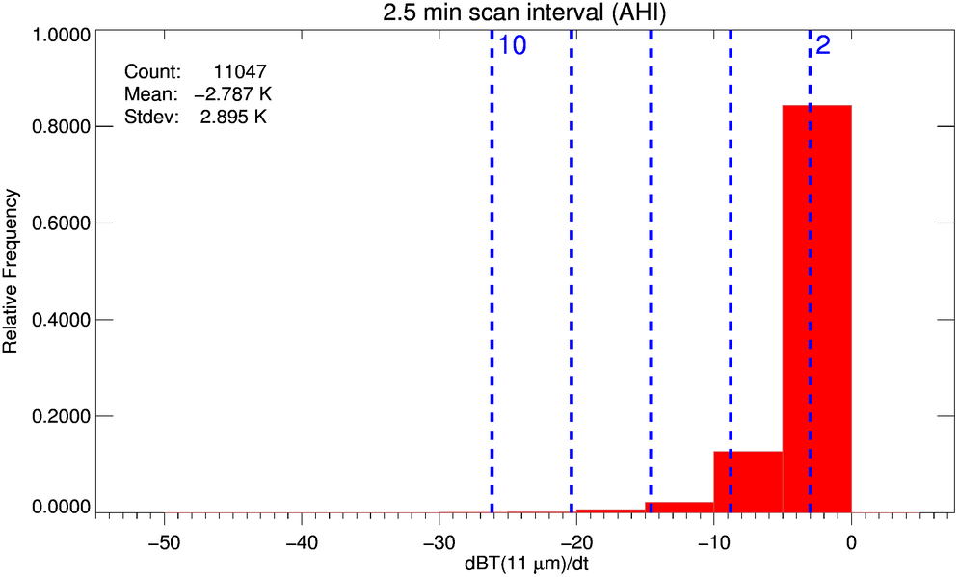
Looking ahead to GOES-R

Slide 19
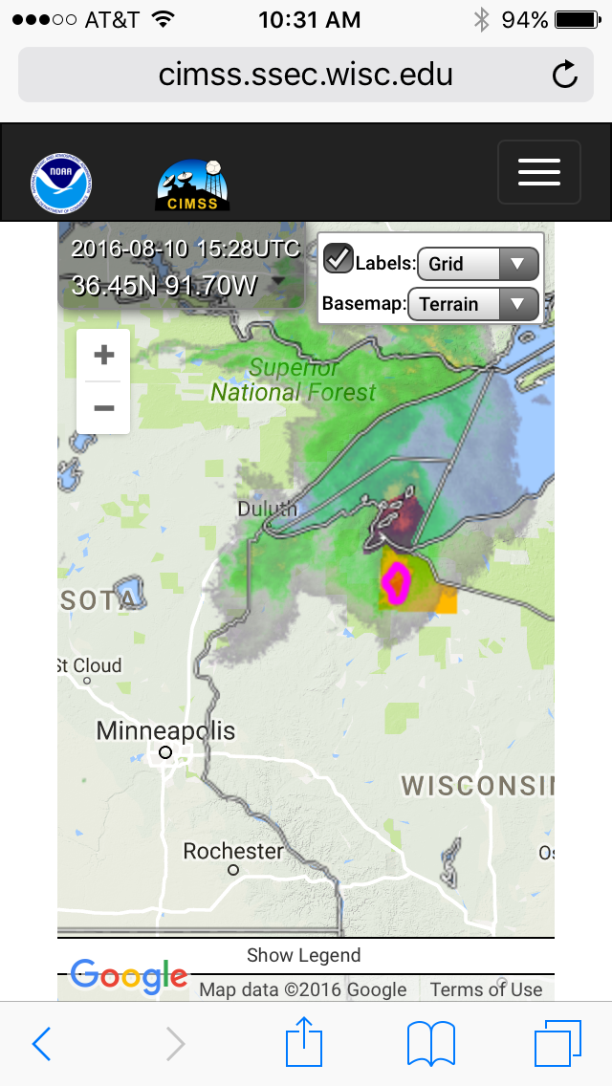
Questions?
http://cimss.ssec.wisc.edu/severe_conv/probsev.html

