Slide 1
ProbSevere timeseries
For a few storms with AACPs

Slide 2
18 May 2017
North-central Texas
Baseball-sized hail
Tornadoes
Case from Bedka et al. (2018) Fig. 4

Slide 3
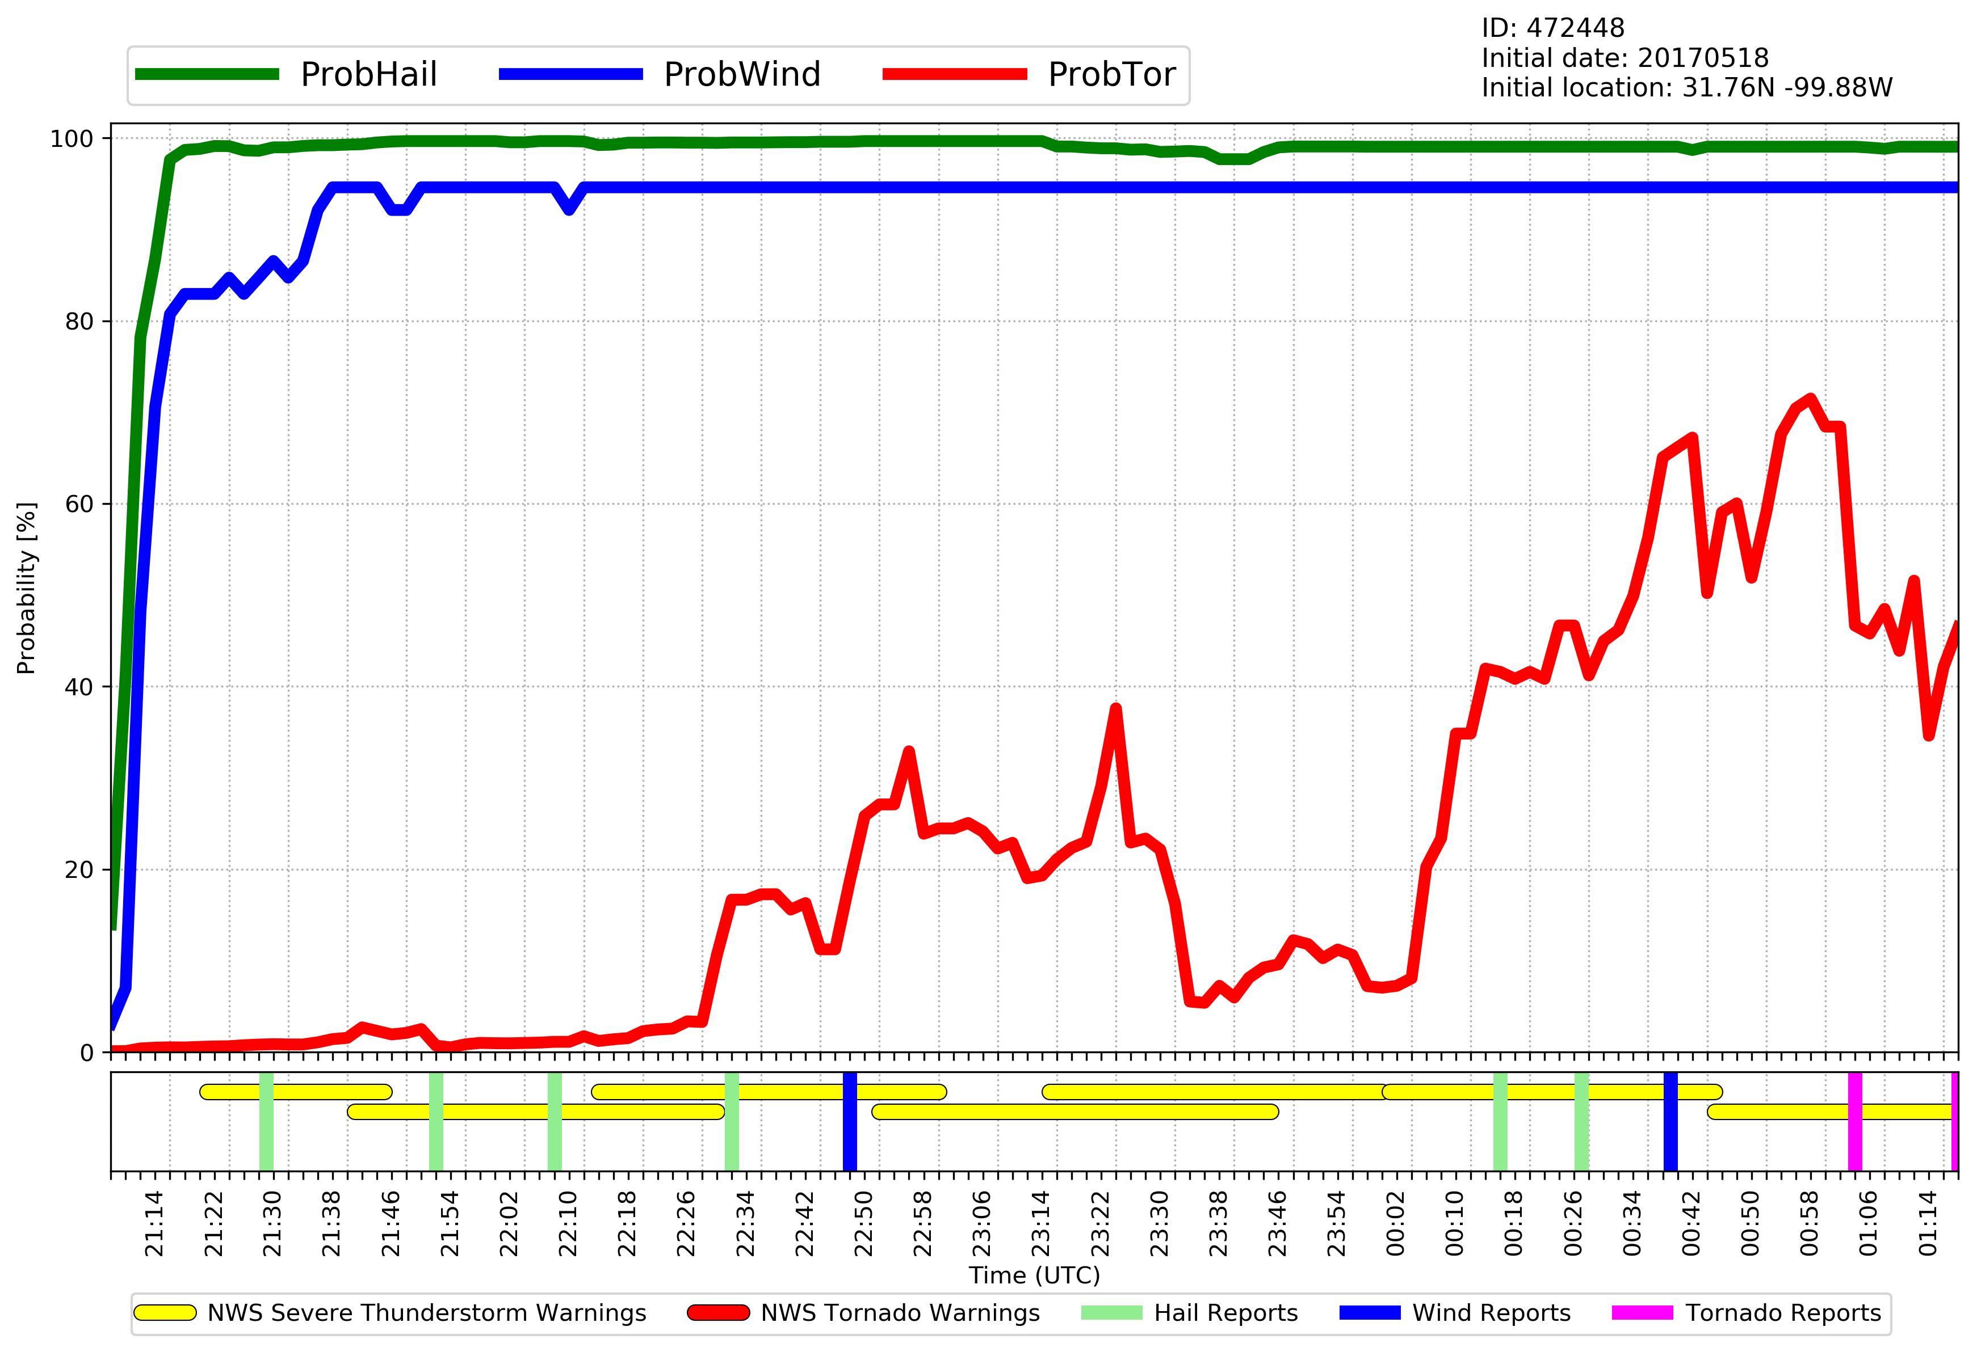
Black line is start of AACP, from Bedka et al. (2018) Fig. 4

Slide 4
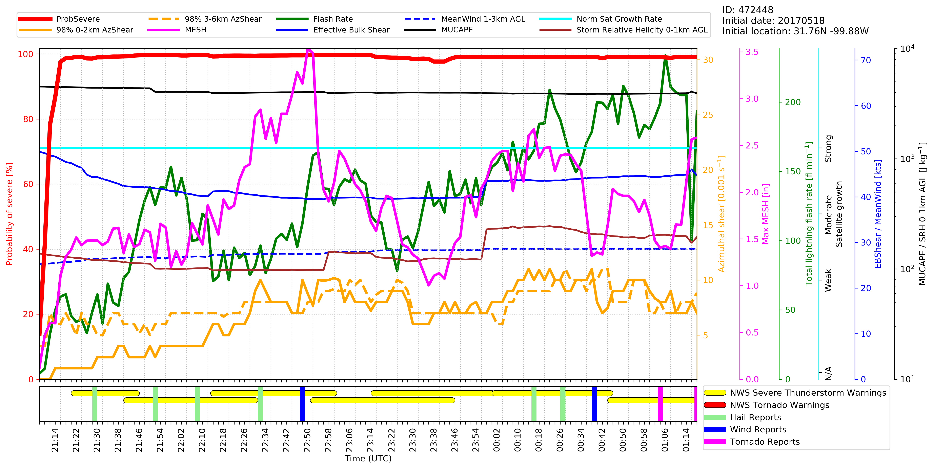
Black line is start of AACP, from Bedka et al. (2018) Fig. 4

Slide 5
19 July 2017
Northern Nebraska
Baseball-sized hail

Slide 6
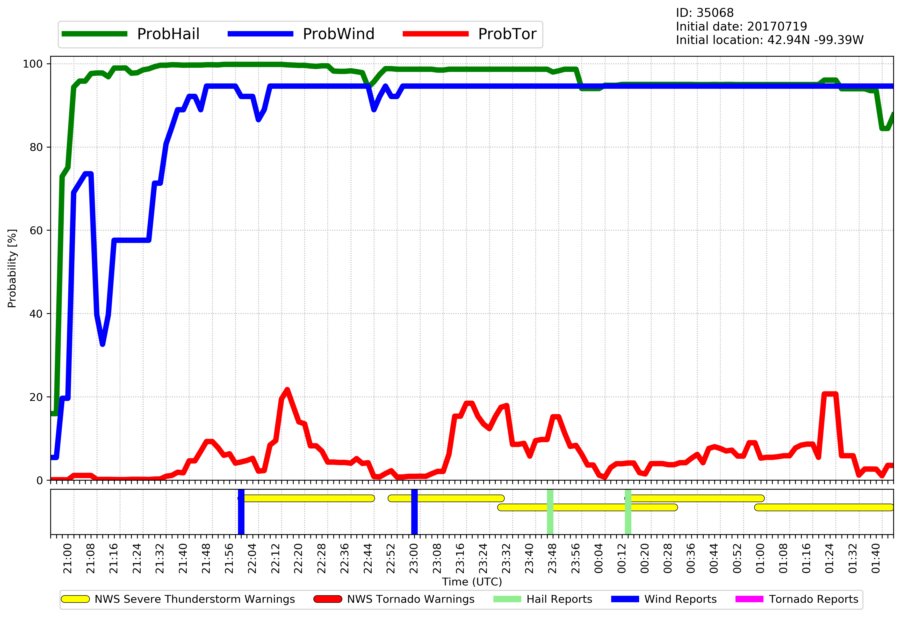
Black shaded area is best guess to start of AACP

Slide 7
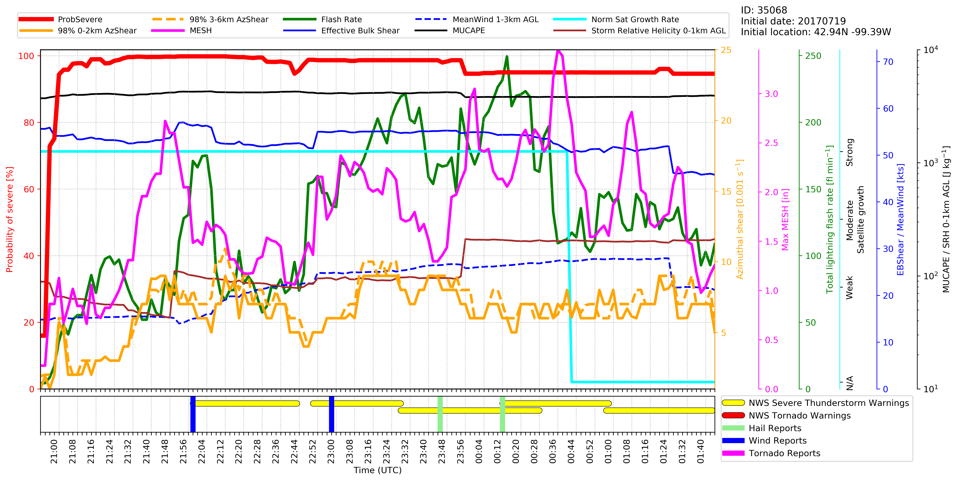
Black shaded area is best guess to start of AACP

Slide 8
05 April 2017
Southern Alabama
Golfball-sized hail

Slide 9
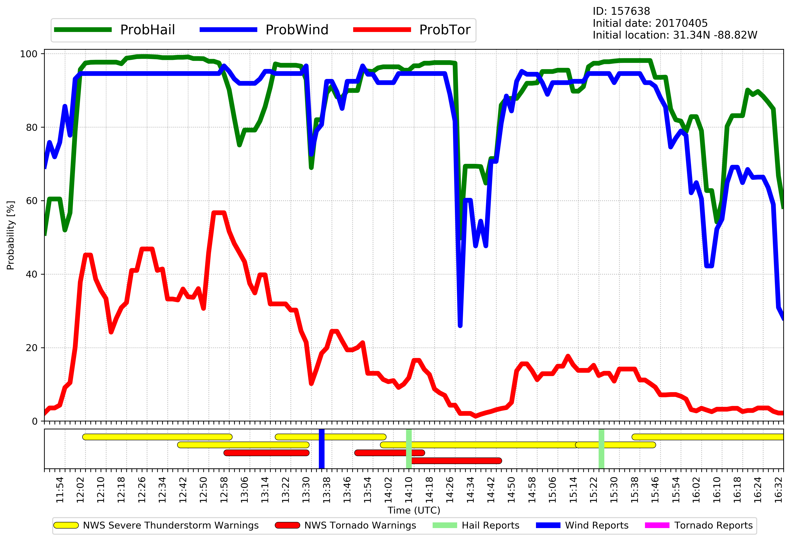
Black shaded area is best guess to start of AACP

Slide 10
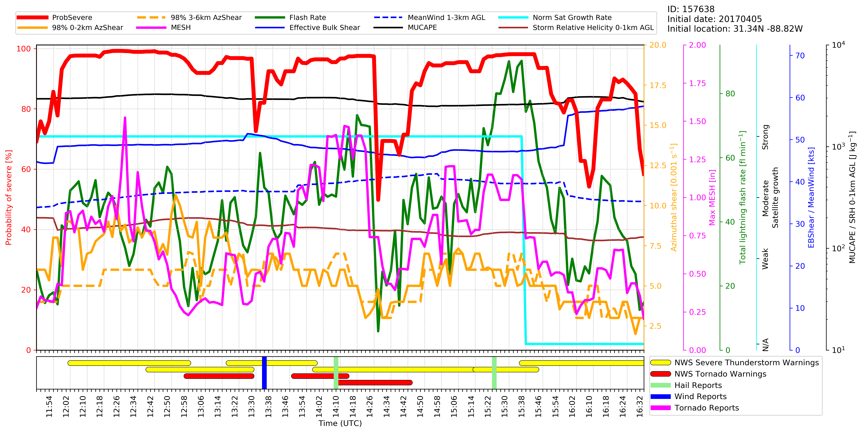
Black shaded area is best guess to start of AACP

Slide 11
29 June 2017
Sioux City, IA
Grapefruit-sized hail

Slide 12
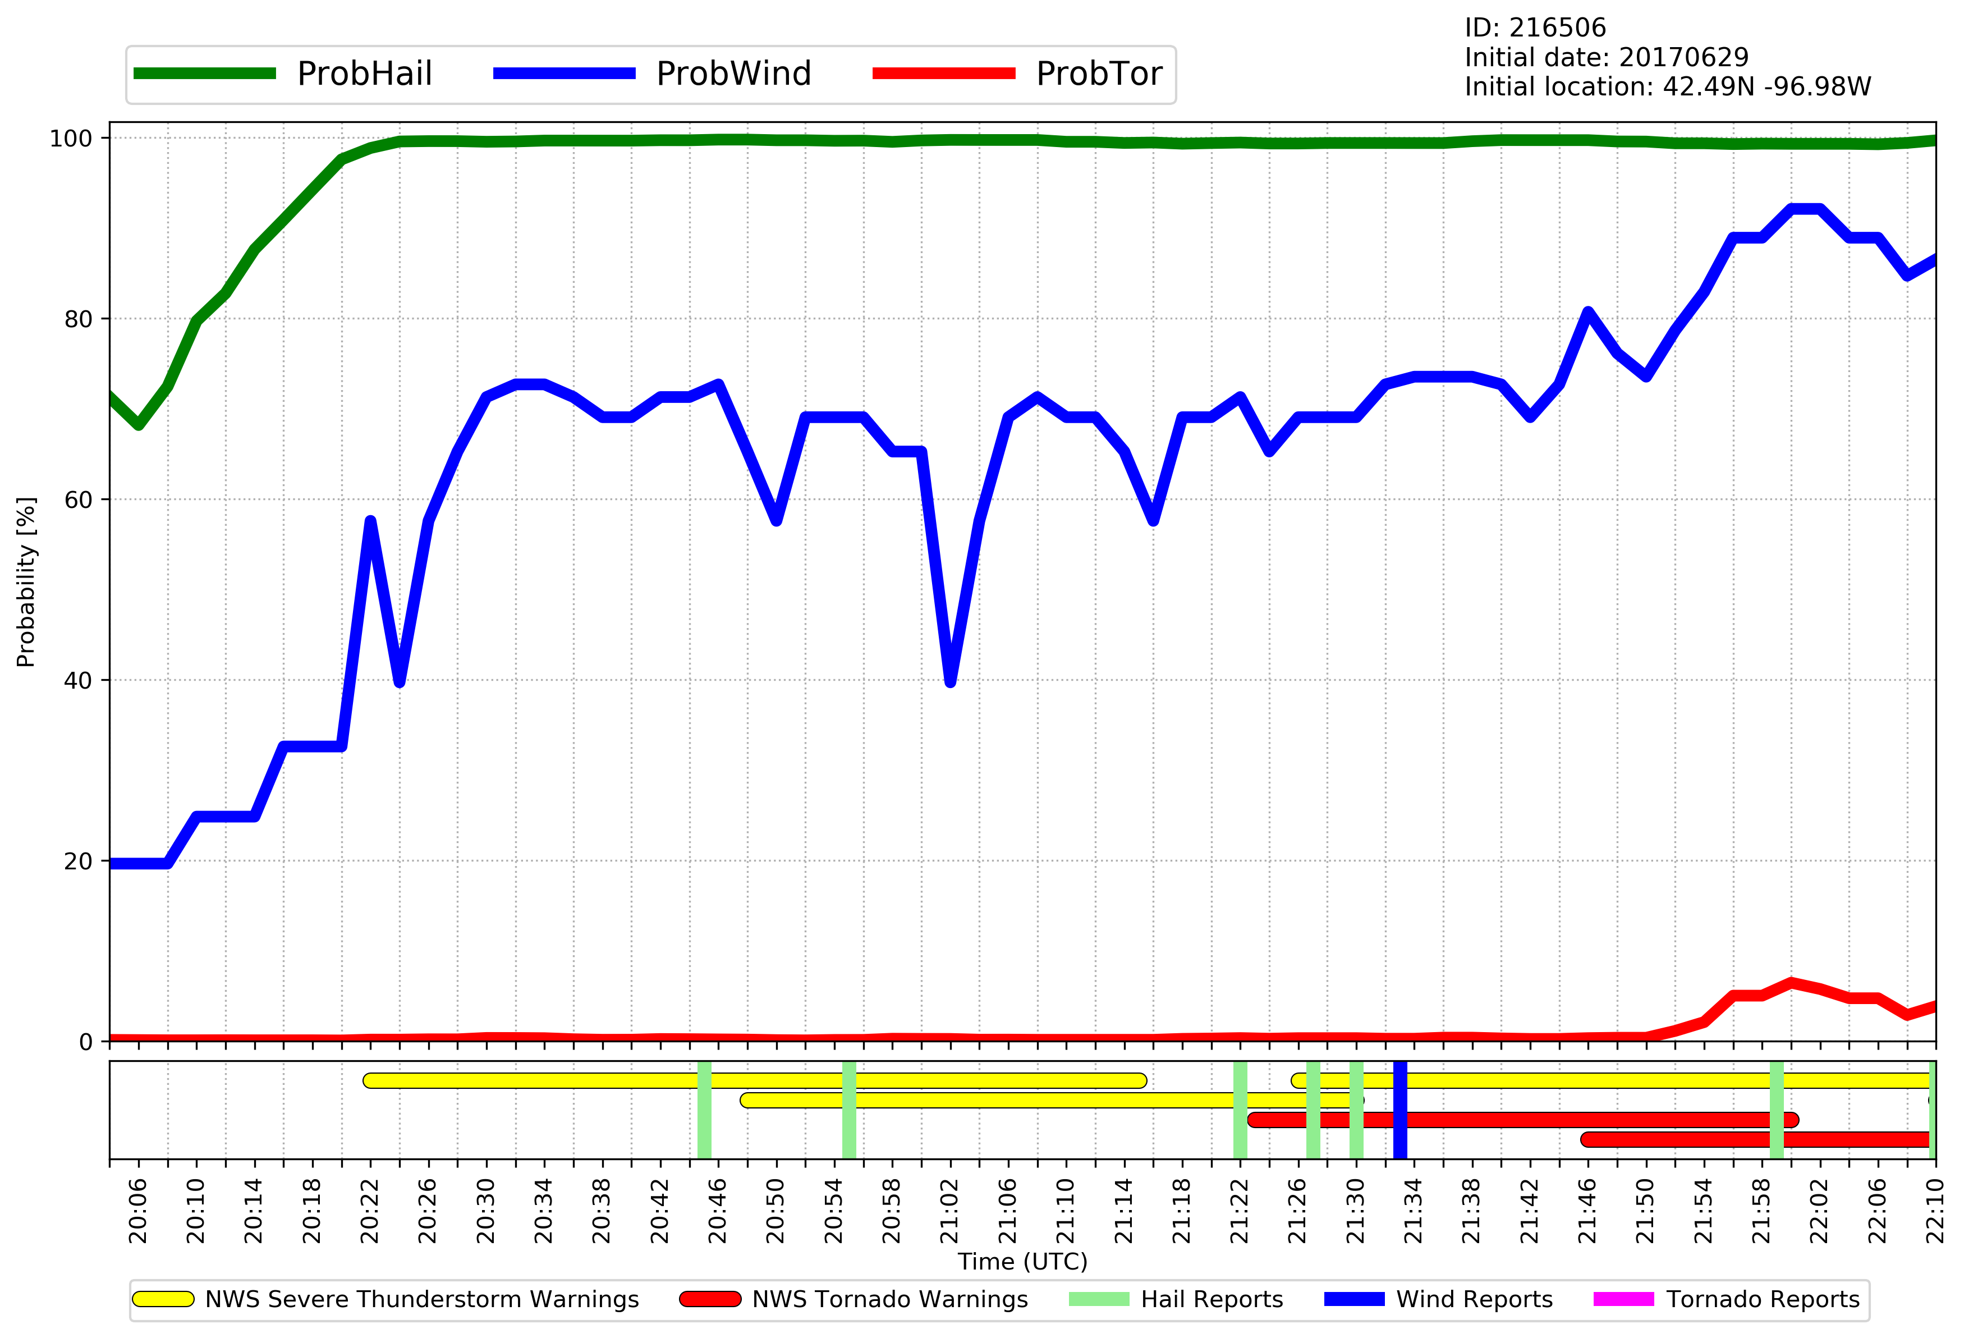
Black shaded area is best guess to start of AACP

Slide 13
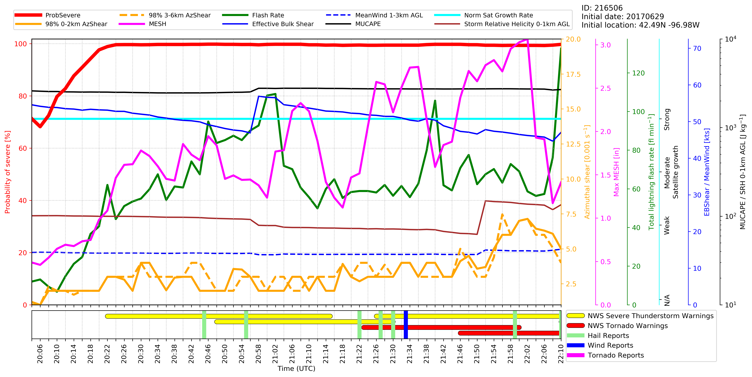
Black shaded area is best guess to start of AACP

