Slide 1
NOAA/CIMSS ProbTor Model
– Training Module –
Spring 2017
Notes:
This is a short training module for users of the NOAA/CIMSS ProbTor Model.
ProbTor is an extension of the NOAA/CIMSS ProbSevere model. This training module is designed for users that are already familiar with the NOAA/CIMSS ProbSevere model and provides only information very specific to the ProbTor model—including data used, examples, validation statistics, and best practices for ProbTor usage by operational forecasters.
If you are not familiar with ProbSevere it is recommended you first complete the ProbSevere training module available at: http://cimss.ssec.wisc.edu/severe_conv/training/training.html

Slide 2
NOAA/CIMSS ProbTor Model Goals
ProbTor is a statistical model designed to increase forecaster confidence and/or increase lead-time in tornado warning issuance.
This statistical model predicts the probability that a storm will produce a tornado in the near-term (in the next 60 min).
ProbTor can be used as a ‘pre-polygon’ product as well as an aid for warning reissuance.
Notes:
ProbTor follows the same radar object-based naïve Bayesian statistical framework as NOAA/CIMSS ProbSevere model and also follows the same display concepts (both in AWIPS-II and PHI visualization).
ProbTor is a statistical model designed to increase forecaster confidence and/or increase lead-time in tornado warning issuance.
Add pretty picture.
Get font shadings to match.

Slide 3
NOAA/CIMSS ProbTor Model
Probability derived from: climatology environment observations
1% of severe storms are tornadic
RAP NWP:
0-1 km Storm Relative Helicity
Effective Bulk Shear
Mean Wind 900-700 mb layer
mlCAPE and mlCIN (penalty only)
OBSERVATIONAL PREDICTORS:
0-2 km AzShear (MRMS)
3-6 km AzShear (MRMS)
Maximum Total Lightning Density (ENTL)
The statistical model is driven by observations. The model does not predict cloud growth, but observes cloud growth, precipitation core intensity, and total storm electrification.
Notes:
Some text. (remove bottom statement or change it)
Do we want to include a slide for each NWP and observation used like we do in the ProbSevere training?
I think those might be a good place to very briefly mention how we couple things and give physical basis for selecting the data we have, but it might be too long?
-Maybe 1 slide explaining by what AzShear is and show an example of AzShear relative to velocity image? (even if it isn’t ours)

Slide 4
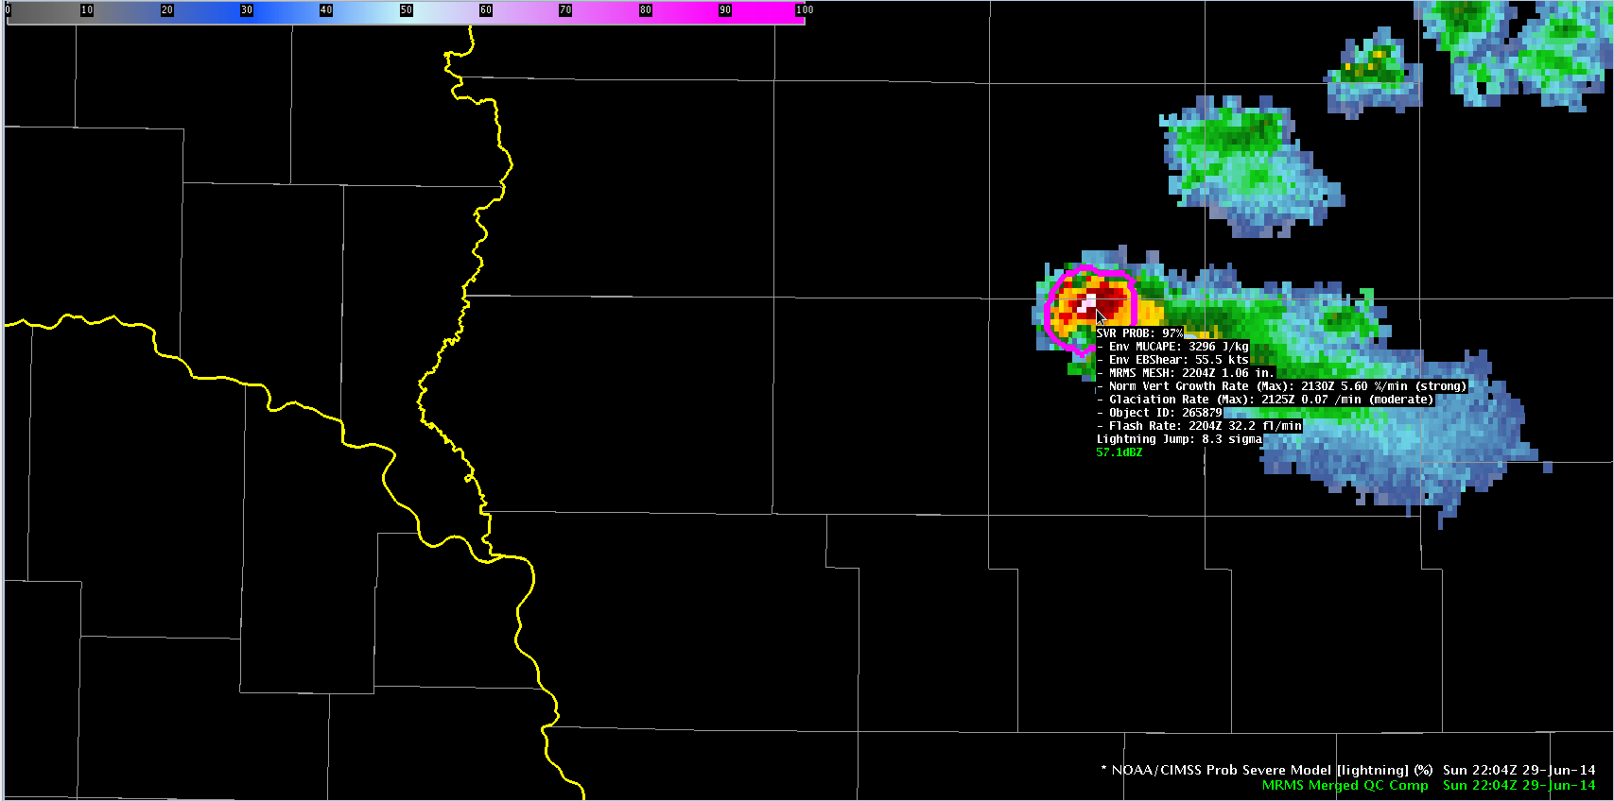
ProbTor Model AWIPS-II Display
Model output are shapefiles contoured around radar storm cells.
Enhancement designed for overlay atop radar reflectivity—but can be overlaid on any field (satellite, radar velocity, etc.).
Sampling offers readout of model probability as well as each model predictor.
Notes:
A walk-through of the visualization information (add additional slides); followed by 2 examples. Maybe 2-3 slides for each example, possibility including time-series plot?
Ideally for examples, we want:
1) One, if not both, examples highlight storm standing out relative to neighbors
2) Show a juicy kinematic environment and a more marginal environment

Slide 5
ProbTor Model Performance
POD/FAR/CSI
Reliability
Skill plots show ProbTor is less skillful (as expected) than experienced forecasters, but offers increased lead-time
Reliability shows slight underforecast bias at ProbTor ≤ 60% and slight overforecast ≥ 70%
Despite small reliability biases, ProbTor is fairly well-calibrated
Notes:
POD/FAR/CSI/reliability statistics are for ALL tornadoes in validation database. (60 days in 2016; 325 tornadic storms; 45,586 non-tornadic storms)
The lead-time statistics are measured to the FIRST tornado report associated with tornadic storms.
ProbTor skill (as expected) is poorer than experienced NWS forecasters, yet still comparable (CSI: ProbTor: 0.XX vs NWS: 0.XX). However, ProbTor, in the median, provides 10-minutes greater lead-time than traditional techniques (ProbTor: 35 min vs NWS: 25 min)**.
ProbTor users should utilize the good reliability of the probabilities, for example a storm with 33% ProbTor will produce a tornado a bit more than 1 in 3 times; a storm with 50% ProbTor will produce a tornado a bit more than 1 in 2 times.
**Note the NWS lead-time values are larger than published statistics. This is due to the validation methodology, since ProbTor can count as a hit up to 90 minutes in the future, we do not penalize the NWS for the first TOR report occurring AFTER (spatially ‘down wind’ of) the initial warning, which acts to inflate total lead-time. The difference between the two lead-times is what is significant.

Slide 6
ProbTor: Helping in the ‘uncertain’ zone
Tornadic
TorWarn
Tornadic Certainty
Uncertain
Tornadic Zone of Uncertainty
Non-tornadic
Time
Notes:
ProbTor will be most useful to forecasters in the uncertain zone between definitely not tornadic and definitely tornadic (or tornado warning worthy). The zone of uncertainty—when a forecaster ponders do I warn or not warn this storm, do I wait for another volume scan, etc. is when the ProbTor value (relative to its neighbors) and very short-term trends (e.g., past 4-6 minutes) COMBINED with base/SRM velocity interrogation can help to increase tornado warning lead-time and/or confidence.
ProbTor is most useful to the warning forecaster to increase confidence that a storm will (will not) produce a tornado, both for the first time and subsequent tornadoes. While validation has not focused on tornado dissipation, qualitative assessment suggests ProbTor can also highlight when a tornado threat has diminished (although beware of storm cycling and subsequent ProbTor increases)

Slide 7
ProbTor: Kinematic Environment Matters!
3%
10%
Vs.
30%
60%
0%
6%
Marginal Kinematics (e.g.)
0-1 km SRH: 100 m² s⁻²
Eff. Bulk Shear: 30 kts
700-900 mb MW: 20 kts
Favorable Kinematics (e.g.)
0-1 km SRH: 200 m² s⁻²
Eff. Bulk Shear: 50 kts
700-900 mb MW: 40 kts
Do not expect the same ProbTor probability value to give the same results from event to event—the kinematic fields impact ProbTor!
It is best to use ProbTor in a relative fashion—like in the example above.
Notes:
It is best to use ProbTor in a relative sense—how does a storm’s ProbTor value compare to its neighbors opposed to using a fixed ProbTor threshold.
ProbTor is well-calibrated and responds to storm observations (total lightning and MRMS AzShear), but the kinematic environment also plays a significant role in formulating the probabilities. A day with more marginal kinematics will in general have lower probabilities than a day with more favorable kinematics—however the storms that pose the highest threat will still stand-out relative to its neighbors. Therefore forecasters are encouraged not to use a fixed ProbTor threshold, but must also consider the kinematic environment.

Slide 8
ProbTor: Known Caveats
ProbTor requires an identifiable object in radar reflectivity
  Most often in linear modes, object identification can become more difficult—the absence of an object and ProbTor value does not mean there is no tornadic threat
ProbTor is impacted by radar beam blockage and increasing beam height away from radar just as base/SRM velocity interrogation
ProbTor interpretation can be more difficult in long convective lines
  Pinpointing the portion of a long convective line posing the highest tornadic threats can become difficult since the entire line is identified as single object
  ProbTor can overforecast in strong convective lines in favorable kinematic environments
ProbTor will typically have very low probabilities with ‘land spout’ tornadoes
Use ProbTor with caution near the radar (within ~10 mi), as AzShear values may be artificially high due t0 non-meteorological targets.
Notes:
We may want to make very brief examples of some of these if we feel the training is not already too long.

Slide 9
ProbTor: Summary
ProbTor is a statistical model that incorporates NWP fields, radar observations, and total lightning observations to predict the probability a storm will produce a tornado in the next 0-90 minutes.
ProbTor should be used in combination with existing radar interrogation techniques
ProbTor is best used in a relative sense—how a storm’s values compare to neighbors since the kinematic environment will impact probabilities in addition to observations (the ‘best’ probability threshold will change based on the environment)
ProbTor is fairly well-calibrated; so a storm with a 25% probability will produce a tornado about 1 in 4 times and so on.

Slide 10
Contact
Mike Pavolonis (michael.pavolonis@noaa.gov)
John Cintineo (john.cintineo@ssec.wisc.edu)
Justin Sieglaff (justin.sieglaff@ssec.wisc.edu)
Dan Lindsey (dan.lindsey@noaa.gov)
To access this training online and access supplement training please see:
http://cimss.ssec.wisc.edu/severe_conv/training/training.html
ProbTor is also available on the web in real-time:
http://cimss.ssec.wisc.edu/severe_conv/probtor.html
Notes:
Please contact the statistical model researchers with questions, suggestions, etc. at the email addresses provided.

