Slide 1
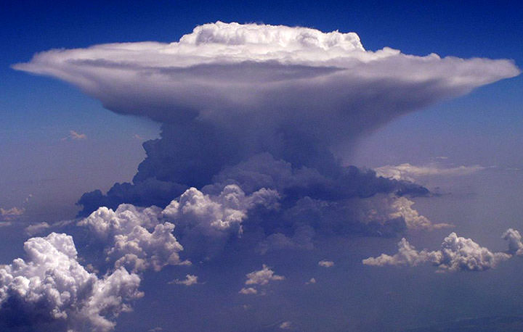
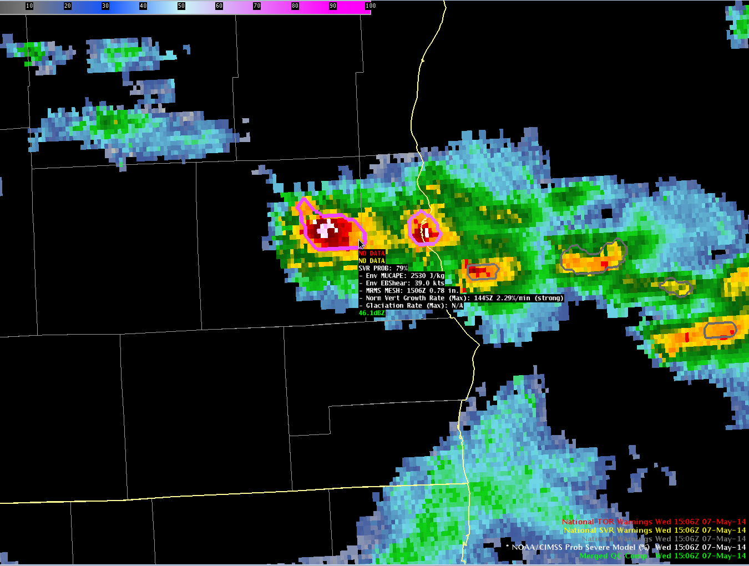
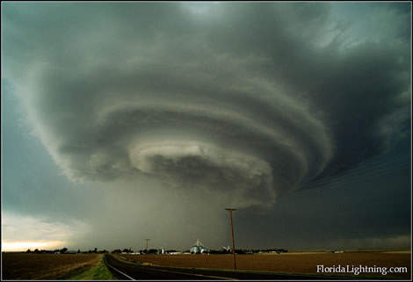
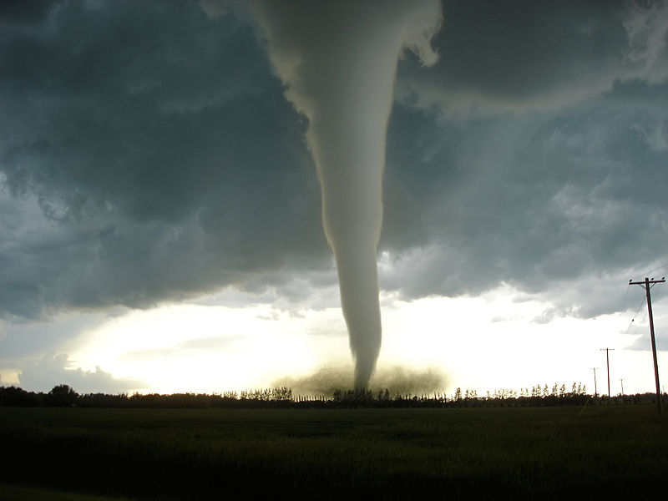


Automated Severe Thunderstorm Guidance from the NOAA/CIMSS ProbSevere Model within the Hazardous Weather Testbed
98th Annual American Meteorological Society Meeting
Austin, Texas
11 January 2018
John Cintineo (UW-CIMSS)
Michael J. Pavolonis (NOAA/NESDIS)
Justin Sieglaff (UW-CIMSS)
Christopher Karstens (NOAA/NWS/SPC)
Kristin Calhoun (OU-CIMMS)

Slide 2
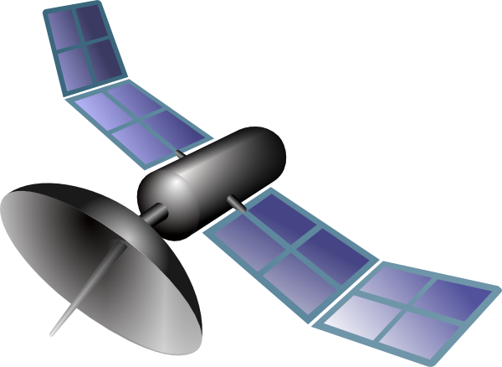
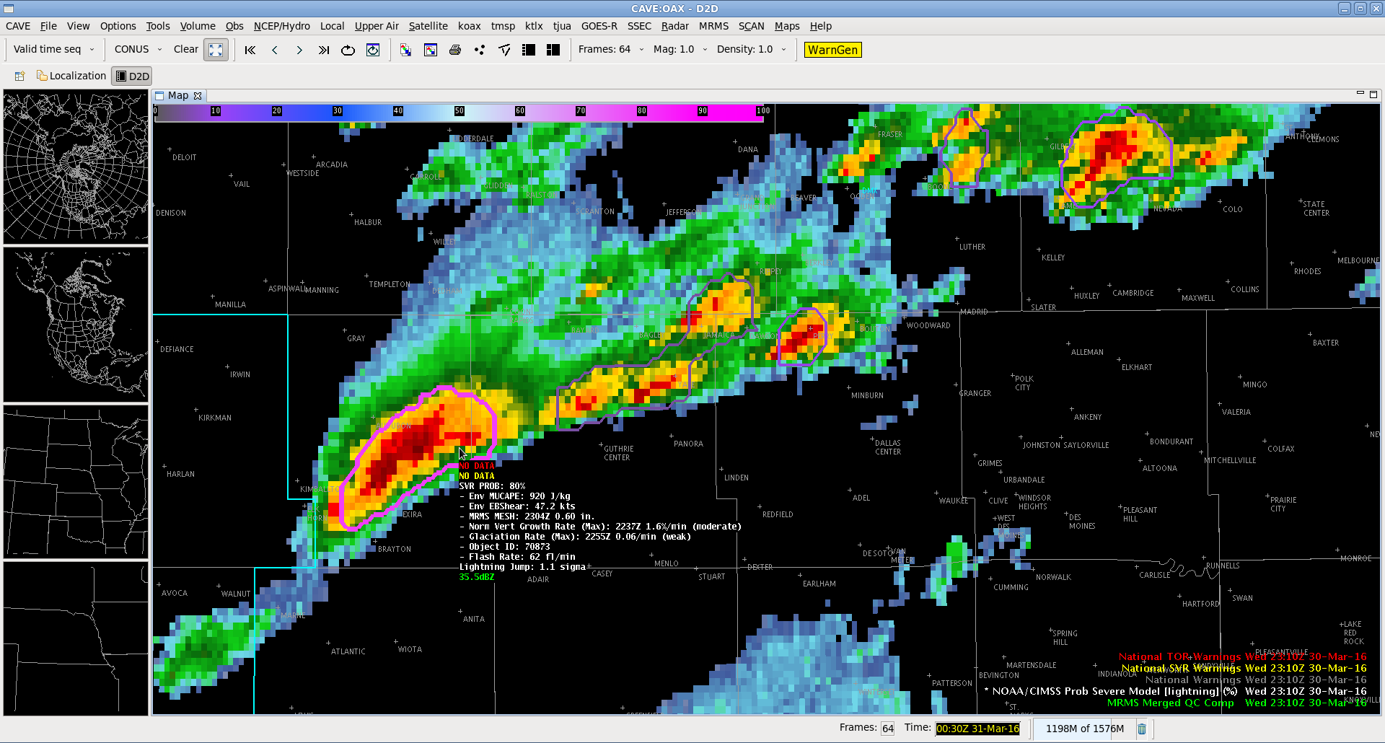

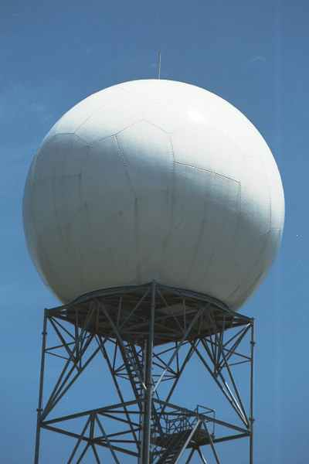
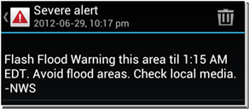
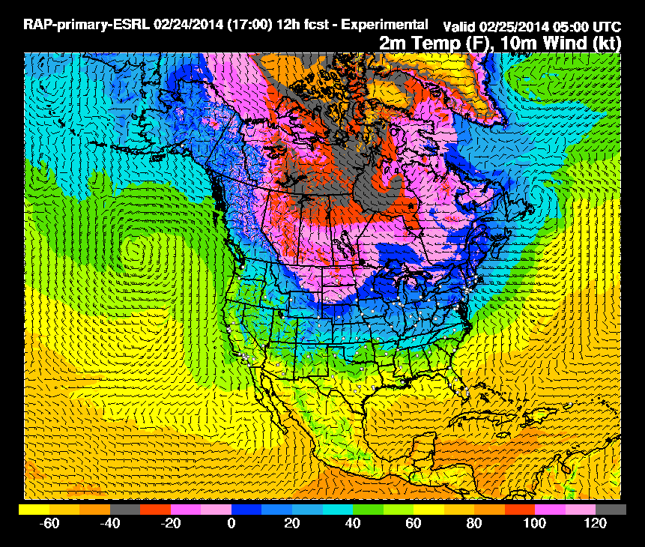
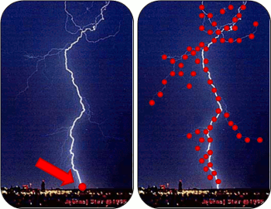
Motivation: convert “Big Data” into
actionable information for weather hazards
Images are from NOAA, NASA, or public domain
Notes:
High-resolution streaming data from a variety of sources

Slide 3

Motivation: FACETS paradigm
Notes:
FACETS involves more than just convective weather, but that’s the focus of this application

Slide 4
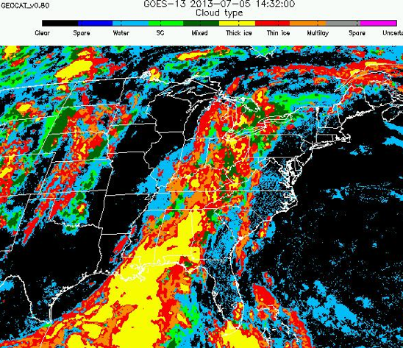
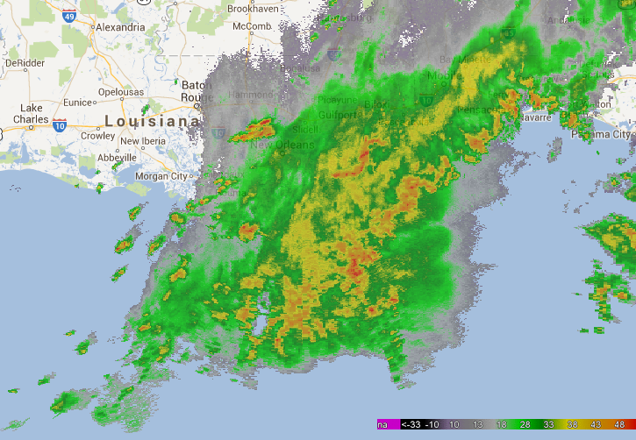
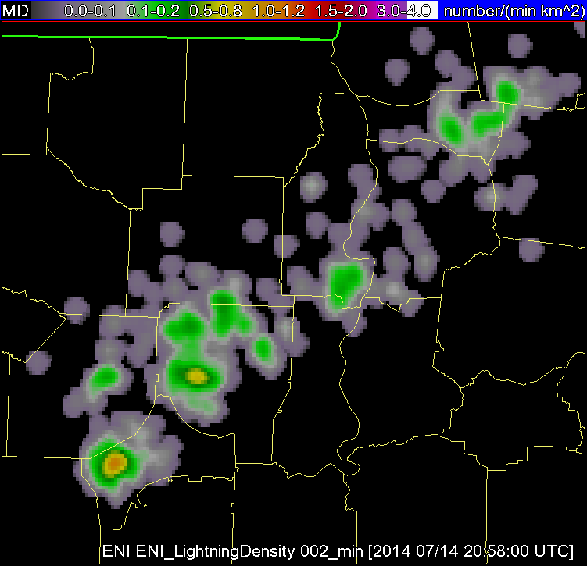
NOAA / CIMSS ProbSevere model
High-resolution NWP Data
GOES Imagery and Derived Products
MRMS Products
Total Lightning
evolution of cumulus to cumulonimbus
storm tracking and hydrometeor properties
storm electrification
storm environment
Probability a thunderstorm will produce severe hail, wind, or tornado in the future (up to 90 minutes)
Images are from NOAA, UW-CIMSS, and OU-CIMMS
Notes:
ProbSevere is a naïve Bayesian model, that is, a statistical model, which integrates data from multiple observation platforms to predict the probability that a thunderstorm will produce severe weather in the near-term (hail ≥25mm diameter, wind gust ≥ 50 kts, tornado). ProbSevere incorporates real-time automated object identification and tracking in both ground-based weather radar reflectivity imagery and satellite imagery. From within the bounds of those identified objects, or storms, data are spatially extracted and certain predictors are computed. Specifically, these predictors are extracted and derived from high-res NWP data, satellite cloud products, radar imagery, and ground-based total lightning data

Slide 5
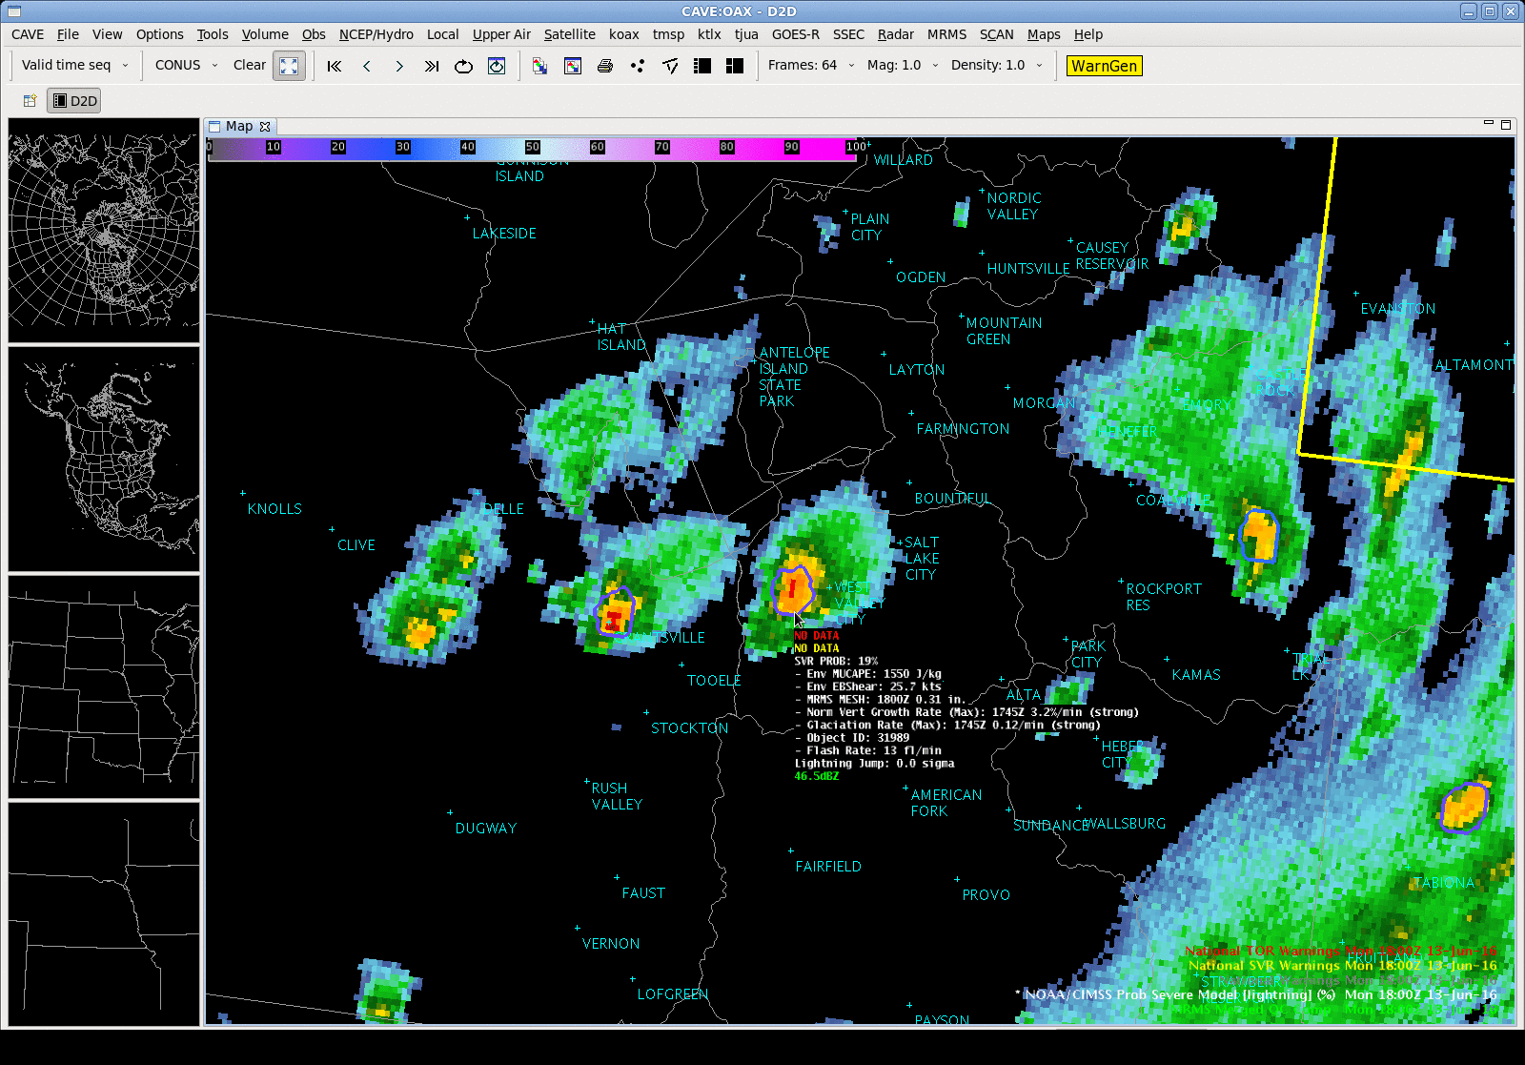
ProbSevere in AWIPS2
Notes:
Contour around storm-object, where the probability determines the color and thickness of the contour
Forecaster mouses over storm to get predictor readout
Lightweight, unobtrusive, intuitive, yet quantitative way to display pertinent information

Slide 6
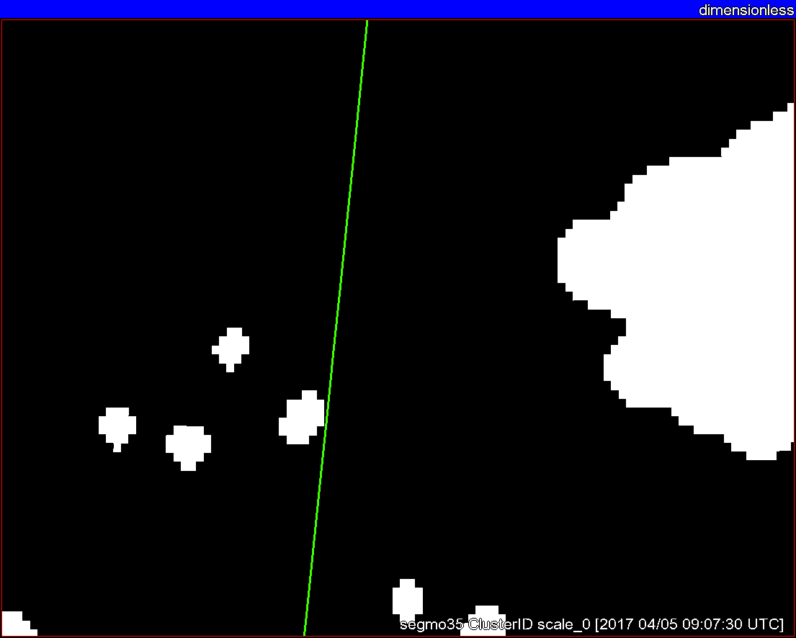
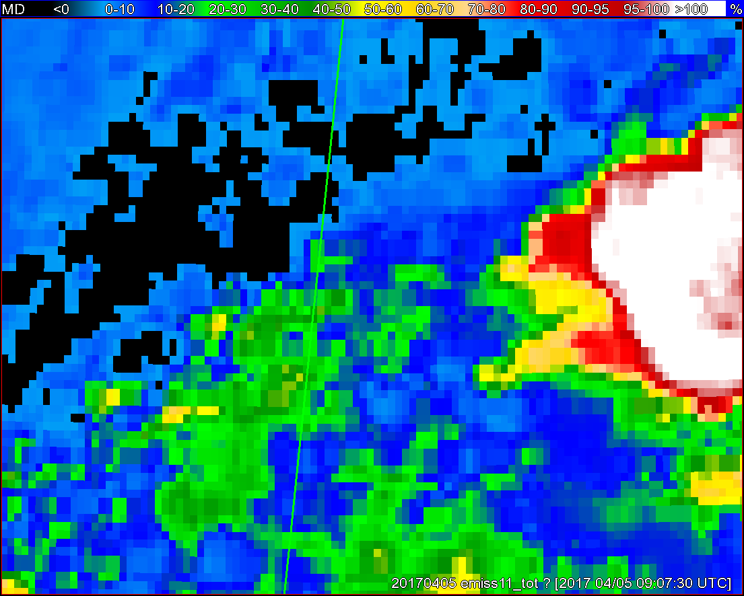
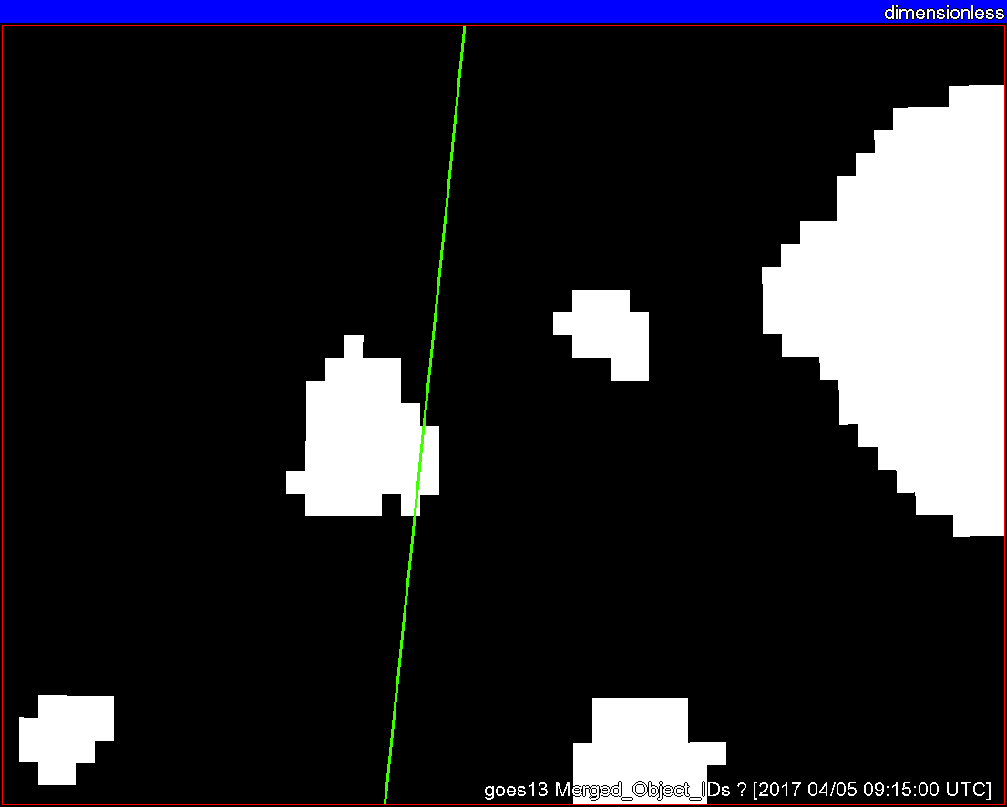
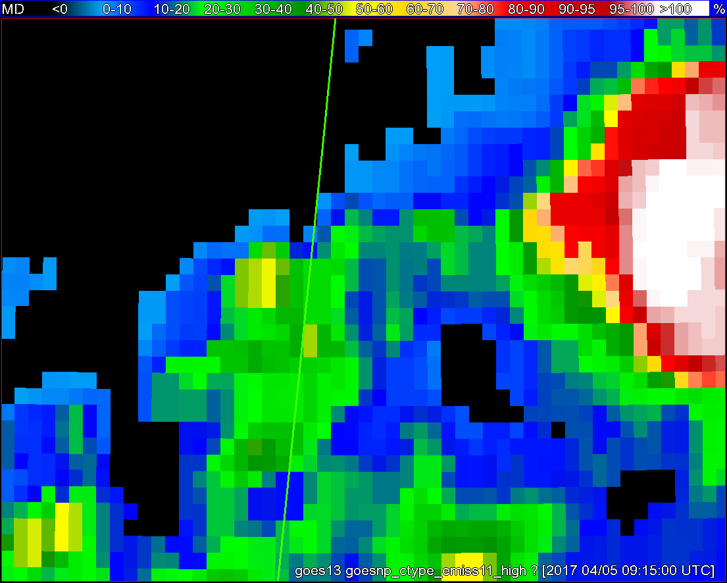
Objects
11-µm top-of-troposphere emissivity
GOES - 16
GOES - 13
Notes:
I put this example in just to illustrate satellite object tracking. I think this does a better job than past examples. Also shows the differences between G16 and NOP. Should go pretty quick.

Slide 7
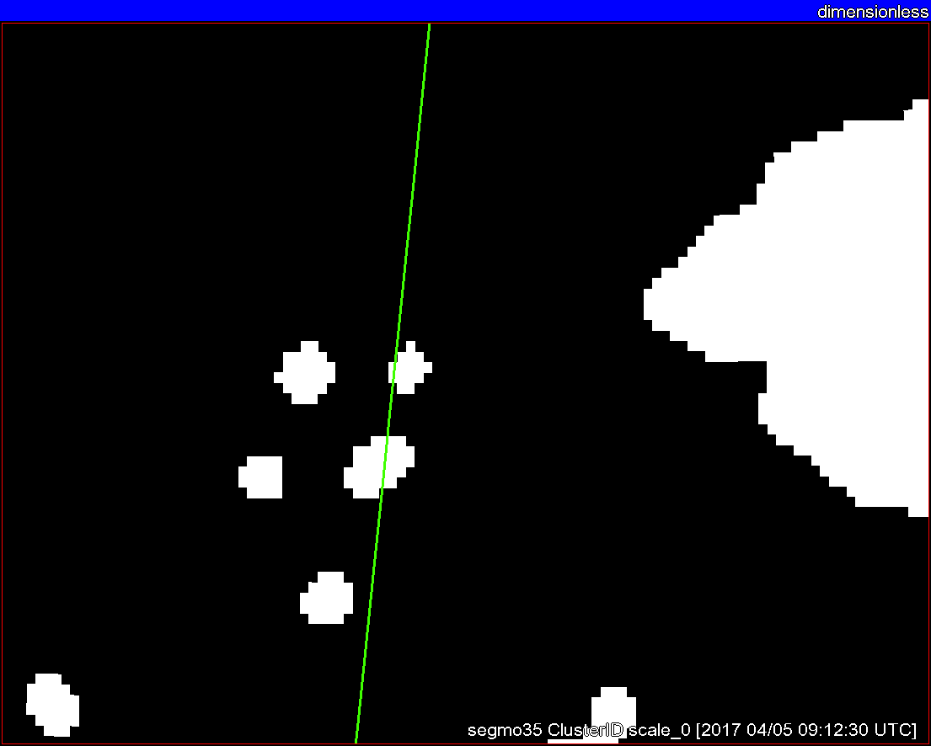
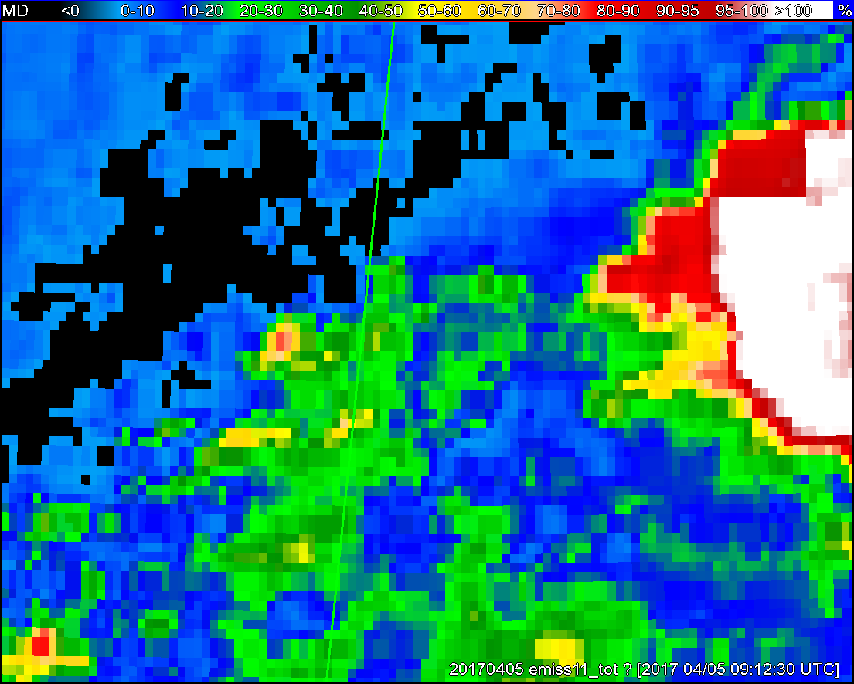
Objects
11-µm top-of-troposphere emissivity
GOES - 16
GOES - 13

Slide 8
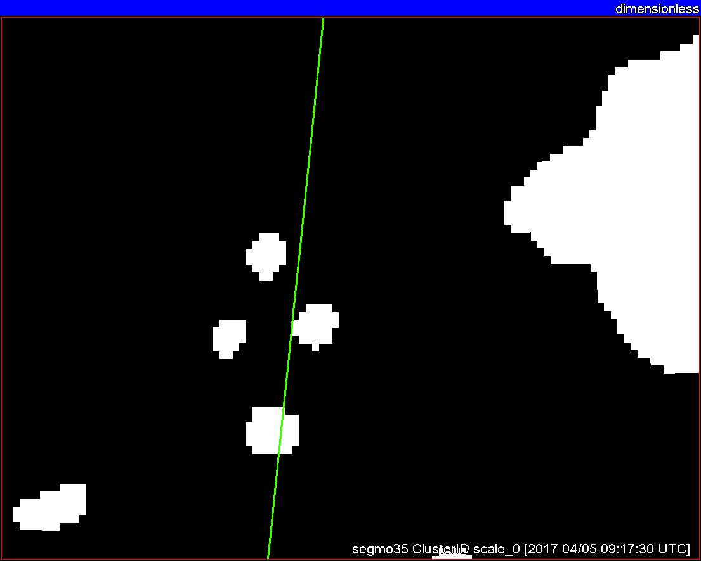
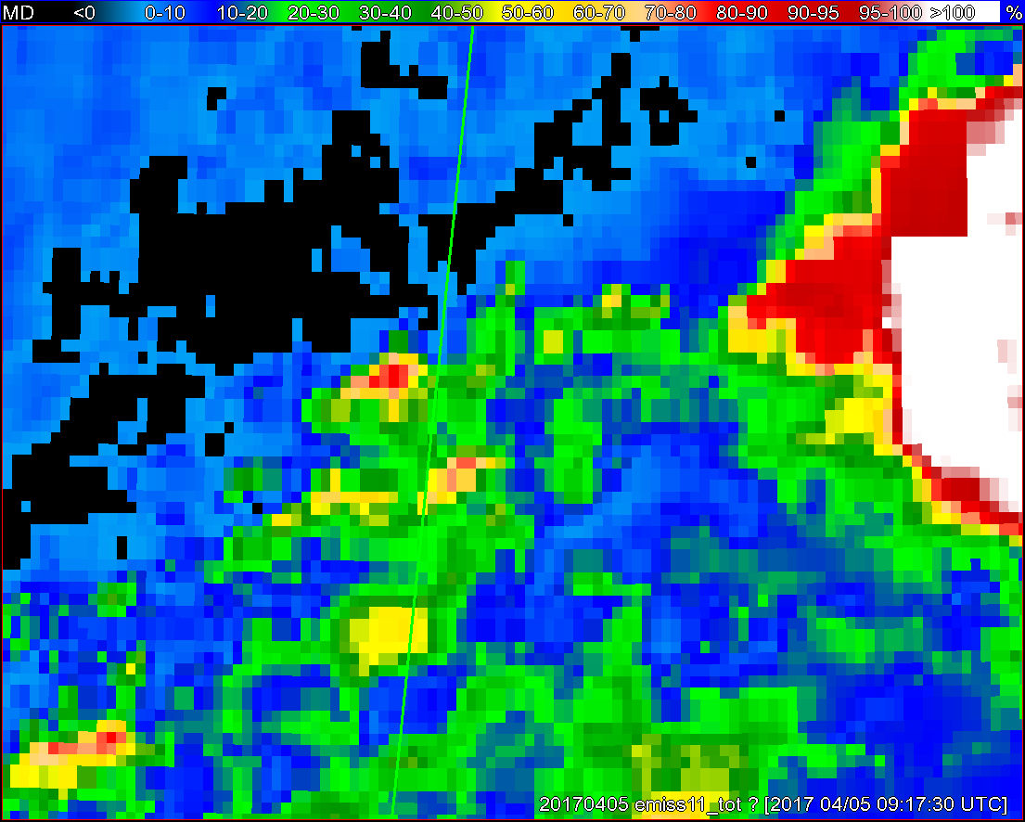
Objects
11-µm top-of-troposphere emissivity
GOES - 16
GOES - 13

Slide 9
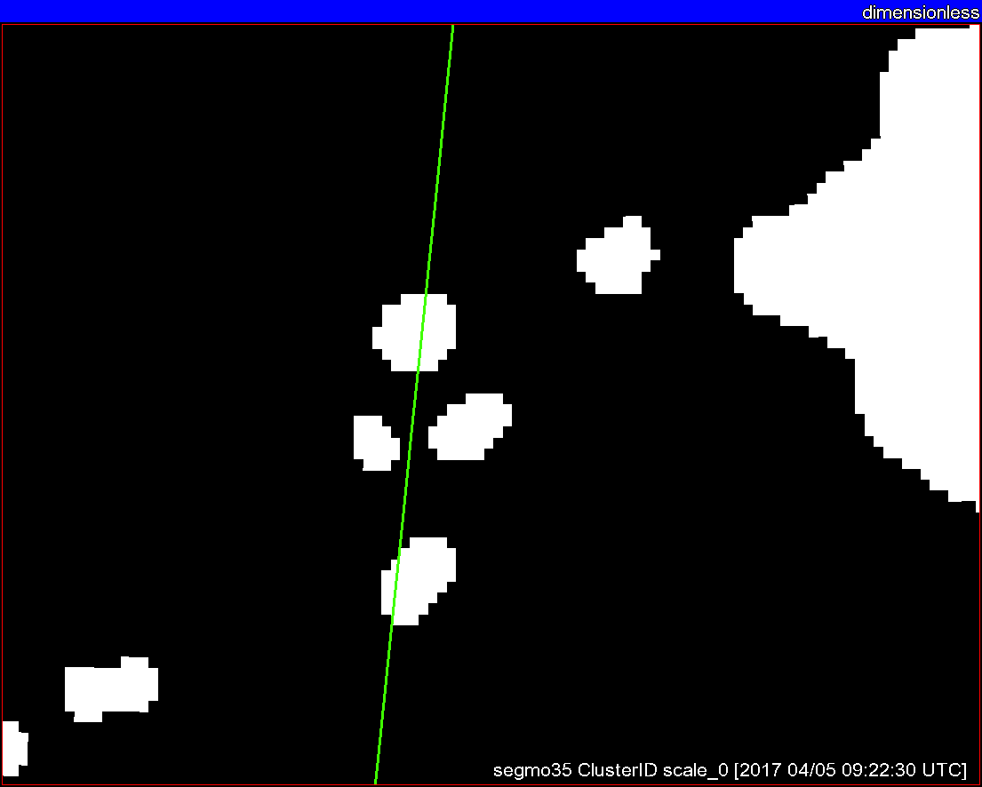
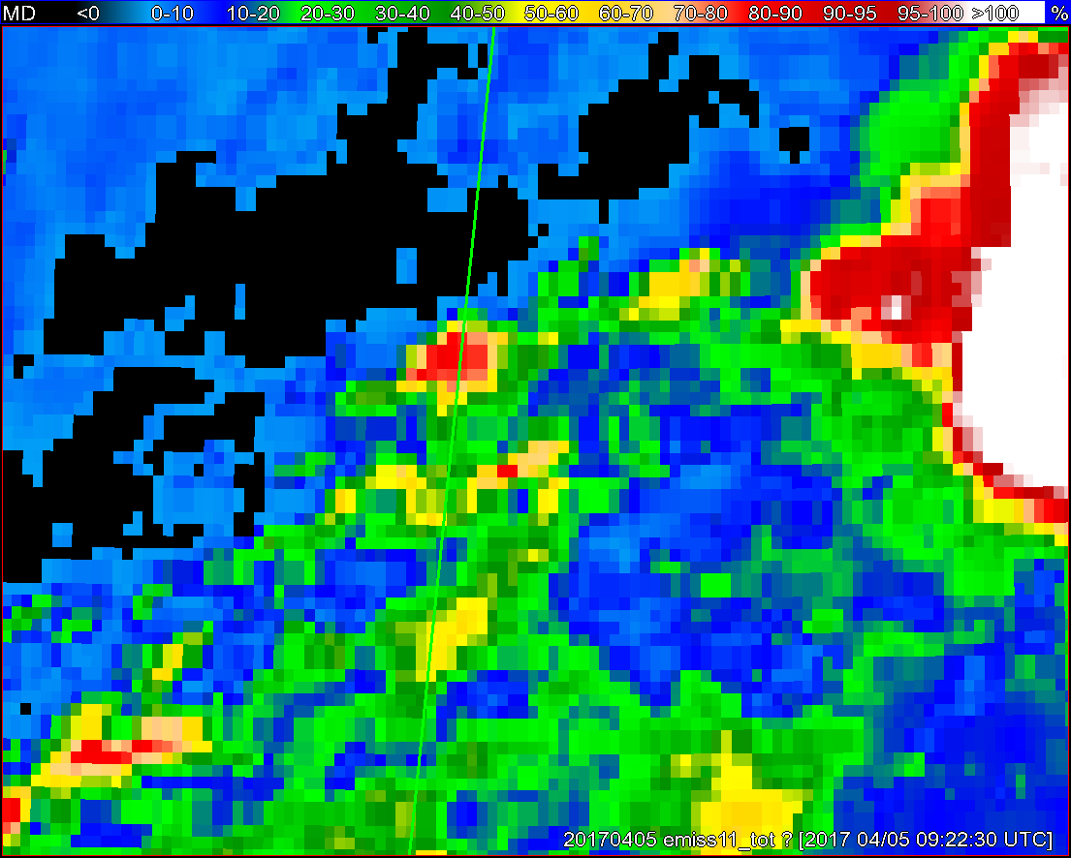
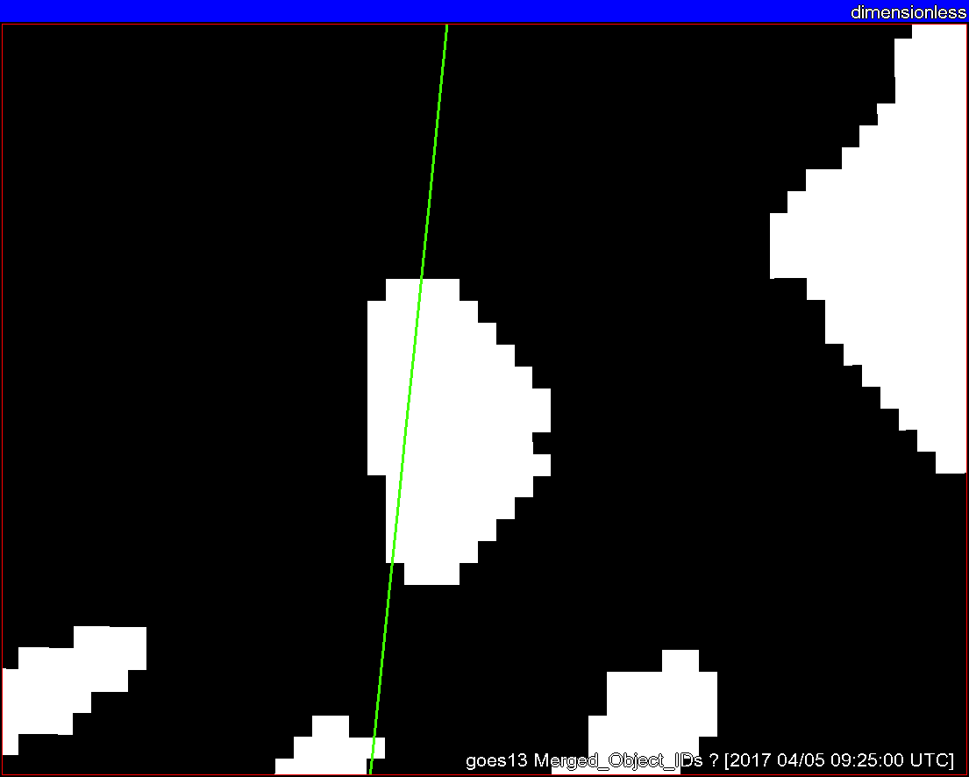
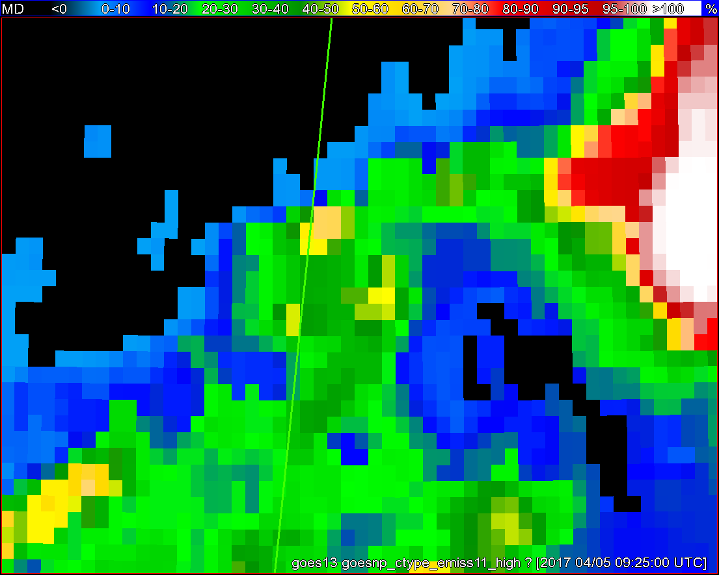
Objects
11-µm top-of-troposphere emissivity
GOES - 16
GOES - 13

Slide 10
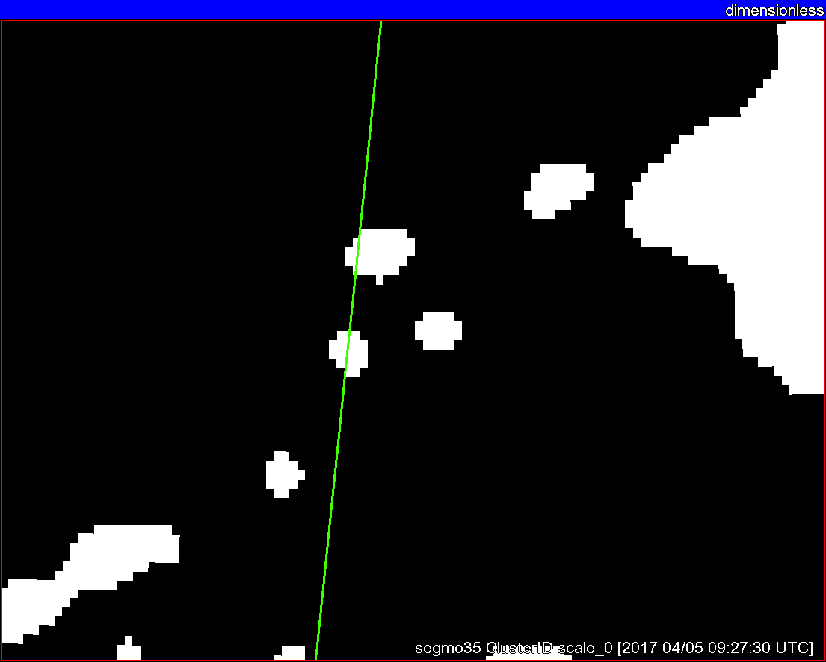
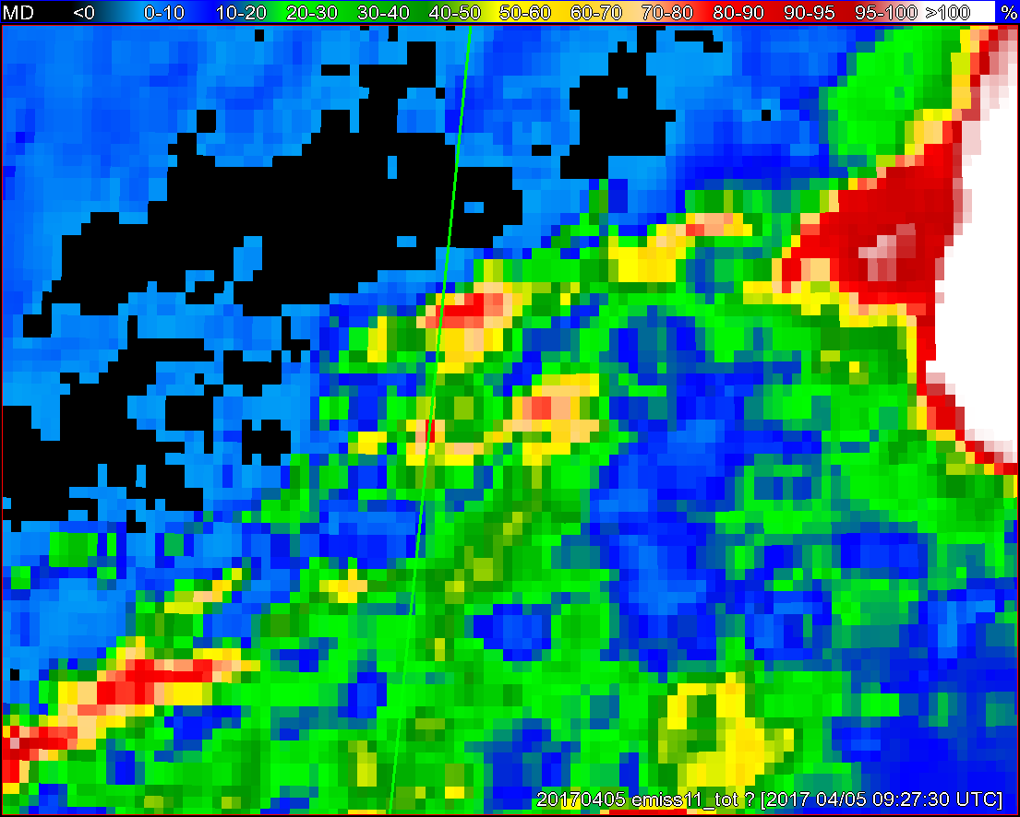
Objects
11-µm top-of-troposphere emissivity
GOES - 16
GOES - 13

Slide 11
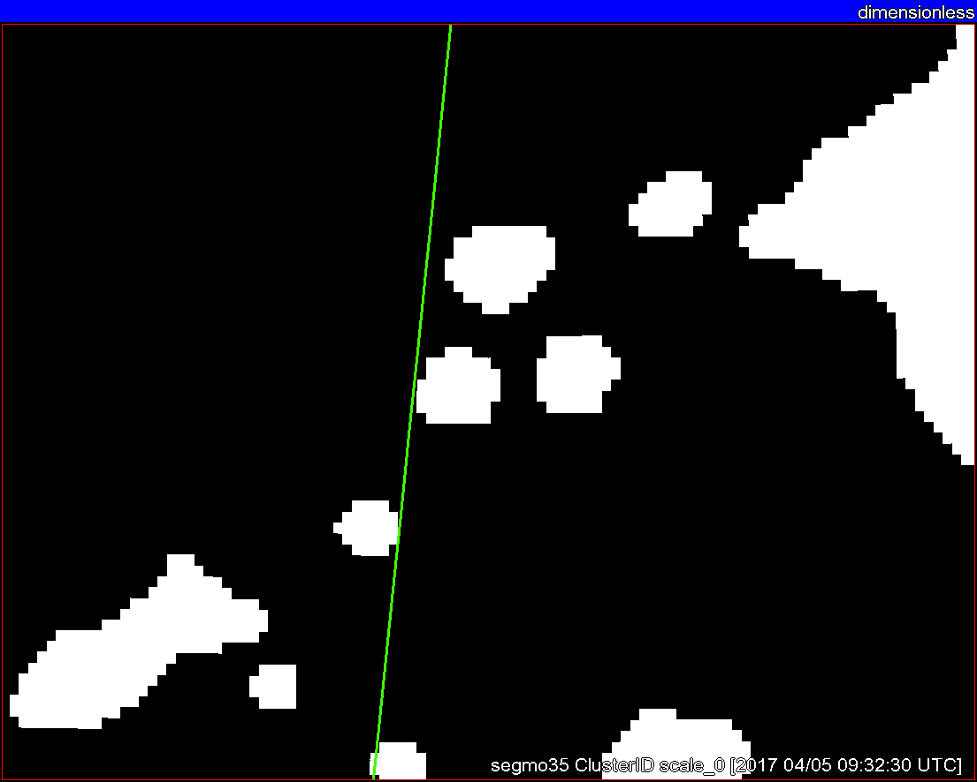
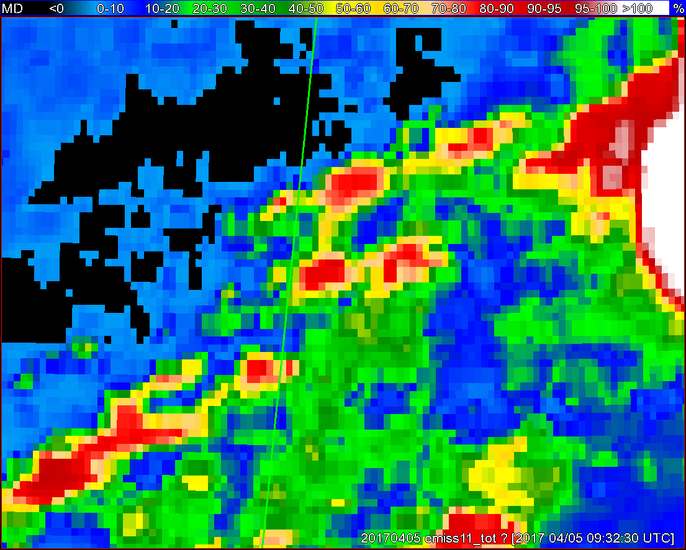
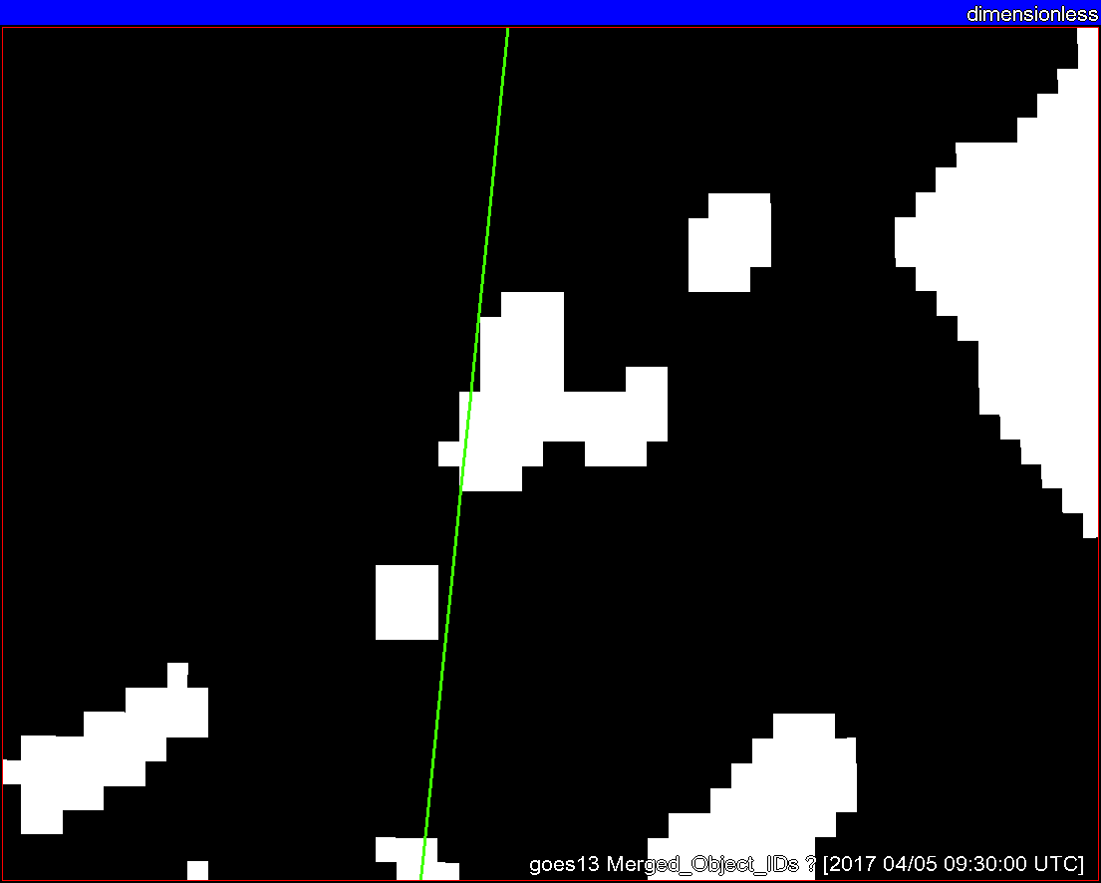
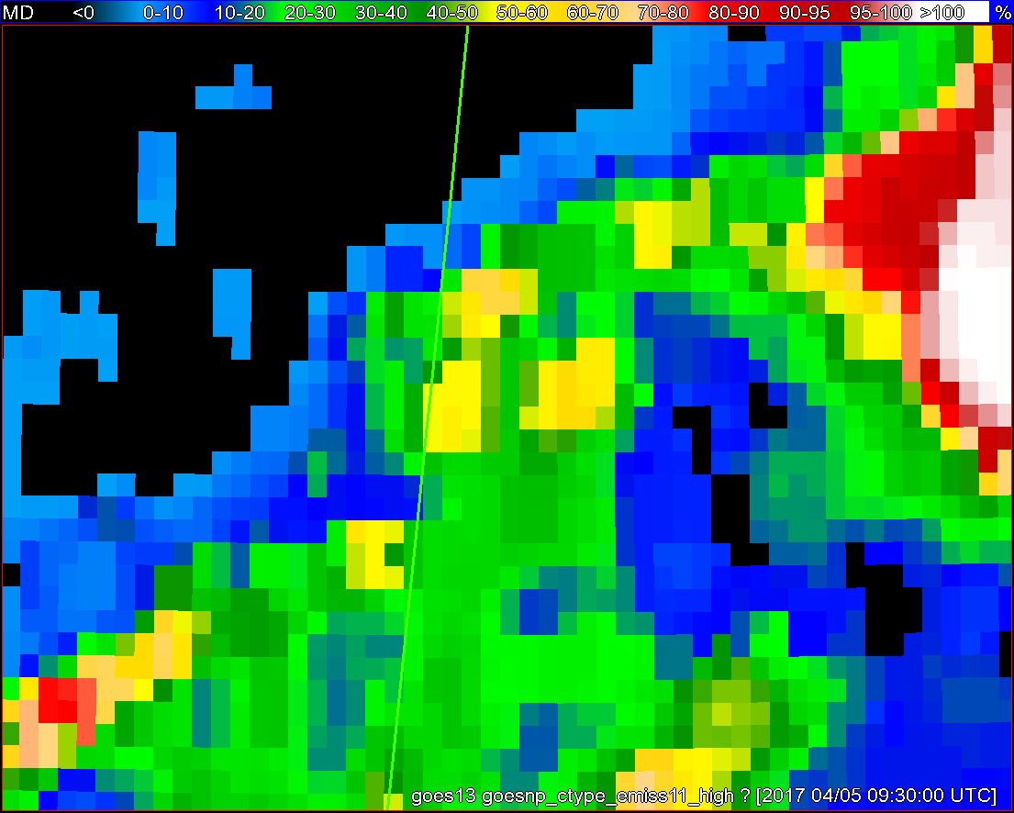
Objects
11-µm top-of-troposphere emissivity
GOES - 16
GOES - 13

Slide 12
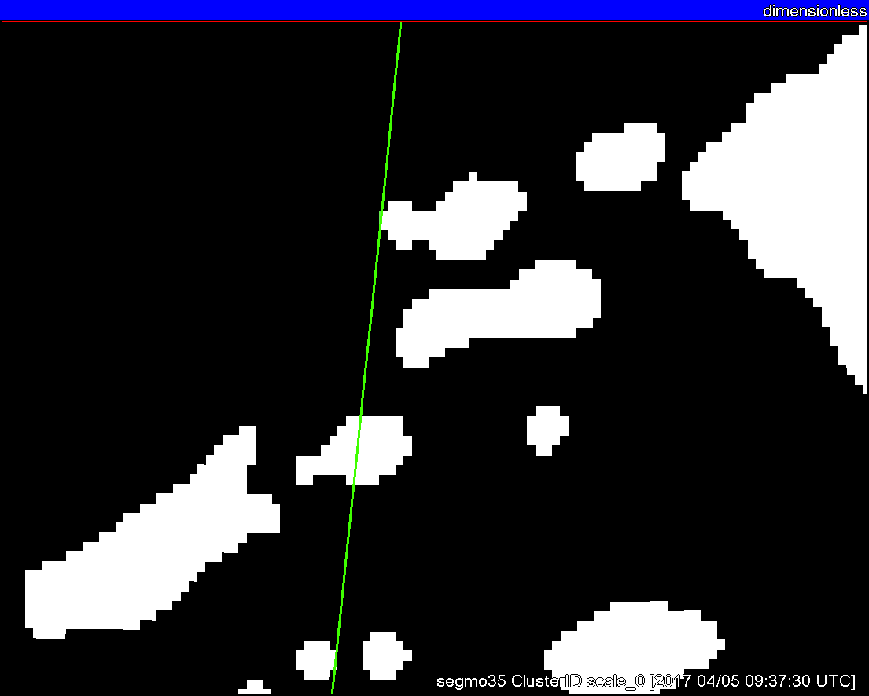
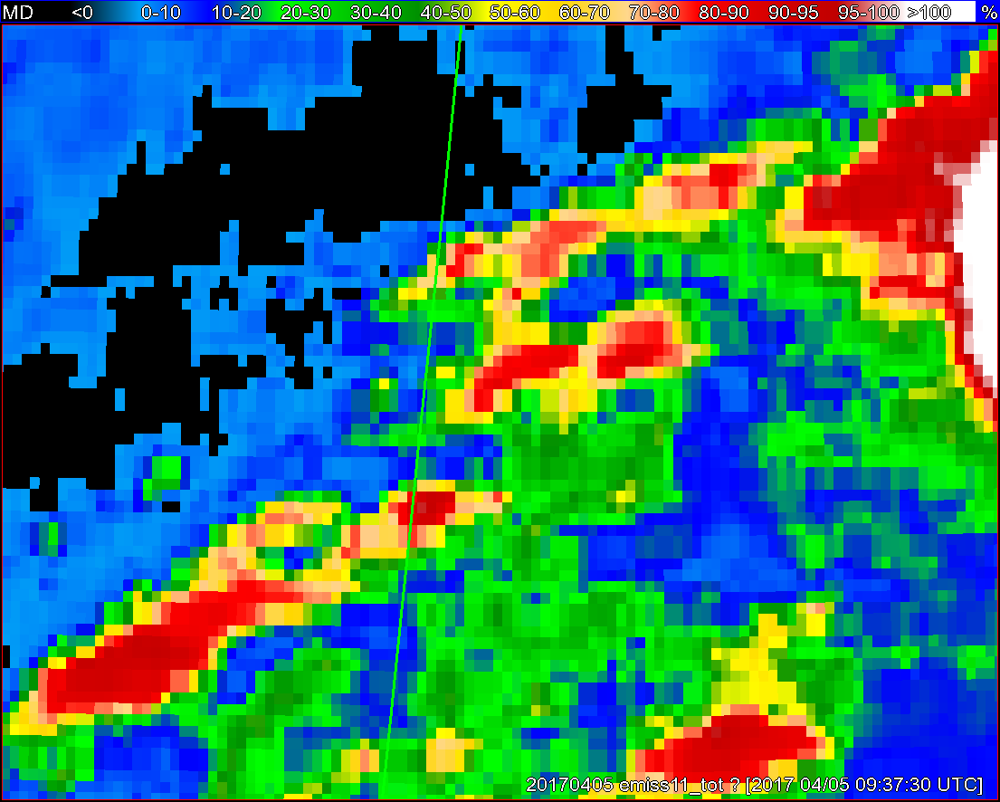
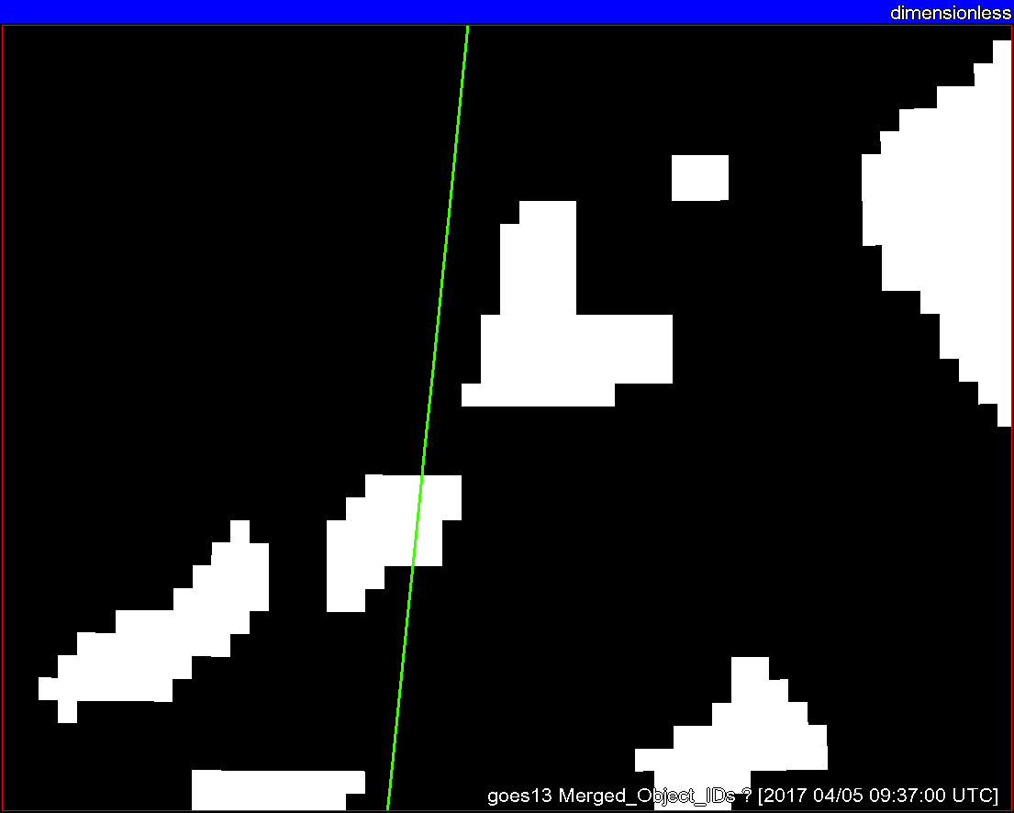
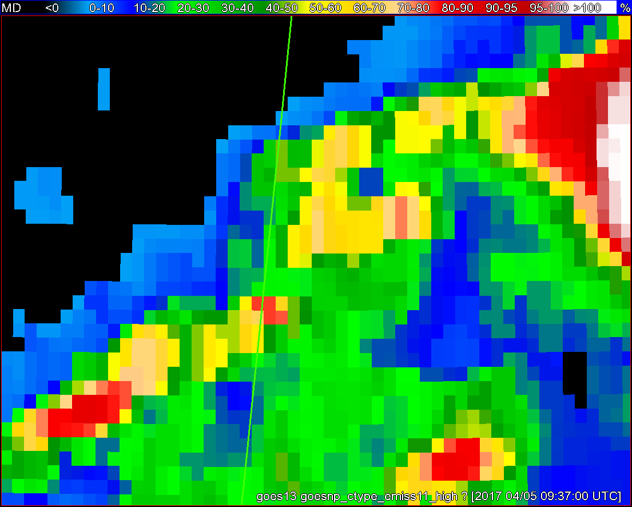
Objects
11-µm top-of-troposphere emissivity
GOES - 16
GOES - 13

Slide 13
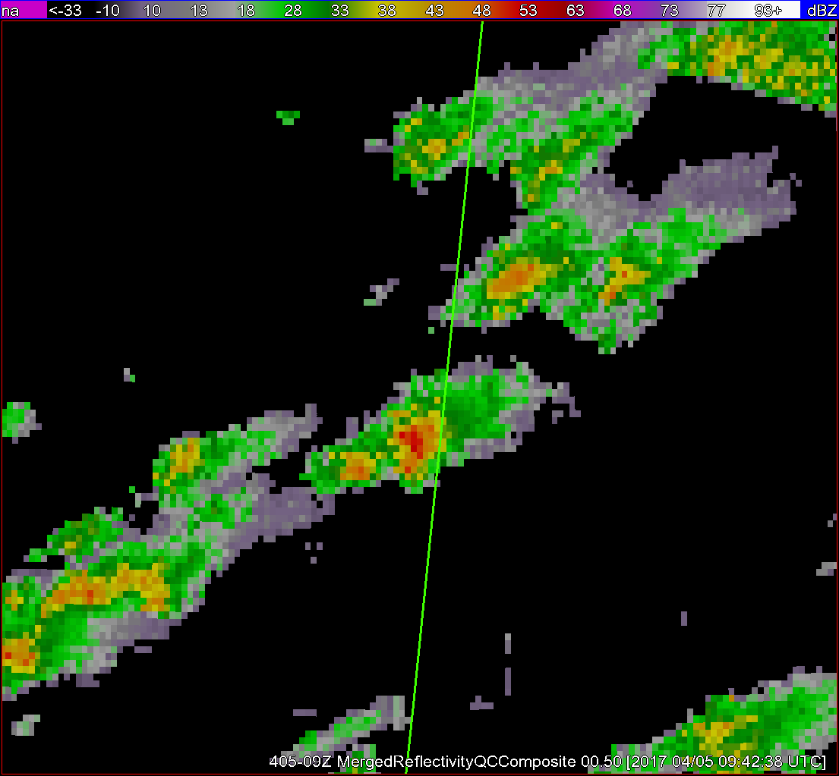
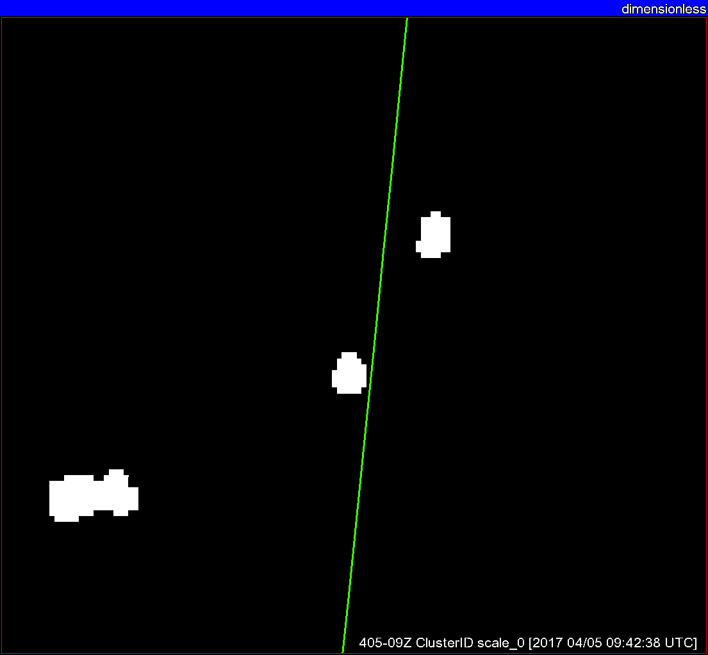
Radar reflectivity
Radar objects
+ G16 satellite objects
Satellite objects
ε_{tot}

Slide 14
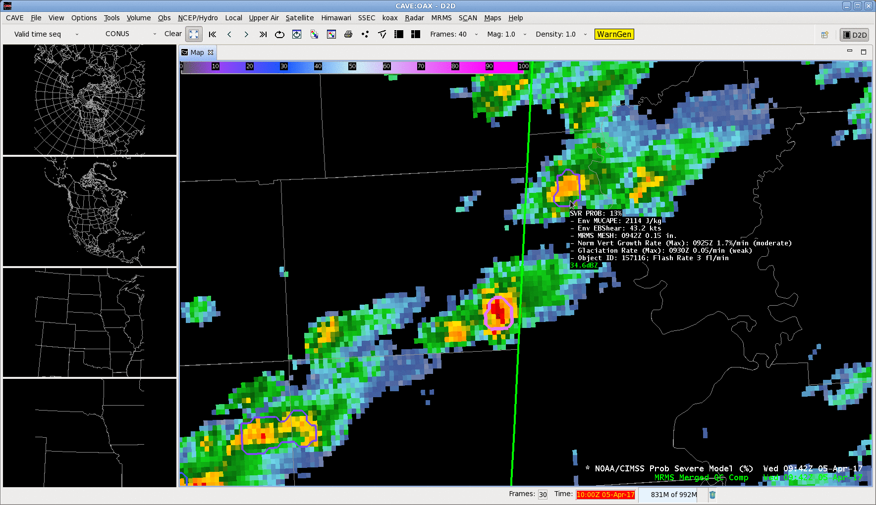

Slide 15
ProbSevere – GOES-16 vs. GOES-NOP
Notes:
April through July 2017
For storms with strong satellite growth (~15% of all severe, ~7% of all non-severe)
G16 adds 4 min of lead time in the median, compared to GOES-NOP. Consistent along all probability thresholds.

Slide 16

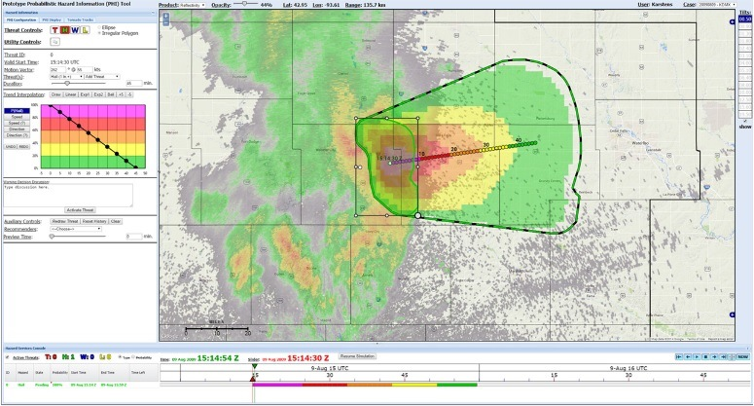
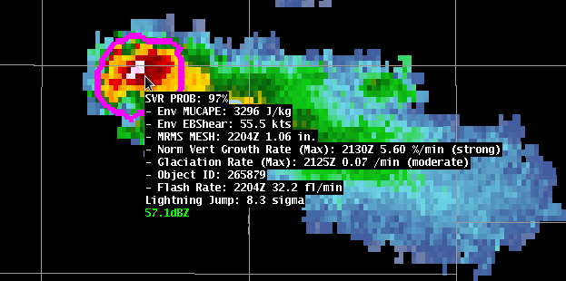
ProbSevere (ProbHail, ProbWind, ProbTor)
Generated at UW-CIMSS
Probabilistic Hazards Information (PHI)
Experimental Warning Program (EWP)
In PHI prototype tool
In AWIPS2
Notes:
Many programs and experiments use the HWT
EWP focuses on tools that can aid warning decision making in current binary convective warning paradigm
PHI pulls together forecasters, EMs, broadcasters in a simulated environment for issuance of gridded probabilistic warnings and their consumption.
PHI encompasses much more than convective scale, but within the HWT, we are solely focused on convective products
Focus on EWP in this talk.

Slide 17
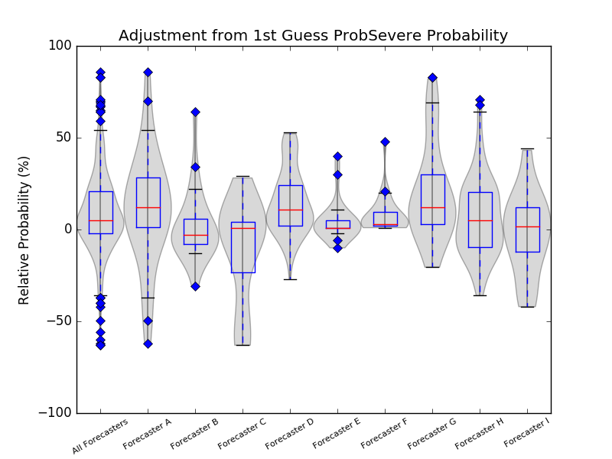
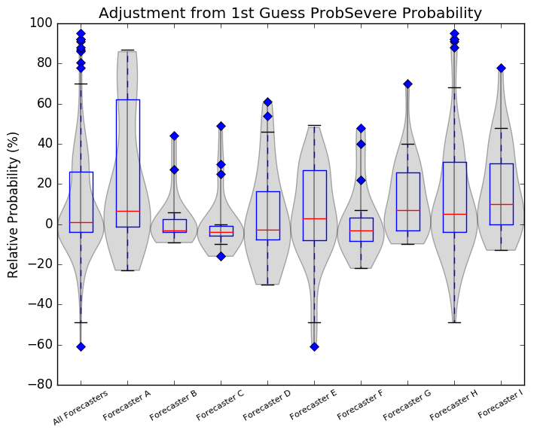
ProbSevere in PHI
2016 (ProbSevere)
2017 (ProbHail, ProbWind, ProbTor)
Forecasters used some level of automation (ProbSevere value and/or object) on ~90% of forecasts in 2016-17
ProbSevere value overridden by forecasters ~75% of time in 2017
  Override median: +8% (2017)
2016
2017
Karstens and Coauthors, 2018: Development of Human-Machine Mix for Severe Convective Warnings.
Wea. Forecasting, in review
Notes:
2016 (left) and 2017 (right)

Slide 18
ProbSevere in EWP
22 June 2017, eastern CO
ProbWind incorporates new predictors:
  0-2km AzShear (MRMS)
  3-6km AzShear (MRMS)
  VIL Density (MRMS)
  MeanWind 900-700mb (RAP)
ProbWind steadily increased 1% → 73% over 20 min
“…evidence in radial velocity of excelerating outbound winds coincident with the time period of ProbWind increase...”
  Forecaster increased wind threat from 60 to 70mph in warning.
Notes:
Good ProbWind example
Subsequent wind damage reports, with speed unknown

Slide 19
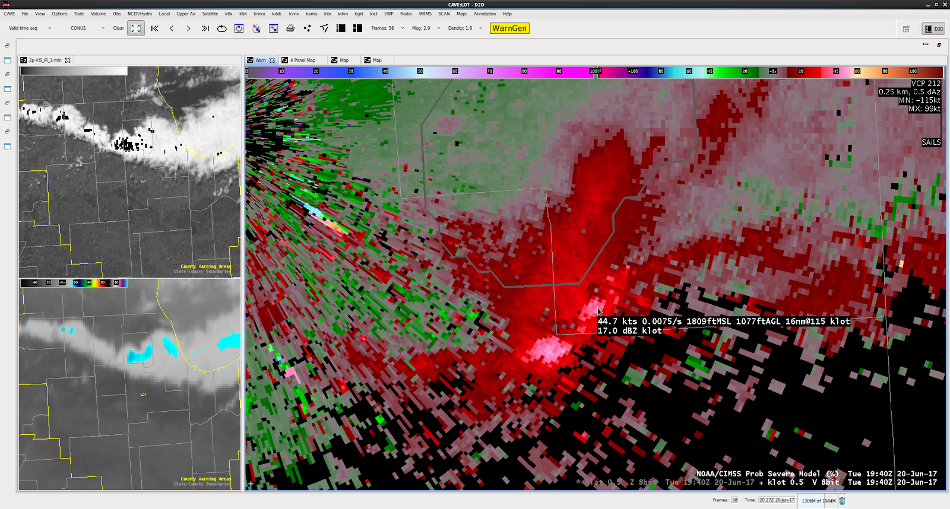
ProbSevere in EWP
ProbWind = 0% with severe wind outflow
Low total lightning activity
“Radial velocity was the only key piece of information that would allow you to issue a warning on this cell” –NWS forecaster
Notes:
Bad ProbWind example
-Still have work to do! Velocity signatures not always collocated with reflectivity signatures
-Radial velocity maxima do not necessarily have strong AzShear values

Slide 20
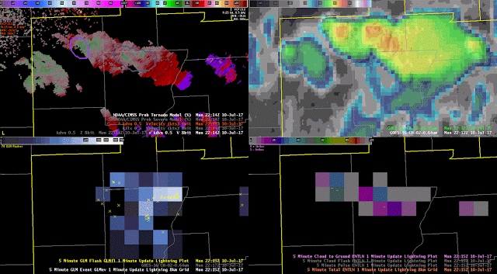
ProbSevere in EWP
ProbTornado
  Predictors: 0-2km AzShear, 3-6km AzShear, max TL flash density, 0-1km SRH, 900-700mb MeanWind, effective bulk shear, MLCAPE, MLCIN
ProbTor and base velocity
GOES-16 IR and VIS
GOES-16 GLM flashes and density
ENTLN flashes and density
Notes:
Low-end probtor example
-SPC outlook in central IL 2% for tornadoes
-Rotation increase in two cells; ProbTor increases to 25-30%.
-Total lightning increases, probable lightning jumps in both cells
-Robust growth in GOES16 imagery, overshooting tops
-Brief tornado in eastern cell, 3 min before warning

Slide 21
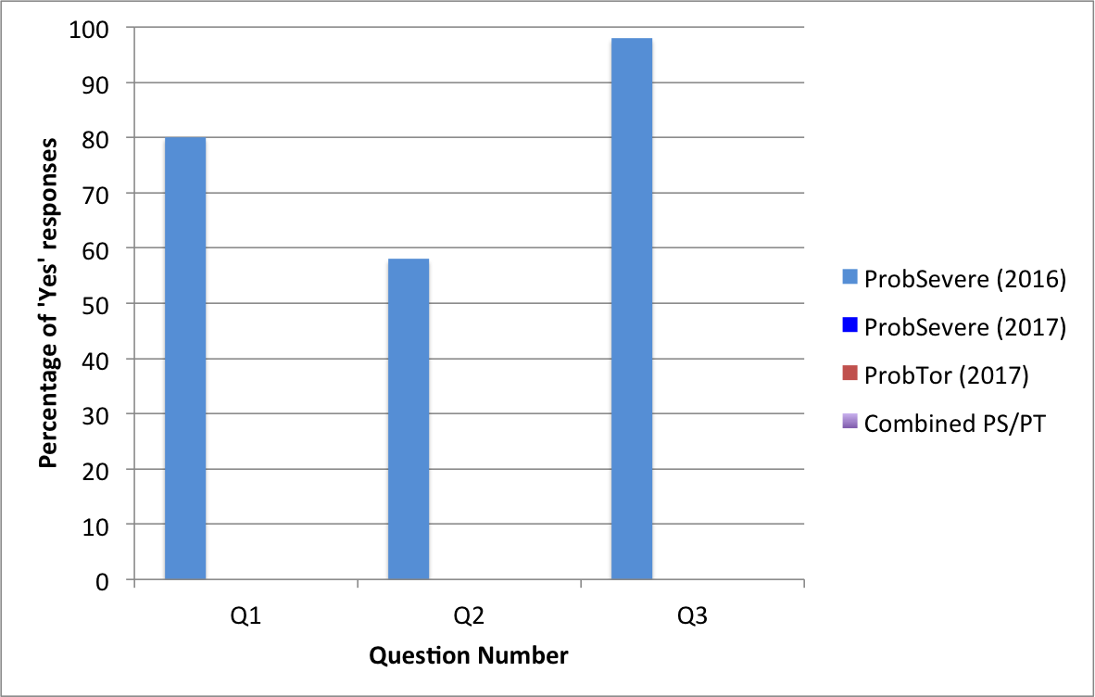
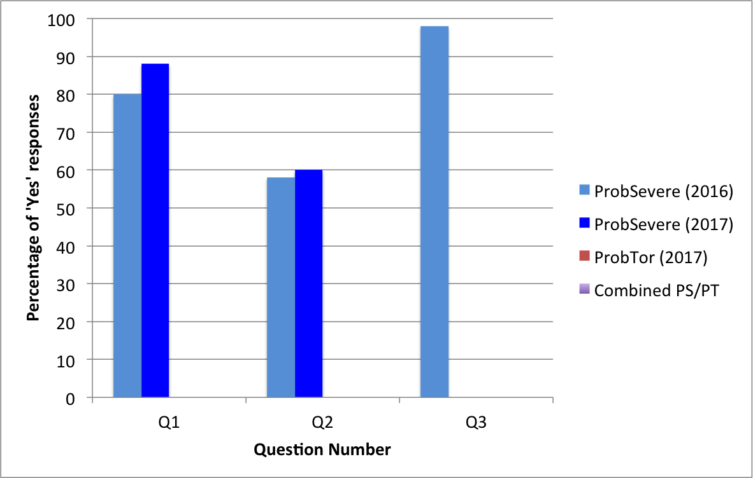
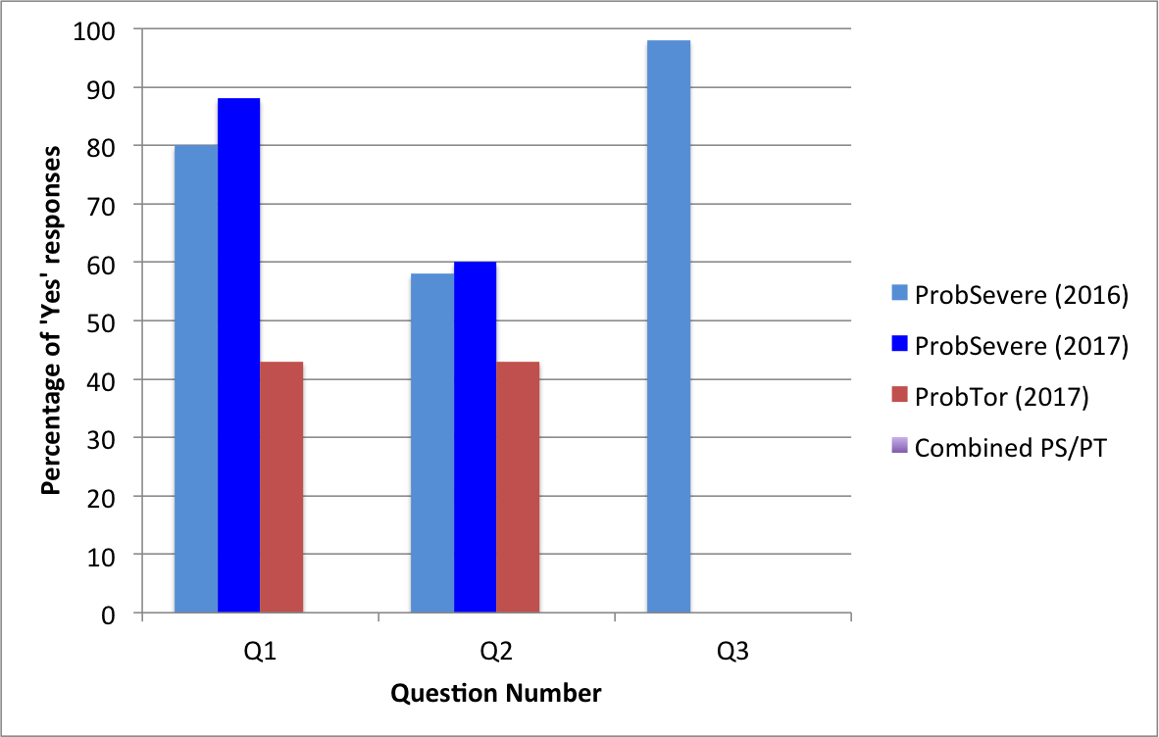
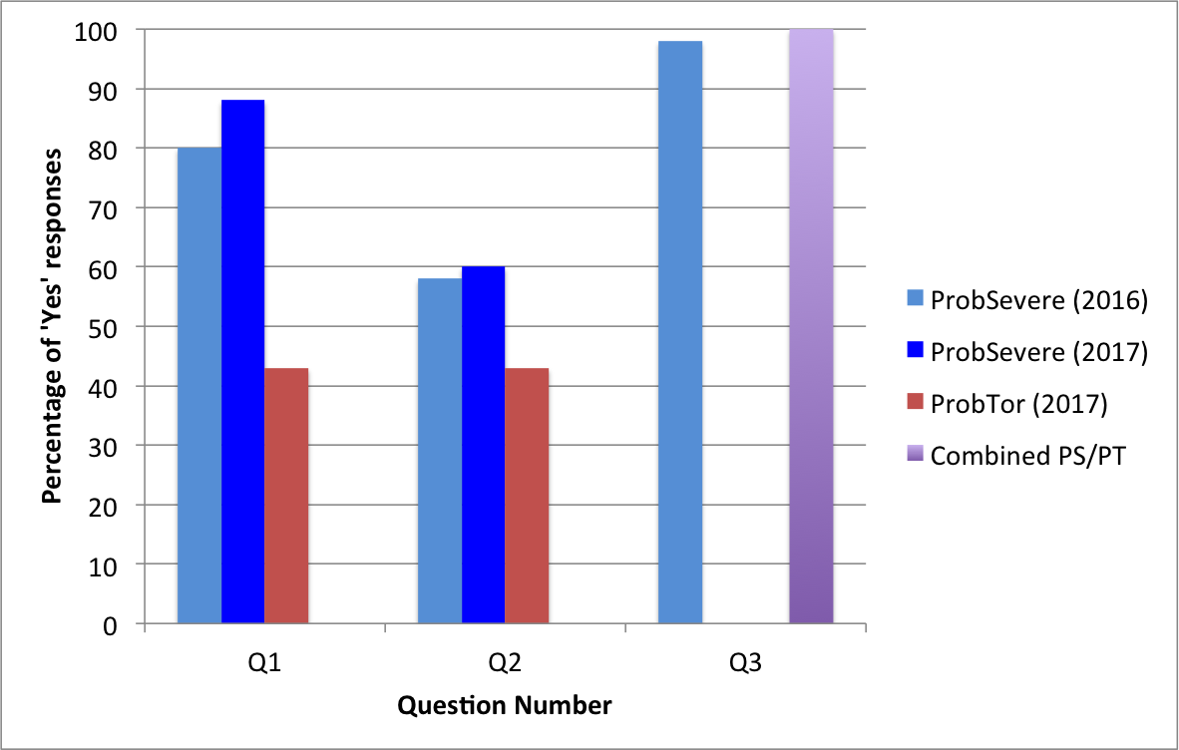
ProbSevere in EWP
Q1: “In general, did model output help you increase your confidence in issuing warnings?”
Q2: “In general, did model output help increase the lead time in which you were able to issue warnings?”
Q3: “Would you use ProbSevere hazard prediction output during warning operations at your WFO if available?”
Notes:
2016 PS = just probability of any severe
2017 PS = ProbHail, ProbWind, ProbTor
Separated out ProbTor, too
Some qualifiers for Q3
-”With other observations”
-”as situational awareness”

Slide 22
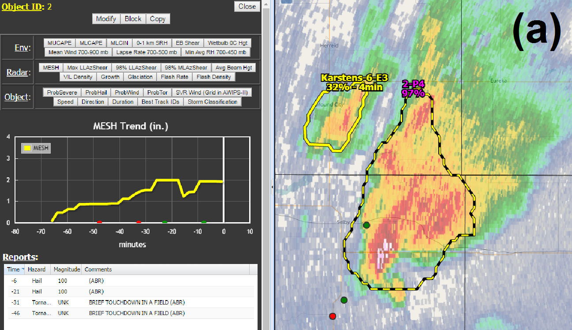
Future work
Improve ProbSevere prediction/calibration in certain modes
  e.g., low-lightning storms, dry microbursts
Investigate more ABI and GLM predictors
  meso sectors
Create trends display in AWIPS2
Working on “OCONUS ProbSevere”
  ABI + GLM + NWP
R2O transition underway!
  NWS OSTI project
  NCO responsibility, under MRMS system

Slide 23
Take Away Points
GOES-16 derived growth rates increase lead time compared to GOES-NOP
ProbHail, ProbWind, and ProbTor improve upon legacy ProbSevere
Forecasters find guidance from ProbSevere models increase confidence and leadtime
  Trust “exact” probabilities in some situations, not others
Investigating more ABI and GLM predictors
Working to improve forecast calibration in certain situations
**We acknowledge NOAA GOES-R Risk Reduction program (grant NA15NES4320001) and NOAA/OAR (grant NA15OAR4590188) for support of this research.**
Images are from NOAA, NASA, and UW-CIMSS

Slide 24
Additional Resources
Mike Pavolonis (michael.pavolonis@noaa.gov)
John Cintineo (john.cintineo@ssec.wisc.edu)
Justin Sieglaff (justin.sieglaff@ssec.wisc.edu)
Dan Lindsey (dan.lindsey@noaa.gov)
ProbSevere training module and supplemental training material:
http://cimss.ssec.wisc.edu/severe_conv/training/training.html
See ProbSevere blog posts:
http://goesrhwt.blogspot.com/search/label/ProbSevere
Real-time ProbSevere on the web:
http://cimss.ssec.wisc.edu/severe_conv/probsev.html
References:
Cintineo, J. L., M. J. Pavolonis, J. M. Sieglaff, D. T. Lindsey, L. Cronce, J. Gerth, B. Rodenkirch, J. Brunner, and C. Gravelle, 2018: The NOAA/CIMSS ProbSevere Model - incorporation of total lightning and validation. Wea. Forecasting, accepted
Cintineo, J. L., M. J. Pavolonis, J. M. Sieglaff, and D. T. Lindsey, 2014: An empirical model for assessing the severe weather potential of developing convection. Weather and Forecasting, 29 (3), 639–653.
Cintineo, J. L., M. J. Pavolonis, J. M. Sieglaff, and A. K. Heidinger, 2013: Evolution of severe and nonsevere convection inferred from GOES-derived cloud properties. Journal of Applied Meteorology and Climatology, 52 (9), 2009–2023.
Pavolonis, M. J., 2010: Advances in Extracting Cloud Composition Information from Spaceborne Infrared Radiances-A Robust Alternative to Brightness Temperatures. Part I: Theory. Journal of Applied Meteorology and Climatology, 49, 1992-2012, doi:10.1175/2010JAMC2433.1 ER.

