Slide 1
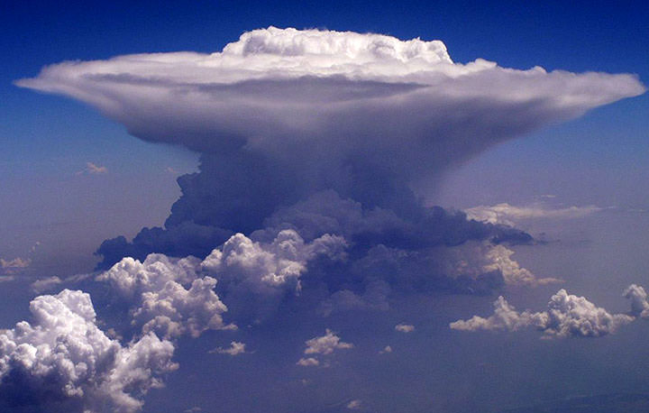
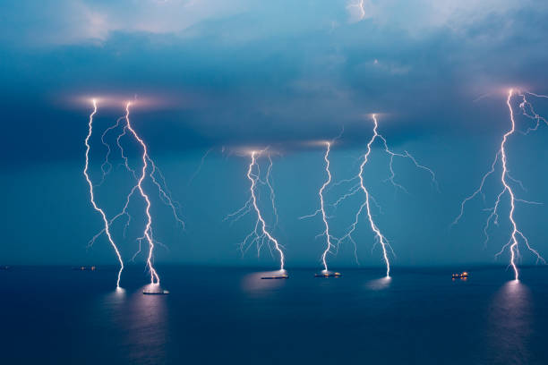
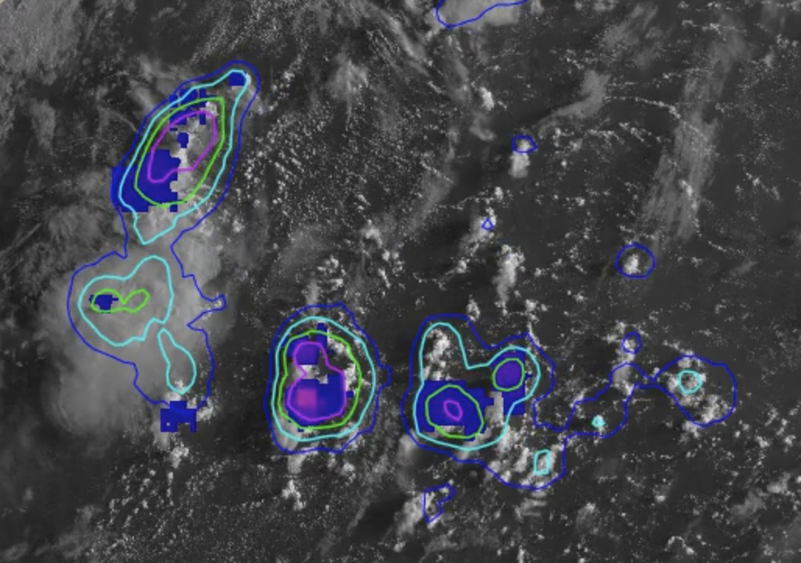
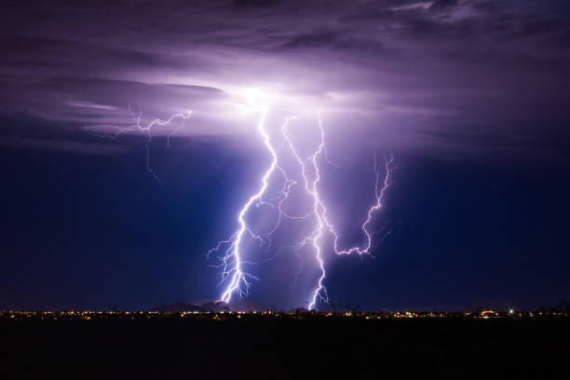
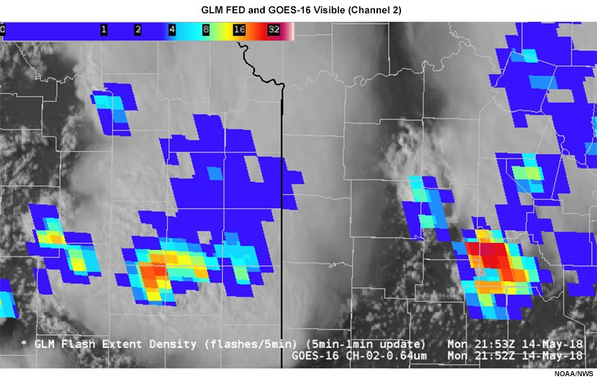
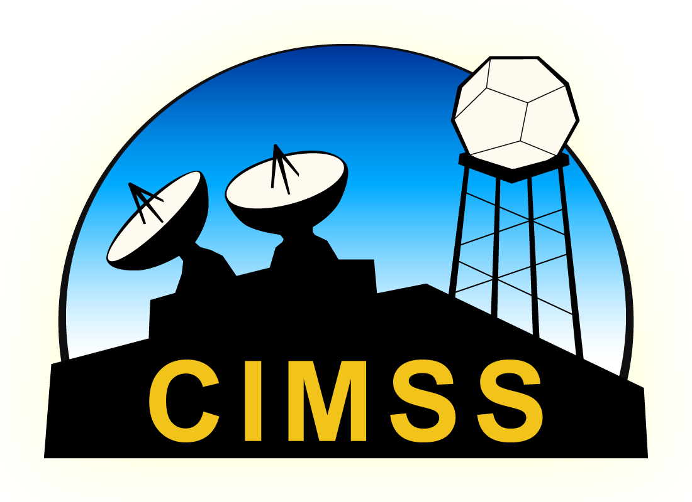
Evaluating and exploring lightning predictions from NOAA/CIMSS ProbSevere LightningCast
2021 NOAA AI Workshop
14 September 2021
John Cintineo (UW-CIMSS)
Michael Pavolonis (NOAA/NESDIS)
Justin Sieglaff (UW-CIMSS)
Acknowledgement: GOES-R program

Slide 2
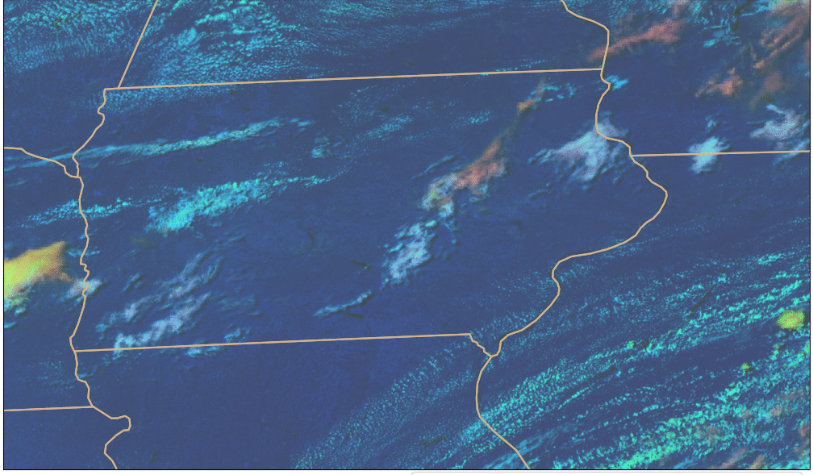
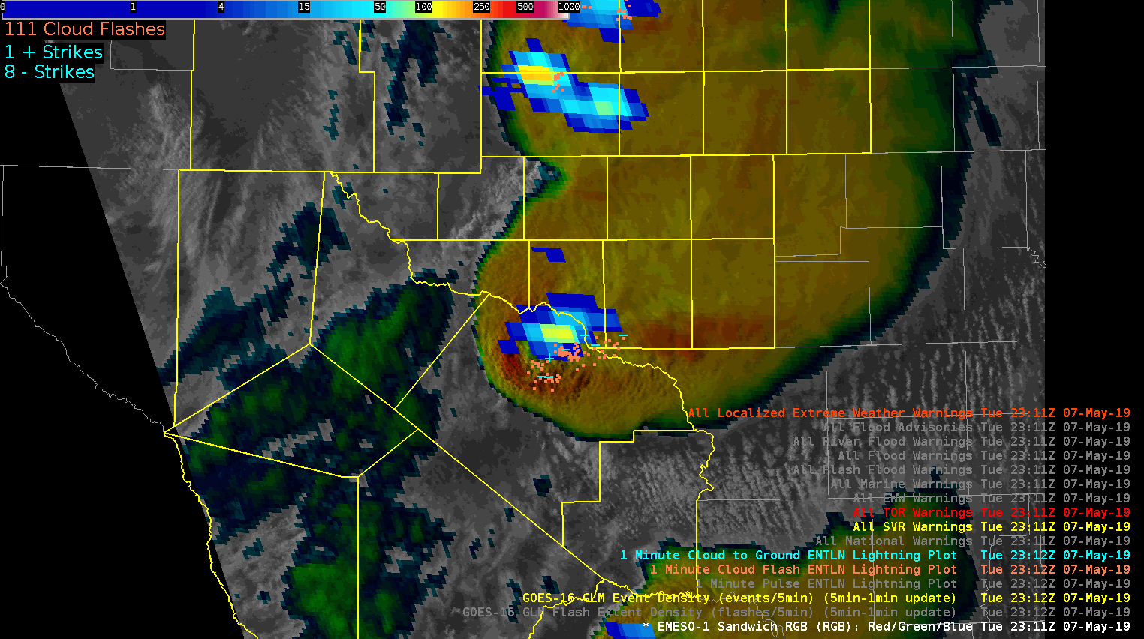
Question: Can we provide accurate and timely lightning guidance using satellite imager data?
Lightning is hazardous for aviation, mariners, and outdoor events and activities.
Geostationary satellite data can provide observations of clouds prior to electrification (CI guidance).
The data can respond to changes in storm structure before radar (e.g., storm intensification or decay).
Credit: NOAA

Slide 3
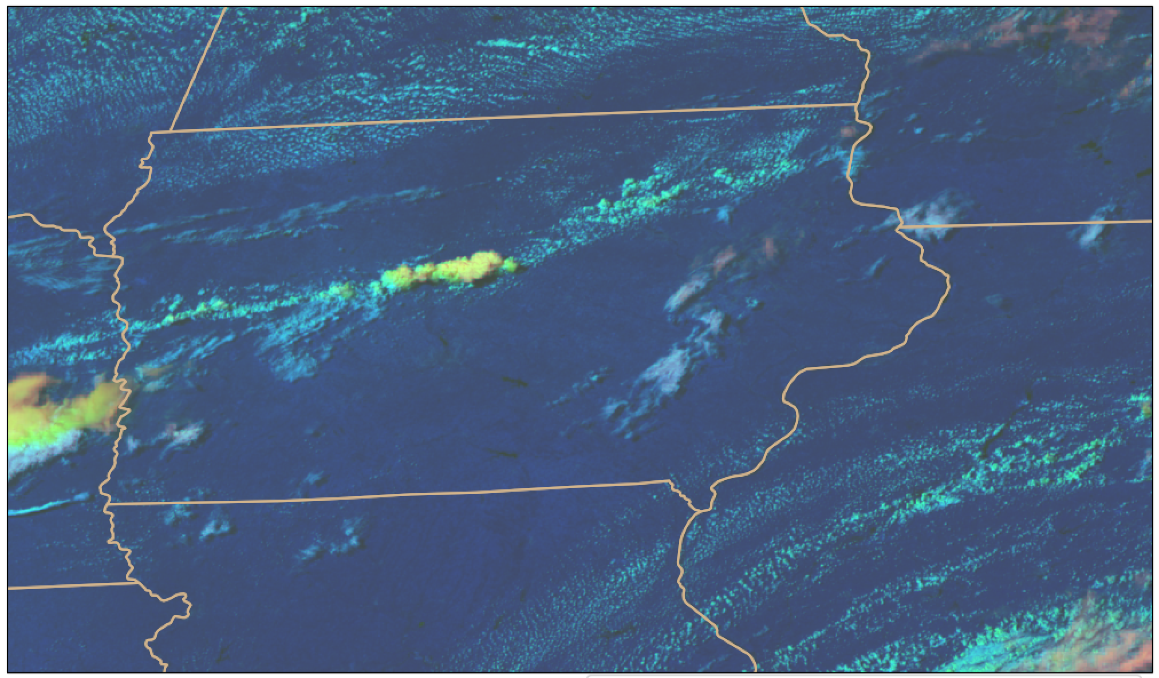
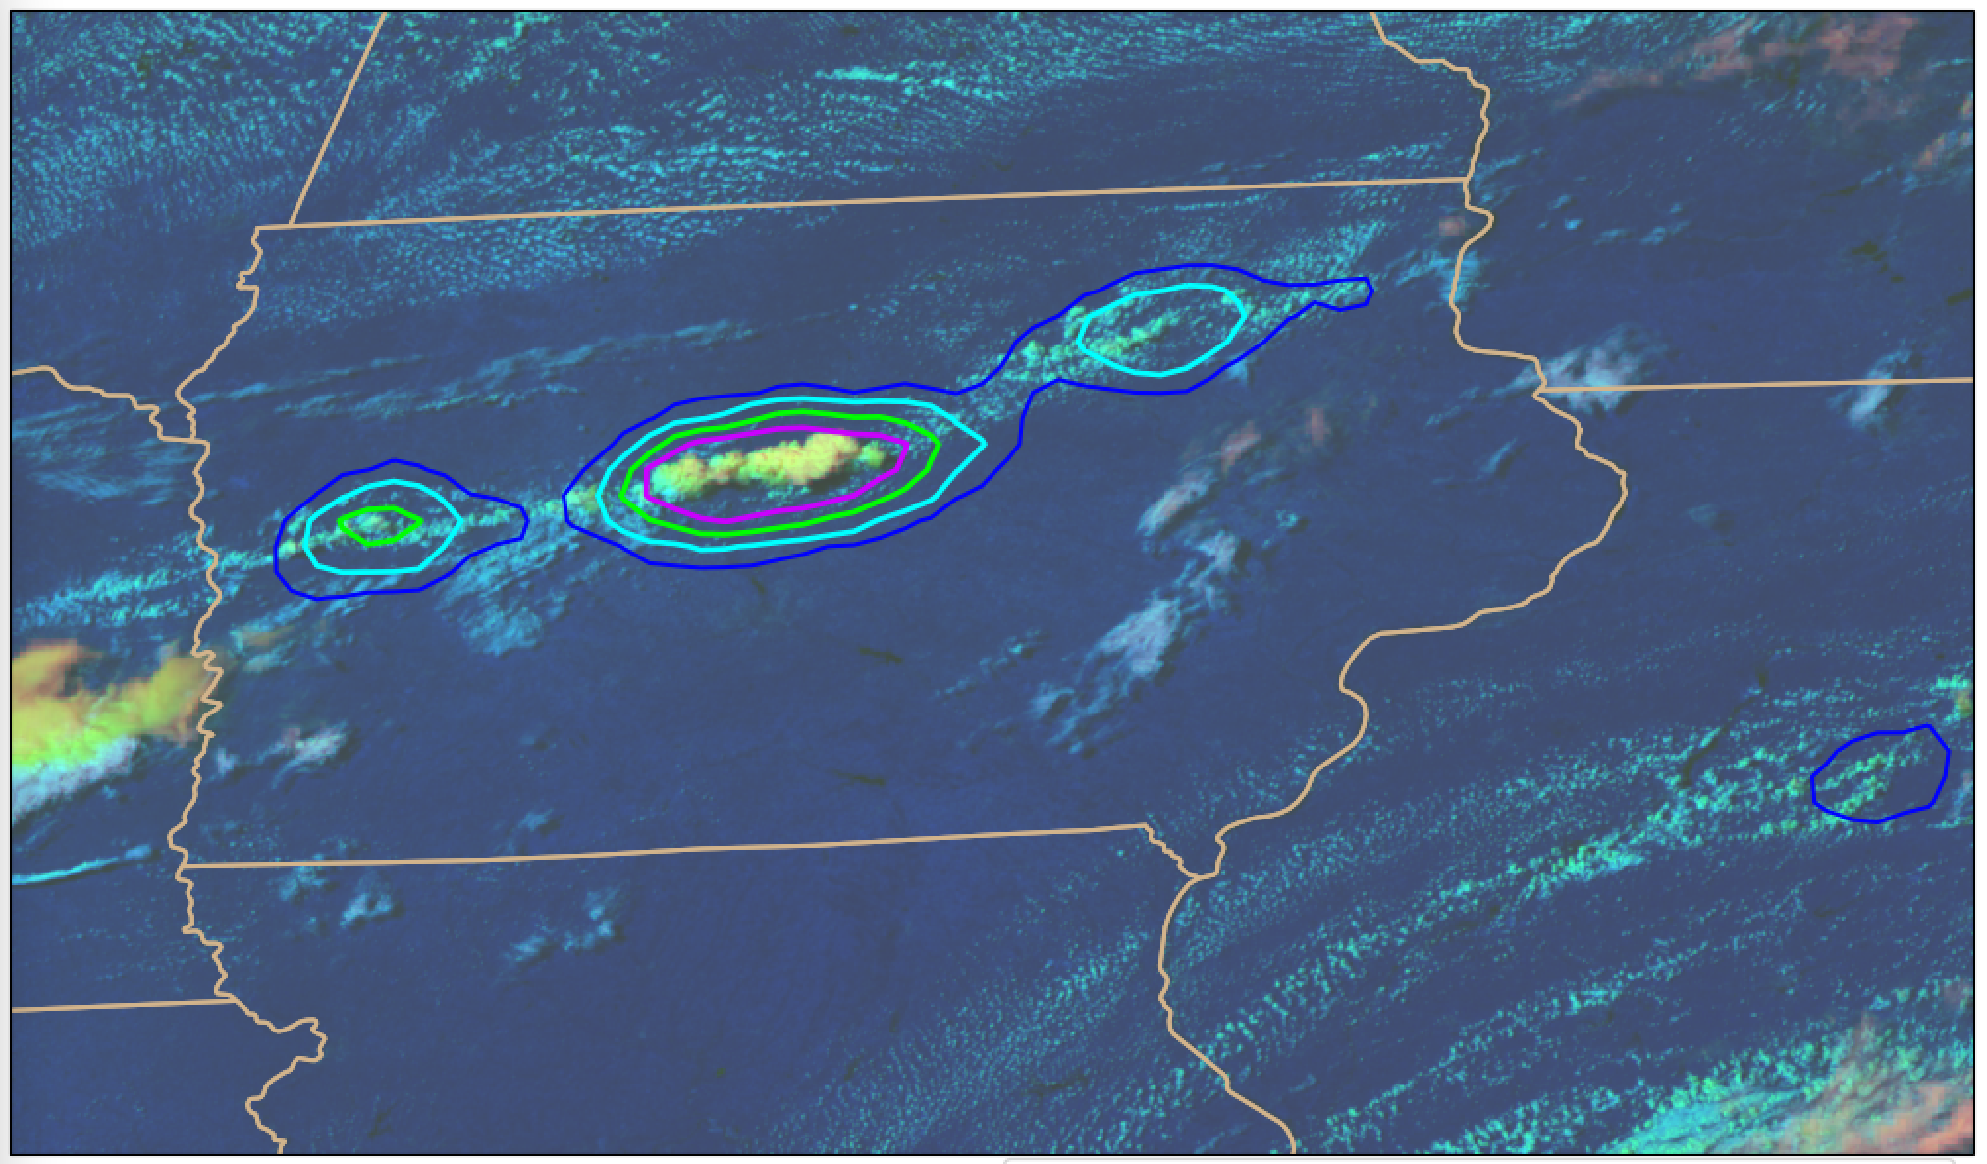
Methods and Data
LightningCast model: U-Net architecture
Learns salient spatial, multispectral features from images; image-to-image translation
Predictor channels (GOES-16 ABI):
0.64-µm reflectance (CH02)
1.6-µm reflectance (CH05)
10.3-µm brightness temperature (CH13)
12.2-µm brightness temperature (CH15)
Still exploring other predictor channels
Target/truth: GLM flash-extent density
Accumulated from t₀ to t₀ + 60 min
Binarized at 1 flash
Output: Pixel-by-pixel probability ≥ 1 GLM flash in the next 60 min

Slide 4
Notes:
Sea-breeze example

Slide 5
Notes:
Early morning example with thick cloud cover

Slide 6
Notes:
Meso example with some overlapping clouds

Slide 7
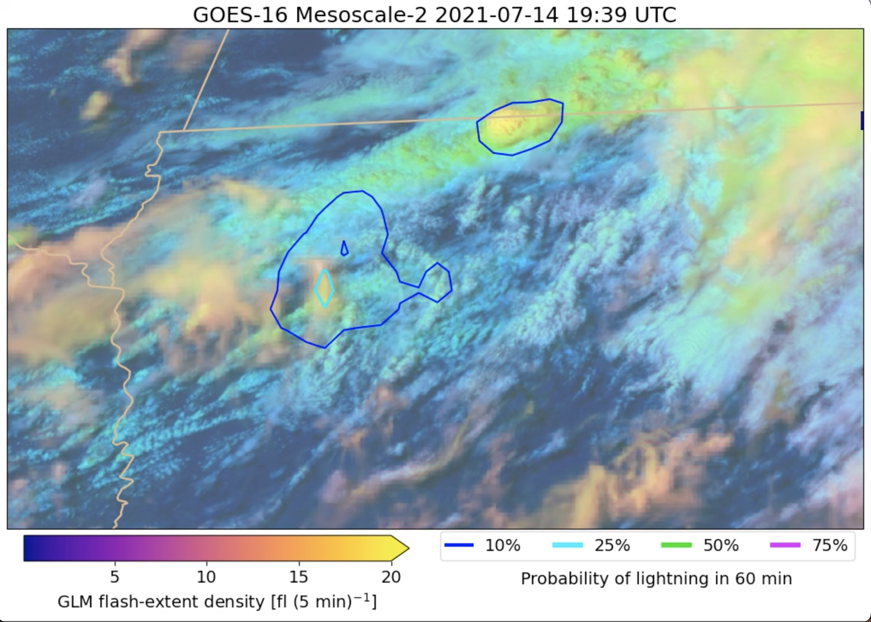
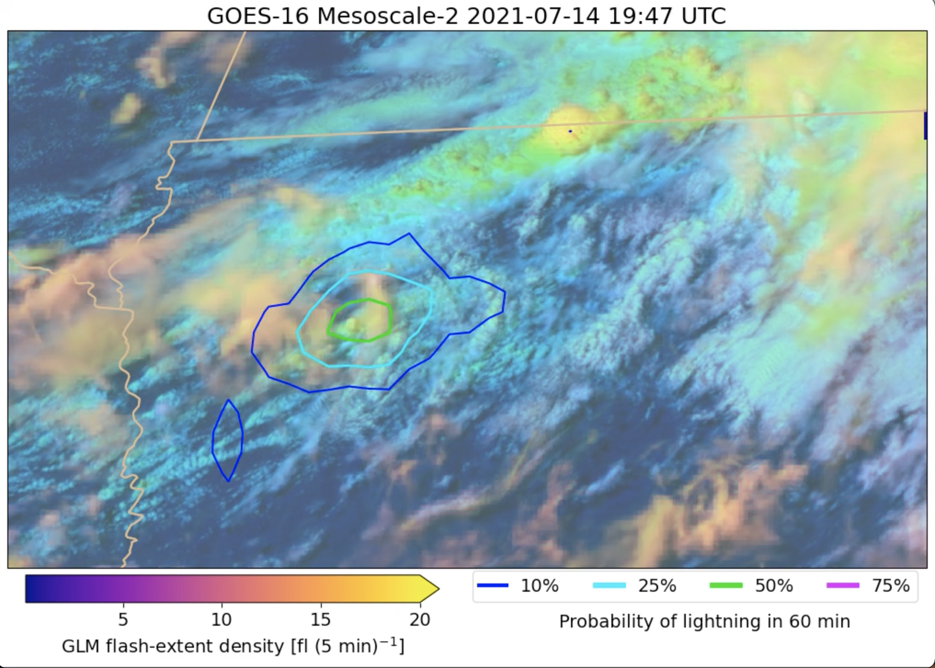
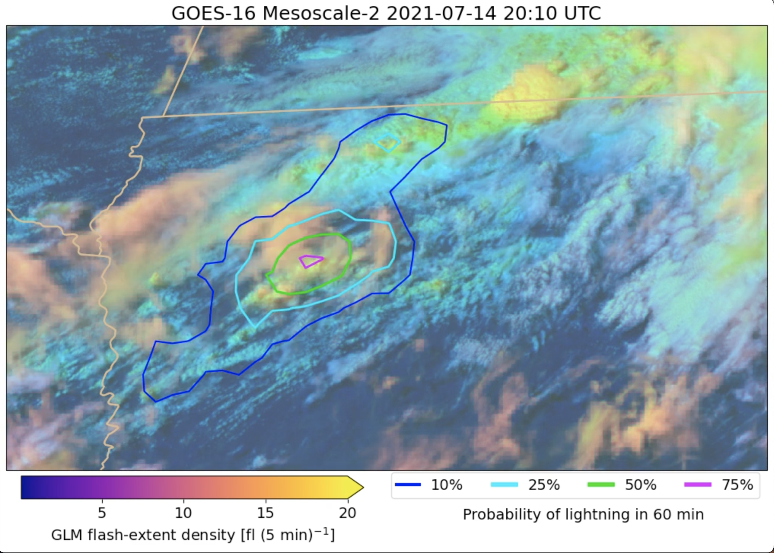
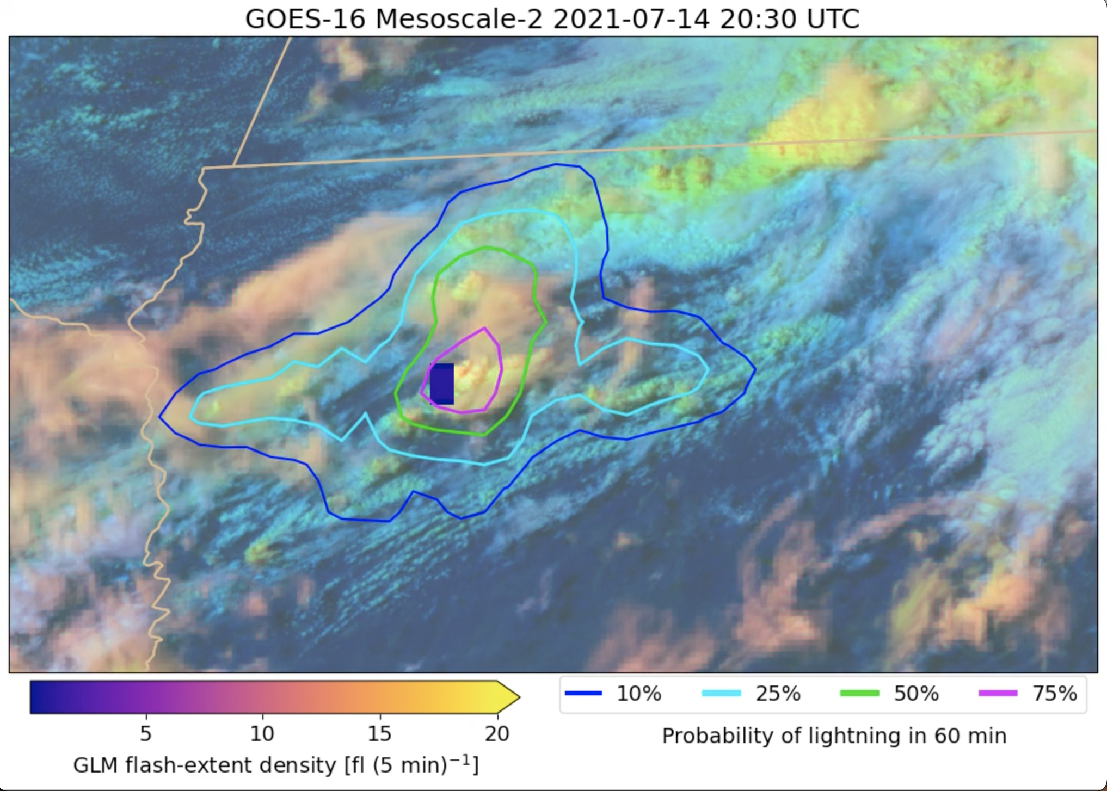
P(LTG) ≥ 25% 51 min prior to first flash
P(LTG) ≥ 50% 43 min prior to first flash
P(LTG) ≥ 75% 30 min prior to first flash
First flash
at 20:30 Z

Slide 8
Notes:
Meso example with mid-level cloud deck. Still good lead-time.

Slide 9
Notes:
Nothing specific to point out here. Just a regional example.

Slide 10
Notes:
Nothing specific to point out here. Different regime and sat viewing angle.

Slide 11
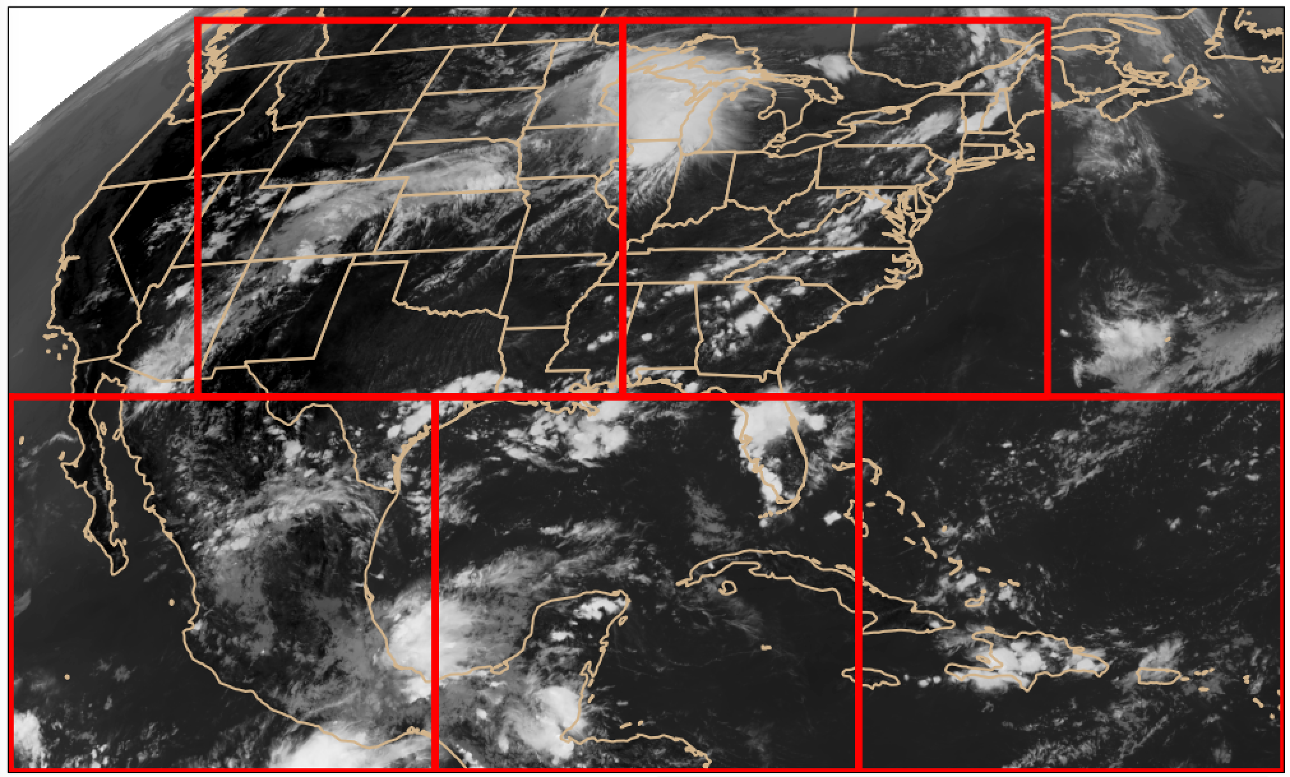
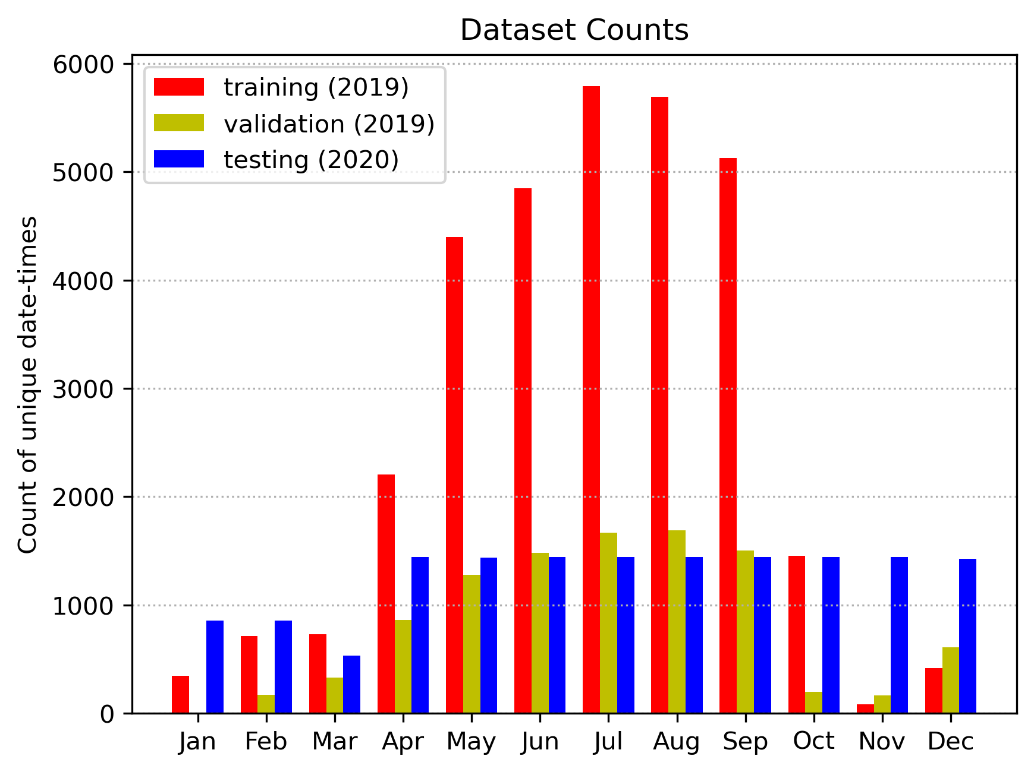
Training and validation data
Training/validation domain: 5 patches from GOES-16 ABI CONUS sector
76,031 training samples
22,539 validation samples

Slide 12
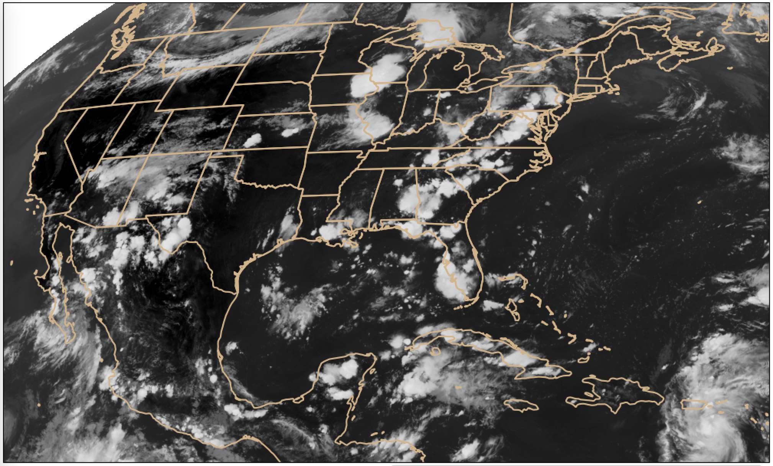
Test data
GOES-16 CONUS sector
5 days of 5-min scans from each month of 2020

Slide 13
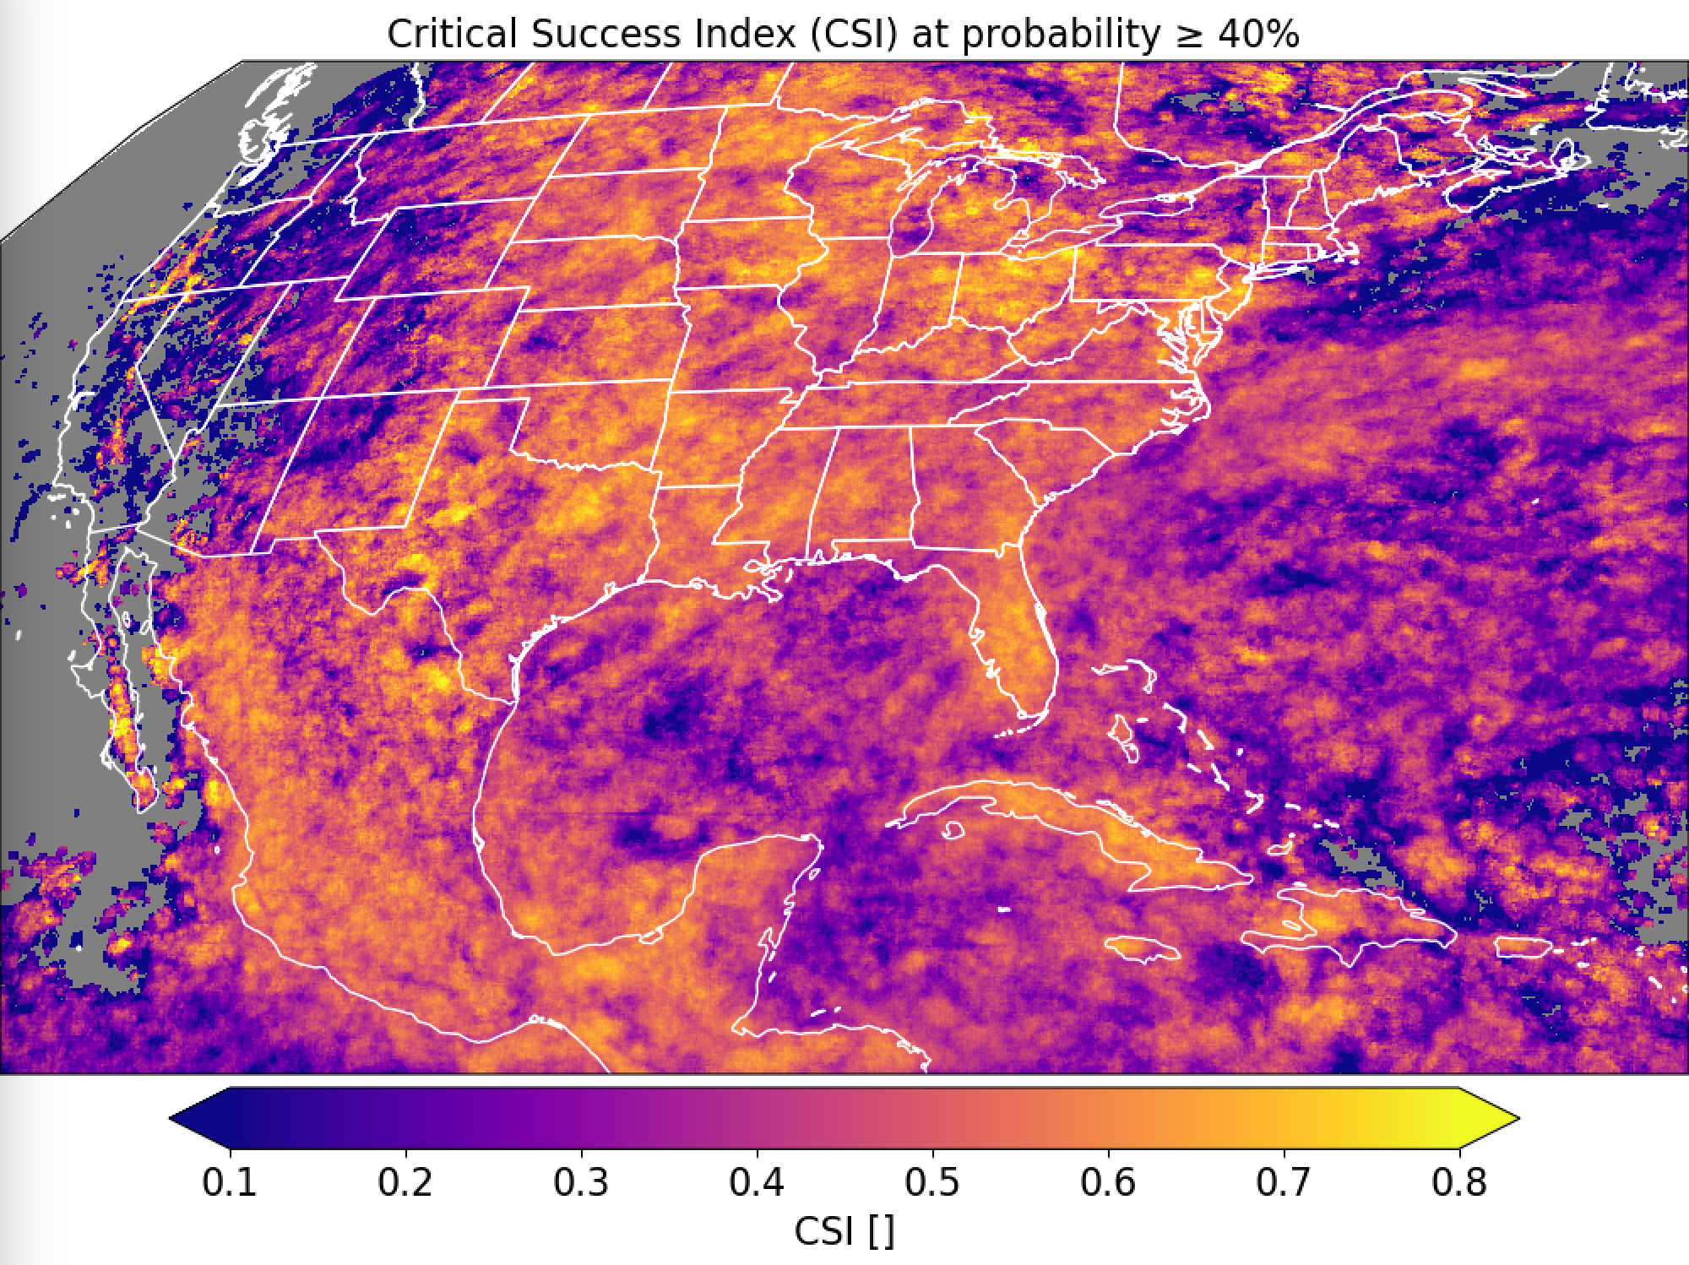
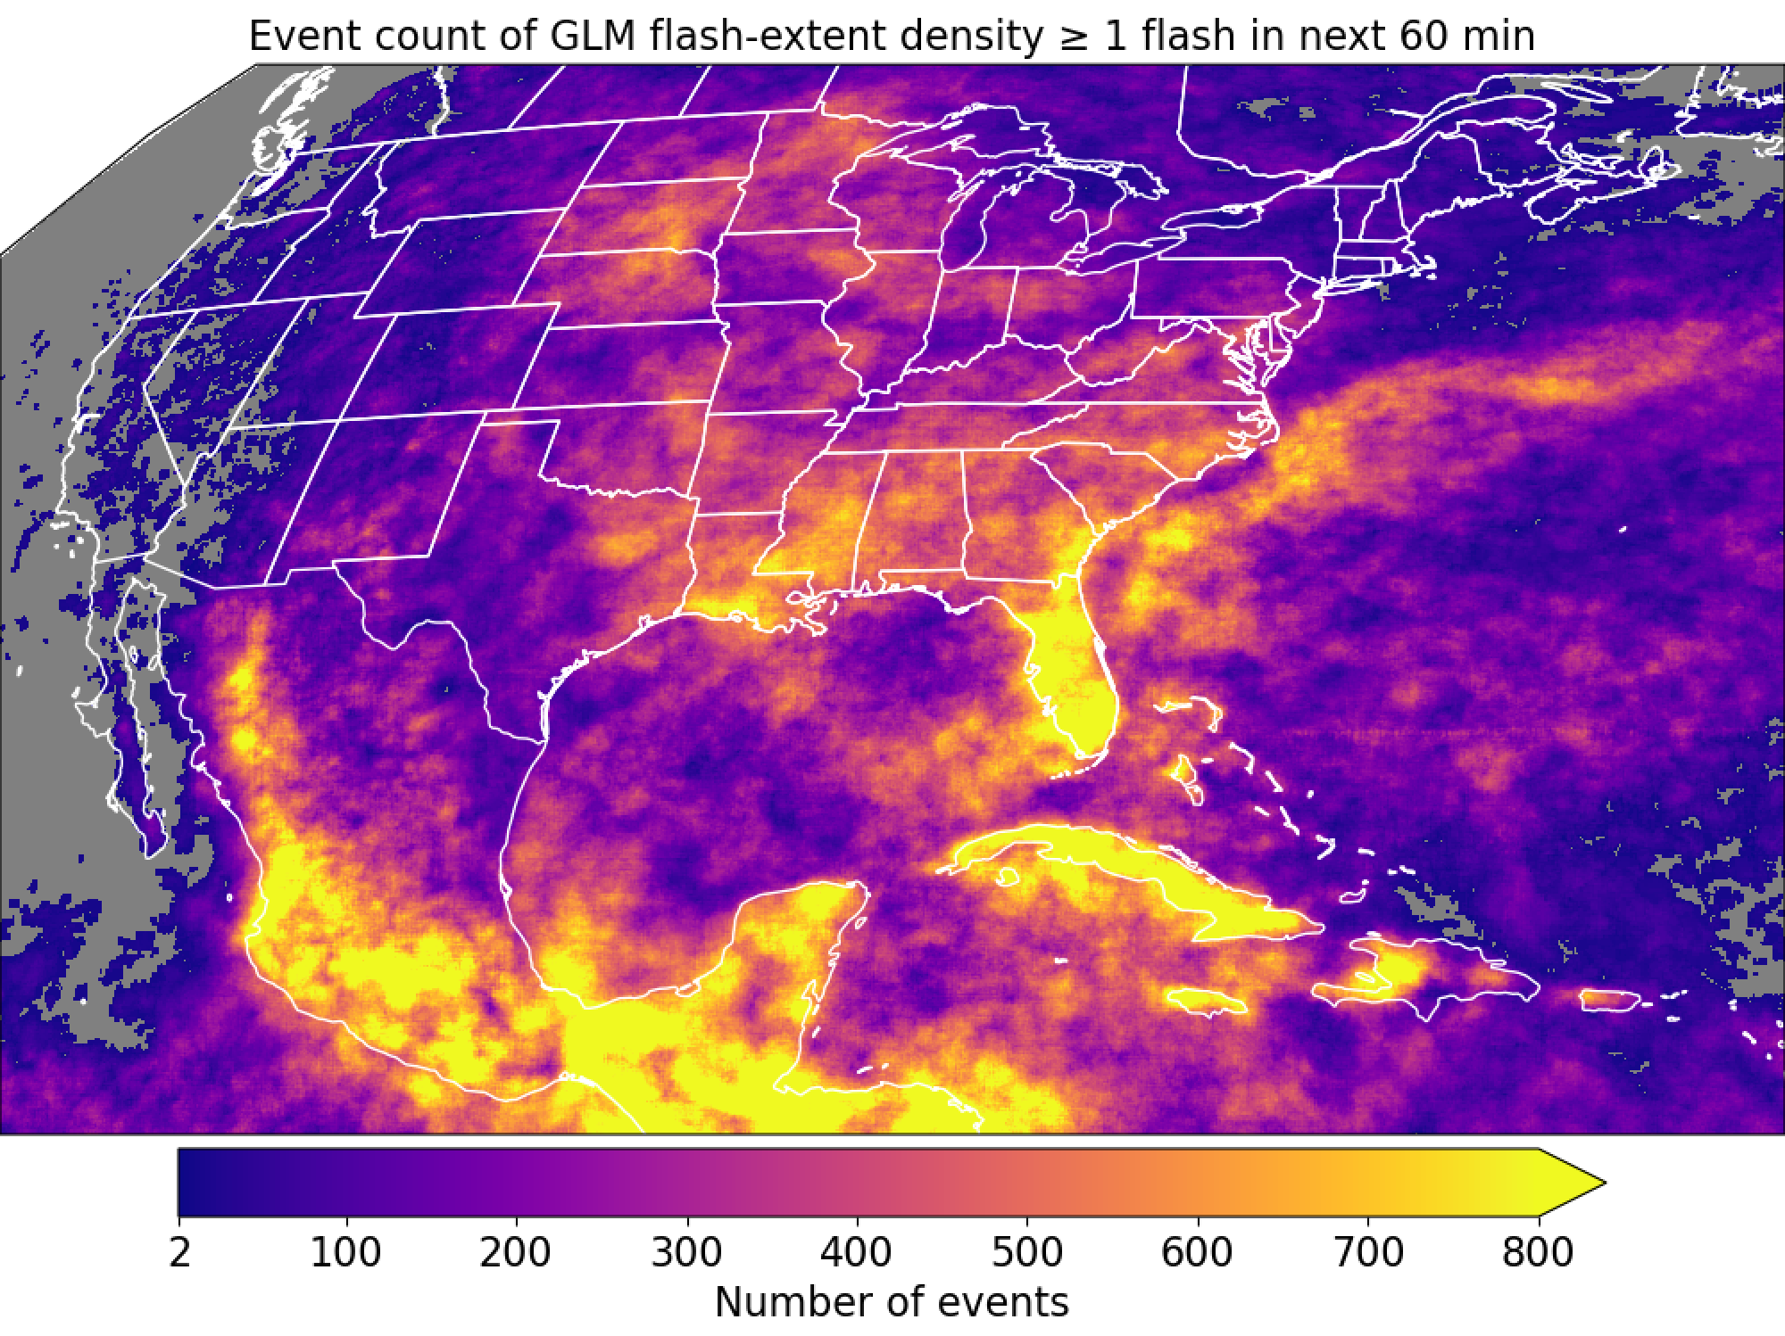
GOES-16

Slide 14
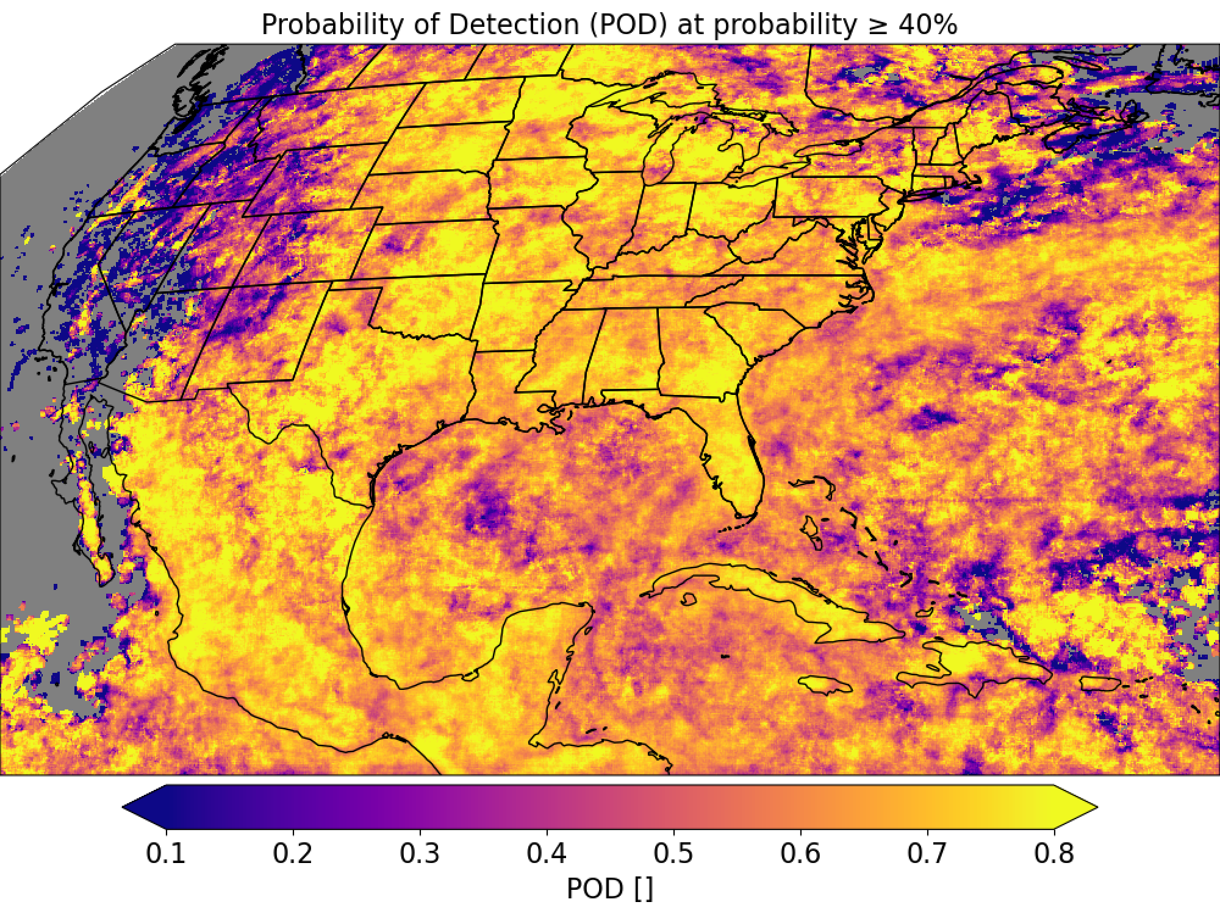
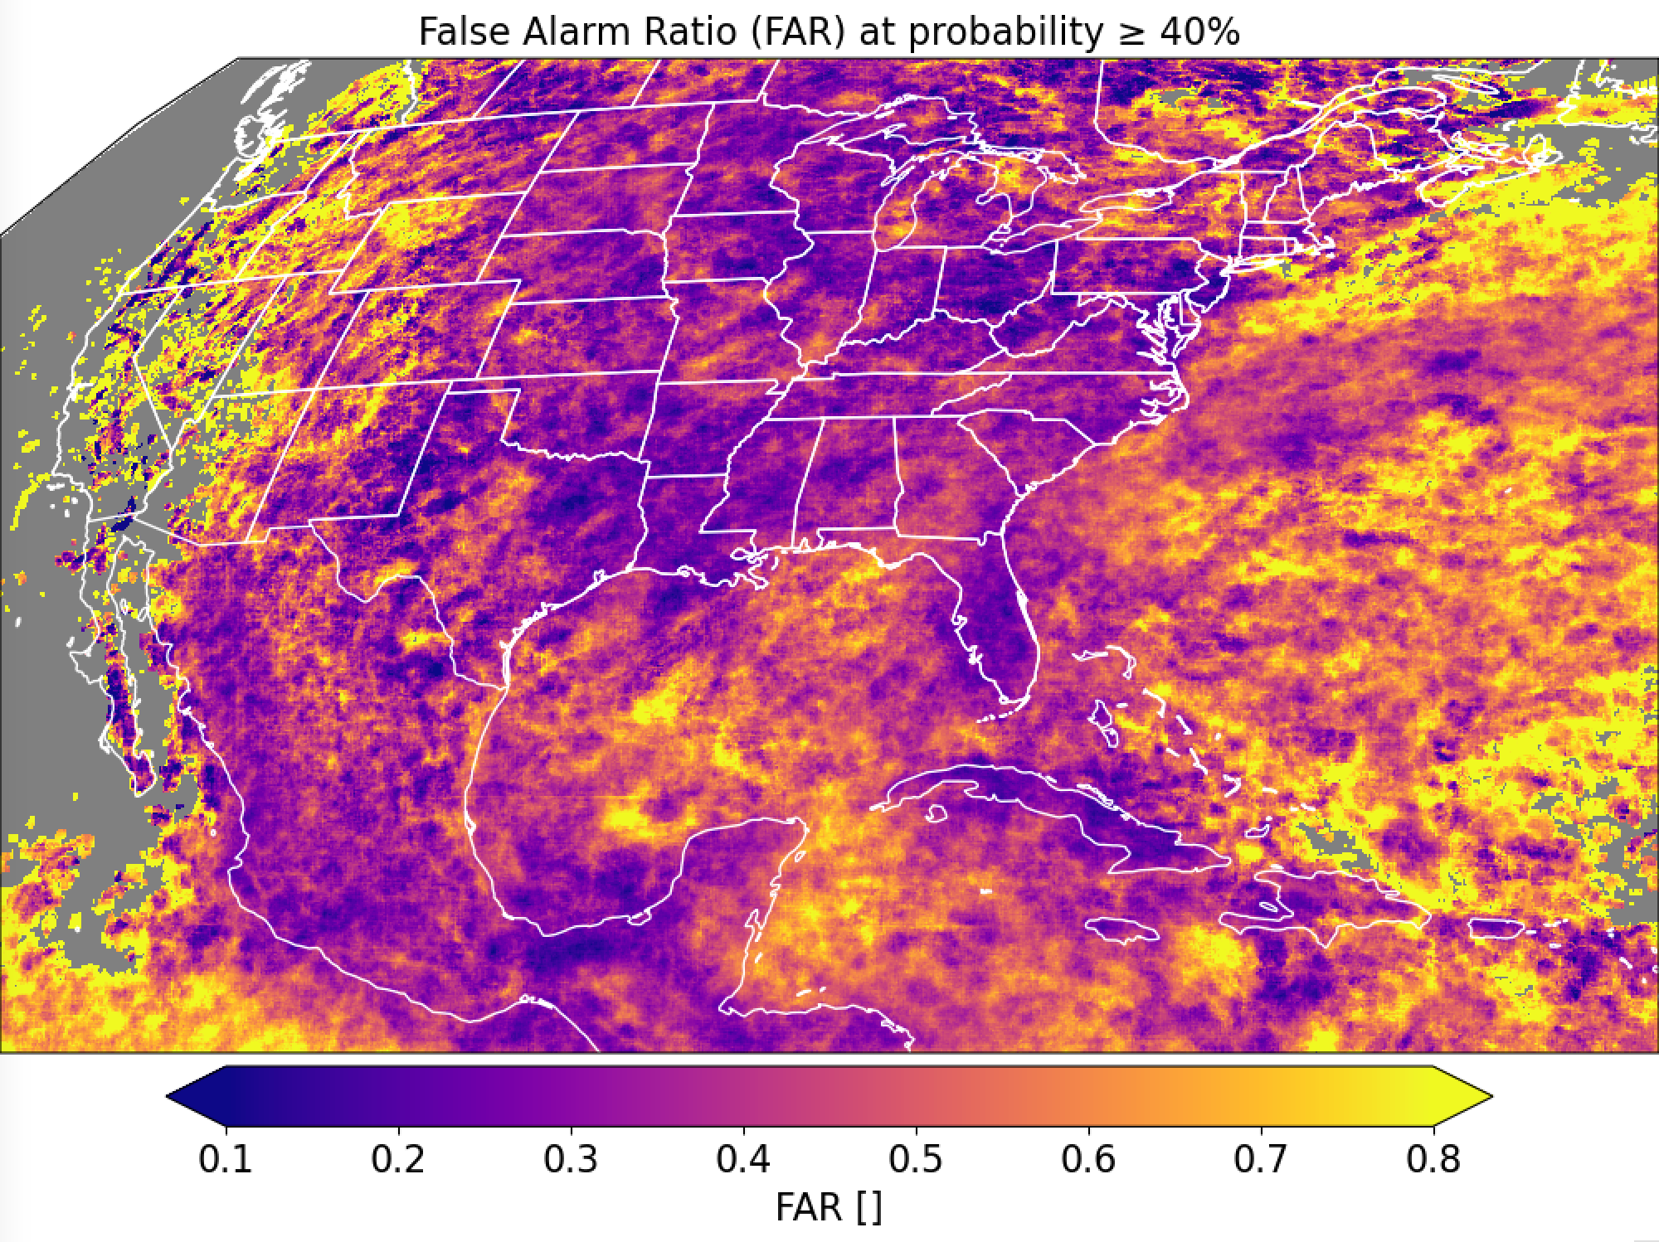
GOES-16

Slide 15
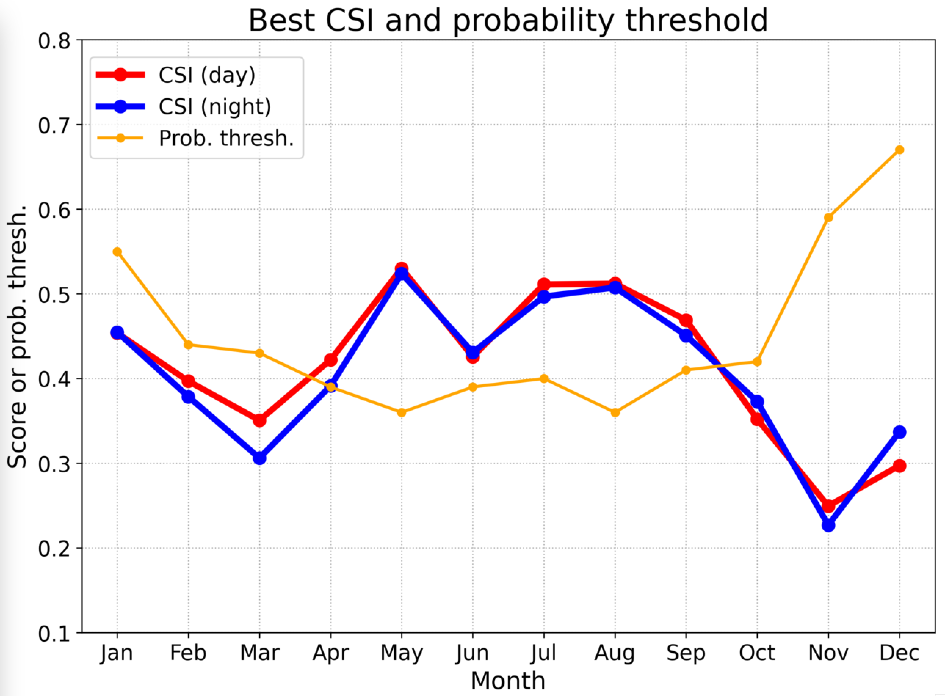
GOES-16

Slide 16
GOES-16
Good
Needs improvement

Slide 17
Layer-wise Relevance Propagation
“Layer-wise Relevance Propagation (LRP) is a technique that brings such explainability and scales to potentially highly complex deep neural networks. It operates by propagating the prediction backward in the neural network, using a set of purposely designed propagation rules.” – Montavon et al. (2019)
LRP propagates the prediction backward to input pixels of each channel.
LRP is subject to a conservation law, whereby what is received by a neuron must be distributed to the lower layer in equal amount.
We’re using LRP-Z rule from innvestigate github.

Slide 18
Layer-wise Relevance Propagation

Slide 19
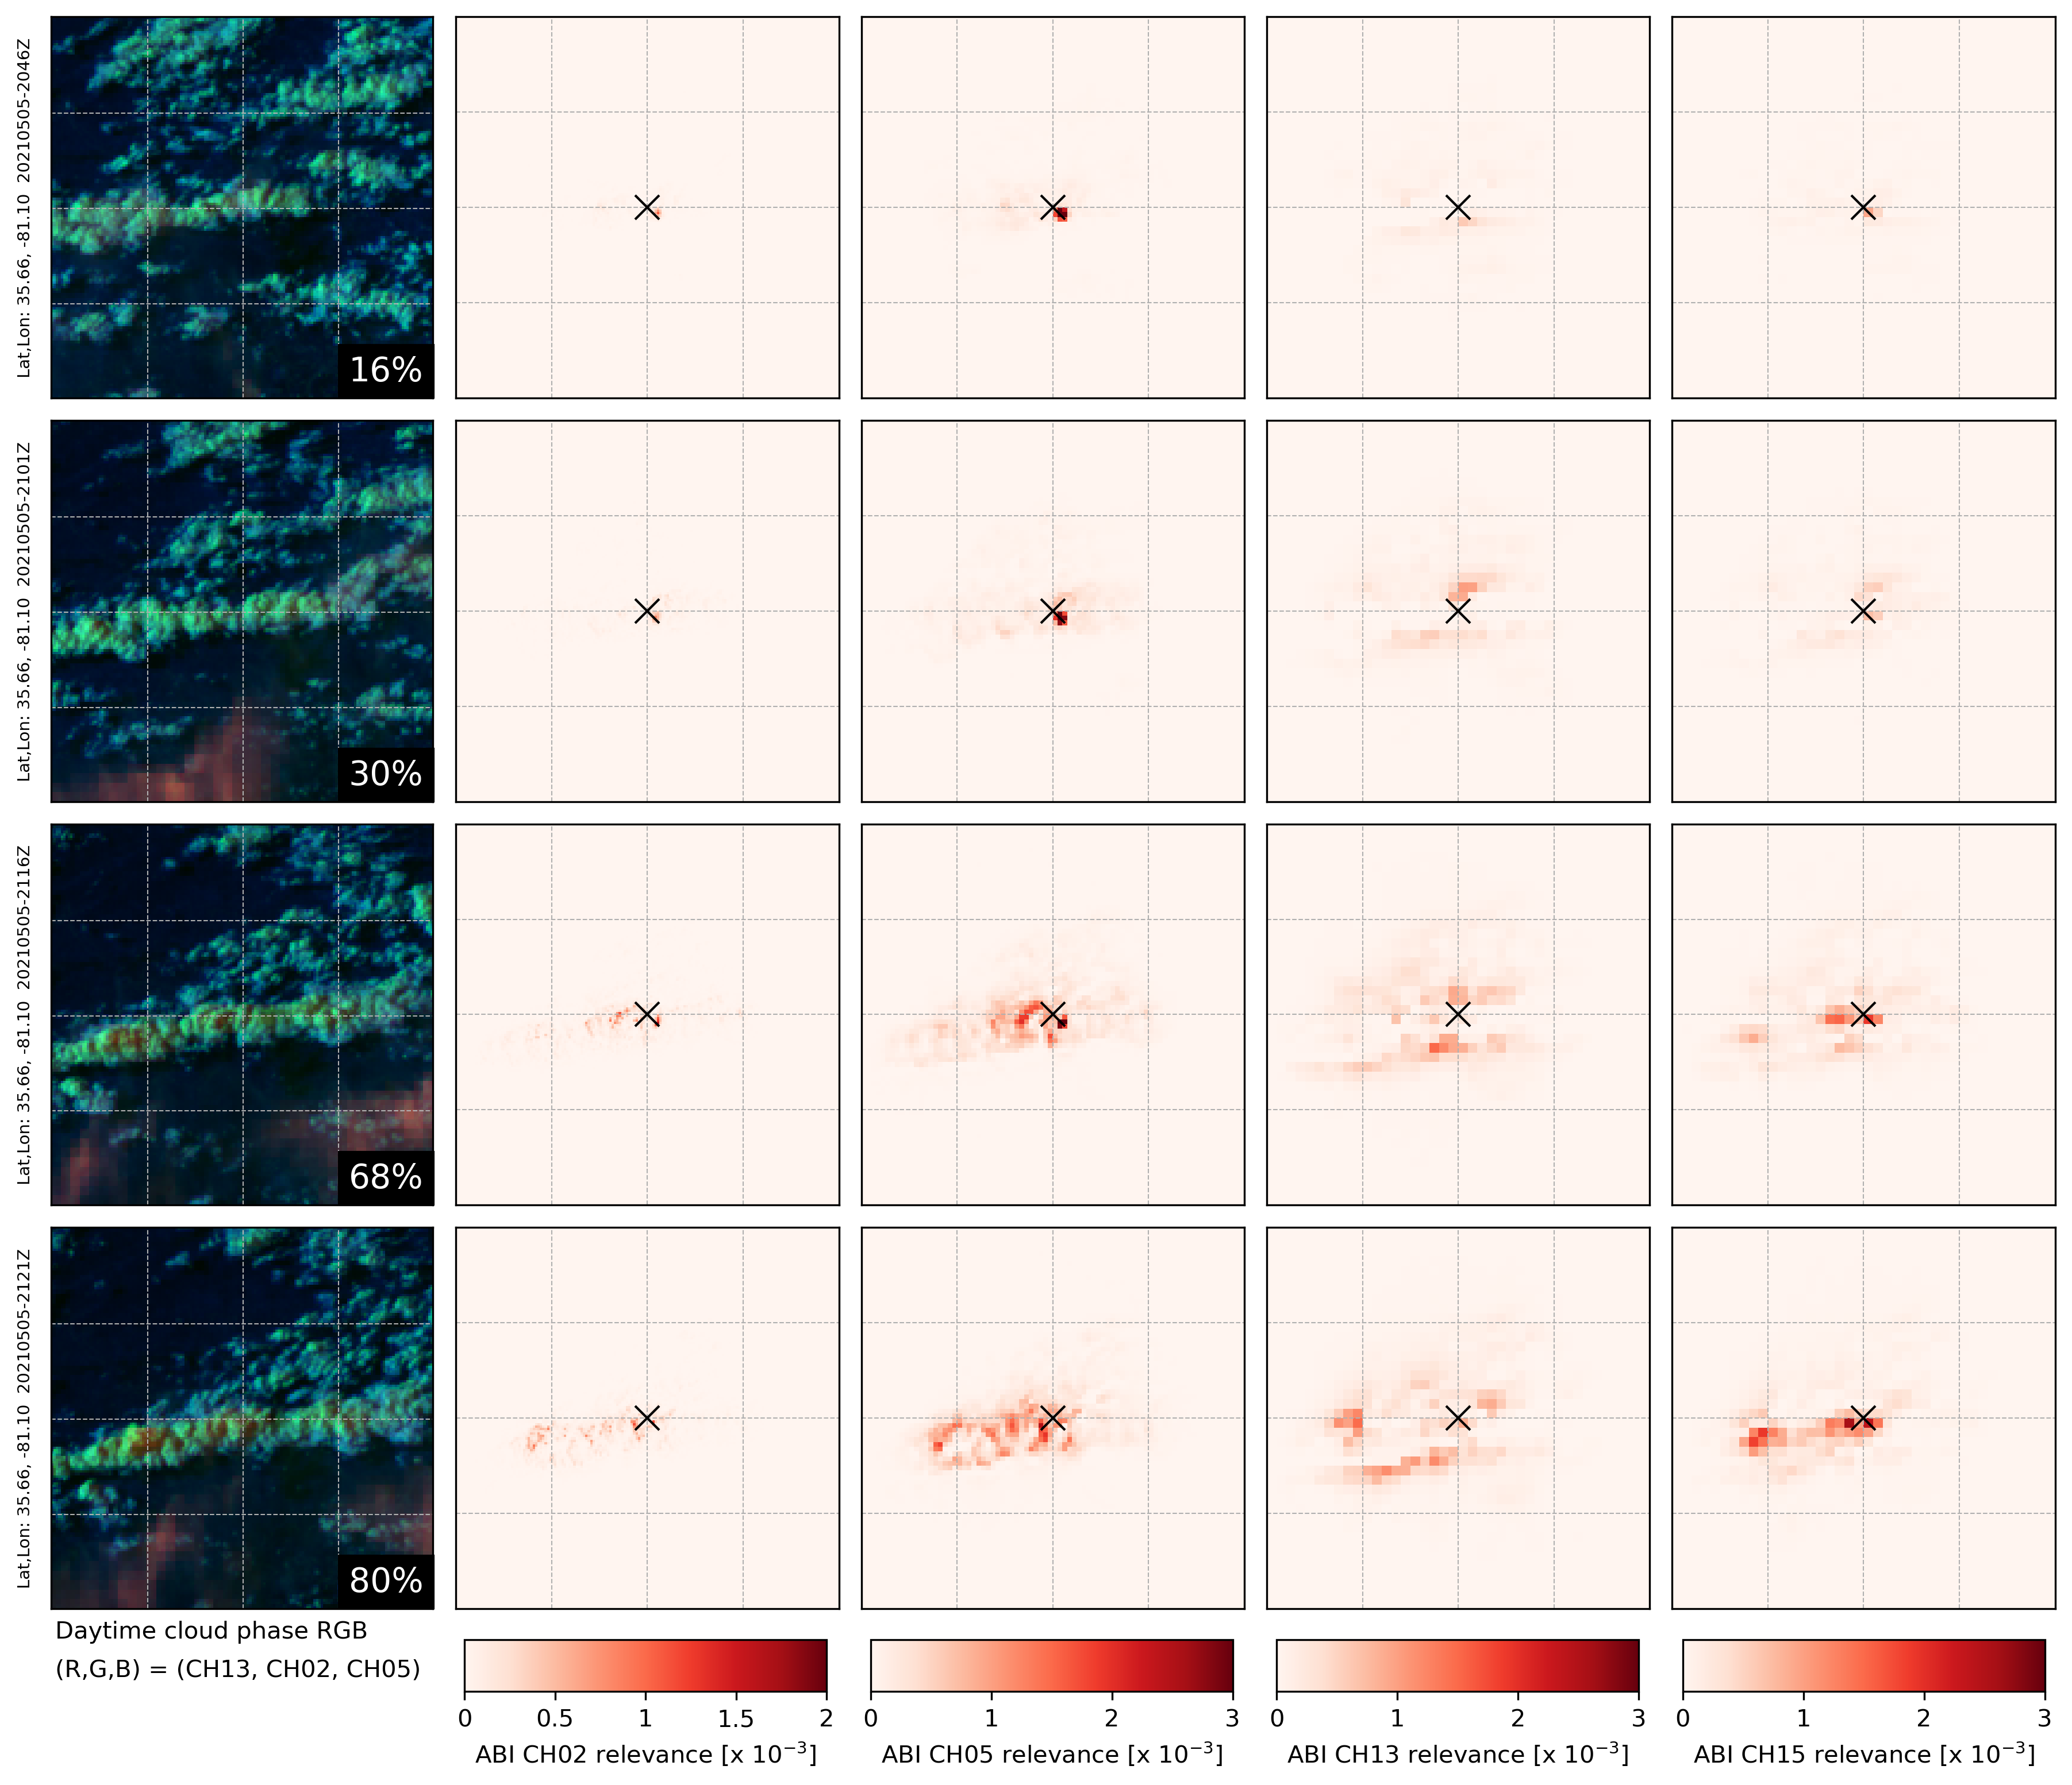
Bright pixels nearby help elevate probability when cloud is not cold enough
“X” is NW-corner of pixel of interest
Predicted probability at pixel X
Cold cloud pixels in CH15
Bright pixels helping
WARM surface pixels in CH13

Slide 20
Wrap up
LightningCast is a CNN (U-Net) that predicts lightning (as observed by GLM) up to 60 min in the future
Inputs: ABI CH02, CH05, CH13, CH15
ABI alone can provide skillful short-term prediction for lightning (including LI), day and night, over land and sea. Very fast to compute.
Daytime a little better than nighttime
Over land a little better than over ocean
Lead-time for LI events often ranges between 10 and 30 minutes.
Near-real-time output: https://cimss.ssec.wisc.edu/severe_conv/pltg.html
GOES-16 and GOES-17 CONUS and MESO sectors
Future work:
Use more training data!
Evaluate more channels (e.g., water vapor channels)
Investigate training models with different lead-time and flash rate criteria

Slide 21
Model: Semantic segmentation, or “U-Net” (Ronneberger et al. 2015)
values indicate layer depth
256
128
128
64
64
32
32
4
16
Input
Conv 3x3 + ReLU
Max-pooling
Upsampling
Concatenation
Conv 1x1 + Sigmoid
16
1

