Slide 1
ProbSevere – AI update
20 June 2019

Slide 2
Data and Methods
Problem:
Identify severe storm-top features from ABI data
E.g., AACP, enhanced-V, strong OTs
Solution:
Use convolutional neural network (CNN) to identify ‘supercell’ and ‘ordinary/non-supercell’ images
What we have right now:
~128,000 ‘ordinary’ or ‘non-supercell’ images
~16,500 ‘supercell’ images
15 days from May 2018; 4 days from June 2018
Each image is one storm from one time (using CONUS ABI images)
Using ProbSevere radar storm object centroids to gather image patches

Slide 3
CNN details
One input (channel 13 BT) – image patches are 32 x 32
Conv2D→MaxPool (4 times)
Number of conv. filters: 8→16→32→64
Each filter is 3 x 3
Two fully connected layers
Vectors of 128 and 16 elements
Output: Probability of ‘supercell’
Number of epochs: 40
Learning rate: 0.0001
Conv/MaxPool4
Flatten
Conv/MaxPool2
Probability of supercell
Conv/MaxPool1
Conv/MaxPool3
Dense layers of size 128, 16, and 1

Slide 4
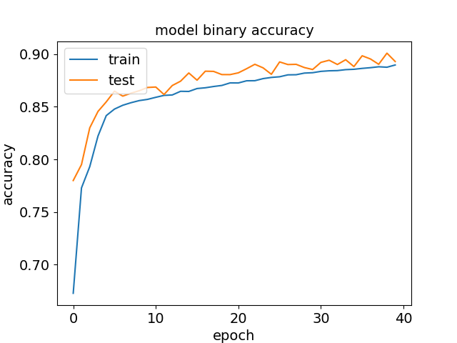
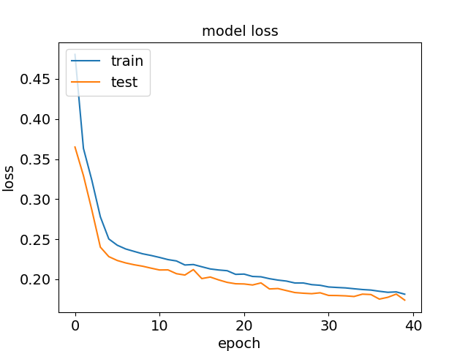
CNN results
Training / validation: 80% / 20% random split
Validation loss still decreasing…we’re probably not done learning!

Slide 5
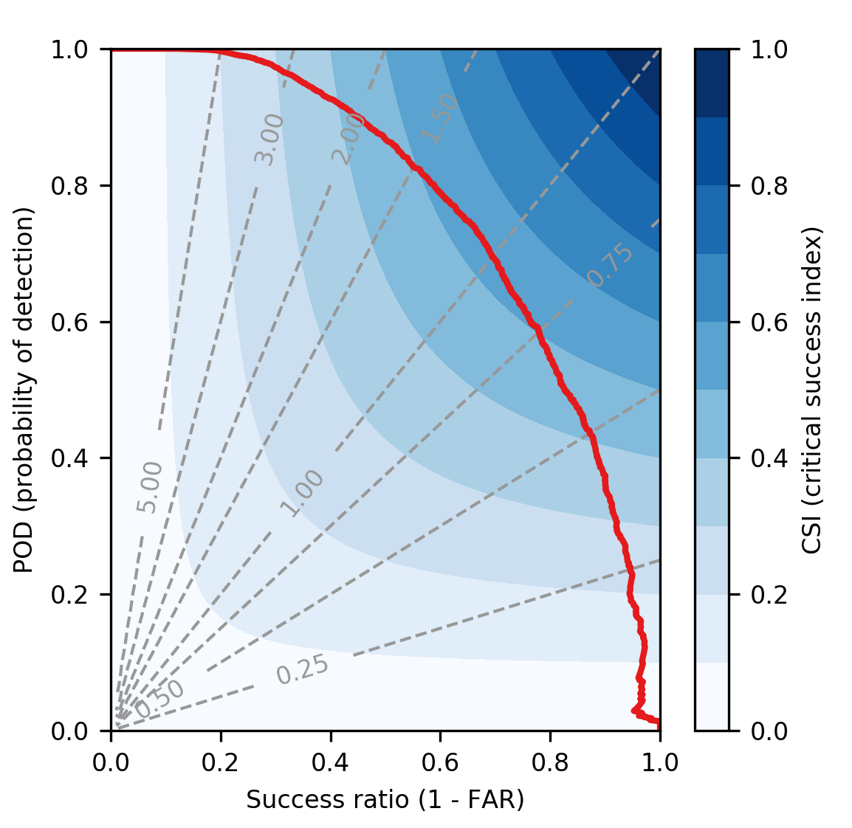
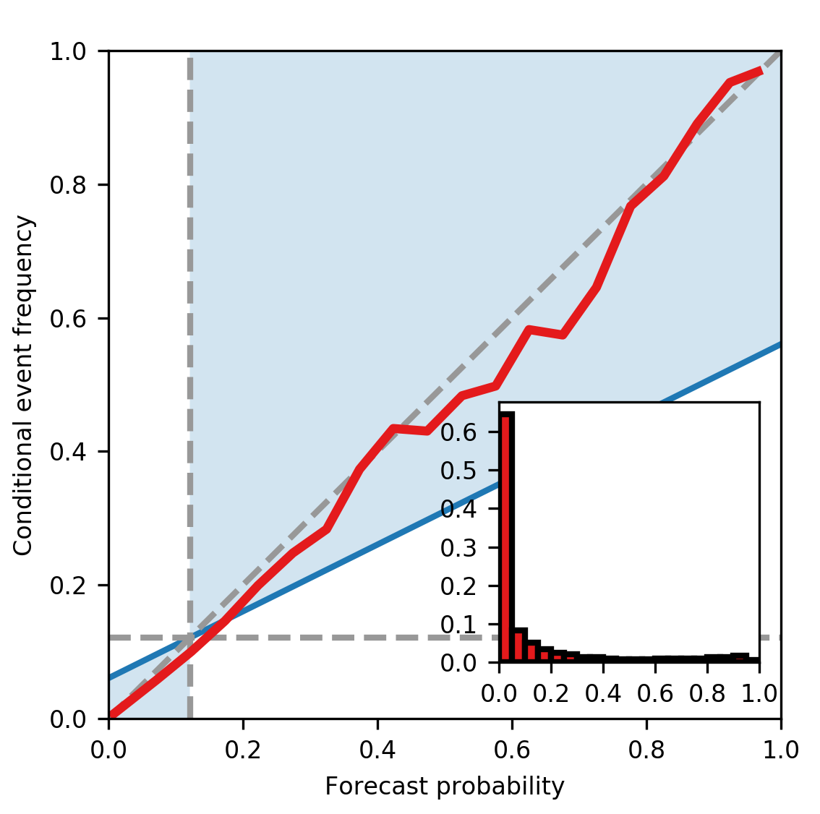
CNN results
Based off the 20% validation samples

Slide 6
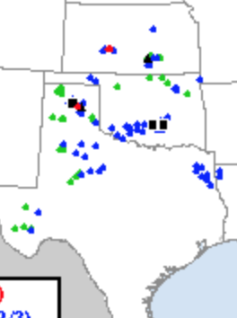
18-19 June 2019 (Tuesday night)
Model run on 32x32 image patches from mesoscale sector
Center points are collected with a stride of 4 pixels in X and Y directions
Takes ~0.7 sec to make predictions on entire scene (one mesoscale scan is ~14,000 predictions)
SPC storm reports
Contours:
Cyan = 90%
Tan = 25%

Slide 7
Next steps and questions
Next steps:
Classify more images!
Add more channels (e.g., CH02, CH05?)
Add image augmentation
Add temporal aspect
Train a CNN+RNN (LSTM)
Questions:
How to train when we run out of RAM?
Generating batches of samples for GPU is very slow (lots of I/O per epoch); even with 12 workers/CPUs
How concerned should we be about class imbalance? Best way to remedy that?
Take note:
Transfer learning has minimum data requirements:
Inception_v3 requires input tensor with width and height ≥ 128 and nchannels = 3
VGG16 requires input tensor with width and height ≥ 48 and nchannels = 3

